Slide 1
OceanOPS Strategic Plan 2021-25
Mathieu Belbeoch & OceanOPS Team
OCG-16 Session, 07 - 11 April 2025
Ifremer, Brest, France
Notes:
Ann

Slide 2
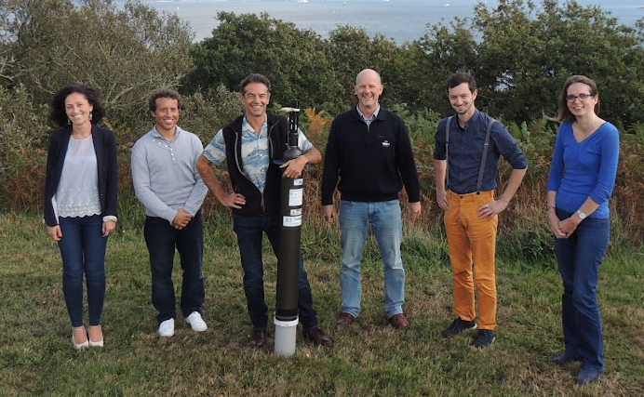
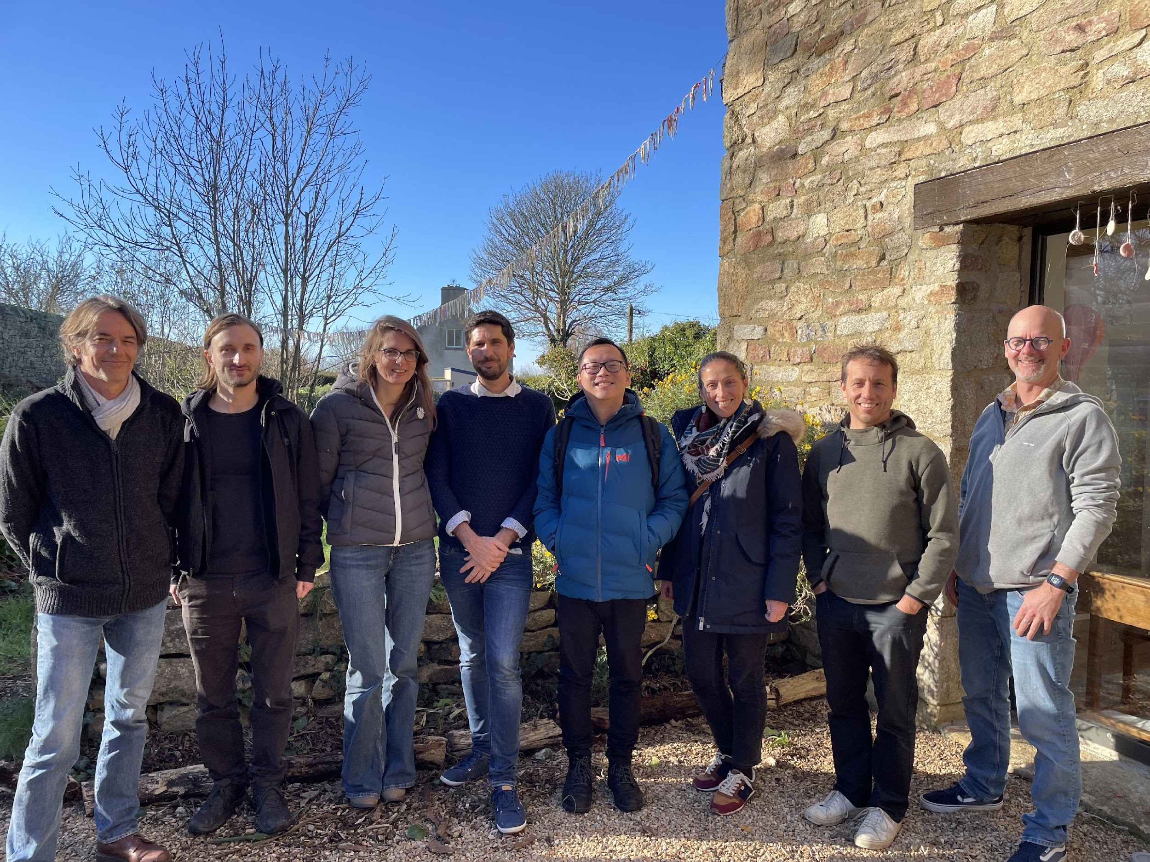
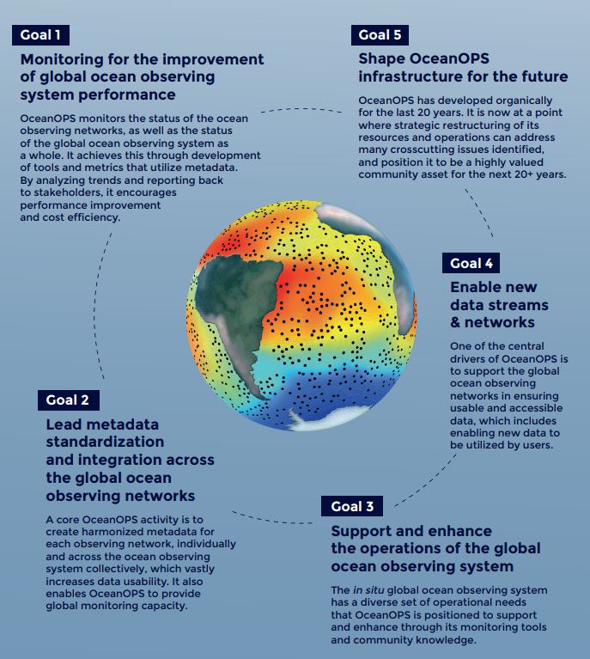
Introduction
The 2021-2025 Strategic Plan is largely on track for implementation though some challenges remain.
The plan was ambitious, and its performance must be assessed in light of resource constraints: initially unsufficient, decreasing midway and ultimately prompting a restructuring. [see agenda 8.2]
OceanOPS success is deeply tied to the achievements of GOOS/OCG and cooperation with network operators. OceanOPS is a collective endeavor.
OCG’s role, support and executive guidance have been critical – A hearfelt thank you to everyone, and special thanks to David Legler for his outstanding leadership !
Hat off to the team, delivering remarkable results in a highly complex and constantly shifting ecosystem.

Slide 3
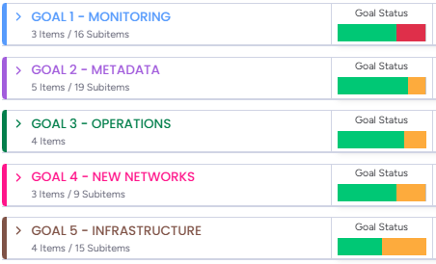
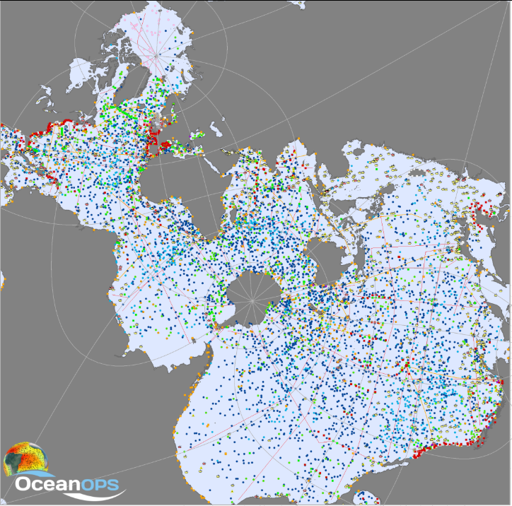
Overview
Goals are being completed with a good performance globally
Over the 25 objectives: 16 are « done », 6 « working on it » and 1 is « stuck »
Main challenges are seen in Goal 1 for some Networks, resulting from the completion of all the others.
EOV/ECV gap analysis tool won’t be developed (1.3)
It needs 2 years of IT development we never secured together with the implementation of OCG Data strategy: global data and metadata nodes harvesting for all Networks.
Resources (« savings ») have been identified to implement this over 2026-27 [see agenda 13].
Other objectives will most likely be completed over 2025.
Notes:
Ann

Slide 4
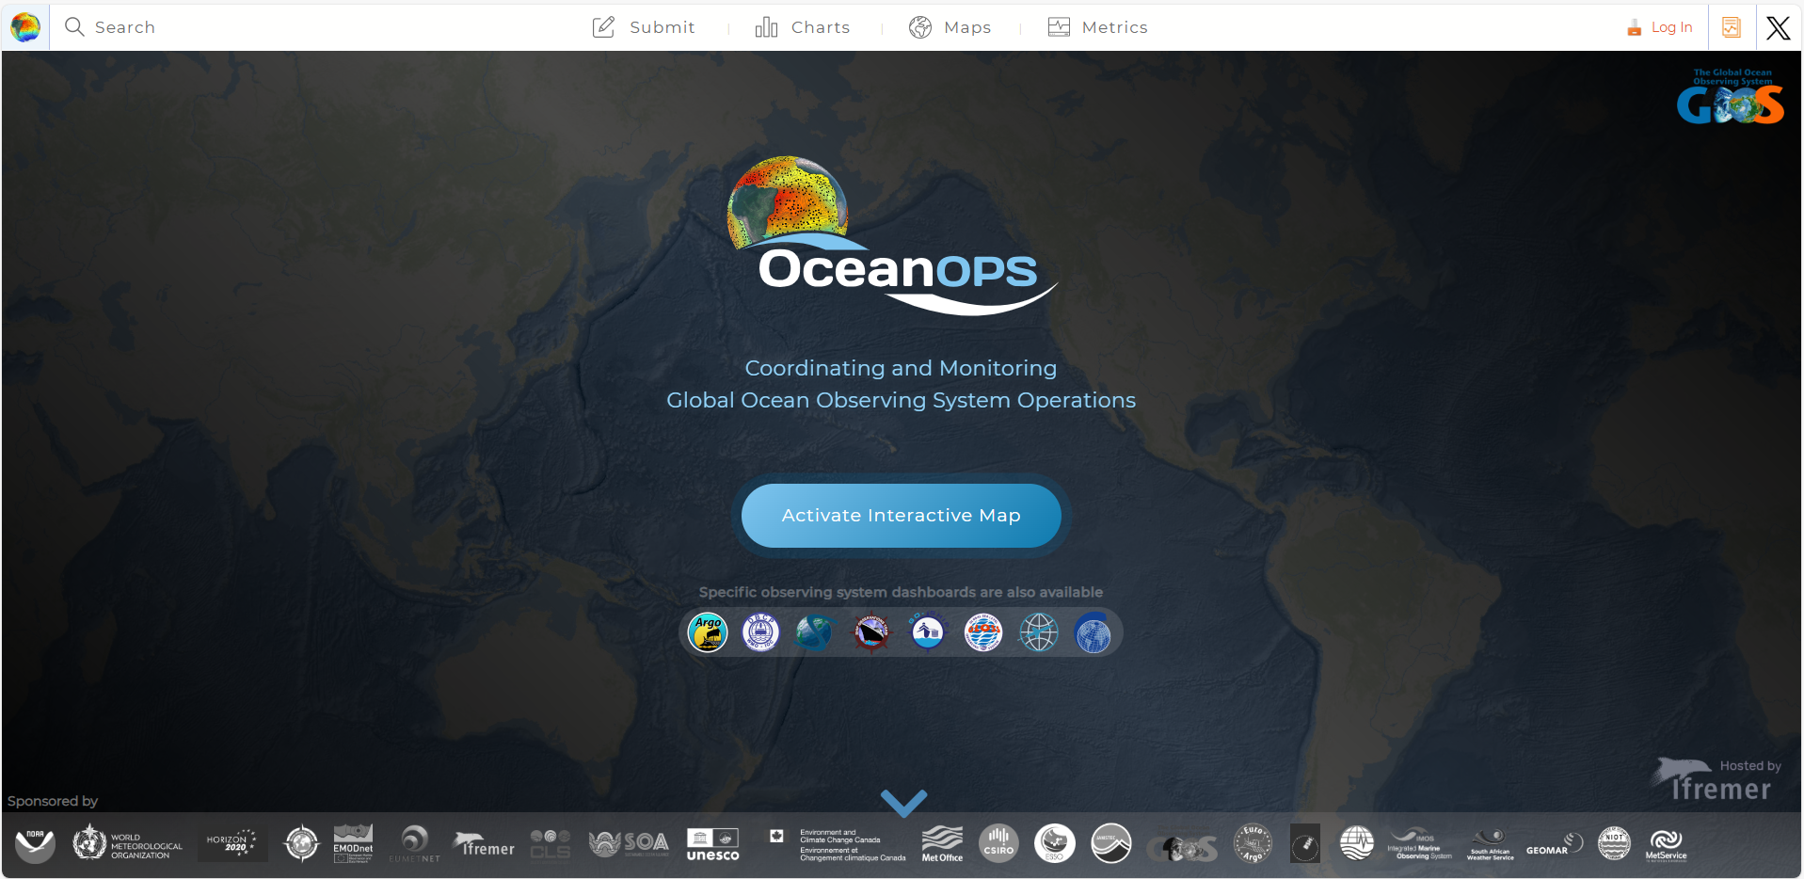
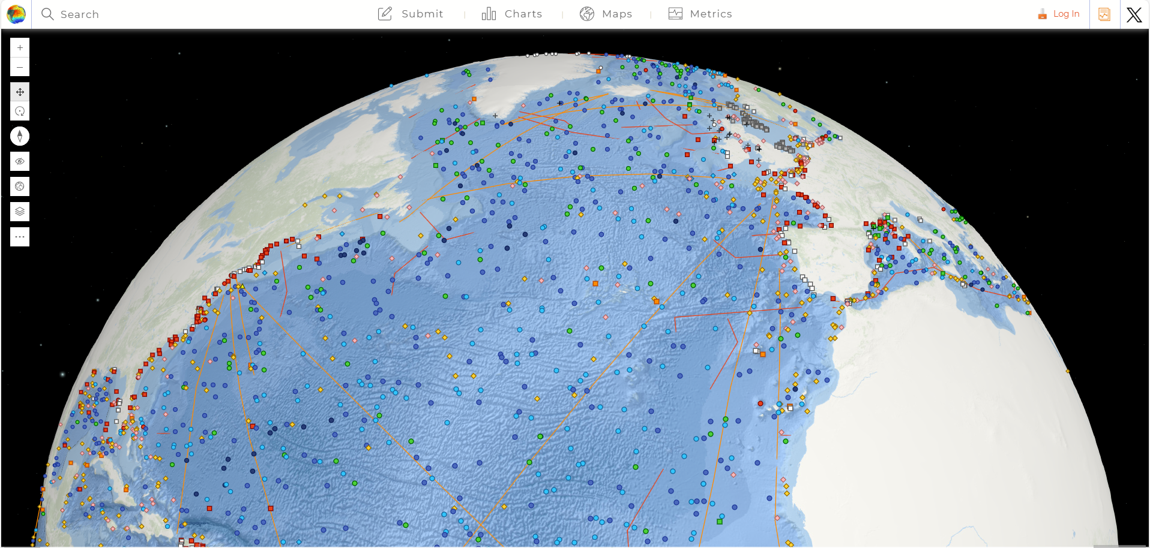
Goal 1
Monitoring Tools: mainly available from the real-time monitoring dashboard (s) and on demand. They are critical for steering and support decision making, communication, and for operators day to day activities.
ocean-ops.org is an achievement – unique integrated display on the GOOS. Powerful search engine on GOOS capabilities, with integrated GIS, routine monthly maps (150+), KPIs (1000+), interactive charts.
Website capacity underexploited for some Networks, by lack of metadata and tools review.
Reporting to Networks (yearly, semestrial bulletin) is not yet fully operationalized - need bandwidth for Network Experts.
Many ad hoc reports and inputs for IOC, WMO -greedy
Report Card: (2021,22,23,25) is an achievement
Notes:
Ann

Slide 5
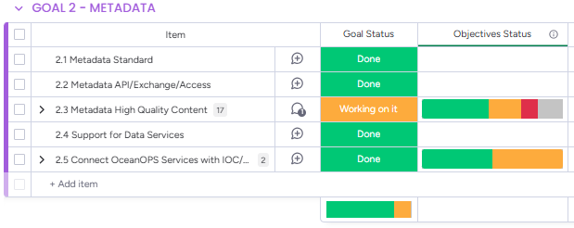
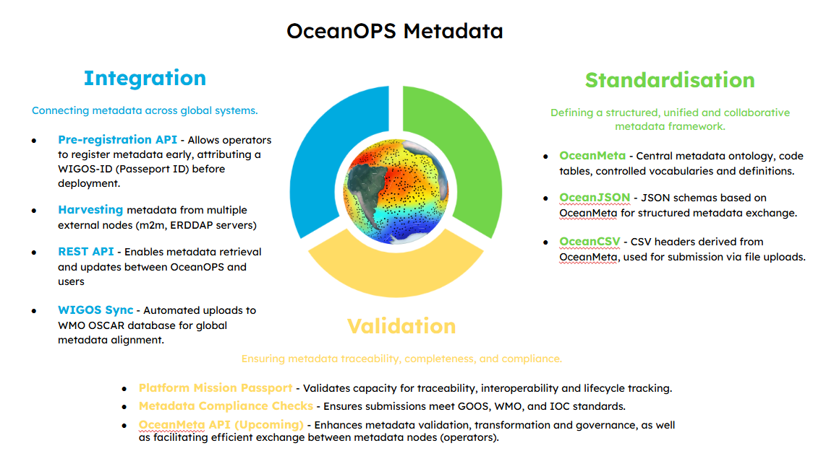
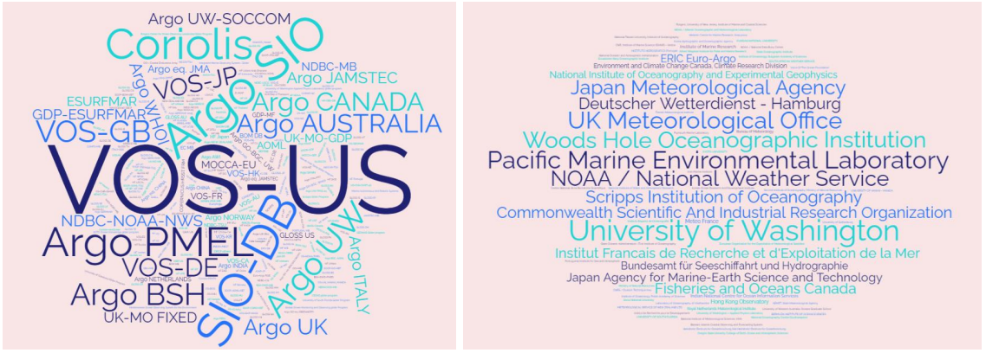
Goal 2
A few fallen trees cannot overshadow a forest of success !
80000 platform metadata records
Millions of underlying observations
300+ program operated by 100 agencies in 30+ countries
API: simple version – no IT bandwidth to develop further
Robust API for WIGOS ID allocation (and Web UI)
Push to WIGOS/OSCAR operational and monitored (75%)
OceanOPS Metadata are interconnected with operational data flows: fueling them for some networks, fueled by them for others
Metadata Standard/Content/Exchange/Support: is an achievements ! But challenges remain …
Notes:
Ann

Slide 6
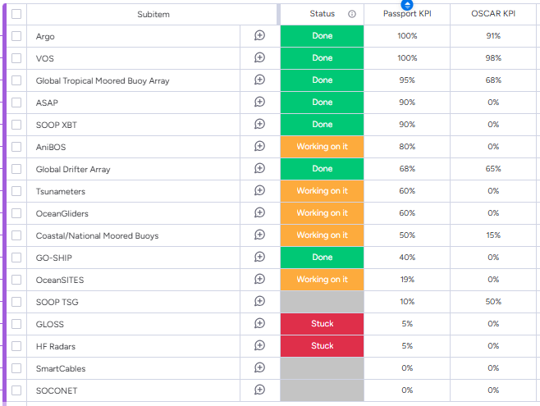
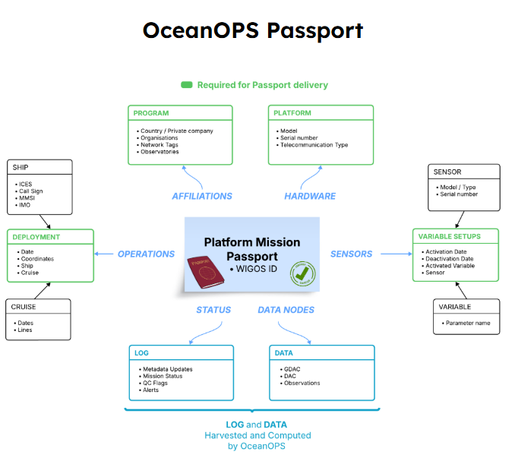
Goal 2
We underestimated the communication dimension
We are preparing a structured, unified and collective metadata framework and tree: the OceanOPS Passport crystallising the concepts.
Some networks/operators are unresponsive – growing authority by the outputs, and by the SLA. GOOS is what we see.
OceanOPS Passport 80/20 rule: the remaining 20% request consequent work and operators cooperation.
OCG Data TT has engaged some good discussions on the technical details.
AMRIT project as well (adding the coastal and R/V cruise plans)
Notes:
Ann

Slide 7
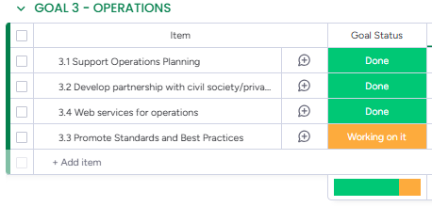
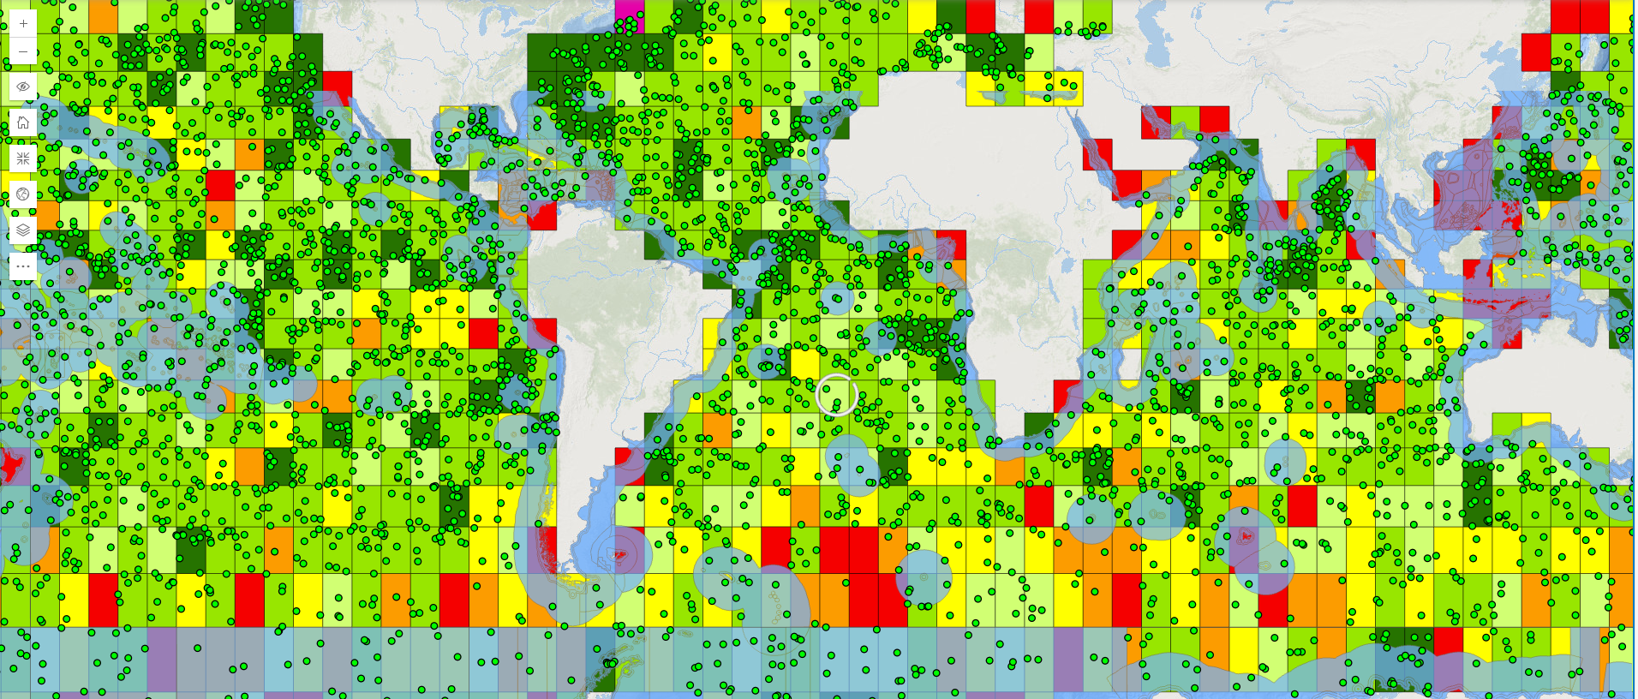
Goal 3
Basin based coordination meetings – enabling opportunities, optimization (North Atlantic bias resolved in Argo).
Support for EEZ operations, transparency, alerts, international cooperation, stickers (QR codes).
COVID/Blue Observer Atlantic Mission: 100 floats on a yacht … achievement!
Tall ships, races (OceanRace, 2 Vendee Globe), individual sailors, mobilizing skippers and citizens for the GOOS.
Operations (floats, drifters, AWS, TSG) addressing gaps
Outreach: only way to mass medias so far … generating GOOS ambassadors.
Notes:
Ann

Slide 8
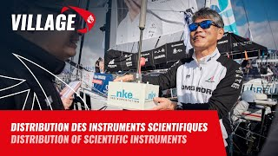
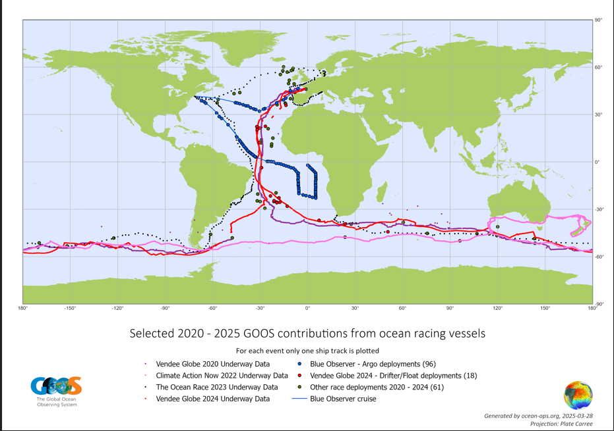
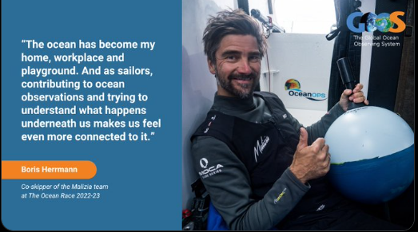
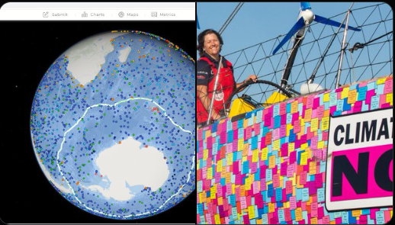
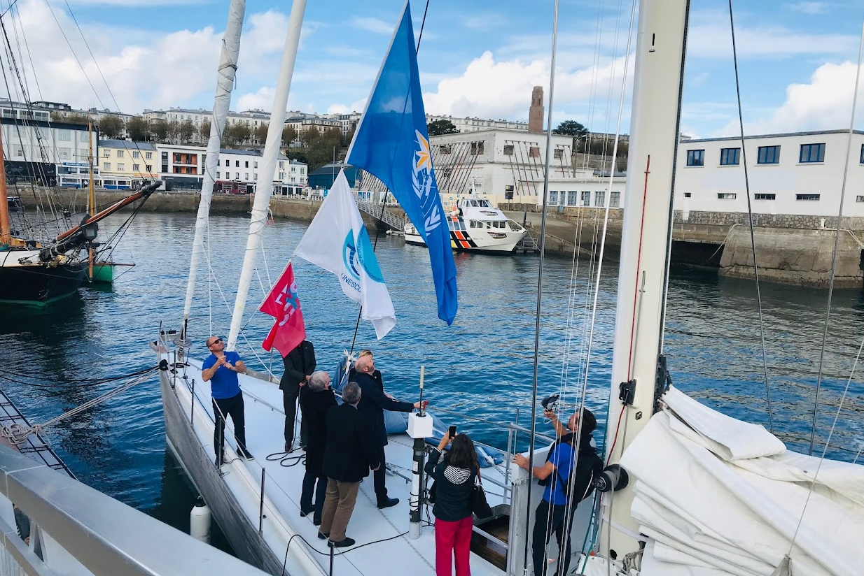
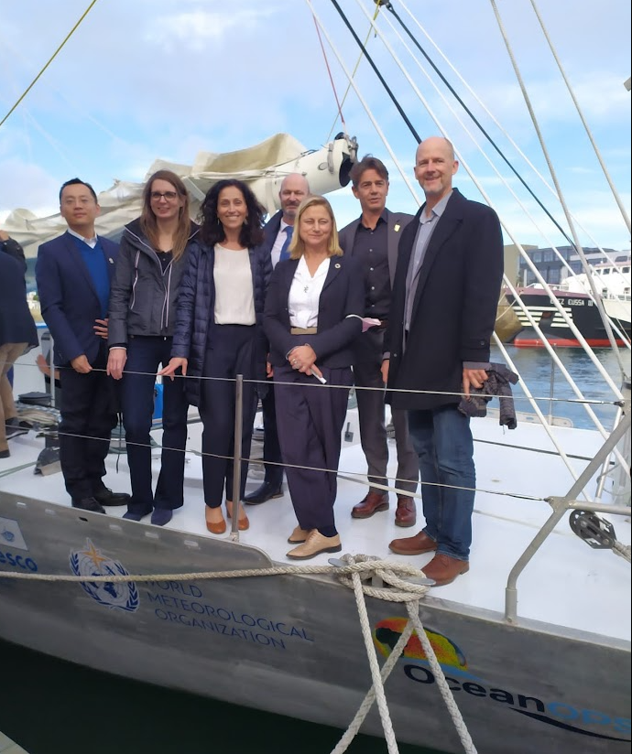
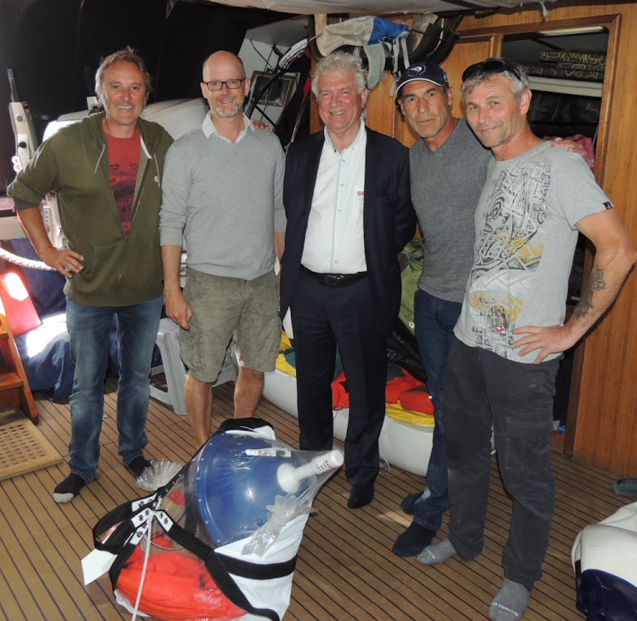
All round partnerships …
GOOS & sailing = OceanOPS achievement !

Slide 9
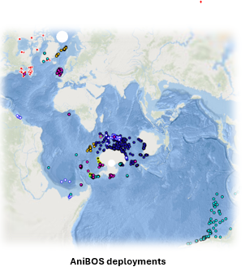
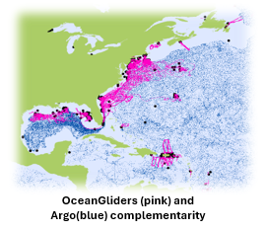
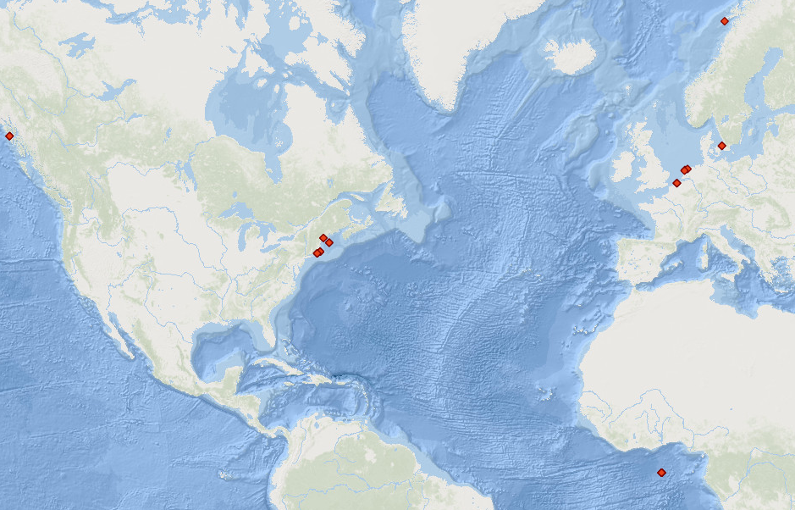
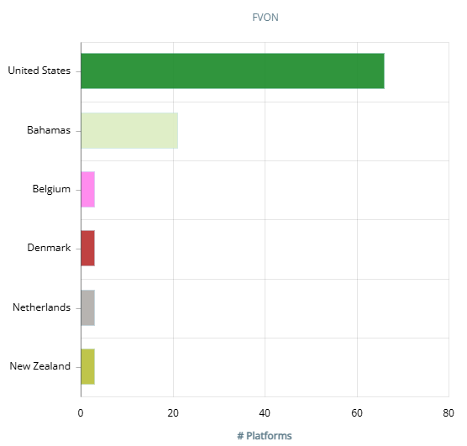
Goal 4
Raising OceanGliders from Baseline to Advanced (SLA)
Strong initial investment by OceanOPS not followed (restructuring)
Basic support to FVON, GLOSS, HFRadars
Baseline support to AniBOS (2500 records) being completed
Regional Pilot in the Med. Sea – fruitful but not financially yet
UN decade Odyssey Project kick off (OneOcean summit)
Vendee Globe /IMOCA / UNESCO partnership
20/40 skippers with instruments on last race
FVON
Notes:
Ann

Slide 10
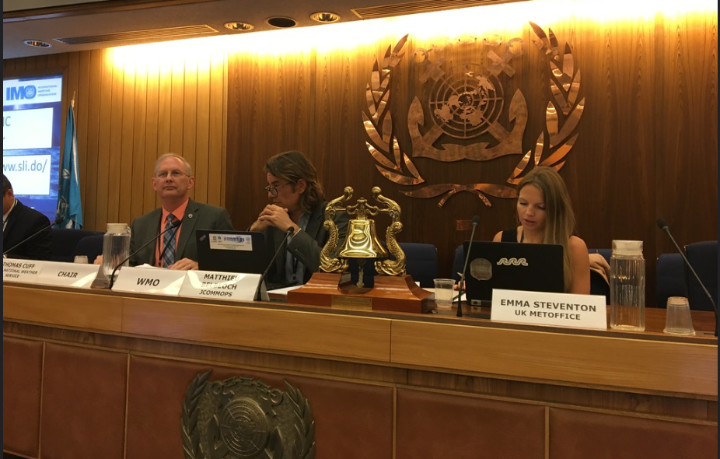
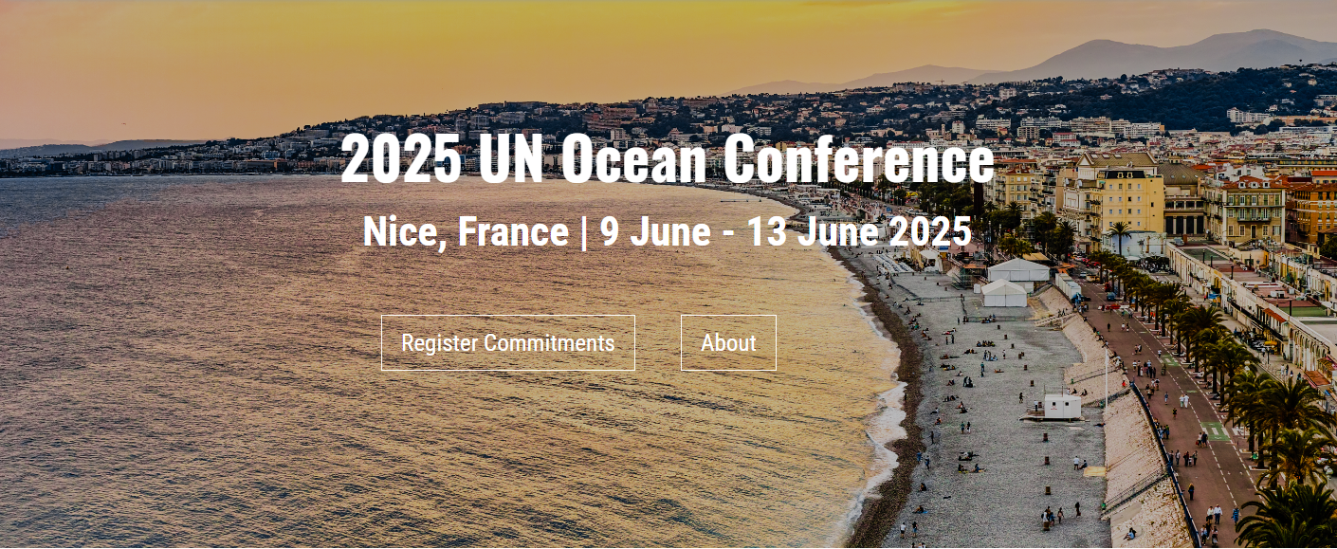
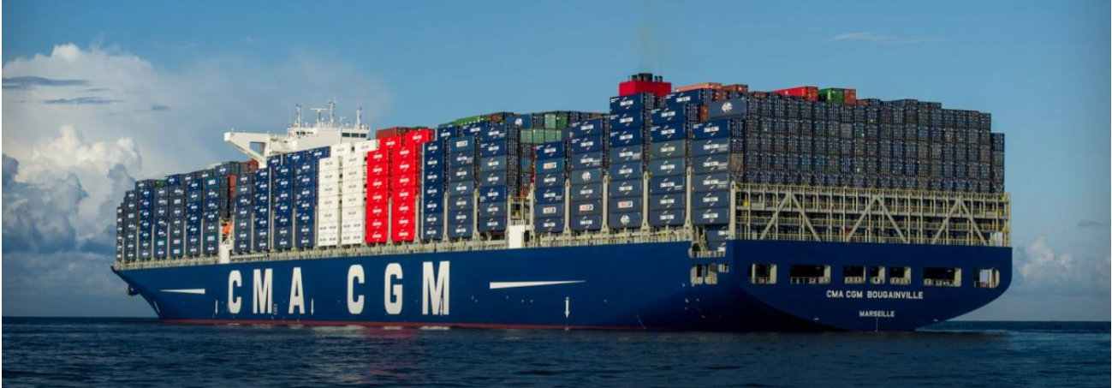
Goal 4
“Unlocking commercial shipping’s role in global ocean monitoring and services”
For over a century, merchant ships have been collecting vital weather and ocean data, enhancing safety, forecasts, and climate understanding. This high-level event unites a global coalition to expand ship-based observations.
Backed by leading international organizations, France and marine industry pioneers, we are gathering the shipping industries to join an ambitious new partnership. Together, we will equip fleets with cutting-edge standardized and automated metocean technologies, unlocking global benefits for operations, forecasting, early warnings and environmental stewardship.
This event will culminate in a bold joint statement, laying out concrete commitments to achieve the UN Decade’s 2030 vision for ship-based observations and calling on the entire shipping industry to step up for SDGs.
“by 2030, increase merchant ships participation in the Global Ocean Observing System tenfold, reaching 10 000 vessels providing real-time weather and surface ocean data”.
This initiative will support WMO commitments on EarlyWarnings4All, Global GreenhouseGasWatch, the outcomes of the latest IMO-WMO symposium on extreme weather events and the ambitions of the UN Ocean Decade Vision 2030 (challenge 7).
Shipping companies present will be invited to seal their commitment and show the way for a smart business move that enhances efficiency, reduces costs, and mitigates risks.
UN organizations, together with Member States involved in the “observations to services” continuum, will coordinate, guide and support the scale up, maximizing benefits for private partners, and for the common good.
From Sailing to Shipping …
High level side event submitted by OceanOPS through WMO (blue zone)
Initial Partners:
World Meteorological Organization (WMO)
Intergovernmental Oceanographic Commission of United Nations Educational, Scientific and Cultural Organization (IOC-UNESCO)
International Maritime Organization (IMO)
International Hydrographic Organization (IHO)
France: Institut Polytechnique de Paris (IP Paris)
France: Ifremer
EUMETNET
European Centre for Medium-Range Weather Forecasts (ECMWF)
Mercator Ocean International
Baltic and International Maritime Council (BIMCO)
Lobbying all round to Shipping …
IMO/WMO Symposiums
Notes:
Ann

Slide 11
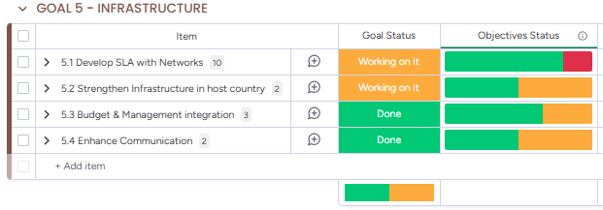
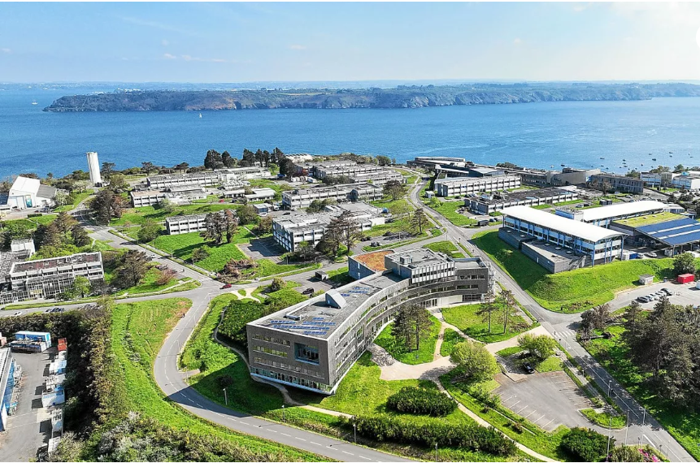
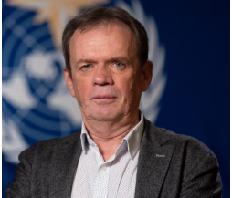
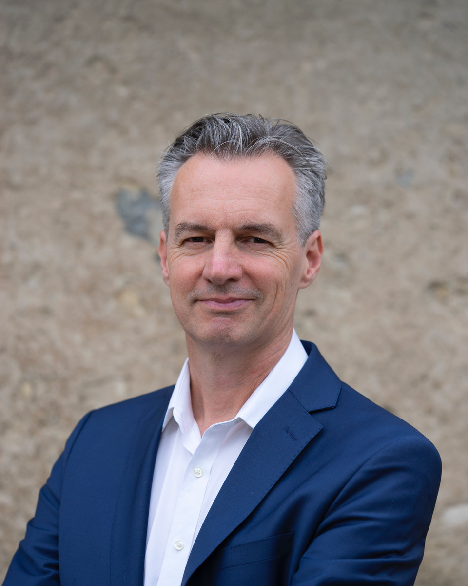
Goal 5
SLA framework developed through ad hoc OCG TT [see agenda 8.2]
OceanOPS Management Board set up (IOC, WMO, NOAA and soon Ifremer)
Infrastructure strengthened
WMO RB support (thanks Lars Peter and Anthony)
IOC/GOOS RB support
Migration IT – 4/5 months outage – robust architecture Increased support/cooperation with Ifremer (and Polytechnique) Host country agreement –To be signed 2025 - UNOC
Contributions transferred to WMO for consolidated budget management
Planning reporting tools developed to be completed through WMO/WIGOS consultant
flat/decreasing contributions triggered a restructuring (effective 09/2024) [see agenda 8.3]
EU projects – boost anticipated
Communication to support Networks and GOOS (brochures, reportcard, news items, videos …)
Lars Peter Riishojgaard WMO/WIGOS & Anthony Rea, WMO/INF Directors
Notes:
Ann

Slide 12
Conclusions
The Strategic Plan has set us on a clear path to success.
We have successfully achieved nearly all objectives, overcoming challenges with remarkable accomplishments, ingenuity, efficiency, innovation-often against the odds.
Some Networks are not fully benefiting from OceanOPS’ potential.
For those affected, what lessons can be learned from service disruption due to migration or reduced service levels caused by restructuring.
What feedback do we have from Networks and GOOS leadership (IOC/WMO) regarding the value and effectiveness of OceanOPS?
Notes:
Ann

Slide 13
Service Denial Exercise
Without GOAL1 "GOOS is flying blind" (S.Wijffels) and no real map can materialize the GOOS integration and display.
Without GOAL2 we don't achieve GOAL 1, data exchange is a jungle, and users uptake is not optimized.
Without GOAL3 we don't support the operators needs and geographical biases and gaps persist.
Without GOAL4 GOOS is stagnant, and remain relatively unkown work
Without GOAL5 you have no infrastructure and framework to enable the whole plan.
Without OceanOPS Networks and GOOS would exist... but would not look the same.
Notes:
Ann

Slide 14
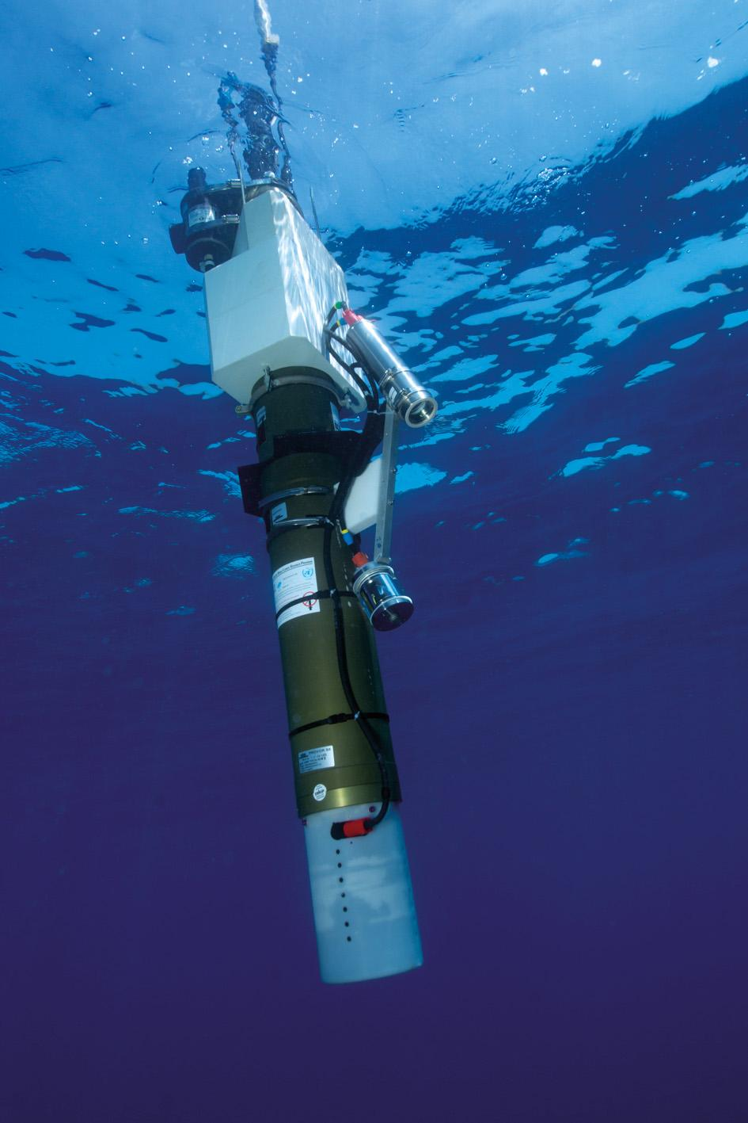
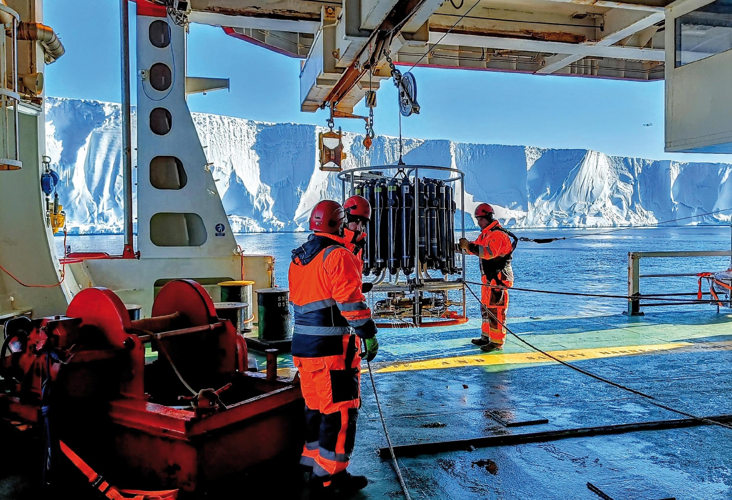
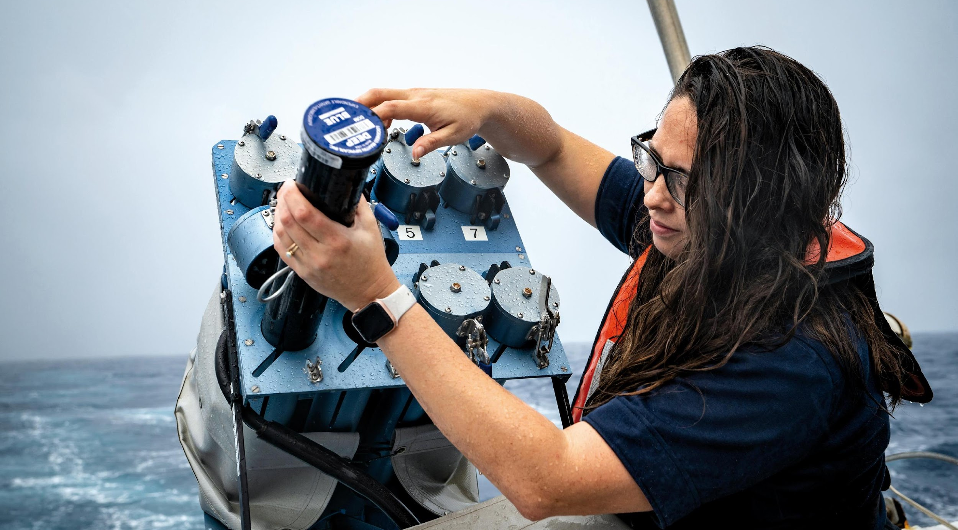
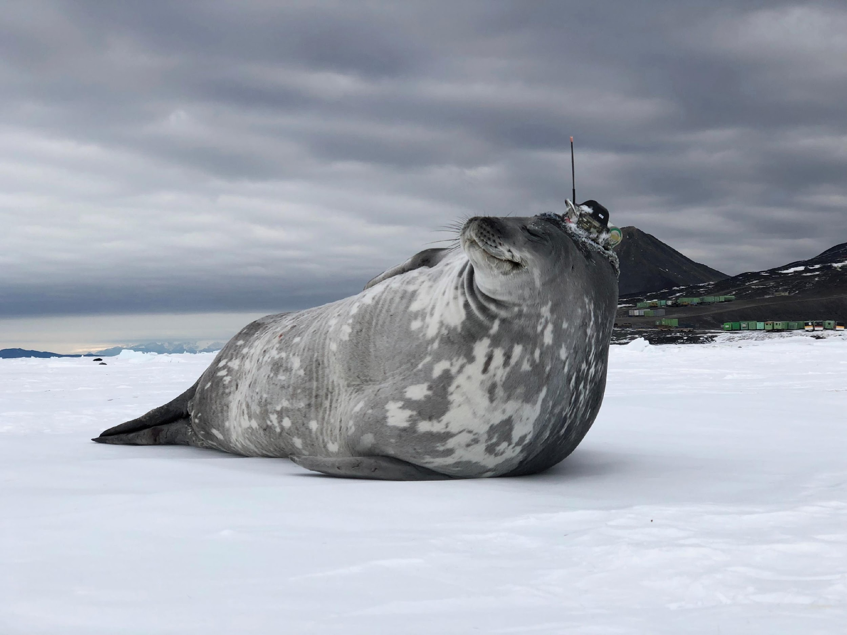
Thank you
goosocean.org ocean-ops.org

