Slide 1
OceanOPS Work Plan 2025-26
Mathieu Belbeoch & OceanOPS Team
OCG-16 Session, 07 - 11 April 2025
Ifremer, Brest, France
Notes:
Ann

Slide 2
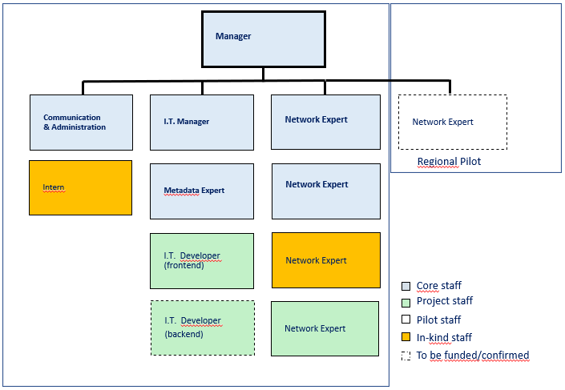
Staff 2025-26
Being recruited:
IT Manager
IT Developer (front) – AMRIT
Network Expert – TRICUSO/SOCONET
Intern (in-kind)
To confirm
IT Developer (back) – EOV project
To fund
Network Expert (Argo BGC/Med pilot funded until 08/2025)
We secure core staff, optimize projects means, enable creative solutions.

Slide 3
SLA 2025-26: dedicated FTE
Advanced (2.5): Argo , SOCONET, OceanGliders
Standard + (1): VOS , GOSHIP, GDA, OceanSITES
Standard (0): SOOP XBT, GTMBA, NMBA Baseline (0): ASAP, TSU, FVON, GLOSS, AniBOS, SmartCables, HF Radars
Total available (recruitable): 3.75
Margin (for Standard): 0.25
 |  | SOT |  |  | DBCP
NETWORKS | GO-SHIP | ASAP | VOS | SOOP | GDA | GTMBA | NMBA | TSU | SOCONET | Argo | OceanSITES | OceanGliders | TOTAL
SLA (2025) | STD+ | BSL | STD+ | STD | STD+ | STD | STD | BSL | ADV | ADV | STD+ | ADV | 17
DEDICATED FP (FTE) | 0.25 |  | 0.25 |  | 0.25 |  |  |  | 0.75 | 1 | 0.25 | 0.75 | 3.5
TOTAL (NETWORKS/PANELS) | 45856 | 65856 |  |  | 85856.25 |  |  |  | 137569 | 183425 | 45856 | 28944 | 593363
2024 CONTRIBUTIONS | 71193 | 62626 |  |  | 94022 |  |  |  | 123000 | 168478 | 55653 | 27684 | 602656
DELTA 2024 | 25337 | -3230 |  |  | 8166 |  |  |  | -14569 | -14947 | 9797 | -1260 | 9294

Slide 4
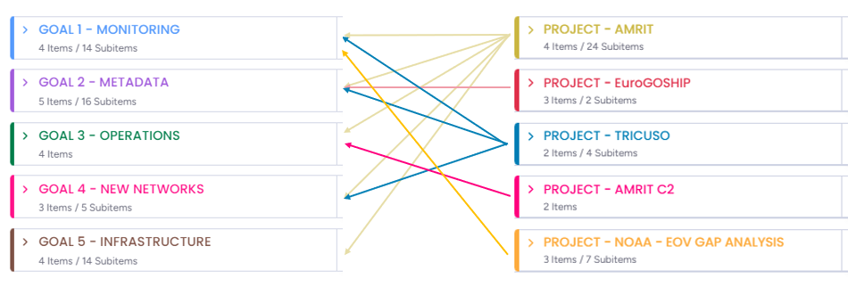
How projects fit to the Strategic Plan ?
All current (and past) projects are fueling our Strategic Plan objectives, for one or for all networks (dedicated/integrated services)
They bring resources for OceanOPS and for Networks
EU Projects represent a firm contractual funding source but they demand investment for the proposal and innovation (research), and need to fit with the call context and constraints.

Slide 5
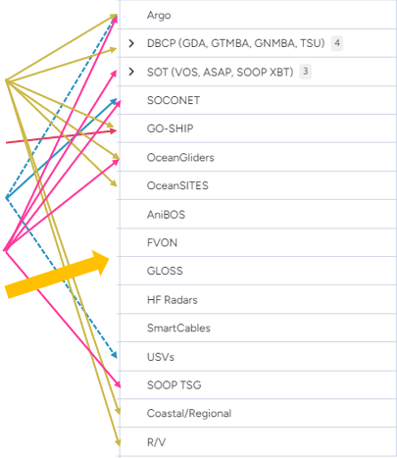
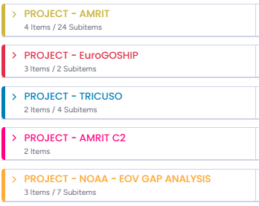
How projects fit to the Networks ?

Slide 6
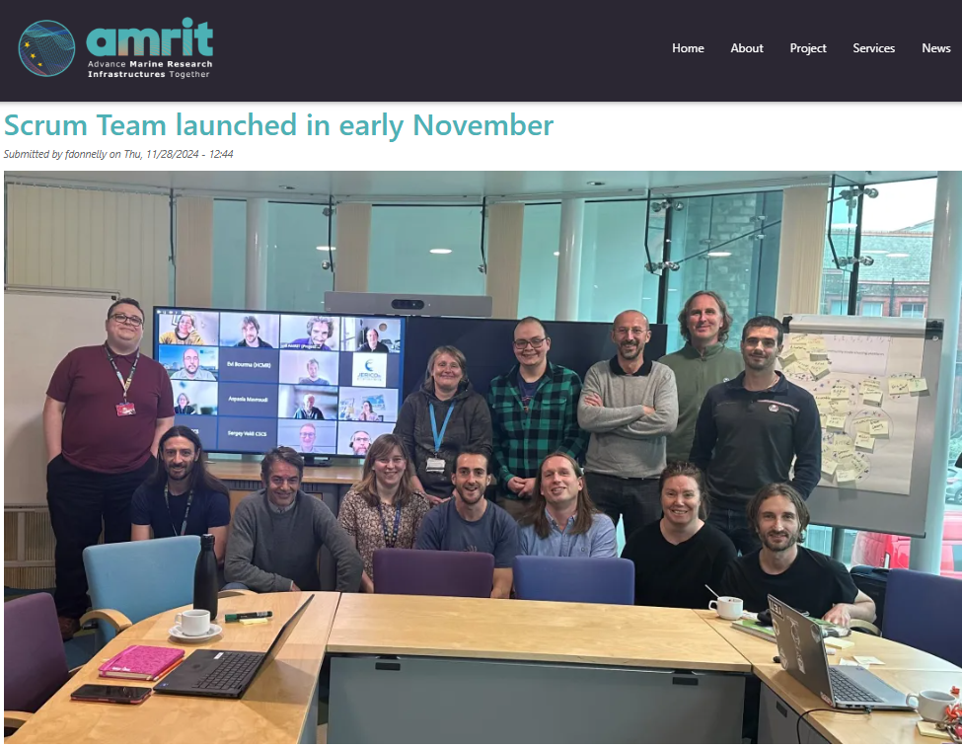
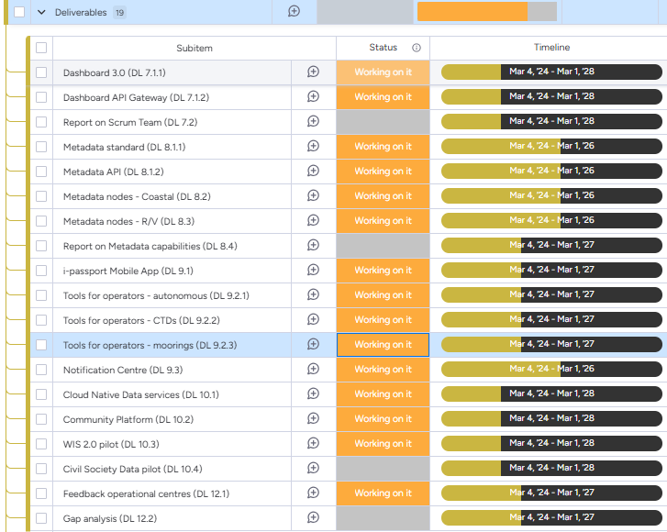
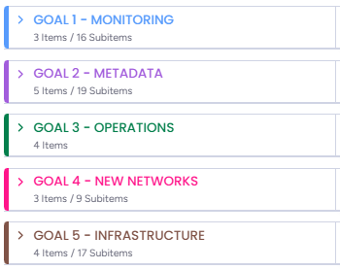
AMRIT 2024-28
OceanOPS Technical Lead WP 7-8-9-10-12 crafted by OceanOPS with Ifremer/NOC (20 EU partners)
Towards OceanOPS (meta) dashboard 3.0 collectively developed on an open platform …with tools fit for operators, connected to modernized global (meta) data and information nodes..

Slide 7
Workplan backbone
Goal 1:
increase our monitoring capacity for some networks and keep developing our future dashboard/architecture
Rationalize our reporting to Network (per SLAs)
Codesign the EOV/ECV gap analysis tool, prepare required architecture (big data – with Ifremer), start developments
Goal 2:
Improve our metadata standard, content and prepare its collective evolution
Improve our API, and m2m connection to data/metadata nodes
Goal 3:
Improve our tools for operators (AMRIT/codesign, & R/V schedules)
Continue opportunistic deployment initiatives
Goal 4:
Focus: VOS expansion/private, shipping
Complete AniBOS - Support 1 or 2 Baseline Network
Goal 5:
marketing plan, strategic plan 2026-30, complete hosting agreement, organize UNOC, reportcards (GOOS, EU/AMRIT), hiring/admin, budget management, SLA …

Slide 8
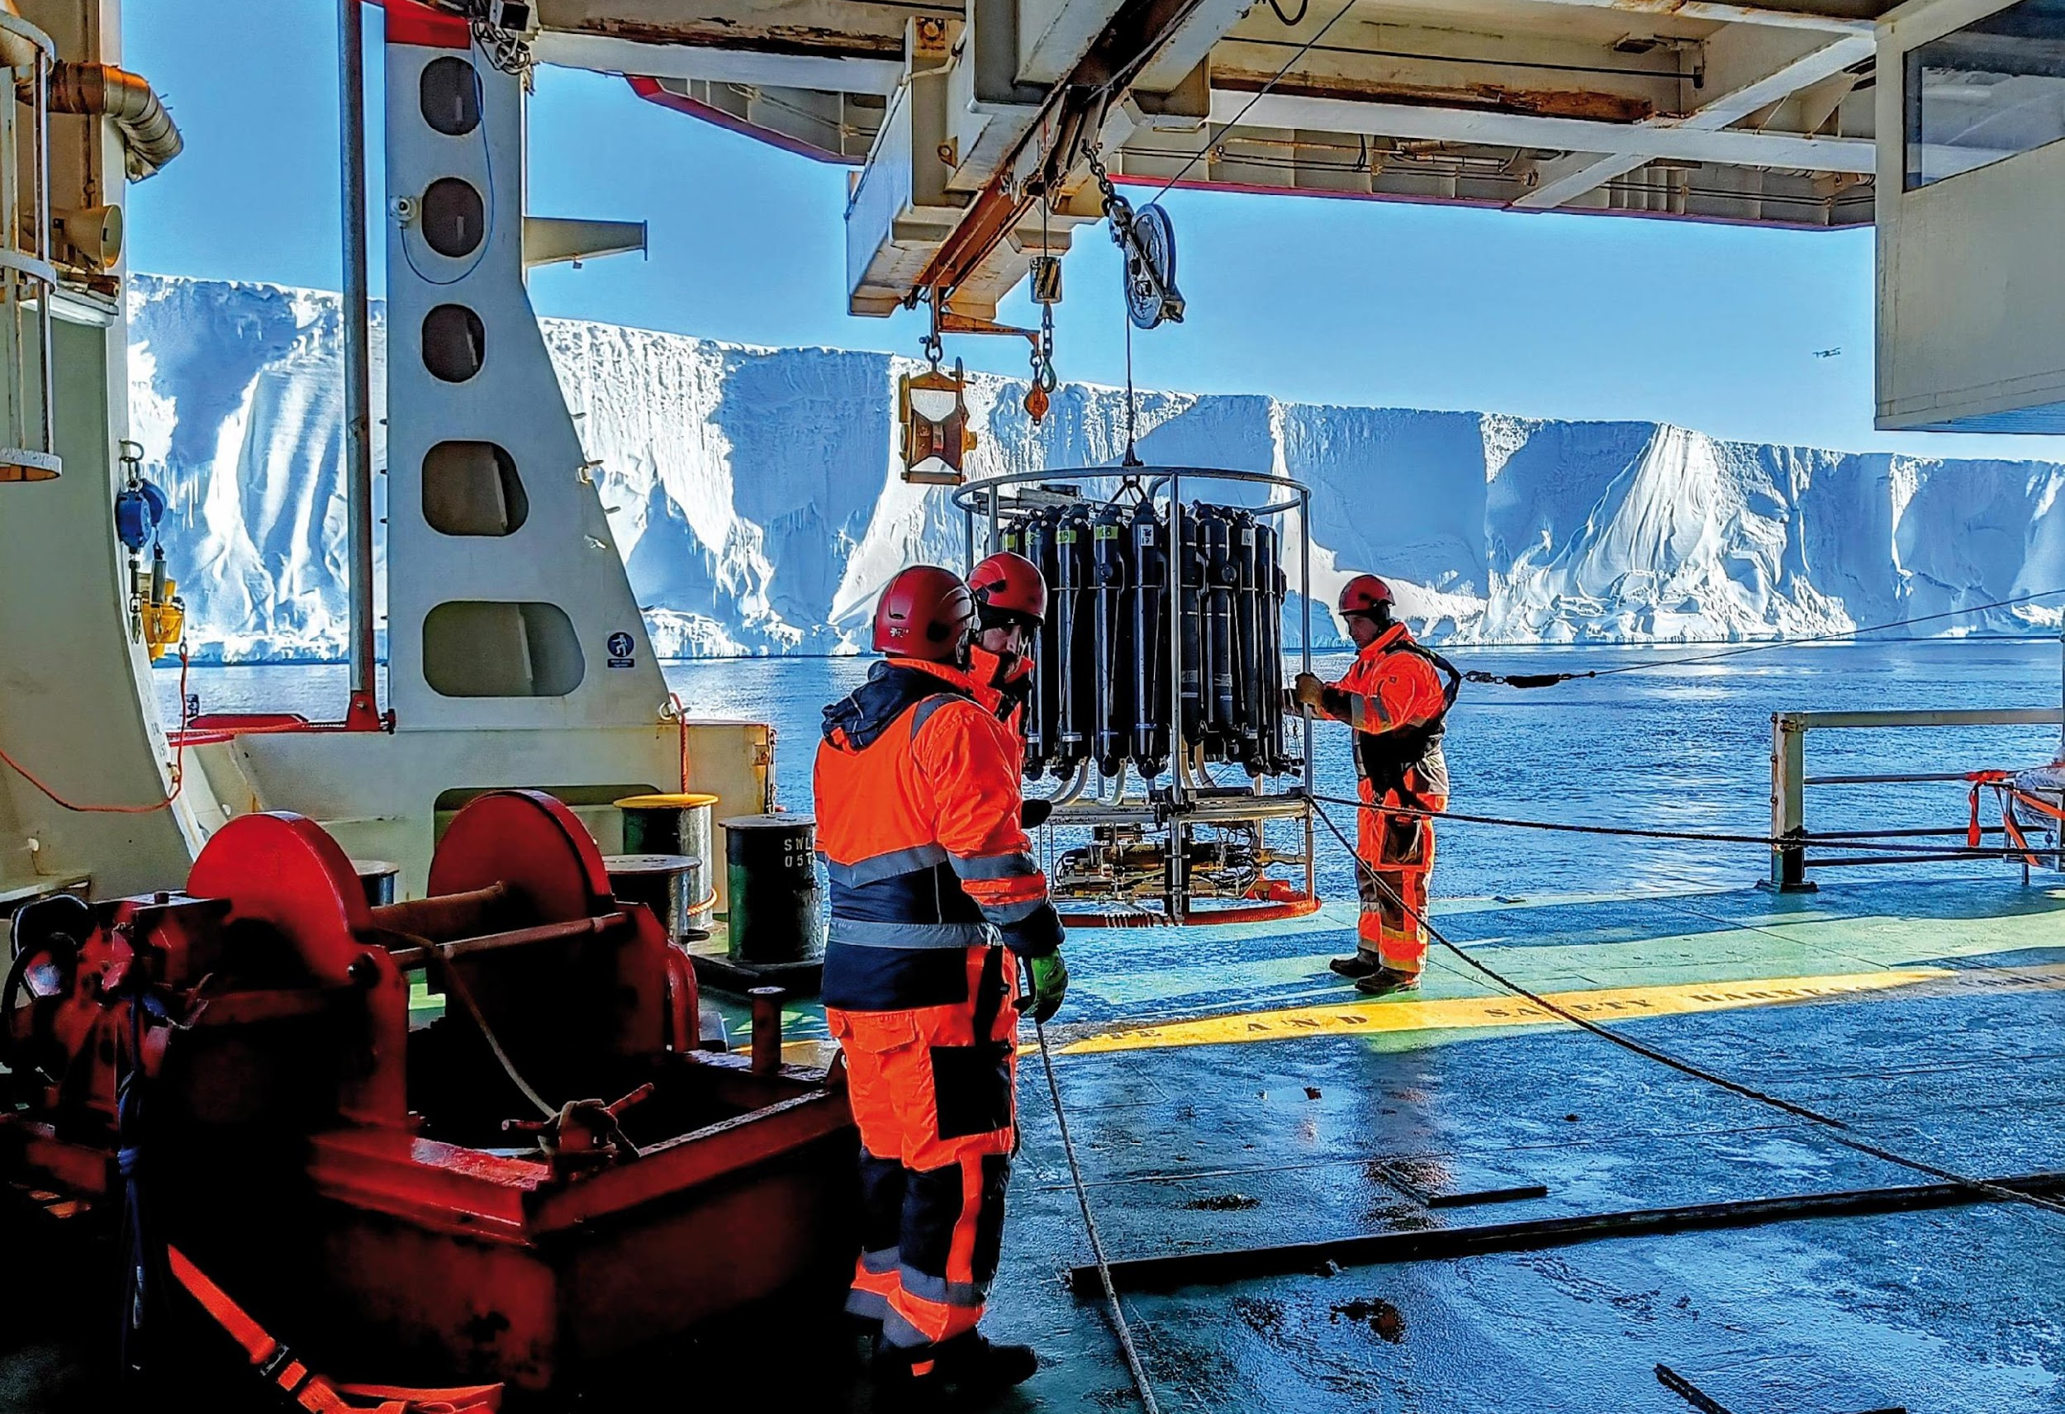
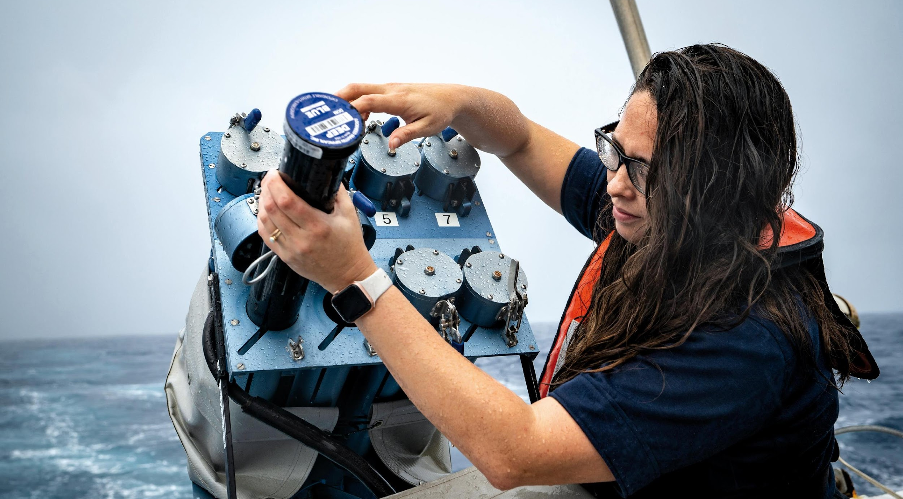
Any feedback and guidance from OCG on the workplan ?

