Slide 1
OceanOPS Strategic Plan 2026-30
Objective: launch the new SP early 2026
2025 - Q1
SLA Synthesis: define new services and networks ambitions
OCG-16: identify & address OCG cross cutting issues, task teams (data, metrics)
2025 - Q2 & Q3
Take advantage of GOOS review (consulting company): expand focus to include OceanOPS alignment
Assemble experts panel: conduct interviews with OceanOPS stakeholders
…
OceanOPS brainstorming retreat: engage key invited experts
2025 - Q4
Overall synthesis
OCG review and feedback
Finalization & Prepare communication and marketing materials
Notes:
Ann

Slide 2
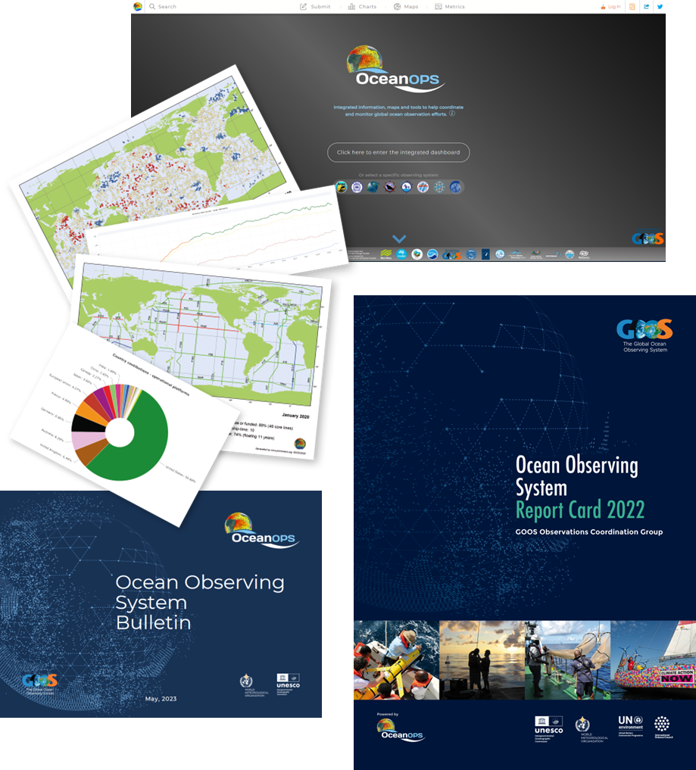
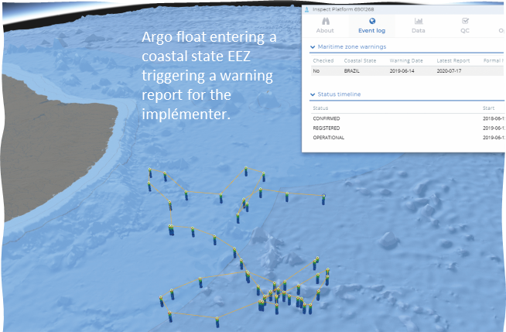
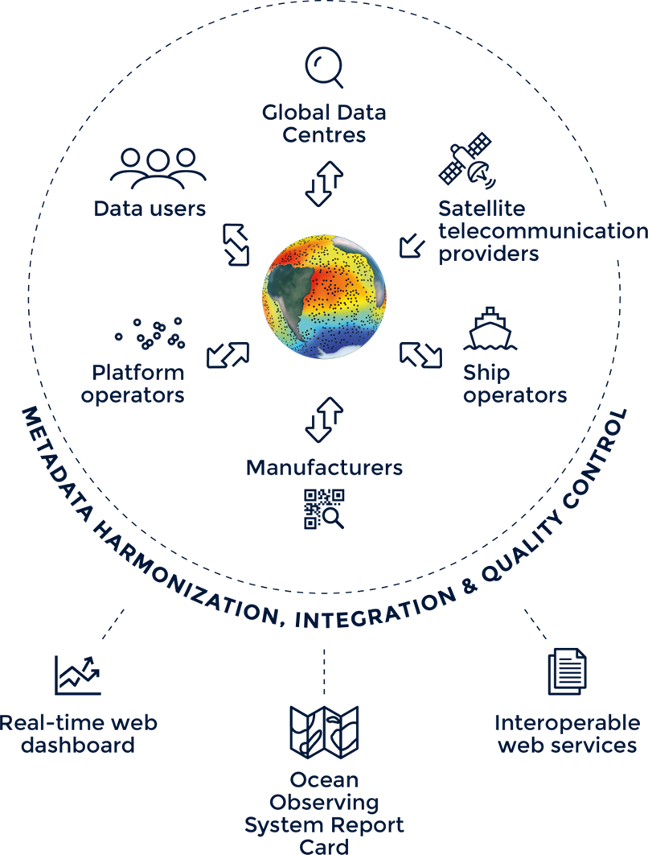
OceanOPS Strategic Plan 2026-30
BRAINSTORMING
Amongst the achievements from 2021-25 report: which goal/activity need to be sustained, expanded, ignored or deprioritized?
Monitoring & reporting
Lead data/metadata standardization & integration
Daily support to implementers’ operations
Support new data streams & networks
Strengthen infrastructure
What role for OceanOPS in supporting integration of Coastal and BioEco observing networks/efforts?
Any strategic elements to be considered by parent organizations:
IOC, WMO and key stakeholders (NOAA, Ifremer) ?
What new core services should OceanOPS provide by 2030 to:
OCG Networks
GOOS
National programmes
Data users
Society

