Slide 1
Framework for risk assessment
Ann-Christine Zinkann, David Legler, Emma Heslop
Sixteenth Observations Coordination Group Meeting (OCG-16)
7-10 April 2025, IFREMER, Brest, France.

Slide 2
Network Priorities
Assess impacts of ocean observations on society, priorities of administrations around the world
Conversations with shipping companies on deployment opportunities
Opportunities/challenges for cost effective technologies - and overlap with network activities?
Developing federated ERDDAP services
Cross platform ocean data reference network
OceanOPS to assist in deployment coordination for multi platform - cross benefit
GOshp - dependencies - opportunities to highlight the information gos hip provides for other networks - communication piece?

Slide 3
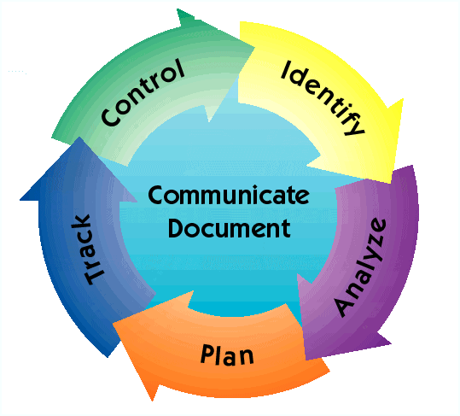
Risk Management Process
Continuous activities throughout life cycle to view and manage risks
Types of Metrics
Network based metrics to assess Performance of a network
Performance or use-based Metrics to assess Fitness to purpose
Metrics to better manage Risks
Examples of metrics
Implementation (#of deployments)
Notes:
Identify: Search for and locate risks before they become problems
Analyze: Convert risk data into useable information for determining priorities and making decisions
Plan: Translate risk information into planning decisions and mitigating actions (both present and future), and implement those actions
Track: Monitor risk indicators and mitigation actions
Control: Correct risk mitigation plans deviations and decide on future actions
Communicate and Document: Provide information to project on risk activities and current/future risks, and emerging risks

Slide 4
Risk Management Process
Identifying impacts and likelihood of occurrence
Process steps
Identify: Search for potential risks
Analyze: Convert risk data into useable information
Plan: Translate information into planning decisions & mitigating actions
Track: Monitor risk indicators & mitigation actions
Control: Correct risk mitigation plans if needed
Communicate and Document: Track information and actions
Notes:
Identify: Search for and locate risks before they become problems
Analyze: Convert risk data into useable information for determining priorities and making decisions
Plan: Translate risk information into planning decisions and mitigating actions (both present and future), and implement those actions
Track: Monitor risk indicators and mitigation actions
Control: Correct risk mitigation plans deviations and decide on future actions
Communicate and Document: Provide information to project on risk activities and current/future risks, and emerging risks

Slide 5
Risk Management Process
Continuous activities throughout life cycle to view and manage risks
Process steps: Identify, Analyze, Plan, Track, Control, Communicate and Document
Identifying impacts and likelihood of occurrence
Example Metrics to monitor:
National funding (e.g. # countries contributing)
Data management
Resourcing/personnel
Ship time needs/schedules/capabilities, availability/projections
Legal (e.g. EEZ permissions)
Piracy/vandalism (incidents)
Instrument and platform diversification, reliabilities
Resiliency (spare instruments, redundancy, etc)
Notes:
Identify: Search for and locate risks before they become problems
Analyze: Convert risk data into useable information for determining priorities and making decisions
Plan: Translate risk information into planning decisions and mitigating actions (both present and future), and implement those actions
Track: Monitor risk indicators and mitigation actions
Control: Correct risk mitigation plans deviations and decide on future actions
Communicate and Document: Provide information to project on risk activities and current/future risks, and emerging risks

Slide 6
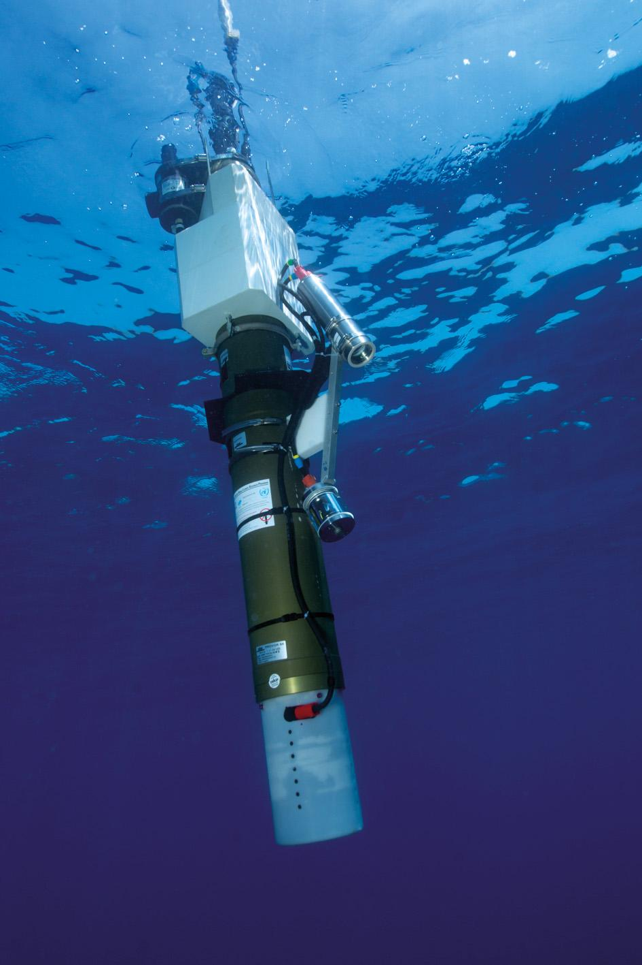
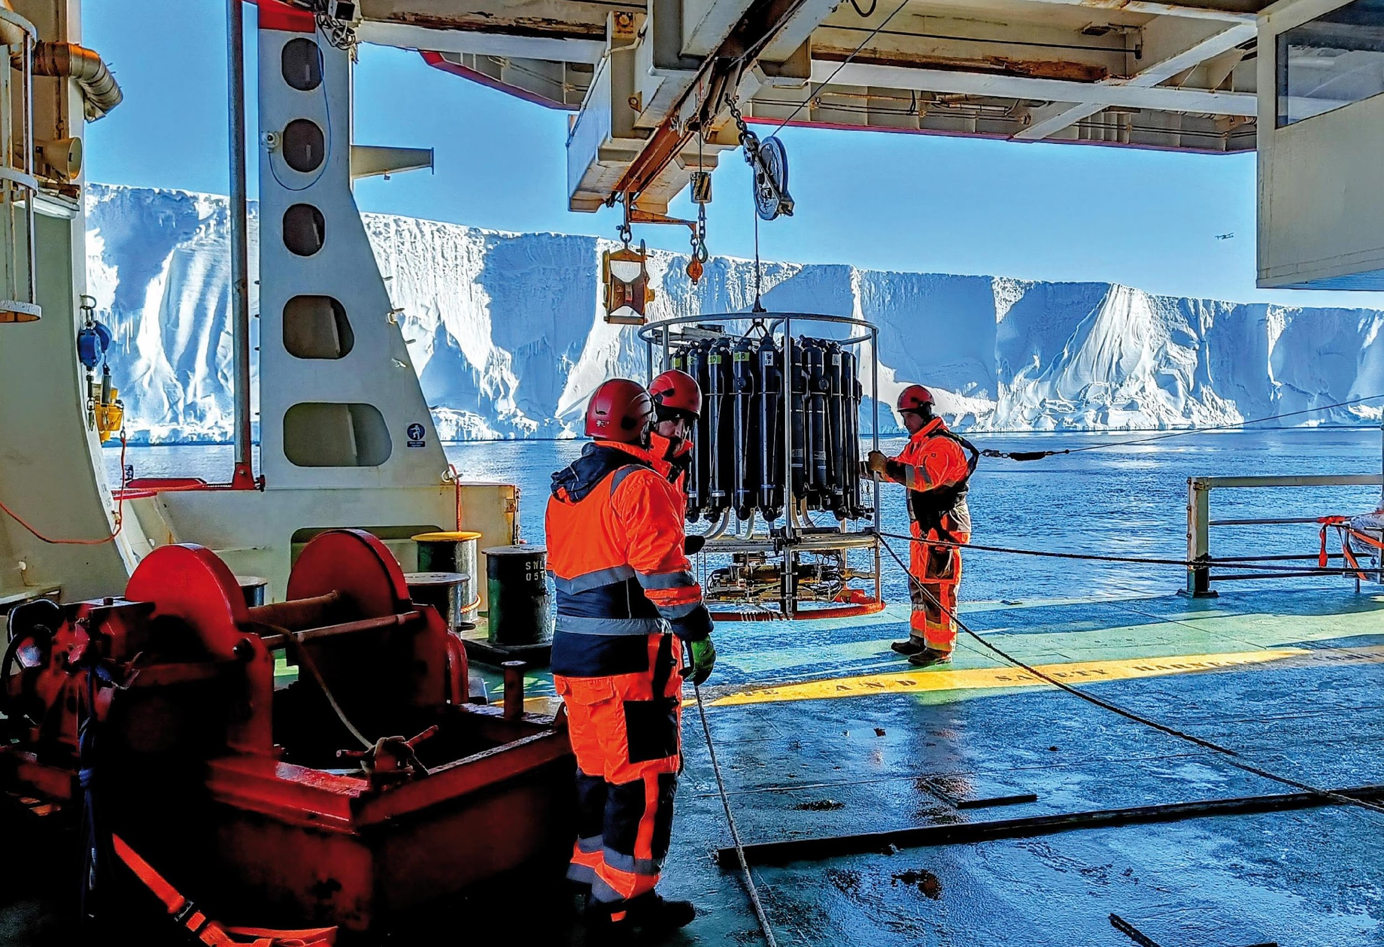
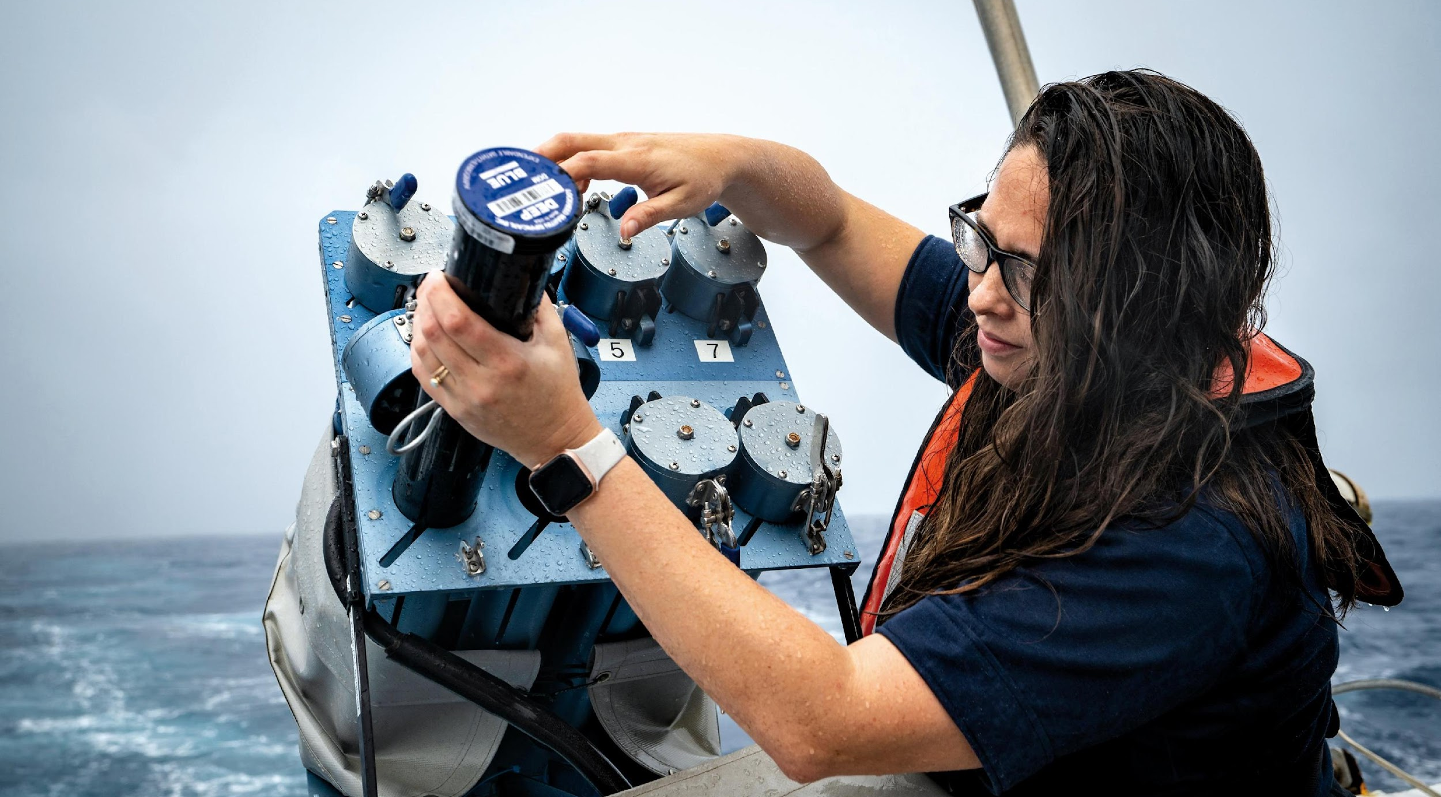
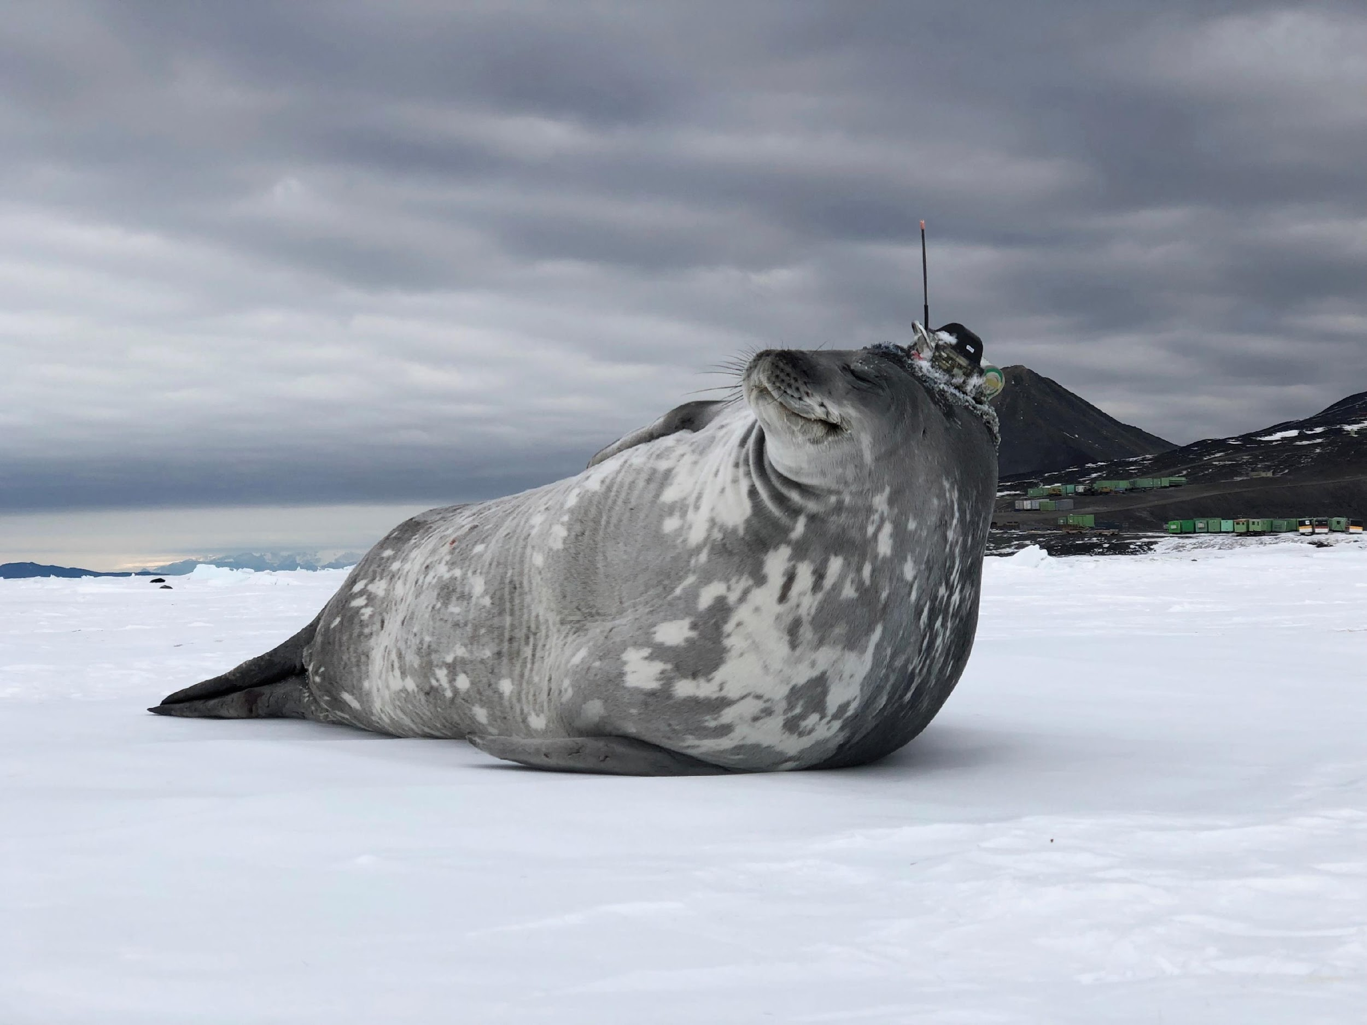
Thank you
goosocean.org

