Slide 1
Session 12. Communications GOOS / OCG Report Card
Part 1: GOOS Communications Toolkit
Laura Stukonytė (GOOS)
Sixteenth Observations Coordination Group Meeting (OCG-16)
7-10 April 2025, IFREMER, Brest, France.

Slide 2
Communications milestones 2025-2026
2025
June 2025: GOOS Brand update + Communications Toolkit launch
October 2025: Report Card 2025 launch
2026
www.goosocean.org website update

Slide 3
GOOS Communications Toolkit
Messaging Guide
GOOS new brand policy and usage guidelines
Communications assets (Logo packages, PPT templates, introductory GOOS slide deck, report templates, specification sheets, etc.)
GOOS Messaging Guide - a guide for different GOOS community representatives to ensure effective, streamlined messages about GOOS and the value of coordinated, sustained ocean observations.
Brand Guidelines
Communications Assets

Slide 4
GOOS Brand update - 2025 June
A brand update was advised by a hired communications agency in 2021 to modernize the look of GOOS

Slide 5
GOOS Branding guidelines for networks
From June 2025, to strengthen our visibility as a coordinated global system, we will kindly request that all networks display the GOOS logo on their respective websites to indicate their affiliation with GOOS.
By visually highlighting network affiliation with GOOS, we:
Reinforce the global recognition of GOOS and its observing networks as part of a unified system.
Showcase the integration and collaboration between observing networks under the GOOS framework.
Enhance visibility and credibility for all participating networks within the broader ocean observing community, policymakers, and stakeholders.
Notes:
To further strengthen our collective identity and visibility as a coordinated global system, we kindly request that all GOOS-contributing networks display the GOOS logo on their respective websites to indicate their affiliation with GOOS.
This initiative aims to:
Reinforce the global recognition of GOOS and its observing networks as part of a unified system.
Showcase the integration and collaboration between observing networks under the GOOS framework.
Enhance visibility and credibility for all participating networks within the broader ocean observing community, policymakers, and stakeholders.

Slide 6
Question set 1 (10 min.):
Messaging Guide
Under which circumstances would the networks benefit from GOOS communications products?
What specific communications products would the OCG and networks find useful?
Brand Guidelines
Communications Assets

Slide 7
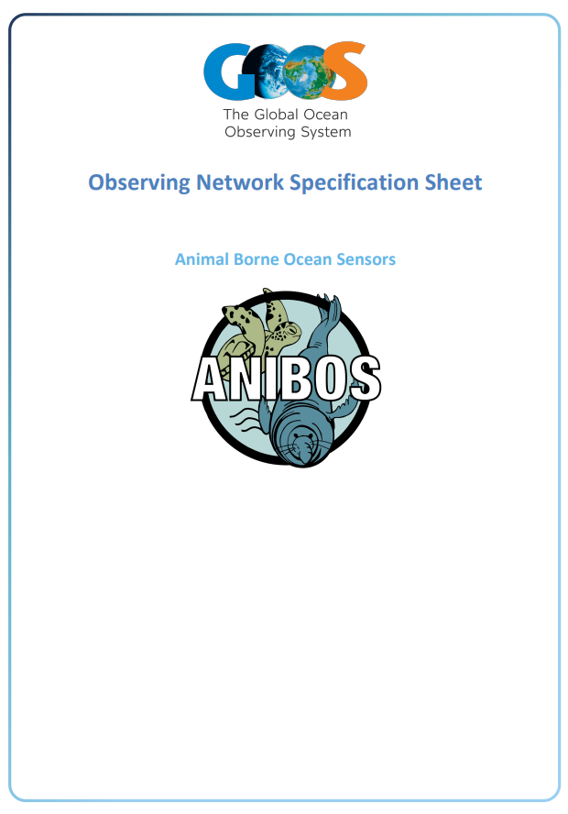
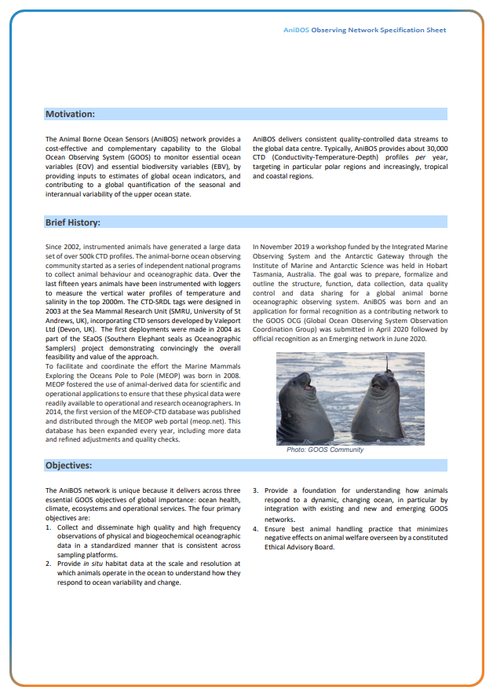
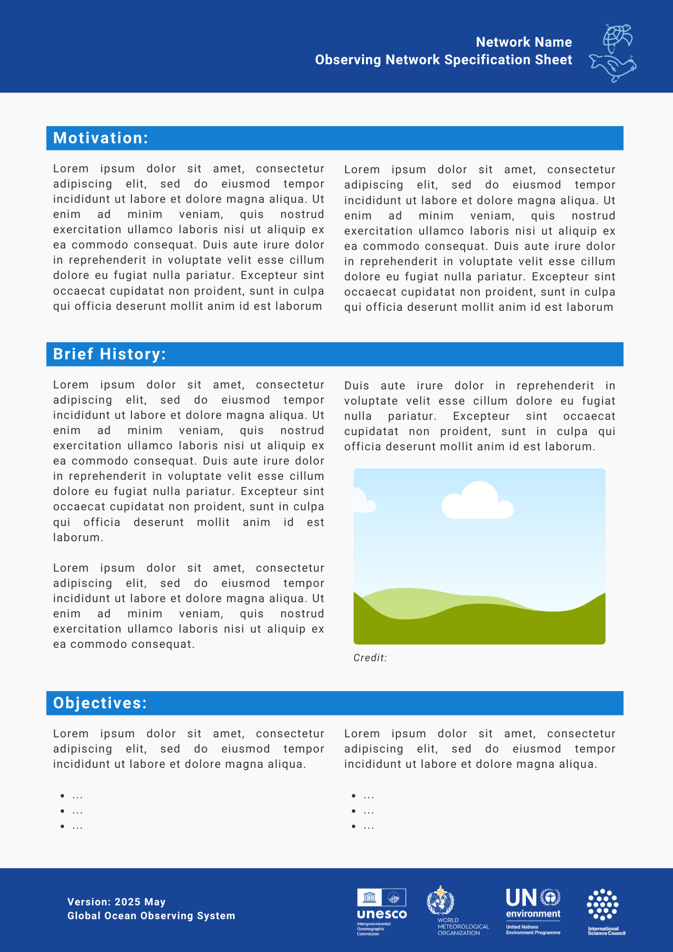
Network Specification Sheet update

Slide 8
Cover options - network icons vs. logos

Slide 9
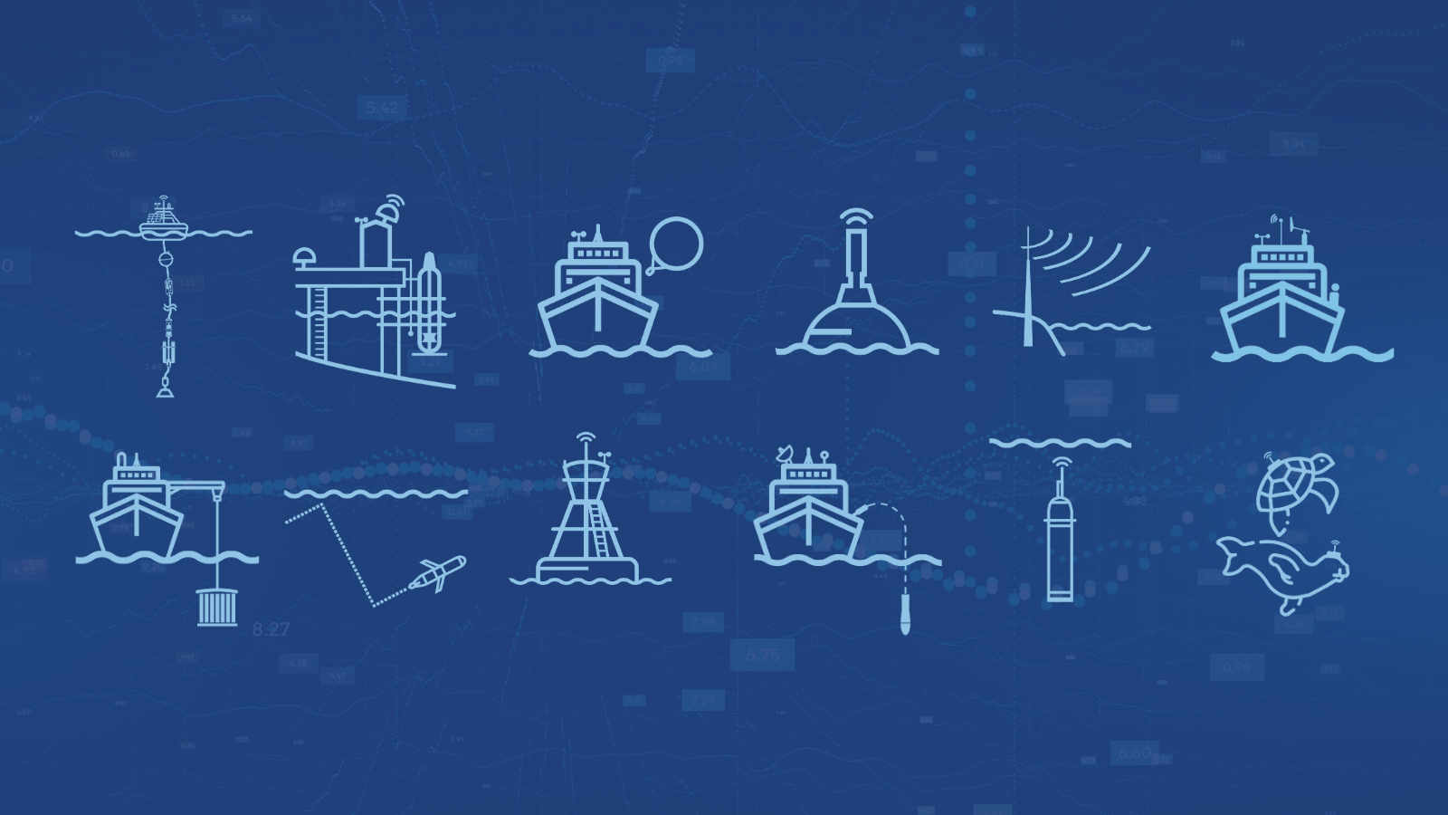
Current observing network icons
Can be used to visually represent the different networks and platforms they use in graphs, maps and other communications products
Currently missing:
Tsunami buoys
3 emerging networks (FVON, SMART Cables, SOCONET)

Slide 10
Question set 2 (10 min.):
Feedback on the suggested design?
What would be the most convenient way to proceed with the network specification sheet updates? Is there a need for networks to update the content of the specification sheets before the design is upgraded?

Slide 11
GOOS Website update - OCG pages
https://goosocean.org/who-we-are/observations-coordination-group/
The OCG webpage needs simplification, the current structure is complicated to navigate
https://goosocean.org/who-we-are/observations-coordination-group/global-ocean-observing-networks/
Networks page does not include emerging networks yet
https://goosocean.org/who-we-are/observations-coordination-group/oceanops/
OceanOPS platform should be more clearly linked on the GOOS website
GOOS website updates are planned for late 2025 to 2026, and we will invite the OCG to participate in the process of improving the website’s functionality for both OCG members and the external audience.
Question 3: How should we best approach the OCG webpage updates?

Slide 12
Part 2: GOOS Ocean Observing System Report Card
2025 Plan & Questions for OCG members
Emanuela Rusciano (OceanOPS) and Laura Stukonyte (GOOS)

Slide 13
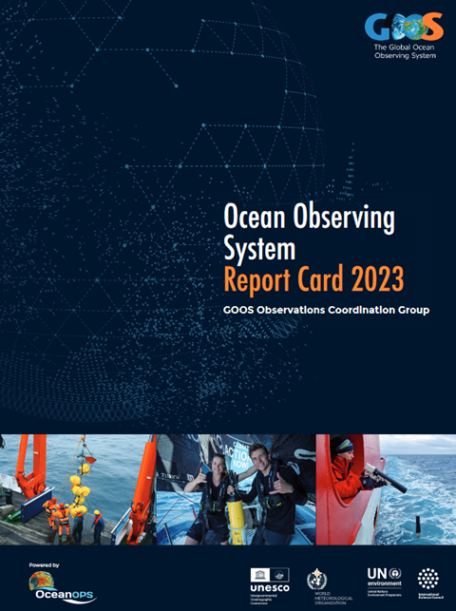
Report Card - Overview
Yearly report on the status and value of the GOOS and its networks since 2016.
Focus: Highlights how an integrated ocean observing system adds value to society across the 3 GOOS delivery areas; Assesses networks’ progress and challenges; Encourages collaborations and attract new partners.
Audience: Targeted towards funders, implementers, high-level stakeholders, decision makers, and WMO-IOC Member States.
Promotion: Disseminated through press-release and impactful video. Web version shared on social media platforms, and hard copies mailed and distributed to key stakeholders.
Engagement (past editions): over 3,000 views from more than 100 countries, and more than 1,000 downloads within a year.
Past feedback from surveys: very positive, with many considering it an informative and useful high-level report.

Slide 14
Evolution Plan for 2025 publication
We aim to enhance the impact and quality of the Report Card by making content more engaging, accessible, and widely used.
Next edition: to be released by early October 2025
Introducing several changes, including:
Improved web version with interactive maps and dynamic graphs, video content, user feedback form, and additional materials to explore;
Simplified and shortened printed version, inviting readers to dive deeper into the online version;
Content developed from interviews with ocean observing experts on different topics;
Topics selected based on input from GOOS Expert Panels, Steering Committee and OCG networks;
Highlighting Member State contributions to the observing system;
Exploring translation opportunities by collaborating with Member States to broaden the report’s reach.

Slide 15
Relevant topics for 2025
Over the past weeks, we have collected suggestions for impactful stories that:
Highlight the value of GOOS-coordinated ocean observations across our 3 GOOS delivery areas.
Connect to recent newsworthy events around the world.
Showcase scientific achievements in a clear and engaging way for a non-expert audience.
2025 selected topics:
Climate: insight into the AMOC variability, explored through a cross-network approach and highlighting the value of international partnerships in monitoring and understanding its changes and strengths.
Operational services: El Niño’s global impact & the key role of ocean observations in predicting and managing its effects - linked to the Early Warnings for All initiative.
Ocean health: real-time, quality-controlled biological data from Antarctic marine mammals, with important implications for conservation and Marine Spatial Planning.

Slide 16
Additional topics for the web version
Strengthening and expanding the local and regional ocean observing system:
Highlighting South Africa’s growing ocean observing capacity and its link to the Ocean Observing Co-Design initiative.
Advancing new technologies and capacity building:
Showcasing FVON (capacity building activities carried out in Ghana and Tanzania), SMART Cables (focus on new technologies) and SOCONET.
Fostering collaboration and engagement:
Featuring civil society role in ocean observing, with a focus on the 2025 Venéee Globe’s contribution to GOOS implementation.

Slide 17
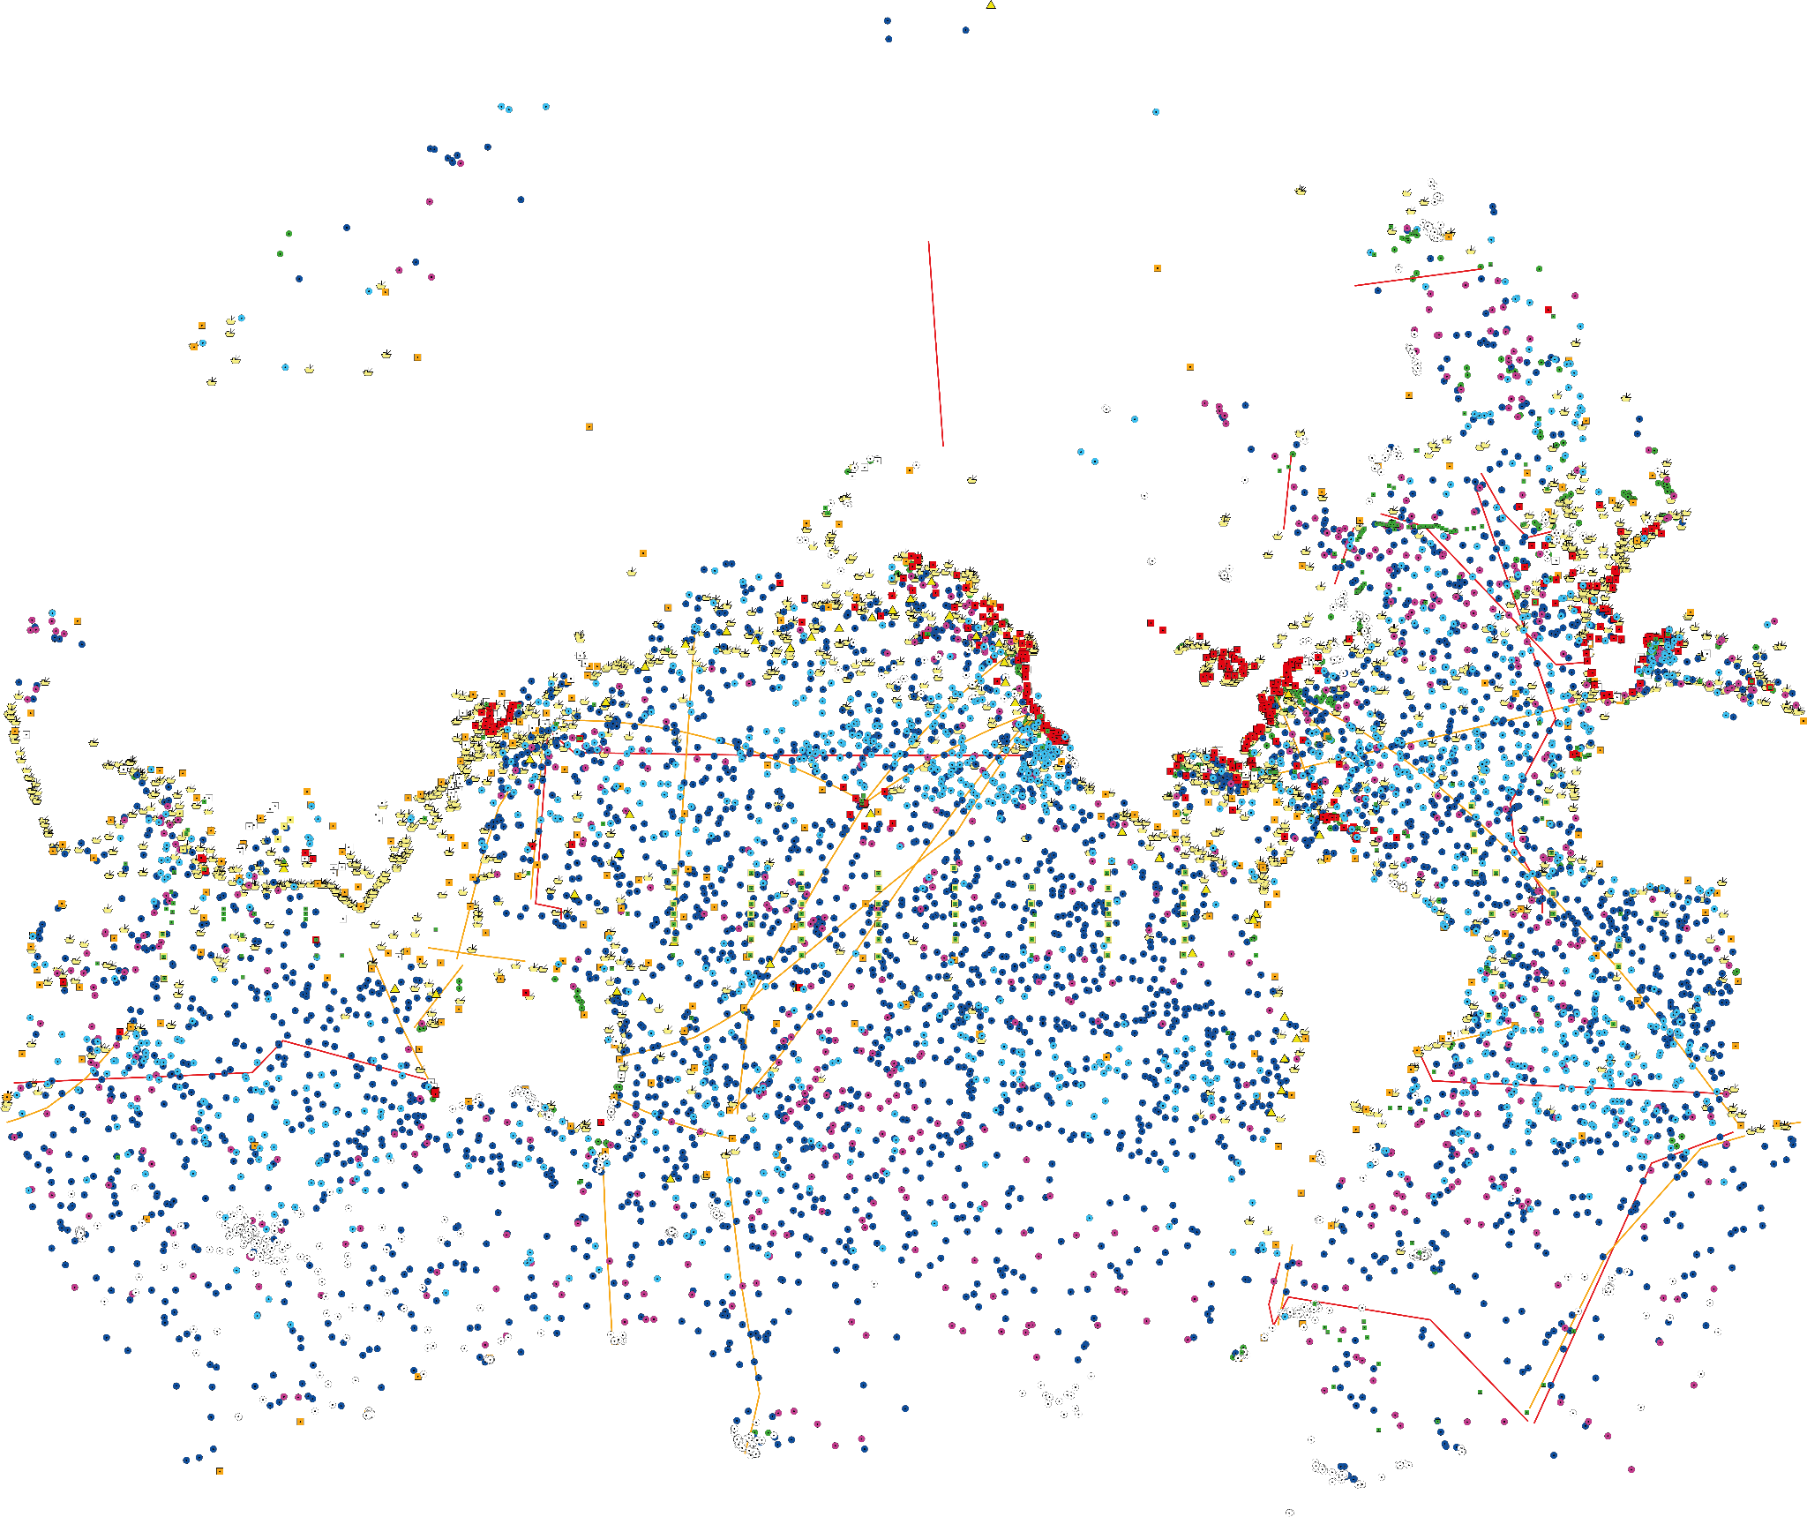
Observing system status SECTION
The Report Card not only highlights the value of ocean observations, but also provides an overview of the state of the observing networks collecting these critical observations.
This section includes:
2024-25 networks highlights (achievements, gaps, challenges, and new opportunities).
An introduction to emerging networks and satellite observations, along with a table illustrating their contributions to GOOS’ delivery areas.
An interactive map displaying the latest locations of all operational platforms and ships.
The networks status table for mature networks, providing messaging on networks’ progress and issues, to an audience of both implementers and funders (policymakers or national funding bodies).

Slide 18
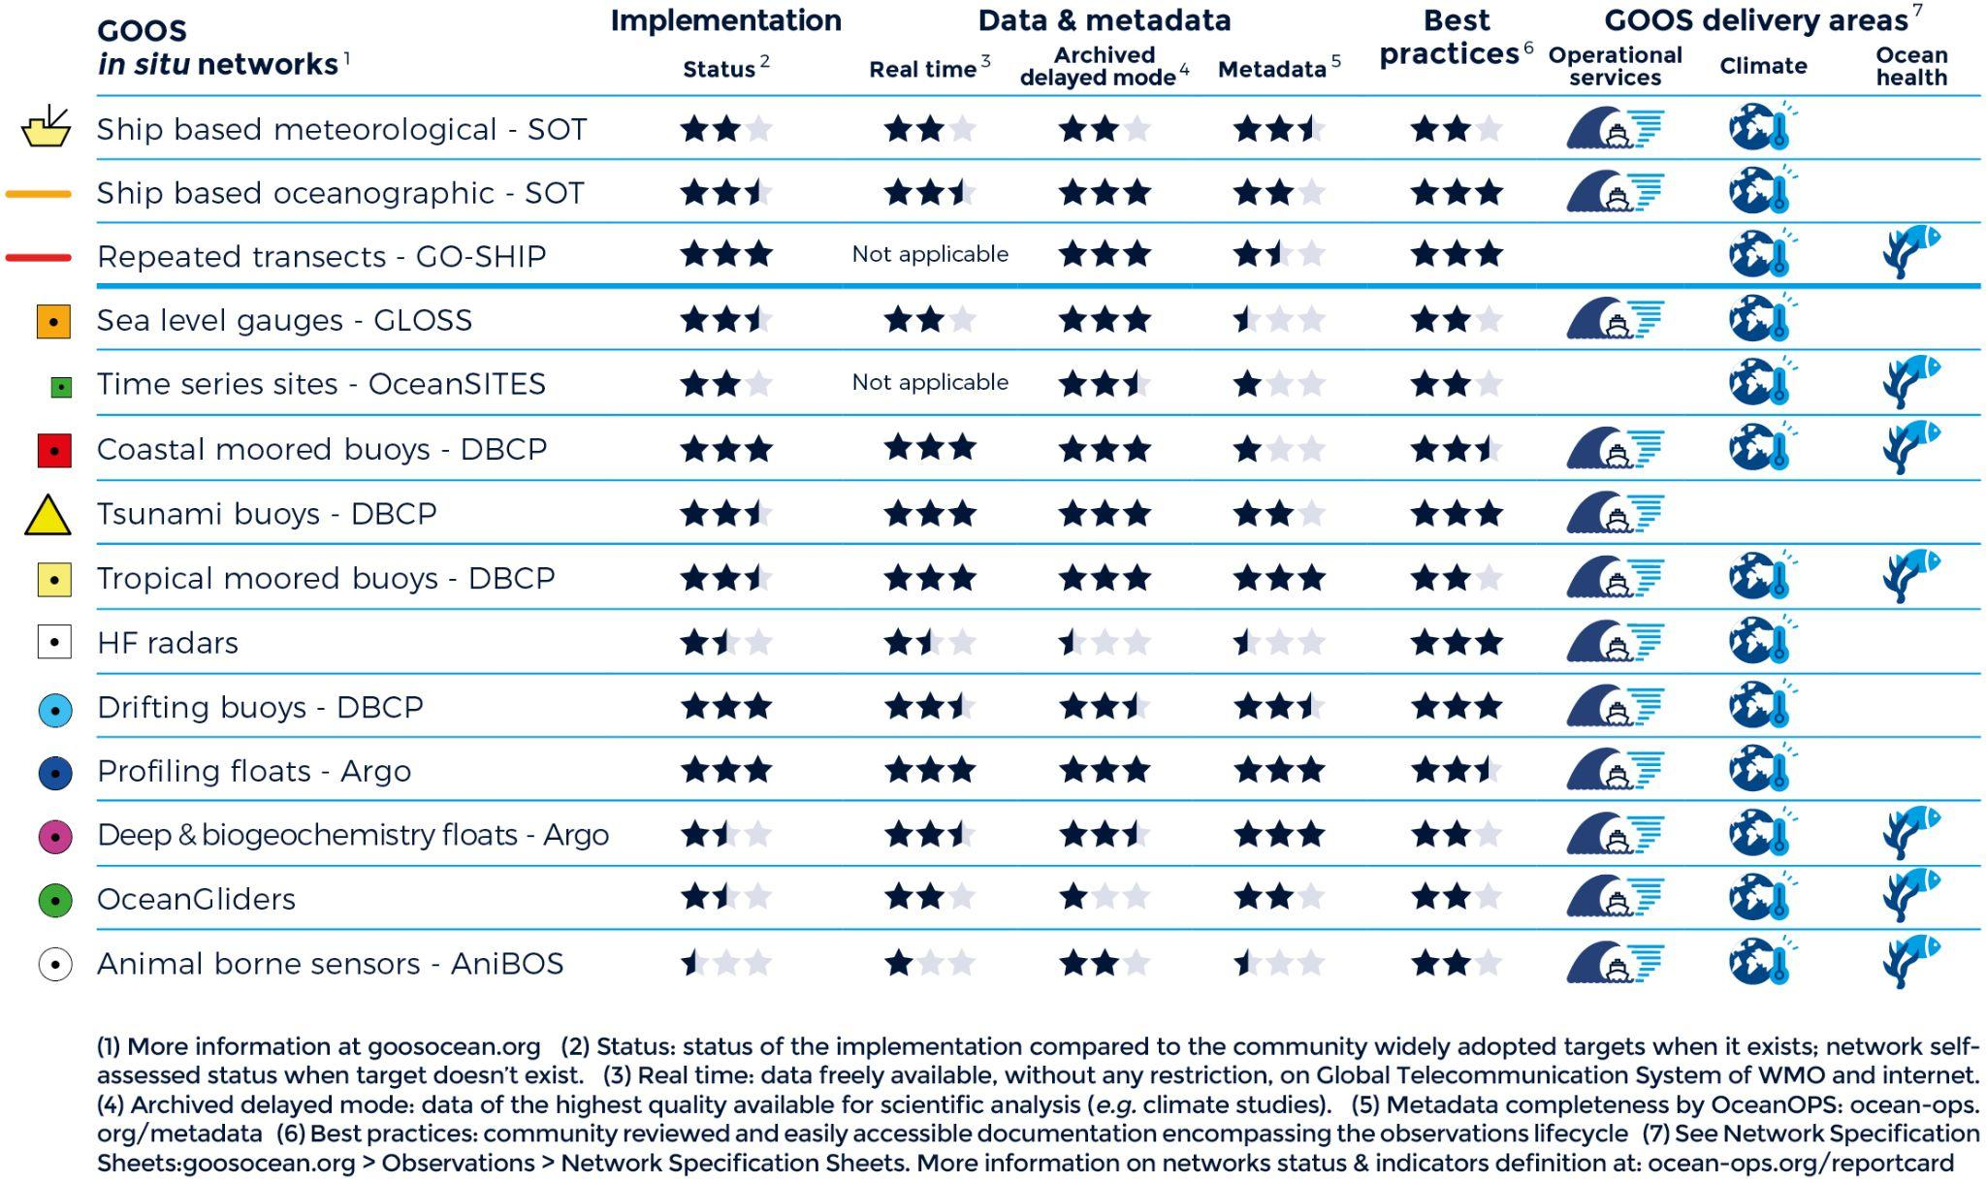
Question set 1 (10 min.):
What is your feedback on the network status table?
Do you think it effectively provide messaging on the status of your networks, or should we improve it - for example, by including different or additional indicators?

Slide 19
Question 2 (10 min.):
What key messages and calls to action should we emphasize in the call for action section?
Recognize the societal value of ocean observing, essential for economies, communities, ecosystems.
Secure long-term commitment and investment for reliable ocean data.
Drive innovation, collaboration, and data sharing to expand global observing coverage and fill critical gaps.
Bridge science and policy for informed decision-making.

Slide 20
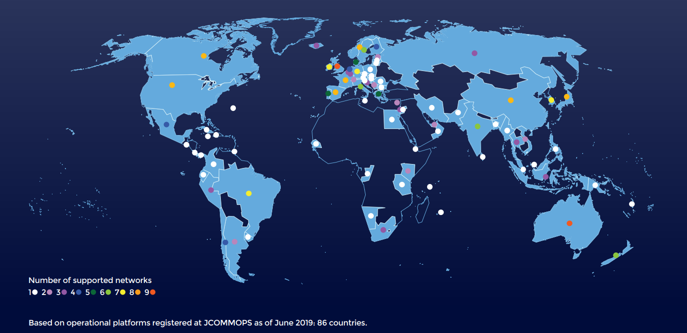
Question 3 (10 min.):
How should we report on Member States’ contributions to GOOS?
In past editions, we included a map highlighting countries supporting different ocean observing networks. Should we bring this back, or explore other ways to showcase National Partners?"

Slide 21
Next steps
May:
OceanOPS will coordinate with each network to complete the status table with appropriate ratings.
Laura will interview identified experts for each topic to start drafting the stories.
June-July:
Content review phase. If interested, you can volunteer for the content review team (both web & print versions).
Visuals needed: share high-resolution photos highlighting ocean observing instruments and the people behind the effort.
Feedback & suggestions: send any input on the Report Card to erusciano@ocean-ops.org and l.stukonyte@unesco.org

Slide 22
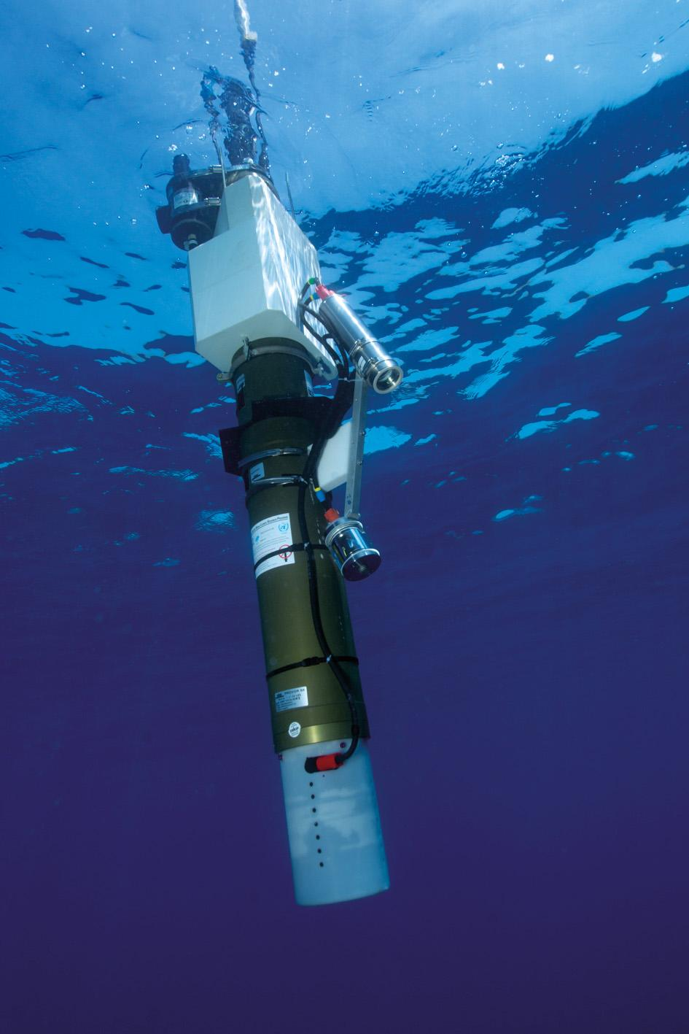
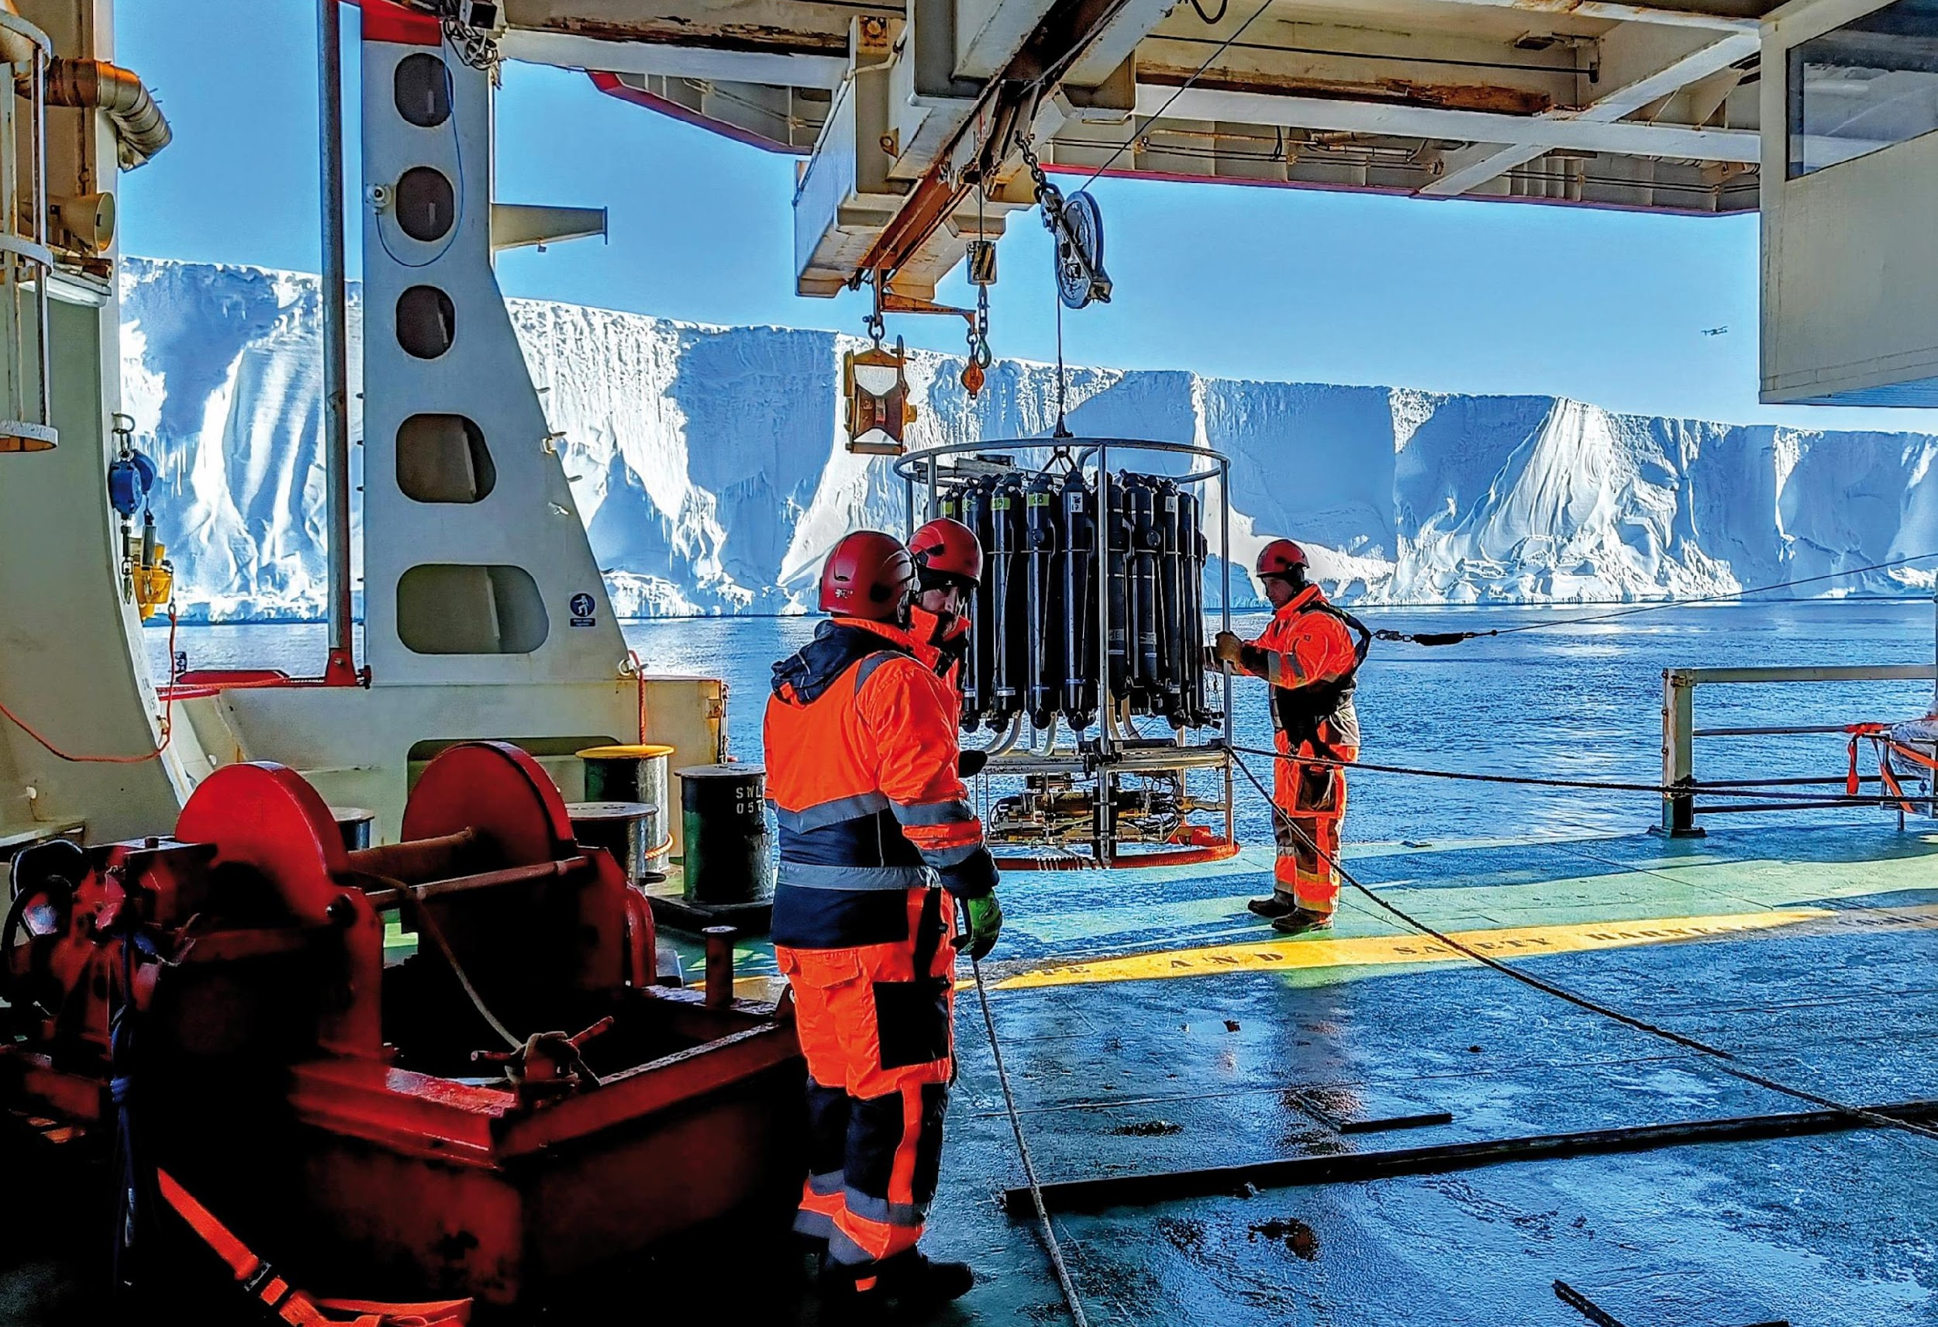
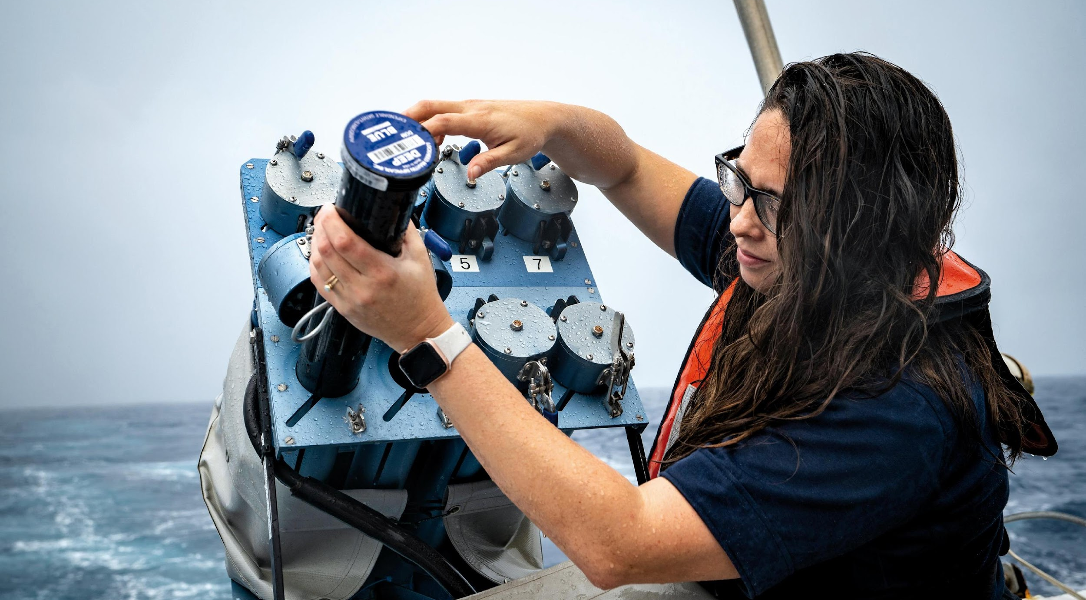
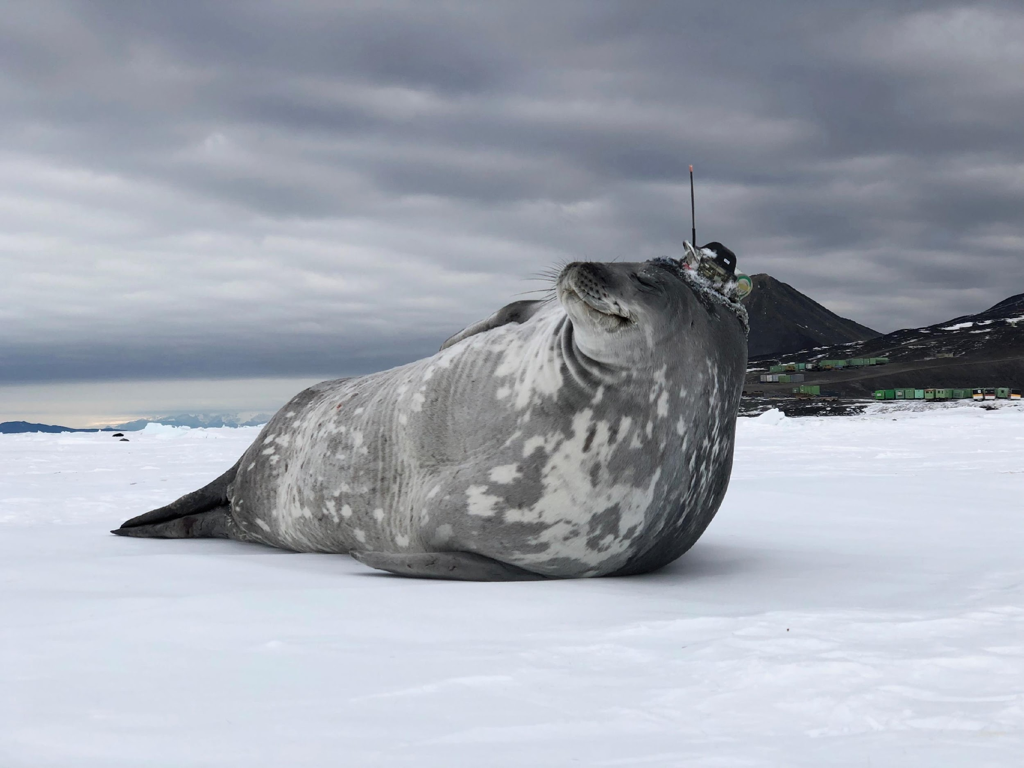
Thank you
goosocean.org

