Slide 1
3.2 ICG/PTWS Secretariat Report
ICG/PTWS XXXI
Beijing - China
7-11 April 2025
Öcal Necmioğlu
Technical Secretary of ICG/PTWS
Tsunami Resilience Section
Jiuta Korovulavula
National Professional Officer for Disaster Risk Reduction and Tsunami Warning
Tsunami Resilience Section

Slide 2
Secretariat support to the ICG/PTWS
during the intersessional period (I)
1) Eleventh Meeting of the ICG/PTWS Regional Working Group on Tsunami Warning and Mitigation System in the South China Sea Region (ICG/PTWS-WG/SCS-XI), 25 - 27 September 2023, Guanzhou, China
2) Dissemination of TS-188 (Hunga Tonga – Hunga Ha`apai Volcanic Tsunami Hazard Response PTWC Procedures and PTWS Products User’s Guide - version 1.6, through CL-2984 ()‘Hunga Tonga Hunga Ha’apai’ Volcano Permanent Monitoring and Warning Procedures of the Pacific Tsunami Warning Center, 2024), 19 January 2024
3) Call for nominations for ICG/PTWS Working Groups and Task Teams (CL-2985), 22 January 2024
4) ICG/PTWS Steering Committee Meeting, 26 - 27 March 2024, online
5) Short-term secondment of international staff from National Tsunami Warning Centres of WG-SCS Member States to South China Sea Tsunami Advisory Center (SCSTAC) (CL-2991), 29 March 2024
6) Notification and Instructions regarding the South China Sea Tsunami Advisory Center (SCSTAC) Communications Test for the Registered SCSTAC Focal Points, 8 May 2024 at 0600 UTC (CL-2994), 18 April 2024

Slide 3
Secretariat support to the ICG/PTWS
during the intersessional period (II)
7) Invitation to online training for seismic and tsunami warning operators in the South China Sea region on theories, applications and operations of tsunami numerical models, 22 May 2024, Zhenjiang, China (CL-2993 Rev.), 19 April 2024
8) Notification and Instructions regarding the Northwest Pacific Tsunami Advisory Center (NWPTAC) Communications Test for the Registered focal points of NWPTAC Advisories scheduled on 28 May 2024 at 0500 UTC (CL-2996), 30 April 2024
9) Seventh Meeting of the Regional Working Group for Central America of the ICG/PTWS (ICG/PTWS-WG-CA-VII), 10 May 2024, Managua, Nicaragua (Final Draft Report was sent to UNESCO-IOC Publication Officer on 7 March 2025)
10) Expert Meeting on Tsunami Sources, Hazards, Risk and Uncertainties Associated with Vanuatu, San Cristobal and New Britain Subduction Zones, 14 - 17 May 2024, Port Vila, Vanuatu
11) PACWAVE24 announcement (CL-2999) and publication of PacWave24 Exercise Manual (TS-191), 28 May 2024
12) ITIC Training Programme on Tsunami Early Warning Systems and the PTWC Enhanced Products, Tsunami Evacuation Planning and Tsunami Ready Programme (ITP-Hawaii-Chile-2024), 19 to 30 August 2024, Valparaiso, Chile (CL-2998)
13) ICG/PTWS Steering Committee Meeting, 16 - 20 September 2024, Hawaii, USA (Report published)

Slide 4
Secretariat support to the ICG/PTWS
during the intersessional period (III)
14) Cessation of fax transmissions of tsunami information products by Tsunami Service Providers by 31 March 2025 (CL-3006), 9 October 2024
15) Twelfth Meeting of the ICG/PTWS Regional Working Group on Tsunami Warning and Mitigation System in the South China Sea Region (ICG/PTWS-WG/SCS-XII), 7 - 8 November 2024, Jakarta, Indonesia (Final Draft Report was sent to UNESCO-IOC Publication Officer on 3 March 2025)
16) 2nd UNESCO-IOC Global Tsunami Symposium: Reflection of the Two Decades of the Indian Ocean Tsunami 2004, 11–14 November 2024, Banda Aceh, Indonesia
17) 20th Anniversary of the 2004 Indian Ocean Tsunami Commemoration Event organized at the UNESCO HQs on 26 November 2024
18) Invitation to the Thirty-first Session of the Intergovernmental Coordination Group for the Pacific Tsunami Warning and Mitigation System (ICG/PTWS-XXXI), Beijing, China, 7–11 April 2025 (CL-3019), 20 December 2024 ((Final Draft Report of ICG/PTWS XXXI was sent to UNESCO-IOC Publication Officer on 24 February 2025)
19) Survey to assess tsunami preparedness capacities in the Pacific Ocean (CL-3027), 5 February 2025

Slide 5
Secretariat support to the ICG/PTWS
during the intersessional period (IV)
20) 9th Joint ICG/PTWS–IUGG/JTC Workshop “60th Anniversary of the ICG/PTWS – Past and Future” (7 April 2025) and its pre-webinar (1 April 2025)
Additionally,
21) Secretariat supported the implementation of the UNESCO-IOC Tsunami Ready Recognition Programme in the Pacific Region
and
22) Continuously updated TNCs/NTWCs/TWFPs, Working Groups and Task Teams contact databases in direct contact with the Member States.

Slide 6
Secretariat support to the ICG/PTWS during the
intersessional period (V) – PICT Focus
23) Fiji, Tonga, Vanuatu and Solomon Islands – Review of Tsunami SOPs
24) Supported Fiji to review of National Tsunami SOP – a pre-requisite for a 72 Million Concessional loan by Government of Japan
25) Supported PacWave24 PICT Regional Exercise – continued to test EQ and Tsunami EW & response operations information sharing capability for NTWC and NDMOs using Slack Applications = transforming EQ & Tsunami EWS/Response Operations.
26) Supported the UNESCO/IOC Tsunami Ready Recognition Programme ( PICTs)
27) Invitation to the 10 Meeting of Pacific Tsunami Warning and Mitigation System, Pacific Islands Countries and Territories Regional Working Group on Tsunami Warning and Mitigation System (ICG/PTWS- X-WGPICT), Apia, Samoa, 26–27th February 2025.
28) Organized a series of online meetings of WG-PICT Task Teams, ORSNET, Volcano and Landslide Network in 2024 and early 2025.
29) Convened Two Regional Geohazards Meeting;
December 2023; and February 2025 ( USGS, VDAP, JICA, UNIVERSITIES, GEM)
April Feb 2005, resulted in the proposed establishment of a Regional Geohazards Body under the Pacific Leaders Forum
presented to the Weather Ready Pacific Technical Committee of the Pacific Meteorological Council
presented to the Pacific Disasters and Emergency Managers Meeting on 2nd April 2025/ PPDMM Decision on 8th April 2025.
to be presented at the Pacific Meteorological Council Meeting in September 2025

Slide 7
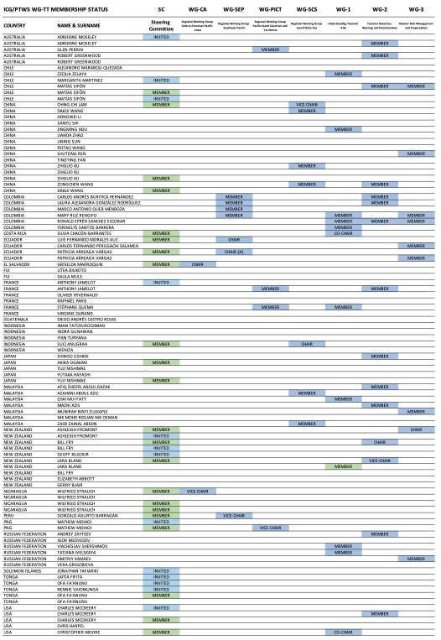
ICG/PTWS WGs/TTs Membership Status
Member States were invited on 22 January 2024 through CL-2985 to nominate experts to the ICG/CARIBE-EWS Working Groups and Task Team.
As of 7 April 2025, there are 84 experts from 21 Member States, with the following distribution:
AUSTRALIA 3
CHILE 4
CHINA 12
COLOMBIA 6
COSTA RICA 1
ECUADOR 3
EL SALVADOR 1
FIJI 2
FRANCE 5
GUATEMALA 1
INDONESIA 5
JAPAN 4
MALAYSIA 7
NEW ZEALAND 6
NICARAGUA 1
PERU 1
PNG 2
RUSSIAN F. 6
TONGA 2
USA 10
VANUATU 3
These statistics may not necessarily reflect the membership status of the Regional Working Groups.
Delegations are invited to inform the Technical Secretary in case of any updates to the ICG/PTWS Working Groups and Task Team Membership status
Registration to OceanExpert is essential!

Slide 8
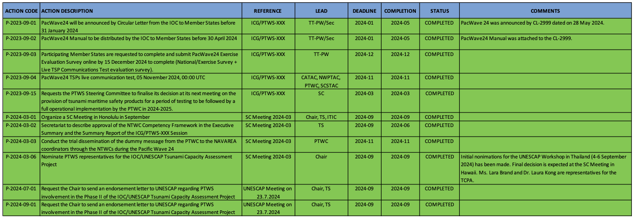
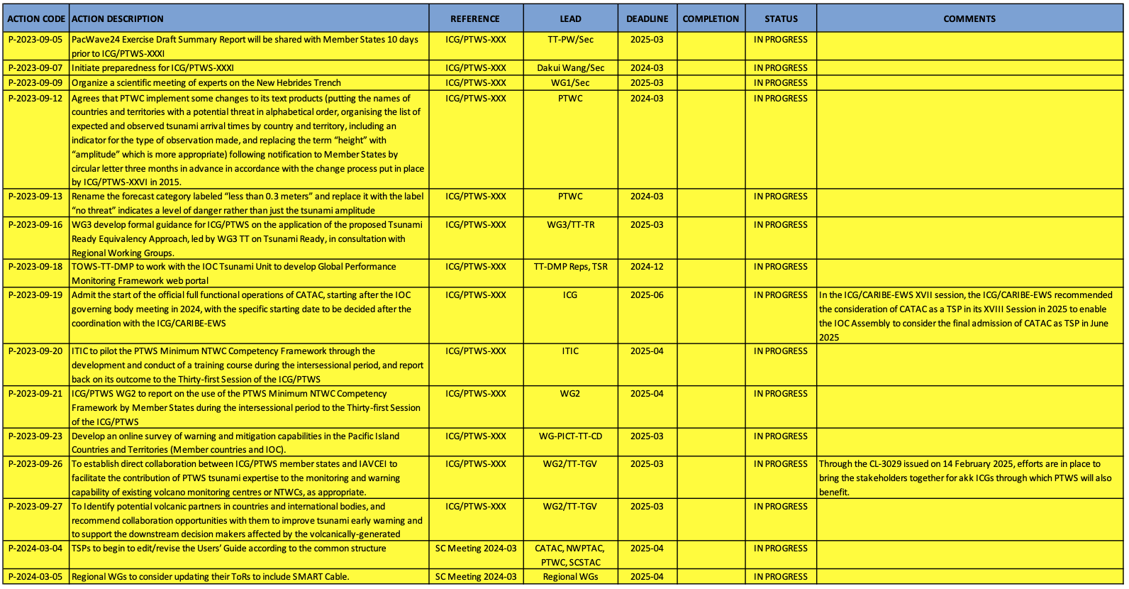
Status of PTWS Action Monitor
Completed / Failed-Delayed / In Progress / Not Started

Slide 9
TSP Communication Tests
The need to reduce number of IOC Circular Letters isssued
Since 2012, NEAMTWS TSPs performs regular communication test during the first full week of every month, according to the following schedule:
Monday (IPMA - Portugal)
Tuesday (KOERI - Türkiye)
Wednesday (CENALT - France)
Thursday (NOA - Greece)
Friday (INGV - Italy)
This eliminates the need for a CL or an announcement from the TSP, since such a test is considered as a routine activity of a TSP.
PTWS TSPs may decide to adopt a mechanism, with an interval that would be considered as the best serving their operational purposes.

Slide 10
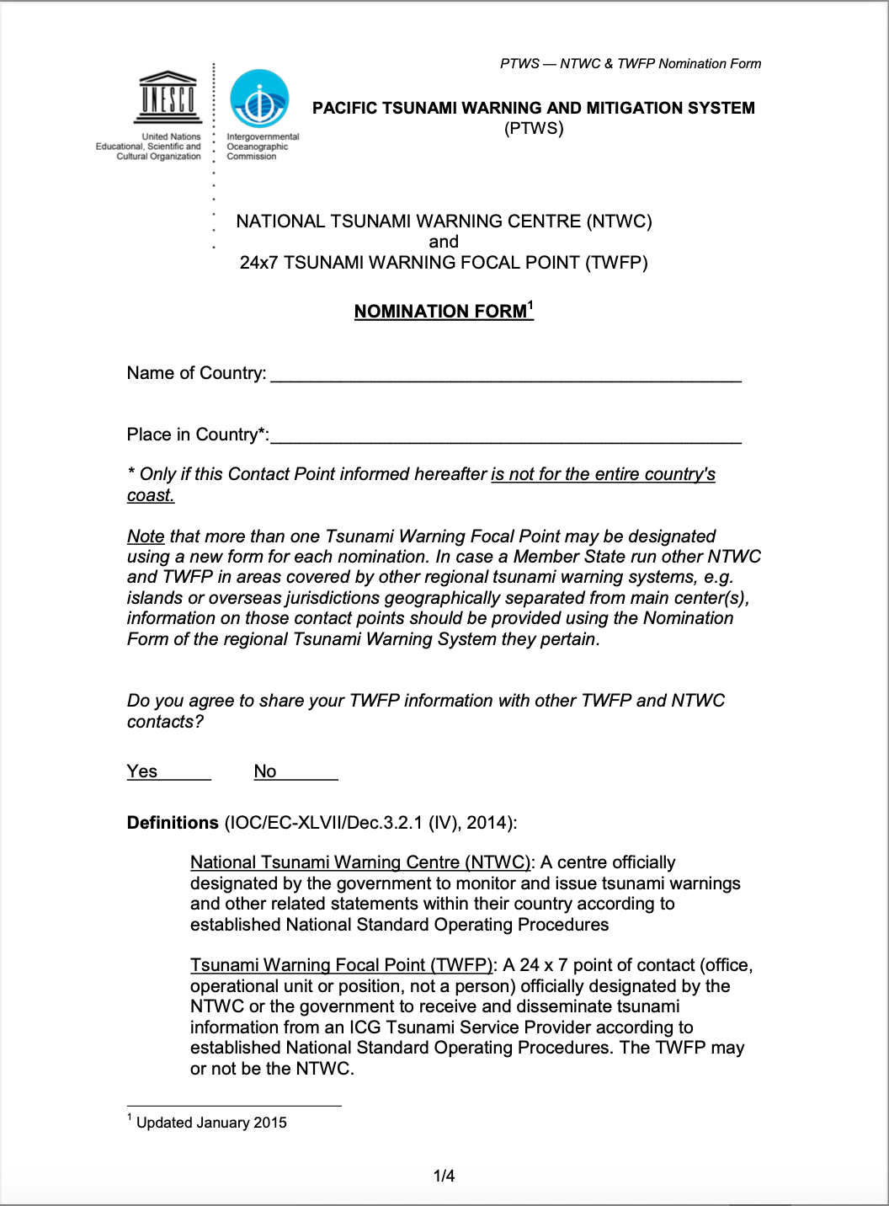
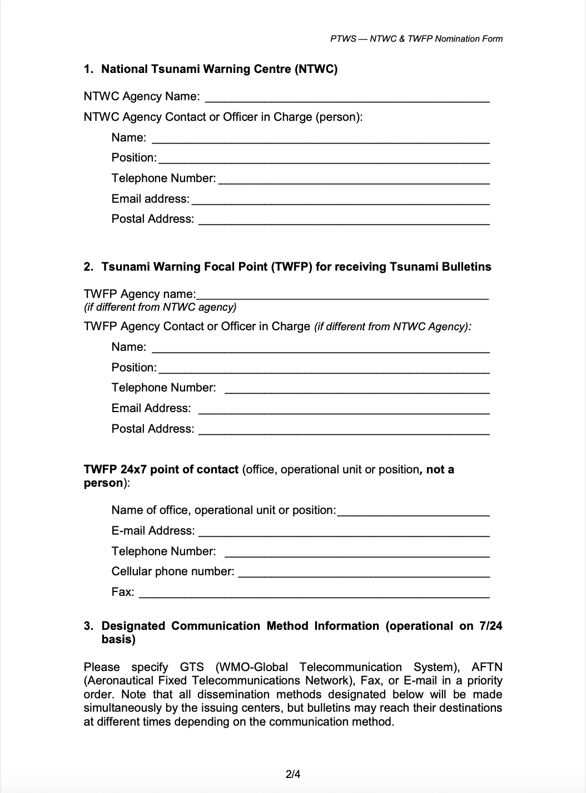
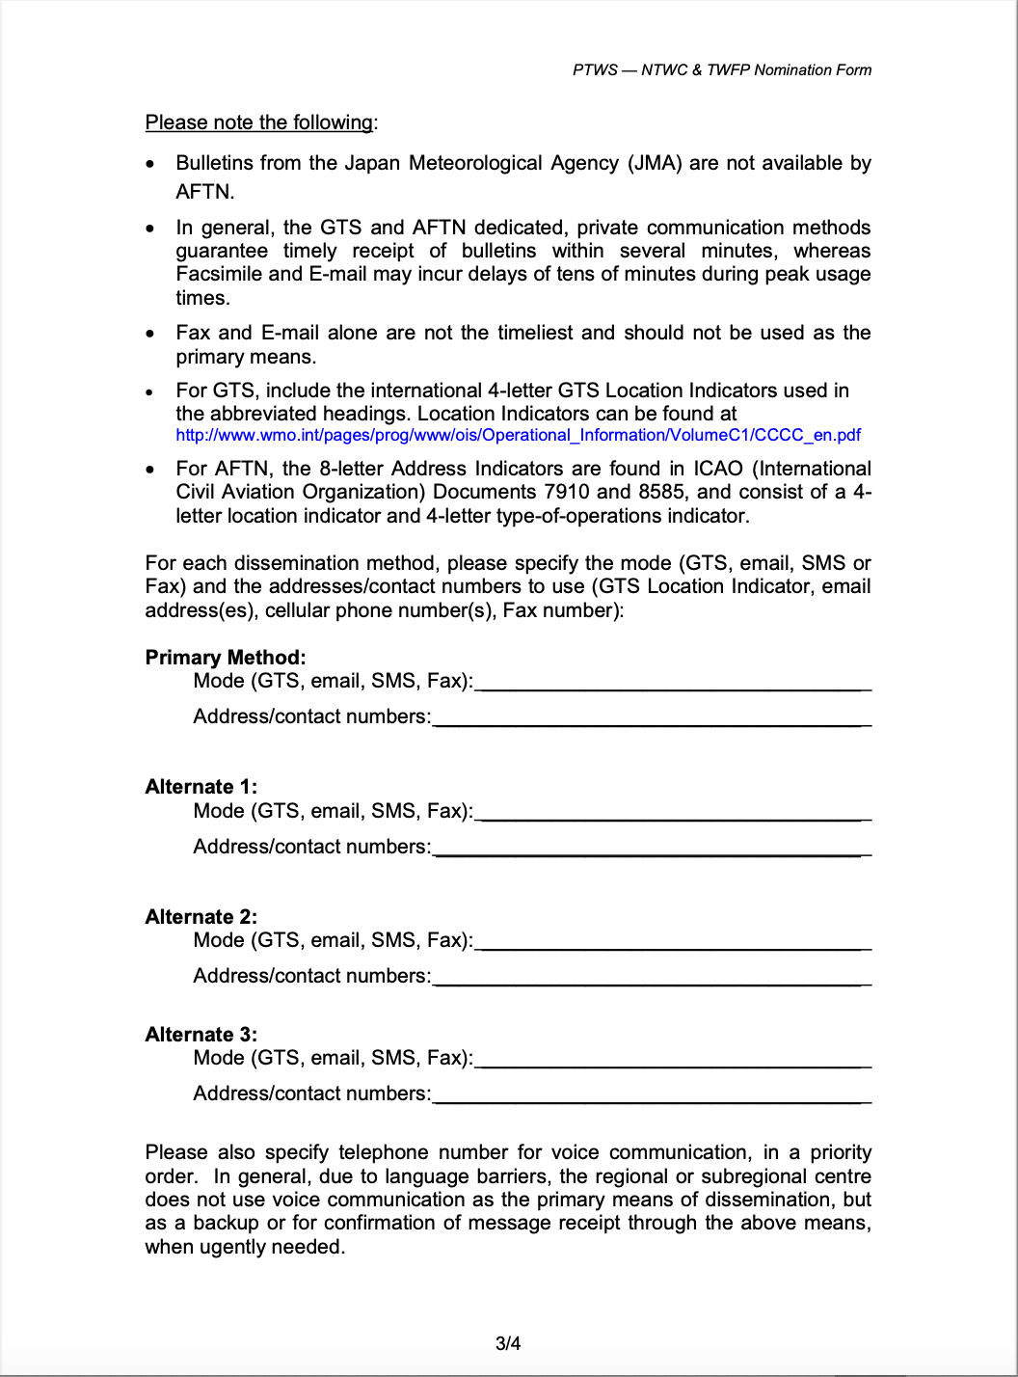
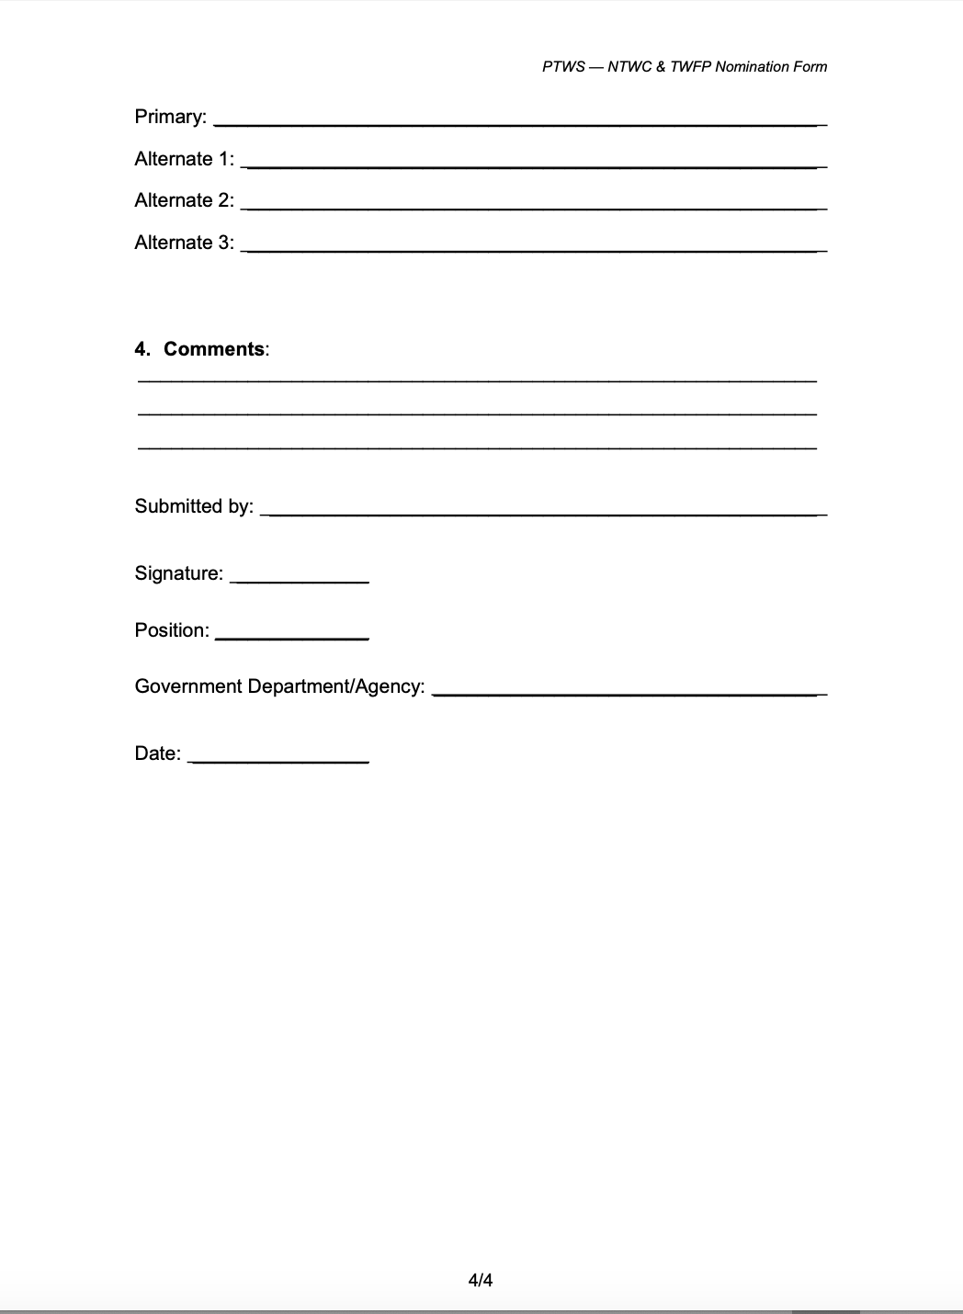
TNC/TWFP/NTWC Contact List
TOWS-WG-XVIII Recommendations
Currently, the collection of the TNC/TWFP/NTWC data is “in theory” governed through CL-2563, issued in 2015.

Slide 11
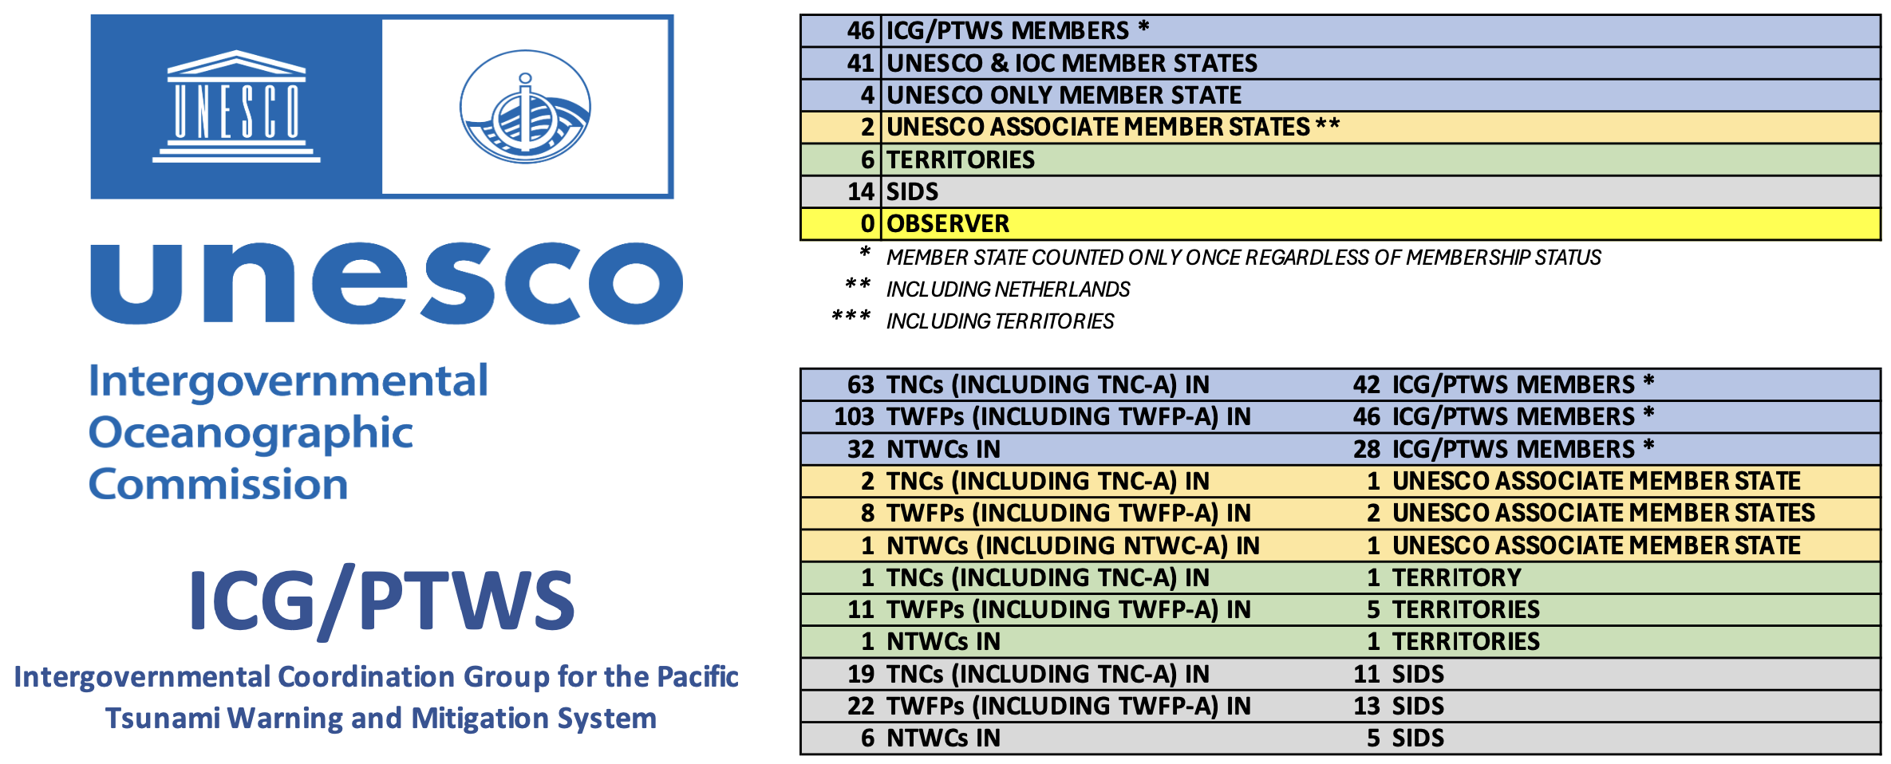
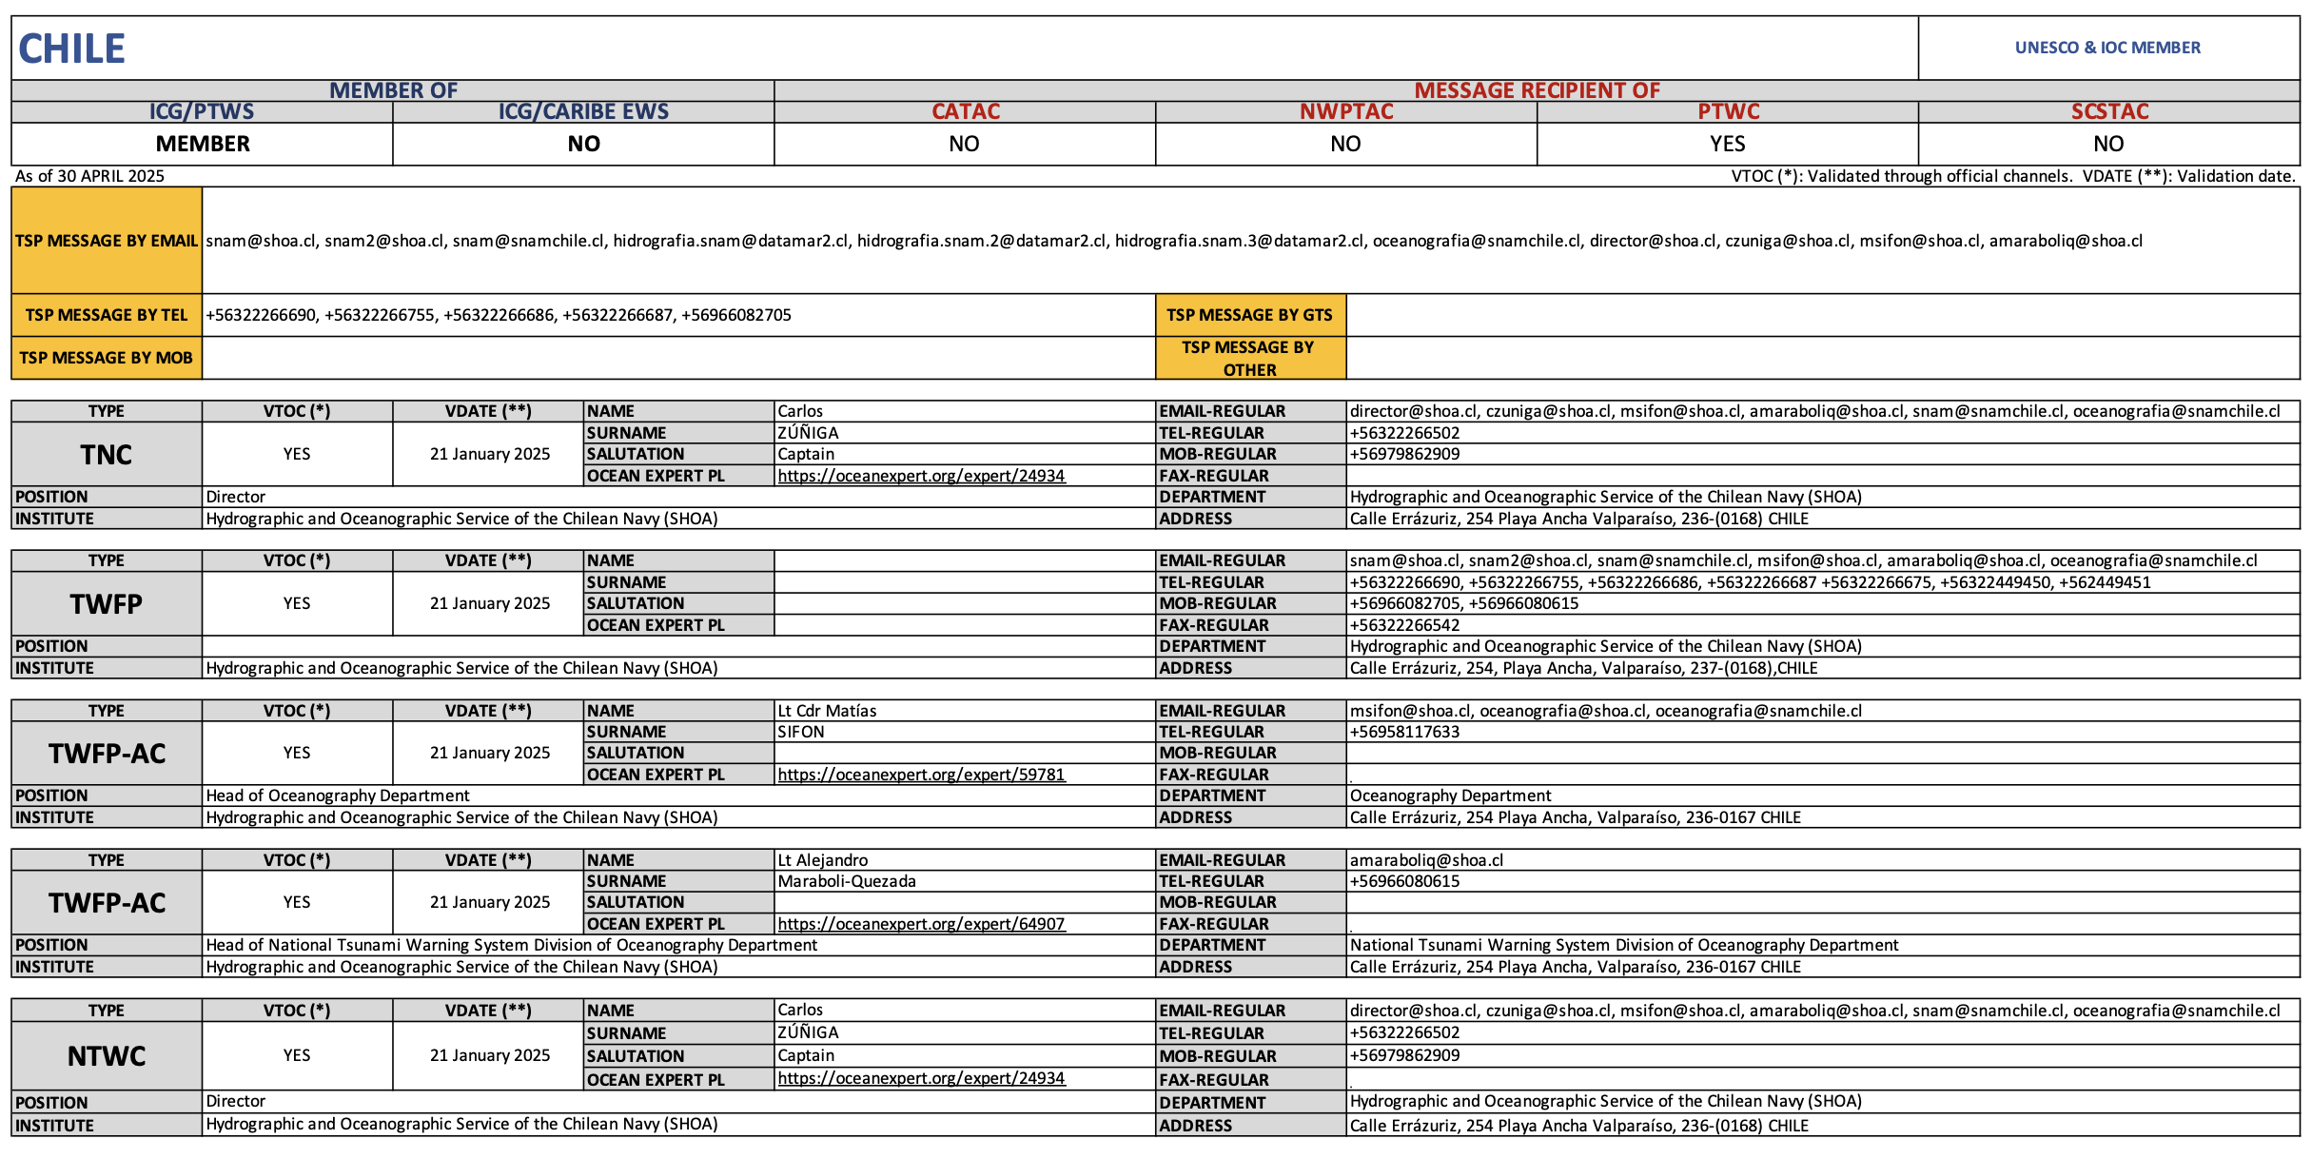
TNC/TWFP/NTWC Contact List
TOWS-WG-XVIII Recommendations
TOWS-WG-XVIII
The Group recommended the IOC Assembly at its 33rd session in 2025 to request the IOC Secretariat to prepare a standard and improved methodology of collecting TNC/TWFP/NTWC contact information, in close collaboration with the TT-TWO and TT-DMP and present its work at the next Joint TT-DMP and TT-TWO Meeting.

