Slide 1
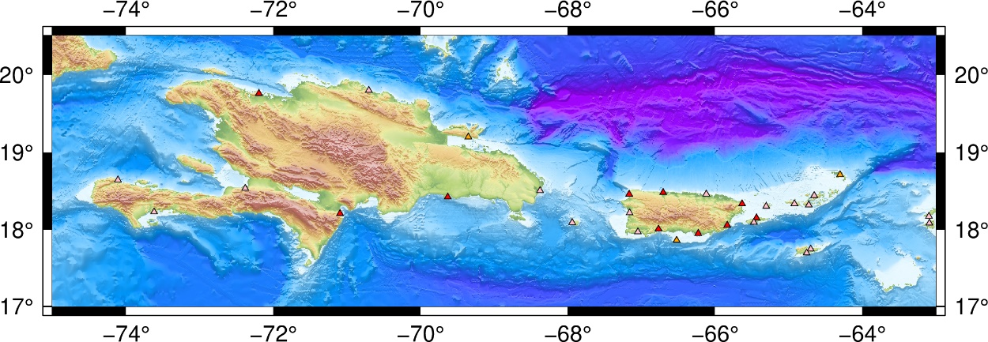

Sea Level Network
The PRSN of the University of Puerto Rico at Mayagüez (UPRM)
operates 7 sea level stations in Puerto Rico and help NOAA/NOS
in the maintenance of their stations (11).
Meteorological sensors were replaced.
Support the operations of three regional stations (Tortola/DDM, Sto Domingo/INDOMet, Barahona/INDOMet).
Data are transmitted every 6 minutes on GOES (1-min tsunami), or via EarthWorm export/seedlink modules each minute (https://worm.uprm.edu:18000).
Data can be accessed via the PRSN GOES/tk, Tides and Currents/tsunami site of NOAA, and the IOC Sea Level Data Facility (https://tidesandcurrents.noaa.gov/tsunami/).
PRSN operates three tsunami cameras.
Future Plans
Upgrade the PRSN web site
Install additional tsunami cameras
New Installations: (1) Samana, DR, (2) Anegada, BVI and Isla Caja de Muertos, PR
Question: Any regional thoughts on hydrophones?

Slide 2

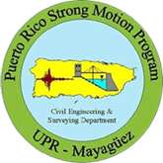
Seismic Network
The PRSN currently operates 35 seismic stations in Puerto
Rico, the Virgin Islands and the Dominican Republic.
Twelve of them use VSAT (PRSN & USGS)
PRSMP operate 120+ accelerometers, 75 free-fields.
Fifty type-C accelerometers, citizen scientists (Raspberry Shakes & Grillo) .
One strong motion seismometer, Ceiba, PR.
Seismic processing upgraded to the ANSS/AQMS.
The data can be accessed via the PRSN seedlink, and the EarthScope Data Facility (https://ds.iris.edu/mda/PR/).
Future Plans
Installation of one station in the northeastern part of the Island.
Two more accelerometers.
Upgrade the PRSN web site.
AI research (E3WS).
CAP integration.

Slide 3

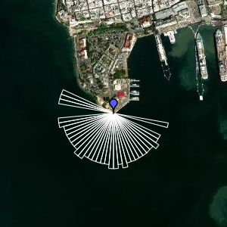
GPS/GNSS Network
The PRSN operates a GPS/GNSS Network of
twenty-two permanent high-rate stations.
All the permanent GPS stations are equipped with either a Trimble NetRs,
NetR9 or Alloy GPS/GNSS receiver and Choke ring antennae.
Twelve stations were upgraded to add RTX correction.
Continuous data are simultaneously logged to three sessions with different sampling rate, 15-sec per sample, 1-sec per sample (1 Hz), and 10-samples per second (10 Hz).
GNSS-IR Training participation2024 (https://psmsl.org/data/gnssir/map.php).
Data are available via the EarthScope server, and PRSN caster or seedlink.
Future Plans
Installation of two new stations in the eastern part of the Island & VI.
Implementation IR algorithms in PRSN/Mayaguez site.
Software upgrades.
Upgrade the PRSN web site.
San Juan, PR

Slide 4
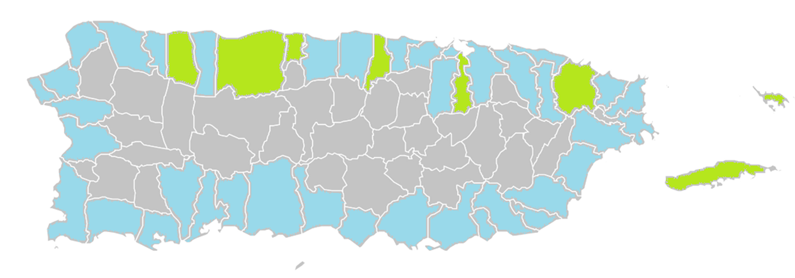


TsunamiReady® / NTHMP.
Forty-seven TsunamiReady communities and Twenty TsunamiReady supporters.
- Luiz Munoz Marin International Airport
Fifty-eight EMWIN/NWWS systems installed in PR, six of then equipped with
DartCom hardware.
Twenty communities modeled using pedestrian evacuation models, (https://maptool.uprm.edu/).
Hundreds of NOAA radios distributed , thousands of tsunami signs installed.
Education & Outreach program (conferences, workshops, activities, etc), thousands impacted.
Tsunami vulnerability profiles upgrade to use new census-2020 data, and new generation of tsunami maps.
More the 175,000 participants in the CaribeWave 2025, and more than 450,000 in ShakeOut 2024. Drills and
exercises.
Participation in the WTAD (750k FB followers).
Future Plans
DartCom new installations, sign language support, not conventional tsunami signage & new tsunami evacuation maps .
Financial uncertainty.

Slide 5
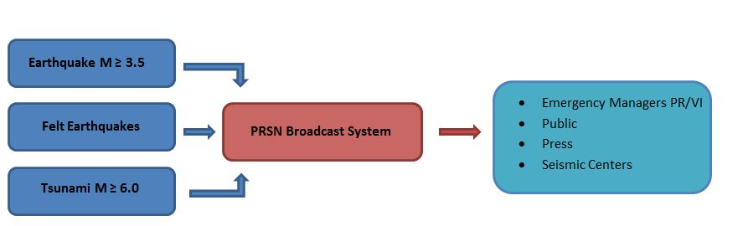
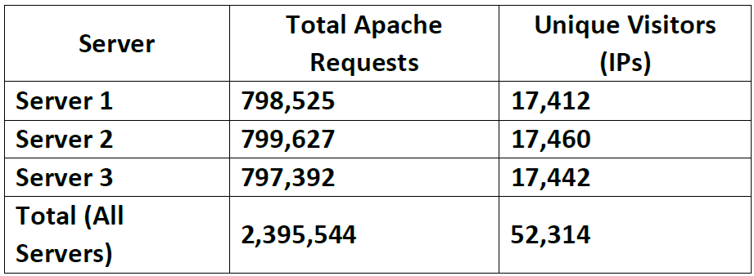
PR EARTHQUAKE AND TSUNAMI PROTOCOL (FEB 08/ 2025 RESPONSE)
Rapid Response
Activation Protocols
Evaluation and Action
(within 5 minutes)
Products Distribution
PTWC - PTime
PTWC Cancelation
PTWC Call
NAWAS
PTWC – 1Dom
EMWIN
PTWC – 2Int
Calls
Radio
Live
Messages
PTWC – Final Int
CISN
EMWIN
PTWC – 1Int
NAWAS
PTWC Call
EMWIN
Earthquake
PRN – Bull1
CISN
ENS
02-08-2025
19:23
EB-Alarm
REA
T0
+2
+5
+6
+8
+10
+14
+16
+21
+30
+N
+114
+124

