Slide 1
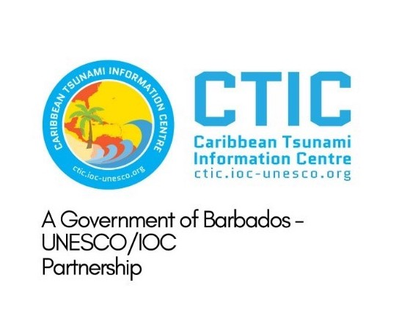
ICG CARIBE-EWS XVIII Session
5.2 CARIBE WAVE 2026
Antonio Aguilar
CARIBE WAVE Chair, FUNVISIS, Venezuela
Gisela Báez-Sánchez
CARIBE WAVE Vice Chair, Puerto Rico Seismic Network, USA
Christa G. von Hillebrandt-Andrade
Manager, ITIC Caribbean Office
ICG CARIBE EWS WG III Chair
May, 2025

Slide 2
Goals for ICG XVIII
Confirm Scenarios for CARIBE WAVE 26
Decide on the Date and Time CARIBE WAVE 26
Suggestions for Scenarios Beyond 2026
Review Recommendation and Decisions for CW

Slide 3
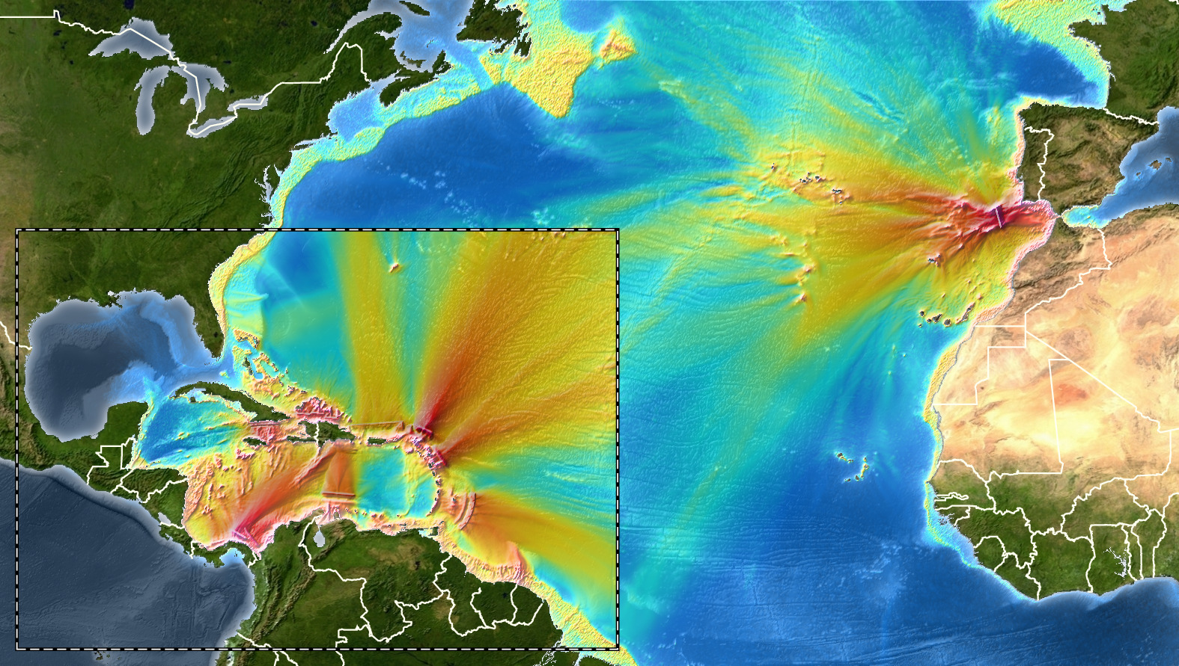
Coverage of Past Exercises
The black circles are the proposed CW 26 scenarios

Slide 4
Decisions of ICG XVI on CW 26
Recommends that the CARIBE WAVE 26 exercise consist of 2 scenarios that include a volcanic scenario as well as an earthquake and tsunami scenario.
It is proposed that these scenarios be:
Volcano generated
Earthquake generated

Slide 5
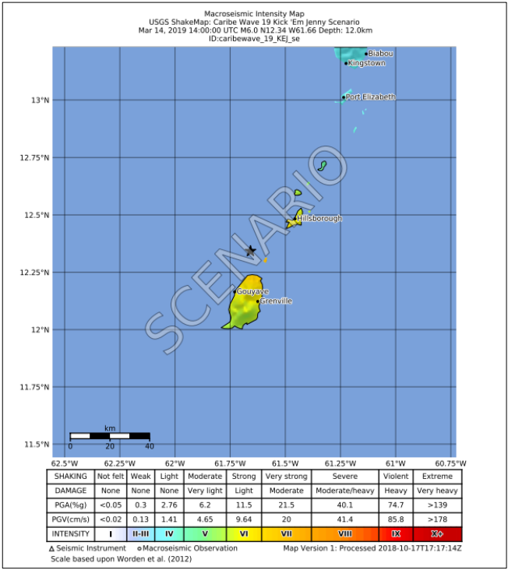
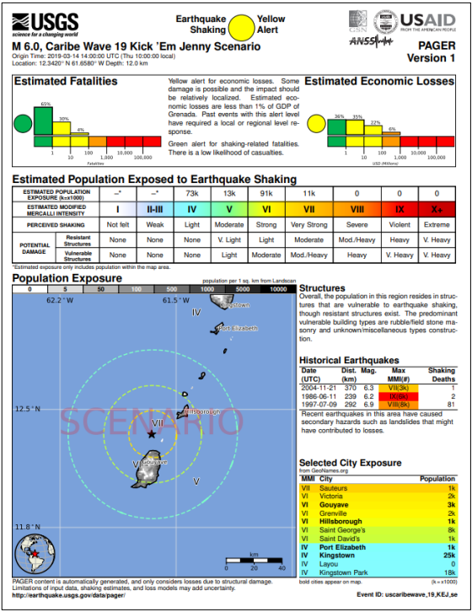
Scenario 1: Kick ‘em Jenny submarine volcano
A flank collapse of the volcano occurs after a M 6.0 earthquake is detected at the volcano. Observed maximum wave height of up to 4.5ft.

Slide 6
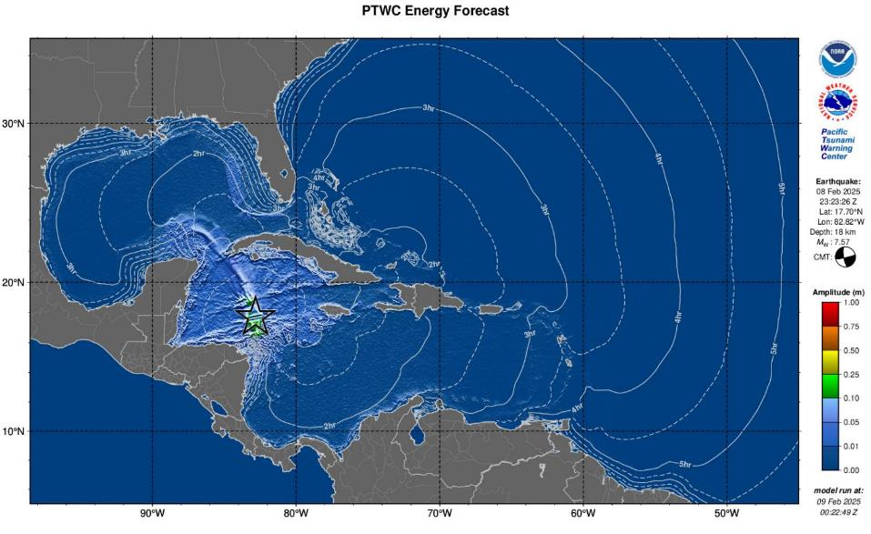
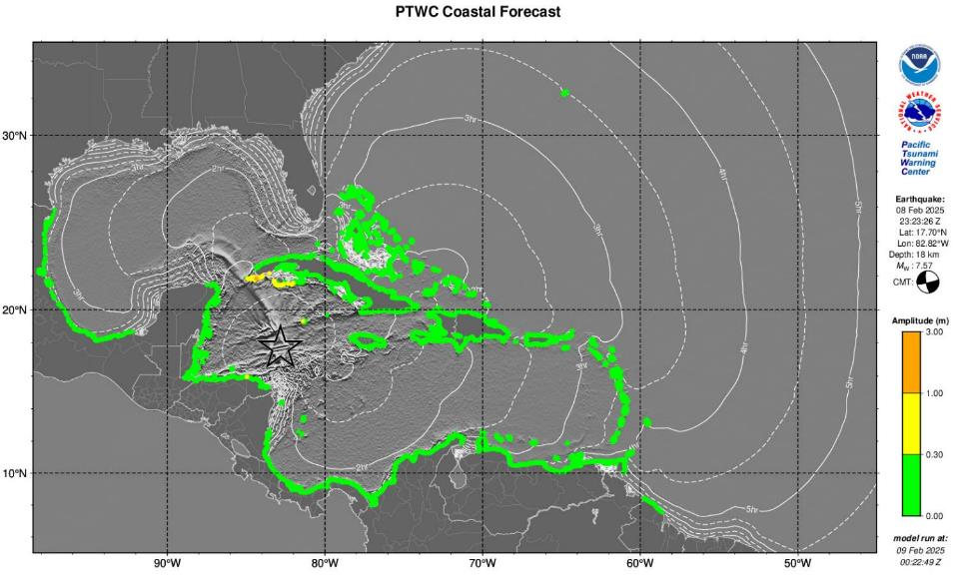
Scenario 2: Cayman Islands
Based on the February 8th M 7.6 earthquake. Possibility of increasing magnitude.

Slide 7
Scenario 2:
Cayman
Islands
*Shortened tsunami Threat Messages*
TSUNAMI MESSAGE NUMBER 5
NWS PACIFIC TSUNAMI WARNING CENTER HONOLULU HI
0200 UTC SUN FEB 9 2025
....FINAL TSUNAMI THREAT MESSAGE...
**** NOTICE **** NOTICE **** NOTICE **** NOTICE **** NOTICE *****
THIS MESSAGE IS ISSUED FOR INFORMATION ONLY IN SUPPORT OF THE
UNESCO/IOC TSUNAMI AND OTHER COASTAL HAZARDS WARNING SYSTEM FOR
THE CARIBBEAN AND ADJACENT REGIONS AND IS MEANT FOR NATIONAL
AUTHORITIES IN EACH COUNTRY OF THAT SYSTEM.
NATIONAL AUTHORITIES WILL DETERMINE THE APPROPRIATE LEVEL OF
ALERT FOR EACH COUNTRY AND MAY ISSUE ADDITIONAL OR MORE REFINED
INFORMATION.
**** NOTICE **** NOTICE **** NOTICE **** NOTICE **** NOTICE *****
PRELIMINARY EARTHQUAKE PARAMETERS
---------------------------------
* MAGNITUDE 7.6
* ORIGIN TIME 2323 UTC FEB 8 2025
* COORDINATES 17.8 NORTH 82.5 WEST
* DEPTH 33 KM / 20 MILES
* LOCATION NORTH OF HONDURAS
EVALUATION
----------
* AN EARTHQUAKE WITH A PRELIMINARY MAGNITUDE OF 7.6 OCCURRED
NORTH OF HONDURAS AT 2323 UTC ON SATURDAY FEBRUARY 8 2025.
* BASED ON ALL AVAILABLE DATA... THE TSUNAMI THREAT FROM THIS
EARTHQUAKE HAS PASSED AND THERE IS NO FURTHER THREAT.
* FURTHER SEA LEVEL DATA INDICATE THAT THERE IS NO LONGER A
HAZARDOUS TSUNAMI THREAT FROM THIS EVENT.
TSUNAMI THREAT FORECAST...UPDATED
---------------------------------
* THE TSUNAMI THREAT HAS NOW LARGELY PASSED.
RECOMMENDED ACTIONS
-------------------
TSUNAMI MESSAGE NUMBER 1
NWS PACIFIC TSUNAMI WARNING CENTER HONOLULU HI
2329 UTC SAT FEB 8 2025
....TSUNAMI THREAT MESSAGE...
NATIONAL AUTHORITIES WILL DETERMINE THE APPROPRIATE LEVEL OF
ALERT FOR EACH COUNTRY AND MAY ISSUE ADDITIONAL OR MORE REFINED
INFORMATION.
PRELIMINARY EARTHQUAKE PARAMETERS
---------------------------------
* MAGNITUDE 8.0
* ORIGIN TIME 2323 UTC FEB 8 2025
* COORDINATES 17.8 NORTH 82.5 WEST
* DEPTH 33 KM / 20 MILES
* LOCATION NORTH OF HONDURAS
EVALUATION
----------
* AN EARTHQUAKE WITH A PRELIMINARY MAGNITUDE OF 8.0 OCCURRED
NORTH OF HONDURAS AT 2323 UTC ON SATURDAY FEBRUARY 8 2025.
* BASED ON THE PRELIMINARY EARTHQUAKE PARAMETERS... WIDESPREAD
HAZARDOUS TSUNAMI WAVES ARE POSSIBLE.
TSUNAMI THREAT FORECAST
---------------------------------
* HAZARDOUS TSUNAMI WAVES FROM THIS EARTHQUAKE ARE POSSIBLE
WITHIN THE NEXT THREE HOURS ALONG SOME COASTS OF
CAYMAN ISLANDS... JAMAICA... CUBA... MEXICO... HONDURAS...
BAHAMAS... HAITI... TURKS N CAICOS... SAN ANDRES PROVID...
BELIZE... DOMINICAN REP... COLOMBIA... PANAMA... PUERTO
RICO... COSTA RICA... ARUBA... BONAIRE... CURACAO... US
VIRGIN IS... BR VIRGIN IS AND SABA
ESTIMATED TIMES OF ARRIVAL
--------------------------
* ESTIMATED TIMES OF ARRIVAL -ETA- OF THE INITIAL TSUNAMI WAVE
FOR PLACES WITHIN THE REGION IDENTIFIED WITH A POTENTIAL
TSUNAMI THREAT. ACTUAL ARRIVAL TIMES MAY DIFFER AND THE
INITIAL WAVE MAY NOT BE THE LARGEST. A TSUNAMI IS A SERIES
OF WAVES AND THE TIME BETWEEN WAVES CAN BE FIVE MINUTES TO
ONE HOUR.

Slide 8
Date and Time of the Scenario
Possible Thursday Date in March:
March 19, 2026
March 23 🡪 World Meteorology Day
March 29 - April 5 🡪 Holy Week

Slide 9
CARIBE WAVE
2026
CW 25
Survey Results
Member State/ Territory | Suggestion
Trinidad and Tobago | In light of the underwater volcano Kick ‘em Jenny being in close proximity to T&T it would be nice to have one of the future CARIBEWAVE exercises simulate an eruption of a submarine volcano to test our response and preparedness for not just tsunamis but other marine hazards caused by such events. With no protocols for volcano-generated tsunami alerts, simulating a submarine eruption in CARIBE-WAVE exercises could identify gaps, test response systems and guide the development of effective procedures.
Brazil | We know there were recent earthquakes at Sandwich Islands. Recent studies pointed to a changing behaviour on the plates activities, and the region is very active. We registered 10cm in our tide gauges along the south/southeastern coast.
Panama | The 1991 Limon earthquake, M7.7, Costa Rica
Dominican Republic | Considering the events of 2018 in northern Honduras and the recent one on February 8, 2025, we would like to emulate a tsunami event in suction zones in this area. It would be a regional tsunami for my country

Slide 10
CARIBE WAVE
2026
CW 25
Survey Results
Member State/ Territory | Suggestion
Mexico | Near Haiti or on some submarine volcano in the Lesser Antilles.
Aruba | Honduras
Venezuela | I would like to repeat the local tsunami of 1900 in Venezuela
France | A volcanic source from an Antilles arc volcano
Haiti | Northern Fault of Hispaniola (NHTF)
Cuba | North of the Dominican Republic
SVG | Focal on a local scale event that give participants limited response time. An event that will trigger the precautionary evacuation clause

Slide 11
Decision and Recommendations:
The Intergovernmental Coordination Group for the Tsunami and Other Coastal Hazards Warning System for the Caribbean and Adjacent Regions (ICG/CARIBE-EWS),
Notes the CARIBE WAVE 25 draft final, media, supplement reports and presentation,
Further notes the successful conduct of the CARIBE WAVE 25 Exercise with the participation of 93% of the Member States and half a million participants,
Additionally notes with satisfaction that the new CARIBE WAVE website hosted by UNESCO-IOC and that the handbook was divided in two: General Guidelines and the CW 25 Participants Handbook highlighting the scenarios, timeline and simulated products.
Congratulates all the Member States who promoted, participated, and provided feedback on the CARIBE WAVE 25 exercise.

Slide 12
Recommendation ICG/CARIBE-EWS-XVII._ (CONT)
Notes 91% of the Member States provided the feedback which is essential for assessing the functionality including warning, response and preparedness capabilities of CARIBE EWS and future actions,
Urges Member States to complete survey evaluations in a timely manner,
Acknowledges again the good collaboration and coordination between the CARIBE WAVE Task Team, CTIC and ITIC-CAR in planning, promoting, executing, and evaluating the annual CARIBE WAVE Exercises.
Appreciates the International Tsunami Information Centre Caribbean Office (ITIC-CAR) for their support in generating the handbooks, reports and overall coordination and the Pacific Tsunami Warning Center (PTWC) and the Central America Tsunami Advisory Center (CATAC) for providing and disseminating dummy message and simulated products for the CARIBE WAVE 25,
Further appreciates the United States Geological Survey (USGS) for their continued support in generating simulated ShakeMap and PAGER products for the Jamaica Scenario of CARIBE WAVE 25,

Slide 13
Recommendations for review of the Intrasessional WG, based on those of ICG XVII
Instructs the CARIBE EWS Working Groups and the CARIBE WAVE Task Team to identify actions arising from CARIBE WAVE 25 and past CARIBE WAVE Exercises and identify follow up actions in coordination with CTIC and the CARIBE-EWS Secretariat,
Reconfirms that CARIBE WAVE 26 will have the following scenarios 1) Kick ‘em Jenny Volcano, and 2) the Cayman Islands earthquake and tsunami,
Decides that the CARIBE WAVE 26 exercise will take place on Thursday, March 19, 2026, commencing at 15:00 UTC with one dummy message for the communication test from PTWC and CATAC to the TWFPs and NTWCs, and the 1st message for the scenarios coming shortly after according to PTWC and CATAC simulated procedures for the respective scenarios they are supporting. Member States are encouraged to execute activities at times deemed convenient based on national procedures and circumstance,
Reminds again Member States to consider alternative dates and times for running of CARIBE WAVE 26, if the agreed date is not feasible, and that information on conducting the exercise on alternative dates be shared in the Handbook,

Slide 14
Recommendation ICG/CARIBE-EWS-XVII. (CONT)
Requests again that Member States consider conducting all or part of their exercise response activities during non-working hours, particularly at night, to be better prepared for tsunami events that are more likely to occur during non-working hours,
Recommends following a coordination process, timetable, and benchmarks for CARIBE WAVE 26, similar to what has been used in prior CARIBE WAVE exercises, and that this includes a series of preparatory webinars,
Further recommends that the registration process remains at www.tsunamizone.org and that Member States promote registration and participation among their stakeholders,
Recalls again the importance of including vulnerable and marginalized groups, including persons with disabilities, in CARIBE WAVE 26,
Recommends continuation of the Task Team for CARIBE WAVE,
Recommends the Secretariat to inform the UNDRR on the date of CARIBE WAVE 26 and request the theme of the WTAD 26 in advance of the exercise,

Slide 15
Recommendation ICG/CARIBE-EWS-XVII. (CONT)
Further recommends that Task Team CARIBE WAVE and Member States consider the theme of WTAD 2026 in the conduct and reporting of the exercise,
Noting again that CATSAM is a tool for identifying tsunami sources and their associated threat for exercise planning purposes,
Reminds again Task Team CARIBE WAVE to assist Working Group 1 in prioritizing scenarios to be included in CATSAM,
Additionally reminds Member States to consider including their selected CARIBE WAVE 26 scenario within a multi-hazard framework wherever possible,
Suggests again that Task Team CARIBE WAVE explores opportunities to further involve tourists and tourism organizations such as the Caribbean Tourism Organization (CTO), in CARIBE WAVE exercises, with the aim to develop multi-lingual guidelines/resources for the involvement of tourists in CARIBE WAVE Exercises,

Slide 16
Recommendation ICG/CARIBE-EWS-XVII. (CONT)
Further suggests that Task Team CARIBE WAVE explores opportunities to further involve national and regional maritime and port authorities so they may exercise their plans and procedures,
Recommends that Member States consider UN agencies operating in their countries for receipt of products and relevant information and further notes the IOCARIBE agreement to support UN Country Teams by encouraging them to engage with emergency management practitioners in their countries of operation,
Acknowledges the consistent support of ITIC-CAR to the work of the TT CARIBE WAVE and looks forward to its continued support to TT CARIBE WAVE,
Suggests that the CARIBE WAVE 27 exercise consist of 2 scenarios that include
1) Southern Caribbean (earthquake), and 2) tele-tsunami.
__
Financial Implications: None

