Slide 1

Planning phase
Coordinated by Task Team on NEAMWave Exercise
(co-chairs: Ceren Ozer Sozdinler - Marinos Charalampakis)
Steering Committee ICG/NEAMTWS
Istanbul, Türkiye, 15 – 16 May 2025

Slide 2

NEAMWave26
@19th ICG/NEAMTWS
Mandate (updated):
The Task Team will support the ICG/NEAMTWS Secretariat to finalize NEAMWave23 Evaluation report - DONE
Decisions:
To organize the next NEAMWave exercise in March 2026.
The exercise scenarios should be created through collaboration between TSPs and NTWCs.
One or more single or joint scenarios proposed to meet the specific needs of the MS.
Steering Committee ICG/NEAMTWS ● Istanbul, Türkiye, 15 – 16 May 2025

Slide 3
NEAMWave26
@19th ICG/NEAMTWS
Recommendations:
Consider the timeline for Tsunami Ready activities within the CoastWAVE Project Phase 2.0, and facilitating the implementation of full-scale Phase B exercises by the project Member States;
Organize the NEAMWave26 exercise with a more flexible schedule, featuring one or two scenarios per week (based on the total number of scenarios), rather than condensing all scenarios into consecutive days;
Revise and enhance the online tools (subscription and evaluation) to make them more user-friendly. The subscription process should be streamlined to more effectively capture participant numbers, and simplified by explicitly requesting "new" contact details for the exercise when necessary and allowing the registration of new participants beyond the current subscribers to TSPs’ services;
Steering Committee ICG/NEAMTWS ● Istanbul, Türkiye, 15 – 16 May 2025

Slide 4
NEAMWave26
@19th ICG/NEAMTWS
Recommendations:
Investigate the potential for further testing of the use of Galileo EWS for message dissemination. Other dissemination methods like SMSs, CAP-TSU or automated phone calls should be explored, in order to evaluate the effectiveness and feasibility of non-internet-based methods, as alternative dissemination ways of sharing information. Moreover, TSPs to consider the live streaming of their activities during the exercise through an online platform;
Organize NEAMWave Preparation Meeting(s) between the TT-TE Exercise Team and targeted participant groups, like TSPs, TWFPs, CPAs etc., as well as ERCC prior to the exercise for discussing on the progress of NEAMWave activities;
Steering Committee ICG/NEAMTWS ● Istanbul, Türkiye, 15 – 16 May 2025

Slide 5
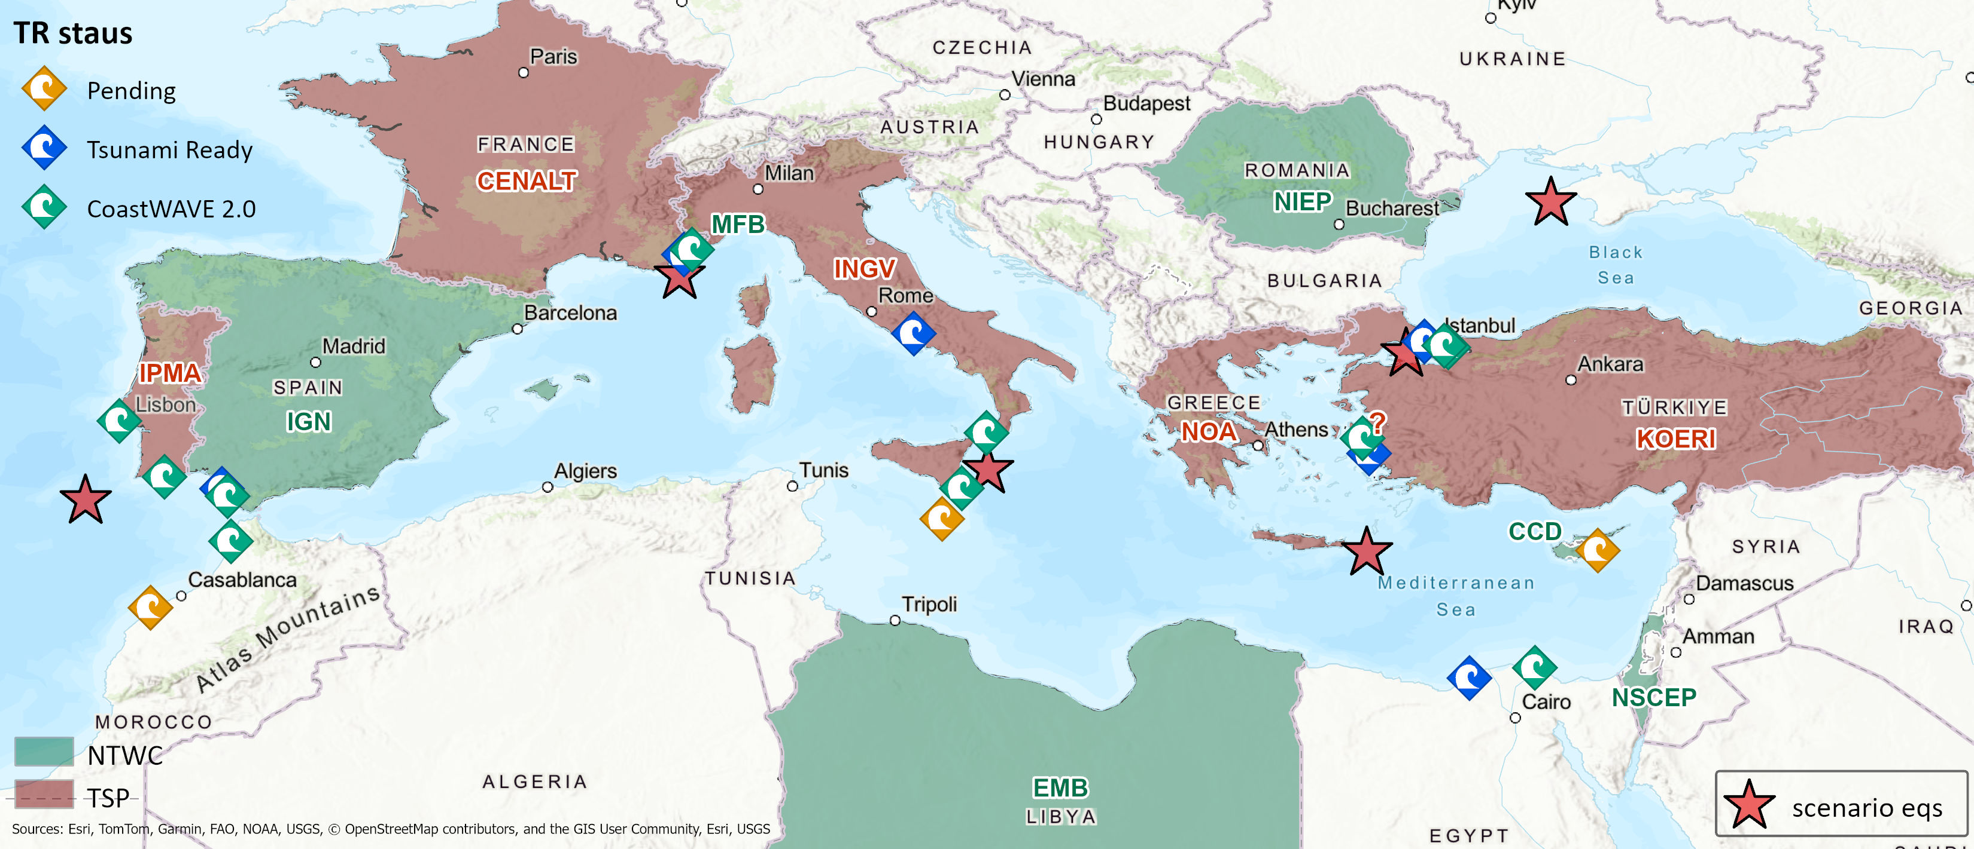
NEAMWave26
Steering Committee ICG/NEAMTWS ● Istanbul, Türkiye, 15 – 16 May 2025

Slide 6


NEAMWave26
DEMONAX / DG-ECHO project
  A Full Scale eXercise will be held between 20 - 23 April 2026, in Cyprus.
  The earthquake’s epicenter will be in the south-west of Cyprus (offshore), generating also a subsequent tsunami event (injects in Larnaka).
  The exercise will examine the response procedures of the essential services involved and based on the scenario; Cyprus will request assistance from the EU Civil Protection Mechanism (ERCC).
  Cyprus Civil Defense (COO & NTWC) – NOA partner.
Potential synergy between NEAMWave26 and DEMONAX:
exercise related activities one month before the FSX in April
Steering Committee ICG/NEAMTWS ● Istanbul, Türkiye, 15 – 16 May 2025

Slide 7
NEAMWave26
NEAMWave26 Scenarios - Options:
  5 scenarios, each one prepared jointly by 1 TSP and 1 NTWC (or more).
  TSPs could prepare more than 1 scenarios (single or jointly) to accommodate MS needs.
  In a joint scenario TSPs disseminate messages with different alert level.
Implementation Date:
  Having NEAMWave26 in March 2026 to be in parallel with Tsunami Ready activities (CoastWAVE Project; DEMONAX project)
  We also propose to have the exercise in a more relaxed schedule, for example one scenario per week.
  Avoid: 19 March 2026 – CaribeWAVE26
Steering Committee ICG/NEAMTWS ● Istanbul, Türkiye, 15 – 16 May 2025

Slide 8
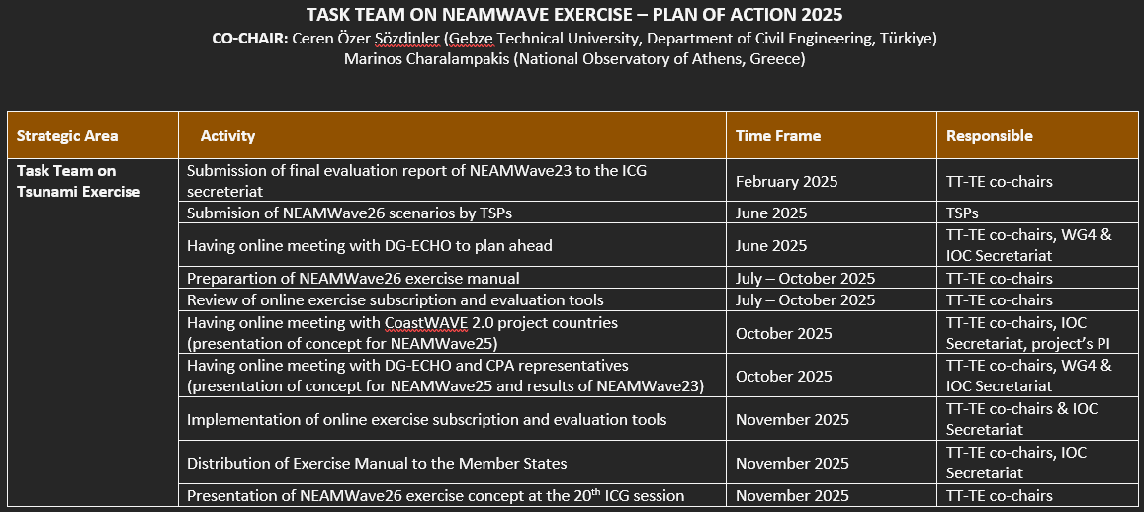
PoA of TT-NW for 2025
Steering Committee ICG/NEAMTWS ● Istanbul, Türkiye, 15 – 16 May 2025

Slide 9
Thank you!
co-chairs: Ceren Ozer Sozdinler
& Marinos Charalampakis
Steering Committee ICG/NEAMTWS ● Istanbul, Türkiye, 15 – 16 May 2025

Slide 10
NEAMWave26
Exercise Final Evaluation Report:
  It should be simplified in a way to be easier to prepare and more user-friendly to read.
TSP Final Evaluation Reports:
  There is no interaction between providers and recipients, thus reports are not describing the whole picture. They should be limited to a couple of pages with certain bullet-point content, including summary of exercise performance, suggestions and recommendations, in the following concept: objectives, success criteria, best practices, lessons learnt and actions for the future.
Subscription Mechanism:
  It should be only for providing “new” contact details “explicitly” for the exercise, if needed, and for registering new participants (other than the subscribers). Minimum information should be requested. We should find a way to also register “public” participants.
Evaluation forms:
  Statistics and assessment of the participation in the exercise will be made only by the evaluation forms and not by the subscription forms.
Steering Committee ICG/NEAMTWS ● Istanbul, Türkiye, 15 – 16 May 2025

