Slide 1
Session 6.1. : Summary of opportunities for networks & framework for risk assessment
Presenter name, position, organisation
Sixteenth Observations Coordination Group Meeting (OCG-16)
7-10 April 2025, IFREMER, Brest, France.

Slide 2
Network Priorities
Assess impacts of ocean observations on society, priorities of administrations around the world
Conversations with shipping companies on deployment opportunities
Opportunities/challenges for cost effective technologies - and overlap with network activities?
Developing federated ERDDAP services
Cross platform ocean data reference network
OceanOPS to assist in deployment coordination for multi platform - cross benefit
GOshp - dependencies - opportunities to highlight the information gos hip provides for other networks - communication piece?

Slide 3
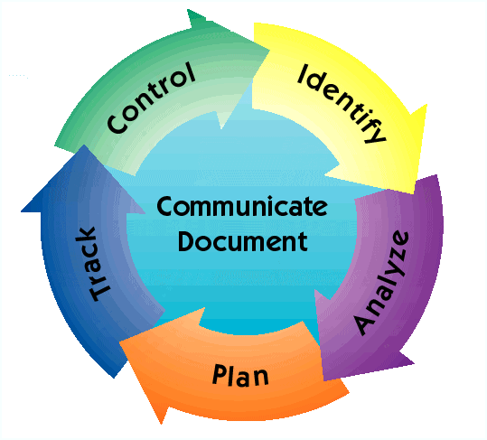
Risk Management Process
Continuous activities throughout life cycle to view and manage risks
Types of Metrics
Network based metrics to assess Performance of a network
Performance or use-based Metrics to assess Fitness to purpose
Metrics to better manage Risks
Examples of metrics
Implementation (#of deployments)
Notes:
Identify: Search for and locate risks before they become problems
Analyze: Convert risk data into useable information for determining priorities and making decisions
Plan: Translate risk information into planning decisions and mitigating actions (both present and future), and implement those actions
Track: Monitor risk indicators and mitigation actions
Control: Correct risk mitigation plans deviations and decide on future actions
Communicate and Document: Provide information to project on risk activities and current/future risks, and emerging risks

Slide 4
Risk Management Process
Identifying impacts and likelihood of occurrence
Process steps
Identify: Search for potential risks
Analyze: Convert risk data into useable information
Plan: Translate information into planning decisions & mitigating actions
Track: Monitor risk indicators & mitigation actions
Control: Correct risk mitigation plans if needed
Communicate and Document: Track information and actions
Notes:
Identify: Search for and locate risks before they become problems
Analyze: Convert risk data into useable information for determining priorities and making decisions
Plan: Translate risk information into planning decisions and mitigating actions (both present and future), and implement those actions
Track: Monitor risk indicators and mitigation actions
Control: Correct risk mitigation plans deviations and decide on future actions
Communicate and Document: Provide information to project on risk activities and current/future risks, and emerging risks

Slide 5
Risk Management Process
Continuous activities throughout life cycle to view and manage risks
Process steps: Identify, Analyze, Plan, Track, Control, Communicate and Document
Identifying impacts and likelihood of occurrence
Example Metrics to monitor:
National funding (e.g. # countries contributing)
Data management
Resourcing/personnel
Ship time needs/schedules/capabilities, availability/projections
Legal (e.g. EEZ permissions)
Piracy/vandalism (incidents)
Instrument and platform diversification, reliabilities
Resiliency (spare instruments, redundancy, etc)
Notes:
Identify: Search for and locate risks before they become problems
Analyze: Convert risk data into useable information for determining priorities and making decisions
Plan: Translate risk information into planning decisions and mitigating actions (both present and future), and implement those actions
Track: Monitor risk indicators and mitigation actions
Control: Correct risk mitigation plans deviations and decide on future actions
Communicate and Document: Provide information to project on risk activities and current/future risks, and emerging risks

Slide 6
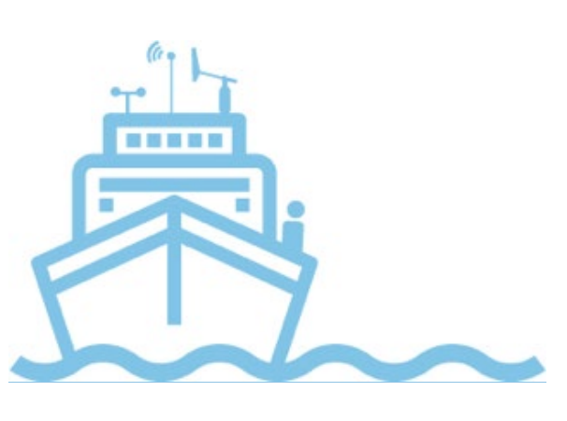
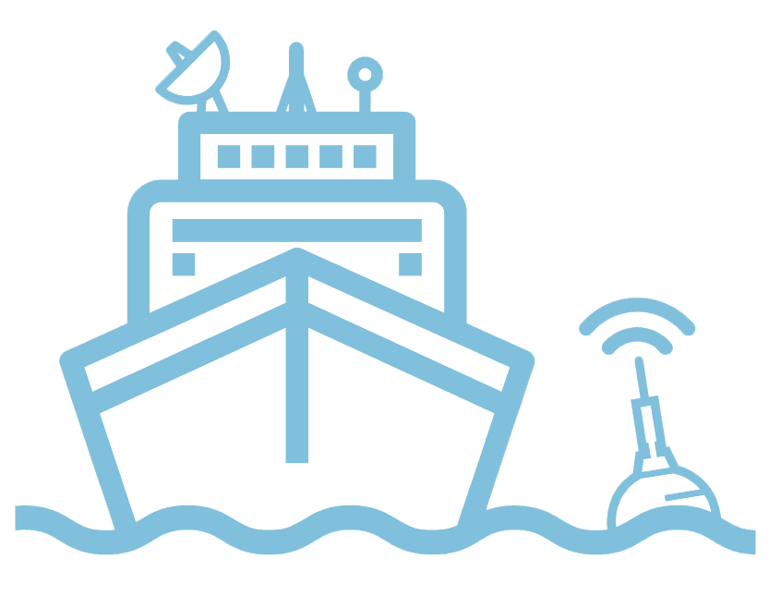
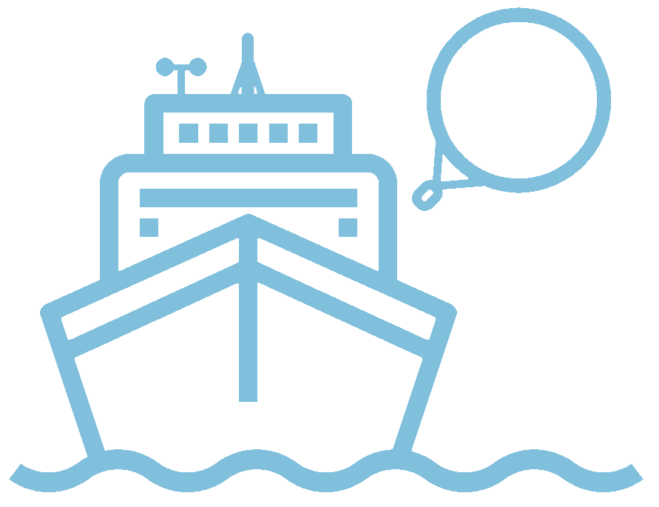
Ship Observations Team - SOT
Voluntary Observing Ships
Ship of Opportunity Program
Automated Shipboard Aerological Programme

Slide 7
Summary on opportunities/issues
Future Plans and Opportunities
1. VOSP: technical expertise and development of the Next Generation Turbowin software
2. SOOPIP: transmission of data to the GTS, push for XBT data unification in the areas of standard data formats…
Challenges and Concerns
Outcomes laid out by HQ
Asks from OCG
1. SOT: discussions with shipping companies should be lifted to very high/exec level
2. VOSP: support outreach to industry partners to identify additional funding sources
3. SOOPIP: letter from IOC/GOOS in support of ships riders to undertake SOOP observations on vessels of opportunity, increase fundraising activities for OceanOPS from network member states, negage industry partners at their forums.

Slide 8
Argo

Slide 9
Summary on opportunities/issues
Future Plans and Opportunities
1. New data formats to serve our data, rather than our unwieldy, complex and slow to read netCDF files.
2. New suppliers for deep floats (Osean), new pH sensors and new CTDs (D2).
3. Production of a longer lived BGC float, S2BGC, is only just now going into production.
Challenges and Concerns
Sustainable funding for the new missions = present major challenge. Argo teams are trying to work within their national contexts to work towards this, and the community is engaging in WMO and the UNOC process. We still face the issue that our user community believes the new missions are ‘in the pipeline’ rather than recognizing the need to ensure these are resourced.
Asks from OCG
1. To find a way to track the efficacy of the combined GOOS – the parameter view of the GOOS and some tracking metrics
2. We lack a clear design (and costing) for ocean carbon observing (beyond surface flux estimates)– this is problematic when trying to articulate our ask from governments.

Slide 10
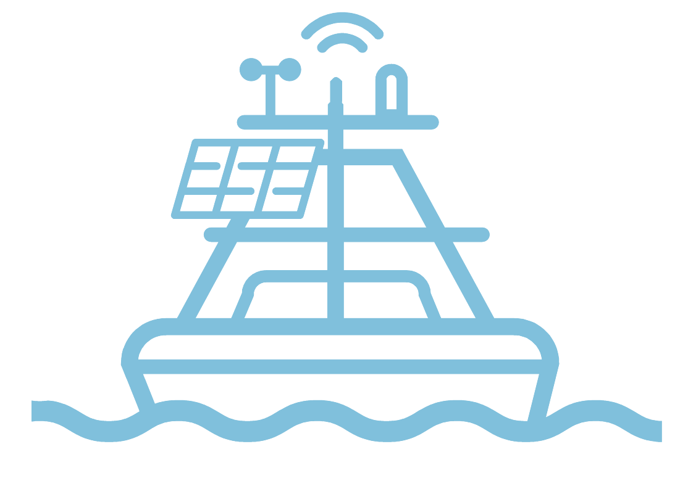
OceanSITES

Slide 11
Summary on opportunities/issues
Future Plans and Opportunities
1. Improve OceanSITES service to community
2. Progress on integration of other non-centralized (GDAC) data.
3. Proactive effort for interaction with modelling community interaction
4. Reference sites for machine learning/validation
Challenges and Concerns
1. Cost of SLA
2. Data & metadata access and exchange with OceanOPS
3, Motivate PIs to update metadata
4, Seamless integration/dialogue with GRAs
5. Motivate participation of ECOPs
6. Ship time and cost of shipping
7. Some sites are at risk (e.g. Greece, Italy)
8, Non-functional and obsolete website
Asks from OCG
1. Strategy for the way to pilot a cross-platform global reference network?
2. Adaptation of OceanOPS dashboard for climate time-series ?

Slide 12
Data Buoy Cooperation Panel - DBCP

Slide 13
Summary on opportunities/issues
Future Plans and Opportunities
1. SLP on all the tropical moored buoy array by end 2025
2.Upgrade PIRATA too
- Ongoing operating testing of biodegradable and wooden buoys will remain a priority
3. Further expansion of the WIS 2.0 nodes for ocean data
4. Continuing effort to the integration of buoy data into WIGOS tools
5. The upcoming DBCP Capacity Development Workshop in 2025
Challenges and Concerns
1. Vandalism
2. The lack of observational coverage in the Southern Ocean
3. The limited availability of ship time
Asks from OCG
No pending question.

Slide 14
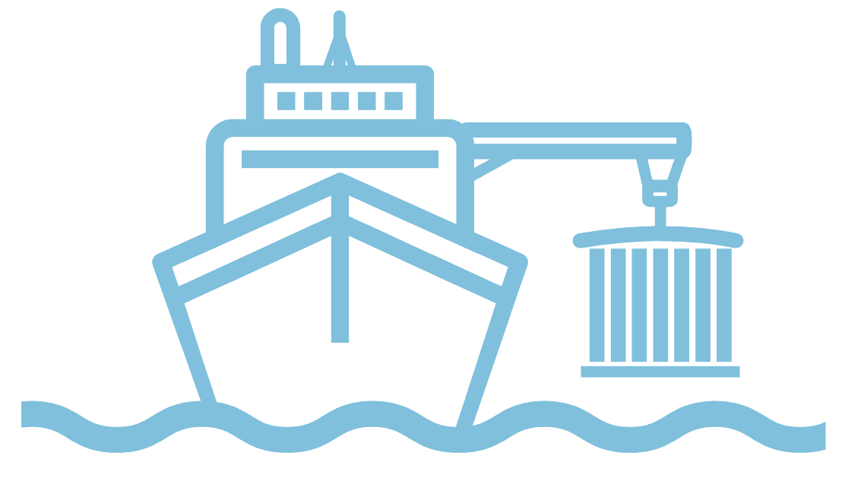
Global Ocean Ship-based Hydrographic Investigations Program - GO-SHIP

Slide 15
Summary on opportunities/issues
Future Plans and Opportunities
1. An updated version of the 2016 Talley et al GO-SHIP review paper has been drafted and a proposal has been made to the Annual Review of Marine Science to include it in their next volume. 2. Presenting GO-SHIP at OOSC in Nice in June 2025. Also exploring participating at the UNOC meeting that takes place the following week.
3. Planning is ongoing for the delayed A16S to take place late in 2025-early 2026.
Challenges and Concerns
1. Uncertainty about the level of sustained support for the US component and potential for disruptions in the decadal occupations if shiptime/personnel are not secured due to budgetary concerns and loss of scientific expertise.
2. An additional challenge could be the limitation for scientific interactions for US federal partners.
Asks from OCG
Nothing has been specified

Slide 16
Animal Bourne Sensors - AniBOS

Slide 17
Summary on opportunities/issues
Future Plans and Opportunities
Focus for the AniBOS community: Integrating physics and biological observations to better understand how in situ physical structure affects biological productivity and animal performance.
Challenges and Concerns
Three needs:
1. Hosting in-person Data Management meetings, ideally twice annually
2. Periodic 1-2 day in-person meetings will allow the Committee to progress essential tasks
3. 1 FTE position to support AniBOS data management development & operation would greatly help
Asks from OCG
1. Can OCG help identifying funding opportunities to support data management & OceanOPS?
2. OceanOPS has raised funding concerns, how will this affect emerging networks that rely on off research funding (noting of course that AniBOS has built and maintained a continuous times series of ocean observing for 21 years)?
3. OceanOPS is a key partner to manage metadata, clear directives from OceanOPS on mutual obligations can facilitate solutions

Slide 18
Global High Frequency Radar Network - HF Radars

Slide 19
Summary on opportunities/issues
Future Plans and Opportunities
- Contribute Data Implementation Strategy- looking at ERDDAP data services and m2m exchange metadata with OceanOPS
Challenges and Concerns
- Funding coordination
- boost the integration of HFR data in services, engage users, enhance applications development, - - Unlock HFR data assimilation, crucial to improve the model
- Funding: UN uncertainty, South Africa running out of funds
- Parts, repair and refurbishment difficult with import etc.
Asks from OCG
Nothing has been specified

Slide 20
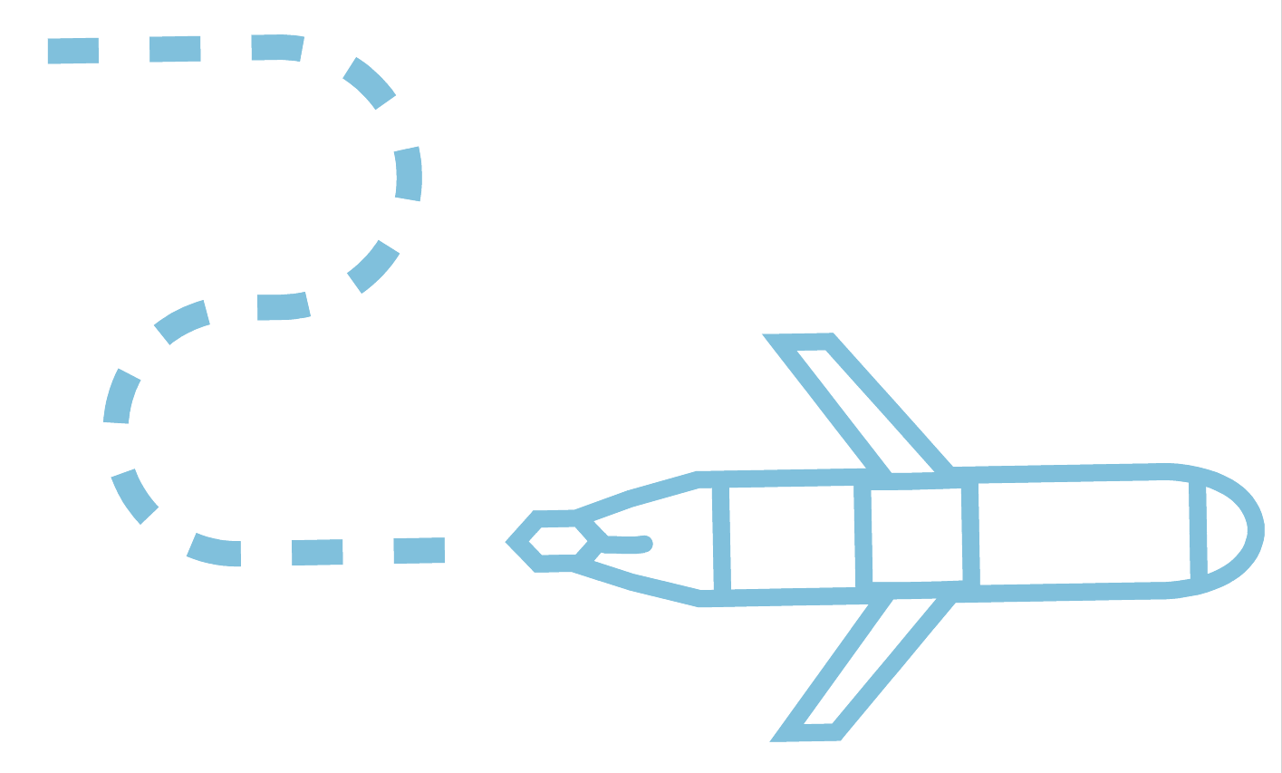
OceanGliders

Slide 21
Summary on opportunities/issues
Future Plans and Opportunities
1. Program vision and task team roles
2. Renewal of chairs
3. UG2 / EGO / OceanGliders relationship
4. Performance Indicators (KPIs) to develop
5. Monthly/yearly Maps
6. Federated ERRDAP
7. Automation of medata collection
8. Possible international meeting in 2027
Challenges and Concerns
Nothing has been specified.
Asks from OCG
Nothing has been specified.

Slide 22
Global Sea Level Observing System - GLOSS

Slide 23
Summary on opportunities/issues
Future Plans and Opportunities
1. Implementation Plan 2025
2. Unified GLOSS data access point and website
3. Best practices review and update
4. Three working groups: Sensor Performance, Data Archeology and Quality control, data processing and data management
5. GLOSS Steering Committee: TORs and membership
6. Enhancing coordination with IHO Tides#, Water Level and Currents Working Group and with GOOS
UN Ocean Decade: exploring potential links and opportunities over the next 2 years
Challenges and Concerns
1. Maintenance funding and data policy issues in certain countries, especially in Africa, Asia and the Mediterranean Sea.
2. Lack of unique identifier: relate to the definition of a tide gauge station.
3. Metadata standards and management, including easy-to-use tools to get
these data from national providers.
4. New low-cost sensors and technologies that require validation and assessment.
5. Unified data processing chain (replicability of sea level products)
6. Faster response to societal needs: from research to operational users
Asks from OCG
1. Are any funding cuts or data policy issues foressen for any of the observing components?
2. How do other networks manage the availability and quality of metadata, including changes of sensor, technology, maintenance problems, and detailed information required at national level?

Slide 24
Surface Ocean CO2 Observing Network - SOCONET

Slide 25
Summary on opportunities/issues
Future Plans and Opportunities
- Steering Committee
- implementation of advanced services at oceanops
- observing network sampling design
- strong working relationship with WMO’s GAW
- discuss overlap with SOOP-CO2 - resolve (EH understood merge?)
Challenges and Concerns
- Longevity of structure
- Aligning SOCONET/ SOCAT with WIS2
Asks from OCG
- Feedback on SOCONET ToRs

Slide 26
Fishing Vessel Operating Network

Slide 27
Summary on opportunities/issues
Future Plans and Opportunities
- Share governance research relates to sustainability
Communications plan/ business plan
Collaborations with private sector
FVON federated data portal, best practices
Cross-network collaboration, Argo and SOT Programs (e.g.,
fisher centric tools to incentivize collection
Link to FAO
Challenges and Concerns
- Find a basic budget for running the network
- Produce a concise global FVON data set from different fishing gears
- Extend biogeochemical sensors (e.g., DO, Chla and pH) to FVON
- How to balance open data and private sector financing
Asks from OCG
- Incentivizing GTS contribution when funding for fisheries science
- link to IOC/WMO Member States obligations?
- Financial Innovation subcommittee: Buyers club of countries to make commitments for monitoring?

Slide 28
SMART Cables

Slide 29
Summary on opportunities/issues
Future Plans and Opportunities
1. The Global Implementation Strategy (2025-2030) focuses on integrating SMART Cable into new routes, prioritizing climate-critical ocean monitoring, and creating a sustainable funding model with public, disaster, and telecom industry support.
2. Host international workshop on SMART Cable data processing and integration. Develop training programs for regional partners in data management and sensor
Maintenance. Create virtual community of practice connecting SMART Cable operators, scientists,and end-users.
3. Collaborate with Argo, Partner with GLOSS, Coordinate with OceanSITES to validate SMART Cable data against fixed-point
observations
Challenges and Concerns
1. Funding constraints: continued need for financial support to sustain the SMART Cables International Prograrmme Office and new deployments
2. Regulatory and Legal Barriers: Addressing legal and regulatory challenges that vary by region, potentially delaying implementation. Request SMART be added to the on-going efforts by IOC, WMO, and ITU regarding data and UNCLOS.
3. Cross-Sector Coordination: Bridging the gap between the telecom industry and ocean science communities to align priorities and objectives.
Asks from OCG
Network Recognition and Integration: Formal recognition of SMART Cables as a GOOS Network with updated specification
Sheet, Integration into GOOS reporting frameworks and assessment processes, Support for securing the network's long-term operational funding
Data Management Support: technical assistance from OceanOPS, Collaboration with EMSO, INGV, IPMA and Ifremer, development of visualization toolss for SMART Cable data presentation alongside other GOOS networks
Cross-Network Coordination: Facilitation of working sessions with complementary networks, Support for developing integrated products, Assistance in identifying priority deployment regions

Slide 30
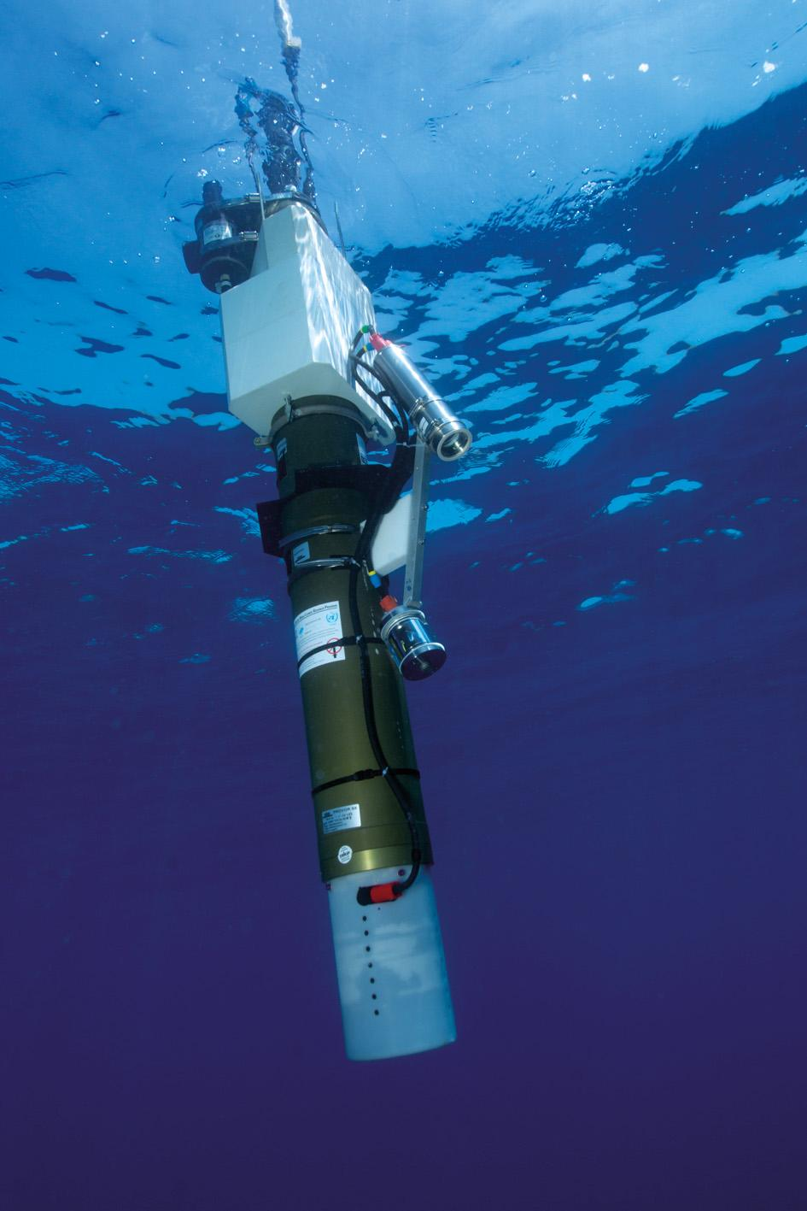
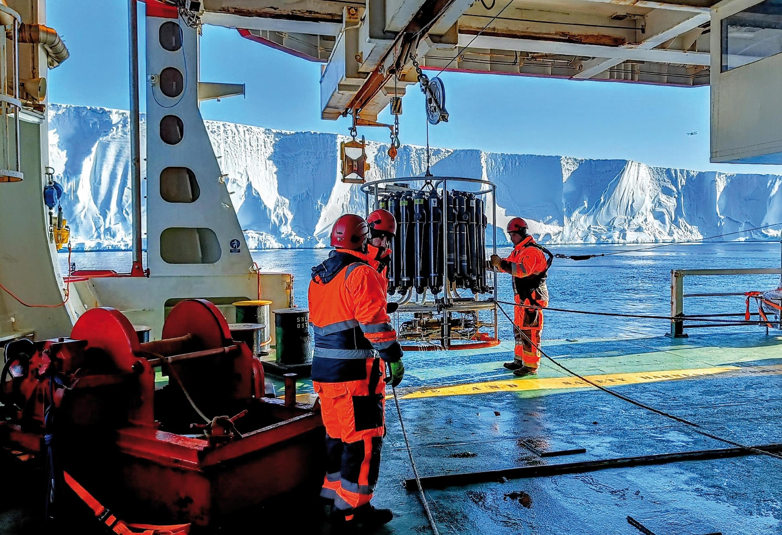
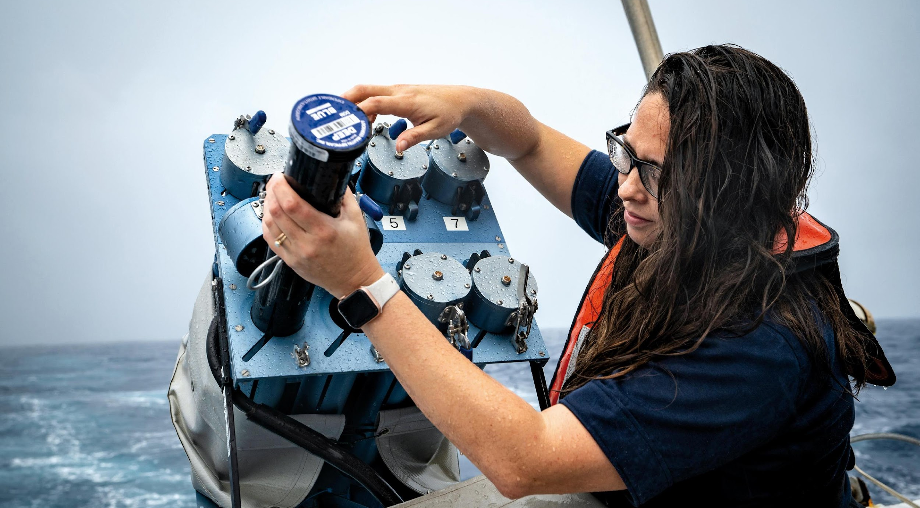
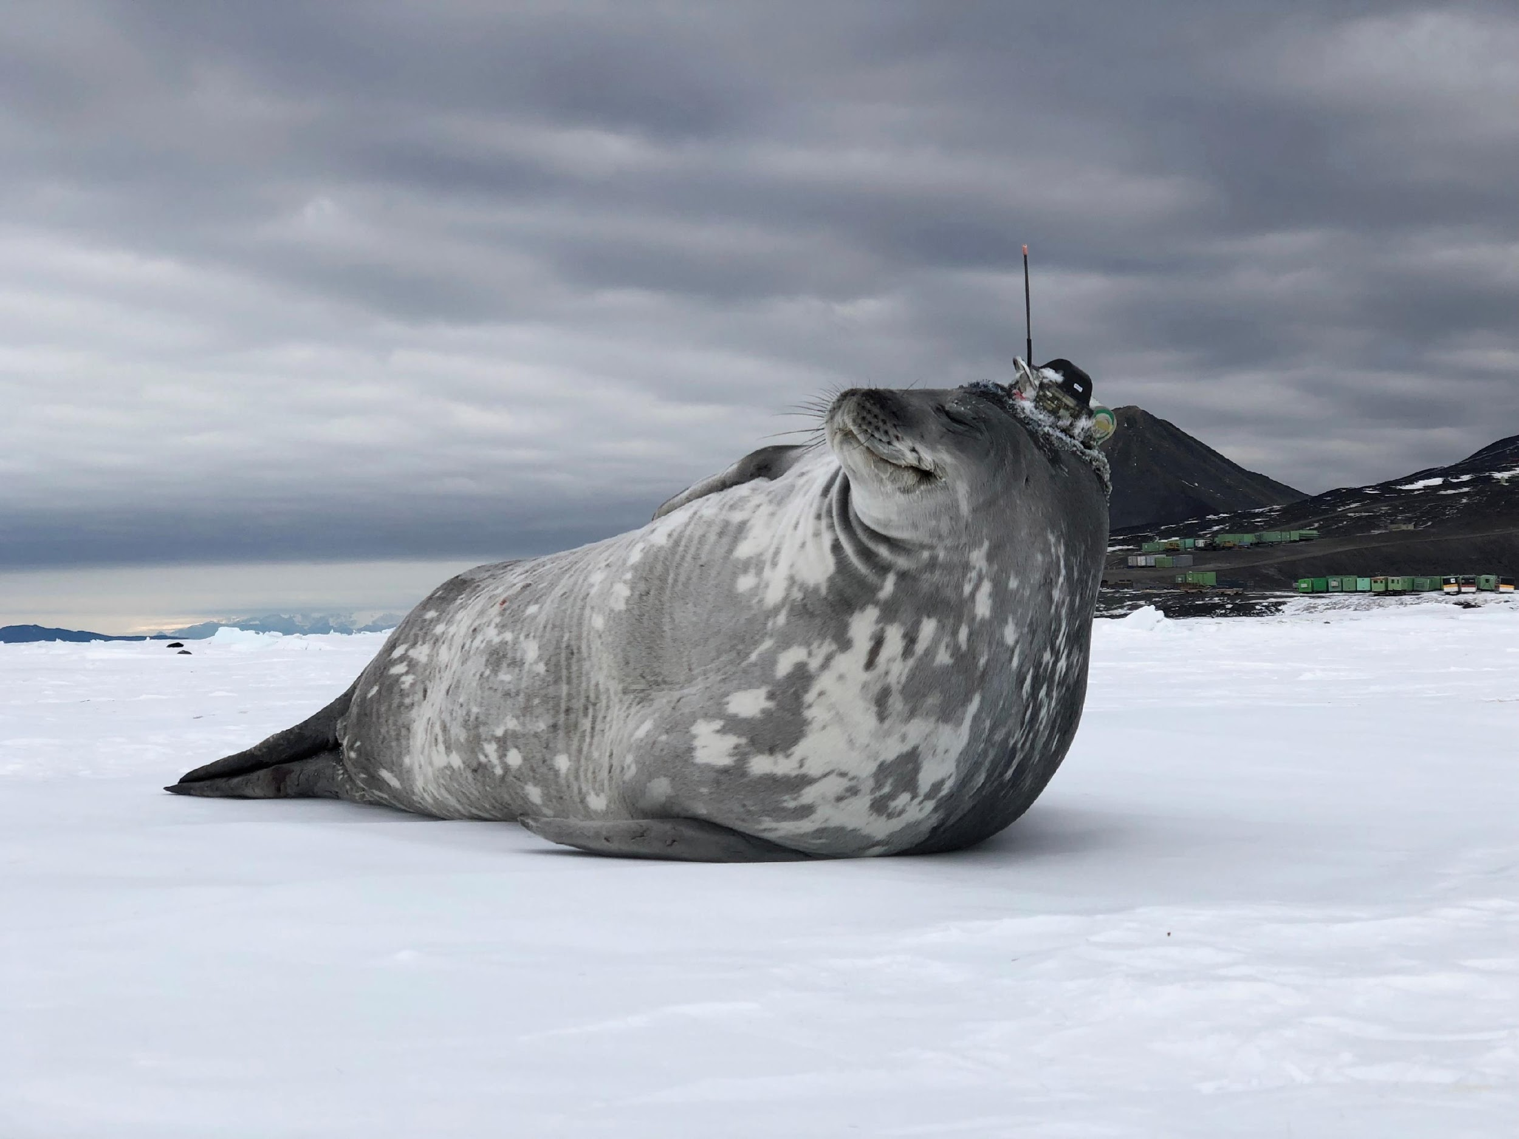
Thank you
goosocean.org

