Slide 1
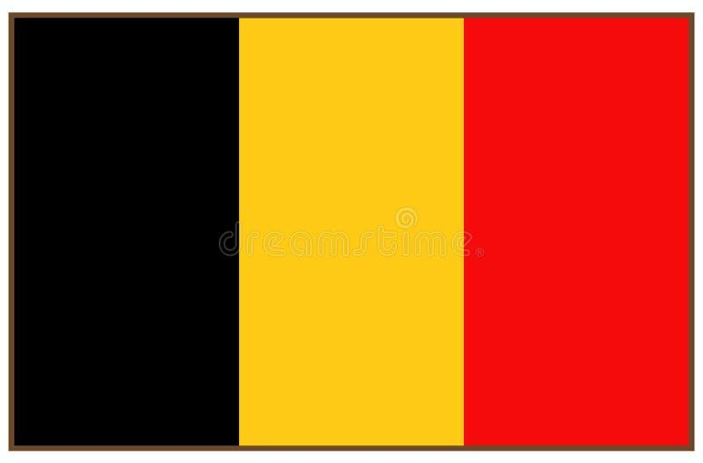
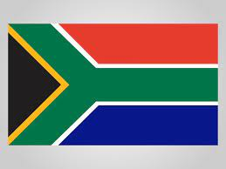
Uncrewed Surface Vehicle Global Network
OCG-16 Session, 7-10 April 2025
IFREMER, Brest, Brittany, France
Ruth Patterson*, Meghan Cronin, Sebastiaan Swart, Joana Beja, Johan Edholm**, Jason McKenna, Jamie Palter, Alex Parker, Charles Addey**, Weiter Boone, Paban Bhuyan**, Justin Buck, Eugene Burger, James Burris, Lionel Camus, Brad de Young, Marcel du Plessis*, Mike Flanigan, Gregory Foltz, Sarah Gille, Laurent Grare, Jeff Hansen, Lars Robert Hole, Makio Honda, Verena Hormann, Catherine Kohlman*, Naoko Kosaka, Carey Khun, Luc Lenain, Lev Looney**, Andreas Marouchos, Elizabeth McGeorge*, Clive McMahon, Satoshi Mitarai, Calvin Mordy, Akira Nagano, Sarah-Ann Nicholson*, Sarah Nickford*, Kevin O’Brien, Davide Peddie, Leandro Ponsoni, Virginie Ramasco, Nick Rozenauers, Elizabeth Siddle*, Cheyenne Steinbarger*, Adrienne Sutton, Noriko Tada, Jim Thomson Iwao Ueki, Lisan Yu, Chidong Zhang, Dongxiao Zhang

Slide 2
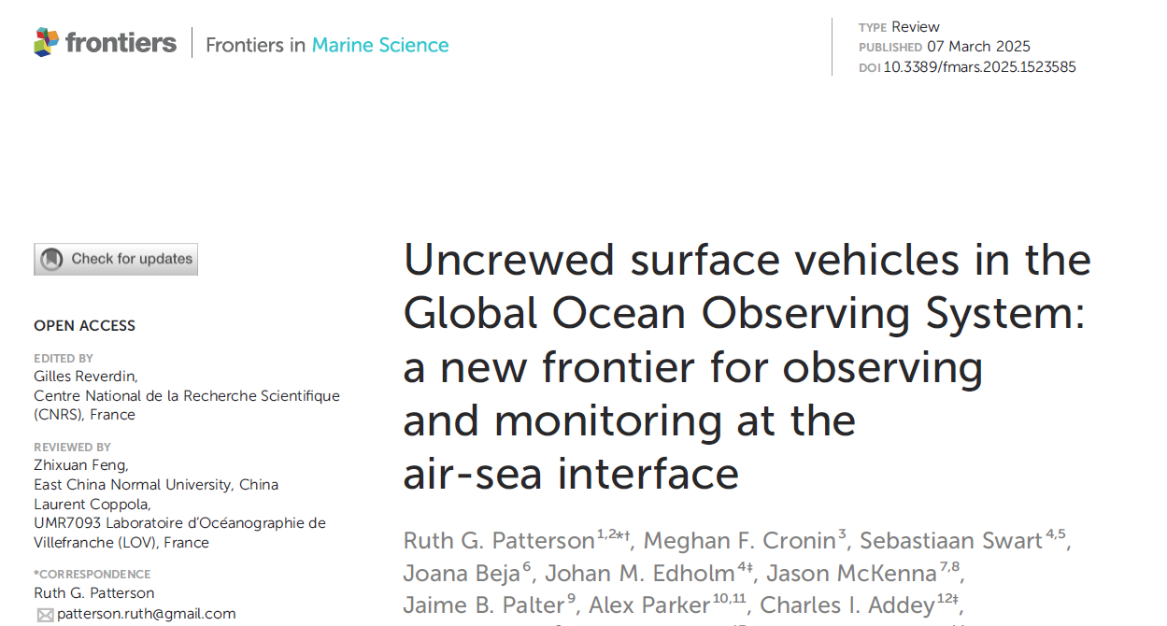
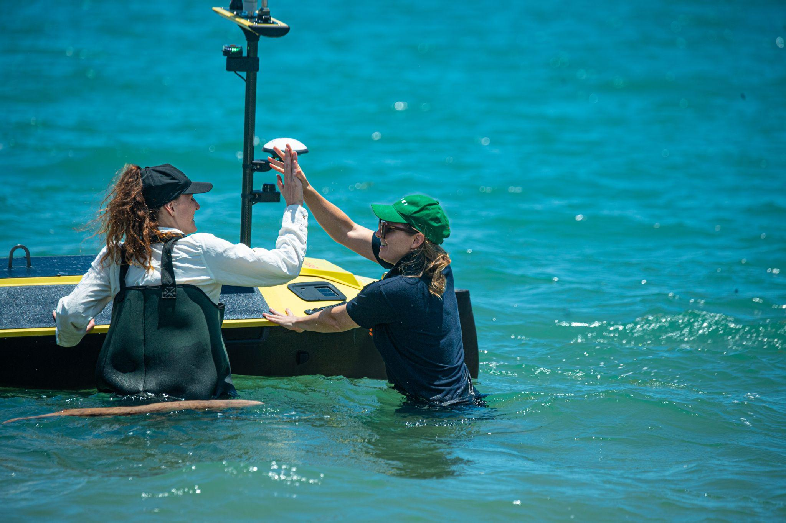
Achievement - 2025
The paper represents global scientific and industry leaders in USV scientific data collection
52 co-authors
9 different countries
9 ECOPs
5 PhD students
40 affiliations
5 businesses
200 USV datasets.
Nurtured a cohesive and collaborative community
200 data sets
Determined our strengths and weaknesses
Agreed on our data and communication goals
Notes:
Our network is based around collaboration. We have a common goal, which is to uplift the USV industry through science, so that we can do better science, for the benefit of society.
We have over 300 people who have registered to be part of our network.

Slide 3
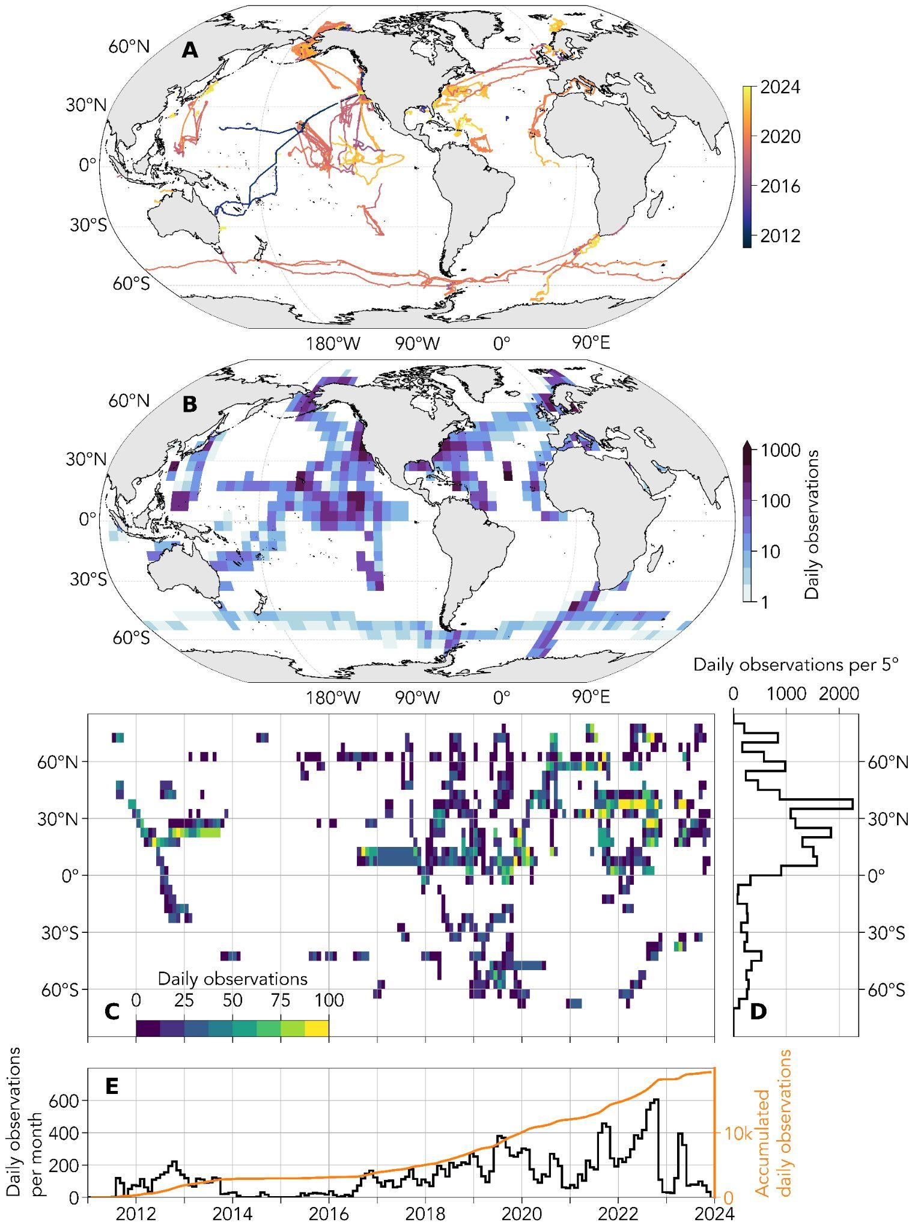
Draft ToRs
Focus on: air temperature, humidity, skin temperature, sea surface temperature and salinity, current profiles, wind speed and direction, wind stress, radiation (long-wave/short-wave), atmospheric pressure, seawater and air pCO₂, dissolved oxygen, and chlorophyll.
Develop an implementation plan for the coordinated collection of biological and ecological data using USVs.
Collaborate with the USV manufacturing industry in a two-way dialogue to develop appropriate practices for sampling and data QC.
Develop and implement interoperability experiments with the broader scientific community
Develop and systematically review data collection recommended practices, working with the OBPS and tools to reduce duplication of effort by learning from other networks.
Notes:
One of the strengths is our ability to collect unprecedented co-located ocean and meteorological data simultaneously.
We have listed a whopping 13 EOV/ECV here as baseline. But our literature review found we can collect 28 EOVs/ECVs, and 5 additional including bathy and eDNA. This include 5 out of the 9 Biology and ecosystems EOVs, as mentioned by the Bio Eco Panel.
In the context of the RRR: The RRR lists in the red: currents, salinity, temperature, waves, sea level and pCO2, but we can do these all at the same time, and in remote areas and during e.g. winter. So gap-filling.
It is important to acknowledge OASIS and the core skills involved in connecting the Ocean and Atmosphere (Joanna mentioned before the need to connect the IOC and WMO, we have the tools to connect the ocean and atmosphere, and a community of specialist scientists who understand it.)
I have the OASIS logo here, this really is the leading group in the USV network and is the reason we are here. OASIS is a driving force, but they are also the data end-users. The USV network will stand alone, but its important in the network’s infancy to be supported by this group and acknowledge their importance in this network.
Acknowledging that we intend on being multidisciplinary (because our tech allows it) a core direction is for us to be developing a plan for ecological and biological data to be coordinated and collected.

Slide 4
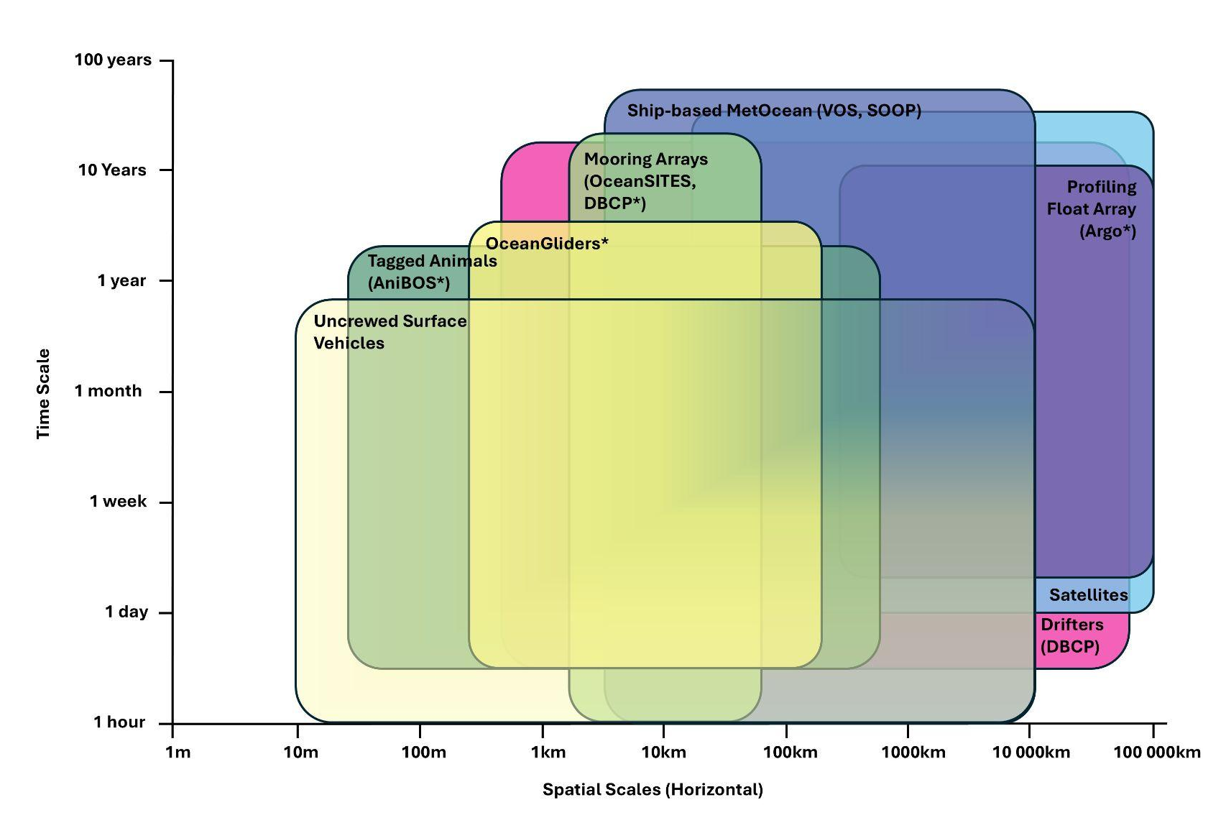
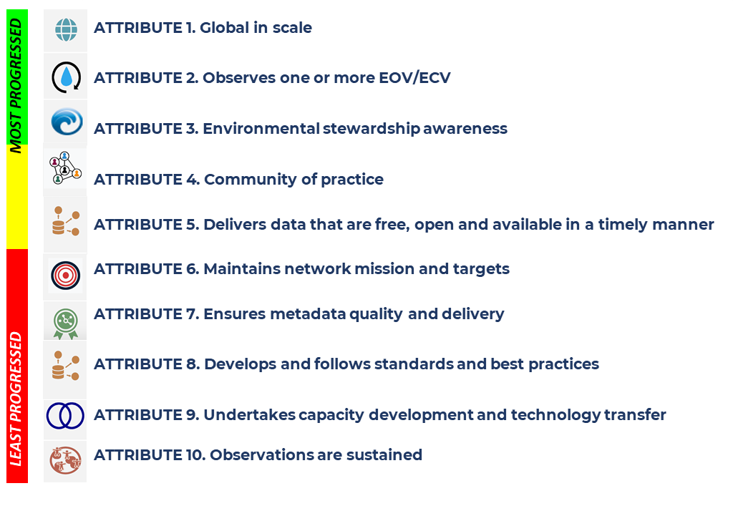
USVs complementary role in the OCG networks
Attributes: Traffic Light Update
Notes:
The USV network already has strong connections across SOCONET, we have a ‘GO-USV’ transect with a saildrone as part of TPOS, which is like GO-SHIP but on finer spatiotemporal scales and focused around seasonal patterns.
We have this spatial and temporal representations here, which is explained in the publication.
In the yellow, we are developing attributes 4 and 5, and we have plans over the next year or two to develop those.

Slide 5
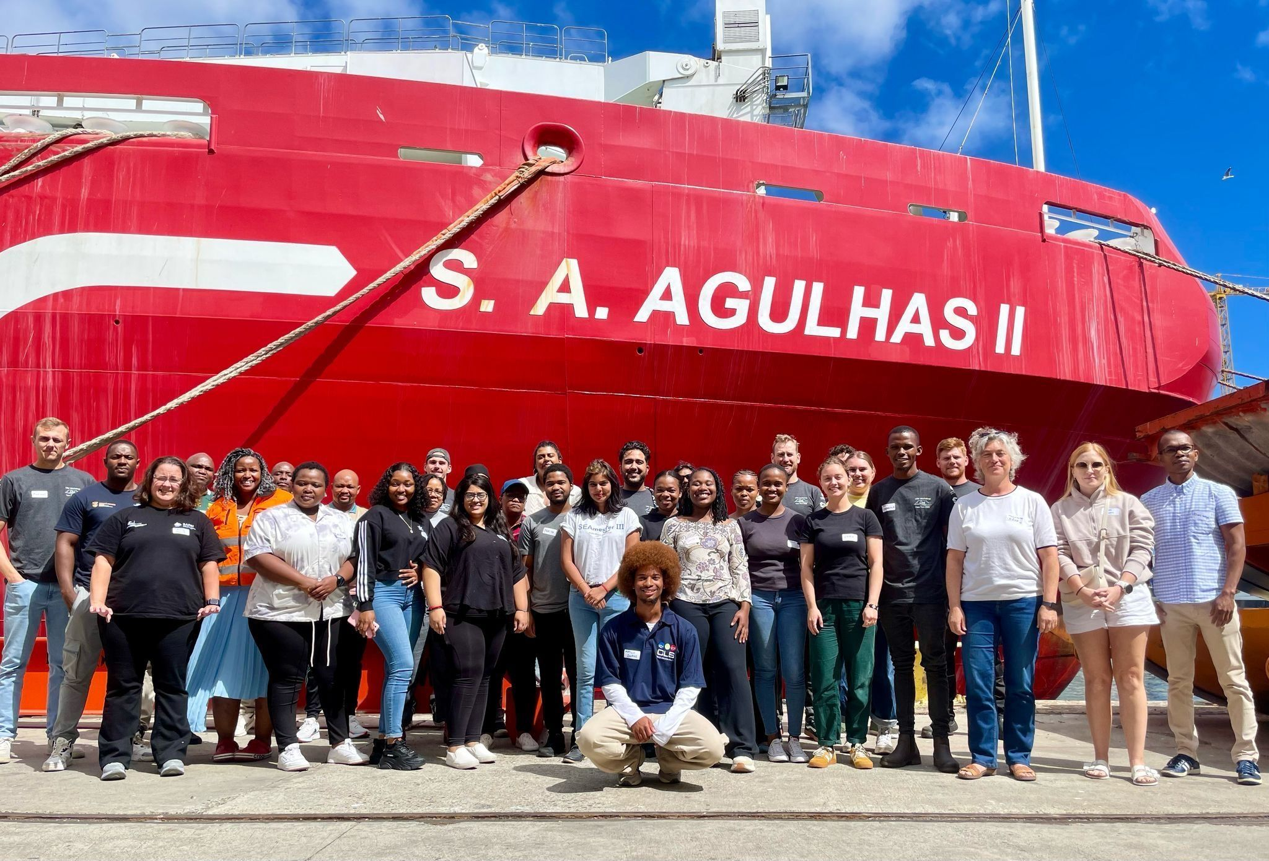
Recent Progress
Established support from the OASIS project office at UCAR to facilitate fundraising and building an independent USV Global Network project office
Webinar continued
USV workshop (continuing)
U.Gothenburg and CSIR USV Workshop in Mar 2026.
The USV Global Network is a UN Decade Project within the OASIS UN Decade Programme.
Notes:
OASIS office has been acting as the USV network project office. This is supported by the UN Ocean Decade.
We have some work to do with how we engage our 300 ‘members’ who have signed up for where we are, and how we get support.

Slide 6
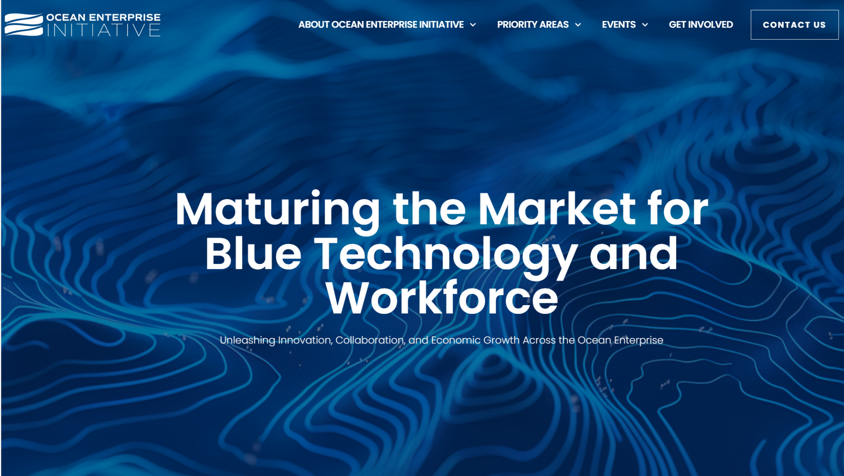
Network Overview
Our USV Global network will connect scientists and manufacturers to develop the technology and industry for use in the scientific market
Notes:
There is a big place for industry in this contemporary landscape. They see ‘science’ as a difficult market, and they are seeking to understand better. And this is the core of our USV network.
We also have this unique case where our platforms are diverse. What we measure, can change depending on the platform, and where the sensor is on the platform. This is misunderstood across industry
I’m sitting on the external advisory committee with the Ocean Enterprise Initiative and helping broker this industry-science-government relations.

Slide 7
Next steps for 2025-26
Challenges and asks
We are ready for endorsement!
Funding proposals in review
USV global network meeting
USV GDAC development and network secretariat
Lloyd’s Register Foundation
Wave spectra intercomparisons
Funding proposals in-prep:
USV global network meeting
OASIS office (UCAR) industry funding proposal
Develop standards and best practices
FAIR air-sea fluxes data
Regional Alliances
(USVs can span many)
Seb Swart et al

Slide 8
USV Global Network is ready to join the OCG Networks
Notes:
This endorsement is really important to our community, planning, funding and function and ability to meet the attributes.

