Slide 1
Progress on coupled modeling and assimilation for operational applications at NOAA
Vijay Tallapragada, Ph.D.
Senior Scientist (ST), NOAA/NWS/NCEP/Environmental Modeling Center
16th session of Observations Coordination Group (OCG-16)
April 9, 2025

Slide 2
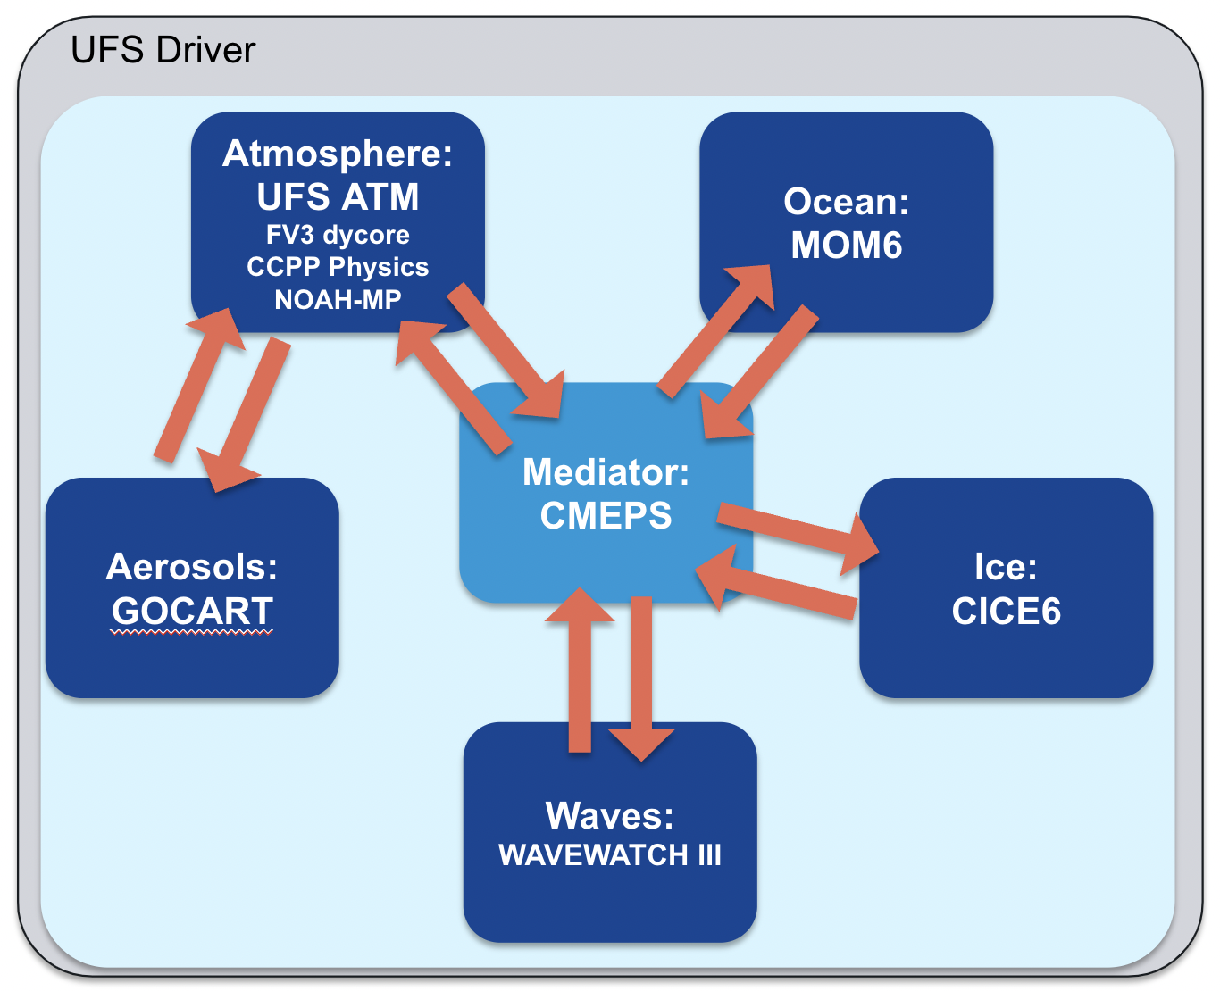
NOAA/NWS Weather to Seasonal Forecast Systems: Moving towards Fully Coupled Earth System Modeling and Data Assimilation
UFS coupled configuration
Current operations
GFSv16 (since March 2021)
Weather scales, deterministic, FV3 with
no coupling with ocean/ice.
GEFSv12 (since September 2020)
Weather to subseasonal, ensemble, FV3 with no coupling with ocean/ice.
CFSv2 (since March 2011)
Subseasonal to seasonal, ensemble,
coupled with ocean & sea ice.
Spectral Atm/MOM4 Ocean/SIS1 sea ice.
Operational targets
GFSv17
GEFSv13
SFSv1

Slide 3
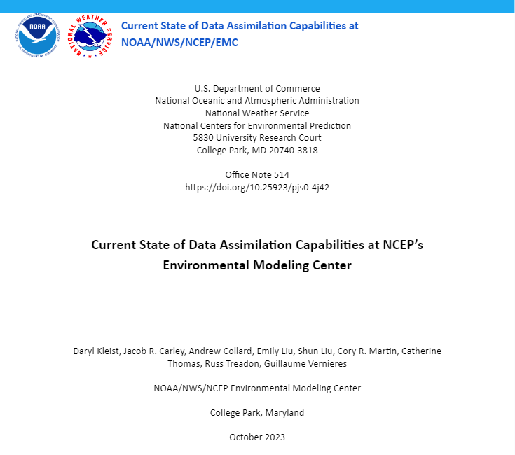
NWS/NCEP/EMC Data Assimilation Review and Current State
Introduction
Atmospheric Systems
GSI Unification, Hybrid DA
Marine, Land, Composition, and Coupled Assimilation
Current Use of Observations
Decoding and Obs Processing
In-situ and anchor obs
Remotely sensed (non-satellite)
Remotely sensed (satellite)
Monitoring & Observation Impacts
Current Implementation Procedure
https://doi.org/10.25923/pjs0-4j42

Slide 4
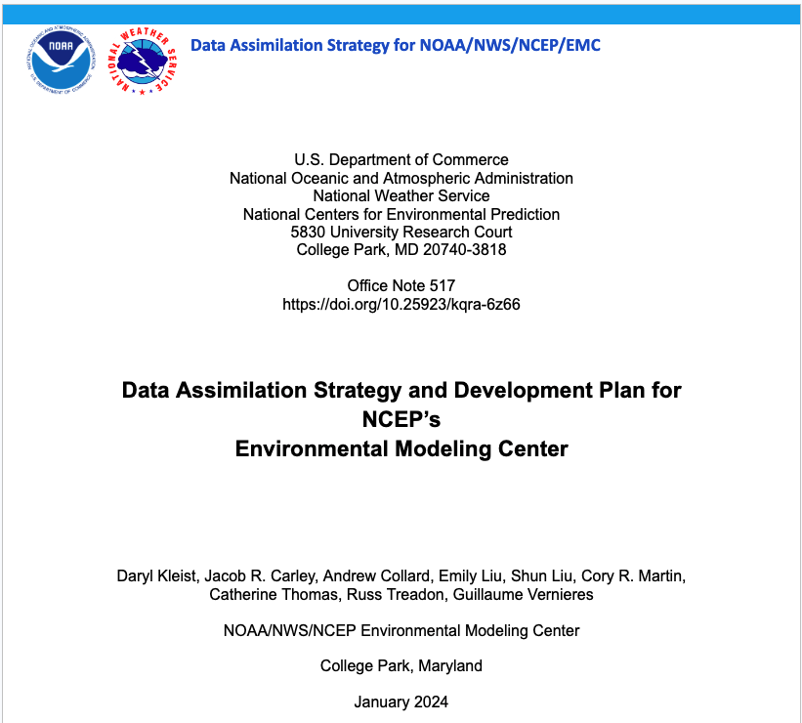
NWS/NCEP/EMC Data Assimilation Development Strategy
Introduction
Advanced Infrastructure / JEDI
Research and Development
Use of Observations
New and Upcoming Observations
Algorithms
Toward Continuous DA
Coupled DA
AI/ML
Reanalysis
Development Practices
Data Assimilation Vision - Holistic Approach
JEDI, Partnerships, Embracing Change, and Workforce
Risk Management
https://doi.org/10.25923/kqra-6z66

Slide 5
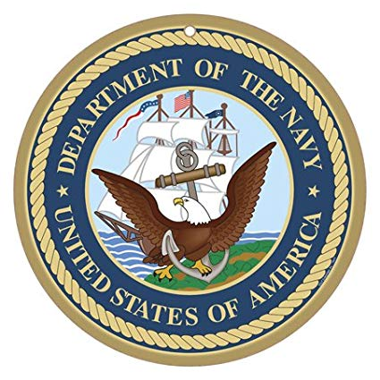
Joint Effort for Data assimilation Integration (JEDI)
Infrastructure for Unified Data Assimilation
JEDI is a project within the Joint Center for Satellite Data Assimilation (JCSDA)
JEDI provides a software infrastructure for data assimilation that
is model agnostic
is generic and portable, from toy models running on laptops to operational Earth system coupled models running in the cloud.
enables DA on the model native grid
does not impose one specific DA methodology or algorithm
provides a framework for rapid uptake of new observations into operations with generic observation handling and modeling
encourages implementation of model-independent observation operators
provides a unified Interface for Observation Data Access (IODA)
JEDI is intended for scientific exploration and operational forecasting.
The keys to success are separation of concerns and interfaces.

Slide 6
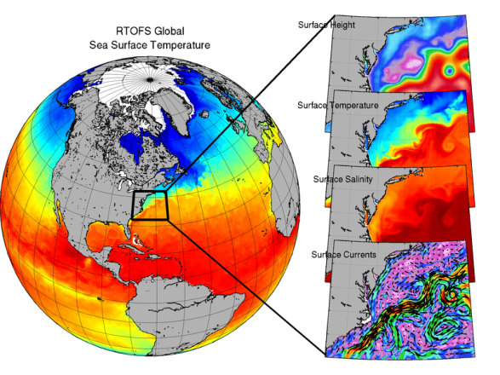
Overview of Real-Time Ocean Forecast System
Multivariate, multi-scale 3D Variational Analysis (VAR).
Flexible and unified end-to-end system:
Quality control of observations.
Variational analysis.
Diagnostics.
Uses HYCOM Ocean and Community Ice CodE (CICE; sea ice) models.
Analysis performed directly on the ocean model tripole grid: 0.08º resolution with 41 layers, 1 m top level thickness.
Daily update cycle.

Slide 7
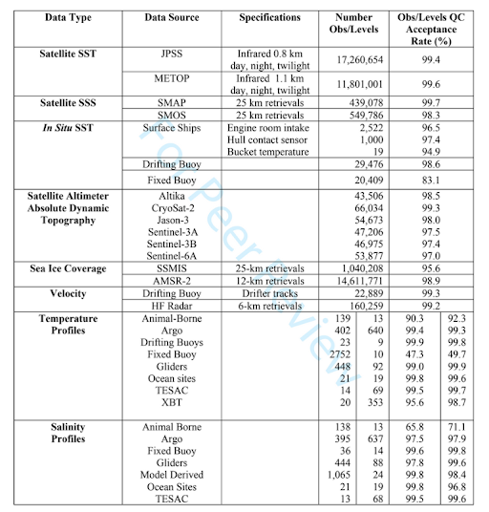
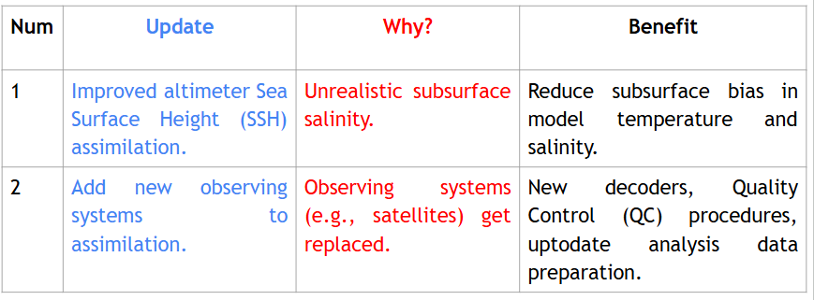
Observations assimilated & Upcoming changes to RTOFSV2.5

Slide 8
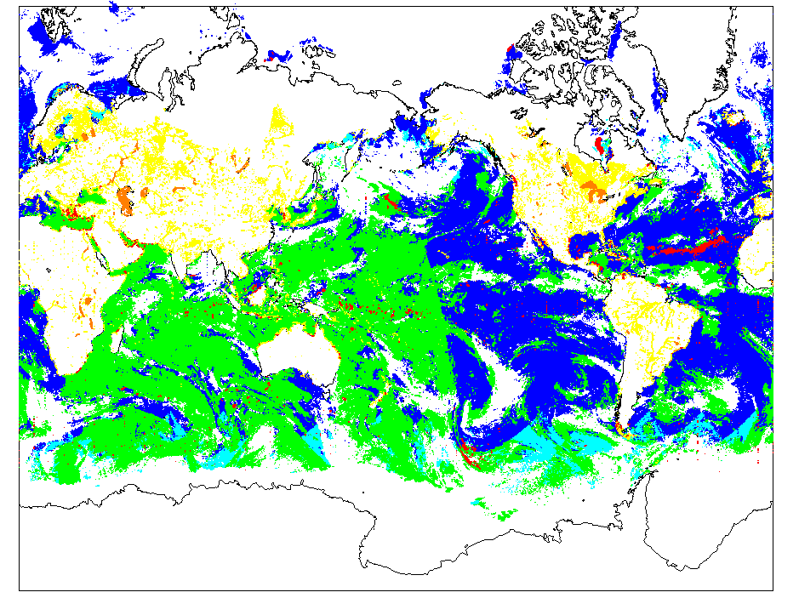
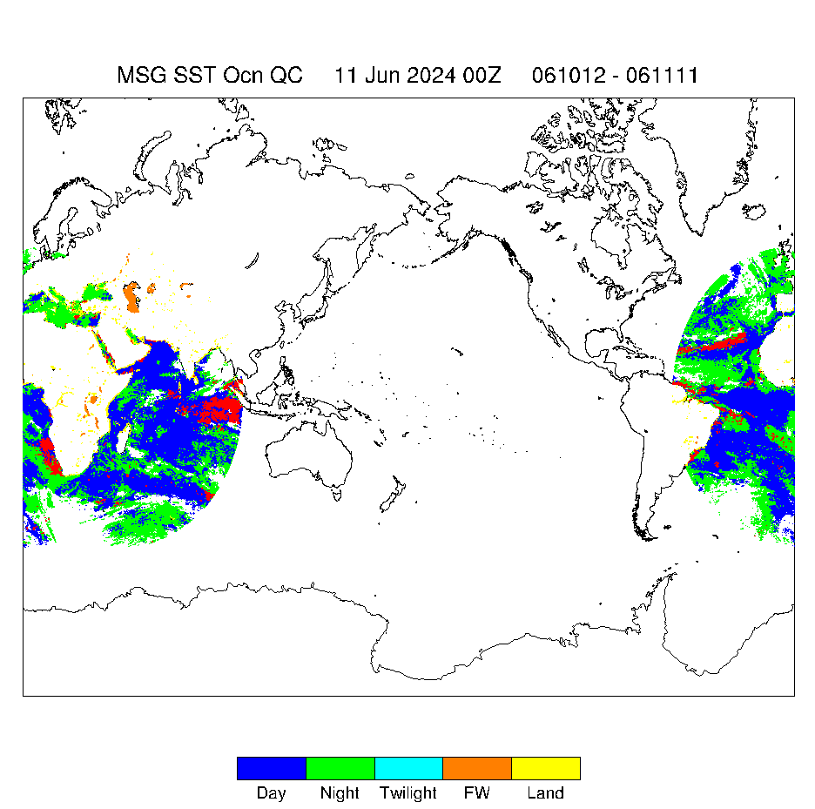
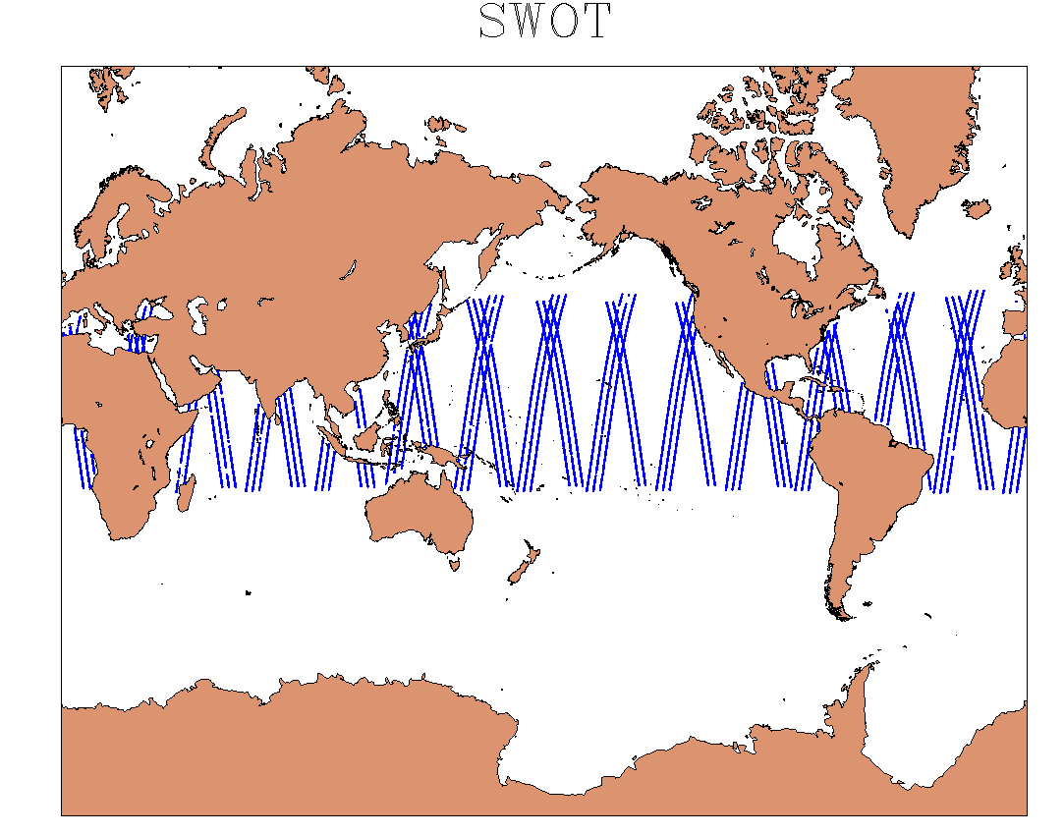
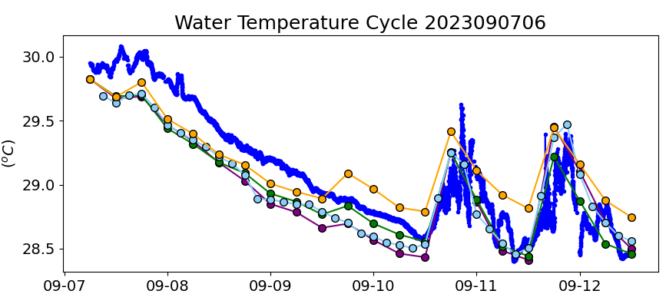
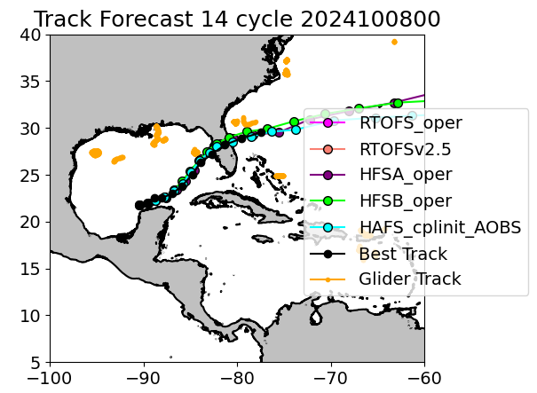
Add New Observing Systems
NOAA-21 SST MSG02/MSG03 SST SWOT SSH
Usage of Glider and Saildrone measurements
Updated BUFR decoder with new WMO rules on identifying profile data types:
- Glider and Argo Profiles
- Marine Mammals
- Saildrone
- Ocean Climate Stations
Glider
Saildrone

Slide 9
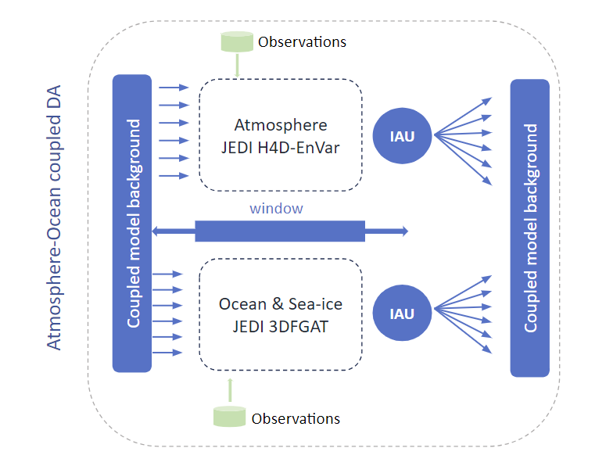
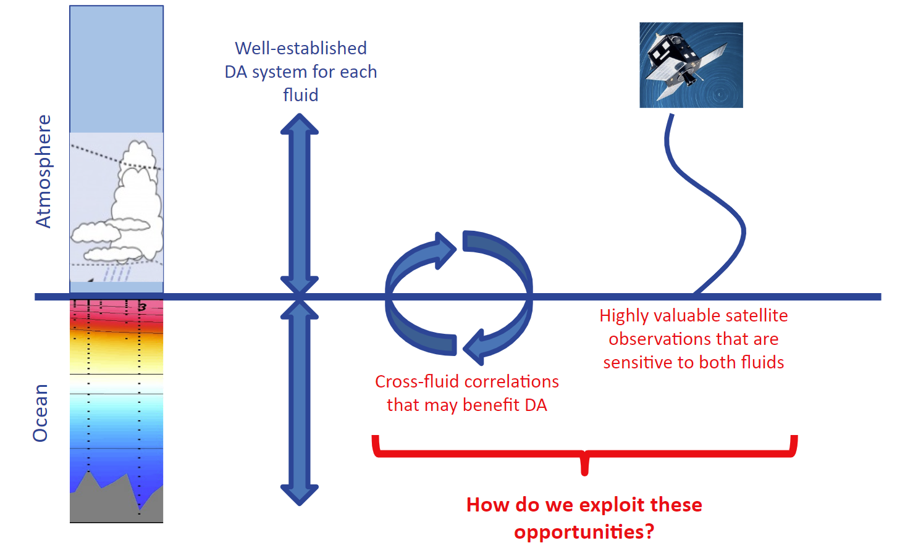
Exploitation of JEDI for Coupled Atmosphere-Ocean DA

Slide 10
Marine DA: Configuration and Observations
 | Target GFSv17 Marine DA system | Current system
Deterministic DA algorithm | JEDI based Hybrid Ens. Var. 4D h(x) and 3D background error | JEDI based Hybrid Ens. Var. 4D h(x) and 3D background error
Perturbation model | JEDI based LETKF | Offline members from an ensemble of coupled UFS forecast
DA window | 6 hr window | 6 hr window
Initialization | 3D IAU for MOM6 direct insertion for CICE | 3D IAU for MOM6 direct insertion for CICE
Ensemble size | 80 | 30 offline members
Obs type | Current assimilation
SST retrievals | AVHRR (METOP-A, -B) VIIRS (NOAA-20, S-NPP) ABI (GOES 16-17) AHI (Himawari-8)
Sea ice concentration | AMSR-2 North, South
Altimeters (sea surface height) | CRYOSAT-2 JASON-1, -2, -3 SARAL Sentinel-3A, -3B
Courtesy of Guillaume Vernieres

Slide 11
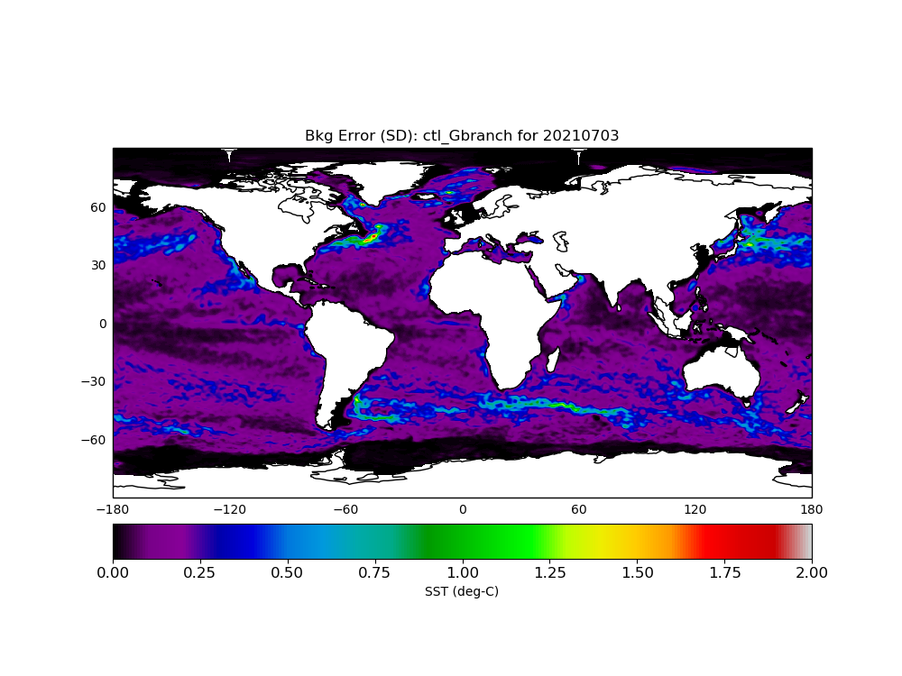
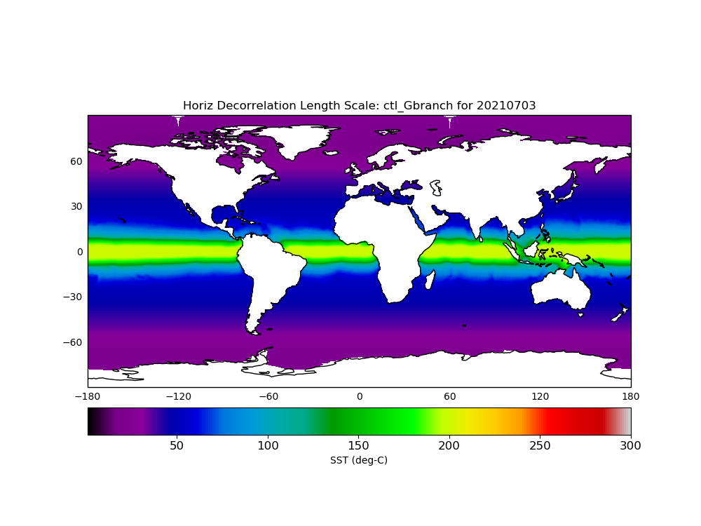
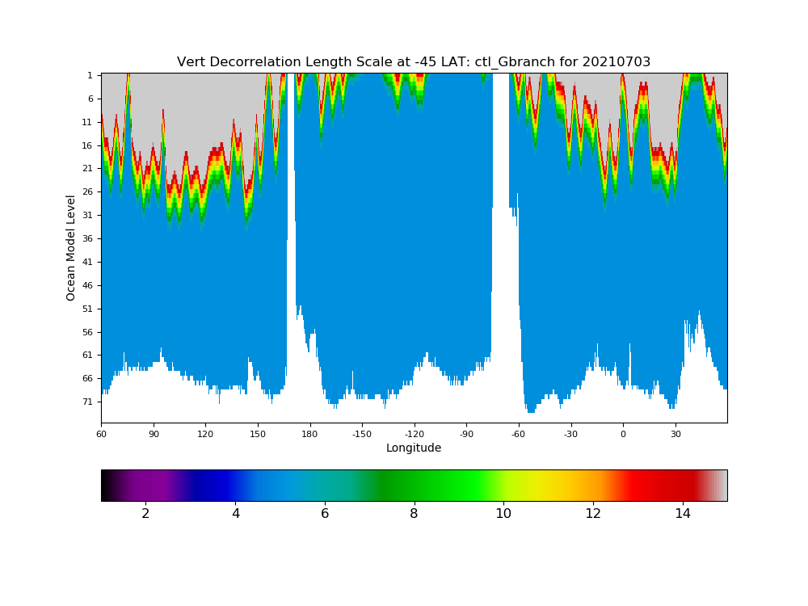
Marine DA: Background Error
Example Bkg Error for SST (D)
B = 𝛽_{s} B_{s} + 𝛽_{se} B_{se}
where 𝛽_{s} = 1 and B_{s} = K D C_{v} C_{h} C_{v}^{T} D K^{T}
Small Scales
Diag B_{s} (D): variance partitioning of the background.
Variance Partitioning: For each point A, compute stddev of all points surrounding point A and assign to point A.
Cross-covariance (K): linearized column physics (steric height balance). Cross correlation for T, S, and ssh
Horizontal and Vertical correlations modeled with an explicit diffusion operator
Horizontal decorrelation length scale (C_{h}) use the Rossby radius of deformation
Within the Mixed Layer (ML), the vertical decorrelation length scale (C_{v}) can be up to 15 layers deep (if the ML is 3 layers deep, C_{v} is 3 layers). Below the ML, 5 layers are used C_{v}
deg-C
Horiz. Length Scales (C_{h})
Vert. Length Scales (C_{v}) at 45°S
s = static
se = static ens.
km
Number of layers
Courtesy of Katie Lukens
Notes:
These are the scales used for static B and also as localization scales for the ens. B.
Vert scale: following MLD. Plot against ocean depth itself

Slide 12
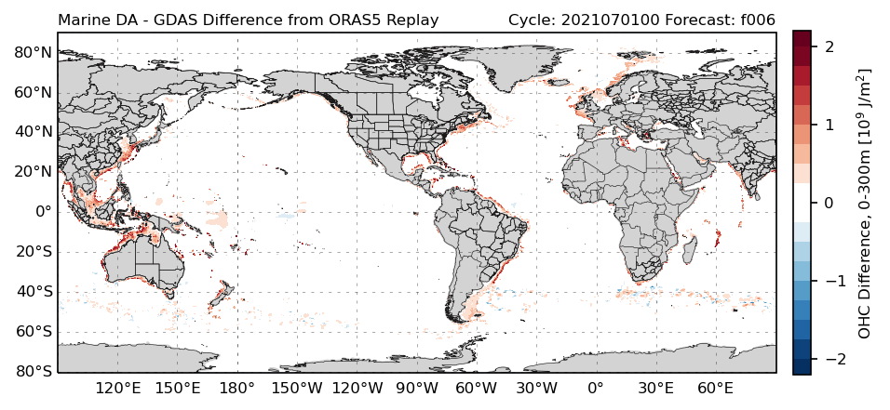
Marine DA: Upper Ocean Heat Content
Comparison of ocean heat content (OHC) 0-300m from f006 background forecasts in the GFSv17 C02 prototype to the Ocean ReAnalysis System 5 (ORAS5) Replay during the period July 1-11, 2021.
Differences in OHC increase with time and are largest along the Equator and in areas with strong currents
Issue with gravity wave propagation is revealed (black circle)
In situ obs (not yet assimilated) may help reduce the larger differences along the Equator
Courtesy of John Steffen
Notes:
Experiment is drifting away from ORAS5 with time, which is not great, but not concerning.
Expect larger diffs near western boundary currents.
Not assimilating ARGO obs (which is global distribution), so why is Equator showing larger differences?
SO: mesoscale circulations, boundary currents
ORAS5 is nudging to OSTIA in a relaxed way. They’re not trying to estimate the synoptic scale of the ocean. There are large errors in the western boundary currents, strong currents (SO). While we are trying to constrain the smaller scales.
No constraint to in situ obs, so large errors in tropics may be from this.

Slide 13
Marine DA: Altimeter Observations
SSH objective obs. analysis from Copernicus
ORAS5
SSH assimilation is critical for the placement of ocean mesoscales and fronts.
UFS NO-DA
UFS JEDI/SOCA
Courtesy of Guillaume Vernieres

Slide 14
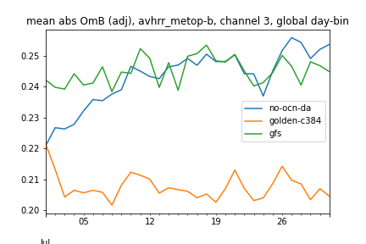
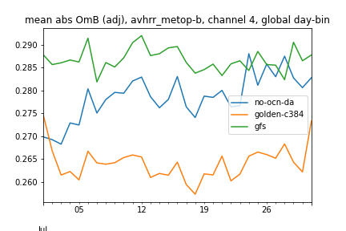
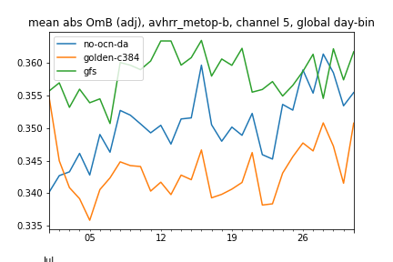
Marine DA: Radiances
Atmos Observation-Minus-Background (OMB) diagnostics that correspond to SST-sensitive radiance obs are smaller when the ocean provides a better foundation temp. (orange lines), implying that marine DA has a positive impact on the atmospheric side. → Improvements in marine DA should help further improve the atmosphere.
Daily Mean OMBs for SST-sensitive Radiances
Coupled C384, ¼ deg Ocean (marine DA off)
GFS (NOAA operations, no ocean model)
Coupled C384, ¼ deg Ocean (marine DA on)
Courtesy of Andy Eichmann
Notes:
Not only do you get better foundation T (as compared to OSTIA) when you use an ocean model and marine DA, but that better foundation T leads to smaller OMBs for radiance obs on the atmospheric side!
These are IR channels that are sensitive to SST in radiance space. OMBs correspond to radiances that are sensitive to SST.

Slide 15
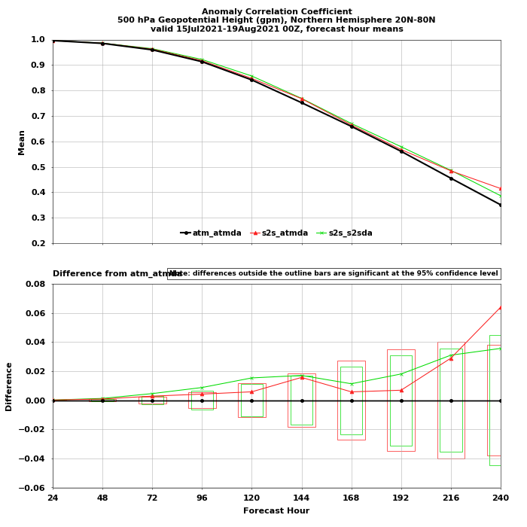
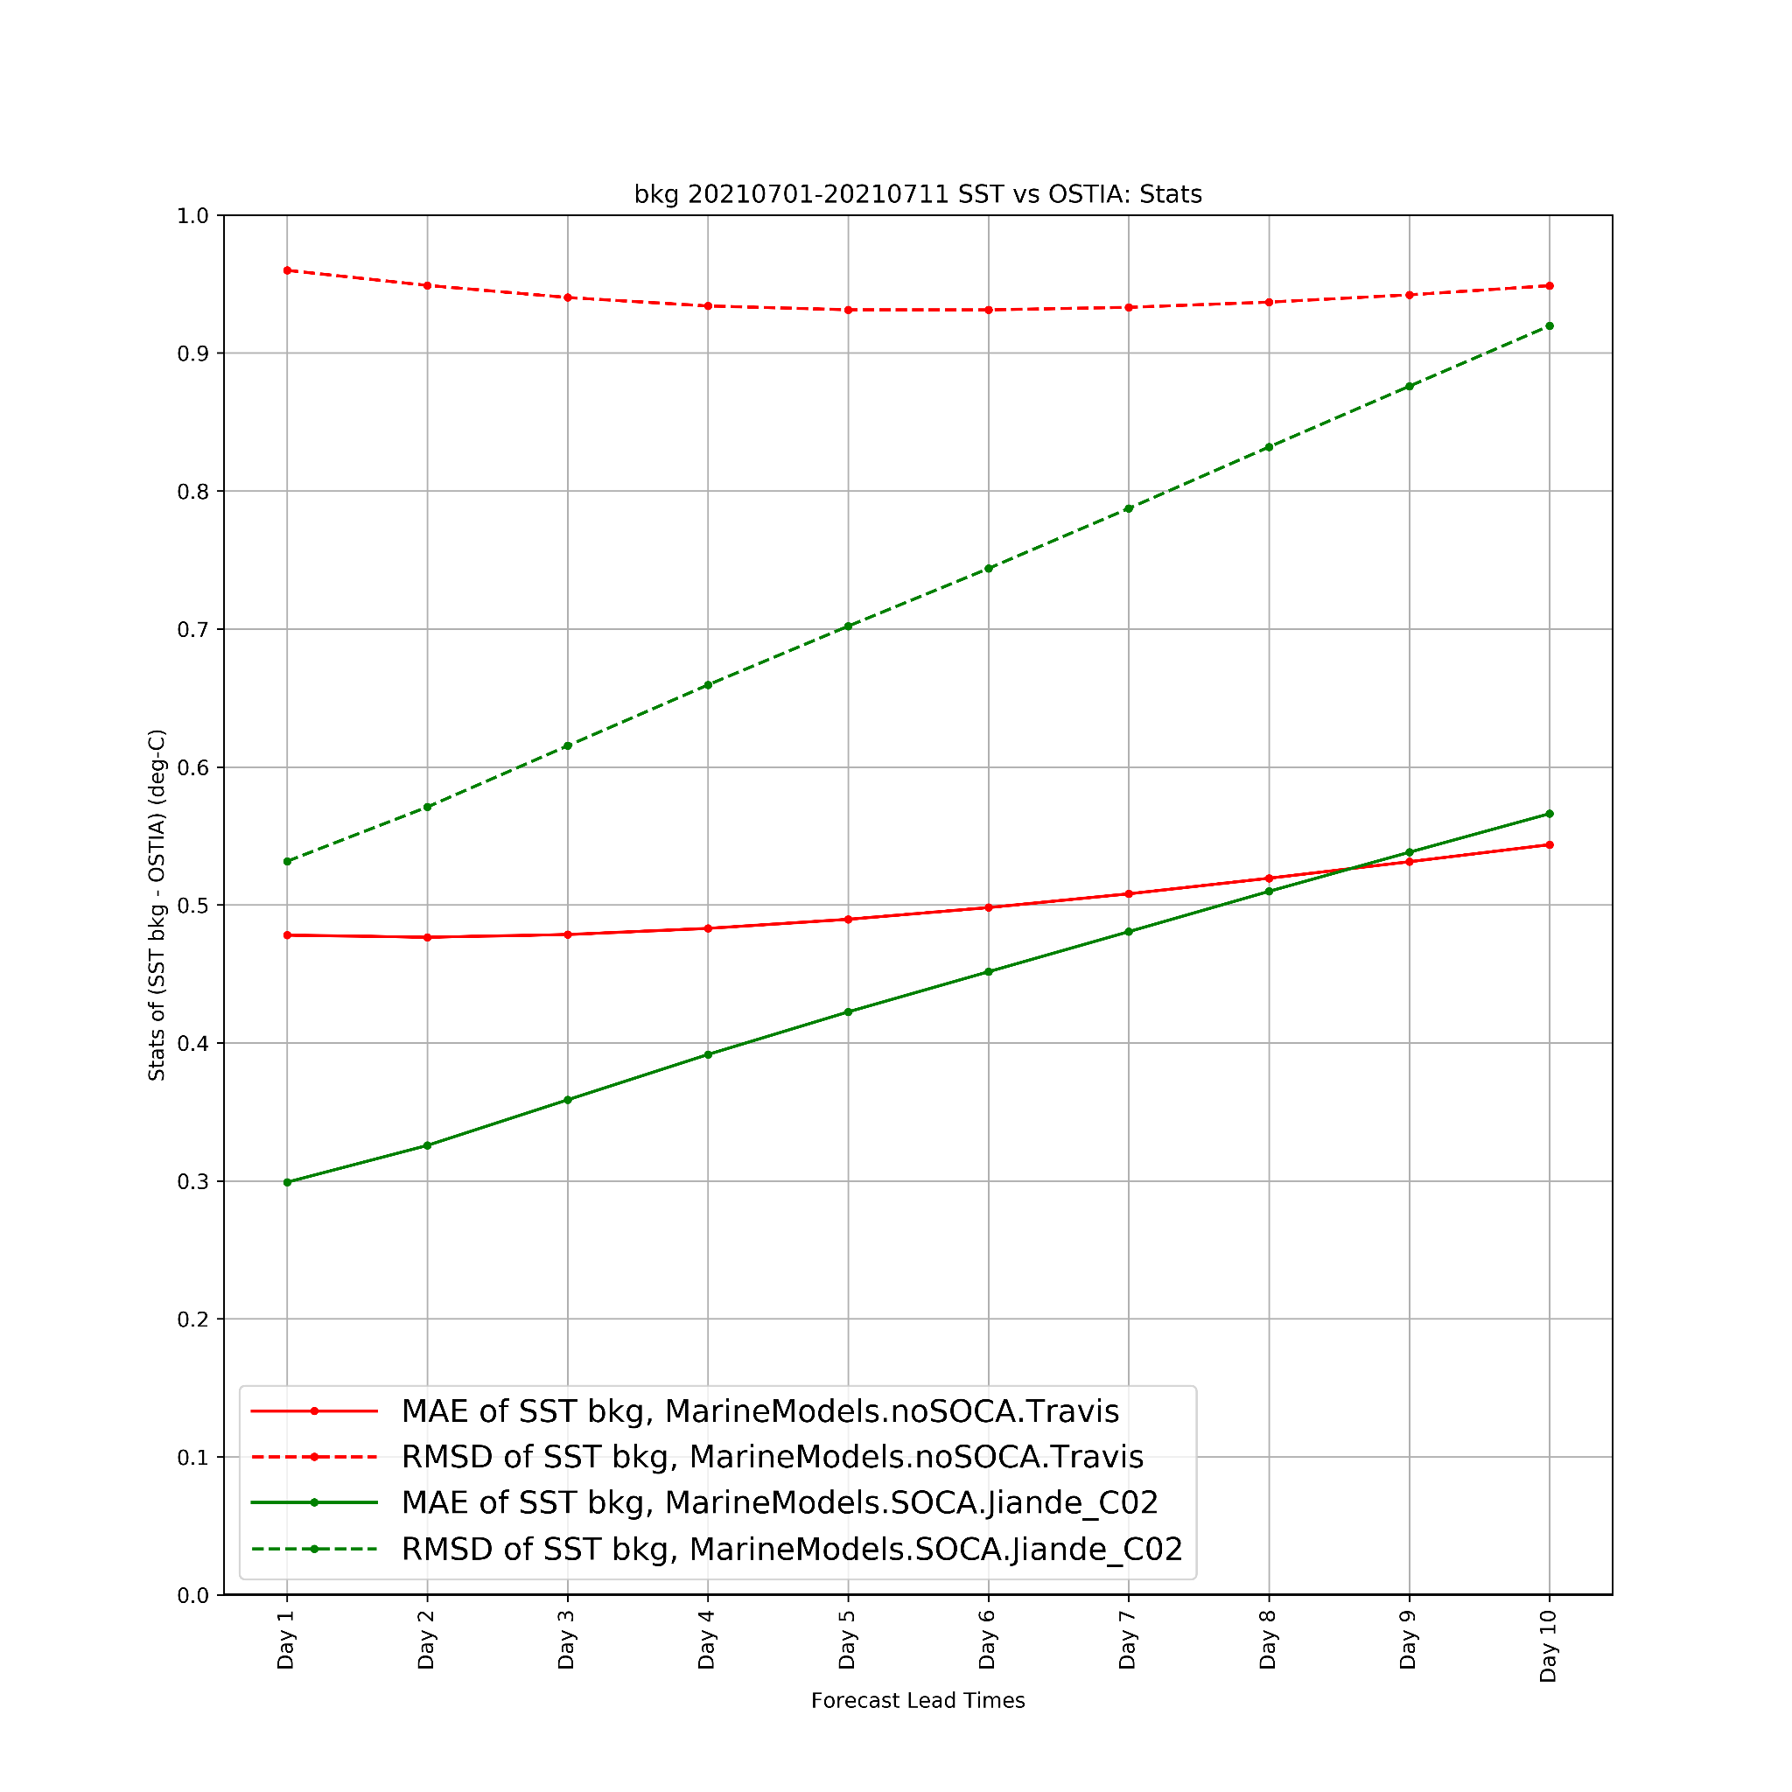
Marine DA: 3DVar Cycling Results
ATM model, ATM DA
S2S model, ATM DA
S2S model,
S2S DA
Mean stats per lead time for July 1-11, 2021
500 hPa NH ACC
SST vs. OSTIA
Figure courtesy of Katie Lukens
Figure courtesy of Xuanli Li
Valid for 60°S-60°N
Weakly coupled DA improves upon the coupled forecast model only

Slide 16
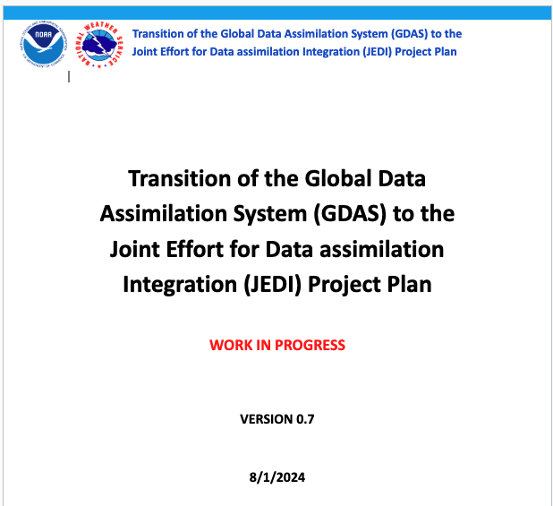
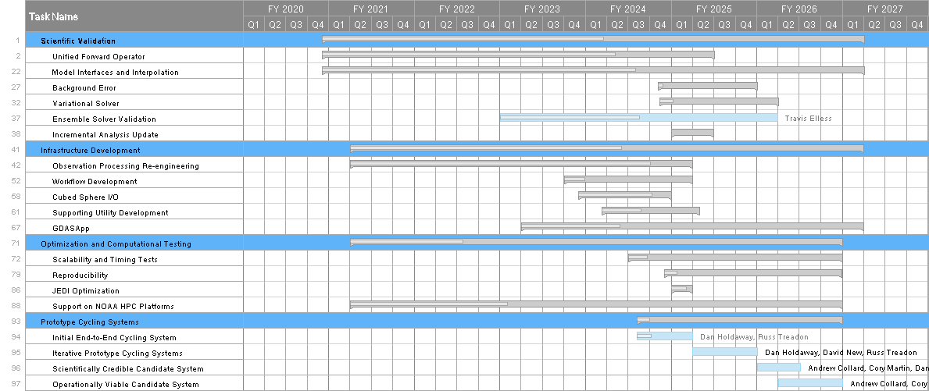
GDAS-JEDI transition and implementation
JEDI-based assimilated will complete transition as part of v17 & v18
Scientific validation
UFO/IODA, model interfaces and interpolation, background error, variational solver
Infrastructure Development
Observation processing reengineering (based on IODA/UFO), workflow, UFS updates, GDASApp
Optimization
Scalability, reproducibility, operational run time, support across platforms
Operational readiness testing and hardening
Intent is to include science / innovation as part of transition, not just reproduction of current ops

Slide 17
Thank you for your attention!
Questions?

