Slide 1
ITSU Master Plan
Third Edition, July 2004
Charles McCreery, Director
NOAA Pacific Tsunami Warning Center
charles.mccreery@noaa.gov

Slide 2
Overview of July 2004 ITSU Master Plan
Key Related Events
December 2004 – Indian Ocean Tsunami
October 2005 – ITSU becomes PTWS at last ICG/ITSU Meeting
The Document
Initiated following an ICG/PTWS Officer’s Meeting
Third and Final Edition - revised from April 1999 Edition
High-level – just 34 pages
Presents ICG/ITSU view on:
Key components and activities for an effective tsunami warning and mitigation system
Areas for highest priority action to improve PTWS

Slide 3
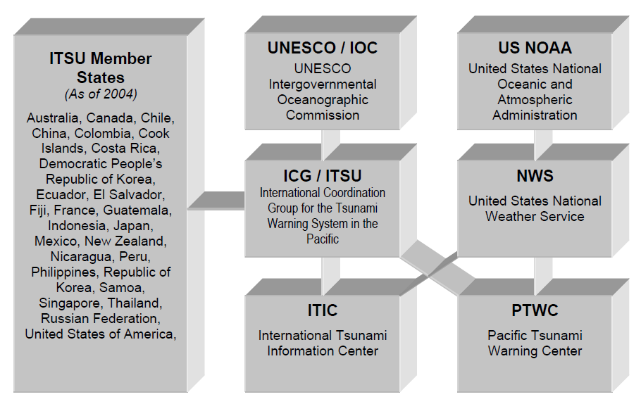
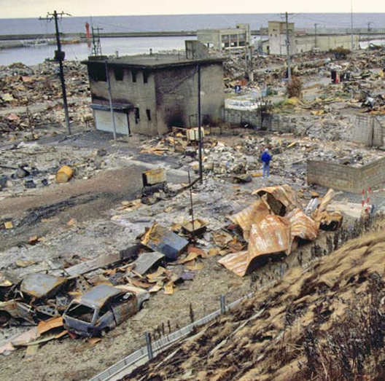
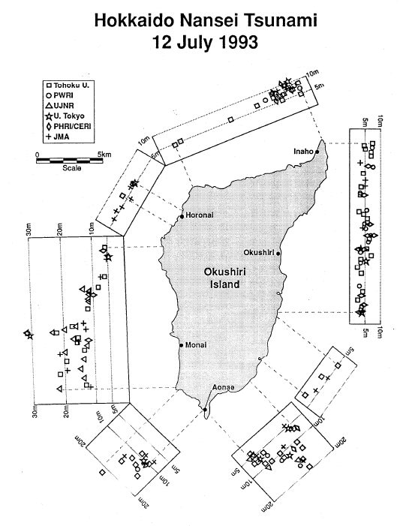
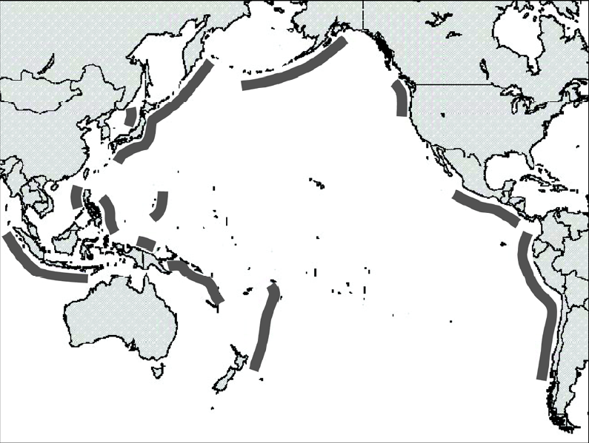
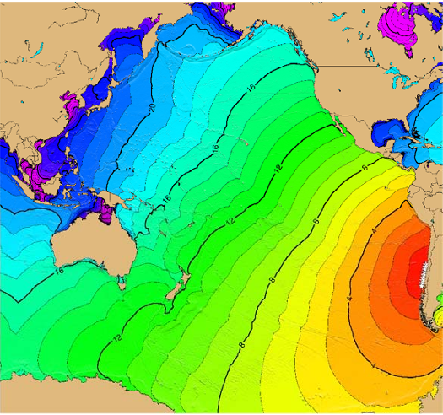
Content – Main Headings
ITSU History and Organizational Structure
Tsunamis and the Tsunami Hazard
Current Status, Limitations, and Future Directions
Conclusions

Slide 4
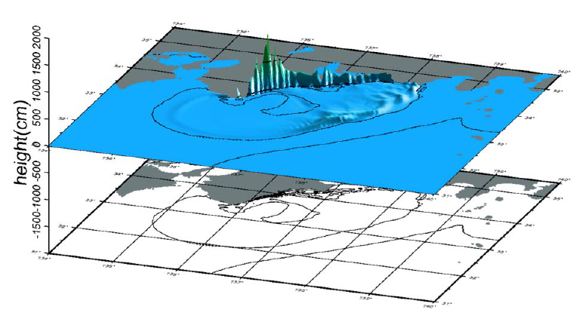
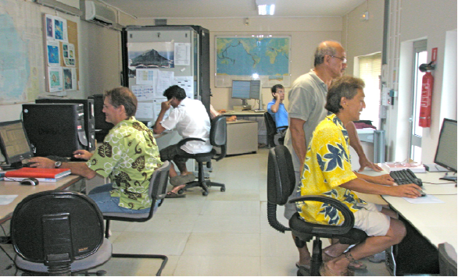
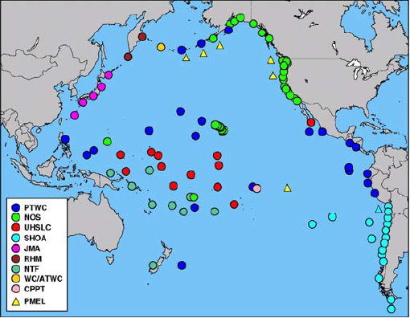
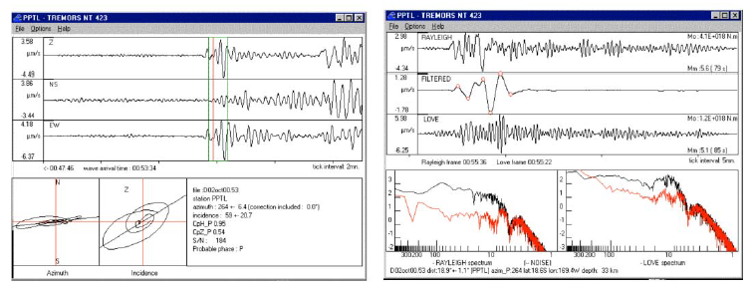
Current Status, Limitations, and Future Directions
Hazard Assessment
Historical Tsunami Data
Paleotsunami Data
Post-Tsunami Surveys
Numerical Modeling
Warning
Warning Systems and Centers
The Pacific Tsunami Warning Center
The West Coast/Alaska Tsunami Warning Center
The Japanese Tsunami Warning Centers
The Russian Federation Tsunami Warning Centers
The French Polynesia Tsunami Warning Center
The National Tsunami Warning Center of Chile
Other National Tsunami Warning Centers
Data
Seismic Data
Sea Level Data
Numerical Model Data
Other Data

Slide 5
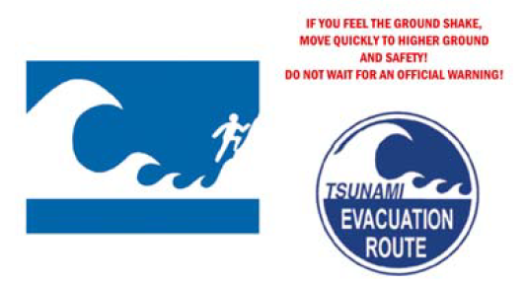
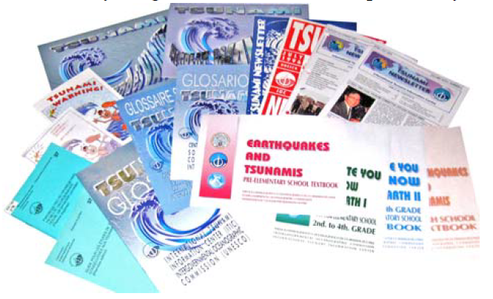
Current Status, Limitations, and Future Directions
Communications
Real-Time Access to Data
Dissemination of Messages
Preparedness
Evacuation
Evacuations for Local Tsunamis
Evacuations for Distant Tsunamis
Education
Public Education
Education for Warning System Operators, Emergency Managers, and Policy Makers
Land Use
Engineering
Research
Structure
Areas for Research
Recent Research Activities

Slide 6
Each section concludes with a brief recommendation
Hazard Assessment
Historical Tsunami Data
Paleotsunami Data
Post-Tsunami Surveys
Numerical Modeling
Warning
Warning Systems and Centers
The Pacific Tsunami Warning Center
The West Coast/Alaska Tsunami Warning Center
The Japanese Tsunami Warning Centers
The Russian Federation Tsunami Warning Centers
The French Polynesia Tsunami Warning Center
The National Tsunami Warning Center of Chile
Other National Tsunami Warning Centers
Data
Seismic Data
Sea Level Data
Numerical Model Data
Other Data
Incomplete historical data exist for many areas in the Pacific, and what does exist is not always widely available, or in a form that is easily useable for hazard assessment. Internet accessible tsunami databases with powerful search capabilities and graphic tools now exist. To increase the effectiveness of these databases continued collection and compilation of historical data are needed, particularly for areas not well covered in existing catalogs.

Slide 7
Conclusions – Brief Statements
Runup Maps
Historical Data
Tsunami Education
Warning Centers
Water Level Instrumentation
Operational Actions
New Tsunamis
Communications
Research
Tsunami Mitigation
Capacity Building
Use numerical model and historical data to create potential runup maps as the basis for hazard assessment, for evacuation maps and plans, and to motivate other key mitigation activities on the local level including public education, land use planning, and engineering efforts.
Collect and archive all water level gauge data as well as runup and inundation measurements following each large earthquake and/or tsunami. The absence of a tsunami signal on a record is also important, and those records should be saved as well.
Establish or strengthen and further develop regional and local tsunami-related expertise, skills and capabilities through development or promotion of training and exchange programs, internet based learning, and formal technical or scientific courses.

Slide 8
Summary
The 2004 ITSU Master Plan, while now outdated, provides:
a benchmark for noting the many kinds of progress made since 2004,
that many areas for progress then remain areas for progress now,
an example way to comprehensively and concisely organize the information regarding tsunami preparedness capacity building needs of the Pacific Tsunami Warning and Mitigation System.
-------------------------------------------------------------------------------------------------------
As a way forward for this meeting, propose that we
review each of the section recommendations,
take into account the progress made since 2004,
modify or rewrite the recommendation based upon the results of the survey as well as the expertise of this group, and
add new recommendations as needed.

Slide 9
Thank You
Charles McCreery, Chair
NOAA Pacific Tsunami Warning Center
charles.mccreery@noaa.gov

