Slide 1
BioEco Panel Day 2

Slide 2
Agenda - Day 2
Summary of ACTIONS
EOV implementation
Communication
Wrap up

Slide 3
ACTIONS
OBIS data group to invite a representative of OCG to join their meetings and establish a better connection between OBIS and OCG
Panel members that know where there is co-located observations of biology and BGC or time-series relevant to OA to connect with Kirsten
Finalise draft Biodiversity Plan
Refine EOV specification sheets to finalise 1st draft using feedback from review and meeting outcomes - make link to portal more visible, derived products available linked in section 1
Create use cases/examples that illustrate the collection of multiple EOVs simultaneously (could be platform based), or illustrate the integration of multiple EOVs to create a product/indicator/scheme that showcases the connections of the EOVs

Slide 4
ACTIONS
Engage GRAs to find derived products that would be useful to add to specification sheets
Form a task team to work on advancing real-time biological data
Develop communication on the benefits of sharing data
Provide guideline on control vocabularies and OBIS node contacts in the specification sheet
Mailing lists of EOV networks to facilitate connections

Slide 5
RECOMMENDATIONS
That GOOS includes biological expertise in the GRA Arctic task force

Slide 6
BioEco EOV implementation
Spec sheet process:
Finalise 1st draft
Upload
Community consultation - survey
Online meeting

Slide 7
Ocean sound implementation plan
Peter Tyack and Lucille Chapuis

Slide 8
BioEco EOV implementation
Spec sheet process:
Finalise 1st draft
Upload
Community consultation - survey
Online meeting
Best Practices

Slide 9
Why we need a GOOS BP endorsement
Identify key community BP, those developed by the observing system community which fulfill specific criteria - OBPS repository is an open house
Repeatedly requested by the community during the BP workshops
Close collaboration between GOOS and OBPS to create process, has improved the metadata for OBPS, will give new search parameters around endorsements, etc.
Helps promote the creation and uptake of best practices

Slide 10
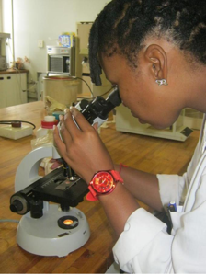
To qualify as “GOOS endorsed” a best practice is expected to
have completed a rigorous community review process
approved by the leadership of the relevant network
is fit for the purpose and fully satisfies the definition of a best practice on the OBPS
has been recognised through the relevant GOOS body
is available and identifiable within the OBPS repository, or will be submitted as soon as endorsement is received.
Is updated at relevant timeframes

Slide 11
Request from GOOS panels
Continue to encourage the creation or convergence of BP where needed
Involve international reviewers where possible
Make openly available
Identify key BP that fit the endorsement process
Reach out to me for further discussions/support

Slide 12
BioEco EOV implementation
Spec sheet process:
Finalise 1st draft
Upload
Community consultation - survey
Online meeting
Best Practices
Data schemas - how do we start?

Slide 13
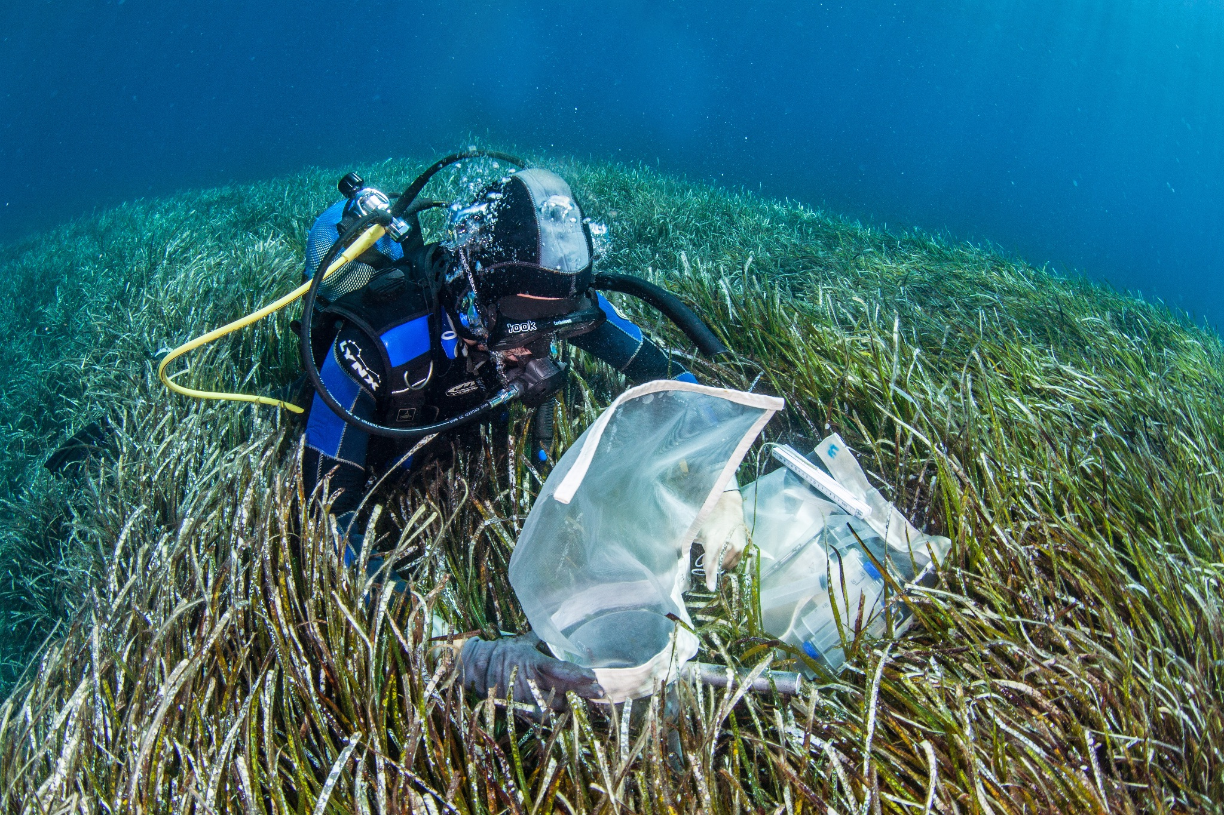
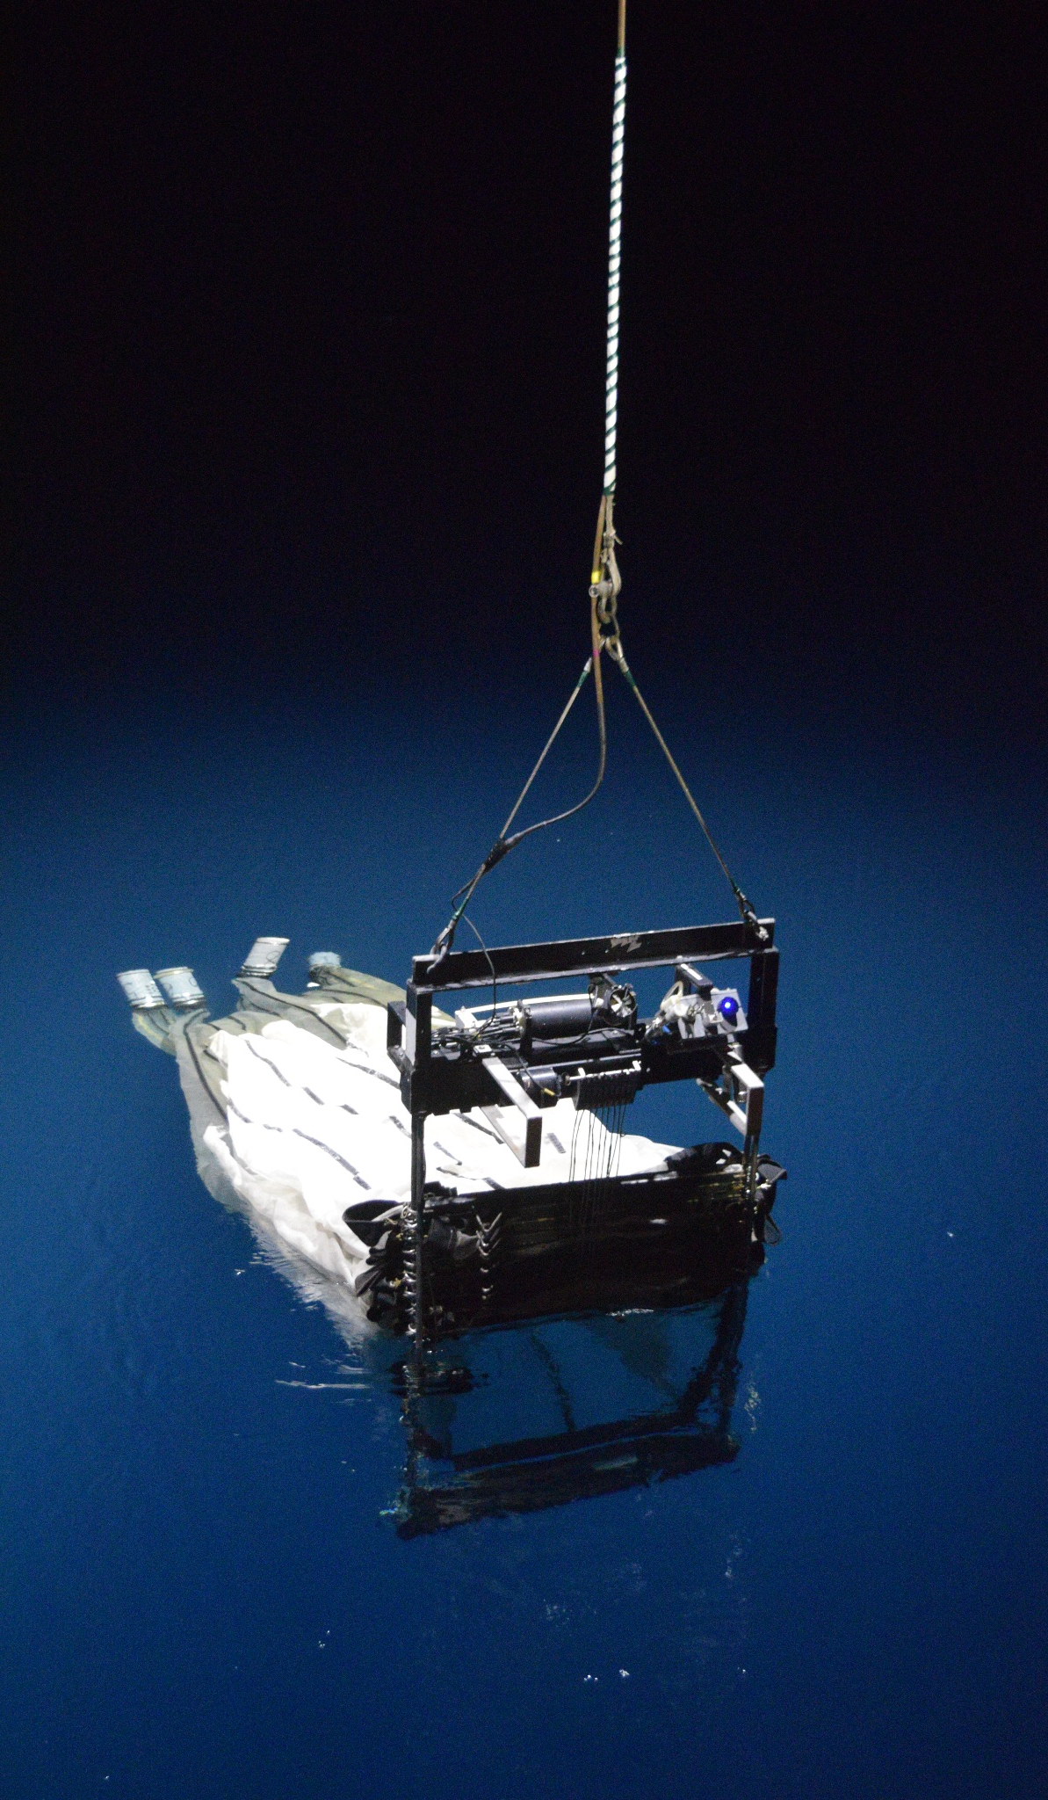
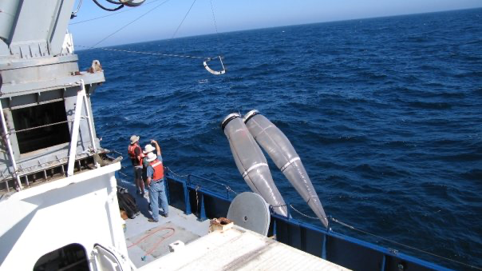
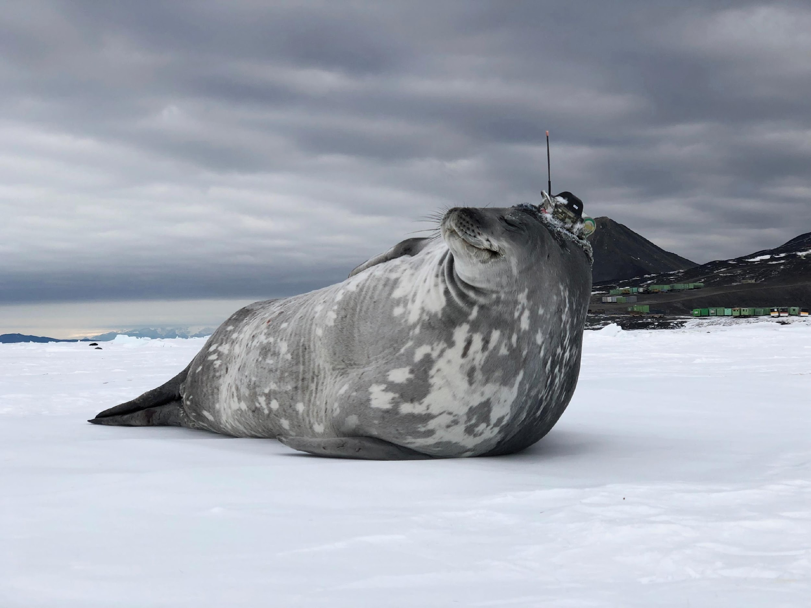
Thank you
goosocean.org
Dimitris Poursanidis / Ocean Image Bank
Giiulia Wood

Slide 14
Next meeting
May/June - stay tuned!

