Slide 1
GOOS Communications tools & Aligning panel communications
Laura Stukonytė
GOOS Communications Specialist
GOOS BioEco Panel Meeting | 3-6 February 2025, Sopot

Slide 2
GOOS Brand update - 2025 May
A brand update was advised by a hired communications agency in 2021 to modernize the look of GOOS
An updated version of the GOOS logo and all communications assets (Sub-branding logos, PPT templates, report templates, virtual backgrounds etc.) will be released in May 2025

Slide 3
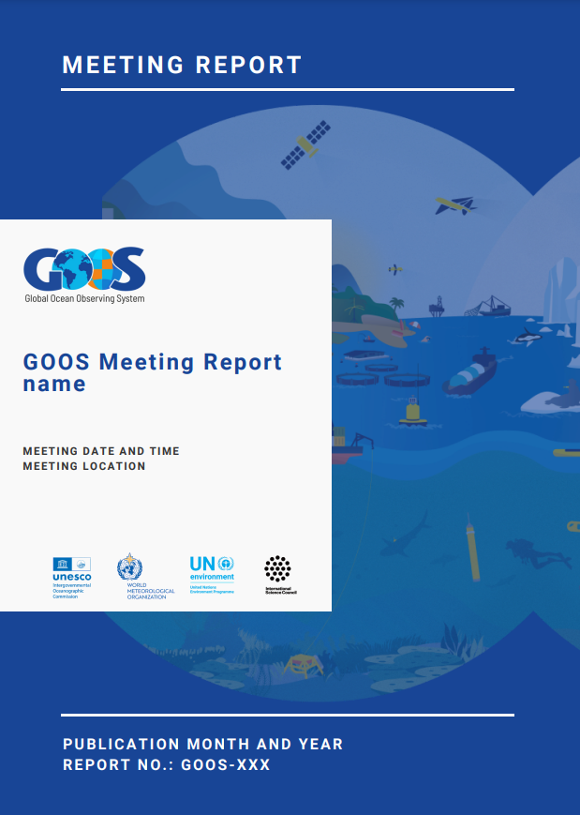
Product examples

Slide 4
How can we improve branding consistency between GOOS components?

Slide 5
Current GOOS Component branding
A visual mess
No consistency between components
No visual connection to GOOS in many cases - not clear that it is part of GOOS
Some logos are not scalable, or too wide to be read in smaller sizes

Slide 6
BioEco Panel logo suggestions
Organized, fully consistent branding
Instantly identifiable as part of GOOS
Not too detailed
Dark and light versions possible for different backgrounds
Keeping the BioEco artwork and individuality

Slide 7
GOOS Communications Tools

Slide 8
GOOS Communications Toolkit
Messaging Guide
Together with the brand update launch, a GOOS Communications Toolkit will be released, including:
GOOS brand policy and usage guidelines
Communications assets (Logo packages, PPT templates, report templates, virtual backgrounds etc.)
GOOS Messaging Guide - a guide for GOOS community representatives to ensure effective, streamlined messages about GOOS and the value of coordinated, sustained ocean observations.
Brand Guidelines
Communications Assets

Slide 9
Communications Toolkit timeline
Dec 2024 - Jan 2025
Feb 2025
Mar - Apr 2025
May 2025
Draft Messaging Guide development
First Review
Iterations and finalization
Launch
Draft Messaging Guide + GOOS brand guidelines presented and reviewed at SC meeting
Agency incorporates feedback from review, finalizes the Messaging Guide with the GMT working group
Messaging Guide shared with stakeholders as part of the Communications Toolkit
Brand update official launch
Stakeholder interviews
Agency preparing first draft

Slide 10
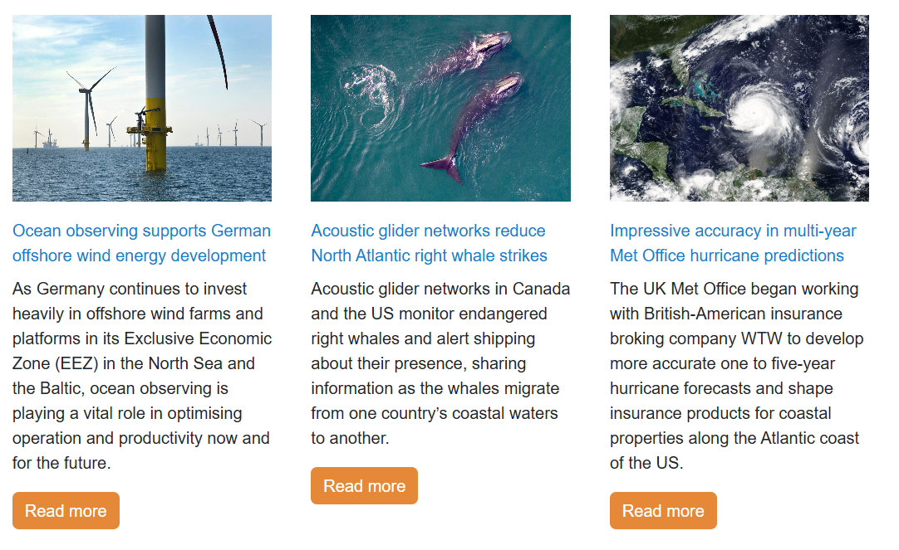
Use cases
https://goosocean.org/our-work/use-cases/
GOOS aims to develop more use cases in the future - potential collaboration with the BioEco Panel?

Slide 11
GOOS Communication Channels

Slide 12
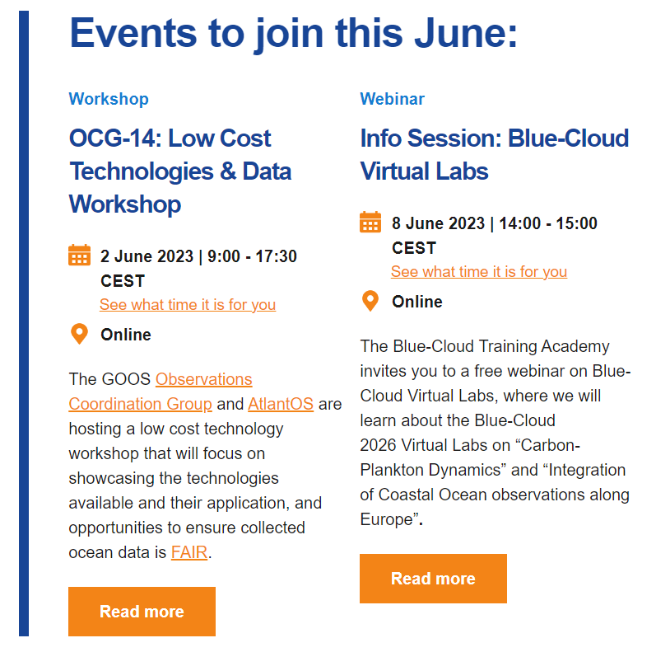
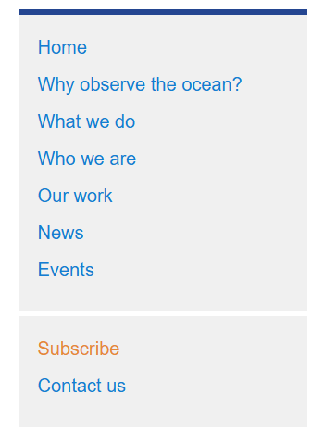
Mailing list
Audience: Ocean observing community (>2000 subscribers)
GOOS Update - quarterly newsletter
GOOS Notes - irregular announcements of events, webinars, vacancies, etc.

Slide 13
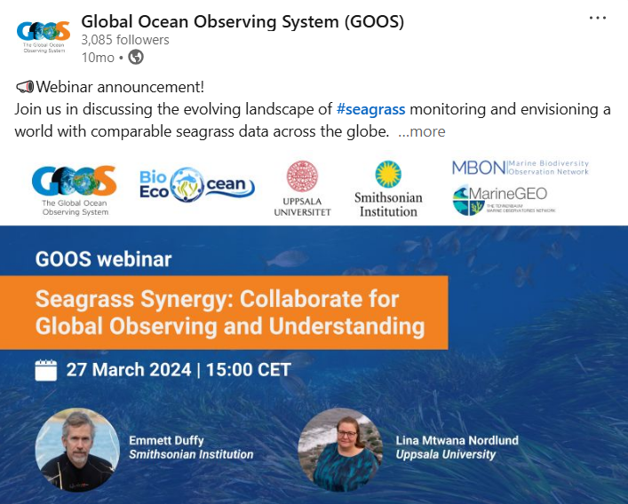
Social media
Audience: Ocean observing community
Linkedin: Global Ocean Observing System (GOOS)
X: @GOOSOcean
Facebook: GOOS Global Ocean Observing System

Slide 14
goosocean.org
Audience: Ocean observing community & General audience
Main repository of information about GOOS and its components, documents, events, use cases and news stories
To be updated and improved in 2025-2026!

Slide 15
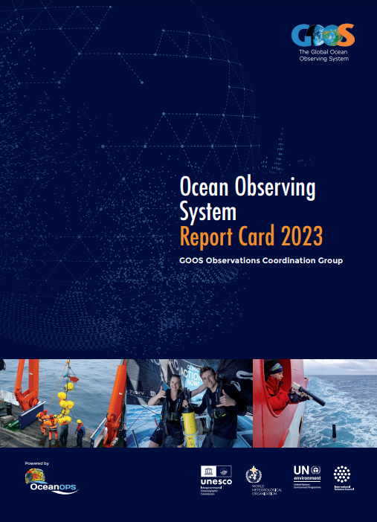
GOOS Ocean Observing Report Card
Audience: Funders, Member States etc.
Annual flagship GOOS report developed with OceanOPS.
Evaluating the current status of the ocean observing networks
Highlighting value to society across the three GOOS delivery areas: climate, operational services, and ocean health
Online versions of previous report cards: https://www.ocean-ops.org/reportcard/
2025 edition to be published in October

Slide 16
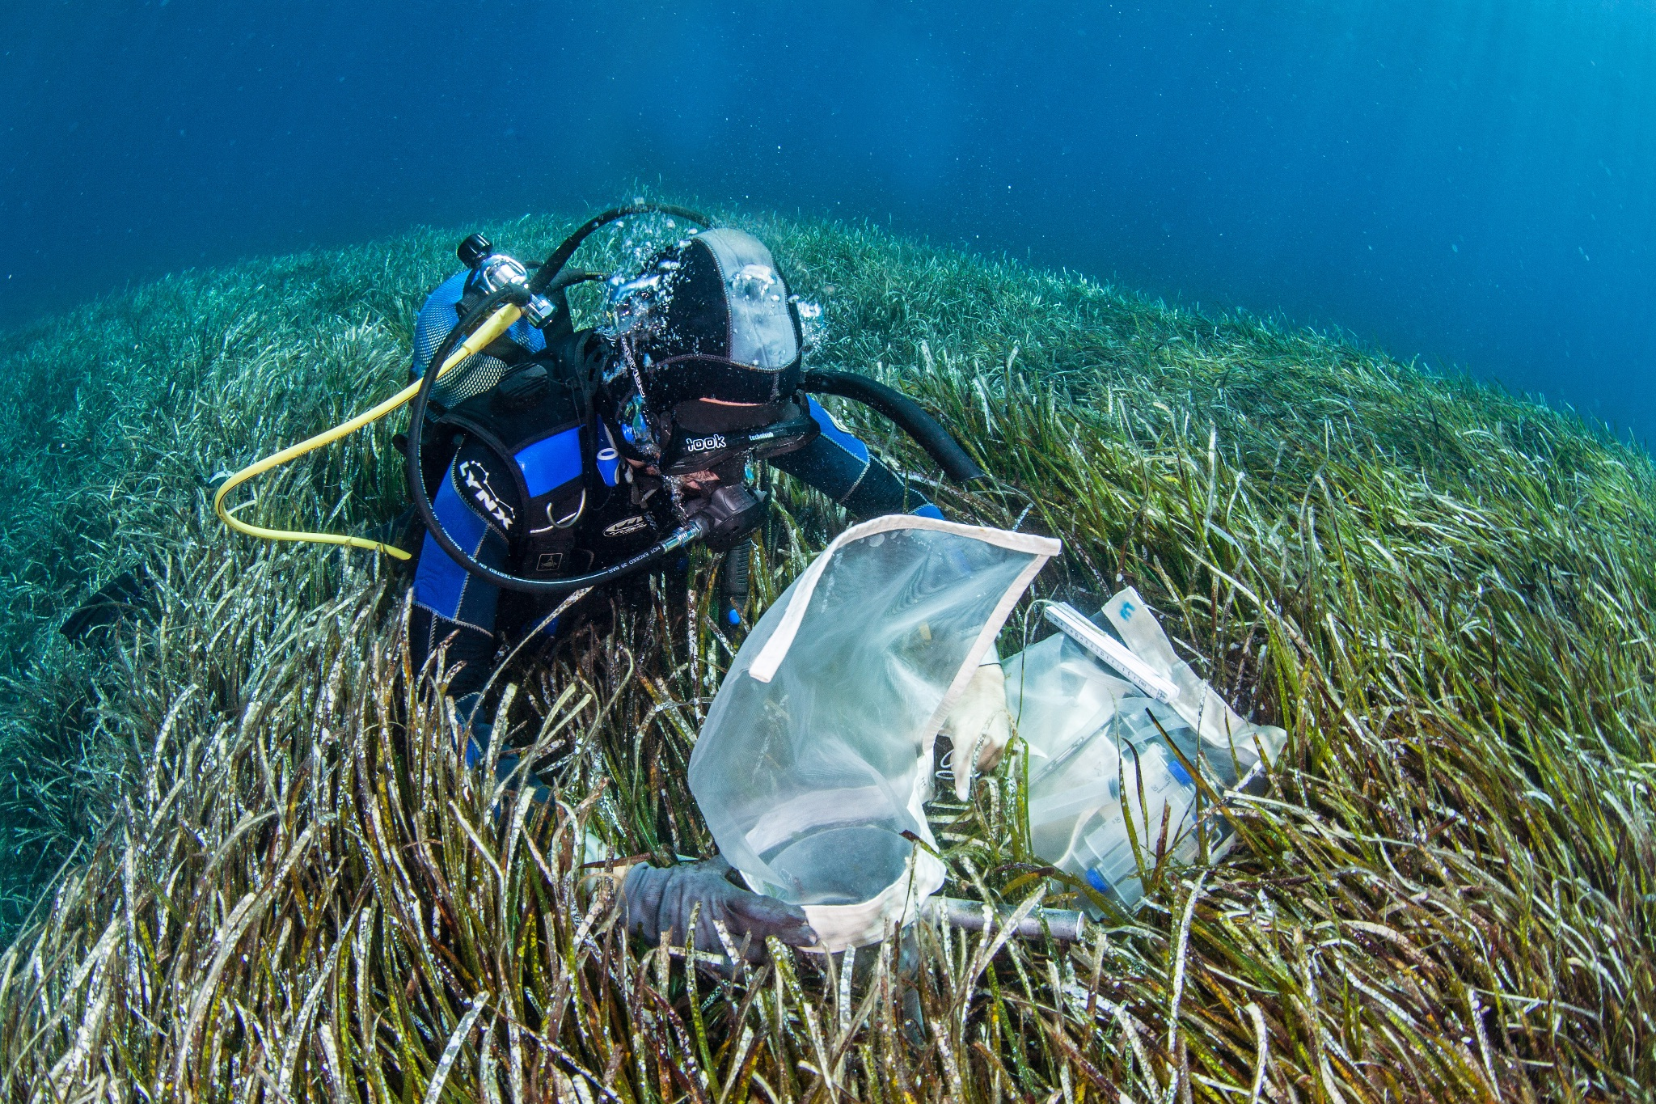
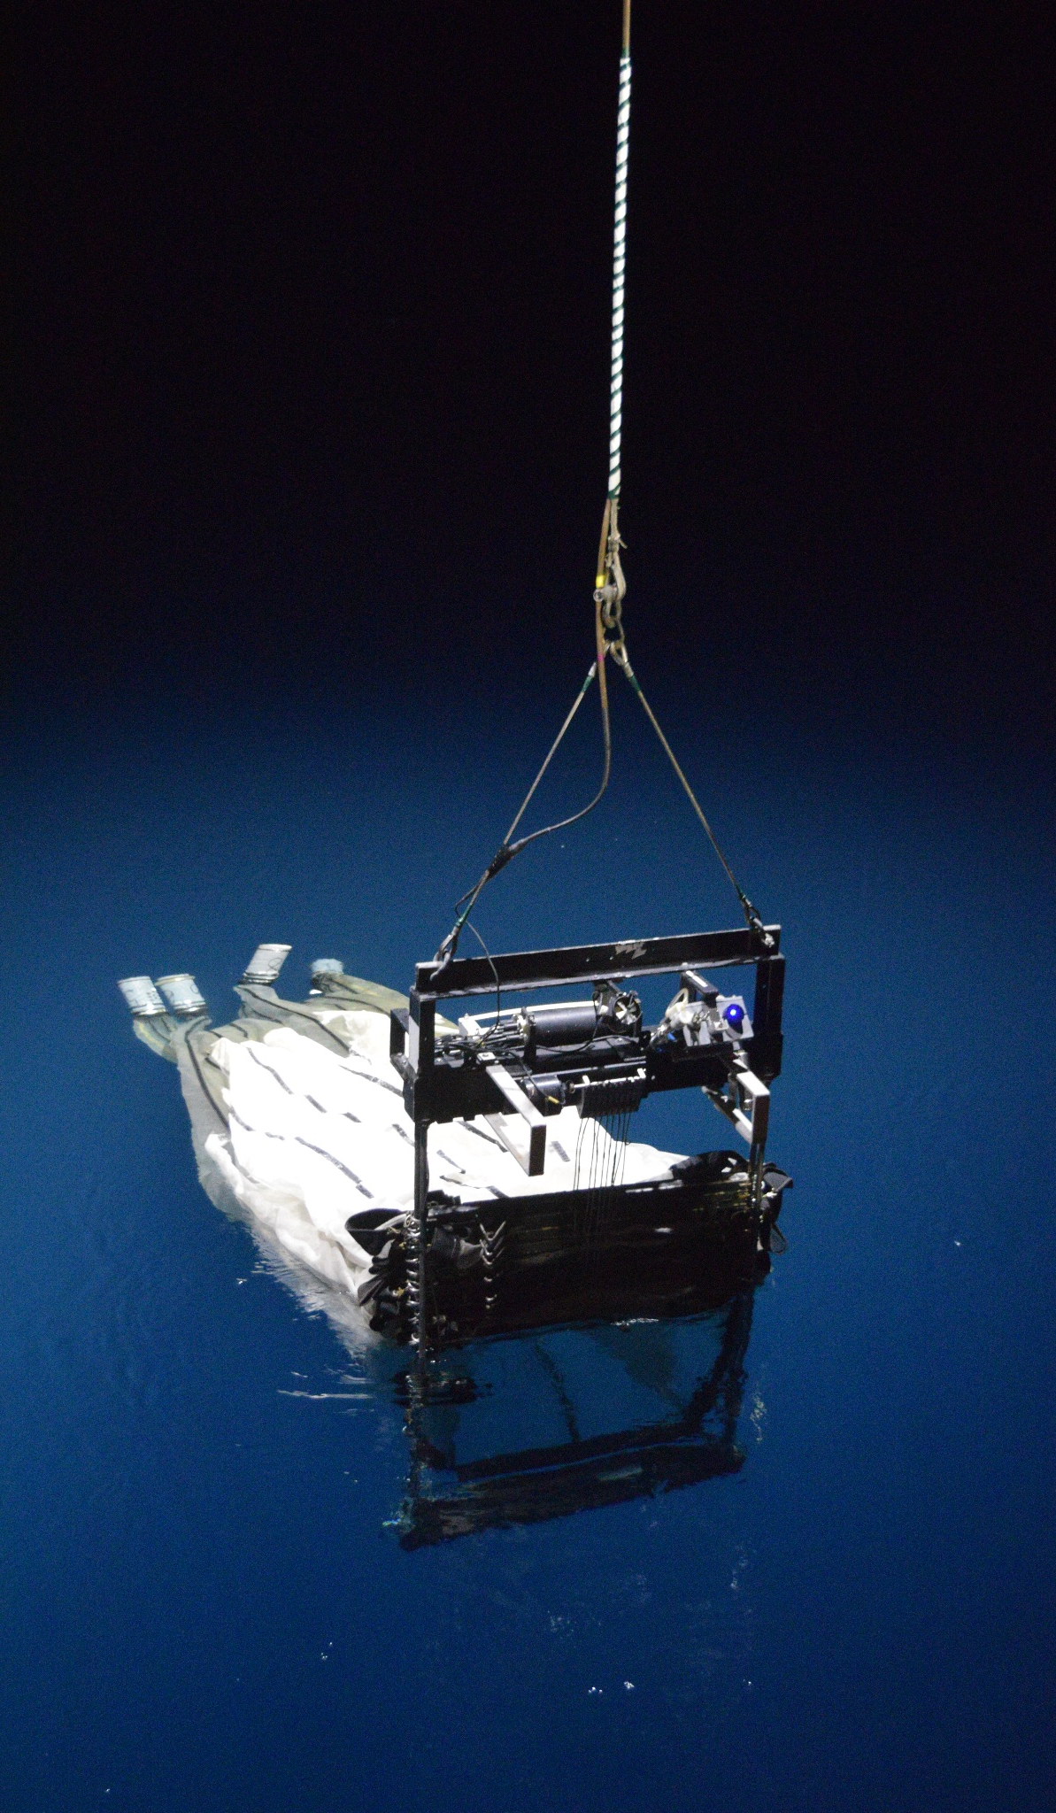
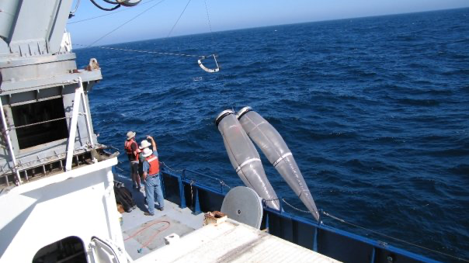
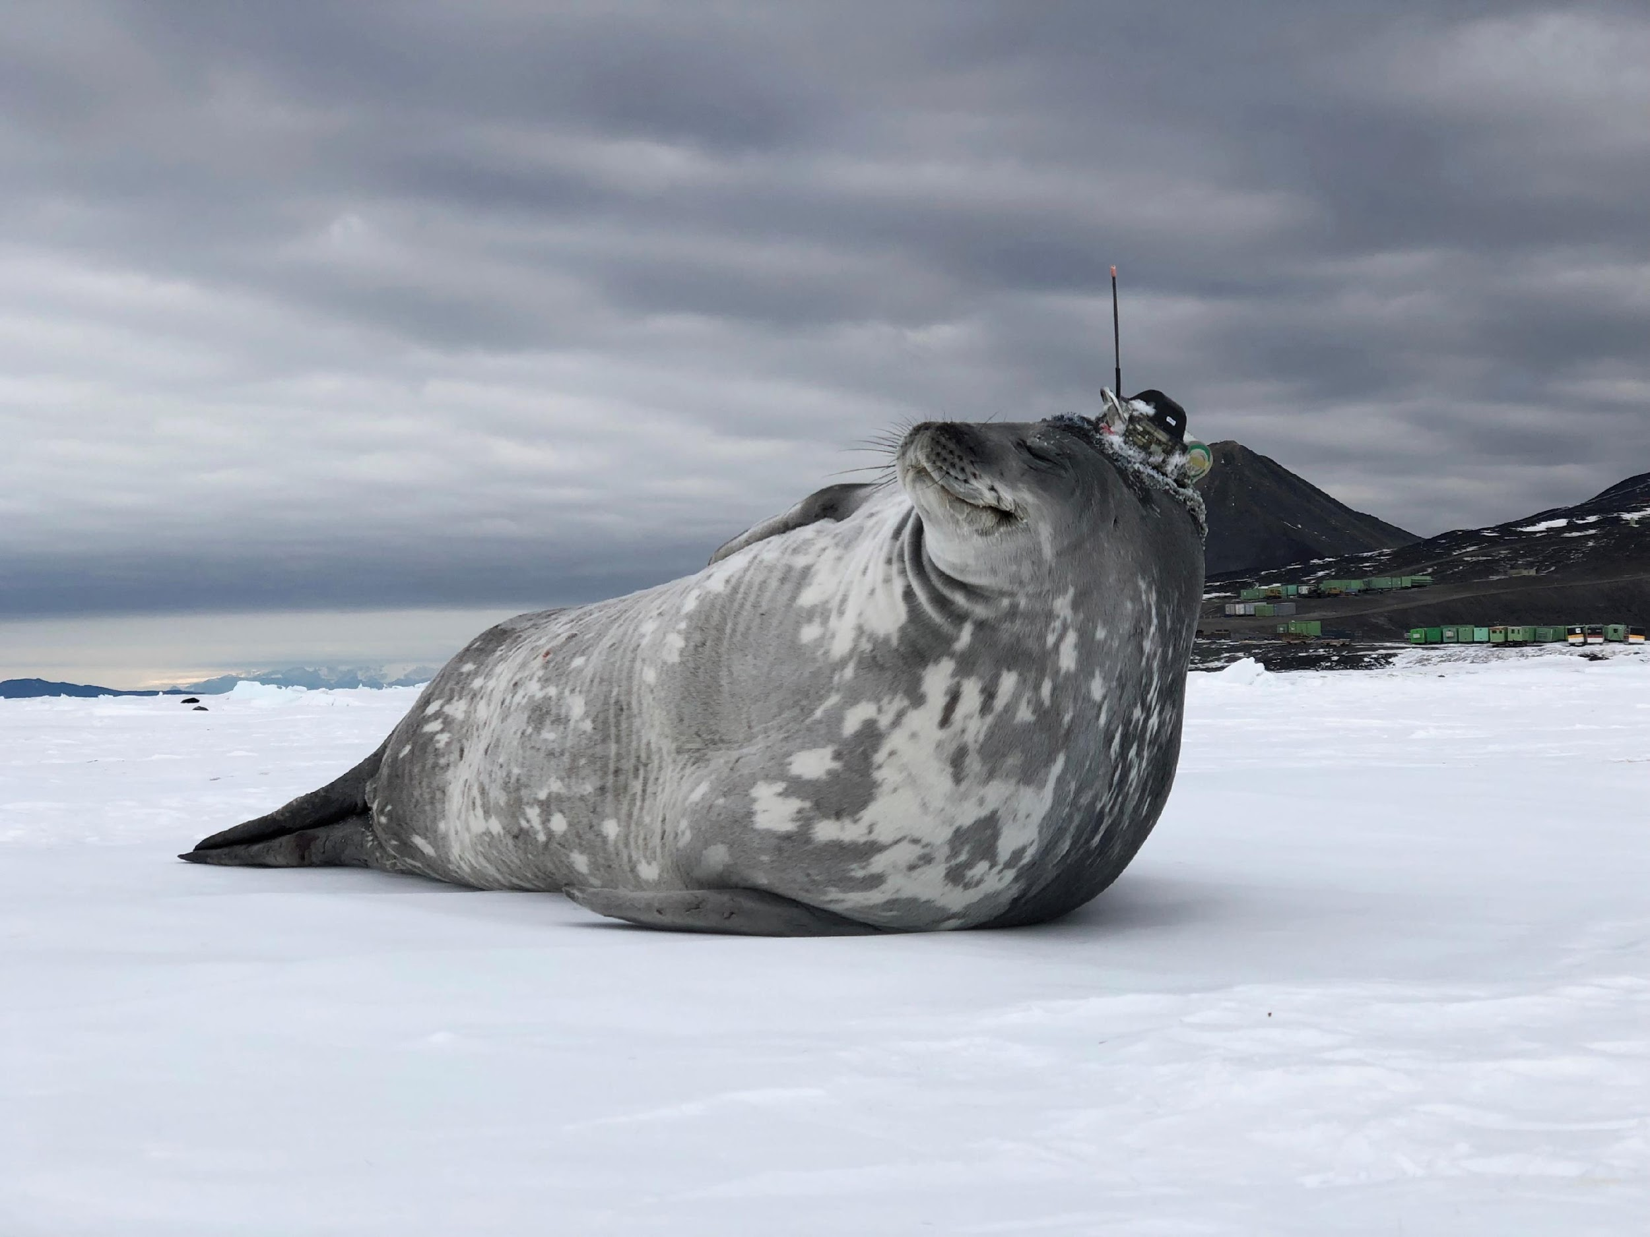
Thank you
goosocean.org
Dimitris Poursanidis / Ocean Image Bank
Giiulia Wood

