Slide 1
Development of Ocean Sound EOV Implementation Plan
Peter Tyack and Lucille Chapuis
Co-leads Ocean Sound EOV
BioEco Panel Meeting 6 Feb 2025 Sopot Poland

Slide 2
Primary GOOS Goals
Climate Change
Wind, Waves, Rain,
Sea Ice
Ocean Health
Marine Ecosystems
Loss of Biodiversity
Impacts on Wildlife
Distribution of Species
Monitoring Threats
Earthquake/Tsunami
Vessels
Other Anthropogenic Sounds
Ocean Sound EOV is cross-disciplinary: a physical variable with derived data products relevant to many GOOS goals
?
Primary Physical Acoustic Variables
Sound pressure (p,t)
Particle motion (x,y,z,t)

Slide 3
Ocean Sound is shared across BioEco and Physics/Climate Panels
Ocean Sound EOV leads have twice briefed Physics/Climate Panel on uses of Ocean Sound to measure critical climate variables such as wind&waves, rain, and sea ice. – They had no idea!
Observations of many of the bioeco EOVs necessarily include collection of data relevant for physics/climate and BGC
How we can be more transparent about those cross-panel and cross-disciplinary connections as we talk about the value BioEco brings to GOOS?

Slide 4
International Quiet Ocean Experiment ¹ Is a self-organized community of scientists² who use acoustics to study the ocean and who study the effects of sound on marine life.
2008-2009: Grew from concerns in about environmental effects of sound with the concept of studying changes to marine ecosystems caused by reducing anthropogenic sound in the ocean.
2010 SCOR and POGO convene international workshop
2011 IOC hosts open science meeting (72 participants) that led to 2015 Science Plan
1. https://www.iqoe.org
2. Sponsored by SCOR and POGO

Slide 5
IQOE Goals from 2015 Science Plan*
ensure that the measurement of the sound field becomes an integrated part of global ocean observations
develop a global approach to investigating ocean sound, engaging the worldwide community of ocean scientists
support innovation in passive ocean observing systems to detect, classify, and track marine organismsummary
support data management and the development of data standards
develop models of how sound travels in the ocean
support the planning and implementation of regional experiments
ensure constructive engagement with industry, regulators, nongovernmental organizations, and the public
*https://scor-int.org/wp-content/uploads/2023/01/IQOE-Science-Plan-Final.pdf

Slide 6
IQOE Focus on Ocean Sound as GOOS EOV
2016 POGO funds Acoustic Working Group AWG to review existing broad-scale acoustic monitoring observations, infrastructure, and technologies
2016 At first meeting of AWG, Mike Coffin (Univ of Tasmania) suggests importance of developing ocean sound as a GOOS EOV
2017 POGO AWG drafts Ocean Sound EOV spec sheet
2018 BioEco Panel accepts Ocean Sound and GOOS posts spec sheet

Slide 7
Process and Timeline for Implementation Plan
Aug 2020 IQOE proposes a committee to develop Ocean Sound EOV Implementation Plan including physical acousticians, bioacousticians, ocean sound network operators, data scientists, GOOS and policy experts
Jan 2021 committee formed with Tyack as chair. Meets regularly to develop text
Nov 2021 first draft of implementation plan distributed for comment by committee and broader community
-> Apr 2023 19 versions edited with Tyack moderating comments and guiding editing
Sep 2023 POGO reviews and supports formatting of final version

Slide 8
Primary GOOS Goals
Climate Change
Wind, Waves, Rain,
Sea Ice
Ocean Health
Marine Ecosystems
Loss of Biodiversity
Impacts on Wildlife
Distribution of Species
Monitoring Threats
Earthquake/Tsunami
Vessels
Other Anthropogenic Sounds
Ocean Sound EOV is a physical variable with derived data products relevant to many GOOS goals
?
Primary Physical Acoustic Variables
Sound pressure (p,t)
Particle motion (x,y,z,t)

Slide 9
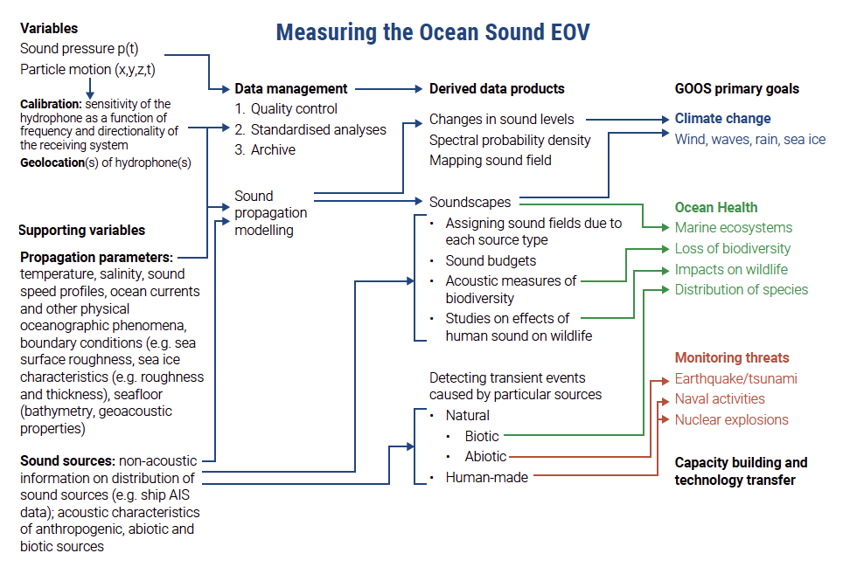

Slide 10
https://zenodo.org/records/10067187
This document should be cited as: Tyack, P.L., Akamatsu, T., Boebel, O., Chapuis, L., Debusschere, E., de Jong, C., Erbe, C., Evans, K. Gedamke. J., Gridley, T., Haralabus, G., Jenkins, R., Miksis-Olds, J., Sagen, H., Thomsen, F., Thomisch, K., Urban, E. 2023. Ocean Sound Essential Ocean Variable Implementation Plan. International Quiet Ocean Experiment, Scientific Committee on Oceanic Research and Partnership for Observation of the Global Ocean, 87 pp. DOI: 10.5281/zenodo.1006718

