Slide 1
Task Team on
Non-Seismic Tsunami Sources (TT-NSTS) Progress and Planned activities 2025
Co-Chairs: Fabrizio Romano (INGV), Rachid Omira (IPMA)
ICG/NEAMTWS Steering Committee and Information Session, 15-16 May 2025

Slide 2
Plan of Actions 2025
Strategic Area | Activity | Time Frame | Responsible Per/ Inst
Task Team on Non-Seismic Tsunami Sources | To gather information about potential approaches to assess hazard, monitor, and warn for tsunamis induced by volcanic activity and meteotsunamis | by November 2025 | TT-NSTS co-chairs
 | To explore warning procedures related with non-seismic tsunami sources | by November 2025 | TT-NSTS co-chairs, TSPs
 | To contribute to organizing webinars/workshops on non-seismic tsunami sources | by November 2025 | TT-NSTS co-chairs, TSPs
ICG/NEAMTWS Steering Committee and Information Session, 15-16 May 2025

Slide 3
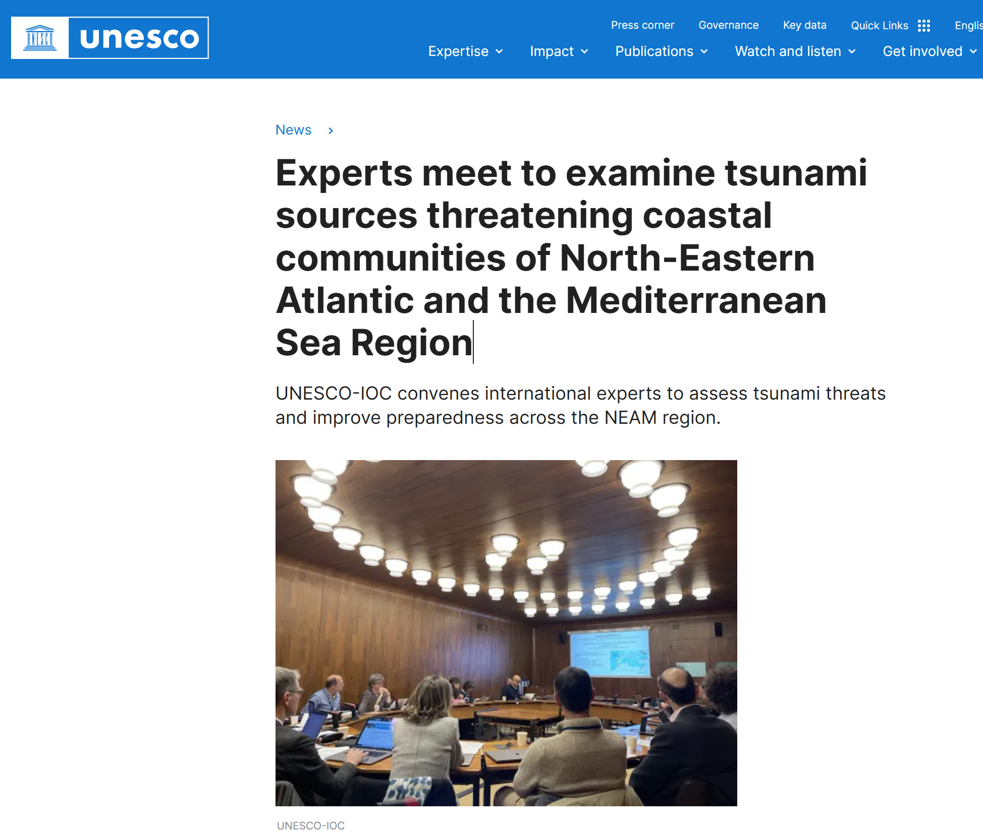
Activities
18 to 20 March 2025, UNESCO Expert Meeting on Seismic and Non-seismic tsunamis in the NEAM Region
ICG/NEAMTWS Steering Committee and Information Session, 15-16 May 2025

Slide 4
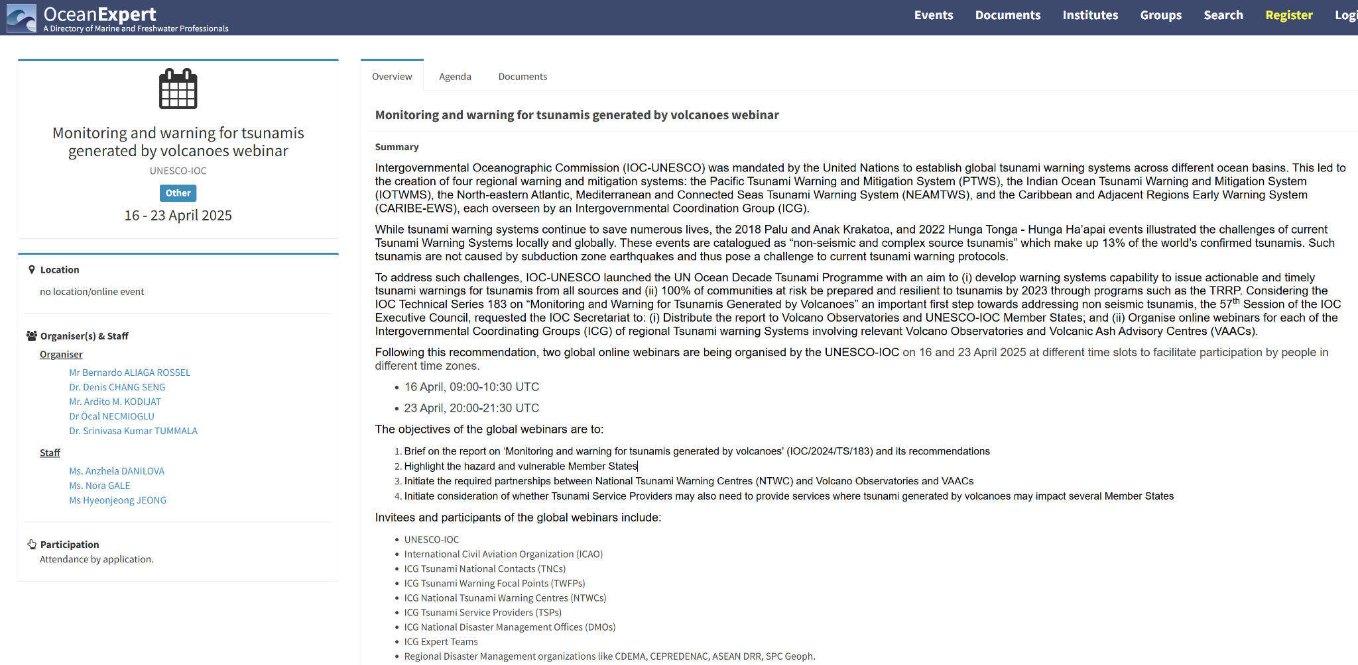
Activities
16 to 23 April 2025, UNESCO Webinar on Monitoring and warning TGV
ICG/NEAMTWS Steering Committee and Information Session, 15-16 May 2025

Slide 5
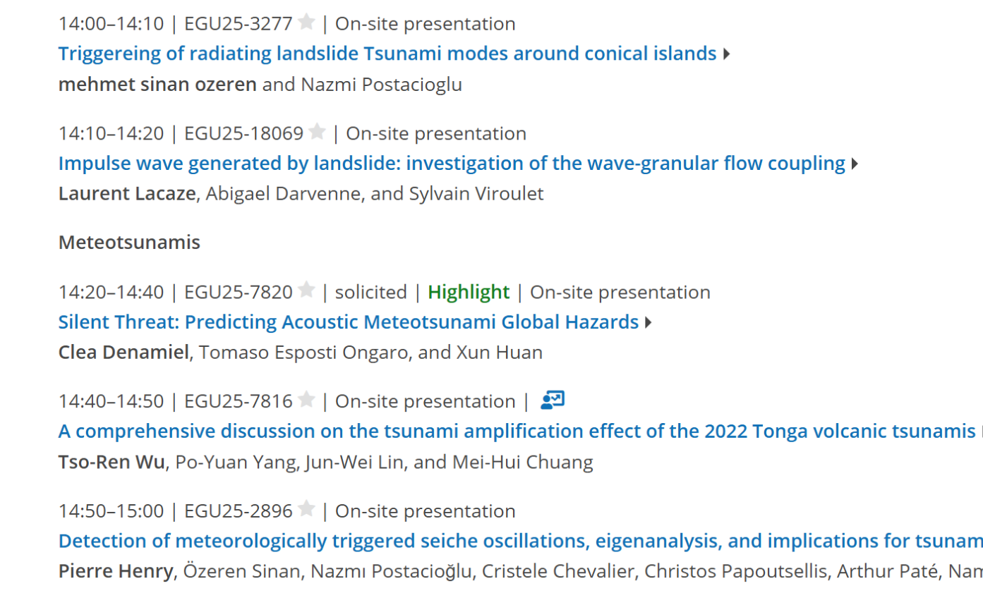
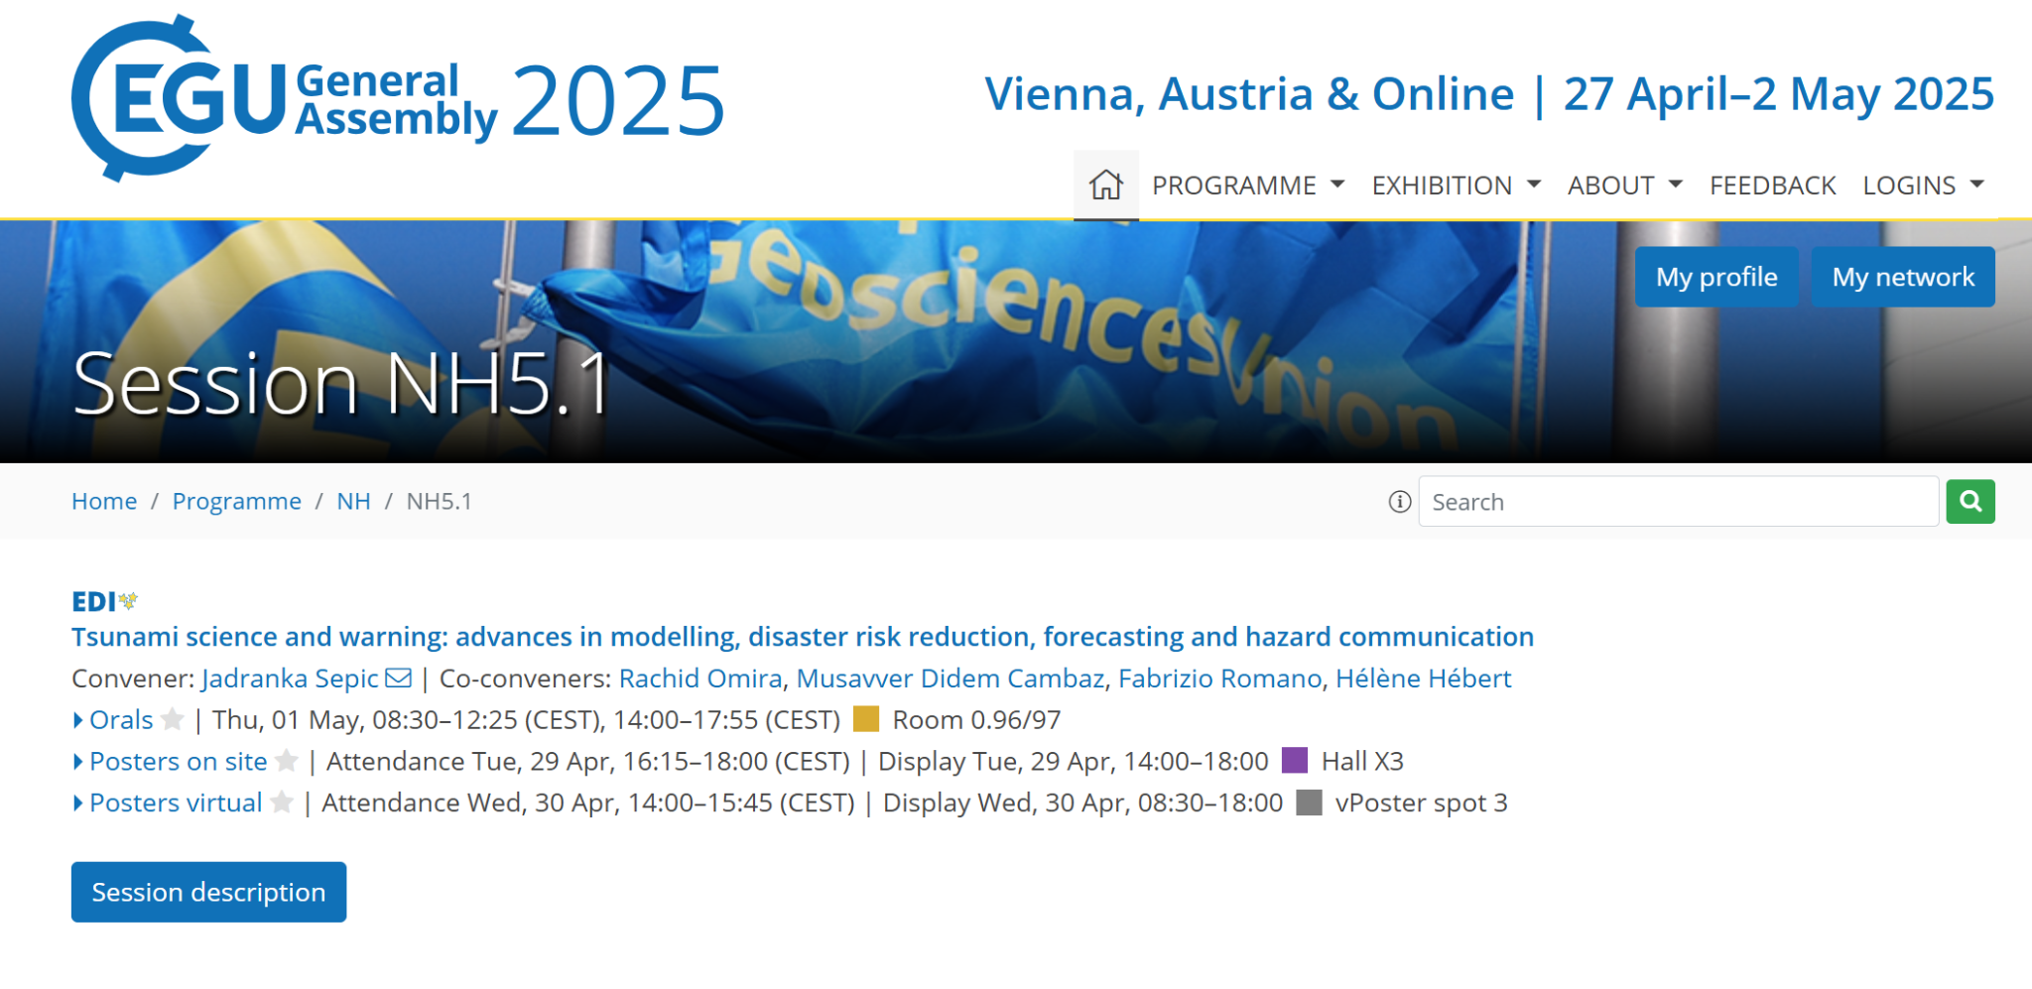
Activities
27 April–2 May 2025, EGU, Vienna, Austria
Audience: ~100 people
ICG/NEAMTWS Steering Committee and Information Session, 15-16 May 2025

Slide 6
Activities
NEAM-COMMITTMENT project (funded by EU-DGECHO): since February 2025
Hi-Res Inundation mapping on Stromboli
Emergency planning considering also the possible effect of volcanic activity (e.g. pyroclastic flows, ash, ballistics)
Italian project about Stromboli (funded by Civil Protection): starting since 2nd half of 2025
Towards the integration of the local system in the Italian TSP at national and NEAM level
ICG/NEAMTWS Steering Committee and Information Session, 15-16 May 2025

Slide 7
Activities (upcoming)
Organizing a Webinar on Non-seismic Tsunami Sources
Tentative period
Mid-September (after the 5th)
or End of October (after the 20th)
List of Potential Speakers:
- Bernardo Aliaga and/or Denis Chang Seng - introduction
- Finn Lovholt - landslides generating tsunami
- Clea Denamiel - meteotsunami/warning systems
- Roger Urgeless - submarine landslides
- Ricardo Ramalho - volcano tsunamis
- Italian DPC - stromboli/warning system
- Marinos Charalampakis/Pio Di Manna for NEAM COMMITMENT Evacuation/Tsunami Ready
ICG/NEAMTWS Steering Committee and Information Session, 15-16 May 2025

Slide 8
Thank you
Fabrizio Romano (INGV) fabrizio.romano@ingv.it
Rachid Omira (IPMA) rachid.omira@ipma.pt
ICG/NEAMTWS Steering Committee and Information Session, 13 May 2024

