Slide 1
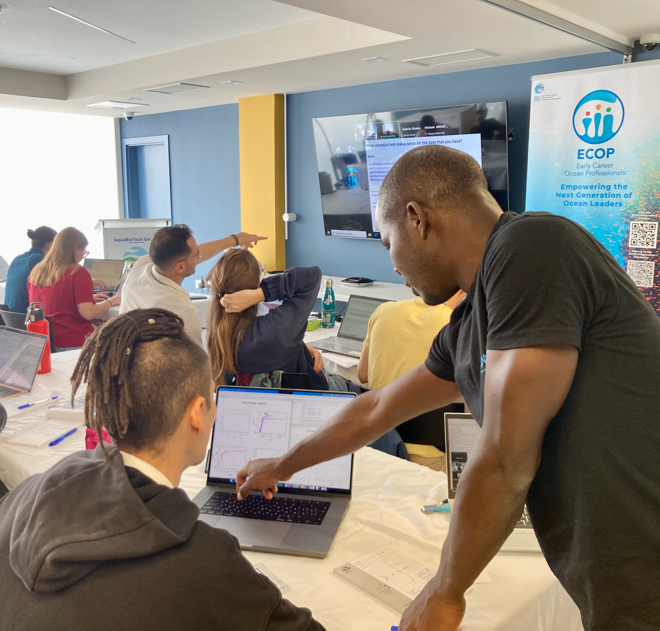
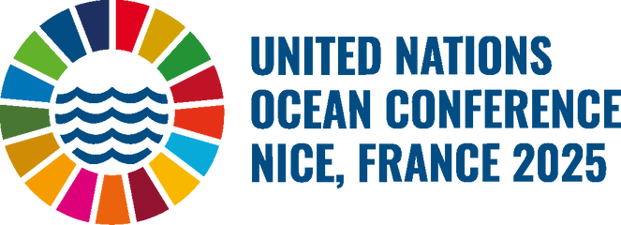


Slide 2


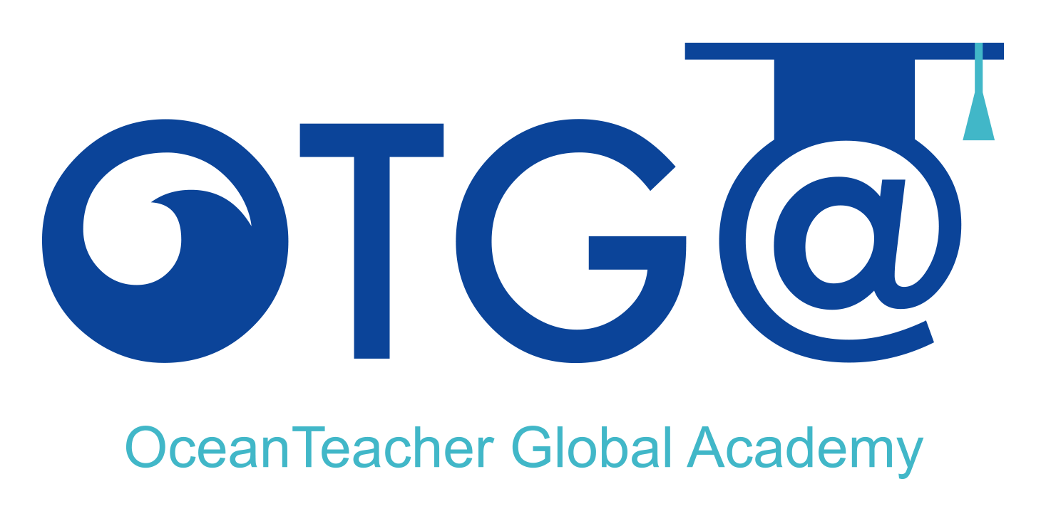

Slide 3
The OceanTeacher Global Academy is UNESCO-IOC’s training platform and learning management system, enabled by a global network of Regional and Specialised Training Centres, and affiliated partners, aiming to build equitable capacity in ocean research, observations, and services worldwide through knowledge sharing and coordinated training.

Slide 4

OTGA builds on a legacy of decades of training initiatives led and facilitated by UNESCO-IOC’s Global Programmes, Regions, Member States, and its network.
1961
2015s
2025, beyond
IODE & Ocean data training
Training in support of IOC needs and priorities
Co-design and bottom-up approach
RTC/STCs
Training to support SDG 14 and Decade
Programme Component
Blue Skills

Slide 5
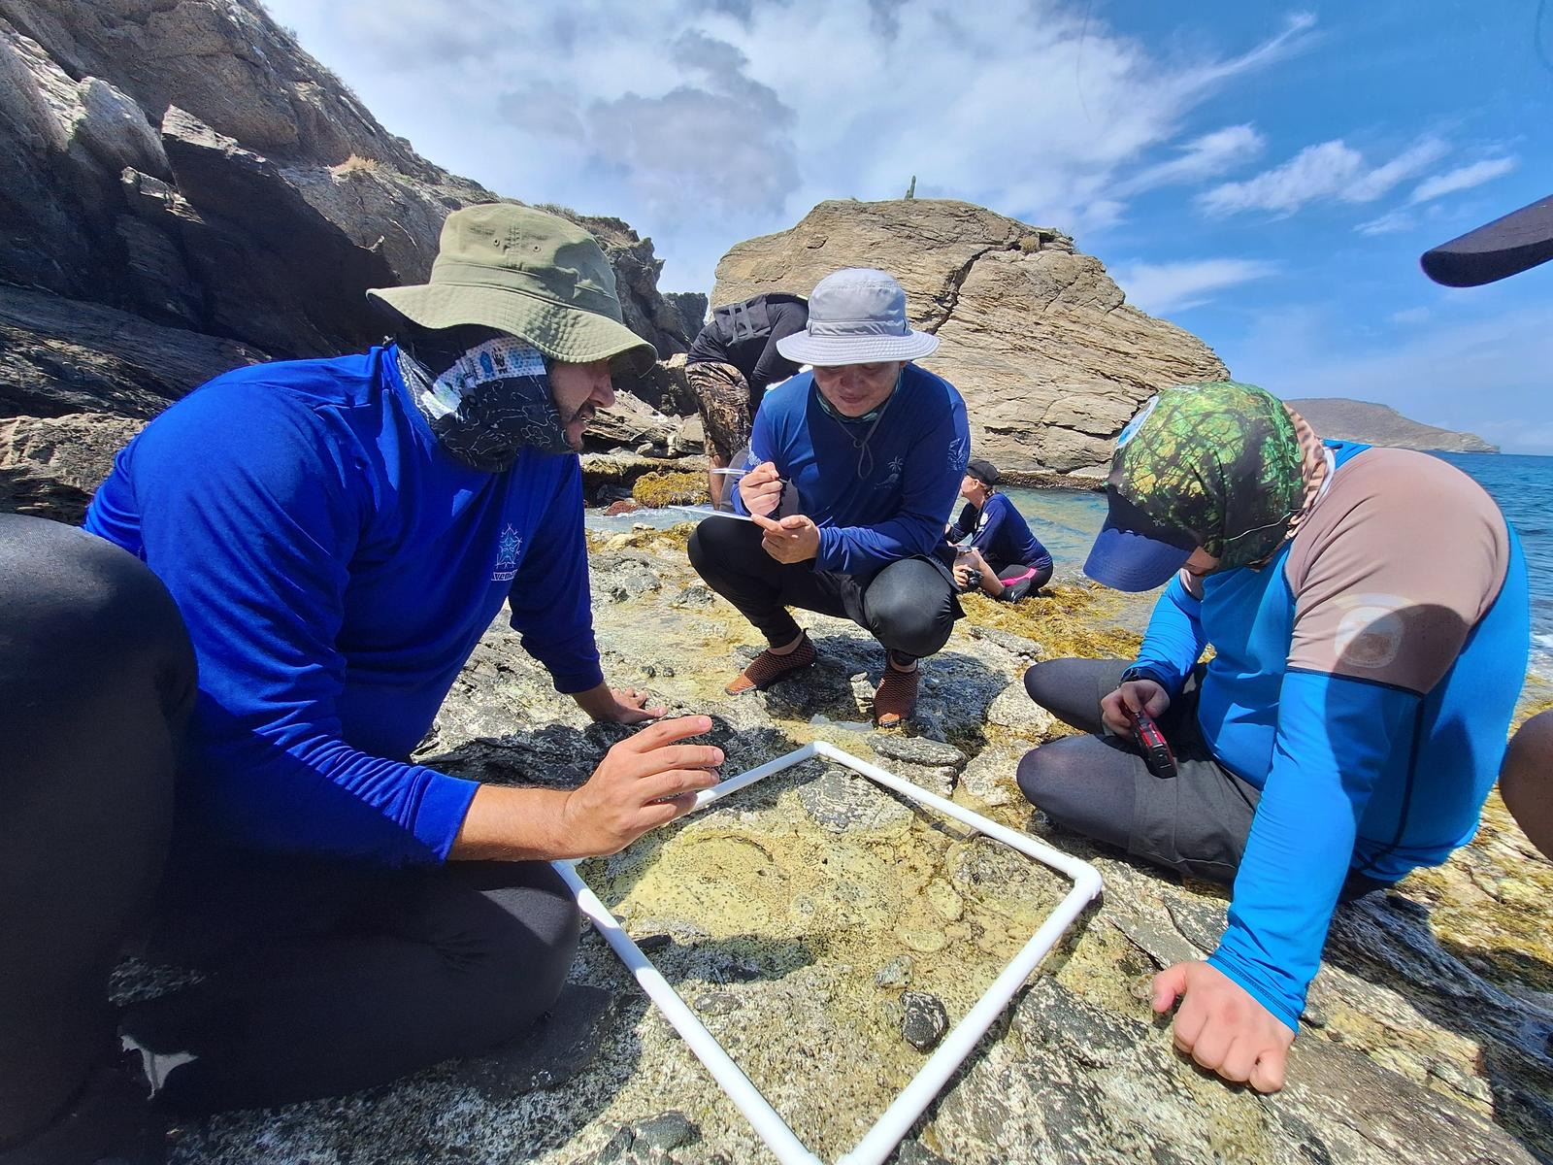
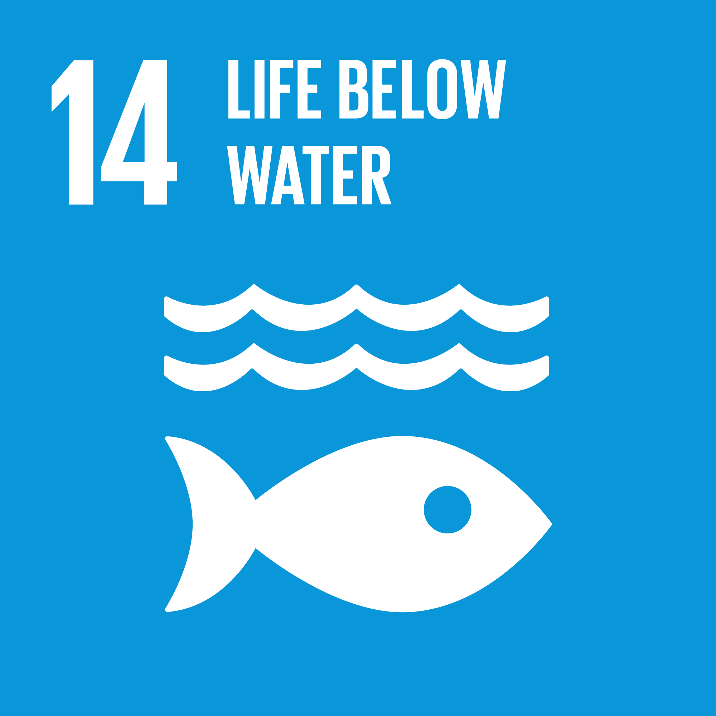
OTGA provides a complete set of learning services and products, standardized, accredited, openly and freely available to the ocean community.
OTGA coordinates, facilitates, develops, and delivers training courses responding to the needs and priorities of the global community, aligned with IOC Mandate and SDG 14.

Slide 6
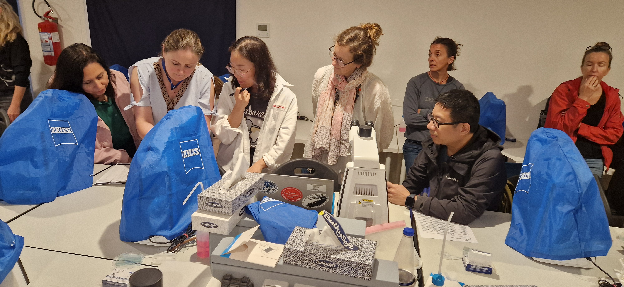
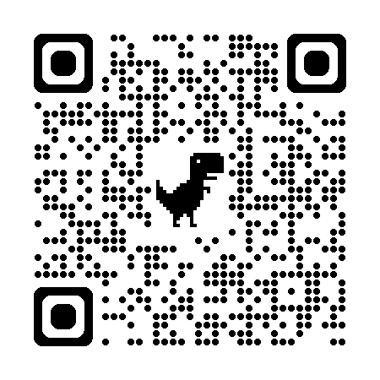
17 Training Centres (RTC/STCs)
+100s of partners
1000 lecturers
+15 000 users e-Learning
+50 courses yearly
4 languages EN ES PT FR
ISO-certified LMS
Automated reporting (KPIs)
OTGA communication pack

Slide 7
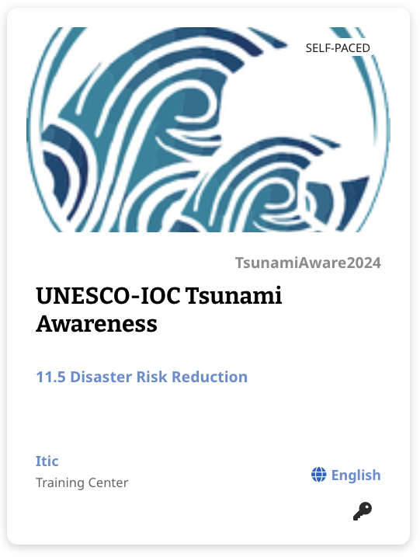
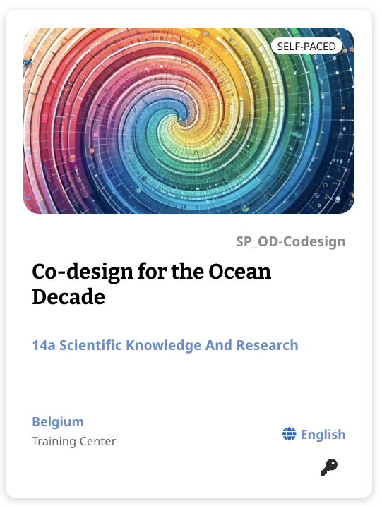
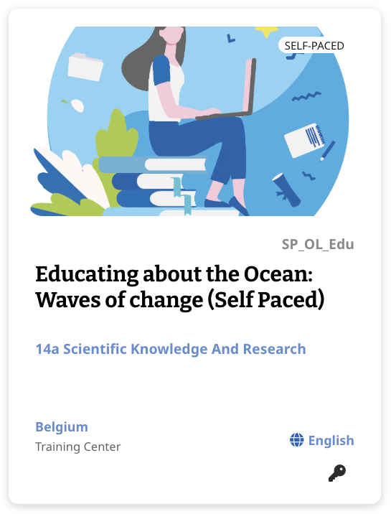
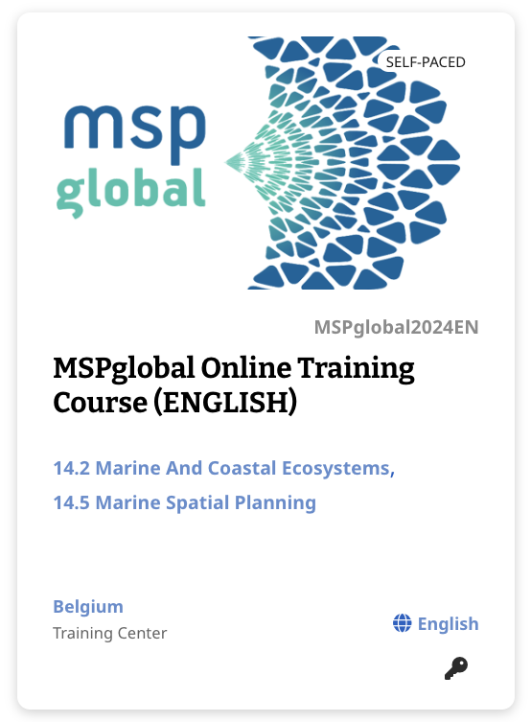
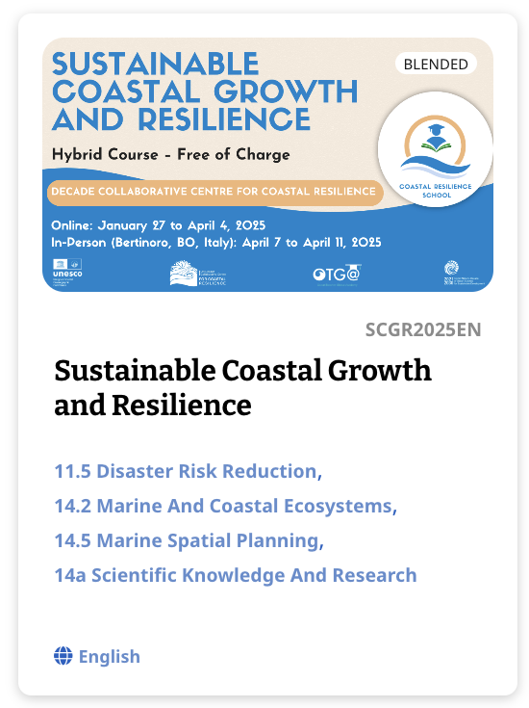
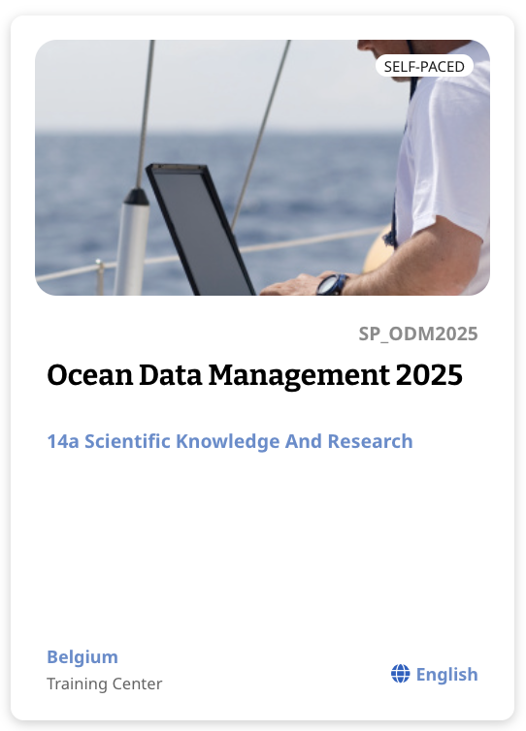
OTGA Alumni
Researchers
Data Managers
Natural Resource Managers
Practitioners in operations and support
Decision and policymakers
Institutional managers
Technicians, advisors and consultants
Extension services
Teachers and educators
ECOPs, graduates and postgraduates
OTGA Partners
Marine and maritime organizations, research projects, capacity development initiatives, international programmes, multi-national organizations
UN agencies

Slide 8
Call for collaborative action, partnership, and investment in the next 5 years

