Slide 1
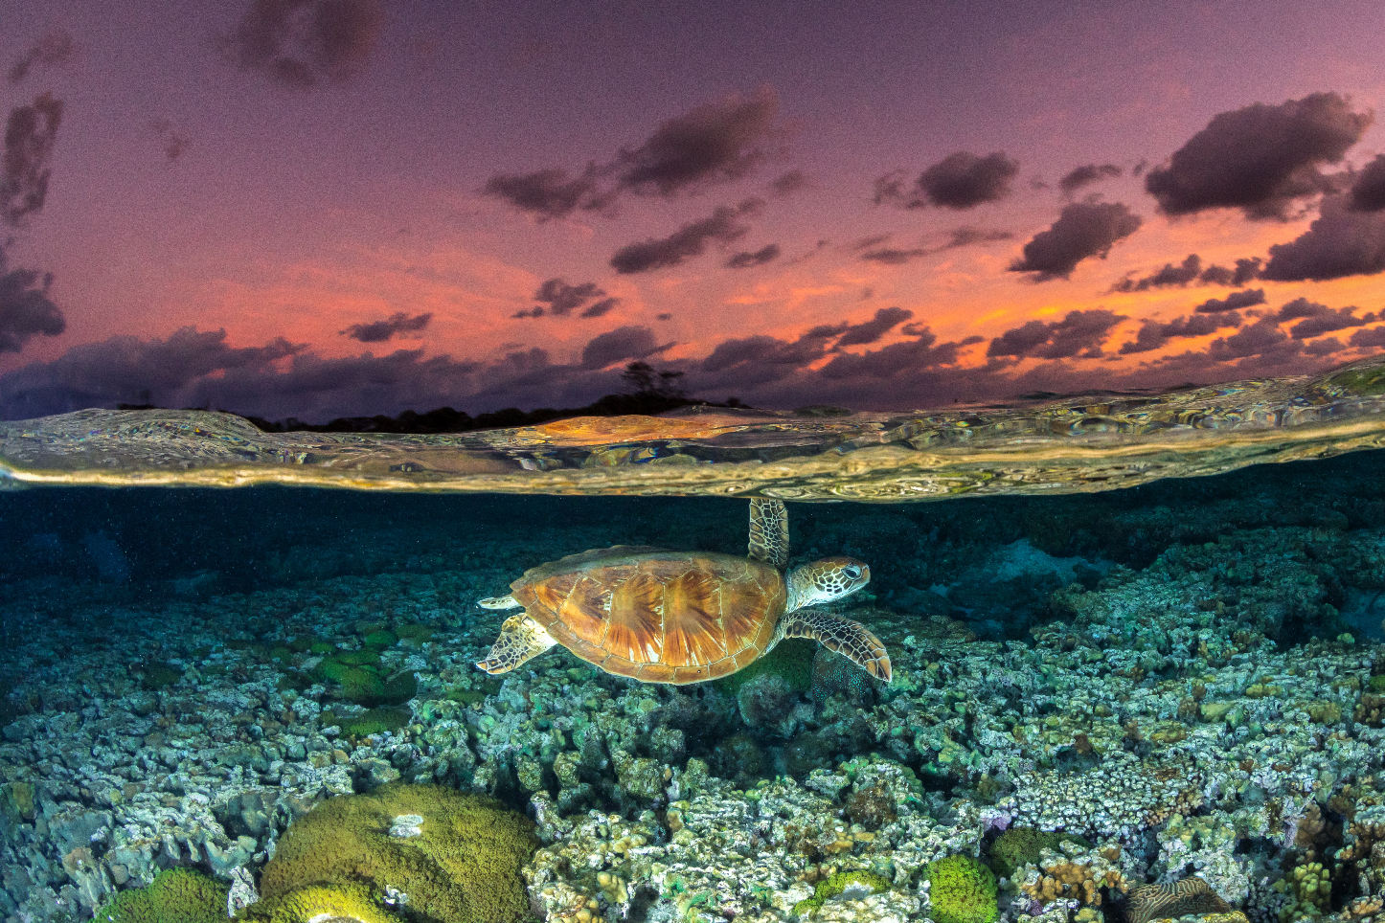




Capacity Development
Matchmaking Platform
NaYeon KIm
Coordinator of Capacity Development Facility, IOC-UNESCO

Slide 2
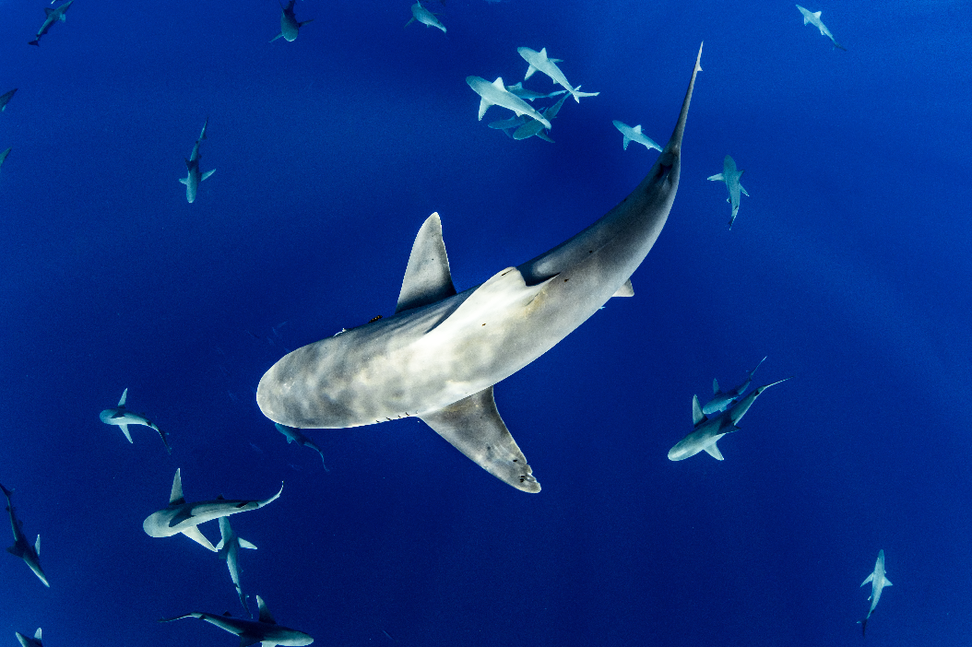
1| Objective of Matchmaking Platform
2| Mechanism behind Matchmaking Platform
CONTENTS
3| Demonstration of the Matchmaking Platform
4| Q&A and Feedback on the Platform
UNO3- SIDE EVENT

Slide 3

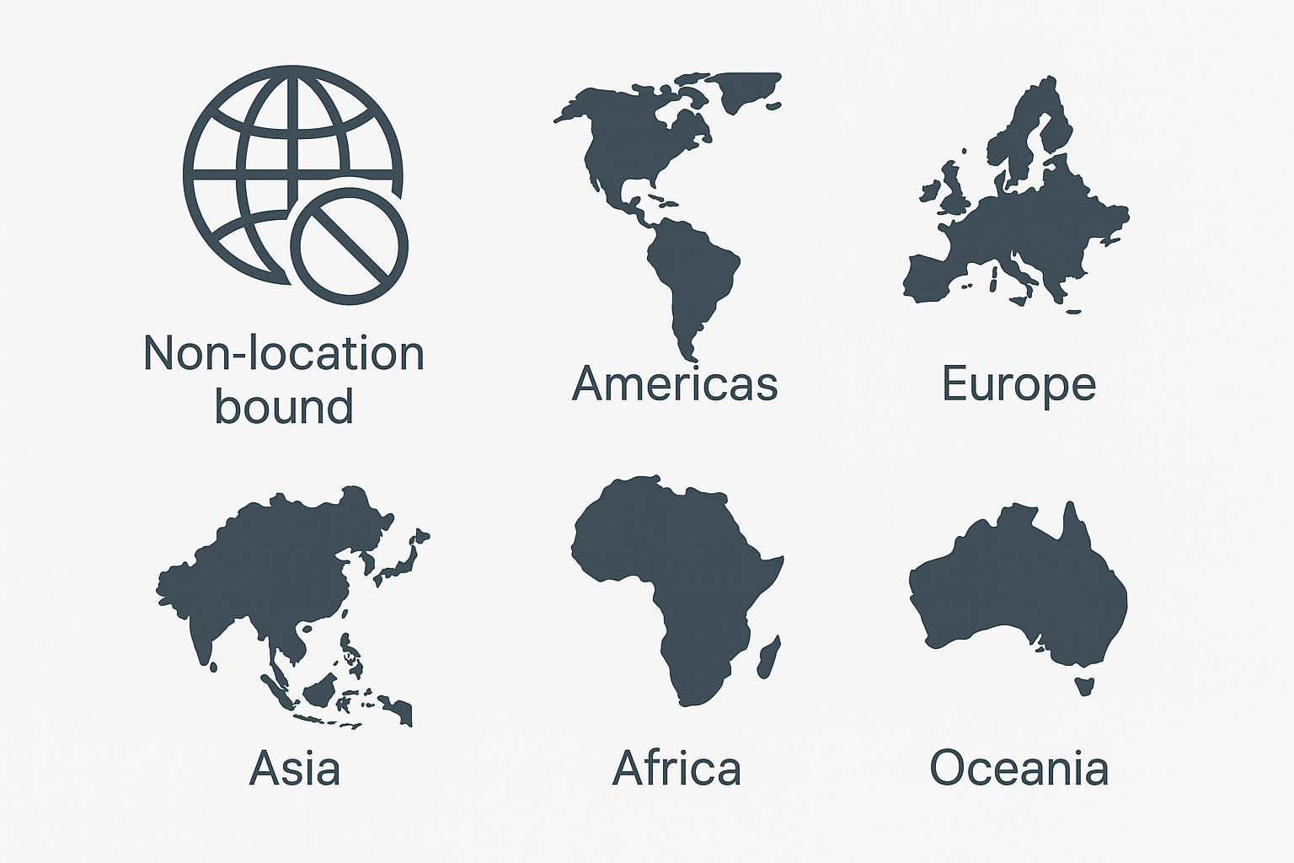
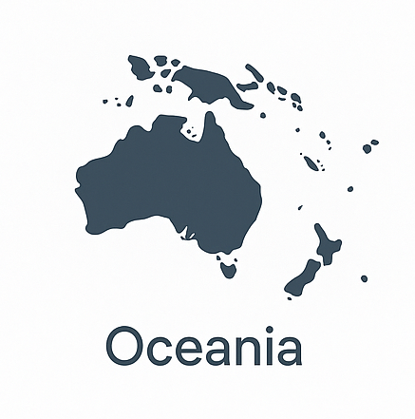
01
Objective of Capacity Development Matchmaking Platform
Objective :
To facilitate the identification, coordination, and delivery of capacity development requests by connecting user needs with relevant technical and financial partners through a transparent digital platform, with a focus on young career professionals, SIDS, and LDCs.
✔️ 625 of 732 Actions (85%)
either indicated they have Challenge 9 (Skills, knowledge, technology and participation for all) or have CD activity within their Actions
Distribution of Decade Actions by Region
41%
31%
31%
19%
17%
14%
UNO3- SIDE EVENT

Slide 4

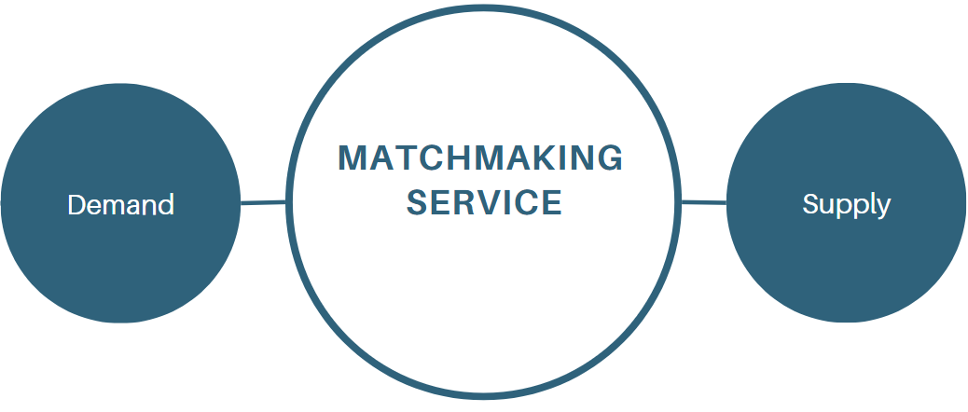


02
Mechanism behind Matchmaking Platform
Demand driven: New requests (Training and Workshop)
Decade Actions
Technical Experts
IOC Secretariat
Users
Partners
Donor
Technical and Funding Partner
prospective Decade Actions
Supply driven: Opportunities from Partners
UNO3- SIDE EVENT

Slide 5
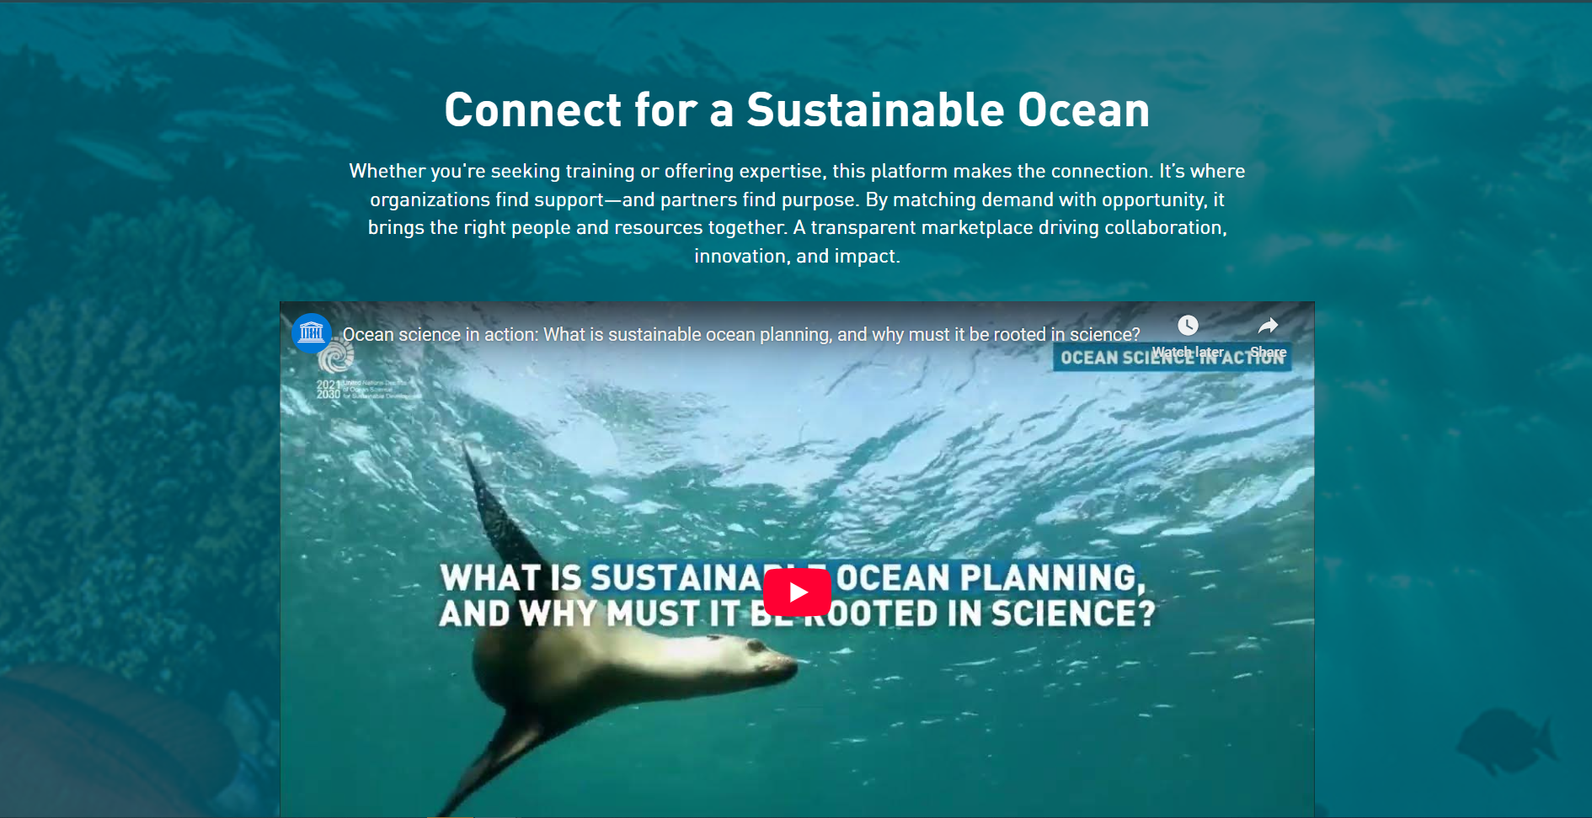
03
Demonstration of the Matchmaking Platform
UNO3- SIDE EVENT

Slide 6
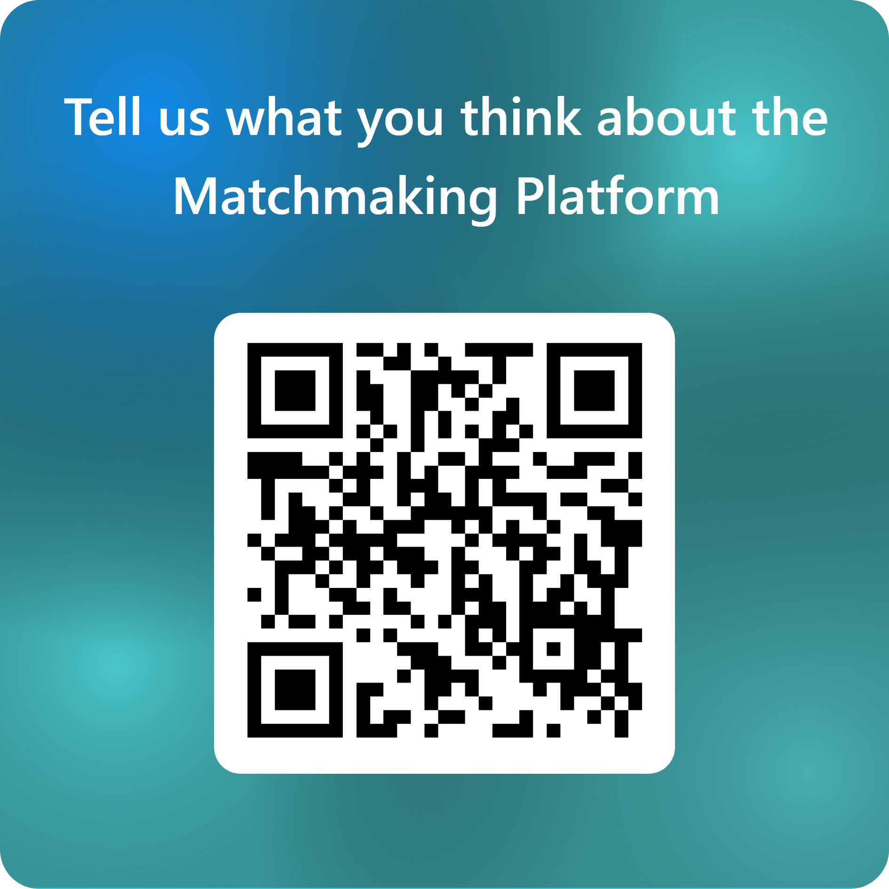
04
Q&A and Feedback on the Platform
Please take this time to ask any questions—either anonymously via the form (your question will appear on the screen) or directly from the floor.
Questions from the floor will be given priority!
UNO3- SIDE EVENT

Slide 7


Slide 9
THANK YOU
NaYeon Kim
cdf@unesco.org

