Slide 1
Tsunami Evacuation Drill
Evacuation Ala Moana Wave 2025
(AMWave25) - Hotwash
AMWave25 Team
Mario Guerra Vera (PUCV, Chile)
Caroline Jackson, Dr. Charles McCreery (PTWC)
Marie Eble, Dr. Laura Kong, Kimberly Maisonet-Gonzales, Christa von Hillebrandt-Andrade (ITIC)
Ardito Kodijat (IOTIC)
Alejandra Gubler (CIGIDEN, Chile)
Dr. Yoshiki Yamazaki (Univ of Hawaii)

Slide 2
Overview and Exercise Plan
Goal:
Evacuate out of Tsunami Hazard Zone before tsunami arrives
Objectives:
Demonstrate efficiency of evacuation, including
Challenges in finding the fastest routes
Challenges for sight-impaired evacuation
Consequences when evacuation is not immediate
Evaluate available hazard information, including usability of maps, electronic information services, and access to information
Conduct
4 groups of 7-9 participants are inside hazard zone and must reach Assembly Location before wave arrives

Slide 3
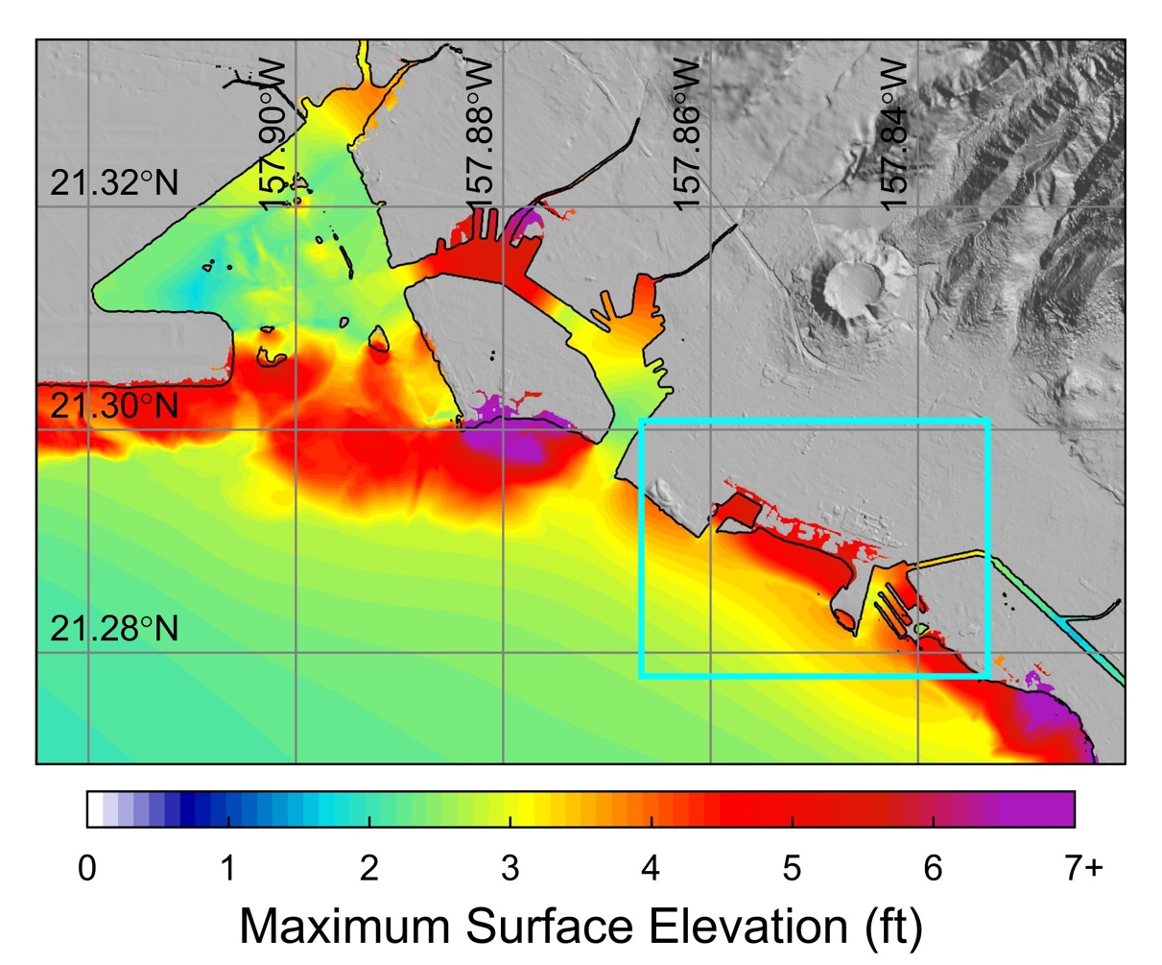
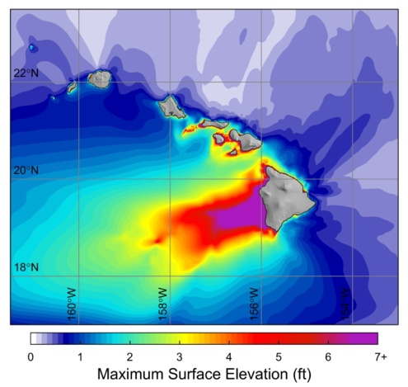
Scenario: M8.1 off-Kona, Big Island
AMWAVE25
Y. Yamazaki, Univ of Hawaii

Slide 4
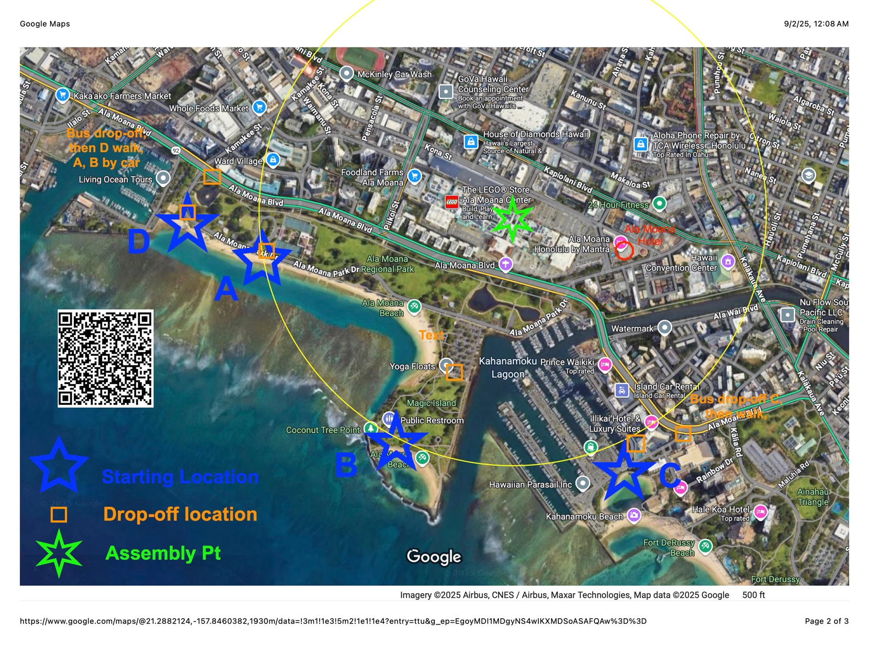

Slide 5
Post-Exercise Evaluation
Summarize, by an animation, evacuation of 4 groups to the Assembly Location.
After drill, participants asked to reflect on:
Were the Alerts timely, useful, understandable, actionable?
Were maps that were available clear and easy to follow?
Were the routes that Group selected clear and easy to follow, and realistic in terms of time required and distance to travel?
What obstacles were encountered (urban, physical, social)?
How could the evacuation process be improved?

Slide 6
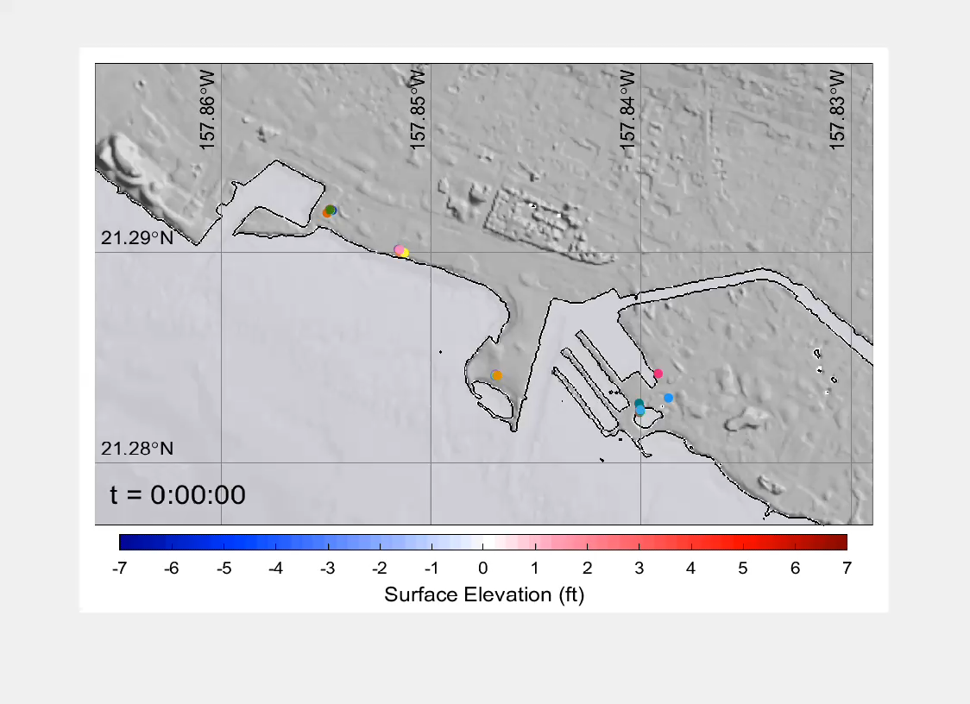
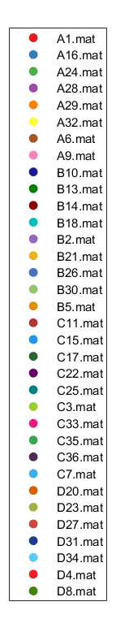
AMWave25 – Evacuation – No Delay (0 minutes)
A. Gubler, CIGIDEN

Slide 7
AMWave25 – Evacuation – Delay in Starting (5 min)
A. Gubler, CIGIDEN

Slide 8
AMWave25 – Evacuation – Delay in Starting (15 min)
A. Gubler, CIGIDEN

Slide 9
AMWave25 – Evacuation – Delay in Starting (30 min)
A. Gubler, CIGIDEN

Slide 10
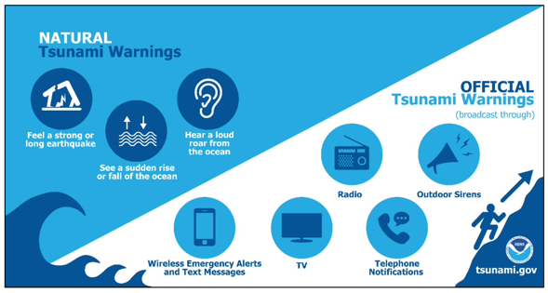
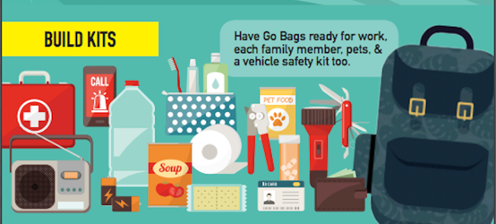
Conclusion
If you have a local tsunami, do not hesitate Self-evacuate immediately
If you delay, then you may not escape the wave You could easily drown
Prepare beforehand!
Know natural tsunami warning signs
Know how official alerts will be transmitted Know what the alerts will say
Know how and where you will evacuate to Have a ‘go-bag’ with important items ready Have a family plan for reuniting

Slide 11
Thank You
Muchas Gracias
AMWave25 Team
Mario Guerra Vera (PUCV, Chile)
Caroline Jackson, Dr. Charles McCreery (PTWC)
Marie Eble, Dr. Laura Kong, Kimberly Maisonet-Gonzales, Christa von Hillebrandt-Andrade (ITIC)
Ardito Kodijat (IOTIC)
Alejandra Gubler (CIGIDEN, Chile)
Dr. Yoshiki Yamazaki (Univ of Hawaii)

