Slide 1







Landslide tsunami hazards
Finn Løvholt^{1,2,3}
Carl Harbitz^{1,2,3}, Sylfest Glimsdal^{1,2,3}
1 - Global Tsunami Model (GTM)
2 - Norwegian Geotechnical Institute (NGI)
3 – International Centre for Geohazards (ICG)
FIRST CONFERENCE OF THE OCEAN DECADE TSUNAMI PROGRAMME
Hyderabad, India
10-11 November 2025

Slide 2
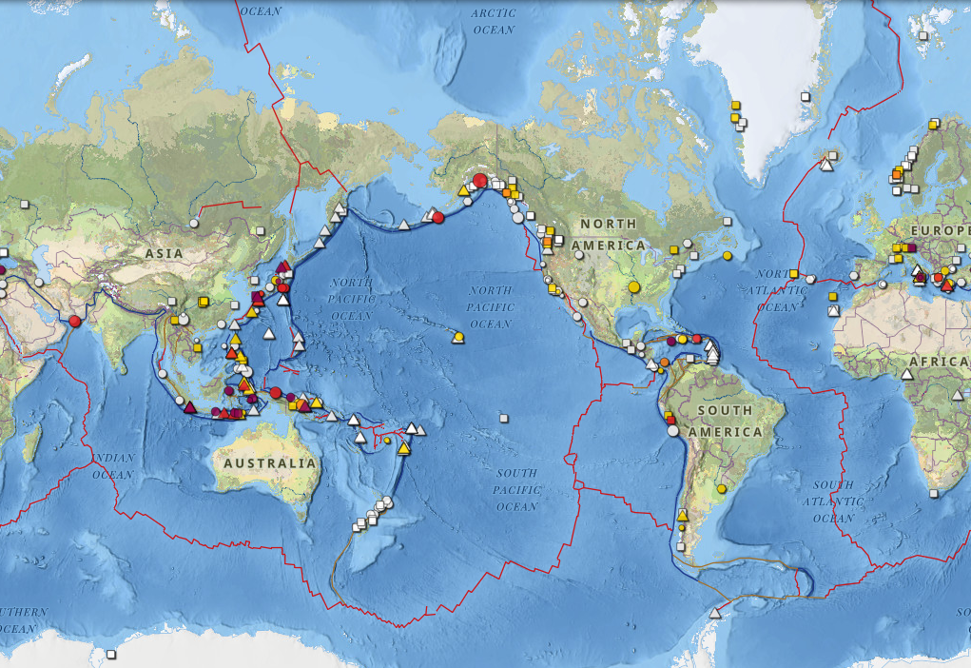
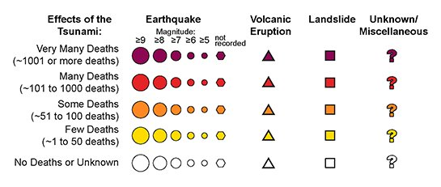
Landslide tsunamis
Map showing landslide tsunamis, volcanic tsunamis, and joint earthquake/landslide tsunami events
Source, NCEI, NGDC, NOAA
Landslide and rock avalanche tsunamis - roughly 10-15% of the reported tsunami sources globally
(Harbitz et al., 2014, Nat Haz)
Two main classes of landslides
Submarine landslides
Subaerial landslides, including volcano flank collapses
Can in principle occur on any slope
Seismically passive or active margins
More local character than earthquake tsunamis, with potentially severe impact
More complex generation and progatation process than earthquakes

Slide 3
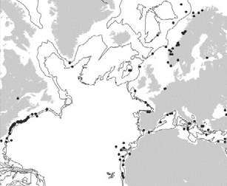
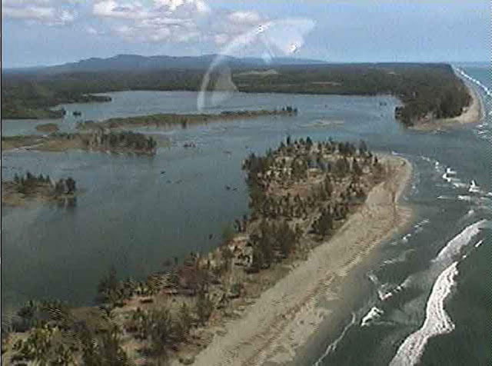
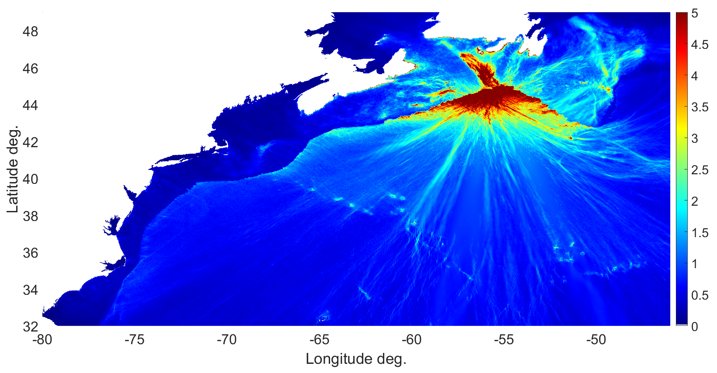
Submarine landslides and tsunamis around the globe
Hühnerbach et al., (2004), Mar Geol
Heterogeneously mapped globally
Many events back far back in time, dating often uncertain
A very small fraction of the mapped events are tsunamigenic
Most major landslides pre-historical
1929 Grand banks tsunami – Løvholt et al., (2019), GSL
> 300 km³ – 27 Fatalities in Newfoundland
1998 PNG tsunami - Image courtesy of Jose Borrero
> 2 000 fatalities
US East Coast database
Lee (2009), Mar Geol
Gulf of Cadiz database, Zengaffinen-Morris et al., (2022), JGR

Slide 4
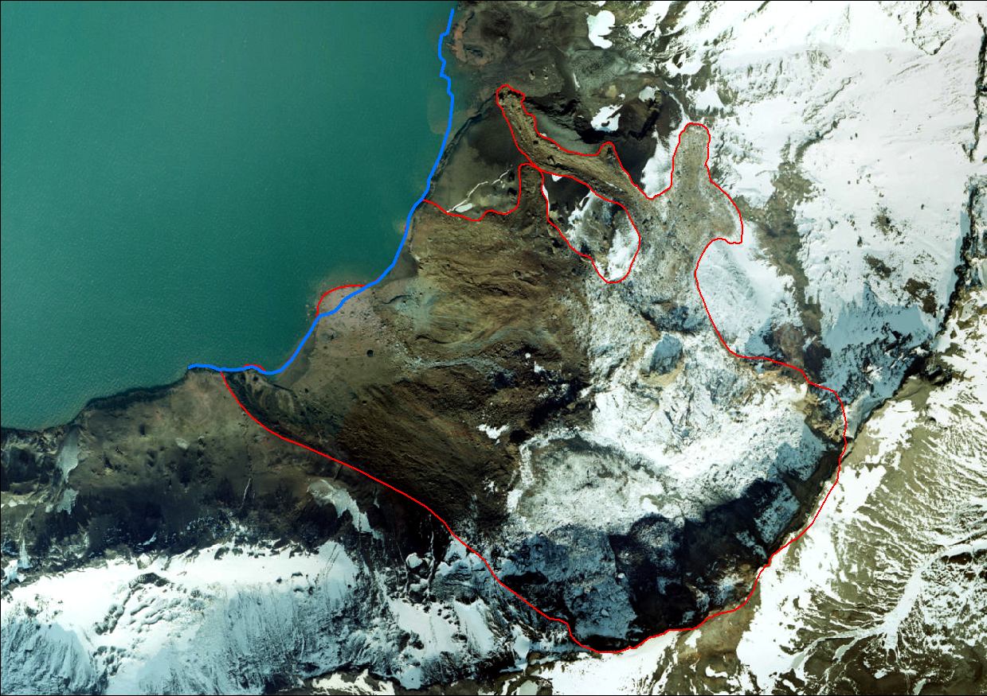
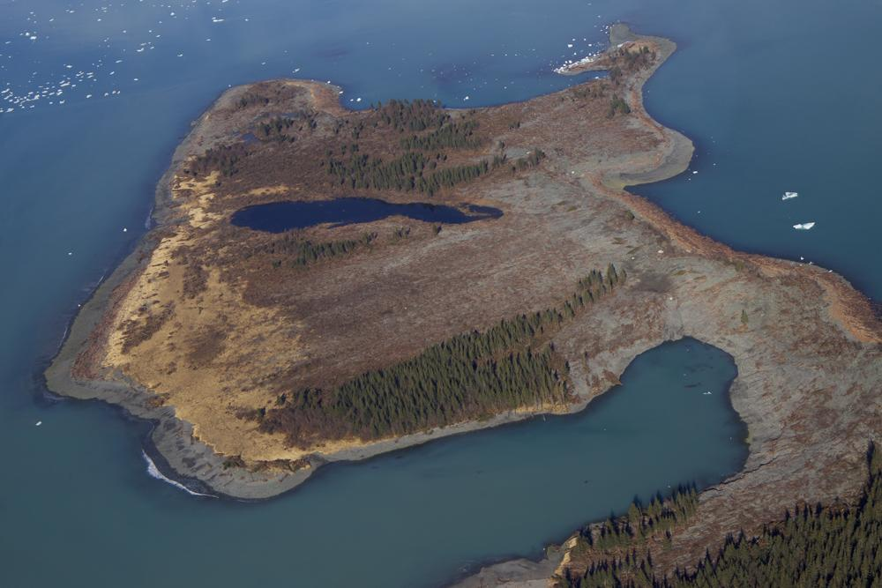
Subaerial landslides tsunamis More frequent, more local, high local impact
Selected events since year 2000
2007 Aysen fjord
Courtesy H Fritz, GA Tech
Lake Askja 2014
Courtesy IMO
Year | Event | Country | Volume | Max run-up
2000 | Paatuut | Greenland | ~50 Mm³ | > 50 m
2002 | Stromboli (two slides) | Italy | 4-9 Mm³ and 20 Mm³ | > 10 m
2003 | Qianjiangping | China | 24 Mm³ | 39 m
2007 | Dayantang | China | 3Mm³ | ~50 m
2007 | Aysen fjord | Chile | High number of slides | ~50 m
2008 | Chehalis Lake | Canada | 3Mm³ | 38 m
2008 | Three Gauges | China | 0.38 Mm³ | 13 m
2014 | Lake Askja | Iceland | ~20 Mm³ | 80 m
2015 | Icy Bay | USA | 76 Mm³ | 193 m
2017 | Karrat fjord | Greenland | ~40 Mm³ | 90 m
2018 | Bureya | Russia | 25 Mm³ | 90 m
2018 | Baige | China | >10 Mm³ | 54 m
2018 | Anak Krakatau | Indonesia | ~210 Mm³ | 85 m
2020 | Elliot Creek | Canada | 13.5 Mm³ | 120 m
2023 | Dickson fjord | Greenland | 25 Mm³ | 200 m
2025 | Tracy Arm | Alaska | ~100 Mm³ | >30 m
76 m
56 m
43 m
2015 Taan fjord / Icy Bay
Courtesy C Larsen
2023 Dickson fjord
Svennevig et al., 2024 - Science
Global seismic signal from seiche

Slide 5
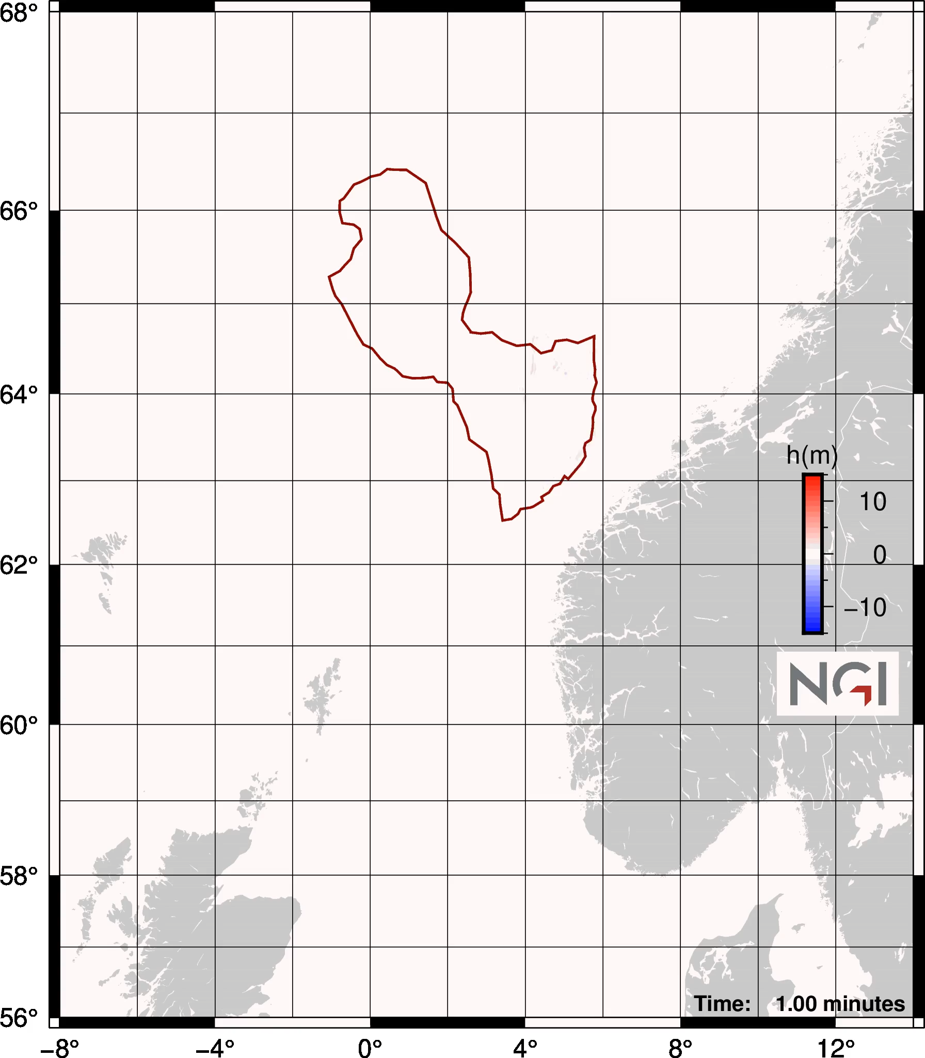
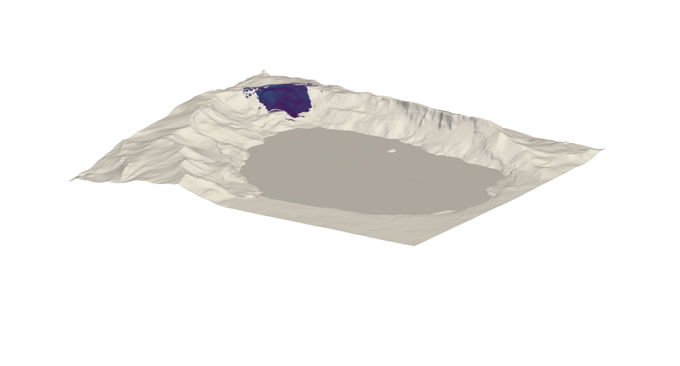
Generation mechanisms
8000 BP Storegga slide and tsunami
(Courtesy, S. Gibbons, NGI)
2014 Lake Askja slide and tsunami
(Courtesy, M. Rauter)

Slide 6
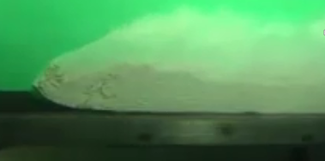
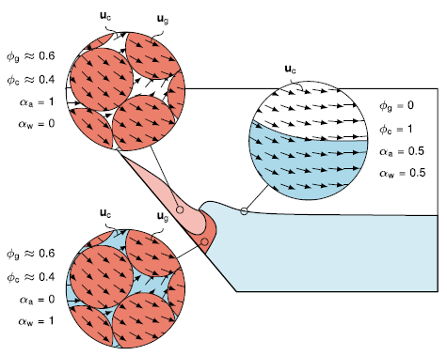
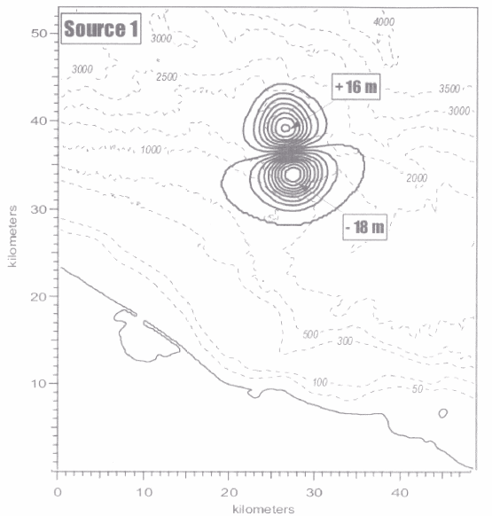
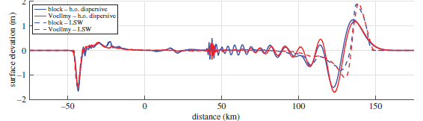
Landslide tsunami characteristics and modelling needs
Landslide rheology and dynamics
Main factors of importance for the generation
Submarine landslides: water depth, slope, rheology
Subaerial landslides: impact area and velocity
Models need to provide time dependent slide motion
Capturing rheological properties of the landslide
Include effect of ambient water
Linking landslide and tsunami models
Wave shapes and propagation differs from earthquakes tsunamis
Higher amplitudes, shorter length and aspect ratio, frequency dispersion
Needs more sophisticated models than SWE, e.g.:Boussinesq, layered models, CFD
Clay material
Particle dominated
Rauter et al., 2022,
Nature Comm
Frequency dispersion
PNG – slump - dipole
(Lynett et al., 2003,
PAGEOPH)
Løvholt et al., 2015, Royal Soc

Slide 7
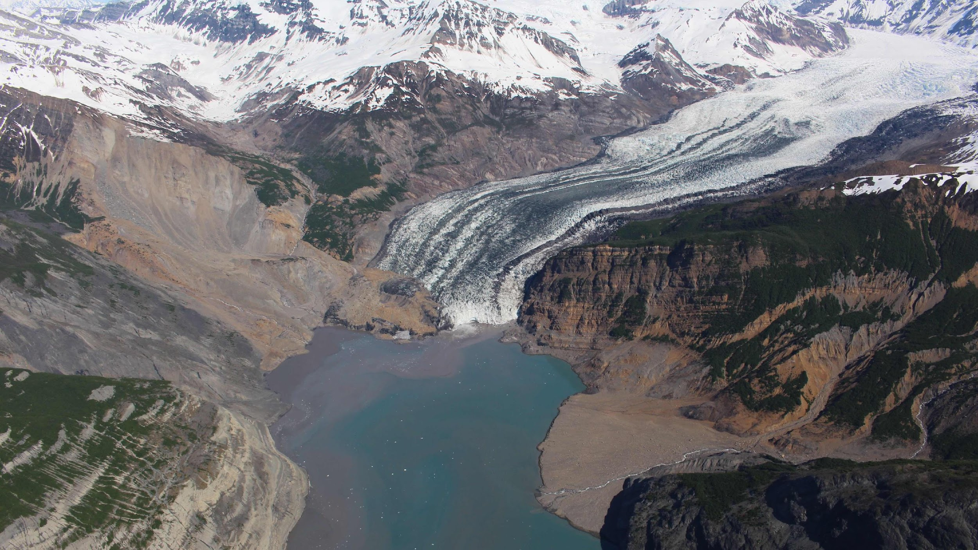
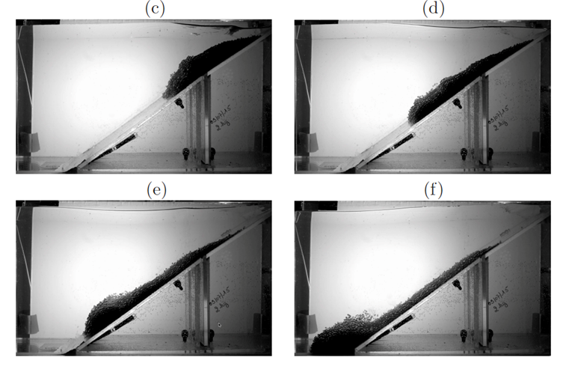
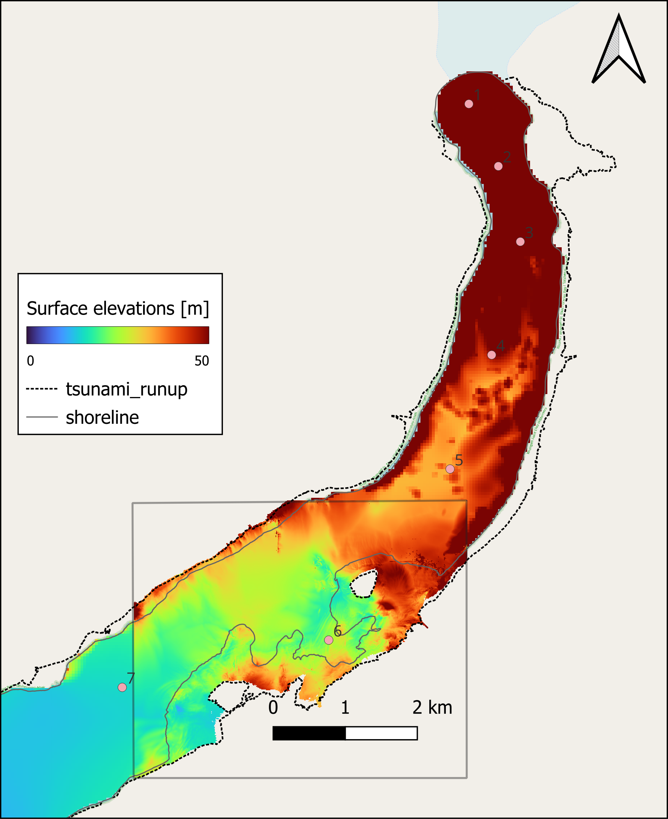
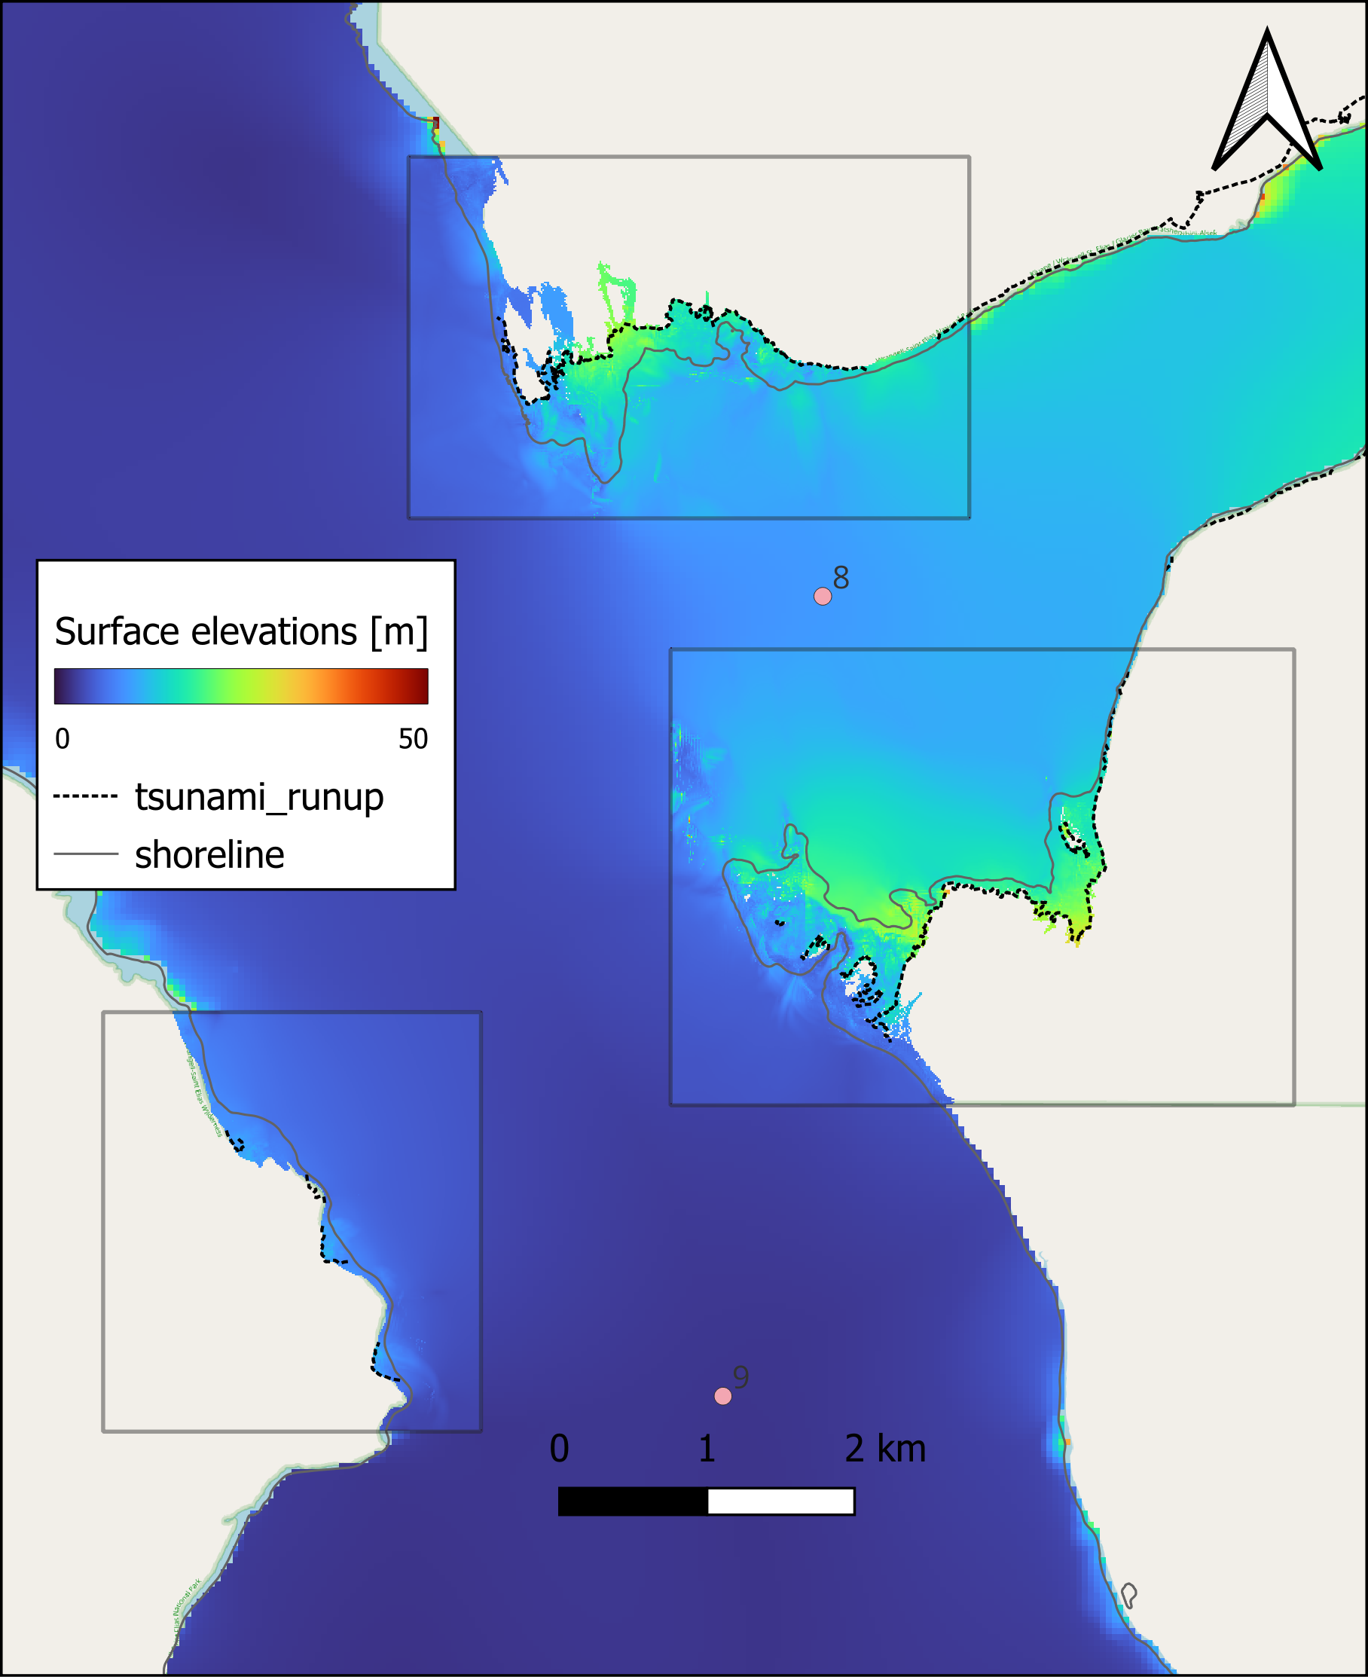
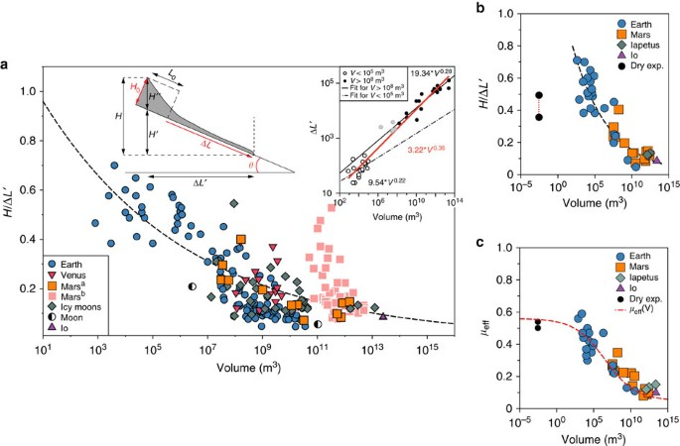
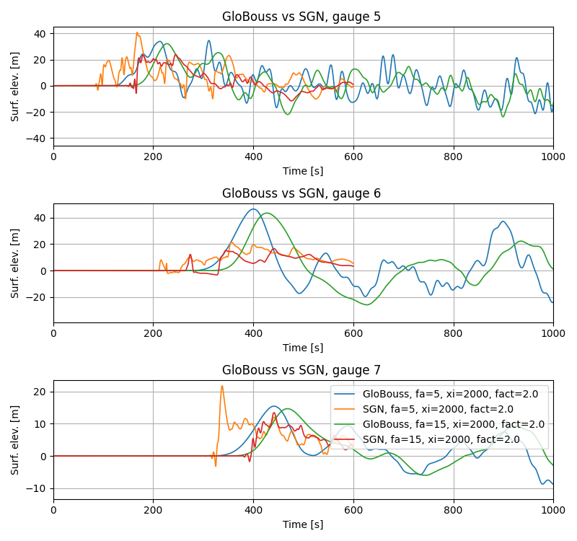
We still need to advance the way we test and improve our prediction models
For idealized studies, physics, model consistency
NTHMP benchmark tests
Mainly laboratory tests
https://www1.udel.edu/kirby/landslide/
Testing towards field events
Tsunami generation does not scale from lab to field
Calibration of hazard model
USGS/USC led initiative – validation towards Taan fjord – revealed need for improvement
A range of the most recent well documented events can be also used (e.g. Greenland, Alaska, Norway, Iceland)
NTMHP Benchmark tests - examples
2015 Taan fjord
Courtesy C Larsen
Friction depends on the volume,
Lucas et al., 2014, Nature Comm
Lake Askja 2014, Rauter et al., 2022, Nature Comm

Slide 8
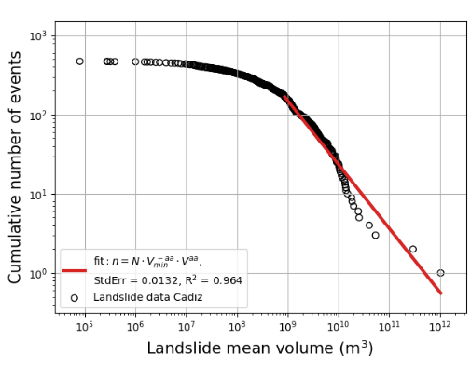
Landslide Probabilistic Tsunami Hazard Assessment (LPTHA)
Landslide statistics, frequency
Estimating tsunami probability of occurrence
Two alternative pathways to anchor probabilities
- Basis on past landslide data
- Based on slope stability
LPTHA can largely mimic PTHA for earthquakes:
Generate a synthetic set of sources
Define annual source probabilities
Simulate the wave propagation for each source
Aggregate probabilities from all simulations to hazard curves
Landslide databases
Tsunami simulation
Hazard
curves

Slide 9
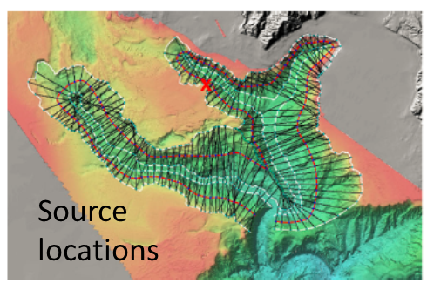
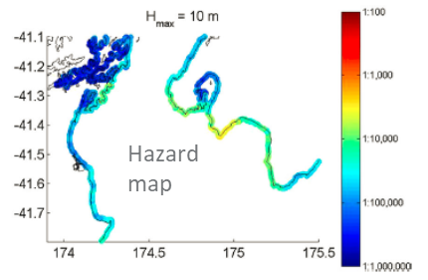
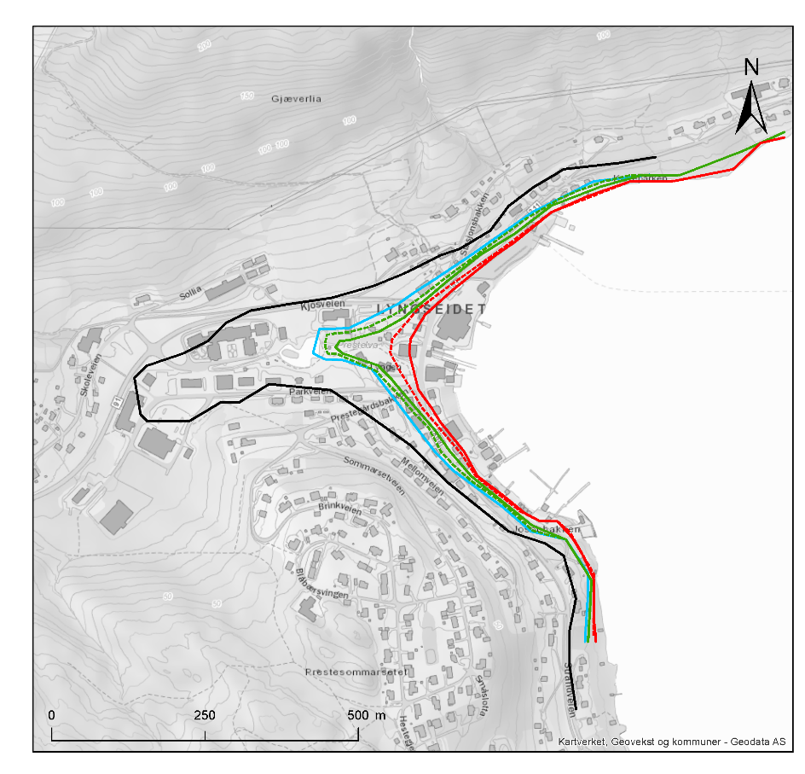
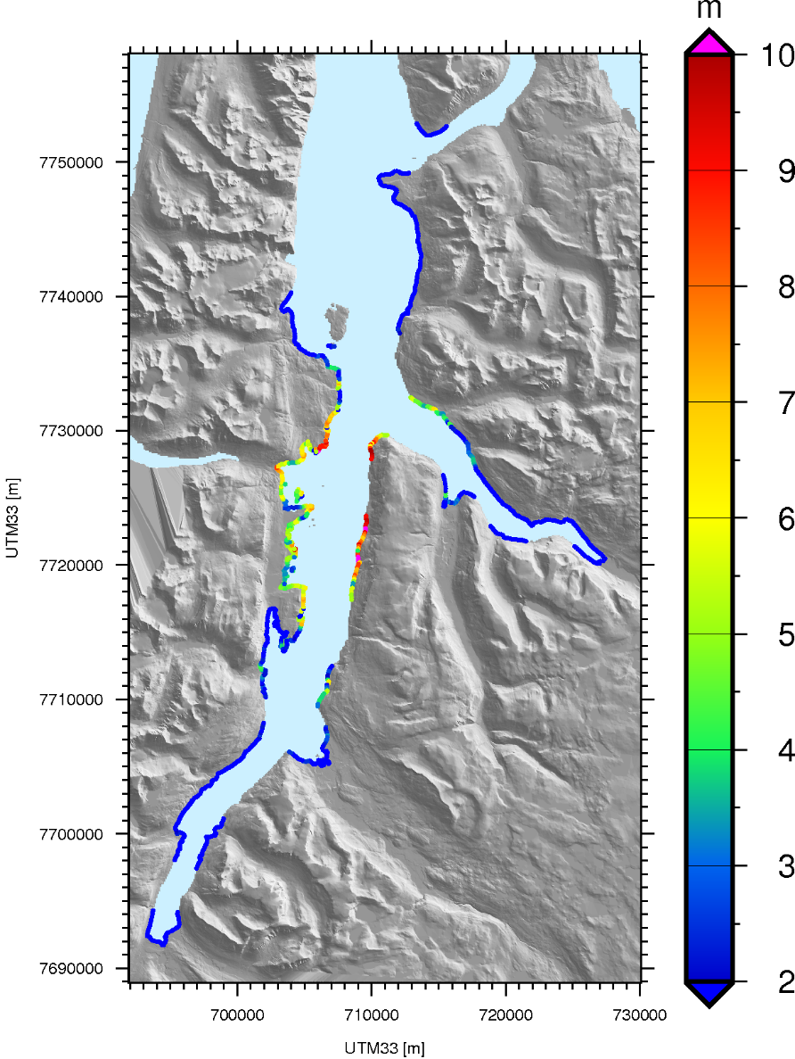
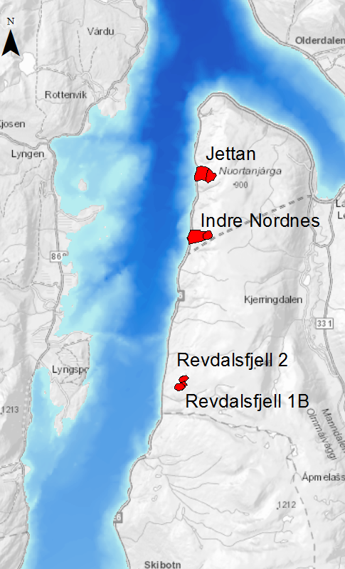
We have only a few extensive hazard applications
Cook Strait Canyon, NZ
(Lane et al. 2016, PAGEOPH)
Submarine landslides
Simplified landslide dynamics
Well constrained geological setting and timing
Lyngen fjord Northern Norway
(Løvholt et al. 2020, Landslides)
Subaerial landslides
Four unstable slopes
Probabilities from rock slope stability analysis (subjectively established)
Uncertainty treatment of generation mechanisms (velocity and impact area)
In both cases, model calibration needed

Slide 10
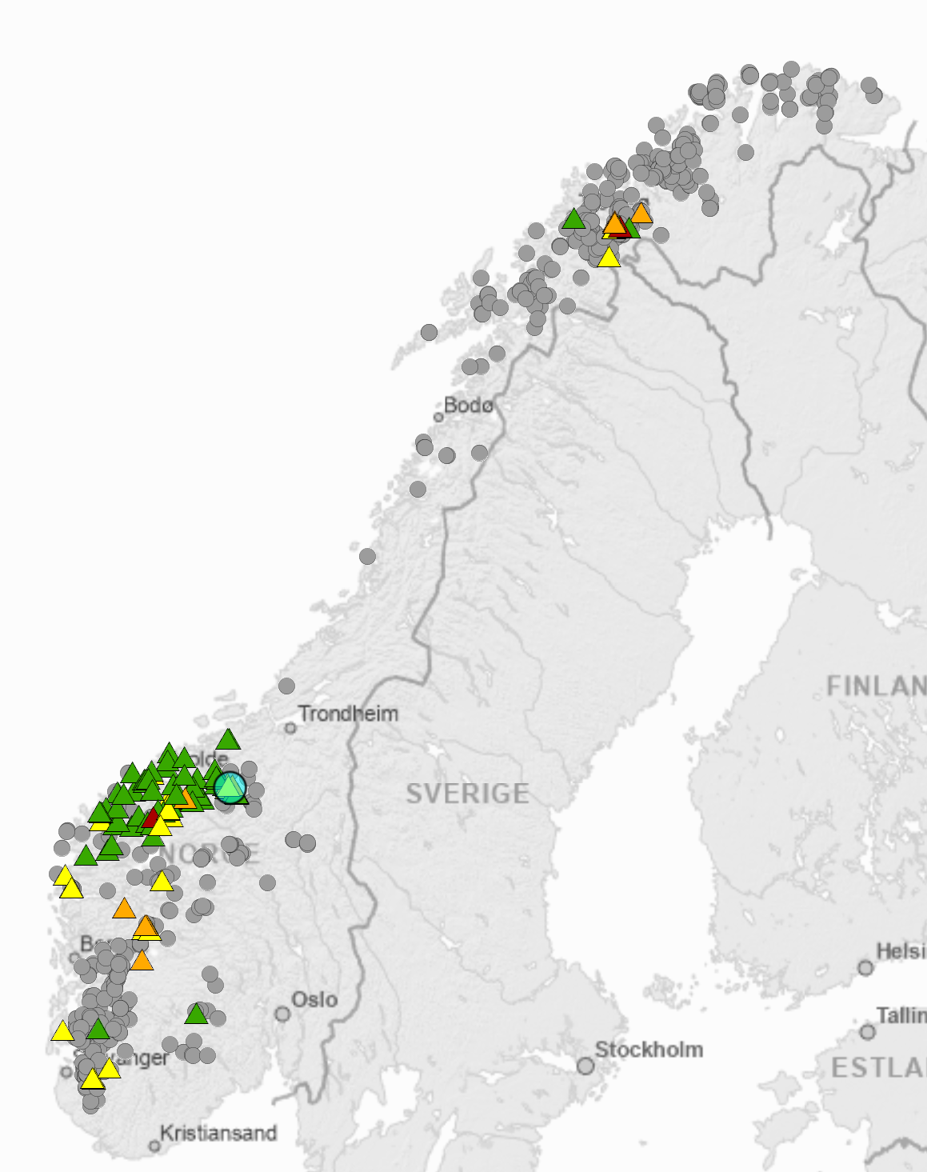
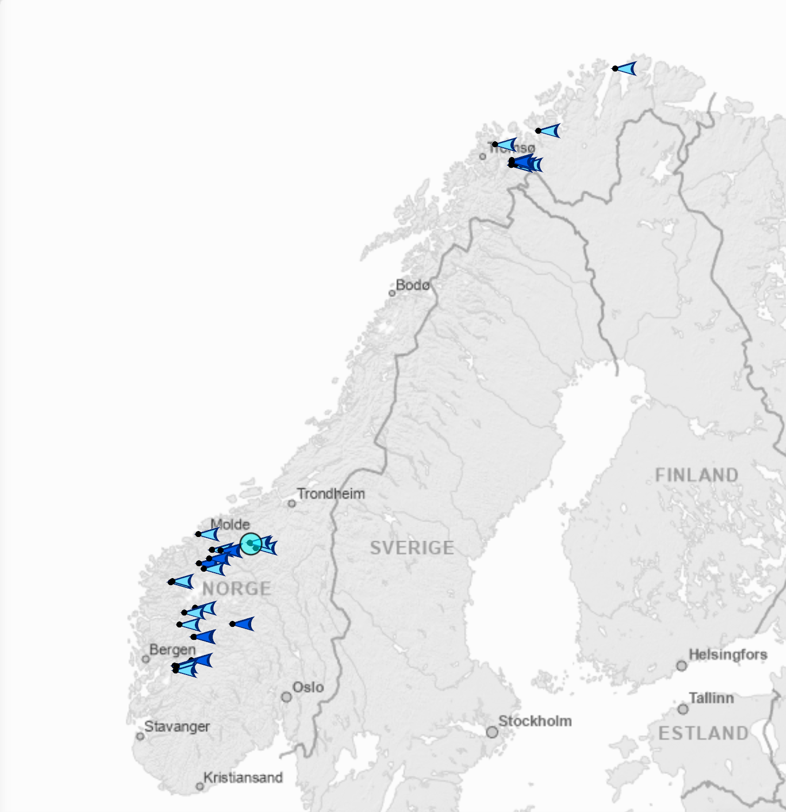
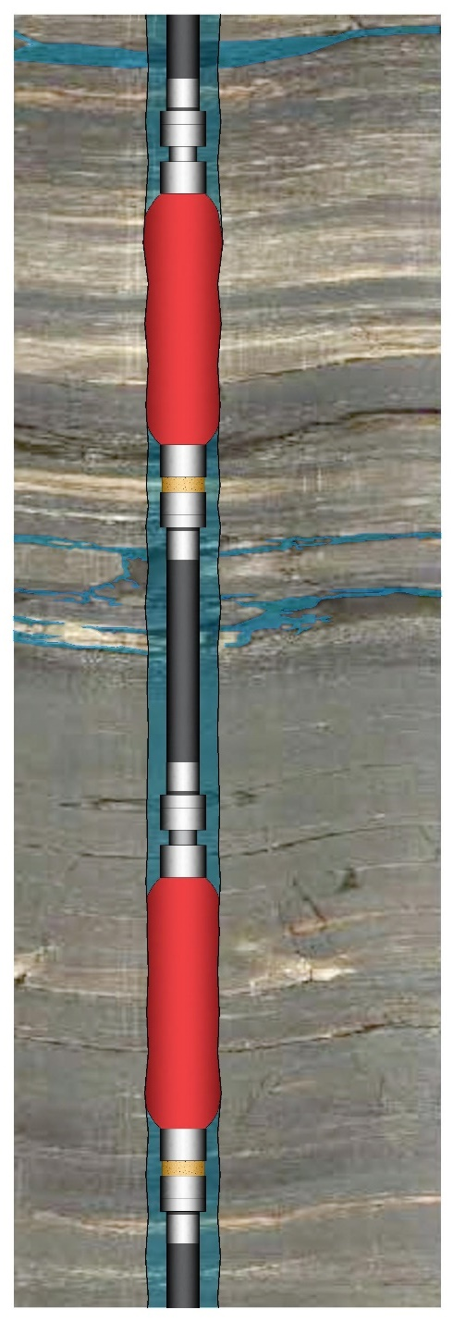
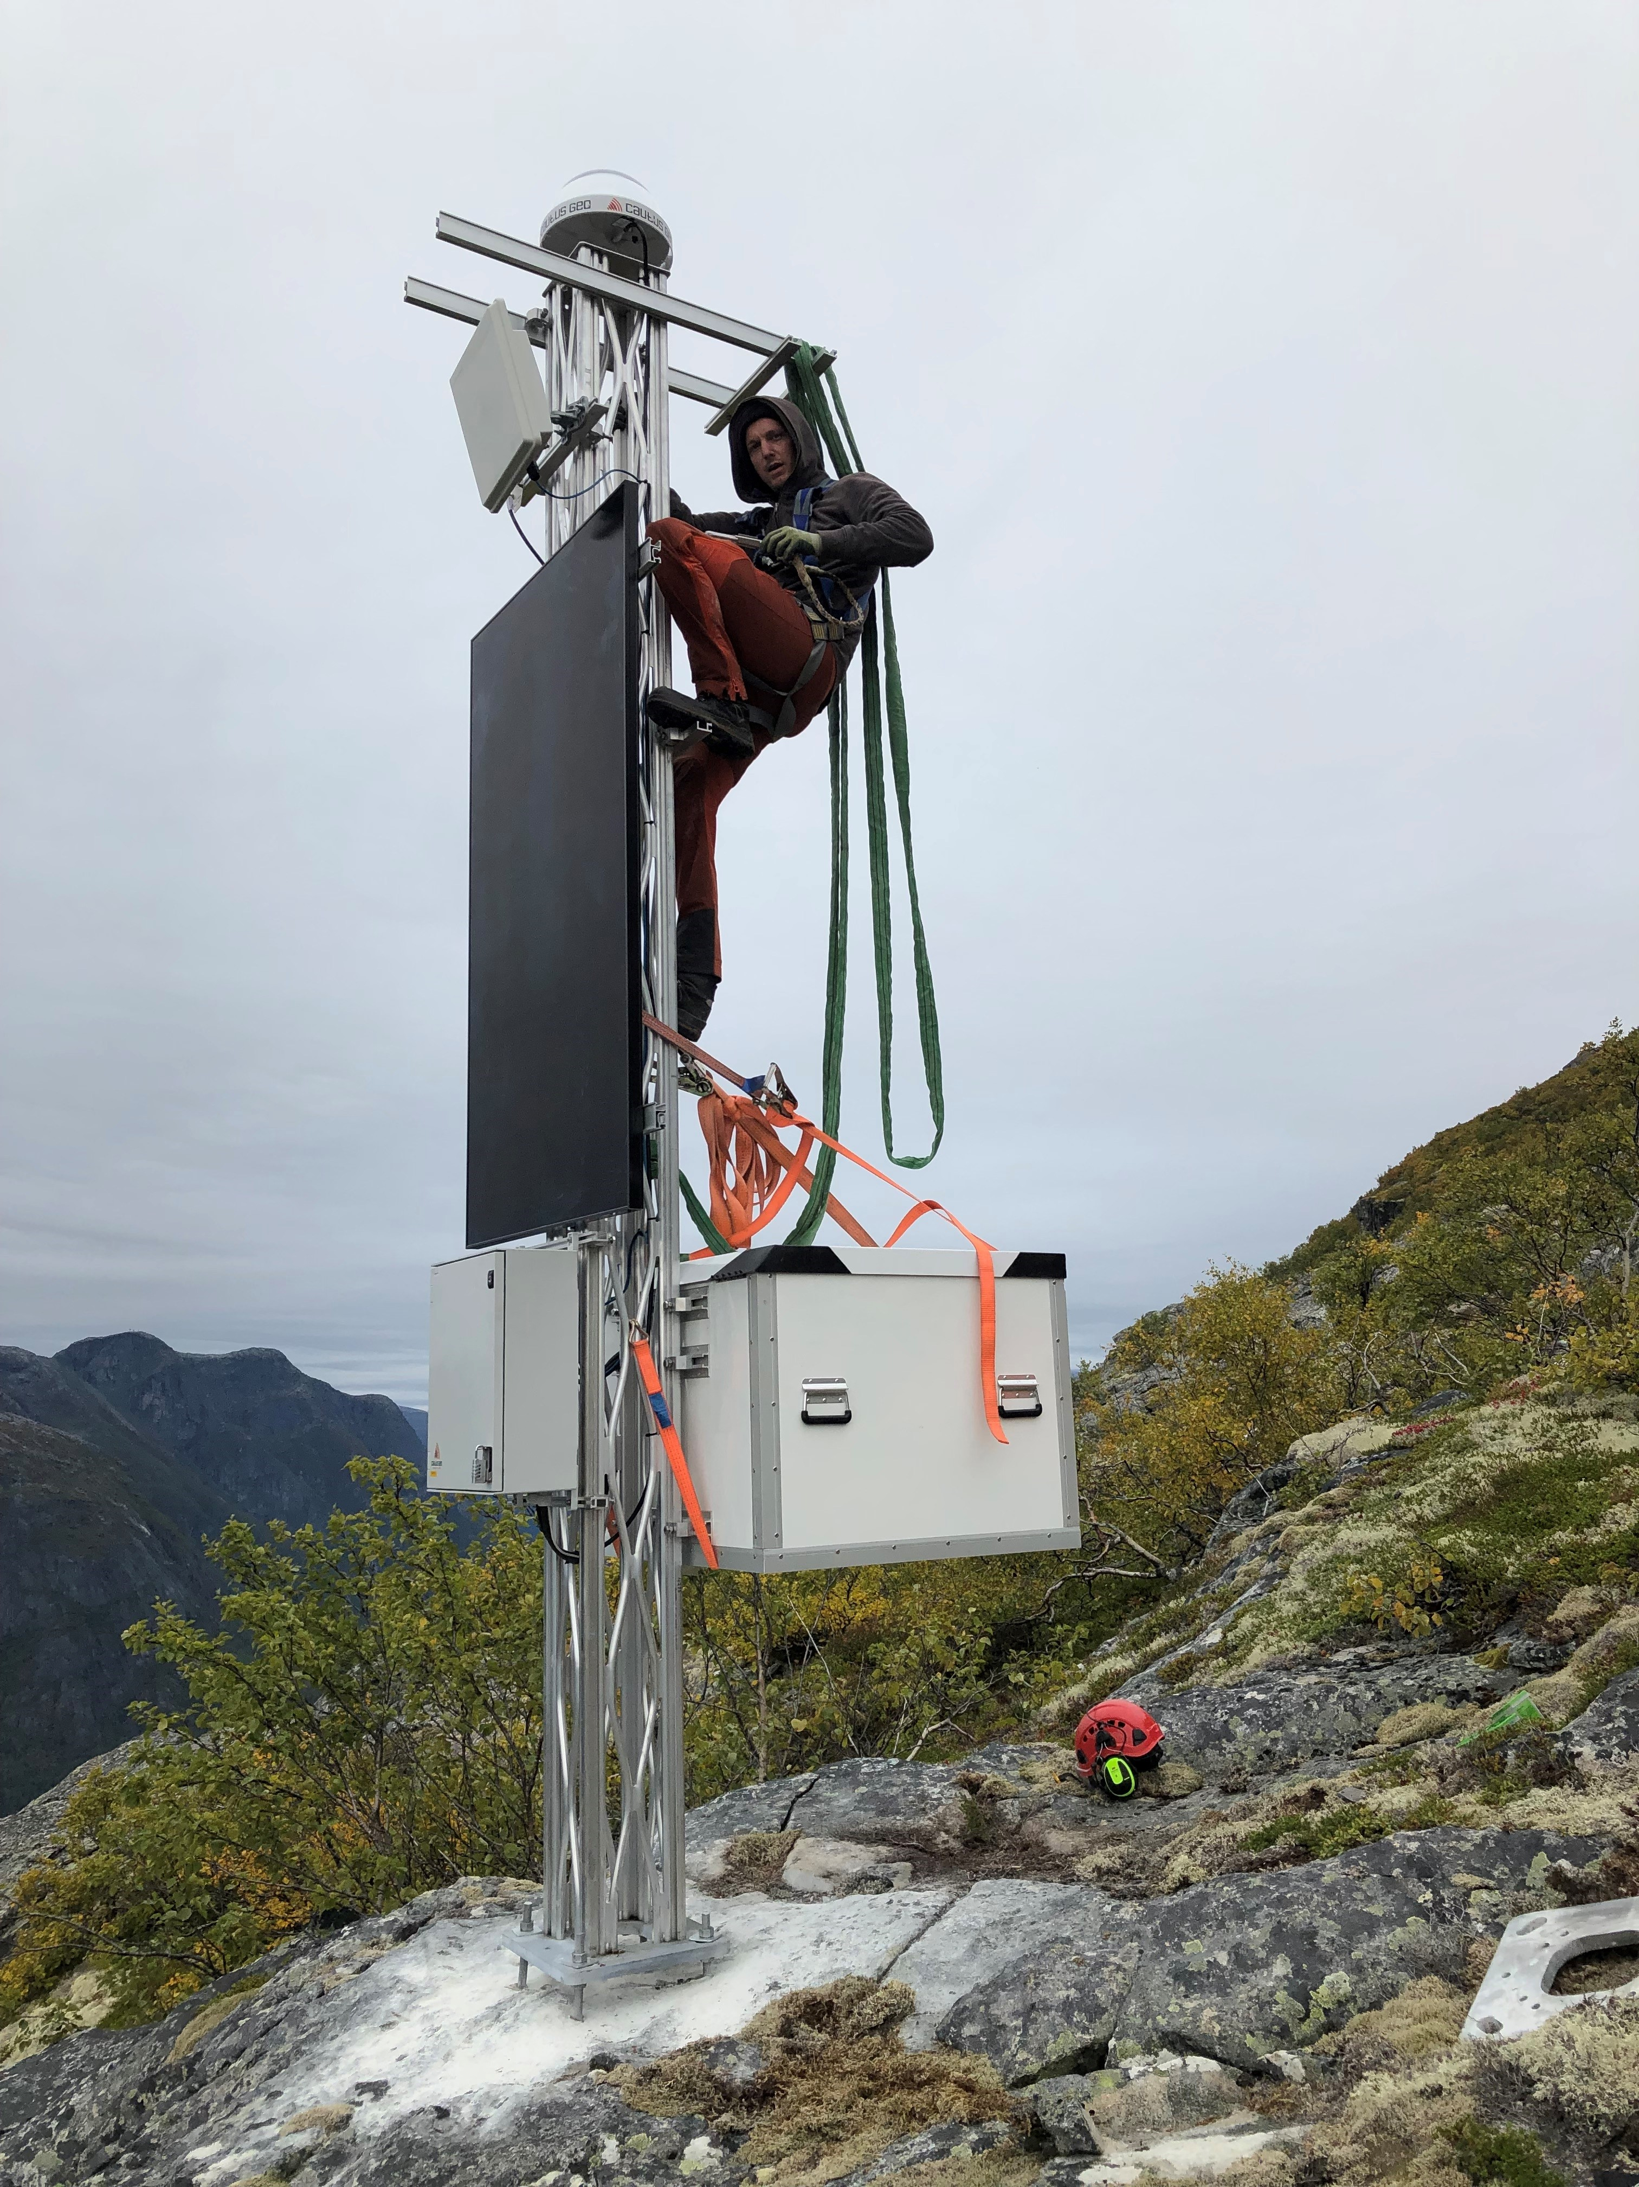
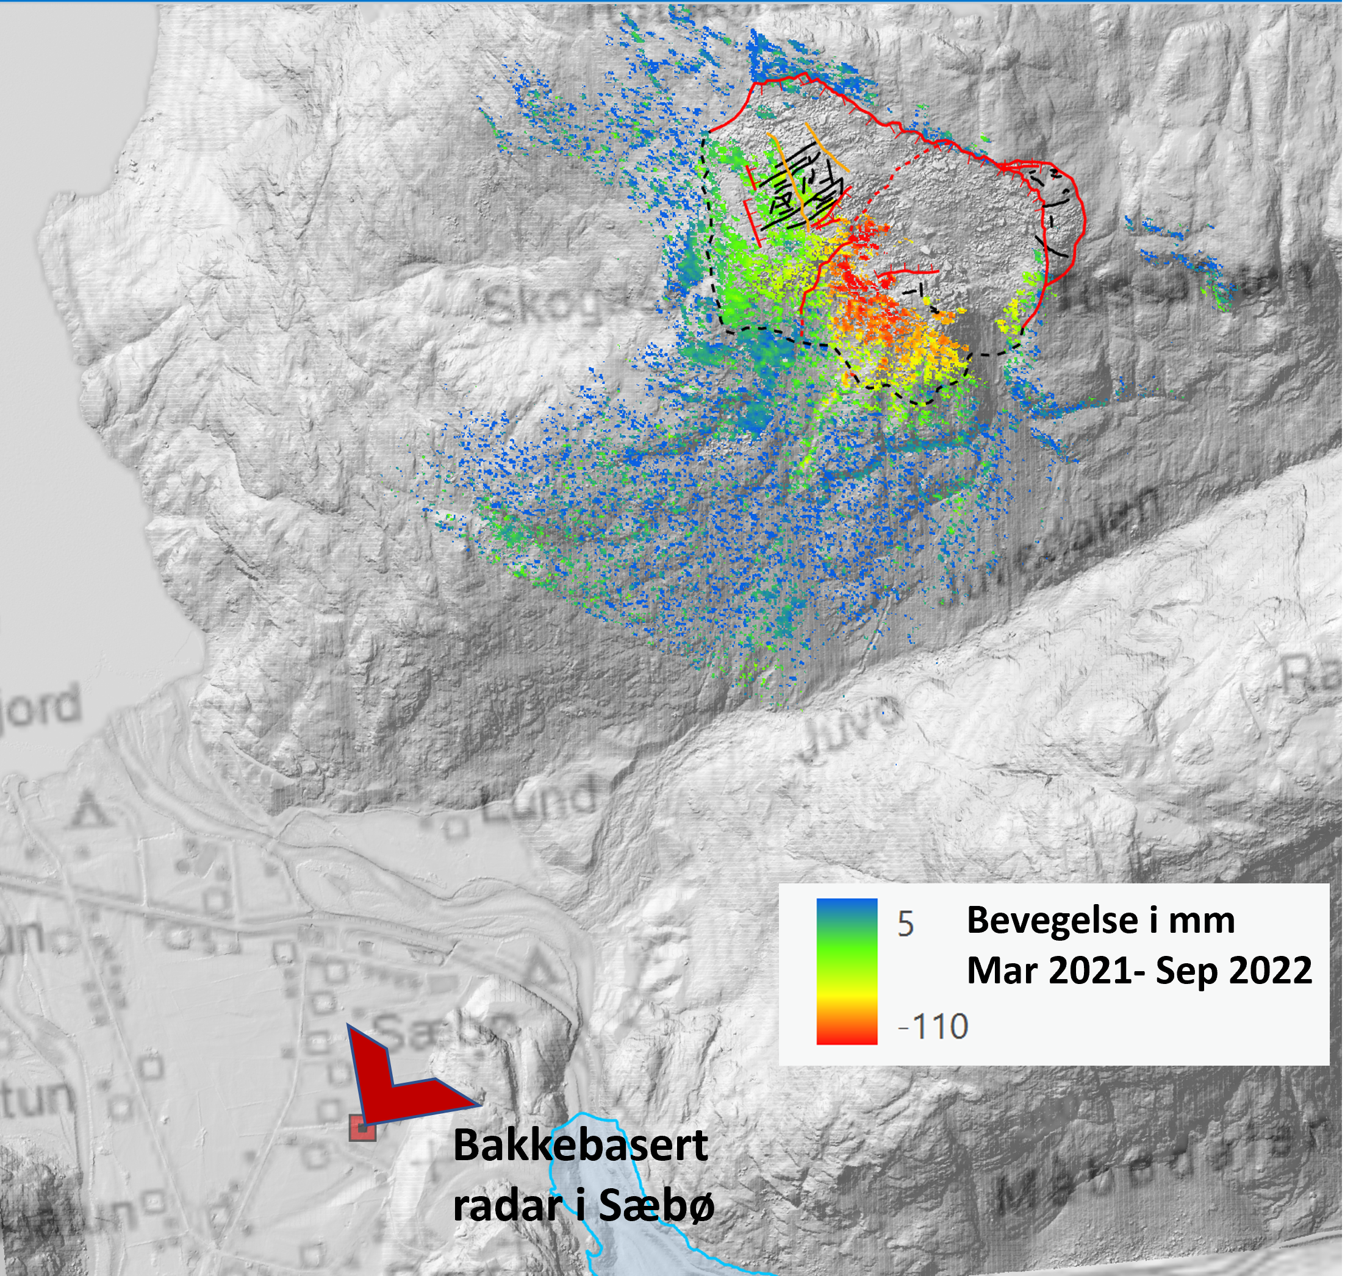
The Norwegian system – an example of early warning and hazard analysis for local communities
Identified slopes
Borehole measurements
Monitored slopes
Some near water bodies
Link between tsunami hazard model and early warning system
Rock slope monitoring using a variety of fit for purpose instrumentation systems e.g.
Boreholes, extensometers
InSAR
GPS
Microseisms
Slope motion mirrored into regional hazards models
Early warning issued a minimum of 72 hours in advance of slide release
InSAR
GPS station
Courtesy:
Lene Kristensen NVE

Slide 11
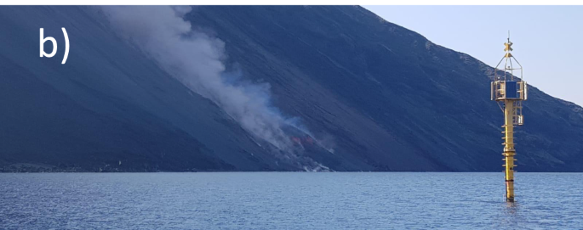
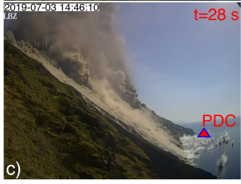
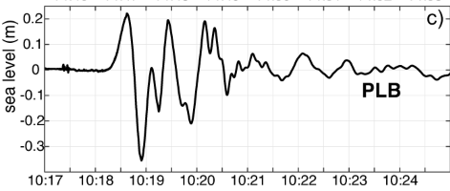
Scaling up: Challenges related to hazard, risk analysis, early warning
Statistical background often lacking, limited, or lacks dating
Data on slope information limited or non-existing
Difficult to constrain volumes and probability
Acquiring data often expensive, and limited to local investigations
More local nature of landslides makes them more difficult to survey
They are not necessarily linked to triggers or precursors – and travel times can be short
→ Warning times based on wave measurements may be too short
Zengaffinen-Morris et al. (2022), JGR Oceans
Stromboli wave recording
Ripepe and Lacanna (2024), Nature Comm

Slide 12
Some final reflections
Landslide tsunamis recognized as an important source for tsunami hazards
Tsunami hazard models less developed, partly because of lack of data
New hazard models will depend on data, either past landslide statistics or slope stability data and models – without it we cannot quantify return periods (only conditional hazard)
With respect to early warning for all, landslide tsunamis constitute a major challenge:
There are few systems today (Norway and Stromboli perhaps the only ones)
Landslide tsunamis are highly local
Wave signature different from earthquakes, and difficult to test as data is lacking
Need for instrumentation extensive and expensive – regional efforts might become infeasible at present
Most effective for areas with known hazard / slope instability

Slide 13
Extra slides

Slide 14


Outstanding questions and gaps – the GTM community response from 2021
Gap 1: Understanding and quantifying landslide volume probability
G1
Gap 4: Lack of available benchmark tests
G5
G3
G6
G2
Many of the landslide related gaps rank high
In particular landslide probability highest but also most difficult
Importance
G4
Gap 3: Lack of constrains on landslide dynamics
Gap 6: Lack of ability to accurately model tsunami generation
Gap 2: The difference in tsunami genesis – from onshore to offshore
Gap 5: Limited past events to inform hazard models
Difficulty to achieve

Slide 15
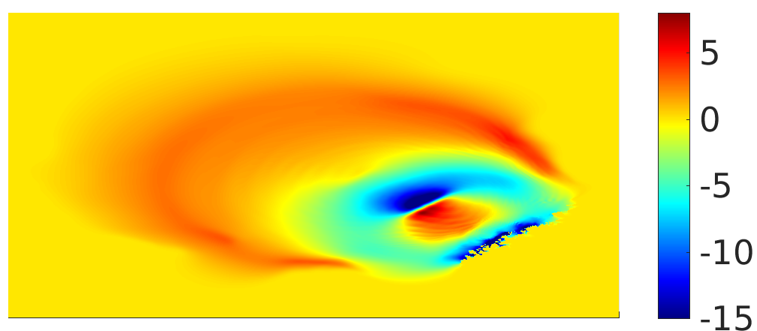
Submarine landslide tsunami generation
Basic generation mechanism from submarine landslide
Mechanism: Water volume displaced by landslide
Time dependent, the motion of the landslide matters
Wave shapes differs from earthquake tsunamis
Dipole or quadrupole shape – different aspect ratio
Shorter wave-length
Main factors of importance
Water depth – shallow events more tsunamigenic
Slope – higher acceleration and velocity increases the tsunami-genesis
Drawdown
Elevation
Quadrupole shape –
Storegga slide
PNG – slump - dipole
(Lynett et al., 2003)
Frequency dispersion

Slide 16
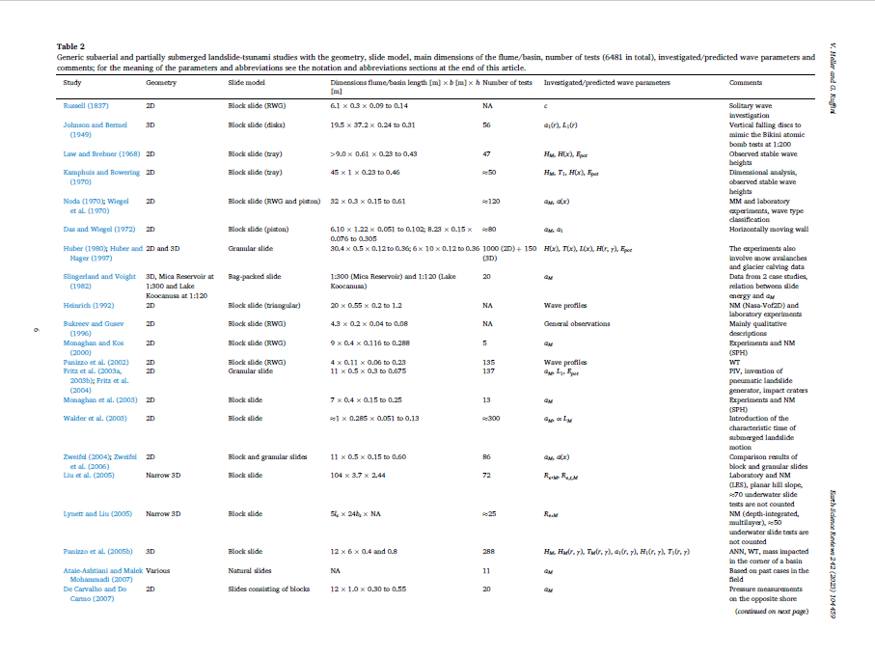
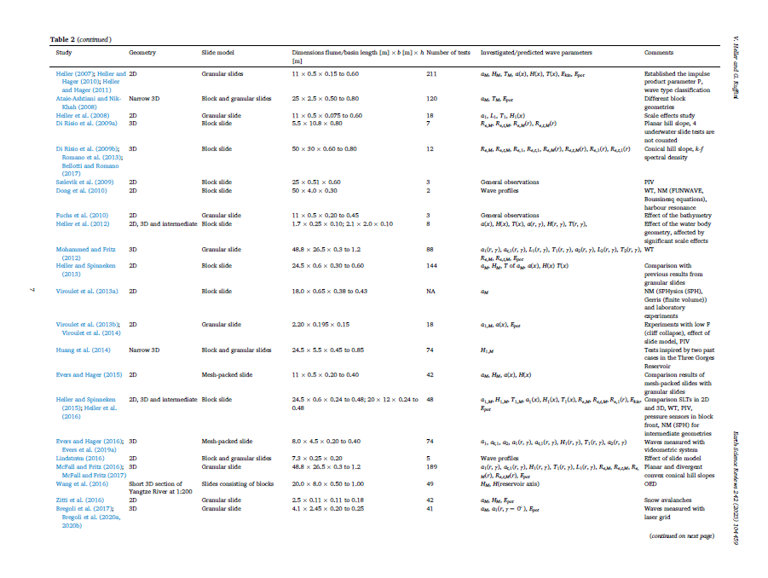
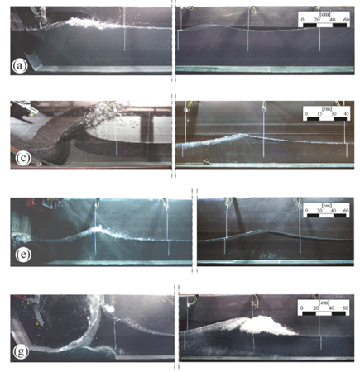
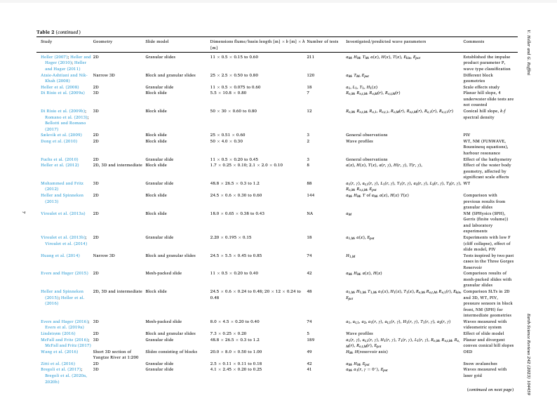
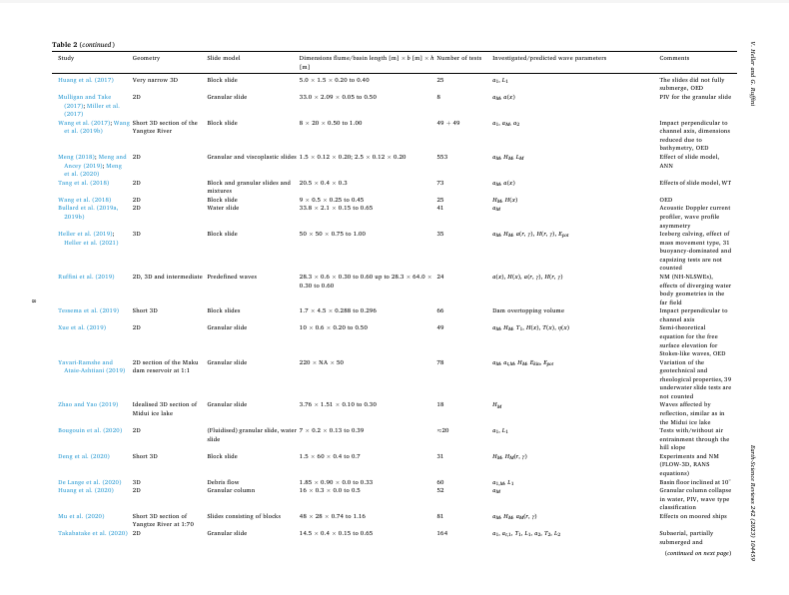
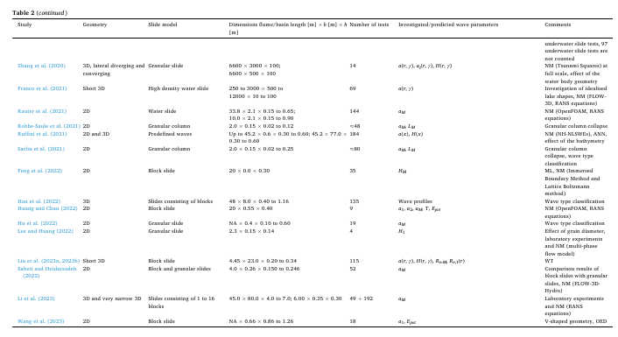
Subaerial landslide tsunami generation
Generation mainly due to the surface impact
Extensively studied in laboratory – numerous papers (likely more than 100 studies)
Wide range of source mechanisms and geometric settings
Various scaling expressions in literature
No consensus model
Parametric scaling relationships – main parameters:
Impact velocity
Frontal area
Review of impact tsunamis studies:
Heller and Ruffini (2023), ESR
Many studies, but heterogeneous outputs
Bullard et al., (2019)

Slide 17
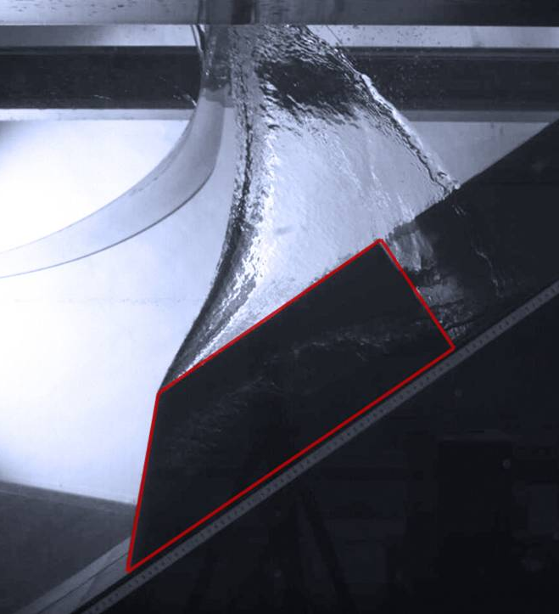
Landslide and tsunami models must be combined for optimal predictions
Landslide dynamics models
Clay dominated: Cohesive fluid dynamics models
Particle interaction dominated, sand / rock: Frictional collisional fluid dynamics models
Hydrodynamic resistance / interaction, erosion, entrainment
Coupling (from seabed to wave generation)
Tsunami propagation model needs
High order dispersion most often needed, e.g. Boussinesq models, layered models, or full 3D models
Subaerial slides – rock avalanches – hydrodynamic cratering
Demanding models – need for some compromise for feasibility for e.g. hazard studies
Submarine clay dominated slide
Effects of granular collisions on dynamics
Impact and generation

