Slide 1
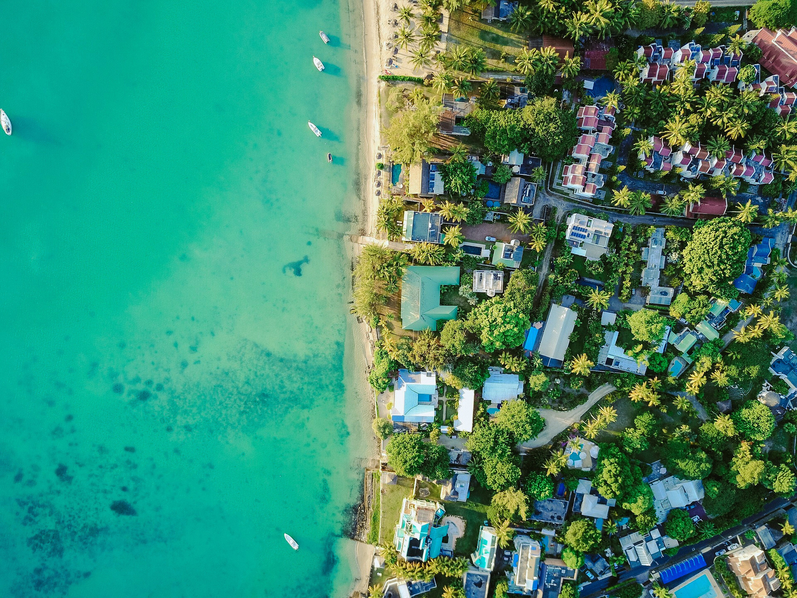




FIRST CONFERENCE OF THE OCEAN DECADE TSUNAMI PROGRAMME
Ceci Rodríguez Cruz
Hyderabad, India
10-11 November 2025

Slide 2

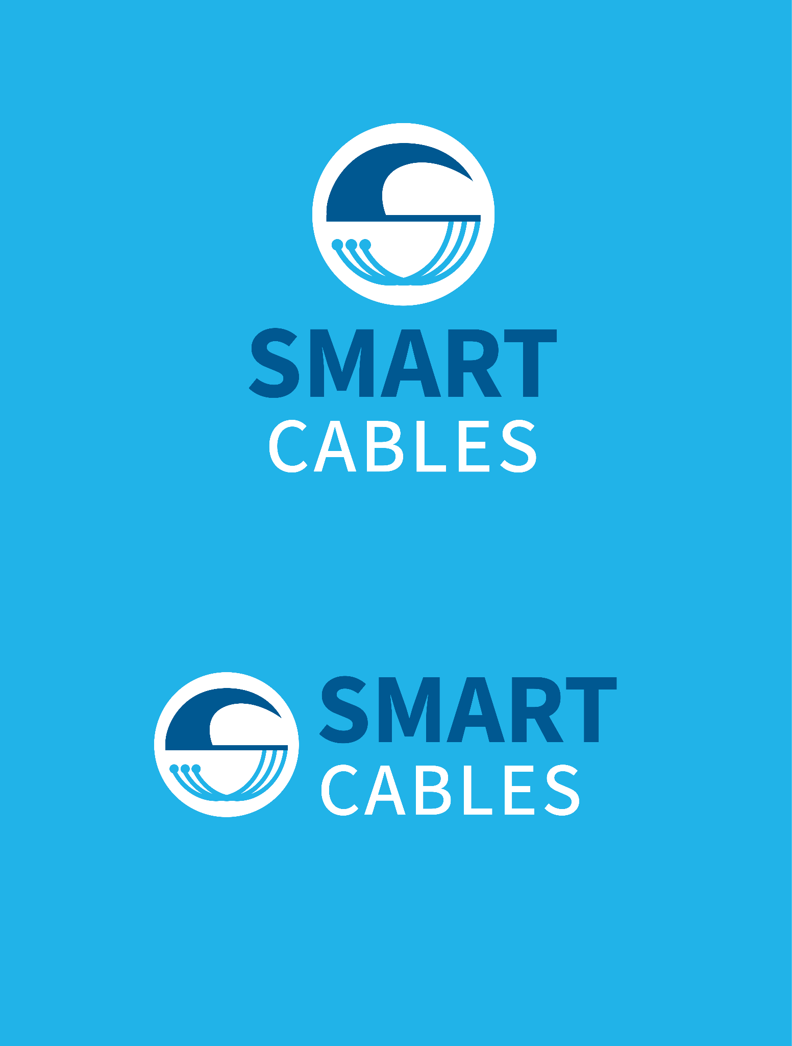


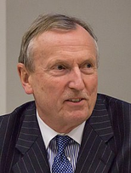
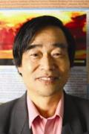
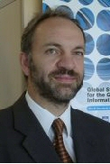


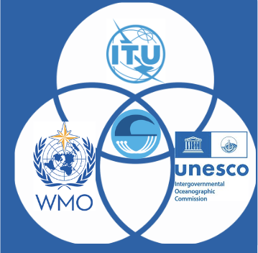
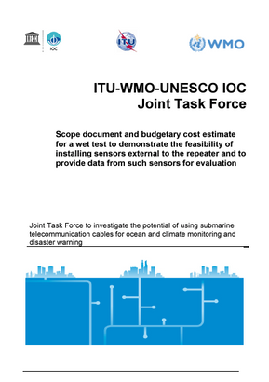
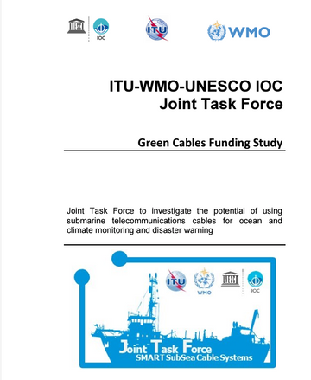
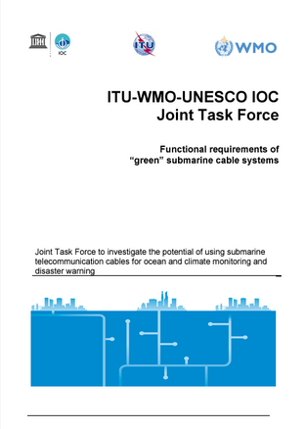

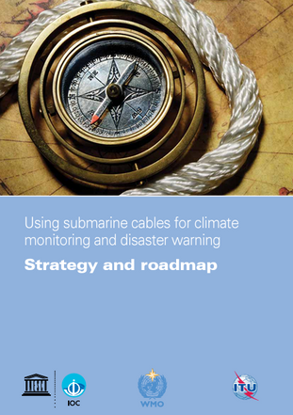
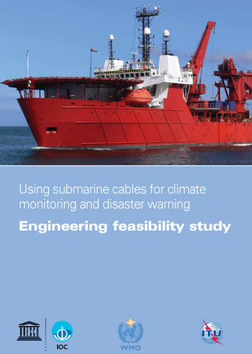

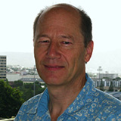
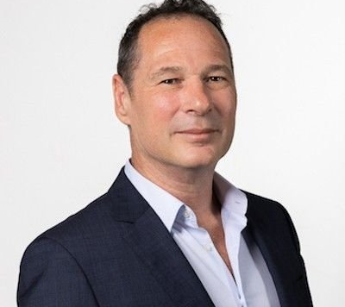
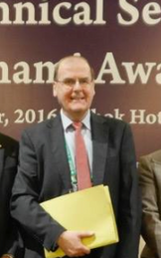
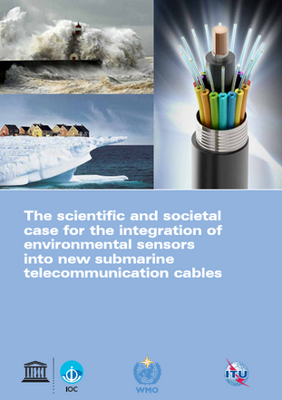





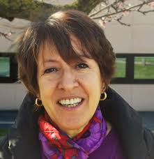



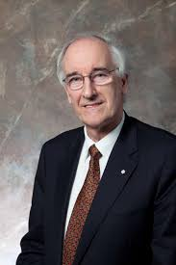

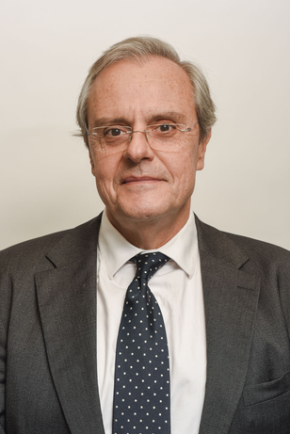
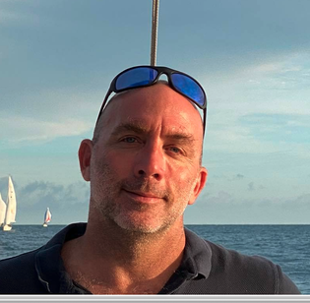
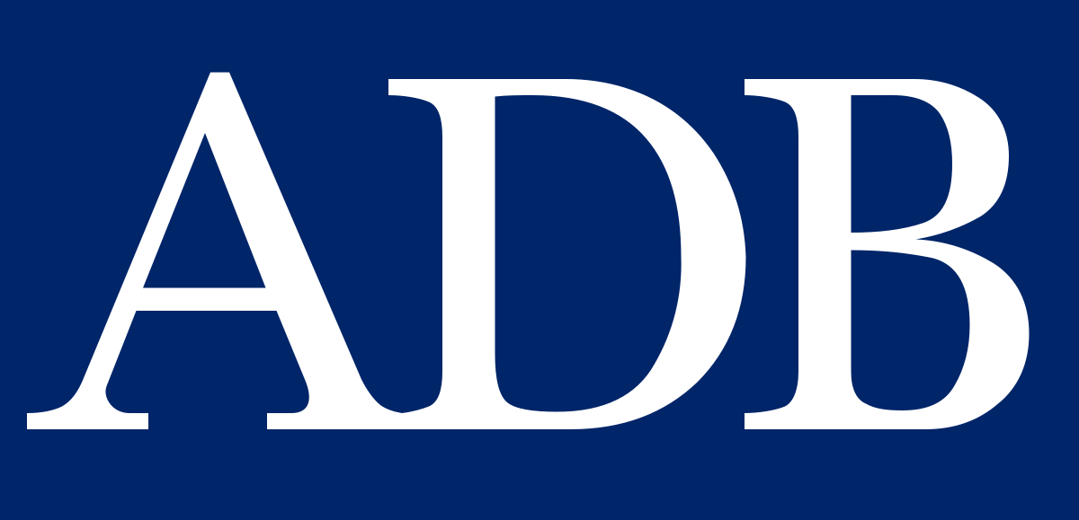


ITU/WMO/UNESCO-IOC JTF SMART Cables
GOAL
Malcolm Johnson
Reinhard Scholl
SMART CABLES GLOBAL NETWORK
John You
NOW
MOMENTUM!
2020
Wenjian Zhang
Thorkild Aarup
2016
COMMERCIAL AVAILABILITY
FOUNDATIONS
2011
CONCEPT

Slide 3
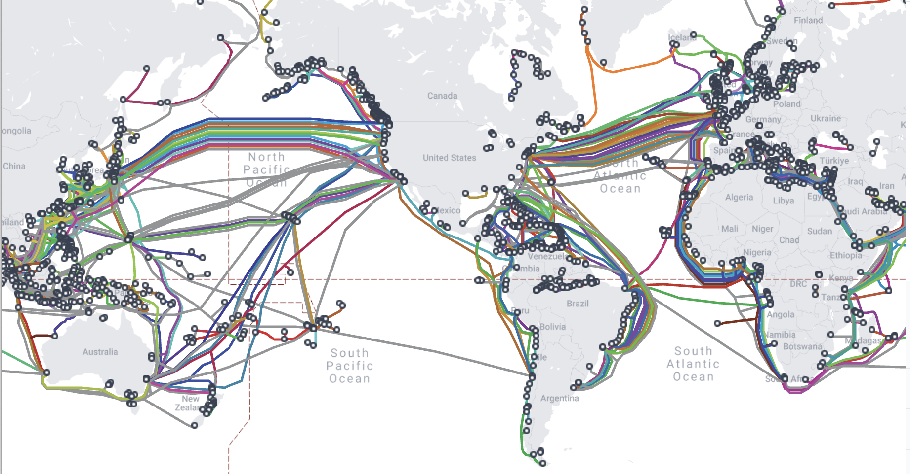
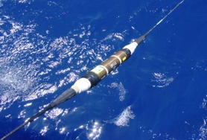

SMART Cables
Global Dual-Purpose Infrastructure (connectivity + science)
for the benefit of Society
NO Interference
Global array
1st order addition to Ocean-Earth observing system
Societal Benefit:
Climate
Oceans
Earthquakes
Tsunamis
Emerging
Network
2027 Systems:
Atlantic CAM
Tamtam
Know the environment, protect the network

Slide 4

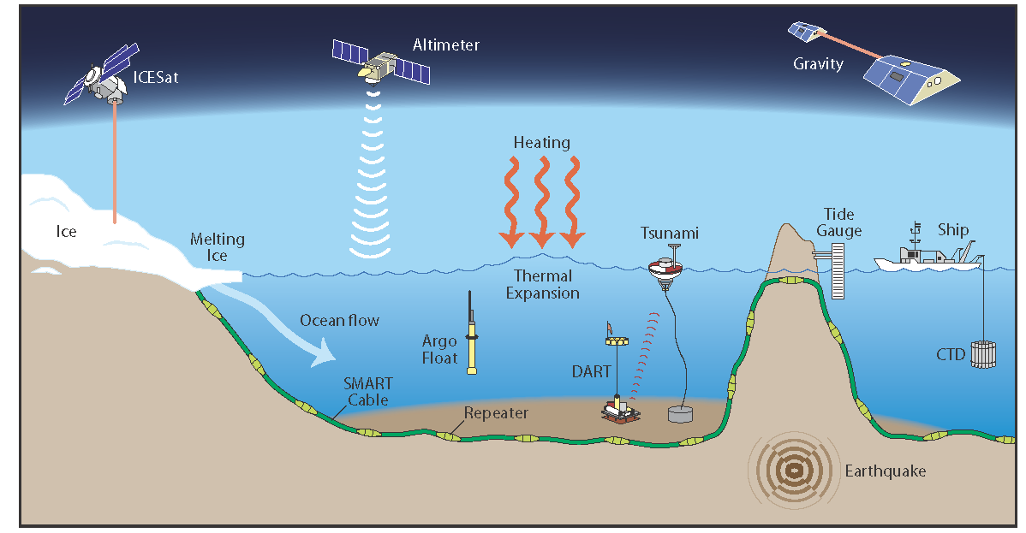

Ocean + Climate change – Long term Observation
Status Southern Ocean – SMART Can Help
SMART Cables Network
Emerging Network
of
GOOS
Monitor ocean circulation that drives weather and climate
SMART Cables measure Essential Ocean Variables:
Temperature, Pressure; Seismic motion + …

Slide 5
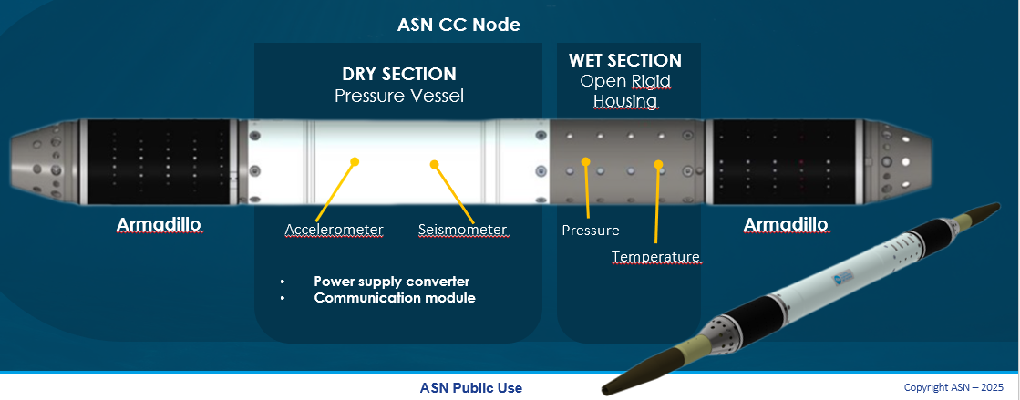
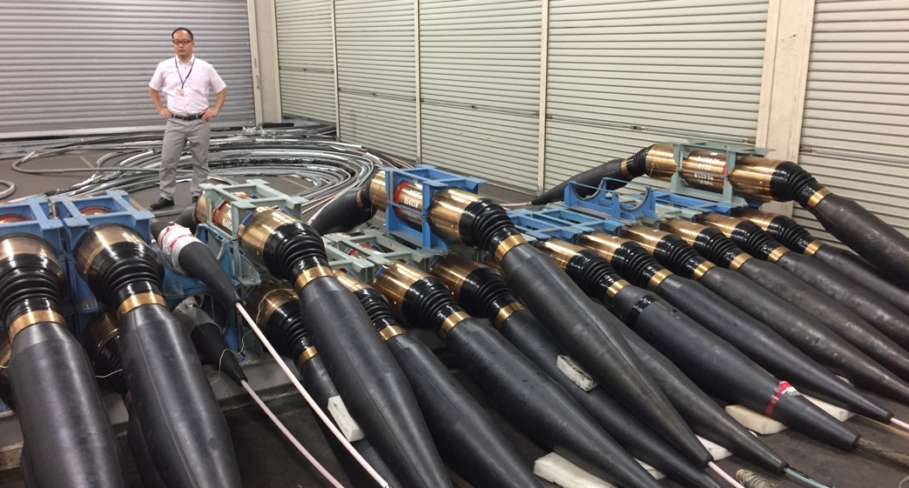
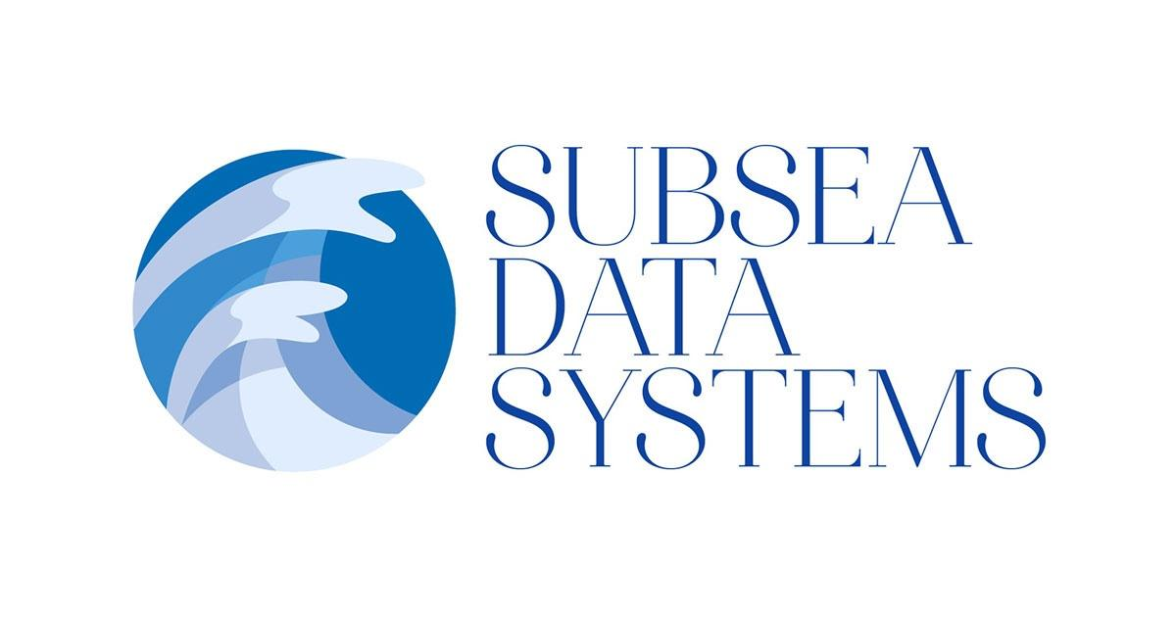

SMART Capability
Shared Cable Infrastructure: Telecom + Science
No Interference
Sensors:
Temperature
Pressure
Seismic
Key point:
Essential Ocean Variables, Global Ocean Observing System
Repeater
Existing Technology

Slide 6
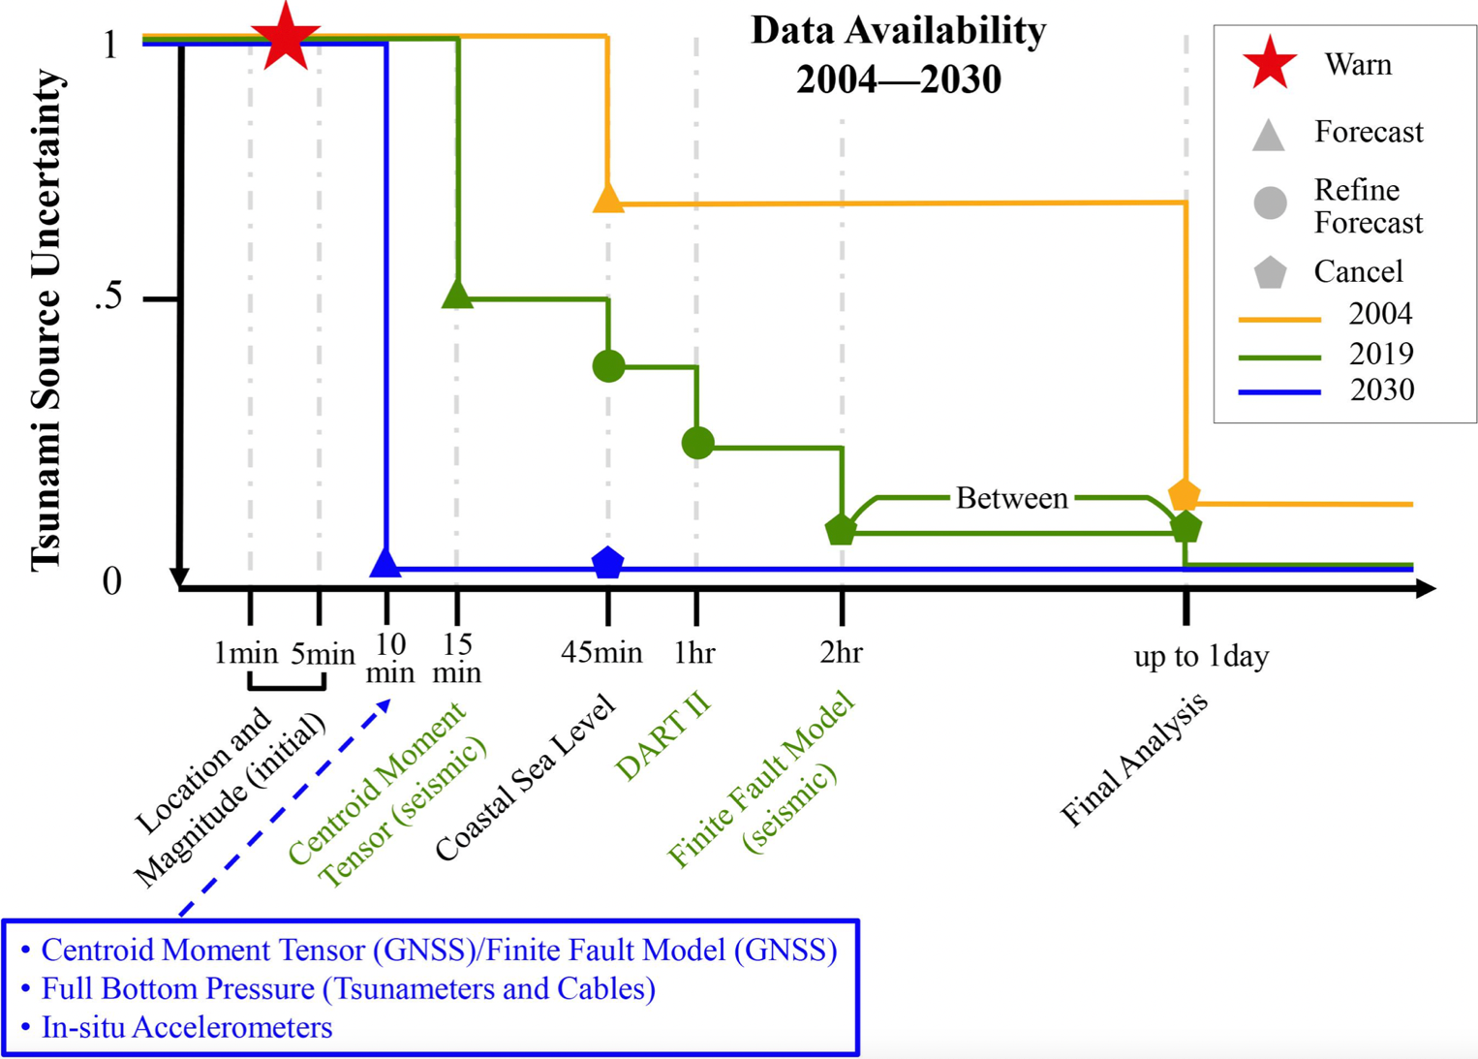
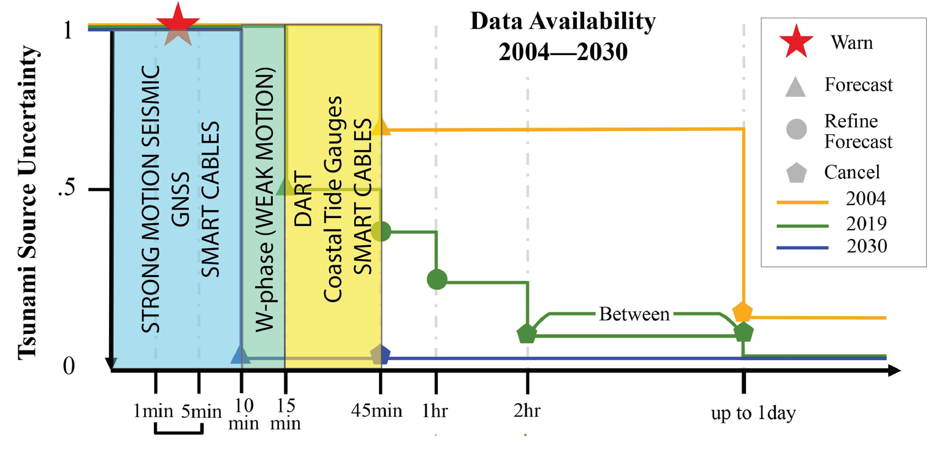

Ocean Decade Tsunami Programme
Improving
Early Warning
by integrating
SMART Capability into
early warning systems
2004
2019
2030

Slide 7
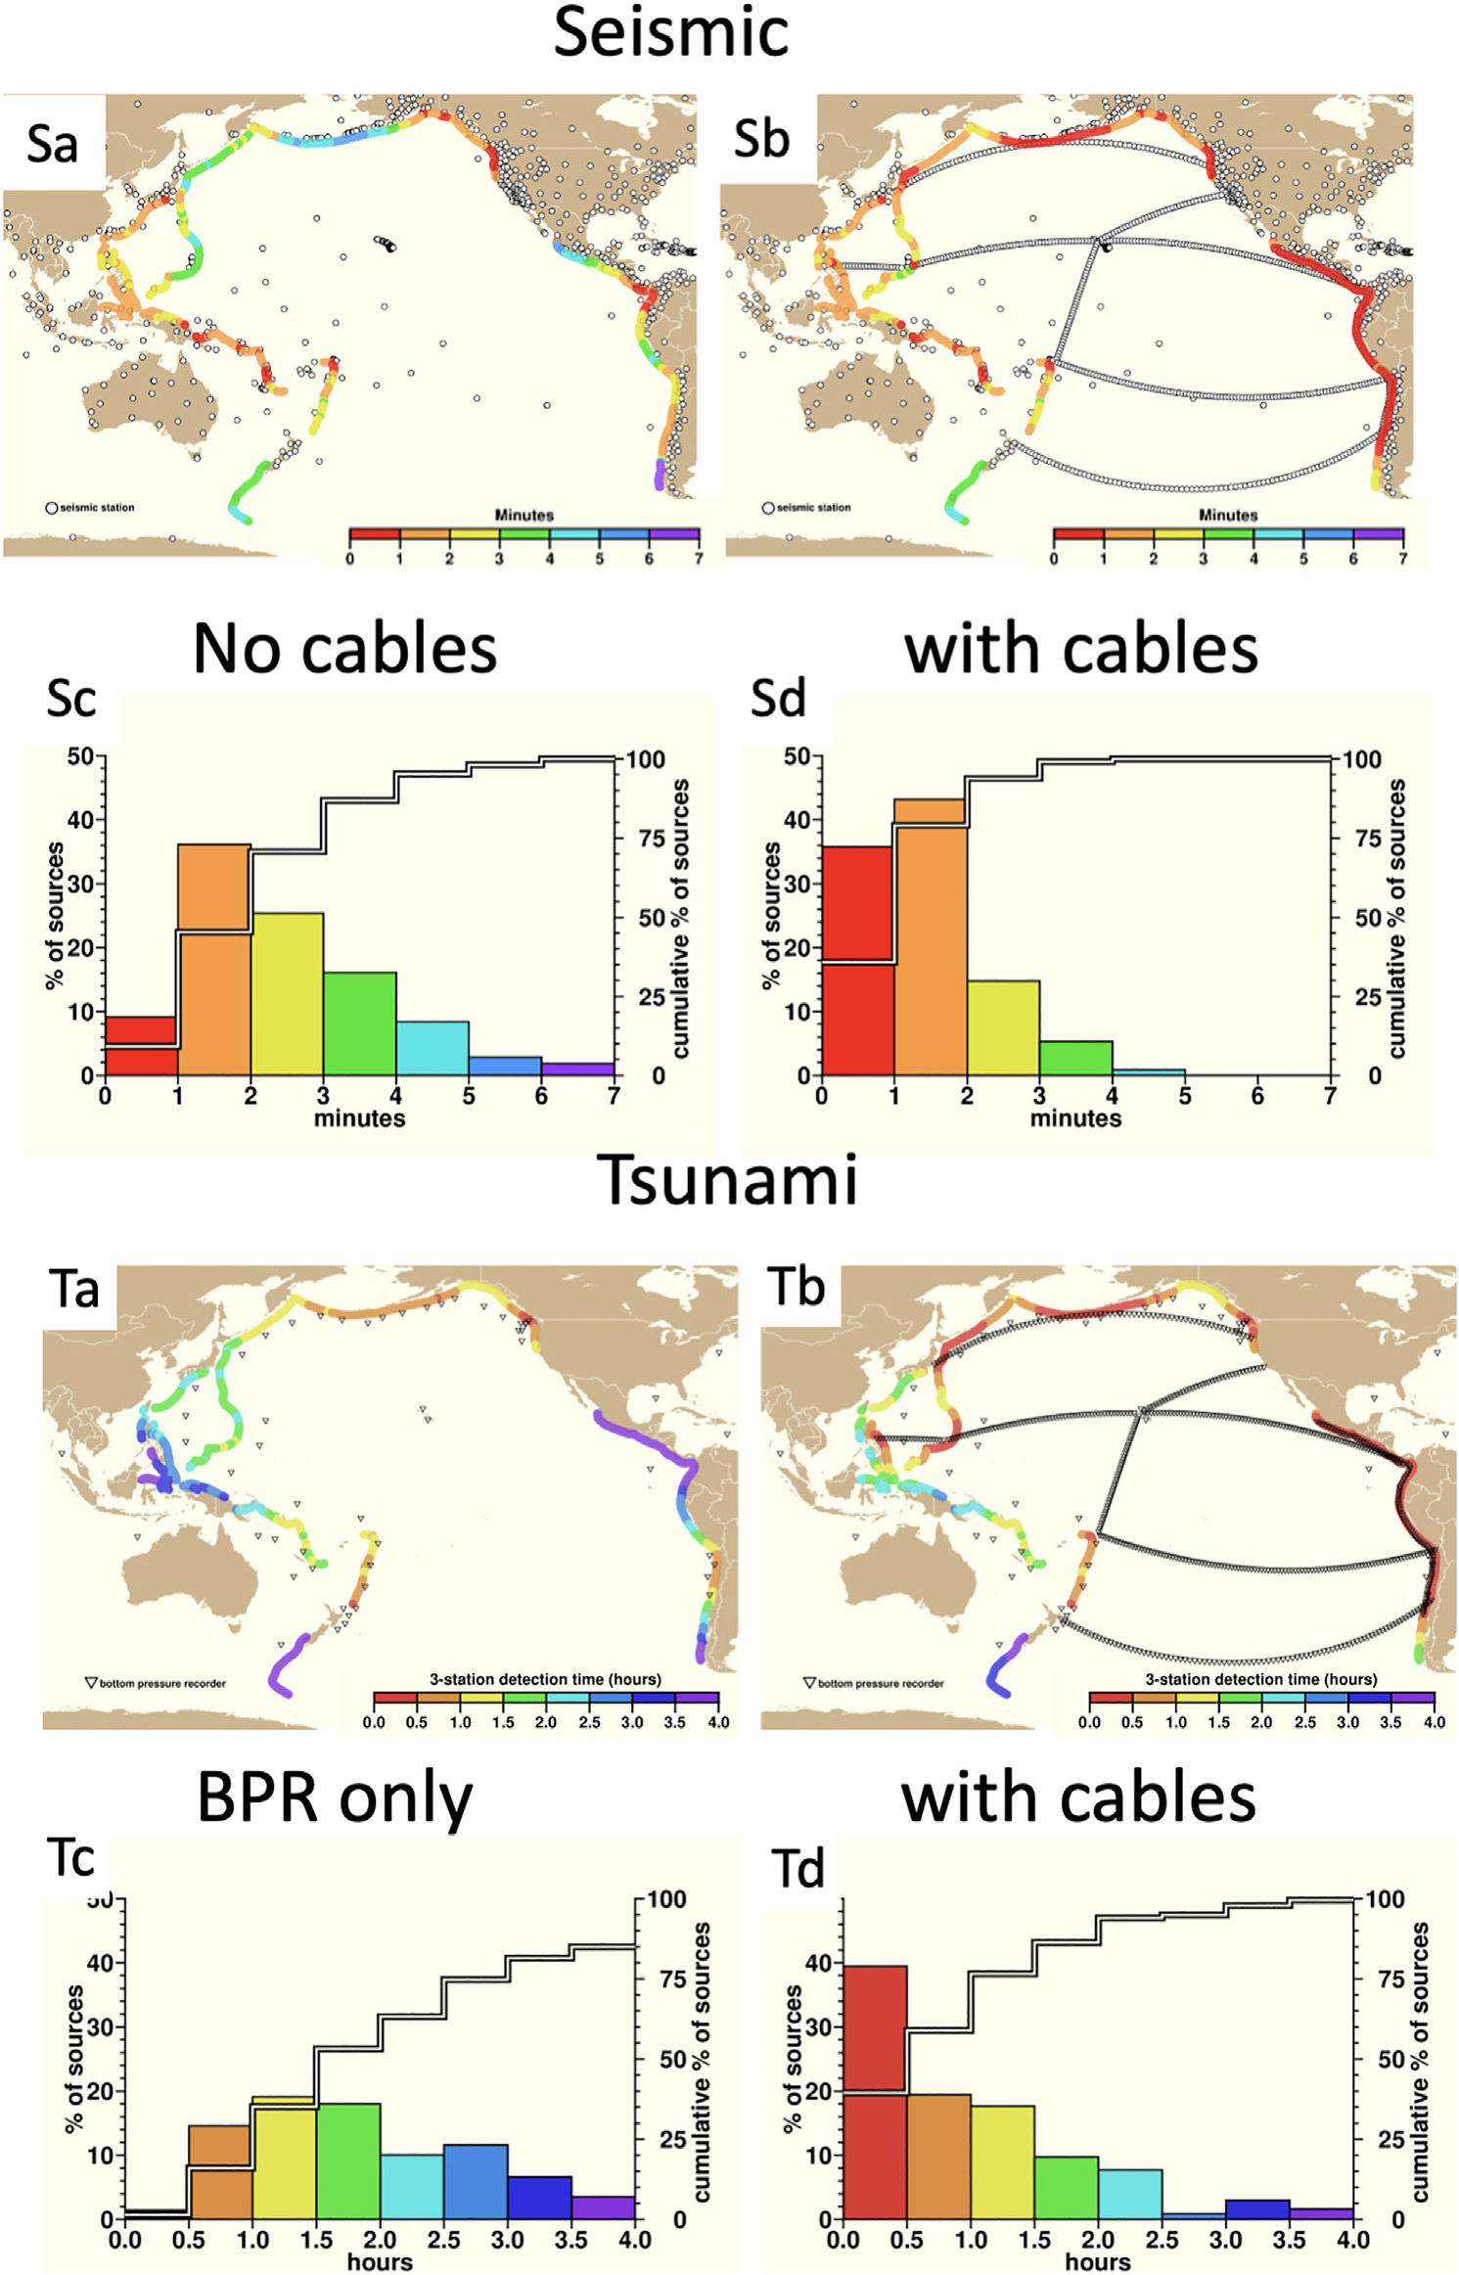



Earthquake and Tsunami Warning
0 - 4 hours
Time scales:
0 - 7 minutes
Travel time calculations,
assumed source locations (trenches)

Slide 8
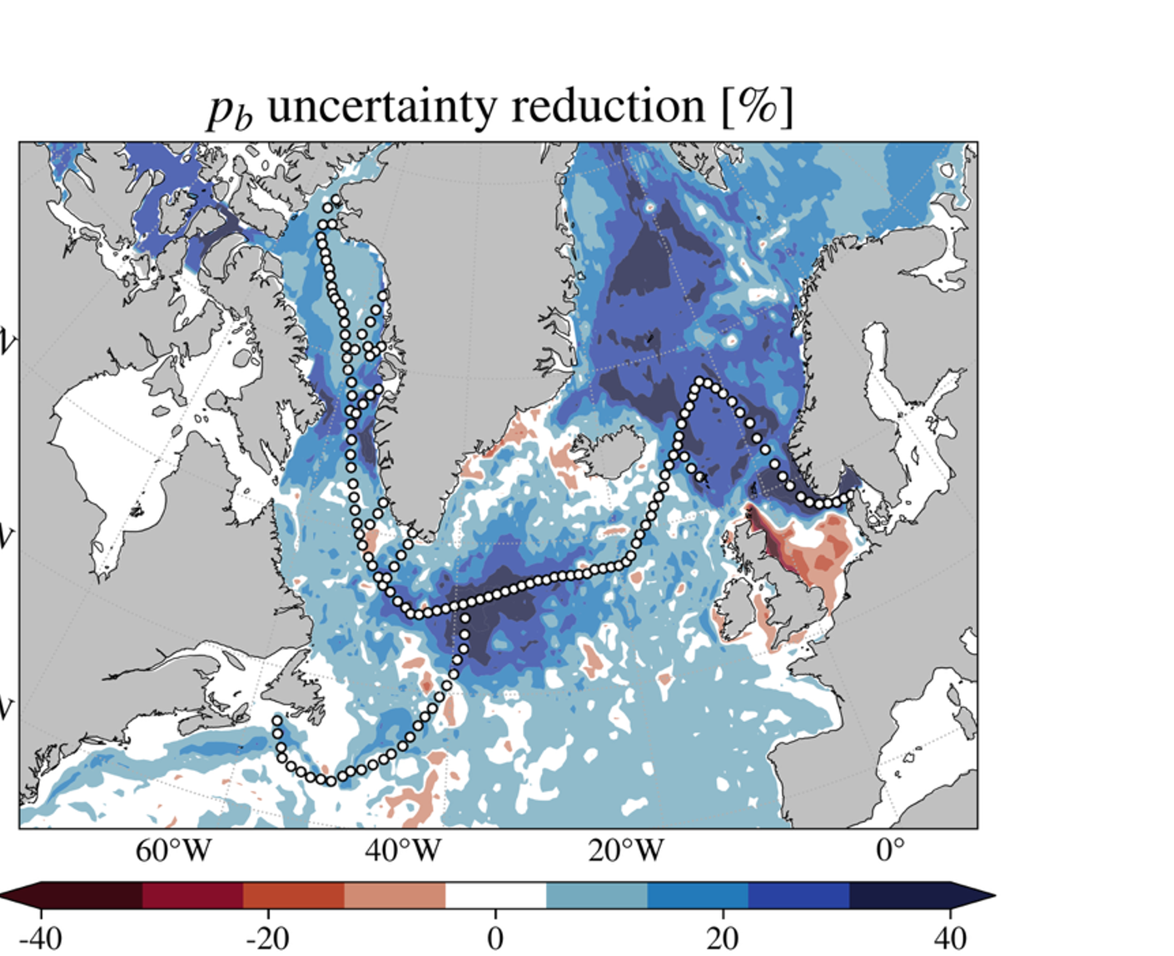
Observing System Simulation Experiment
Atlantic Meridional Overturing Circulation
Evaluating the potential of SMART subsea cable pressure sensors to constrain Subpolar North Atlantic circulation variability through Observing System Simulation Experiments
M. Goldberg, A. T. Nguyen, H. Pillar, B. M. Howe, P. Heimbach Submitted J. Atmos. Oceanic Tech. https://doi.org/10.31223/X51F2Z
Using computer simulations, … seafloor pressure measurements can reduce uncertainty in redistribution of water masses and freshwater due to ocean currents throughout the North Atlantic, a region critical for climate.
… changes in surface atmospheric pressure and winds strongly influence these signals. … high-frequency monitoring from seafloor cables effectively reduces uncertainty in sub-monthly ocean processes.
These results suggest that sensor-equipped cables will be a powerful addition for quantifying circulation variability and improving climate predictions.

Slide 9

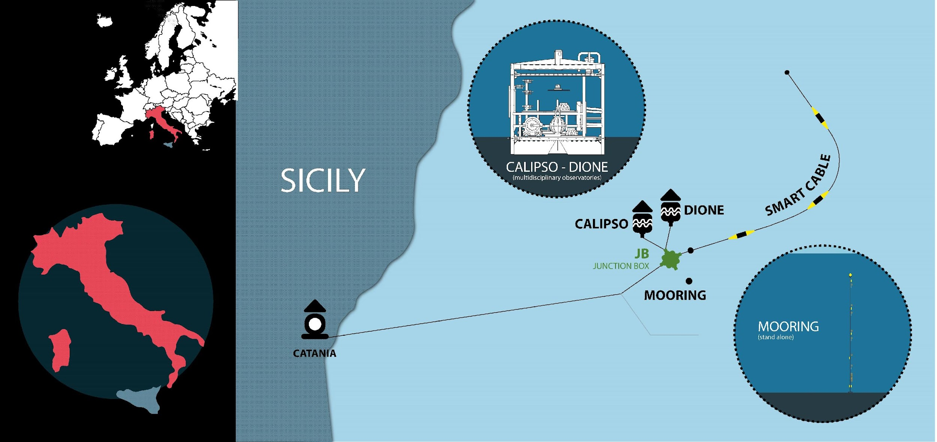




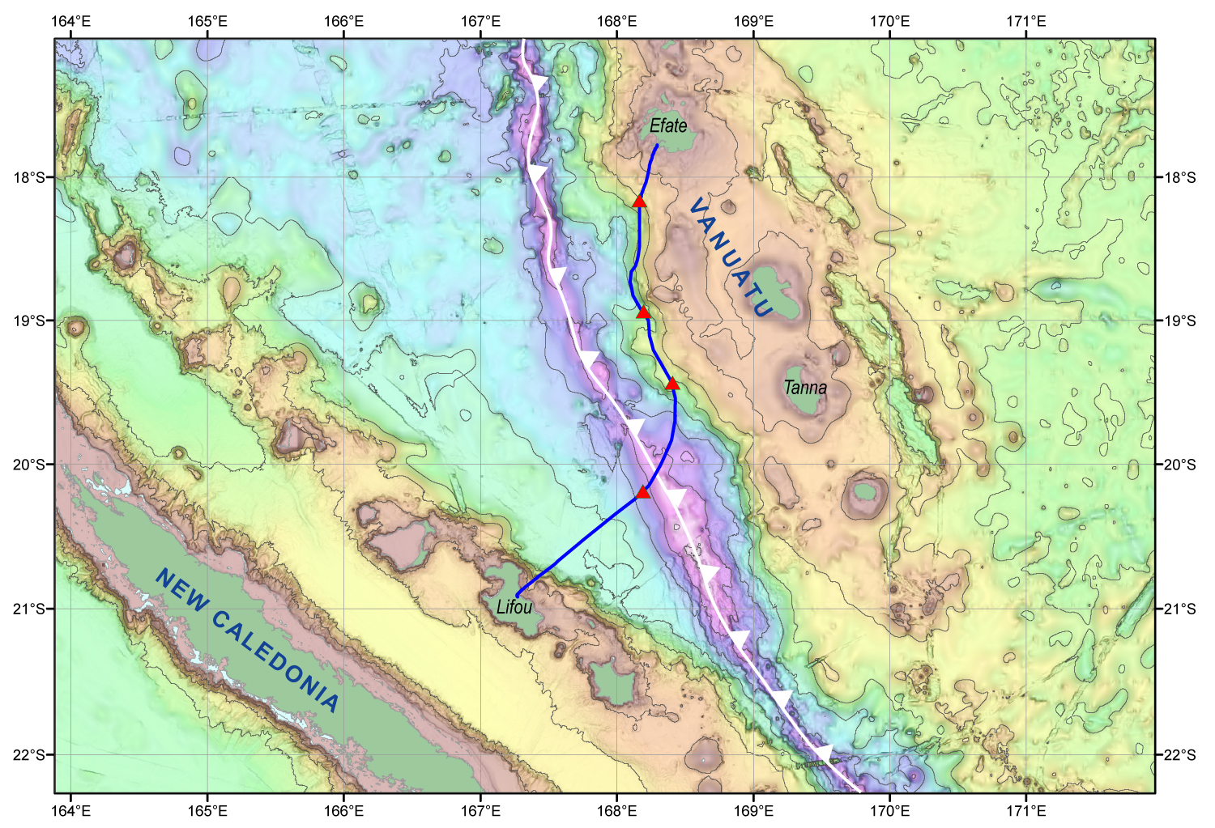
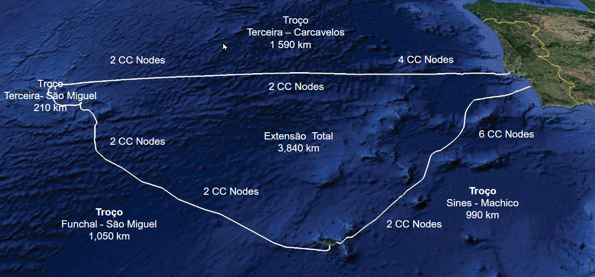


Global Momentum – Initial SMART Systems
InSEA Wet Demo
Tamtam
Atlantic CAM
Carcavelos
Terceira Is.
Sines
S. Miguel Is.
Atlantic CAM
Total extension
5 fp (telecom)
+ 1 fp (SMART)
+ 1 fibre at each landing for DAS (~100 km)
154 M€ total investment
(1/3 CEF2 + 2/3 Public)
Madeira Is.
DAS (over ~100 km)
CC Nodes (location of CC Nodes zone is indicative)

Slide 10
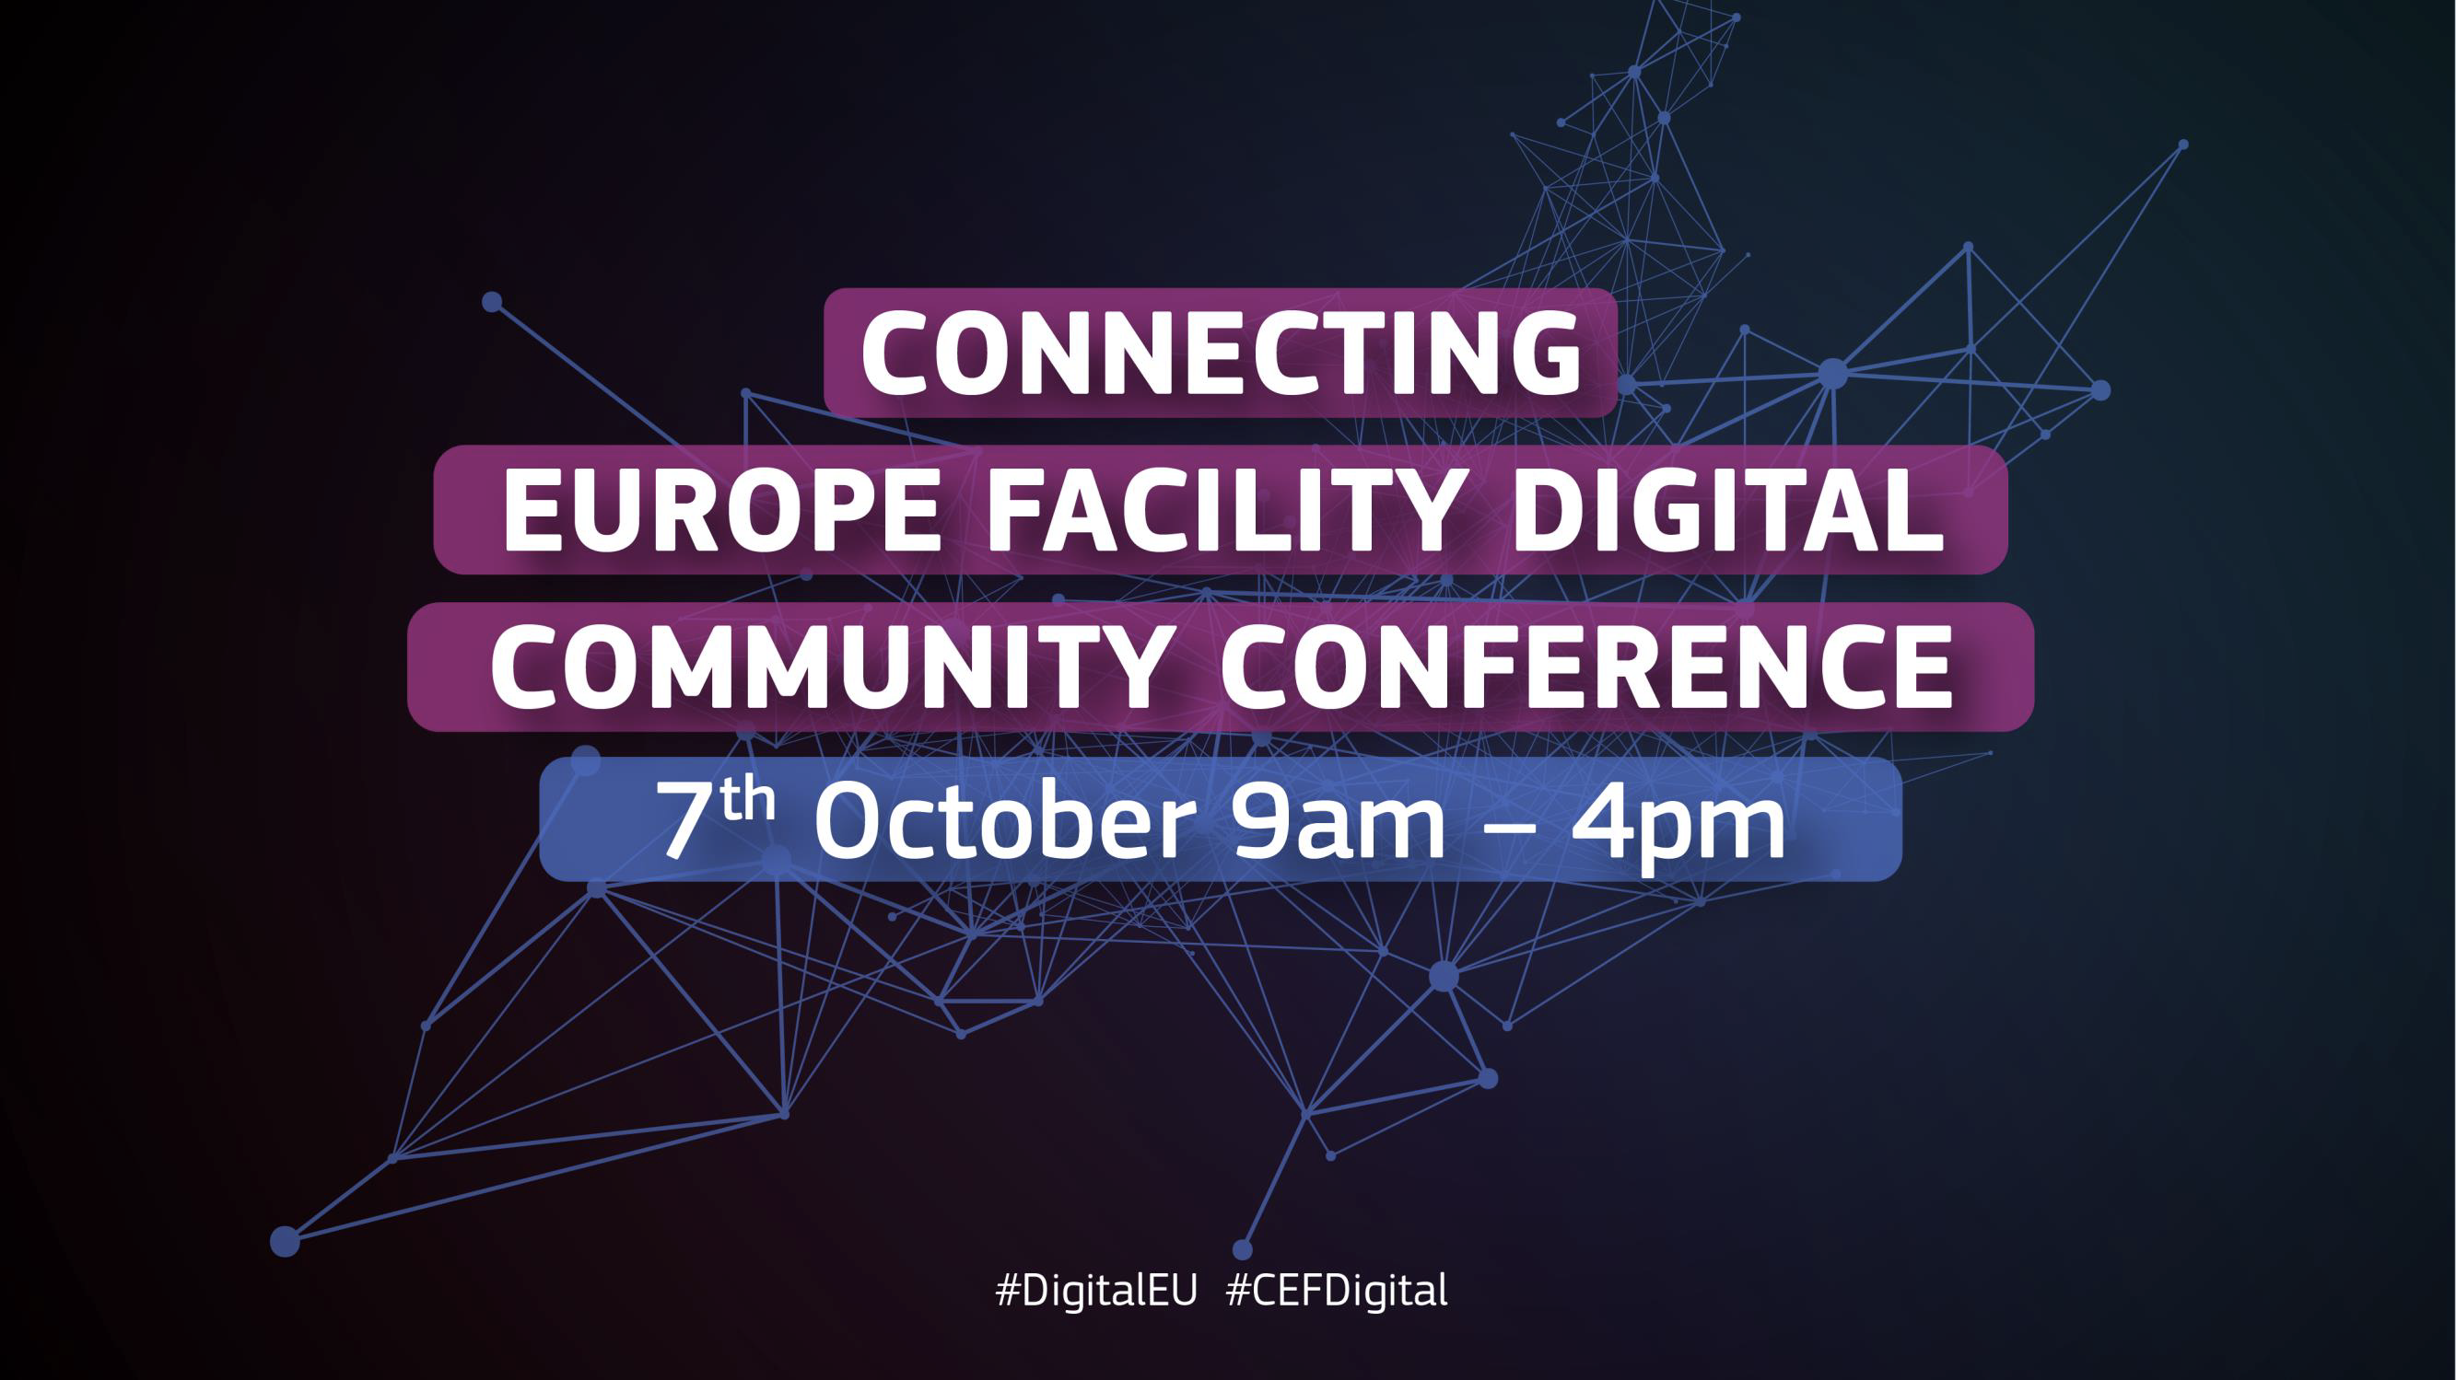

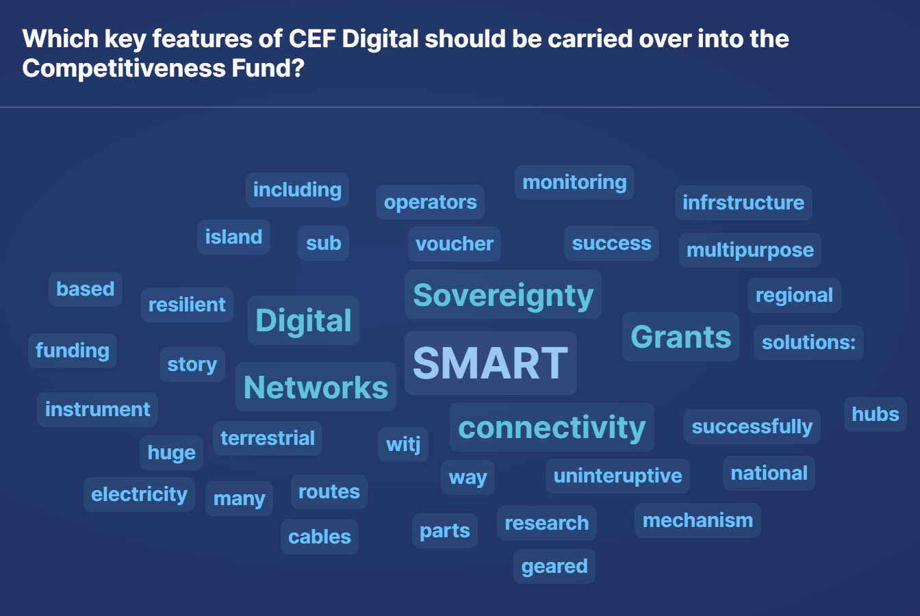
Global Momentum – European Commission
New projects signed under CEF Digital to enhance and strengthen submarine cable infrastructure across and to the EU
(5 December 2024)
Many of the funded projects include SMART technologies, …
JOINT COMMUNICATION TO THE EUROPEAN PARLIAMENT AND THE COUNCIL
EU Action Plan on Cable Security 21.2.2025
2.2.3 Smart Cables and early warning
CEF Digital promotes smart cables in the 2024-27 work programme.

Slide 11



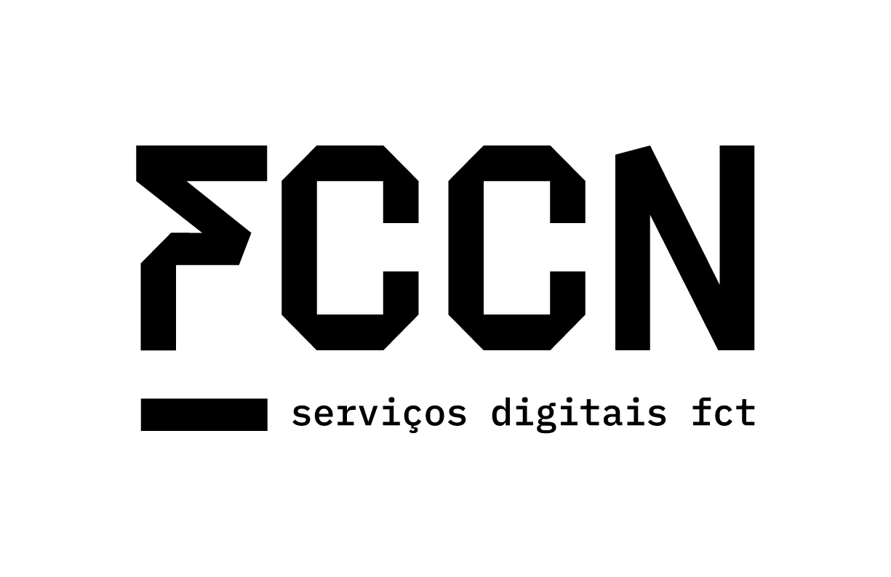


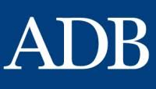
Global Momentum – New stakeholders on board!
Research and Education Networks
Multilateral Banks
Academia
Researchers
Government and agencies
Companies
Including optical fiber sensing

Slide 12
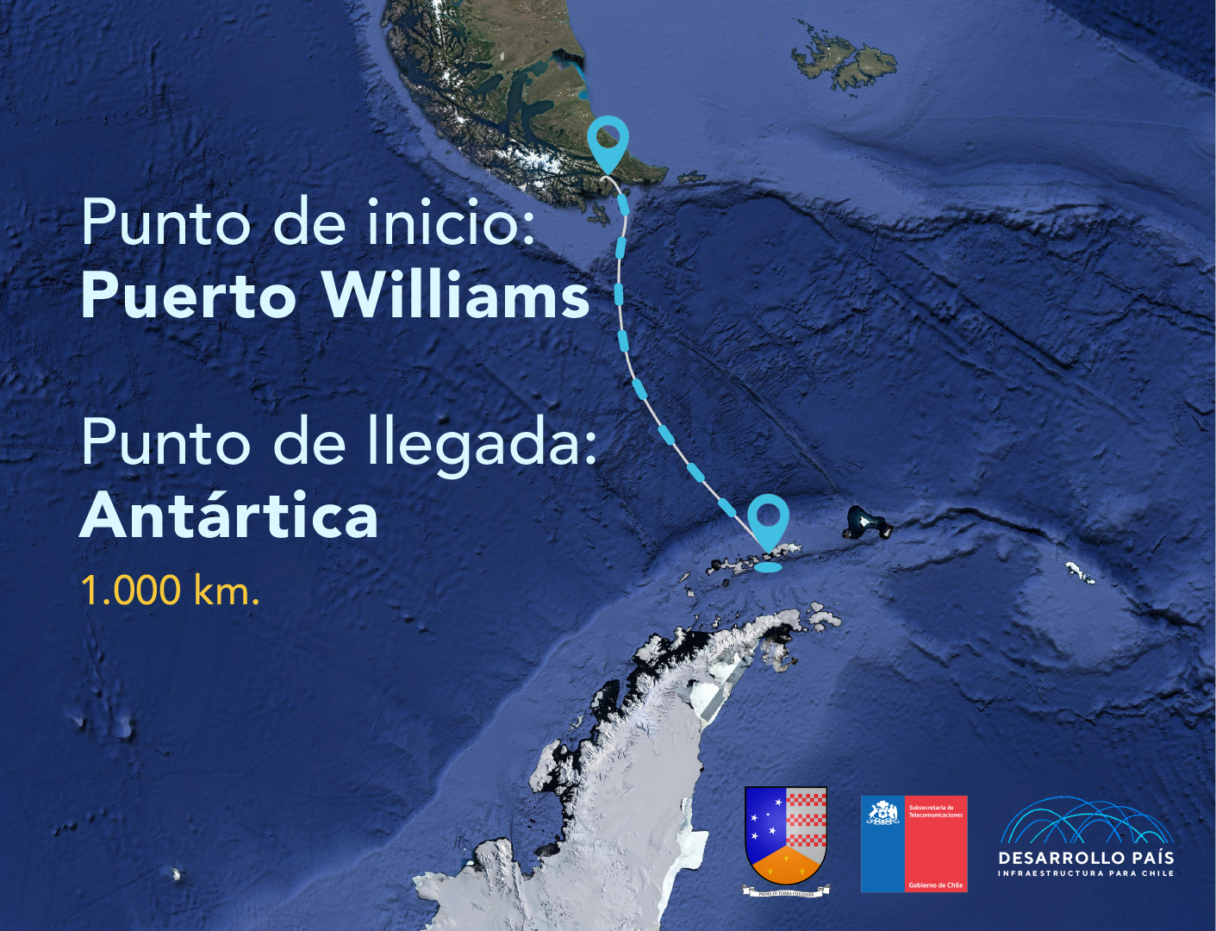
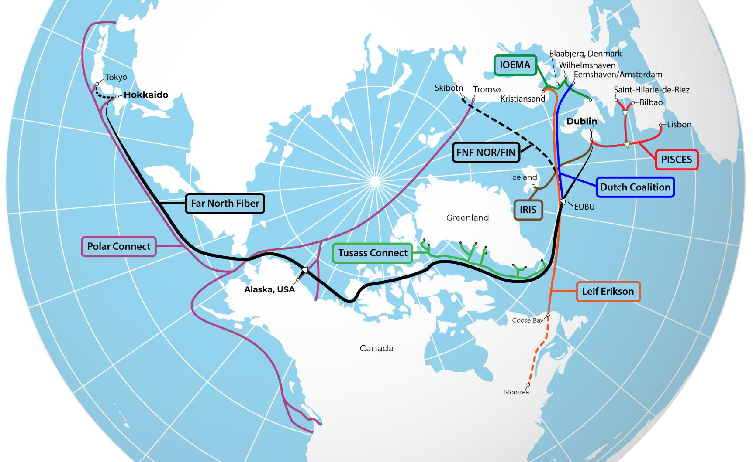
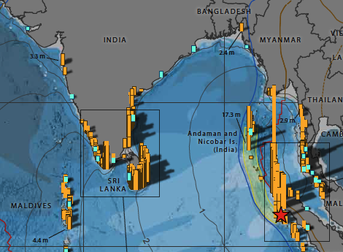
Global development
Polar Connect, Far North Fiber, Tussas, PISCES, IRIS, IOMEA, +
Antarctica Chile
Drake Passage
Indian Ocean
Andaman Islands

Slide 13

SMART
Global Array: Climate, Oceans, Sea Level, Earthquakes, Tsunamis
Science + Subsea telecom + governments = to serve
Dual purpose infrastructure
Transform global connectivity into a real-time observing network for resilience and climate
Part of the global environmental monitoring system
Together with the Ocean Decade Tsunami Programme, we advance a future where every person at risk receives timely warning.
Member States and partners worldwide are turning vision into action.

Slide 14


Scan to Join!
10-11 November 2025
INCOIS, Hyderabad, India
First Conference of the
Ocean Decade Tsunami Programme

