Slide 1
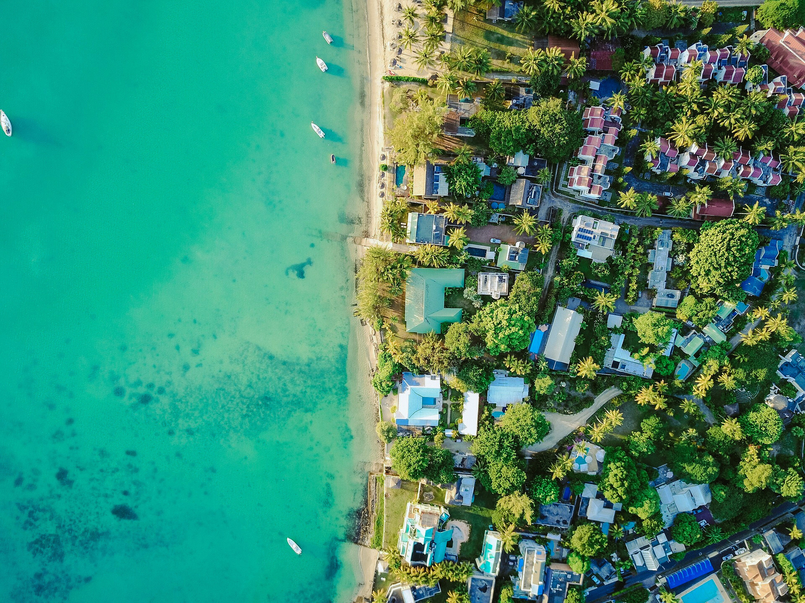



FIRST CONFERENCE OF THE OCEAN DECADE TSUNAMI PROGRAMME
Hyderabad, India
10-11 November 2025

Slide 2


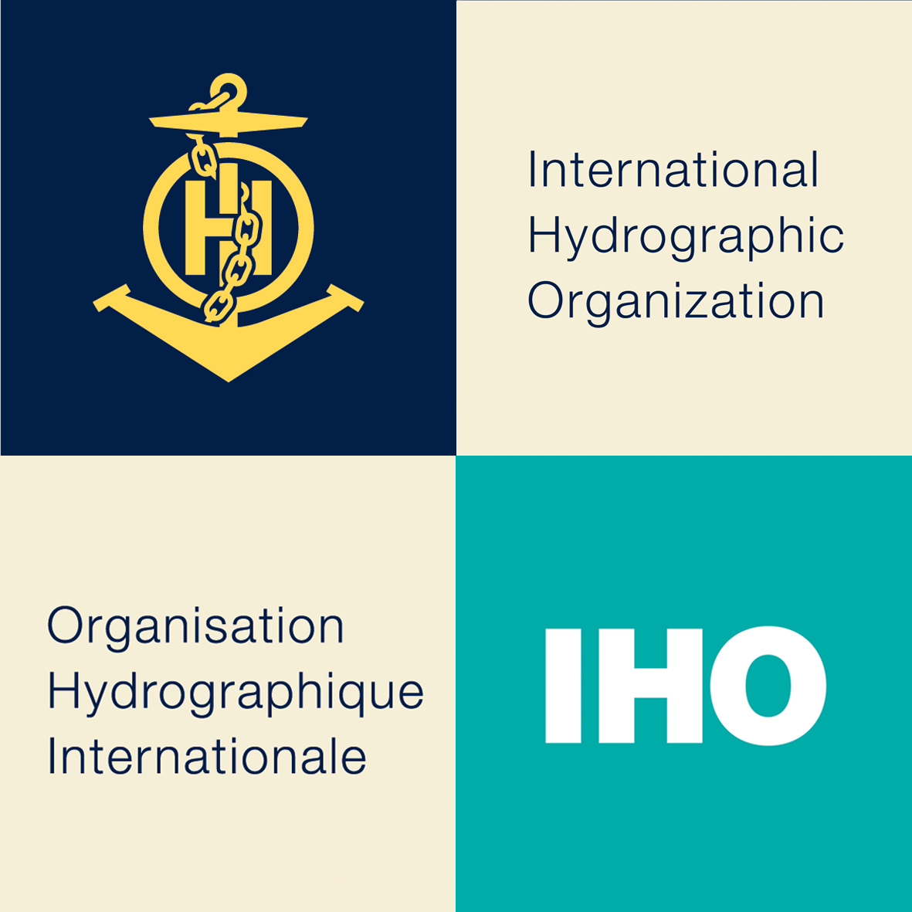

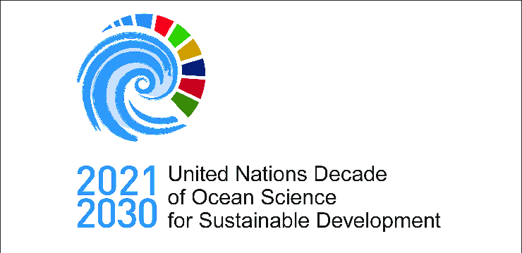

SEABED 2030
Accelerating Ocean Floor Mapping
Steve Hall CMarSci FIMarEST
Seabed 2030 Head of Partnerships
partnerships@seabed2030.org
10-11 November 2025
INCOIS, Hyderabad, India
First Conference of the
Ocean Decade Tsunami Programme

Slide 3
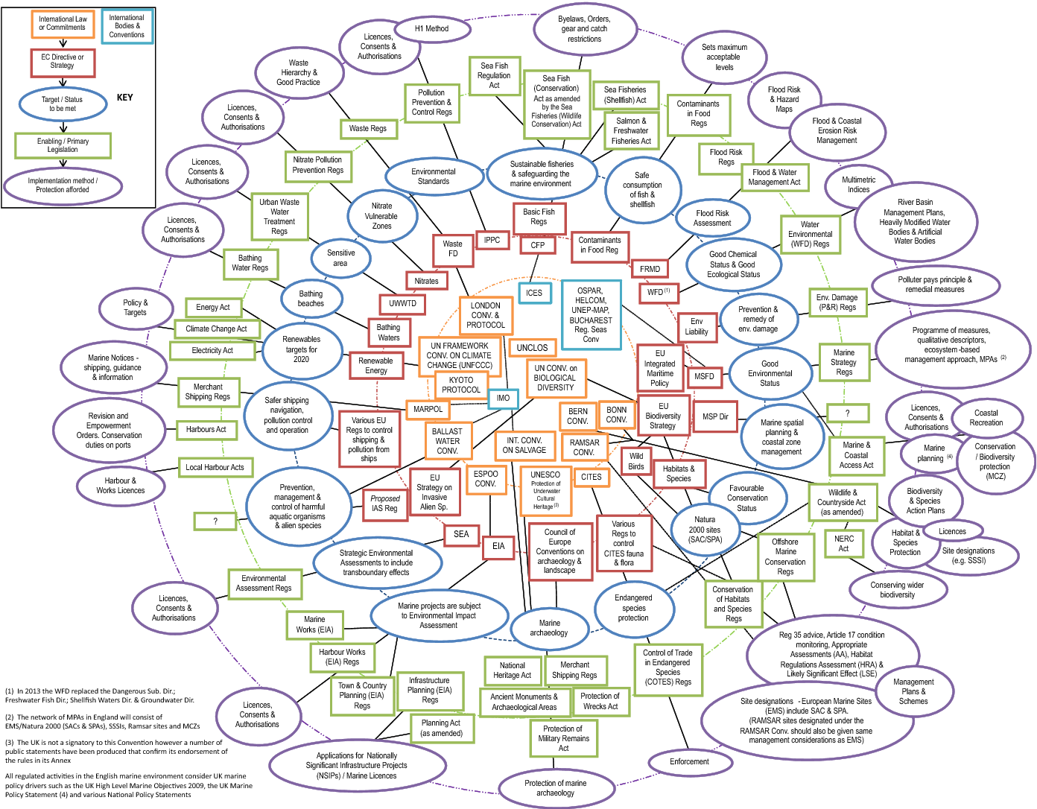
The full version…

Slide 4
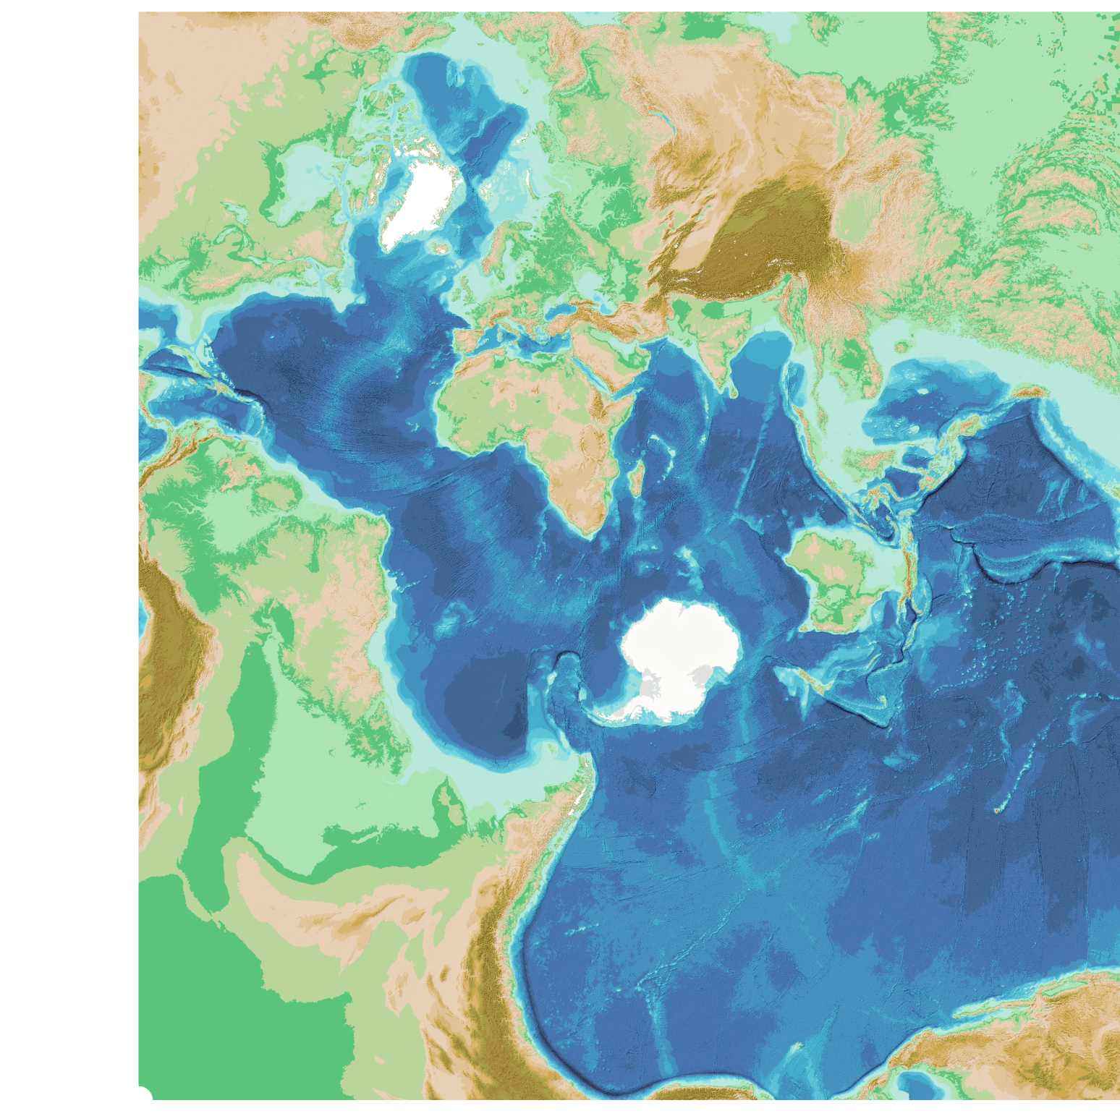
Accurate global seabed maps are essential for tsunami response planning and prediction

Slide 5
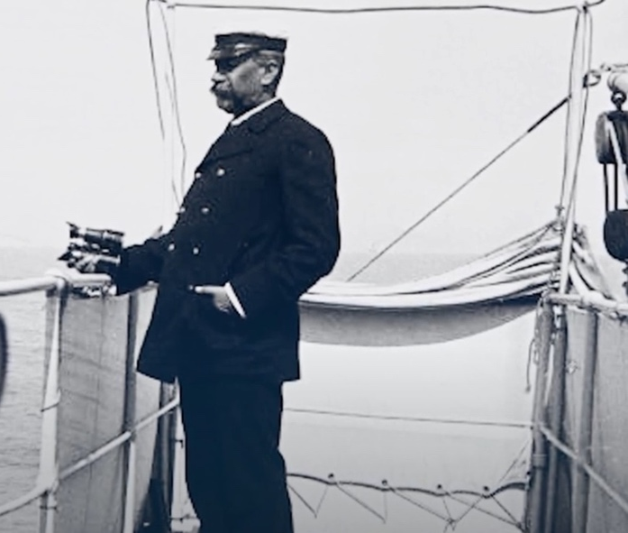
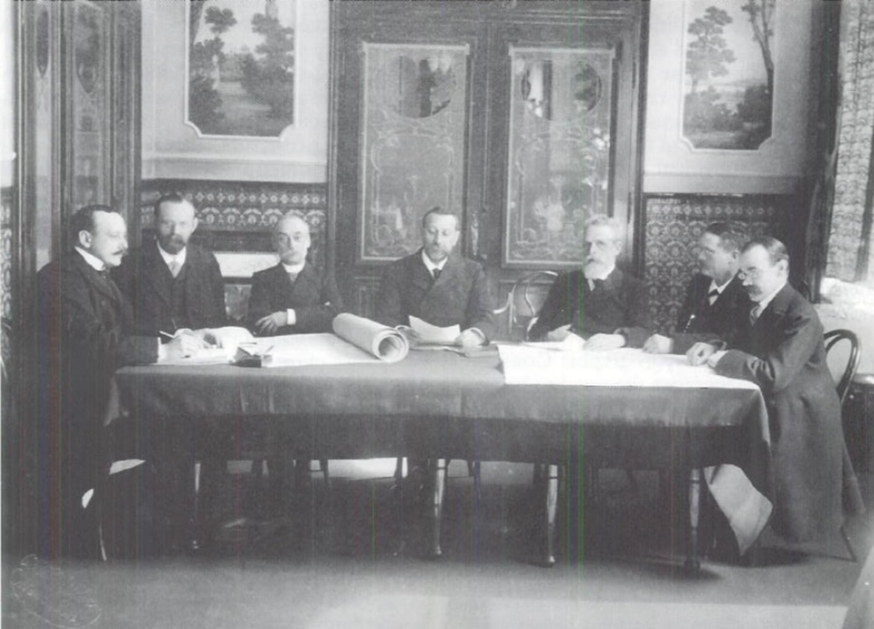
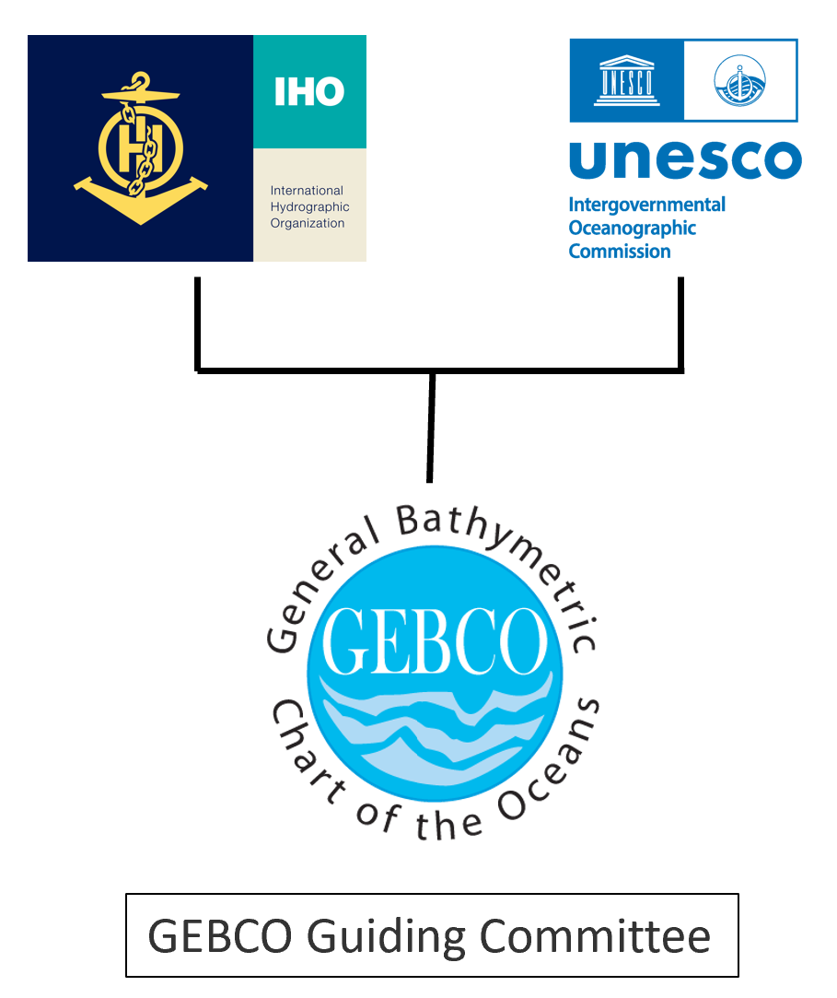
History - GEBCO – established 1903
Now a joint programme of:
  The International Hydrographic Organization (IHO)
  &
  The Intergovernmental Oceanographic Commission (IOC/UNESCO)
Aim: provide authoritative, publicly-available
bathymetry (depth) data sets of the world’s oceans
Mainly voluntary international community of:
  Scientists
  Oceanographers
  Hydrographers
  Citizens

Slide 6
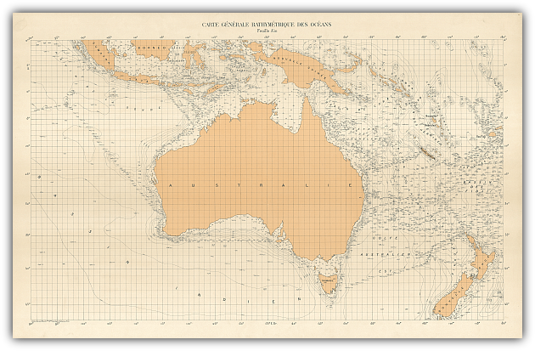
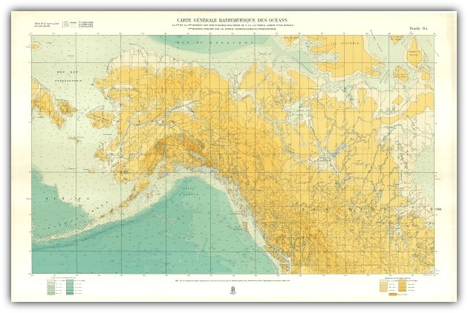
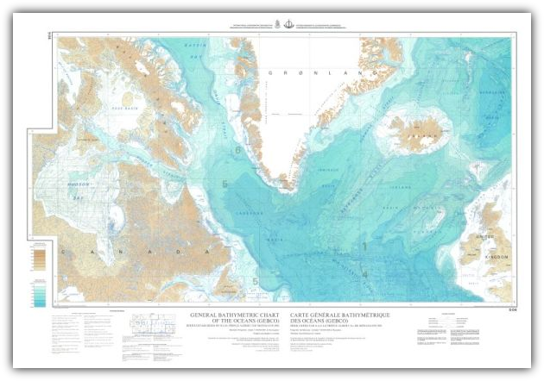
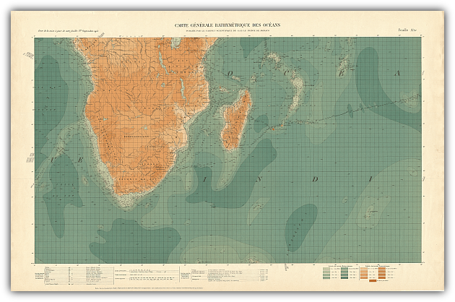
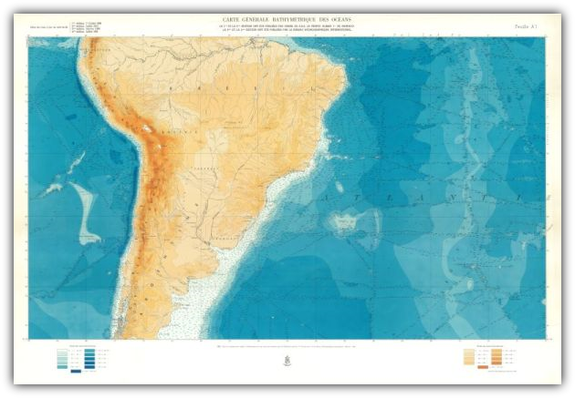
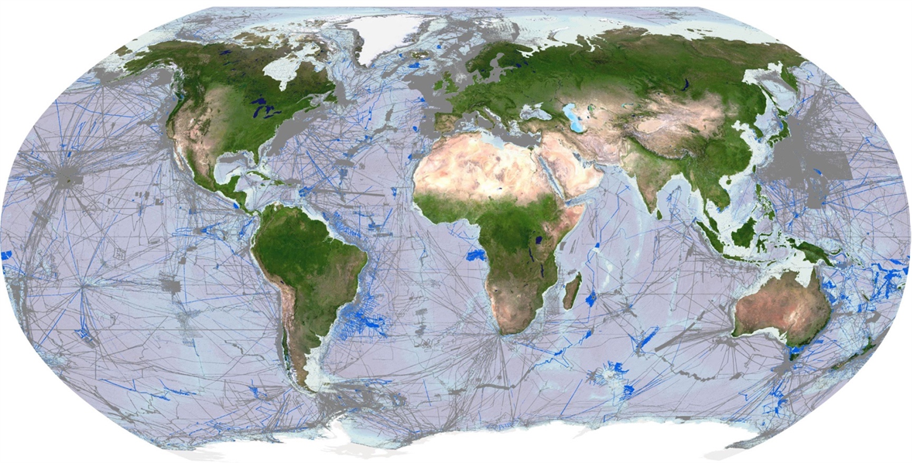
GEBCO over the decades – more data, higher resolution
1st Edition 1903
3rd Edition 1932-66
5th Edition 1973-82
2nd Edition 1910-30
4th Edition 1958-73
Present day annual Releases

Slide 7

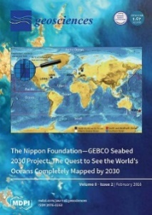



The Nippon Foundation-GEBCO Seabed 2030 Project
Flagship
Programme
June 2016
June 2017
June 2021
Seabed 2030 = accelerator to GEBCO’s aim
Collaboration to:
  inspire 100% seabed mapping
  compile the GEBCO Map

Slide 8

Seabed 2030 Simplified Network
GEBCO
Guiding Committee
5x Sub Committees *
Project
Team
Alumni Network
SRTM15+
Team
IHO’s
Data Centre
N Pacific &
Arctic Ocean Center
Atlantic &
Indian Ocean Center
Global Center
South & West
Pacific Center
Southern
Ocean Center
* Technical | Regional | Undersea Feature Names | Engagement & Outreach | Education & Training

Slide 9
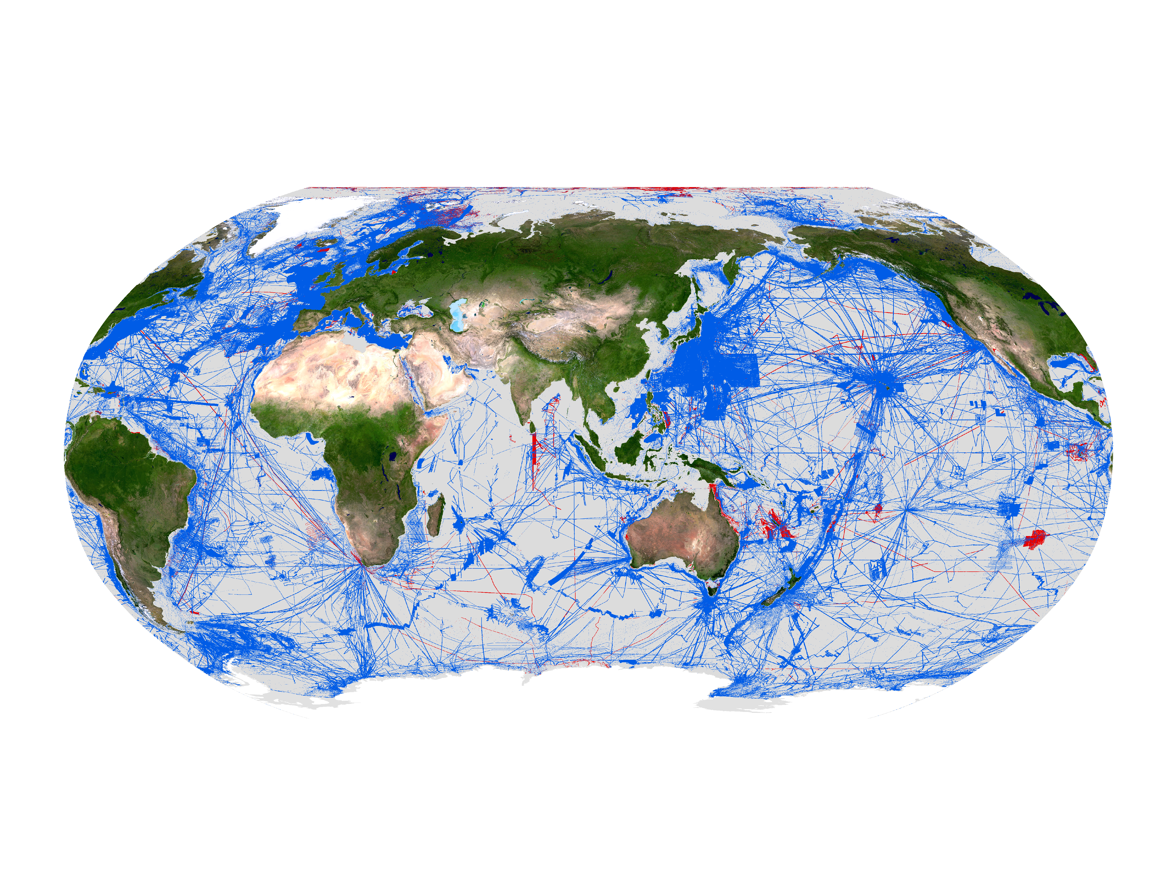
Progress so far …
GEBCO Map: 6% in 2017
Now 27.3%
Over 70% ocean floor still to go …..

Slide 10
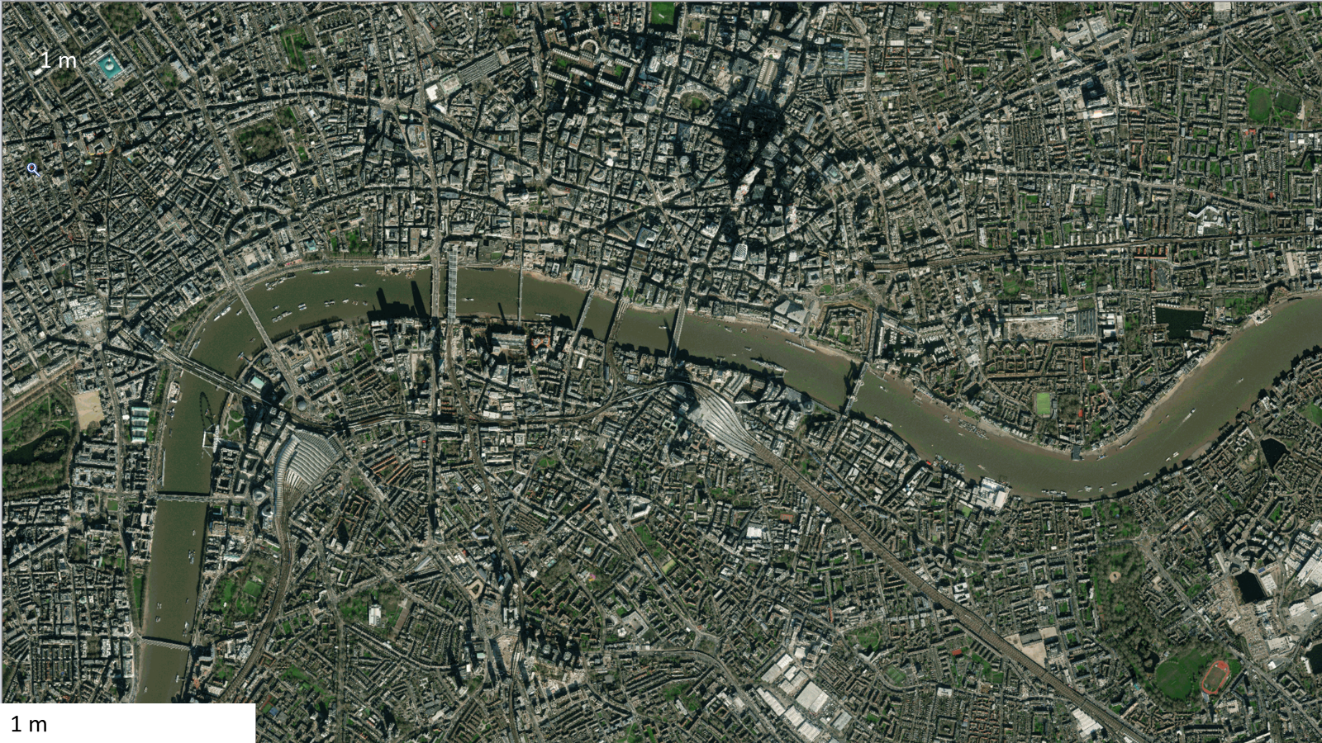
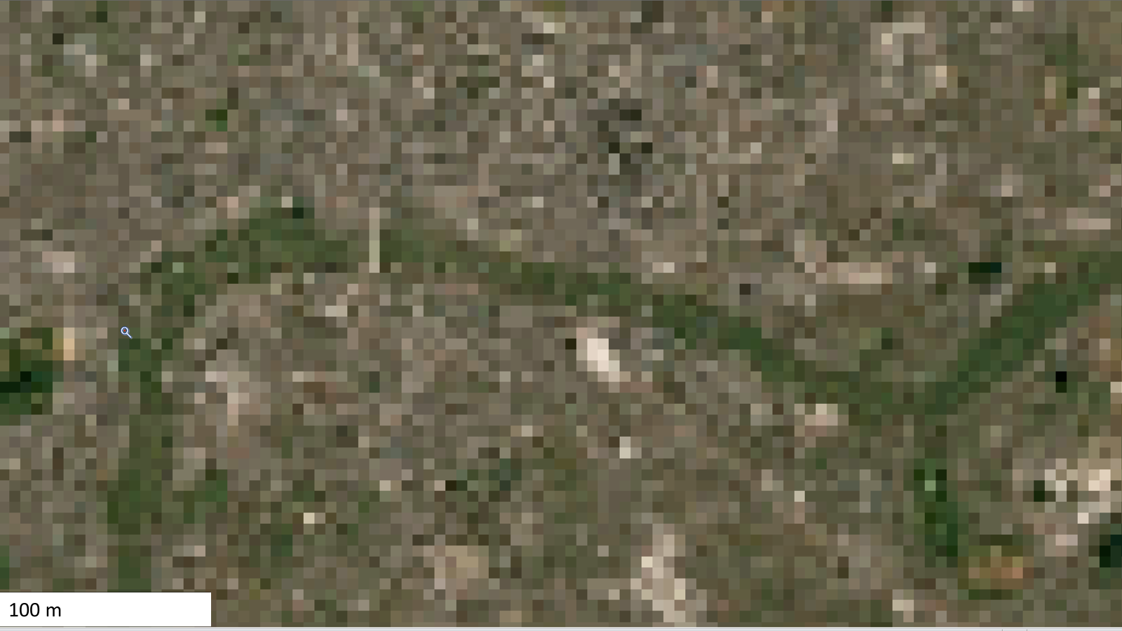

In Perspective
X Not this resolution
✓✓ We ask for this
✓ But will work with lower resolution
Credit: Larry Mayer

Slide 11
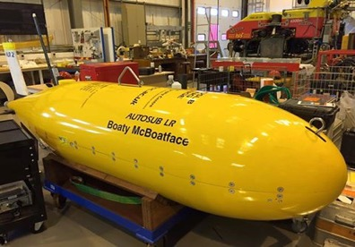
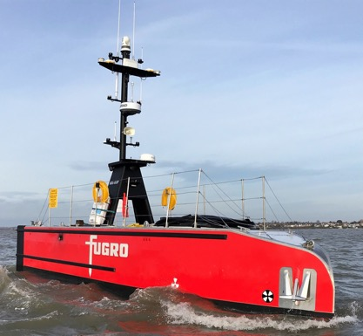
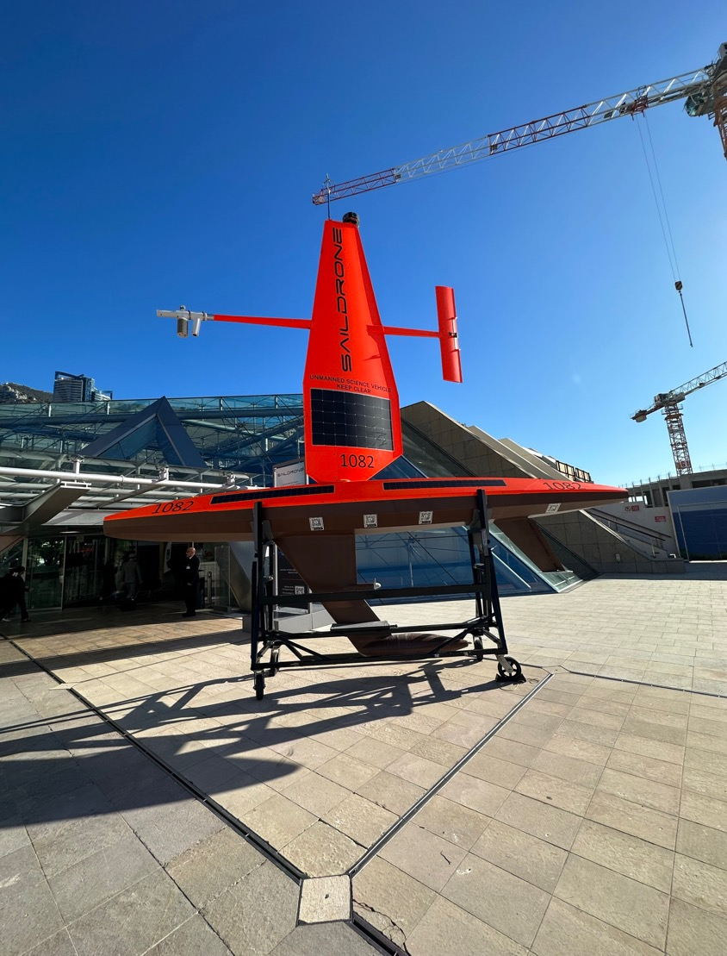
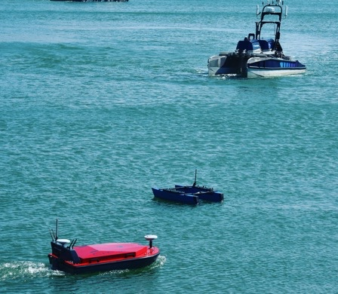
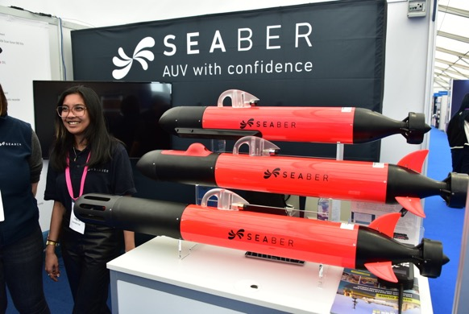
The Rise of the Robots
The use of marine autonomous systems, surface and subsurface, lets us gather data from hard-to-reach places, often at a lower cost than a traditional survey vessel, & widens access to users who can’t afford a ship.
A new generation of sensors & sonars offer constantly-improved mapping, from shelf seas to the deepest trenches.

Slide 12

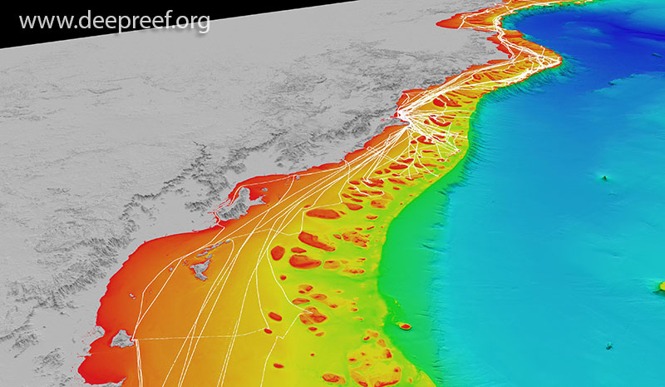

The Value of Crowdsourced
Bathymetry Data
Data with scientific, commercial & research value at no cost to the public sector
Fill gaps where data is scarce (eg: Arctic, SIDS)
Useful along shallow, complex coastlines
Identify uncharted features
Assist in verifying charted information
Confirm whether charts are appropriate for the latest traffic patterns.
3D view of northern Great Barrier Reef showing all vessel tracks as of December 2019
  ...but only if vessels collect depth information while on passage!
Notes:
JJ

Slide 13
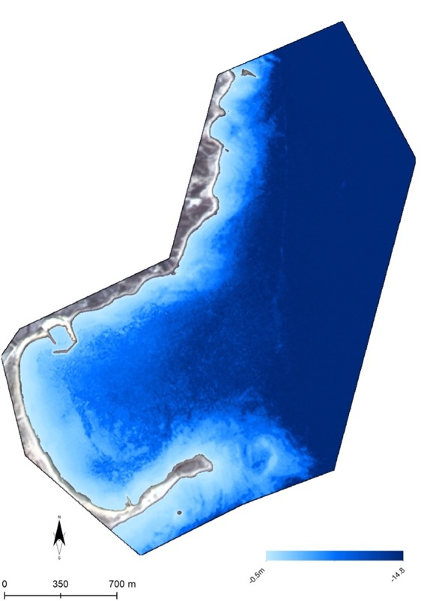
Satellite, aircraft & drone
Derived Bathymetry
The bathymetry of Plaka area, Lemnos estimated by Planet SuperDove 8-bands imagery on 16/05/2022
Credit – Dimitris Poursanidis, Terrasolutions.eu
  Physically measuring the depth and shape of the ocean floor with multibeam techniques is accurate – but slow, and can be expensive.
  Robotic systems help – but remote sensing is much faster and more affordable.
  There are limitations – limited max depth, can’t see through ice or turbid conditions – but still gives useful data that is more accurate than legacy maps.
  Deep LIDAR is becoming possible but early days..
  Perhaps in the future a breakthrough in quantum imaging sensors will enable true ocean transparency, but it’s a long way off.

Slide 14
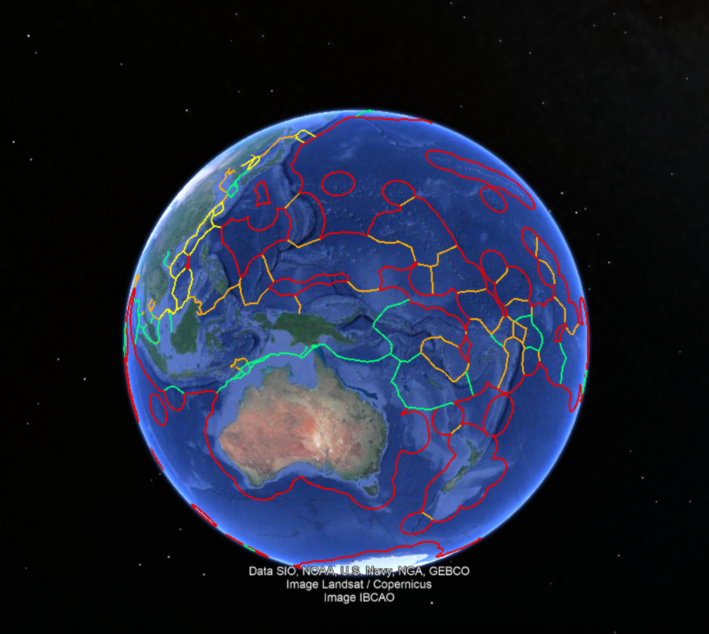
CHALLENGES WE FACE:
Reluctance to release existing data – often because data gatherers don’t own the data, they gather it for clients..
Who will pay for new data collection?
  especially beyond national jurisdiction
Even if someone pays – reluctance to grant permission – MSR / UNCLOS issues
Credit: UNH/CCOM-JHC
Notes:
Polygons = EEZs

Slide 15
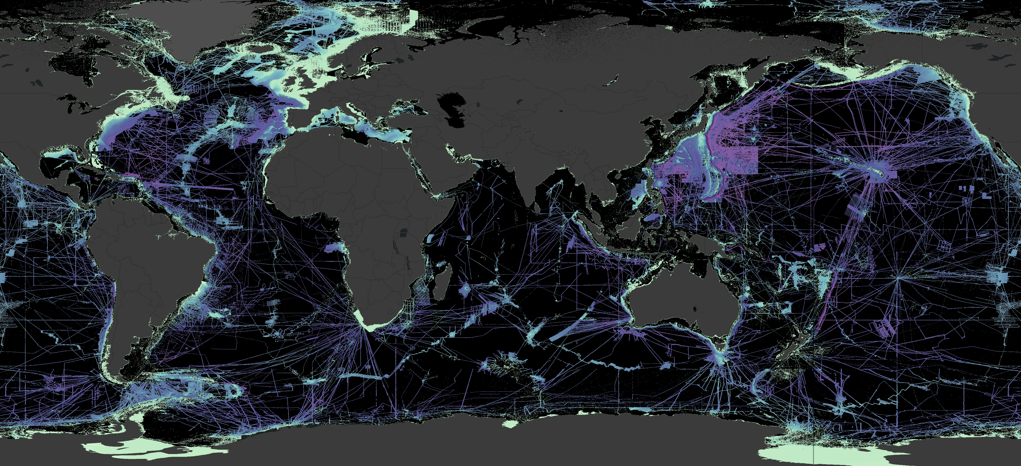
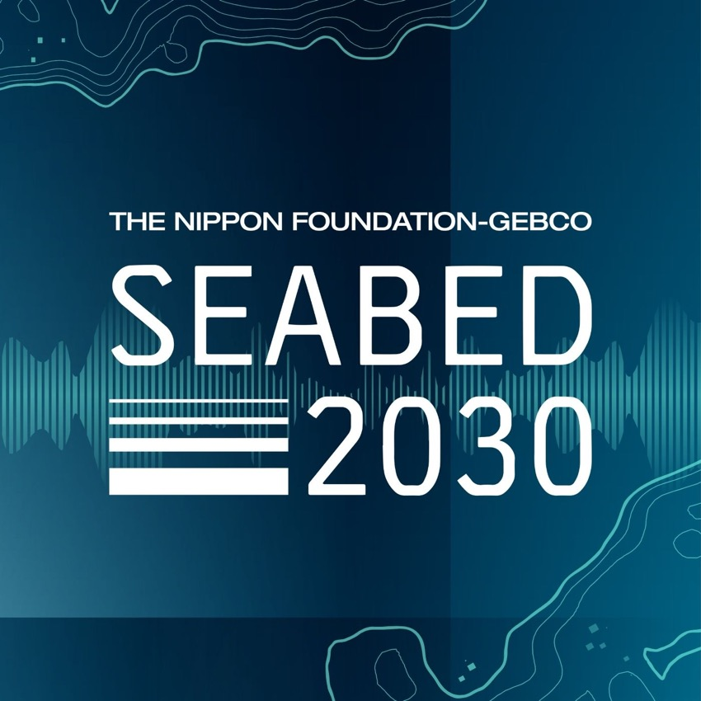
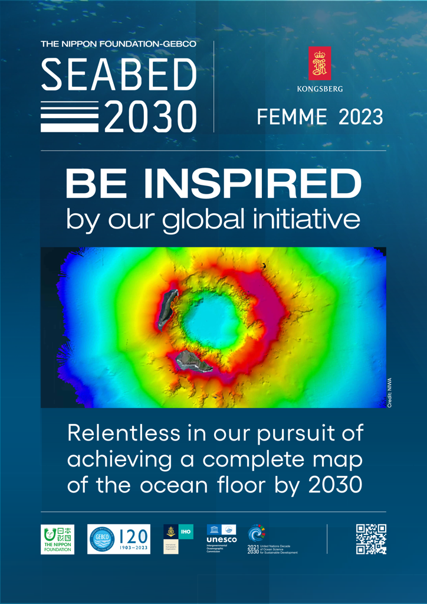
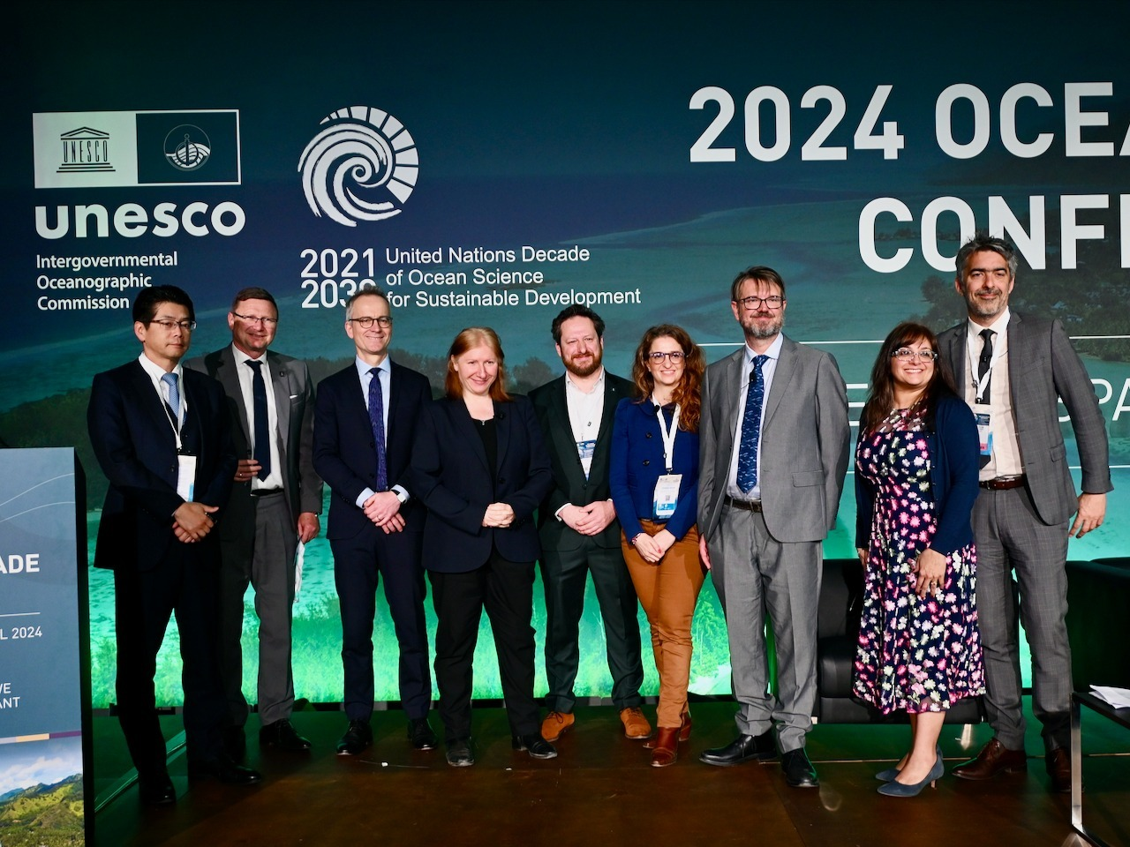
Outreach is vital, we try and engage widely, & as early as possible.
PODCAST

Slide 16

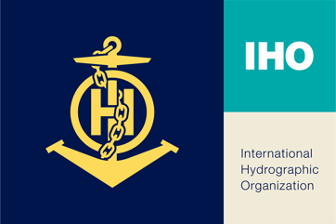



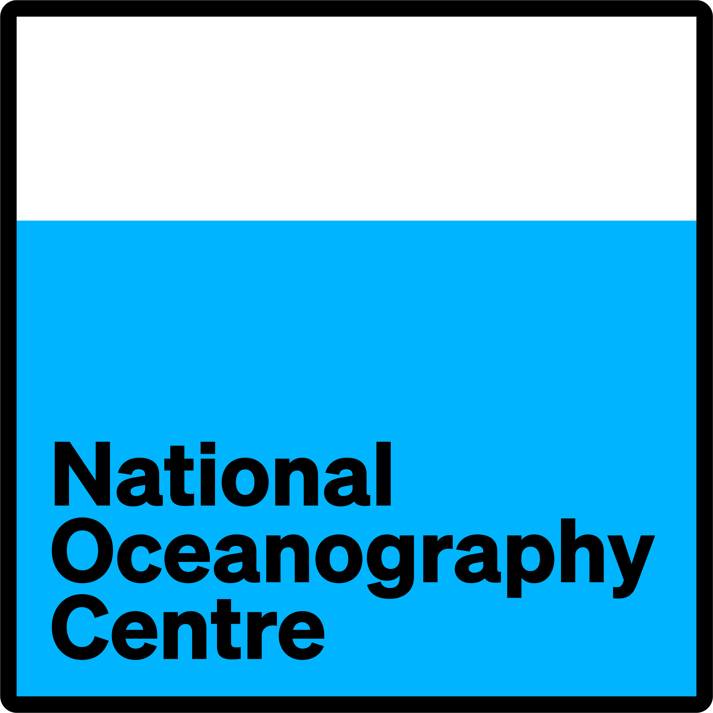




Thank You ☺
Stephen Hall
partnerships@seabed2030.org
10-11 November 2025
INCOIS, Hyderabad, India
First Conference of the
Ocean Decade Tsunami Programme

