Slide 1
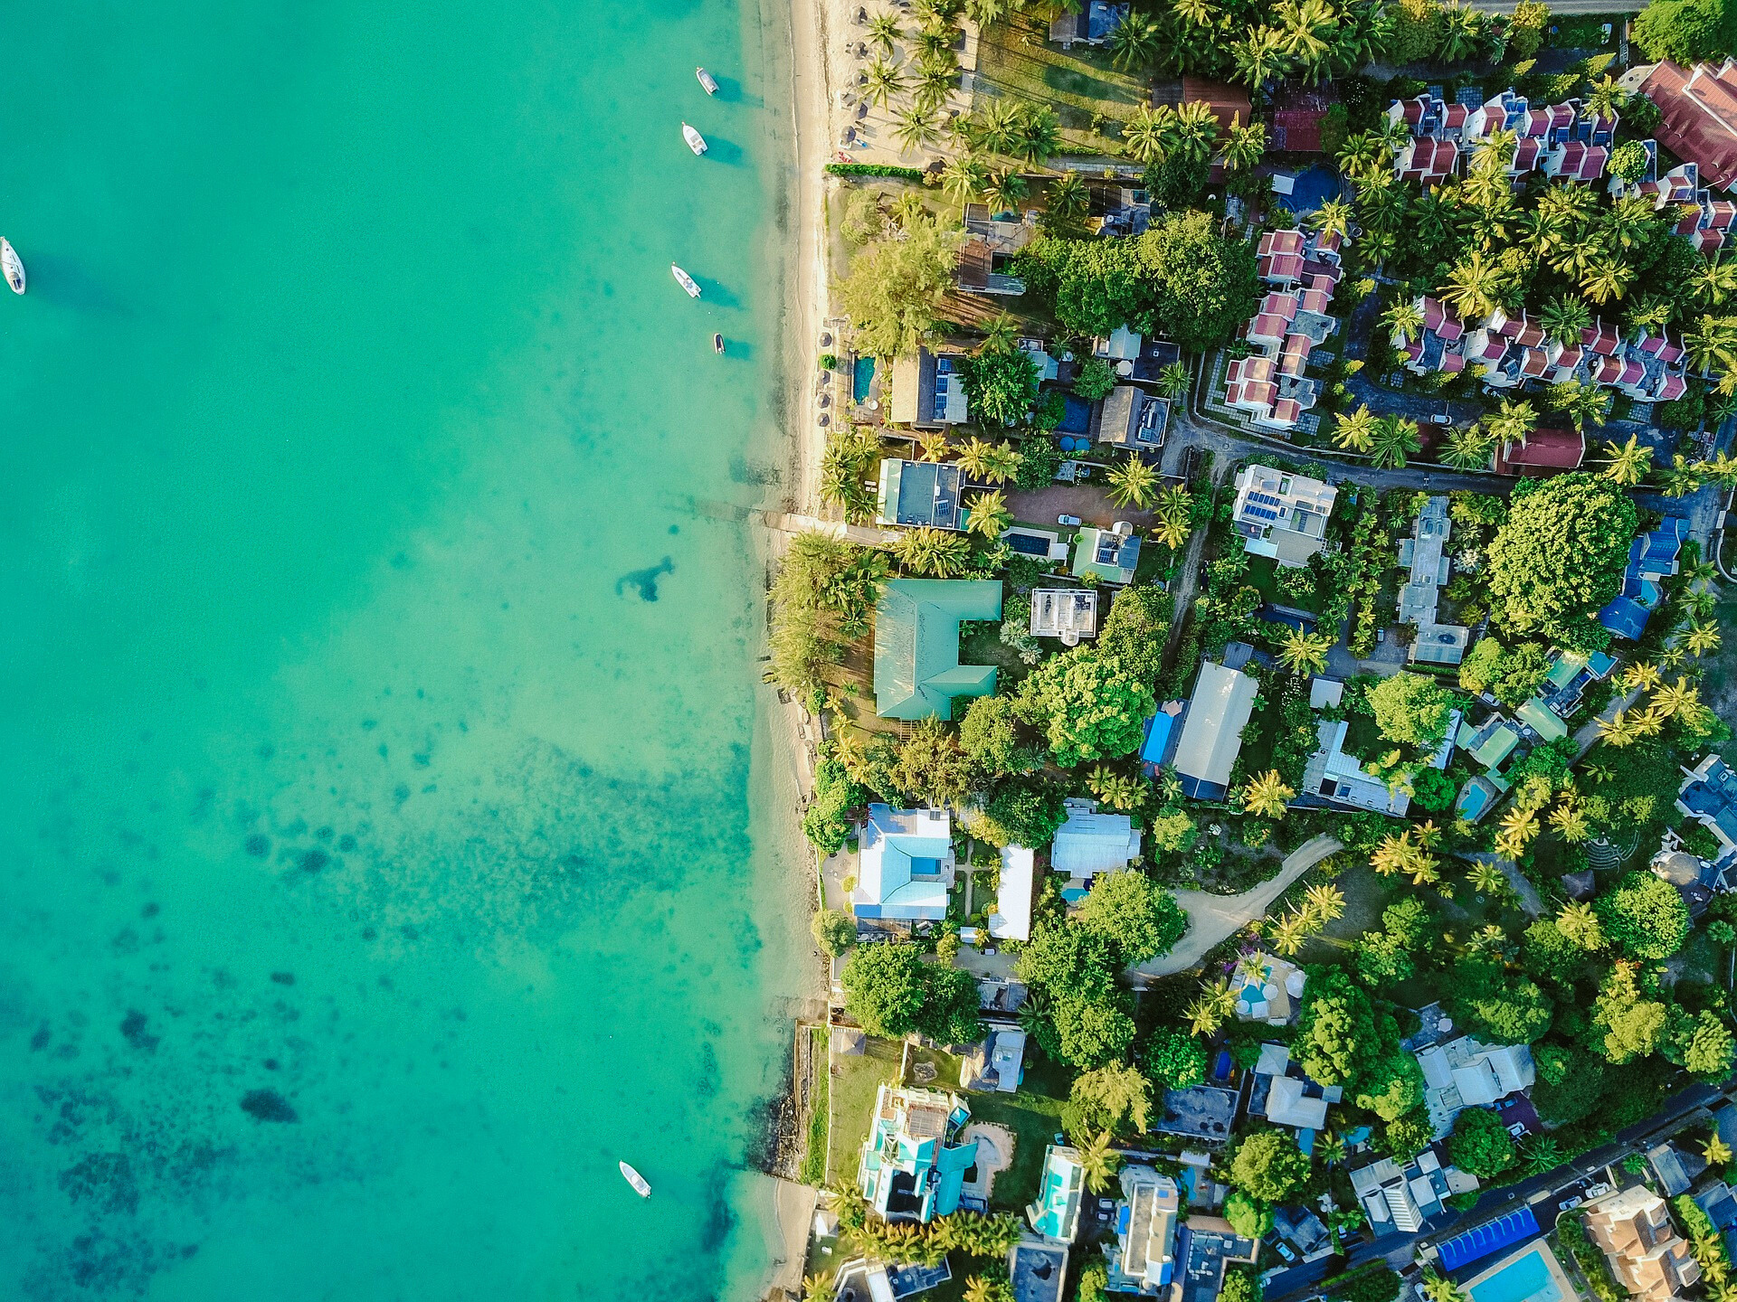



Monitoring
high-frequency
sea level fluctuations in coastal regions of Ukraine
Alexander Matygin
Natalia Iakovleva
Hydrometeorological Center
for Black and Azov Seas
Odessa,
Ukraine
FIRST CONFERENCE OF THE OCEAN DECADE TSUNAMI PROGRAMME
Hyderabad, India
10-11 November 2025

Slide 2

The purpose of the message: the state of hydrometeorological monitoring of the Ukrainian part of the northwestern part of the Black Sea
Tsunamis and meteotsunamis are relatively rare in the Black Sea. Meteotsunamis have been recorded three times in the Black and Azov Seas over the past 20 years.
The Hydrometeorological Service needs to conduct appropriate observations to assess the impact of tsunamis on coastal infrastructure.
These observations should ensure high-quality recording of sea level fluctuation parameters.
Meteotsunami studies should also include recording certain meteorological parameters.
10-11 November 2025
INCOIS, Hyderabad, India
First Conference of the
Ocean Decade Tsunami Programme

Slide 3
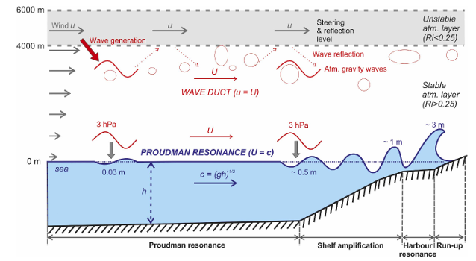
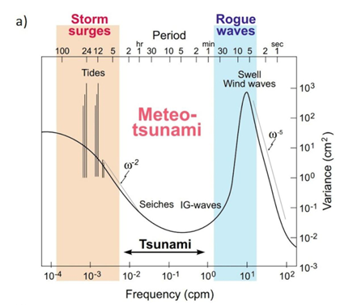
In accordance with the frequencies (periods) of meteotsunami (tsunami) wave oscillations, it is necessary to record sea and atmospheric parameters with the following resolution:
1 - sea level, resolution every 30 s;
2 - atmospheric pressure (high-frequency fluctuations of 2-6 hPa/5 min) - resolution every 1 min;
3 - wind speed vector, resolution every 1 hour;
4 - aerological parameters of the atmosphere, once daily (wind distribution by height, unstable layers, Richardson number).
*by Rabinovich, Sepic
10-11 November 2025
INCOIS, Hyderabad, India
First Conference of the
Ocean Decade Tsunami Programme

Slide 4
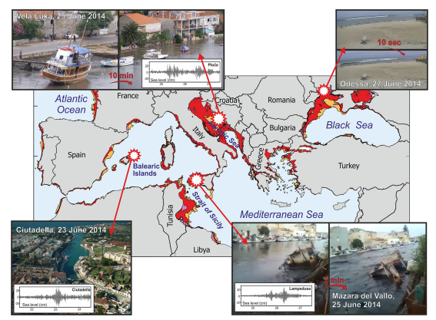
Mediterranean regions
Where meteotsunamis
may occur are highlighted
in red
Areas shaded in red represent parts of the sea for which the Froude number is close to unity (0.9\Fr\1.1)
Modified from Sˇepic´ et al.
Areas shaded in red represent
parts of the sea for which the Froude
number
Is close to unity (0.9\Fr\1.1)
Modified from Sˇepic´ et al.
10-11 November 2025
INCOIS, Hyderabad, India
First Conference of the
Ocean Decade Tsunami Programme

Slide 5
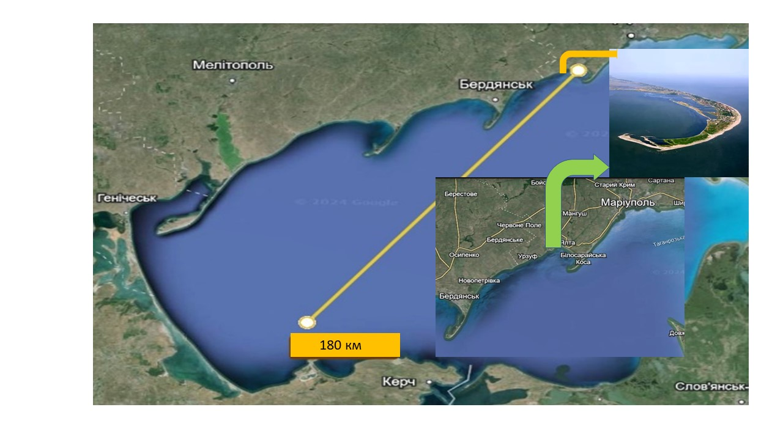
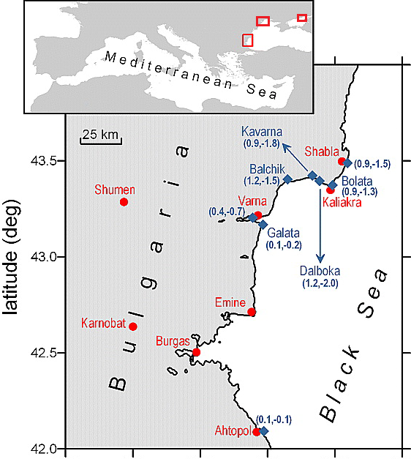
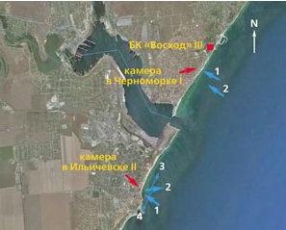
Meteotsunamis of Black and Azov Seas
Region Data Wave height, m
Azov Sea
Bulgaria 07/05/2007 3
Black@Azov Sea
Odessa 26/06/2014 3
Azov Sea 19/07/1017 1.5
The areas
of the Black
and Azov Seas
where meteotsunamis
were observed,
as well as the maximum
heights
of the meteotsunami
waves,
are shown.
Odessa
Bulgaria
10-11 November 2025
INCOIS, Hyderabad, India
First Conference of the
Ocean Decade Tsunami Programme

Slide 6
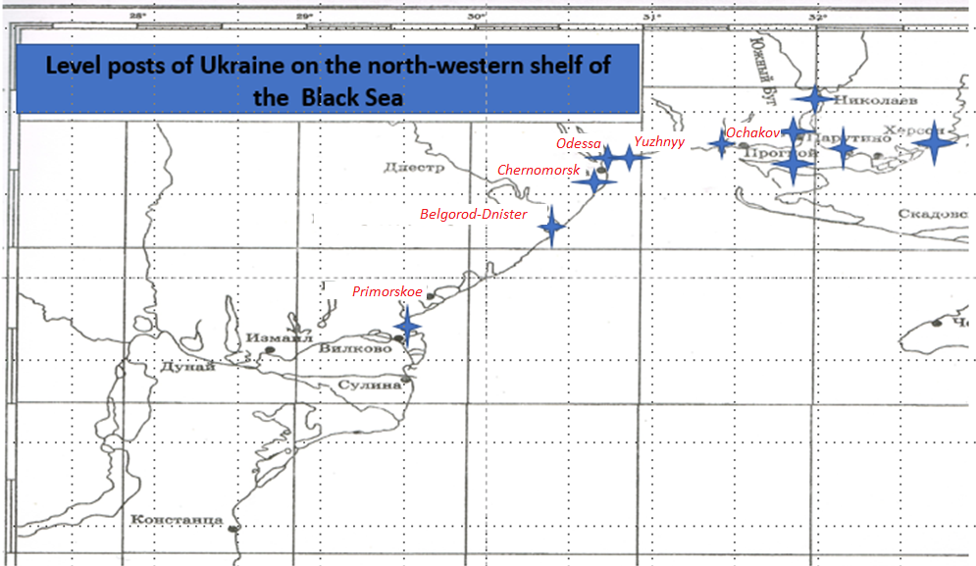
Six hydrometeorological stations
are located on the Ukrainian coast
of the northwestern Black Sea.
Only two of them are equipped with tide gauges,
But the meteorological equipment
can record changes
in atmospheric pressure and wind
with a resolution of 30 seconds.
The location
of the hydrometeorological stations
allows for the recording of localized
meteotsunami waves
along almost the entire coast.
10-11 November 2025
INCOIS, Hyderabad, India
First Conference of the
Ocean Decade Tsunami Programme

Slide 7
Currently, Ukraine lacks the capacity to fully implement a marine environmental monitoring system (although atmospheric processes are monitored fairly comprehensively, with the exception of aerorological observations due to military actions).
We'd like to make use of Croatia's experience. Meteotsunamis occur quite frequently in this country. Assistance to Ukraine could be provided through the European Twinning and EU4GRE programs.
Ukraine will establish the sea level fluctuation monitoring system to obtain information on processes in the tsunami frequency range.
10-11 November 2025
INCOIS, Hyderabad, India
First Conference of the
Ocean Decade Tsunami Programme

Slide 8
Thank you for your attention
10-11 November 2025
INCOIS, Hyderabad, India
First Conference of the
Ocean Decade Tsunami Programme

