Slide 1

Tsunami Detection on Standard Telecommunication Cables
M. Mazur(1), N. K. Fontaine(1), R. Ryf(1), M. Karrenbach(2),
K. L. McLaughlin(3), B. J. Sperry(3), A. G. Butler(3), V. Kamalov(4), L. Dallachiesa(1), E. Burrows(1), D. Winter(1), H. Chen(1), J. Naik(5), K. Padmaraju(5), A. Mistry(5) and D. T. Neilson(1)
(1) Nokia Bell Labs, 600 Mountain Ave, Murray Hill, NJ 07974, USA
(2) Seismics Unusual LLC, Brea, CA 92821, USA
(3) Leidos Inc., Arlington, VA 22203, USA
(4) Valey Kamalov LLC, Gainesville, FL 32607, USA
(5) Nokia Advanced Optics, 171 Madison Ave, New York City, NY 10016, USA
mikael.mazur@nokia-bell-labs.com

Slide 2
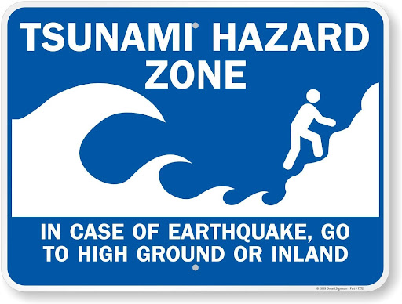
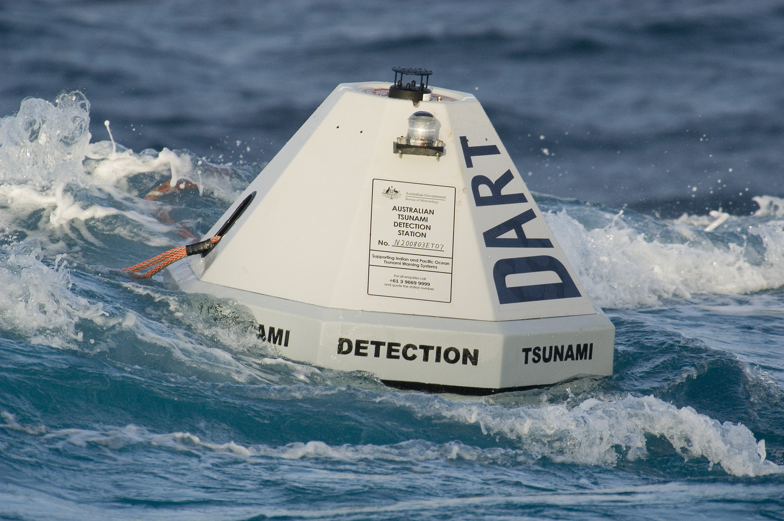
Global Earthquake and Tsunami Warning
Insufficient offshore
Today's global monitoring and warning system
>>1000 Land-based seismic stations (e.g., Global Seismic Network)
DART buoys with bottom pressure sensors
Dedicated tsunami warning cable arrays (S-Net, DONET 1&2)
Challenge: Increase global coverage
Most of the deep ocean remains unmonitored
DART buoy coverage sparse (<100 points globally)
Continuous, real-time, monitoring required for any sensor (<1s latency)
Is there a path to build out global connectivity and early warning together?
https://nctr.pmel.noaa.gov/Dart/
M. Mazur et. al., Submarine Cable Deep-Ocean Observation of Mega-Thrust Earthquake and Tsunami with 44,000 100-m Spaced Sensors, 2025

Slide 3
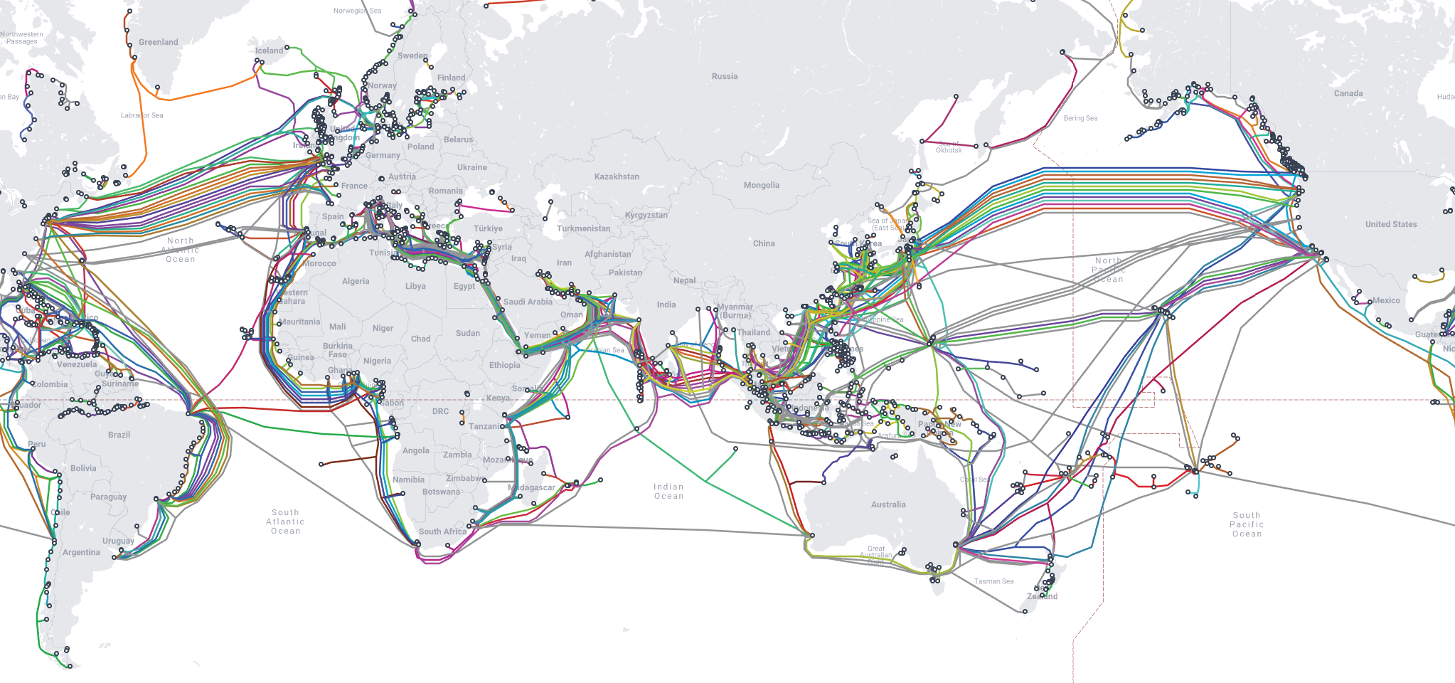
Telecom Submarine Cables
Internet Backbone network, ~1.5 million km globally
www.submarinecablemap.com (19-10-2025)

Slide 4
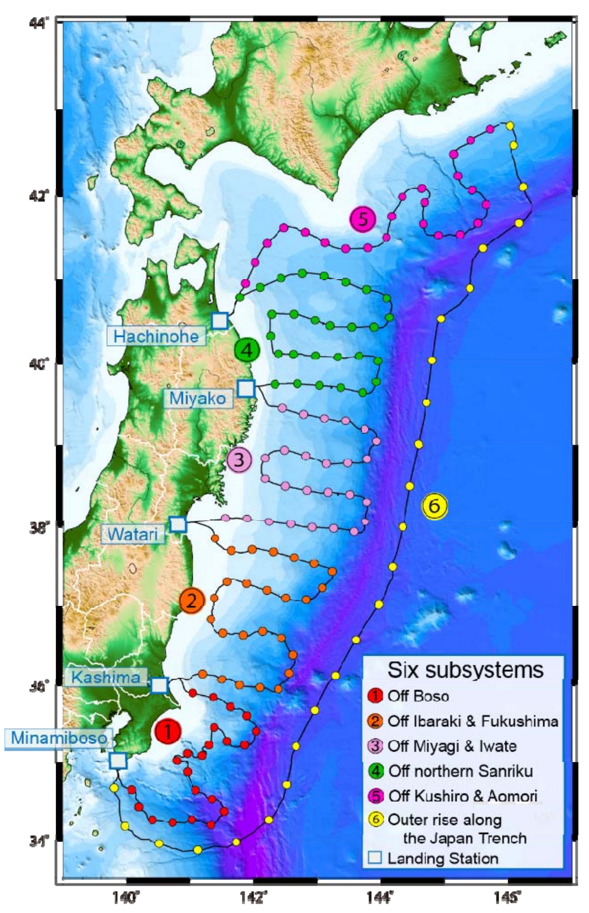
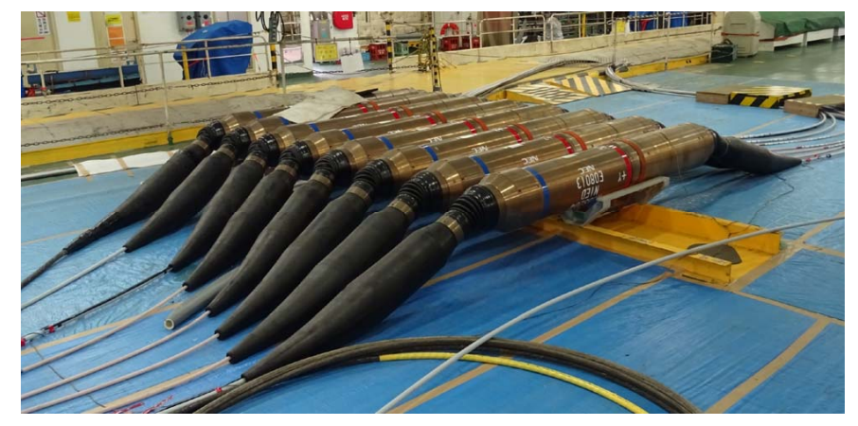
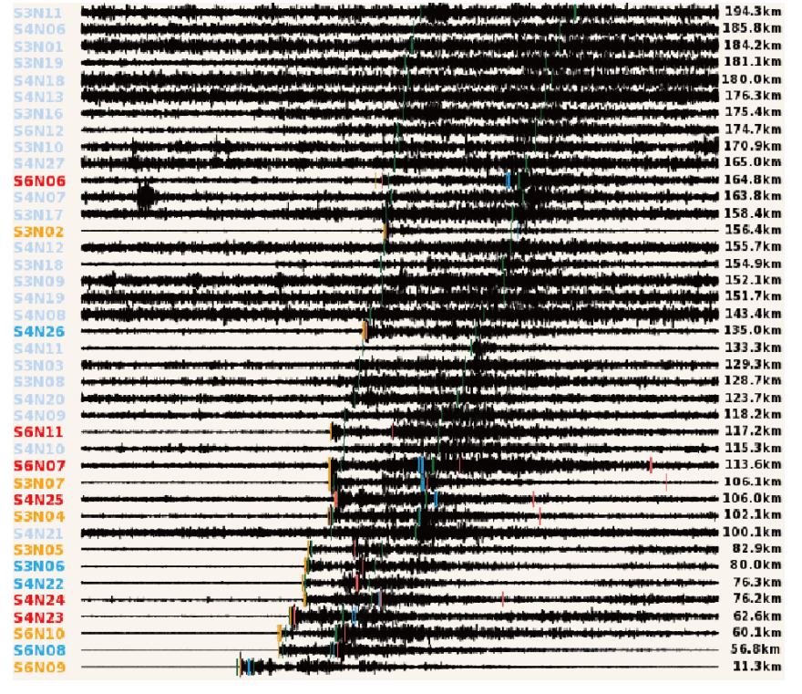
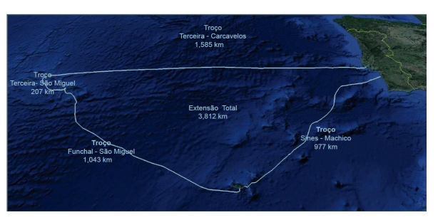
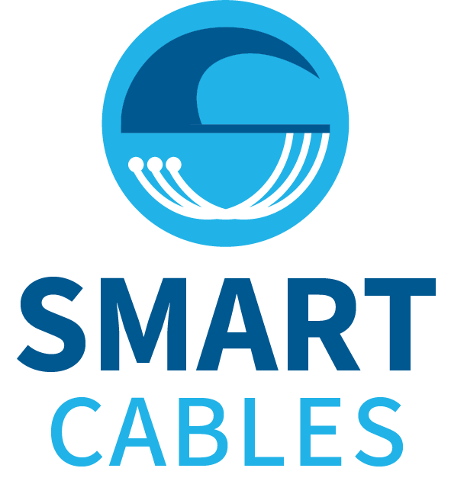
Tsunami Detection using Subsea Cables
Dedicated cable-based observatories
Expensive, custom-made deployment
Point-based pressure and seismic sensors
S-Net, DONET 1&2, scientific ocean monitoring cables
Science Monitoring and Reliable Telecommunications (SMART)
Hybrid cable: telecom and point-based sensors
First cable expected 2027 (Atlantic CAM in Portugal)
Fiber sensing
Existing and future telecom cables
Telecom fibers as distributed strain sensors
Can be part of future SMART and dedicated cables
M. Mochizuki et. al., S-net project:…, OCEANS, 2018
Portugal Atlantic CAM project: : 22-PT-DIG-Atlantic CAM
M. Mazur et. al., Submarine Cable Deep-Ocean Observation of Mega-Thrust Earthquake and Tsunami with 44,000 100-m Spaced Sensors, 2025

Slide 5
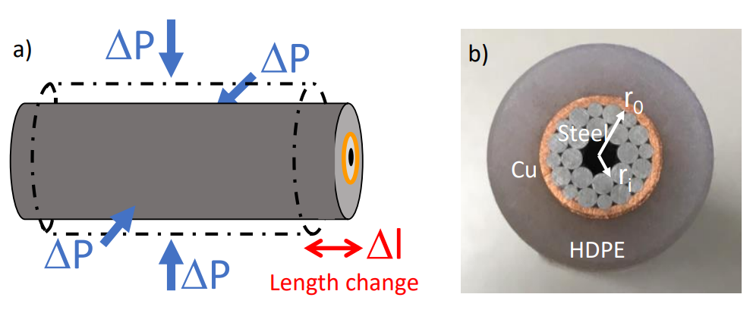
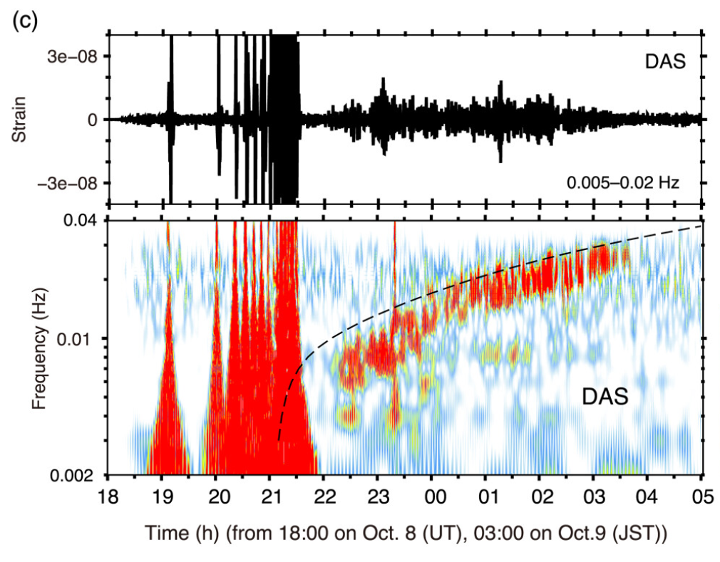
Fiber Sensing
Detecting tsunami waves
Change in water pressure changes cable length
Turn telecom fibers into distributed strain sensors
Can co-exist with telecom traffic (if properly engineered)
Distributed acoustic sensing (DAS)
High spatial resolution and sampling rate
Tsunami detection shown near shore
Limited reach up until first repeater (~50km)
Fiber sensing as a compliment for tsunami detection
Overcoming reach limitation foundational
L. Moeller, arXiv: 2304.06905, 2023
T. Tonegava and E. Araki, GRL, 51 (11), 2024
M. Mazur et. al., Submarine Cable Deep-Ocean Observation of Mega-Thrust Earthquake and Tsunami with 44,000 100-m Spaced Sensors, 2025

Slide 6
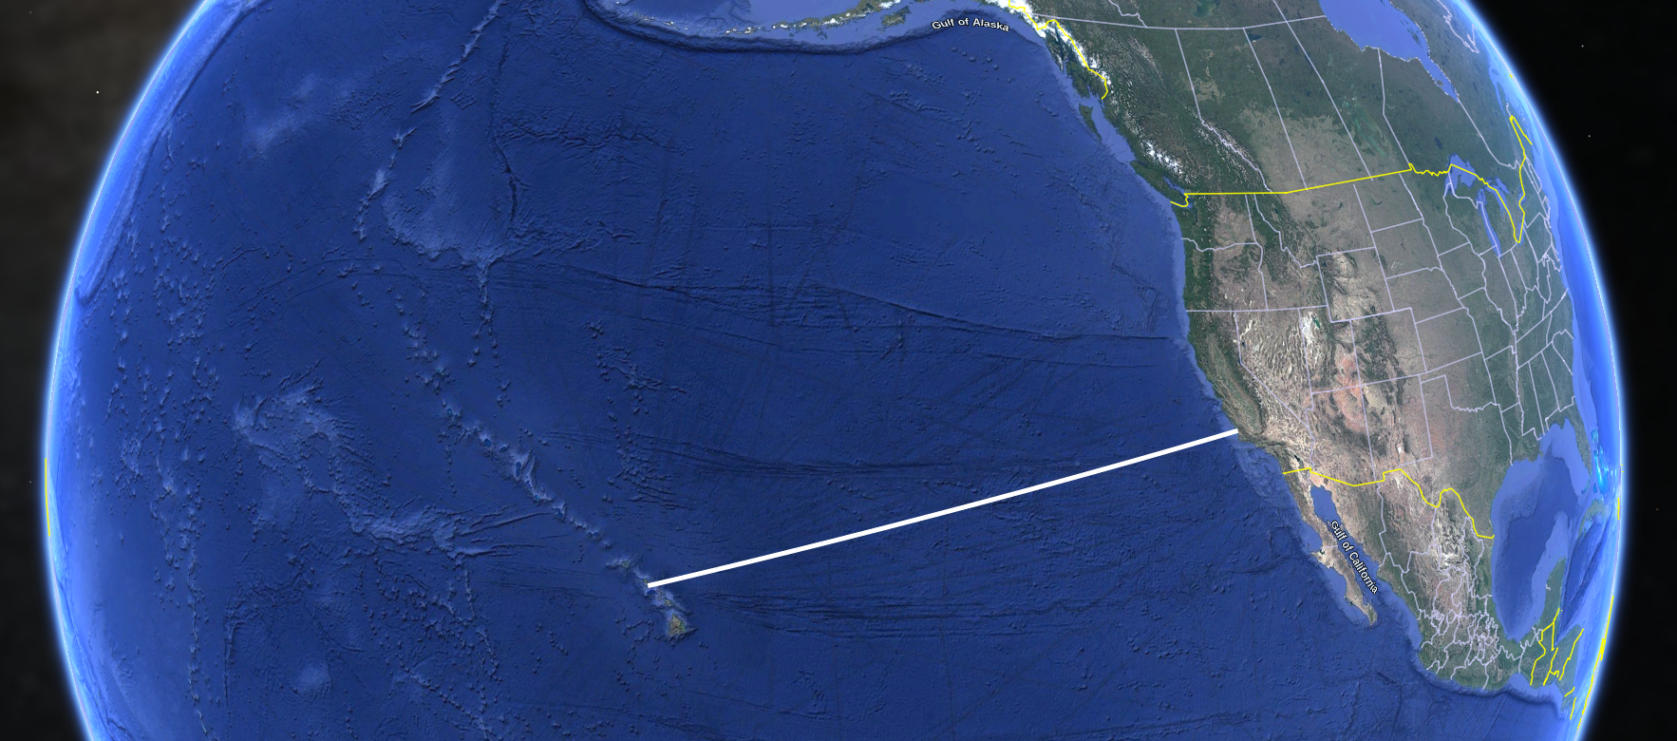
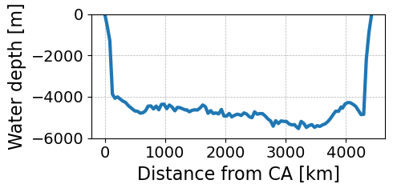
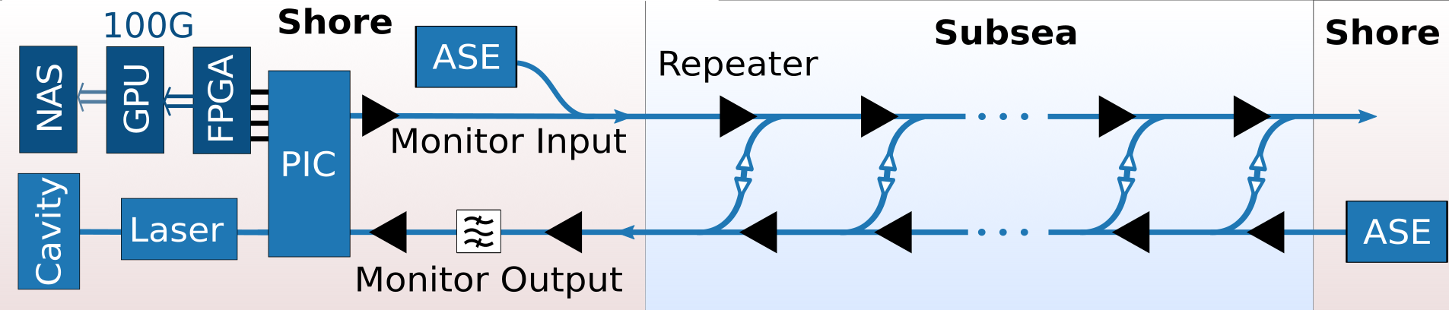
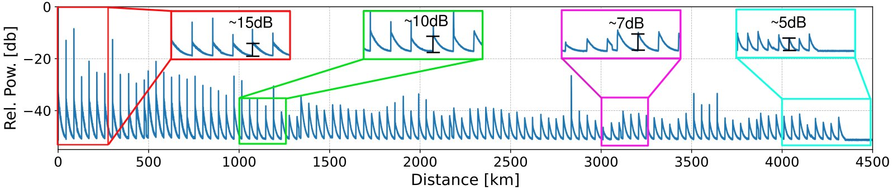
Experimental Setup
Submarine cable: California --- Hawaii
About 4400km long, ~100 optical repeaters
First repeater ~35km offshore
High-loss loopback couplers ~40dB loss
>4200km at water depths exceeding 4000m
Bell Labs Long-Reach Fiber Sensing
Supports distances exceeding 10000km
Compatible with live traffic
Based on optical frequency domain reflectometry
Intensity measurement
Single trace, ~1s averaging
SNR varies between 15 and 5dB
~4400km
HI
CA
M. Mazur et. al., Submarine Cable Deep-Ocean Observation of Mega-Thrust Earthquake and Tsunami with 44,000 100-m Spaced Sensors, 2025

Slide 7
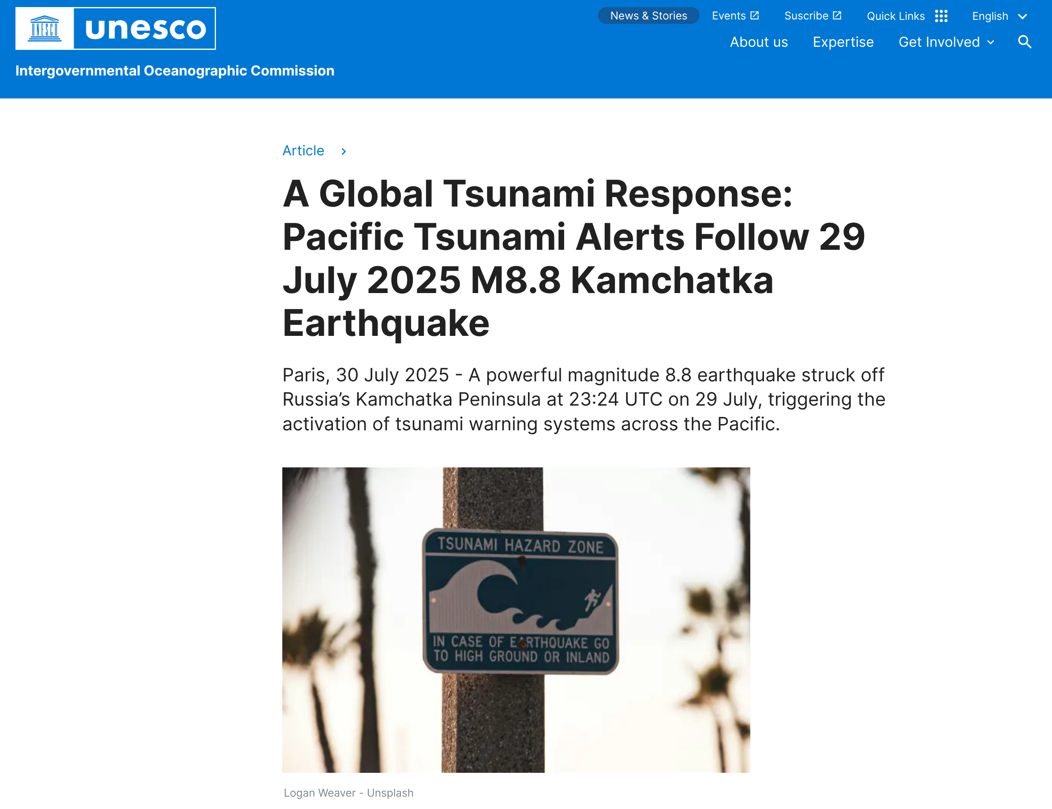
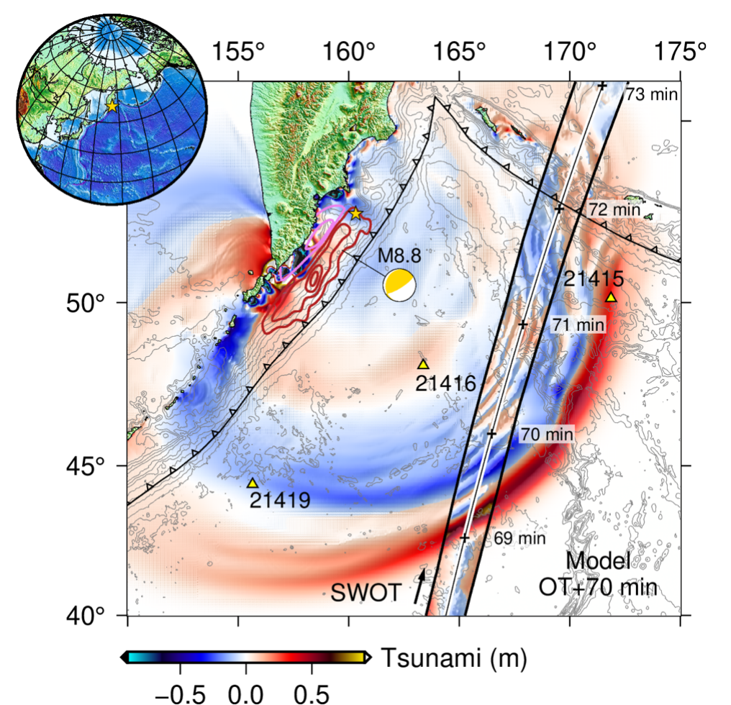
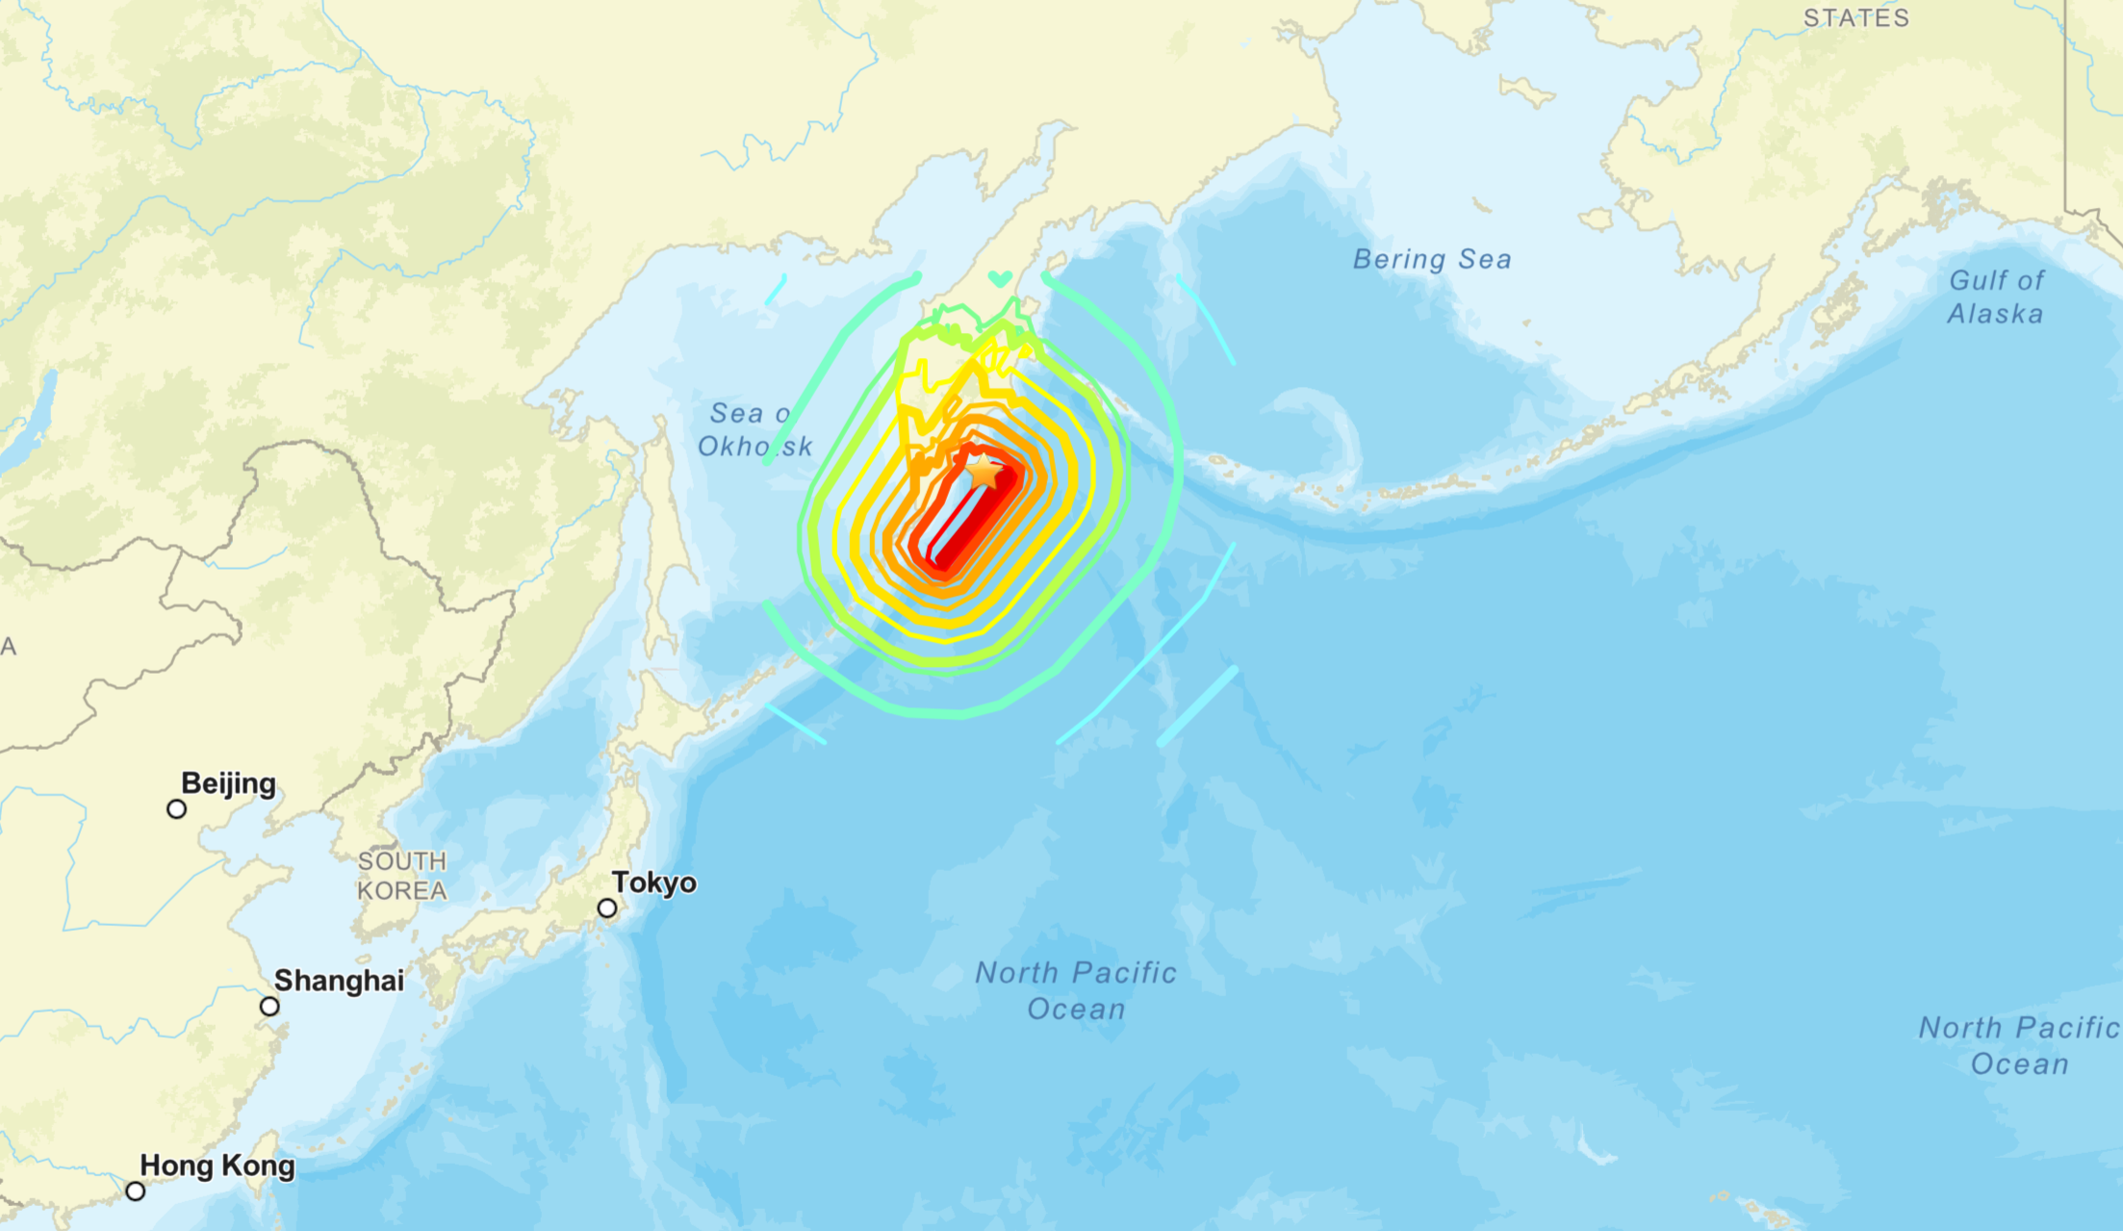
M8.8 Megathrust Earthquake
July 29th 2025
Kamchatka Peninsula, Eastern Russia
Frequent fault for large-scale earthquakes and tsunamis
6th largest recorded earthquake to date
Tsunami-generating event
https://earthquake.usgs.gov/earthquakes/eventpage/us6000qw60/executive
A. Ruiz-Angulo et. al., https://eartharxiv.org/repository/view/10335/
M. Mazur et. al., Submarine Cable Deep-Ocean Observation of Mega-Thrust Earthquake and Tsunami with 44,000 100-m Spaced Sensors, 2025

Slide 8
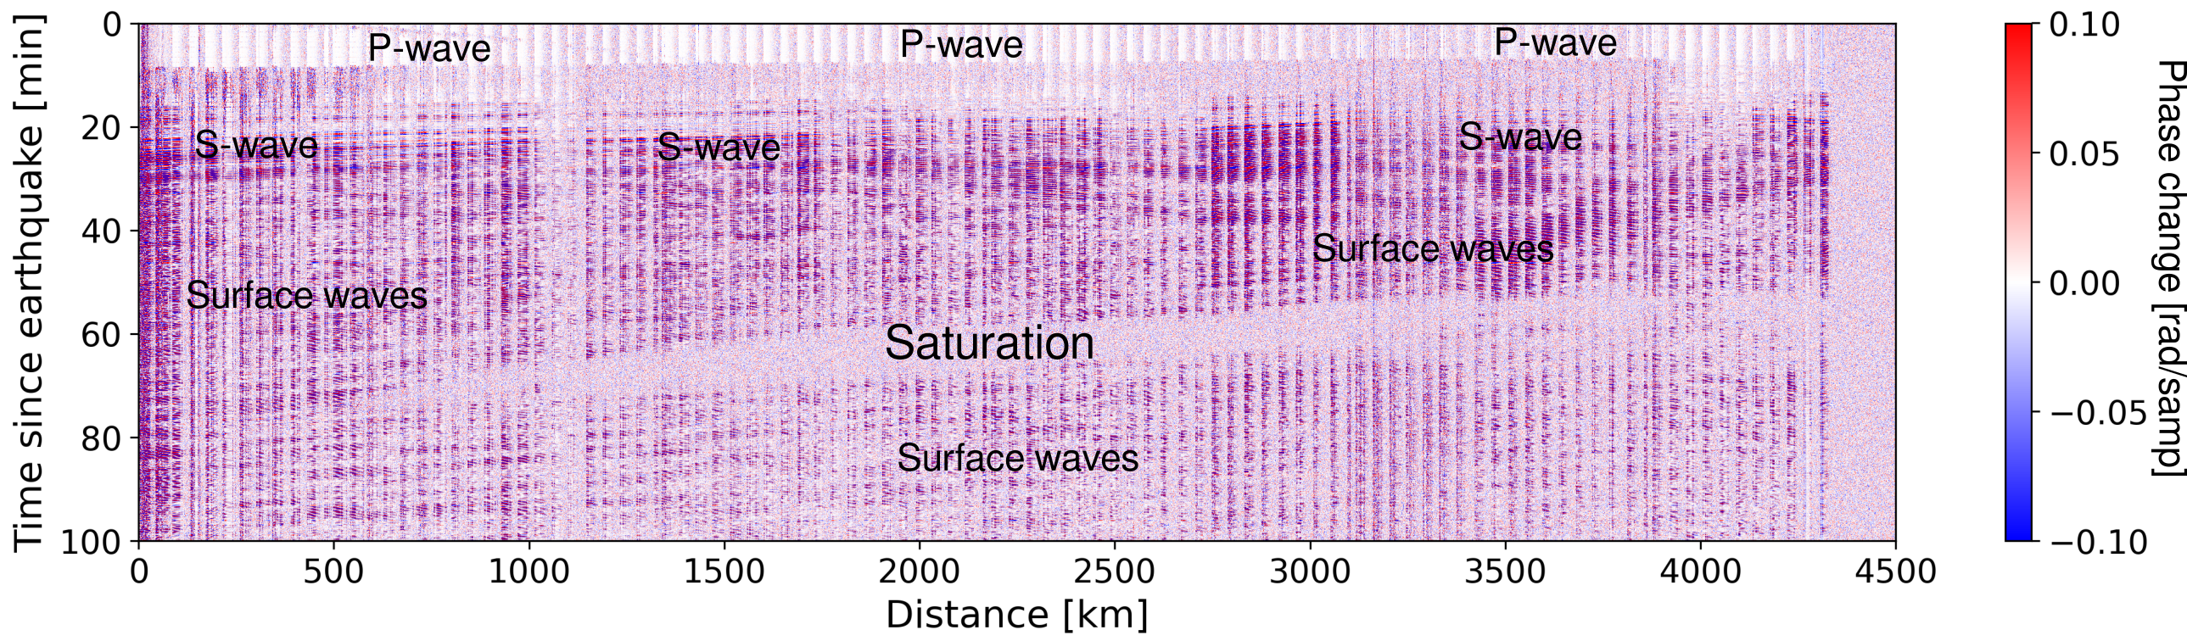
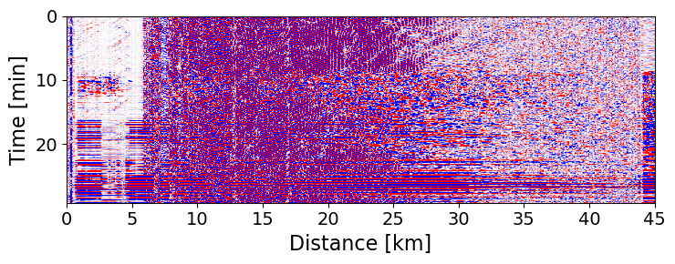
M8.8 Mega-Thrust Earthquake
First span
Regular DAS reach limit
P-wave
First Span
100m resolution
M. Mazur et. al., Submarine Cable Deep-Ocean Observation of Mega-Thrust Earthquake and Tsunami with 44,000 100-m Spaced Sensors, 2025

Slide 9
M8.8 Mega-Thrust Earthquake
Regular DAS reach limit
P-wave
First Span
100m resolution
M. Mazur et. al., Submarine Cable Deep-Ocean Observation of Mega-Thrust Earthquake and Tsunami with 44,000 100-m Spaced Sensors, 2025

Slide 10
M8.8 Mega-Thrust Earthquake
First Span
100m resolution
M. Mazur et. al., Submarine Cable Deep-Ocean Observation of Mega-Thrust Earthquake and Tsunami with 44,000 100-m Spaced Sensors, 2025

Slide 11
M8.8 Mega-Thrust Earthquake
All the spans
All the spans 4400km
100m resolution
M. Mazur et. al., Submarine Cable Deep-Ocean Observation of Mega-Thrust Earthquake and Tsunami with 44,000 100-m Spaced Sensors, 2025

Slide 12
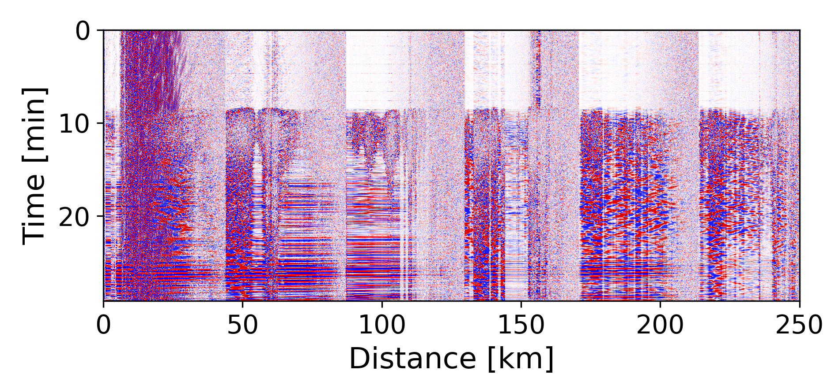
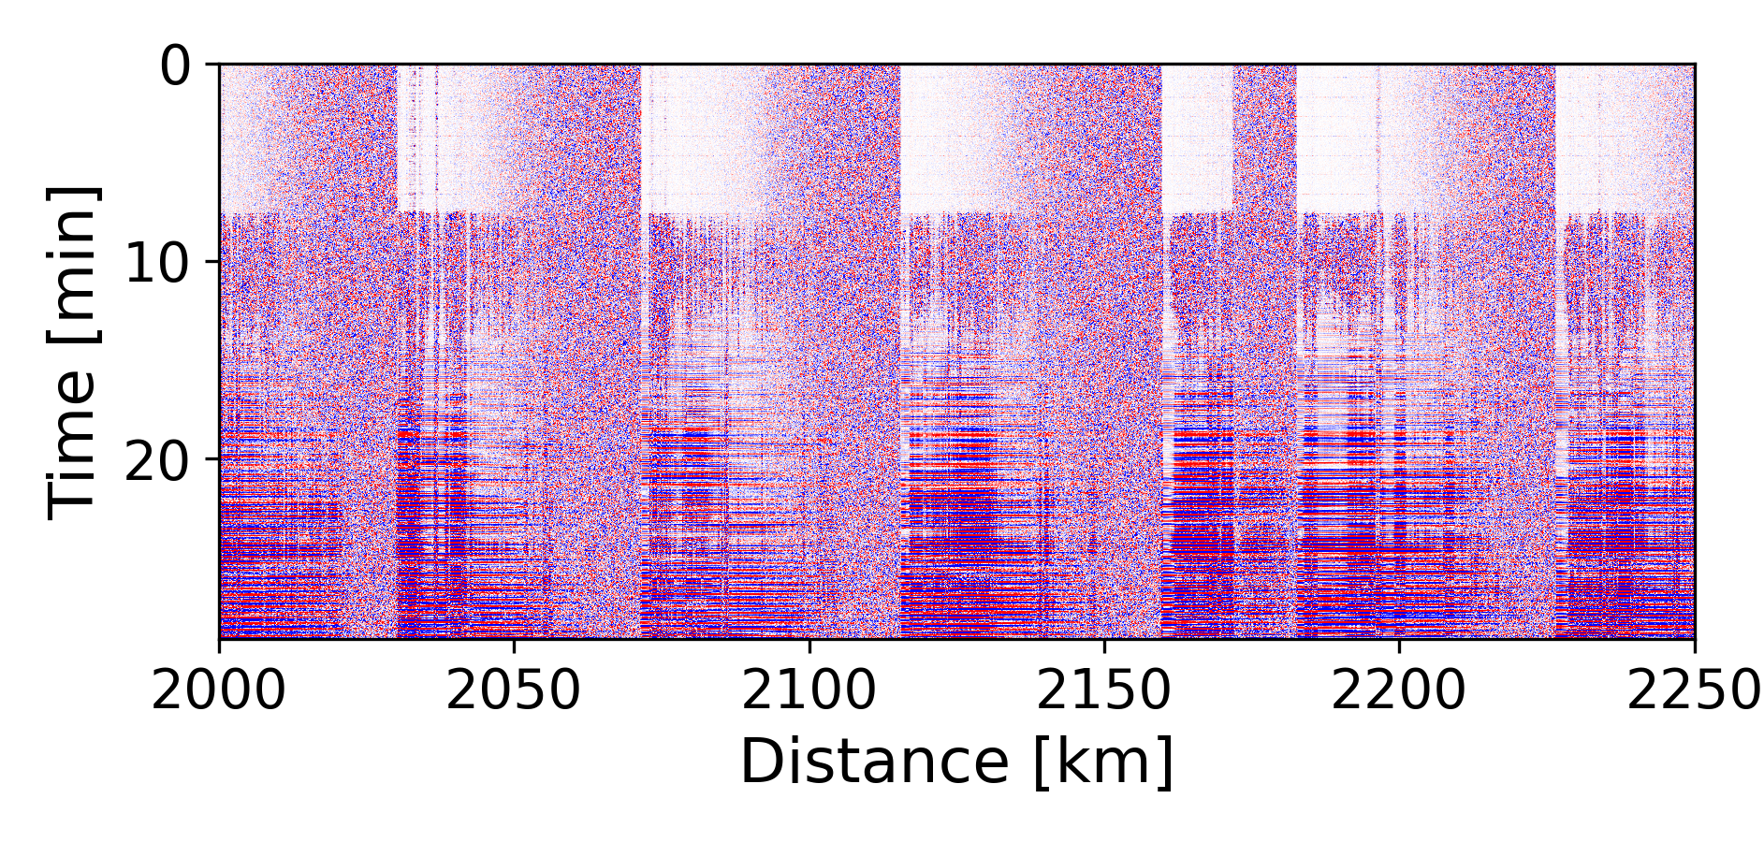
M8.8 Mega-Thrust Earthquake
Near shore
Deep Ocean
M. Mazur et. al., Submarine Cable Deep-Ocean Observation of Mega-Thrust Earthquake and Tsunami with 44,000 100-m Spaced Sensors, 2025

Slide 13
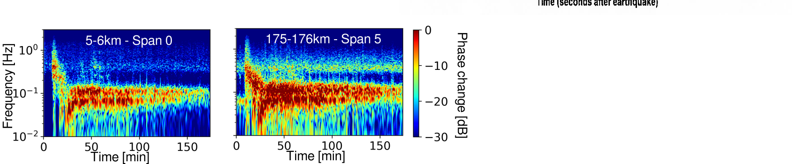
M8.8 Mega-Thrust Earthquake
Earthquake Spectrograms
u
u
M. Mazur et. al., Submarine Cable Deep-Ocean Observation of Mega-Thrust Earthquake and Tsunami with 44,000 100-m Spaced Sensors, 2025

Slide 14
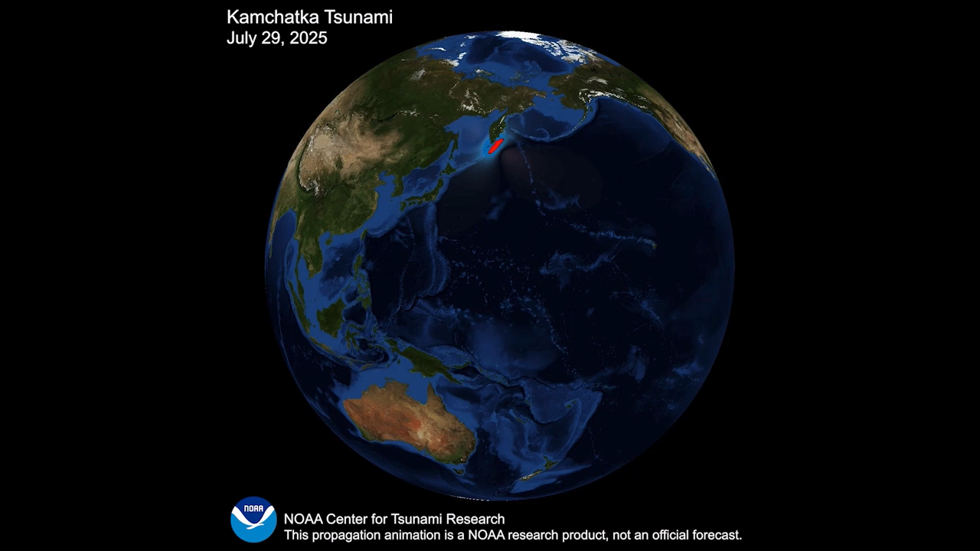
https://nctr.pmel.noaa.gov/kamchatka20250729/

Slide 15
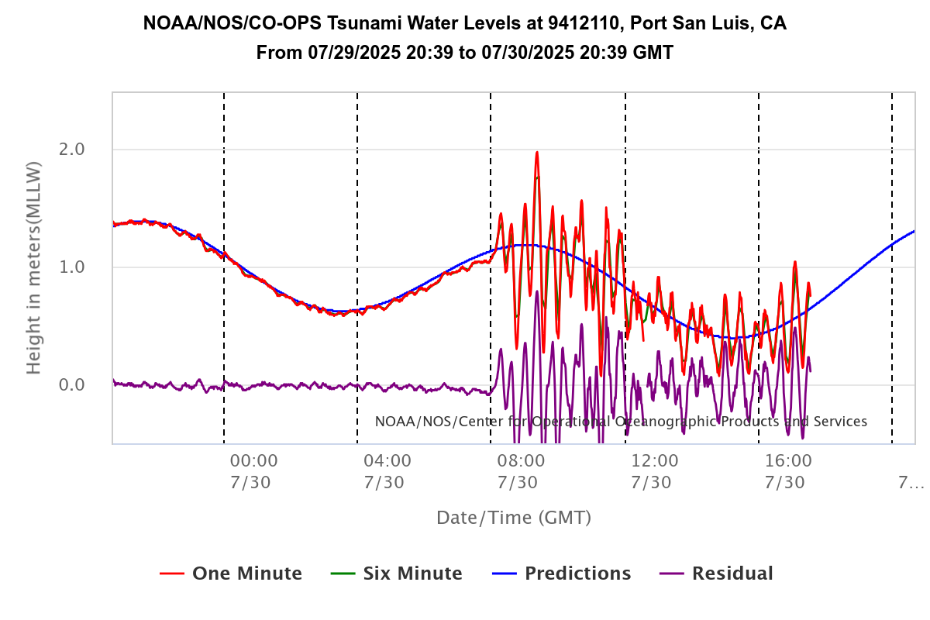
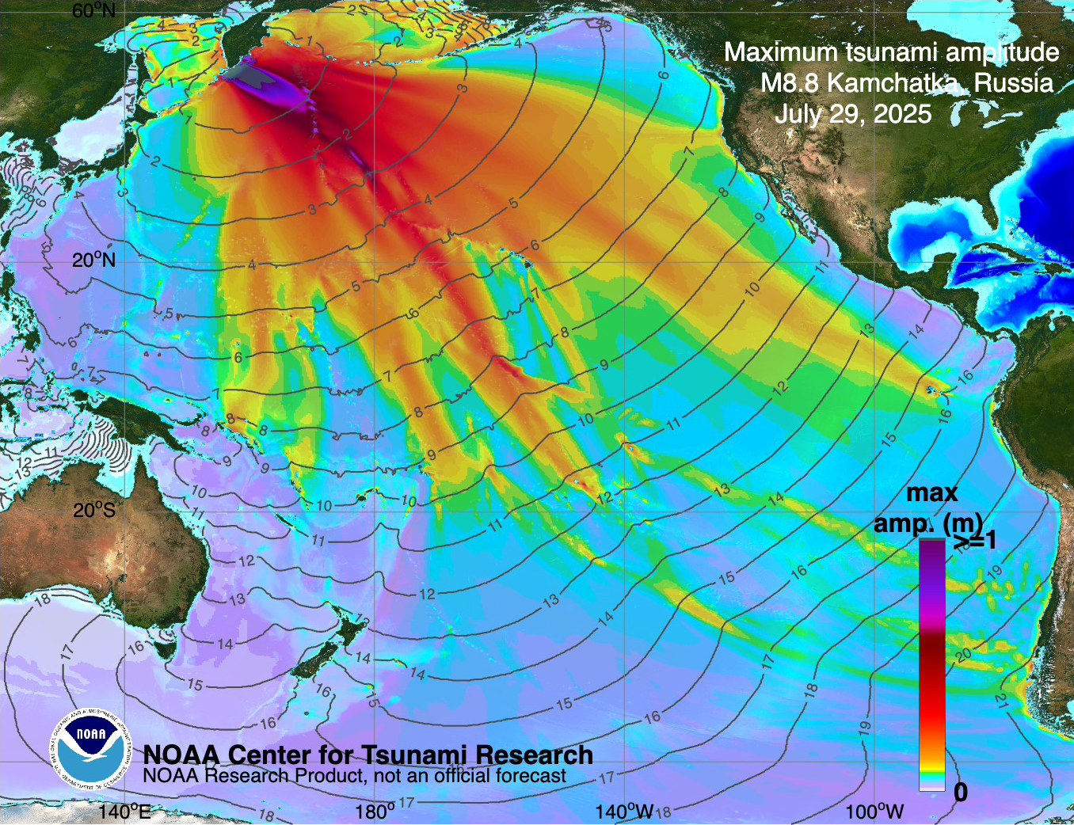
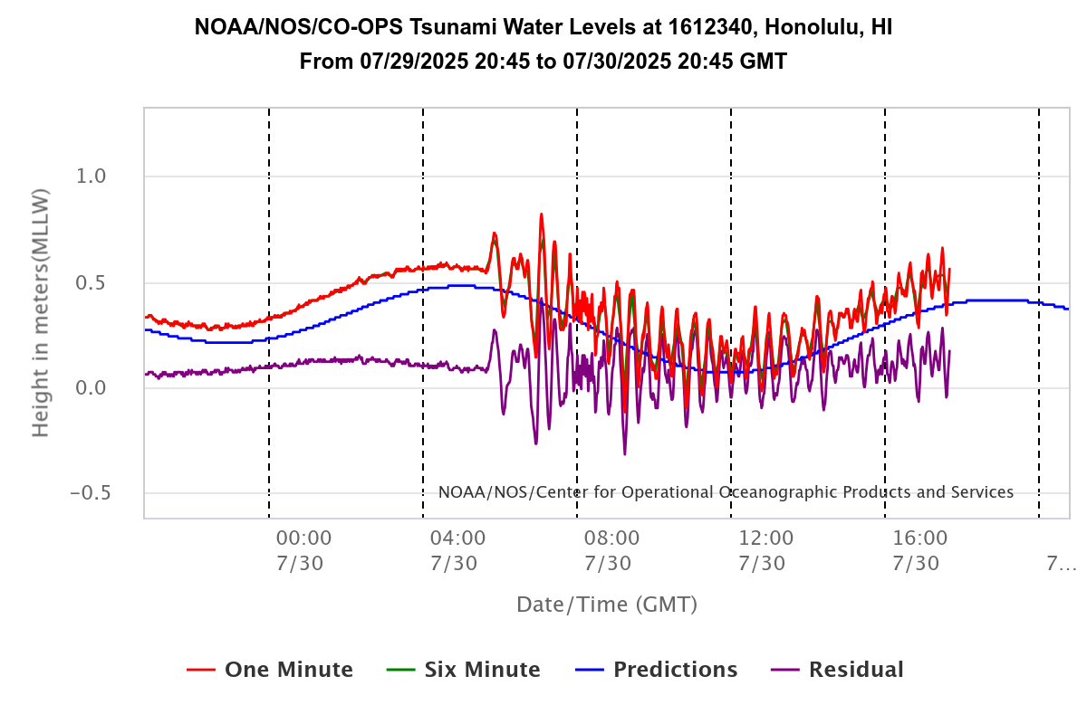
Tsunami Observation
NOAA reference data
MOST (Method of Splitting Tsunami) model
DART Buoy's offshore HI and CA
https://nctr.pmel.noaa.gov/kamchatka20250729/
M. Mazur et. al., Submarine Cable Deep-Ocean Observation of Mega-Thrust Earthquake and Tsunami with 44,000 100-m Spaced Sensors, 2025

Slide 16
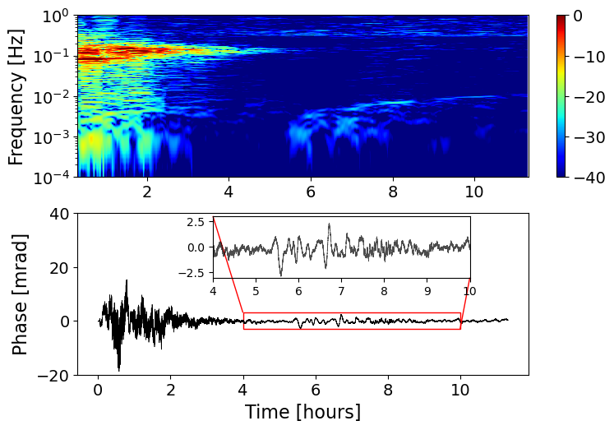
DART
Tsunami
DART is close to shore
Fiber sensing enables deep-ocean tracking
Fiber Sensing, 500km offshore Hawaii
https://nctr.pmel.noaa.gov/kamchatka20250729/
M. Mazur et. al., Submarine Cable Deep-Ocean Observation of Mega-Thrust Earthquake and Tsunami with 44,000 100-m Spaced Sensors, 2025

Slide 17
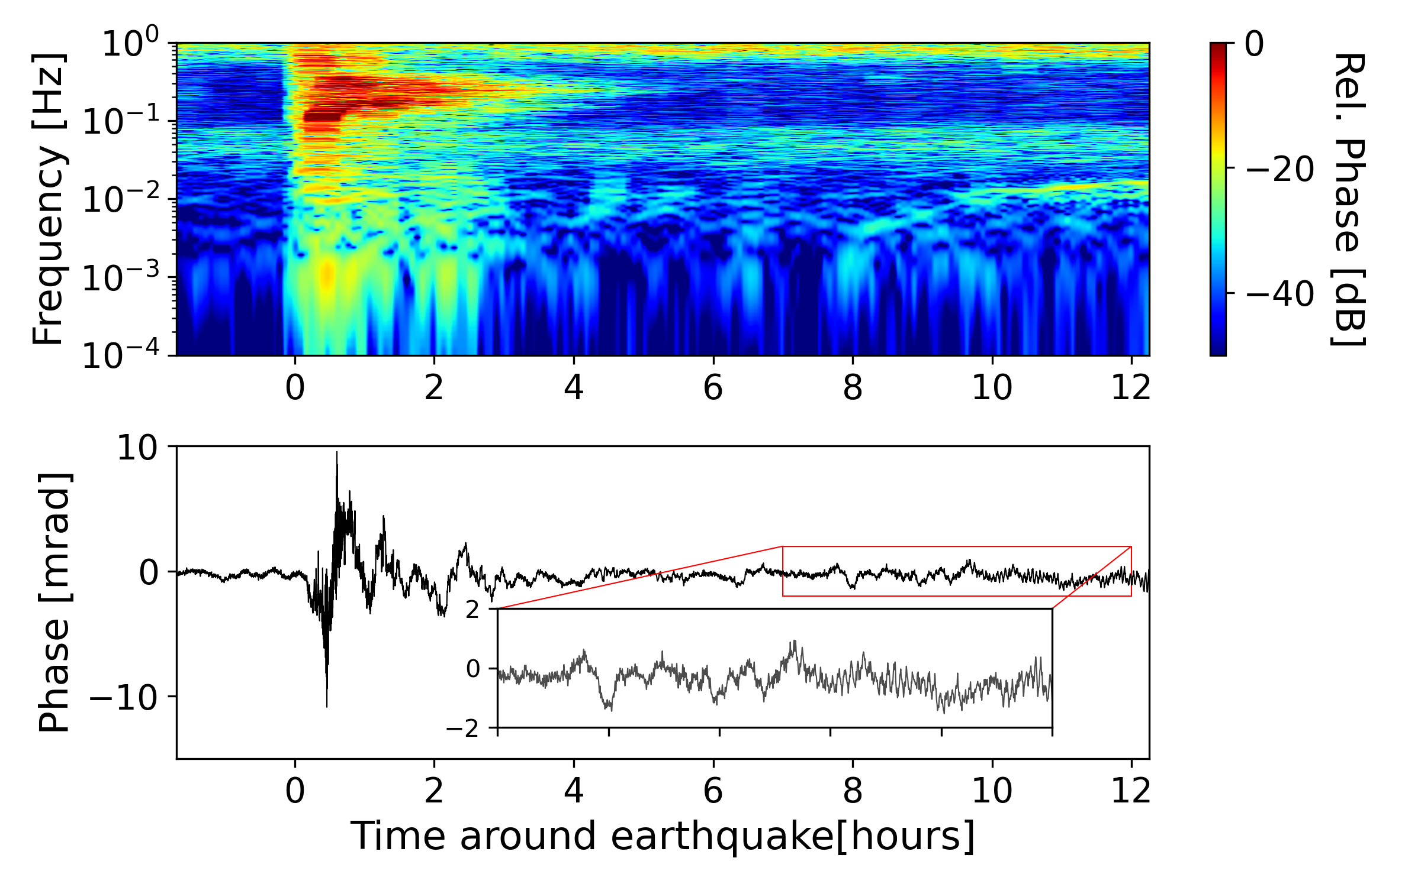
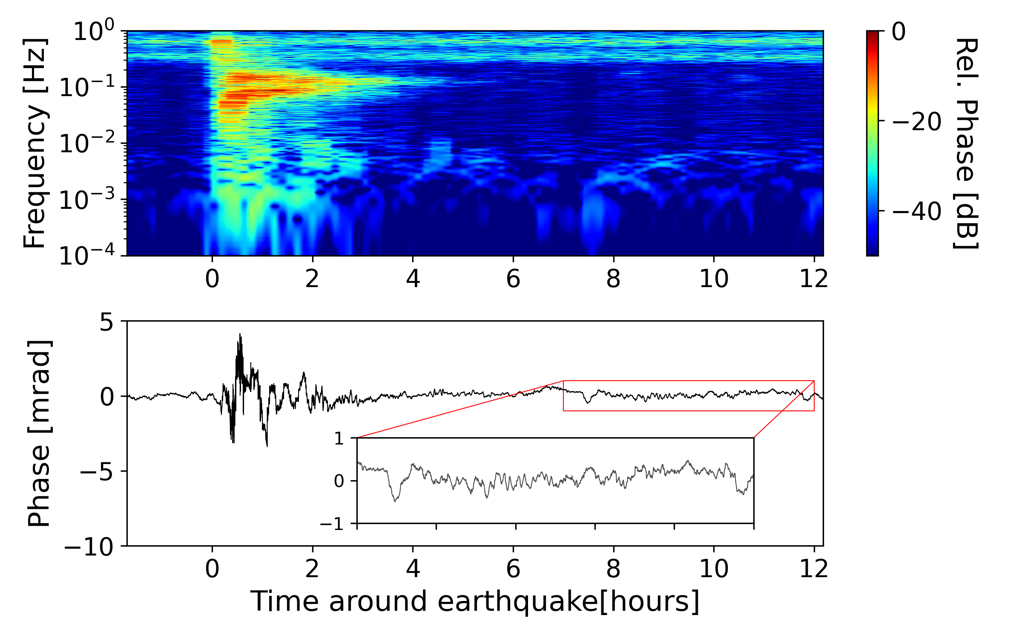
Tsunami Monitoring
15km offshore California, ~30m depth
500km offshore California, >4000m depth
M. Mazur et. al., Submarine Cable Deep-Ocean Observation of Mega-Thrust Earthquake and Tsunami with 44,000 100-m Spaced Sensors, 2025

Slide 18
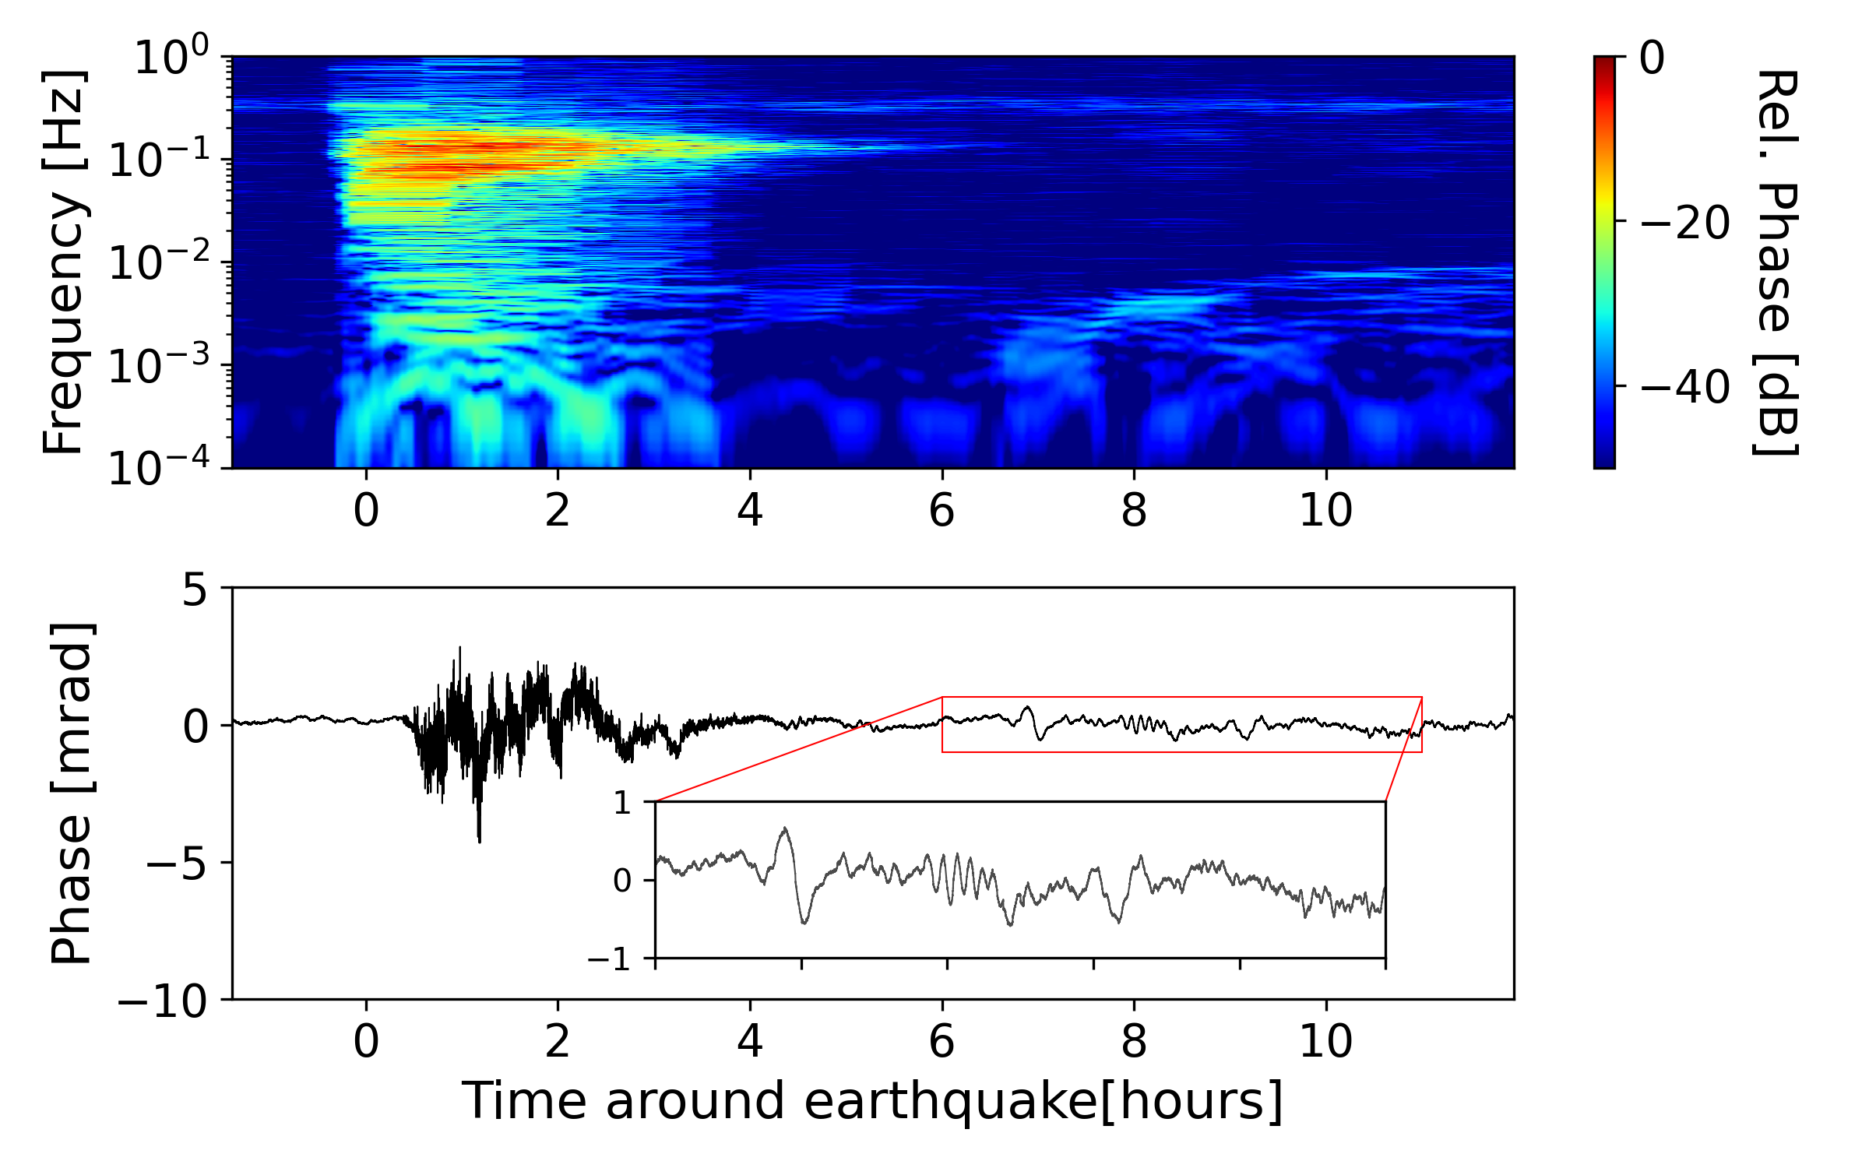
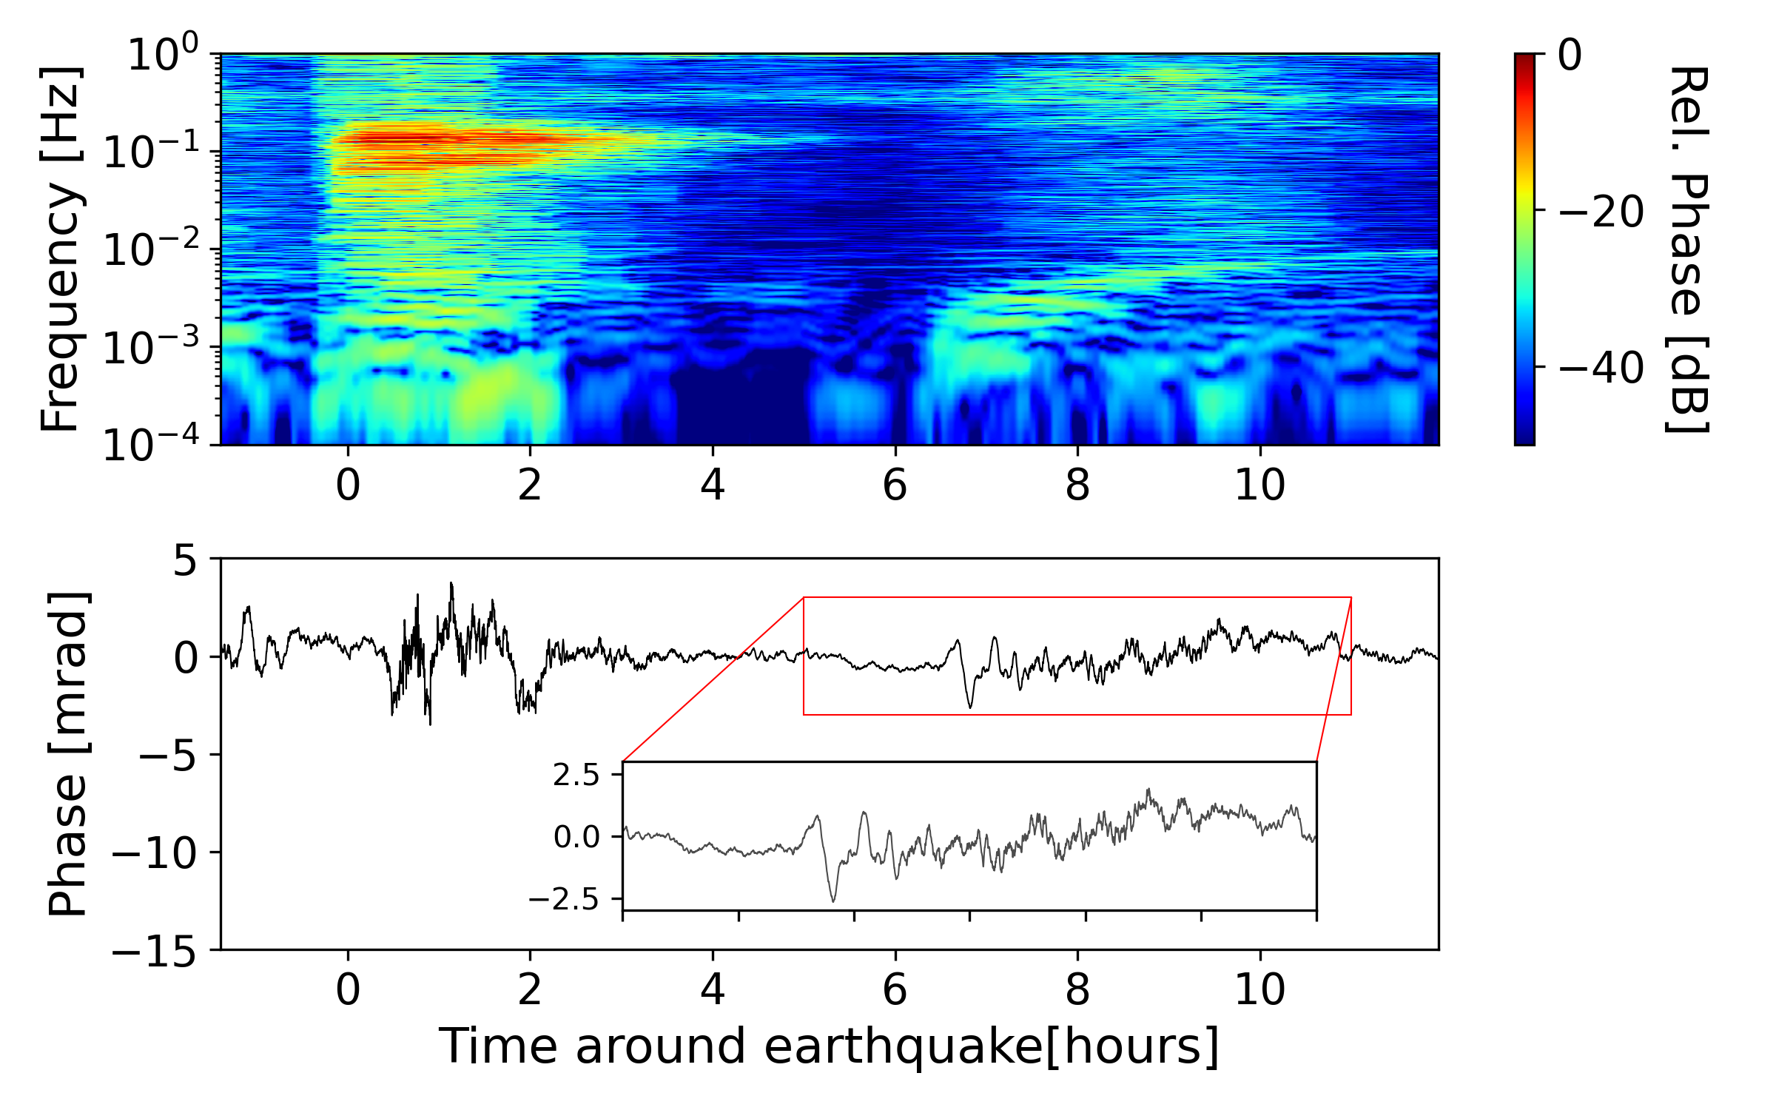
Tsunami Monitoring
1000km offshore California, >4000m depth
1500km offshore California, >4000m depth
M. Mazur et. al., Submarine Cable Deep-Ocean Observation of Mega-Thrust Earthquake and Tsunami with 44,000 100-m Spaced Sensors, 2025

Slide 19
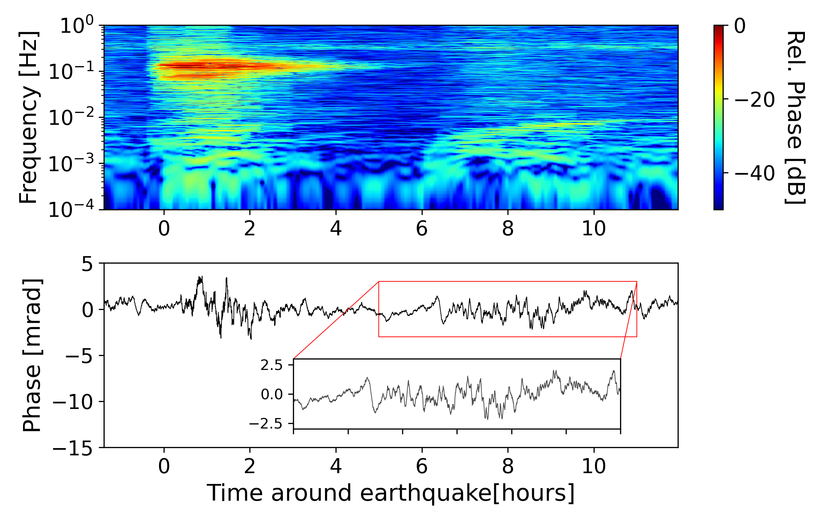
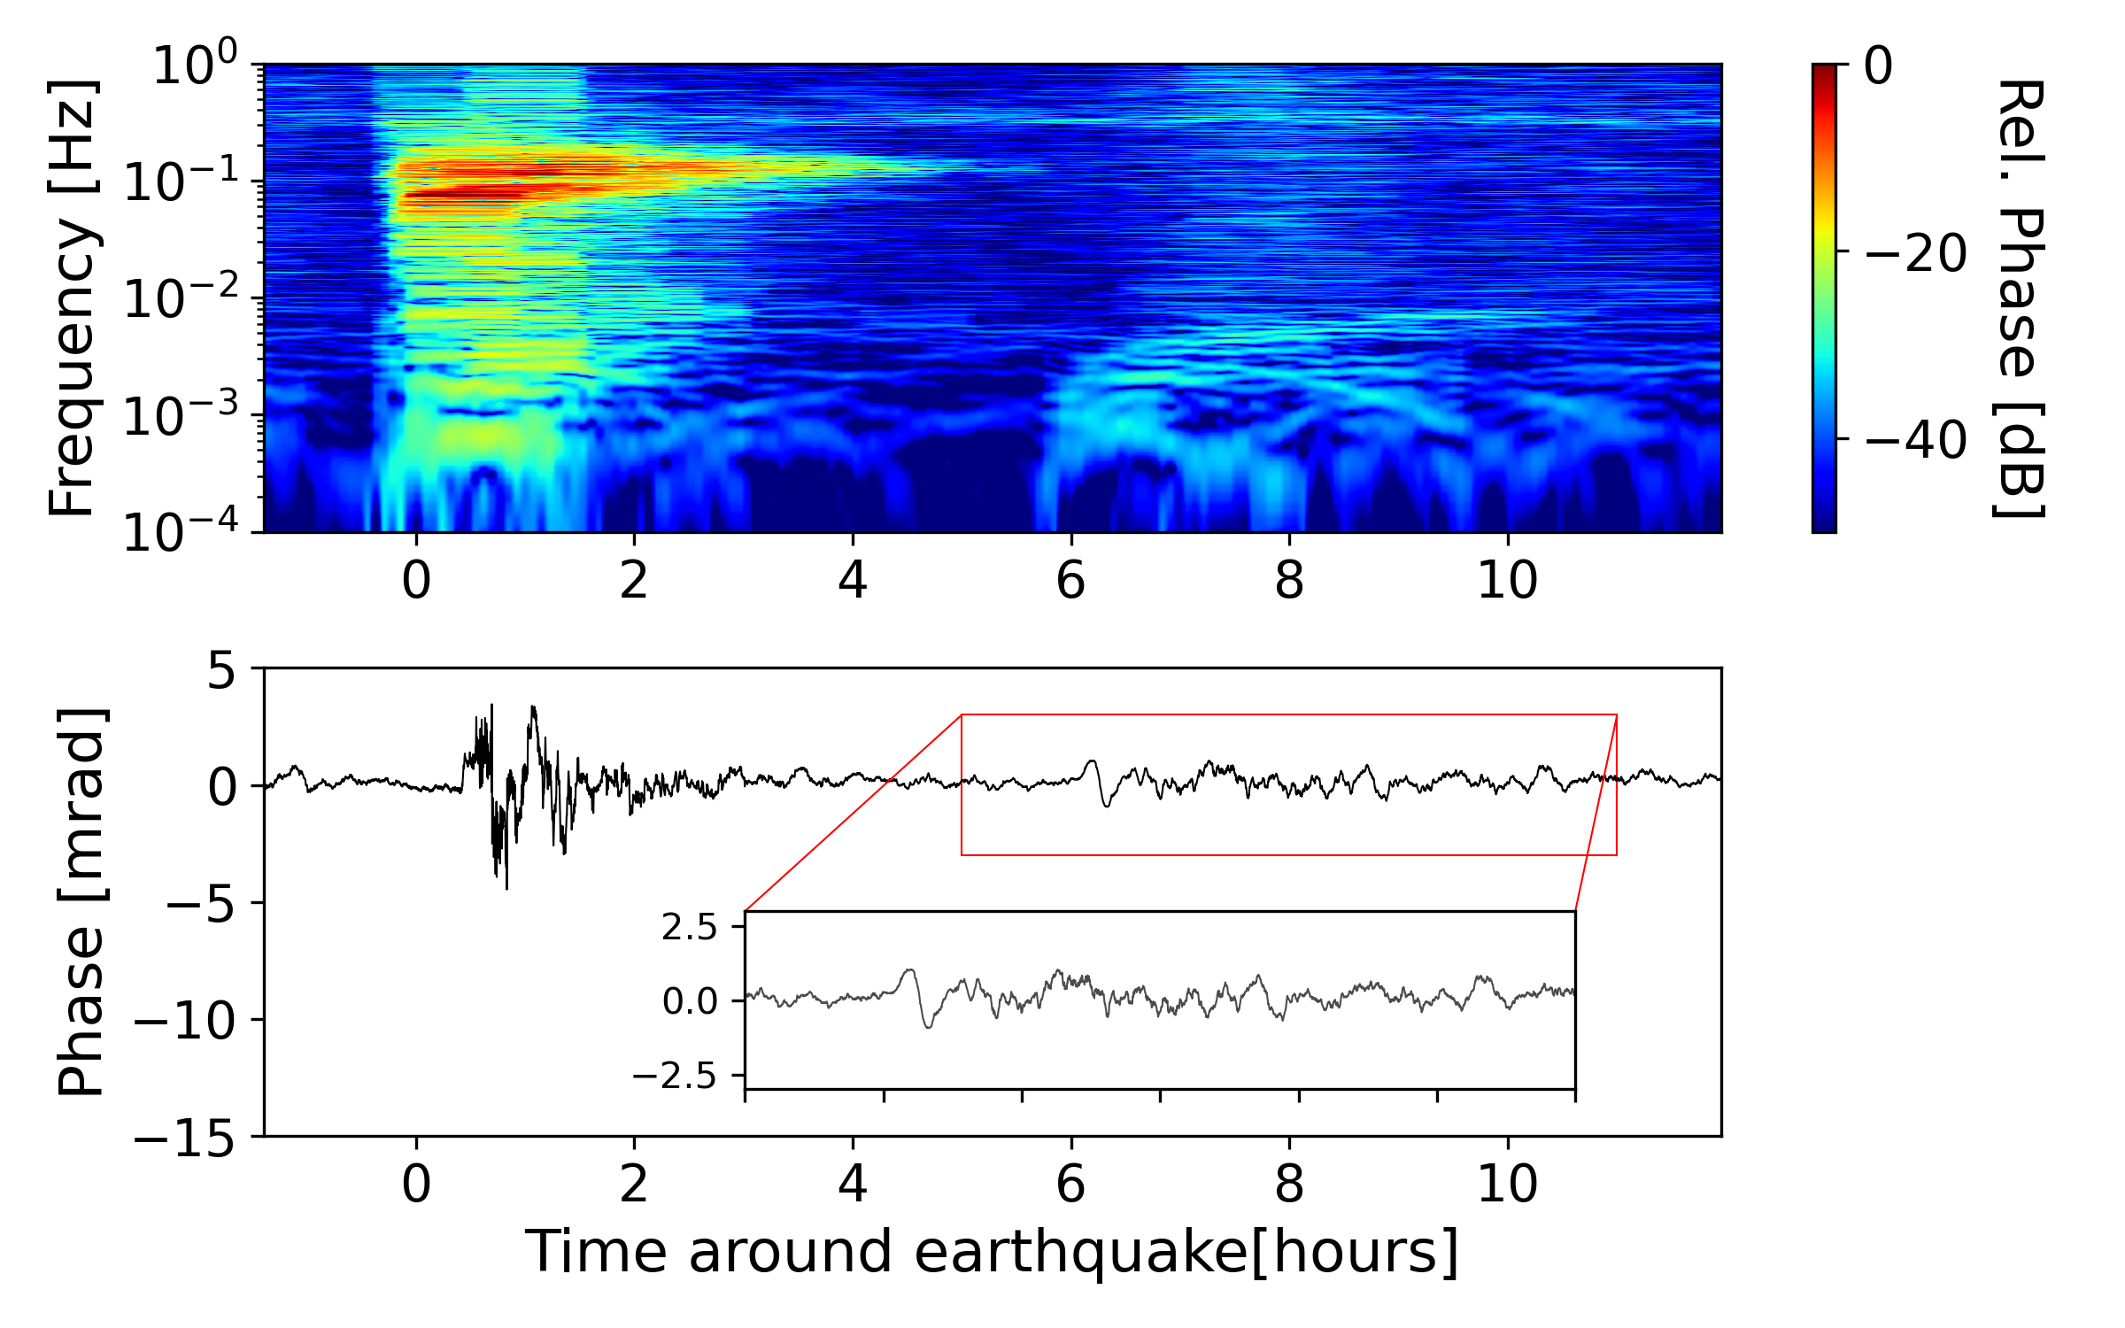
Tsunami Monitoring
2000km offshore California, >4000m depth
2500km offshore California, >4000m depth
M. Mazur et. al., Submarine Cable Deep-Ocean Observation of Mega-Thrust Earthquake and Tsunami with 44,000 100-m Spaced Sensors, 2025

Slide 20
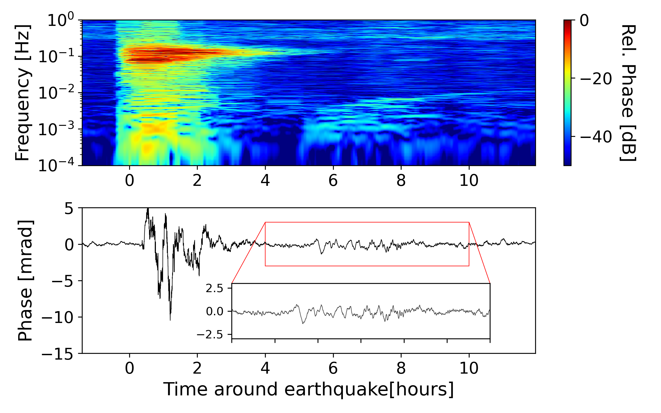
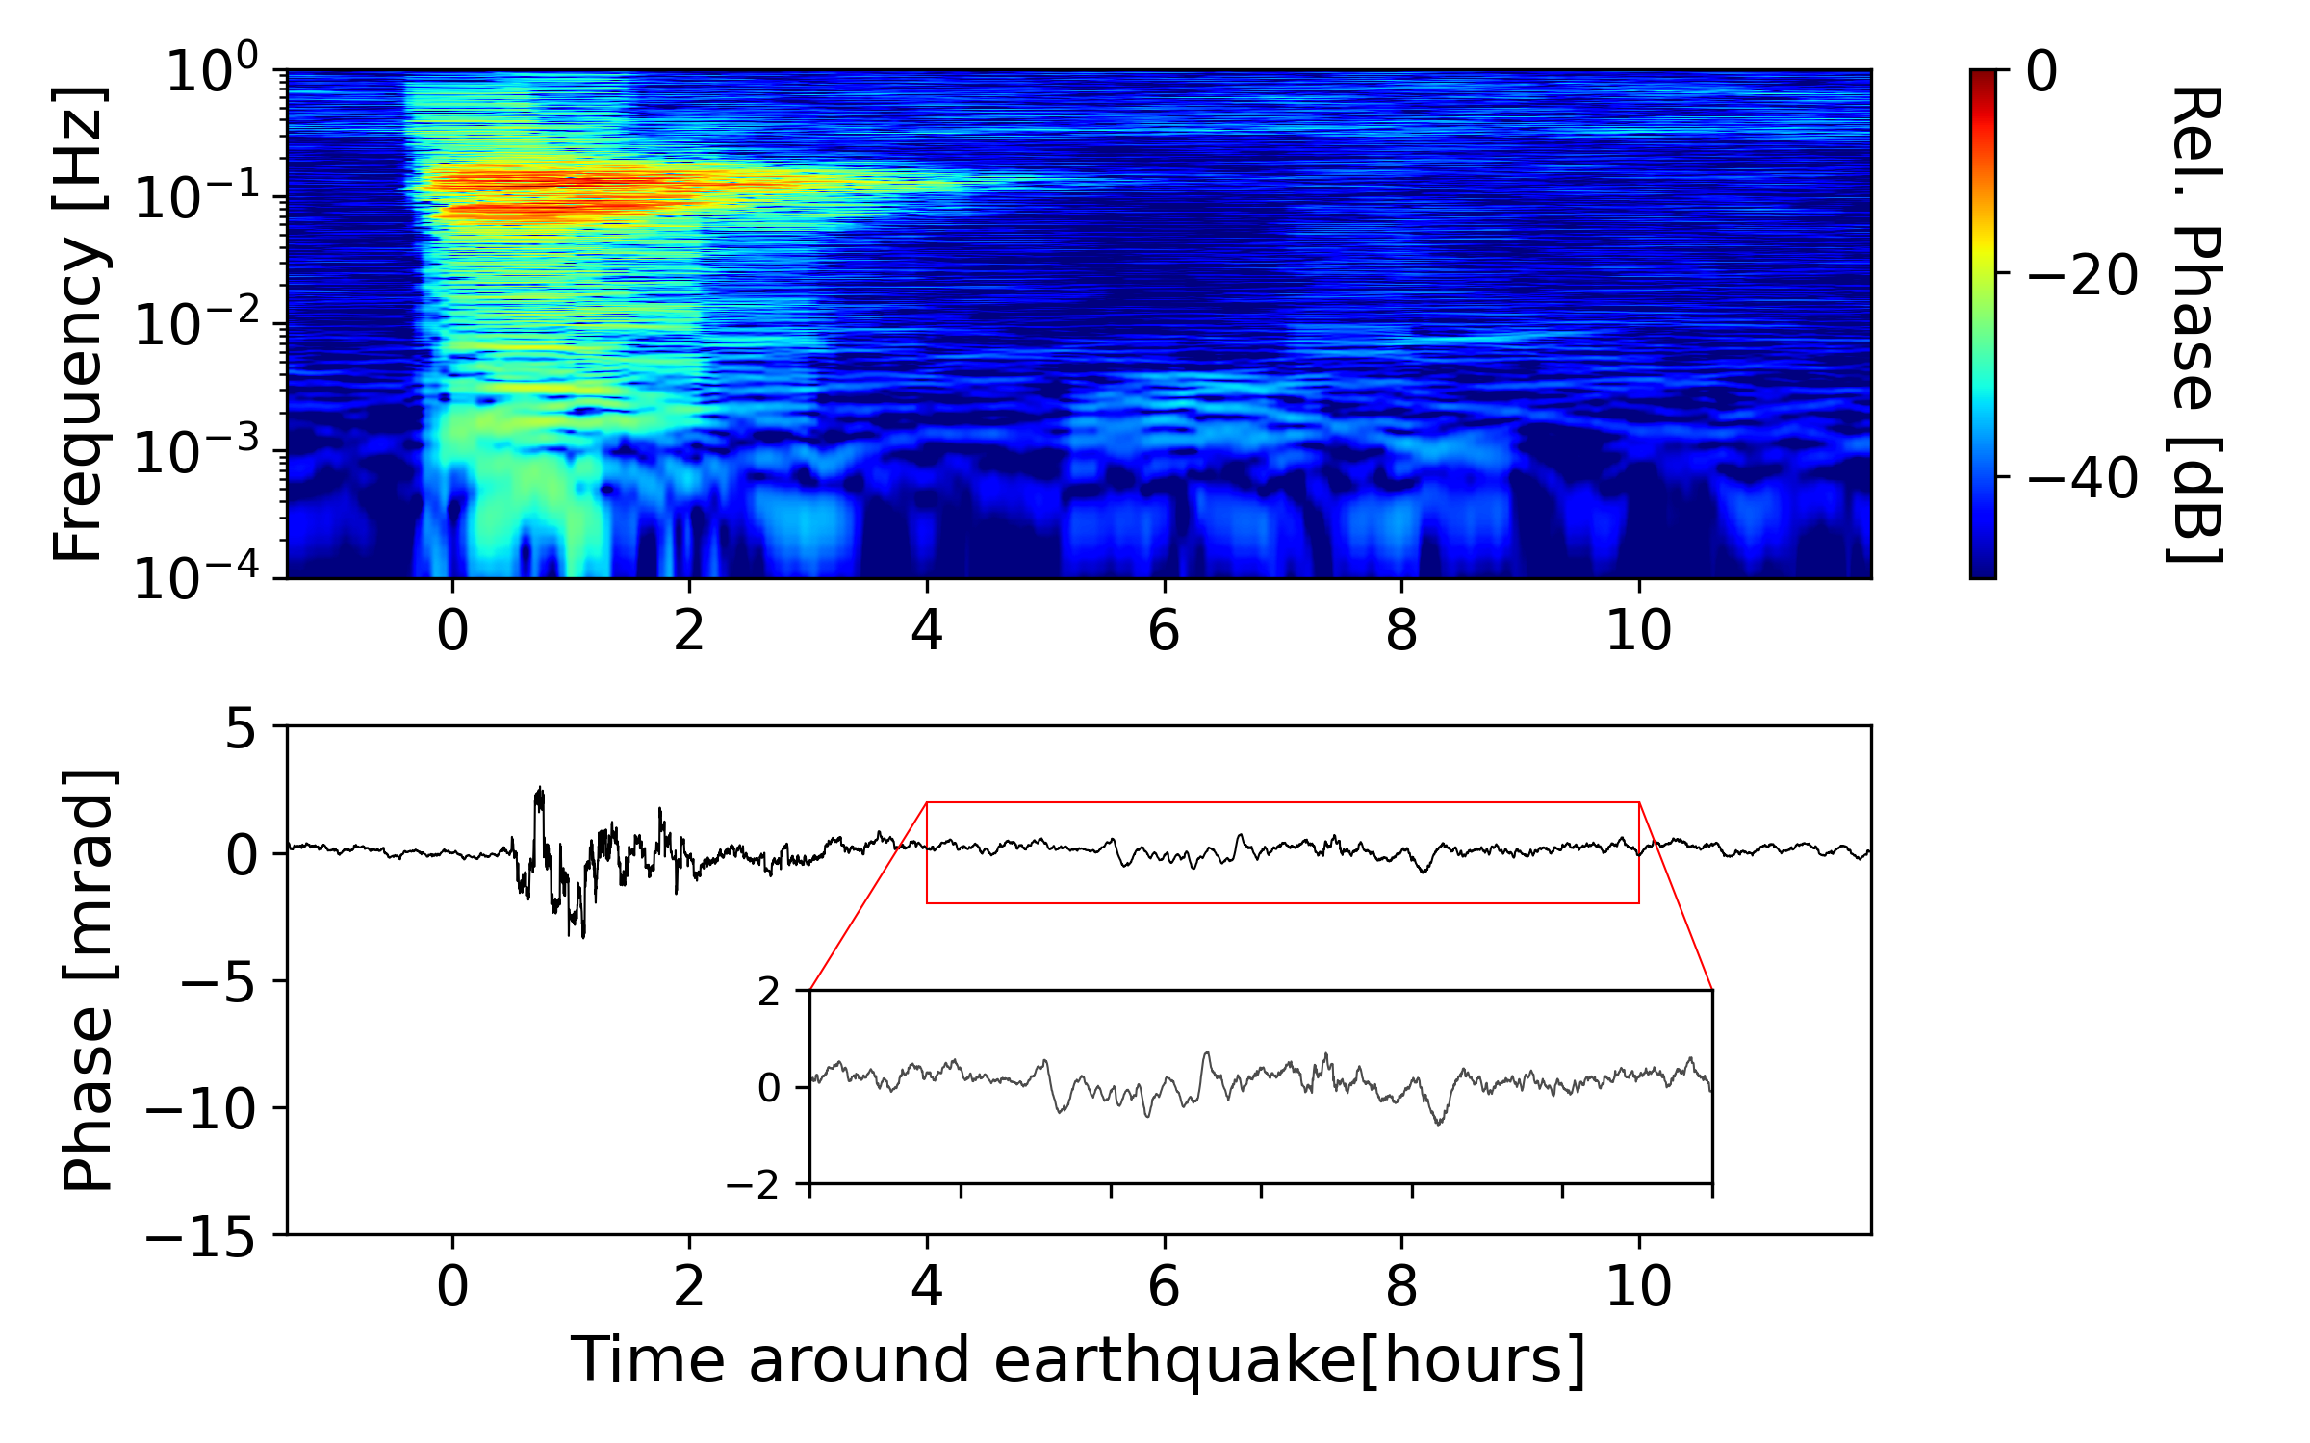
Tsunami Monitoring
500km offshore Hawaii, >4000m depth
50km offshore Hawaii, >1000m depth
M. Mazur et. al., Submarine Cable Deep-Ocean Observation of Mega-Thrust Earthquake and Tsunami with 44,000 100-m Spaced Sensors, 2025

Slide 21
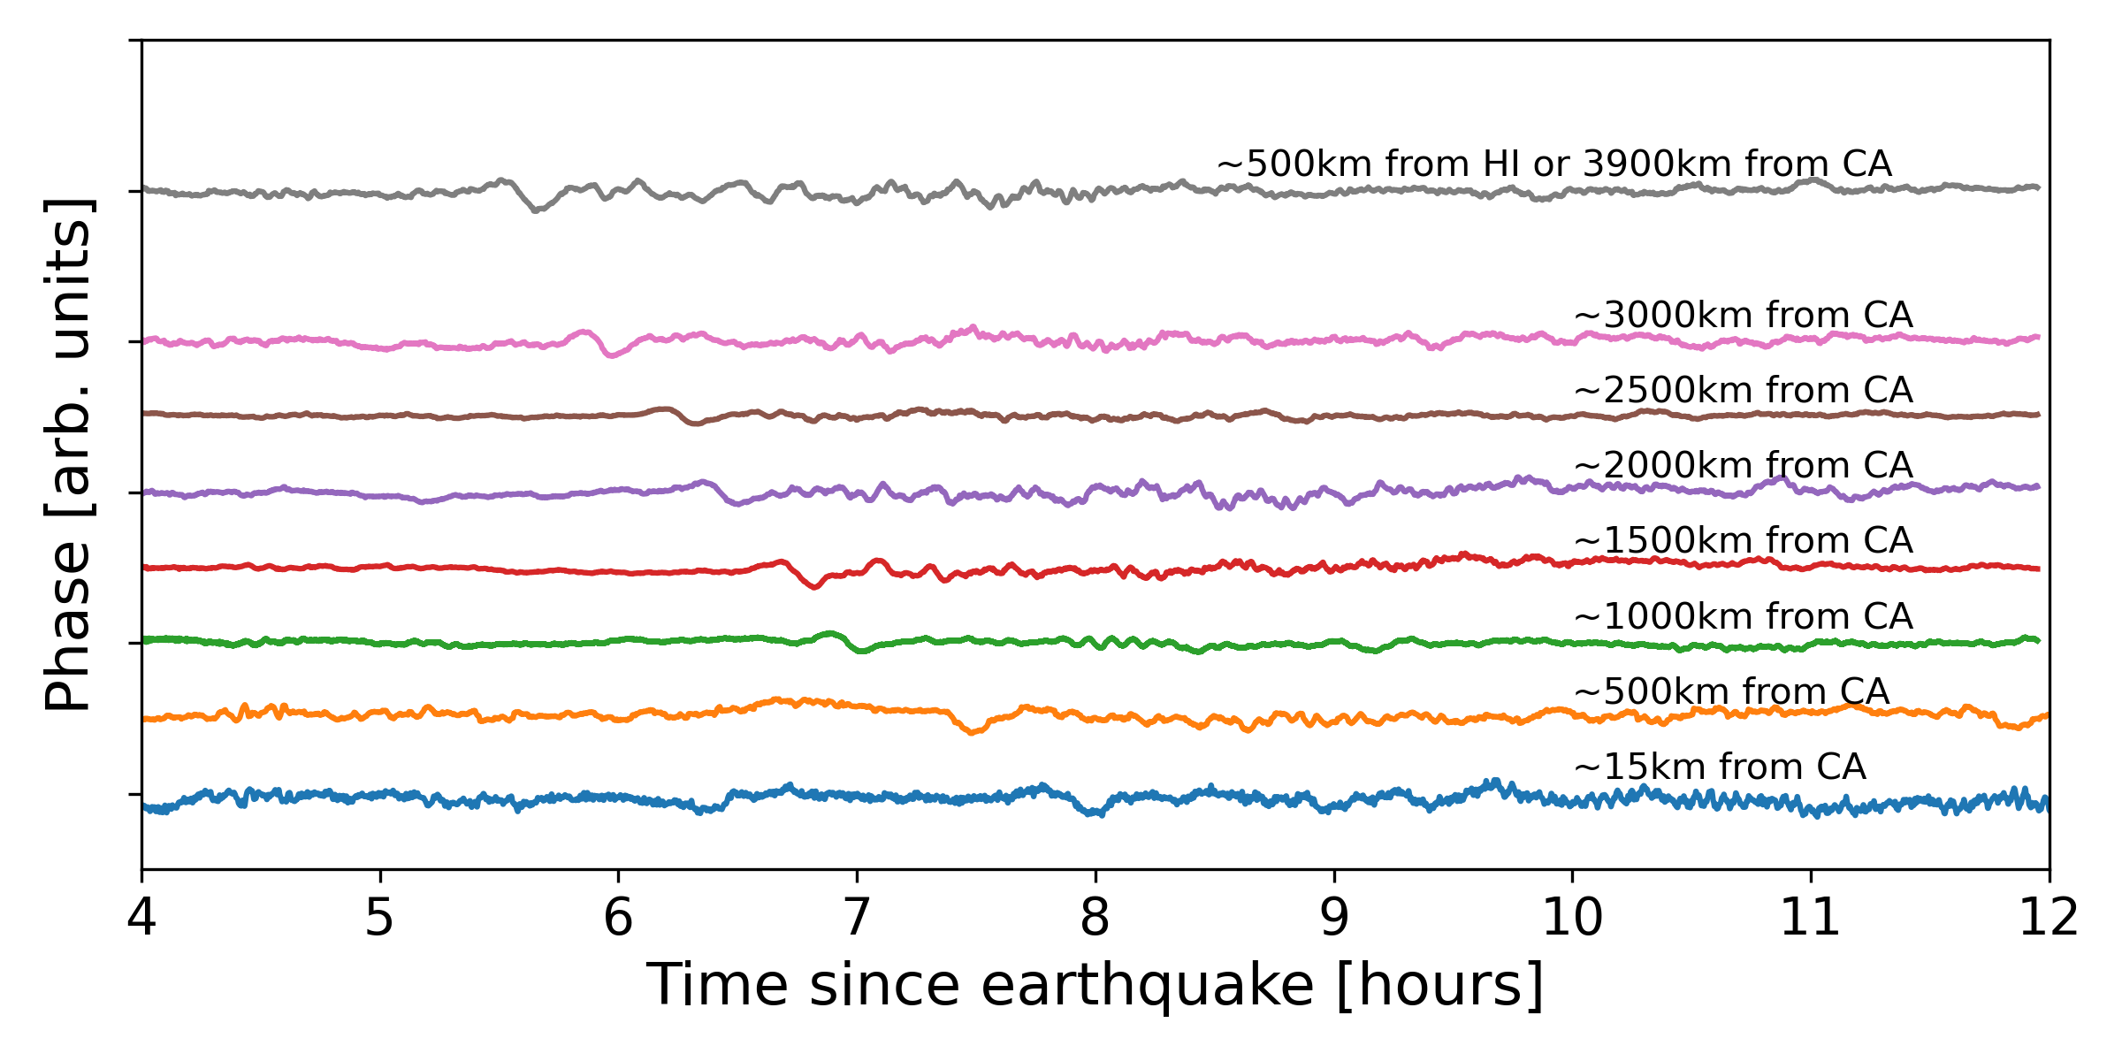
Tsunami Heading for California
Bandpass: 100uHz - 50mHz
M. Mazur et. al., Submarine Cable Deep-Ocean Observation of Mega-Thrust Earthquake and Tsunami with 44,000 100-m Spaced Sensors, 2025

Slide 22
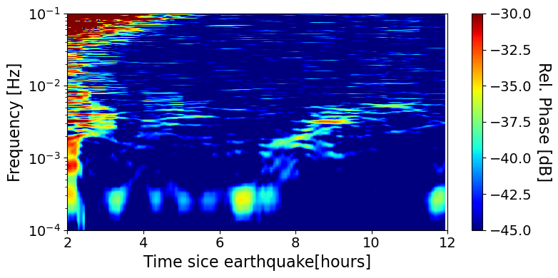
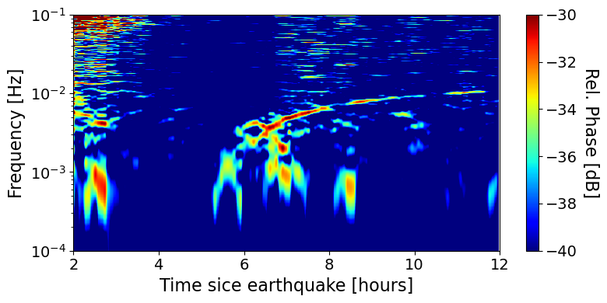
Tsunami
First Fiber-Optic Deep-Ocean Tracking
500km offshore California
500km offshore Hawaii
https://nctr.pmel.noaa.gov/kamchatka20250729/
M. Mazur et. al., Submarine Cable Deep-Ocean Observation of Mega-Thrust Earthquake and Tsunami with 44,000 100-m Spaced Sensors, 2025

Slide 23
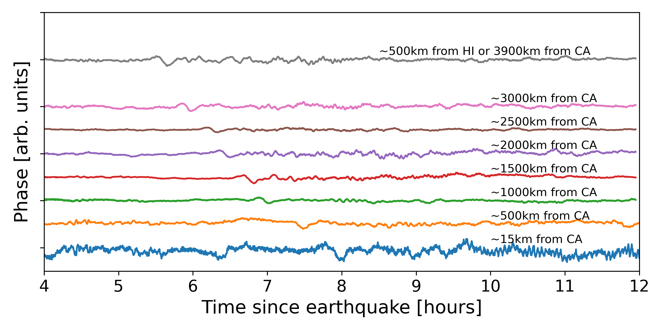
Conclusions
Tsunami 500km offshore Hawaii, >4000m depth
Earthquake and Tsunami observation
Demonstrated high-resolution distributed acoustic sensing
~100m spatial resolution
44,000 measurement points
Largest coherent detection array to date
Compatible with all installed submarine cables
Detection of the M8.8 mega-trust earthquake
P-, S- and several other phases clearly visible
Unprecedented spatial resolution on the ocean floor
Demonstrated detection of a tsunami in the deep ocean
Continuous tracking along the entire cable
Proves the ability for telecom cables to track tsunamis
M. Mazur et. al., Submarine Cable Deep-Ocean Observation of Mega-Thrust Earthquake and Tsunami with 44,000 100-m Spaced Sensors, 2025

