Slide 1






EPOS Thematic Core Services TSUNAMI
A. Babeyko (GFZ Potsdam)
Hyderabad, India
10-11 November 2025

Slide 2

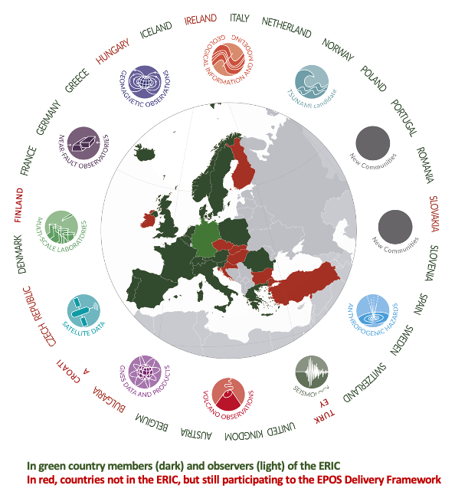

EPOS is a European Research Infrastructure Consortium (ERIC)
a legal entity recognized in all EU Member States
515 Data and Service Providers
172 Research Organisations
26 European Countries
10+ Scientific communities
5 International Organizations
ORFEUS, EMSC, EGS, ESA, EUREF
10-11 November 2025
INCOIS, Hyderabad, India
First Conference of the
Ocean Decade Tsunami Programme

Slide 3
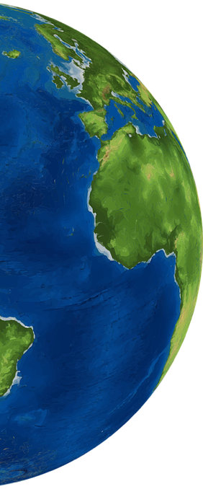






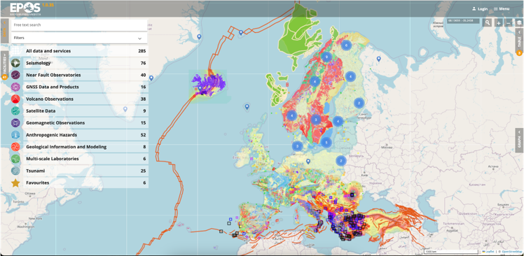





The reference RI
for solid Earth science in Europe
Seismology
Near Faults Observatories
EPOS harmonizes and integrates
multidisciplinary solid Earth data
acquired through diverse scientific systems and disciplines and ensures open and FAIR access to them through its digital platform, supporting multidisciplinary research.
GNSS Data and Products
Volcano Observations
Satellite Data
We are Open
Geomagnetic Observations
Anthropogenic Hazards
Geological Information
and Modeling
Multi-scale Laboratories
Tsunami
https://www.epos-eu.org/dataportal
33,976 visitors from 124 Countries
(last updated: 22/09/2025)
10-11 November 2025
INCOIS, Hyderabad, India
First Conference of the
Ocean Decade Tsunami Programme

Slide 4
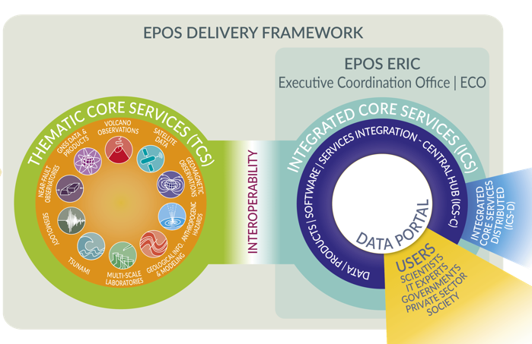

EPOS has been built by assembling key elements
to allow the whole system to work as a single, but distributed, sustainable research infrastructure
DATA Integration
DATA Access
ICS integrate data and services and make them FAIRly accessible through a single-access point
DATA Generation
NRIs and other organisations generate and manage data for science and society
users exploit the EPOS Platform to
access, visualise, combine, download data from different scientific domains
TCS provide the governance framework necessary to ensure
that data and metadata, from different sources and in different formats,
are harmonised and made accessible through services on the Platform
10-11 November 2025
INCOIS, Hyderabad, India
First Conference of the
Ocean Decade Tsunami Programme

Slide 5
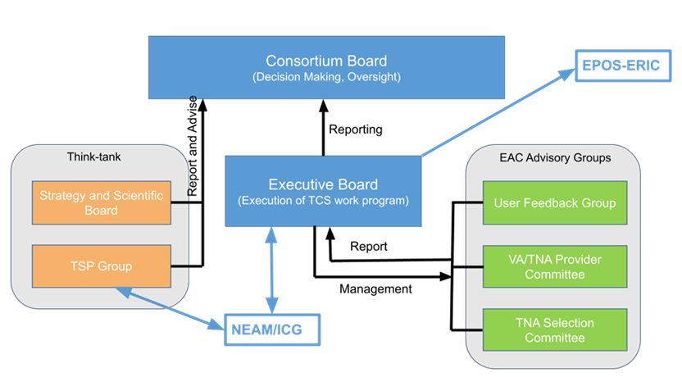
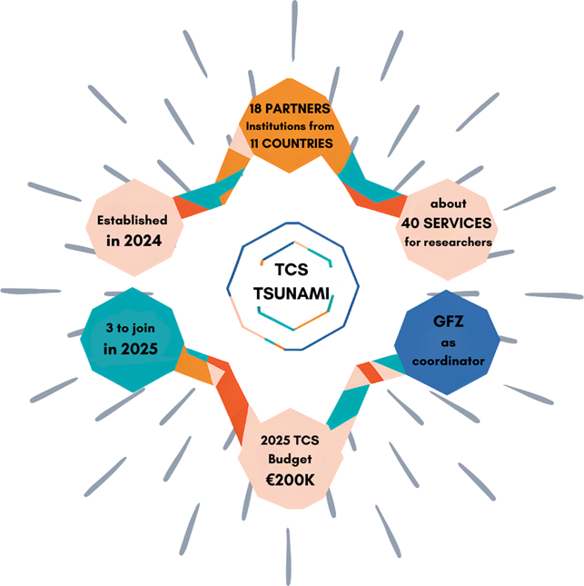
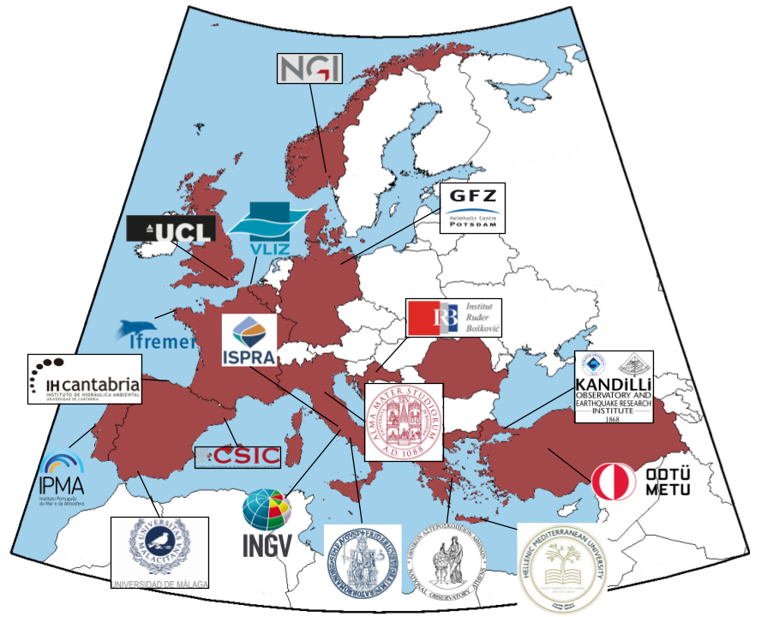
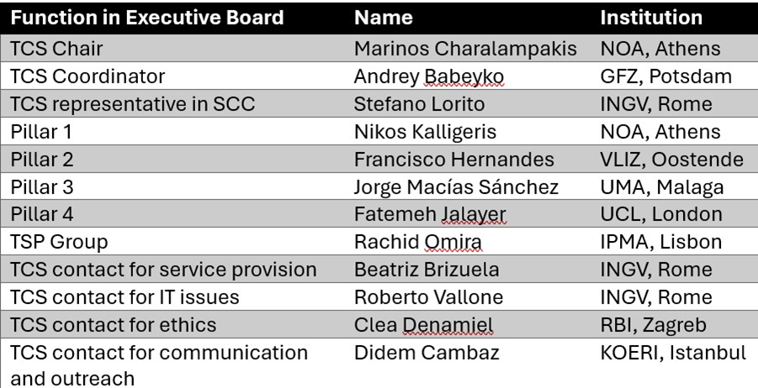

Thematic Core Services TSUNAMI
Governance
Executive Board & functions
https://www.epos-eu.org/tcs/tsunami
https://youtu.be/loFW0vkRwY8?feature=shared
https://tsunamidata.org
10-11 November 2025
INCOIS, Hyderabad, India
First Conference of the
Ocean Decade Tsunami Programme

Slide 6
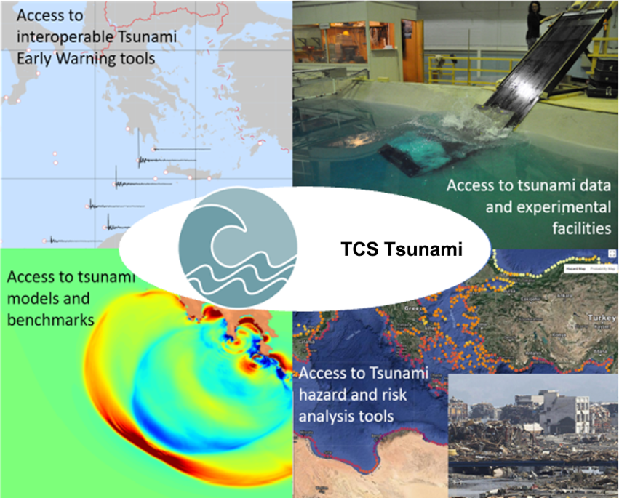
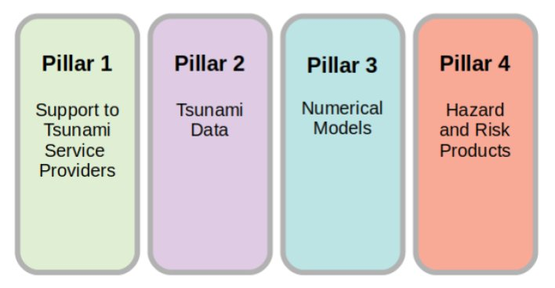
Thematic Core Services TSUNAMI
Services organized by 4 Pillars
ODTP HLO-1
ODTP HLO-2
10-11 November 2025
INCOIS, Hyderabad, India
First Conference of the
Ocean Decade Tsunami Programme

Slide 7
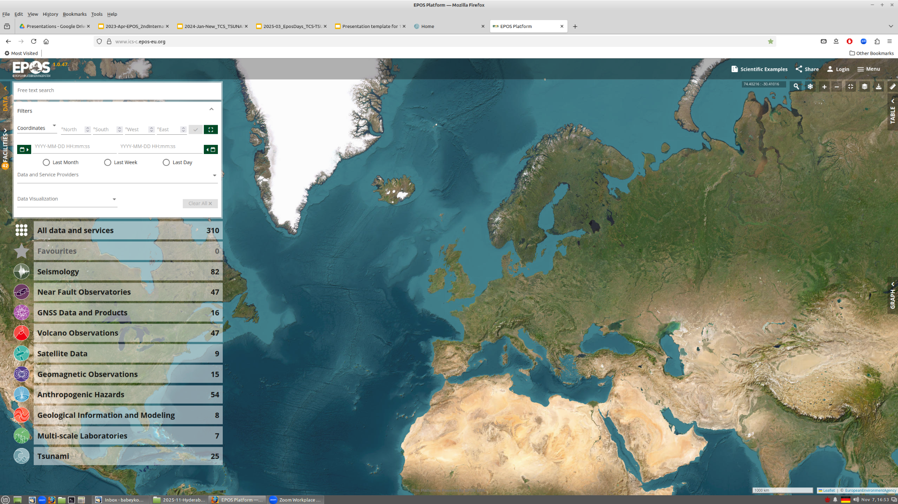
Services distribution channel: EPOS Data Portal https://ics-c.epos-eu.org
ICS-C Data Portal
10-11 November 2025
INCOIS, Hyderabad, India
First Conference of the
Ocean Decade Tsunami Programme

Slide 8
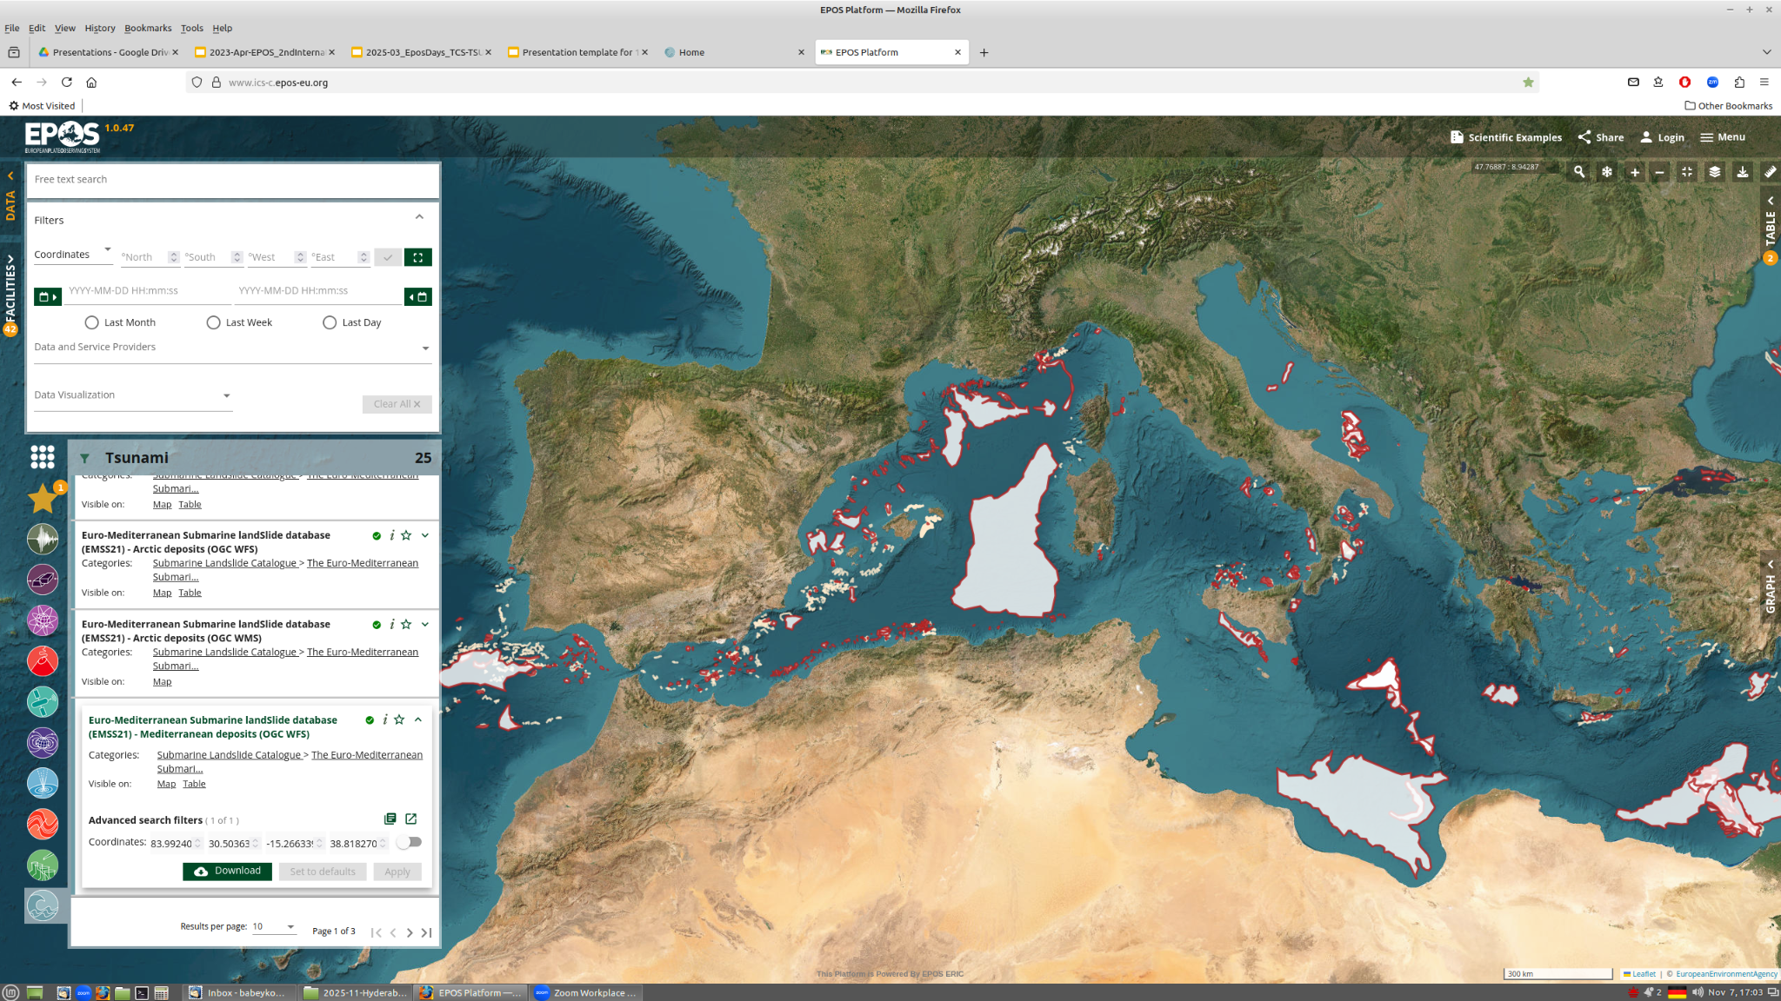
Services distribution channel: EPOS Data Portal https://ics-c.epos-eu.org
Example: Submarine landslide database (by CSIC, Spain)
ICS-C Data Portal
10-11 November 2025
INCOIS, Hyderabad, India
First Conference of the
Ocean Decade Tsunami Programme

Slide 9
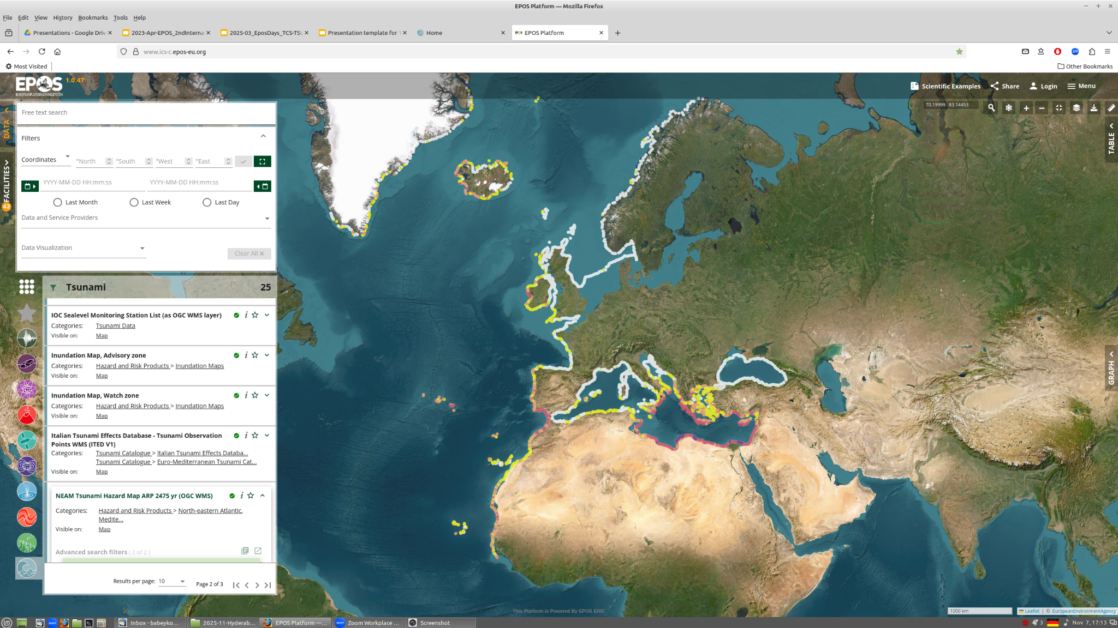
Services distribution channel: EPOS Data Portal https://ics-c.epos-eu.org
Example: NEAM Hazard Map APR 2475yr (by INGV, Italy)
10-11 November 2025
INCOIS, Hyderabad, India
First Conference of the
Ocean Decade Tsunami Programme

Slide 10
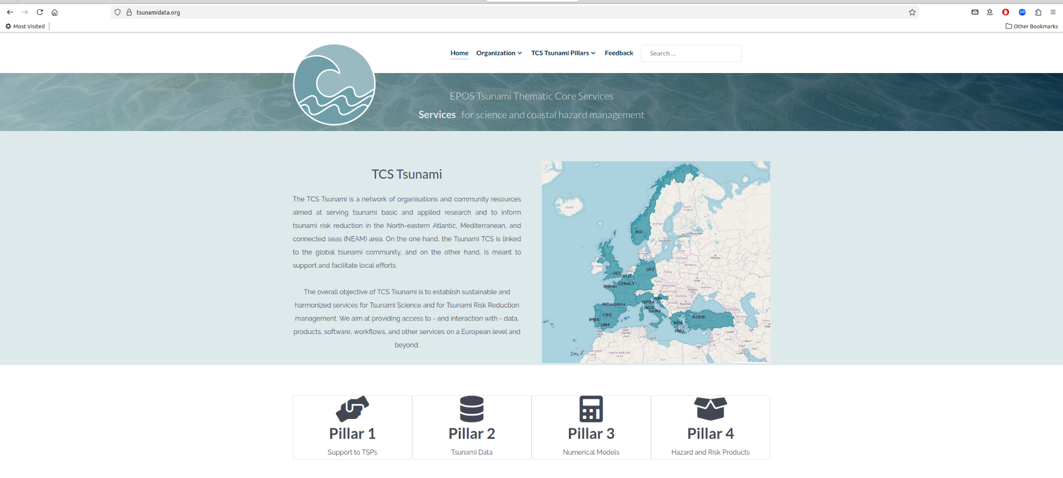
Services distribution channel: Community Portal https://tsunamidata.org
10-11 November 2025
INCOIS, Hyderabad, India
First Conference of the
Ocean Decade Tsunami Programme

Slide 11
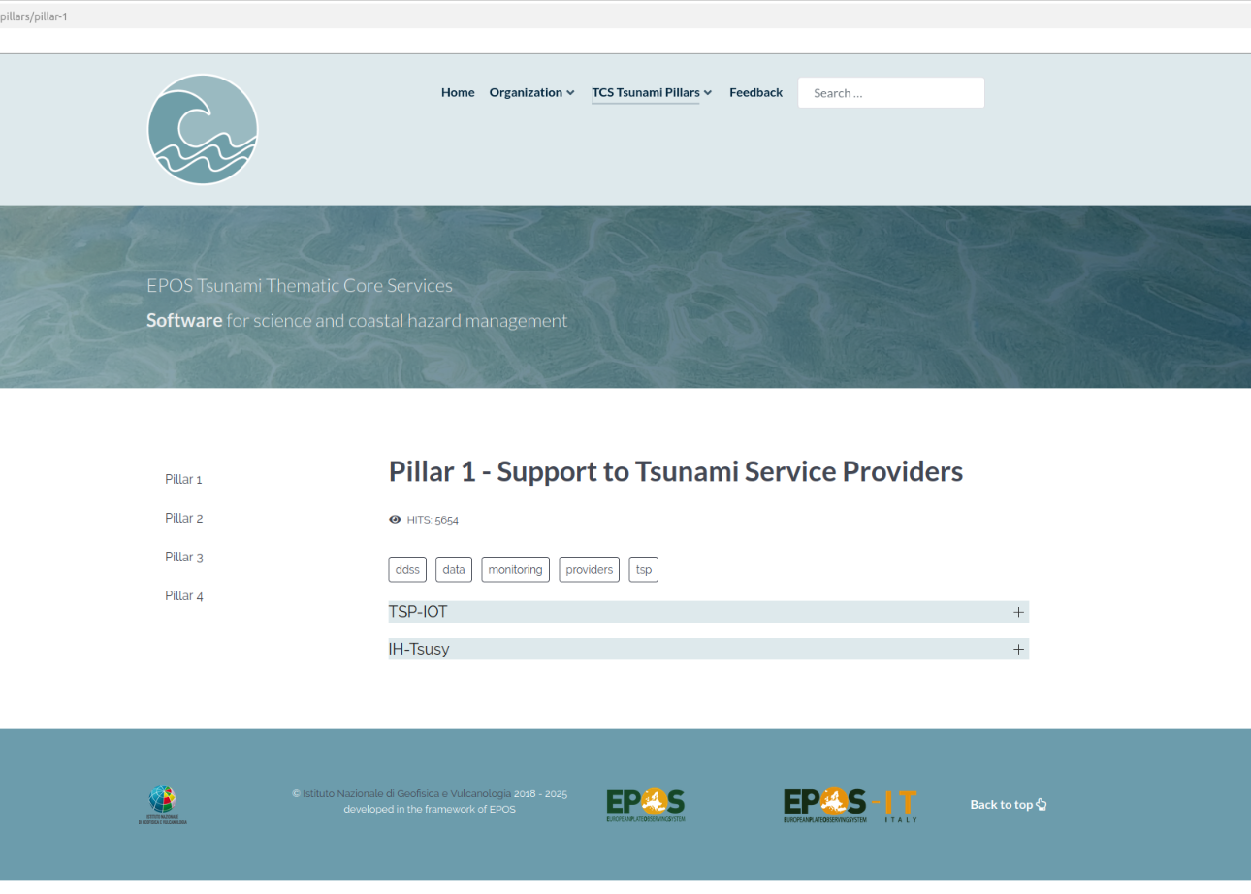
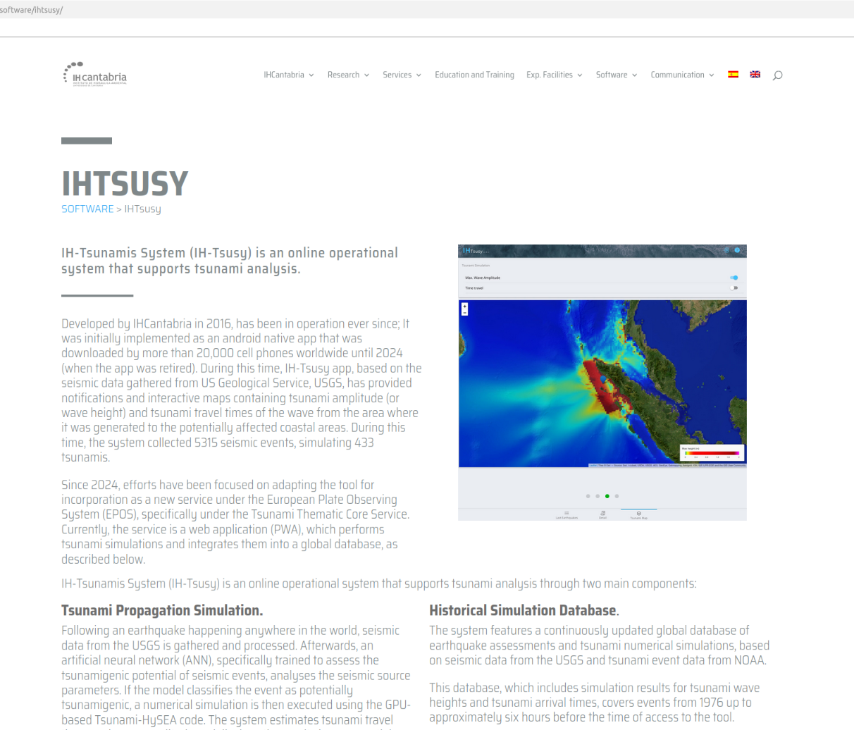
Services distribution channel: Community Portal https://tsunamidata.org
10-11 November 2025
INCOIS, Hyderabad, India
First Conference of the
Ocean Decade Tsunami Programme

Slide 12
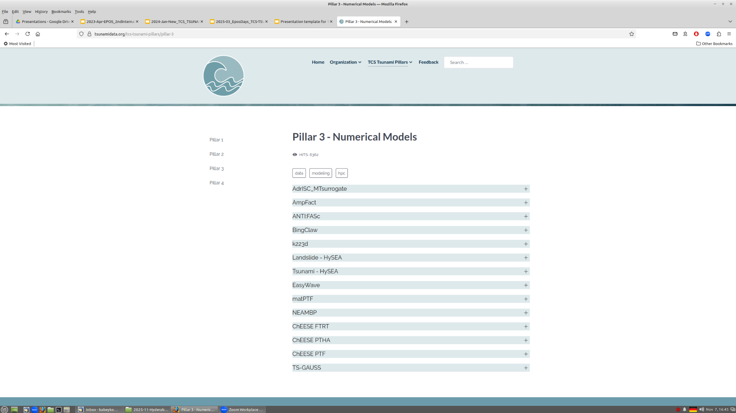
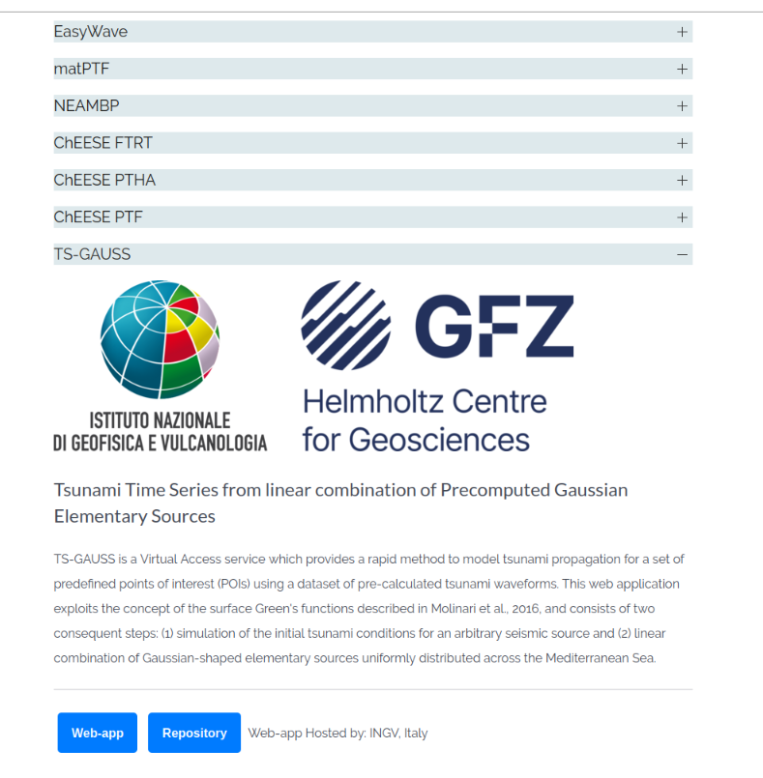
Services distribution channel: Community Portal https://tsunamidata.org
10-11 November 2025
INCOIS, Hyderabad, India
First Conference of the
Ocean Decade Tsunami Programme

Slide 13
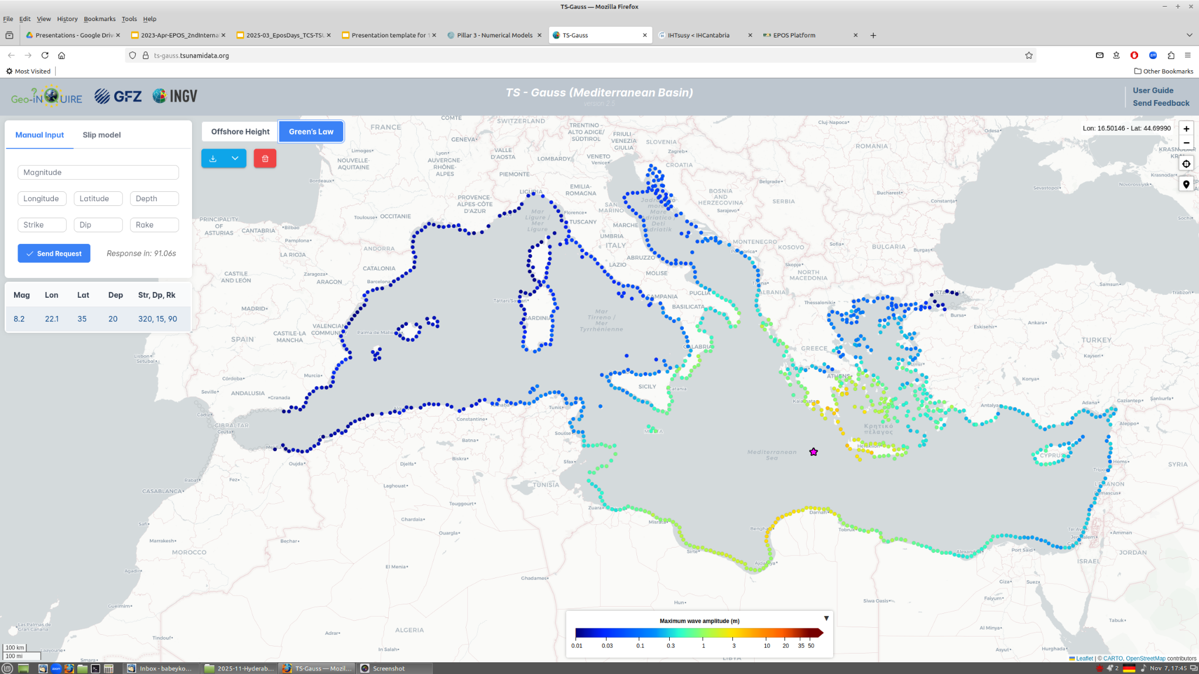
Services distribution channel: Community Portal https://tsunamidata.org
Example: TS-GAUSS fast simulations (by INGV & GFZ)
10-11 November 2025
INCOIS, Hyderabad, India
First Conference of the
Ocean Decade Tsunami Programme

Slide 14
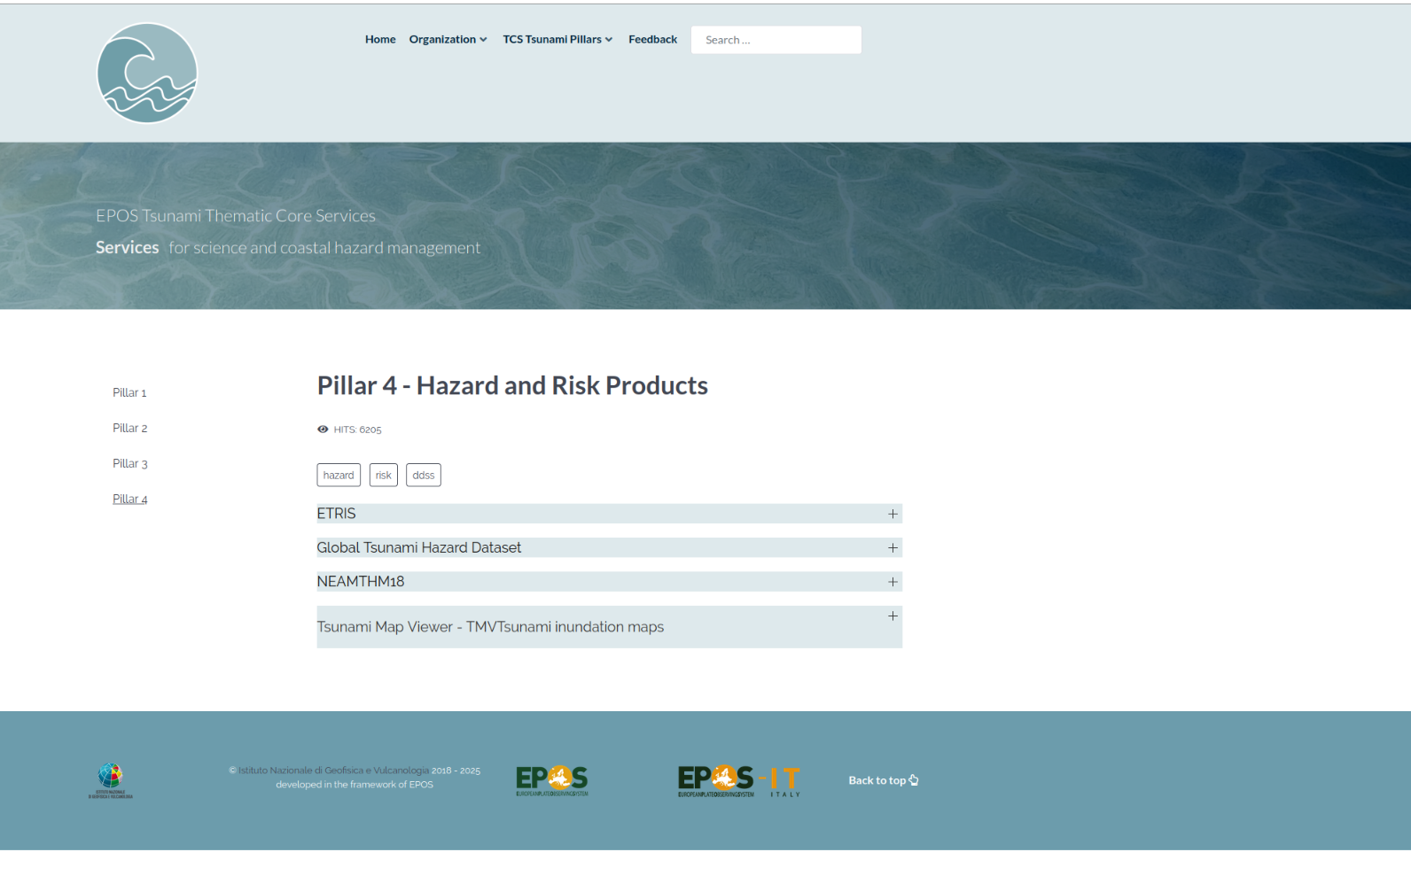
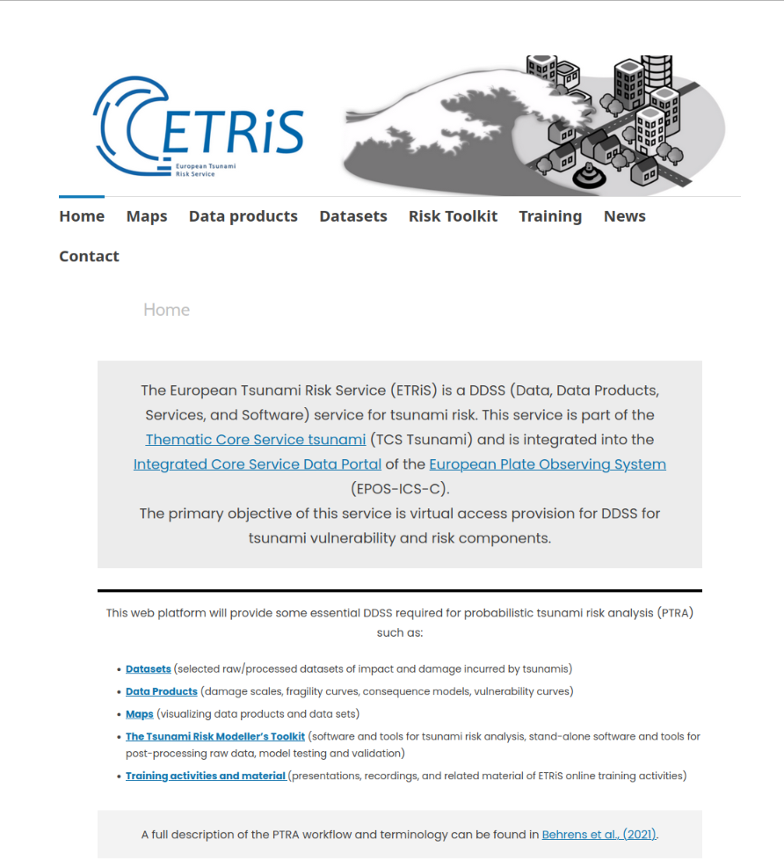
Services distribution channel: Community Portal https://tsunamidata.org
https://eurotsunamirisk.org/
10-11 November 2025
INCOIS, Hyderabad, India
First Conference of the
Ocean Decade Tsunami Programme

Slide 15
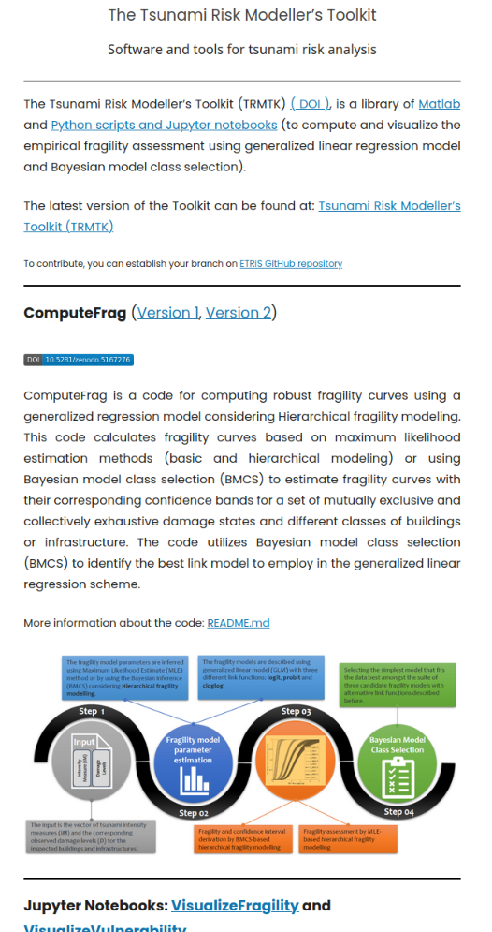
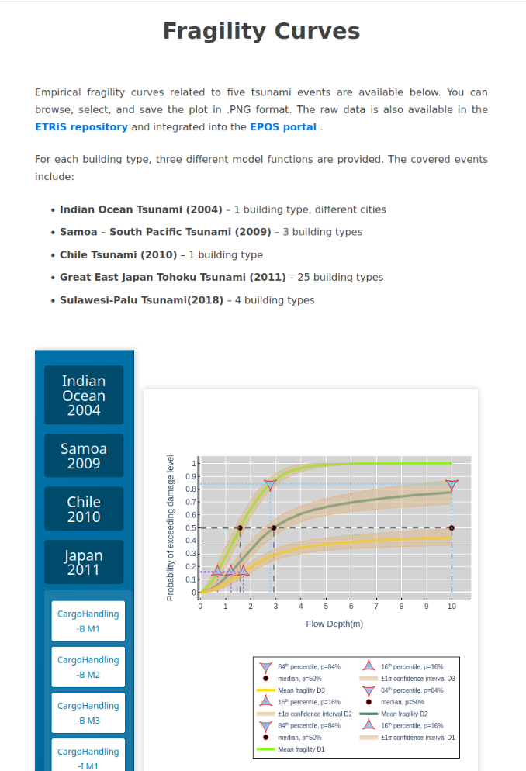
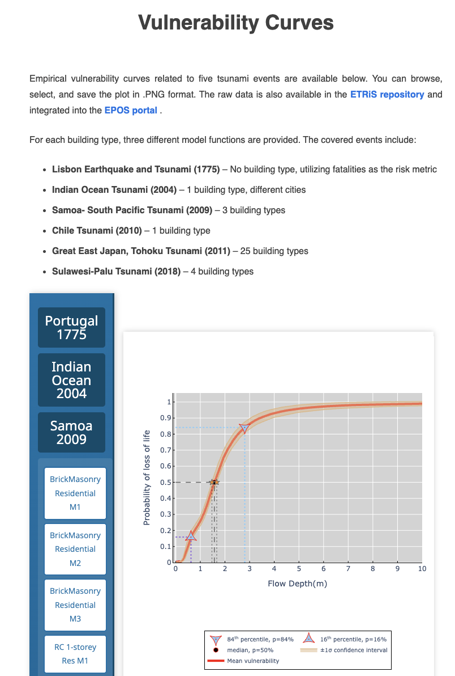
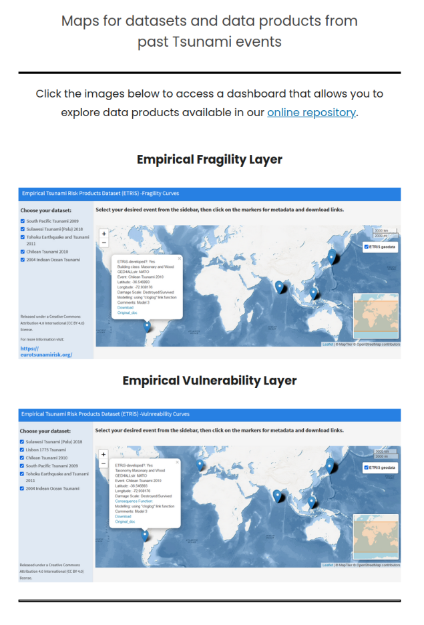
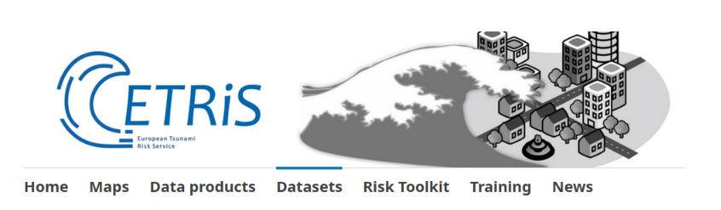
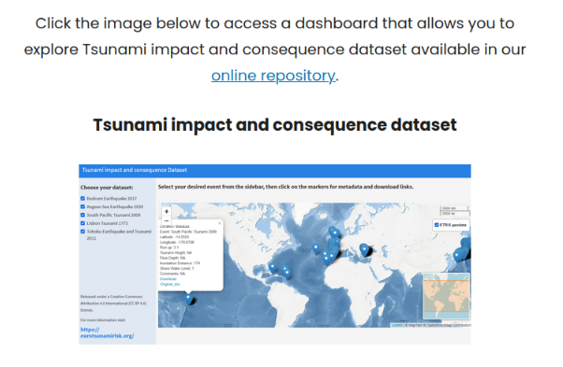
Services distribution channel: Community Portal https://tsunamidata.org
Example: ETRIS Risk Services (by UCL, UK)
10-11 November 2025
INCOIS, Hyderabad, India
First Conference of the
Ocean Decade Tsunami Programme

Slide 16
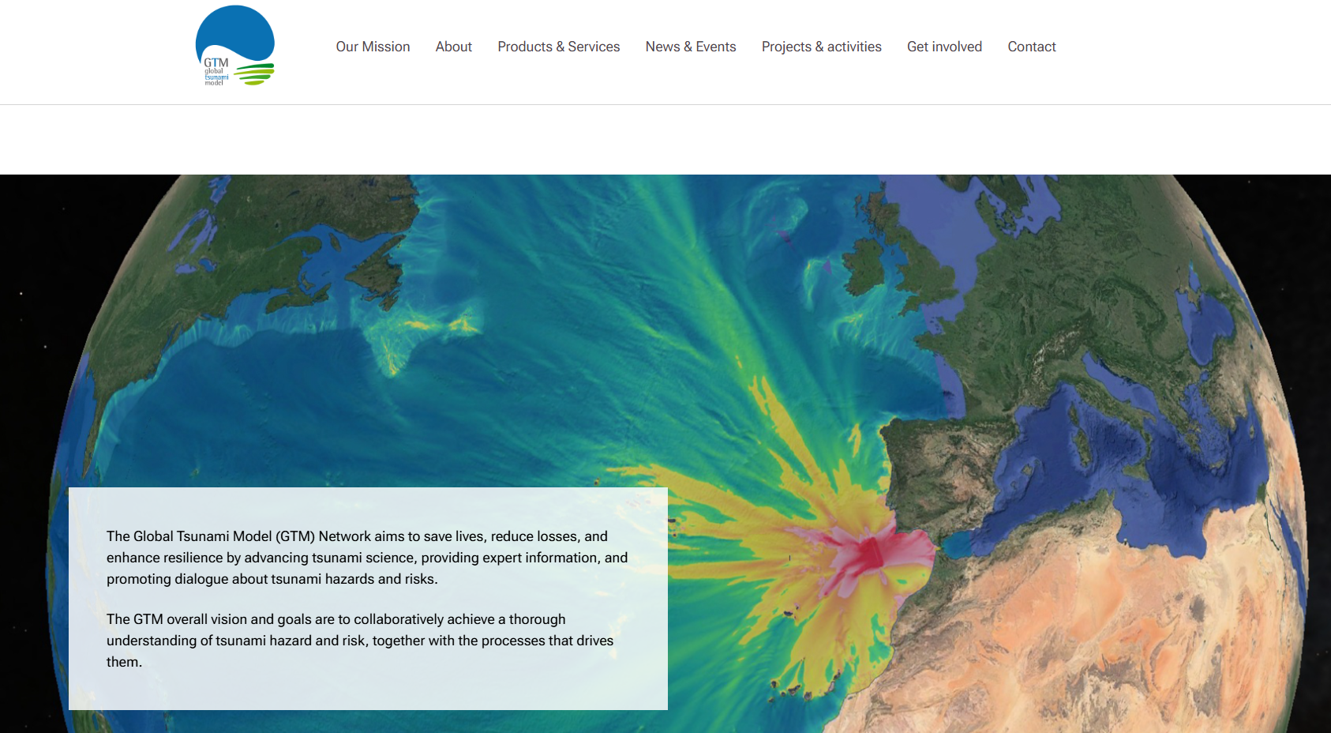
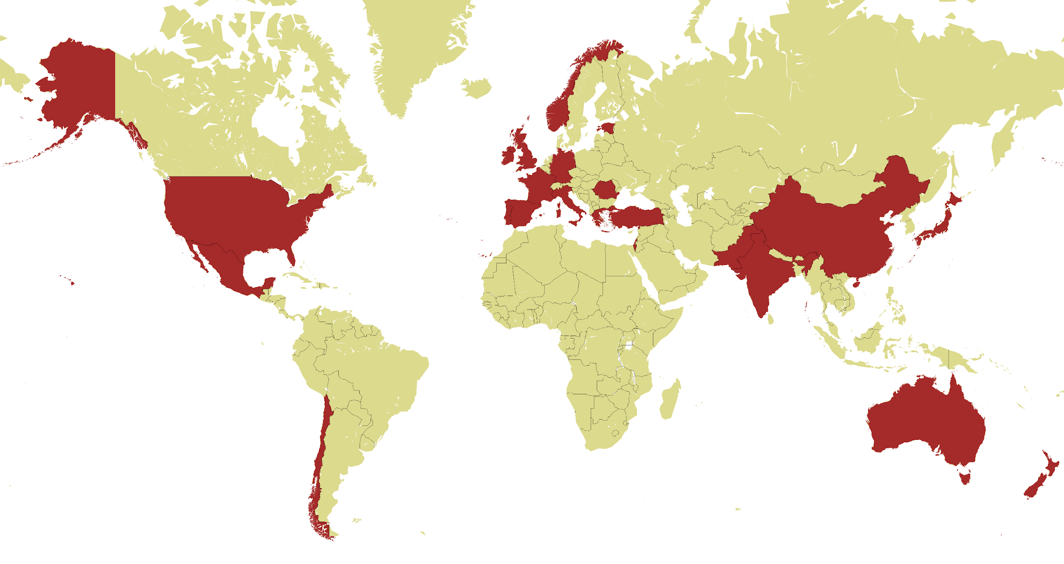
EPOS TCS TSUNAMI liaison with GTM (Global Tsunami Model)
Experts Products
Services (Pillars 2,3,4)
ttps://www.globaltsunamimodel.org/
10-11 November 2025
INCOIS, Hyderabad, India
First Conference of the
Ocean Decade Tsunami Programme

Slide 17
Thank you!
https://www.epos-eu.org/tcs/tsunami
https://youtu.be/loFW0vkRwY8?feature=shared
https://tsunamidata.org
10-11 November 2025
INCOIS, Hyderabad, India
First Conference of the
Ocean Decade Tsunami Programme

Slide 18

10-11 November 2025
INCOIS, Hyderabad, India
First Conference of the
Ocean Decade Tsunami Programme

