Slide 1




TSUNAMI READY IN INDIAN OCEAN
Suci Dewi Anugrah:
Chair of Tsunami Ready Implementation of the ICG/IOTWMS
Chair of South China Sea Working Group ICG/PTWS
Coordinatror/ Deputy Director of Tsunami Mitigation fo Indo-Pacific fo BMKG
FIRST CONFERENCE OF THE OCEAN DECADE TSUNAMI PROGRAMME
Hyderabad, India
10-11 November 2025

Slide 2
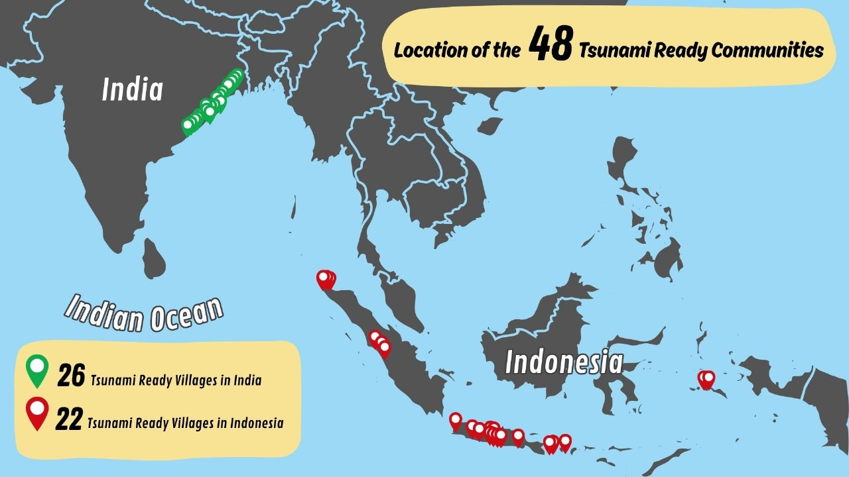
CURRRENT STATUS OF THE INDIAN OCEAN TSUNAMI READY COMMUNITIES
INDIA
1 Provinsi, 6 Kecamatan, 26 Desa
Jagatsinghpur District
Bahgeipur Village,
Bhuyanpala Village,
Dhanaharbelari Village,
Noliasahi Village,
Shadabedi Village,
Kendrapada District
Chinchiri Village,
Kaitha Village,
Kantilo Village,
Tantiapala_Sasan Village,
Puri District
Chhotipada Village,
Keutajanga Village,
Khalakatapatana Village,
Narasinghpatana
Balasore District
Jayadevkasaba Pahi Village,
Jagannathpur Village,
Kanyanagari Village,
Sahapur Village,
Bhadrak District
Mohanpur Village,
Sanakrushnapur Village,
Adhuan Village,
Badahabelisahi Village,
Ganjam District
Kantiagada Village,
Markandi Village,
Prayagi Village,
Uppalaputi Village,
Venkatraipur Village,
INDONESIA
10 Provinsi, 14 Kecamatan, 22 Desa
Sumatera Barat
Purus-Kota Padang
Lolong Belanti-Kota Padang
Tapakih-Kota Padang
Jawa Tengah
Sidaurip-Cilacap
Maluku
Galala-Ambon
Hative-Ambon
Jawa Timur
Tambakrejo-Malang
Aceh
Deah Glumpang-Banda Aceh
Gampong Jawa-Banda Aceh
Mon Ikeun-Aceh Besar
Lamkruet-Aceh Besar
Yogyakarta
Glagah-Kulon Progo
Kemadang-Gunung Kidul
Parangtritis-Bantul
Gading Sari- Bantul
Tirto Hargo- Bantul
Poncosari- Bantul
Bali
Tanjung Benoa-Badung
Pangastulan-Buleleng
Banten
Panggarangan-Lebak
Jawa Barat
Pangandaran-Pangandaran
Nusa Tenggara Barat
Kuta Mandhalika-Lombok Tengah
10-11 November 2025
INCOIS, Hyderabad, India
First Conference of the
Ocean Decade Tsunami Programme

Slide 3
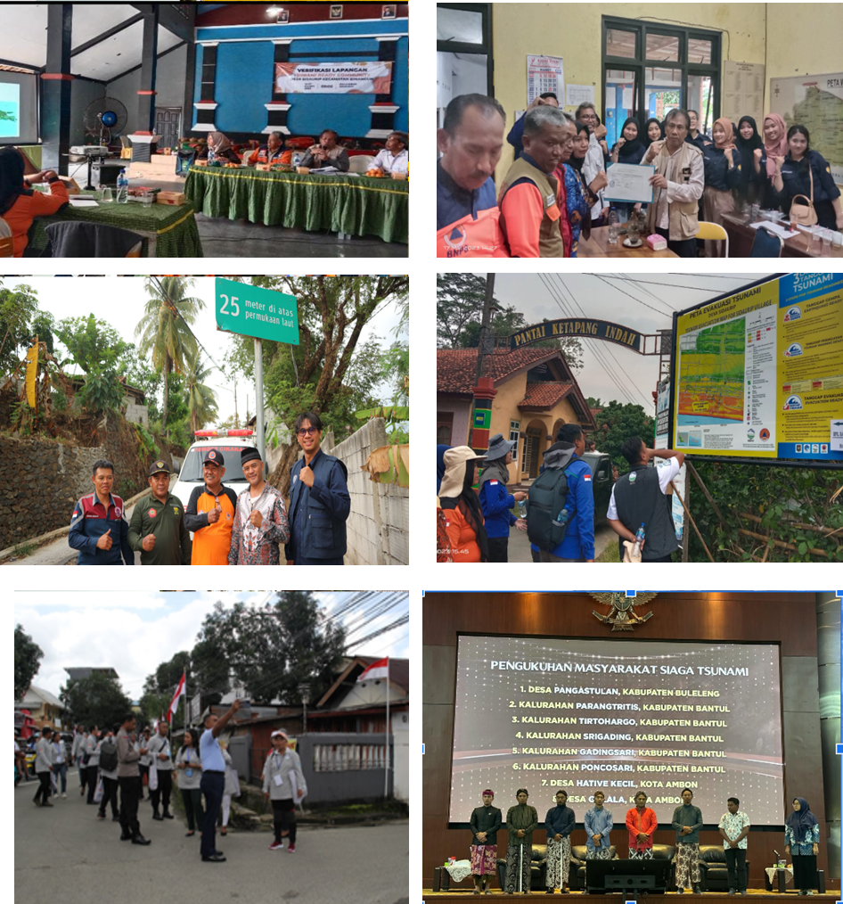

COMMUNITIES PLANNED TO BE RECOGNIZED
India:
India plan to recognize TR from many provinces
Indonesia: communities had been nationally recognized:
Cikakak, Sukabumi, Jawa Barat
Citepus, Sukabumi, Jawa Barat
Wapia-Pia, Wakatobi,
Desa Tua Pejat, Kab. Mentawai
⁠Desa Sidomulyo, Kab. Pacitan3. ⁠
Desa Pemenang Barat, Kab. Lombok Utara4.
⁠Desa Penurunan, Kota Bengkulu
⁠Desa Lempuing, Kota Bengkulu
6. ⁠Desa Teluk Sepang, Kota Bengkulu
Krakatau Sarana Properti, Banten
Iran has started to implement in Chabahar and Jask
Most countries still identify the pilot sites
10-11 November 2025
INCOIS, Hyderabad, India
First Conference of the
Ocean Decade Tsunami Programme

Slide 4
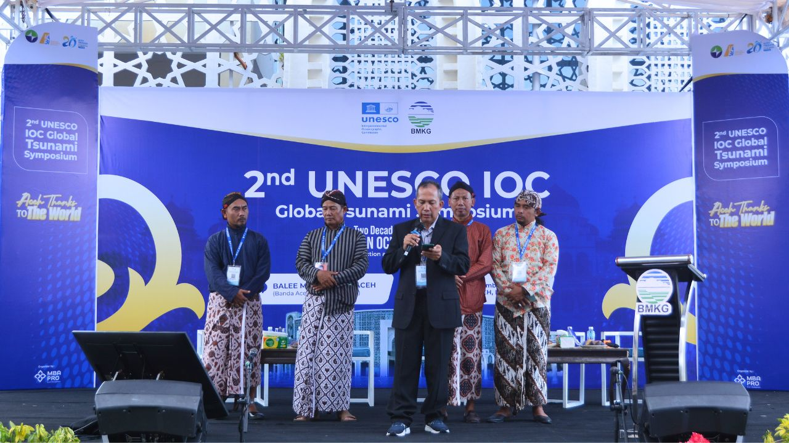
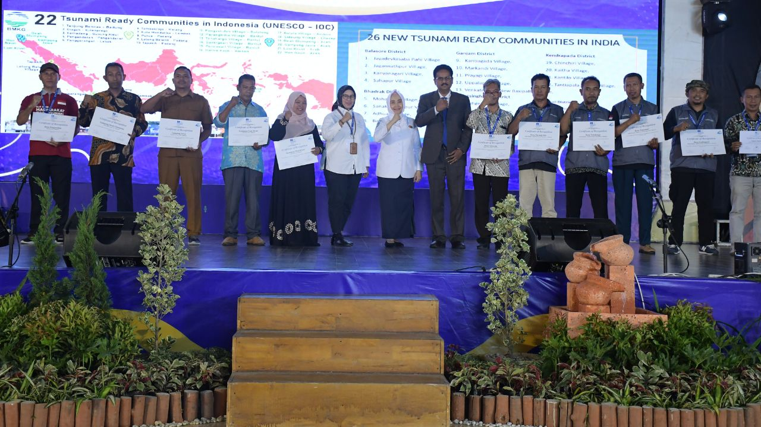
Tsunami Ready for Global Tsunami Symposium 2024
36 communities: 12 from Indonesia and 24 from India were recognized as Tsunami ready Community
Banda Aceh Statement:
Global Tsunami Warning and Mitigation System: Building Sustainability for the next decade through Transformation and Innovation.
UNESCO and its partners call on States and civil society to drastically step up their investments and efforts to achieve 100% Tsunami Ready Communities worldwide by 2030.

Slide 5
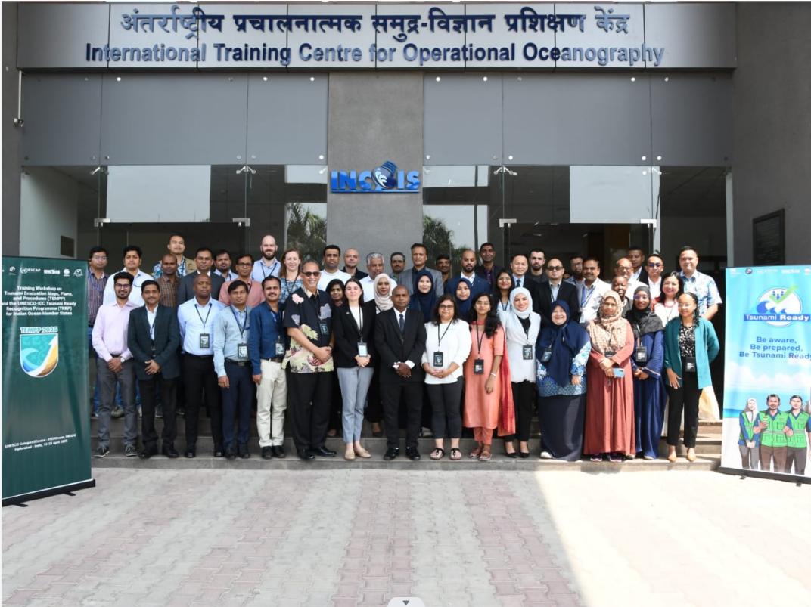
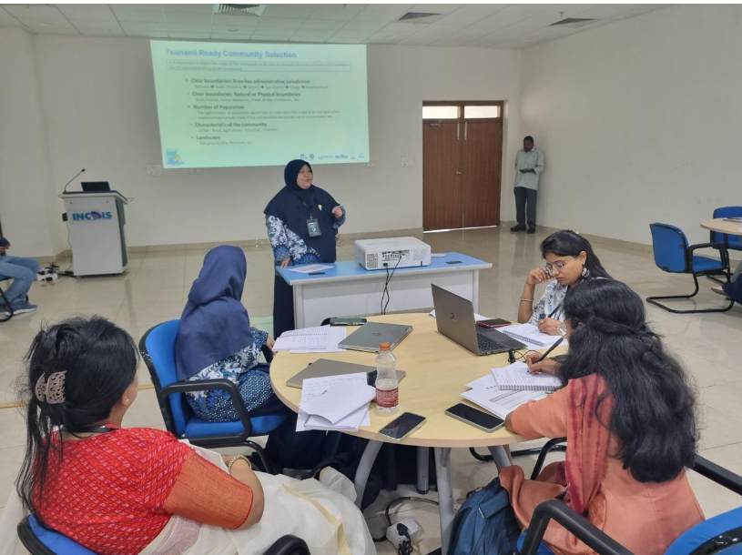
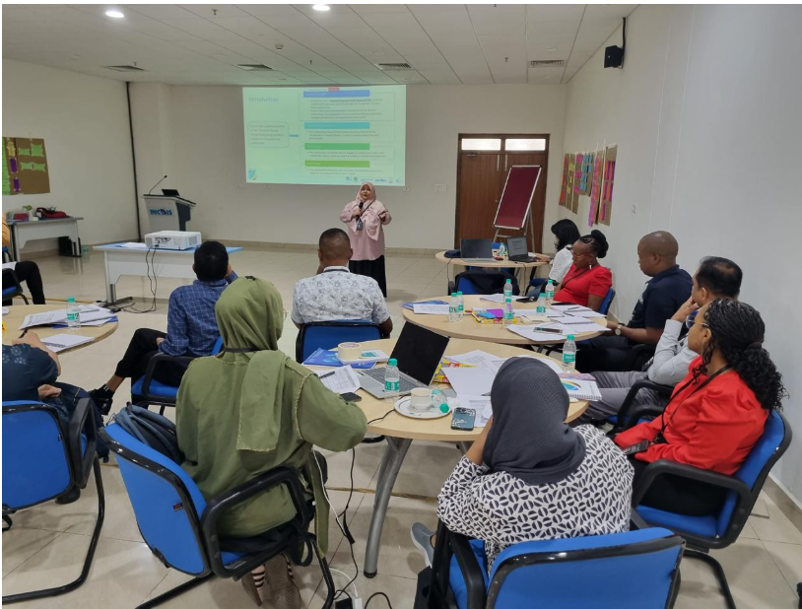

CAPACITY DEVELOPMENT ON TSUNAMI READY
Together with IOTIC, BMKG, INCOIS, UN ESCAP, Conducting :
TEMPP training, INCOIS Hyderabad, 15-23 April, 2025.
National Tsunami Ready training in Seychelles (2023), Timor Leste (2023), Maldives (2024)
10-11 November 2025
INCOIS, Hyderabad, India
First Conference of the
Ocean Decade Tsunami Programme

Slide 6
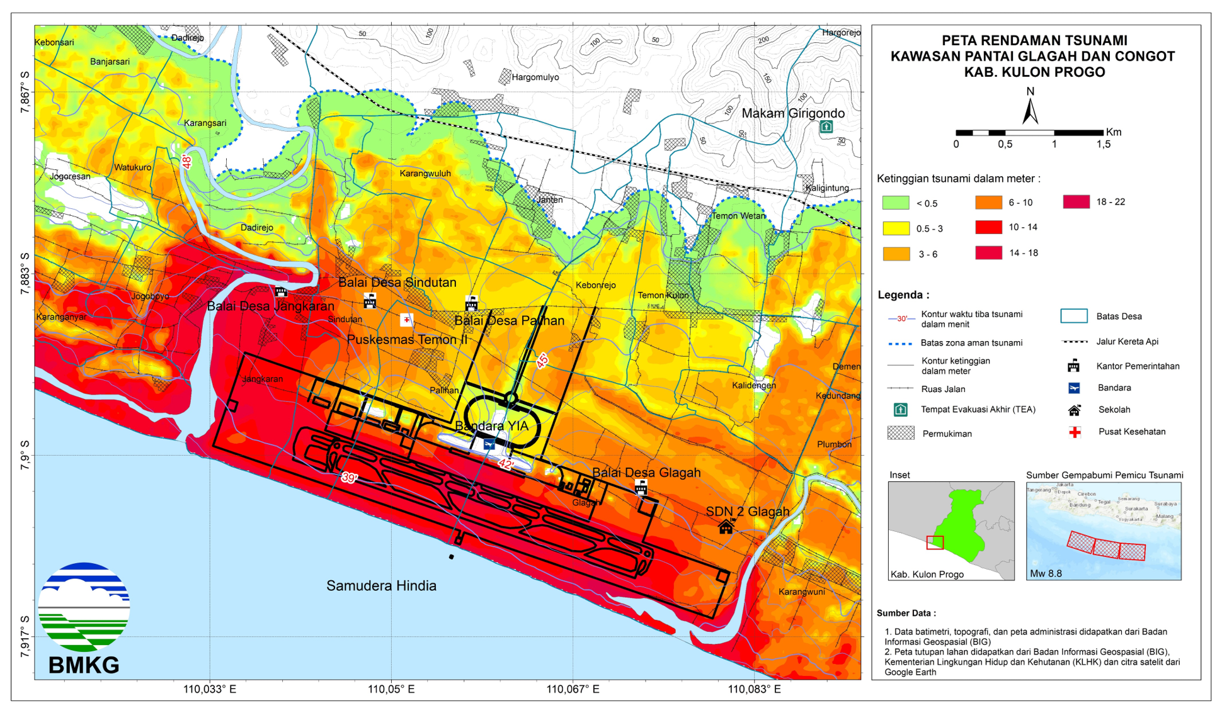
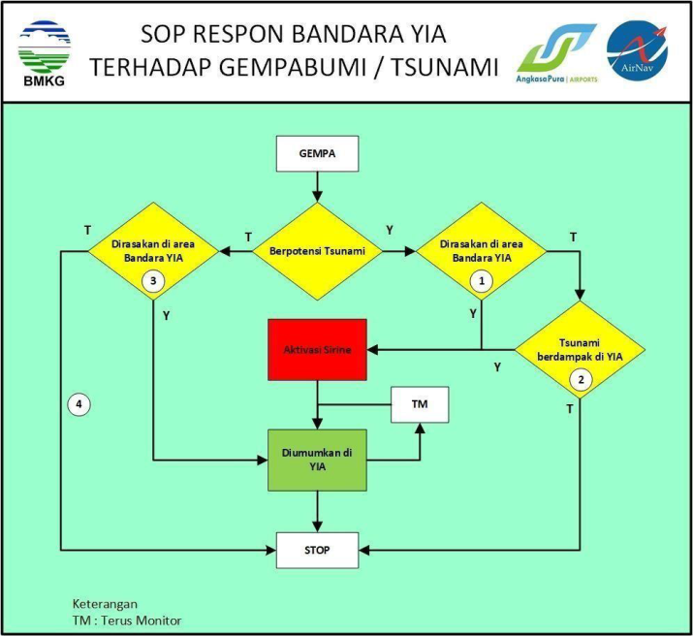
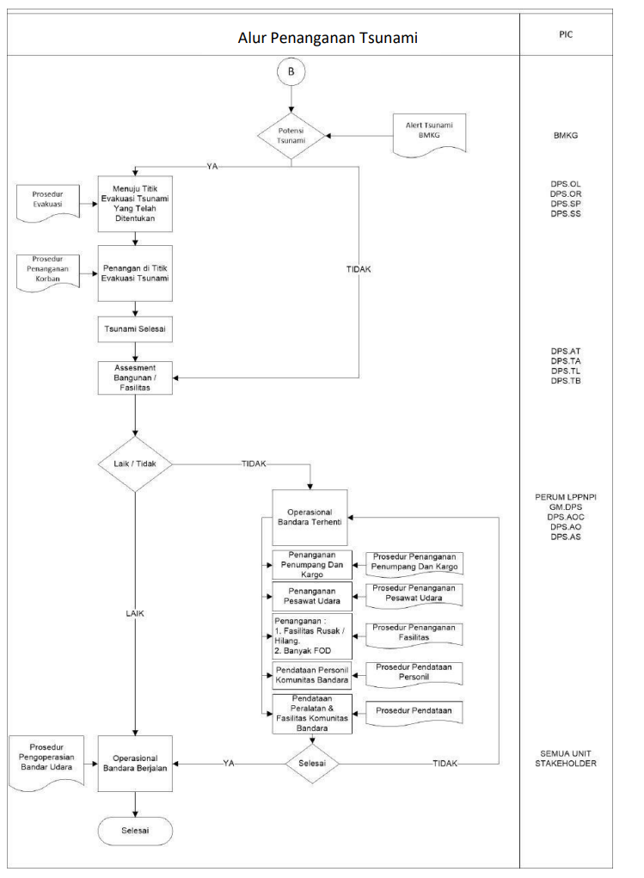
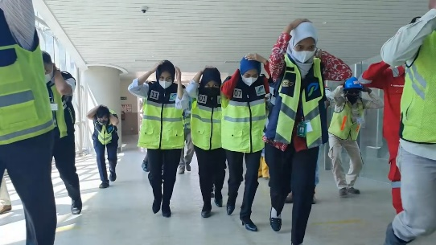
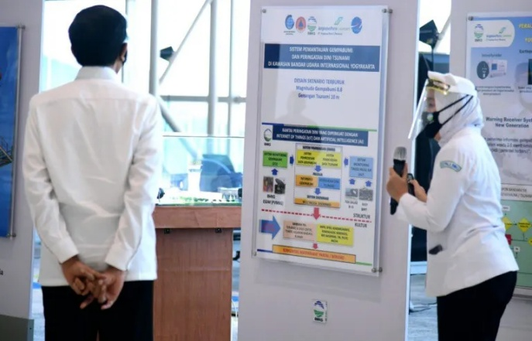
EXTENDING TSUNAMI READY PRINCIPLE FOR CRITICAL INFRASTRUCTURE
Tsunami Ready had been implemented in Yogyakarta International Airport
Ngurah Rai International airport
Benoa Port
Krakatau Industrial Zone
10-11 November 2025
INCOIS, Hyderabad, India
First Conference of the
Ocean Decade Tsunami Programme

Slide 7
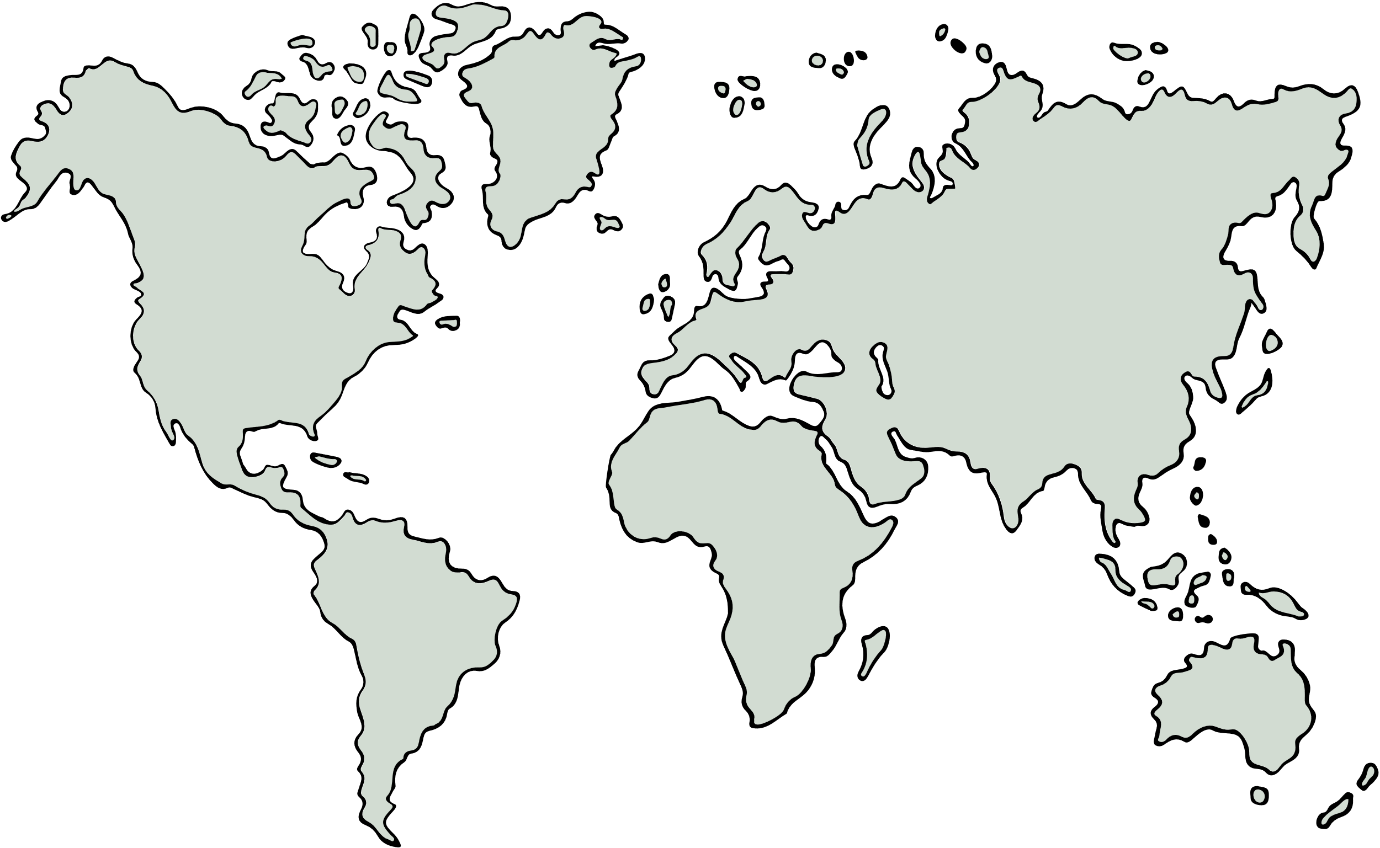
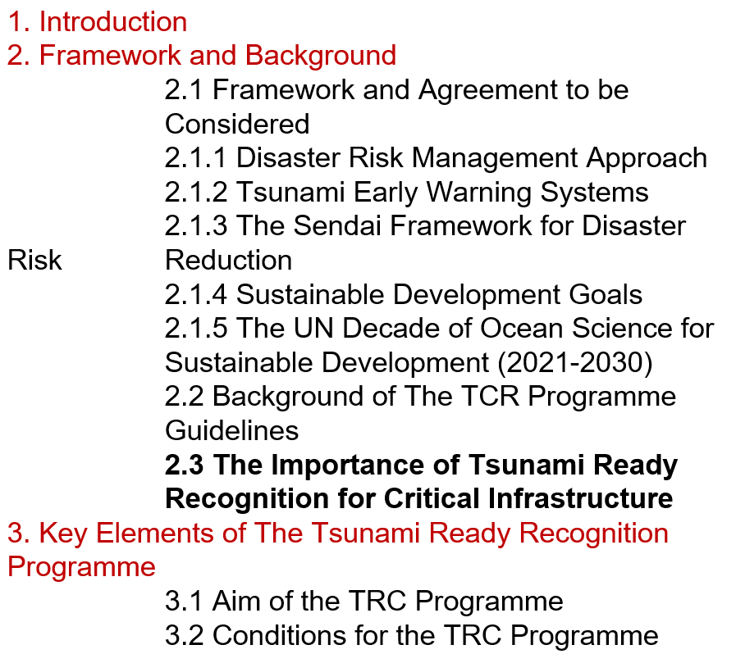

TSUNAMI READY GUIDELINE FOR CRITICAL INFRASTRUCTURE
Al Rayyan
International Airport
Thandwe Airport
Colombo
International Airport
Critical infrastructure also forms an integral part of coastal communities.
With operations running continuously 24 hours a day, seven days a week, these facilities have a distinct advantage in maintaining tsunami preparedness.
There are currently no standardized guidelines specifically developed for recognizing Tsunami Ready for critical infrastructure community.
Many of critical infrastructure are constructed along coastal areas directly facing the sea
TRC aims to:
  Ensuring Human Safety
  Anticipating Cascading Hazards
  Accelerating Recovery and Business Continuity
  Maximizing the Role of Critical Infrastructure in Strengthening Community Preparedness
I Gusti Ngurah Rai
International Airport
Seychelles
International Airport
Yogyakarta
International Airport
Indian Ocean
Sainte Marie Airport
Port Hedland Airport
King Shaka
International Airport
Same Foundation, The approach adopts the 12 UNESCO-IOC Tsunami Ready indicators, adjusts them based on the type and function of each critical infrastructure (e.g., airport, port, industrial zone).
Breakdown Each indicator is interpreted in context:
      Assessment,
      Preparedness,
      Response
10-11 November 2025
INCOIS, Hyderabad, India
First Conference of the
Ocean Decade Tsunami Programme

Slide 8
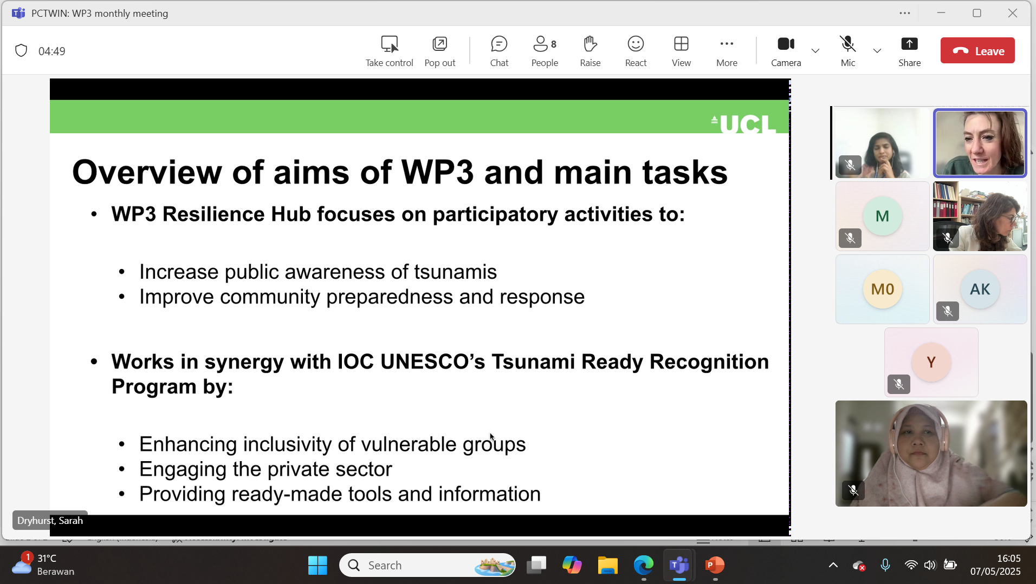

PROJECT COLLABORATION ON
PEOPLE CENTRE TSUNAMI EARLY WARNING FOR THE INDIAN COASTLINE (PCTWIN)
The WG 3 is involved to the PCTWIN (initiated by UK Natural Environment Research Council (NERC) and the Indian Ministry of Earth Sciences (MoES) for the WP3 Resilience Hub, focus on:
Increase public awareness of tsunami
Improve community preparedness and response
Work in Synergy with WG3 by
Enhancing inclusivity of Vulnerable Groups
Engaging the Private Sectors
Providing ready-made tools and Information: Develop a clear and practical guideline based on the exercise to effectively measure inclusivity and engagement within Tsunami Ready
10-11 November 2025
INCOIS, Hyderabad, India
First Conference of the
Ocean Decade Tsunami Programme

Slide 9
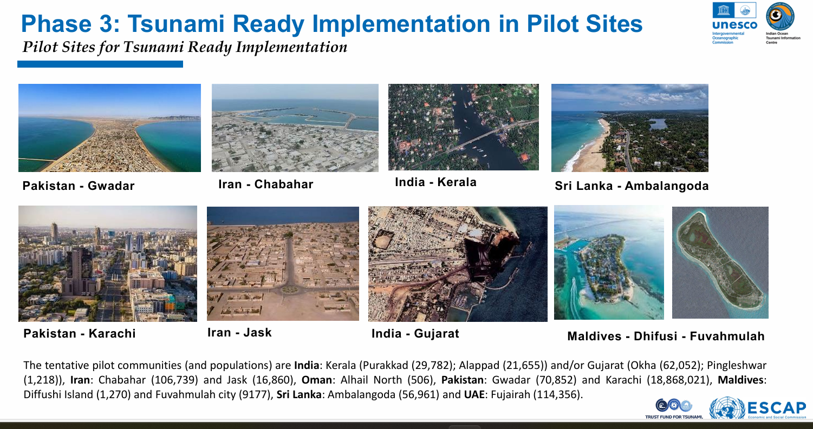
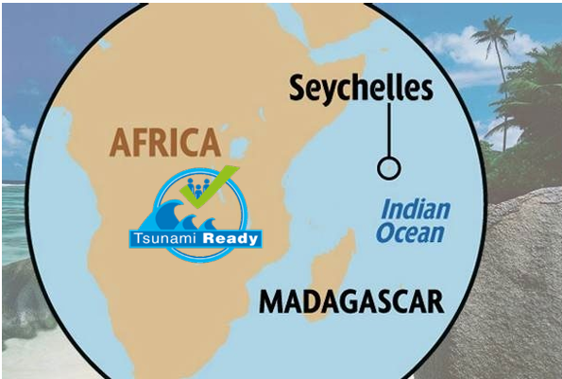
PROJECT COLLABORATION ON UNESCAP & FUST
UNESCAP:
In Strengthening tsunami warning in the North-West Indian Ocean through regional cooperation: Independent Evaluation Assessment
Phase 3: Tsunami Ready Implementation in Pilot Site: Improved community capacities for tsunami preparedness and response that are in line with the set of indicators of the UNESCO Tsunami Ready Recognition Programme (TRRP) in the 5 participating countries
FUST Tsunami Ready in Indian Ocean SIDs and Africa:
Objective: To implement the UNESCO-IOC Tsunami Ready Recognition Programme in selected pilot communities within Madagascar and Seychelles
10-11 November 2025
INCOIS, Hyderabad, India
First Conference of the
Ocean Decade Tsunami Programme

Slide 10
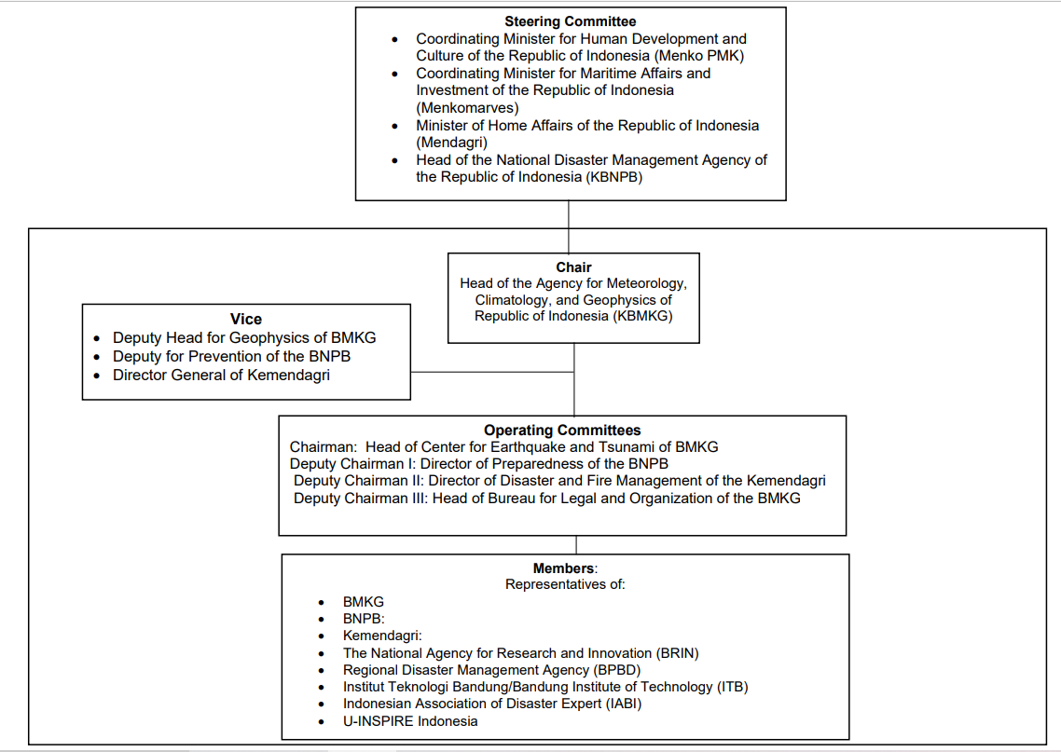
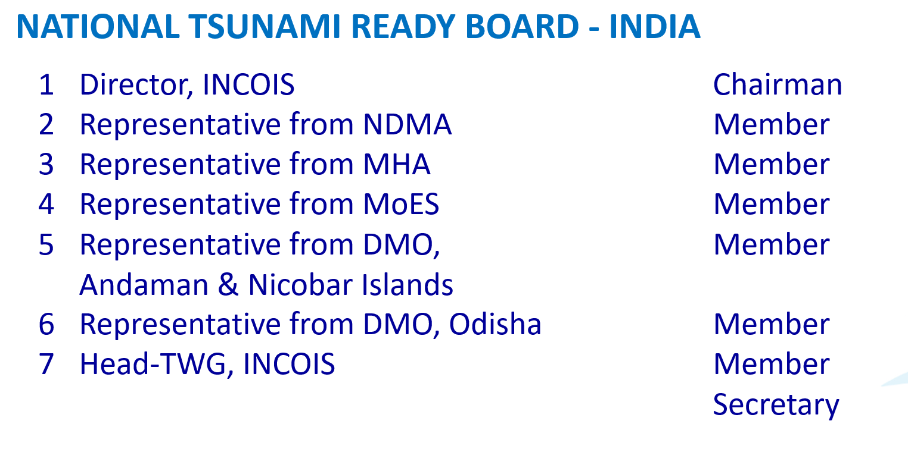
NATIONAL TSUNAMI READY BOARD
IN THE INDIAN OCEAN
Role of NTRB: Coordinating, advocacy, promotion,and socialization TRC, Recommend the Tsunami Ready Community to gain UNESCO-IOC Tsunami Ready Recognition,
      New NTRB in Seychelles has been established in 2025
10-11 November 2025
INCOIS, Hyderabad, India
First Conference of the
Ocean Decade Tsunami Programme

Slide 11
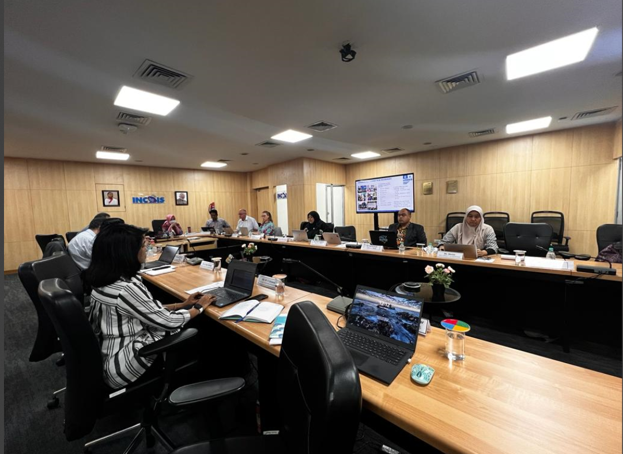
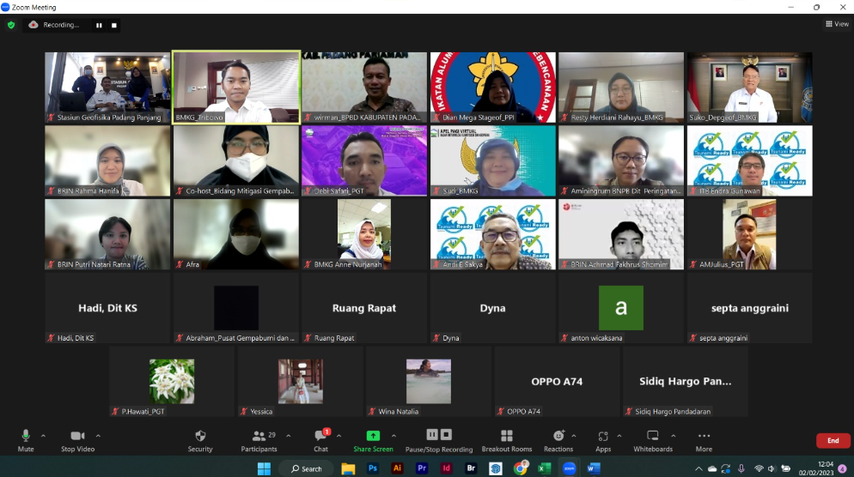
NTRB ACTIVITIES
Regular meeting of the NTRB to share the progress, challenge, and planning the implementation of tsunami Ready
NTRB Evaluate and gives input to improve the implementation
Tsunami Ready Field Verification
Verificator Workshop for NTRB in Indonesia
Meeting of National Tsunami Ready Board India, 7 Februari 2024
10-11 November 2025
INCOIS, Hyderabad, India
First Conference of the
Ocean Decade Tsunami Programme
Online Meeting of National Tsunami Ready Board Indonesia

Slide 12
ICG/IOTWMS TSUNAMI READY FOCAL POINT (TRFP)
Definition: The Tsunami Ready Focal Point (TRFP) is a Member State point of contact (person) officially designated by the Tsunami National Contact (TNC) to liaise with UNESCO-IOC Intergovernmental Coordination Group for the Indian Ocean Tsunami Warning and Mitigation System (ICG/IOTWMS) through the UNESCO-IOC Secretariat on the implementation of the UNESCO-IOC Tsunami Recognition Programme (TRRP), or a recognized similar national initiative, to help make at-risk communities prepared and resilient to any tsunami threat within their Member State
The Role of Tsunami Ready:
Act as a national advocate for national implementation of the TRRP or a recognized similar initiative to help make at-risk communities prepared and resilient to any tsunami threat within their Member State.
Actively contribute to the national implementation of the TRRP or a recognized similar initiative.
Routinely update the UNESCO-IOC ICG/IOTWMS on the status of the national implementation of the TRRP or a recognized similar initiative.
Inform relevant national authorities and organisations involved in the implementation of the TRRP or a recognised similar initiative on any information and/or updates provided by UNESCO-IOC on activities related to making at-risk communities Tsunami Ready.
10-11 November 2025
INCOIS, Hyderabad, India
First Conference of the
Ocean Decade Tsunami Programme

Slide 13
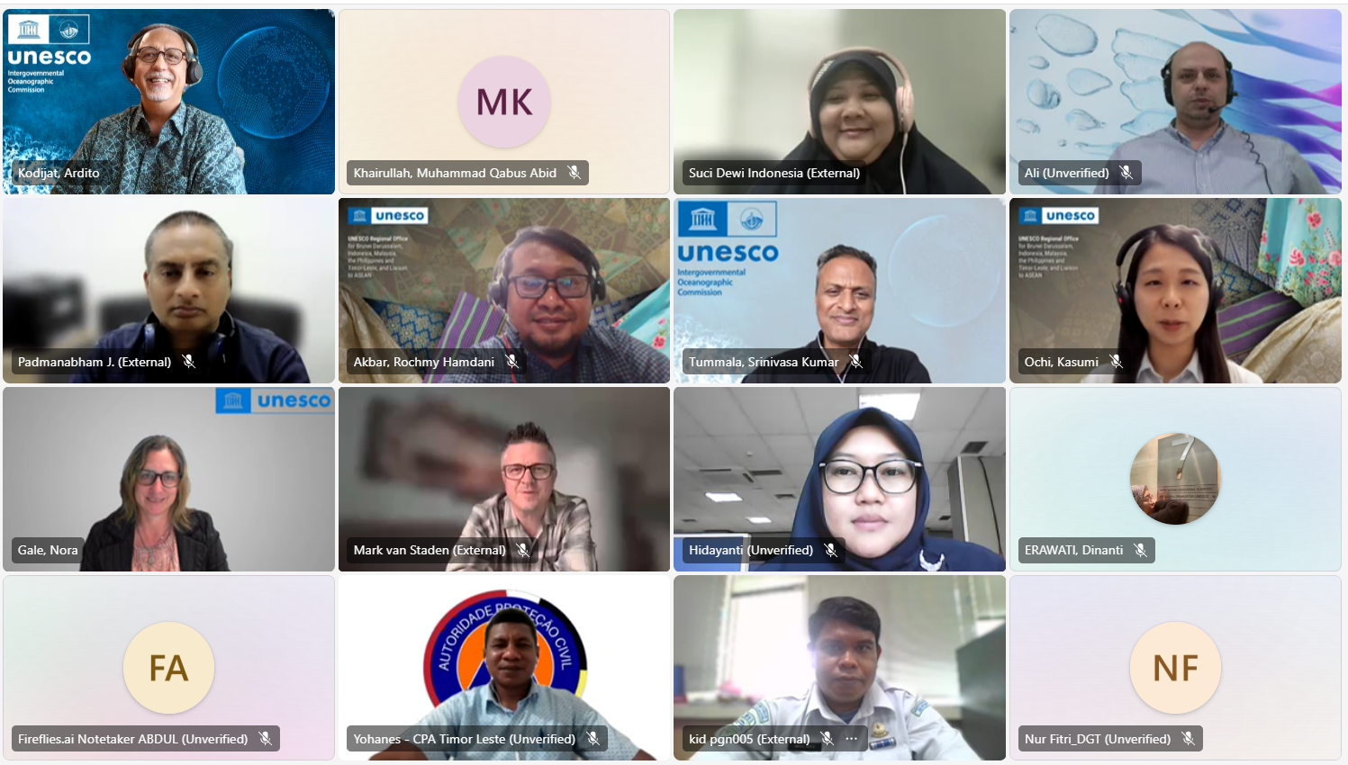
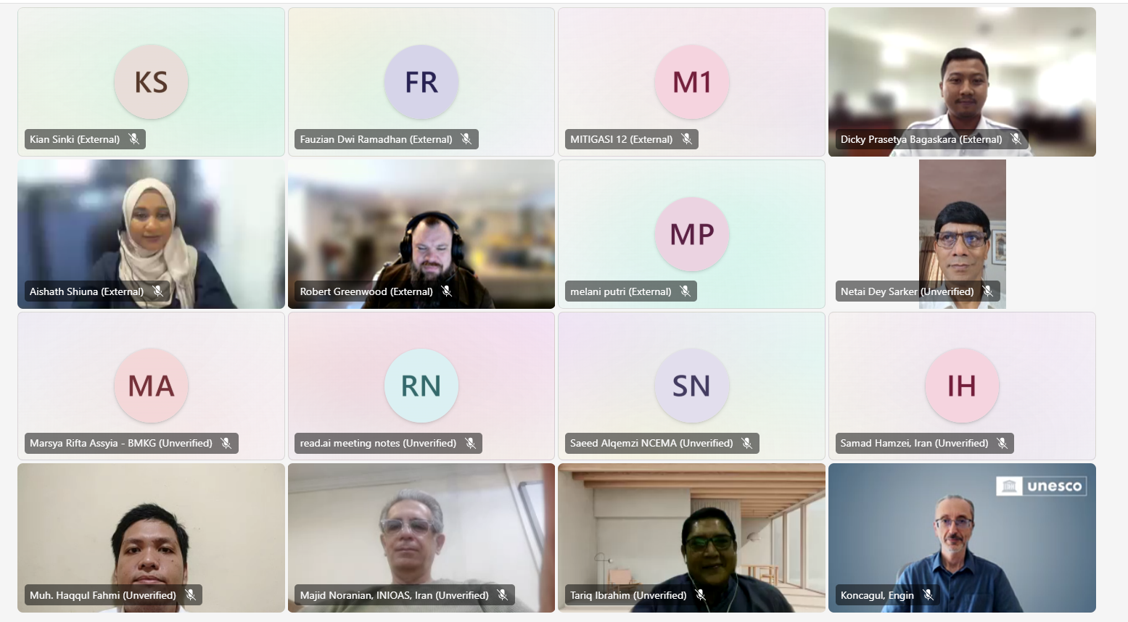
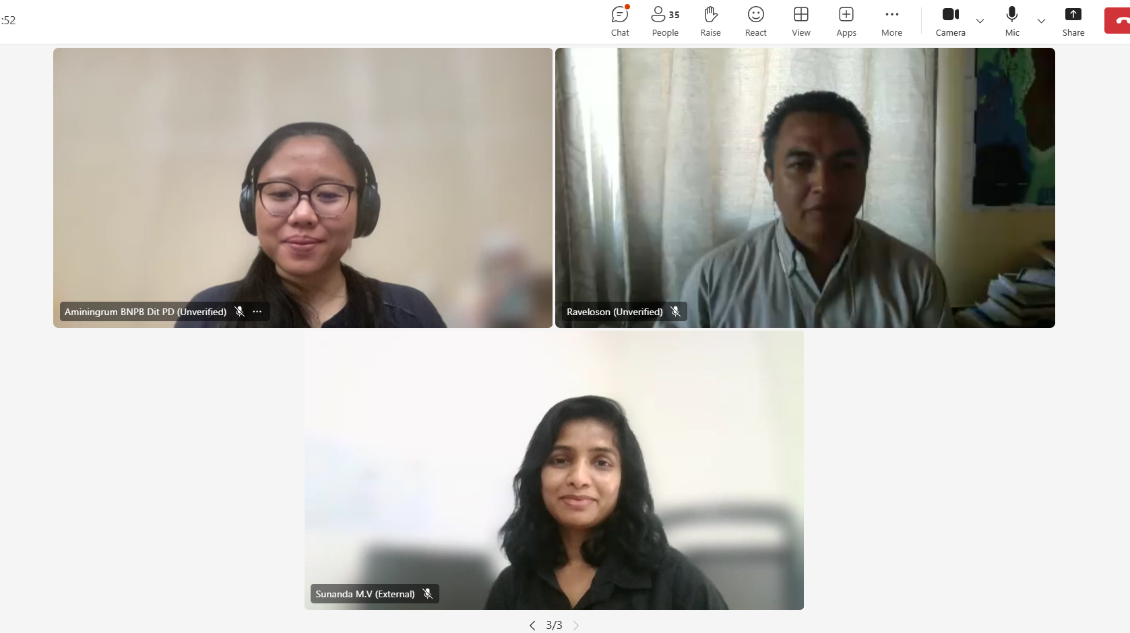
NTRFP COORDINATION MEETING,
14 OCTOBER 2025
Participants:
Chair and Vice Vhair of: WG3, WG-2 Expert, Observer, ICG/IOTWMS Secretariat, NTRFPs from:
Bangladesh
Madagascar
Maldives
Mozambique
Myanmar
Pakistan
South Africa
Sri Lanka
India
Indonesia
India
Timor Leste
UEA
Currently there are 19 NTRFPs
(Australia, Comoros, Malaysia, Mauritius, Seychelles)
Outcomes
Sharing activities (training, progress, plan)
Drafting Tsunami Ready–Critical Infrastructure guidelines and share to the member for feedback.
Send updated guidelines to TT-DMP for technical review.
Review PTWS equivalency draft for IOTWMS relevance.
Consider PCTWIN Toolkit integration into WG-3 activities.
Support TRRP pilots and NTRB setup under UNESCAP/FUST.
10-11 November 2025
INCOIS, Hyderabad, India
First Conference of the
Ocean Decade Tsunami Programme

Slide 14
CHALLENGES
Less participation on the Implementation of Tsunami Ready:
Result from the capacity assessment: 13 countries (59%) confirmed that they are already participating in TRRP
Limited resources to process the recognition including to verify and giving advocacy the TRC
Less awareness of tsunami due to the rare event, based on our observation during the tsunami ready in Seychelles, because of they do not have the local source of tsunami, the issue on the tsunami preparedness is not considered to be prioritized
10-11 November 2025
INCOIS, Hyderabad, India
First Conference of the
Ocean Decade Tsunami Programme

Slide 15
THANK YOU
suci.anugrah@bmkg.go.id
10-11 November 2025
INCOIS, Hyderabad, India
First Conference of the
Ocean Decade Tsunami Programme

