Slide 1




FIRST CONFERENCE OF THE OCEAN DECADE TSUNAMI PROGRAMME
Hyderabad, India
10-11 November 2025

Slide 2

















The NEAM-COMMITMENT EU project
aiming to support improved tsunami risk management and planning in the NEAM region
Marinos Charalampakis*, Nikos Kalligeris, Laura Graziani, Ignacio Aguirre Ayerbe, Pio Di Manna, Vitor Silva, Jorge Macias, Domenico Russo, Costas E. Synolakis, Andreas Antonakos, Sylvana Pilidou, Luigi D'Angelo, Carlos González González, and the NEAM-COMMITMENT project team
*Institute of Geodynamics, National Observatory of Athens
Hellenic National Tsunami Warning Center
10-11 November 2025
INCOIS, Hyderabad, India
First Conference of the
Ocean Decade Tsunami Programme

Slide 3

Call: UCPM-2024-KAPP
Type of Action: UCPM-PJC
Title: NEAM Collaboration fOr iMproved
tsunaMirIsk miTigation and manageMENT
Acronym: NEAM-COMMITMENT
Number: 101193486
Duration: 24 months (31 January 2027)
Start Date: 01 February 2025
Estimated Project Cost: €985 629.70
Requested EU Contribution: €887 066.62
Project Officer: Juan Francisco GALVAN MONTERO
Budget categories/activity types:
- A. Personnel costs
A.1 Employees
- B. Subcontracting costs
- C. Purchase costs
C.1 Travel and subsistence
C.3 Other goods, works and services
- E. Indirect costs (flat-rate: 7% of the eligible direct costs)
10-11 November 2025
INCOIS, Hyderabad, India
First Conference of the
Ocean Decade Tsunami Programme

Slide 4
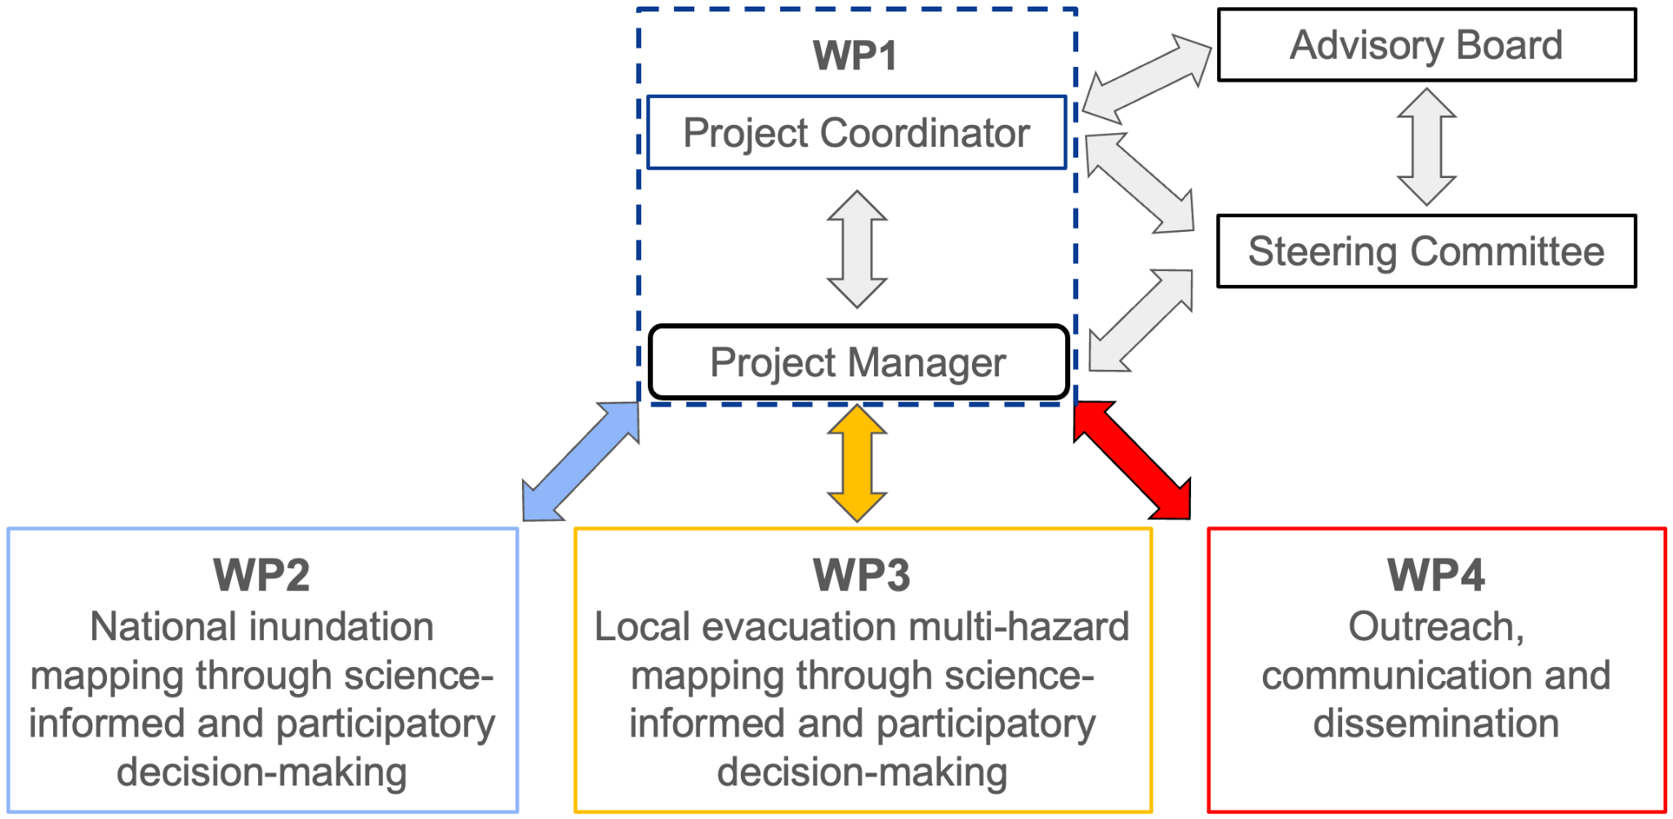
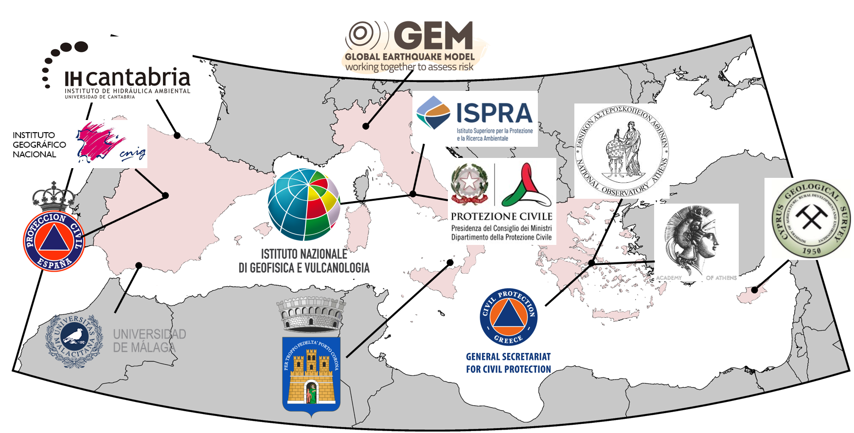
The Consortium
No | INSTITUTE | Sort Name
1 | National Observatory of Athens, Greece - COO | NOA
2 | Istituto Nazionale di Geofisica e Vulcanologia, Italy | INGV
3 | Cantabria Environmental Hydraulics Institute Foundation, Spain | FIHAC
4 | Institute for Environmental Protection and Research, Italy | ISPRA
5 | Global Earthquake Model Foundation. Italy | GEM
6 | University of Malaga. Spain | UMA
7 | Municipality of Lipari, Italy | MoL
8 | Academy of Athens. Greece | AoA
9 | General Secretariat of Civil Protection, Greece | GSCP
10 | Geological Survey Department, Cyprus | GSD
11 | Civil Protection Department, Italy | DPC
12 | Directorate General of Civil Protection and Emergency, Spain | DGPCE
13 | National Geographic Institute, Spain | IGN
NOA
Project management's organizational structure
INGV
IHC
NOA
13 partners from 4 counties: Cyprus, Greece, Italy and Spain
3 national CPAs (GR, IT, ES)
1 municipality (Lipari)
1 international organization (GEM)
4 National Tsunami Warning Centers (GR, IT, CY, ES)
10-11 November 2025
INCOIS, Hyderabad, India
First Conference of the
Ocean Decade Tsunami Programme

Slide 5
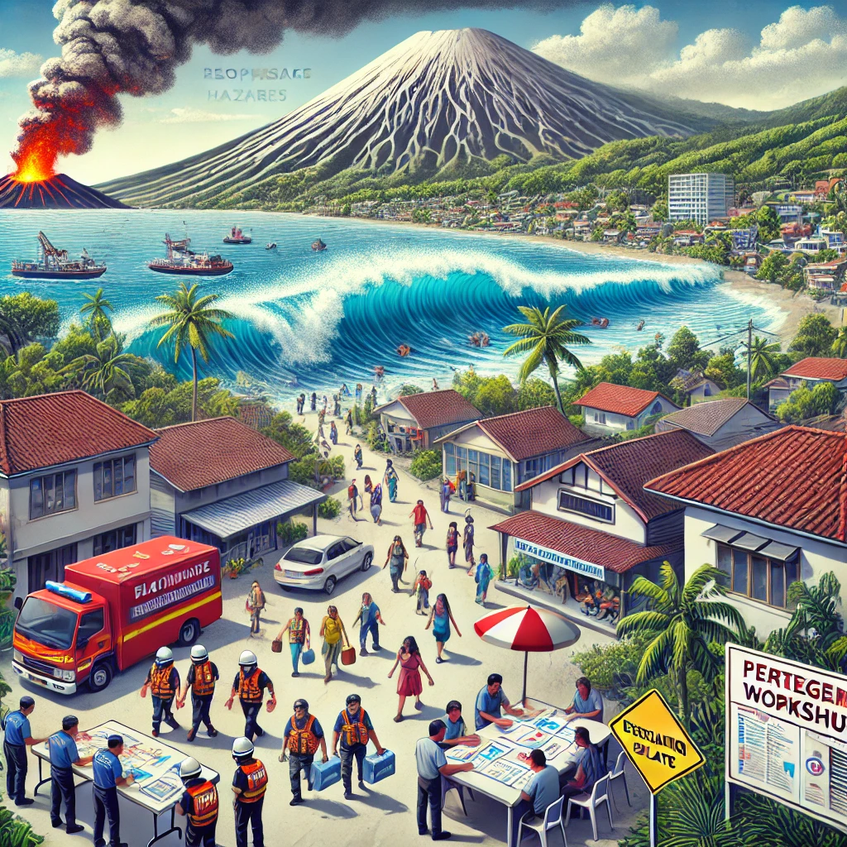
Aim - Rationale
Aim: Improve tsunami preparedness in the NEAM region, at different scales, for effective risk, evacuation and emergency management.
Objectives are spanning from the national to local levels, addressing needs for national tsunami risk planning and for enhancing multi-hazard preparedness in coastal communities at risk.
National level:
National-level tsunami inundation maps are crucial for coastal planning and risk management.
Support local tsunami hazard assessment and evacuation planning.
Contribute to important global tsunami initiatives like IOC/UNESCO’s Tsunami Ready Recognition Programme (TRRP) and Ocean Decade Tsunami Programme (ODTP) by scaling hazard assessment nationally.
Local level:
Tsunamis from earthquakes and volcanic activity pose significant risks for coastal communities in the NEAM region.
A multi-hazard approach considering cascading effects is needed for effective tsunami evacuation and emergency management.
Emphasis on science-informed participatory workshops and decision-making to improve local planning and implementation effectiveness.
10-11 November 2025
INCOIS, Hyderabad, India
First Conference of the
Ocean Decade Tsunami Programme

Slide 6
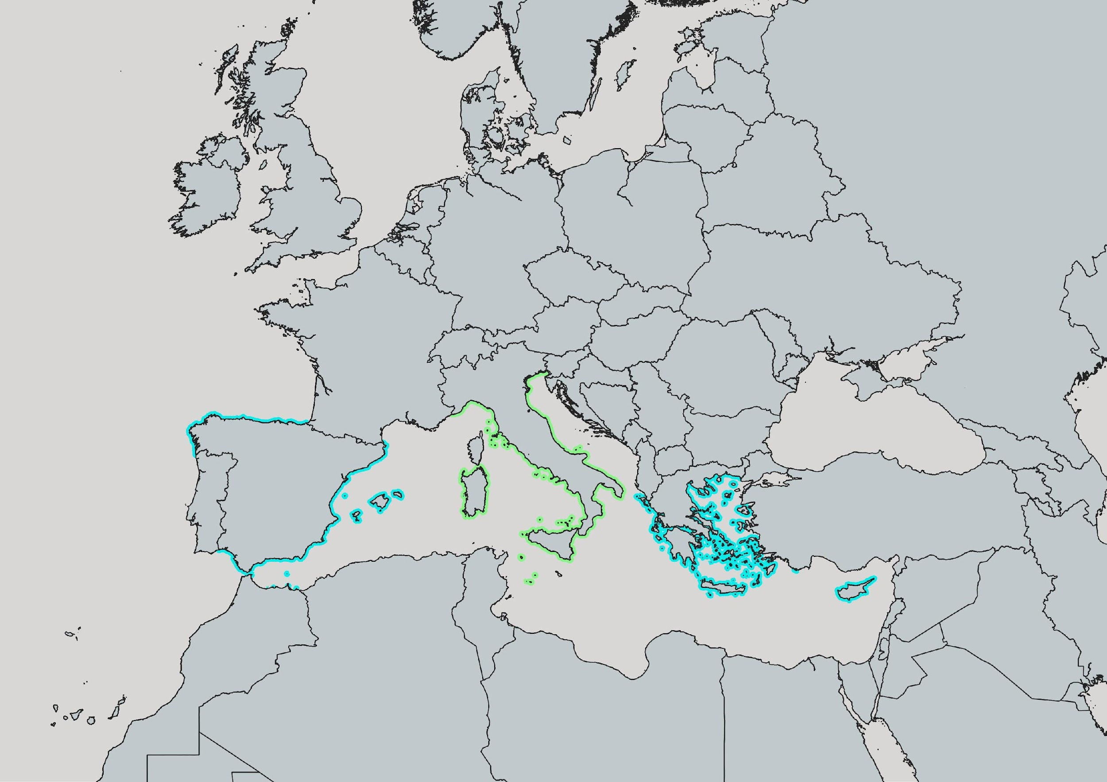
Geographical coverage
Italy
Capacity building – knowledge sharing
Tsunami evacuation mapping @ Stromboli
Spain
National tsunami inundation mapping
Greece
National tsunami inundation mapping
Tsunami evacuation mapping @ Methoni
Cyprus
National tsunami inundation mapping
10-11 November 2025
INCOIS, Hyderabad, India
First Conference of the
Ocean Decade Tsunami Programme

Slide 7
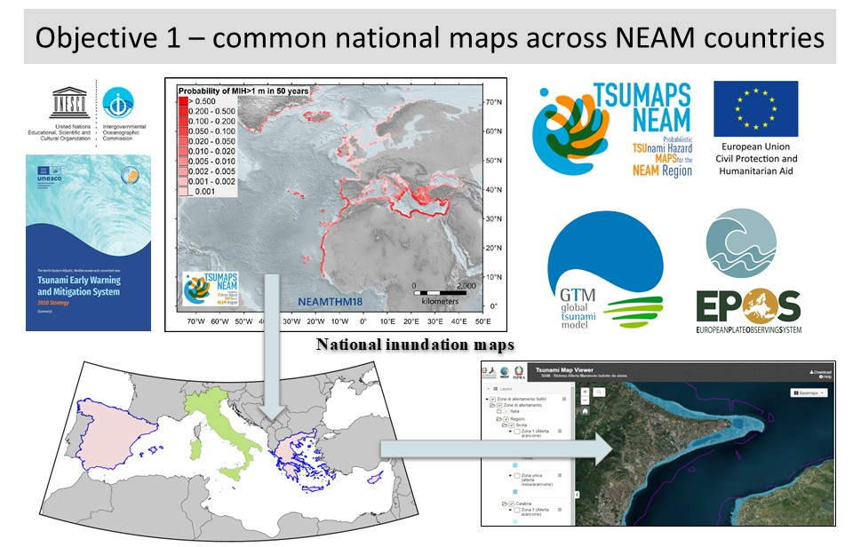
Expected project outputs
National level
Development of national tsunami Inundation maps (CY, GR, ES)
Dissemination of results across relevant national stakeholders
Development of guidelines and tools for implementation in other countries/regions
Dissemination of methodological approach at international level
10-11 November 2025
INCOIS, Hyderabad, India
First Conference of the
Ocean Decade Tsunami Programme

Slide 8
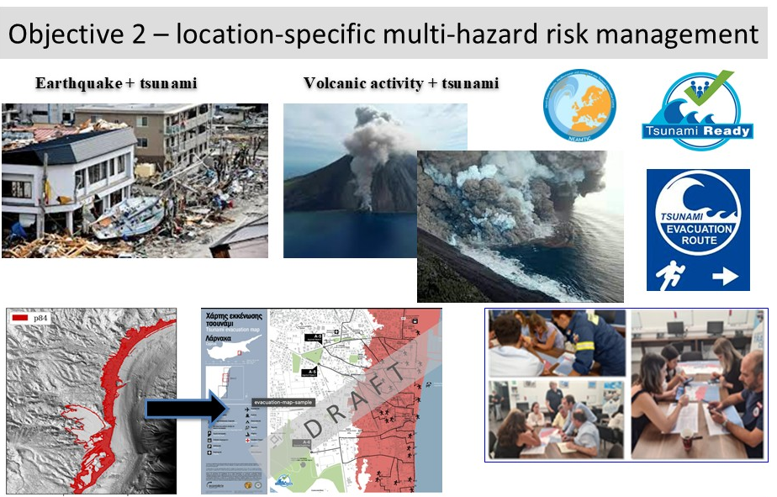
Expected project outputs
Local level
Science-informed and participatory decision-making for tsunami evacuation planning and management, considering multi-hazard effects
Application @ two pilot sites in Greece and Italy
Development of guidelines
Awareness raising activities
10-11 November 2025
INCOIS, Hyderabad, India
First Conference of the
Ocean Decade Tsunami Programme

Slide 9
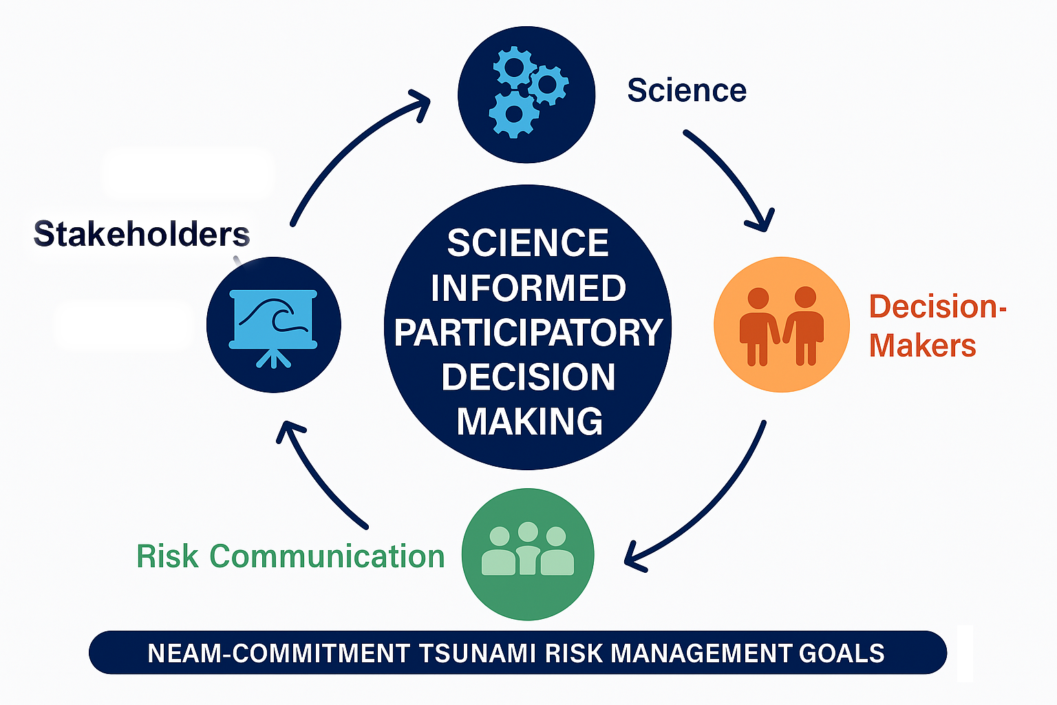
Key Approach to Achieving Project Goals
The project will accomplish its goals through a science-informed, participatory decision-making approach.
Decision-makers take ownership of the products and maximizes implementation effectiveness.
The project aims to contribute to improved tsunami risk management and
planning in NEAM countries and beyond by creating open-access guidelines
and tools that document the methodologies used.
Guidelines will be developed to outline mapping methodologies that enhance
tsunami risk management. Building on previous initiatives, the project promotes
cross-border collaboration, supports the implementation of the SFDRR
2015-2030 objectives, and strengthens preparedness within the NEAM Tsunami
Warning System.
10-11 November 2025
INCOIS, Hyderabad, India
First Conference of the
Ocean Decade Tsunami Programme

Slide 10
Ocean Decade Outcomes and Challenges
🎯 Outcomes
🧩 Challenges
🔮 Outcome 4: A predicted ocean where society understands and can respond to changing ocean conditions.
🛟 Outcome 5: A safe ocean where life and livelihoods are protected from ocean-related hazards.
🔓 Outcome 6: An accessible ocean with open and equitable access to data, information and technology and innovation.
🌊 Challenge 5: Enhance understanding of the ocean-climate nexus and generate knowledge and solutions to mitigate, adapt and build resilience to the eﬀects of climate change across all geographies and at all scales, and to improve services including predictions for the ocean, climate and weather.
⚠️ Challenge 6: Enhance multi-hazard early warning services for all geophysical, ecological, biological, weather, climate and anthropogenic related ocean and coastal hazards, and mainstream community preparedness and resilience.
🤝 Challenge 9 : Ensure comprehensive capacity development and equitable access to data, information, knowledge and technology across all aspects of ocean science and for all stakeholders.
10-11 November 2025
INCOIS, Hyderabad, India
First Conference of the
Ocean Decade Tsunami Programme

Slide 11








Thank you
10-11 November 2025
INCOIS, Hyderabad, India
First Conference of the
Ocean Decade Tsunami Programme

