Slide 1
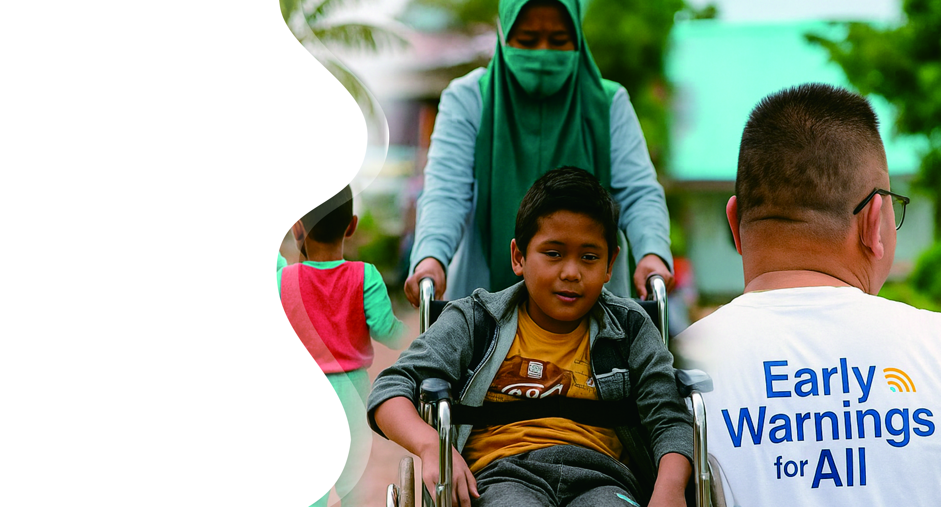
Technology and Inclusiveness for EWALL
Harkunti Pertiwi Rahayu
Vice Chair of ICG IOTWMS
Chair of TTDMP – TOWS WG
Sumatra Institute of Technology, Indonesia
harkunti@gmail.com

Slide 2

Challenges & Opportunity
Early Warning for ALL EW4A
To respond ODTP HL Objective 2:
  100% all people at risk are prepared and resilient to tsunami by 2030 (UNESCO IOC ODTP).
People with disability:
  1.3 billion disability people in the world (16% global population, WHO Mar 7, 2023)
  22.5 million disability people in Indonesia (8.5% of national population, BPS 2023)
Barriers to full social and economic inclusion, inaccessible physical environments and transportation, unavailability of inclusive assistive devices and technologies, non-adapted means of communication, gaps in service delivery, and discriminatory prejudice and stigma in society.
Limited access to Tsunami Warning Information → time is very critical for disability living at the tsunami prone area → very short golden time
SDGs: Leaving no one left behind

Slide 3

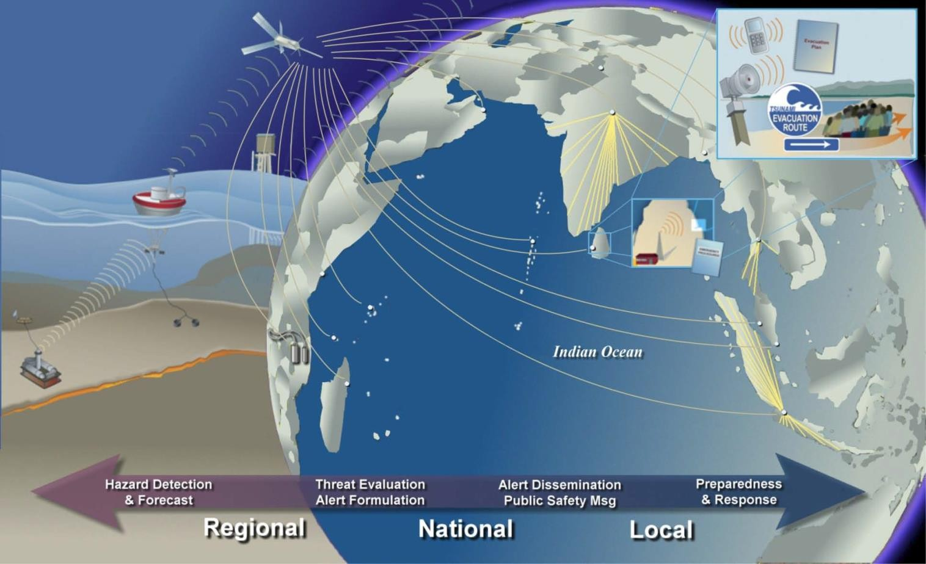
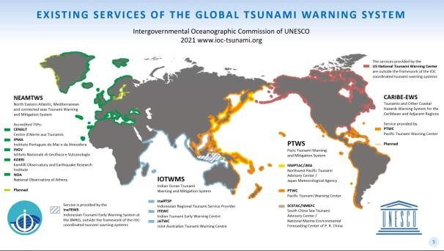
ODTP HL Objective 2: Perspective of End To End System” From 0.0 to 4.0
5
Has it considered reaching the last mile and the very last mile ??
Has it considered the response of all people at risk to the warning message??
?
?
4.0
4.0

Slide 4
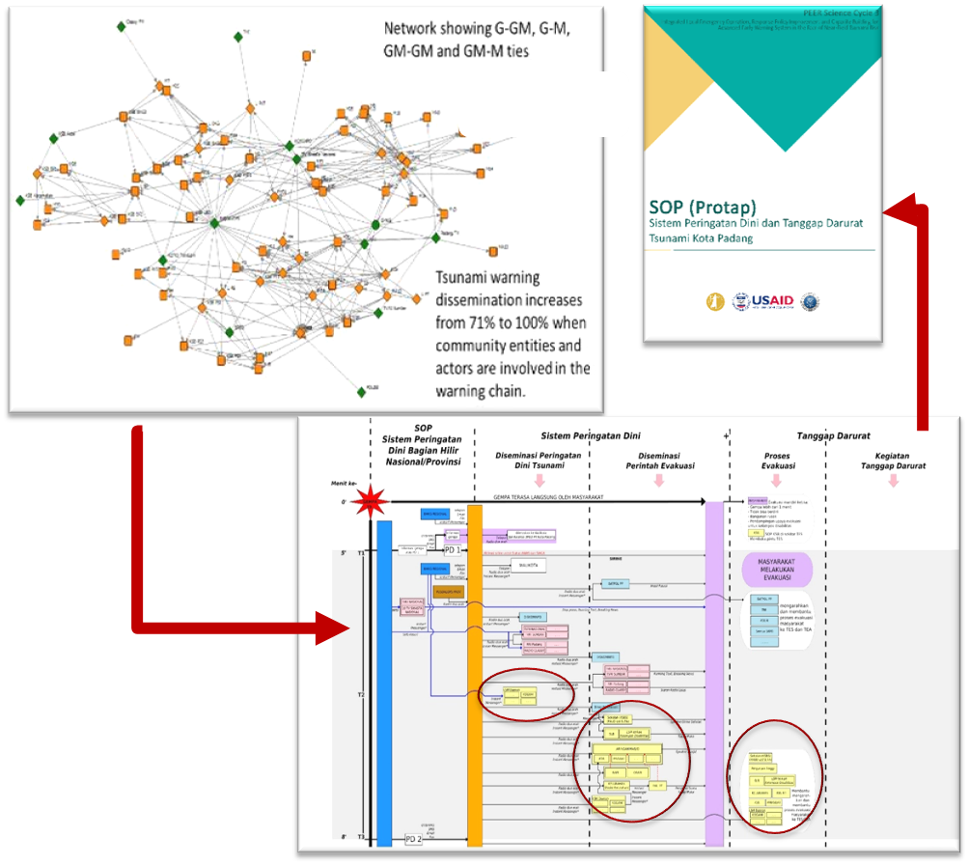
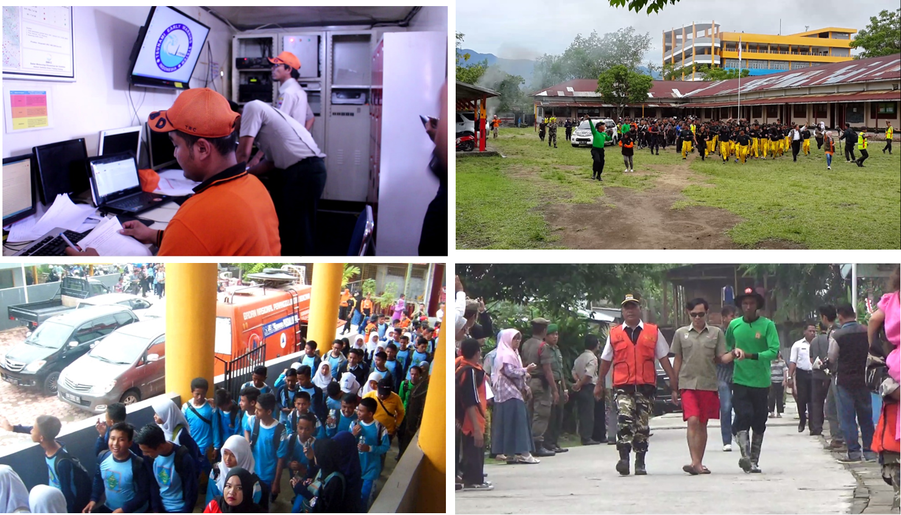
Need to Improve People Center Tsunami Warning Chain (2016) to Accommodate the Very Last Mile
Identifikasi aktor perantara (intermediate aktor) potensial dalam diseminasi informasi peringatan dini hingga ke last miles → terbukti meningkatkan cakupan peringatan dari 71% menjadi 100%
Testing the SOP in IOWave 2016
Need for Inclusive SOP for Disability

Slide 5
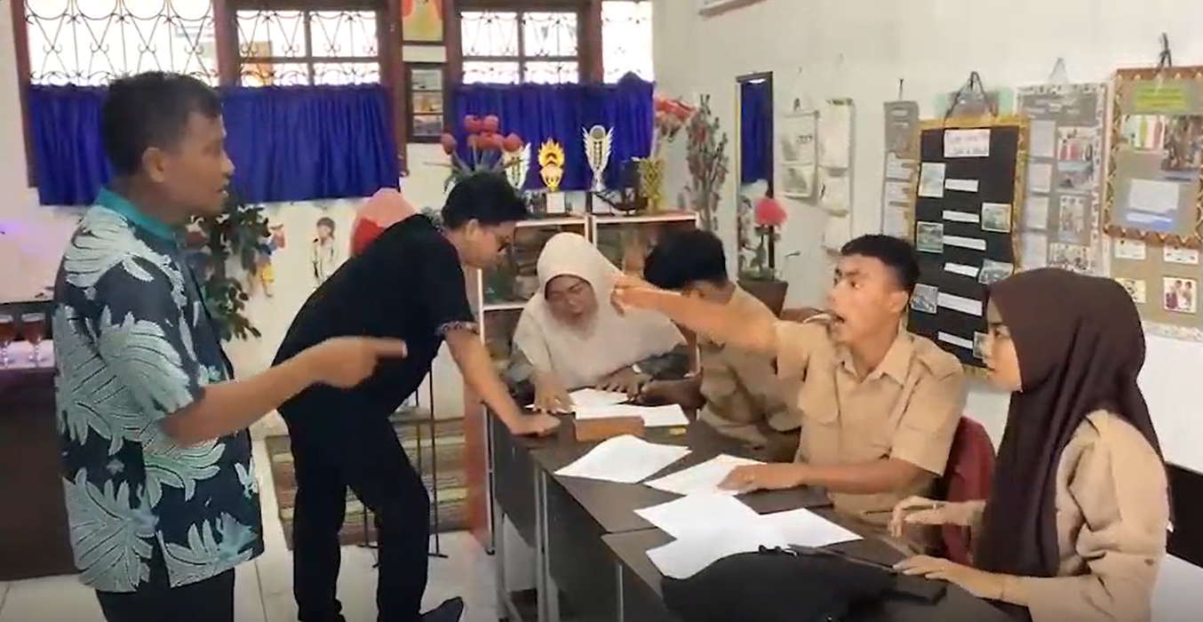
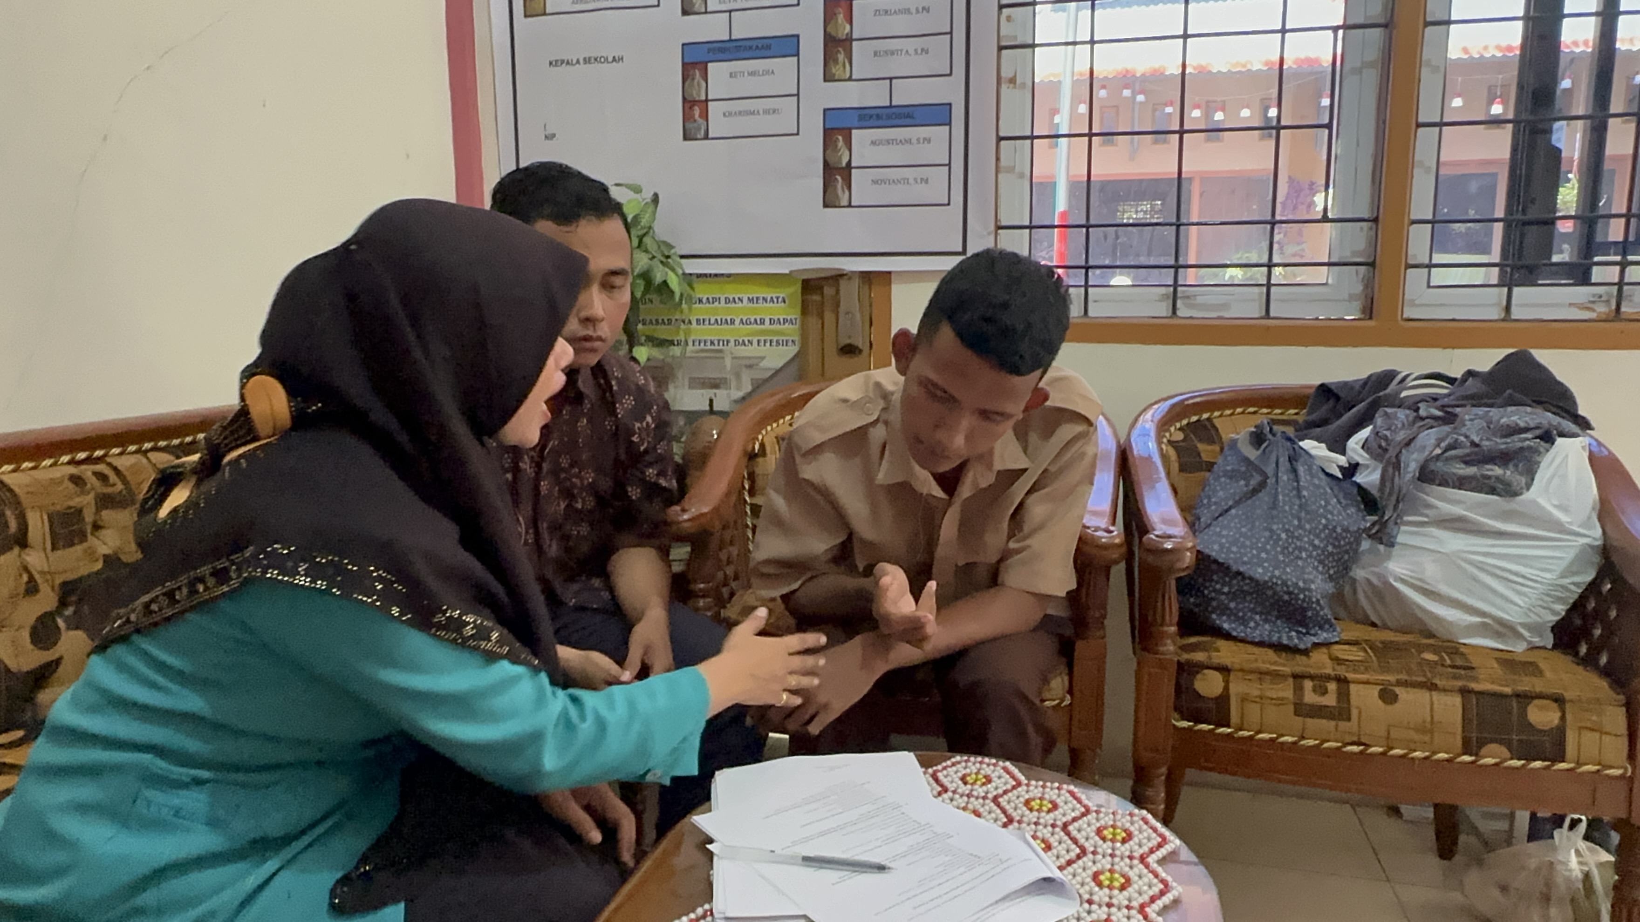
Issues For Inclusive Evacuation Planning
How is social cognitive behavior of all community at risk in responding tsunami early warning system for evacuation?
In what ways physical/non-physical factors of urban and rural setting and inclusivity mobility will affect all community at risk in evacuation?
In what ways did multiple disaster-related actors in case study area obtain, utilize, and exchange information regarding tsunami warning?
What were the characteristics of inclusive network of information flow and multiple actors including inclusive group for coordination in responding tsunami early warning system?
How to develop inclusive SOP that will be appreciated by the community with disability?

Slide 6
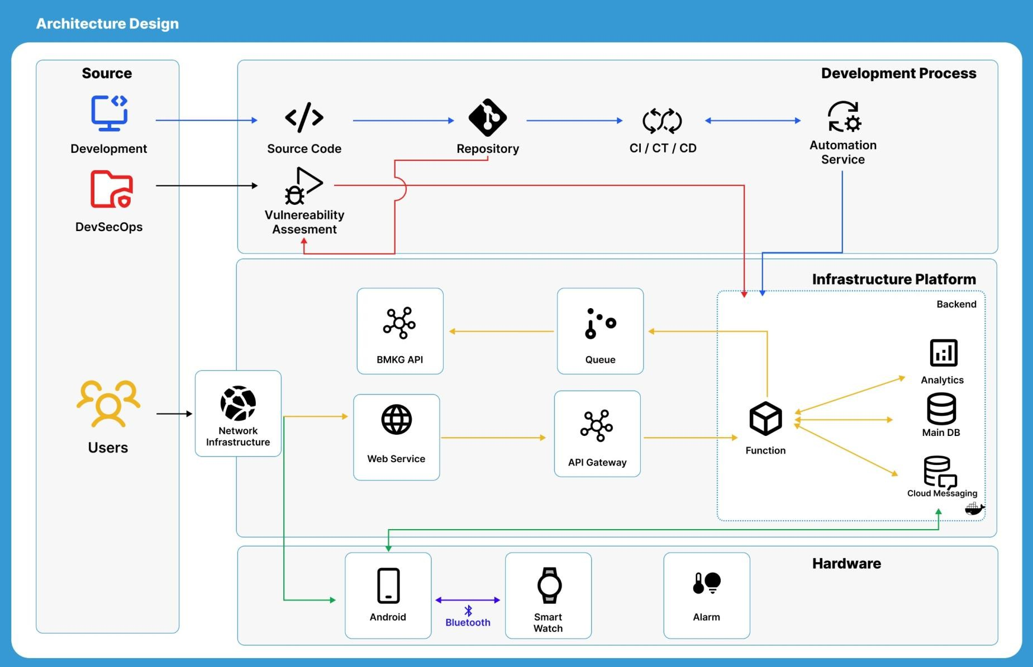
Technical Detail of Inclusive Tsunami Early Warning: System Conceptual Design
Notes:
The system integrates development, infrastructure, and hardware to deliver real-time alerts. Secure source code is managed through automated CI/CD pipelines, while data from the BMKG API is processed via API Gateway, Queue, and Function services connected to analytics, databases, and cloud messaging.
Users receive alerts through networked web and mobile services, where Android devices link with smartwatches and alarms to ensure inclusive and rapid tsunami warning dissemination.

Slide 7
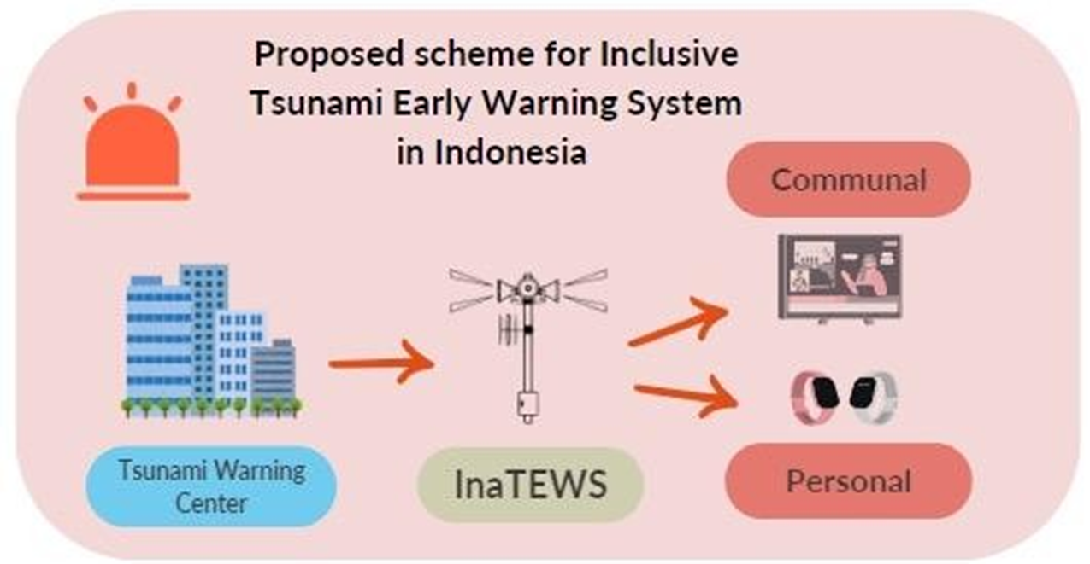
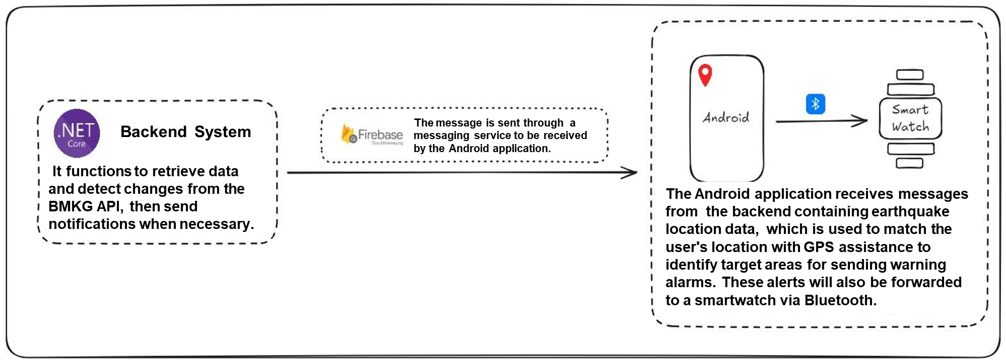
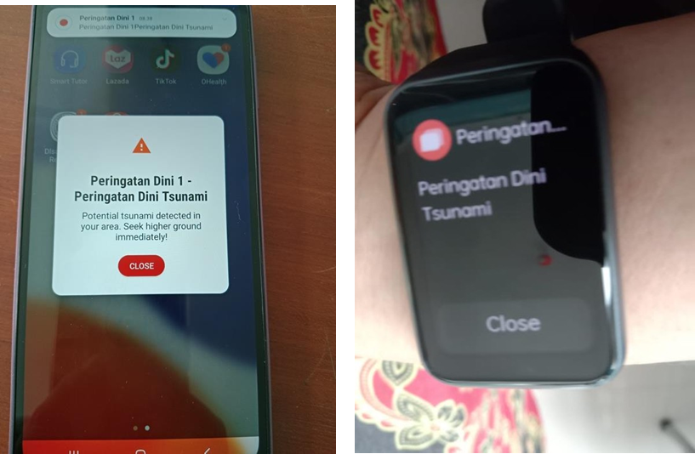
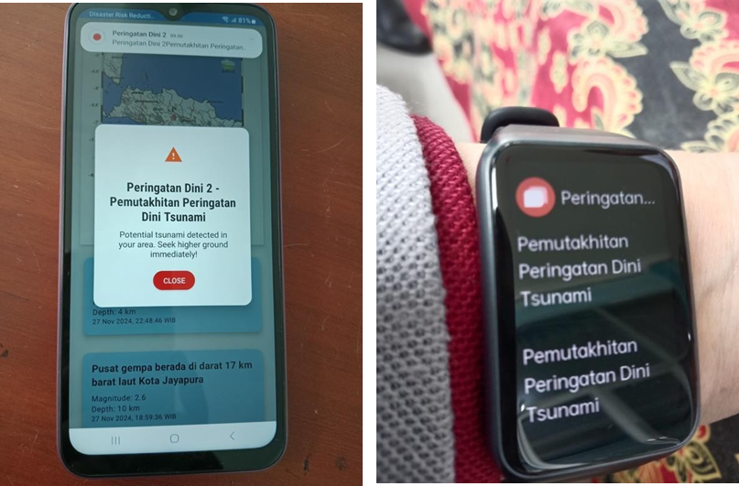
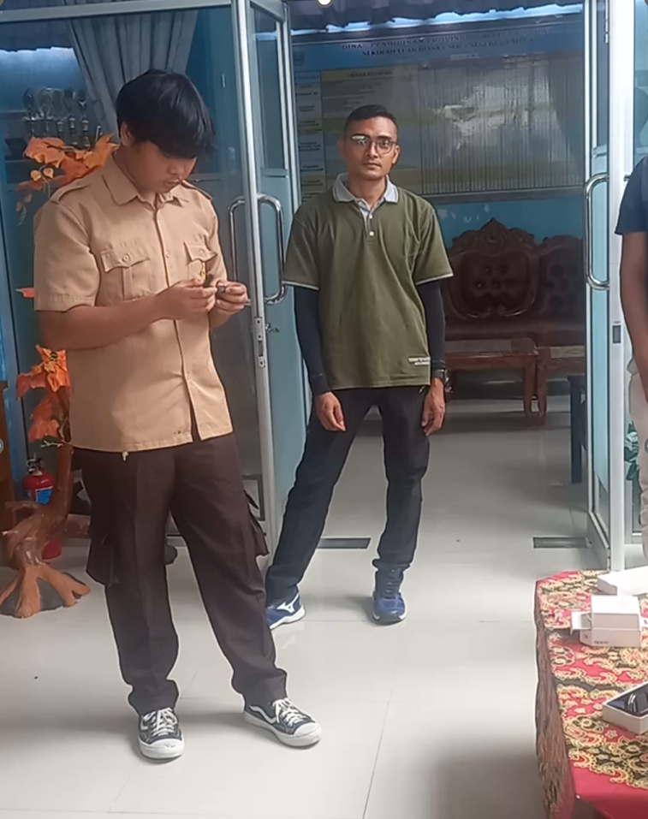
Inclusive Early Warning System: Vibration-based Prototype Tested in Padang, West Sumatera
Design of Inclusive Tsunami Early Warning System
Prototype of vibration-based and Visual-based Early Warning Information for tsunami warning dissemination for people with disabilities

Slide 8
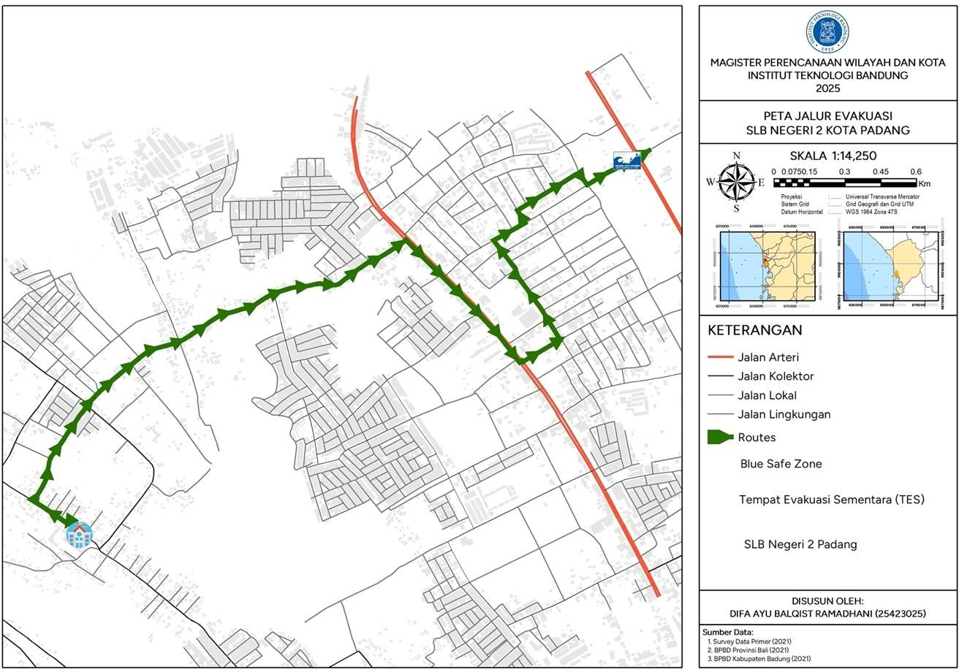
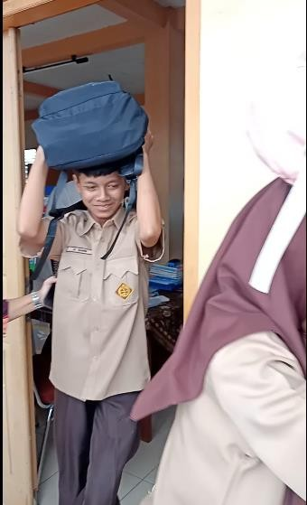
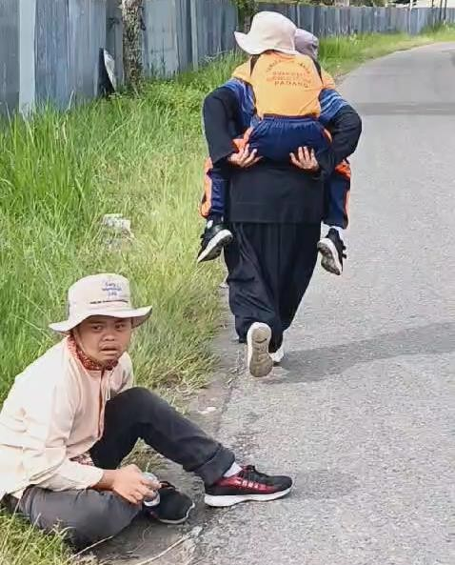
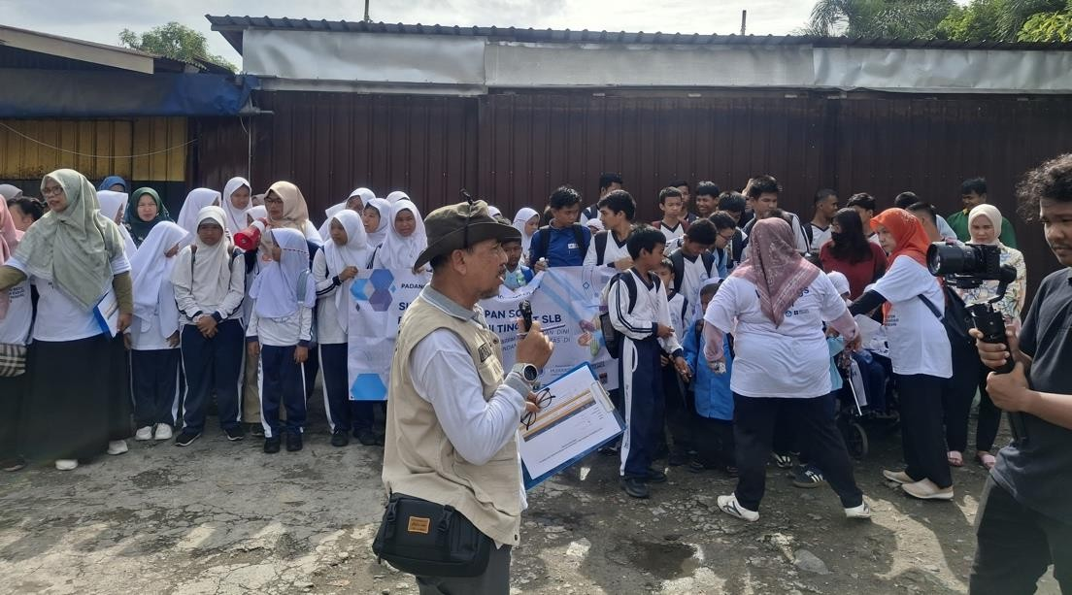
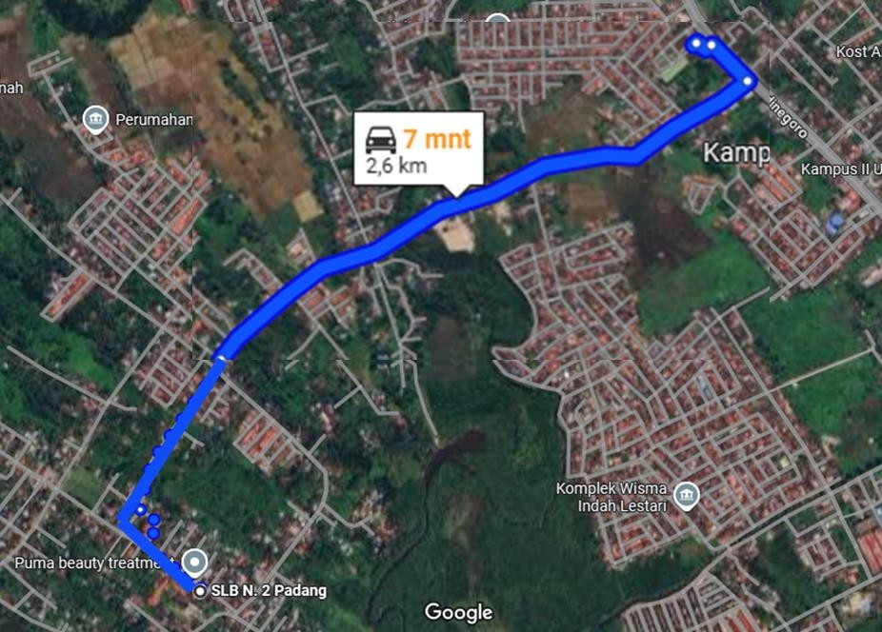
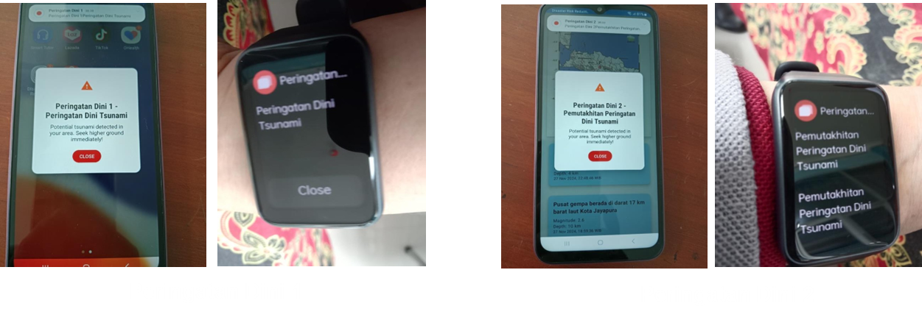
Inclusive Tsunami Warning Technology / Tools and Evacuation Plan
Evacuation route from Network Analysis Model
Simulation of Testing Inclusive SOP and Inclusive Tsunami Early Warning Device (Visual-based and Vibration-based) at the Special Needs School Level
Evacuation route after discussion with stakeholders

Slide 9

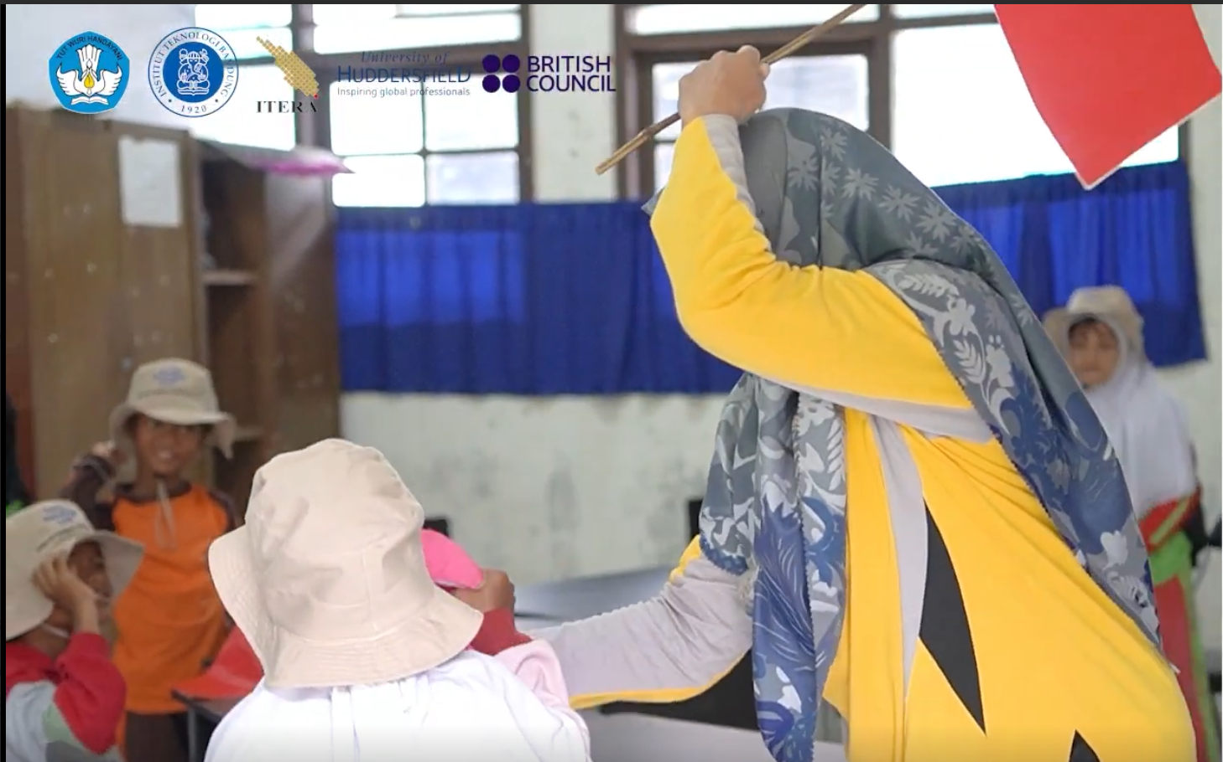
Inclusive Warning Dissemination and Communication
In SLBN 2 Padang, teacher for hearing-impaired student disseminate tsunami warning information using sign language and red flag as a symbol of emergency situation

Slide 10
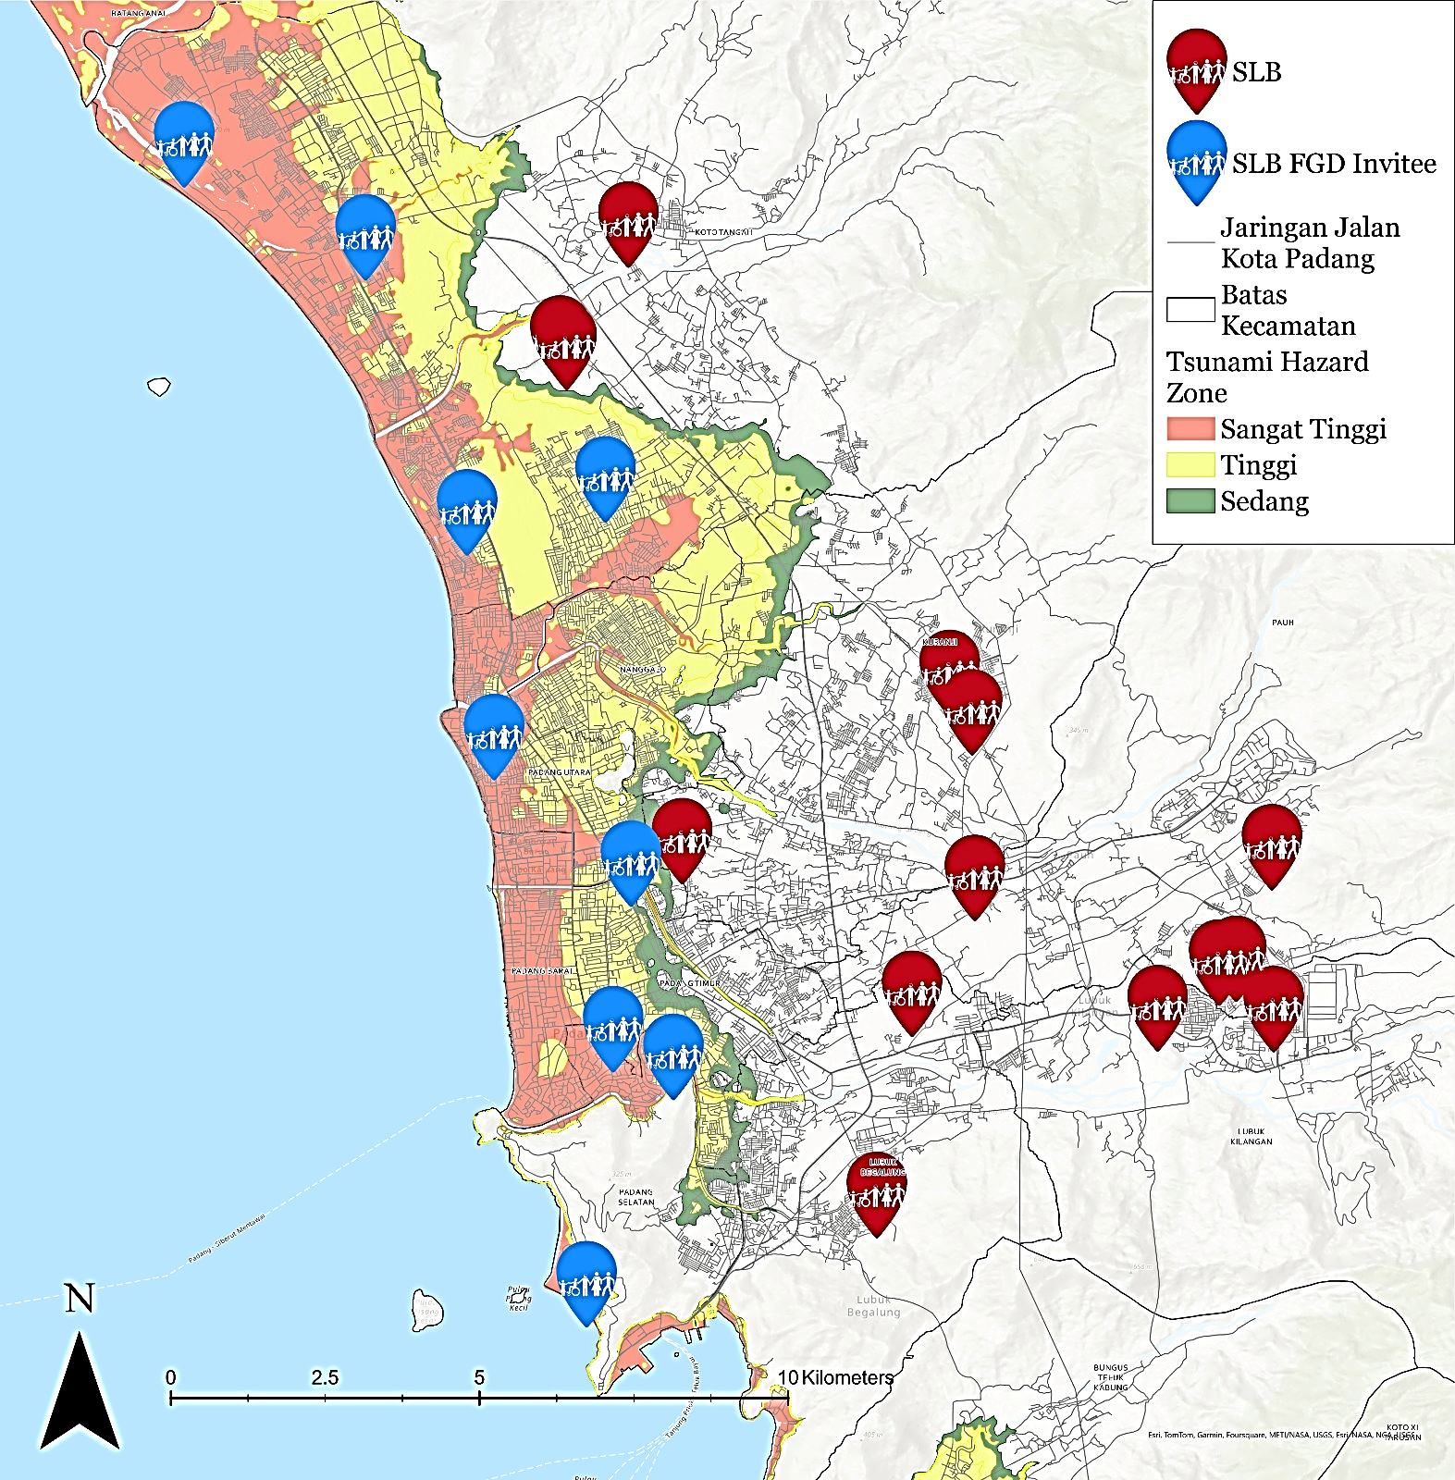
Special Schools for Disabilities at Tsunami Prone Area in Padang City
No | Special Schools | Number of Teachers | Number of Students
1 | SLBN 2 Padang​ | 44 | 134
2 | SLB Bakti​ | 7 | 22
3 | SLB MGF Lubuk Buaya Padang | 5 | 22
4 | SLB Karya Padang​ | 7 | 25
5 | SLB Perwari (Padang Utara)​ | 10 | 32
6 | SLB YPAC SUMBAR (Padang Utara)​ | 8 | 35
7 | SLB Wacana Asih (Padang Selatan)​ | 18 | 78
8 | SLB Al-Ishlaah Padang (Padang Selatan)​ | 12 | 26
9 | SLB Etnik Kreatif (Padang Selatan)​ | 5 | 19
10 | SLB Samudera Biru​ | 3 | 39
 | TOTAL | 119 | 432
SLB 2 Padang
SLB Bakti Padang
SLB MGF Lubuk Buaya Padang
SLB Karya Padang
SLB PERWARI Padang
SLB YPAC Sumatera Barat
SLB Wacana Asih Padang
SLB Al-Ishlaah Padang
SLB Etnik Kreatif Padang
SLB Samudera Biru

Slide 11
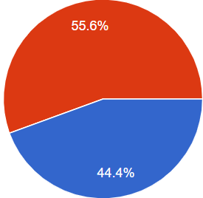
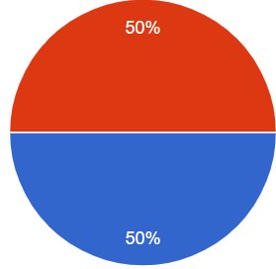
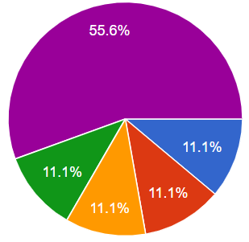
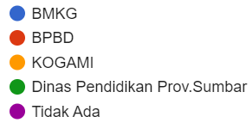
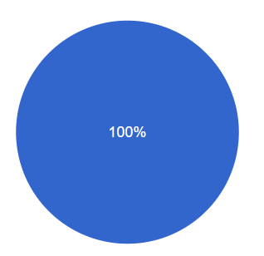
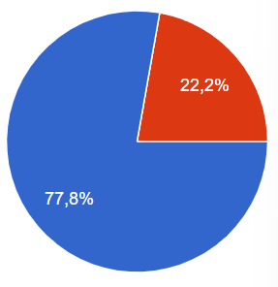
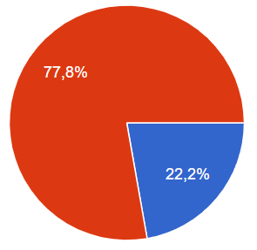
Challenges in tsunami warning dissemination and response for disability
Difficulties in accessing warning information
Lack of reachable Tsunami Vertical Evacuation Shelter
Evacuation route road condition (small, steep road, poor pavement, no sidewalk, side by side with open drainage channel )
Need for Evacuation
Need supporting help in evacuation: deaf (no need), blind (1 helper) and physical disability (min 1)
Availability of Early Warning Dissemination Tools
EWS Condition
Early Warning Information Dissemination Cooperation
Yes
No
Berfungsi
Tidak berfungsi
Existing
Evacuation Route
Tsunami drill
Tsunami Shelter near School
Pernah
Tidak Pernah
Ada
Ya
Tidak
Tidak Ada

Slide 12
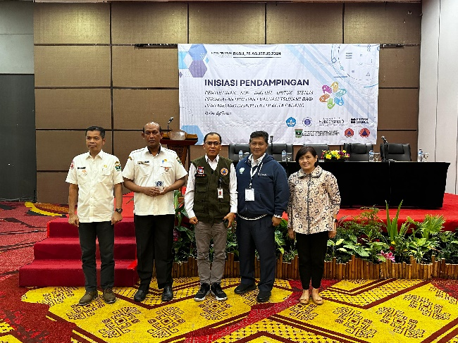
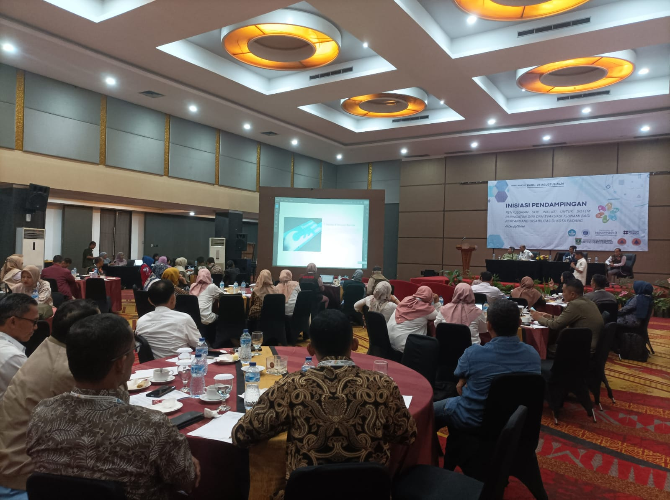
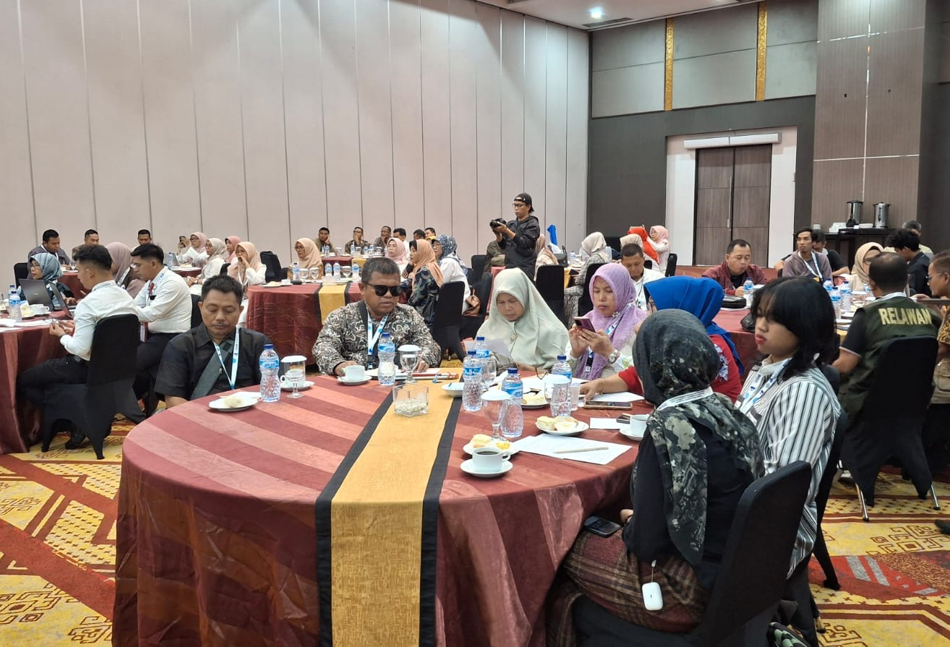
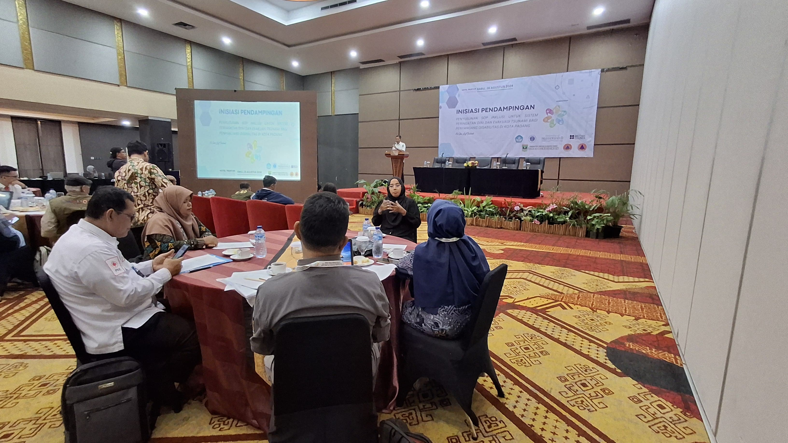
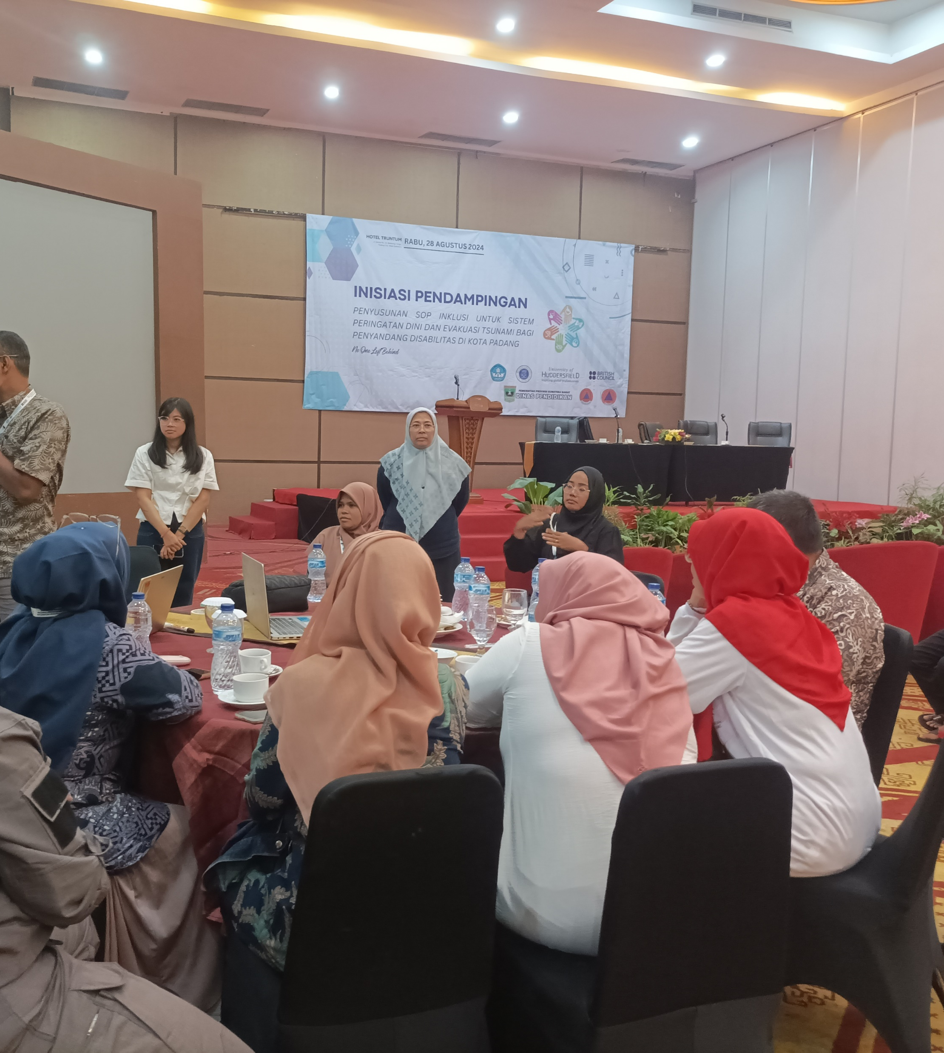
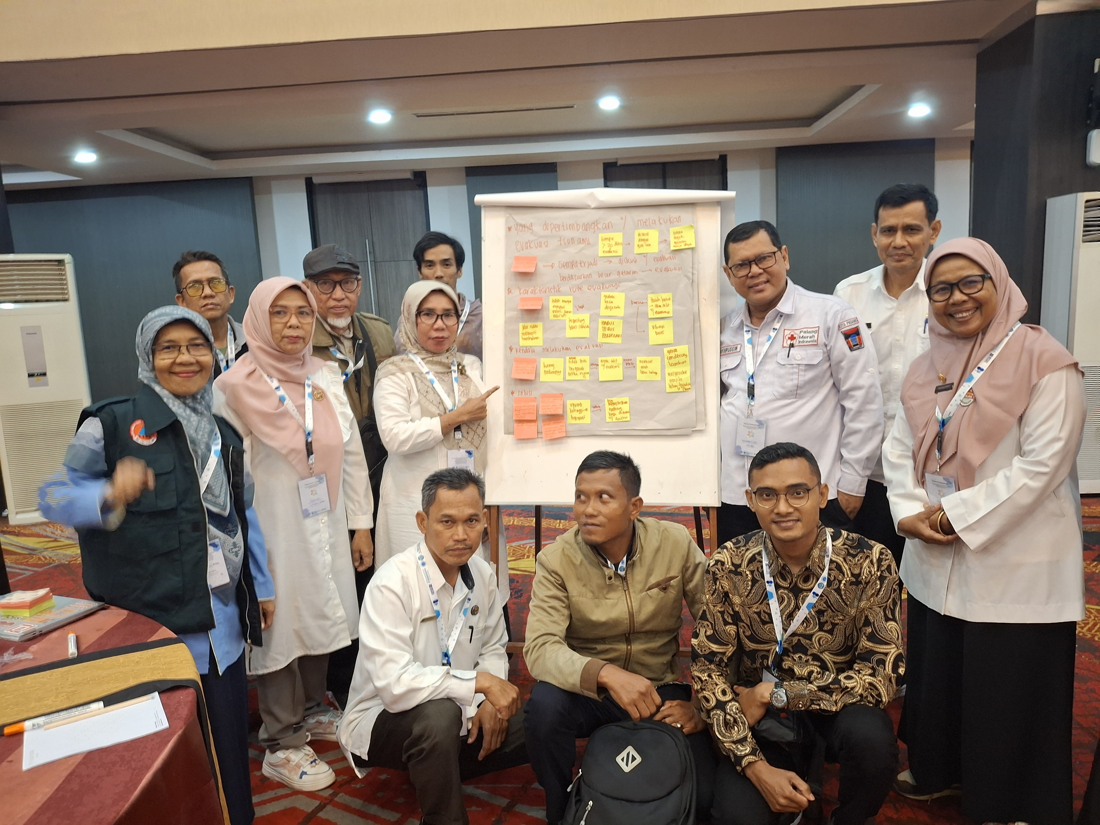
FGD Inclusive SOP in Padang, 28 August 2024
(Government, Schools, Forums for Disability Community)

Slide 13
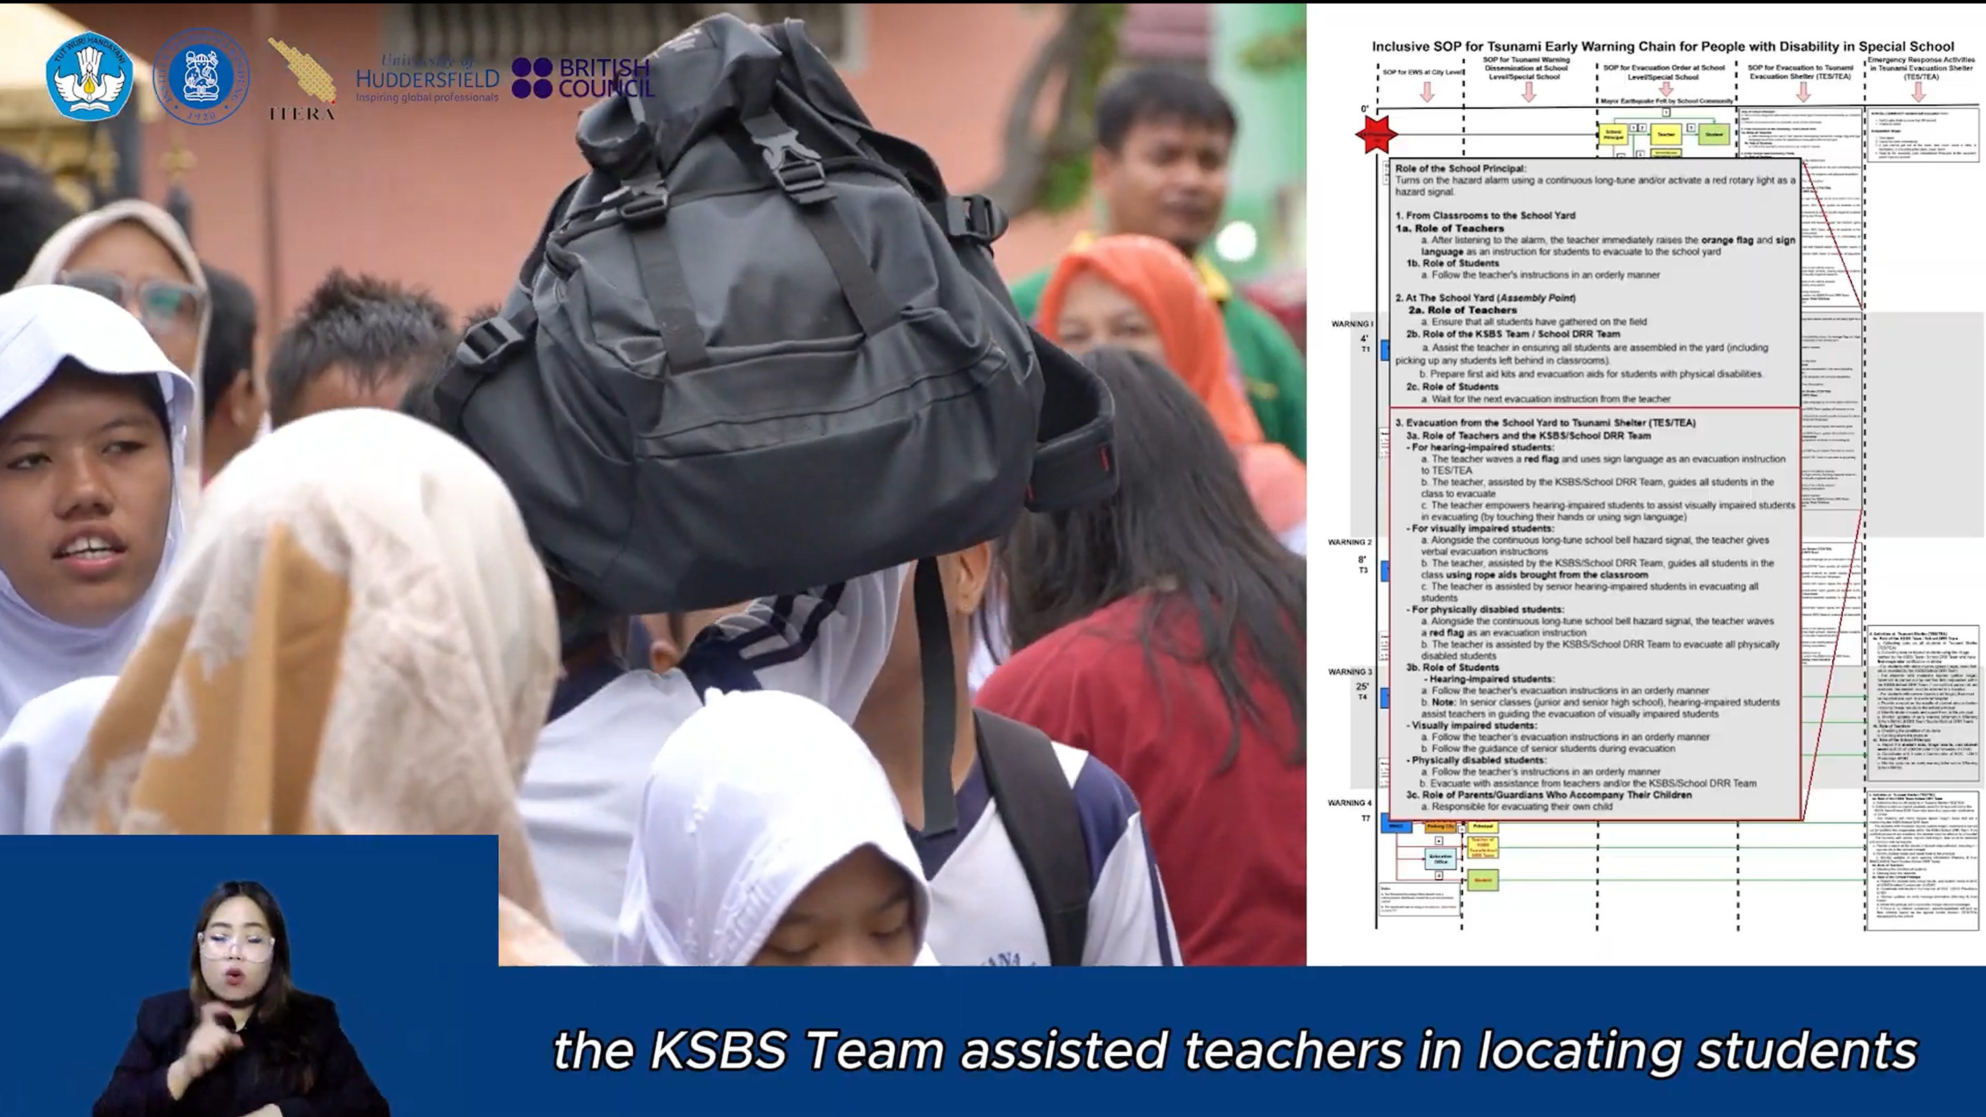

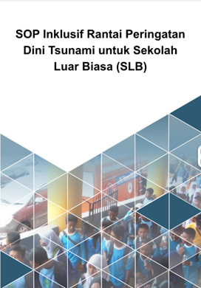
Inclusive SOP (Audio-Video, Sign Language and Text)
Inclusive SOP material are available in audio-video and text format
Audio-visual format include sign language
Available in 2 languages (Indonesia & English)

Slide 14
Thank you

