Slide 1
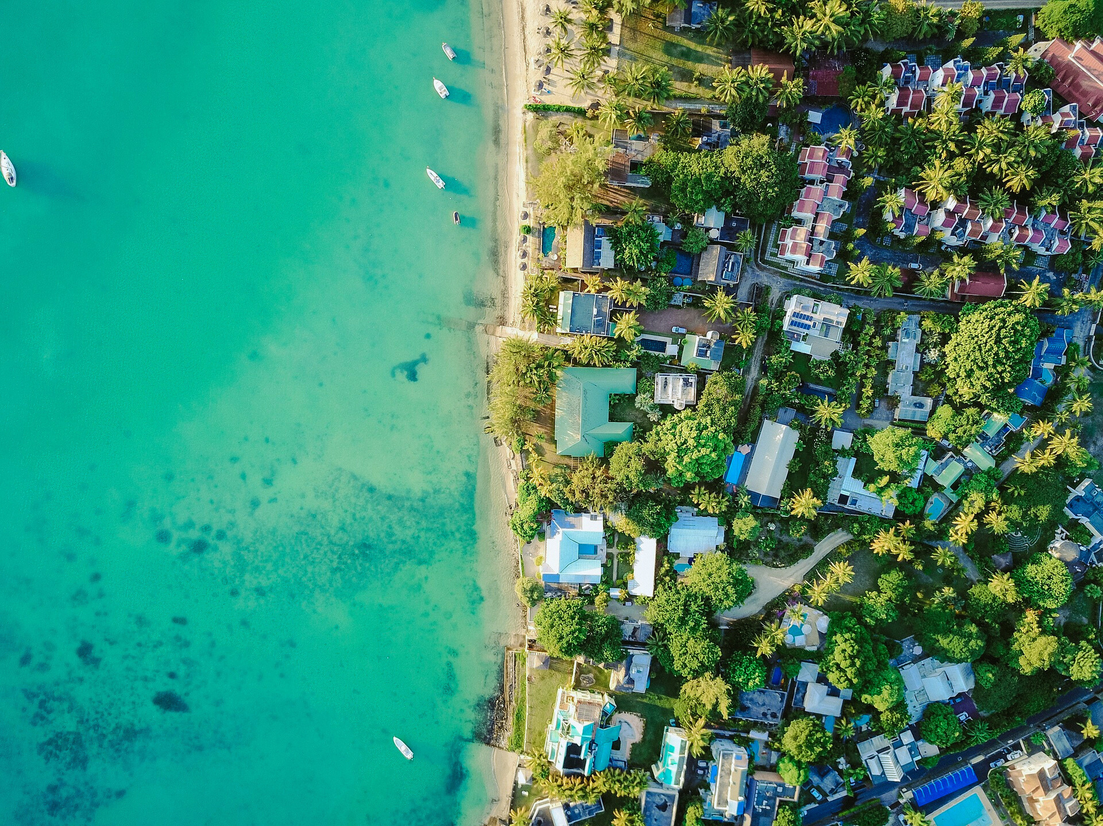



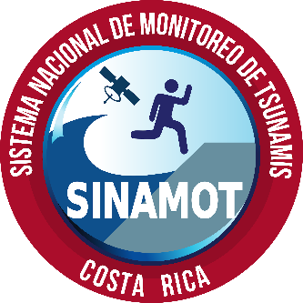
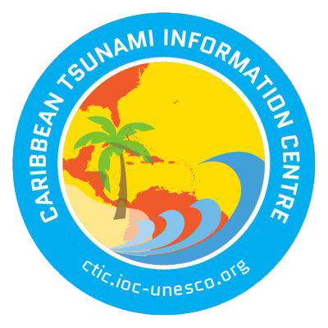

Tsunami Ready in the Caribbean and Adjacent Regions
Silvia Chacon Barrantes
SINAMOT, UNA, Costa Rica
Alison Brome
Caribbean Tsunami Information Center
Christa von Hillebrandt-Andrade
International Tsunami Information Center – Caribbean Office
FIRST CONFERENCE OF THE OCEAN DECADE TSUNAMI PROGRAMME
Hyderabad, India
10-11 November 2025

Slide 2
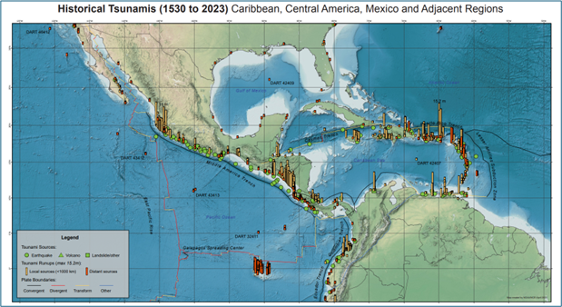
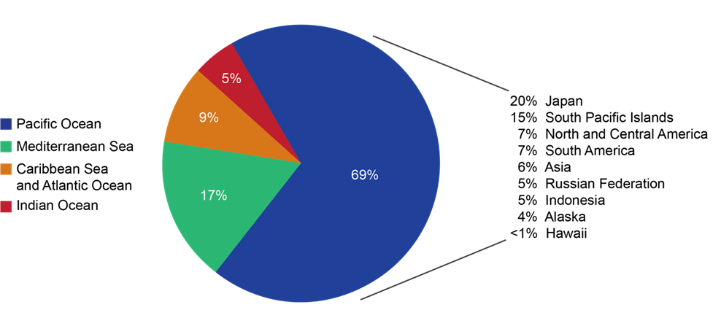

SOURCE LOCATION OF DEADLY TSUNAMIS – GLOBAL (1620 B.C to A.D. 2023)
Source: NOAA National Centers for Environmental Information and International Tsunami Information Center.
Notes:
9% of deadly tsunamis are generated in the Caribbean and Altlantic – but noting that Indian Ocean accounts for 5%, but where almost 230,000 people lost their lives in 2004, highlights that infrequency does not protect us, but may make us complacent, annual tsunami exercises and the Tsunami Ready program offer that continuous motivation and mechanisms to get and stay prepared.

Slide 3


“The global tsunami warning system, led by UNESCO, is particularly effective in detecting tsunamis very quickly. But sounding the alarm is not enough: to save lives, coastal communities must also be trained to respond in the right way.”
10-11 November 2025
INCOIS, Hyderabad, India
First Conference of the
Ocean Decade Tsunami Programme

Slide 4
The 20 year history of tsunami ready in the Caribbean…

Slide 5


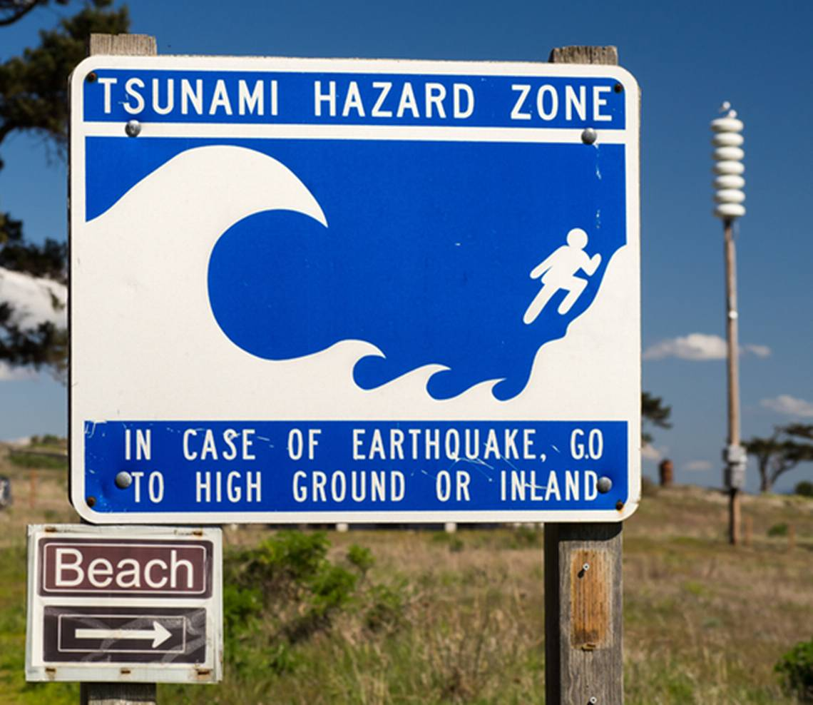

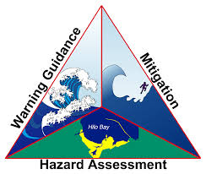
Ocean Shores, Washington, USA
The First TsunamiReady® Community, 2001
Notes:
The US TsunamiReady Program was the precursor to the UNESCO-IOC Tsunami Ready Recognition Program. It was established in 2001.

Slide 6
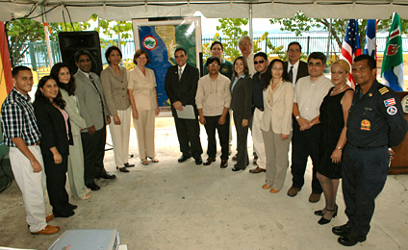
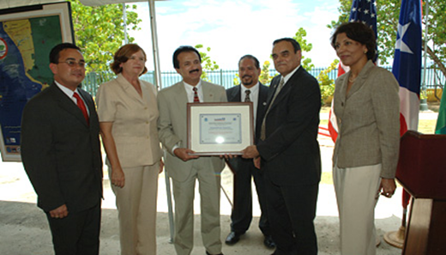
TsunamiReady® Recognition Ceremony
Mayagüez, Puerto Rico, May 19, 2006
Notes:
In 2006 the first TsunamiReady community in the Caribbean was recognized in Puerto Rico. The number of communities grew over the years. By 2015, 100% of coastal communities in Puerto Rico were recognized as Tsunami Ready.

Slide 7
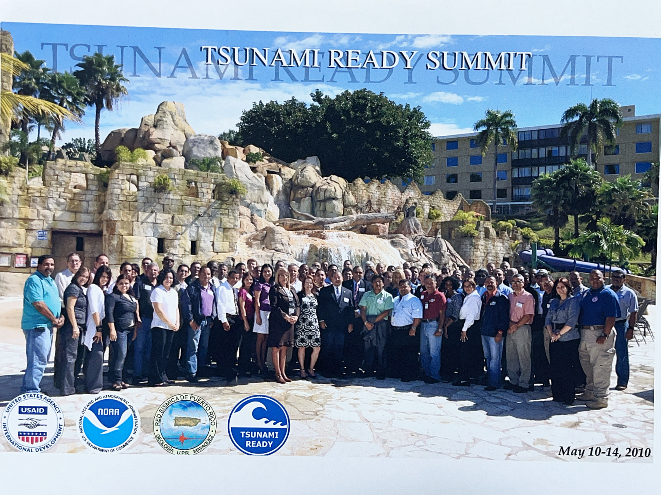
Notes:
The Puerto Rico TsunamiReady experience was shared within the ICG-CARIBE EWS. In 2010 a TsunamiReady summit was held in Puerto Rico to provide capacity to the Puerto Rico emergency management community in the implementation of the TR program and tsunami stakeholders from the Caribbean were invited. One of the reccomendations of the Summitt was the piloting of the US TR program in the Caribbean.

Slide 8
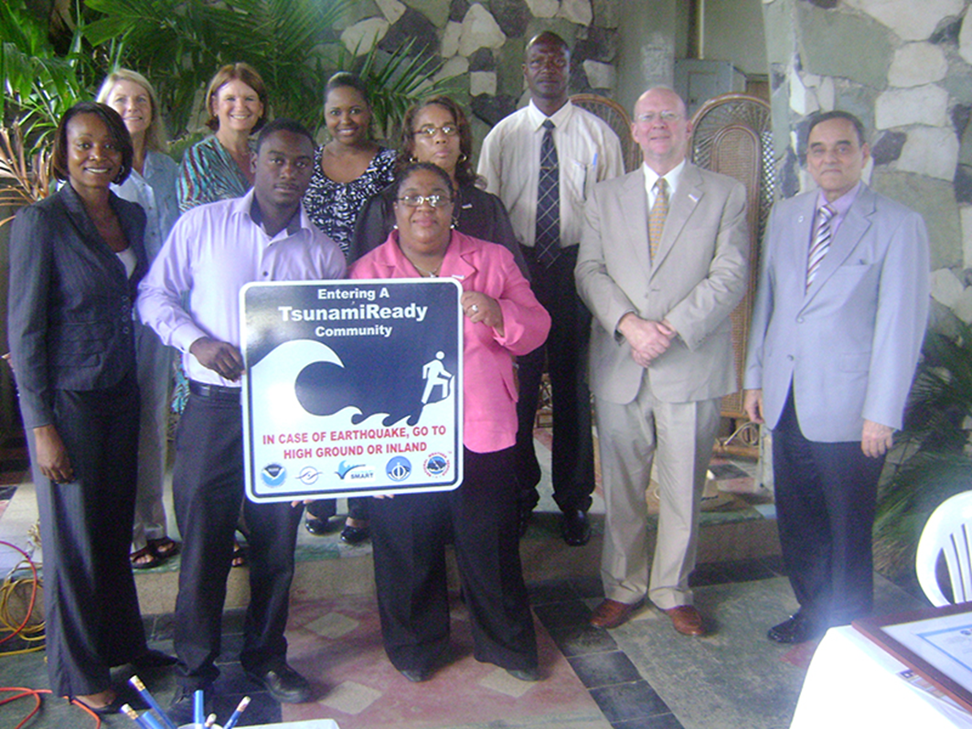
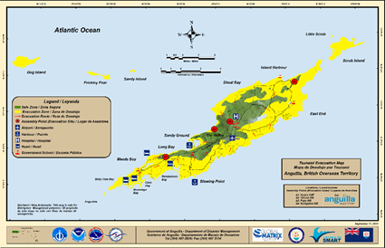
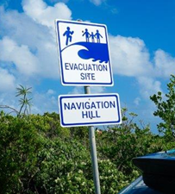
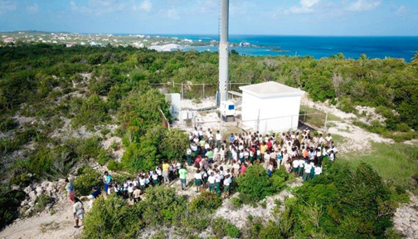
TsunamiReady® Recognition Ceremony
Anguilla, UK, December 12, 2011
Notes:
In 2011 the first community outside of the US was recognized jointly by the US and UNESCO/IOC as a TsunamiReady community. This effort led to a pilot UNESCO/IOC Tsunami Ready program in 2015, becoming the UNESCO/IOC Tsunami Ready (two words) Recognition Program in 2022.

Slide 9

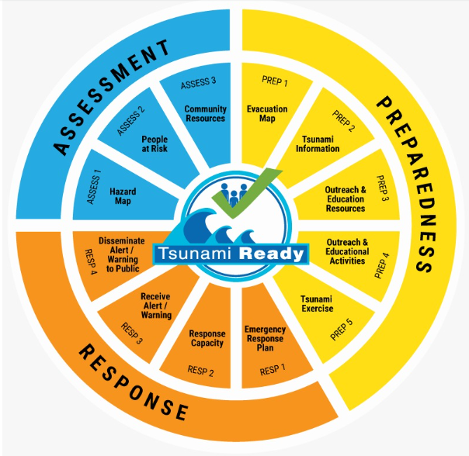

100% AT-RISK COMMUNITIES TSUNAMI READY
UN OCEAN DECADE TSUNAMI PROGRAMME:
STRATEGY:
  Be Aware, Be Prepared
FRAMEWORK:
  Harmonized global guidelines UNESCO IOC Tsunami Ready
  Performance-based Community Recognition
ACTION:
  National programs empower Communities,
  Communities demand national actions
UP TO DATE COMMUNITIES
  4 year renewal cycle
Standard Guidelines for the Tsunami Ready Recognition Program, UNESCO IOC TS 74
Notes:
In 2022, after 11 years of piloting UNESCO IOC approved its Tsunami Ready Recognition Programme and Guidelines

Slide 10
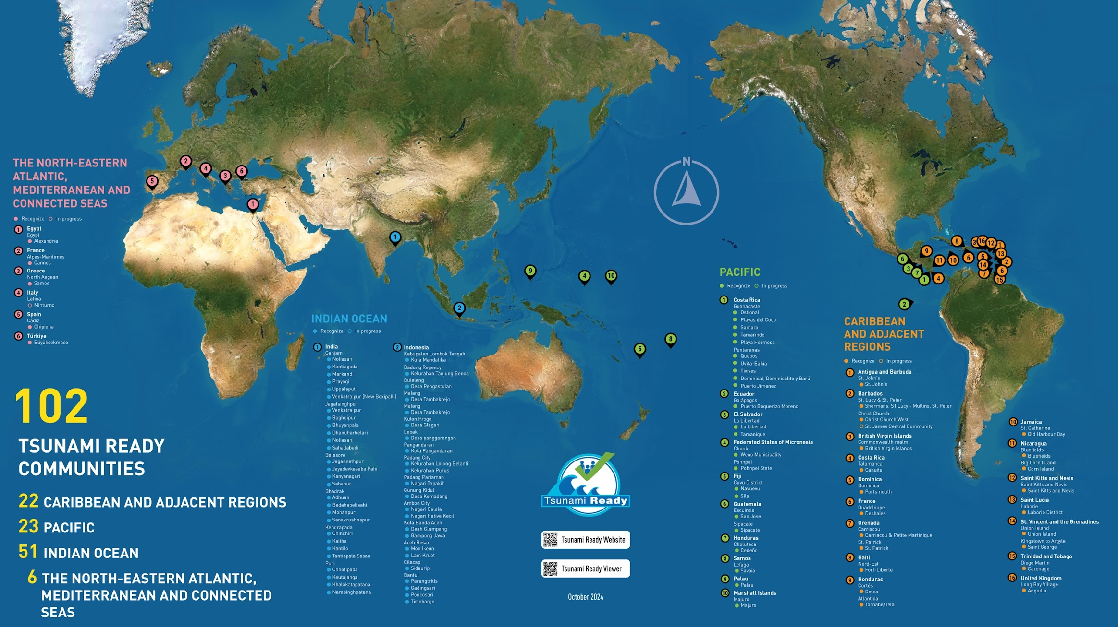
UNESCO/IOC Tsunami Ready Communities
100 (Sep 2025, IOC TSR)
TSUNAMI READY
COMMUNITIES
23 CARIBBEAN AND ADJ REGIONS
48 INDIAN OCEAN
6 NORTH-EASTERN ATLANTIC,
MEDITERRANEAN AND
CONNECTED SEAS
23 PACIFIC OCEAN
Notes:
Currently there are 23 communities in 14 Member States recognized as Tsunami Ready in the Caribbean, in addition to these are the 50 TsunamiReady communities of Puerto Rico and the US Virgin Islands. Of the 23 UNESCO/IOC TR communities, 10 have TR renewals delayed, 2 Renewals due in 2025 for a toral of 12 Renewals needed, of which only 2 Renewals in Process. There are an additional 5 new renewals in process (Belize, Saint Lucia, Grenada, Trinidad and Tobago). According to Mathieu Peroche analysis of Caribbean and Adjacent Regions there are around 900 communities (administrative districts) with direct acces to the sea that are included in the evacuation zone at an altitude of 15 or 30 meters. So we are at less than 10% of the 100% prepared prepared and resilient goal of the Ocean Decade.

Slide 11
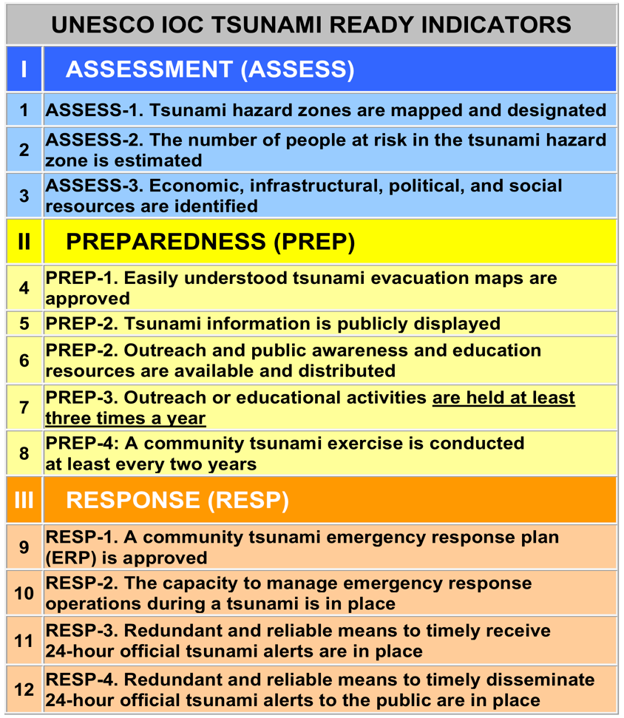
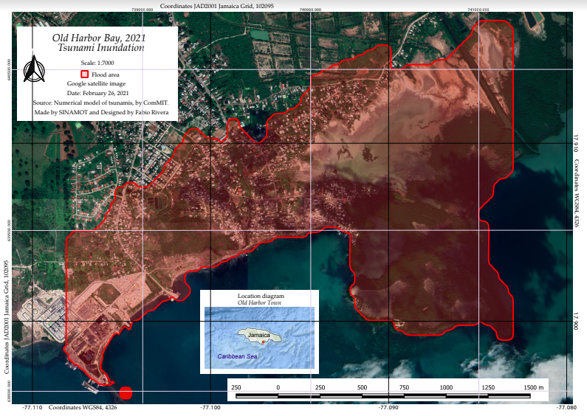
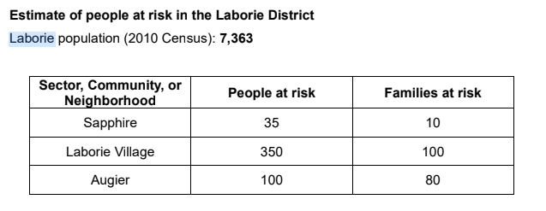
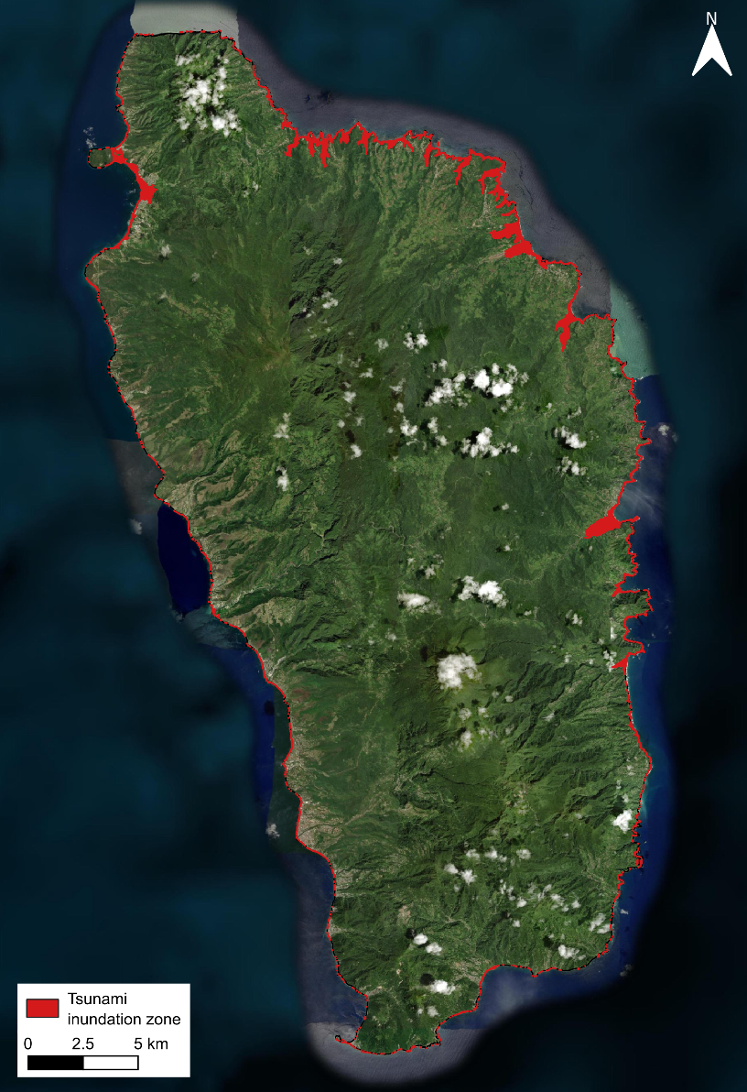
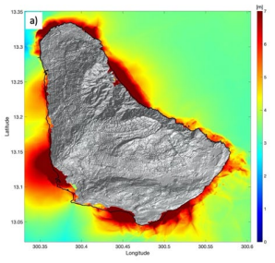
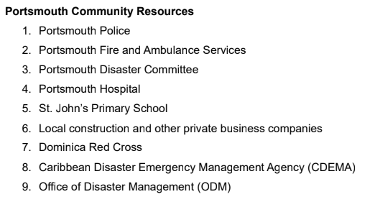
Assessment
Inundation map
Old Harbour Bay, Jamaica
Hazard Assessment
Dominica
Hazard Assessment
Barbados

Slide 12
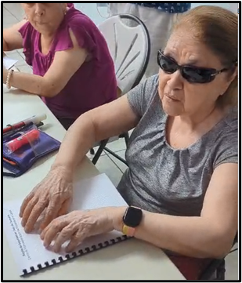
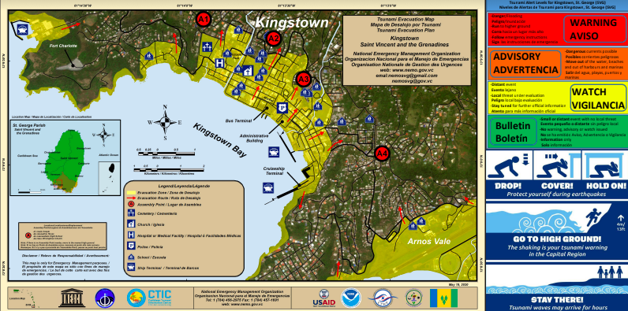
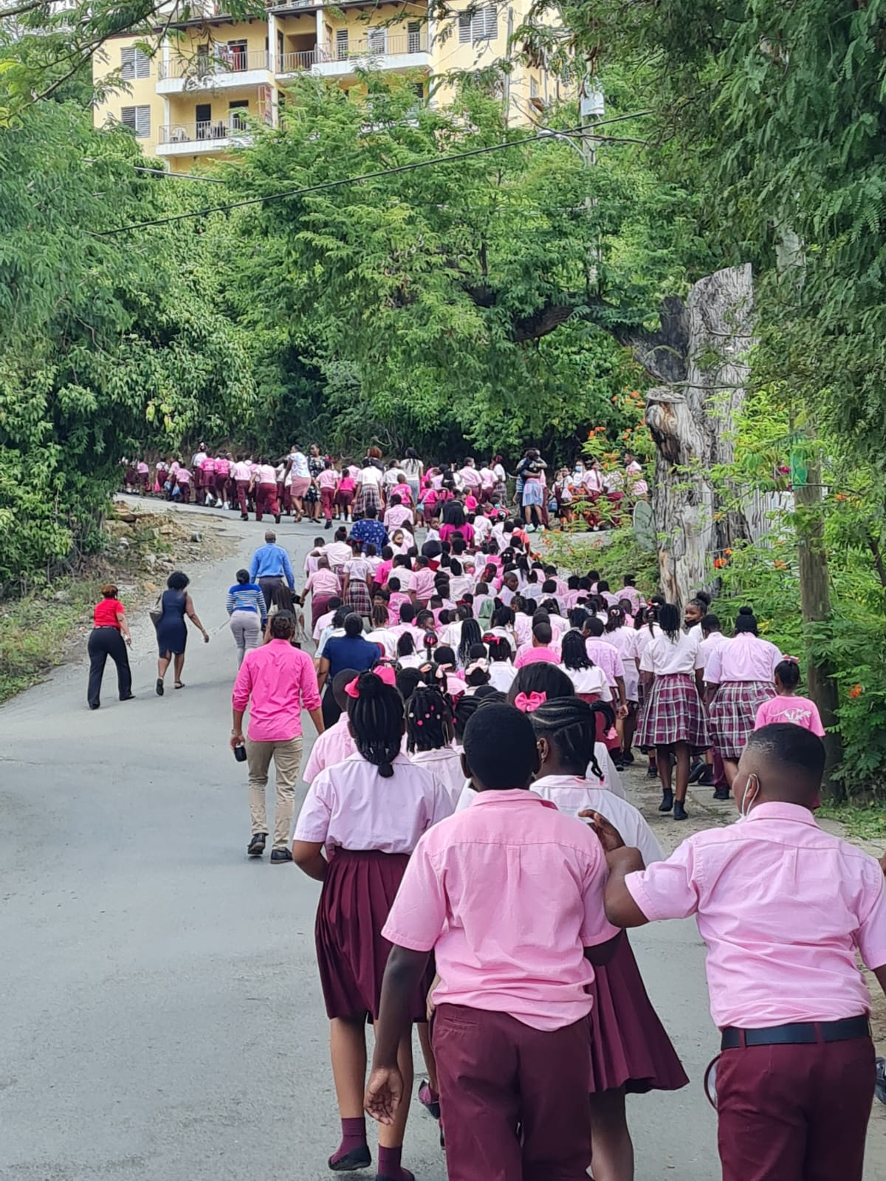
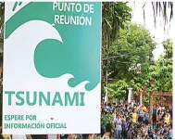
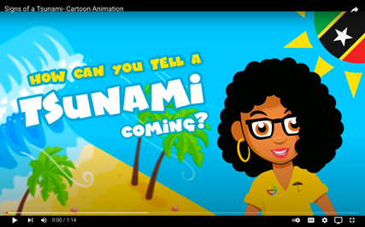
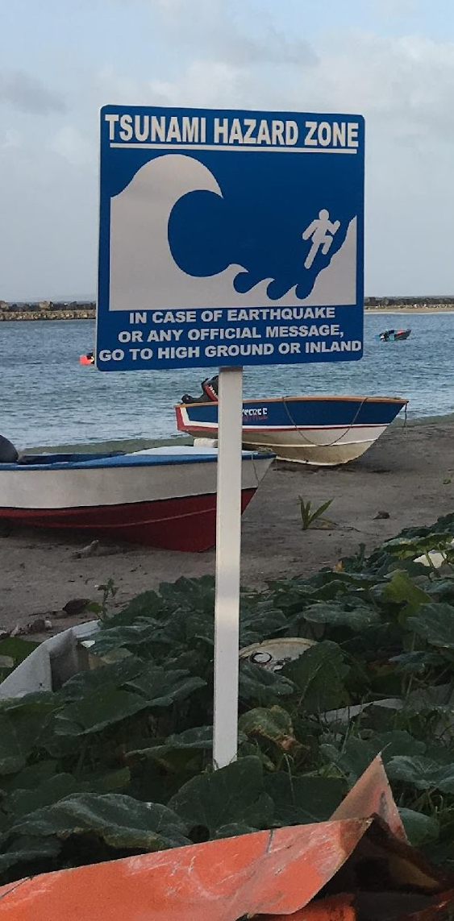
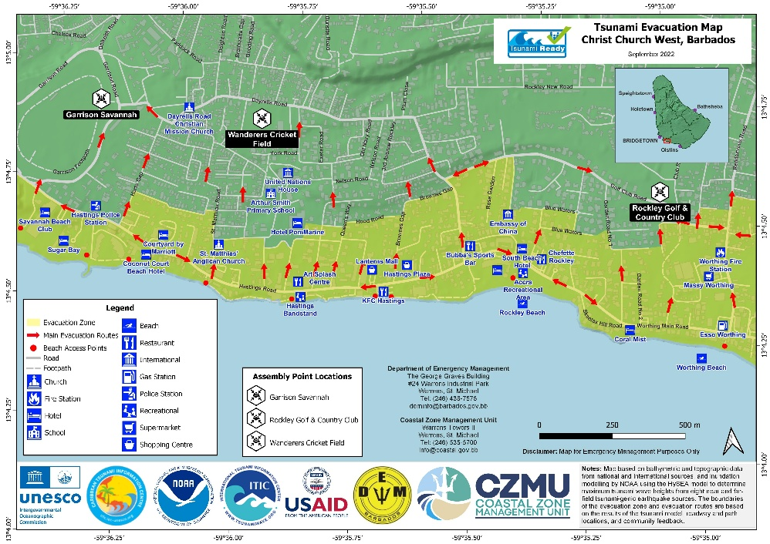
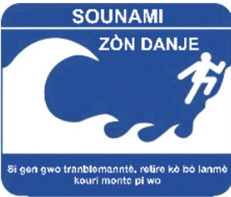
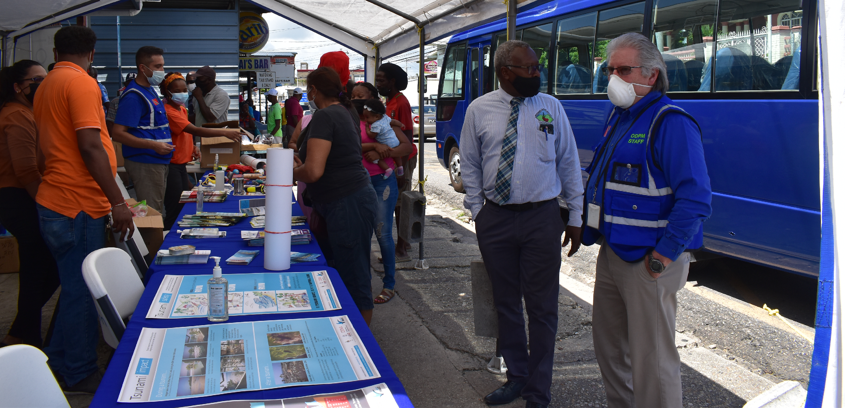
Preparedness
Integration of the Blind
Evacuation map billboard, Kingstown, SVG
Saint Kitts and Nevis
Omoa, Honduras
Fort Liberte, Haiti
Grenada
Evacuation map, Christ Church West, Kingstown, SVG
Tsunami exercise, BVI
Educational activity in Trinidad and Tobago

Slide 13
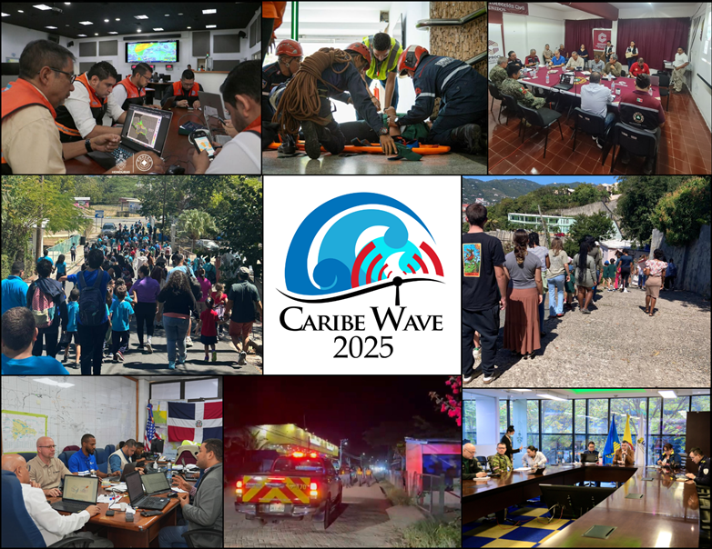
CARIBE WAVE – Key Component of Tsunami Ready implementation and sustainability
CARIBE WAVE has been conducted annually since 2011
Member States and Territories chose from different scenarios and decide if any additional activity would be carried out.
PTWC and CATAC (Nicaragua) issue dummy messages and simulated products.
In 2025, 45 Member States and Territories participated with a total of over 510,360 people.

Slide 14
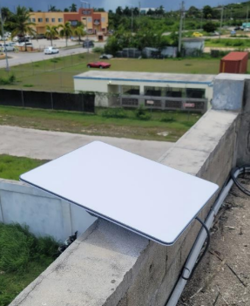
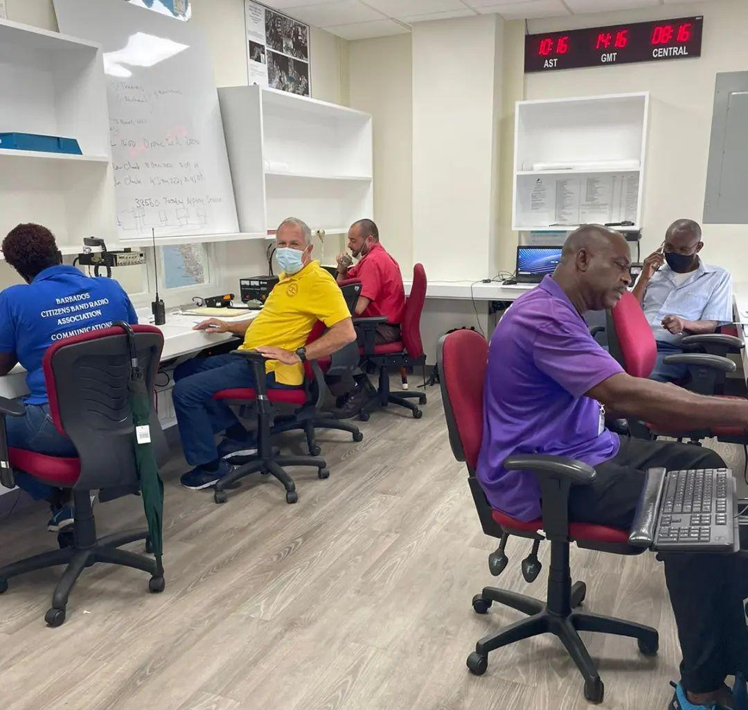
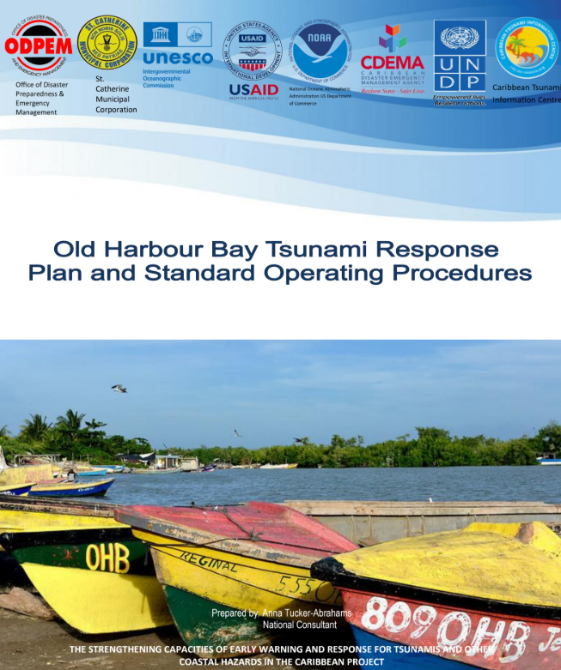

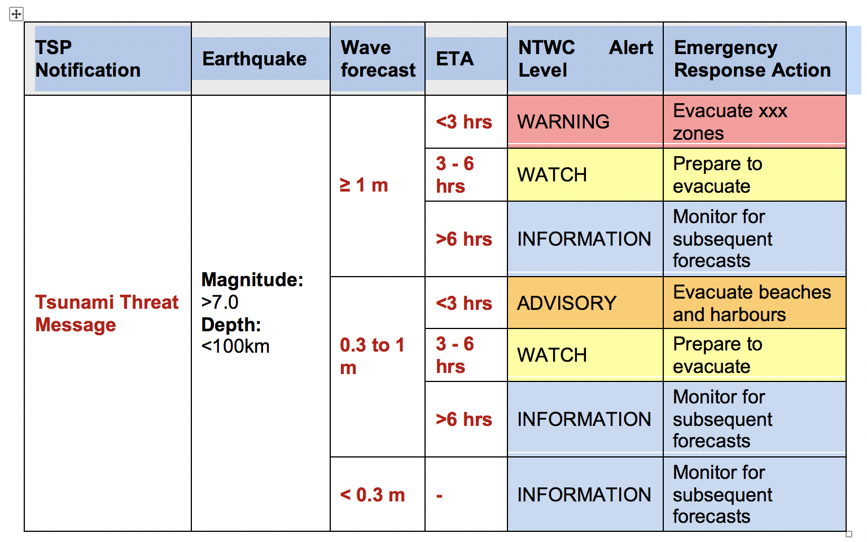
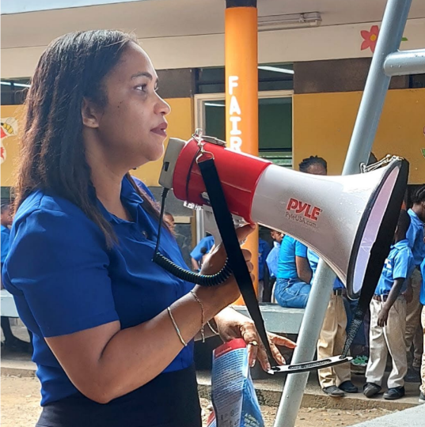
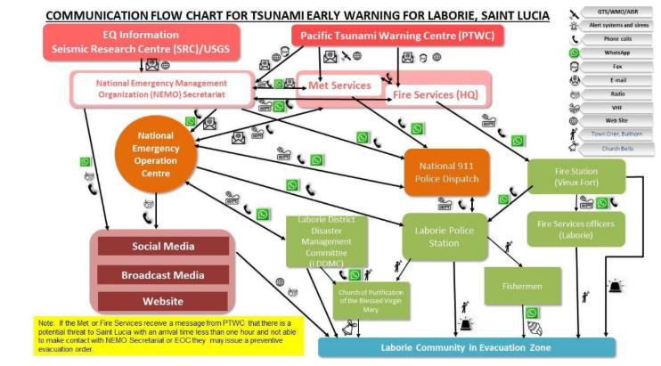
Response
Anguilla comms backup
Old Harbour Bay, Jamaica
Laborie, Saint Lucia
Dominica
Criteria for tsunami alerts and emergency response actions

Slide 15
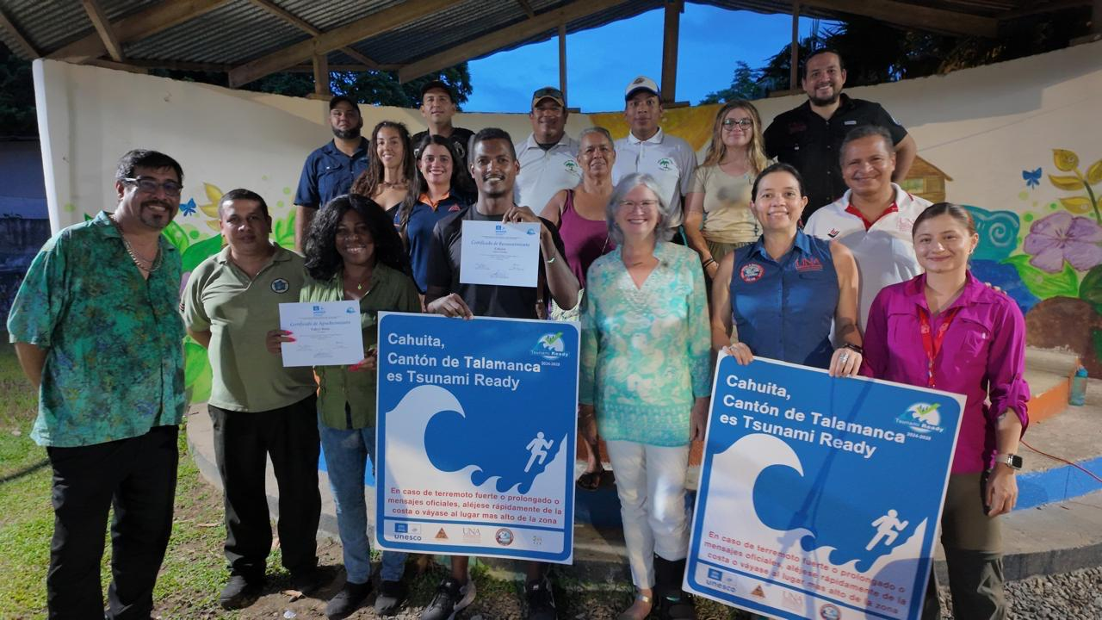
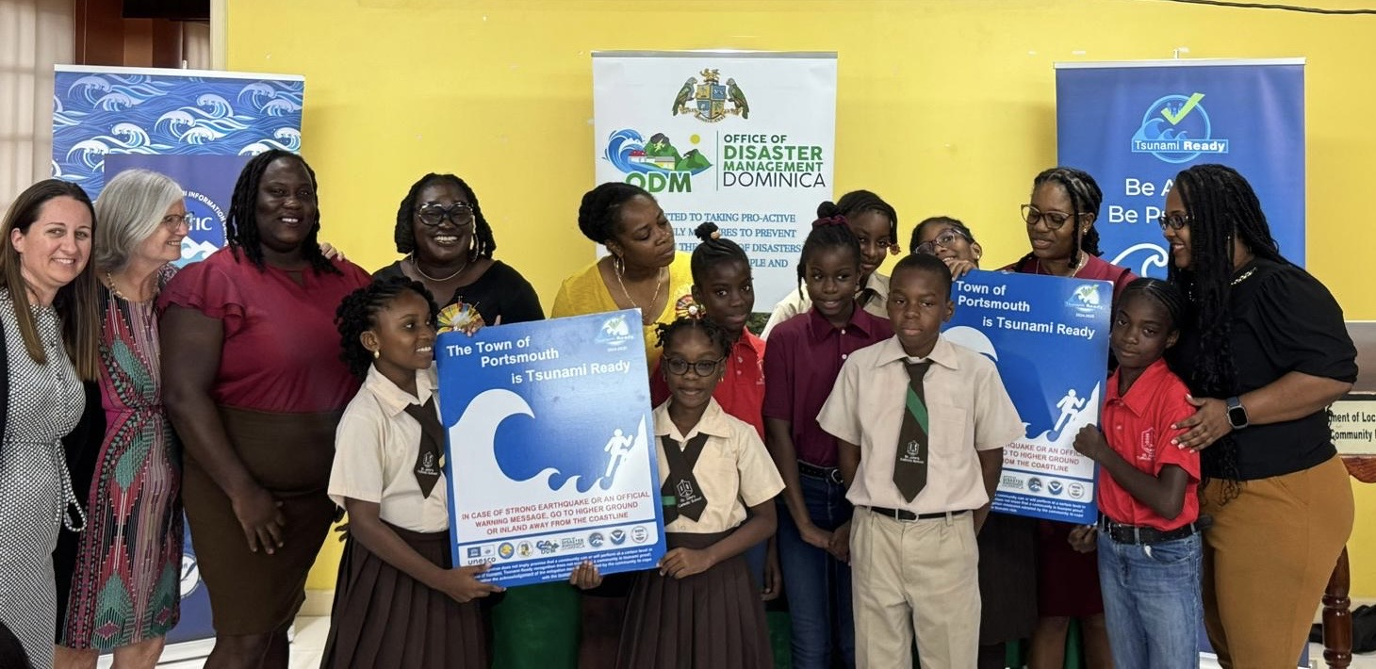
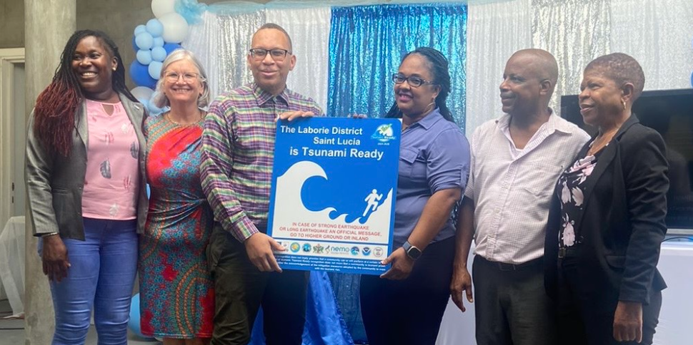
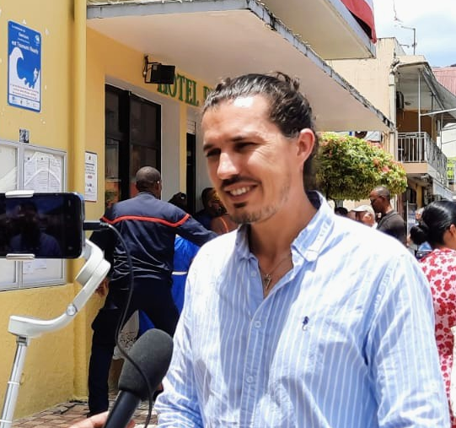
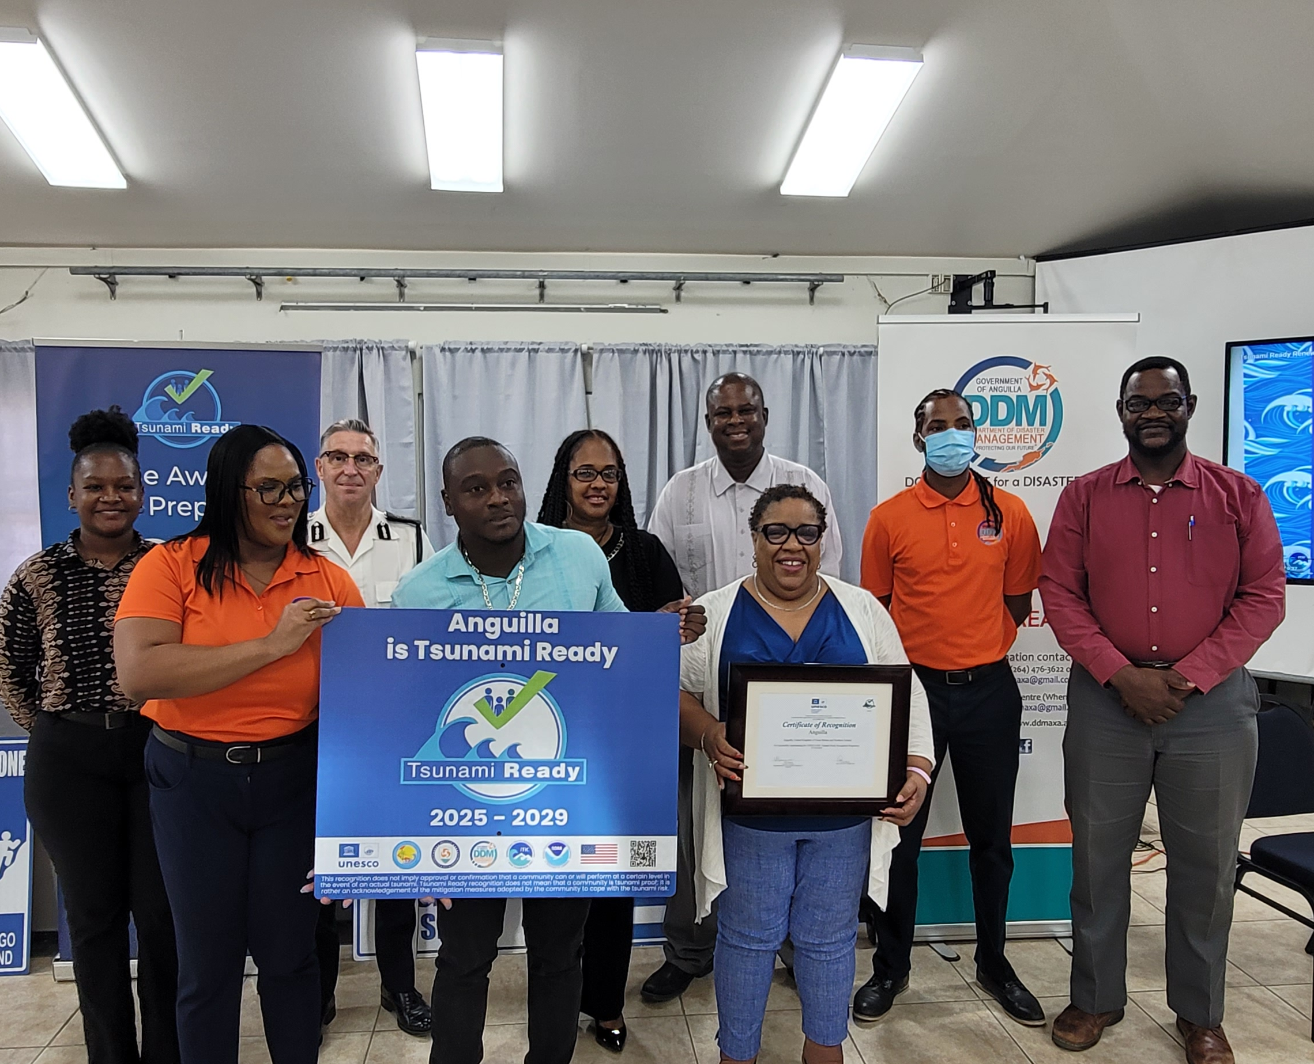
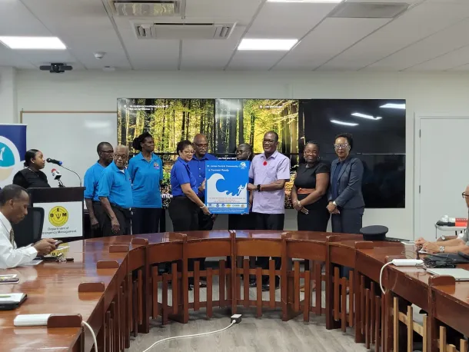
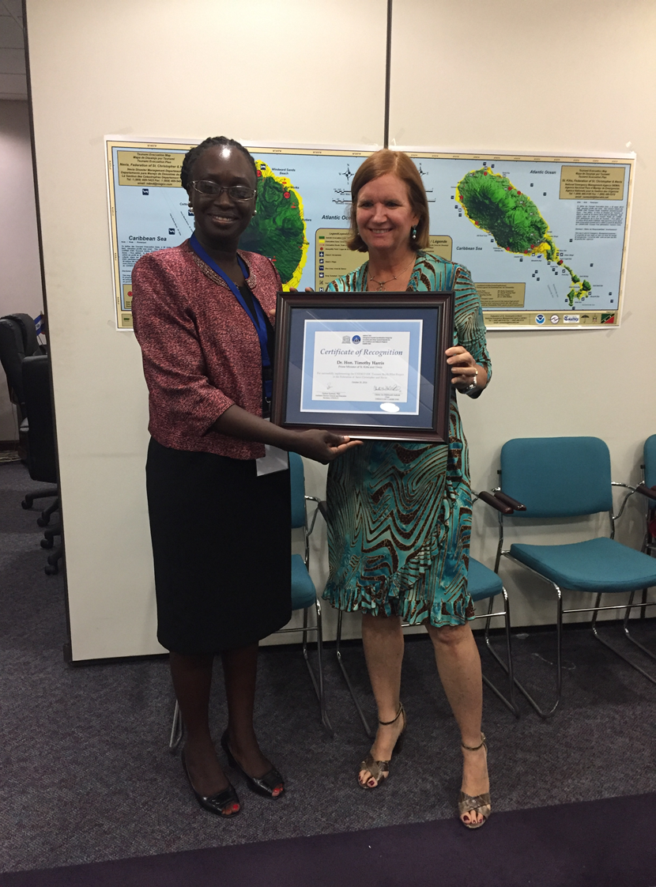
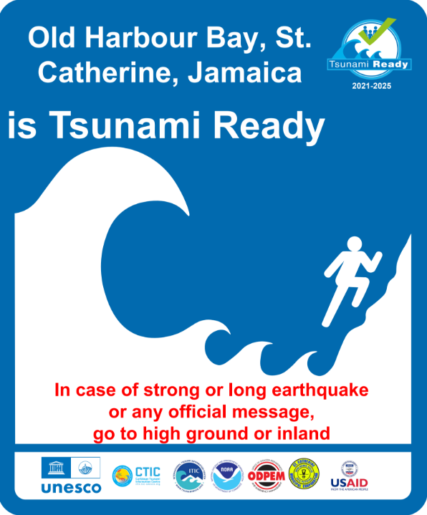
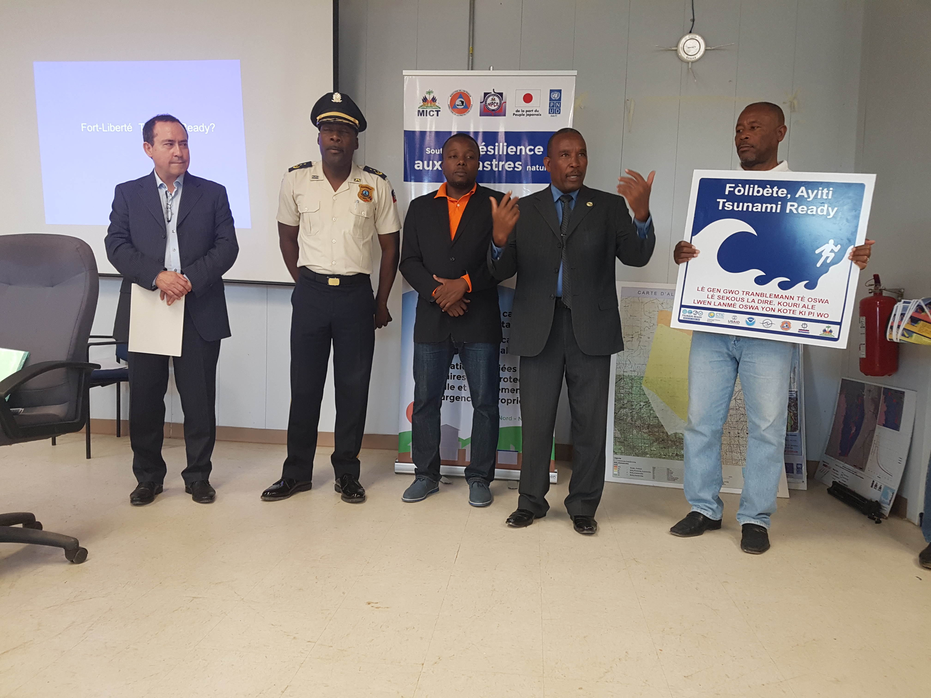
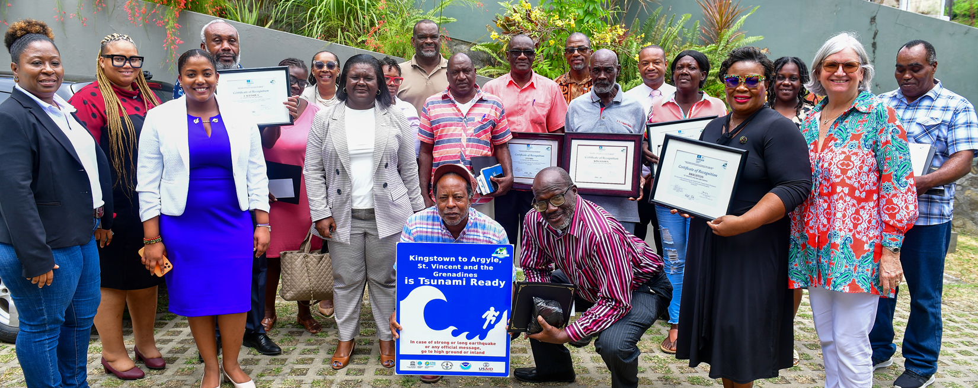
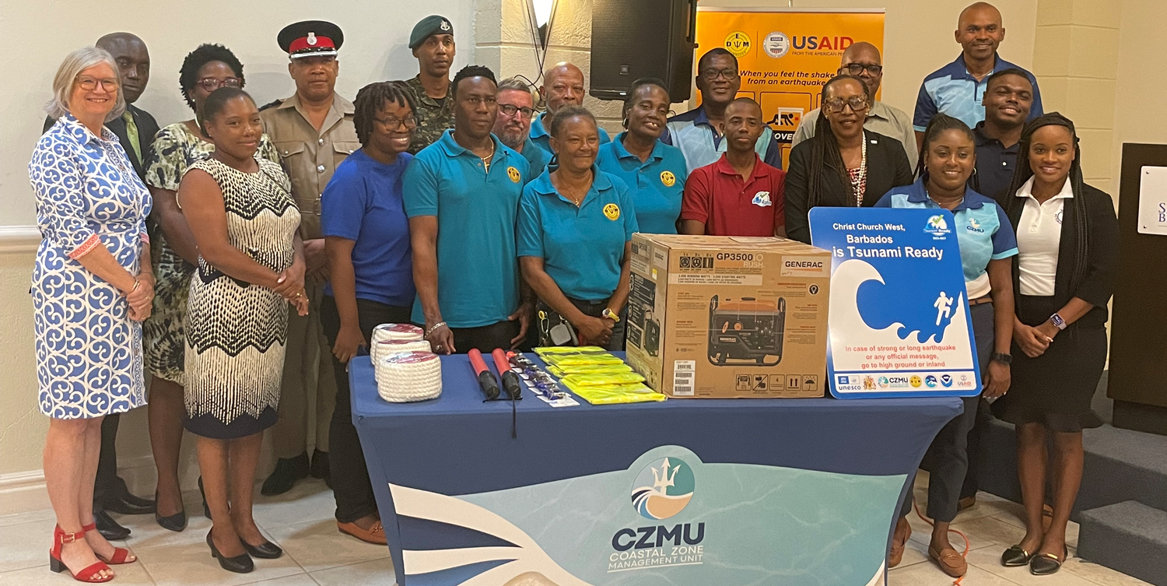
RECOGNITION Congratulations to Caribbean Tsunami Ready Coastal Communities

Slide 16
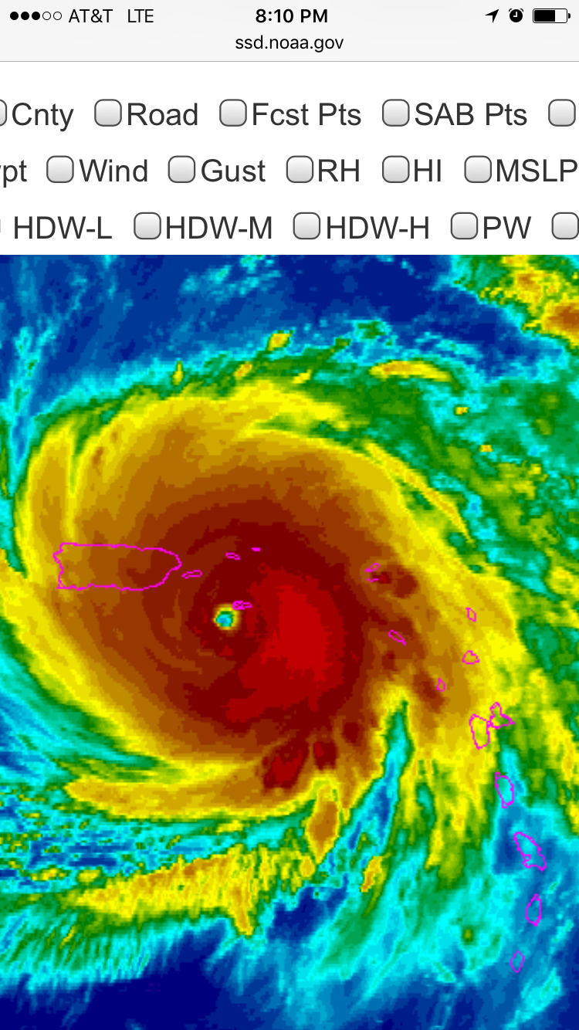



Hurricane María, September 2017
TsunamiReady® Helps Alert and Speed Response
Notes:
British Virgin Islands also indicated that TsunamiReady helped them with the response to Hurricane Irma in 2017. Awaiting to see if this would be the case for Old Harbour Bay in Jamaica for Melissa in 2025

Slide 17
Summary – Tsunami Ready Feedback Survey 2023
Grace Lemoine, NOAA/NWS Lapenta Scholar at International Tsunami Information Center- Caribbean Office
Tsunami Ready has been successful in bolstering community preparedness and response with its strong culture of outreach, education, and capacity building.
It is important to ensure that Tsunami Ready remains efficient and effective in its requirements through efforts like the pilot survey.
Additional support is still needed to address gaps in data collection, communication, funding, and resource mobilization issues.
Page 8

Slide 18




implementation of the tsunami ready programme in the Caribbean has been possible thanks to:
External funding from
National/territory funding: British Virgin Islands and costa rica
facilitation and oversight by the UNESCO/IOC Tsunami resilience section, the Caribbean tsunami information center and the international tsunami information center budgets
10-11 November 2025
INCOIS, Hyderabad, India
First Conference of the
Ocean Decade Tsunami Programme

Slide 19
Concluding Remarks and Call to Action
Despite significant Advances and note benefits and strengths of Tsunami Ready, the implementation including UNESCO/IOC and US Tsunami Ready Communities is at 7%
The renewals of 43% of the 23 communities recognized by UNESCO/IOC are delayed
Scaling up and sustainability would benefit from:
  Caribbean Strategy for Tsunami Ready
  Science and technology
  Local, national and international financial commitment
  Leveraging of regional exercises such as CARIBE WAVE and World Tsunami Day, as well as global initiatives like the Sendai Platform and EW4ALL
  UNESCO/IOC Global Tsunami Ready Coalition to mobilize awareness and stakeholders
10-11 November 2025
INCOIS, Hyderabad, India
First Conference of the
Ocean Decade Tsunami Programme

Slide 20
Thank you very much
For more information on Tsunami ready in the Caribbean:
Alison Brome, CTIC, a.brome@unesco.org
Christa von Hillebrandt, ITIC-CAR christa.vonh@noaa.gov
10-11 November 2025
INCOIS, Hyderabad, India
First Conference of the
Ocean Decade Tsunami Programme

