Slide 1
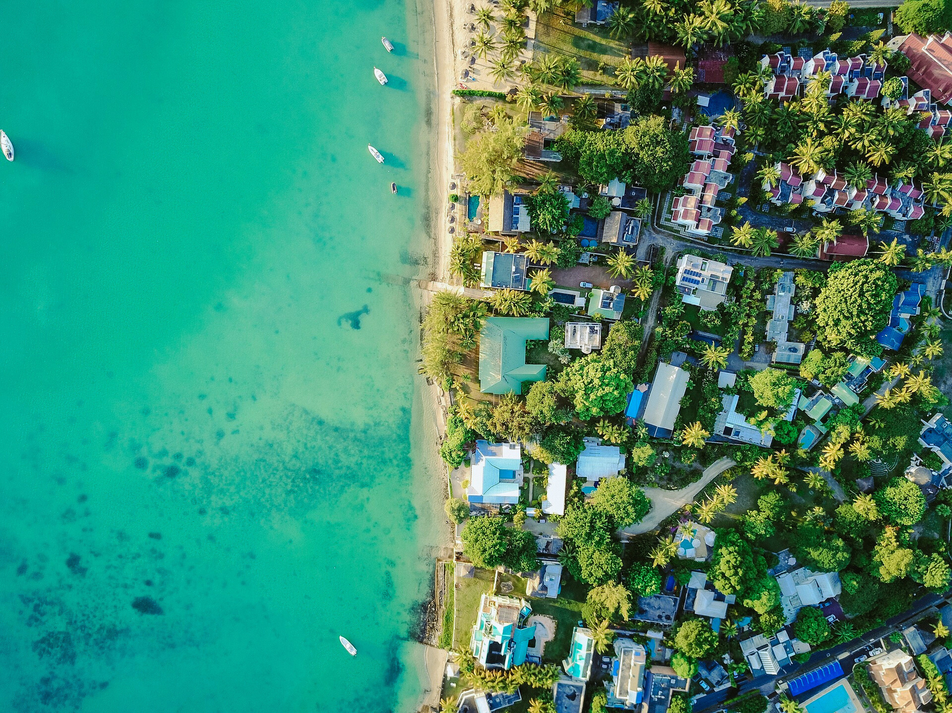




Session 2: (HLO 2)
Tsunami Ready and Preparedness
FIRST CONFERENCE OF THE OCEAN DECADE TSUNAMI PROGRAMME
Tsunami Ready in the Pacific (ICG/PTWS)
Hyderabad, India
10-11 November 2025

Slide 2


OVERVIEW
Background of TRRP – ICG/PTWS
Current State of TRRP
Impact Stories that highlight areas that needs strengthening through partnership
10-11 November 2025
INCOIS, Hyderabad, India
First Conference of the
Ocean Decade Tsunami Programme

Slide 3
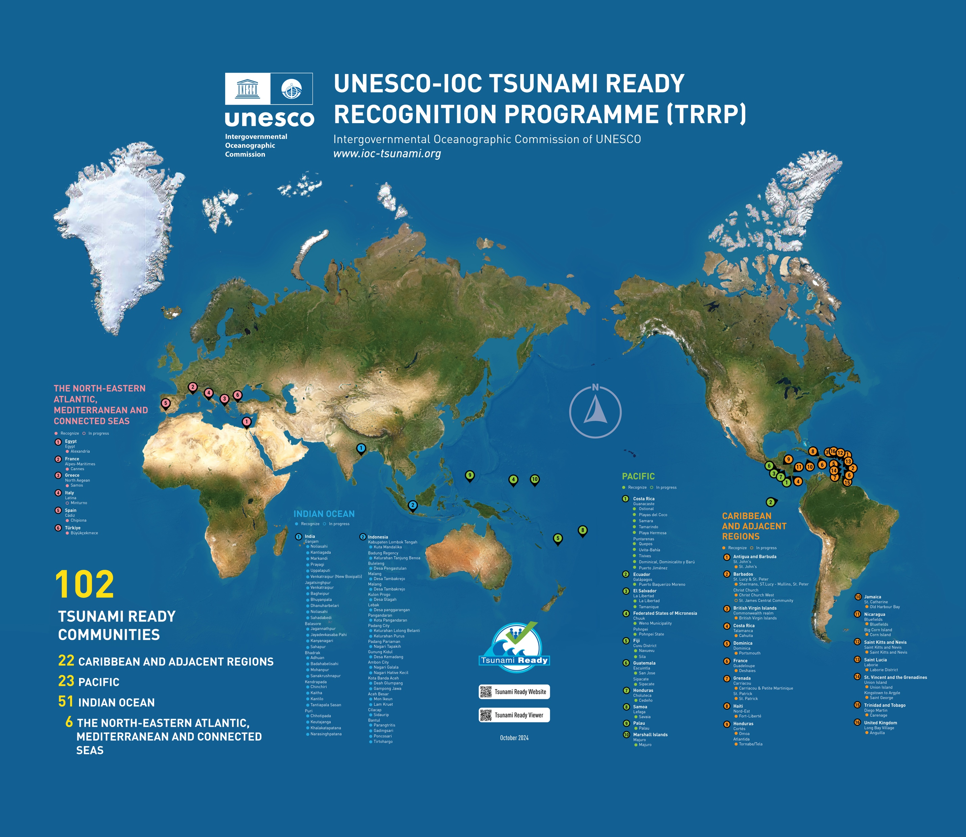
Global Implementation Status
Map, Nov 2024 (IOTIC)
103 (Oct 2025, IOC TSR)
TSUNAMI READY
COMMUNITIES
26 CARIBBEAN AND ADJ REGIONS
48 INDIAN OCEAN
6 NORTH-EASTERN ATLANTIC,
MEDITERRANEAN AND
CONNECTED SEAS
26 PACIFIC OCEAN
100
TSUNAMI READY
COMMUNITIES
23 CARIBBEAN AND ADJ REGIONS
48 INDIAN OCEAN
6 NORTH-EASTERN ATLANTIC,
MEDITERRANEAN AND
CONNECTED SEAS
23 PACIFIC OCEAN

Slide 4


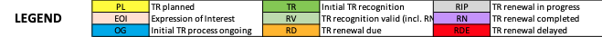
TRRP Implementation Status
GLOBAL OVERVIEW OF UNESCO-IOC TSUNAMI READY RECOGNIZED COMMUNITIES
 | PL | EOI | OG | TR | RV | RD | RIP | RN | RDE | TOTAL # OF COMMUNITIES CERTIFIED | IN # MEMBER STATES | OF WHICH # ARE SIDS
CARIBE-EWS | 2 | 2 | 0 | 0 | 9 | 2 | 1 | 0 | 10 | 22 | 14 | 10
IOTWMS | 2 | 0 | 0 | 0 | 48 | 0 | 0 | 0 | 0 | 48 | 2 | 0
NEAMTWS | 0 | 2 | 10 | 0 | 6 | 0 | 0 | 0 | 0 | 6 | 6 | 0
PTWS | 4 | 1 | 2 | 0 | 15 | 3 | 1 | 0 | 7 | 26 | 10 | 5
TOTAL | 8 | 5 | 12 | 0 | 78 | 5 | 2 | 0 | 17 | 102 | 32 | 15
Active Need renewal
Notes:
PTWS
26 communities certified
10 out of 46 countries
5 out of 21 Pacific SIDS in PTWS

Slide 5





October 2025
Implementation – as of October 2025 (IOC TSR)
4-year renewal cycle
Year | Tsunami Ready Recognition or Renewal
2017 (To RENEW) | Costa Rica (Ostional), Honduras (Cedeno), Samoa (Savaia Lefaga)
2019 (To RENEW) | Costa Rica (Playa El Coco), El Salvador (Tamanique, La Libertad ) Guatemala (Sipacate, San Jose Port)
2021 | Costa Rica (Samara, Tamarindo, Uvita-Bahía)
2022 | Costa Rica (Quepos Municipality ,Playa Hermosa, Tivives, Puerto Jiménez, Dominical, Dominicalito y Barú)
2023 | Fiji (Navuevu, Sila)
2024 | Ecuador (Puerto Baquerizo Moreno), Federated States of Micronesia (Chuuk, Pohnpei), Marshall Islands (Majuro), Palau (14/16 communities Palau)
2025 | Ecuador (Puerto Ayora. Puerto Villamil), Federated States of Micronesia (Yap)
Underway / Planned | Federated States of Micronesia (Kosrae), Nicaragua, Panama (La Punta), Puerto Armuelles), Peru ( Solomon Islands (Honiara, Western Provinces), Tonga, Vanuatu (Port Vila, Luganville, Aneiysym), Vietnam, Costa Rica, El Salvador, Fiji ( Tore, Cuvu, Yadua, Narukurukulevu)
5 SIDS
10 Countries
26 communities
Notes:
Some PTWS member states have TR communities in other ocean basins (e.g. Indonesia, Honduras, Nicaragua)
Status
Number of Communities
Active Tsunami Ready Recognition-15
Tsunami Ready Planned - 4
Tsunami Ready process underway -3
Interested in undertaking Tsunami Ready-2
Tsunami Ready Renewal Delayed - 8
This includes SIDS like Palau where the whole islands is officially recognized TR. This could be the same approach for Nauru and Niue as one island country.

Slide 6


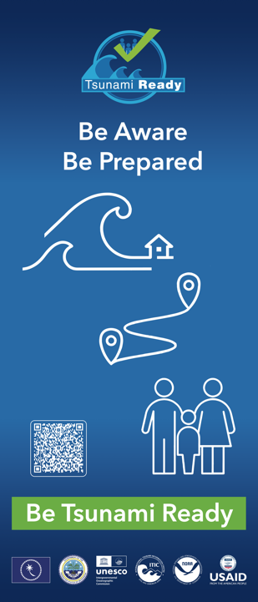
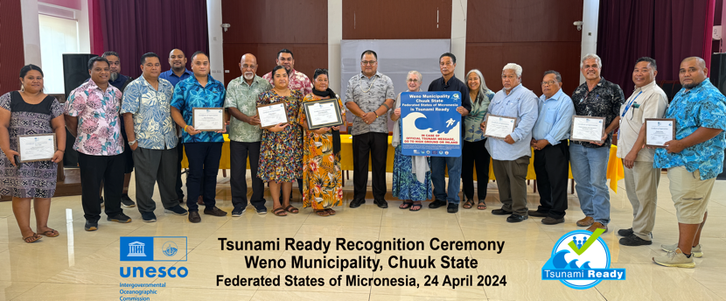
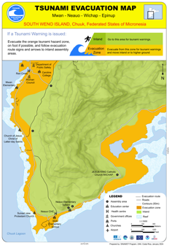

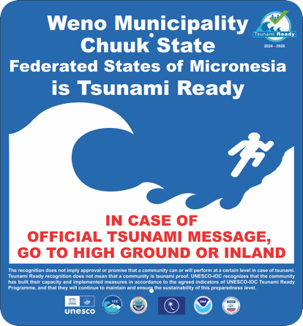

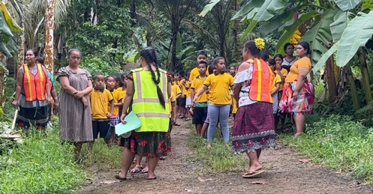
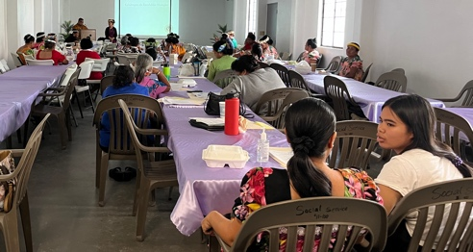
Federated States of Micronesia (Chuuk, Pohnpei)
Apr 2024

Slide 7




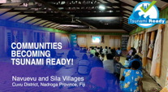
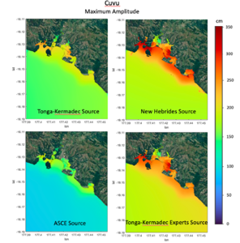
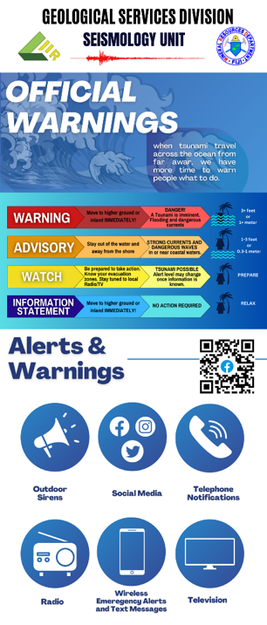

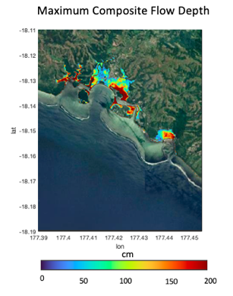


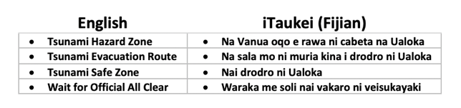
Fiji Coral Coast: Nayevuyevu and Sila Villages
World Tsunami Awareness Day TR Recognition Ceremony: Nov 3, 2023
Implementation Approach - Stakeholders
Mineral Resources Dept, National Disaster Management Office, Ministry of Lands, Provincial Administrator, iTaukei Affairs, Plan International, Partners in Community Development (Fiji), People Living with Disability Organization
Preparedness: Hazard and Evacuation
Community participatory training, 18-22 Sep 2023
Hazard Assessment: Tsunami Sources and Inundation
Warning, Response, Awareness

Slide 8

ICG/PTWS XXXI April 2025
PTWS Tsunami Ready Implementation Survey
Challenging to maintain awareness of TR implement progress, success & barriers.
To be proposed at ICG/PTWS-XXXI that a regular ‘Tsunami Ready Implementation Survey’ is established for the PTWS.
Supports monitoring reporting on Tsunami Ready across the Pacific and also ensures that PTWS activities are representative of whole Pacific needs.
              Questions planned:
                Intent & progress with implementing the Tsunami Ready Recognition Programme (TRRP)
                Barriers and challenges with TRRP implementation
                Is there is national programme instead of Tsunami Ready
                Questions consistent with 2025 PTWS Tsunami Preparedness Capacity Assessment, and 2025/2026 Global KPI/ODTP KPI
Notes:
Since 2021, TRRP implementation kicked off in 2022-23 ( 4 years of learning so far but more yet to be better understood)
In PTWS, intends to implement a regular Tsunami Ready Implementation Survey
- To address the needs of all PTWS MS.
To identify sustainability approaches for Tsunami Ready as in development of National Programmes

Slide 9

ICG/PTWS XXXI April 2025
Summary of Implementation Learnings
At the meeting of the PTWS Task Team Tsunami Ready in July 2024, implementation challenges in the Pacific and globally were discussed.
Key challenges reported across ICGs include:
        Hazard assessment, esp. inundation modelling and GIS capacity (+ data layers)
        Application process is cumbersome / time consuming
        Communities can’t be too small as that uses high levels of administration to roll out across a country but must also be meaningful (not too large)
        Sustainability in effort, expertise and funding
        Awareness & education both in community and government
Notes:
Key Challenges
Hazard Assessment – baseline data and GIS capability
Application process is cumbersome ( process – roles – function- timeline)
Additional function on existing staff members – is this a role for a dedicated person to be onboarded or a new team??
Definition of a community to be recognized TR by UNESCO-IOC e.g. Palau (Whole Country) vs Sila Village in Cuvu District, Fiji.
Sustaibility Framework, expertise and funding
Awareness and education both in community and government
)

Slide 10
ICG/PTWS XXXI April 2025
Further support needed for inundation modelling
The lack of inundation modelling presents real difficulties to tsunami preparedness, and Tsunami Ready Recognition.
Accurate inundation modelling requires the availability of high-resolution bathymetry and topography, which often isn't available at every location, or is very expensive to obtain.
Advances in satellite-derived bathymetry which, when chart survey data is also available, can be used for inundation modelling. Other options considered, include taking offshore wave amplitude from PTHA tools and extrapolating to coast using accepted scaling procedures.
The WG3 Task Team Tsunami Ready recommends that the ICG/PTWS:
Notes the barrier that the lack of availability of high-resolution bathymetry and topography for inundation modelling presents to tsunami preparedness and Tsunami Ready Recognition,
Requests Working Group One to consider the collation of existing or creation of new guidance on techniques for inundation modelling where high-resolution bathymetry and topography isn’t available.
Notes:
Lack of tsunami inundation modelling presents difficulty for TR preparedness and response
PTWS considers WG 1 – Understanding Tsunami Risk to work on alternative approach for Tsunami Hazard Assessments.
For example, AI or Machine Learning

Slide 11
ICG/PTWS XXXI April 2025
Tsunami Ready ‘Equivalency’
in the Pacific
Established: ICG/PTWS-XXX (Sep 2023)
Consolidated and focused efforts in PTWS
Provided clear engagement point for cross-ICG discussion
Met 3 times in 2024 to progress activities for ICG/PTWS-XXXI
Members:
Co Chairs: Laura Kong, ITIC; Ashleigh Fromont, NZ NEMA
Members (2023-2025: Chile, China, Ecuador, France, Japan, Malaysia, New Zealand, USA
Noting TOWS WG-XVII (2024) appreciation of PTWS progress on mechanisms of how to include national tsunami preparedness and readiness programmes and initiatives in the UN Ocean Decade Programme
Notes:
Who is working on T

Slide 12


ICG/PTWS XXXI April 2025
TT TR proposal for Tsunami Ready Equivalency
Noted & Endorsed the proposed Tsunami Ready Equivalency Approach that seeks to enable reporting of tsunami preparedness in a manner compatible with the UNESCO/IOC Tsunami Ready Recognition Programme
Recommends the TT TR to develop formal guidance for the application of this approach, in consultation with the Regional Working Groups.
Notes:
Lead by NEMA New Zealand in collaboration with other MS – Indonesia, PICTs

Slide 13
PTWS Tsunami Ready ‘Equivalency’ (ICG/PTWS-XXXI)
UN Ocean Decade Goal is to make ”100% of communities at risk of tsunami prepared for and resilient to tsunamis by 2030 through the implementation of the UNESCO/IOC Tsunami Ready Recognition Programme and other initiatives.”
Where possible, the TRRP should be implemented as a first option
PTWS ‘equivalency’ approach has 3 steps:
  Identify or establish national governance
  Assess / cross-reference preparedness & resiliency against TRRP indicators
  Report progress toward UNOD Goal to ICG
PTWS ‘equivalency’ features are
  12 indicators of UNESCO-IOC Tsunami Ready Recognition Programme taken as definition of ‘prepared and resilient’
  Every country can contribute to progress reporting for UNOD goal
  Process does not require application to UNESCO-IOC for formal TR recognition but will support ICG reporting towards ‘100%’
  Assumptions
    Countries have a strong motivation to ensure tsunami resilience
    Countries can build upon existing programmes, capacities and strengths
    Process applied to most pragmatic definition of community, so that assessment can be conducted in a meaningful but sustainable manner.
Notes:
Where possible, the TRRP should be implemented as a first option
PTWS ‘equivalency’ approach has 3 steps:
Identify or establish national governance
Assess / cross-reference preparedness & resiliency against TRRP indicators
Report progress toward UNOD Goal to ICG

Slide 14

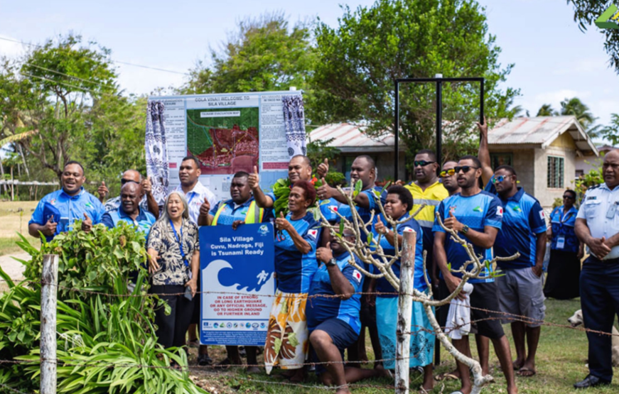
FOOTPRINTS OF TSUNAMI READY IN PACIFIC SIDS
TRRP INFORMS THE REVIEW AND UPDATE OF NATIONAL TSUNAMI RESPONSE PLANS, UNEW4ALL – NATIONAL MHEWS ROADMAP, NATIONAL & SUB-NATIONAL DRR STRATEGY, DRF POLICY.
TRRP INFORMS THE REVIEW AND UPDATE OF NATIONAL SCHOOL DRR HANDBOOK AND EMERGENCY IN EDUCATION POLICIES.
TRRP INFORM AND STRENGTHEN NATIONAL DISASTER RISK MANAGEMENT (DRM) ARRANGEMENTS E.G. FORMALIZATION OF NATIONAL TSUNAMI READY BOARD (NTRB) TO ADVICE NATIONAL DRR COMMITTEES.
TRRP NATIONAL IMPLEMENTATION PLAN INFORMS NATIONAL AGENCIES, NGOs, PARTNERS, ANNUAL WORK PROGRAMME – HAZARD & RISK ASSESSMENTS – PREPAREDNESS, RESPONSE ARRANGEMENTS , DISASTER RISK FINANCING (DRF)
TRRP FOSTER COLLABORATION BETWEEN MHEWS, DRR AND DRM AGENCIES (PARTNERSHIP) DRAWING TOGETHER RELEVANT NGO/CSO & DEVELOPMENT PARTNERS ENABLING RESOURCE POOLING
TRRP STRENGTHENS RESILIENCE OF CRITICAL INFRASTRUCTURE [ PORTS, HOSPITALS, TELECOM]
Notes:
Alignment of National to Community Tsunami Warning Arrangements. NTRP formalizes national TRP and stipulates the establishment of a National TR Implementation Plan and Governance Arrangement i.e. NTRB and LTRB
TTRP framework and indicators strengthens any sectoral approach to Tsunami Resilience i.e. mainstreaming Tsunami preparedness, prevention (DRR/mitigation) and response
TTRP Governance and Monitoring Framework ( NTRB) provides positive influence [ strengthens national DRM Governance Arrangement). This opportunity formalizes the national effort on strengthening national tsunami warning and mitigation system where NTRB also acts as the National Technical Working Group (NTWG) guiding national Tsunami DRR effort and advising National DRR Committee for formalization of endorsements of work programmes.
4. National Agencies, Development Partners, Scientific & Technical Institutions, Civil Society & NGOs annual workplans aligned and resources pooled on delivering TTRP in local communities. Enabling pooling of resources (human and capital). The AWP is guided by the TR National Implementation Plan on Tsunami Hazard & Risk Assessments, Preparedness & Response Arrangements.
5. Hotels, Hospitals, Ports and Airports – a critical infrastructure that attains the 12 indicators of the TRRP strengthen it’s resilience to disasters.
6. Creates a healthy relationship between NTWC and DMO/EM personal including partners (requires a dedicated team to deliver national TR programme at national level) – Fosters Partnerships

Slide 15


Thank you for your kind attention
10-11 November 2025
INCOIS, Hyderabad, India
First Conference of the
Ocean Decade Tsunami Programme

