Slide 1

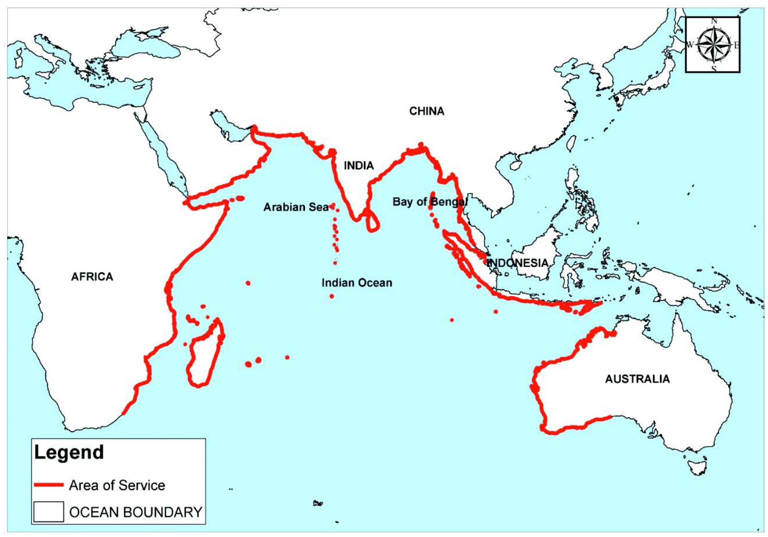



People-centred Tsunami Early Warning for India (PCTWIN)
The First “Ocean Decade Tsunami Program (ODTP) Conference”
INCOIS, Hyderabad, 10 - 11 November 2025
Notes:
A project funded by NERC UKRI and the Indian MoES NERC Grant NE/Z503496/1

Slide 2
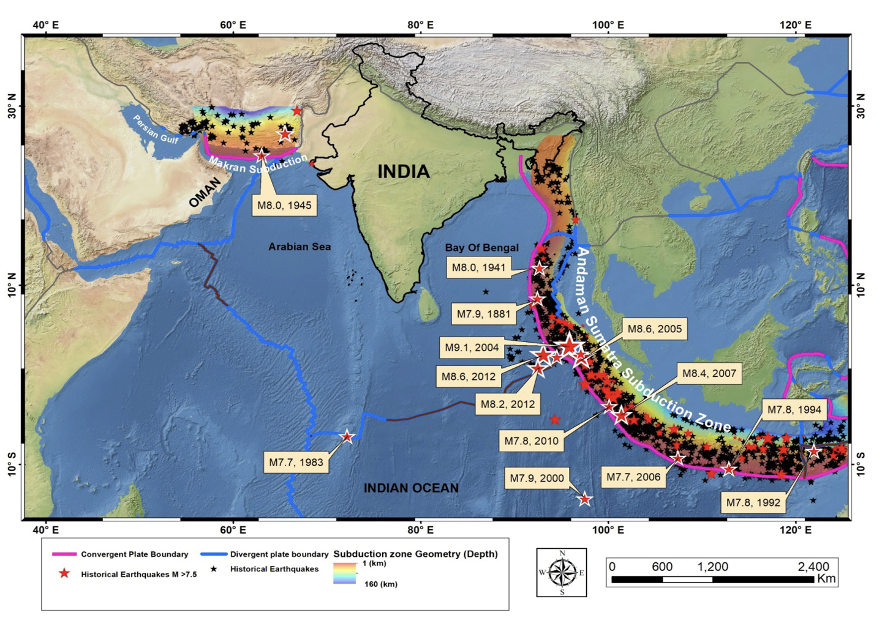
Tsunami arrival time to Indian coastlines could range between 15 minutes for the Andaman Nicobar Islands to 2 to 3 hours for the mainland.
Tsunami arrival time to Indian coastlines could range between 15 minutes for the Andaman Nicobar Islands to 2 to 3 hours for the mainland.
This is a time scale where effective early warning and being prepared to act can save many lives.
This is a time scale where effective early warning and being prepared to act can save many lives.
The Indian Tsunami Early Warning Centre (ITEWC) is an official tsunami service provider for the IOTWMS.
Figure courtesy of INCOIS.

Slide 3
WP1 Knowledge Hub (Lead NGI) will unravel the fundamental physics and processes of earthquake and landslide tsunamis, to improve baseline tsunami hazard, exposure, and risk information.
PCTWIN makes concrete steps towards ensuring that the communities are more disaster resilient (HLO2).
WP2 Early Warning (lead INCOIS) is the operational core of the project. It aims to improve and boost the technical and operational capabilities of ITEWC at the national level and the IOTWMS at the regional level.
PCTWIN aims at actions in the fields of rapid tsunami detection, measurement and forecasting capabilities (HLO1).
WP3 Resilience Hub (Lead UCL) focuses on participatory activities aiming at increasing public awareness and the level of preparedness of communities to respond to tsunamis.

Slide 4
WP1: The Knowledge Hub (Lead NGI)
Probabilistic hazard analysis - PTHA
Define sources and events probabilities
Create events with associated rates
Define hazard Points of Interest (POIs)
Simulate the wave propagation (and inundation)
Associate tsunami heights at the POIs with event probability and quantify the hazard
Risk and impact - PTRA
Integrate inundation area with exposure
Assign vulnerability to each exposed asset
Compute Loss and risk metrics
Better understanding of the physics of tsunami genesis
Scenaniors for Earthquakes (EQ’s) and Landslides (L’s)
PTHA
(EQ, conditional for L)
Exposure Maps
Risk-informed evidence-based alerts (Maps)
PTRA Maps: distribution of population at risk for different return periods

Slide 5
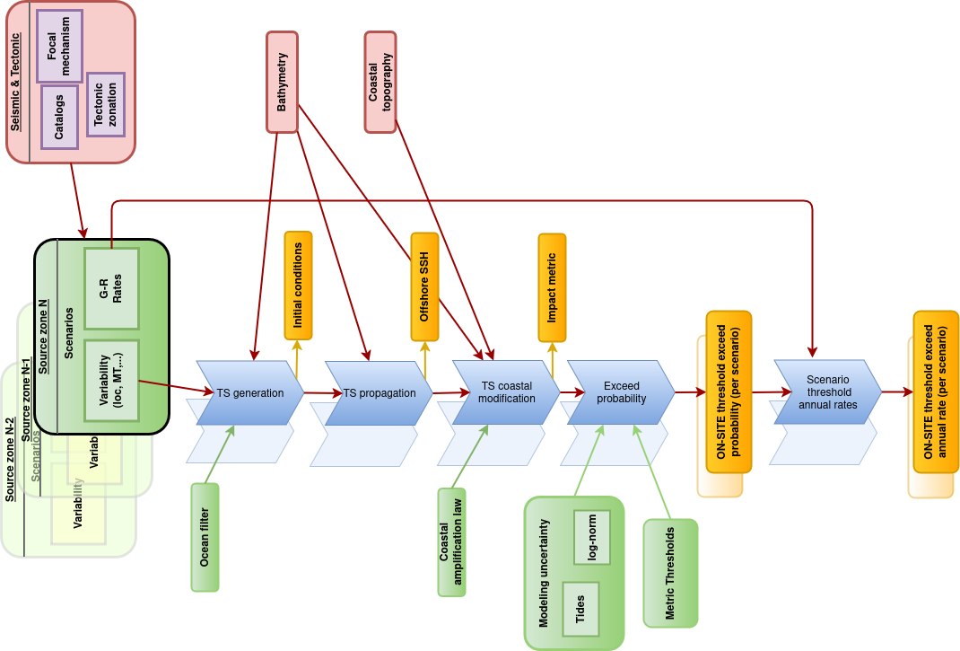







Define sources and events probabilities
Currently underway: A Roadmap to Regional PTHA for India

Slide 6
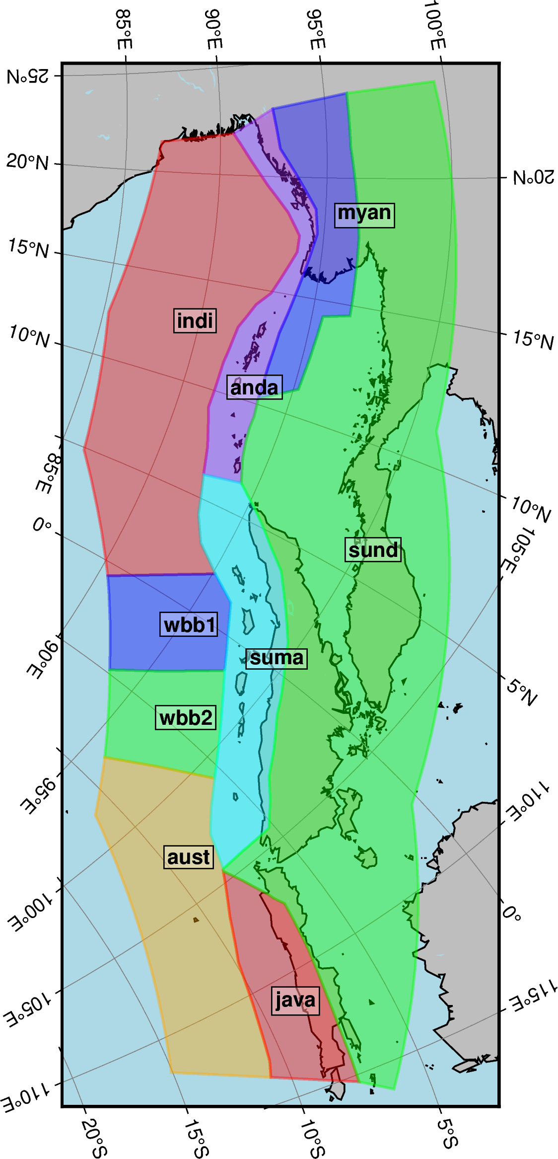
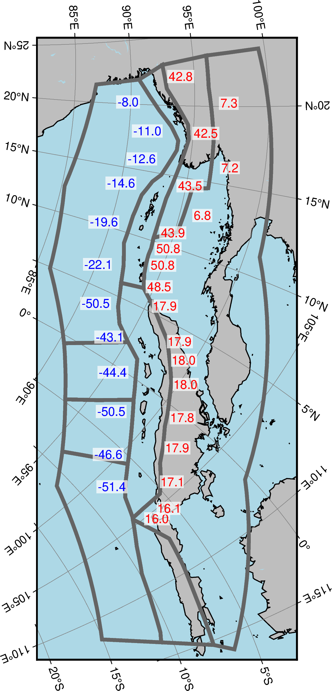



Seismotectonics of Sumatra-Andaman region
Initial results of kinematic block model (Agrawal in prep)
Deriving a geologically accurate and self-consistent 3D fault model
  Using GNSS and seismic earthquake data
  Identifying active faults and their slip rate
  Find significant changes in slip rate along the megathrust
  Improve characterization of tsunamigenic seismic sources
Investigating re-locking of the megathrust after the great 2004 earthquake
  Using unique GNSS data from the forearc islands
  Is re-locking uniform? How does it relate to slip in 2004?

Slide 7
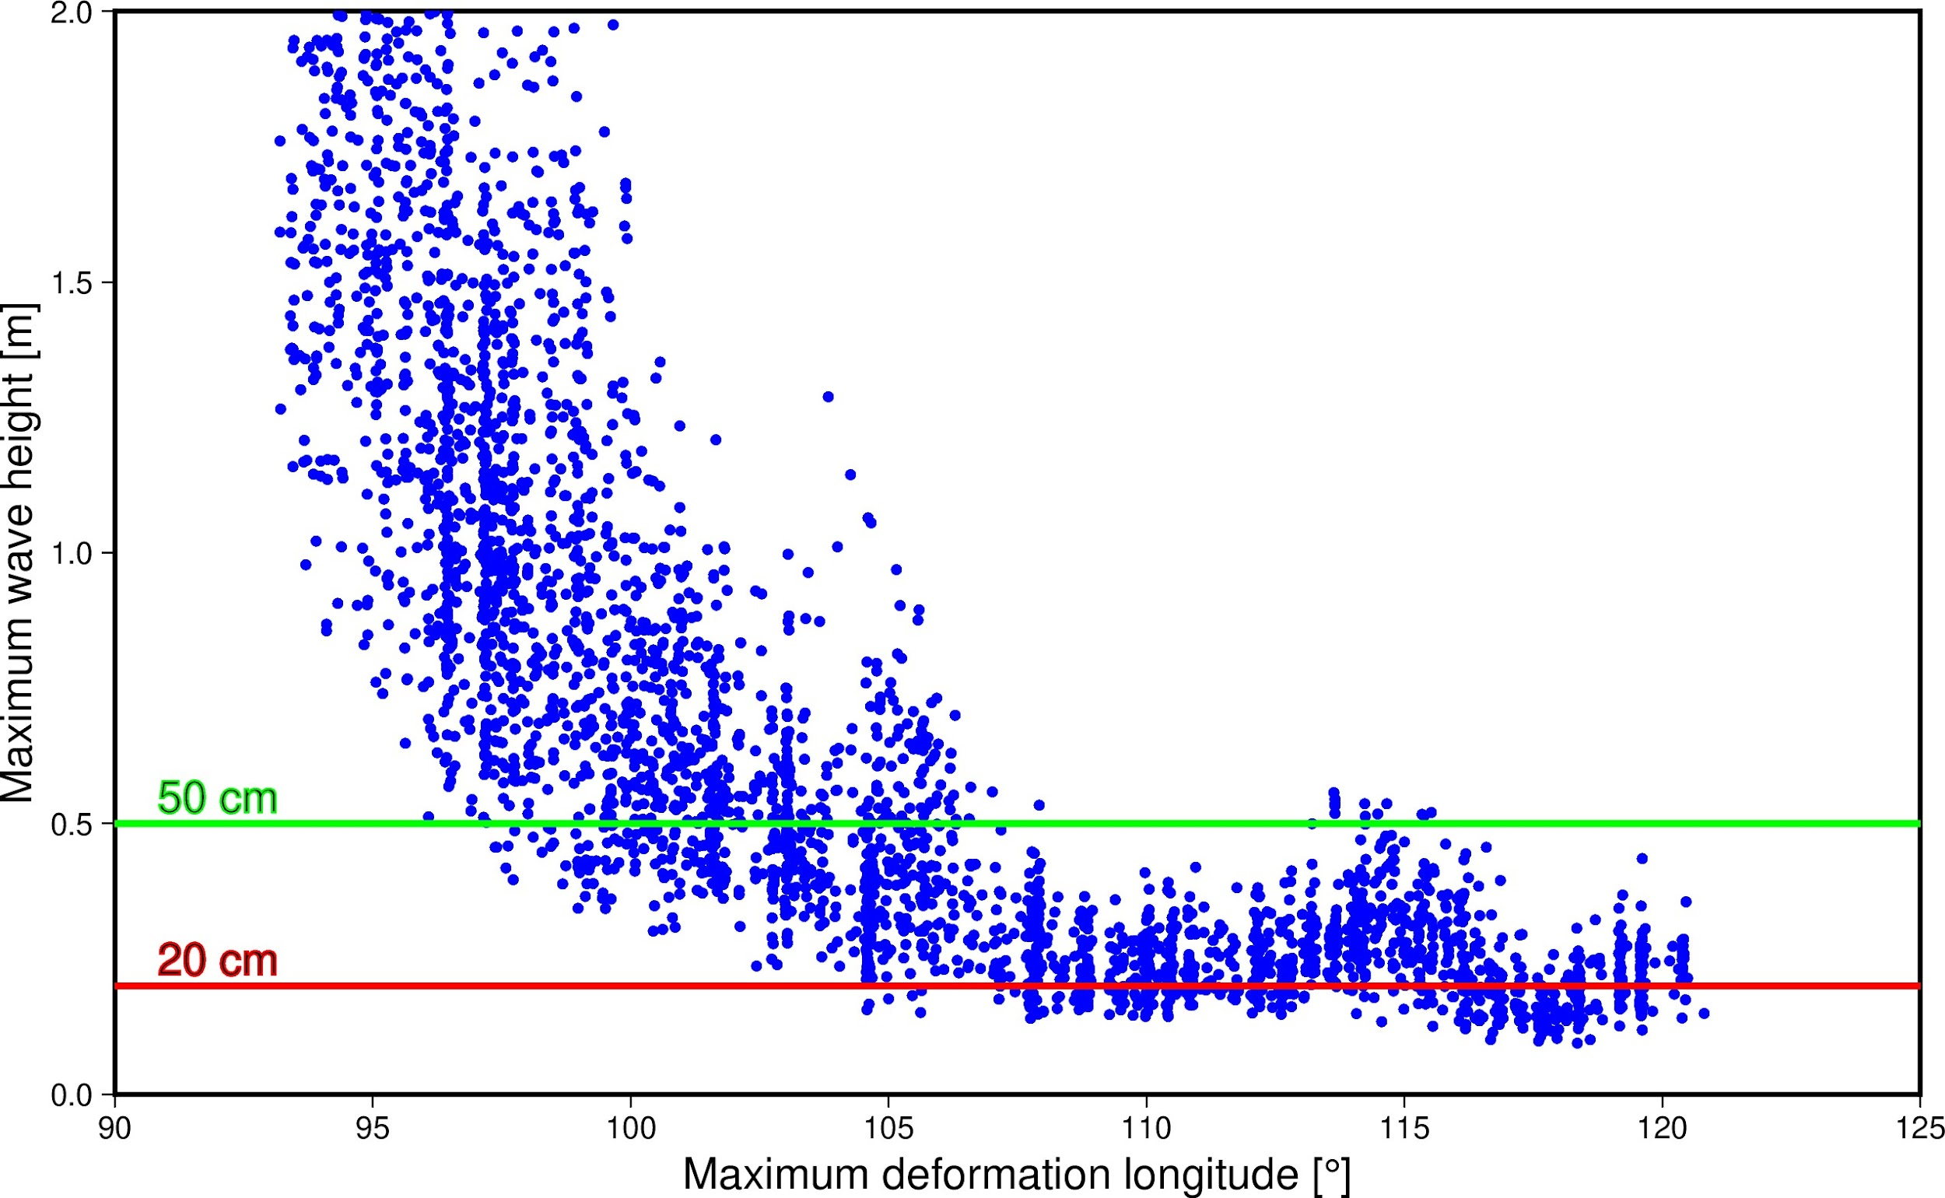
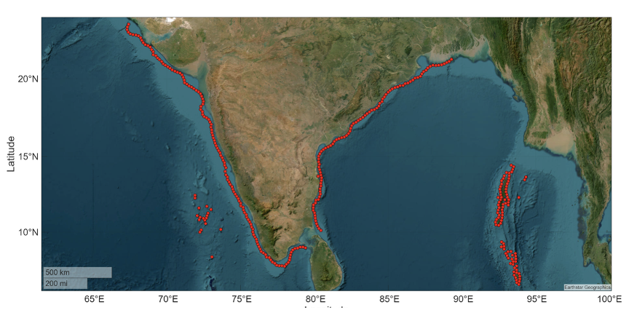
Andaman Sumatra Subduction Zone: Seismic Source zone definition
Aim:
To identify the source regions in the Andaman–Sumatra subduction zone that can generate significant tsunami wave heights at selected Points of Interest (POIs) along the Indian coast.
Observations:
The maximum wave height (MWH) falls below 50 cm for source zones located east of 107°E.
However, for ruptures beyond 107°E, reflected waves from the Mauritius Island region occasionally elevate the MWH above 50 cm along the southern coast of India.
Notes:
(at the 50 m isobath), we simulated 5,590 stochastic earthquake ruptures with magnitudes Mw 9.0 to 9.4, spanning the subduction interface up to 121.5°E

Slide 8
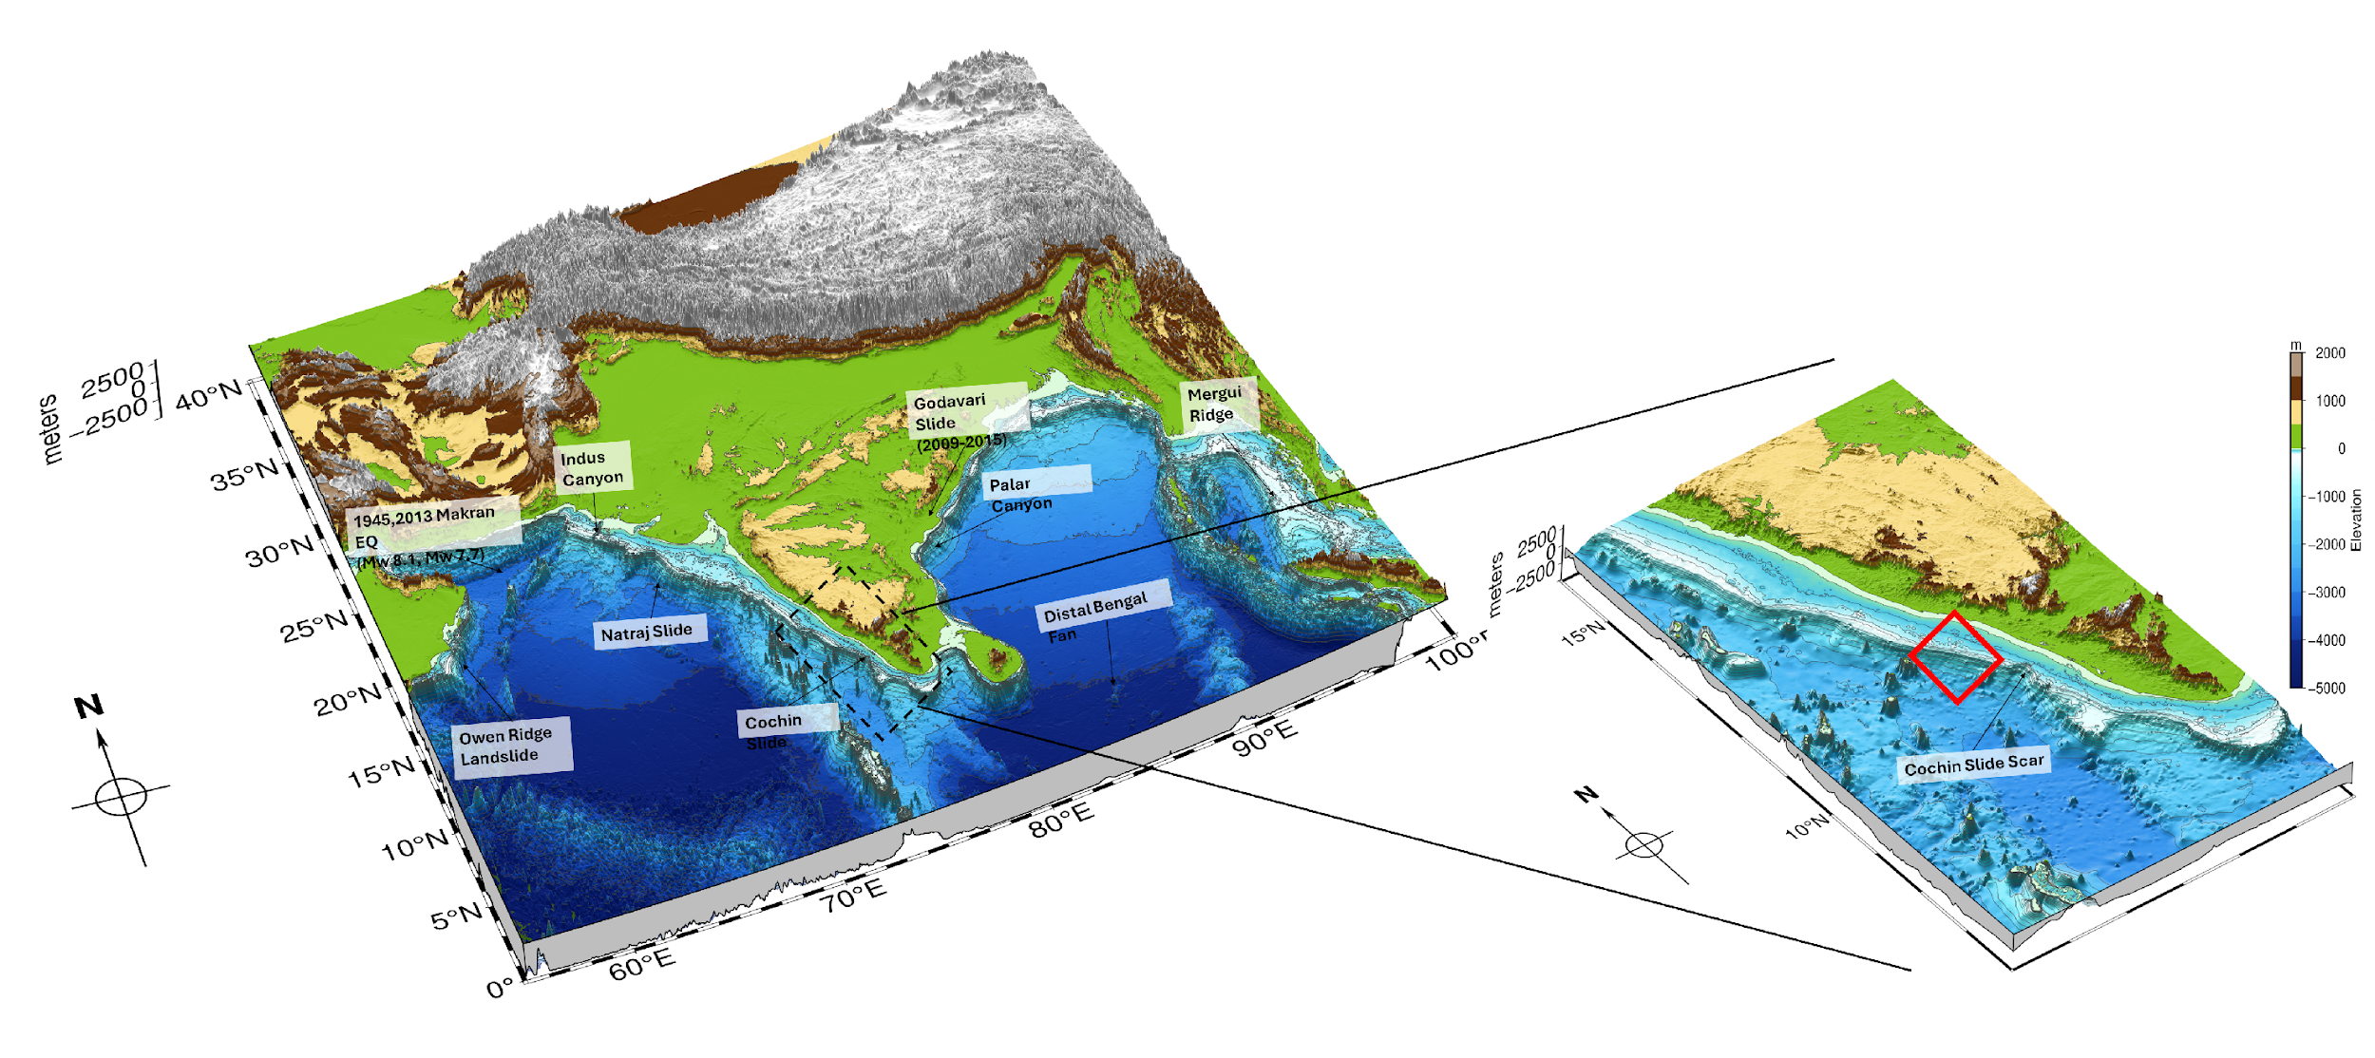

Characterisation of the landslide sources
Understand local submarine landslide characteristics and their tsunami potential
Regions of concern include the Makran subduction zone, steep coastal margins and the Bay of Bengal submarine fans
Some evidence of past events but lack of dated historical records in the region.
Stochastic workflow for generating landslide volumes based on bathymetry, slope, and geometric sampling to capture a wide range of plausible scenarios
Numerical modelling of a landslide-generated tsunami (Cochin Slide case) combining landslide dynamics (BingClaw) and tsunami propagation (Tsunami-HySEA)

Slide 9
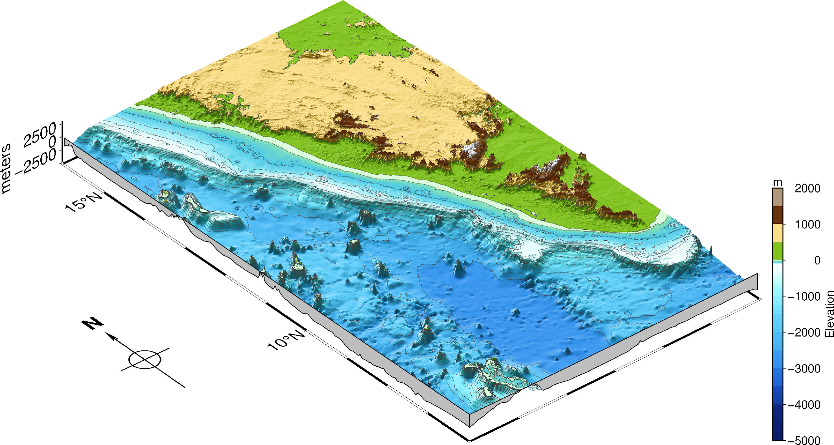
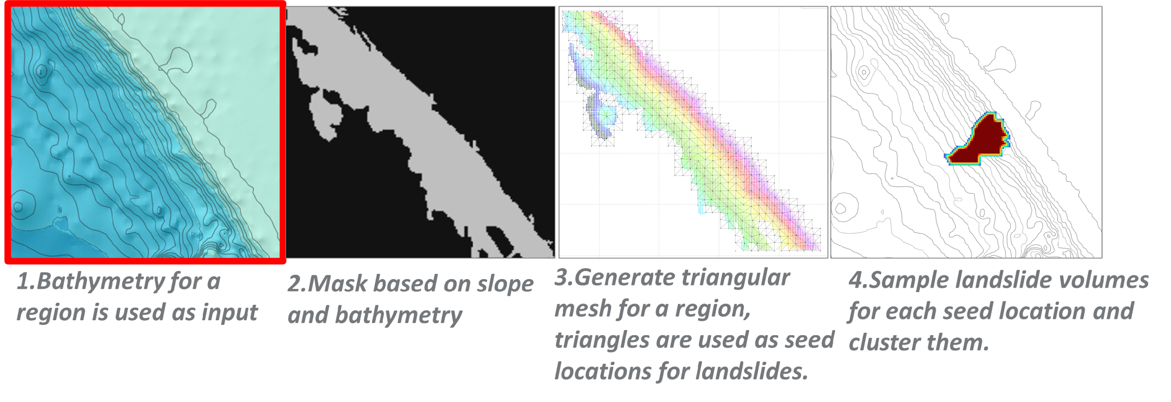
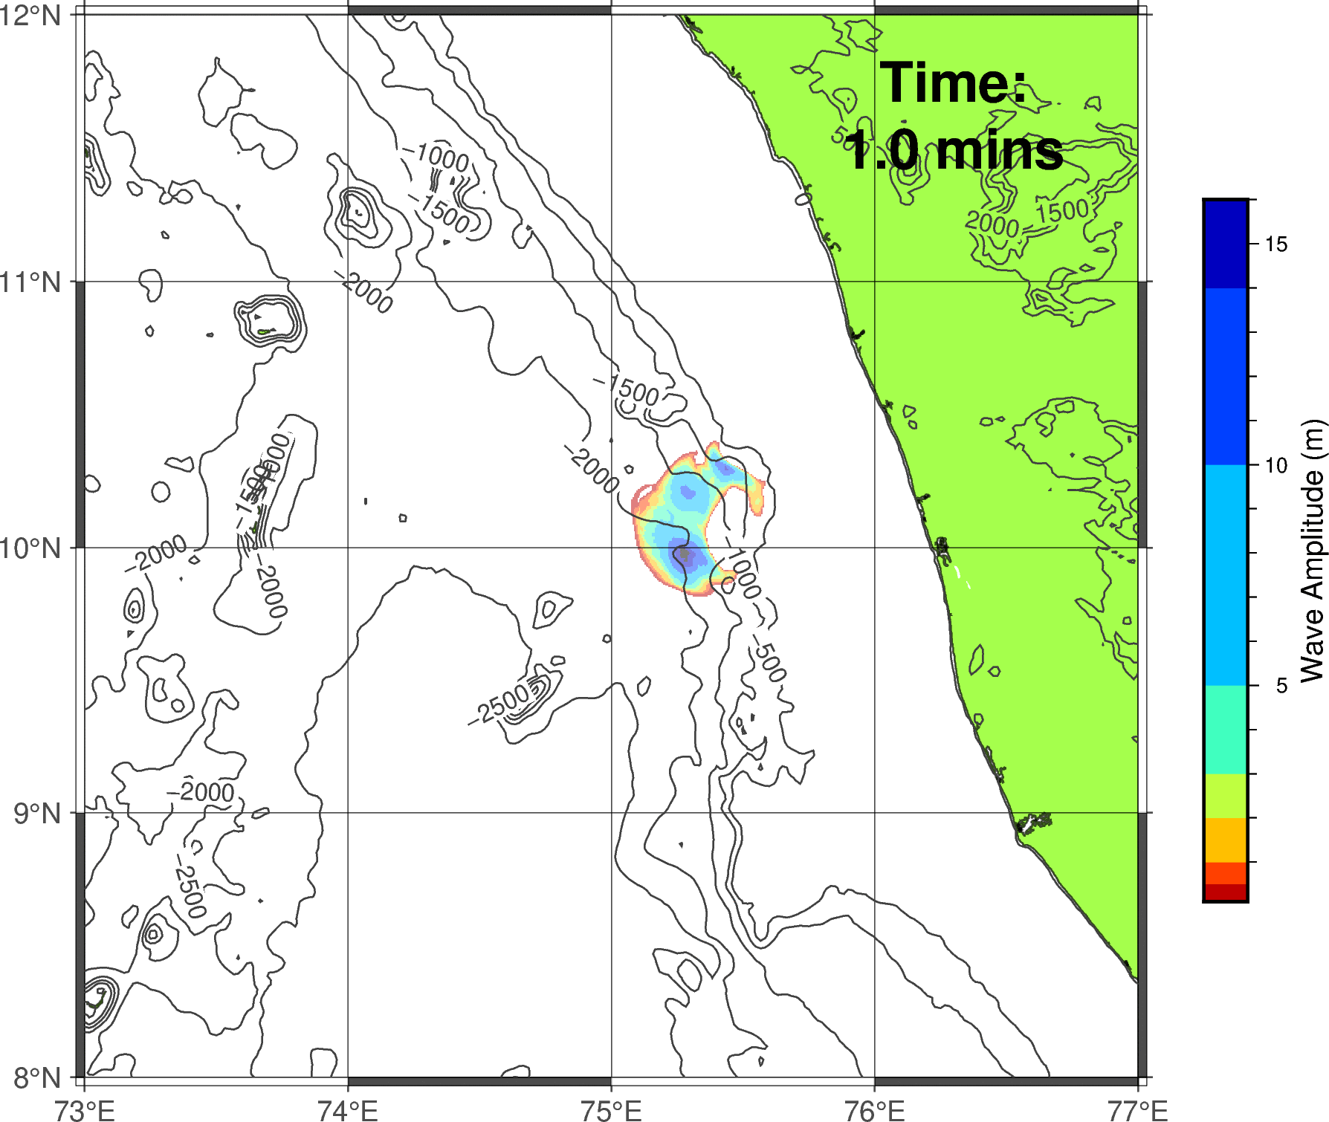
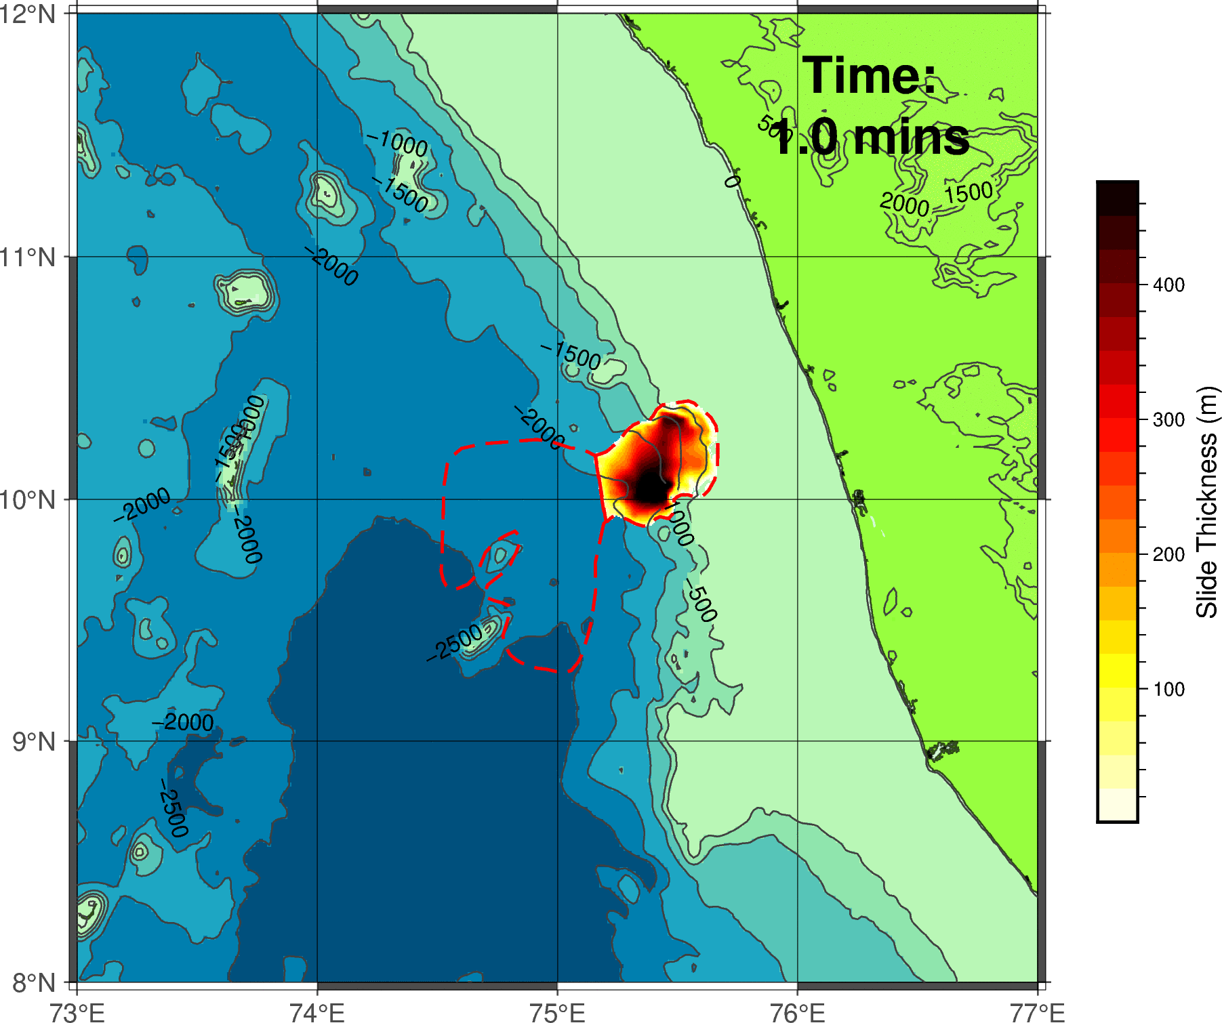
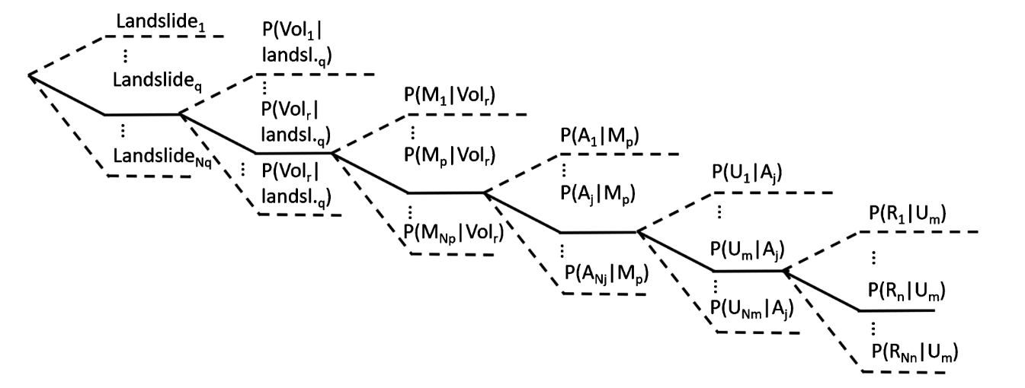
An integrated workflow for landslide – tsunami modelling
Generating landslide volumes based on bathymetry, slope, and geometric sampling to capture a wide range of plausible scenarios.
Numerical modelling of a landslide-generated tsunami by coupling landslide runout outputs into wave propagation models.
Testing along the SW Indian margin to evaluate a range of potential landslide scenarios and resulting tsunami impacts at coastal sites.
varying volume, geometry and runout dynamic

Slide 10
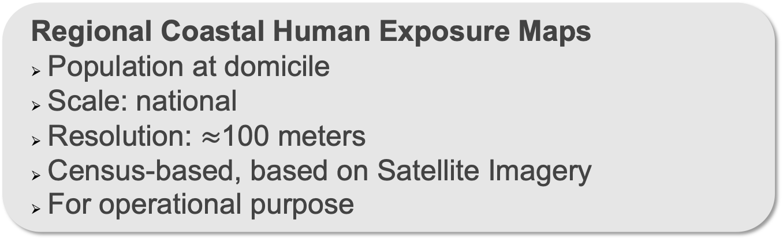

Roadmap for Exposure Modelling
Action 1
(Human) Exposure Mapping
Time-dependent Human Exposure Maps
Consider mobility patterns (daily, weekly, seasonal)
Scale: Site-specific (village level), verify scalability
Human mobility-based, based on mixed methods
For prototype
Action 2

Slide 11
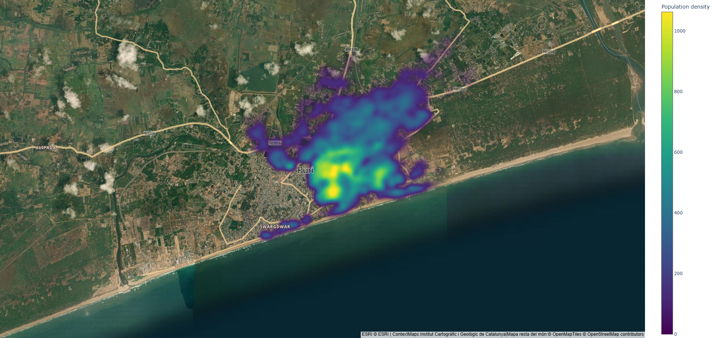

Currently underway: Exposure Modelling
Using 2011 Indian Census data projected based on growth rates estimated by UN World Urbanization Prospects Database (UNPD).
Action 1
Area 1: Puri
(Human) Exposure Mapping
Notes:
Proper estimation of Population growth pattern
Built-up area extraction for administrative regions
Building occupancy is trained through Deep Learning algorithms with coarse census counts
Compare the predicted human exposure values with data of INCOIS (for selected areas)
Using Explainable AI to interpret the results and comparison with open-source data

Slide 12
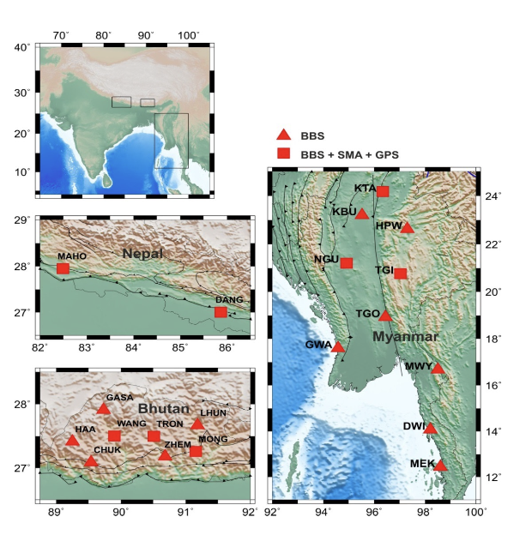
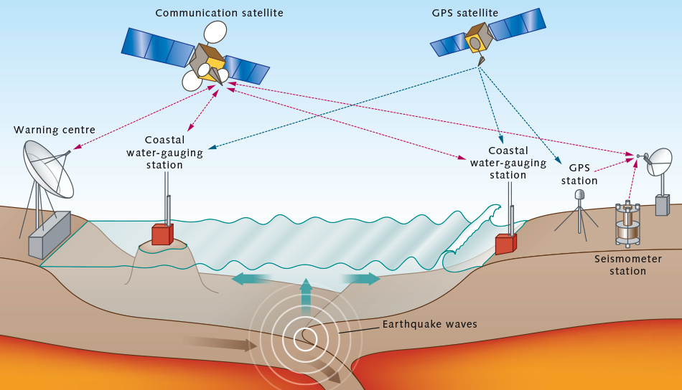
WP2: Early Warning (Lead INCOIS)
Aims:
Enhance the technical and operational capacities of the Indian Tsunami Early Warning Centre (ITEWC) and, in turn, the Indian Ocean Tsunami Warning and Mitigation System (IOTWMS) through advanced methods.
Goal: To Improve tsunami detection, forecasting, and impact estimation capabilities to provide more effective and more inclusive tsunami warnings
Key Tasks:
Rapid source characterization using GNSS
Machine-learning based tsunami inundation and impact forecasting
Probabilistic tsunami forecasting
Communication of uncertainties

Slide 13
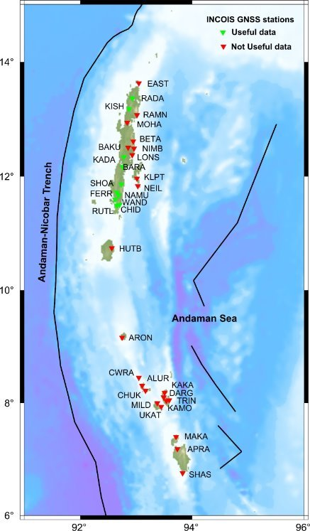
Rapid Source Characterisation Using GNSS
Current Period: October 2025 - January 2026 (M20-M23)
🔧 GNSS Data Pre-processing & QC Module Development
  • Developing open-source Python framework for data quality control
  • Processing real-time data from 35 GNSS stations in A&N Islands
🔧 Real-time Coseismic Displacement Processing Package
  • Integration with Andaman & Nicobar GNSS Network
  • Real-time displacement estimation from network stations
🔧 Validation Against Trimble Integrity Manager
  • Testing Rapid Motion and Network Motion Engine results
  • Comparison with commercial software outputs
⏭ Next Phase: Co-seismic Fault Model Estimation Module (Starting M23)
  • Python framework development for fault parameter estimation
Expected Outcome: Reduced warning time to <5 minutes for near-field tsunamis in Andaman-Nicobar region

Slide 14
Probabilistic Tsunami Forecasting (PTF)
Future Activities
🎯 Main Objective: Implement and validate a prototype PTF system for the Indian Ocean region based on Selva et al. (2021) framework
Phase 1: Implementation
(M20-M32)
Phase 2: Testing & Validation
(M33-M48)
Adapt PTF methodology from Mediterranean to Indian Ocean
Build pre-computed tsunami scenario database
Integrate with INCOIS GNSS network (32 stations)
Develop real-time workflow (target: <5 min)
Hindcasting: Historical events (2004, 2011, etc.)
Scenario testing: Mw 6-9 range
Blind testing: Real-time validation
Performance metrics: Accuracy & timing

Slide 15
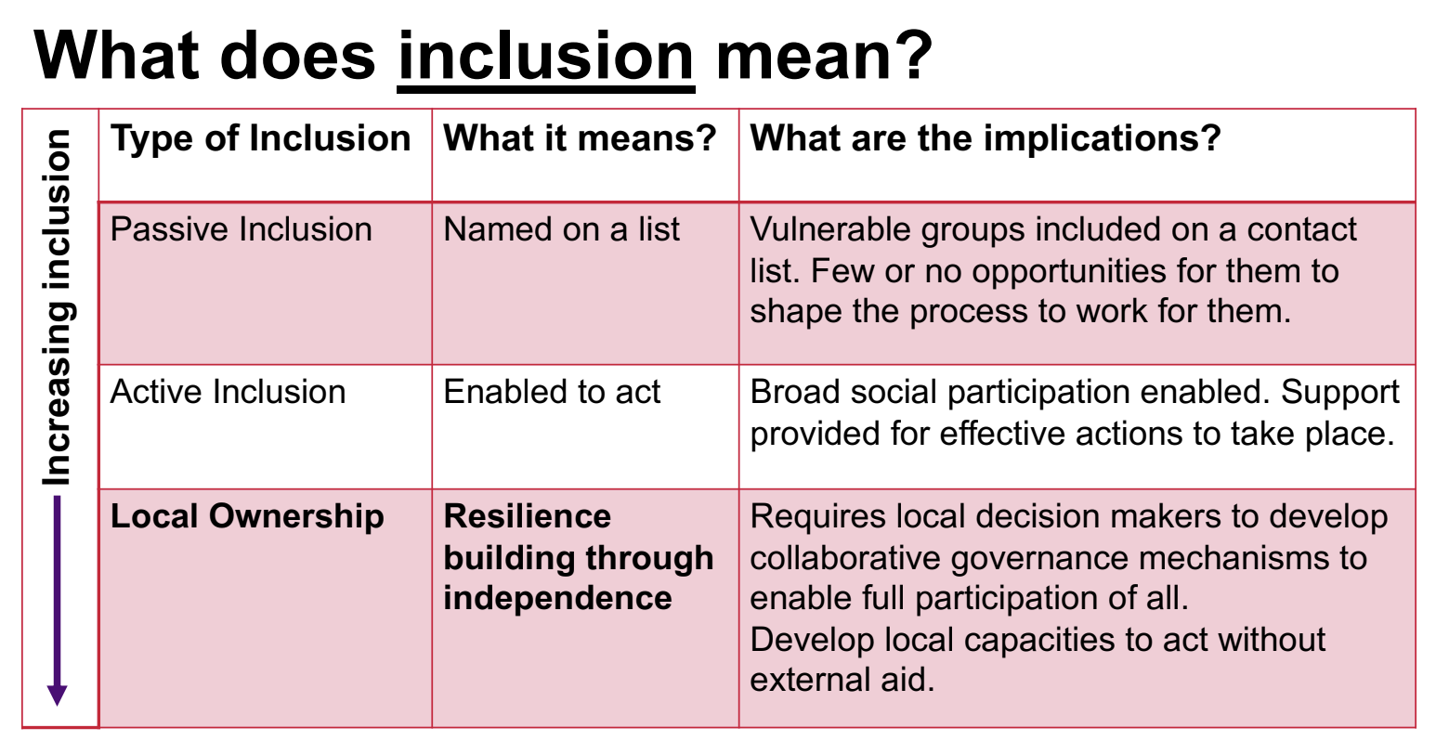
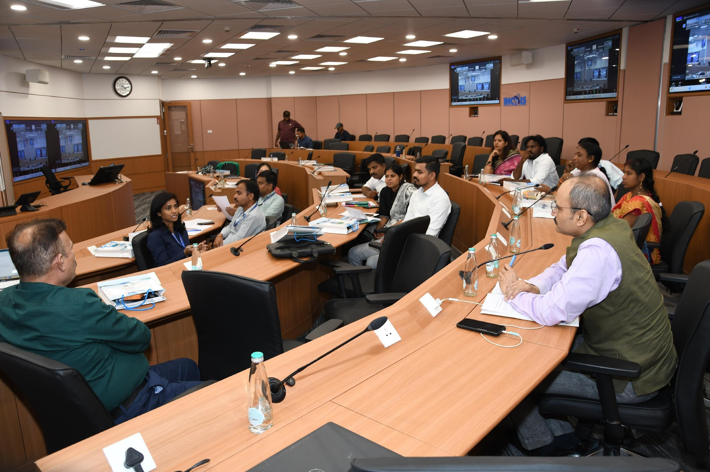
WP3 Resilience Hub
Assess risk perceptions, situational awareness, and behavioural readiness for tsunamis in communities in Odisha and Kerala
Understand human responses, decisions, and reactions to natural signs and official tsunami warnings.
Co-design inclusivity markers that, alongside Tsunami Ready’s existing 12 preparedness indicators, can measure the level of inclusiveness of preparedness actions.
PCTWIN embraces inclusive, local, and participatory methods for increasing the preparedness of the communities at tsunami risk.
This is facilitated by synergies with UNESCO initiatives in the Indian Ocean region such as the Tsunami Ready Recognition Program.
PCTWIN Kick-Off Meeting
May28-30 2024, INCOIS, Hyderabad, India
Sources: INCOIS, Maureen Fordham
Notes:
Inspired by GITEWS Tsunami Kit

Slide 16
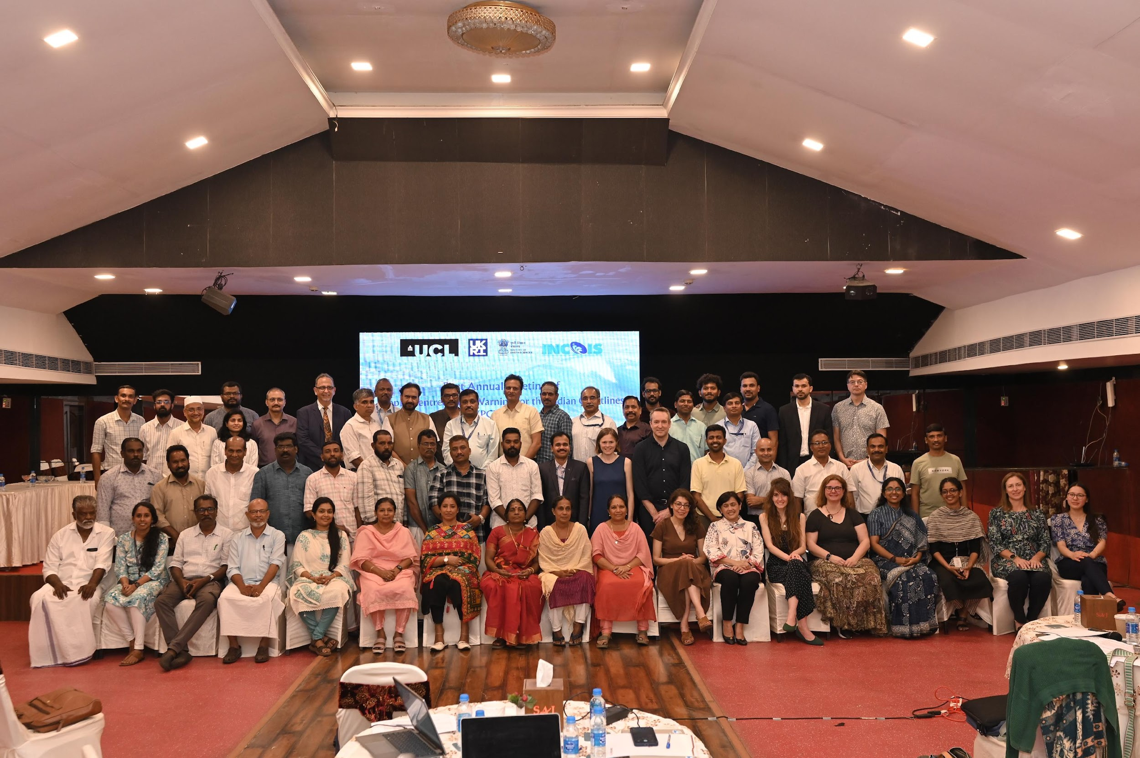
PCTWIN First Annual Meeting
April 08-11 2025, Kochi, India

Slide 17
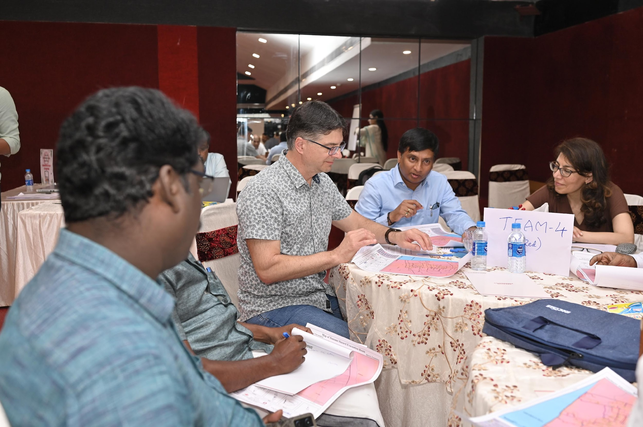
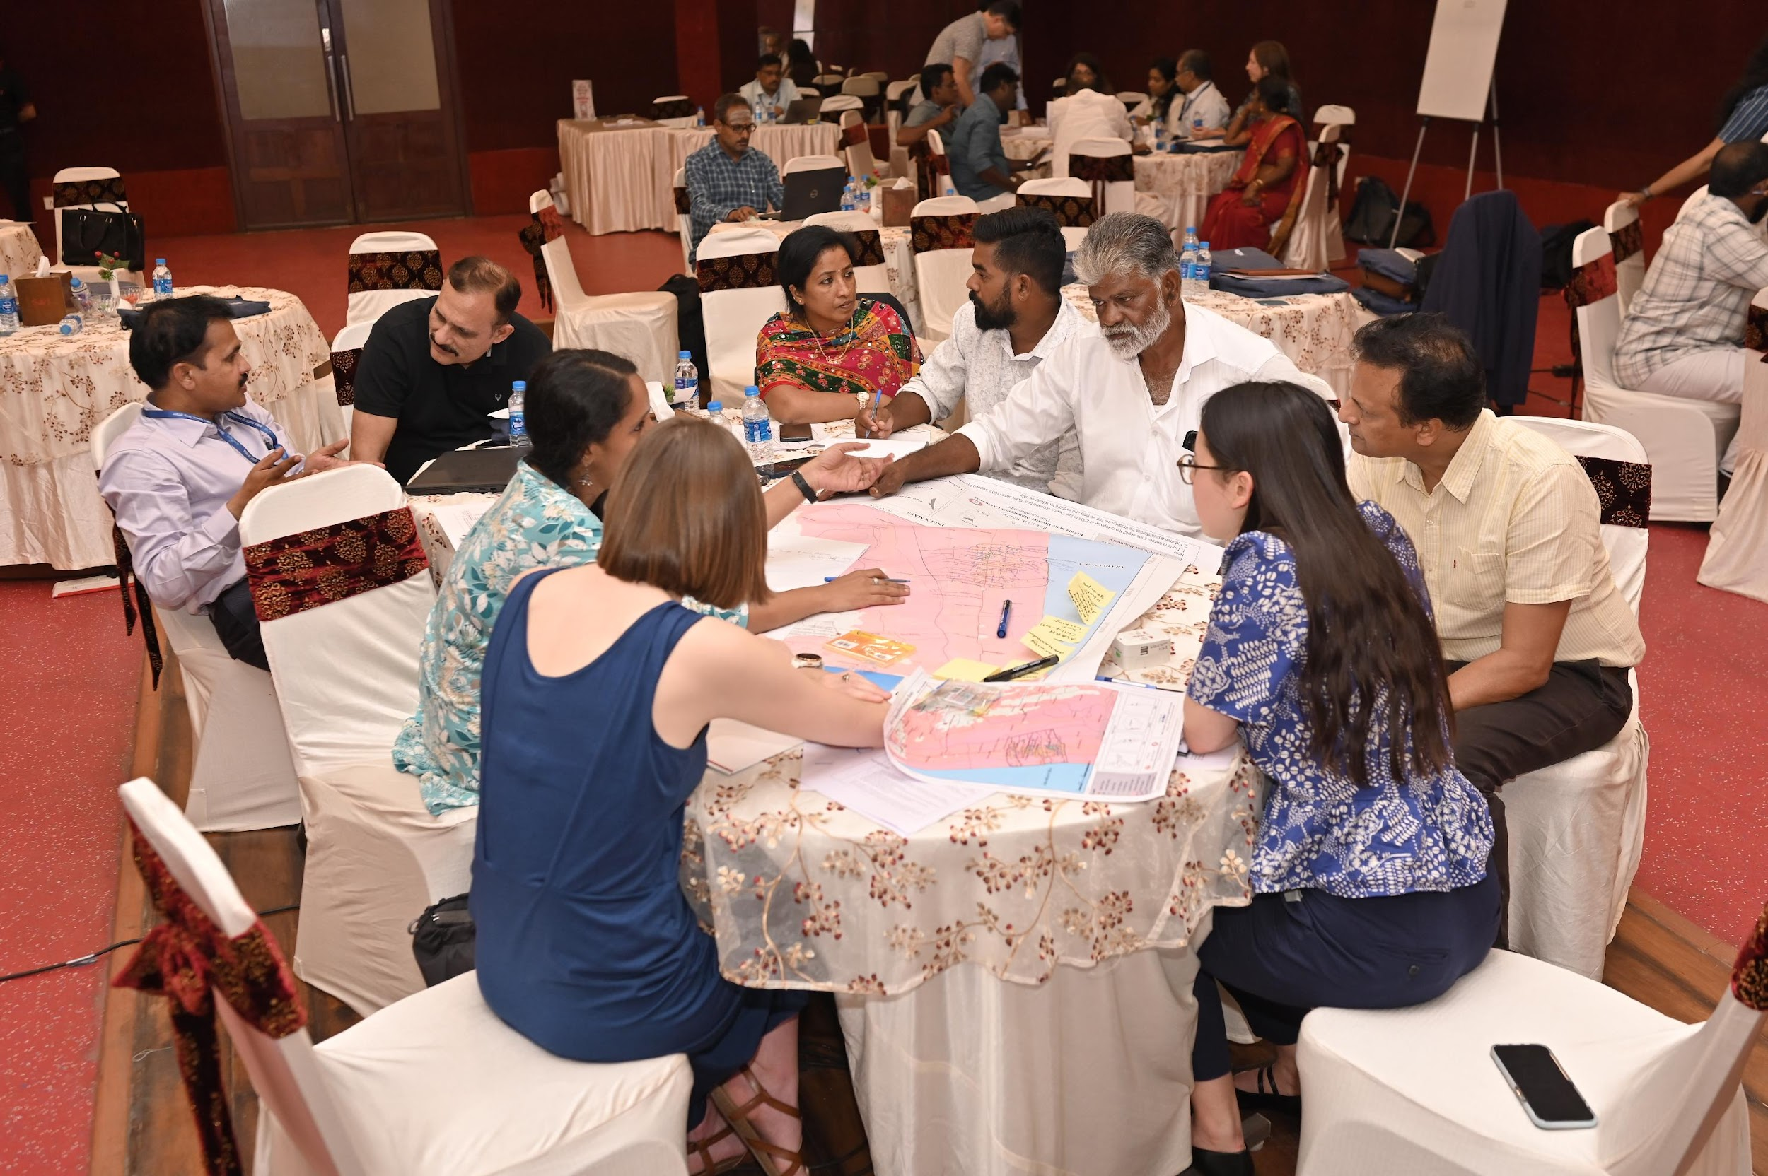
Stakeholders Workshops:
Participatory evacuation mapping
Crafting Storylines
PCTWIN First Annual Meeting
April 08-11 2025, Kochi, India

Slide 18
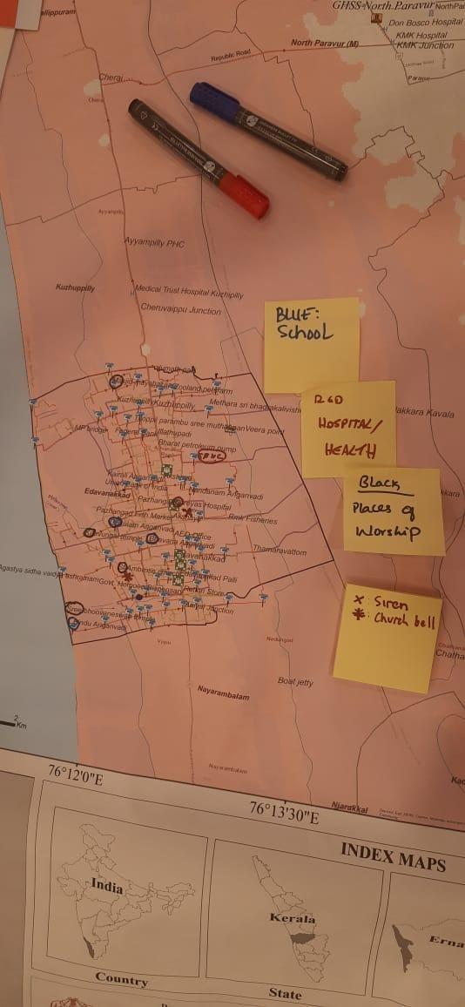
Workshop 1: Participatory Mapping of Edavanakkad
Aim: Identify characteristics of “vulnerable groups”
Participants: 5 mixed groups including community members, KSDMA emergency managers, INCOIS and academic researchers.
Findings:
Key locations: schools, health centres, places of worship, major access routes
EWS locations: Most groups reported no local siren; nearest is ~8–9 km away. Alerts flow via DDMA/Police, ward WhatsApp groups, loudspeakers, church bells; INCOIS app, CAP, TV/radio also referenced.
Vulnerable groups: elderly; bedridden; intellectual disabilities; female-headed households; isolated households; children 0–5; PwDs; pregnant/widows; migrants; beggars; tourists; fishers/boat owners. Time dependent clustering at worship sites/schools/homes; some groups (e.g. bedridden) more static
Access: poor roads; some areas only accessible by boat; no shelter in panchayat
Notes:
Protocol: Each group given printed Tsunami Evacuation Map and asked to:
Mark key locations (e.g. schools, access routes)
Mark EWS locations (e.g. siren locations)
Identify and mark vulnerable groups and time of day patterns;
Assess if each vulnerable group can receive/understand/act on warnings, and reach evacuation routes/shelters

Slide 19
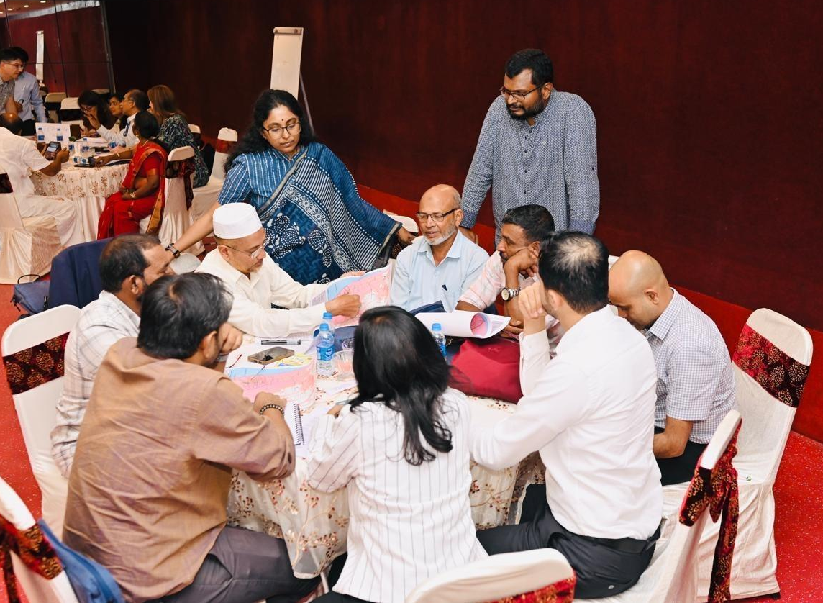
Workshop 2: Persona storylines: Edavanakkad tsunami scenario
Aim: “Play” vulnerable group personas through an evolving tsunami scenario to identify barriers, resources and trust dynamics
Participants: Same 5 groups as participatory mapping workshop
Findings:
Barriers to action: Malayalam-only alerts, mobility and access constraints (e.g. narrow/poor roads, boat availability, lack of disability-friendly infrastructure), lack of access to digital comms
What enabled success: local volunteers, ASHA workers, Jaagratha Samiti (local emergency comms group), small rapid-response vehicle for narrow lanes; private accommodation for particular needs.
Notes:
Personas played: migrant labourer; single mother + neurodiverse child living in isolated location; pregnant woman + toddler; teen with temporary disability; elderly woman living alone.

Slide 20
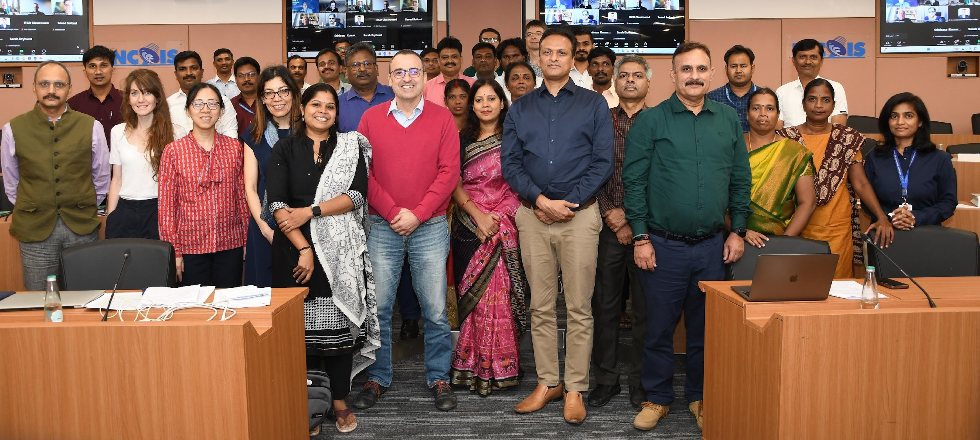
PCTWIN Kick-Off Meeting
May28-30 2024, INCOIS, Hyderabad, India
Thank you!

