Slide 1





Tsunami Ready Toolkit
FIRST CONFERENCE OF THE OCEAN DECADE TSUNAMI PROGRAMME
Ardito Kodijat, IOTIC
Dr. Laura Kong, ITIC
Alison Brome, CTIC
Denis Cheng Sang, NEAMTIC
Derya Dilmen Vennin NEAMTIC
Hyderabad, India
10-11 November 2025

Slide 2

Definition and Guidance
Manual and Guide 74 (to be updated)
Tsunami Ready Community Definition
Tsunami Ready Application Form (updated)
Submission procedures (Automated tool)
File naming and file types (file metadata)
TR Renewal procedures (Use the same form as new application)

Slide 3
Definition and Guidance
Implementation communications (sample letters and templates)
  Letter of Intent, NTRB/RTRB,
  Application submission,
  IOC acknowledgement,
  Recognition and Appreciation Certificate names,
  Community summary for web page

Slide 4



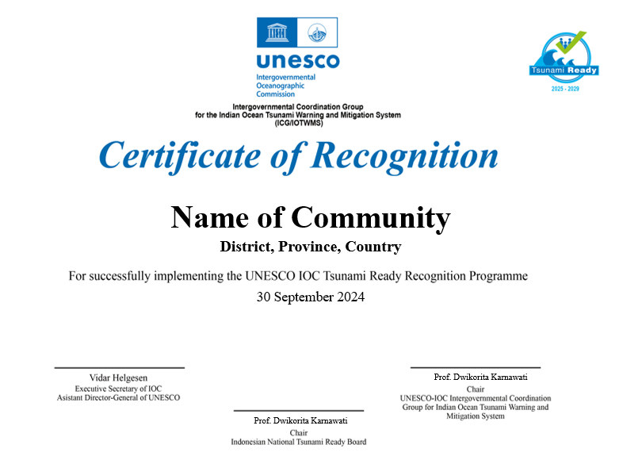
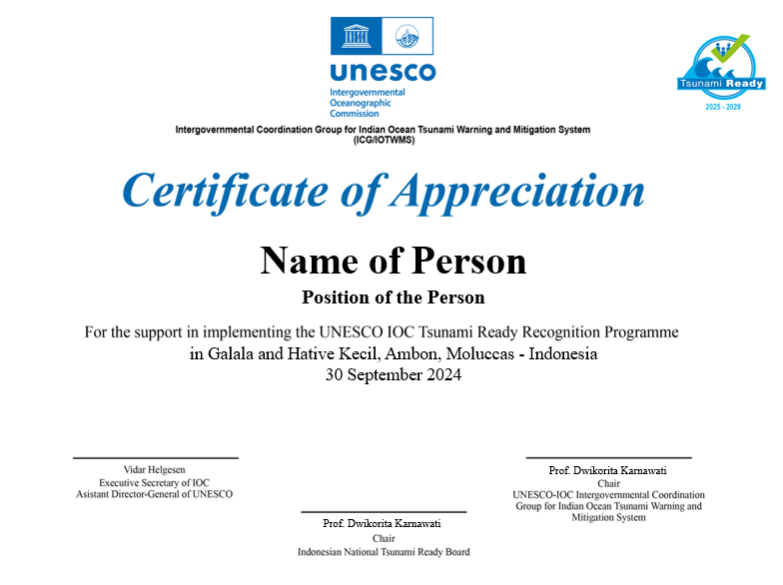
Definition and Guidance
  Recognition Sign (Size, Color, Fonts, Placements of Logos, etc.)
  Recognition and Appreciation Certificates (All ICGs)
  Recognition Ceremony – sample Concept Note and Agenda

Slide 5

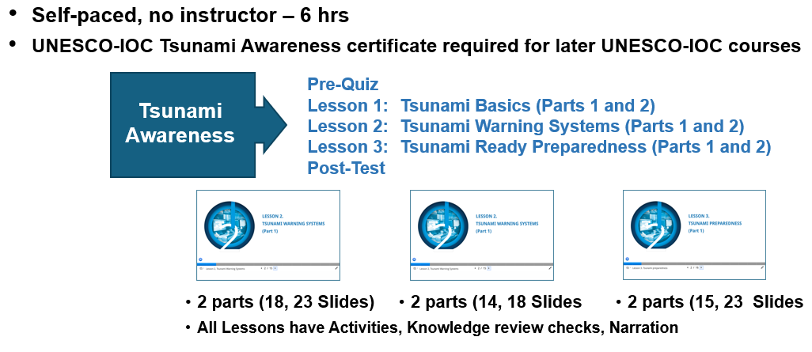
Trainings

Slide 6
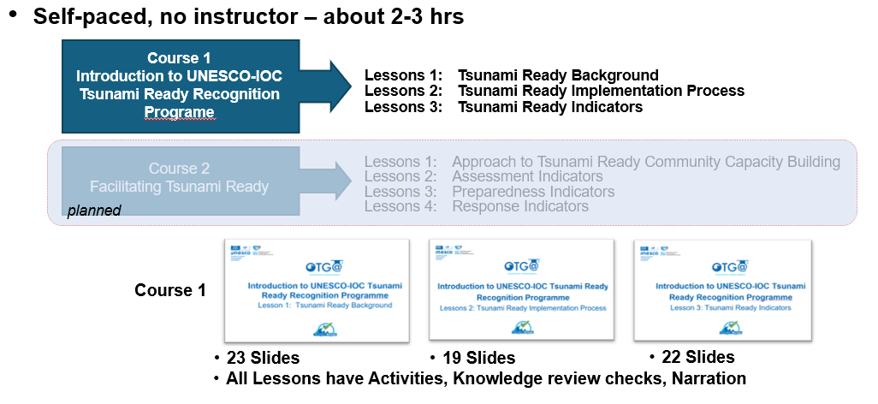
Trainings

Slide 7
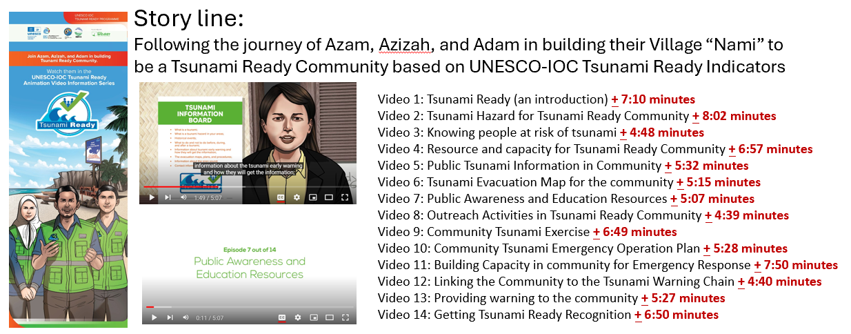
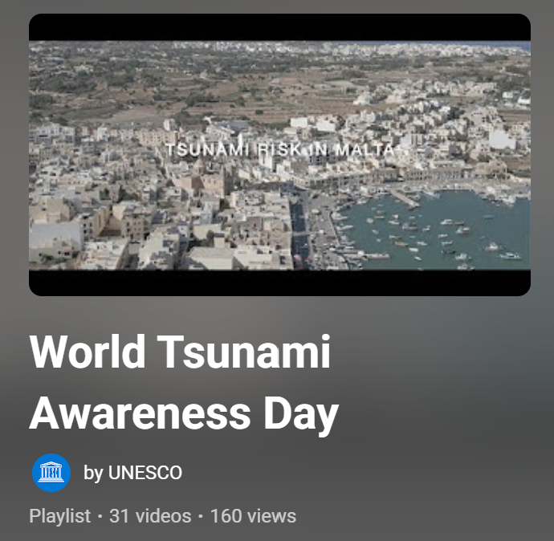

Awareness and Education Tools
Tsunami Ready Videos
10-11 November 2025
INCOIS, Hyderabad, India
First Conference of the
Ocean Decade Tsunami Programme

Slide 8
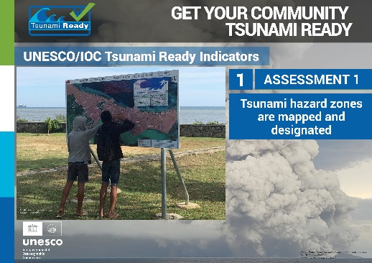
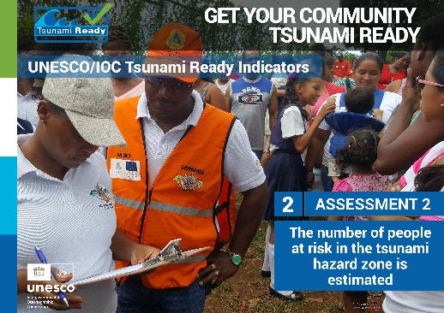
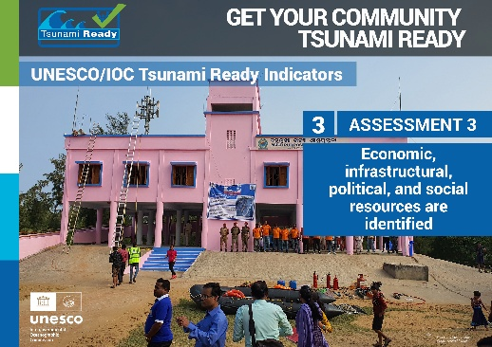

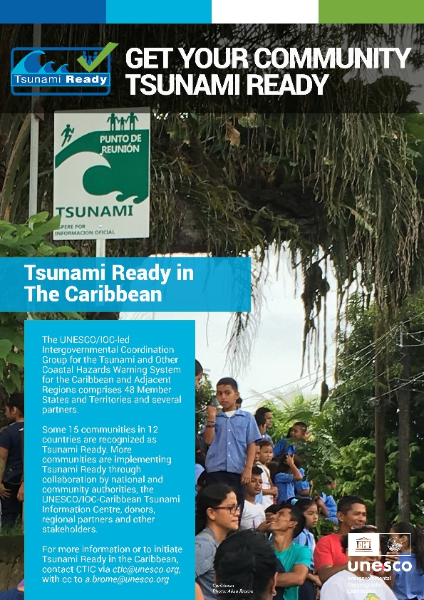
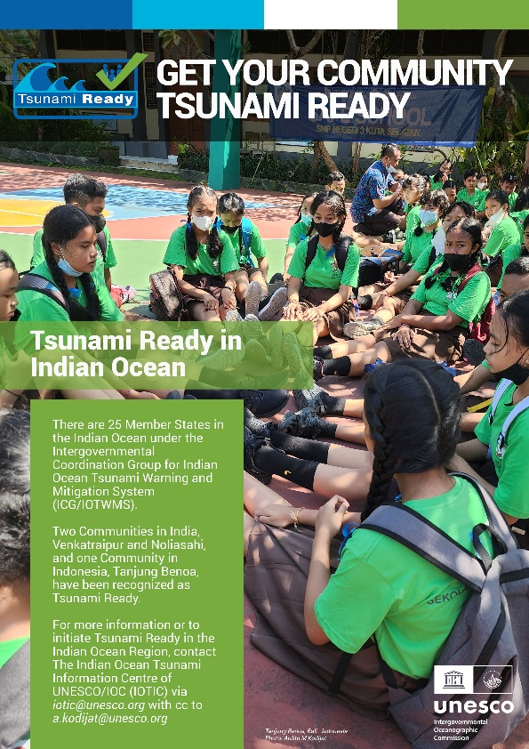

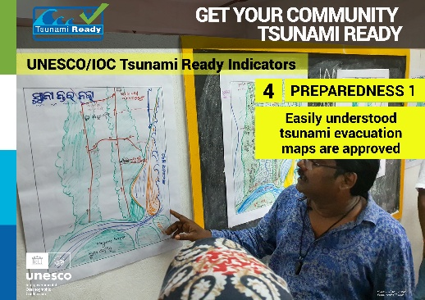
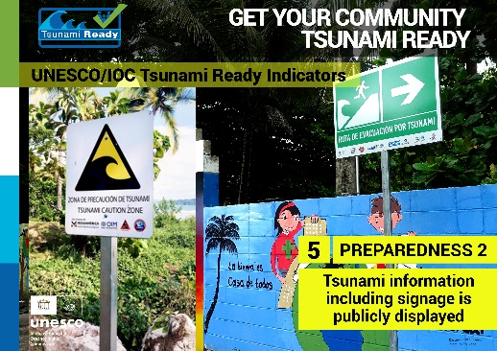
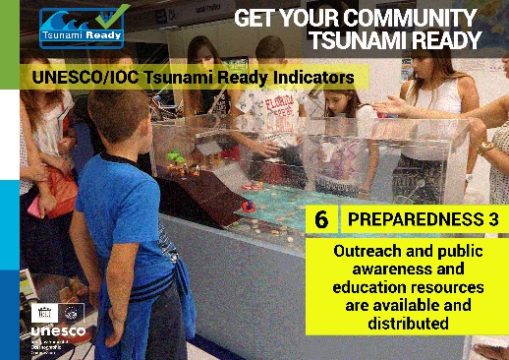
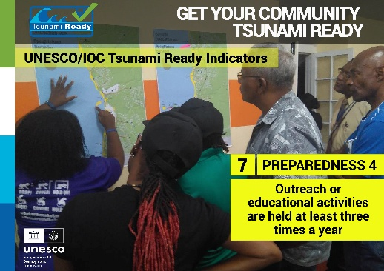
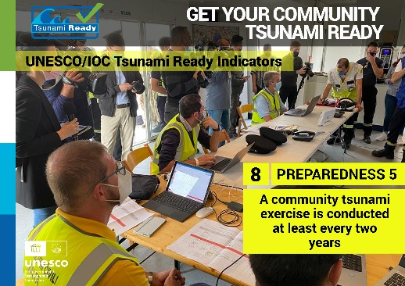
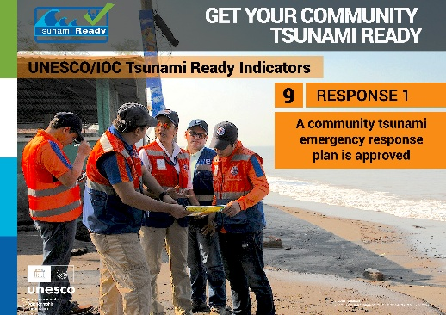
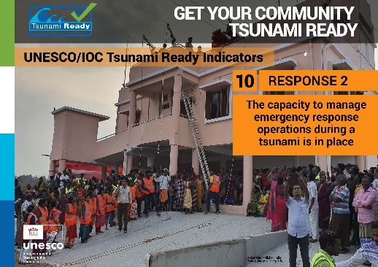
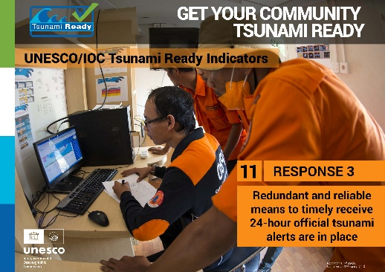
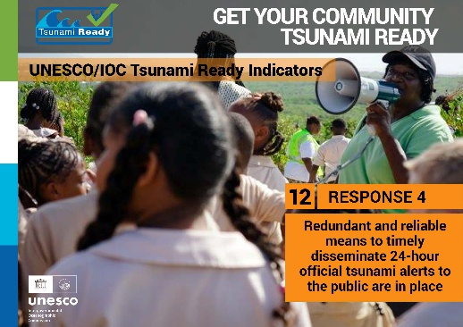
Awareness and Education Tools
Tsunami Ready Posters
10-11 November 2025
INCOIS, Hyderabad, India
First Conference of the
Ocean Decade Tsunami Programme

Slide 9

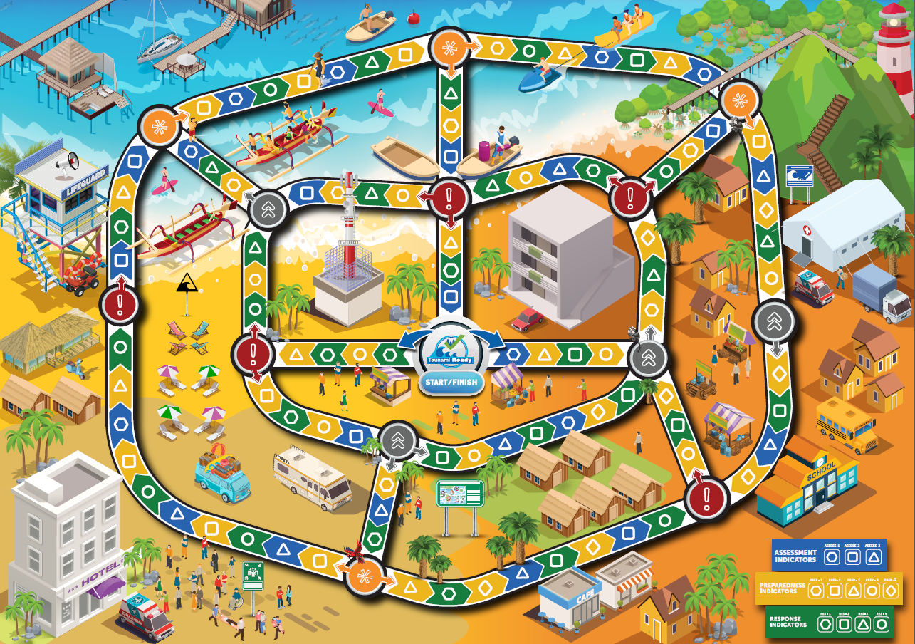


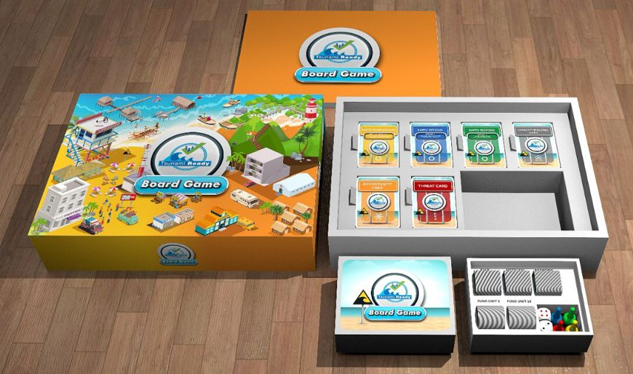
Awareness and Education Tools
Boardgames
Tsunami Ready
RUNAMI
10-11 November 2025
INCOIS, Hyderabad, India
First Conference of the
Ocean Decade Tsunami Programme

Slide 10
Assessment Tools
Capacity Assessment to Implement Tsunami Ready Indicators
Feedback Survey on the Implementation of the UNESCO-IOCTsunami Ready Recognition Programme in ICG/CARIBE-EWS
Assessment tools on the impact of Tsunami Ready to UNESCO-IOC Recognized Community in Indonesia
10-11 November 2025
INCOIS, Hyderabad, India
First Conference of the
Ocean Decade Tsunami Programme

Slide 11

Thank You
Ardito Kodijat, IOTIC
Dr. Laura Kong, ITIC
Alison Brome, CTIC
Denis Cheng Sang, NEAMTIC
Derya Dilmen Vennin NEAMTIC
10-11 November 2025
INCOIS, Hyderabad, India
First Conference of the
Ocean Decade Tsunami Programme

