Slide 1





Sectorized EWS
SIPAT – SSD
the Chilean experience
Valparaíso
L: 33.05° S
G: 071.61° W
10-11 November 2025
INCOIS, Hyderabad, India
First Conference of the
Ocean Decade Tsunami Programme

Slide 2
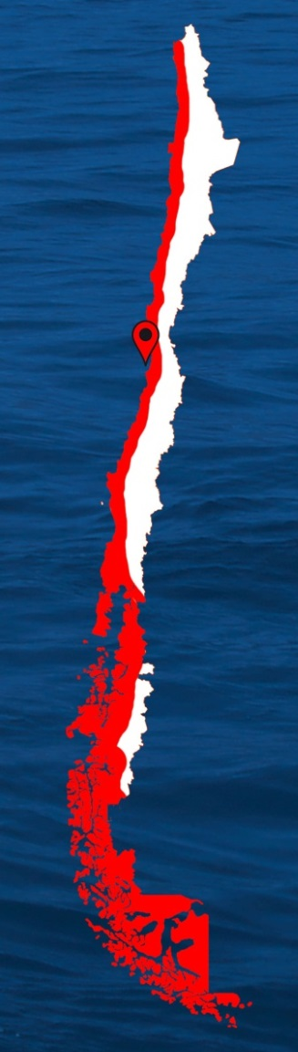


SIPAT Integrated Tsunami Prediction and Alarm System
SSD Decision Support System
4334 km
10-11 November 2025
INCOIS, Hyderabad, India
First Conference of the
Ocean Decade Tsunami Programme

Slide 3







Before SIPAT
After SIPAT
SIPAT Integrated Tsunami Prediction and Alarm System
SSD Decision Support System
10-11 November 2025
INCOIS, Hyderabad, India
First Conference of the
Ocean Decade Tsunami Programme

Slide 4
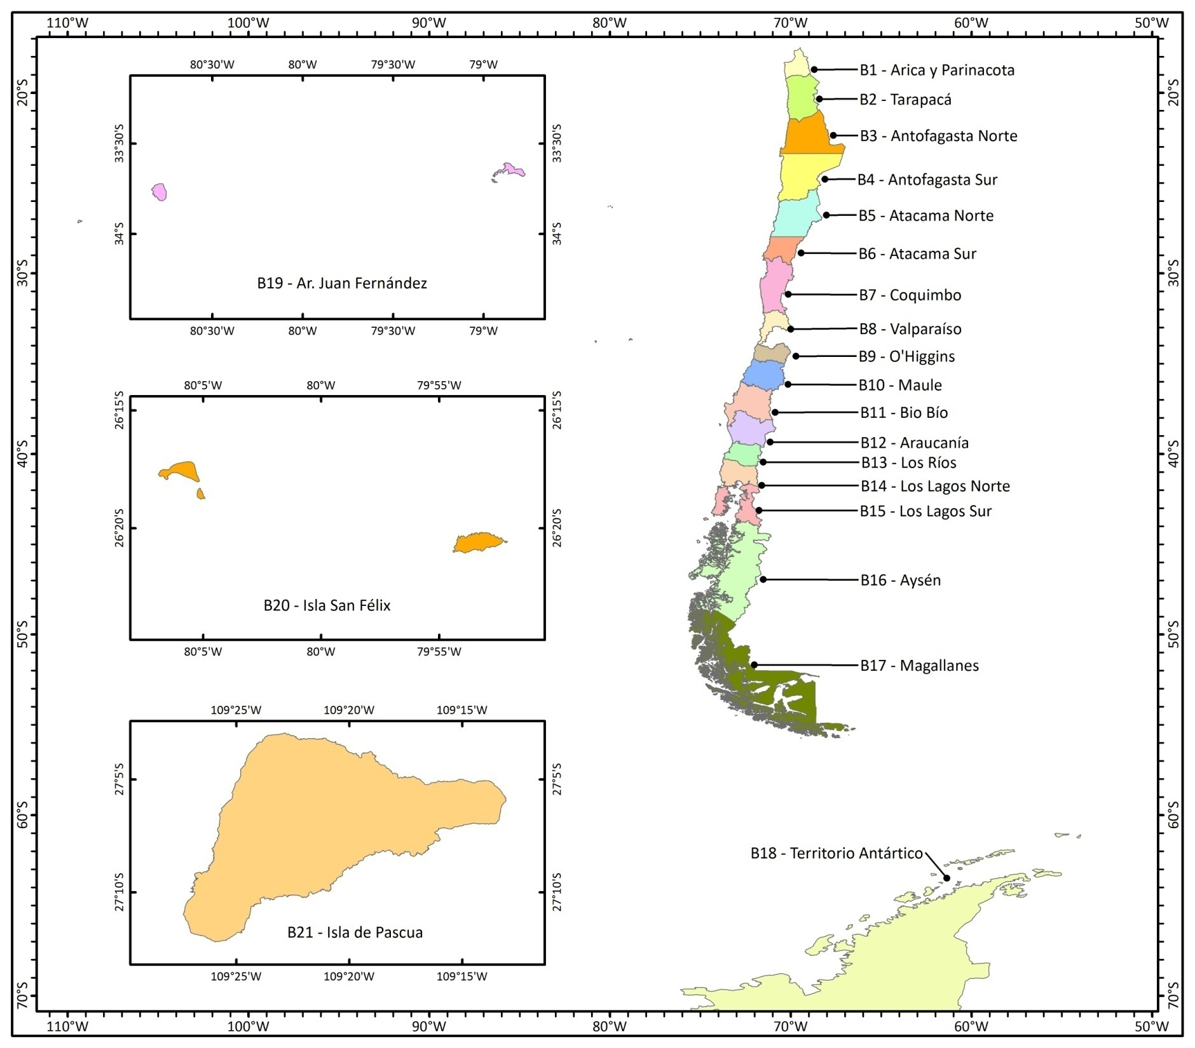
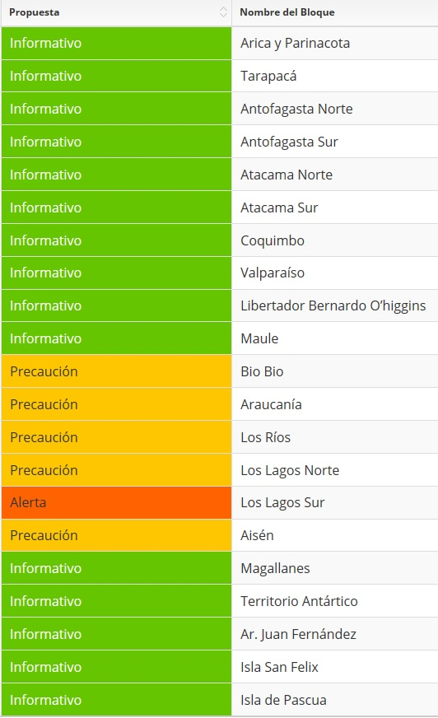

PTWC blocks
10-11 November 2025
INCOIS, Hyderabad, India
First Conference of the
Ocean Decade Tsunami Programme

Slide 5
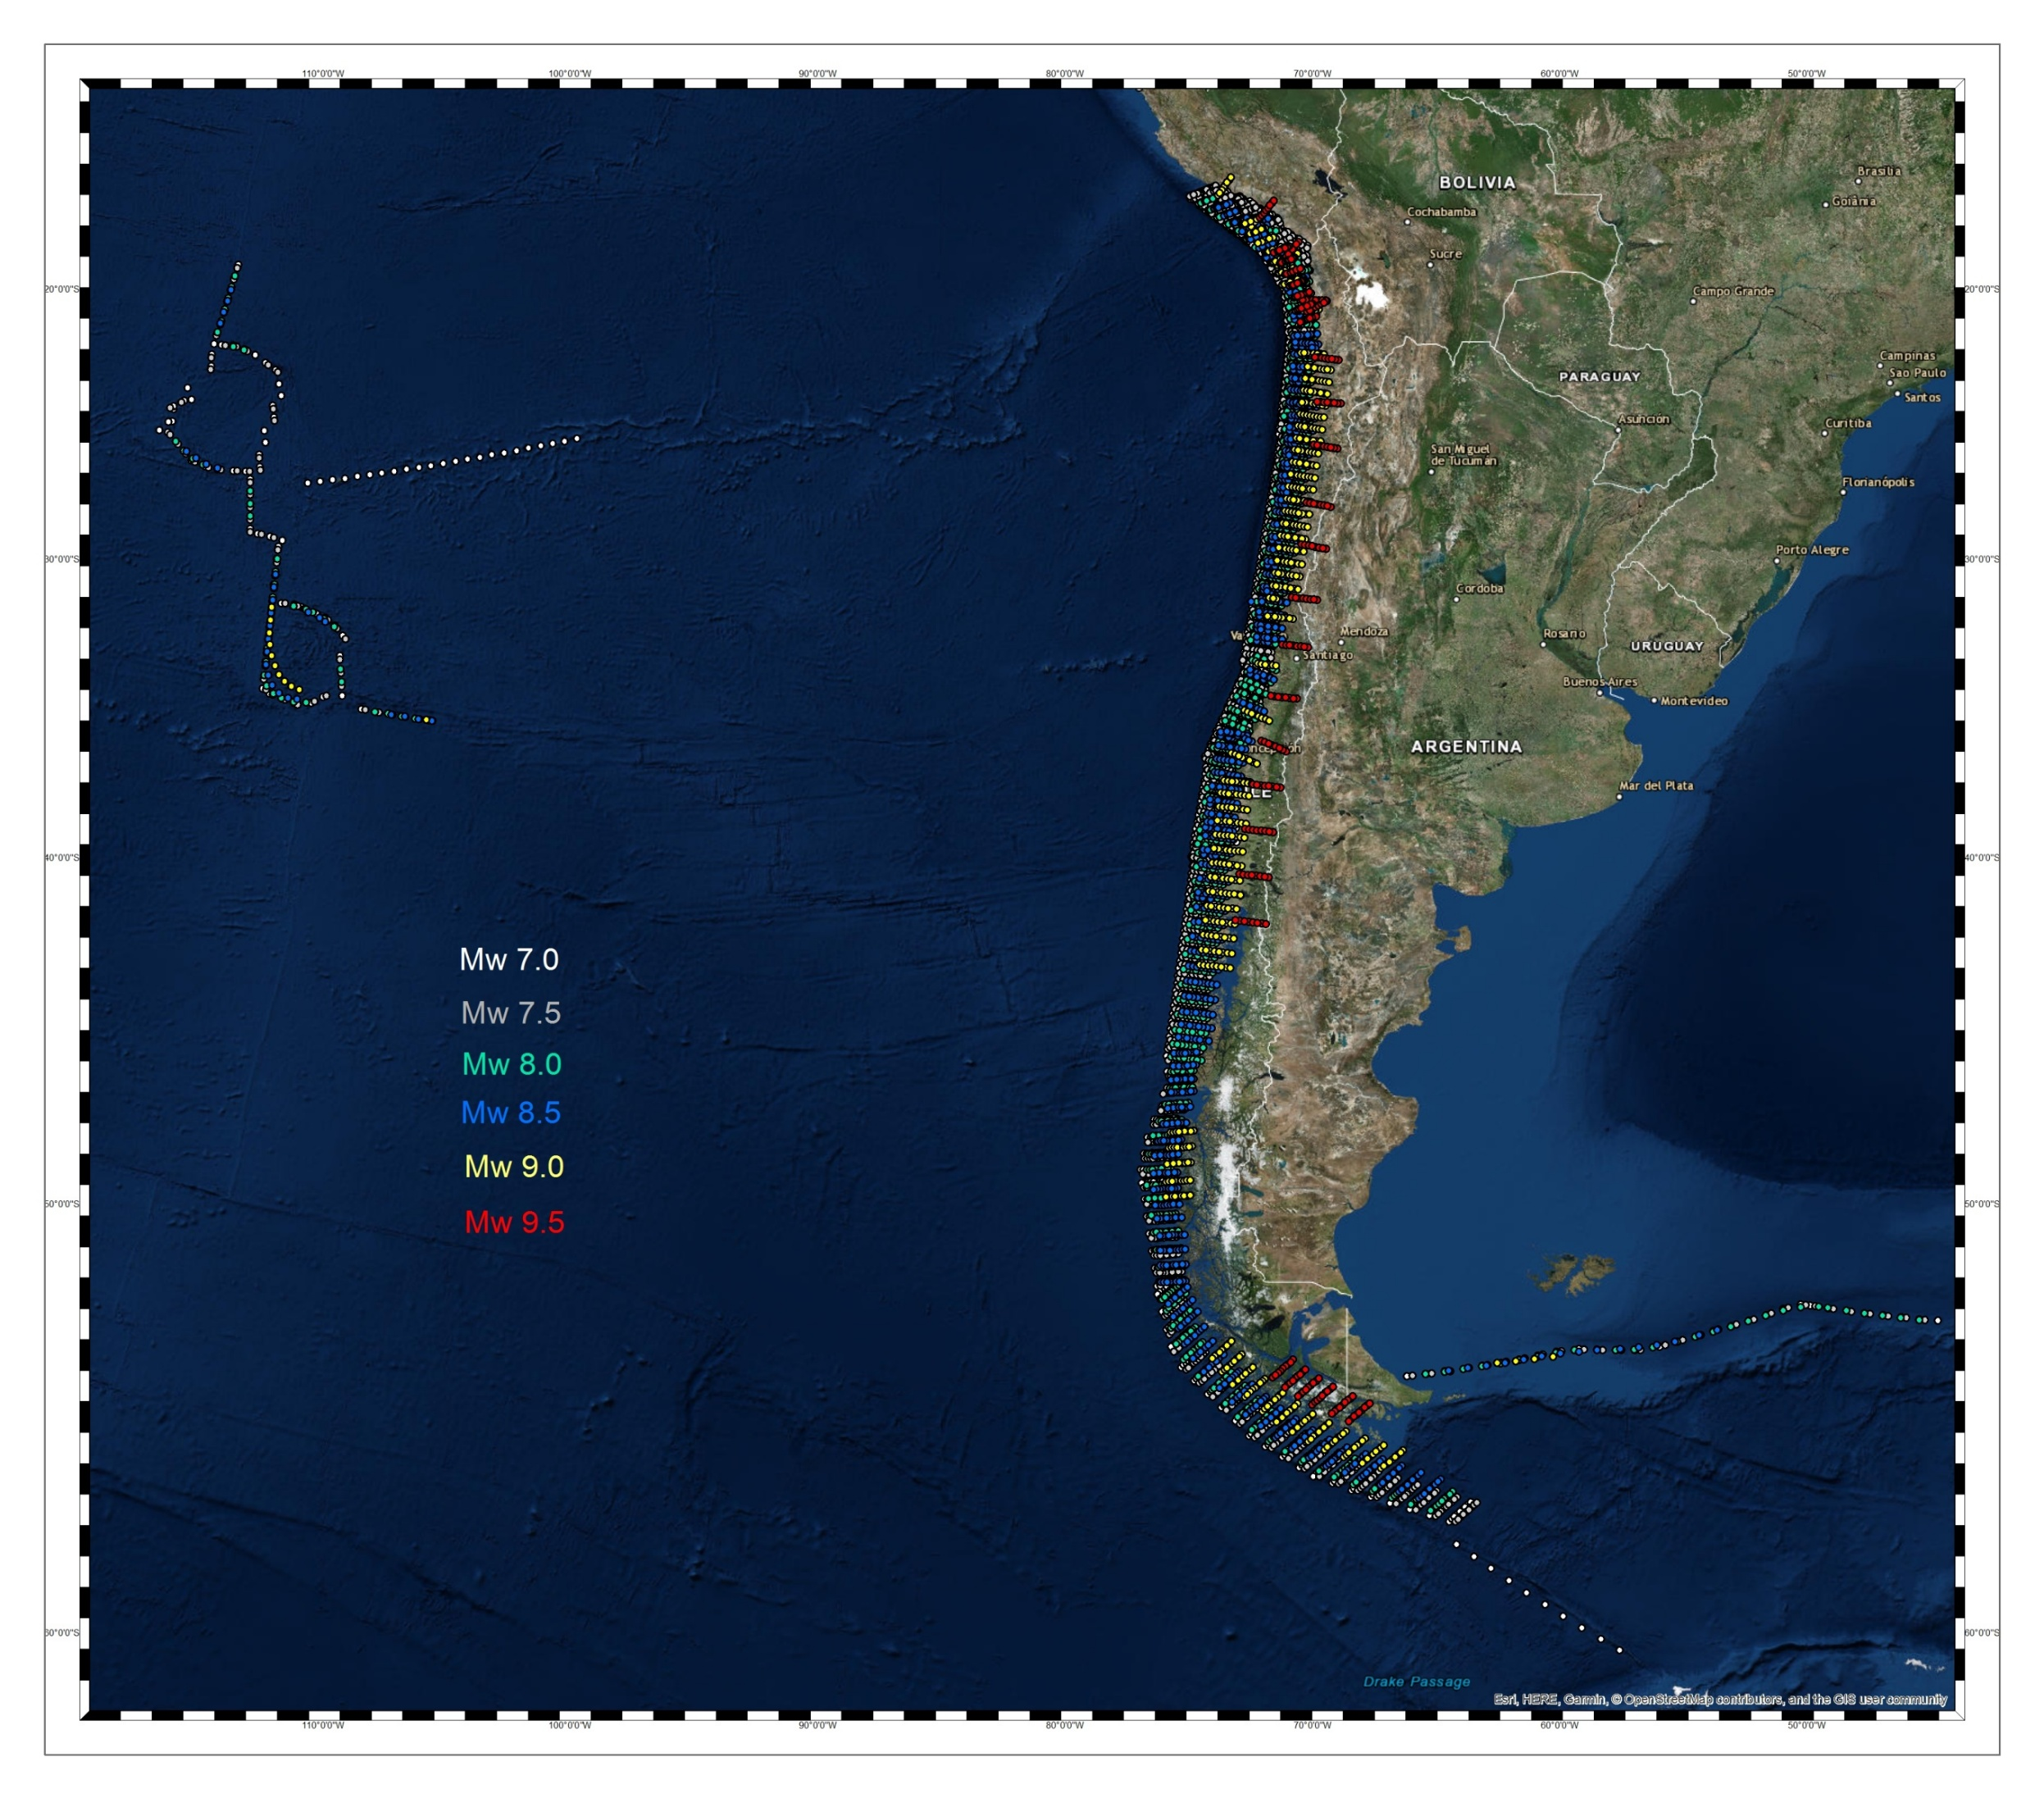
SIPAT CONCEPTUAL OPERATION
Area of service
ORIGINAL VERSION
~ 10.000 SCENARIOS
ONLY FOR NEAR FIELD EVENTS
10-11 November 2025
INCOIS, Hyderabad, India
First Conference of the
Ocean Decade Tsunami Programme

Slide 6

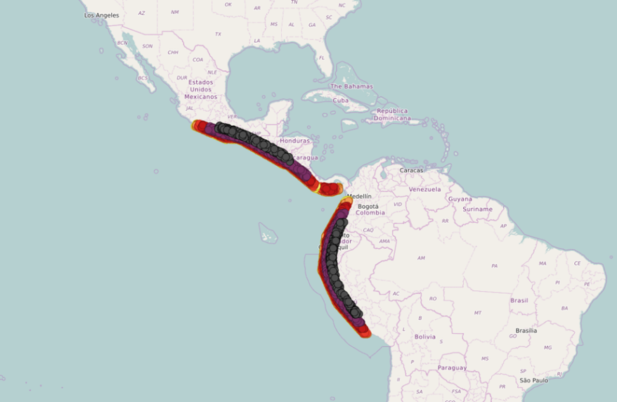
SIPAT CONCEPTUAL OPERATION
Area of service
Tsunami generation zone that could potentially affect the coasts of Chile. Area extends from southern Mexico to Peru.
ORIGINAL VERSION
~ 10.000 SCENARIOS
ONLY FOR NEAR FIELD EVENTS
Original DSS
Additional 6,500 modeled scenarios
SIPAT V2
10-11 November 2025
INCOIS, Hyderabad, India
First Conference of the
Ocean Decade Tsunami Programme

Slide 7
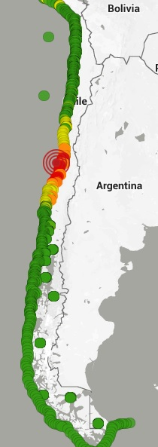
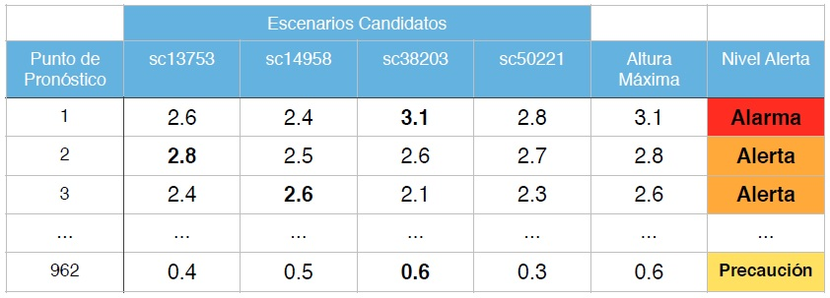
SIPAT CONCEPTUAL OPERATION
Forecast points
Estado de Amenaza
INFORMATIVO
PRECAUCIÓN
ALERTA
ALARMA
Amplitud esperada
<0.3m
0.3 a 1m
1 a 3m
≥ 3 m
10-11 November 2025
INCOIS, Hyderabad, India
First Conference of the
Ocean Decade Tsunami Programme

Slide 8
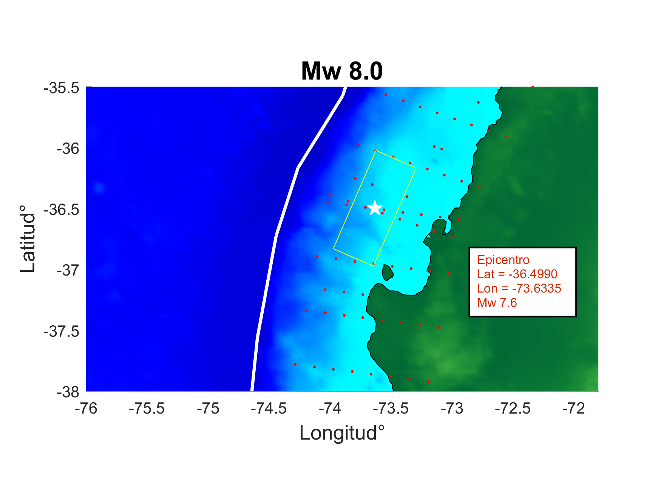

SIPAT CONCEPTUAL OPERATION
Searching boxes
10-11 November 2025
INCOIS, Hyderabad, India
First Conference of the
Ocean Decade Tsunami Programme

Slide 9

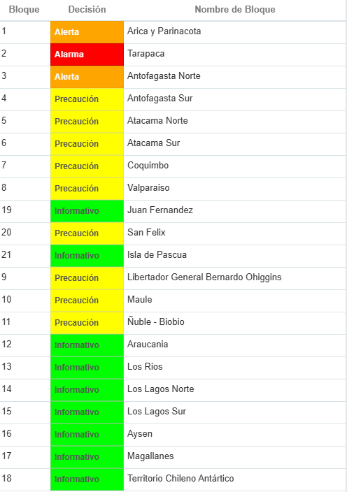
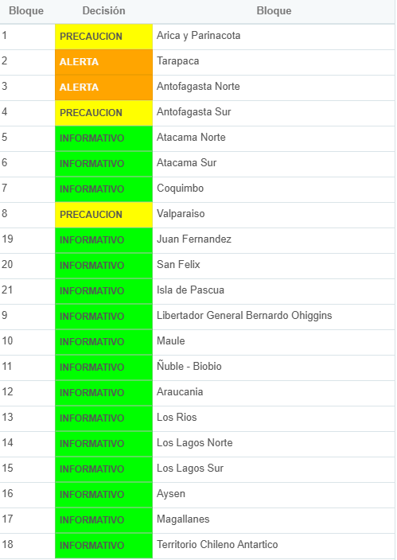
SIPAT CONCEPTUAL OPERATION
Interpolation (recent improvement)
Mw 7,3
From pre-modeled candidates
Tsunami amplitudes with Mw 7.0
Tsunami amplitudes with Mw 7.5
SCENARIO: Iquique Mw 7.8
Interpolated tsunami amplitudes for a 7.3 eq
Original DSS
SIPAT V2
It converts discrete data into continuous values, optimizing the use of available information, improving analysis and decision-making.
10-11 November 2025
INCOIS, Hyderabad, India
First Conference of the
Ocean Decade Tsunami Programme

Slide 10
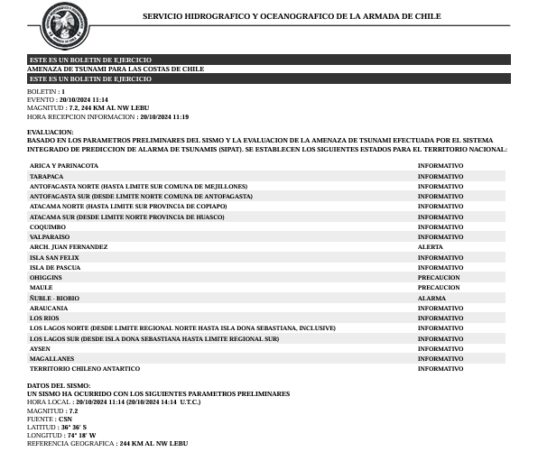
SIPAT CONCEPTUAL OPERATION
ACTIVATION
INFORMATION RECEPTION
EVALUATION
DISSEMINATION
MONITORING
CANCELLATION
10-11 November 2025
INCOIS, Hyderabad, India
First Conference of the
Ocean Decade Tsunami Programme

Slide 11
Sectorized EWS
SIPAT – SSD
the Chilean experience
Valparaíso
L: 33.05° S
G: 071.61° W
10-11 November 2025
INCOIS, Hyderabad, India
First Conference of the
Ocean Decade Tsunami Programme

