Slide 1
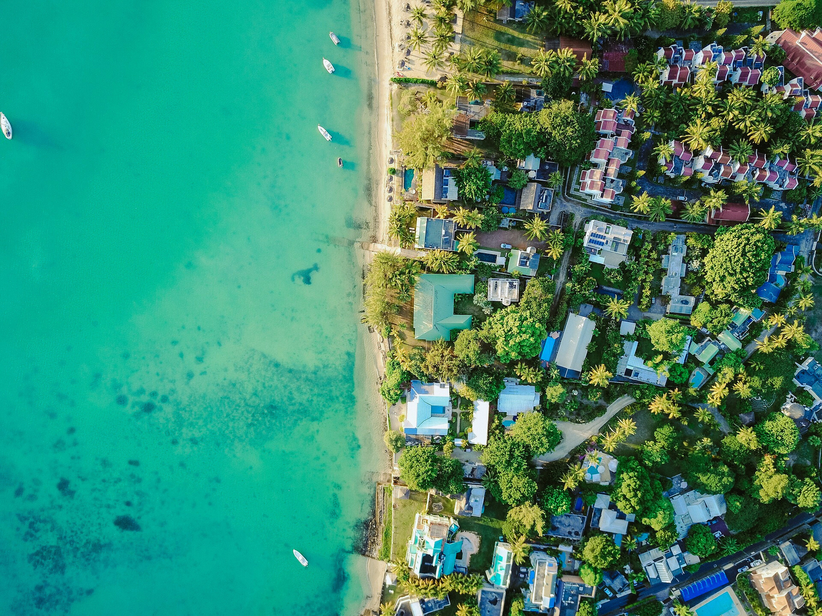



Report of the session 1,
High-level Objective 1 (HLO 1), Day 1 10th November 2025
FIRST CONFERENCE OF THE OCEAN DECADE TSUNAMI PROGRAMME
Hyderabad, India
10-11 November 2025

Slide 2

Report of the session 1, High-level Objective 1 (HLO 1), day 1 10th November
Moderators,
Prof. Yuichiro Tanioka, IUGG-JTC chair, Japan
Prof. Juanjo Dañobeitia, IOC-UNESCO and CSIC, Spain
Contributors:
Joern Behrens, GMT, Germany
Finn Lovholt, GTM, Germany
Ceci Rodriguez Cruz, University of Hawaii, USA
Steve Hall, UK
Alessandro Amato, ICG/NEAMTWS chair,
Yuelong Maio, Co-Director JATWC, Australia
Alexander Matygin, Hydrometerological center for Black and Azov Seas, Ukraine
Mikael Mazur, Nokia Bell Labs, USA.
Usama Kadri. Cardiff University, Cardiff, UK
Toshitake Baba, Tokushima University, Japan
Andrey Babeyko, GFZ, Potsdam, FRG
10-11 November 2025
INCOIS, Hyderabad, India
First Conference of the
Ocean Decade Tsunami Programme

Slide 3

Overall categories presentations
PTHA/PTF and Knowledge Transfer, one talk about the global tsunami model for PTHA and one about landslide tsunamis.
Observation, one talk for SMART cables, one for GEBCO bathymetry data, and one for Deep observatories, the SMART cable, Deep-Sea buoys, and landslide tsunami observation. One talk concerning sea level network in Australia, another one focus on different sources of what is called Meteotsunami which are sea waves triggered by external forcings due to meteorological events in this occasion related to fluctuations in coastal regions of Black Sea areas. The third presentation was dealing with novelty technologies for tsunami detections applied on telecommunication subsea cables.
Forecasting and Warning, in this subsection a talk was given about the importance of Global Real time for early tsunami warning.
Technology tools, here a meaningful development of a compressive tsunami software JAGURS.
Service provider, a European legal consortium named EPOS ERIC, showed a recent implementation of thematic core services dedicated on tsunami.
10-11 November 2025
INCOIS, Hyderabad, India
First Conference of the
Ocean Decade Tsunami Programme

Slide 4
Overall categories presentations
Joern Behrens
GMT is bridging a gap between science and society providing Cookbook including Recipes for PTHA. Science needs to provide uncertainty. Then, the society can decide the action.
For ODTP, it can provide the uncertainty of the forecast or early warning.
Finn Lovholt
Landslide tsunami hazard models are less developed, partly because of lack of data. New hazard models will depend on data, either past landslide statistics or slope stability data and models.
With respect to early warning for ODTP, landslide tsunamis constitute a major challenge: there are few systems today (Norway and Stromboli perhaps the only ones) Because landslide tsunamis are highly local, we need extensive and expensive instrumentation.
10-11 November 2025
INCOIS, Hyderabad, India
First Conference of the
Ocean Decade Tsunami Programme

Slide 5
Overall categories presentations
Ceci Rodríguez Cruz
SMART Cables is a global initiative supported by the International Telecommunication Union (ITU), the World Meteorological Organization (WMO), and the UNESCO Intergovernmental Oceanographic Commission (IOC), and driven by a community of over 400 volunteer experts worldwide. By integrating scientific sensors into telecommunication cables, SMART Cables merge connectivity with ocean and Earth observation, creating dual-purpose infrastructure that both connects and protects.
The goal is simple yet transformative: to turn the world’s digital backbone into a real-time global observing network, strengthening climate science, disaster warning, and international cooperation for the benefit of all.
For ODTP
We recognized the SMART Cables initiative as a practical mechanism bridging telecommunications and science with significant socio-economic benefits, and invited Members to explore the adoption of this innovative technology, SMART Cables, to integrate environmental sensors into new subsea fiber optic cable systems, thereby enhancing early warning, climate observation, and global resilience.
10-11 November 2025
INCOIS, Hyderabad, India
First Conference of the
Ocean Decade Tsunami Programme

Slide 6
Overall categories presentations
Steve Hall
Accurate global seabed maps, GEBCO-2030, are essential for tsunami response planning and prediction. The progress of the detailed survey up to now is 27.3 % of the ocean. The use of marine autonomous systems in the deep ocean and satellite, aircraft, and drone derived bathymetry in shallow seas are important.
For ODTP, Accurate bathymetry is essential for accurate tsunami early warning
Alessandro Amato
Recent developments ongoing in the tsunami warning system for North East Atlantic, Mediterranean are SMART cable in the Atlantic, deep-sea observatories, cabled buoy near Stromboli volcano for volcanic tsunami warning.
For ODTP, Including various observation systems are needed for tsunami early warning
10-11 November 2025
INCOIS, Hyderabad, India
First Conference of the
Ocean Decade Tsunami Programme

Slide 7
Report of the session 1, High-level Objective 1 (HLO 1)
OBSERVATION
Yuelong Maio provides the main components of the Australian Sea Level Monitoring Network consisting in;
44 tide gauges stations in Australia plus 14 SW Pacific countries which became real-time after the ATWS project.
6 DART deep Ocean highlining the dual stations in the Indian Ocean, Coral Sea, and Tasman Sea for redundancy purposes and essential to differentiate between a false alarm and a real threat, avoiding frequent warnings.
Yuelong describes the importance of sea level monitoring in Australia for tsunami warnings by providing real-time data, enabling the Joint Australian Tsunami Warning Centre (JATWC) to deliver highly accurate alerts, and an internal Sea Level Viewer for more reliable data access. He also referred to NBC's DART/Tsunameters website for data access, illustrating that these systems transmit data via satellite to ground stations and through warning centers and websites, then to the general public. He explained that JATWC is jointly operated by the Bureau of Meteorology (forecasting and warning services) and Geoscience Australia (monitoring seismic activity).
Alexander Matygin reported on sea level fluctuations that can be amplified by the combined atmosphere-ocean effect and coastal topography, showing a higher mean sea level with potential for damage in low-lying areas. He showed that these fluctuations, known as Meteotsunamis, have occurred on the coast of Ukraine in the Black Sea, and also in other places in the Mediterranean such as the Balearic Islands in Spain.
10-11 November 2025
INCOIS, Hyderabad, India
First Conference of the
Ocean Decade Tsunami Programme

Slide 8
Report of the session 1, High-level Objective 1 (HLO 1)
OBSERVATION
Mikael Mazur exposed a tsunami detection using submarine telecommunications cables, using the recent magnitude 8.8 earthquake in Kamchatka as an example. He used 4,400 km of operational cable (from California to Hawaii) with a spatial resolution of 100 m along its entire length. Mazur presented this as the first fiber optic detection of a tsunami wave in deep water, > 1,000 km offshore. His experimental demonstration, validates the use of existing submarine networks for high-resolution seismic monitoring and establishes a new pattern for deep-water detection, opening up possibilities for a globally scalable network for scientific knowledge and potential early warning of earthquakes and tsunamis.
Although using Fiber sensing detecting tsunami wave, provides
Change in water pressure changes cable length
Turn Telecom fibers into a distributed strain sensor
It is compatible with telecom traffic
Distributed acoustic sensing (DAS) can deliver
High spatial resolution and sampling rate
Tsunami detection shown near shore
Limited reach up until first repeater
10-11 November 2025
INCOIS, Hyderabad, India
First Conference of the
Ocean Decade Tsunami Programme

Slide 9
Report of the session 1, High-level Objective 1 (HLO 1)
Forecasting and Warning
Usama Kadri presents a tsunami early warning technology for real-time global analysis, based on the analysis of acoustic signals generated alongside the tsunami. These signals propagate much faster than the tsunami itself and can therefore be recorded at hydrophone stations, enabling real-time analysis. The technology comprises a series of models integrated into software to complement the efforts of warning centers, providing a more reliable assessment on a global scale. Usama showed test cases performed with this software and compares them with DART observations, demonstrating satisfactory agreement, especially over long distances and in locations separated by land. He applied this methodology (GREAT v1.0) for Kamchatka earthquake of M. 8.8 using analysis of infrasound data at 4 stations;
Satisfactory preliminary results.
Sampling rate is 20 Hz, what is the threshold ? --- down sampling
Infrasound analysis requires a new model that considers elasticity effects.
10-11 November 2025
INCOIS, Hyderabad, India
First Conference of the
Ocean Decade Tsunami Programme

Slide 10
Report of the session 1, High-level Objective 1 (HLO 1)
Technology tools
Toshtaka Baba presented JAGURS, an open-source numerical code that calculates tsunami propagation and inundation based on long or dispersive waves. This code considers the effects of the Earth's elastic deformation caused by the tsunami's weight and variations in seawater density along the vertical profile. The software includes two-dimensional equations for shallow water, widely used in tsunami risk assessment, and allows for the calculation of dispersive tsunamis. Parallel tsunami calculations can be performed on both laptops and supercomputers. The option to generate not only seismic tsunamis but also non-seismic tsunamis caused, for example, by submarine landslides and volcanic eruptions has also been tested. User-friendly input/output interfaces are provided. He displayed more than 100 users for JAGURS software in all the continents. He showed a number of examples off Japan trench for the outer rise faults. Main conclusions
JAGURS is an open-source package optimised for modelling dispersive tsunamis
2-D outer rise tsunami simulation (using different dispersion model) closely matched 3D simulations
The inclusion of self-attraction and loading effects improved prediction accuracy at far-field stations.
GPUs (Graphic Process Units) are being tested for enabling and applying them to landslides-tsunamis.
10-11 November 2025
INCOIS, Hyderabad, India
First Conference of the
Ocean Decade Tsunami Programme

Slide 11
Report of the session 1, High-level Objective 1 (HLO 1)
Service provider
Andrey Babeyko described in detail the EPOS consortium, composition, countries and the general scope of this large research infrastructure. EPOS ERIC is a European research infrastructure that, as a legal entity, offers services related to various topics in the field of Earth sciences. Specifically, in this case related it focuses on tsunamis, which includes data, numerical models, and risk products, to support tsunami research and risk reduction. Organized as a consortium of 18 institutions in 11 countries, its services are structured around four pillars:
Support for Tsunami Service Providers,
Tsunami Data,
Numerical Models, and
Risk and Hazard Products.
The service focuses on the Northeast Atlantic, the Mediterranean, and adjacent seas, but also collaborates with global tsunami communities. Andrey explained the relation between EPOS TCS Tsunami liaison with GTM (Global Tsunami Model) as complementary options for the benefit scientist and earthquakes/tsunamis centres providing an extensive information, expertise and knowledge about tsunamis.
10-11 November 2025
INCOIS, Hyderabad, India
First Conference of the
Ocean Decade Tsunami Programme

Slide 12
Report on session 1, High-level Objective 1 (HLO 1)
ODTP Challenge 6 Framework
As requested, we attempt to associate this HLO-1 section, and in particular these presentations, with their potential impact on ODTP Challenge 6, which focuses on increasing community resilience to ocean hazards by creating a global, "people-centered" early warning system for tsunamis and other ocean-related risk.
This challenge is being addressed through initiatives such as the Ocean Decade Tsunami Programme (ODTP) and this event we are holding now in November 2025 in Hyderabad as the first ODTP Conference. The overarching goal is for all at-risk communities to be prepared and resilient by 2030, supported by early warning services for multiple hazards and adaptation strategies.
10-11 November 2025
INCOIS, Hyderabad, India
First Conference of the
Ocean Decade Tsunami Programme

Slide 13
Report on session 1, High-level Objective 1 (HLO 1)
Final Remarks
For HLO-1 section, we consider it essential to strengthen early warning systems for multiple hazards, implementing the use of open-source code to improve response times and/or expanding sea level stations across all oceans.
Furthermore, the implementation of innovative technologies, such as SMART cables and fiber optic sensing, as a complementary tool, will improve data quality and resolution, and therefore response time in terms of preparedness. This includes geophysical hazards, climate change, sea level rise, and other coastal hazards, and will provide faster and more effective warnings, increasing their accuracy.
In addition, strengthening links with regional organizations such as EPOS- ERIC, and/or GTM will undoubtedly increase the knowledge and tools available to achieve the objectives.
10-11 November 2025
INCOIS, Hyderabad, India
First Conference of the
Ocean Decade Tsunami Programme

Slide 14
Thanks to all the participants in this session within the First CONFERENCE OF THE OCEAN DECADE TSUNAMI PROGRAMME
10-11 November 2025
INCOIS, Hyderabad, India
First Conference of the
Ocean Decade Tsunami Programme

