Slide 1
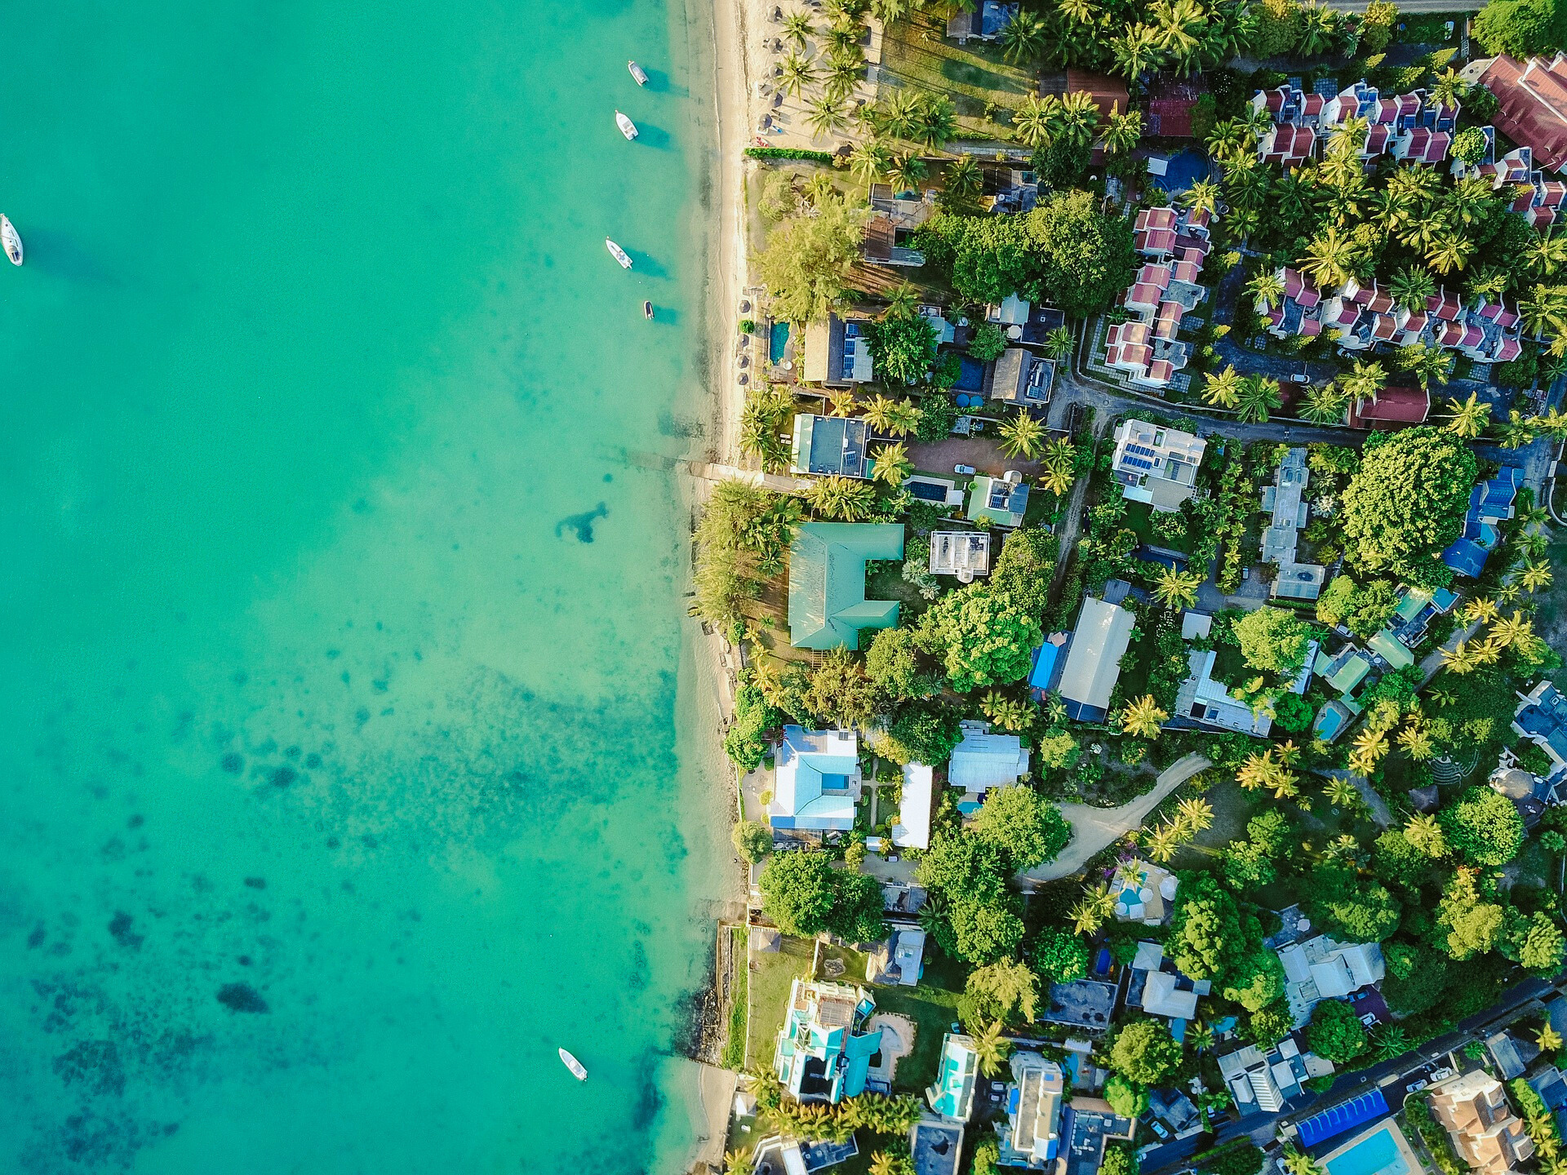



Tsunami Ready in Büyükçekmece (İstanbul) and Seferihisar (İzmir), Türkiye (NEAM)
Dr. Musavver Didem Cambaz - KOERI
didem.samut@bogazici.edu.tr
Prof. Dr. Ahmet Cevdet Yalciner - METU
yalciner@metu.edu.tr
FIRST CONFERENCE OF THE OCEAN DECADE TSUNAMI PROGRAMME
Hyderabad, India
10-11 November 2025

Slide 2


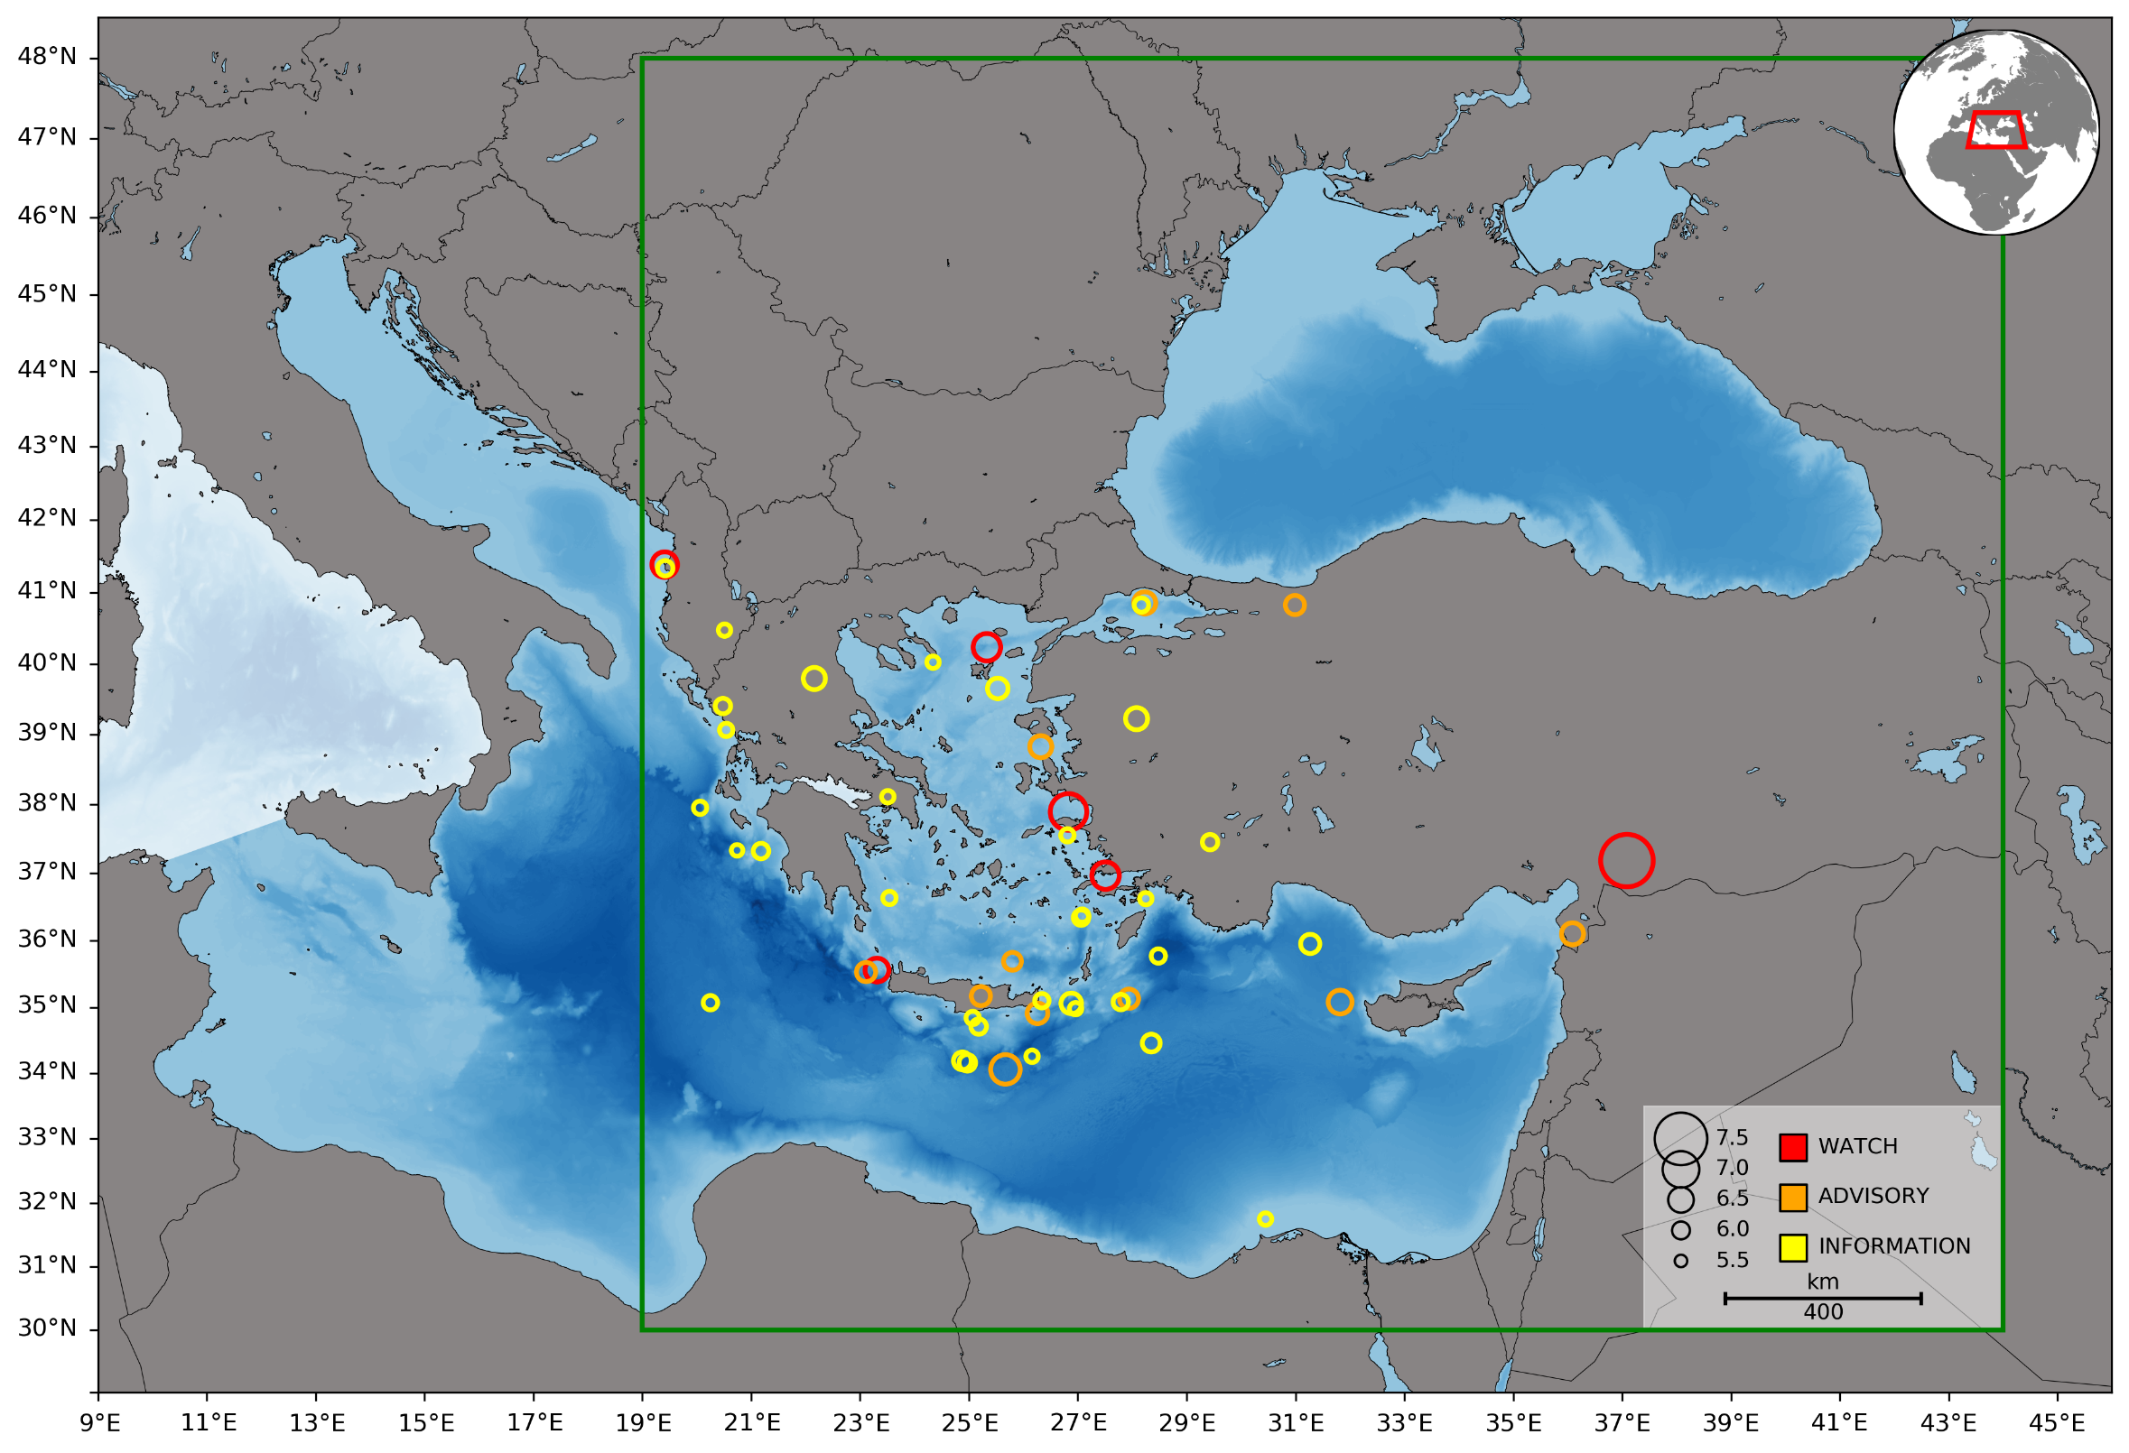
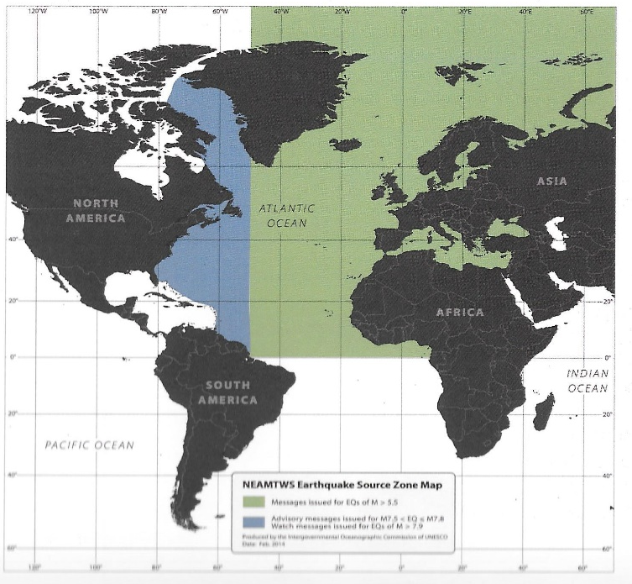

Tsunami Hazard and Risk in Türkiye
UNESCO-IOC ICG/NEAMTWS
TSP/NTWC KOERI
51 tsunami messages
(34 Information,
11 Advisory, 6 Watch)
between 2012-2025
in the monitoring area
(green rectengle)
10-11 November 2025
INCOIS, Hyderabad, India
First Conference of the
Ocean Decade Tsunami Programme

Slide 3
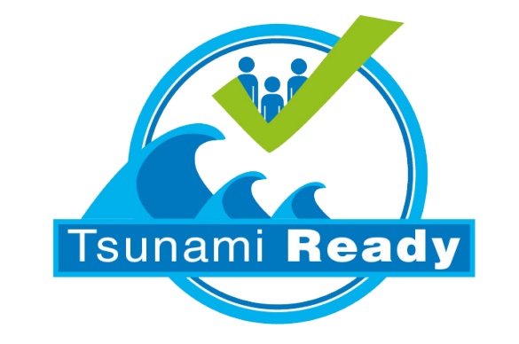



Tsunami Risk Mitigation Studies in Türkiye:
CoastWAVE, CoastWAVE II, LAST MILE …
LastMile : 2018 – 2019, Bodrum Muğla
CoastWAVE I : 2021-2023, Büyükçekmece İstanbul
CoastWAVE II : 2024- 2026, Seferihisar İzmir
10-11 November 2025
INCOIS, Hyderabad, India
First Conference of the
Ocean Decade Tsunami Programme

Slide 4
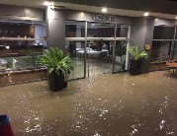
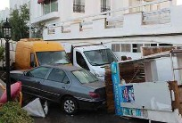
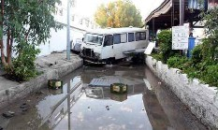
LastMile : 2018 – 2019, Bodrum Muğla
On 21 July 2017, a large earthquake 6.6 Mw struck Kos in Greece and Bodrum in Türkiye with a tsunami
10-11 November 2025
INCOIS, Hyderabad, India
First Conference of the
Ocean Decade Tsunami Programme

Slide 5
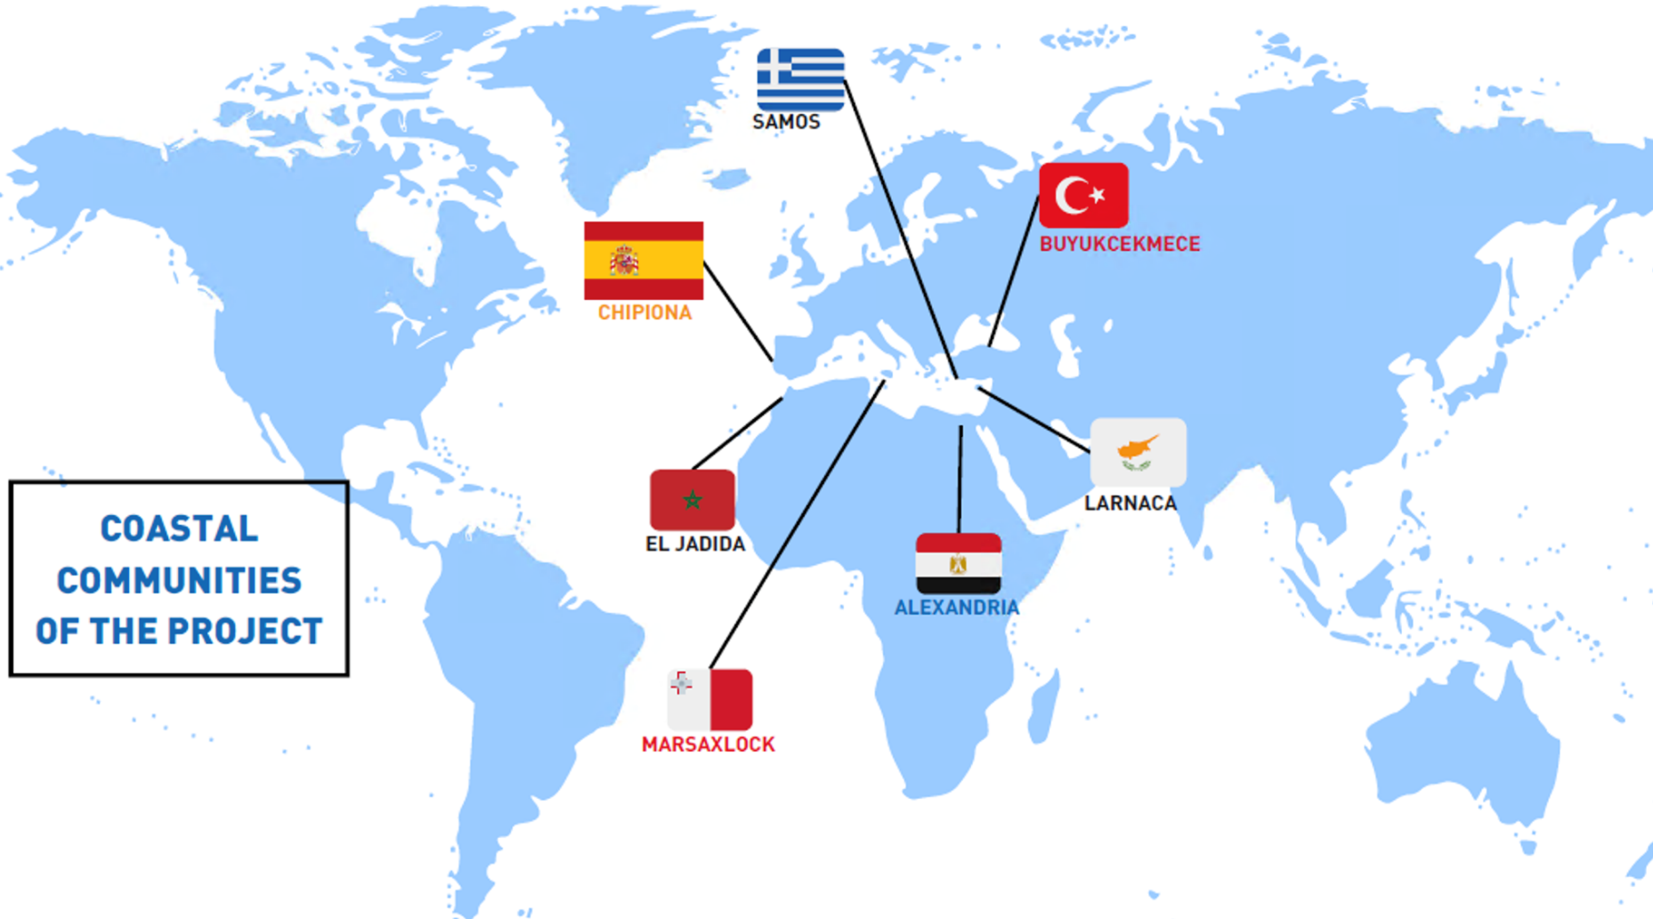


CoastWAVE: 2021-2023, Büyükçekmece, İstanbul, Türkiye
https://oceanexpert.org/document/33763
10-11 November 2025
INCOIS, Hyderabad, India
First Conference of the
Ocean Decade Tsunami Programme

Slide 6
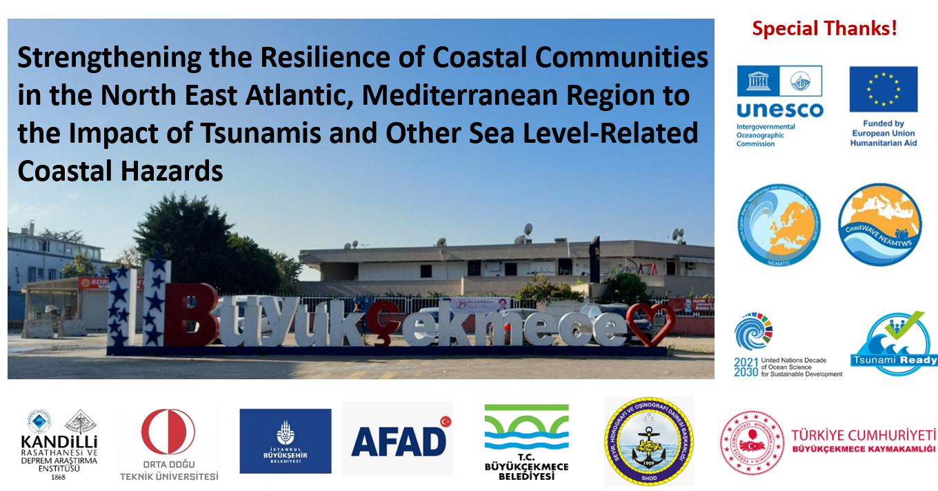
10-11 November 2025
INCOIS, Hyderabad, India
First Conference of the
Ocean Decade Tsunami Programme

Slide 7
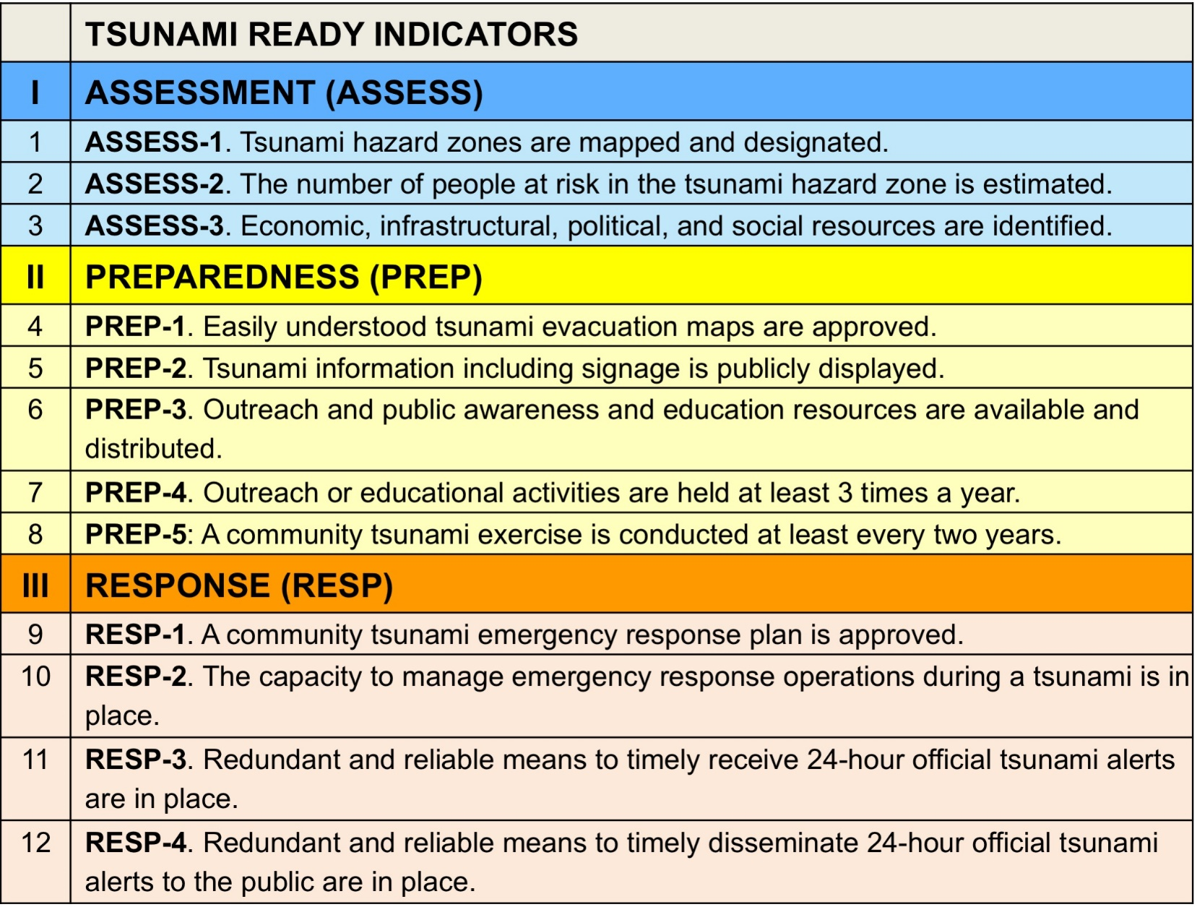

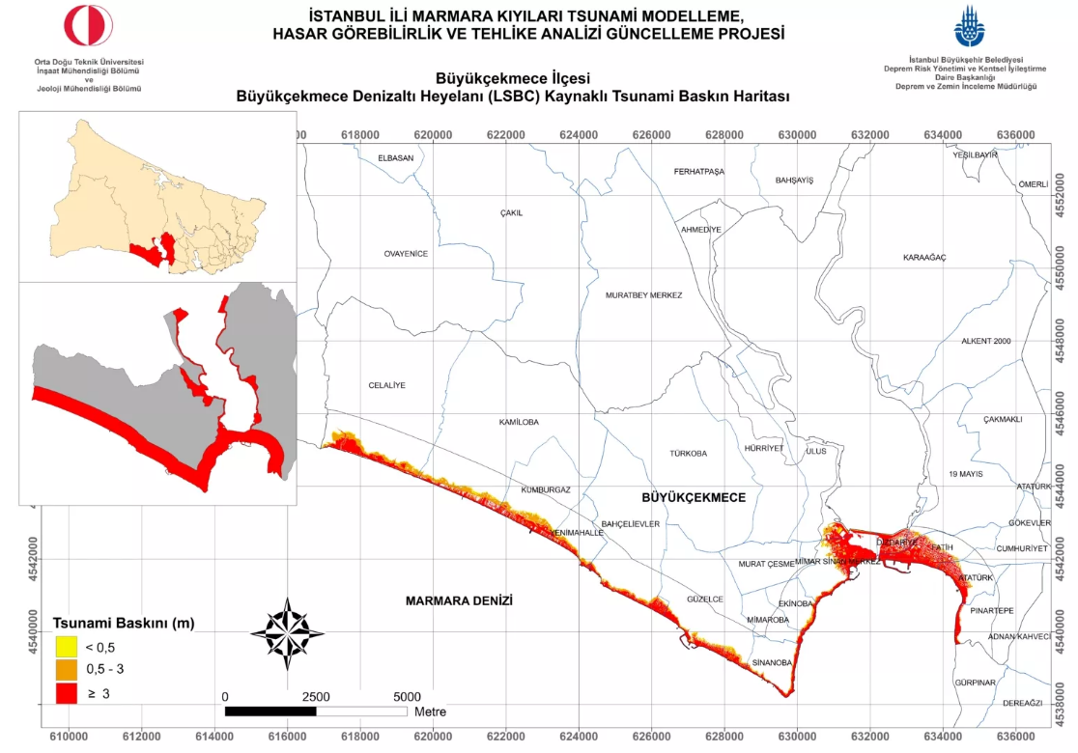
https://depremzemin.ibb.istanbul/guncelcalismalarimiz/#le-tsunam-blg-ktapiklari
10-11 November 2025
INCOIS, Hyderabad, India
First Conference of the
Ocean Decade Tsunami Programme

Slide 8
Identifying Political & Social Resources – Büyükçekmece, Istanbul
Resources that can be used in Büyükçekmece community for TR Implementation:
Istanbul Metropolitan Municipality: Province Level
Istanbul Directorate of AFAD: Province Level
Buyukcekmece Municipality: Local Level
Local/National emergency budget
National Emergency Budget for Buyukcekmece :
AFAD (Disaster and Emergency Management Presidency)
Local Emergency Budget :
Istanbul Metropolitan Municipality
DRRs integrated in development planning : EQ: Urban Transformation
Tsunami Action planning: IMM Earthquake and Ground Investigation Department,
before (increasing tsunami awareness, tsunami signage, tsunami information boards), during (Early Warning System), after tsunami (should be established)
Local parliament members support : No local parliament in Türkiye
Policy and Regulation framework at local, province and national level
Several active NGOs mainly expertised and involved in earthquake conditions
School communities
Religious associations
Social and volunteer organizations
Religious buildings
Community social facilities: community auditorium
Hospital and health clinics
10-11 November 2025
INCOIS, Hyderabad, India
First Conference of the
Ocean Decade Tsunami Programme

Slide 9
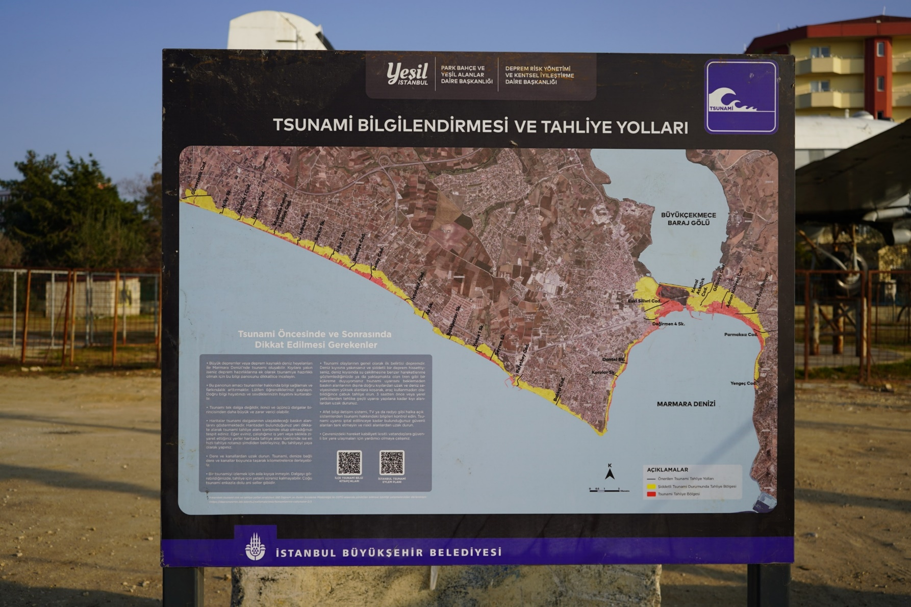





IMM & Transportation Coordination Directorate Collaboration!
(UNESCO ITIC Standards & National signage standards.)
10-11 November 2025
INCOIS, Hyderabad, India
First Conference of the
Ocean Decade Tsunami Programme

Slide 10
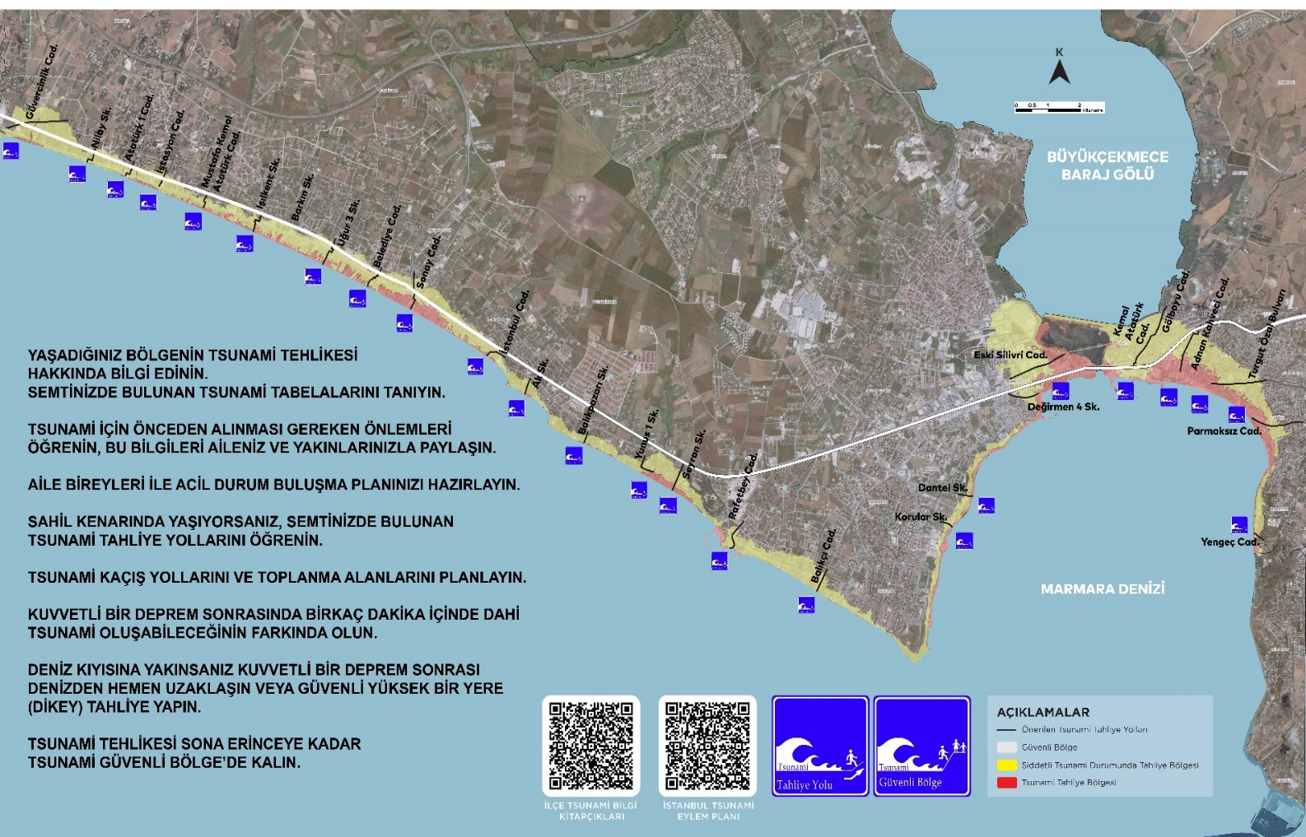
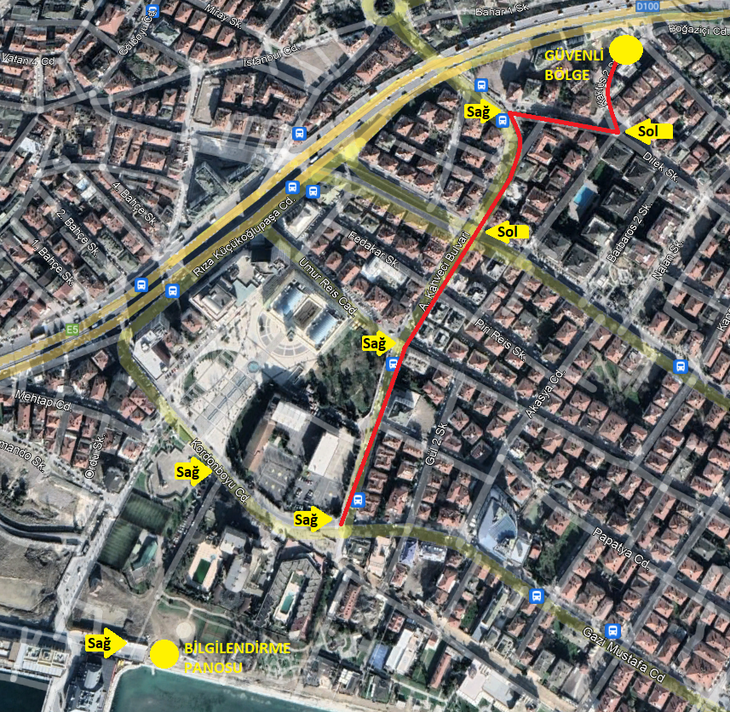
10-11 November 2025
INCOIS, Hyderabad, India
First Conference of the
Ocean Decade Tsunami Programme

Slide 11
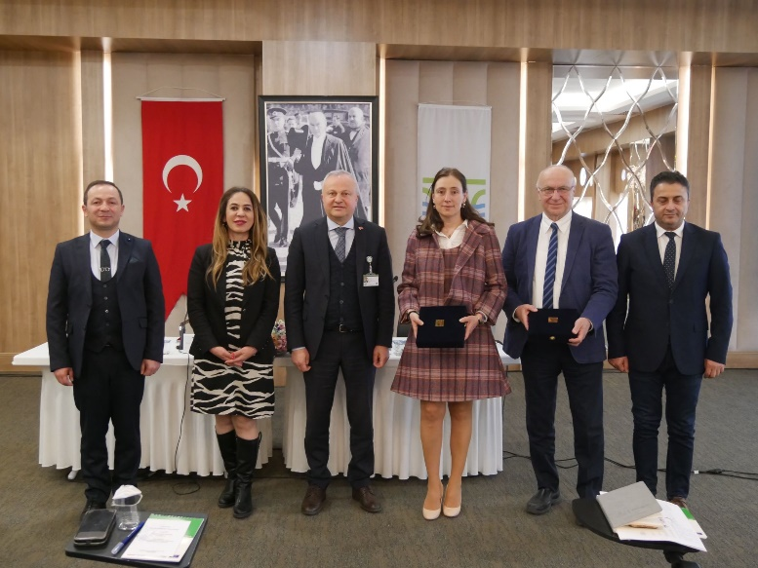
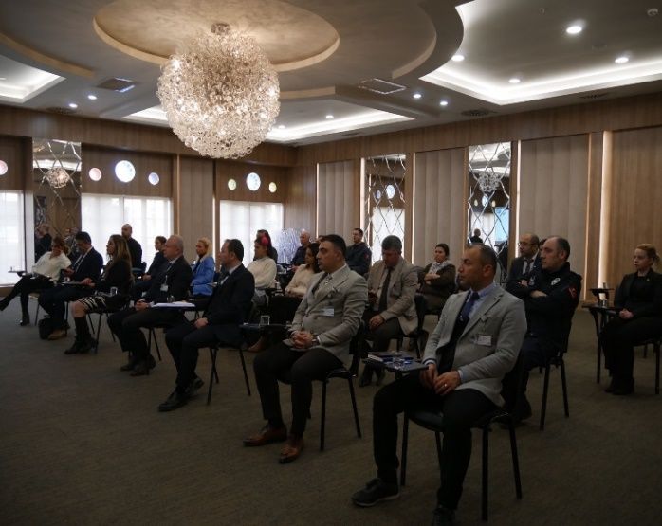
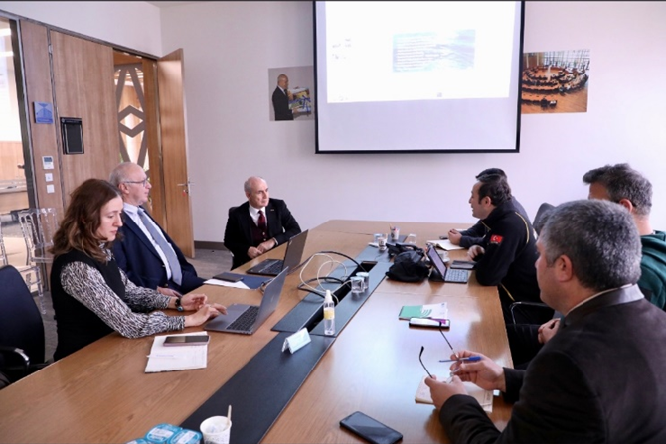
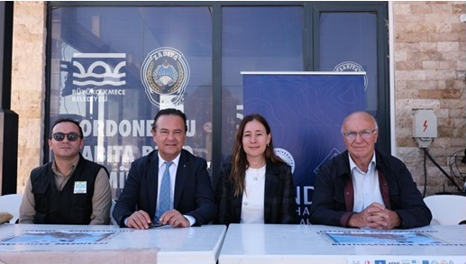
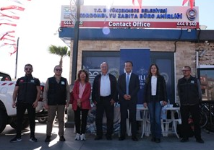
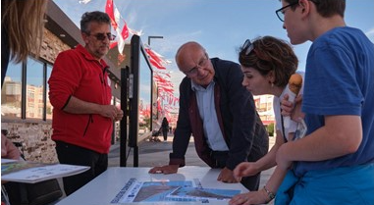
Preparedness: Tsunami Awareness Meetings with local and provincial level stakeholders
Preparedness: Tsunami Awareness Meetings with local residents
10-11 November 2025
INCOIS, Hyderabad, India
First Conference of the
Ocean Decade Tsunami Programme

Slide 12
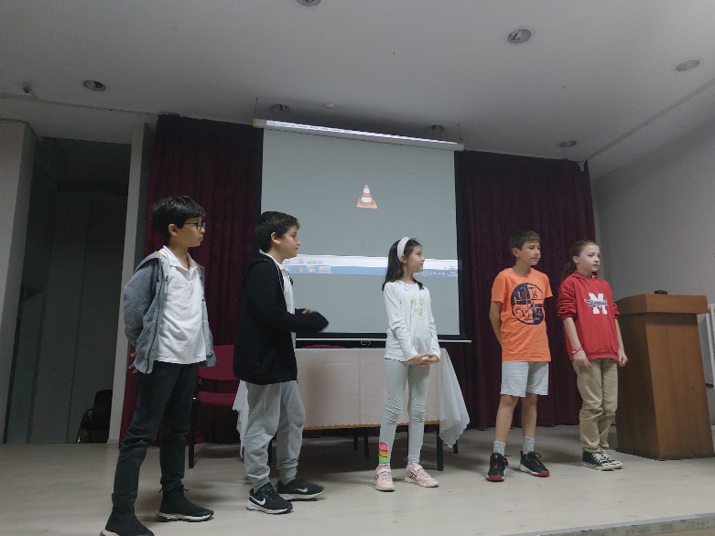
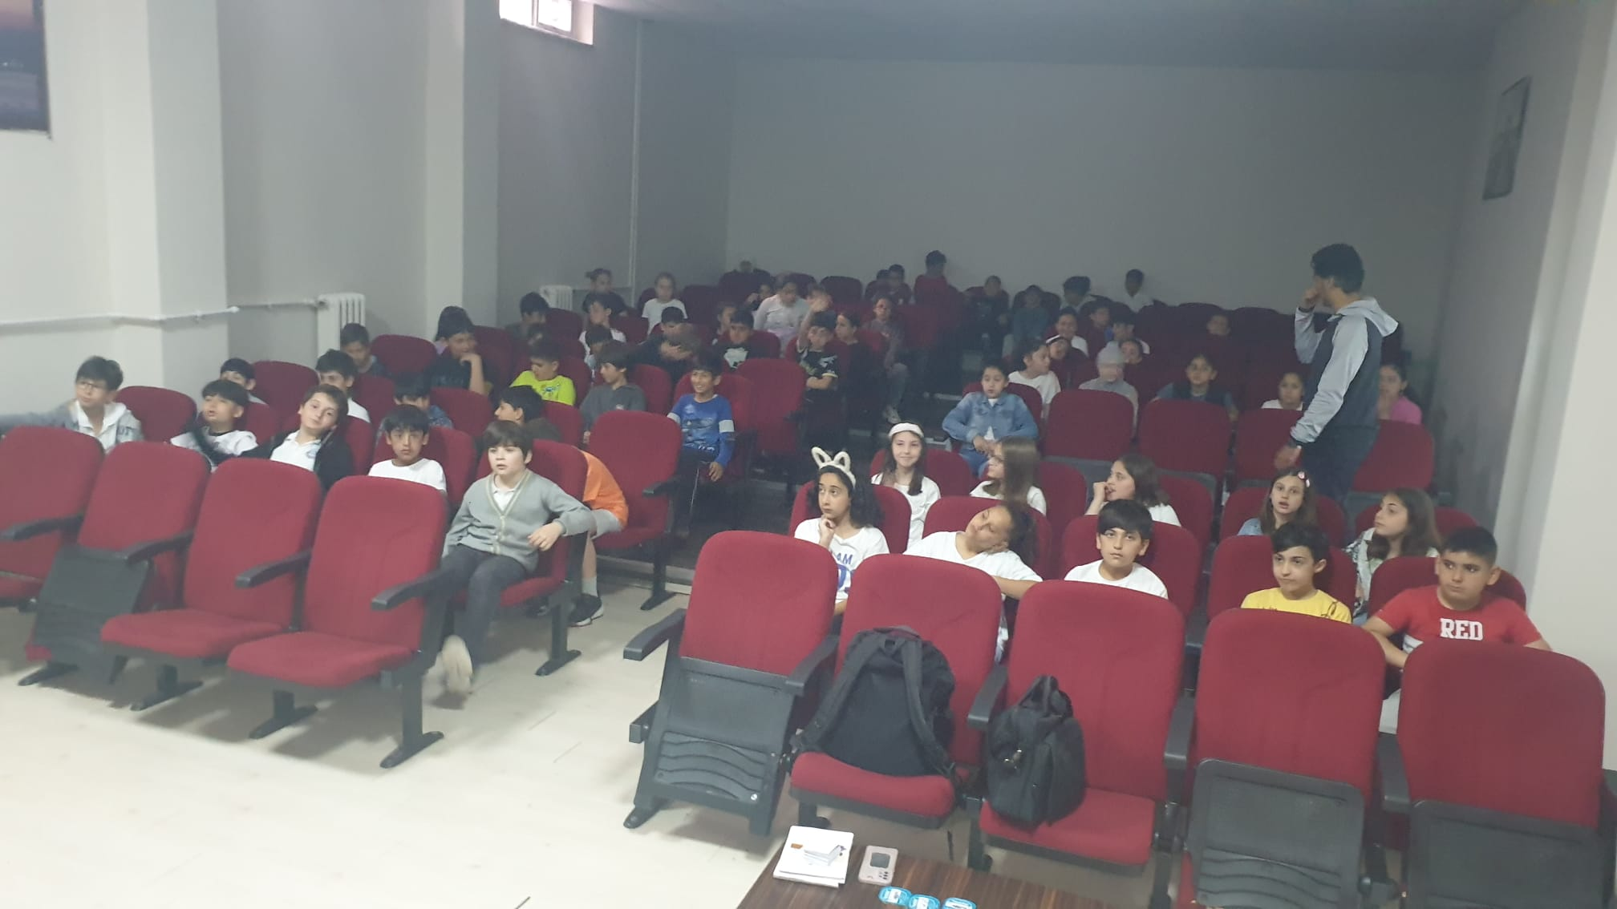
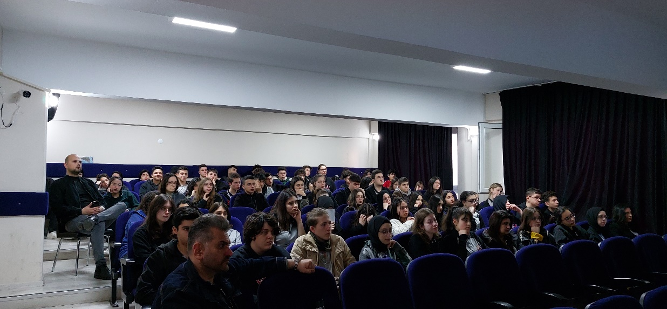
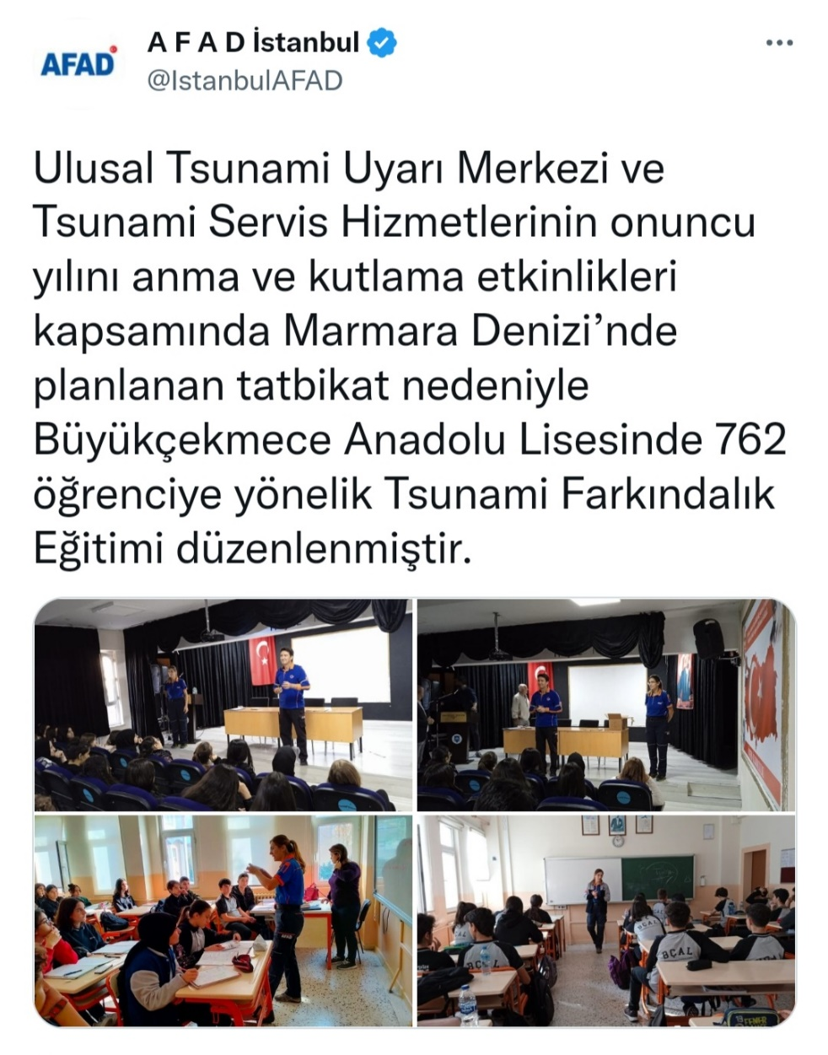
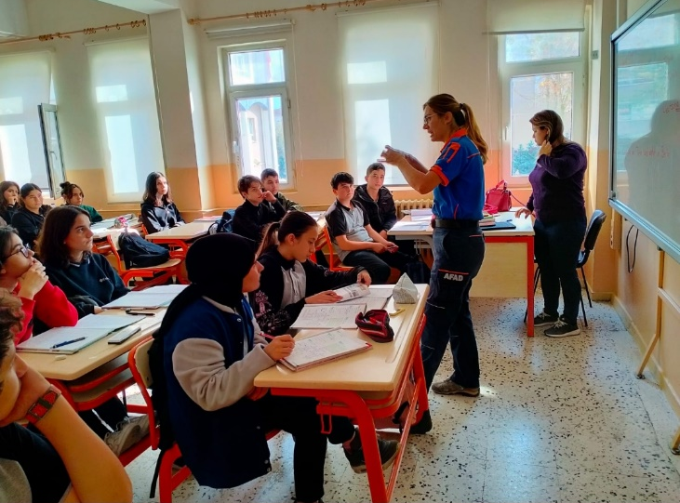
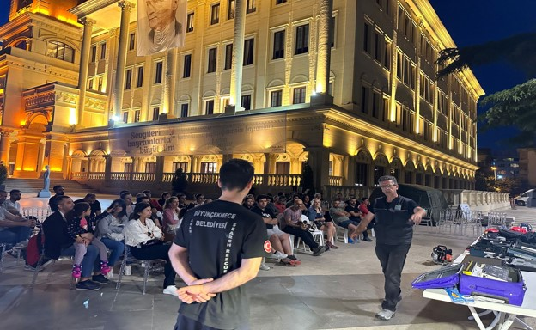
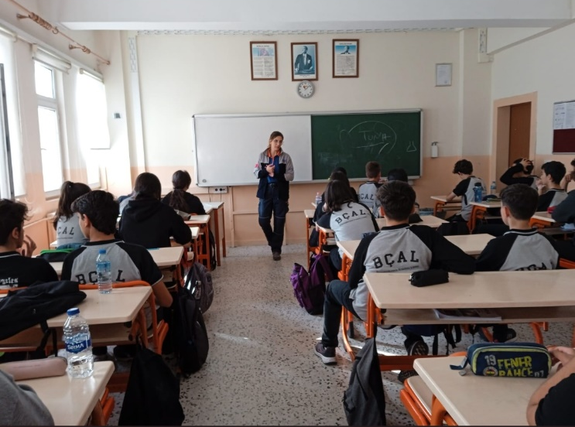
Preparedness: Outreach and educational activities
https://twitter.com/IstanbulAFAD/status/1589564360032407552?t=Gpvr5hciMuPqJRisKuk5VA&s=03
10-11 November 2025
INCOIS, Hyderabad, India
First Conference of the
Ocean Decade Tsunami Programme

Slide 13

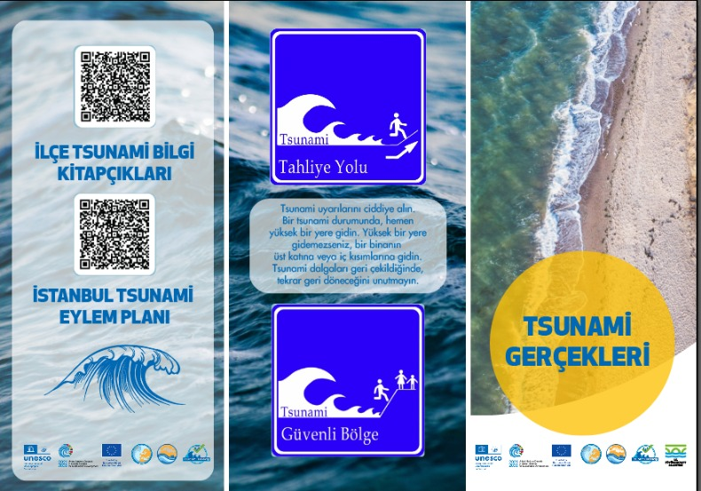
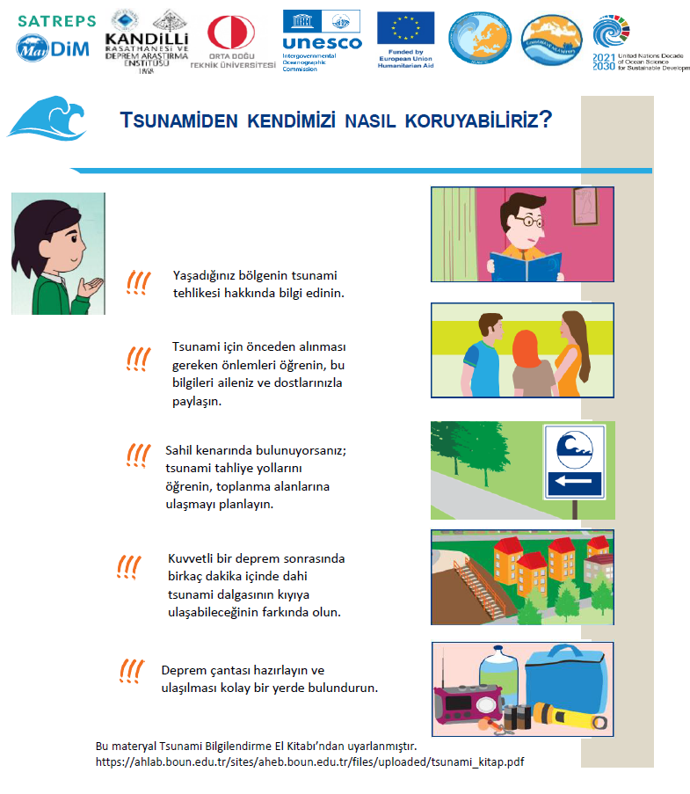
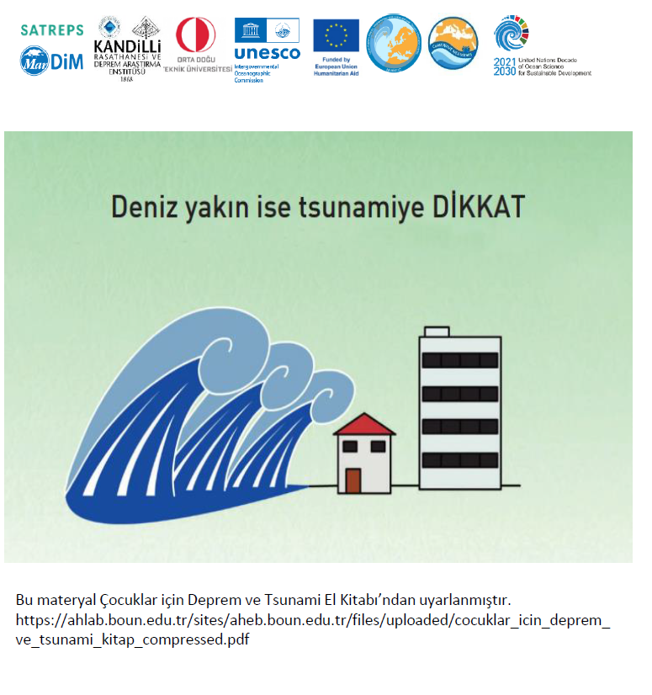
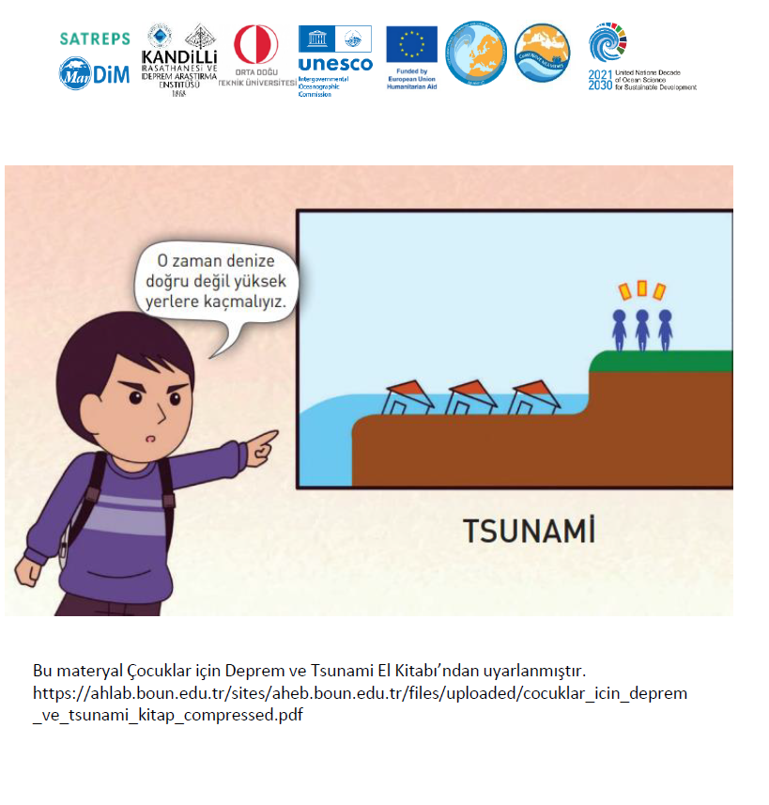
Preparedness: Outreach and educational activities
10-11 November 2025
INCOIS, Hyderabad, India
First Conference of the
Ocean Decade Tsunami Programme

Slide 14
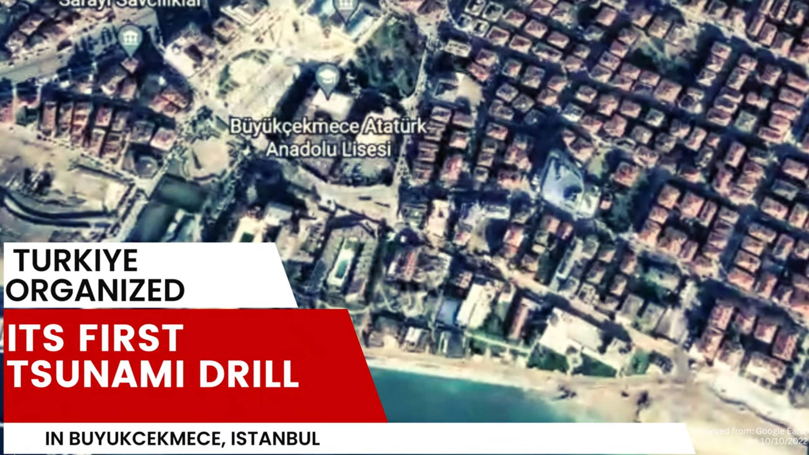
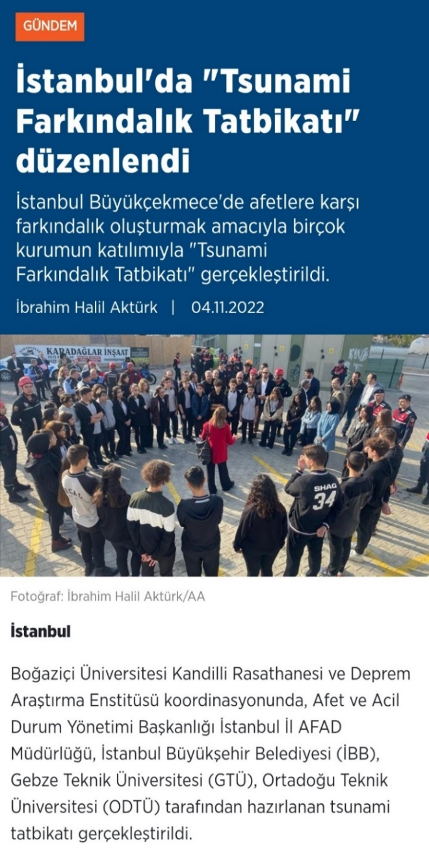
https://youtu.be/8NX58DlYIt0
10-11 November 2025
INCOIS, Hyderabad, India
First Conference of the
Ocean Decade Tsunami Programme

Slide 15
10-11 November 2025
INCOIS, Hyderabad, India
First Conference of the
Ocean Decade Tsunami Programme

Slide 16
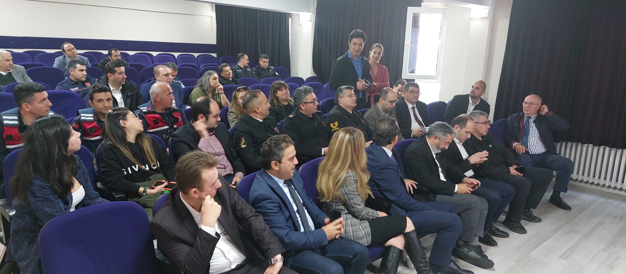
10-11 November 2025
INCOIS, Hyderabad, India
First Conference of the
Ocean Decade Tsunami Programme

Slide 17
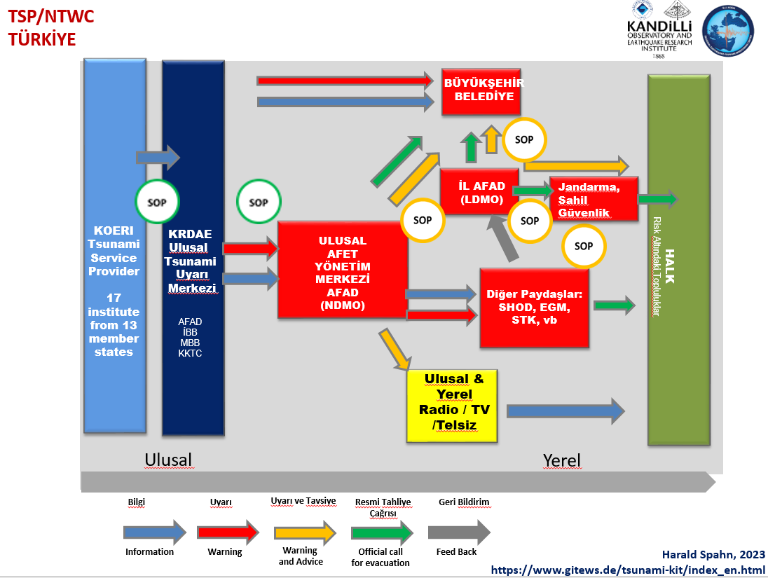
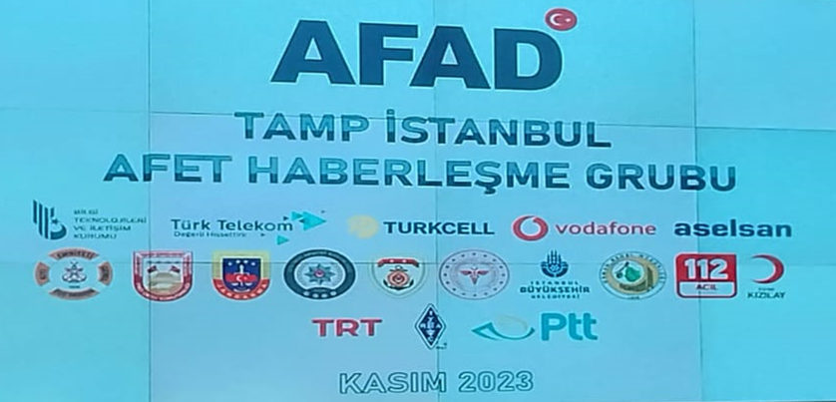
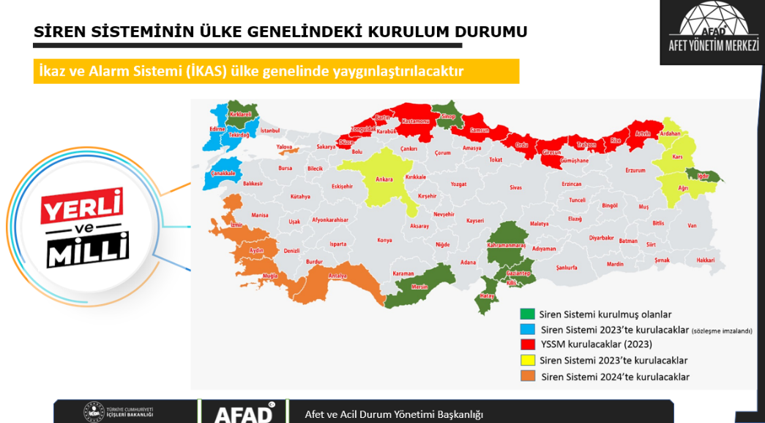
10-11 November 2025
INCOIS, Hyderabad, India
First Conference of the
Ocean Decade Tsunami Programme

Slide 18
NTRB & TRLC
NTRB – National Tsunami Ready Board Members:
KOERI: Prof. Dr. Haluk Özener (ozener@bogazici.edu.tr ) NTWC (Chair)
AFAD: Abdullah Özçelik (Abdullah.ozcelik@afad.gov.tr ) CPA
AFAD: Prof. Dr. Orhan Tatar (orhan.tatar@afad.gov.tr ) CPA
KOERI: Dr. Musavver Didem Cambaz (didem.samut@bogazici.edu.tr ) NTC
METU: Prof. Dr. Ahmet Yalçıner (yalciner@metu.edu.tr ) NTC
ONHO: Lt.Cdr.Dr. Emre Tükenmez (etukenmez@shodb.gov.tr ) IOC
TRLC- Tsunami Ready Local Committee Members:
Büyükçekmece Municipality: Caner Denizli (caner.denizli@bcekmece.bel.tr ) (Chair)
AFAD İstanbul: Kaan Tankut Aktar (istanbul.planlama@afad.gov.tr )
Büyükçekmece District Governorate: Dr. Güler Doğan (buyukcekmece@istanbul.gov.tr)
Büyükçekmece District Governorate : Dursun İlçi (buyukcekmece@istanbul.gov.tr)
İstanbul Metropolitan Municipality: Dr. Evrim Yavuz (evrim.yavuz@ibb.gov.tr )
İstanbul Metropolitan Municipality : Y. Müh.Esra Kalkan Ertan (esra.ertan@ibb.gov.tr )
10-11 November 2025
INCOIS, Hyderabad, India
First Conference of the
Ocean Decade Tsunami Programme

Slide 19
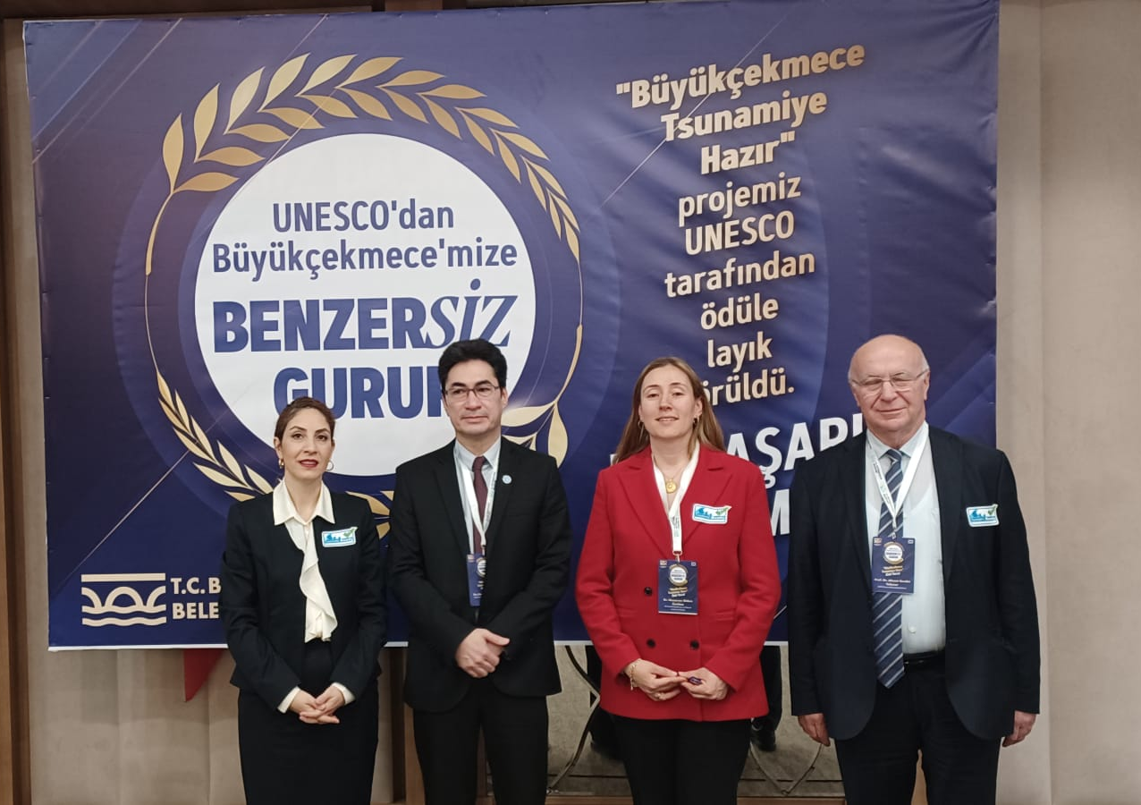
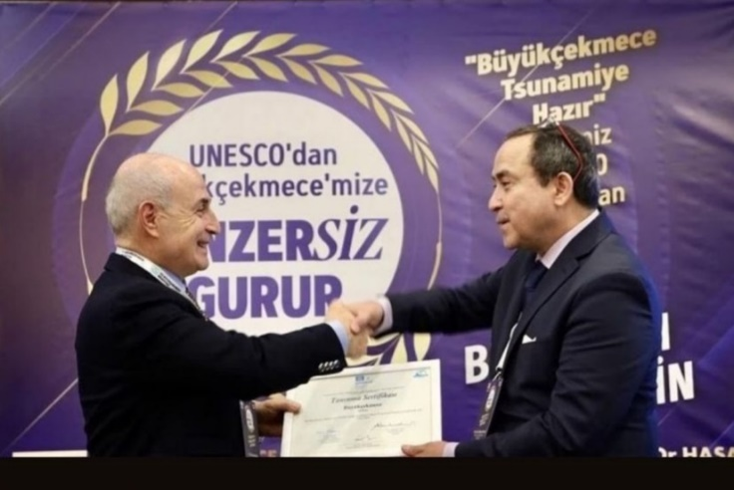
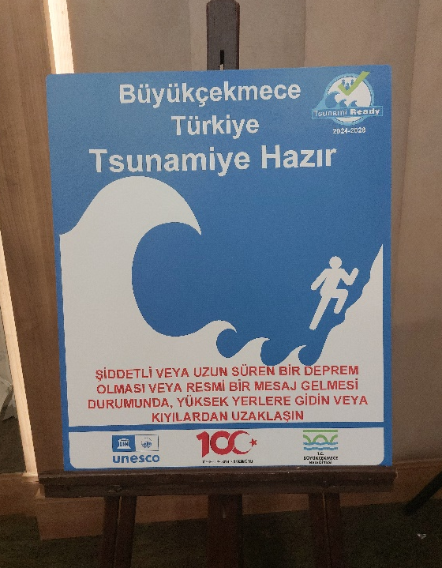
UNESCO-IOC officially recognized the Büyükçekmece community as Tsunami Ready and presented the certificate on 15 March 2024.
10-11 November 2025
INCOIS, Hyderabad, India
First Conference of the
Ocean Decade Tsunami Programme

Slide 20
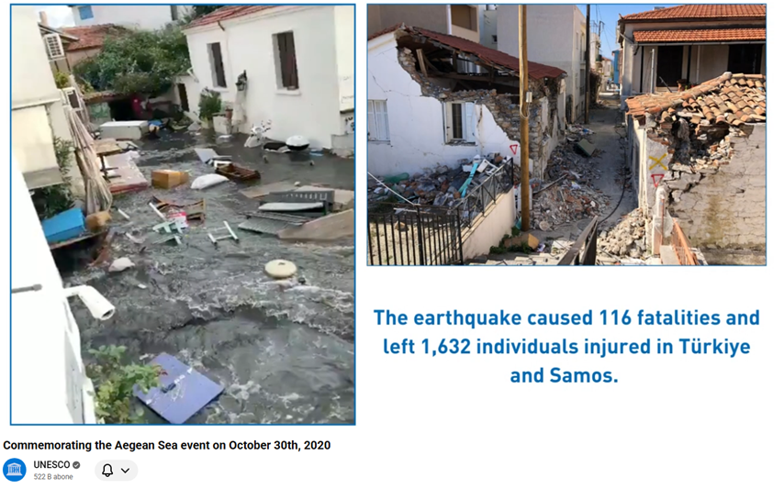
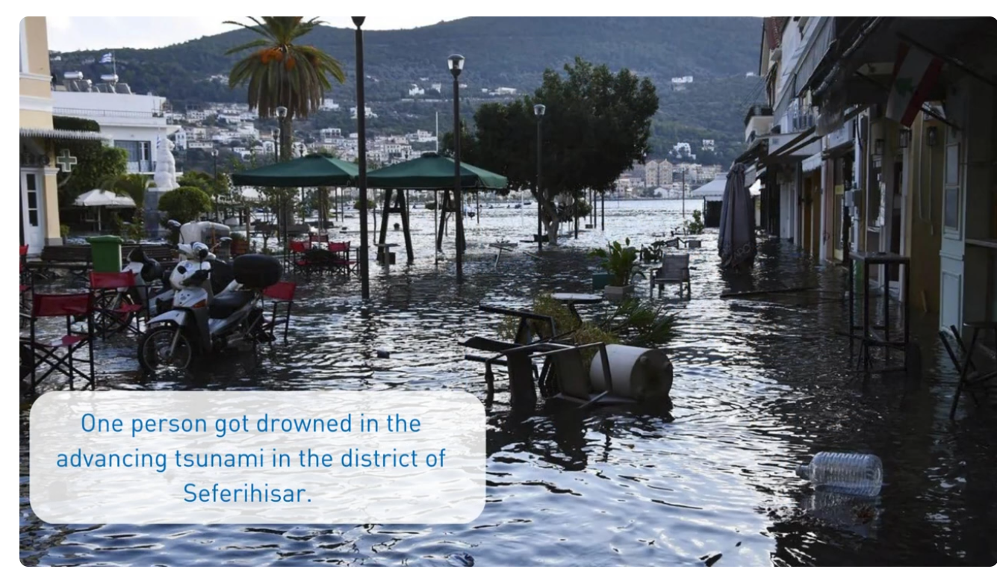
CoastWAVE II : 2024-2026, Seferihisar, İzmir, Türkiye
https://legacy.itic.ioc-unesco.org/legacy.itic.ioc-unesco.org/indexebdf.html?option=com_content&view=category&layout=blog&id=2623&Itemid=3214
10-11 November 2025
INCOIS, Hyderabad, India
First Conference of the
Ocean Decade Tsunami Programme

Slide 21
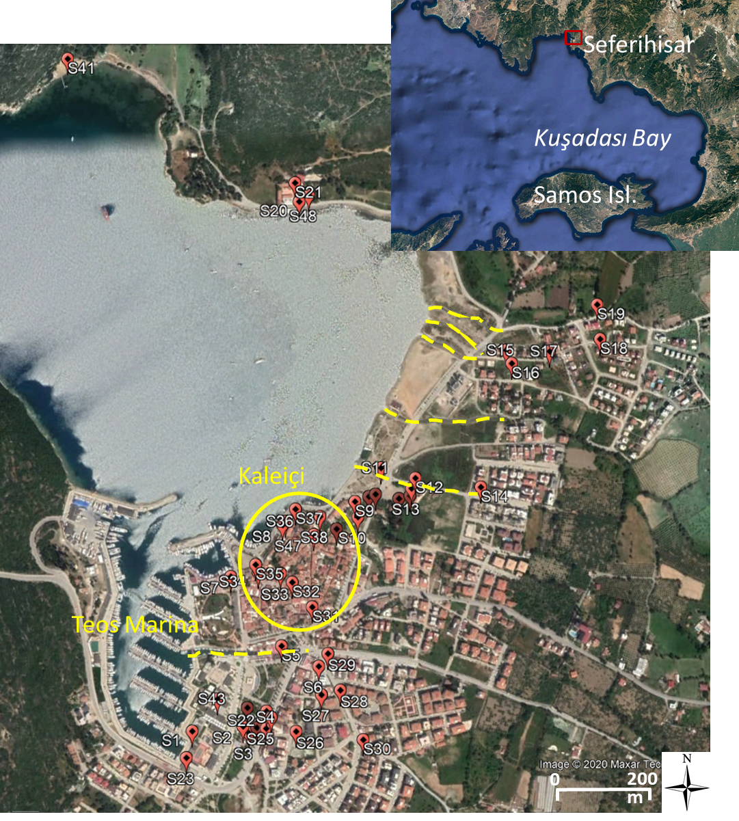
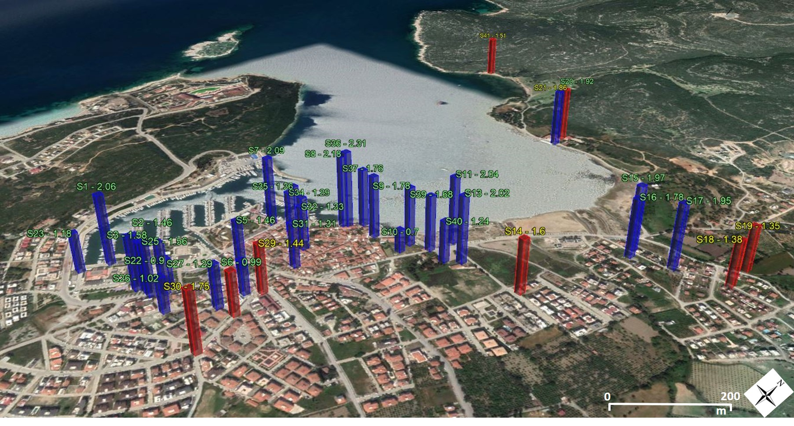
ANALYSIS OF THE 30 OCTOBER 2020 AEGEAN SEA TSUNAMI TOWARDS FUTURE TSUNAMI PREPAREDNESS – SIĞACIK SEFERİHİSAR
Highest impact with one casualty, injured people
Significant damage and extensive property loss in Teos Marina and Kaleiçi region
Maximum tsunami height 2.3 m
Maximum inundation 415 m
Distribution of the measured tsunami heights (blue) and runups (red) in Sığacık
Dogan G.G and Yalciner A. C. (2021), EGU21-15882
10-11 November 2025
INCOIS, Hyderabad, India
First Conference of the
Ocean Decade Tsunami Programme
Notes:
.

Slide 22
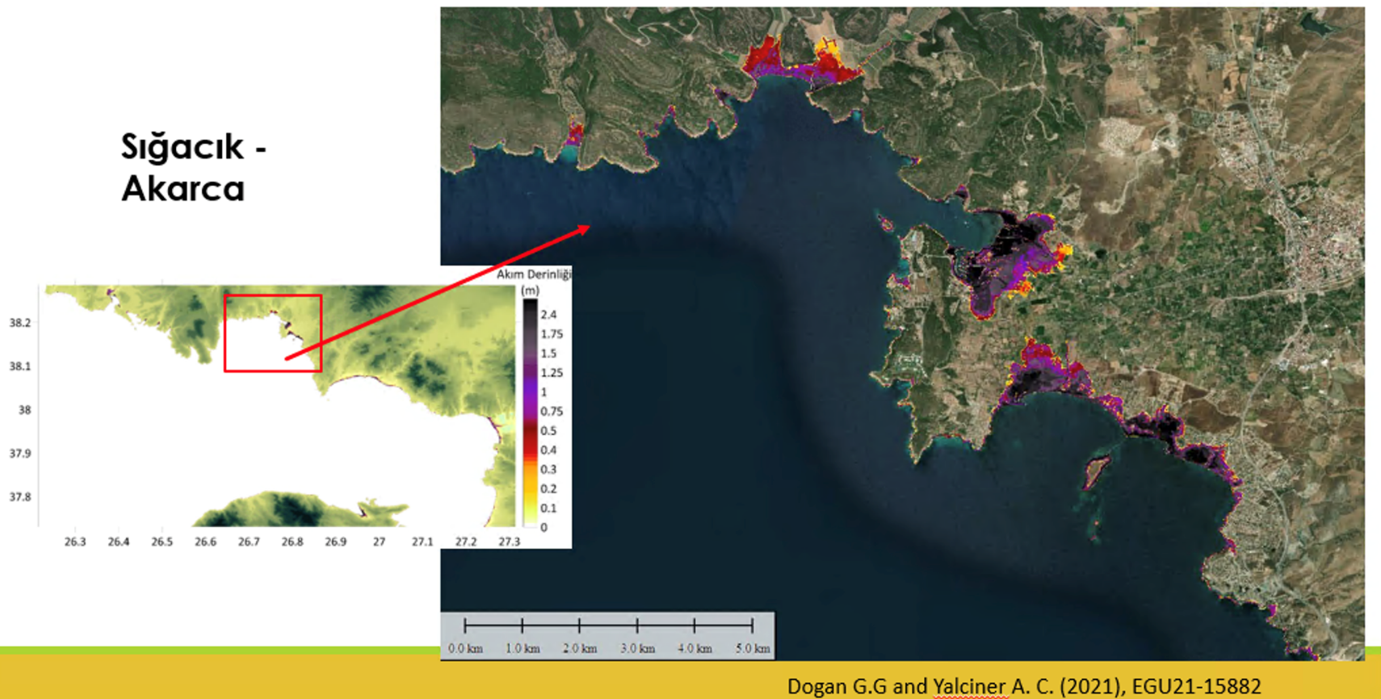
CoastWAVE II : 2024-2026, Seferihisar, İzmir, Türkiye
Conclusions:
Critical tsunami scenarios for the Seferihisar district have been identified through the analysis of tsunami-generating fault zones, supported by the development of a high-resolution modelling database and preliminary simulations.
Collaboration with İzmir Metropolitan Municipality, İzmir AFAD and Seferihisar Municipality is ongoing to fulfill the Tsunami Ready requirements.
10-11 November 2025
INCOIS, Hyderabad, India
First Conference of the
Ocean Decade Tsunami Programme

Slide 23


Thank You…
10-11 November 2025
INCOIS, Hyderabad, India
First Conference of the
Ocean Decade Tsunami Programme

