Slide 1




Training / Capacity Development in support to ODTP
Update and Progress
FIRST CONFERENCE OF THE OCEAN DECADE TSUNAMI PROGRAMME
Ardito M Kodijat, IOTIC
Dr. Laura Kong, ITIC
Hyderabad, India
10-11 November 2025

Slide 2



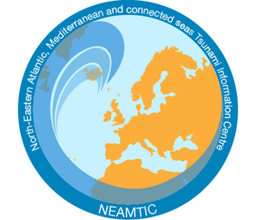
1. UNESCO-IOC Tsunami Information Centres
Standard Operation Procedures for Tsunami Early Warning and Emergency Response SOP (Regional) ➔ ITIC, IOTIC
Tsunami Evacuation Map, Plans, and Procedures - TEMPP (Regional) ➔ ITIC, IOTIC
Tsunami Ready Recognition Programme - TRRP (Regional) ➔ ITIC, IOTIC

Slide 3
2. Project Activities Supports (Regional and National)
Makran Project ➔ Strengthening Tsunami Early Warning in the northwest Indian Ocean Through Regional Cooperation (UNESCAP) - IO
COASTWAVE ➔ Strengthening resilience of coastal communities in the North-Eastern Atlantic and Mediterranean Regions to the impact of tsunamis and other sea-level-related coastal hazards. (DG-ECHO) - NEAMS
Strengthening Community Resilience to Ocean Hazards through implementation of TRRP in SIDS & Africa ➔ Flanders Funds In Trust – IO
Tsunami Ready Implementation in the Caribbean (6 countries) and Pacific (11 countries) - US Dept of State Office of Intl Disaster Response funds.
Sistema Nacional de Monitoreo de Tsunamis - SINAMOT (National Tsunami Monitoring System) in Costa Rica – Caribe – National Programme
National Tsunami Ready Training (NTRT), Maldives, Seychelles, Timor-Leste ➔ IOTIC-BMKG

Slide 4


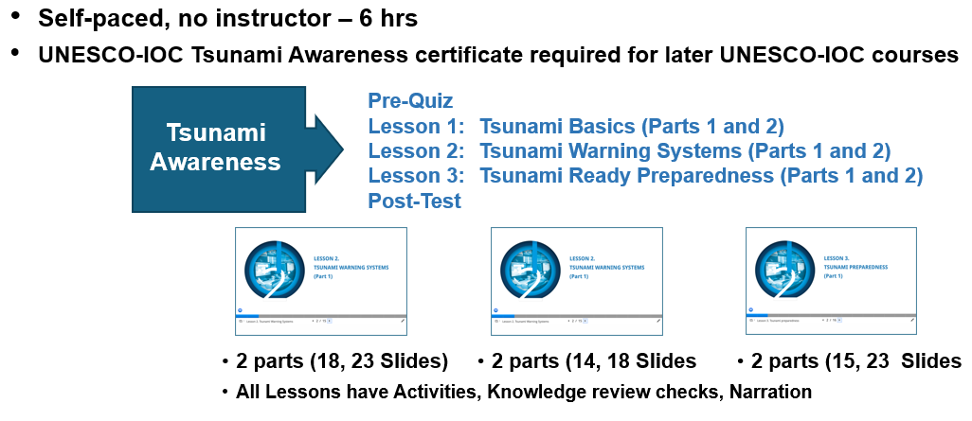
3. Ocean Teacher Global Academy

Slide 5
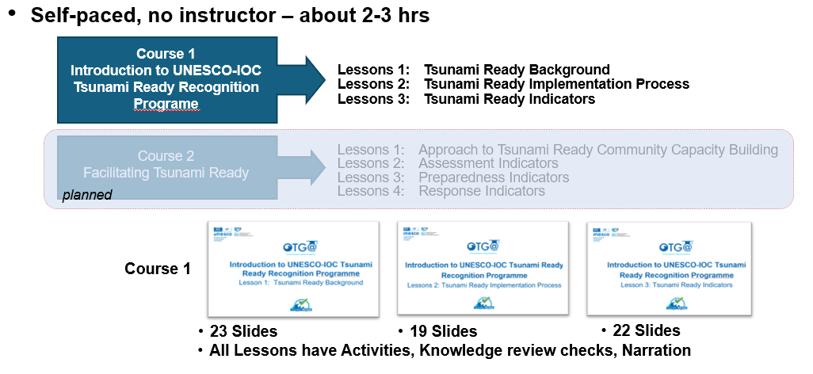
3. Ocean Teacher Global Academy

Slide 6
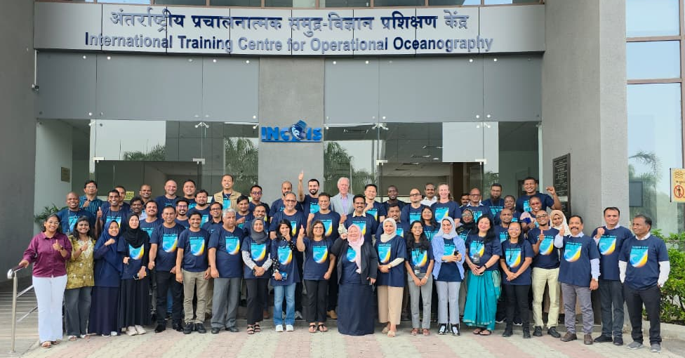
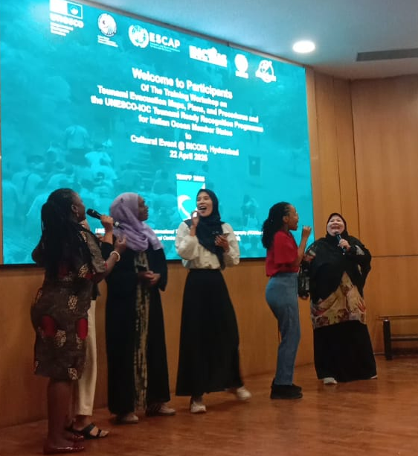
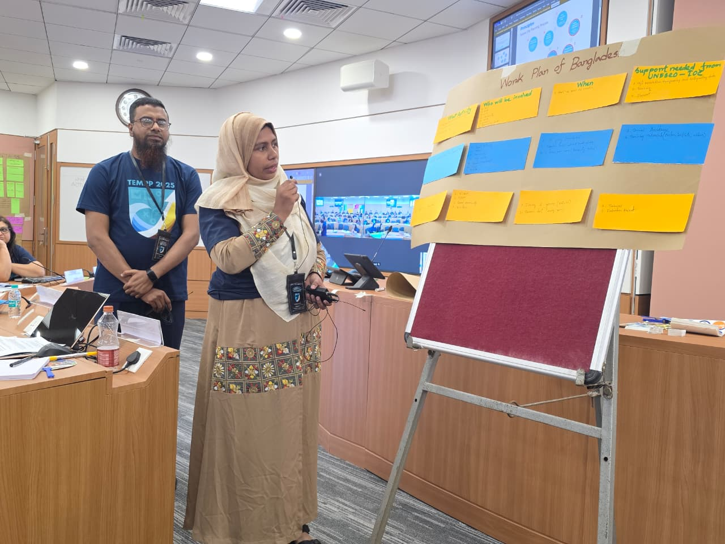
6. International Training Centre for Operational Oceanography (ITCOocean) – Category 2 Centre
Training Course on Ocean Observation System, operational Services and Ocean Data Utilization, December 02-06, 2024
Training/Workshop on Tsunami Evacuation Maps, Plans, and Procedures (TEMPP) UNESCO-IOC, April 15-23, 2025
Fundamentals of Remote Sensing & GIS and Oceanographic Application, May 05- 09 2025
DBCP - INCOIS Training workshop on Ocean Observations for Operational Services in the Indian Ocean, August 05-07, 2025
Operational Services Training to National Institute of Hydrography Officers (NIH - Advance Hydrography Course), September 09 2025

Slide 7
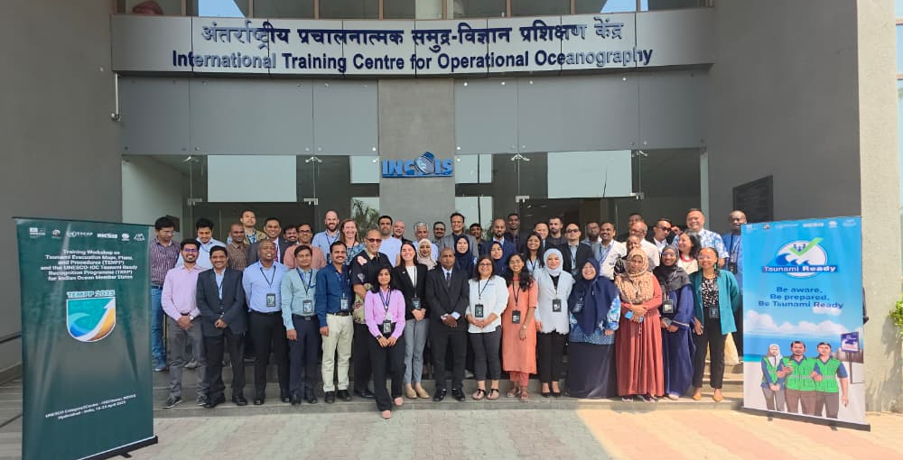
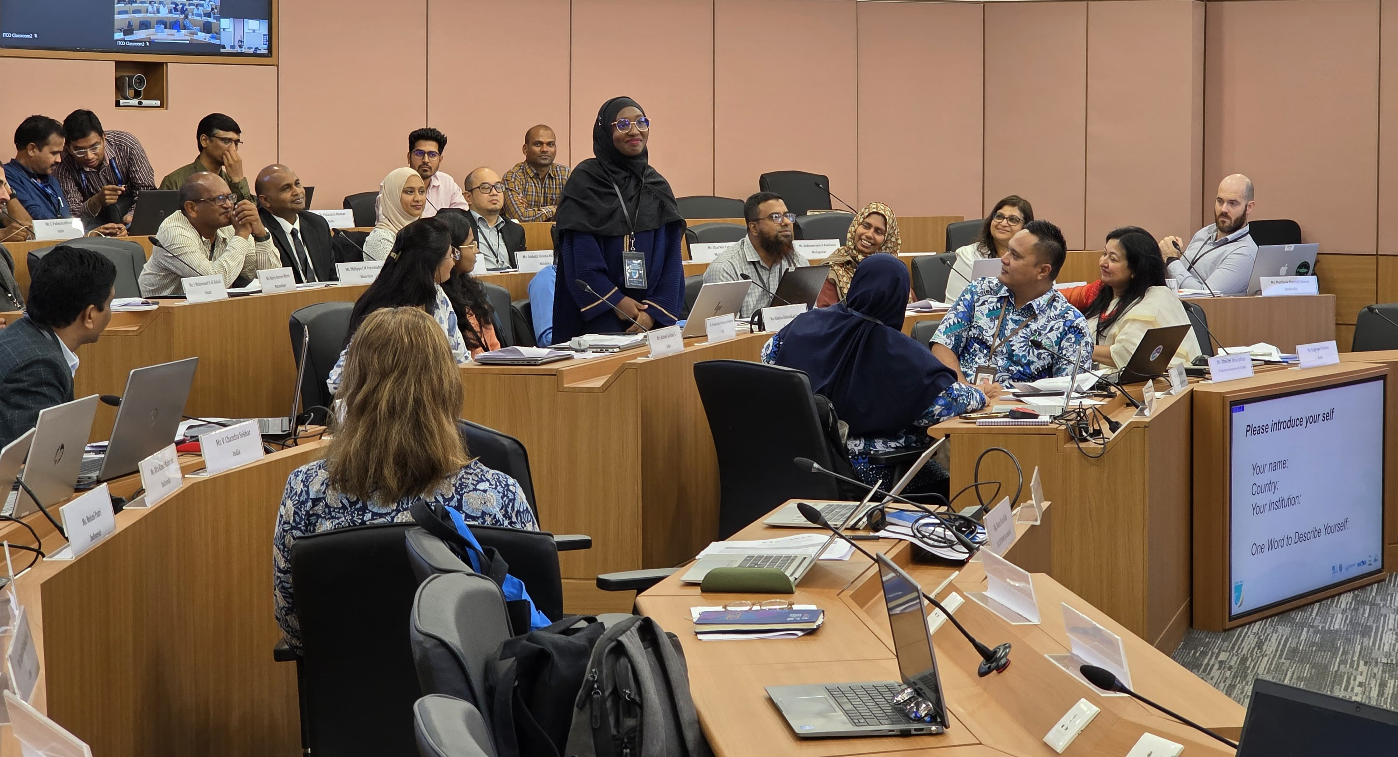
6. International Training Centre for Operational Oceanography (ITCOocean) – Category 2 Centre
Visualization of Oceanographic Data using Open-Source Tools, September 15-26, 2025
Ocean Remote Sensing and GIS-Conceptual Understanding with Practical Applications September 01-12, 2025
Operational Services Training to CSSTEAP members, October 31, 2025
International Training Centre for Operational Oceanography, November 24-28, 2025
Training course for Oman operators in early warning systems of Tsunami, November 24-28, 2025

Slide 8
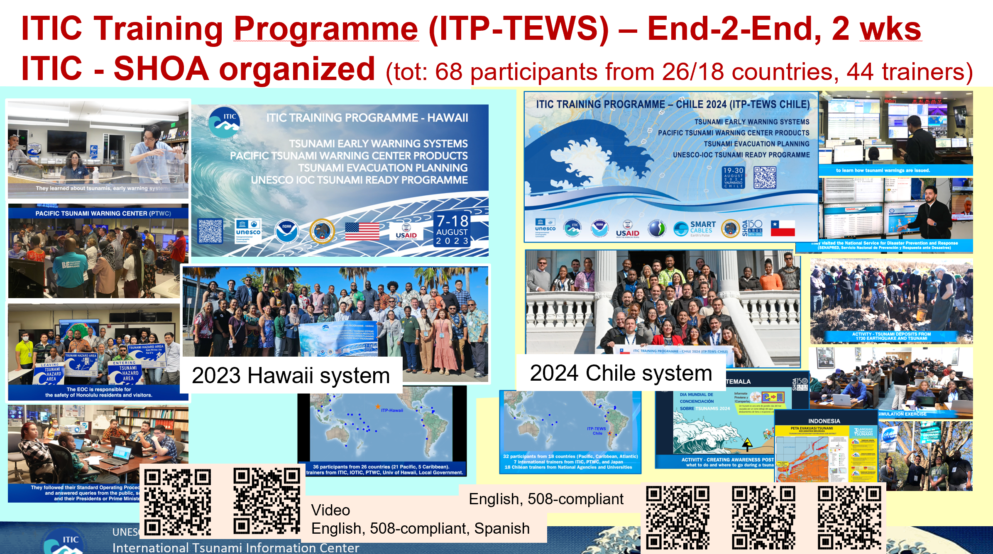
4. STC ITIC

Slide 9
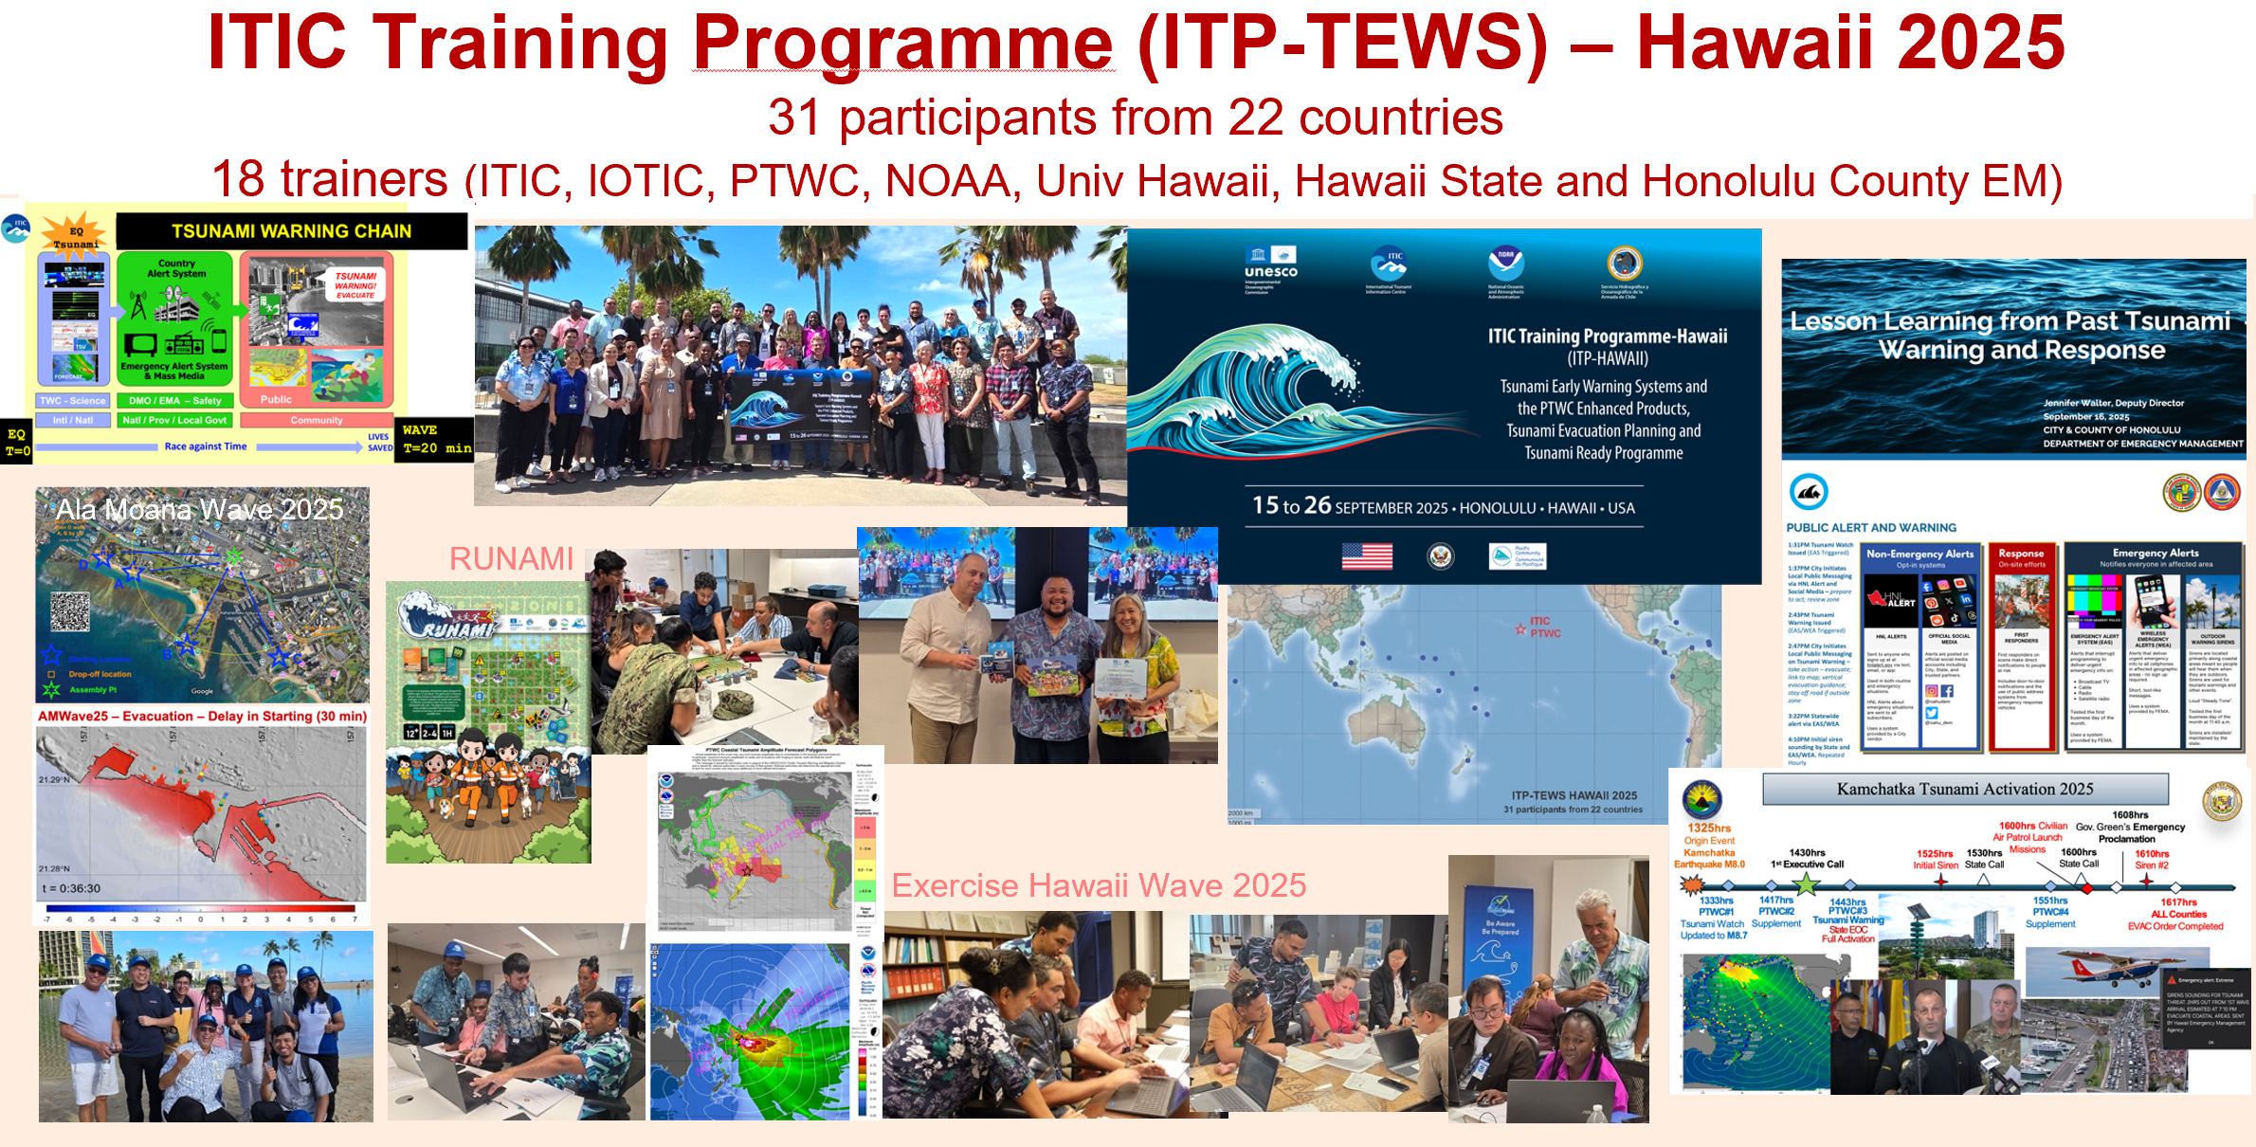
STC ITIC

Slide 10
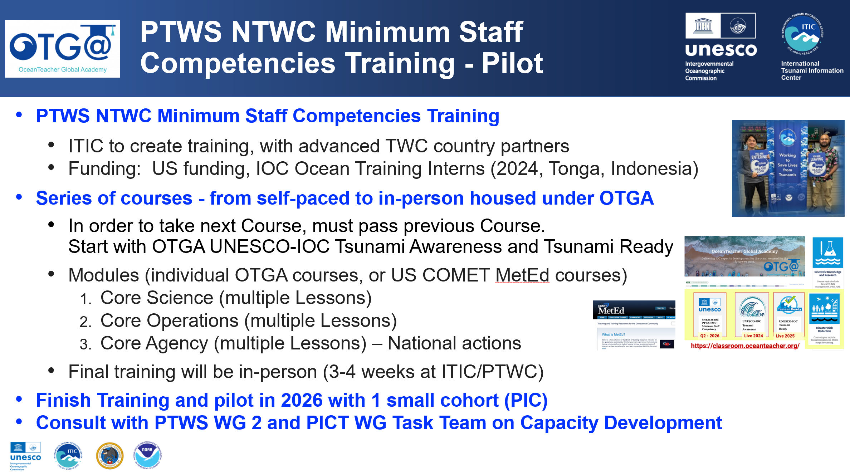
4. STC ITIC

Slide 11
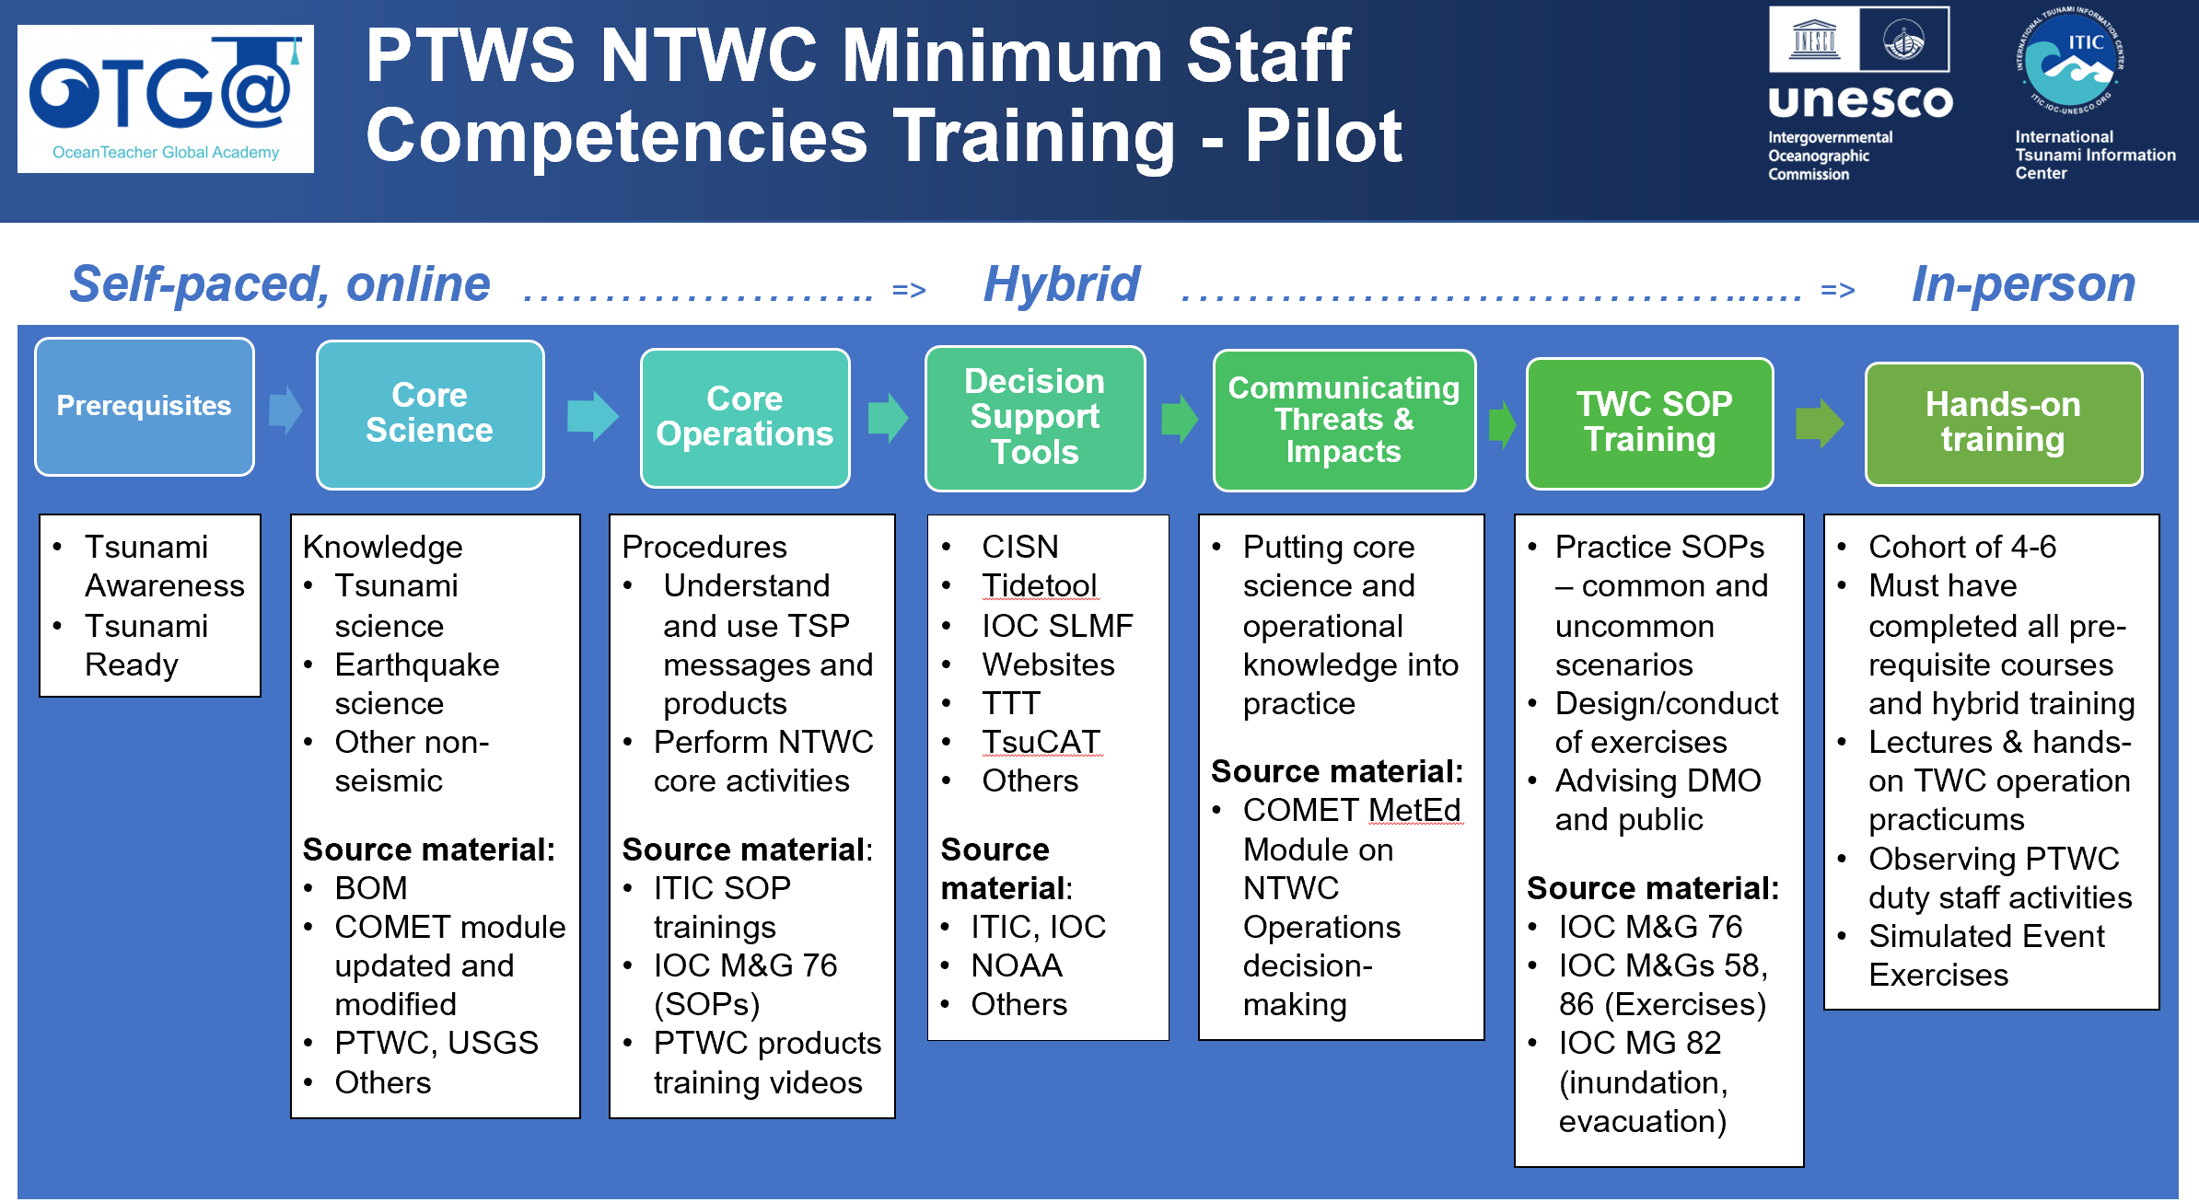
4. STC ITIC

Slide 12
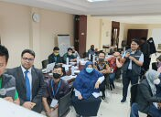
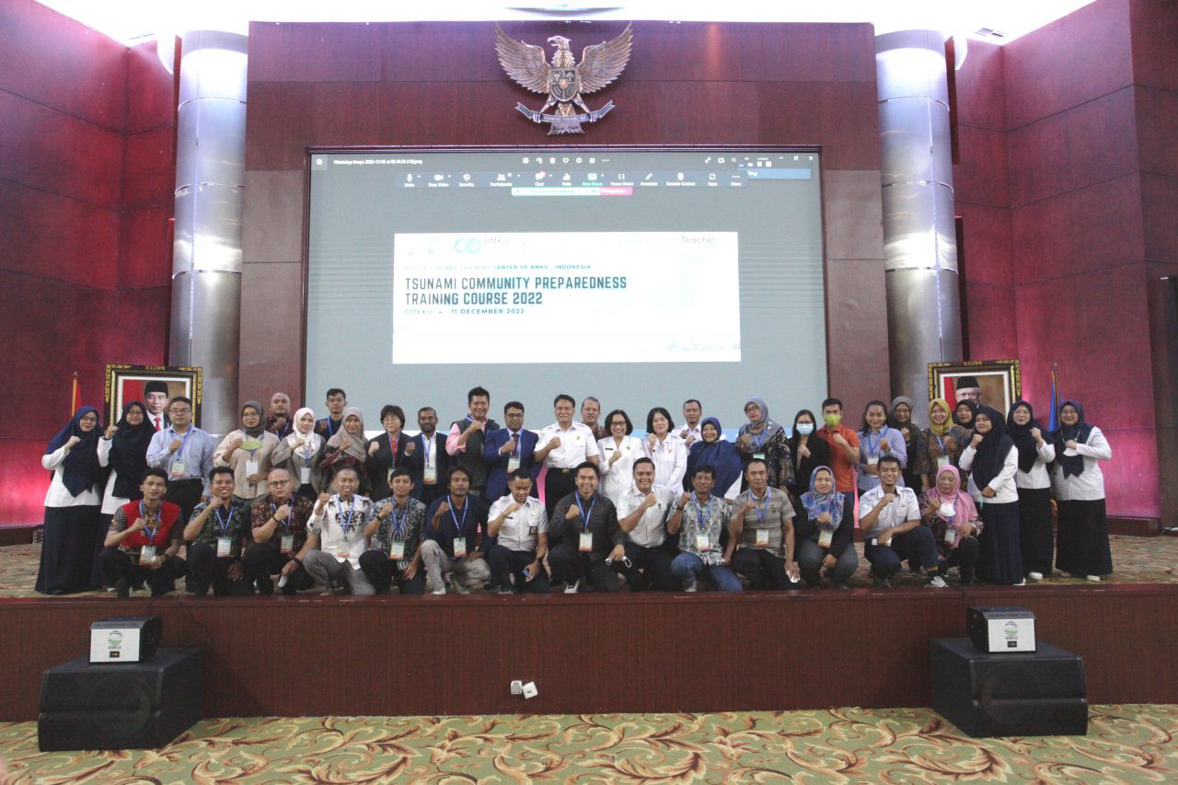
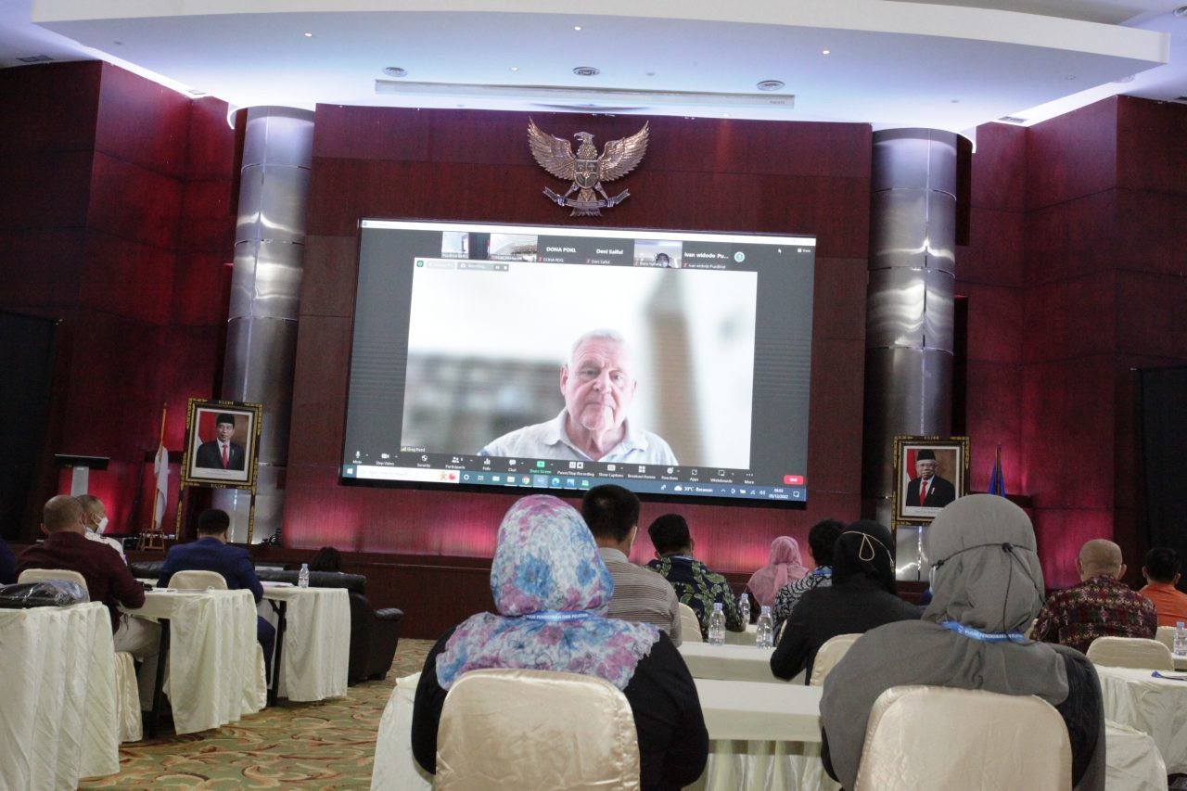

5. STC BMKG
OTGA Tsunami Ready Training Course 12–30 November 2021
OTGA Tsunami Community Preparedness Training 5–11 December 2022
Bangladesh, Malaysia, the Philippines, Seychelles, and Indonesia.
OTGA/BMKG Training on Tsunami Mitigation 13–17 July 2025
10-11 November 2025
INCOIS, Hyderabad, India
First Conference of the
Ocean Decade Tsunami Programme

Slide 13
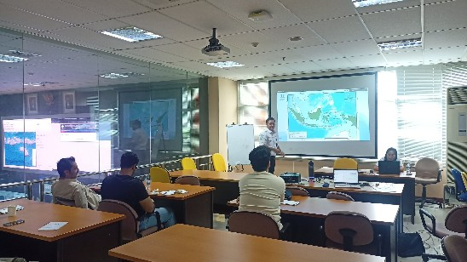
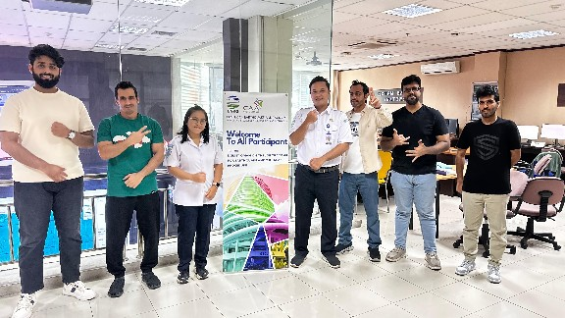
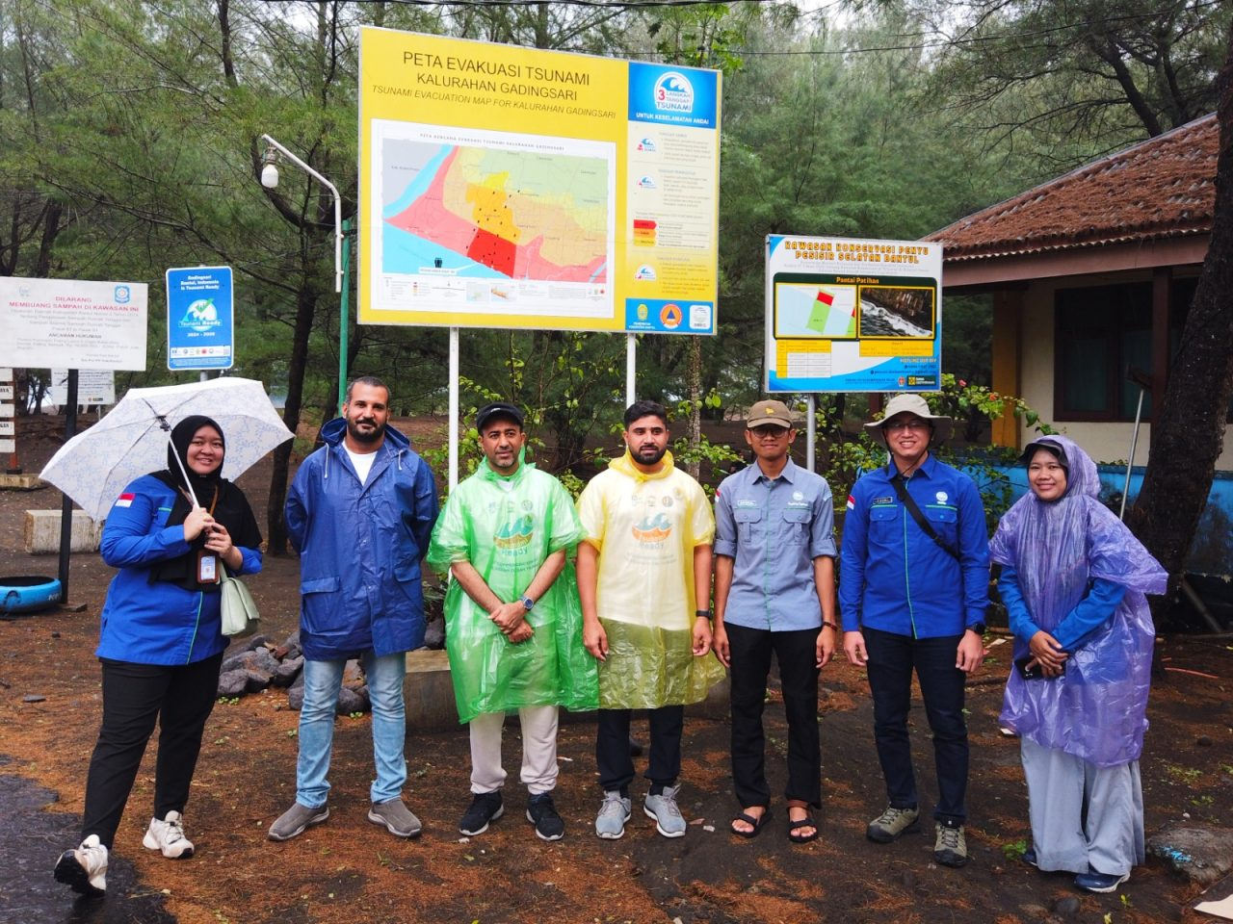
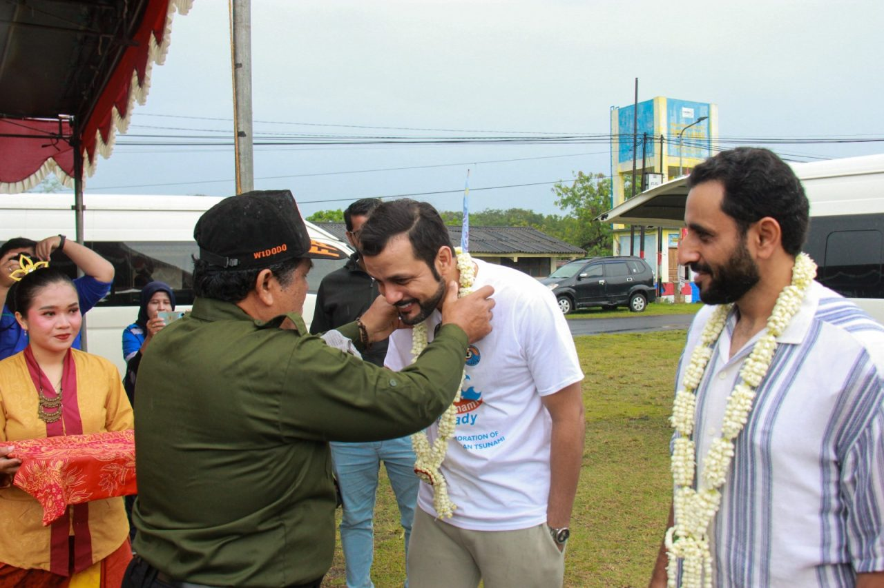
5. STC BMKG
On Job Training - General Directorate of Meteorology (DGMET) Oman
10–26 September 2023
On Job Training - General Directorate of Meteorology (DGMET) Oman
21 April - 6 May 2024
On Job Training - General Directorate of Meteorology (DGMET) Oman
1–16 September 2025
10-11 November 2025
INCOIS, Hyderabad, India
First Conference of the
Ocean Decade Tsunami Programme

Slide 14

Thank You
Ardito Kodijat, IOTIC
Dr. Laura Kong, ITIC
Alison Brome, CTIC
Denis Cheng Sang, NEAMTIC
Derya Dilmen Vennin NEAMTIC
10-11 November 2025
INCOIS, Hyderabad, India
First Conference of the
Ocean Decade Tsunami Programme

