Slide 1



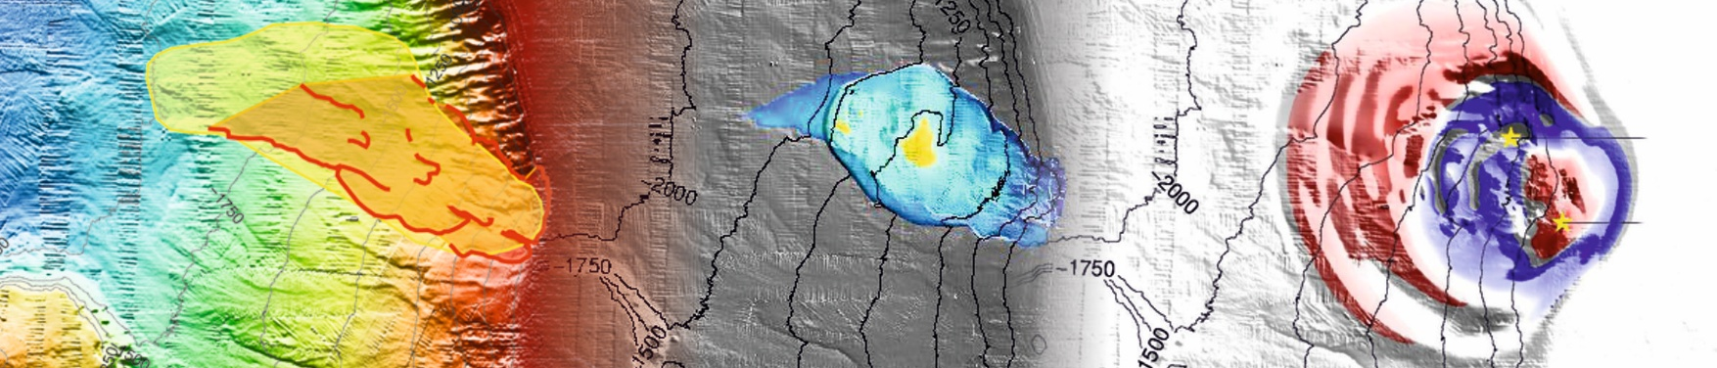






Frequency, magnitude and mobility of submarine landslides in the NEAM region: towards probabilistic tsunami hazard assessment
Roger Urgeles
With contributions from: Finn Løvholt
and developers of the EMSS25 (Davide Gamboa, Carla Vila, Ricardo León, Sjur Beyer, Maarten Vanneste, Carl Frederich Forsberg, Angelo Camerlenghi, Denise C. Ruther, Rachid Omira, Laura Fantoni Nils W. Brückner, Yolanda De Pro)

Slide 2
Introduction
Earthquake tsunami
  Frequent events
  Occur along well defined zones (faults)
  Well established PTHA methods
Submarine landslide tsunamis
  Not so frequent events (2nd most frequent tsunami source, likely underreported) → better evaluated on the long term, in periods not covered by tsunami DB.
  Do not tend to occur where they did in the past / they are more spatially random
  Not accounted in current PTHA methodologies
Critical infrastructure→ P_{f} ∼ 10^{–4} - ​​10^{–6} → events with return periods of 10 kyrs - 1 Myrs.
    The US Nuclear Regulatory Commission considers submarine landslides as the most probable tsunami source to the US east coast.

Slide 3
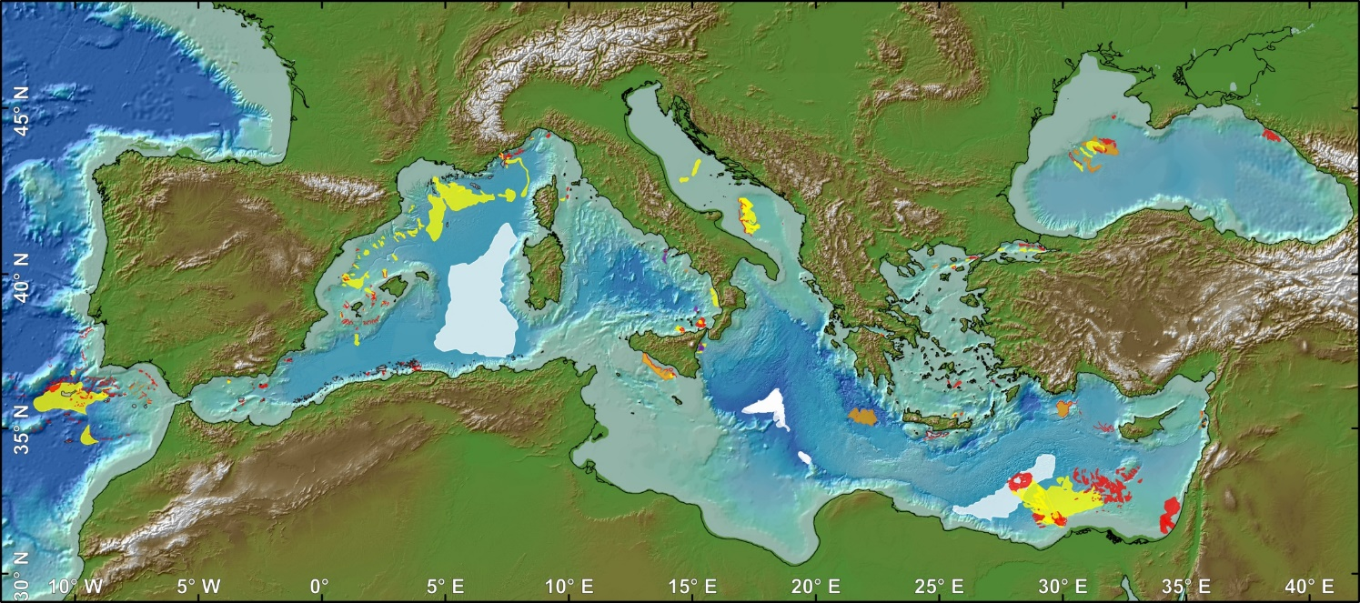
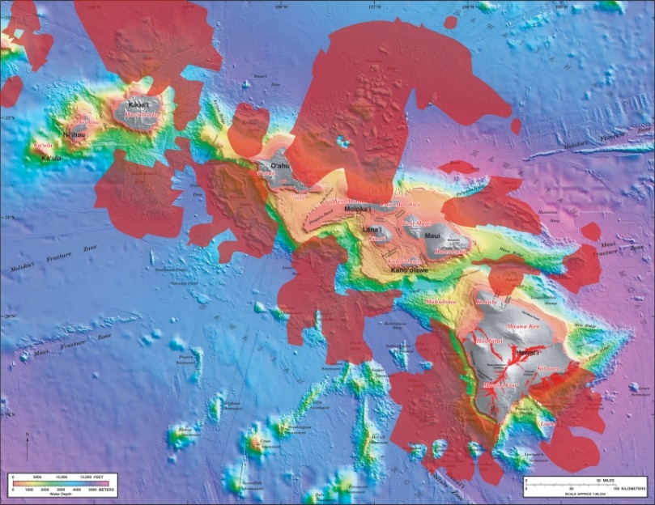
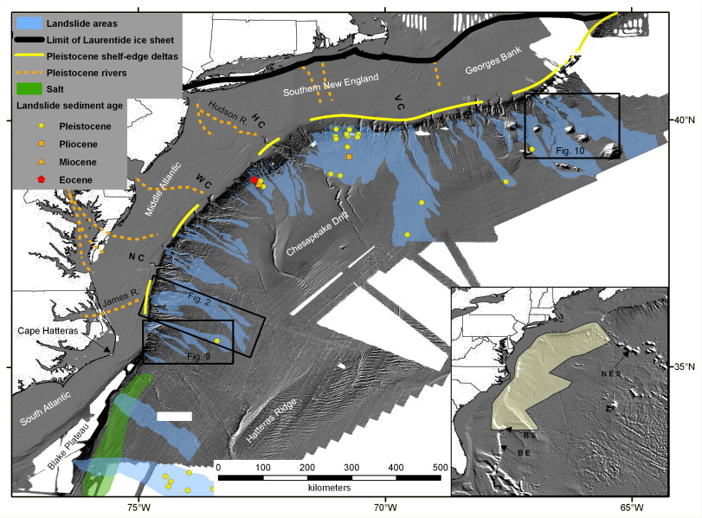
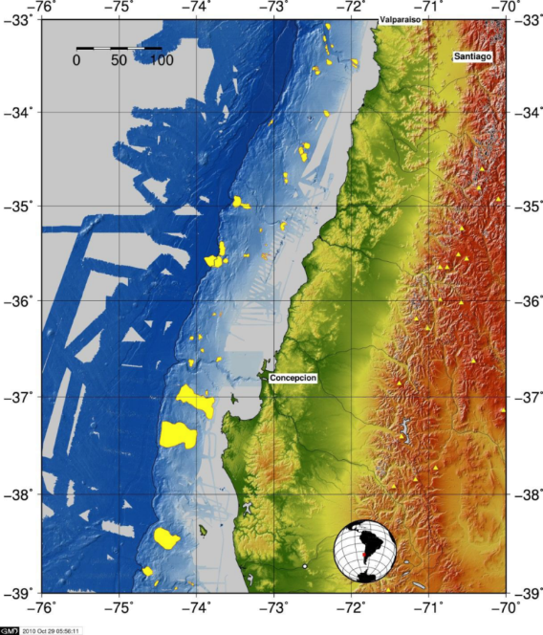
Introduction & aim
Landslide location & geomorphology →
  Trigger mechanisms
  Strength characteristics
  Landslide dynamics
  Tsunamigenic potential
Landslide catalogues →
  PLHA
  PTHA
Urgeles et al., 2013, JGRES
Moore et al., 1994, Ann. Rev. EPS
Twichell et al., 2009 Mar.Geol.
Völker et al., 2011, SMMTC
Gamboa et al., 2021, Sci.Data

Slide 4
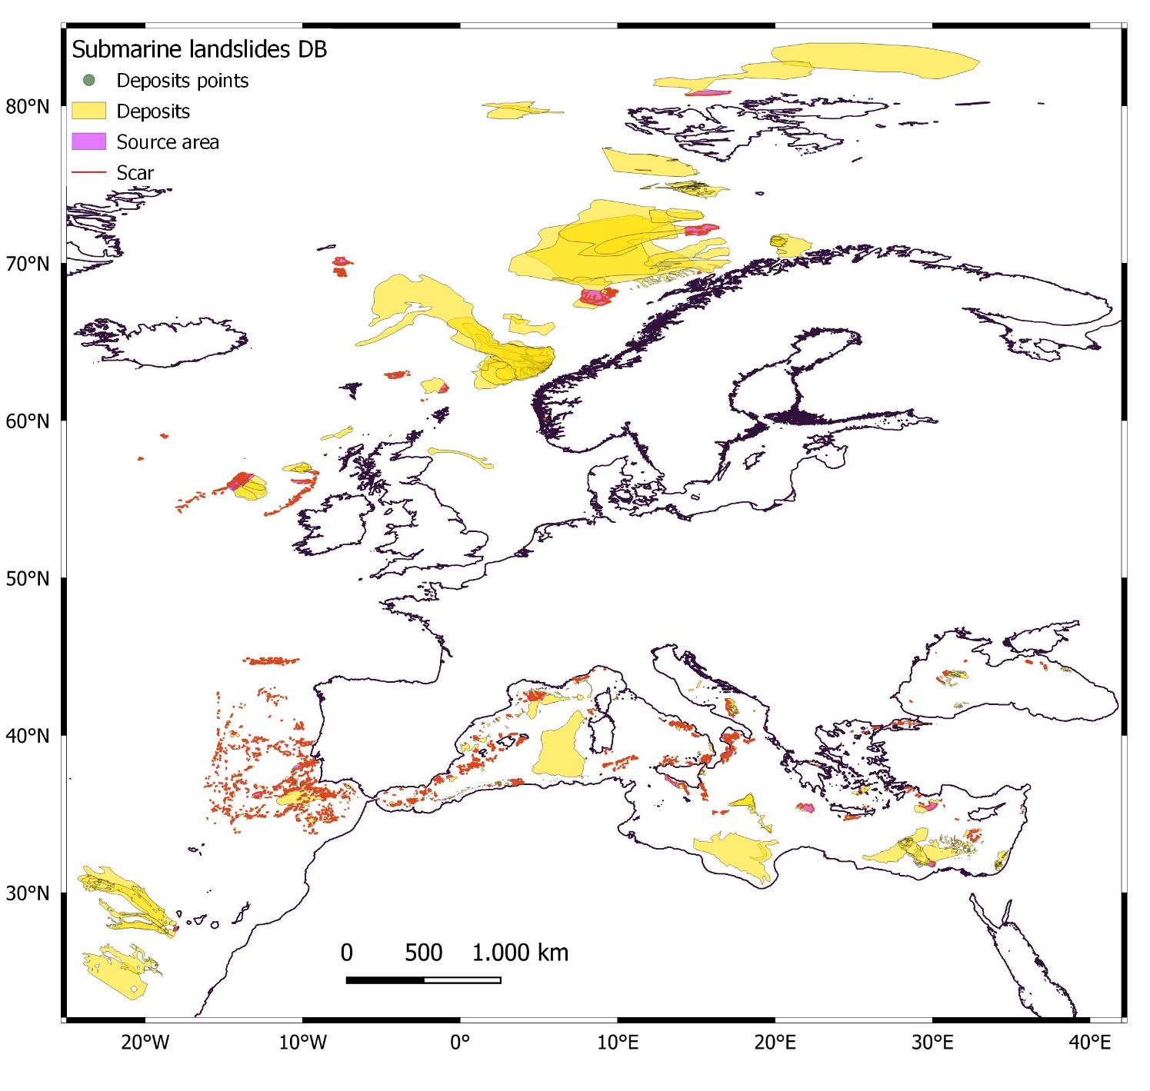


EMSS25
Increased coverage
More events
  6954 Scars
  6945 Source areas
  2191 Deposits
More features & information
Seed for the world ocean submarine landslide database

Slide 5
Landslide Tsunami Hazard
Landslide hazard – H_{L} (Guzzetti et al., 2006; NHESS):
H_{L} = P(M_{L} ≥ m_{L}) × P(N_{L}) × P(S) expresses landslide hazard H_{L} as the conditional probability of
  P(M_{L}≥ m_{L}) landslide size, the magnitude (A|V) of a landslide greater or equal than a minimum magnitude, m_{L}.
  P(N_{L}) landslide occurrence in a given region in an established period
  P(S) landslide spatial occurrence given the local environmental setting.
For H_{T}, H_{L} needs to be propagated for
Landslide runout
Tsunami generation
Tsunami propagation
Tsunami runup
P(H_{T} ≥ h_{T}); P(R_{T} ≥ r_{T})

Slide 6
What matters?
DB driven
Model driven
Where? How deep? → P(S)
How large? → P(M_{L})
How often? How many? → P(N_{L})
Which runout?
Which runout?
How fast? (landslide dynamics)
How tsunamigenic?
P(H_{T} ≥ h_{T}); P(R_{T} ≥ r_{T})

Slide 7
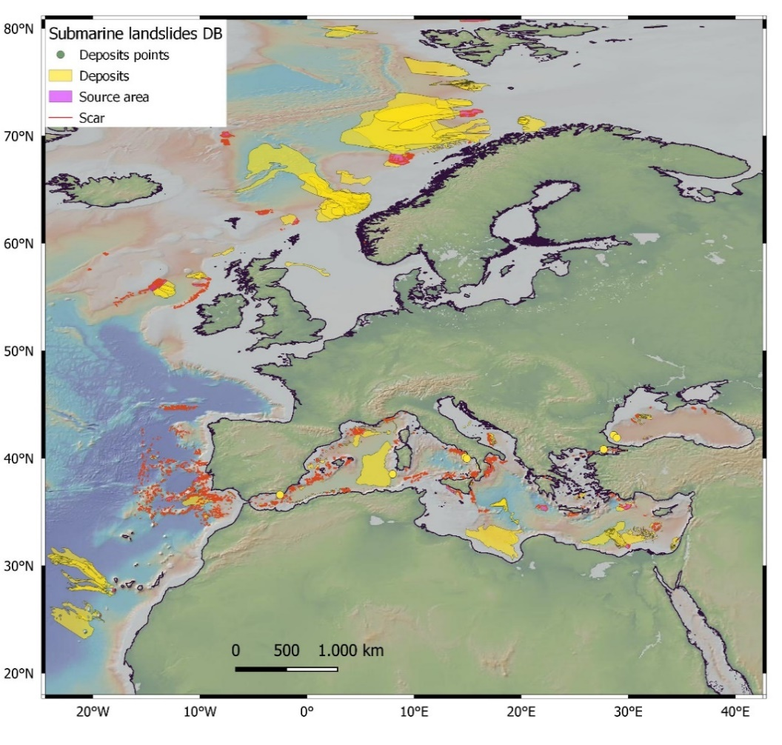
Where? How deep? → P(S)
Most landslides occur in between 100-1500 mbsl → continental slope
Max
Min
EMSS25

Slide 8
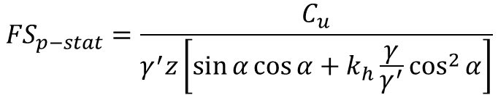

Where? How deep? → P(S)
Hazard models cannot predict when a landslide will occur based on where landslides have occurred in the past (Guzzetti, 2003)
Model performance quantification
Receiver Operating Characteristic (ROC) curves compare
model outputs (probabilistic susceptibility maps)
observations (i.e. grid cells with mapped landslide)
Local Geotechnical data
Global Geotechnical data
Local Geotechnical data
Global Geotechnical data
Digital Elevation Model
Fault catalogue
PDF(μ_{Cu/σ’v0})
PDF(σ_{Cu/σ’v0})
PDF(μ_{γ/γ’})
PDF(σ_{γ/γ’})
Random perturbation
ξ ~ N(μ_{εDEM}, σ_{εDEM})
Random fault activated
Random sample
Random sample
Random sample
Random sample
Perturbated DEM
Uniform PDF(M_{wmax}) of the fault
PDF(C_{u}/σ’_{v0})
PDF(γ/γ’)
Perturbated Slope gradient
Random M_{w} sample
Random sample
Random sample
PDF(α)
Fault Mechanism
Epicentral distance to fault
Slope stability model
Random sample
PGA grid
after i simulations
Dynamically- corrected pseudo-static factor of safety FS_{p-stat}
PDF(PGA)
Collico et al., 2021. Mar. Geol.
after i simulations
(η)
Random sample
Probability of failure P_{f}
Receiver Operating Characteristic (ROC) curves
Collico et al., 2021. Mar. Geol.
Notes:
Mean estimates of Factor of safety. b) Uncertainty in Factor of safety estimation. c) Probability of failure map considering the η factor from Rampello et al. (2010). Outlined in blue in figures (a) and (b) are the landslides in the SW Iberian margin inventory. (For interpretation of the references to colour in this figure legend, the reader is referred to the web version of this article.)
Receiver Operating Characteristic (ROC) curves and Optimal thresholds for Pseudo-static model and Displacement-based method.

Slide 9
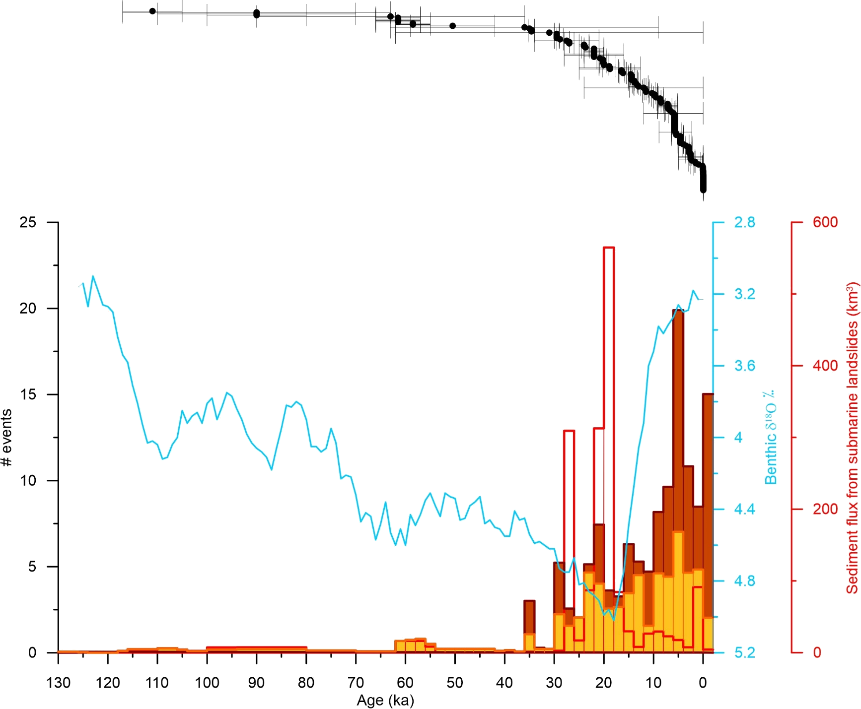

How often?
Age → not so important if we can put an overall time frame and assume equal probability in time
Accounting for age uncertainty
Mediterranean subset (n=141)
Flux
#
V > 1 km³
EMSS25

Slide 10

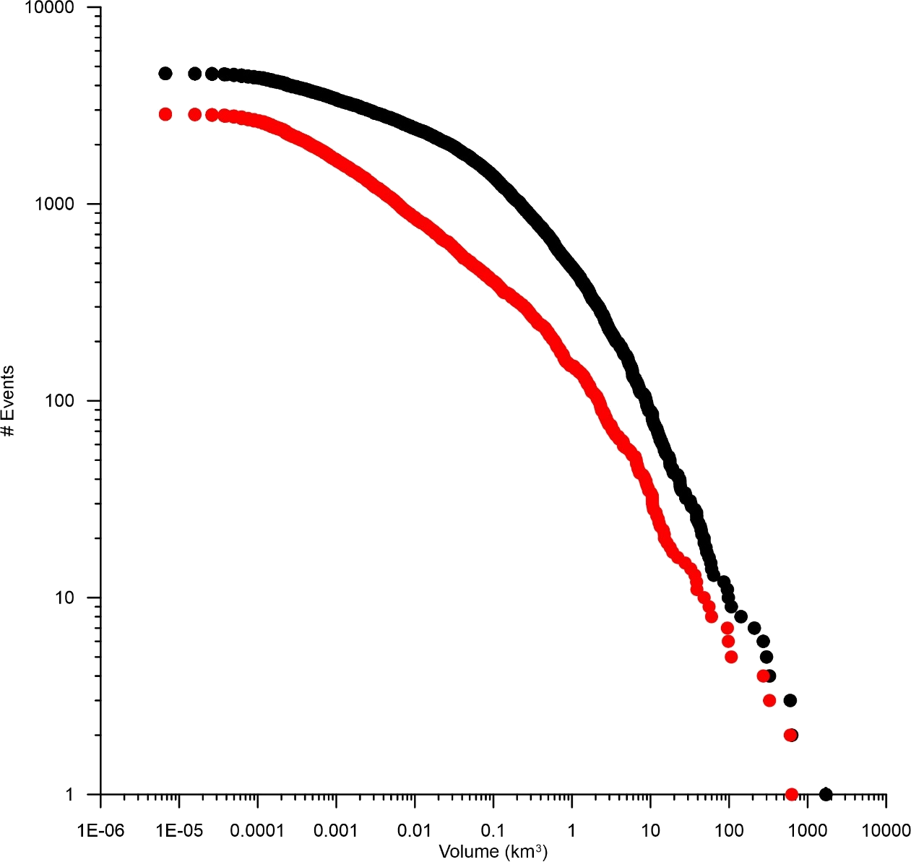
How large? → P(M_{L}); How many? → P(N_{L})
Frequency/magnitude distribution
Complete data set
Roll-over
~500 events/kyr
~150 events/kyr
# Events V>v
Mediterranean data set

Slide 11
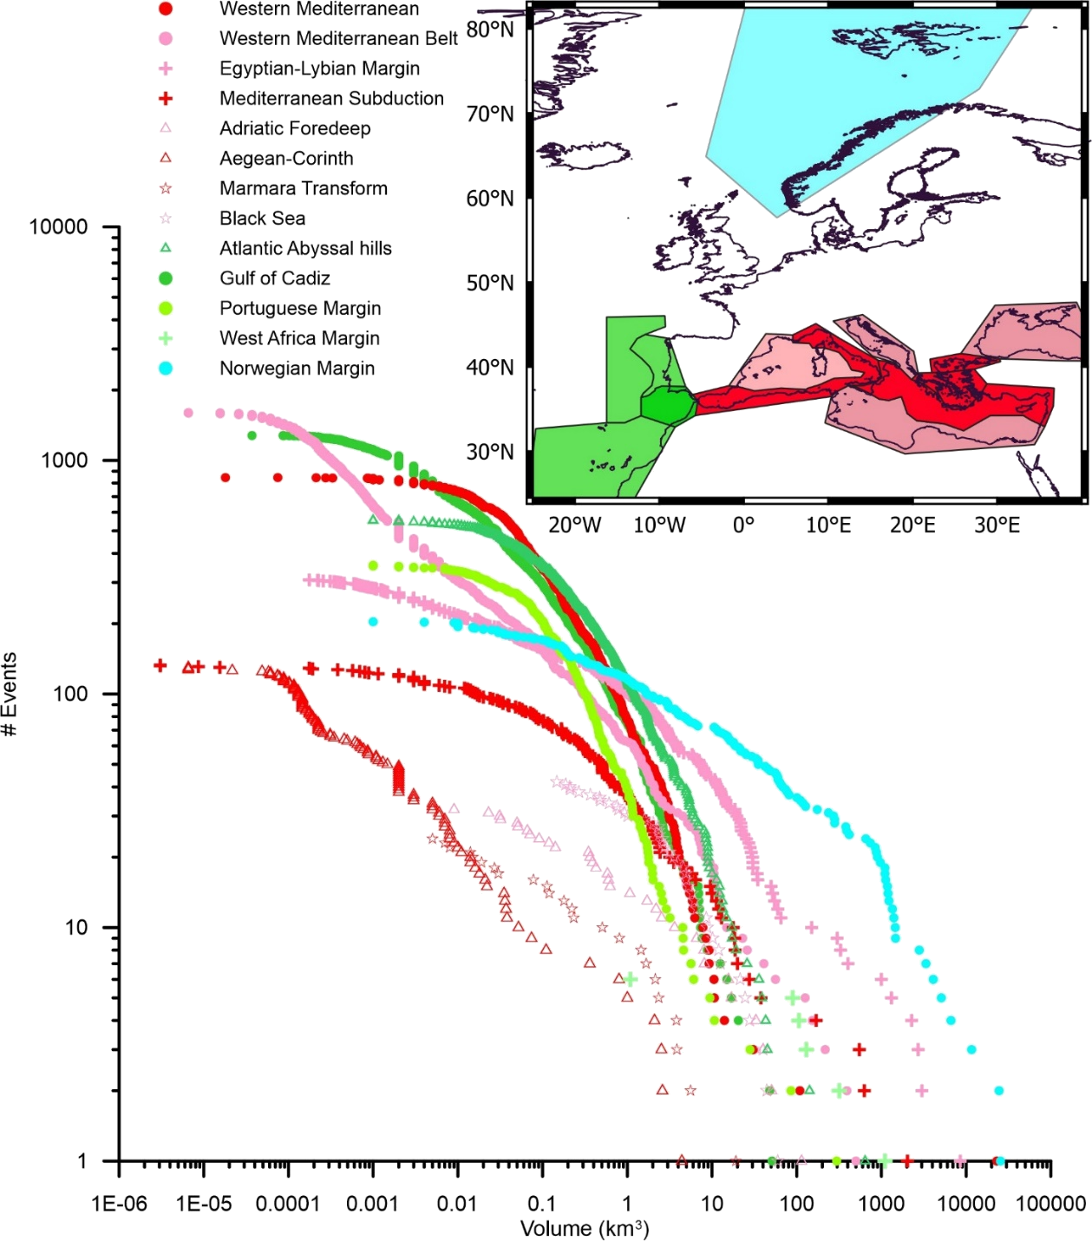
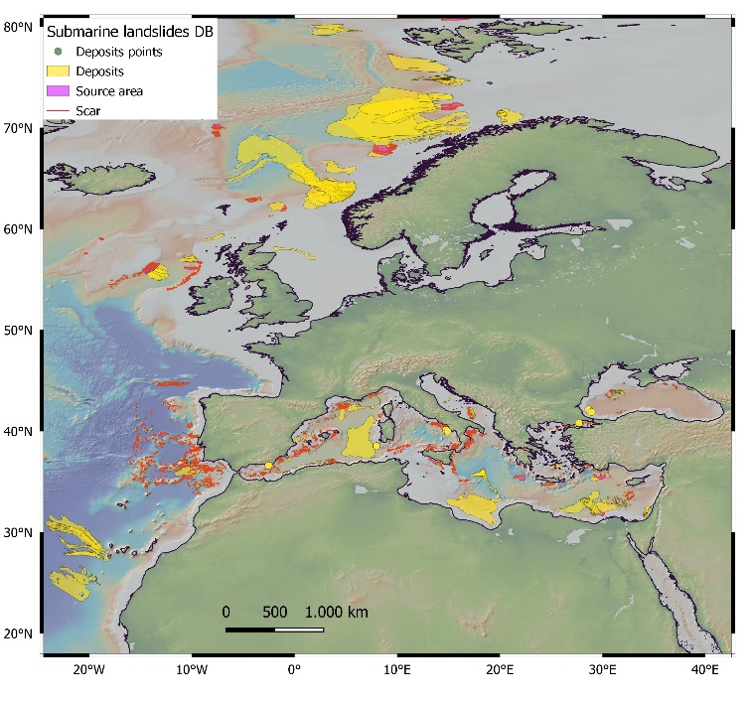
How large? → P(M_{L}); How many? → P(N_{L})
Poison process?
Active/passive margins have different slopes of the F/M relationship
The larger failure volumes dominate the flux, even for active margins
# Events V>v

Slide 12
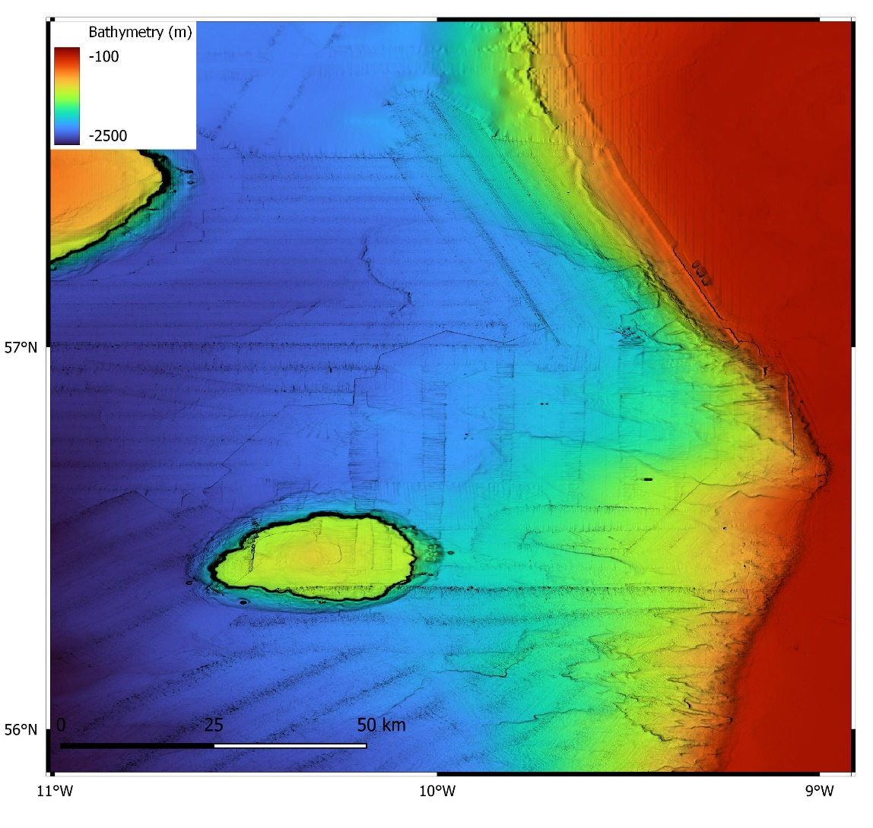

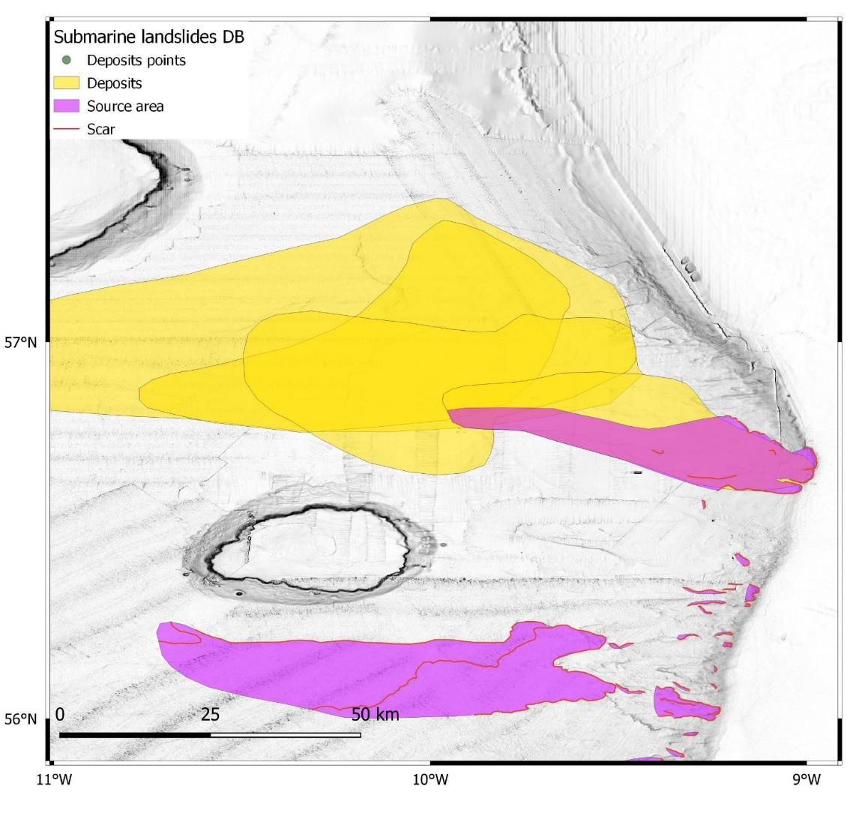
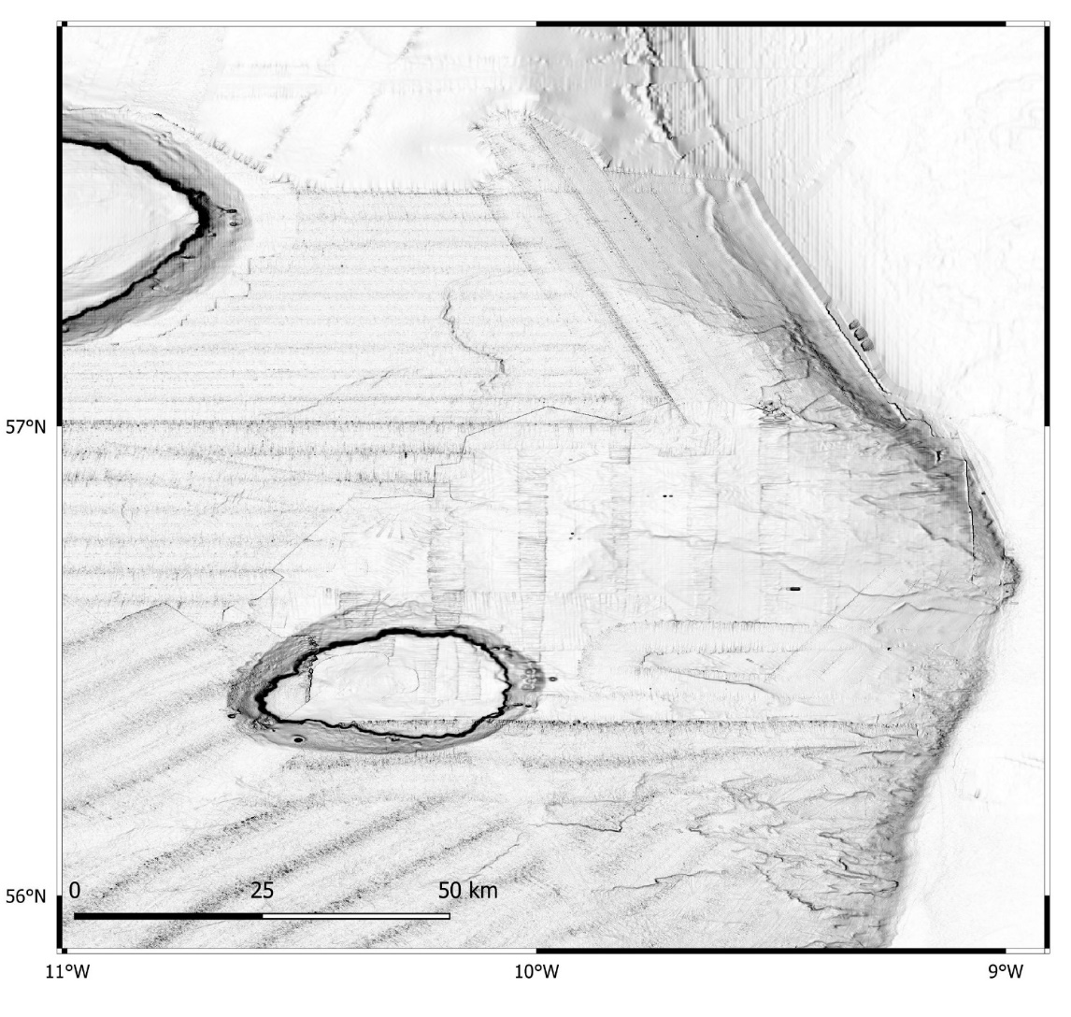
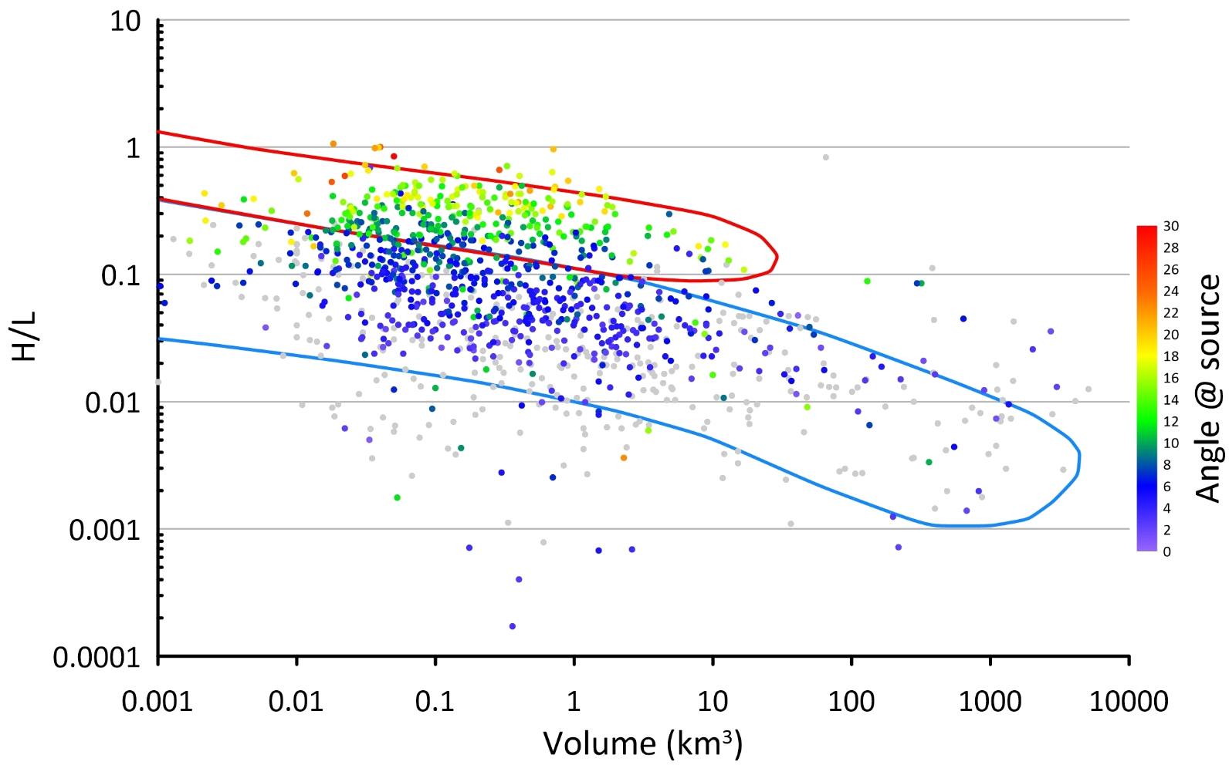
How fast?
Structured in:
  Source areas
  Deposits
Implications for:
  Initial tsunami source
  Landslide rheology
  Acceleration history
  Tsunami build-up
Subaerial
Locat and Lee (2000); De Blasio (2011)
Submarine
Locat and Lee (2000); De Blasio (2011)

Slide 13
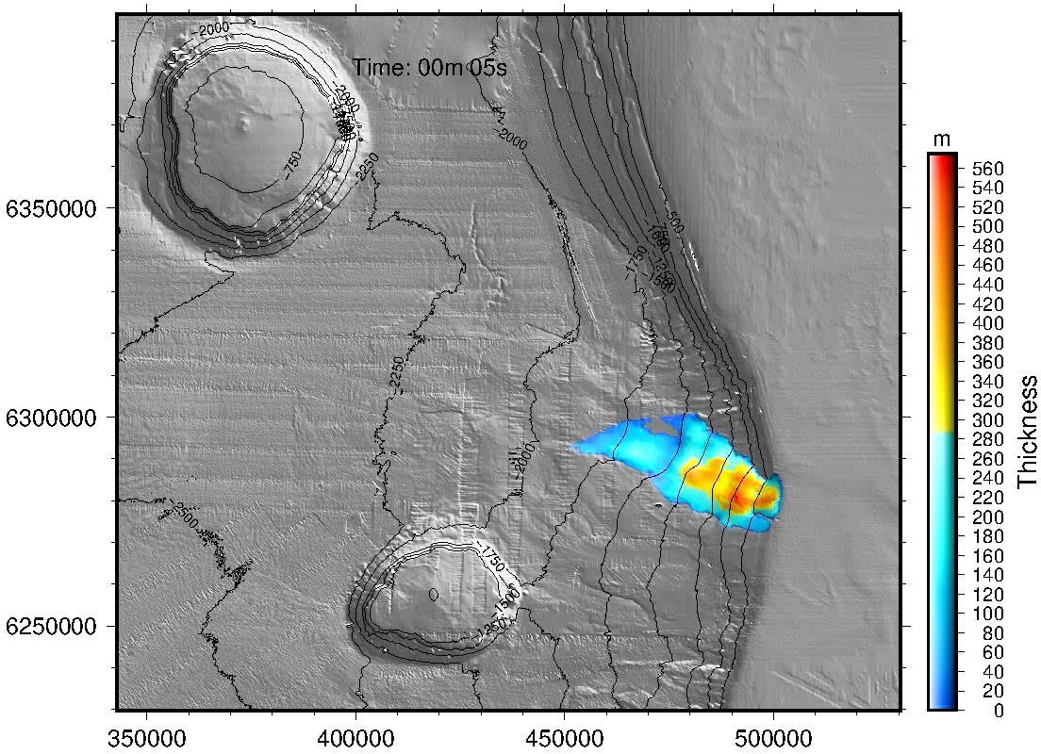
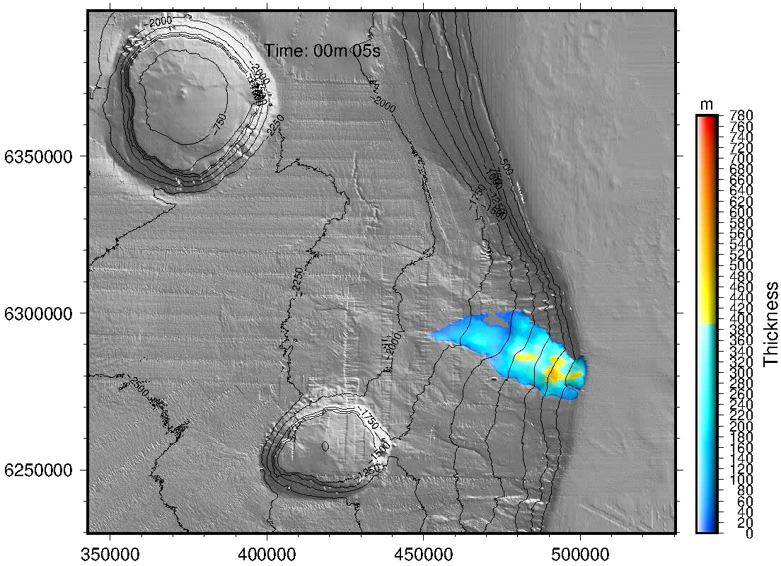

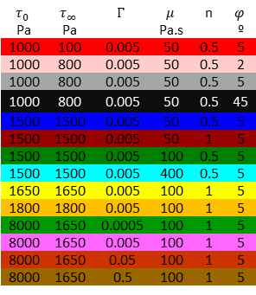
How fast?
 |  |  |  | n
Pa | Pa |  | Pa.s |  | º
1000 | 100 | 0.005 | 50 | 0.5 | 5
1000 | 800 | 0.005 | 50 | 0.5 | 2
1000 | 800 | 0.005 | 50 | 0.5 | 5
1000 | 800 | 0.005 | 50 | 0.5 | 45
1500 | 1500 | 0.005 | 50 | 0.5 | 5
1500 | 1500 | 0.005 | 50 | 1 | 5
1500 | 1500 | 0.005 | 100 | 0.5 | 5
1500 | 1500 | 0.005 | 400 | 0.5 | 5
1650 | 1650 | 0.005 | 100 | 1 | 5
1800 | 1800 | 0.005 | 100 | 1 | 5
8000 | 1650 | 0.0005 | 100 | 1 | 5
8000 | 1650 | 0.005 | 100 | 1 | 5
8000 | 1650 | 0.05 | 100 | 1 | 5
8000 | 1650 | 0.5 | 100 | 1 | 5

Slide 14
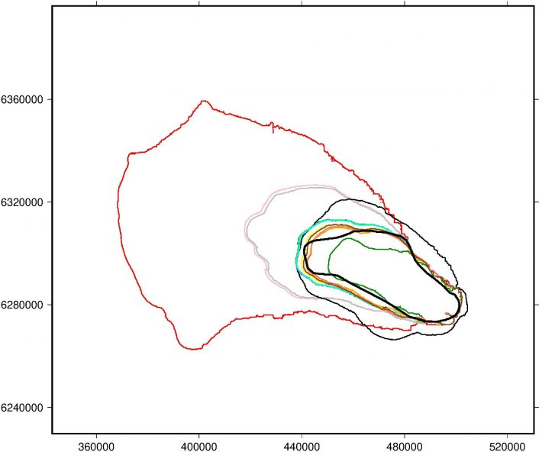
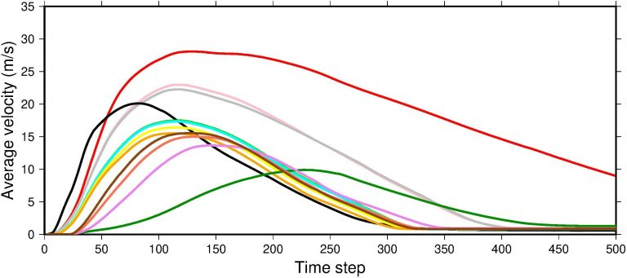
How fast?
Initial Yield Stress | Min Yield Stress | Wetting efficiency | Viscosity | HB Exp | Int Friction
Pa | Pa |  | Pa.s |  | º
1000 | 100 | 0.005 | 50 | 0.5 | 5
1000 | 800 | 0.005 | 50 | 0.5 | 2
1000 | 800 | 0.005 | 50 | 0.5 | 5
1000 | 800 | 0.005 | 50 | 0.5 | 45
1500 | 1500 | 0.005 | 50 | 0.5 | 5
1500 | 1500 | 0.005 | 50 | 1 | 5
1500 | 1500 | 0.005 | 100 | 0.5 | 5
1500 | 1500 | 0.005 | 400 | 0.5 | 5
1650 | 1650 | 0.005 | 100 | 1 | 5
1800 | 1800 | 0.005 | 100 | 1 | 5
8000 | 1650 | 0.0005 | 100 | 1 | 5
8000 | 1650 | 0.005 | 100 | 1 | 5
8000 | 1650 | 0.05 | 100 | 1 | 5
8000 | 1650 | 0.5 | 100 | 1 | 5
Actual observation

Slide 15

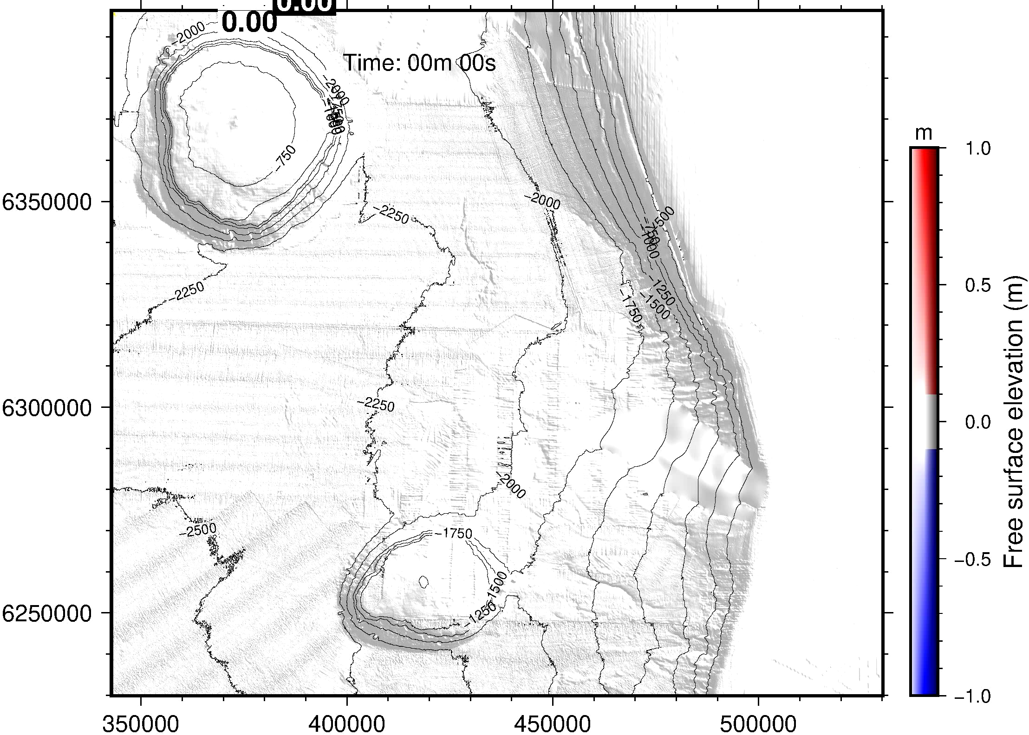
How fast?

Slide 16
Conclusions
Despite size and time biases, landslide catalogs offer adequate data for assessing landslide tsunami hazard
  Where → Susceptibility mapping
  When and how large → Frequency/magnitude relationships
  Dynamics → Runout
H_{L} → H_{T}
Hazard models cannot predict when a landslide will occur based on where landslides have occurred in the past
Synthetic submarine landslide catalogue consistent with:
  DB ground-truthed landslide susceptibility
  Frequency/Magnitude relationship
  Aspect ratio
  Slope/size relationship
Propagated into
  Landslide dynamics (consistent with DB runout statistics)
  Tsunami genesis & propagation
Offer potential approaches to characterize H_{T}
Geotechnical data
Digital Elevation Model
Fault catalogue
Subamrine landslide catalogue
Slope stability model
Frequency-magnitude relationship
Power-law CDF(V_{min},θ)
Probability of failure P_{f}
SUBMARINE LANDSLIDE SUSCEPTIBILITY
SUBMARINE LANDSLIDE
FREQUENCY-MAGNITUDE ANALYSIS
SEISMOLOGICAL ANALYSIS
SYNTHETIC
CATALOGUE GENERATION
Morphology consistent synthetic catalogue n(X, Y, R|α, V)
Depth-averaged Landslide dynamics model
Rheological data
LANDSLIDE
DYNAMICS
Landslide Dynamics: a(t, x, y), v(t, x, y),
PDF(a₀, v_{max})
Tsunami propagation model
TSUNAMI
SIMULATION
PDF(μ, σ) maximum tsunami height at the coastline
PDF(μ, σ) minimum tsunami time at the coastline

