Slide 1

UNESCO-IOC
ICG/NEAMTWS
Working Group 2&3:
Seismic, Geophysical and Sea Level measurements
Co-chairs
A n n a v o n Gy l d e n fe l d t ( B S H )
Musavver D i d e m C a m b a z ( KO E R I )
ICG/NEAMTWS XX Session
3-5 December 2025
Paris, France

Slide 2
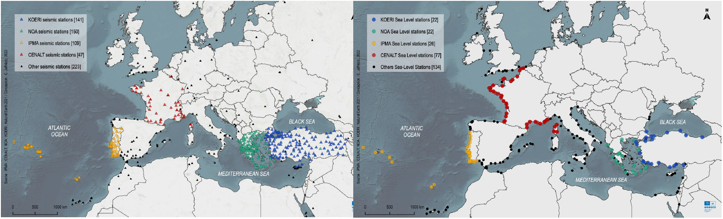
Seismic and Sea Level Data Base in NEAM REGION (2025)
Seismic Stations Sea-Level Stations
by Claire Jaffrézic (UNESC0-IOC), March 2023
WG2&WG3 – Seismic, Geophysical & Sea Level Measurements
IOC-UNESCO ICG/NEAMTWS, 3-5 December 2025, Paris, France

Slide 3
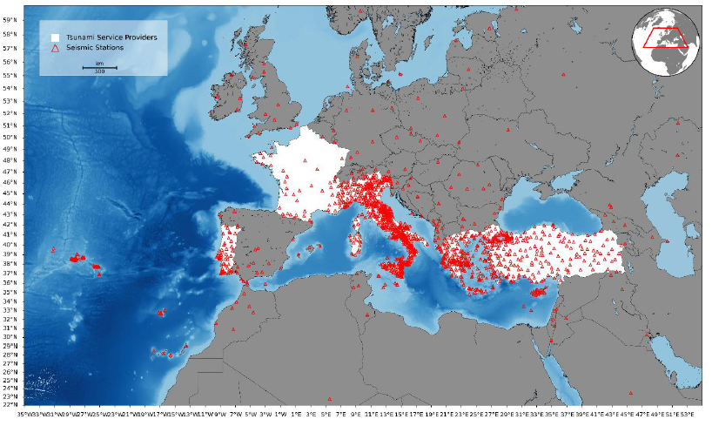
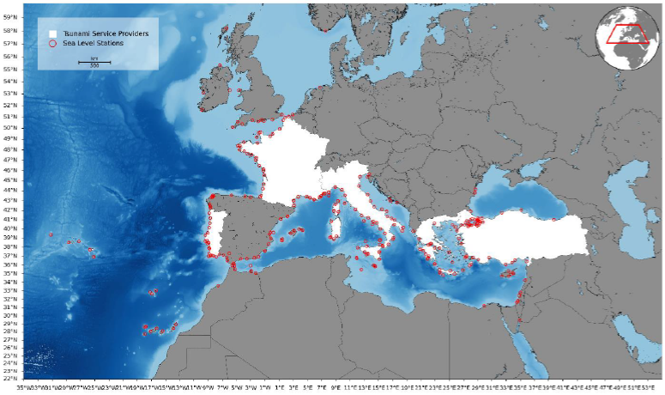
Seismic and Sea Level Data Base in NEAM REGION (2024)
Seismic Stations Monitored by TSP
Sea-Level Stations Monitored by TSP
WG2&WG3 – Seismic, Geophysical & Sea Level Measurements
IOC-UNESCO ICG/NEAMTWS, 3-5 December 2025, Paris, France

Slide 4
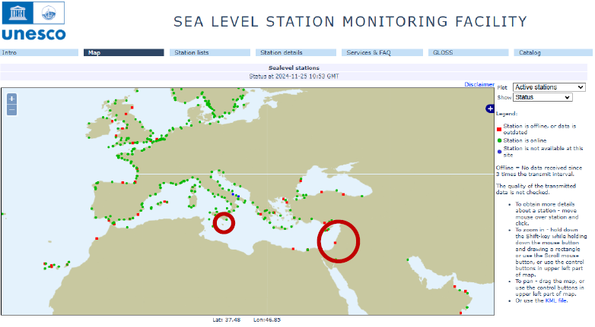
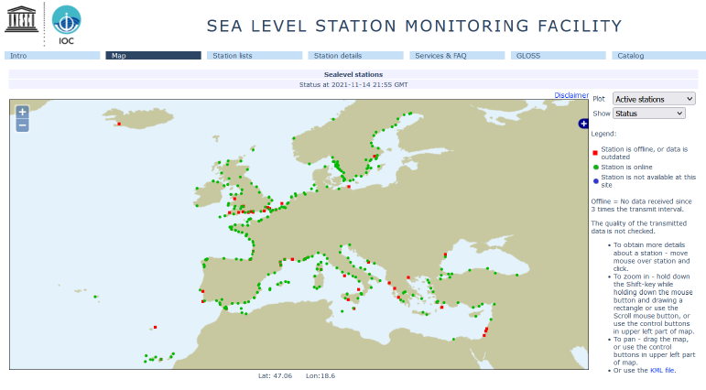
2024
2021
WG2&WG3 – Seismic, Geophysical & Sea Level Measurements
IOC-UNESCO ICG/NEAMTWS, 3-5 December 2025, Paris, France

Slide 5
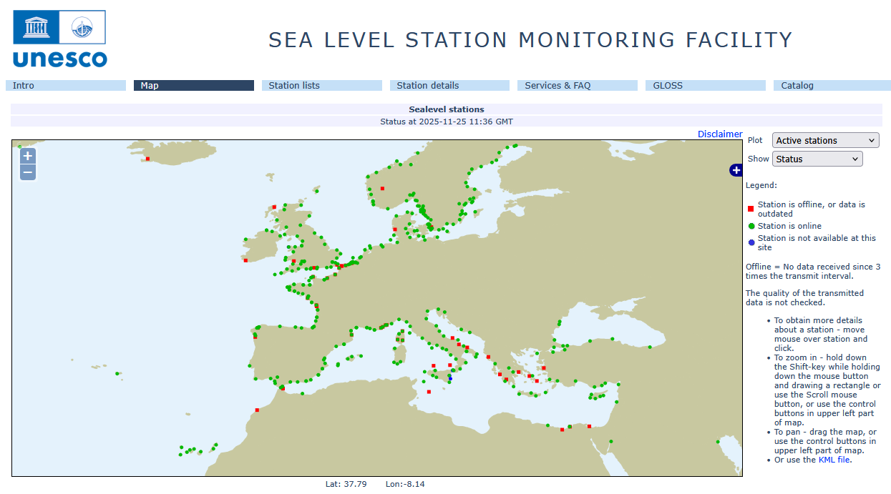
2025
2024
WG2&WG3 – Seismic, Geophysical & Sea Level Measurements
IOC-UNESCO ICG/NEAMTWS, 3-5 December 2025, Paris, France

Slide 6



EPOS, the European Plate Observing System, is a multidisciplinary, distributed research infrastructure that facilitates the integrated use of data, data products, and facilities from the solid Earth science community in Europe.
Virtual access
Seismological waveform data
GNSS data
Sea level and ovean bottom data
https://www.geo-inquire.eu/
https://dtgeo.eu/
WG2&WG3 – Seismic, Geophysical & Sea Level Measurements
IOC-UNESCO ICG/NEAMTWS, 3-5 December 2025, Paris, France

Slide 7
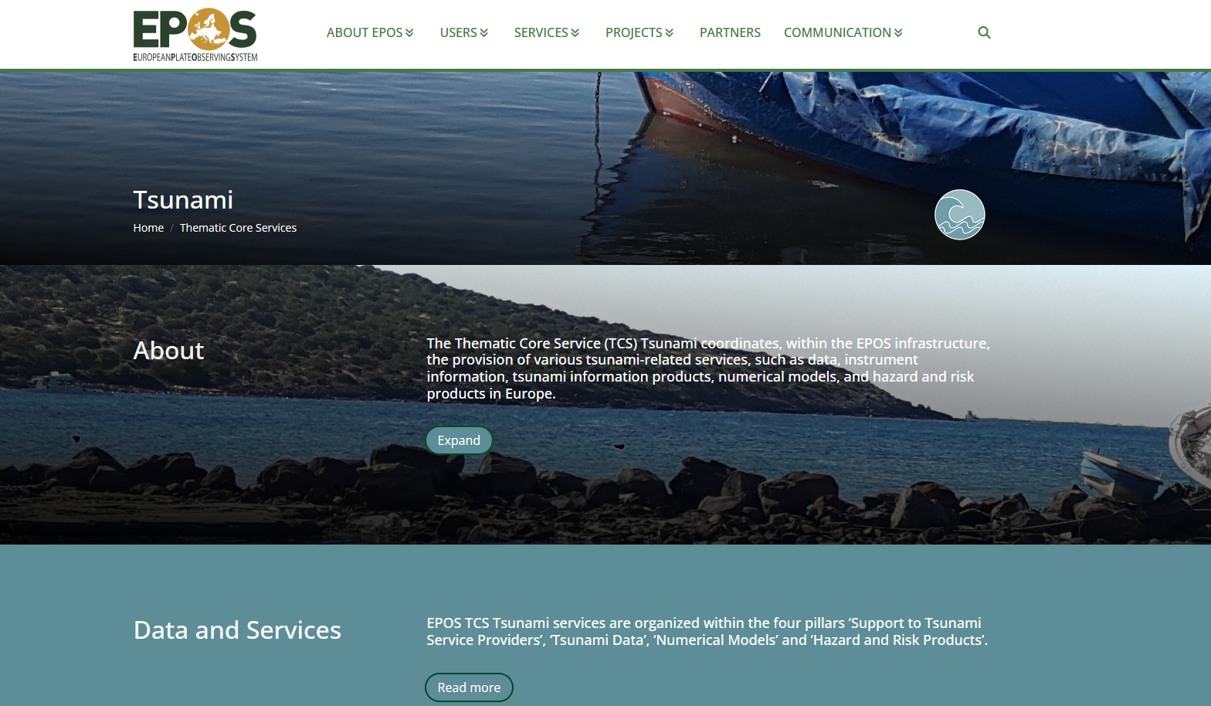
Publicly Accessible Tsunami Data Portal
https://www.epos-eu.org/tcs/tsunami
WG2&WG3 – Seismic, Geophysical & Sea Level Measurements
IOC-UNESCO ICG/NEAMTWS, 3-5 December 2025, Paris, France

Slide 8
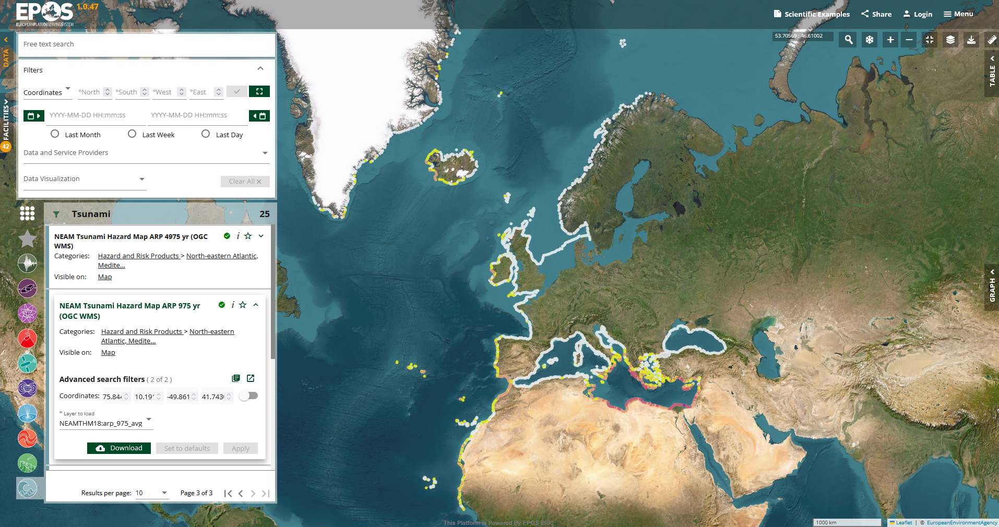
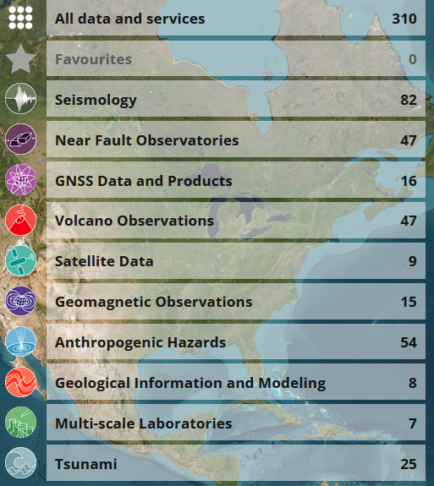
Publicly Accessible Tsunami Data Portal
https://www.ics-c.epos-eu.org/
WG2&WG3 – Seismic, Geophysical & Sea Level Measurements
IOC-UNESCO ICG/NEAMTWS, 3-5 December 2025, Paris, France

Slide 9
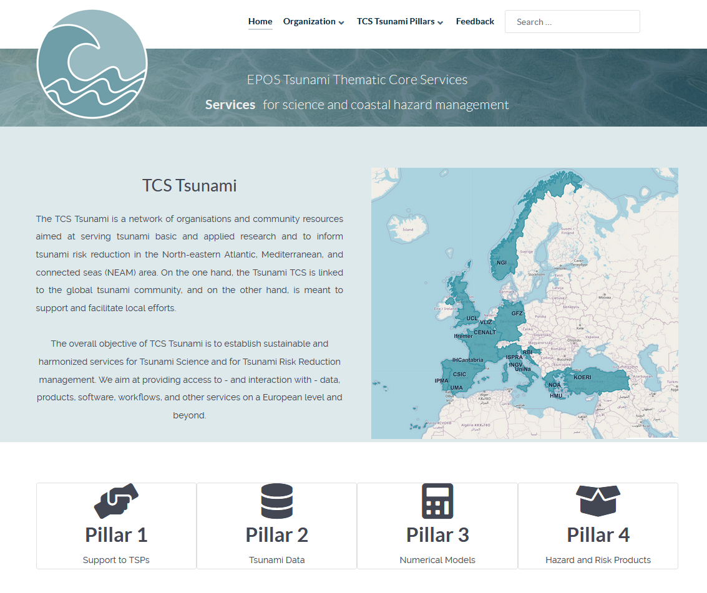
https://tsunami-data.org
WG2&WG3 – Seismic, Geophysical & Sea Level Measurements
IOC-UNESCO ICG/NEAMTWS, 3-5 December 2025, Paris, France

Slide 10

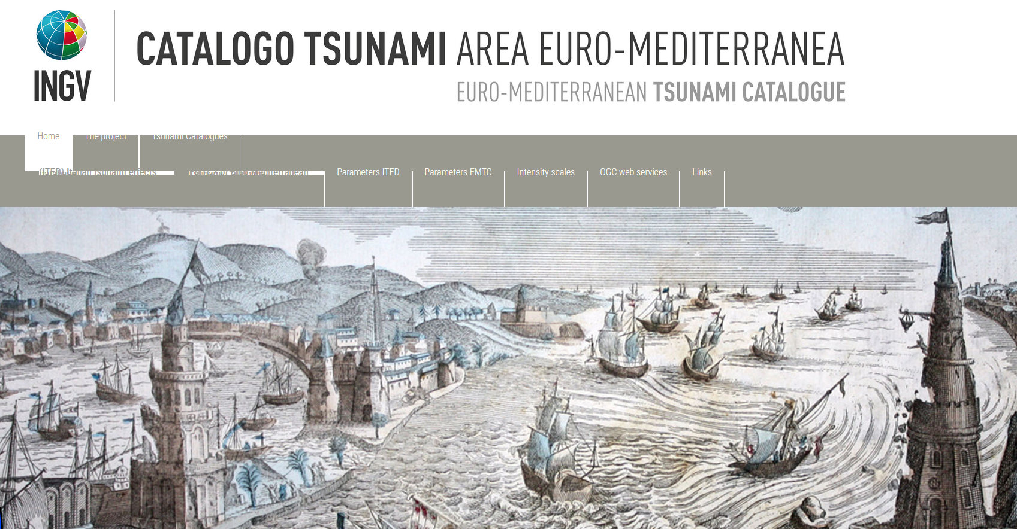
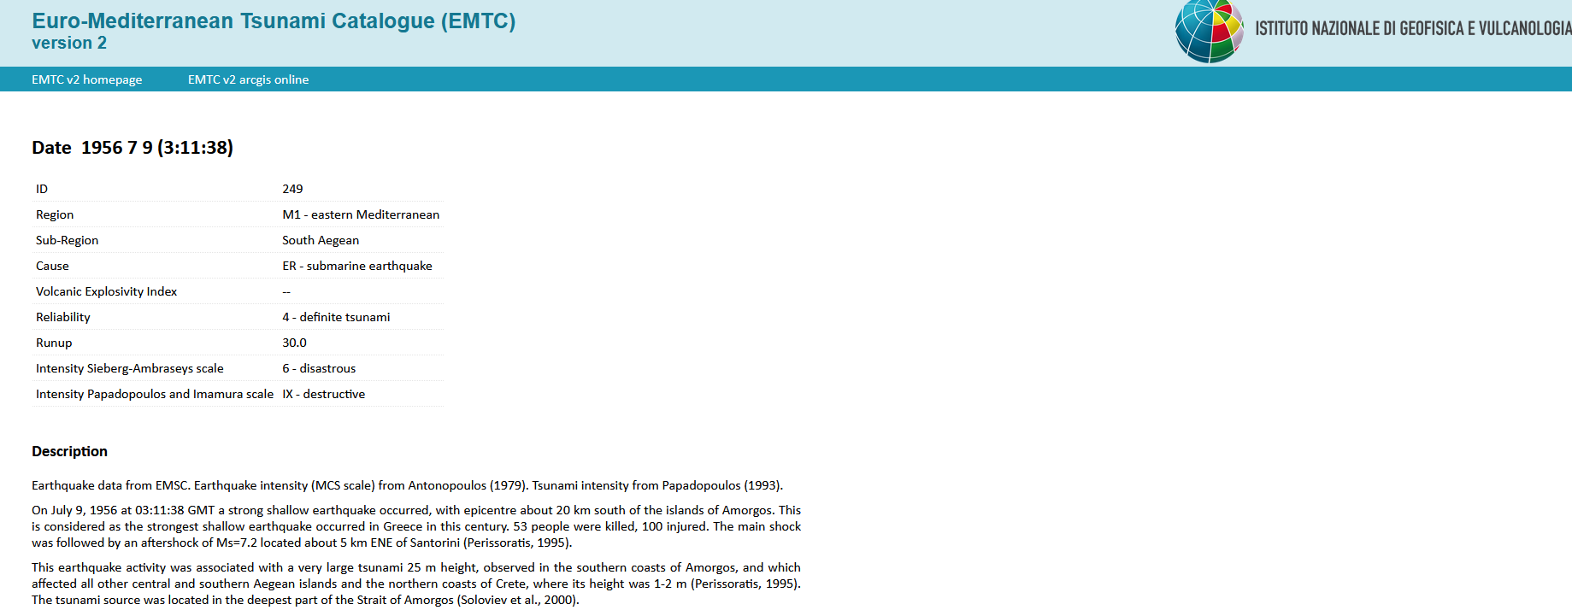
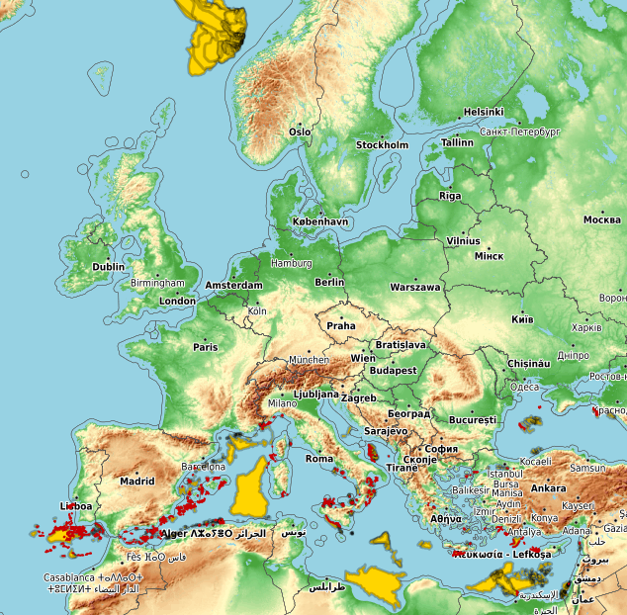
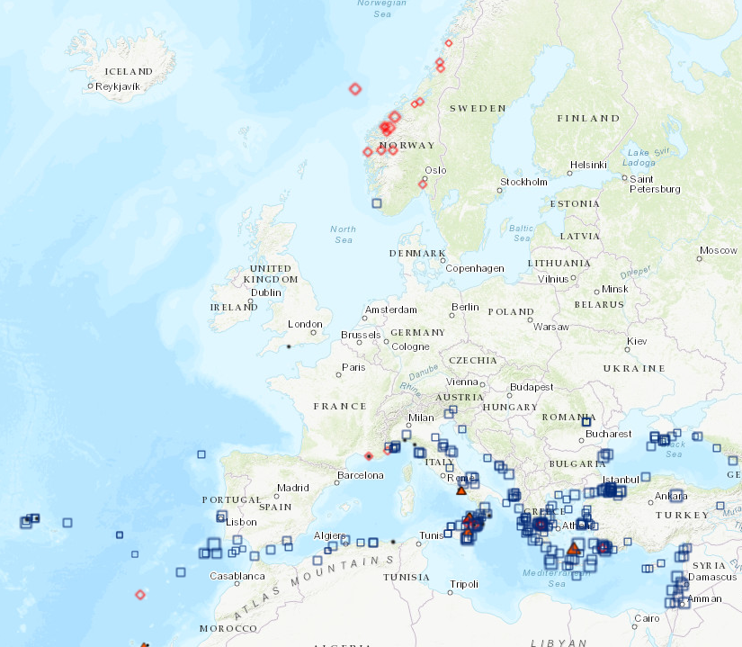
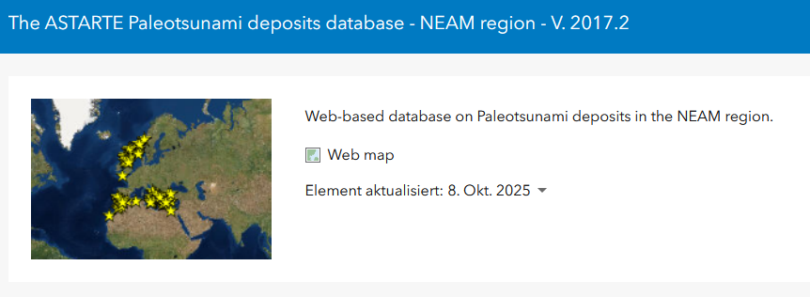
MISELA: 1-Minute dataset for 331 Stations, ~2004-2019
WG2&WG3 – Seismic, Geophysical & Sea Level Measurements
IOC-UNESCO ICG/NEAMTWS, 3-5 December 2025, Paris, France

Slide 11
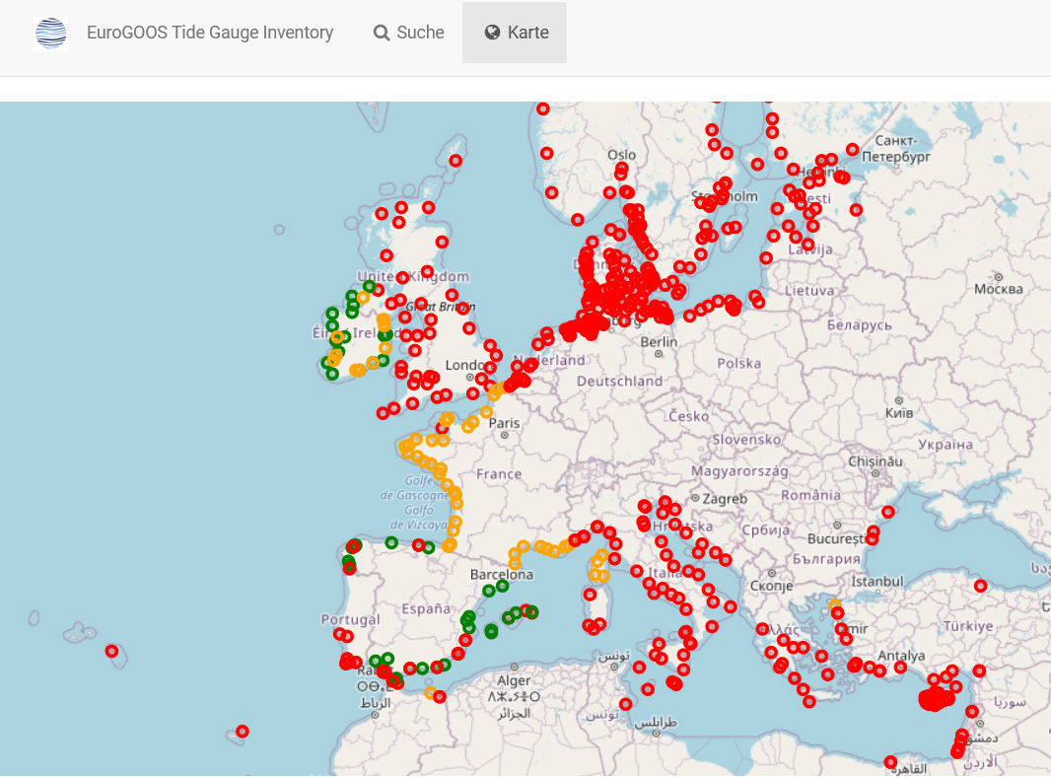
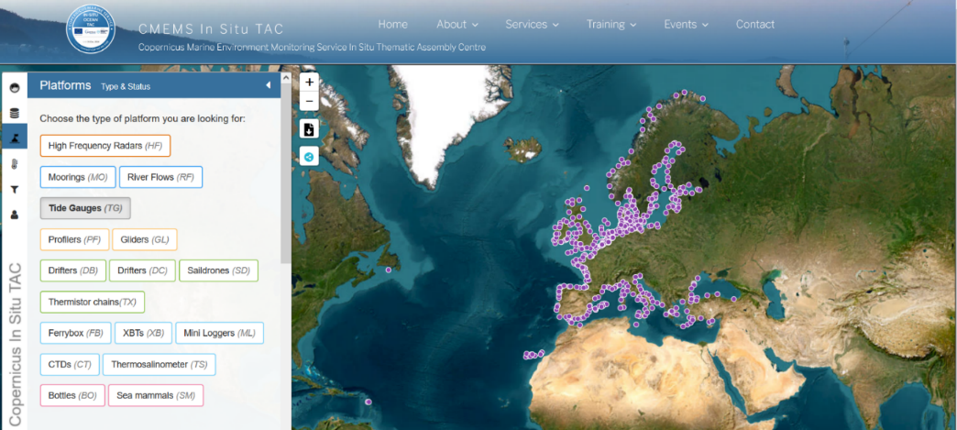
Publicly Accessible Sea Level Stations
EuroGOOS Tide Gauge Inventory
Metadata catalogue of all permanent, managed tide level monitoring stations across Europe and adjacent coastlines, including North Africa
IOC SLSMF
CMEMC In Situ TAC
Copernicus Marine Environment Monitoring Service In Situ Thematic Assembly Centre
WG2&WG3 – Seismic, Geophysical & Sea Level Measurements
IOC-UNESCO ICG/NEAMTWS, 3-5 December 2025, Paris, France

Slide 12

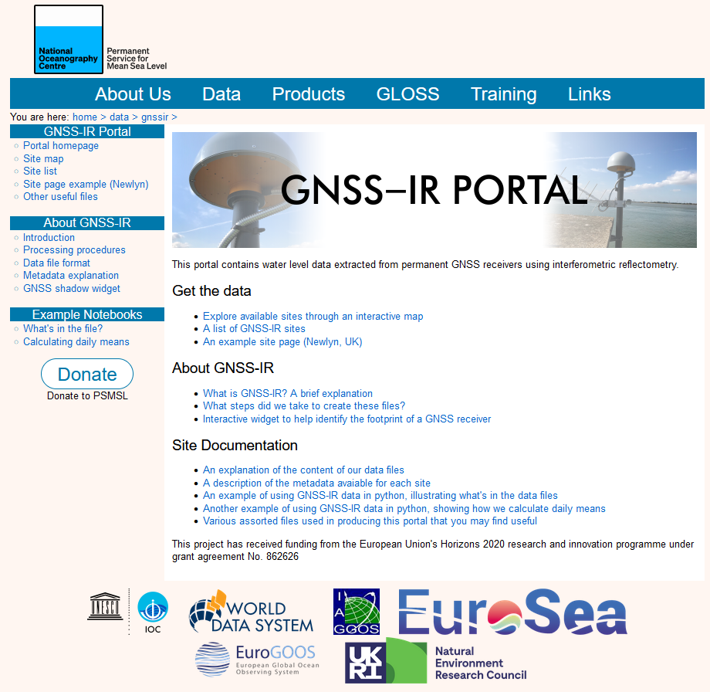
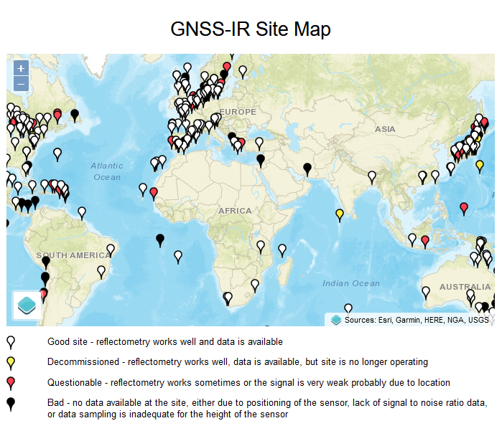
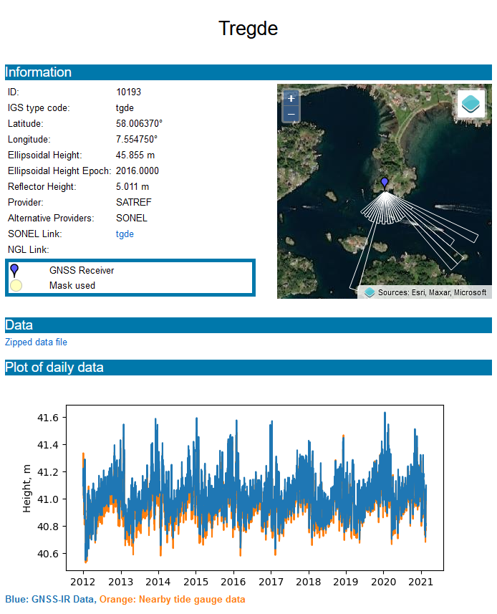
https://psmsl.org/data/gnssir/index.php
https://psmsl.org/data/gnssir/index.php
WG2&WG3 – Seismic, Geophysical & Sea Level Measurements
IOC-UNESCO ICG/NEAMTWS, 3-5 December 2025, Paris, France

Slide 13
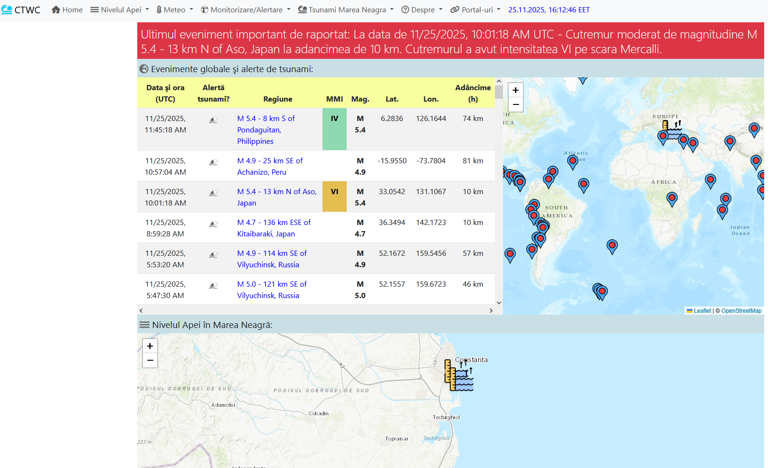
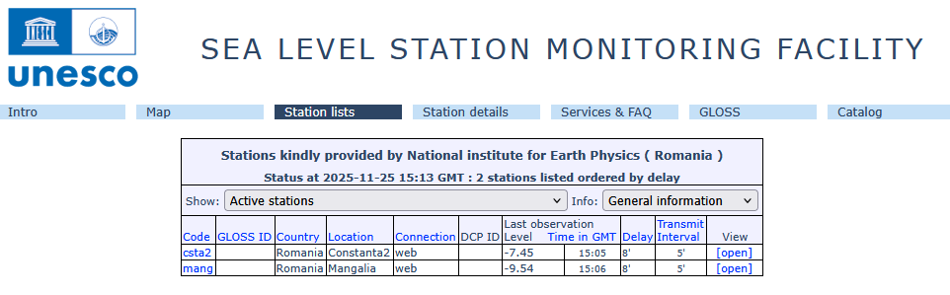
UPDATES FROM MEMBER STAT ES
ROMANIA
For both earthquake and tsunami monitoring, there are 2 sea level stations, 7 GPS/GNSS stations and 25 seismic stations installed in Dobrogea area.
NIEP is active member in the international project All Risk Integrated System TOwards Trans-boundary hoListic Early-warning - enhanced European Natural Hazards Scientific Partnership (ARISTOTLE-eENHSP) Project.
WG2&WG3 – Seismic, Geophysical & Sea Level Measurements
IOC-UNESCO ICG/NEAMTWS, 3-5 December 2025, Paris, France

Slide 14
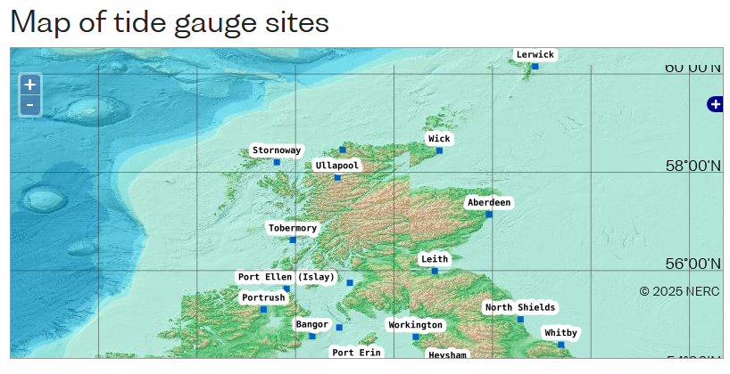
UPDATES FROM MEMBER STAT ES
United Kingdom
https://www.bodc.ac.uk/data/hosted_data_systems/sea_level/uk_tide_gauge_network/
Funding for the installation of 4 new tide gauges at Aberdeen, Lerwick, North Shields and Stornoway.
High frequency sampling for tsunami detection
GNSS for VLM
Interferometric reflectometry
Powered by renewable energy
Installation will be completed within the next 2 years
WG2&WG3 – Seismic, Geophysical & Sea Level Measurements
IOC-UNESCO ICG/NEAMTWS, 3-5 December 2025, Paris, France

