Slide 1
Task Team on
Non-Seismic Tsunami Sources (TT-NSTS) Activities in 2025
Co-Chairs: Fabrizio Romano (INGV), Rachid Omira (IPMA)
ICG/NEAMTWS 20th Session, 03-05 December 2025, Paris

Slide 2
Plan of Actions 2025
Strategic Area | Activity | Time Frame | Responsible Per/ Inst
Task Team on Non-Seismic Tsunami Sources | To gather information about potential approaches to assess hazard, monitor, and warn for tsunamis induced by volcanic activity and meteotsunamis | by November 2025 | TT-NSTS co-chairs
 | To explore warning procedures related with non-seismic tsunami sources | by November 2025 | TT-NSTS co-chairs, TSPs
 | To contribute to organizing webinars/workshops on non-seismic tsunami sources | by November 2025 | TT-NSTS co-chairs, TSPs
ICG/NEAMTWS 20th Session, 03-05 December 2025, Paris

Slide 3
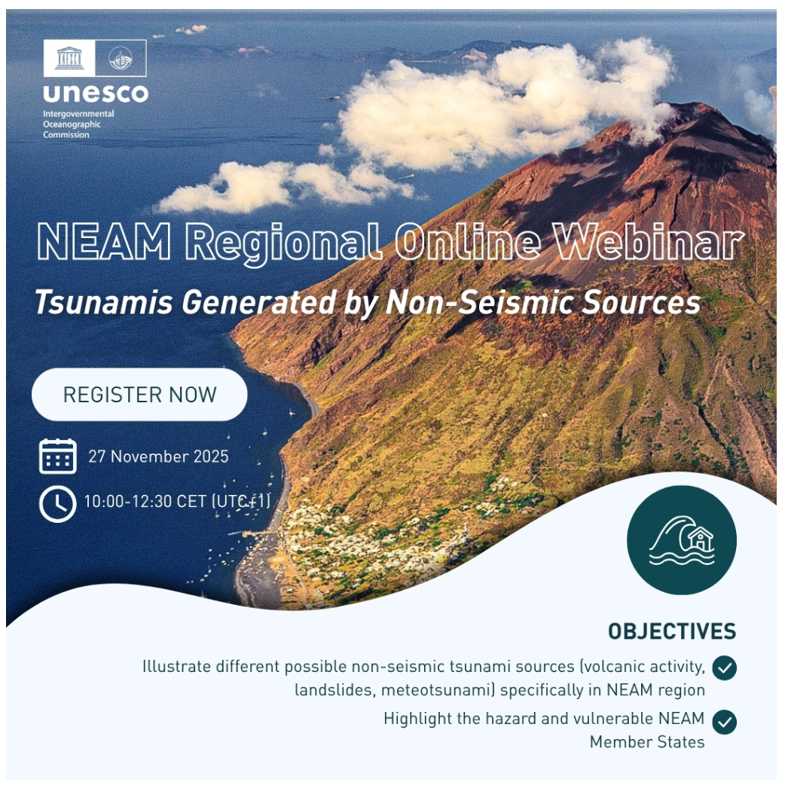

Activities
Organizing a Webinar on Non-seismic Tsunami Sources
27 November 2025 (Audience: 80+ people)
Panelists:
Bernardo Aliaga | OPENING
Denis Chang Seng | Overview UNESCO-IOC and ODTP Goal and Efforts on Non-Seismic Tsunamis
Roger Urgeless | Frequency, magnitude, and mobility of submarine landslides in the NEAM region and their role in probabilistic tsunami hazard assessment:
Carl Harbitz | Mechanisms, triggers, and case studies of landslide-generated tsunamis, with implications for early detection and modelling.
Raphael Paris | Volcanic sources in the NEAM region, eruption-linked wave generation, and lessons from historical events.
Domenico Mangione | Stromboli’s volcanic early-warning system, monitoring tools, and operational protocols for rapid alerts.
Paraskevi Nomikou | New findings on the Kolumbo system near Santorini and its implications for hazard assessment.
Marinos Charalampakis | The NEAM-COMMITTMENT Project on Multi-Hazard Assessment and the Stromboli volcano test site for Tsunami Evacuation Planning
Clea Denamiel | Probabilistic framework for understanding global meteotsunami hazards linked to explosive volcanic events.
ICG/NEAMTWS 20th Session, 03-05 December 2025, Paris

Slide 4
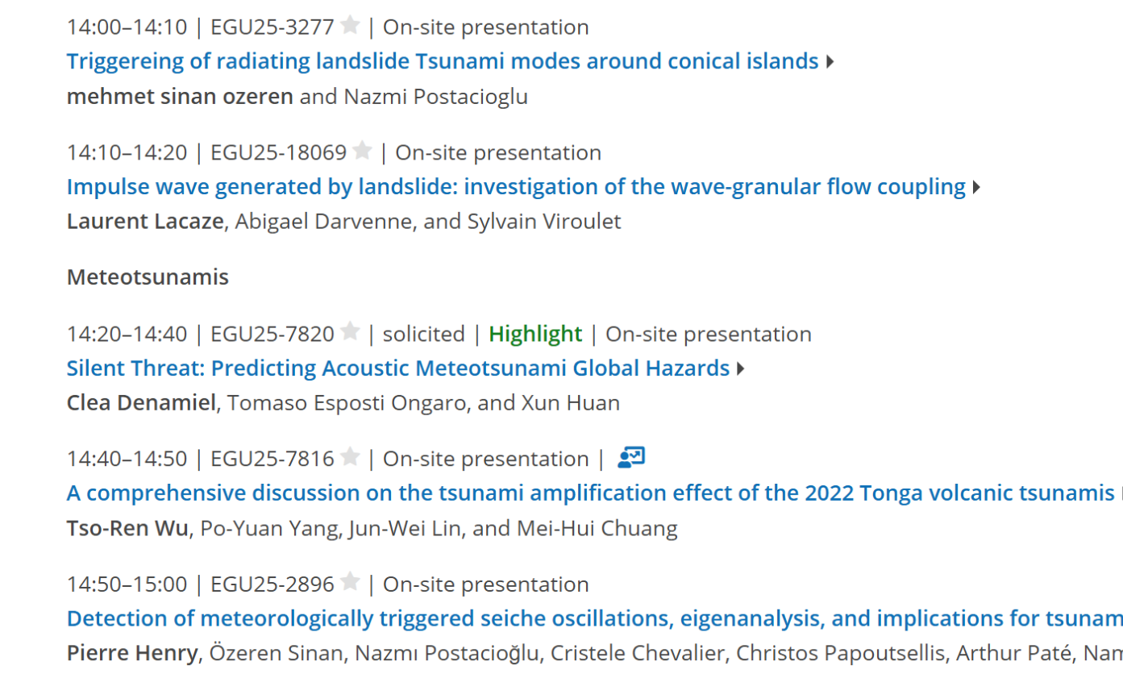
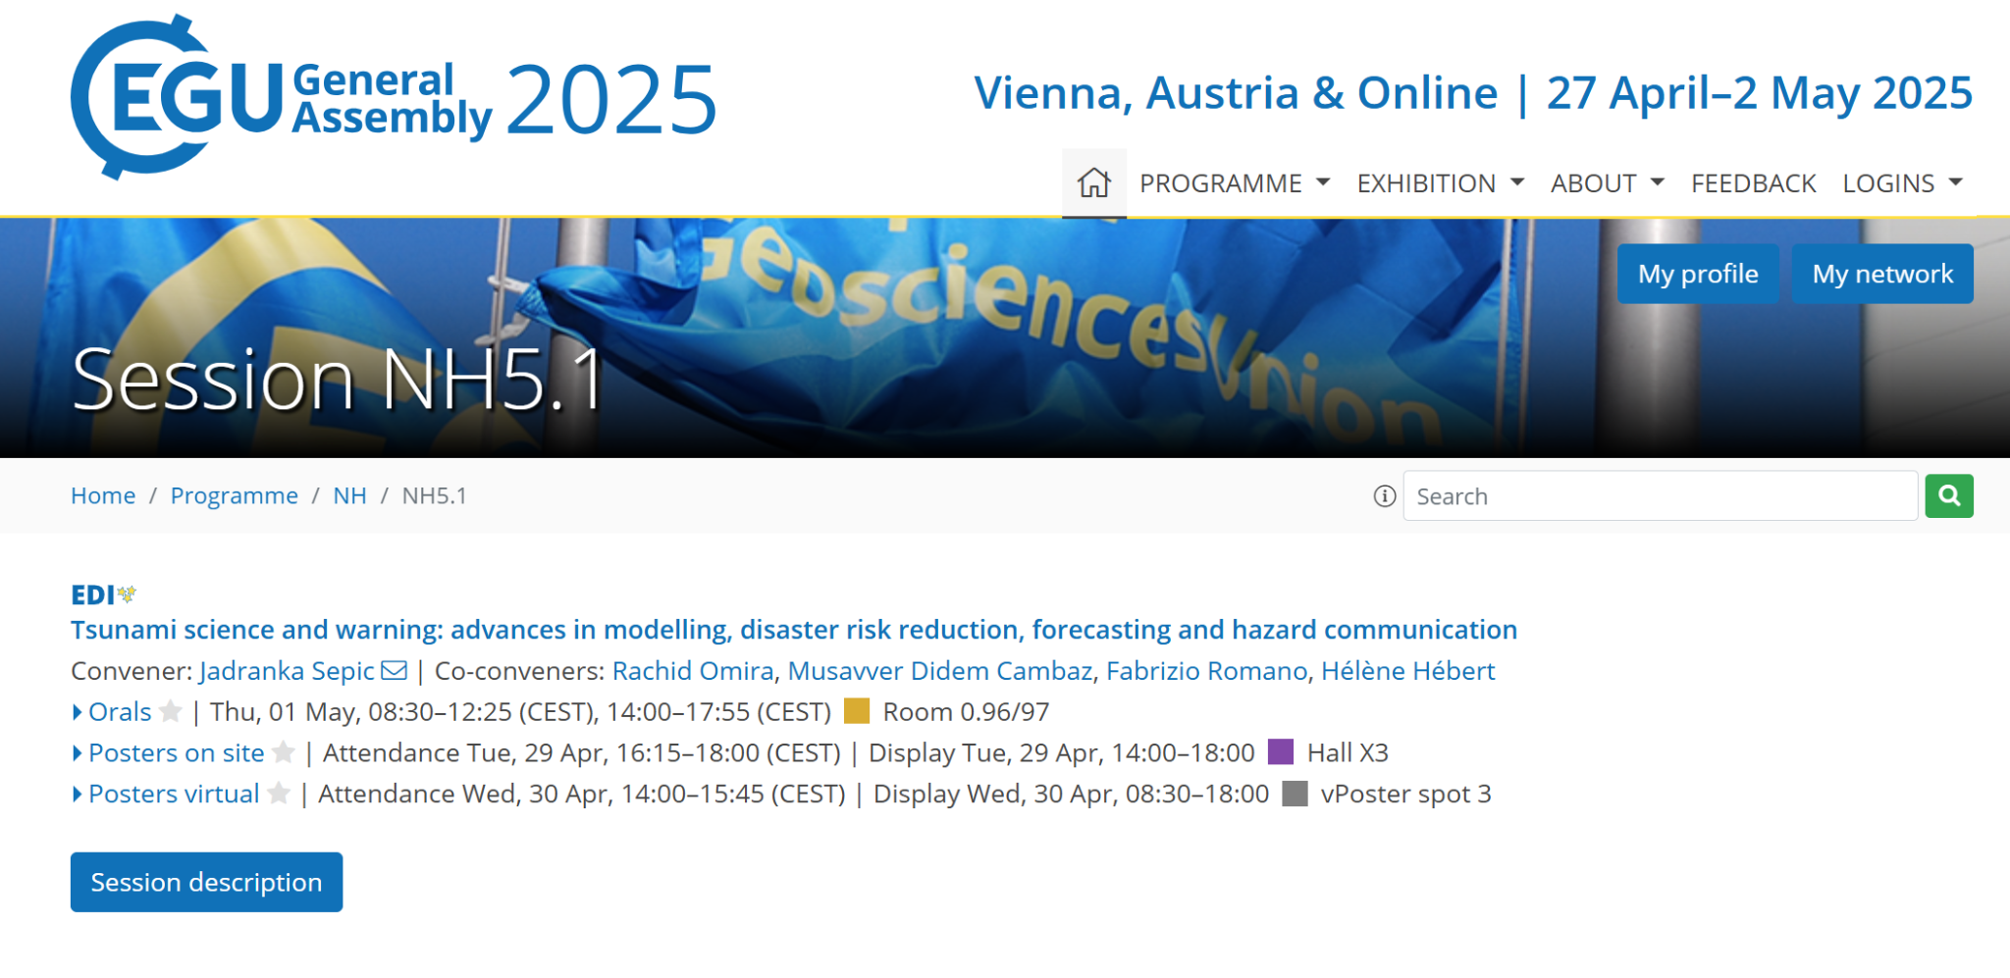
Activities
Participating at EGU, Vienna, Austria (RO & FR as conveners)
27 April–2 May 2025
Audience: ~100 people
ICG/NEAMTWS 20th Session, 03-05 December 2025, Paris

Slide 5
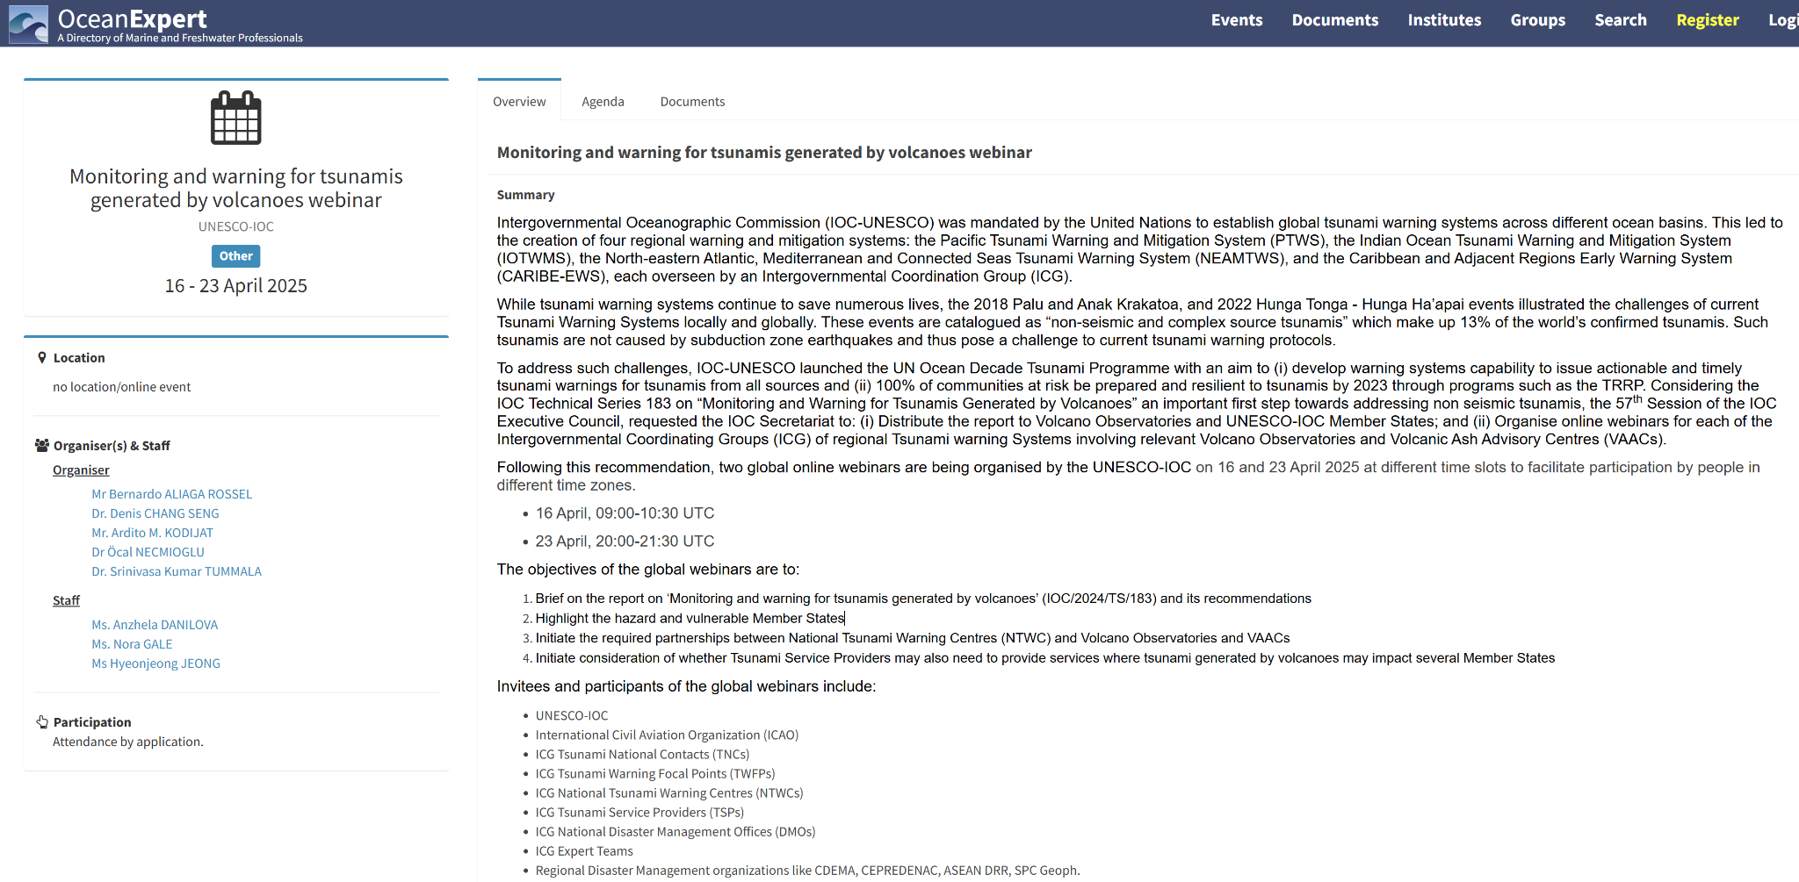
Activities
UNESCO Webinar on Monitoring and warning TGV 16 to 23 April 2025
ICG/NEAMTWS 20th Session, 03-05 December 2025, Paris

Slide 6
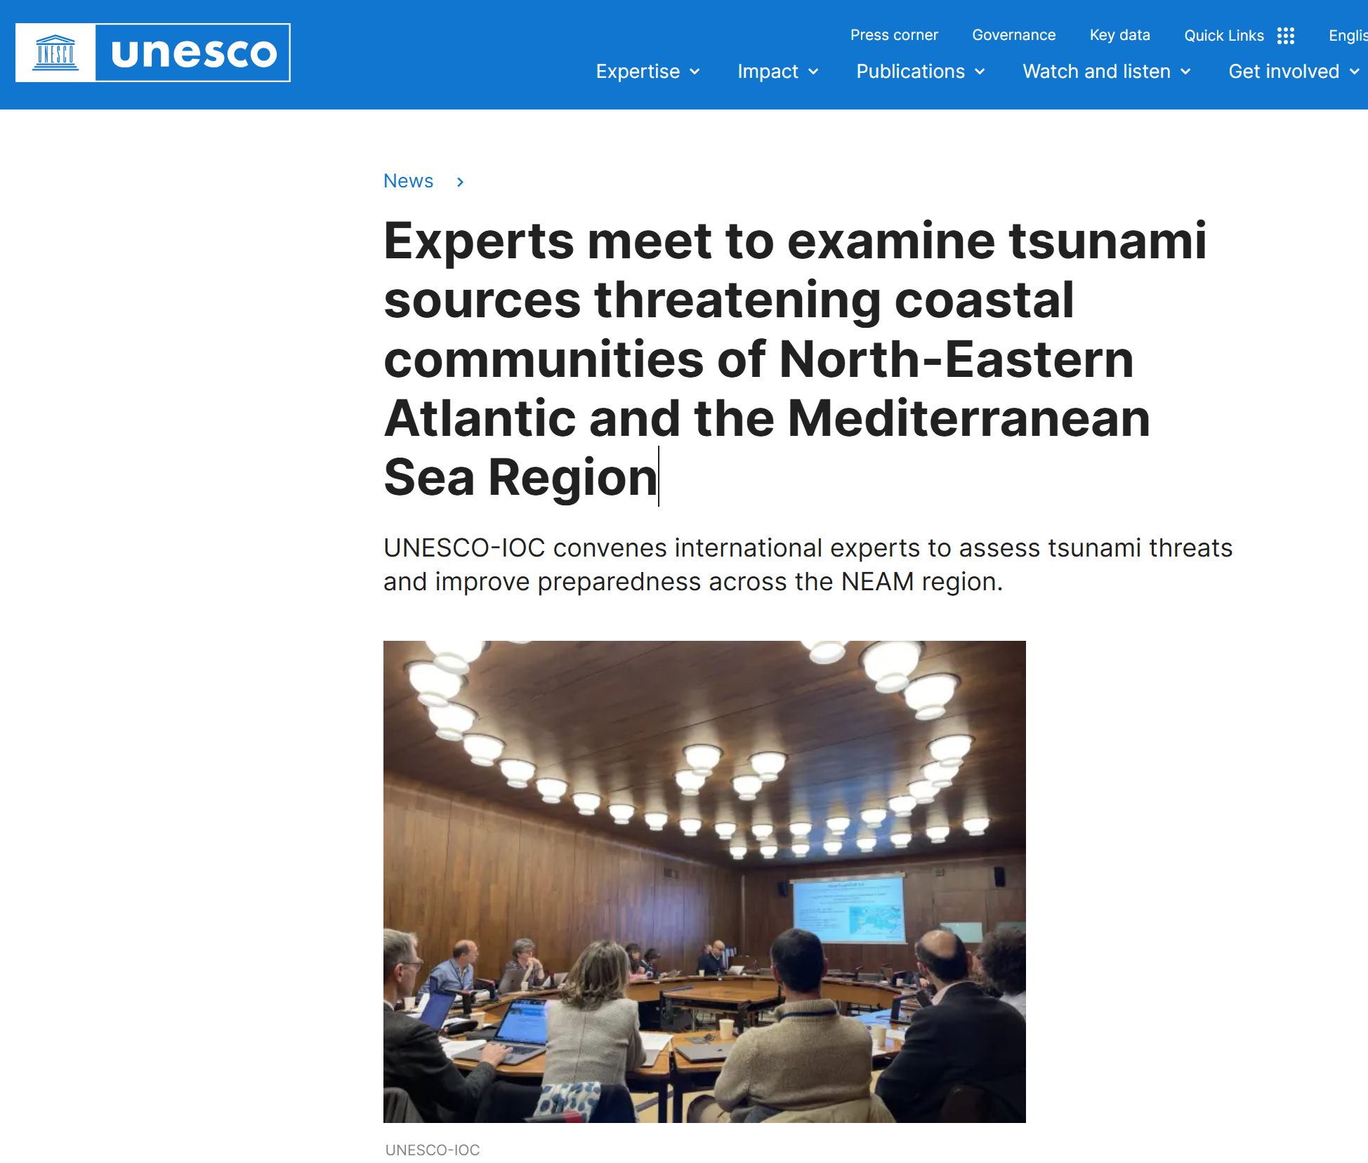
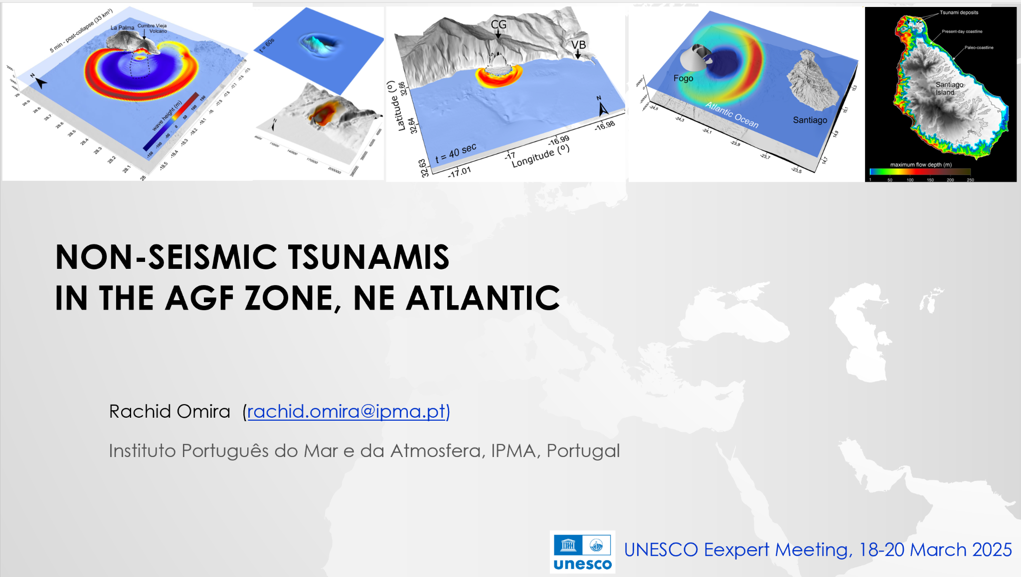
Activities
Participating in the UNESCO Expert Meeting on Seismic and Non-seismic tsunamis in the NEAM Region
18 to 20 March 2025
ICG/NEAMTWS 20th Session, 03-05 December 2025, Paris

Slide 7
Activities
NEAM-COMMITTMENT project (funded by EU-DGECHO): since February 2025
Hi-Res Inundation mapping on Stromboli
Emergency planning considering also the possible effect of volcanic activity (e.g. pyroclastic flows, ash, ballistics)
Italian project about Stromboli (funded by Civil Protection): starting probably since 2nd half of 2025
Towards the integration of the local system in the Italian TSP at national and NEAM level
ICG/NEAMTWS 20th Session, 03-05 December 2025, Paris

Slide 8
Thank you
Fabrizio Romano (INGV) fabrizio.romano@ingv.it
Rachid Omira (IPMA) rachid.omira@ipma.pt
ICG/NEAMTWS Steering Committee and Information Session, 13 May 2024

