Slide 1
IPMA National Tsunami Warning Center and TSP - Status
Fernando Carrilho
ICG/NEAMTWS, Paris
03-05 December 2025

Slide 2
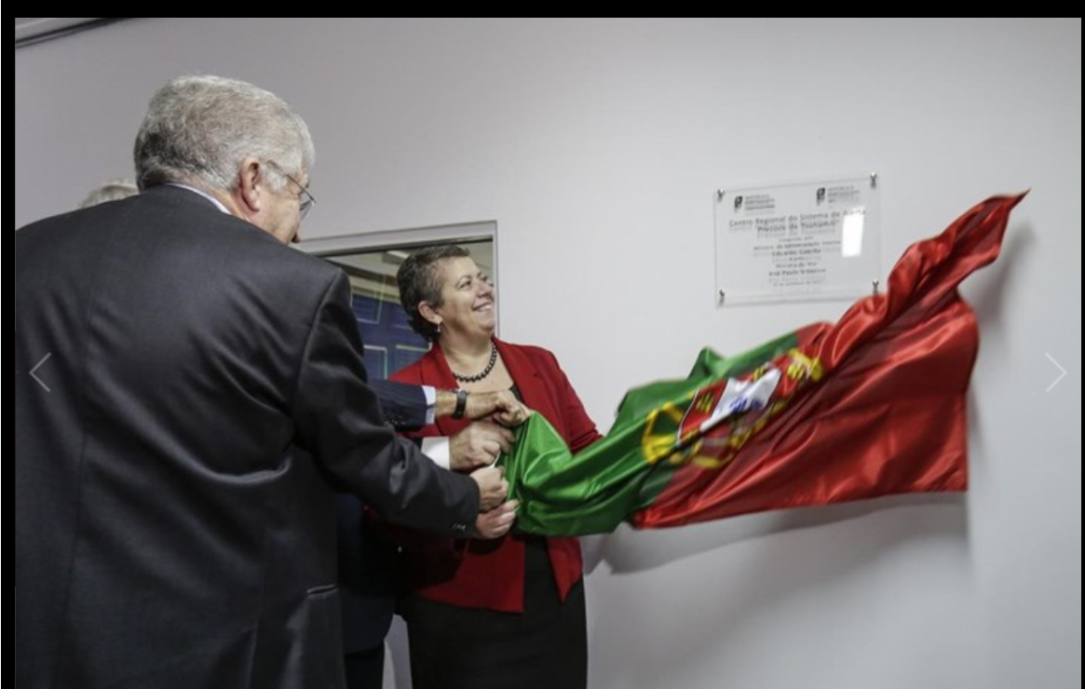
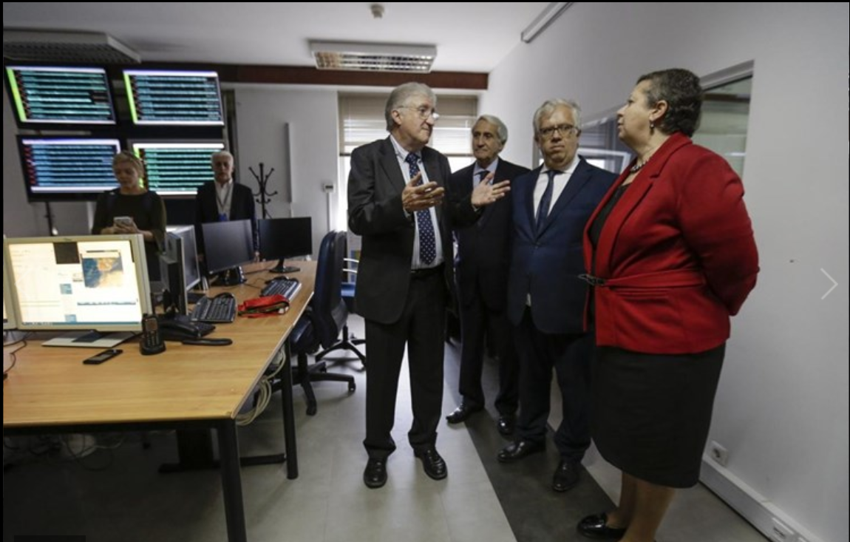
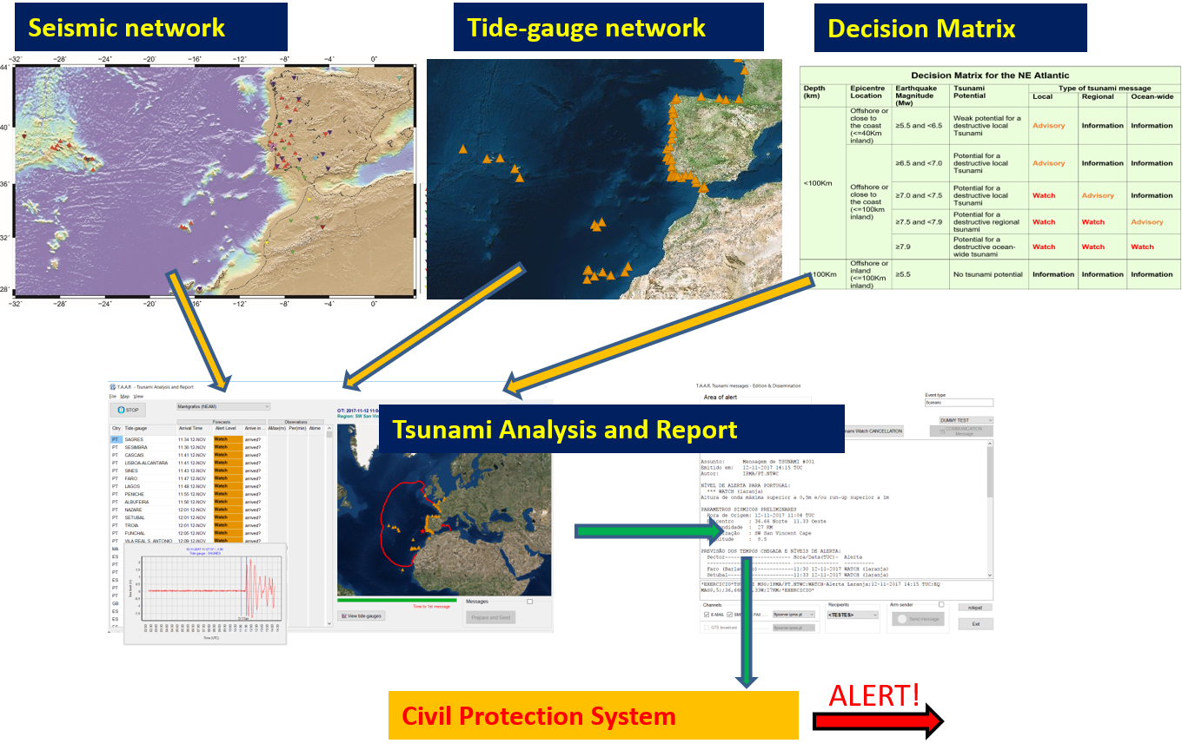
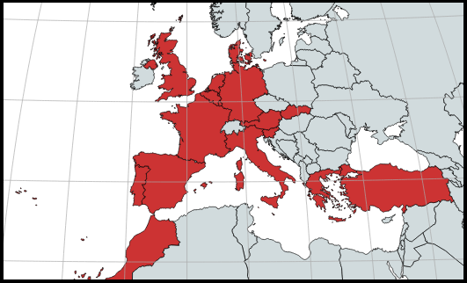
PT.NTWC
NTWC – November 2017
CTSP - January 2018
Accreditation as TSP on 2019
Subscribers:
Portugal, Spain, France, Morocco, Germany, UK, Denmark, Turkey, Italy and Greece
JRC, IOC, ERCC

Slide 3
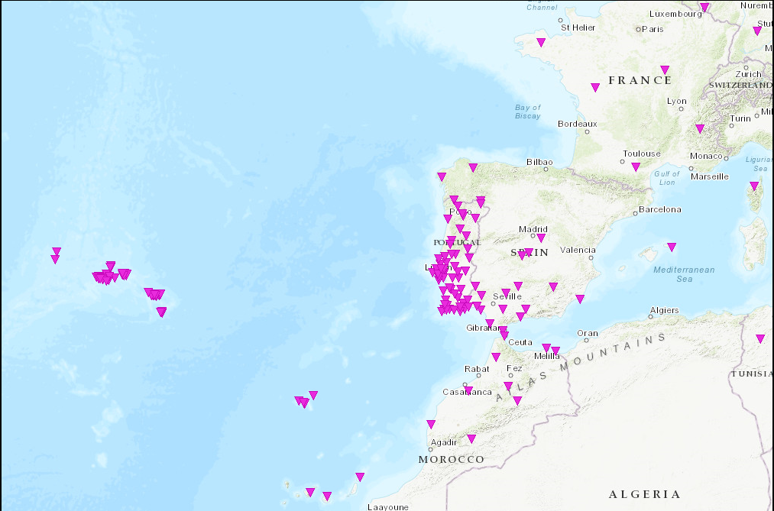
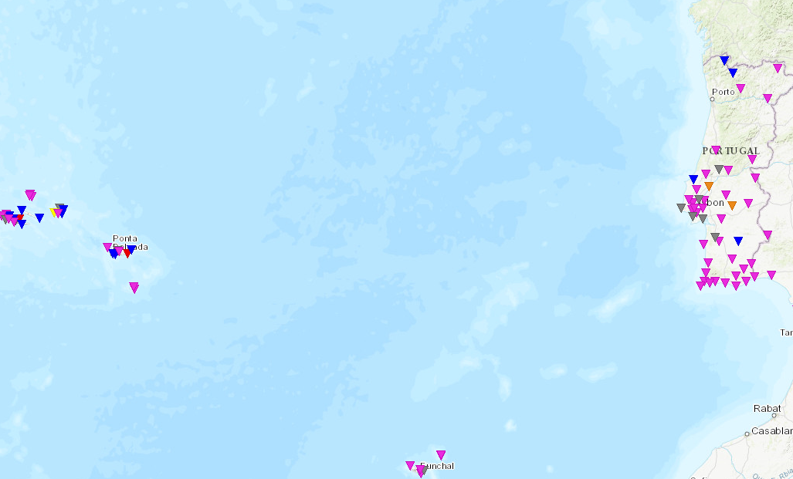
Seismic Network
VSAT
Internet
MPLS
IPMA broadband network (+ SM sensors co-located)
IPMA short-period network (+ SM sensors co-located)
IPMA/IST strong-motion network
Real-time, Internet (mobile, mini-link, fiber optic) & VSAT connection
Complemented with stations from other agencies: Portugal, Spain, Morocco, France and CTBTO (Internet, VPN and MPLS);
83 Broadband, 28 short-period and 97 accelerometers (real-time)
Broadband / Short-period
VSAT
Internet
Strong-motion

Slide 4
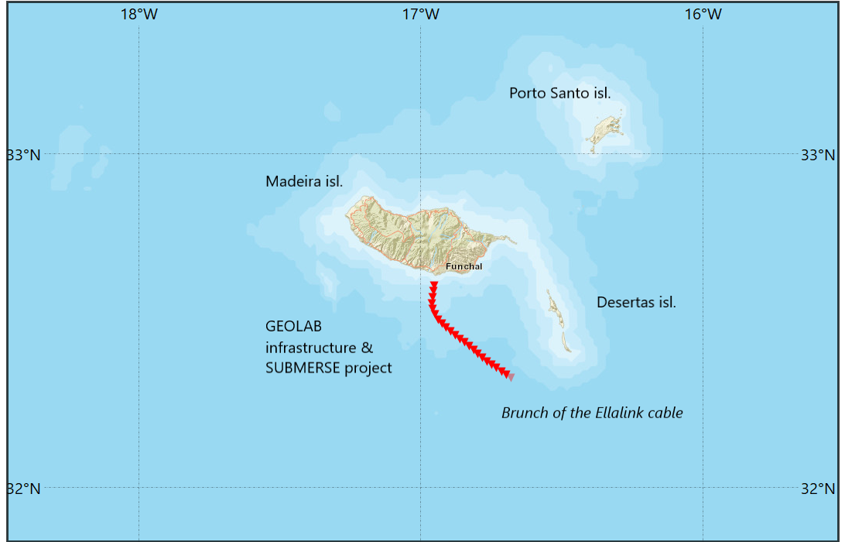
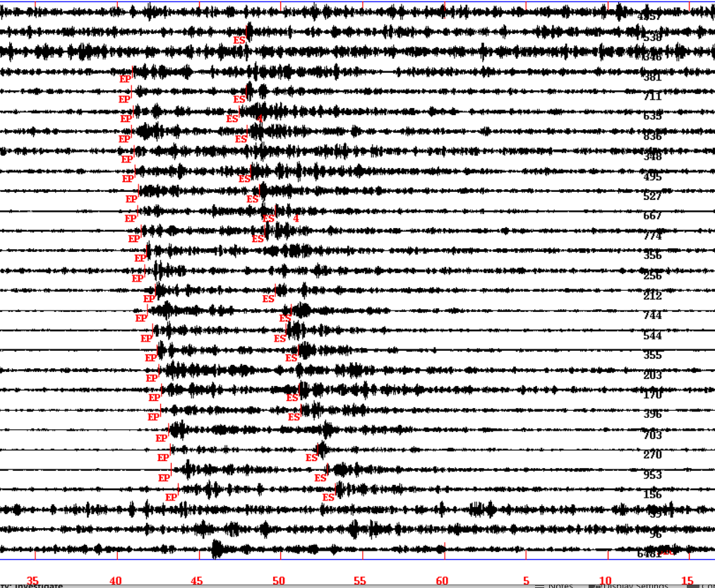
Seismic Network – NEW real time DAS
- 57Km DAS
- virtual stations each 2km
- downsampled to 125Hz
Example of a 1.8ML
60 to 90Km from the cable

Slide 5
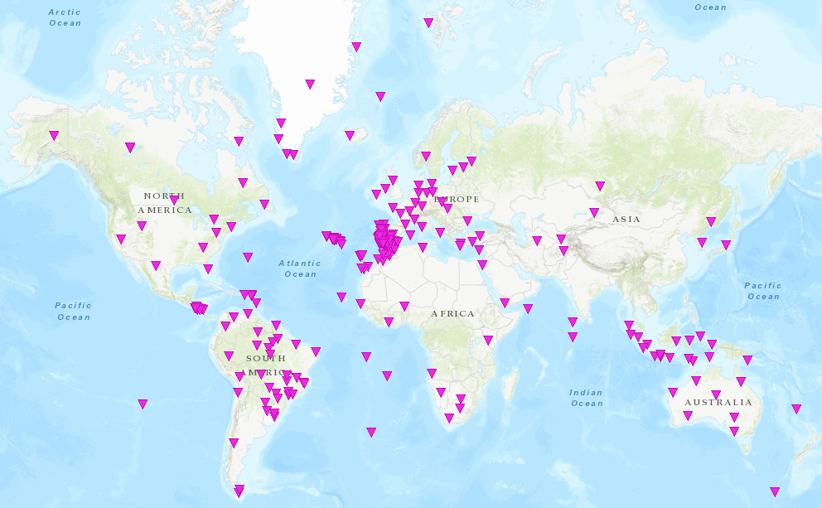
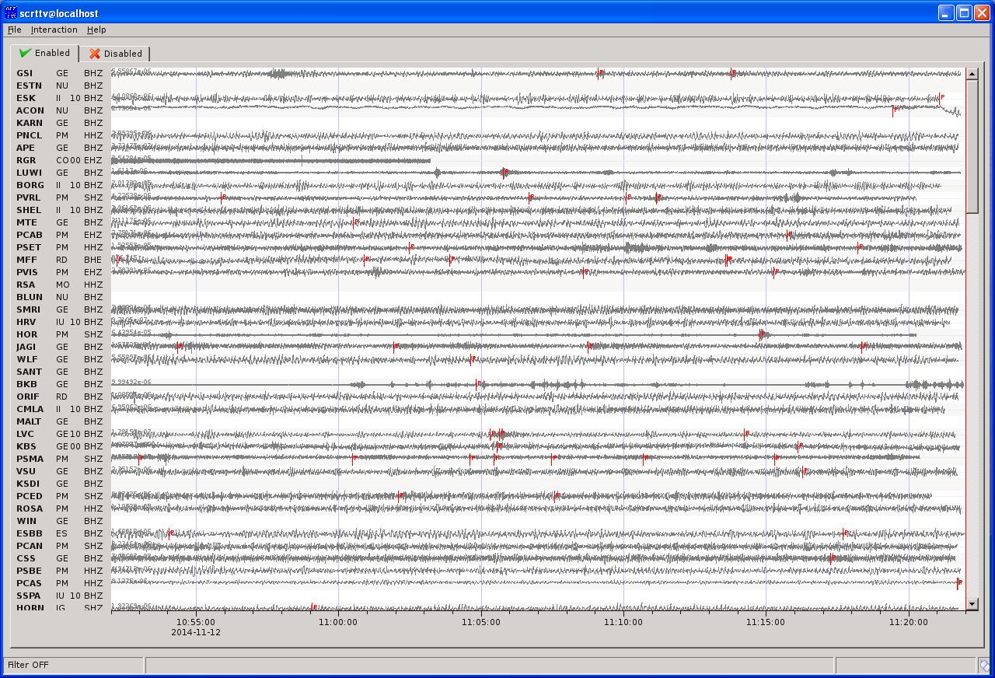
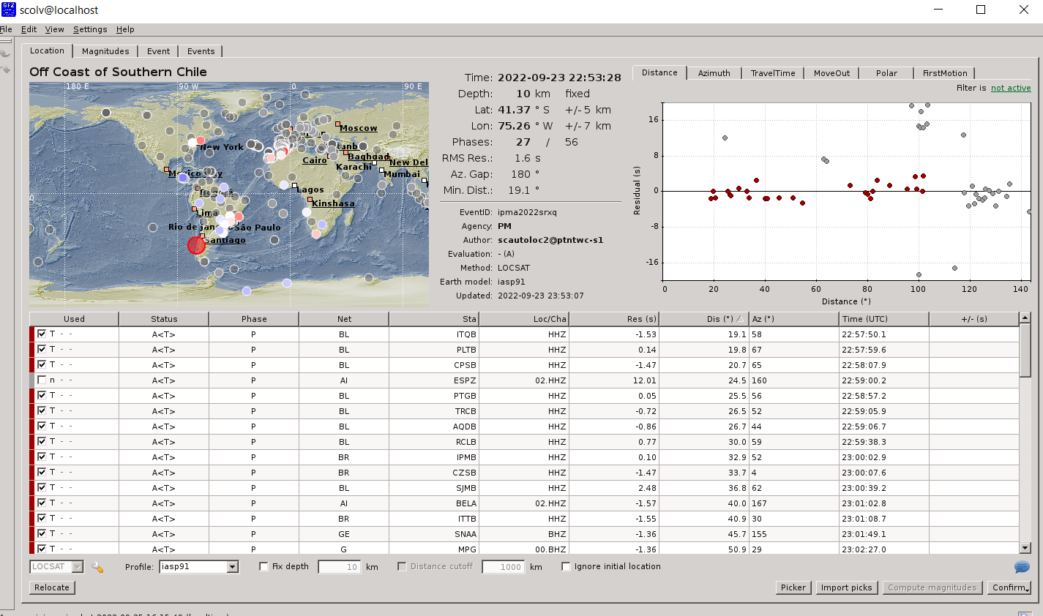
SeiscomP – Global Seismic Monitoring
Fast locations
Fast MW evaluations

Slide 6
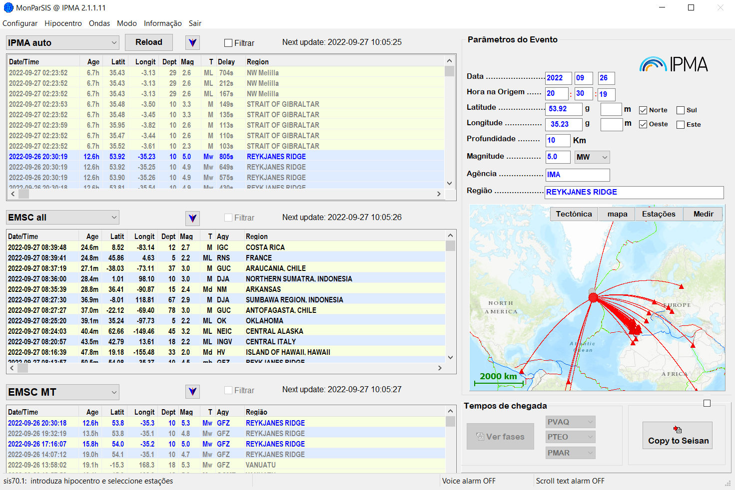
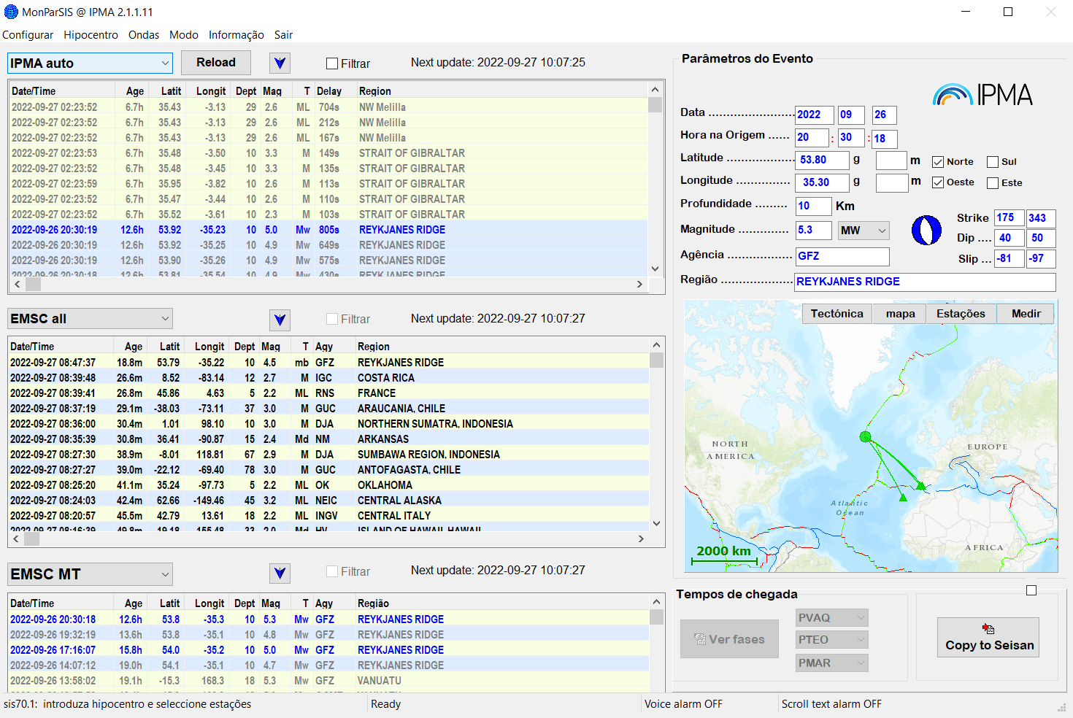
Seismic Monitoring
IPMA Automatic solutions
Other agencies solutions
(hypocenters/Mags/MT)

Slide 7
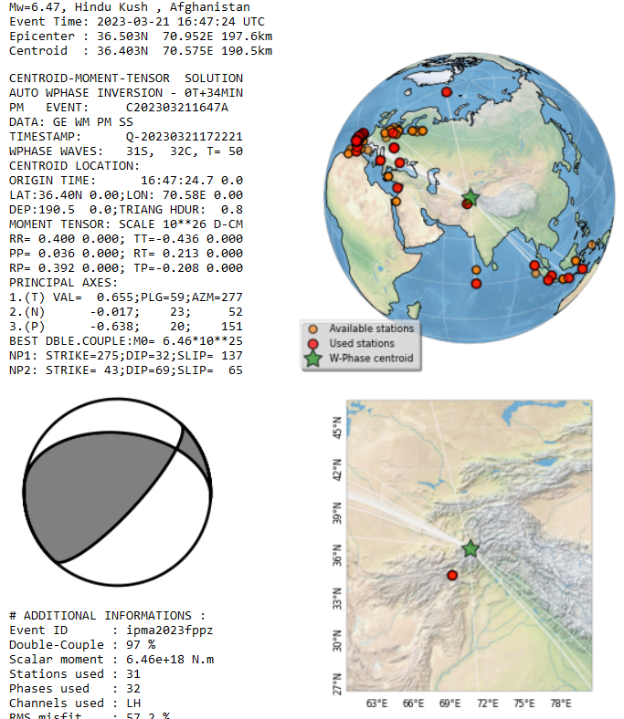
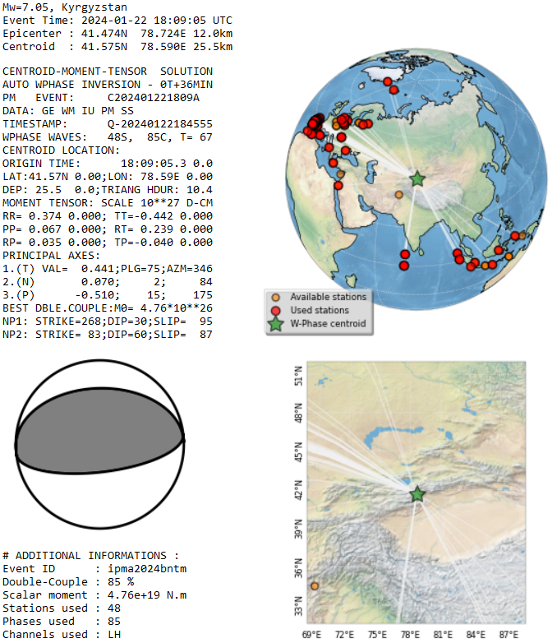
Seismic Monitoring
IPMA Automatic Mw & CMT
W-Phase method
Implemented on Seiscomp
in late Feb 2023
Contribution:
(Luis Rivera & Anthony Jamelot)

Slide 8
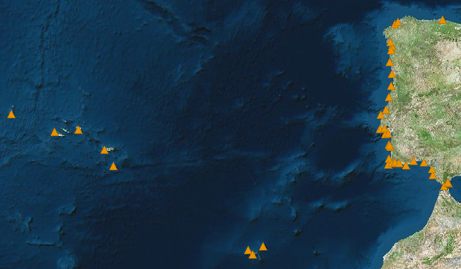
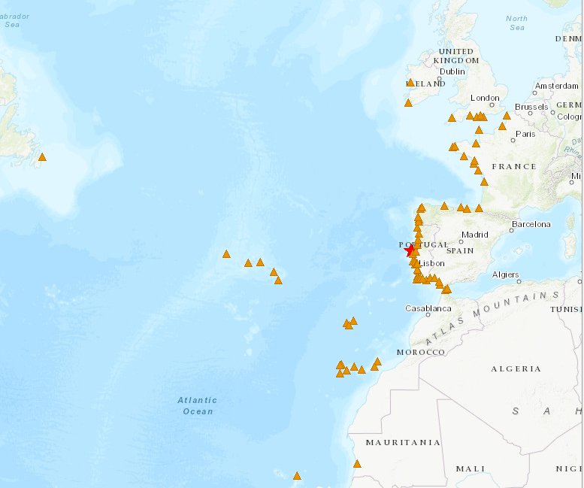

Tide-gauge network
Internet
MPLS
Internet
MPLS
71 stations
El Jadida
Sources:
CENALT, seiscomp/MPLS (SHAUM stations)
IH, webservice/Internet (Instituto Hidrográfico)
JRC, webservice/Internet
EMSO-PT/UBI/IPMA, webservice/Internet
DGT sites, webservice/Internet (Direção geral do Território)
IGN seiscomp/Internet (Puertos del Estado stations)
Instituto Hidrográfico
Puertos Del Estado (via IOC & IGN)
Direção Geral do Território
CNRST (via CNRST & JRC)
JRC (ipma & ign support)
IOC

Slide 9
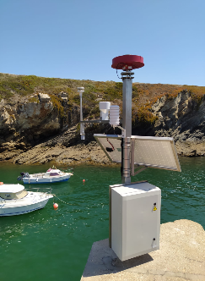
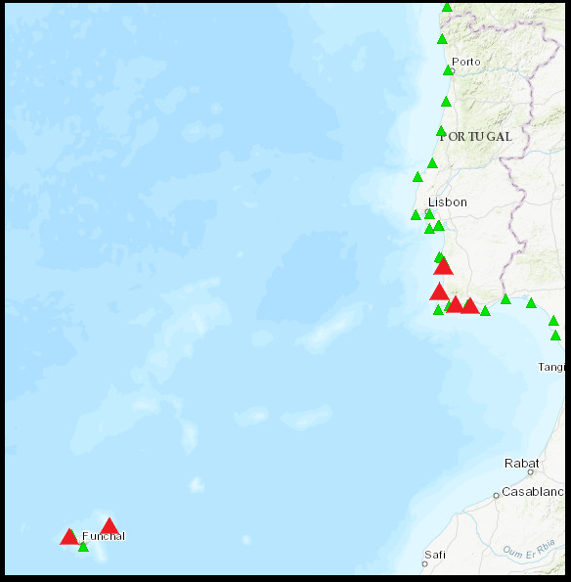
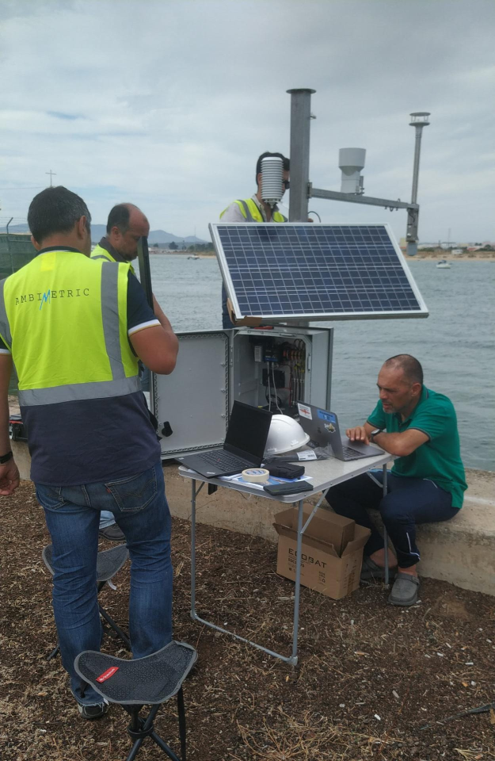
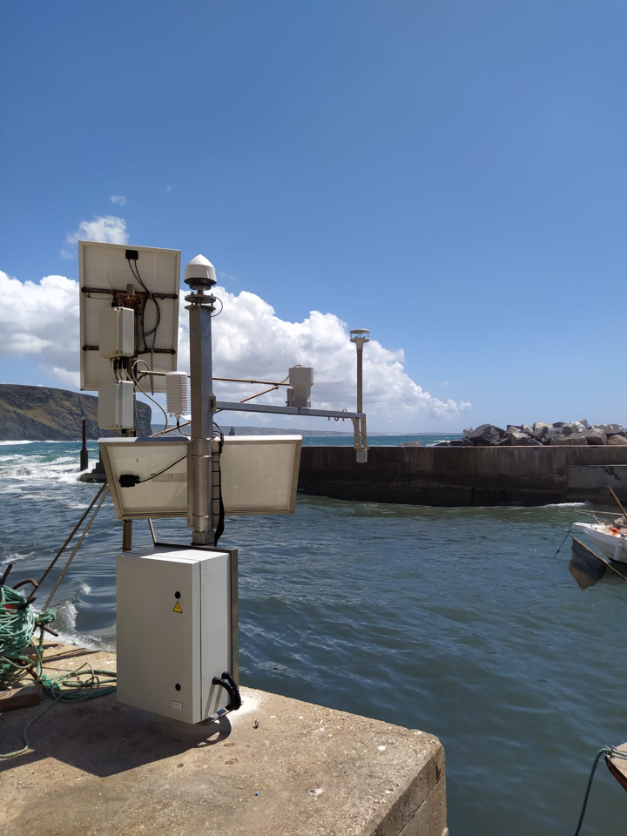
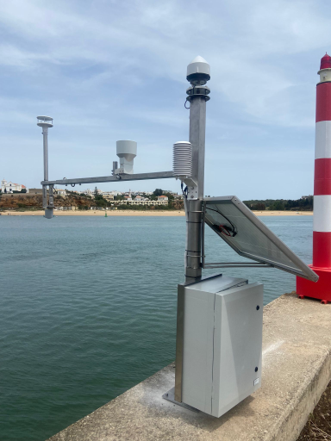
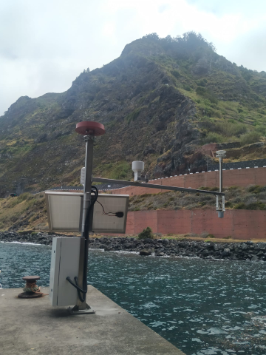
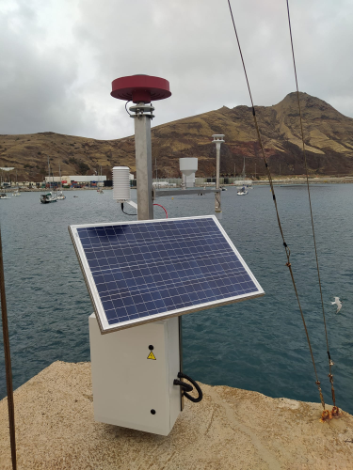
EMSO-PT
MultiParameter Stations
Porto Covo
Albufeira
GNSS
Tide-Gauge
Meteo
Atmospheric Pressure
Temperature
Humidity
Wind
Arrifana
Portimão
Solar Power
Mobile Internet
Local buffer
University of Beira Interior
Instituto Português do Mar e Atmosfera
Porto Moniz
Porto Santo

Slide 10
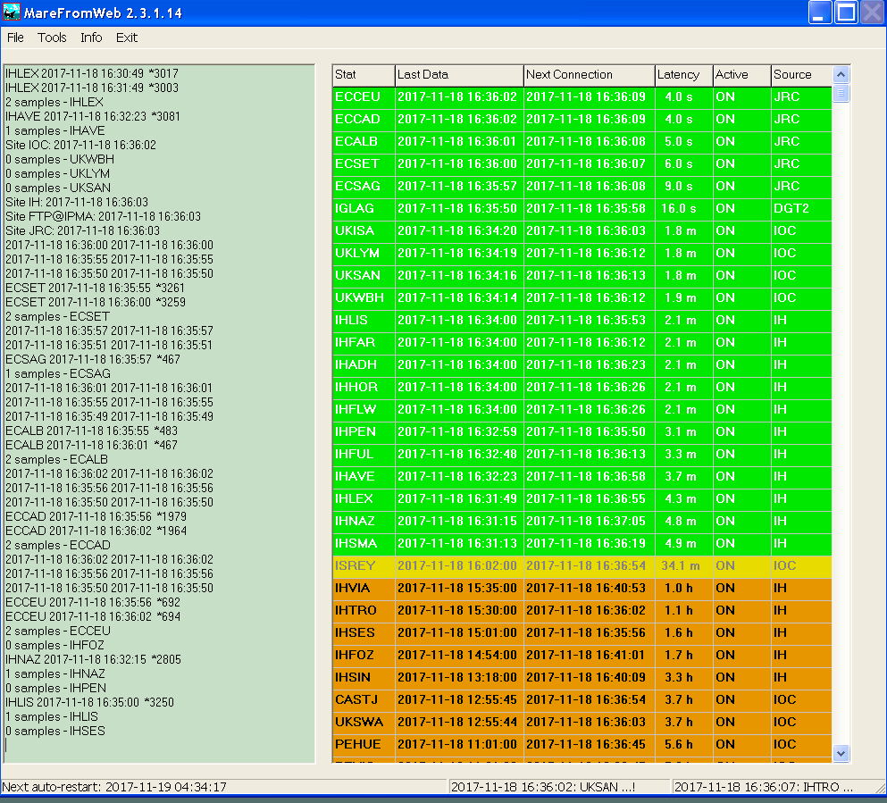
Tide-gauge data acquisition
and management
DGT
sites
IH
dataservice
JRC
dataservice
EMSO-PT/UBI/IPMA
ftp
IOC dataservice
CENALT
seiscomp
IGN
seiscomp
MareFromWeb
TREMOR01
Seiscomp

Slide 11
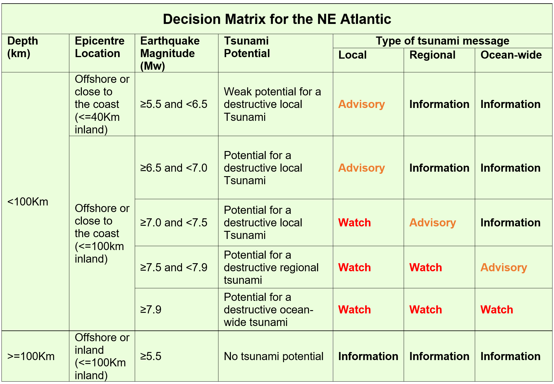
Decision Matrix

Slide 12
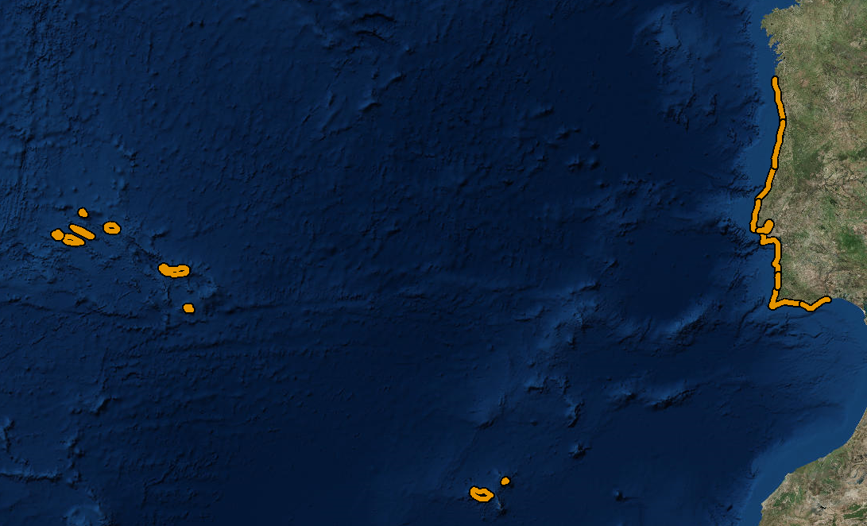
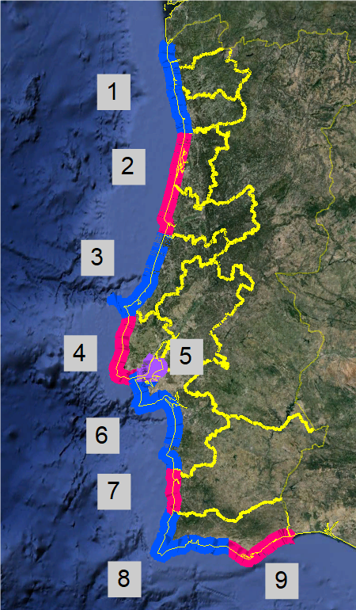
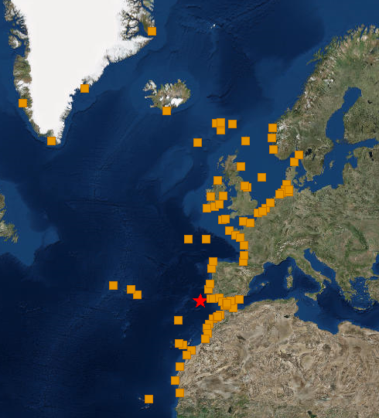
Forecast coastal segments (national)
Forecast points (regional)
Regional NEAM level
Islands
10-11. Madeira & Porto Santo
12-20. Azores islands
Mainland
1. Viana-Braga-Porto
2. Aveiro-Coimbra
3. Leiria
4. Lisboa Atlântico
5. Estuário Tejo
6. Setúbal
7. Beja
8. Faro Barlavento
9. Faro Sotavento
National level

Slide 13
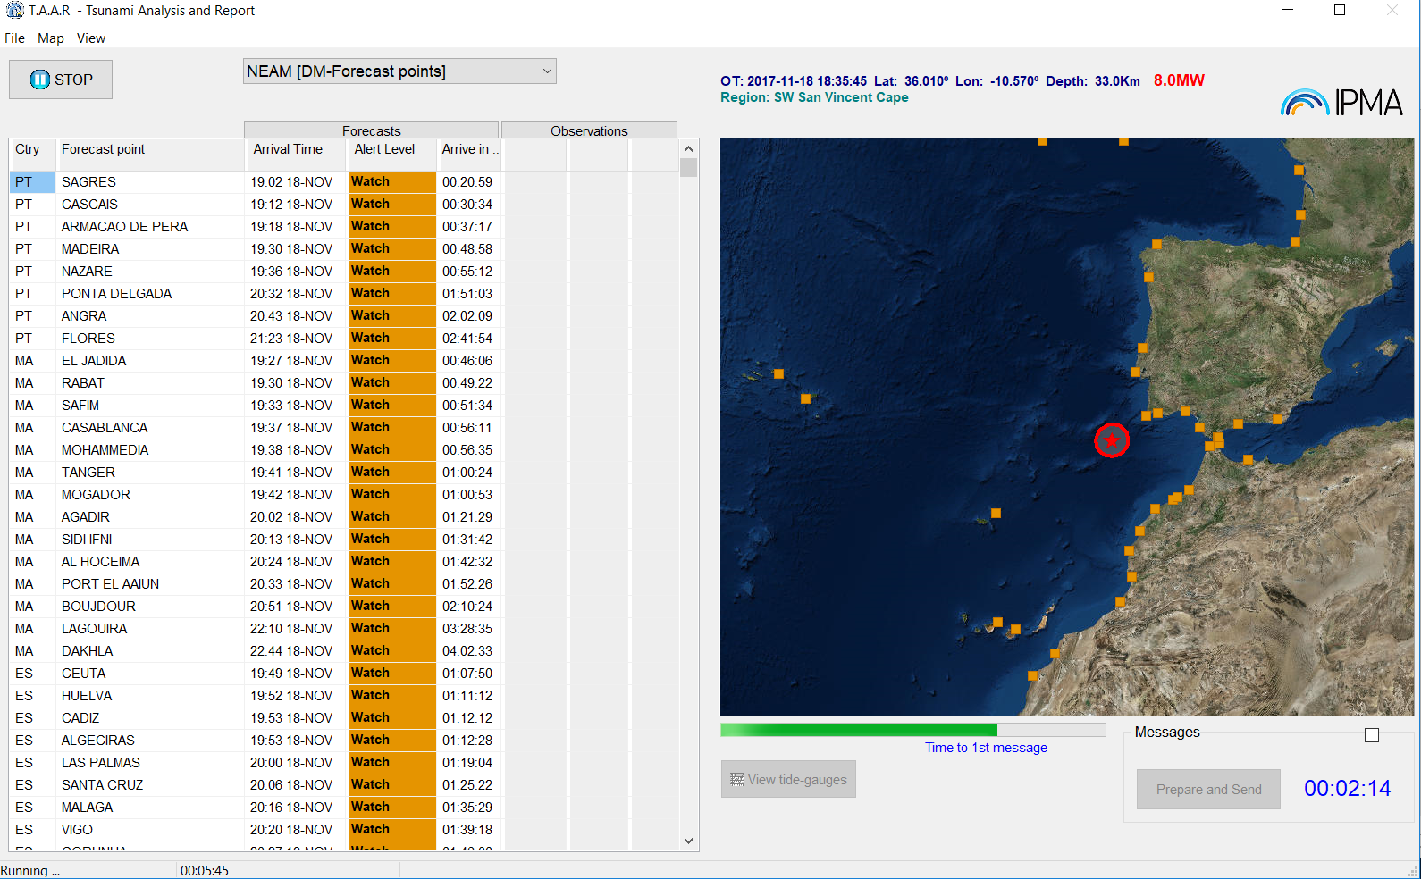
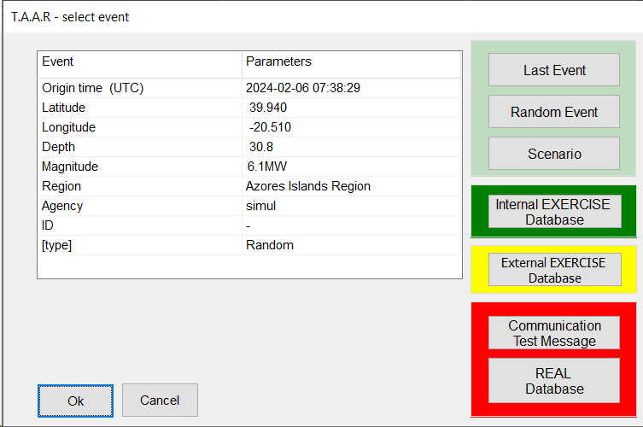
TAAR – Tsunami Analysis And Report
Testing purposes
(include random full scenarios)
Internal Exercise Mode
Exercise Mode
(Neamwave21, others)
Real events and
Communication tests

Slide 14
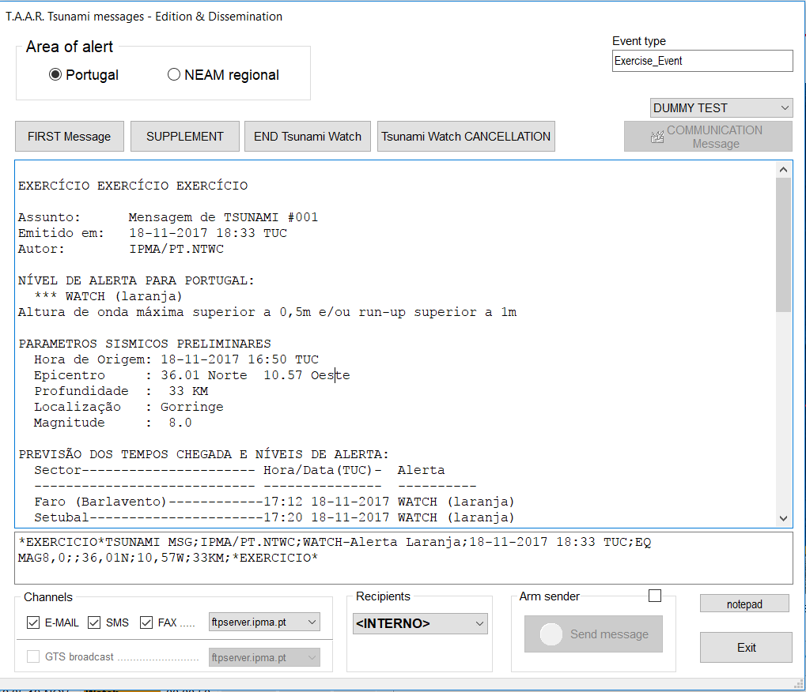
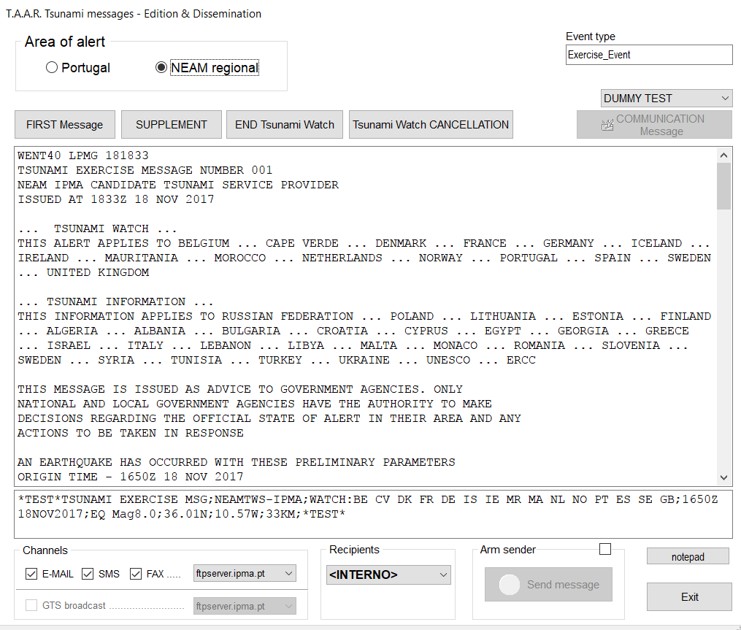
TAAR – Tsunami Analysis And Report
EMAIL
FAX
GTS
EMAIL
FAX
SMS
SMS

Slide 15
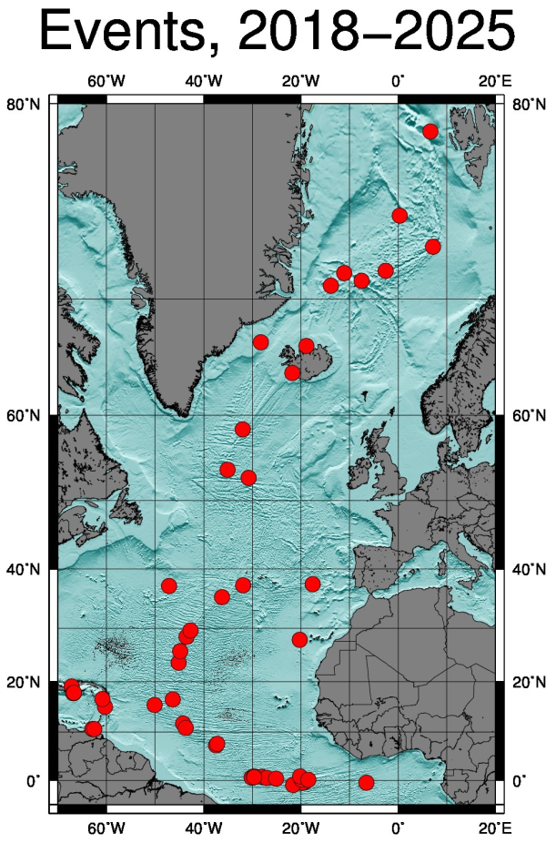
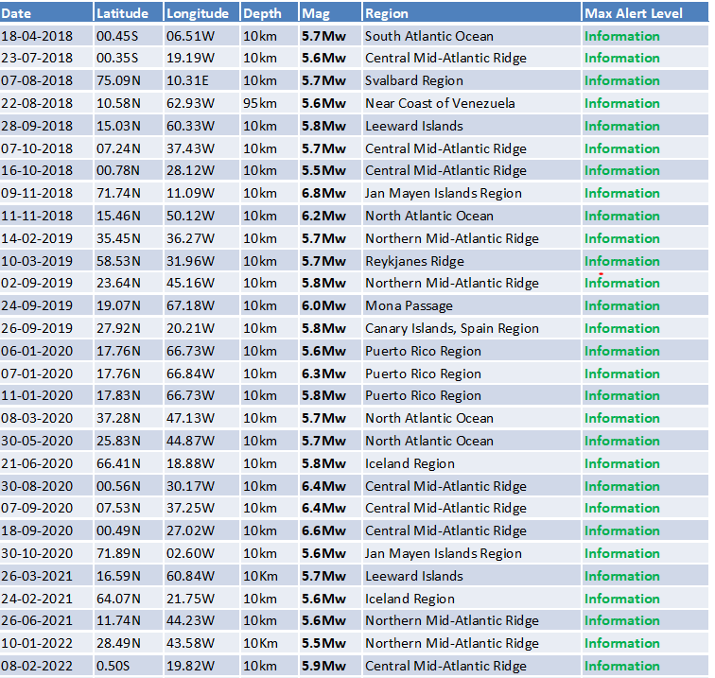
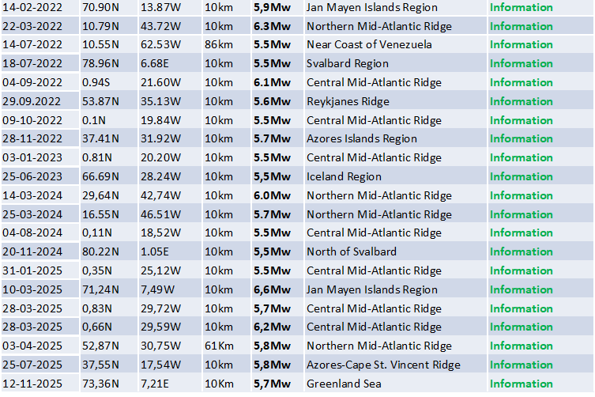
Regional level – TSP for NE Atlantic
50 Tsunami messages issued:
50 events

Slide 16
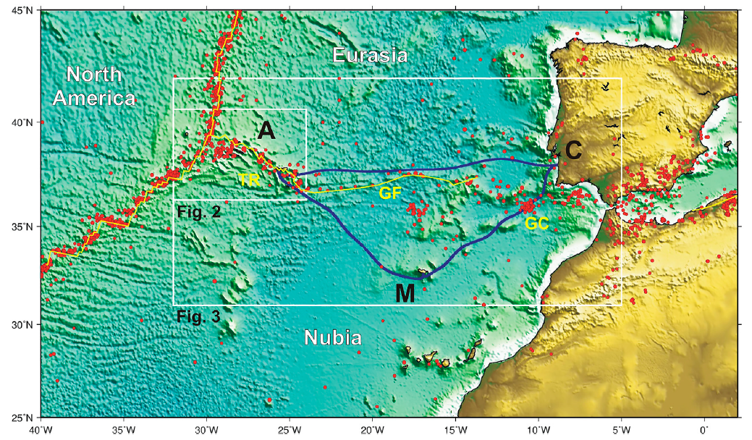


Atlantic SMART CAM
New Submarine Cable Ring connecting PT Mainland-Azores-Madeira –
SMART - Science Monitoring And Reliable Telecommunications - SYSTEM

Slide 17

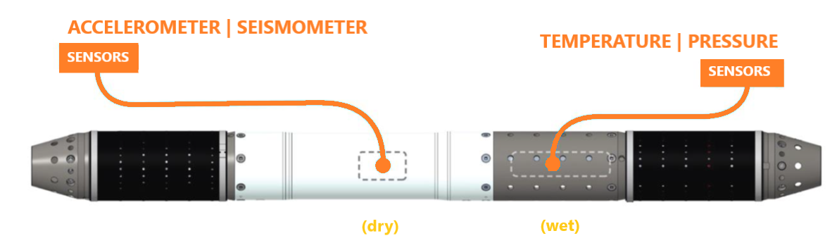
SMART CAM – Physical Layout
One of the world’s first “SMART” cables, capable of carrying internet data, but also monitoring the ocean above and the earth below
For an average of 15% increase in cost, four sensors – accelerometer, seismometer, water pressure, and temperature – into the CC Node
Carcavelos-Terceira
1 650 km
8 CC nodes
Total Extention 3,950 km
8 CC nodes
Sines-Funchal
990 km
Terceira-São Miguel
210 km
4 CC nodes
São Miguel-Funchal 1,100 km
to be operational on the second half of 2027
addapted from ASN

Slide 18

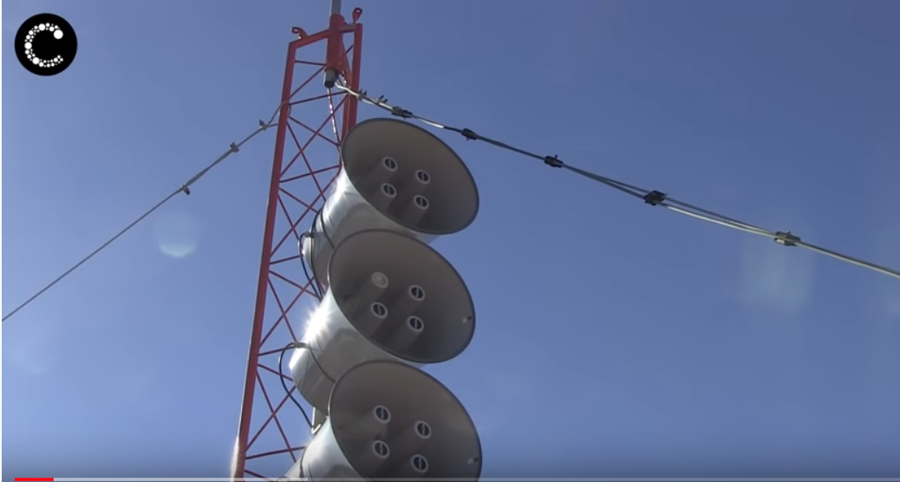
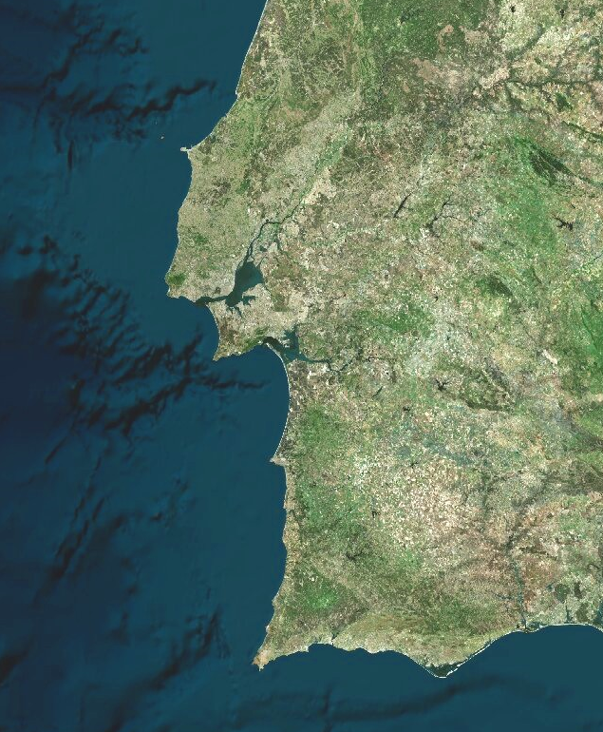

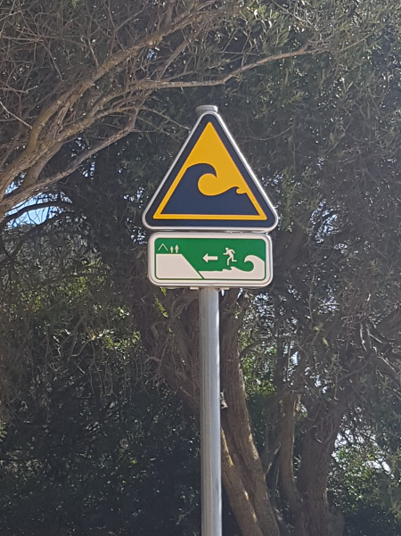
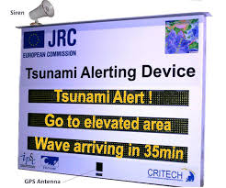
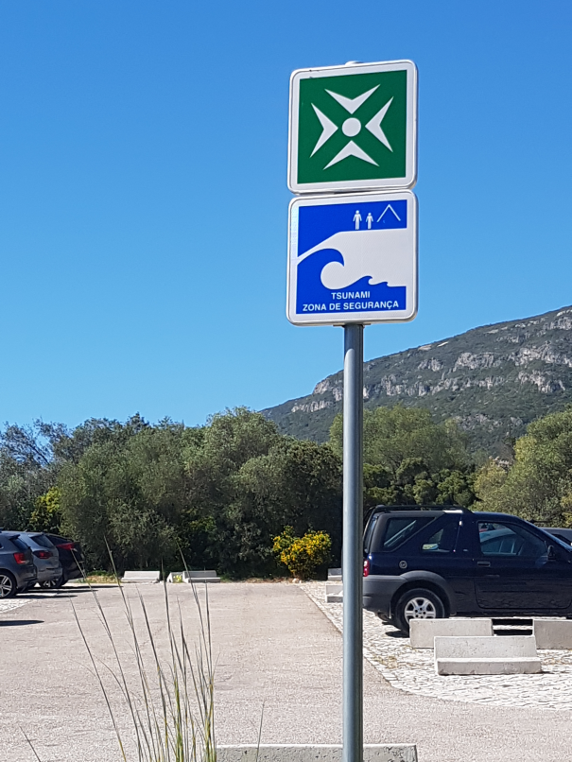

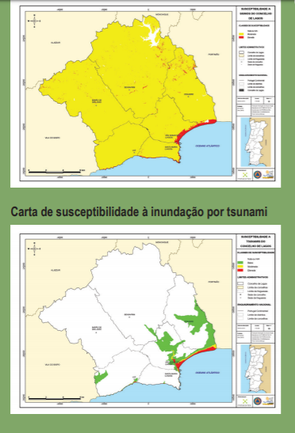

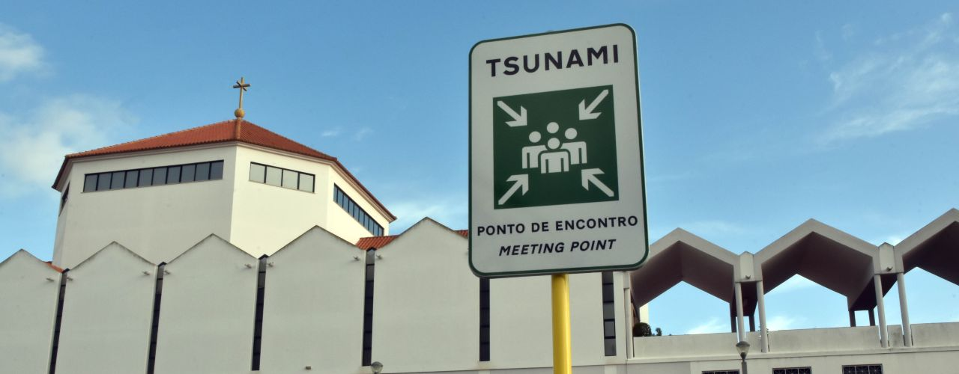

“Tsunami Ready” Initiatives
(Lourinhã)
Lisbon
to become
TSUNAMI READY
coastwave 2.0
(National Tsunami
Ready Board Pending)
Cascais
(Sesimbra)
Setúbal
Lagos
Portimão
Loulé

Slide 19
Thank you for your attention

