Slide 1








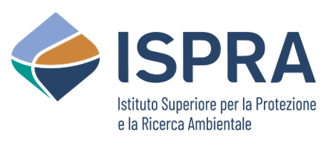









ICG/NEAMTWS-XX
Paris, 3-5 December 2025
Supporting Improved Tsunami Risk Management and Planning
in the North-Eastern Atlantic and Mediterranean Region, through the NEAM-COMMITMENT EU Project
Marinos Charalampakis*, Nikos Kalligeris, Laura Graziani, Ignacio Aguirre Ayerbe, Pio Di Manna, Vitor Silva, Jorge Macias, Domenico Russo, Costas E. Synolakis, Andreas Antonakos, Sylvana Pilidou, Luigi D'Angelo, Carlos González González, and the NEAM-COMMITMENT project team
*Institute of Geodynamics, National Observatory of Athens
Hellenic National Tsunami Warning Center
NEAM-COMMITMENT project team: 1: Elena Daskalaki, Marina Athanasopoulou; 2: Andrea Bevilacqua, Mauro Coltelli, Umberto Fracassi, Stefano Lorito, Alessandro Tadini; 3: María Merino; 4: Federica Ferrigno, Daniele Spizzichino; 5: Marco Baiguera, Helen Crowley; 6: Carlos Sánchez; 7: Cristina Roccella; 8: Georgios-Marios Karagiannis, Nikolaos Protonotarios, Vassilios Skanavis; 9: Evangelos Aggelopoulos, Natalia Patsioti; 10: Iordanis Dimitriadis, Nikolas Papadimitriou; 11: Domenico Mangione, Antonella Scalzo; 12: Beatriz Gaite Castrillo

Slide 2
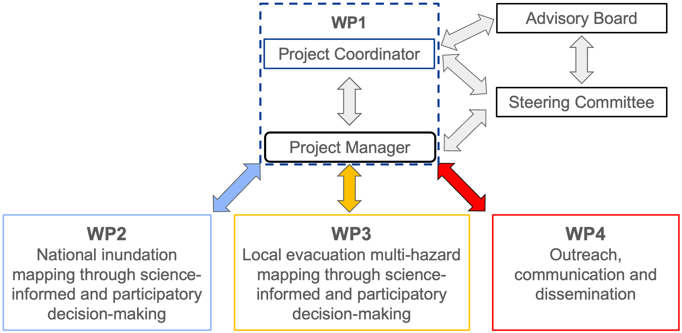
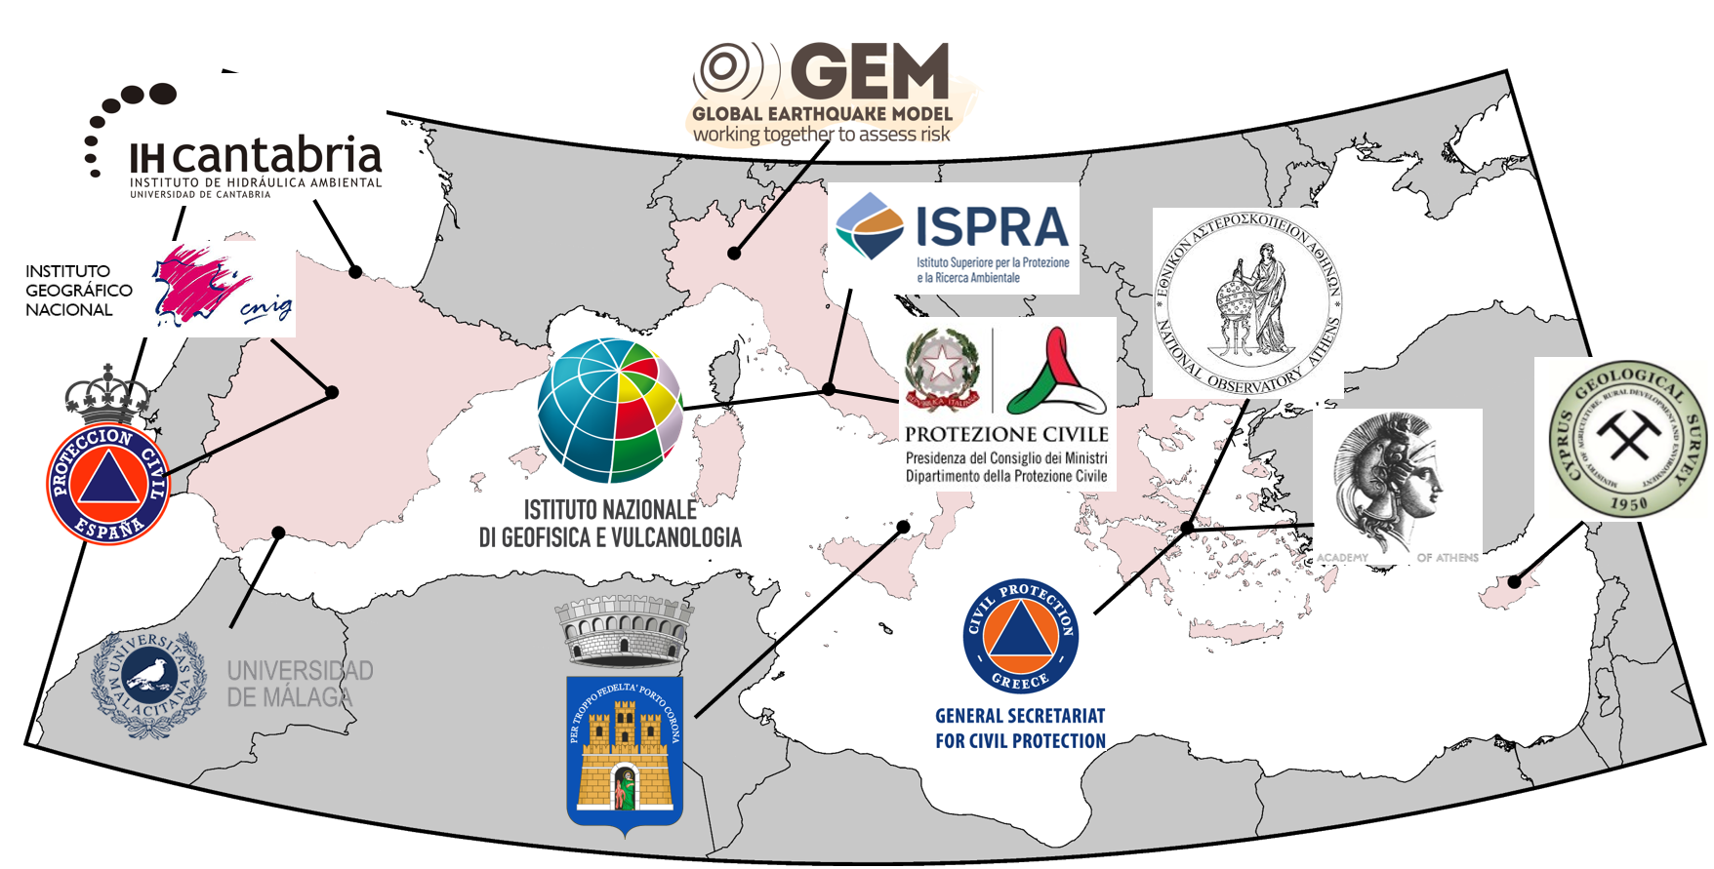
The Consortium
Project management's organizational structure
No | INSTITUTE | Sort Name
1 | National Observatory of Athens, Greece - COO | NOA
2 | Istituto Nazionale di Geofisica e Vulcanologia, Italy | INGV
3 | Cantabria Environmental Hydraulics Institute Foundation, Spain | FIHAC
4 | Institute for Environmental Protection and Research, Italy | ISPRA
5 | Global Earthquake Model Foundation. Italy | GEM
6 | University of Malaga. Spain | UMA
7 | Municipality of Lipari, Italy | MoL
8 | Academy of Athens. Greece | AoA
9 | General Secretariat of Civil Protection, Greece | GSCP
10 | Geological Survey Department, Cyprus | GSD
11 | Civil Protection Department, Italy | DPC
12 | Directorate General of Civil Protection and Emergency, Spain | DGPCE
13 | National Geographic Institute, Spain | IGN
NOA
INGV
IHC
NOA
13 partners from 4 counties: Cyprus, Greece, Italy and Spain
3 national CPAs (GR, IT, ES)
1 municipality (Lipari)
1 international organization (GEM)
4 National Tsunami Warning Centers (GR, IT, CY, ES)
Duration: 24 months, started on 01 February 2025
Call: European Union Civil Protection Mechanism-2024-Knowledge for Action in Prevention & Preparedness
Title: NEAM Collaboration fOr iMproved tsunaMi rIsk miTigation and manageMENT
Estimated Project Cost: €985 629.70

Slide 3
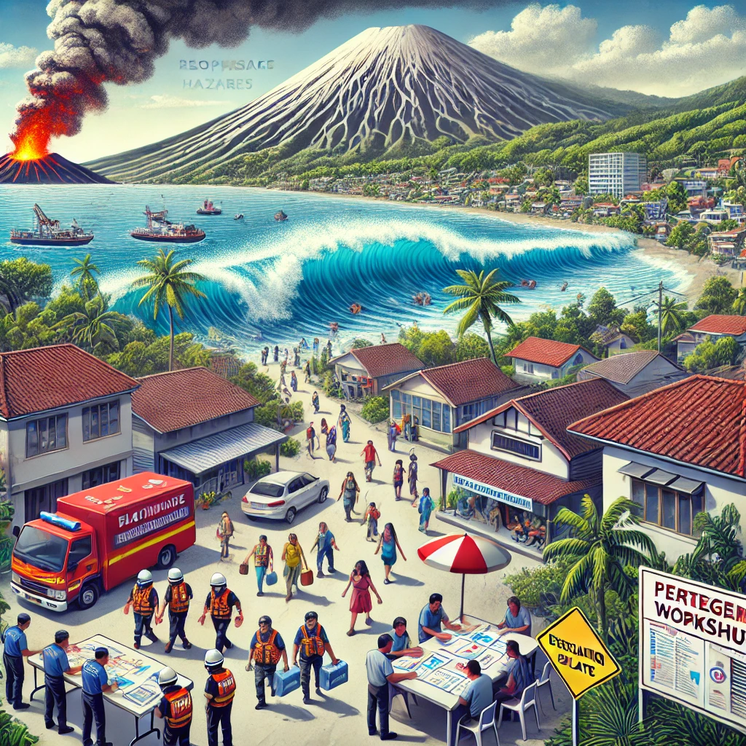
Aim - Rationale
Aim: Improve tsunami preparedness in the NEAM region, at different scales, for effective risk, evacuation and emergency management.
Objectives are spanning from the national to local levels, addressing needs for national tsunami risk planning and for enhancing multi-hazard preparedness in coastal communities at risk.
National level:
National-level tsunami inundation maps are crucial for coastal planning and risk
management.
Support local tsunami hazard assessment and evacuation planning.
Contribute to important global tsunami initiatives like IOC-UNESCO’s Tsunami Ready Recognition Programme (TRRP) and Ocean Decade Tsunami Programme (ODTP) by scaling hazard assessment nationally.
Local level:
Tsunamis from earthquakes and volcanic activity pose significant risks for coastal communities in the NEAM region.
A multi-hazard approach considering cascading effects is needed for effective tsunami evacuation and emergency management.
Emphasis on science-informed participatory and decision-making workshops to improve local planning and implementation effectiveness.
ICG/NEAMTWS-XX, Paris, 3-5 December 2025

Slide 4
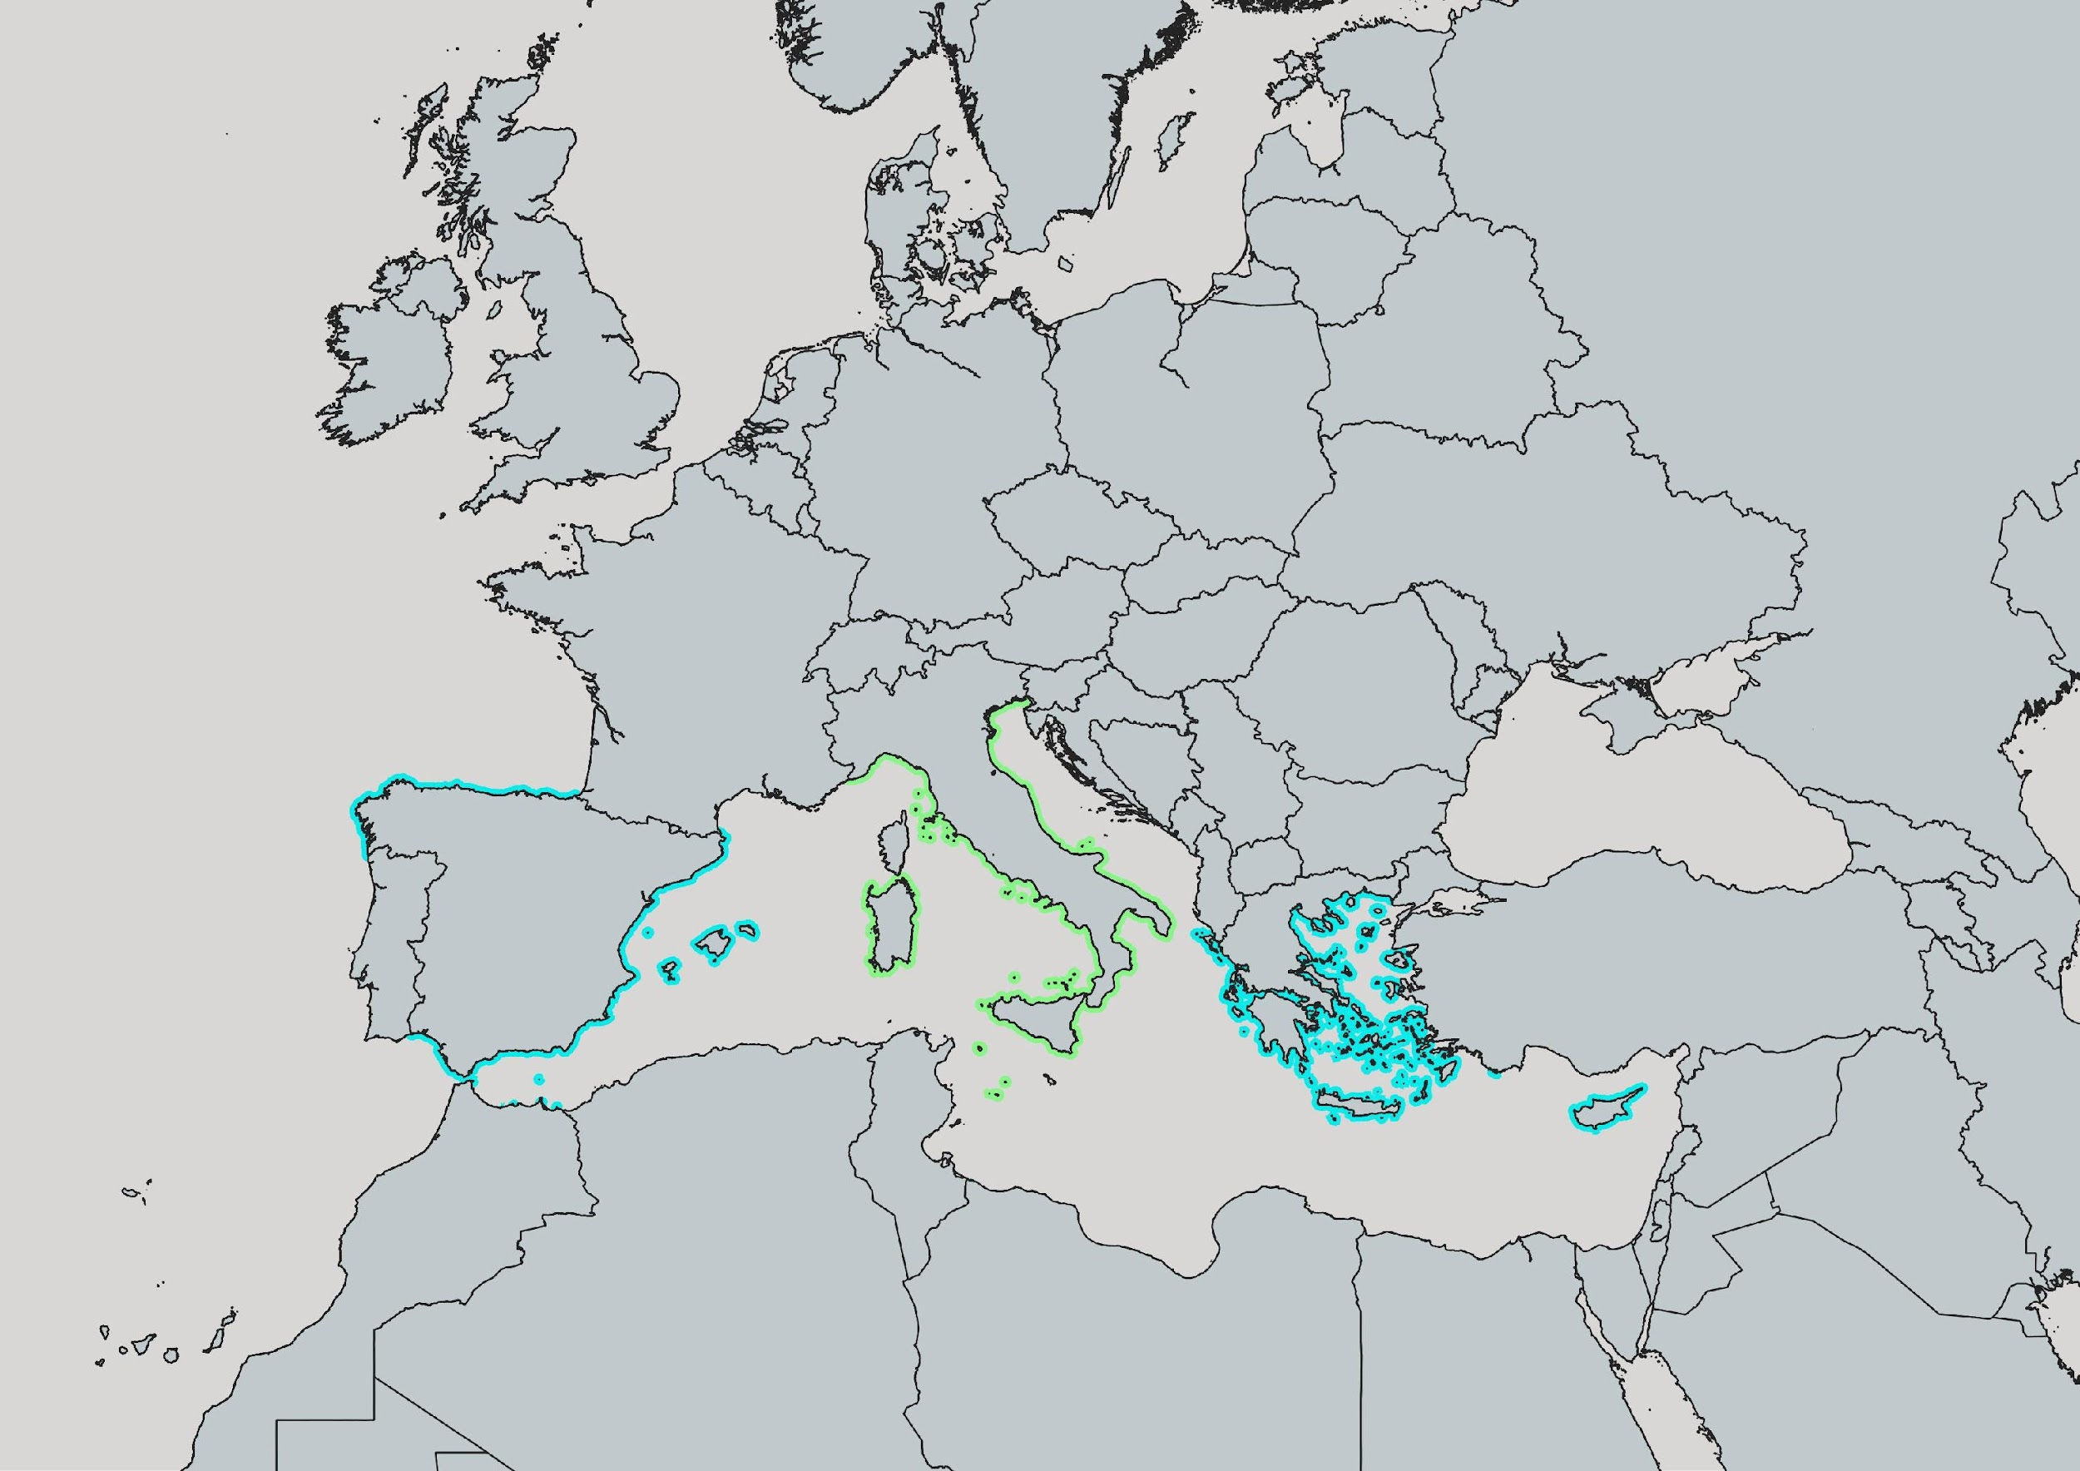
Geographical coverage
Italy
Capacity building – knowledge sharing
Tsunami evacuation mapping @ Stromboli
Spain
National tsunami inundation mapping
Greece
National tsunami inundation mapping
Tsunami evacuation mapping @ Methoni
Cyprus
National tsunami inundation mapping
ICG/NEAMTWS-XX, Paris, 3-5 December 2025

Slide 5
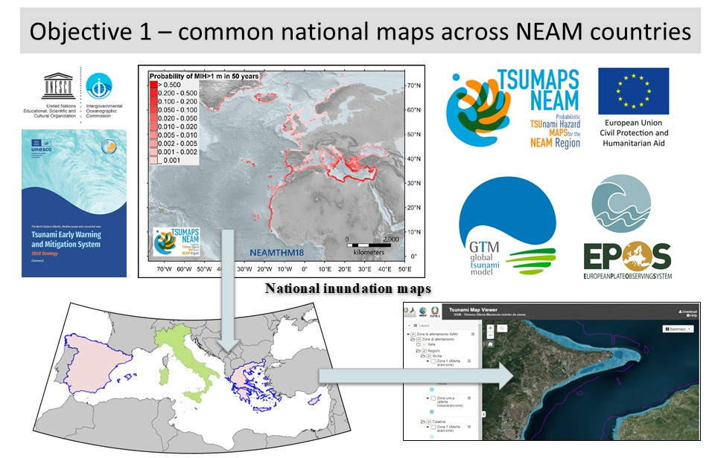
Expected project outputs
National level
Development of national tsunami Inundation maps (CY, GR, ES)
Development of guidelines and tools for implementation in other countries/regions
Dissemination of results across relevant national stakeholders
Dissemination of methodological approach at international level
ICG/NEAMTWS-XX, Paris, 3-5 December 2025

Slide 6
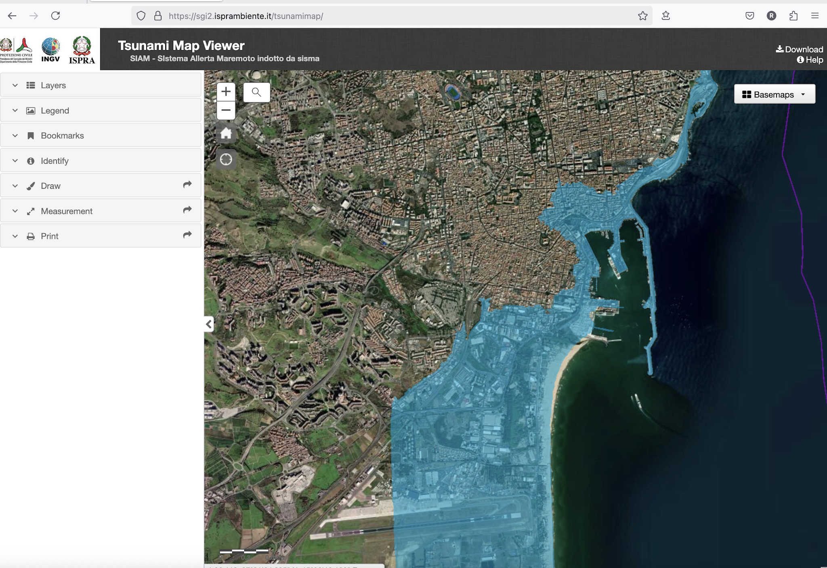

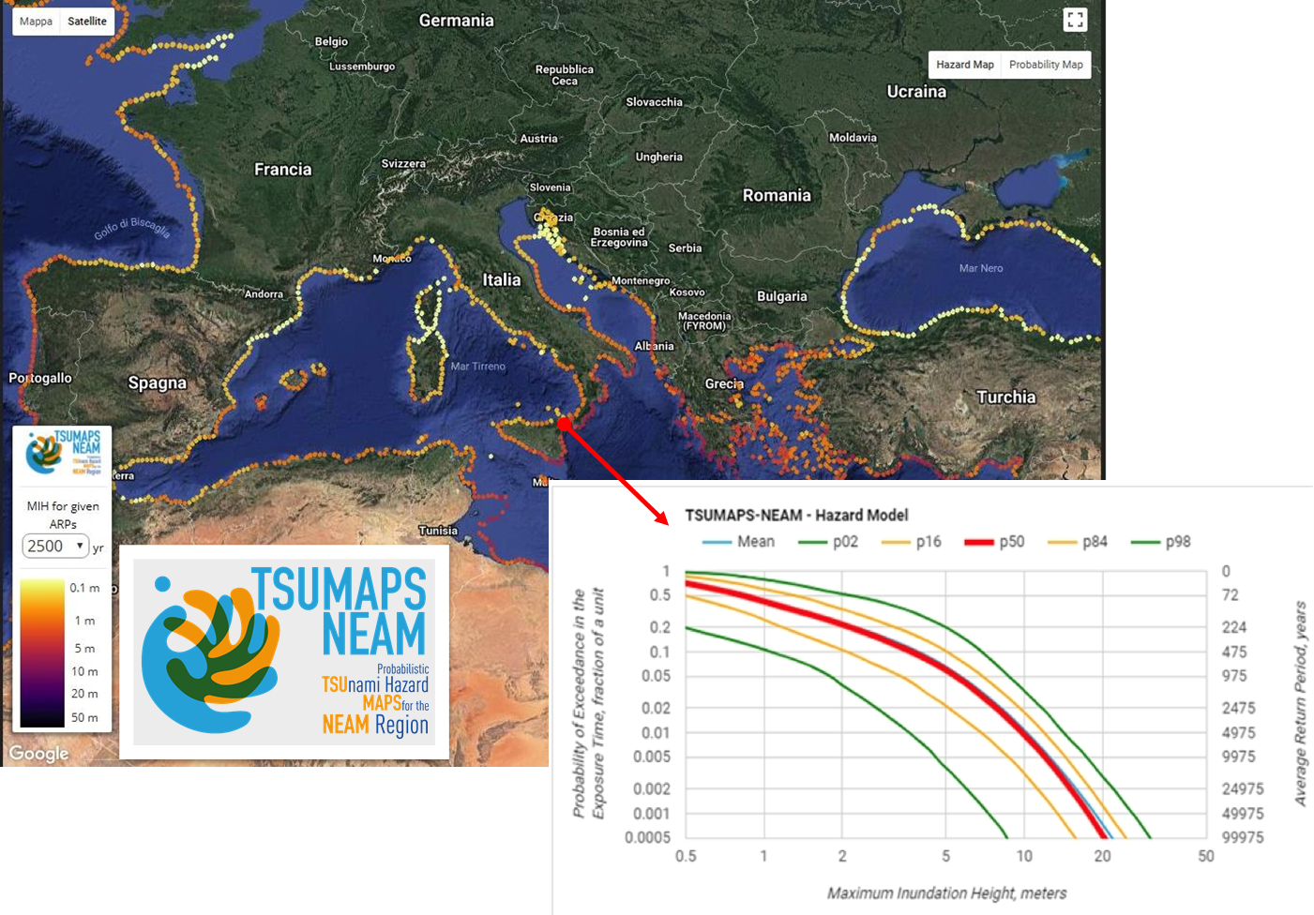
Expected project outputs
Tsunami Inundation Maps
Tsunami inundation maps are an important tool for coastal risk assessment:
support the operations of tsunami early warning systems (design of evacuation maps and evacuation plans)
assist in planning and regulating the coastal development
Tsunami inundation maps workflow:
Quantify hazard levels through a probabilistic tsunami hazard assessment (PTHA) and convert the MIH to inundation distance (Tonini et al., 2021).
Decision making process on the acceptable level of risk; selection of design rate, probability, return period, safety factors;
Application of methodology; processing of inundation maps, analysis and refinements of maps, validation of results, etc.
sgi2.isprambiente.it/tsunamimap/
ICG/NEAMTWS-XX, Paris, 3-5 December 2025

Slide 7
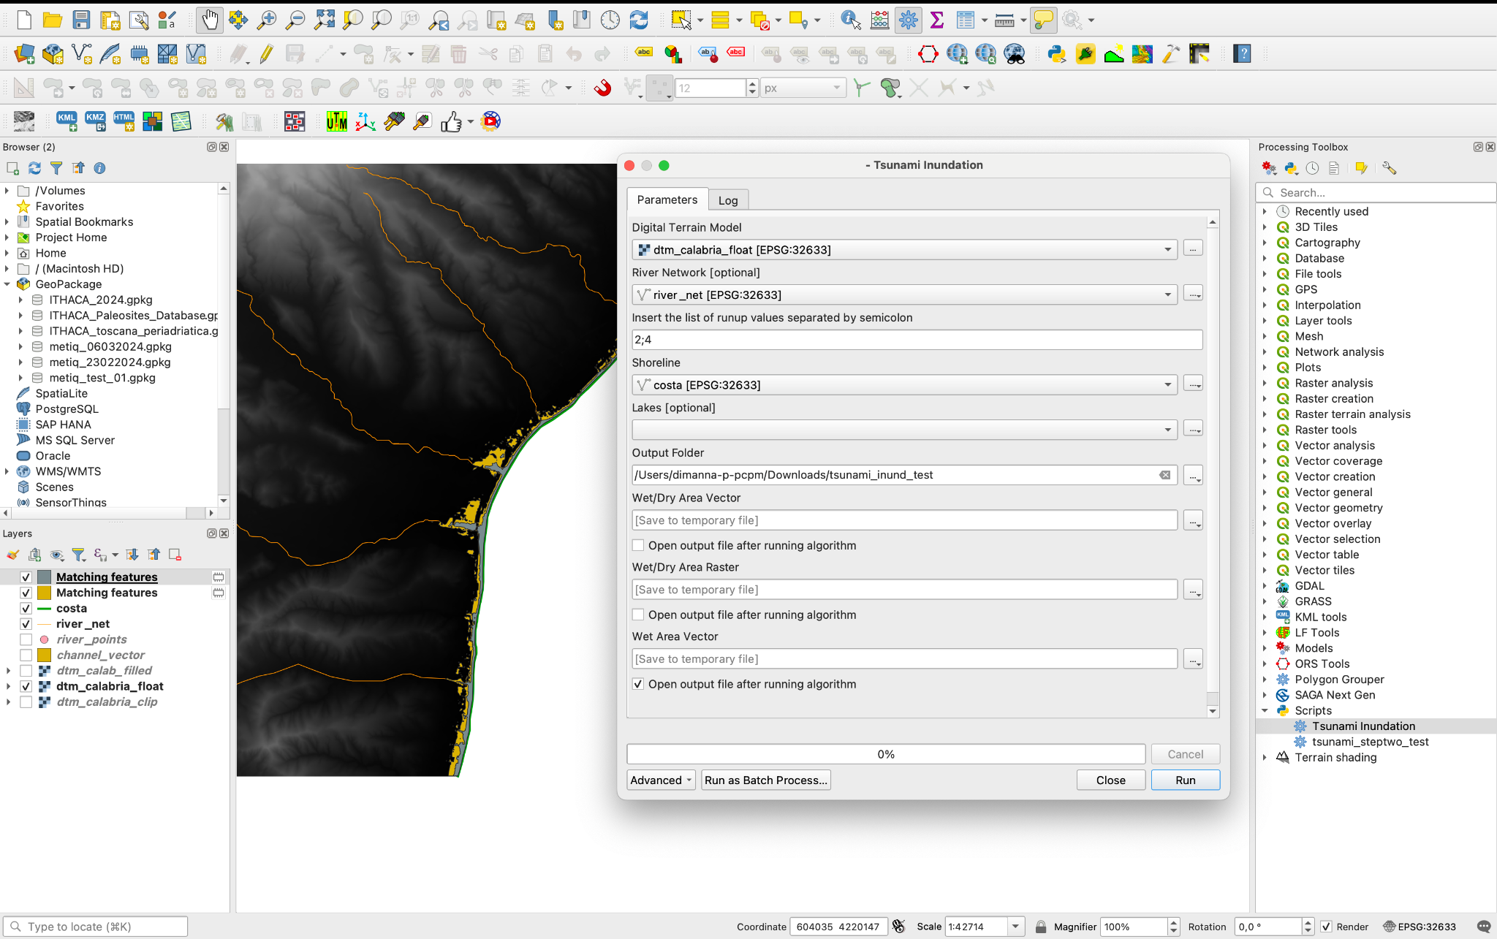
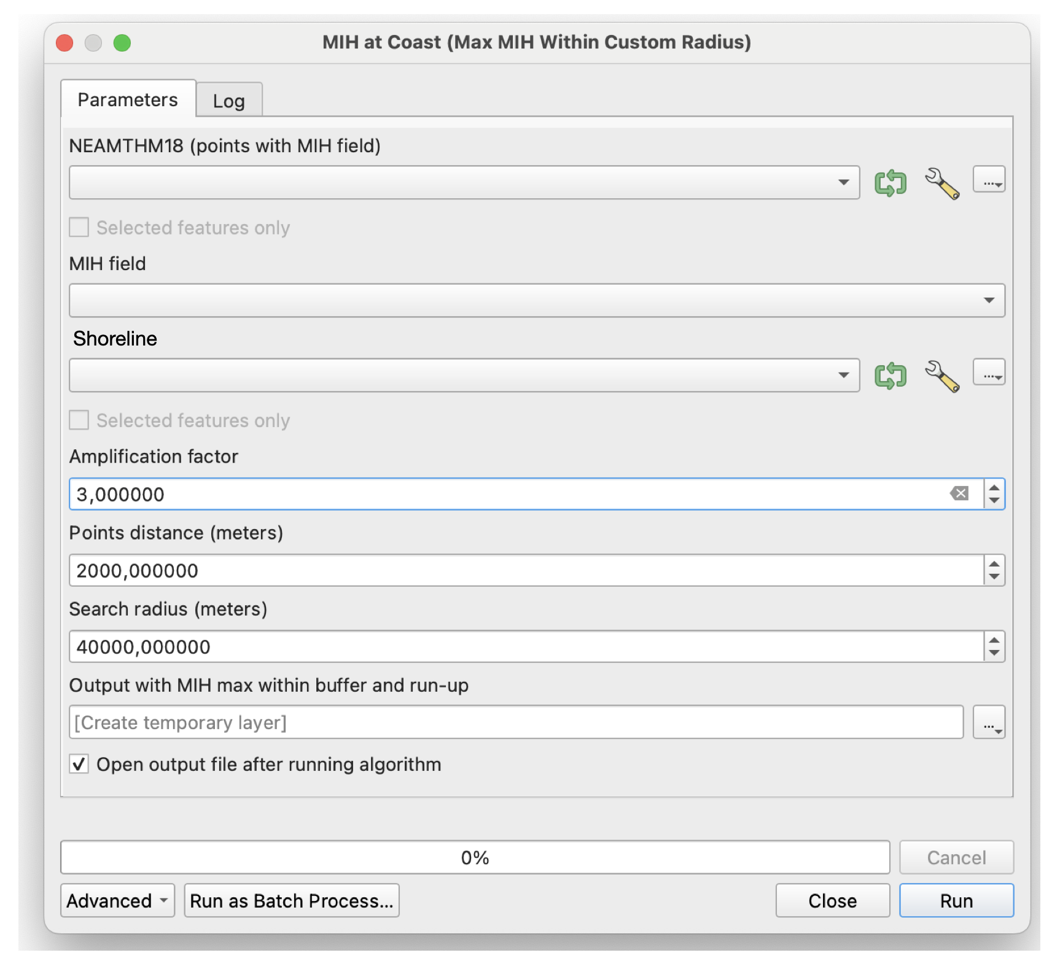

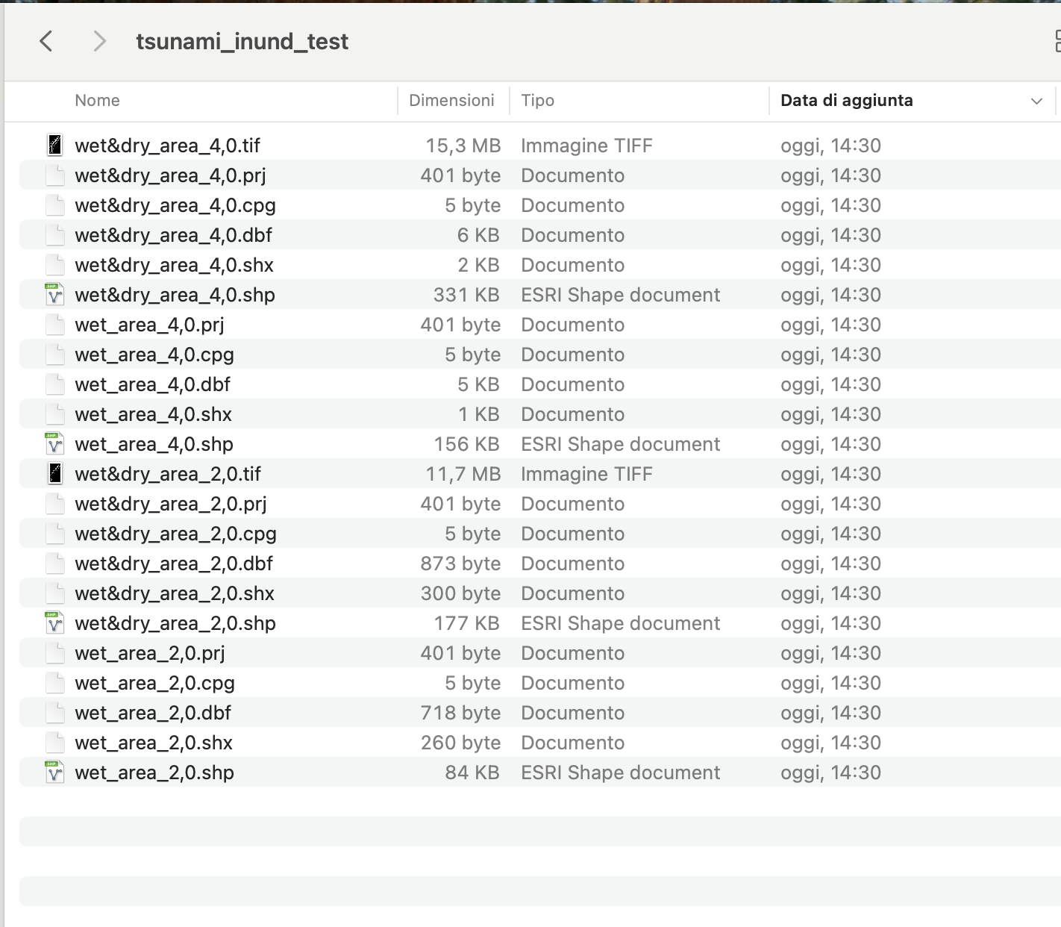


Expected project outputs
Working in progress to provide the tools as Jupyter Notebook in the EPOS platform
TCS Tsunami
“Tsunami inundation” QGIS tools and plugins
We have created specialized QGIS tools using Python, designed to reduce the complexity of processing inundation maps via the application of empirical rules.
ICG/NEAMTWS-XX, Paris, 3-5 December 2025

Slide 8
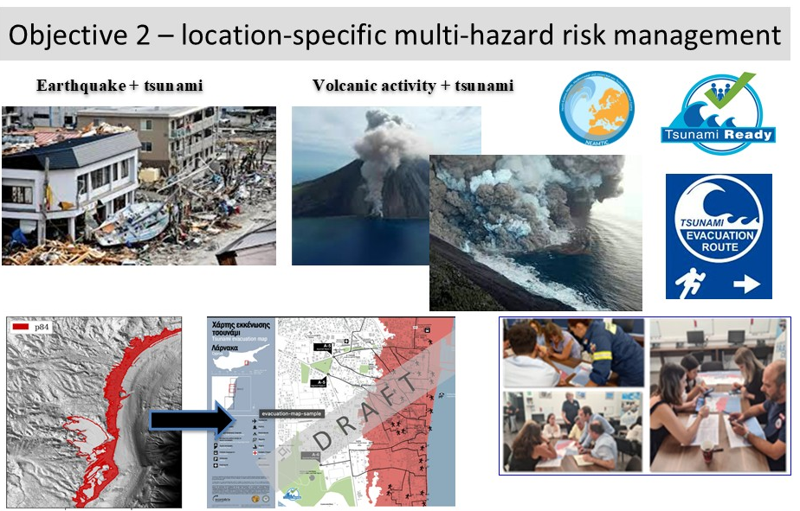
Expected project outputs
Local level
Application @ two pilot sites in Greece and Italy
Local evacuation mapping through science-informed and participatory decision-making, considering multi-hazard cascading effects, i.e. earthquakes and volcanic activity
Development of guidelines
Awareness raising activities
ICG/NEAMTWS-XX, Paris, 3-5 December 2025

Slide 9
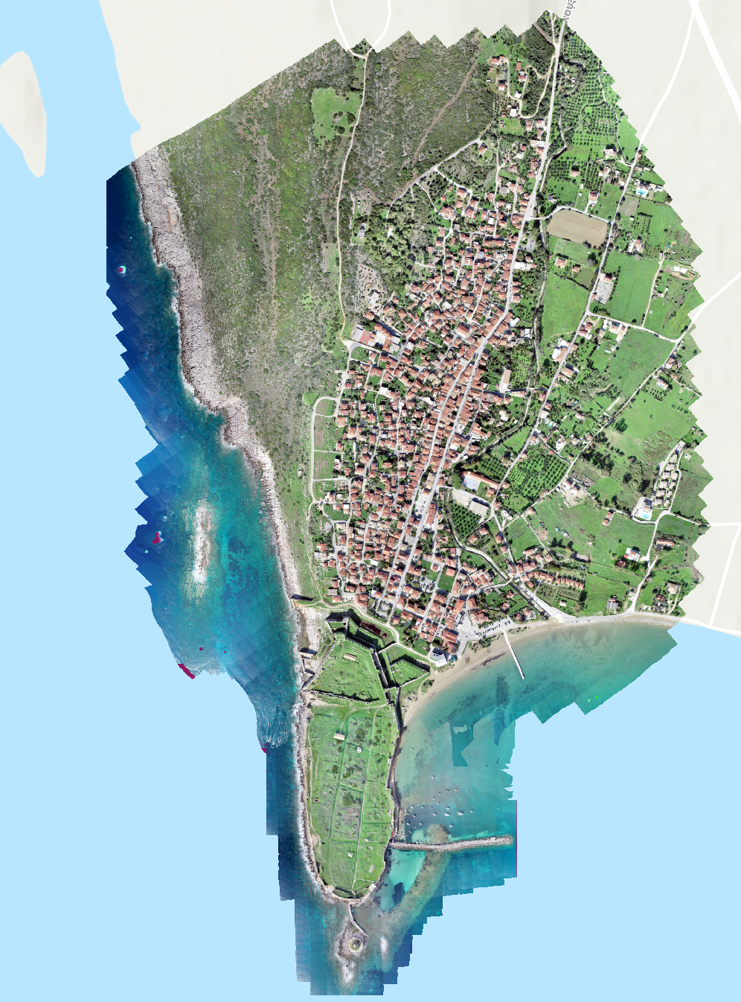
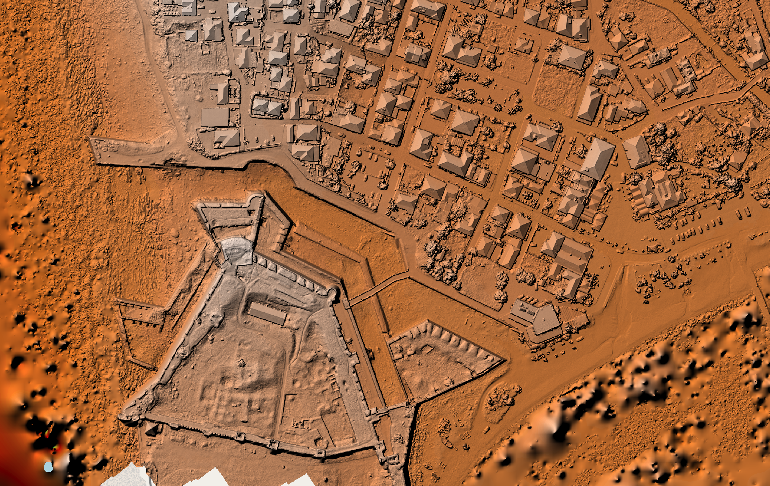
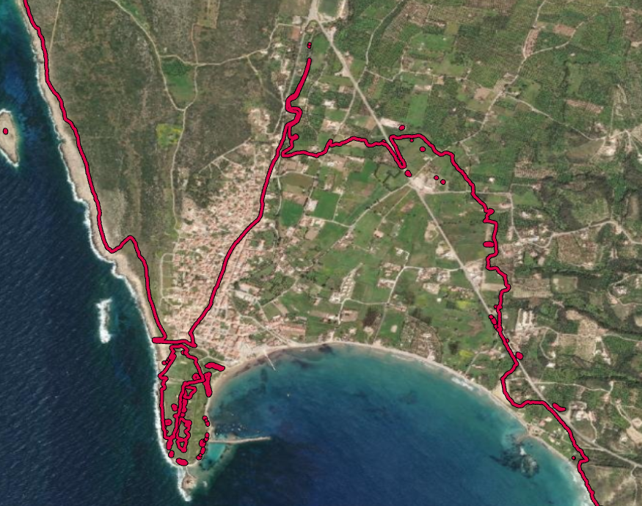
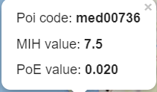
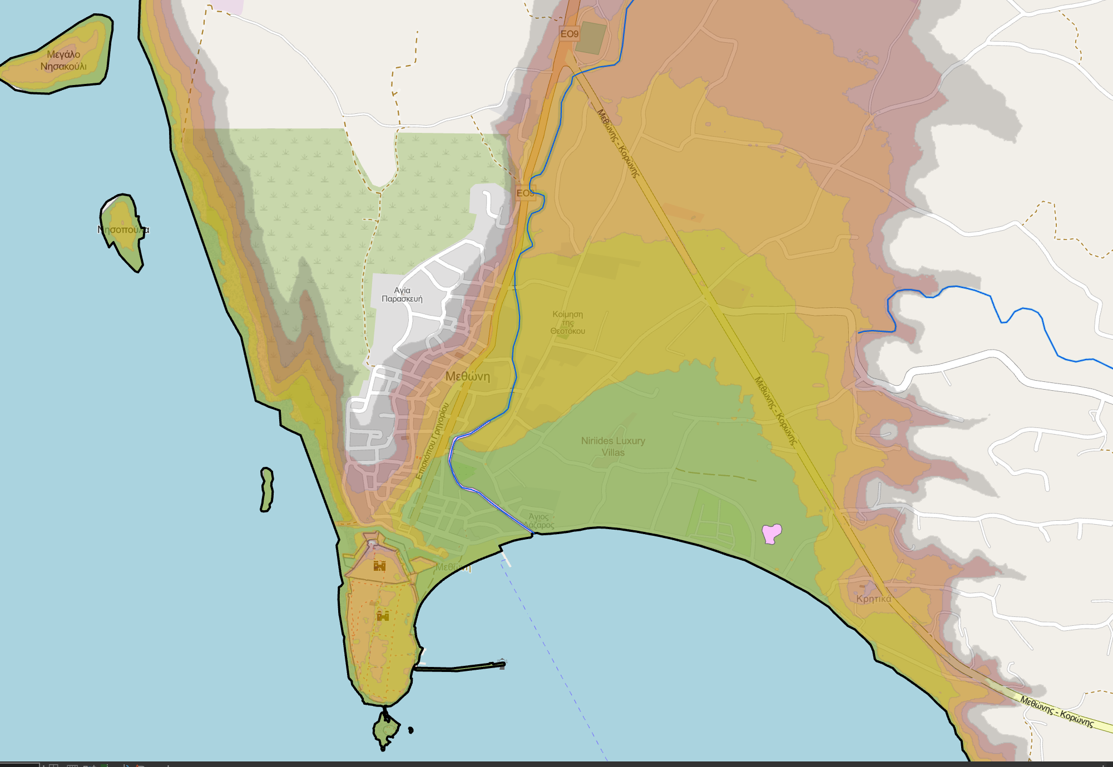
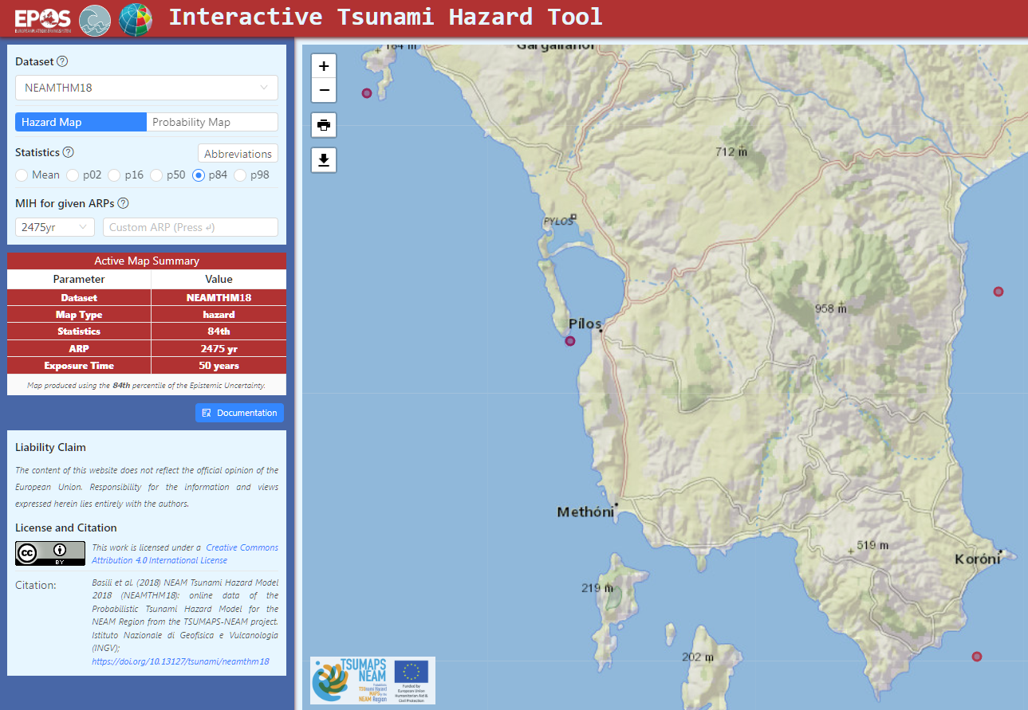
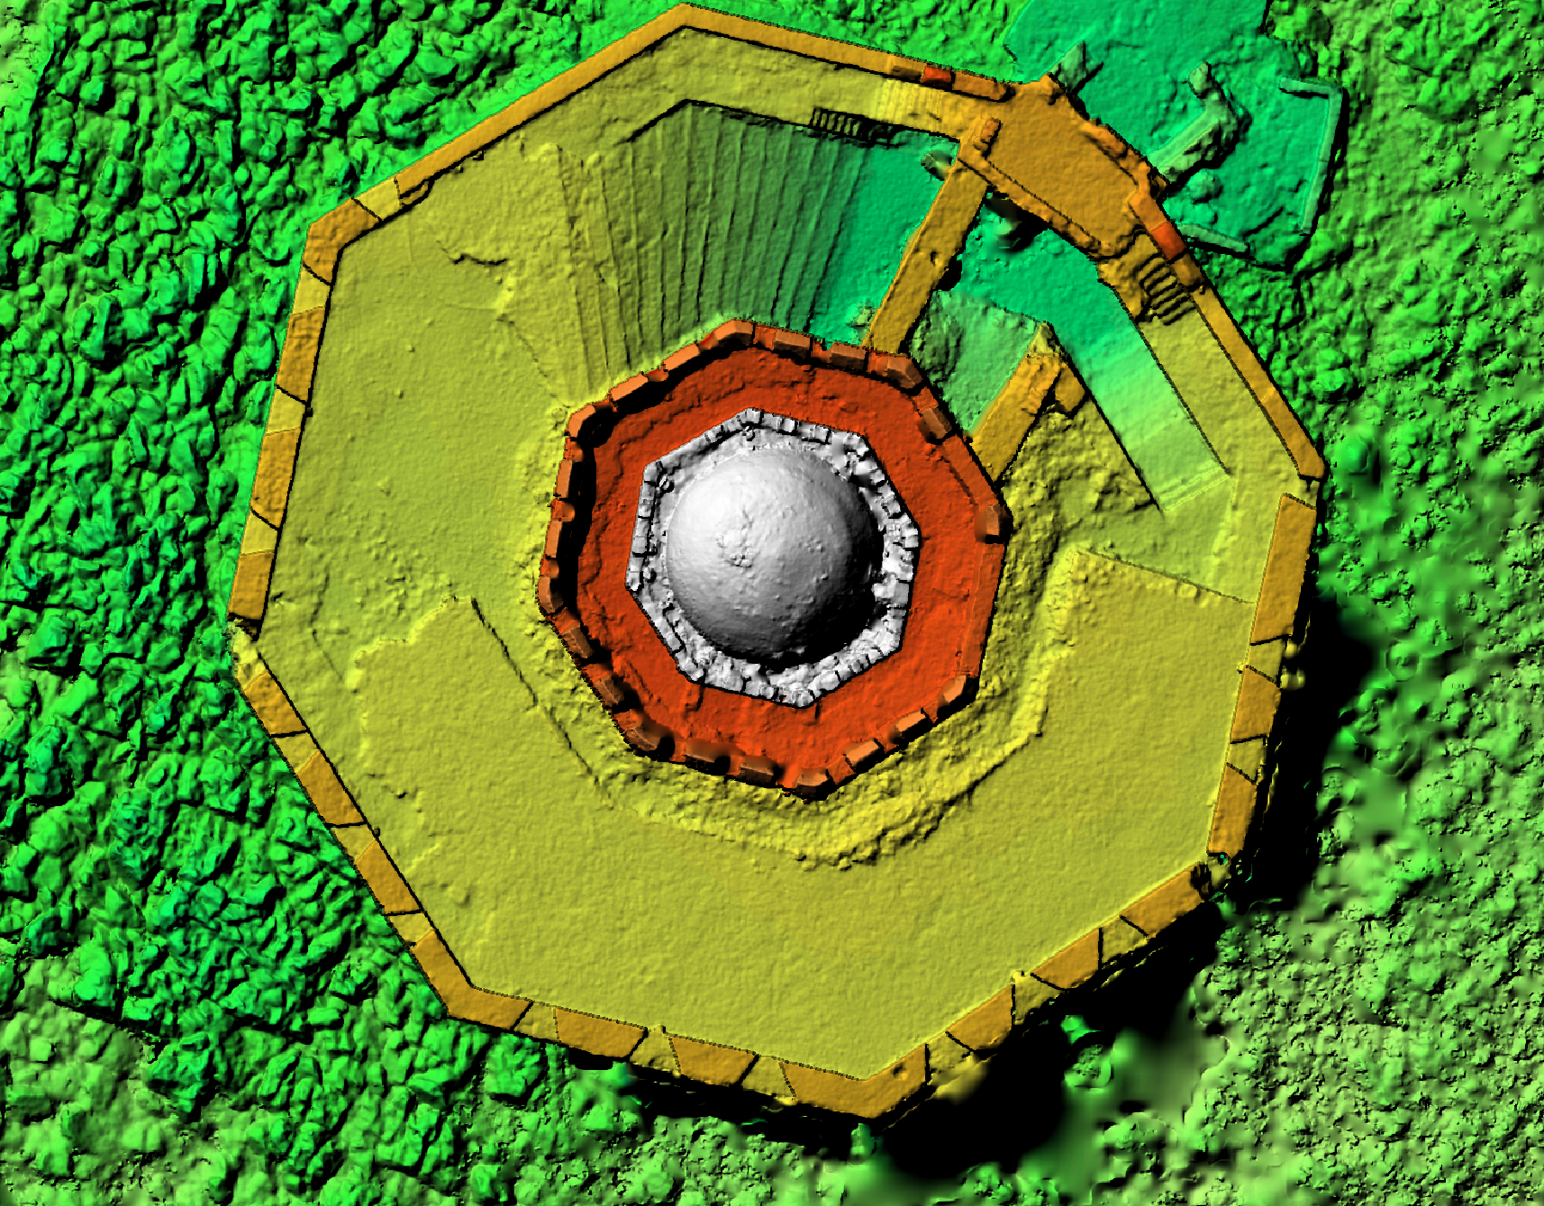
Expected project outputs
Assessment of multiple hazards (earthquake and tsunami) in Methoni
Methoni
10 m elevation contour
Application of the GIS methodology based on the NEAMTHM18; run-up values every 5m
Methoni

Slide 10
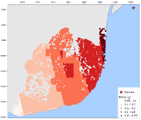
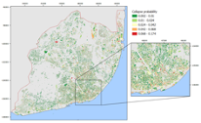
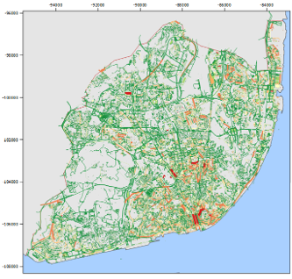
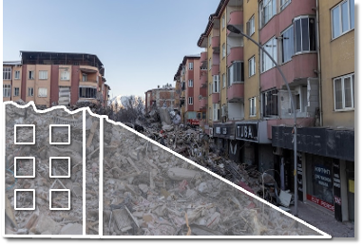

Proposed Methodology for evacuation mapping
Expected project outputs
Seismic Scenario
Spatial distribution of building collapses
Earthquake and Tsunami Hazard
Exposure and Vulnerability
Impact on Evacuation Routes
1
2
3
Same earthquake scenarios used both for tsunami and seismic impact assessment
Tsunami inundation zone, by numerical simulations
Building by building exposure model
Critical infrastructure (road and hospitals)
Tsunami fragility functions
(e.g. EPOS-ETRIS)
Impact on critical infrastructure
Horizontal evacuation
Vertical evacuation (?)
multiple-hazard evacuation mapping
Debris modelling
ICG/NEAMTWS-XX, Paris, 3-5 December 2025

Slide 11
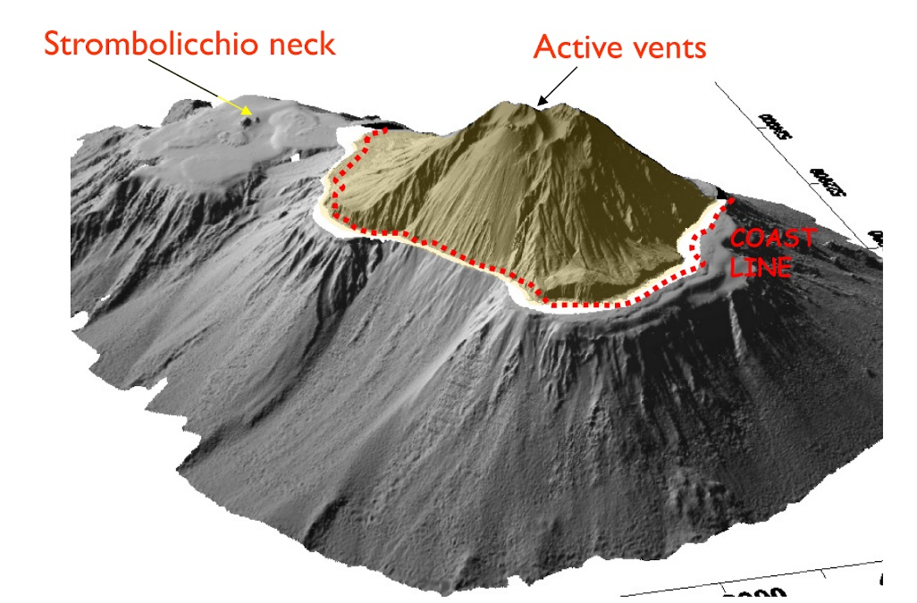
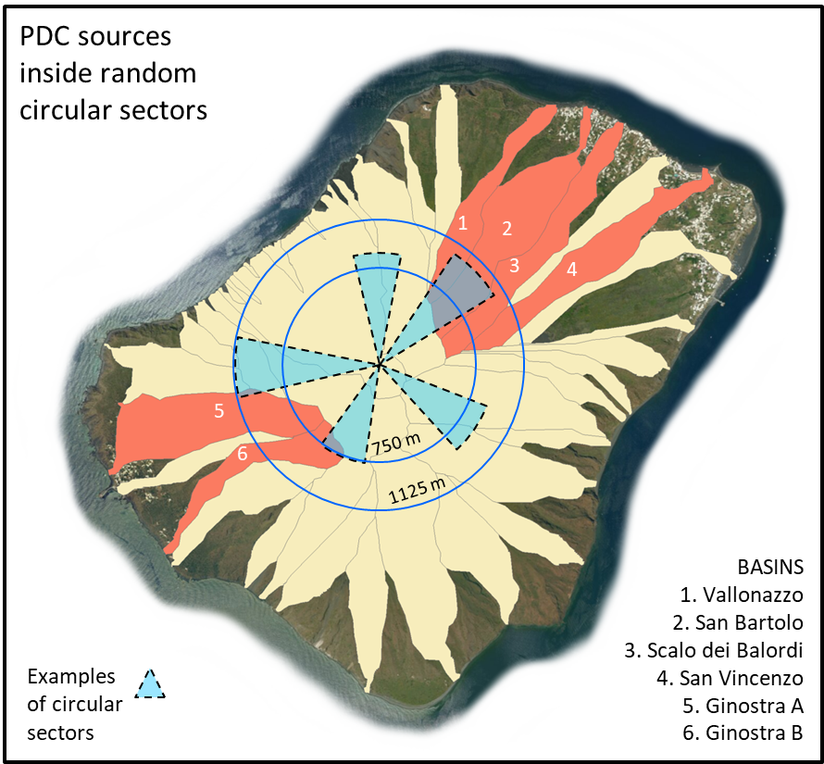
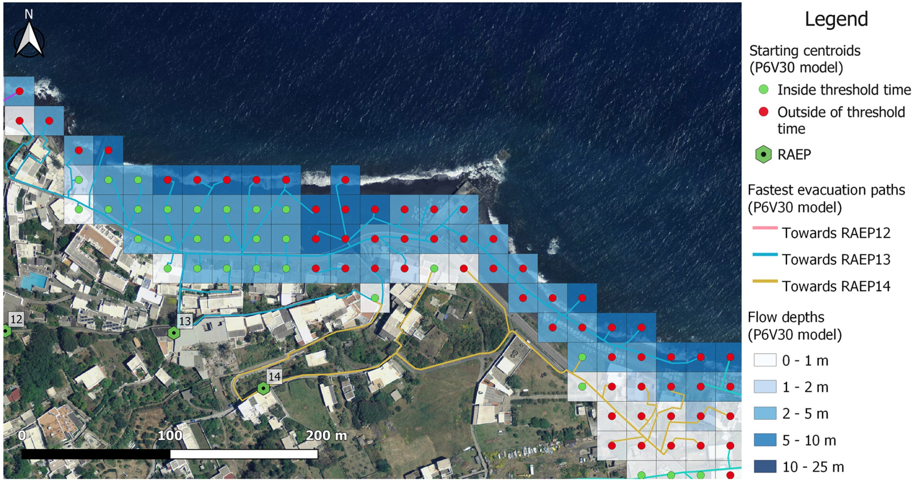
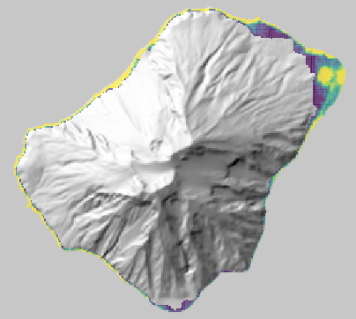
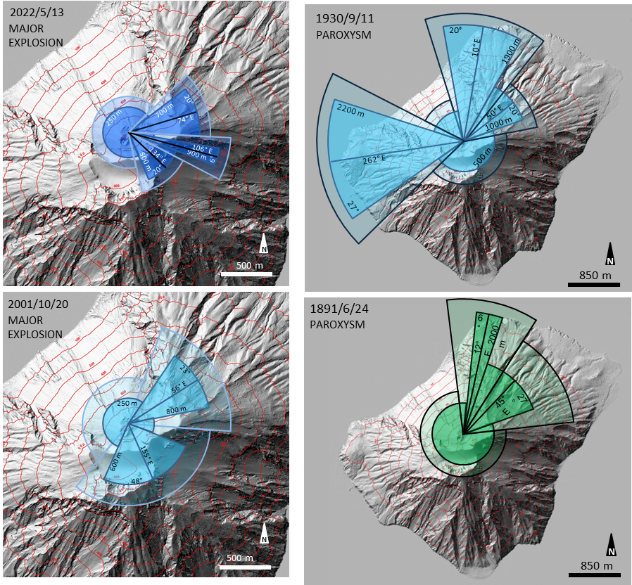
Expected project outputs
Assessment of multiple hazards (volcanic activity and tsunami) in Stromboli
Pyroclastic flows
multiple-hazard evacuation mapping
Sciara del Fuoco
Landslide and earthquake generated inundation
Ballistics

Slide 12
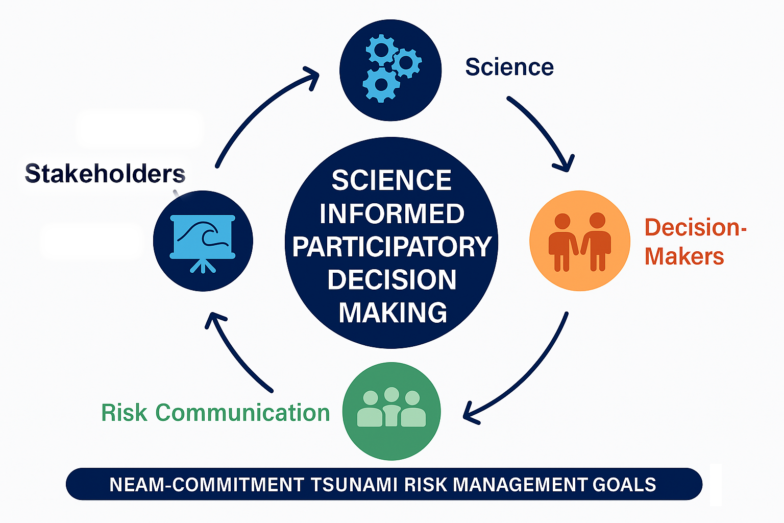
Key Approach to Achieving Project Goals
The project will accomplish its goals through a science-informed, participatory decision-making approach.
Decision-makers take ownership of the products and maximizes implementation effectiveness.
The project aims to contribute to improved tsunami risk management and
planning in NEAM countries and beyond by creating open-access guidelines
and tools that document the methodologies used.
Guidelines will be developed to outline mapping methodologies that enhance
tsunami risk management. Building on previous initiatives, the project promotes cross-border collaboration, supports the implementation of the SFDRR 2015-2030 objectives, and strengthens preparedness within the NEAM Tsunami Warning System.
“Preparation through education is less costly, than learning through tragedy”
Max Mayfield (meteorologist )
ICG/NEAMTWS-XX, Paris, 3-5 December 2025

Slide 13
ICG/NEAMTWS-XX
Paris, 3-5 December 2025
Thank you

