Slide 1

Global Tsunami Model Association
Major Assets and Goals for Tsunami Preparedness and Early Warning
J. Behrens
ICG/NEAMTWS-XX, Paris, 3-5 December 2025

Slide 2



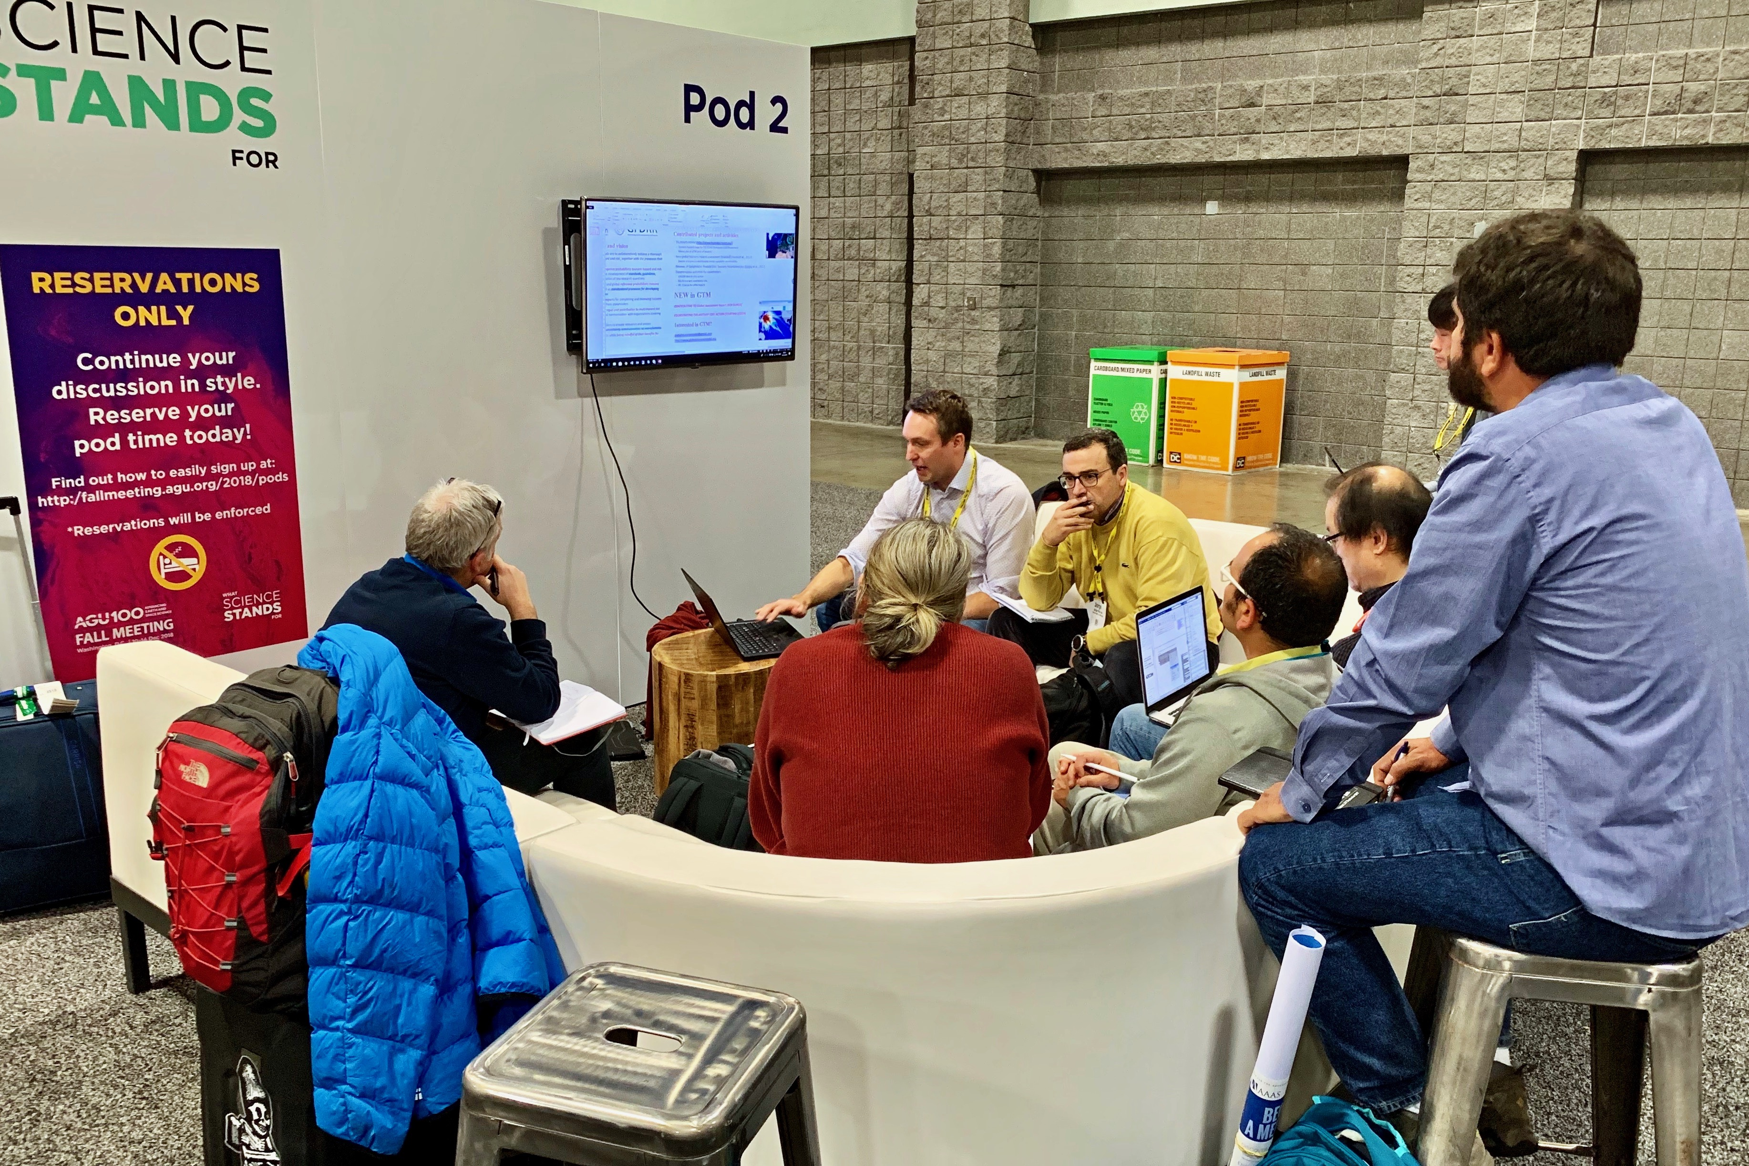
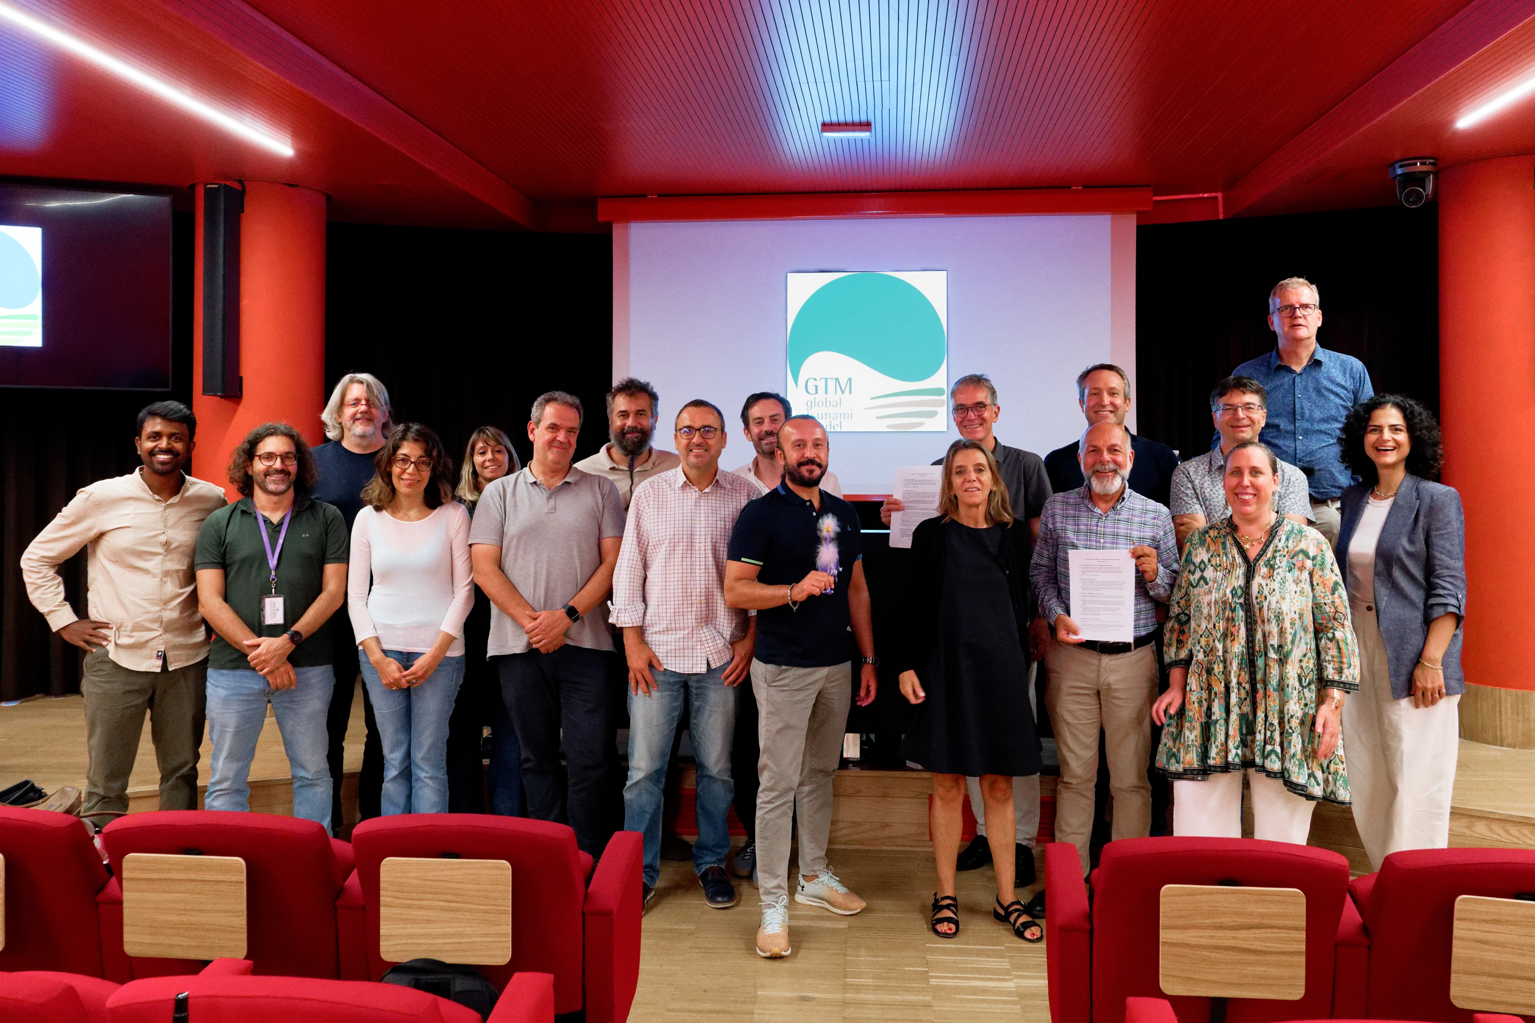





GTM evolution
First vision statement
PTHA community paper
EPOS TCS initiation
GAP papers on tsunami risk
EPOS TCS
AGITHAR ends →
CIG starts
Legal entity (e.V.) formally established
GAR15
Proposition of GTM
Cookbook:
Scientific rationale
AGITHAR startup
LoI
collection
starts
2015
2016
2017
2018
2019
2020
2021
2022
2023
2024
2025
Many community meetings
(EGU, AGU, WB, UNDRR…)
Interdisciplinary EU projects provides advanced hazard and risk products
Tsumaps, GTM Global hazard map

Slide 3
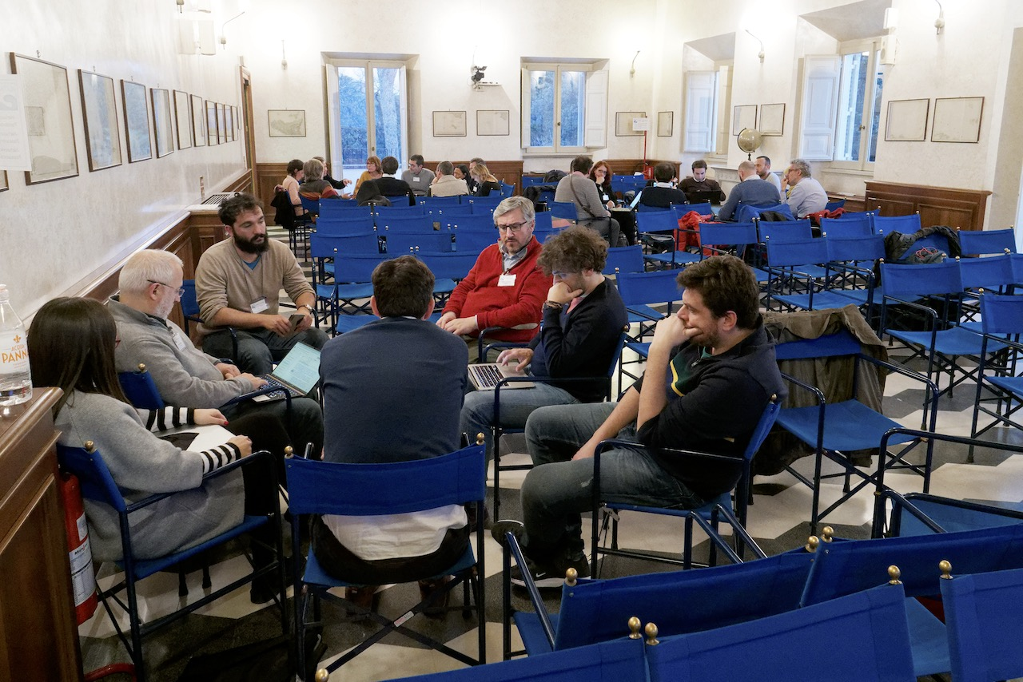
GTM vision and mission
Saving lives, reducing losses, and enhancing resilience, through the advancement of tsunami science, provision of expert information, and promoting dialog about tsunami hazard and Risk.
Competence Center
Pool of Experts
Training Next Generation
Services and Products (PTHA/PTRA)
Co-creation and Collaboration with Users
Collaboration towards Multi-Hazard and Risk

Slide 4
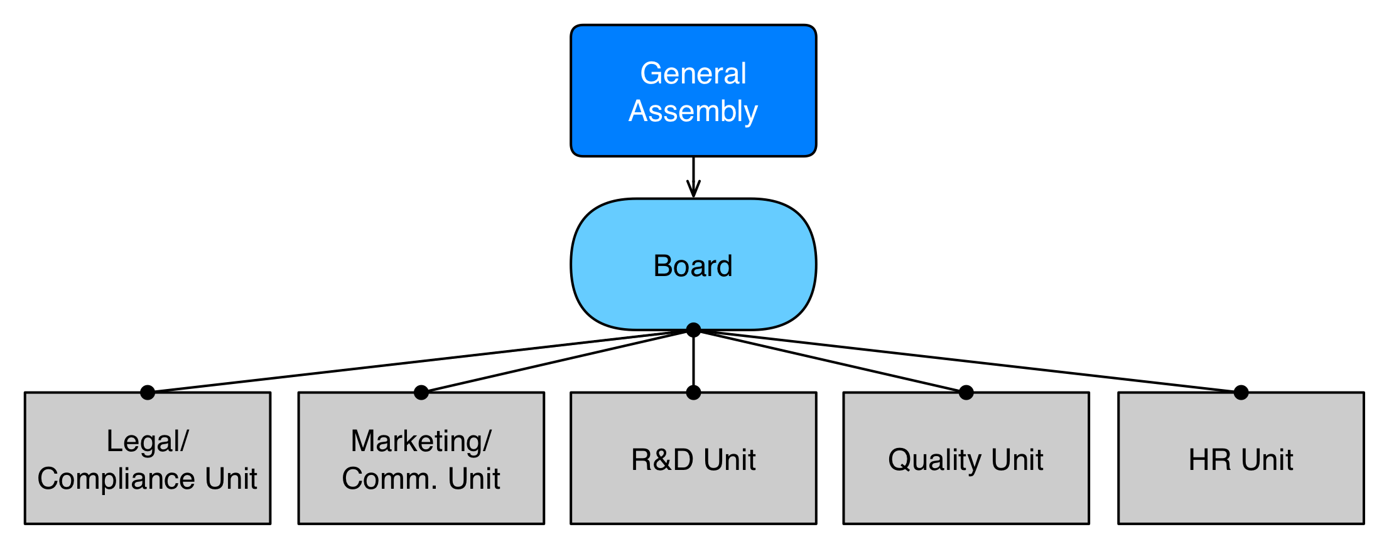
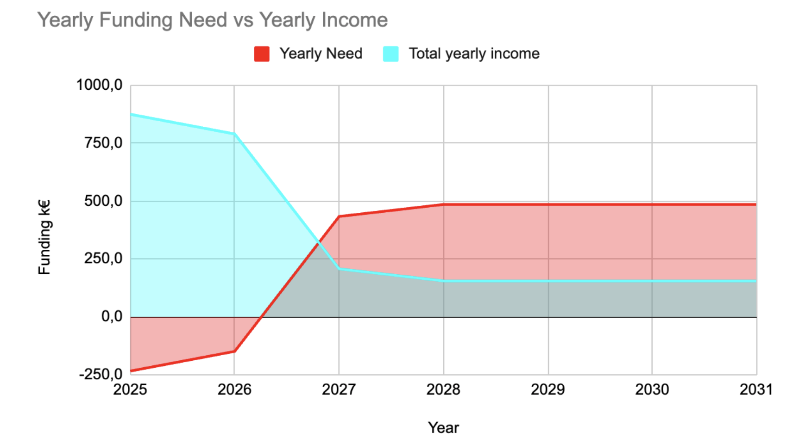
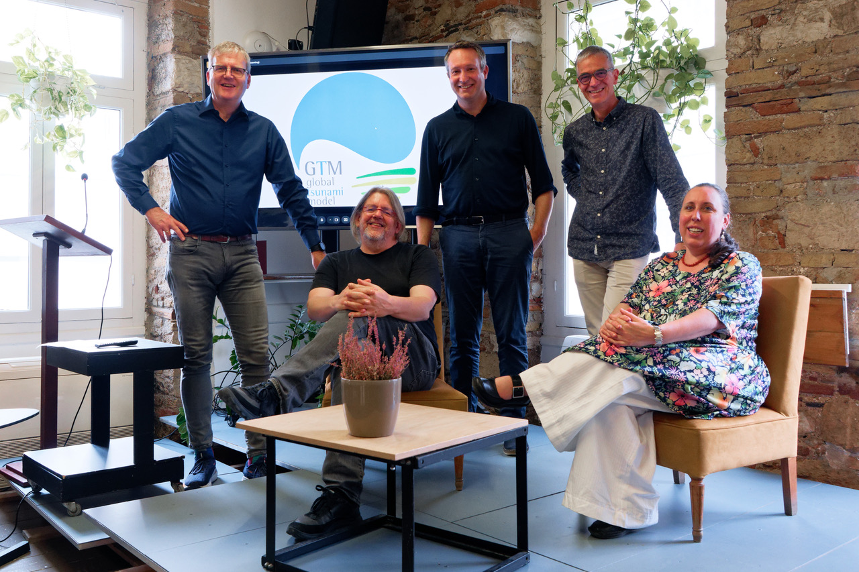
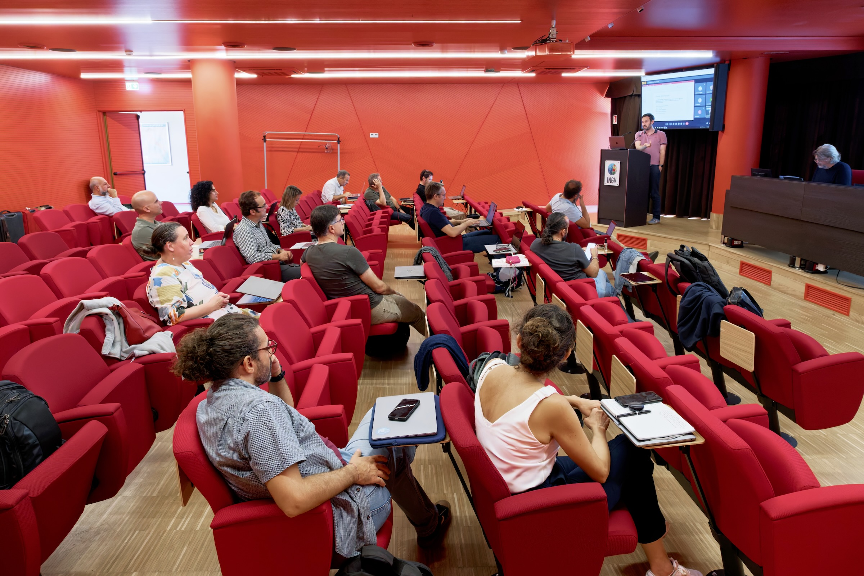
GTM structure and business plan
General Assembly directs general strategy
Board manages actual work
Structured into Units with dedicated mandates
Units are nurtured by scientific community (individual members)
Current projects contributions
(ChEESE, DT-Geo, Geo-INQUIRE, etc.)
Sustained future budget through mix of
In-Kind, Projects, direct consulting and licensing, membership fees
Institutional membership in progress...

Slide 5
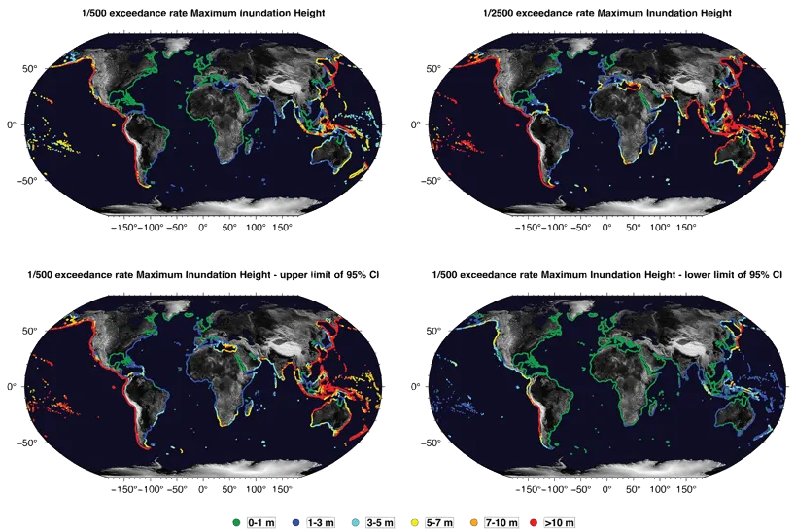
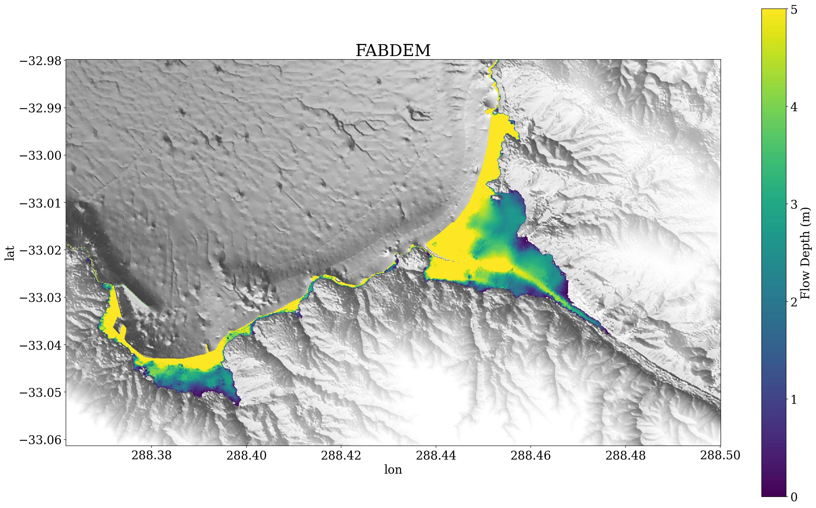
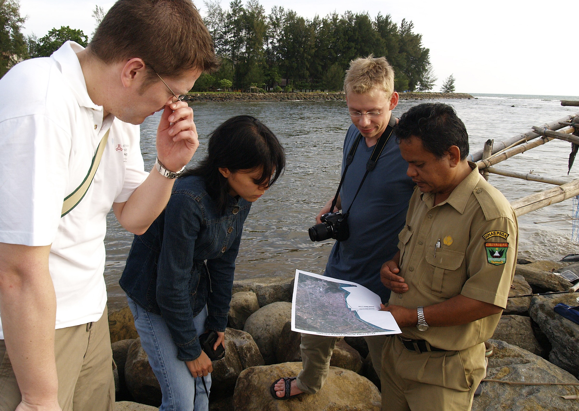
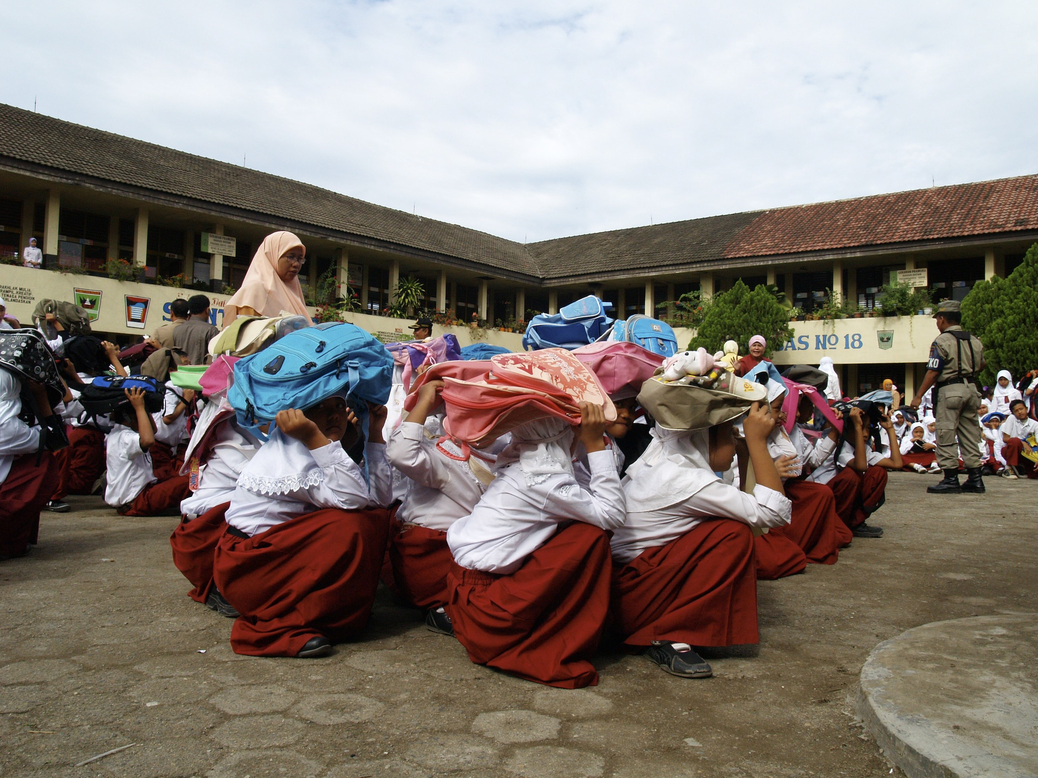
GTM – Bridging Gap between Science and Society
Global Hazard Model
  free
  first assessment
Communicating best practices
  Work with decision makers
  Consulting to Re-Insurance
GTM is still formable and invites contributions

Slide 6
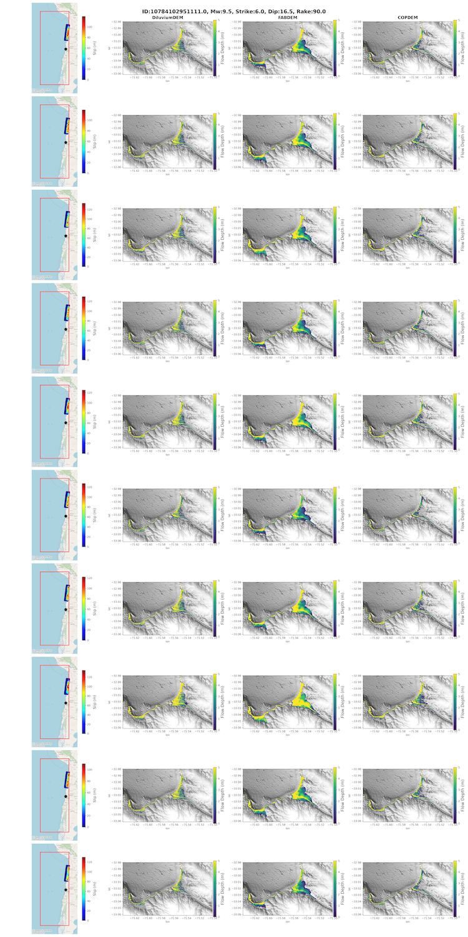

Examples
Cookbook
  For Scientists and Decision Makers
  Recipes for different situations
Pilot project with Munich Re
  Probabilistic inundation maps
  Semi-automated workflow

Slide 7


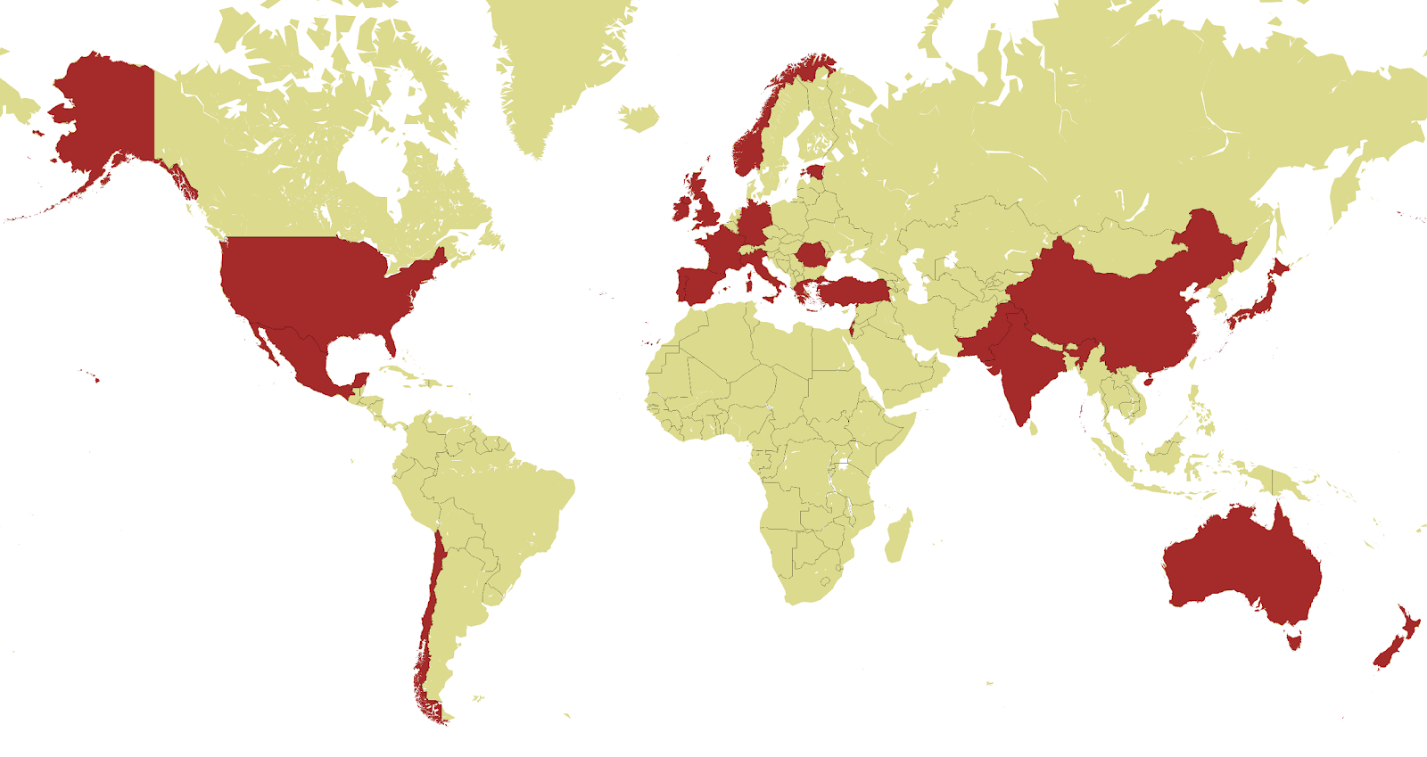
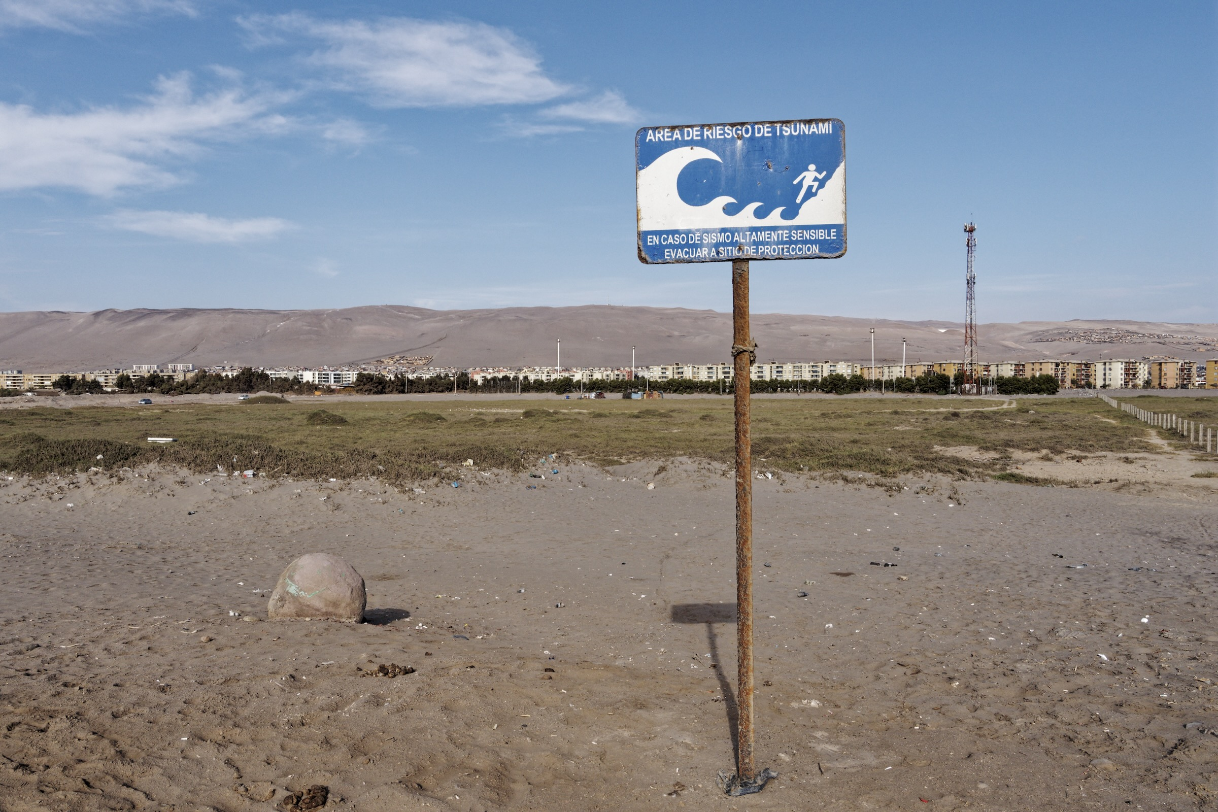
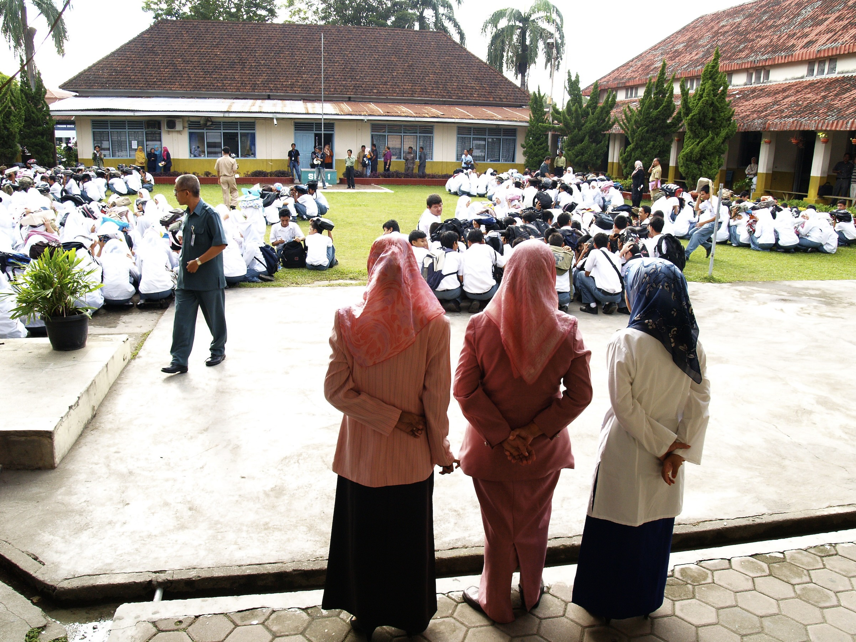
GTM future
Professionalization
Secretariat
Service Center
Growth
Individual & institutional
Members
Service and Products Development
Expert Solicitation
Consulting
Co-Design, Stakeholder Interaction

Slide 8
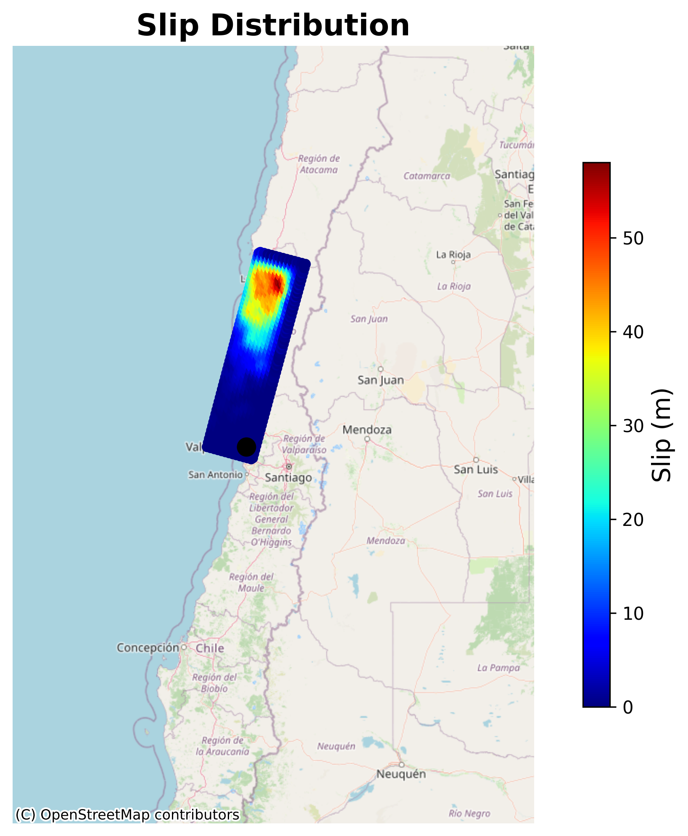
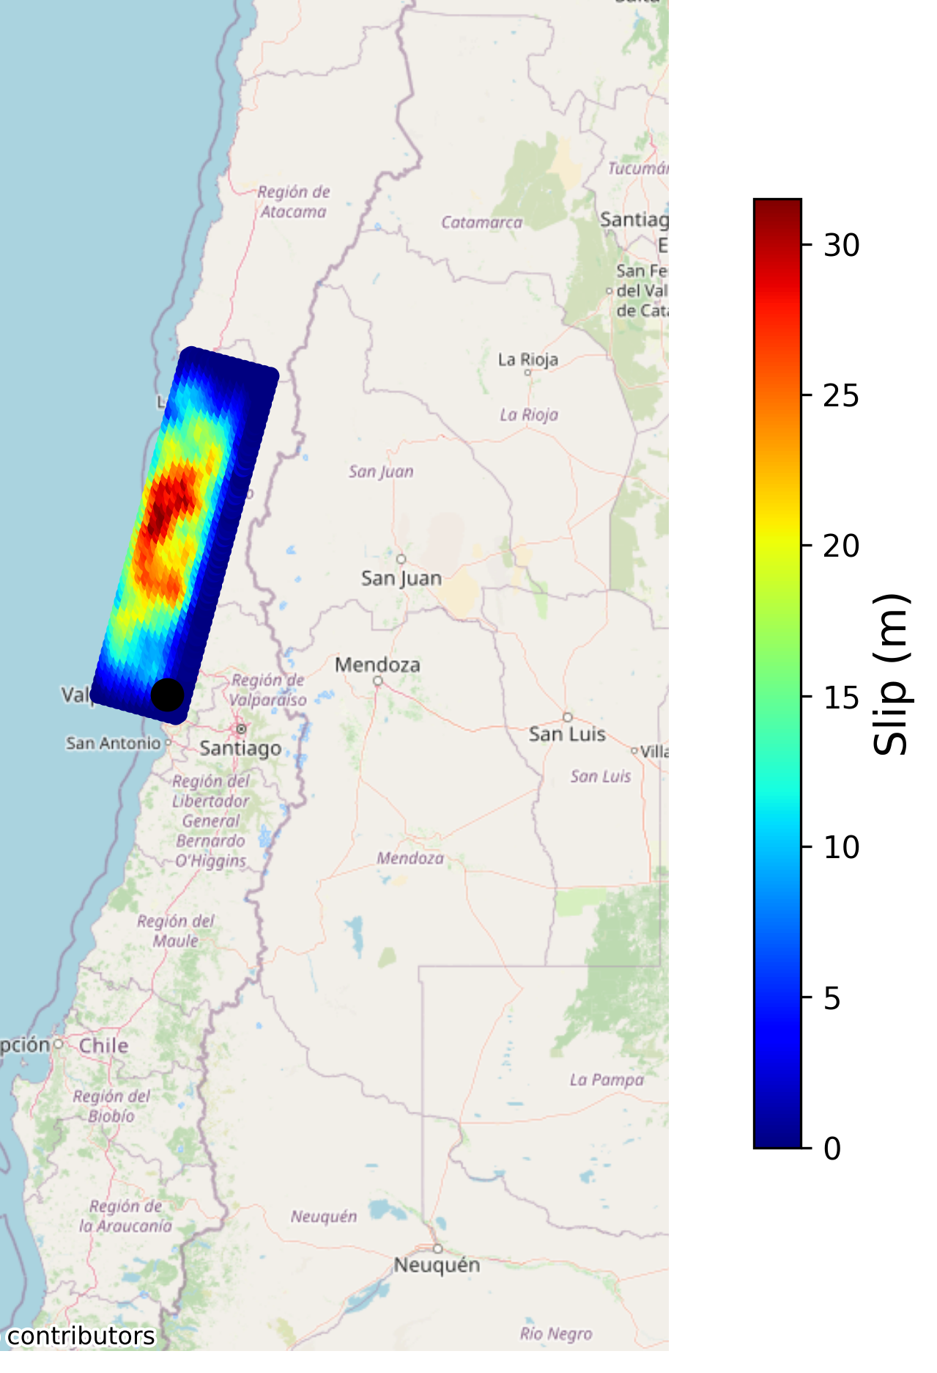
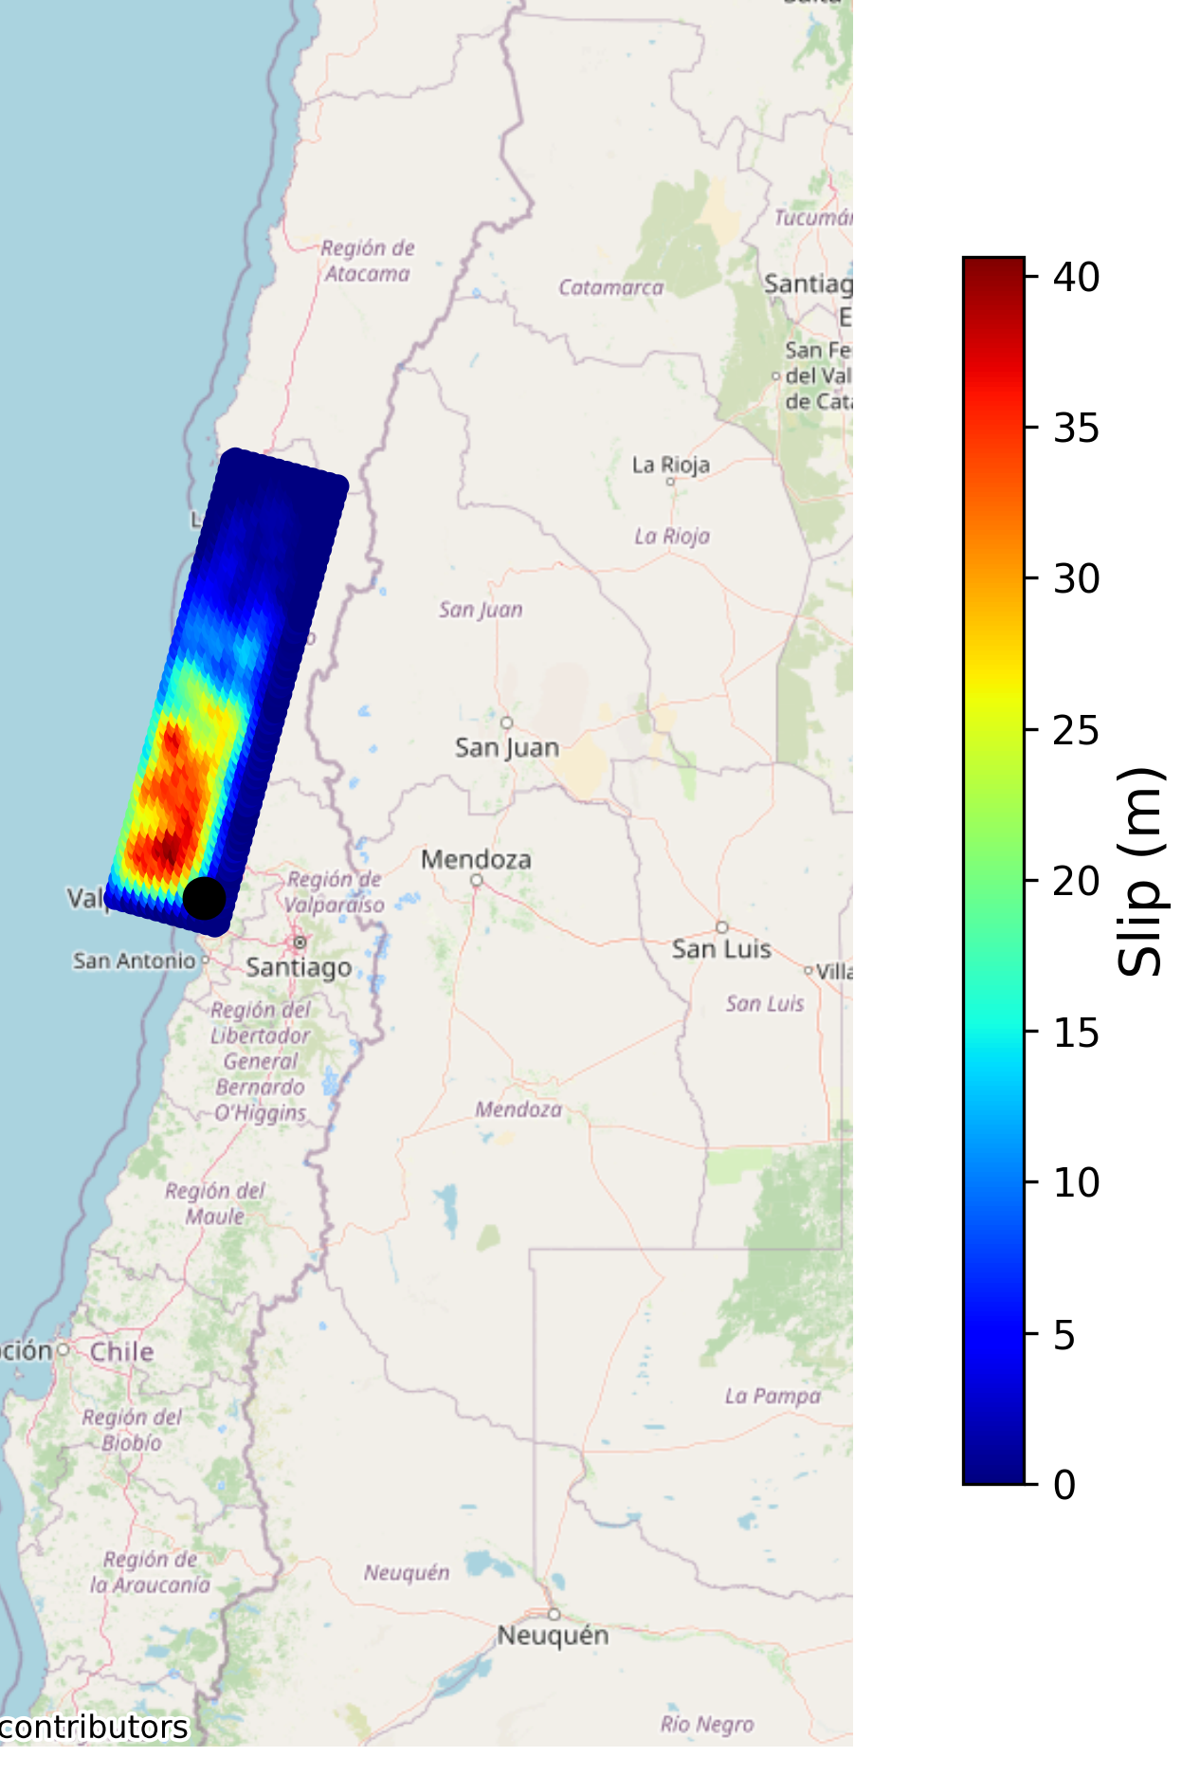
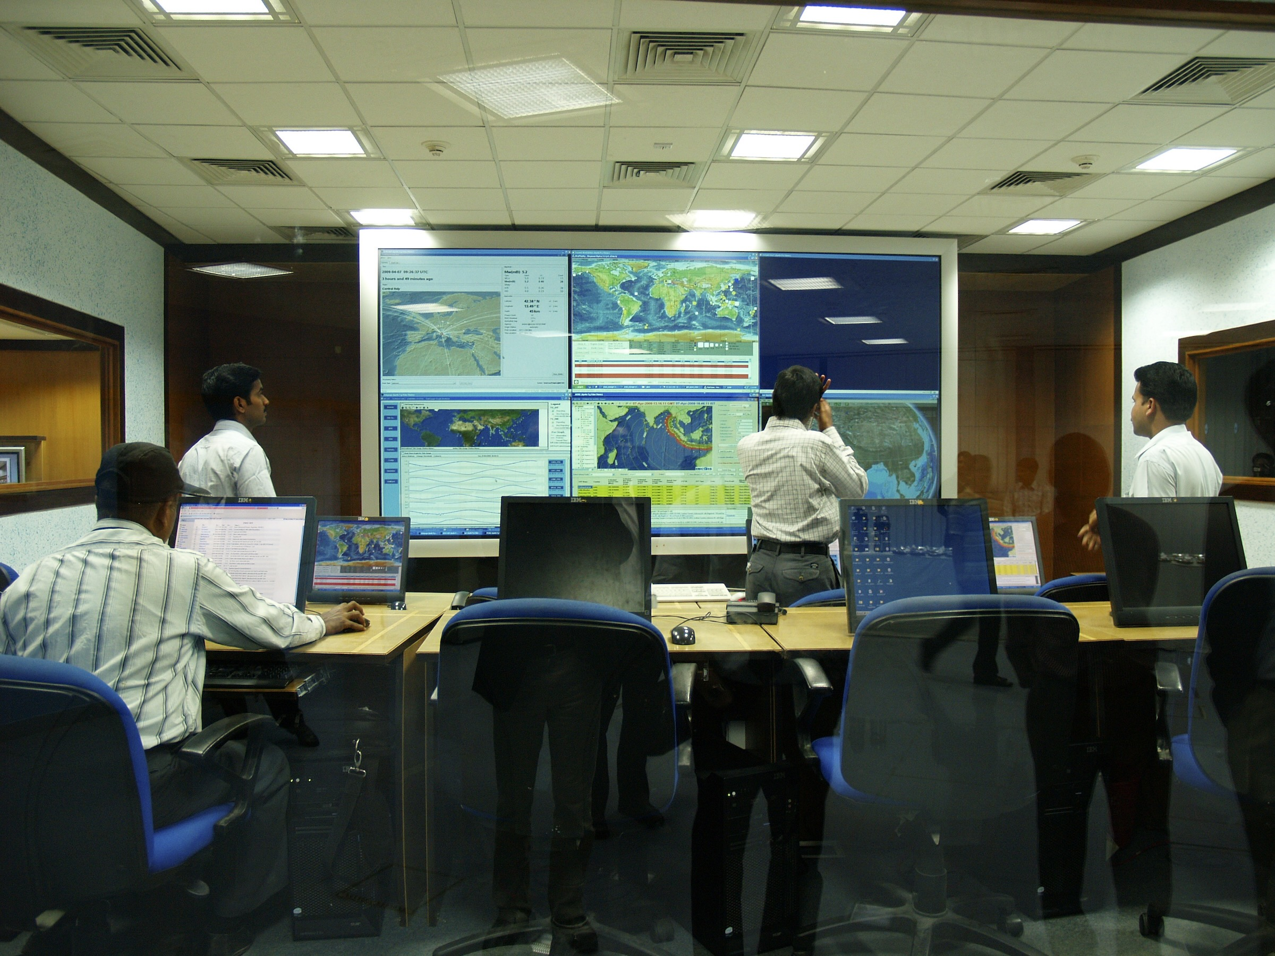
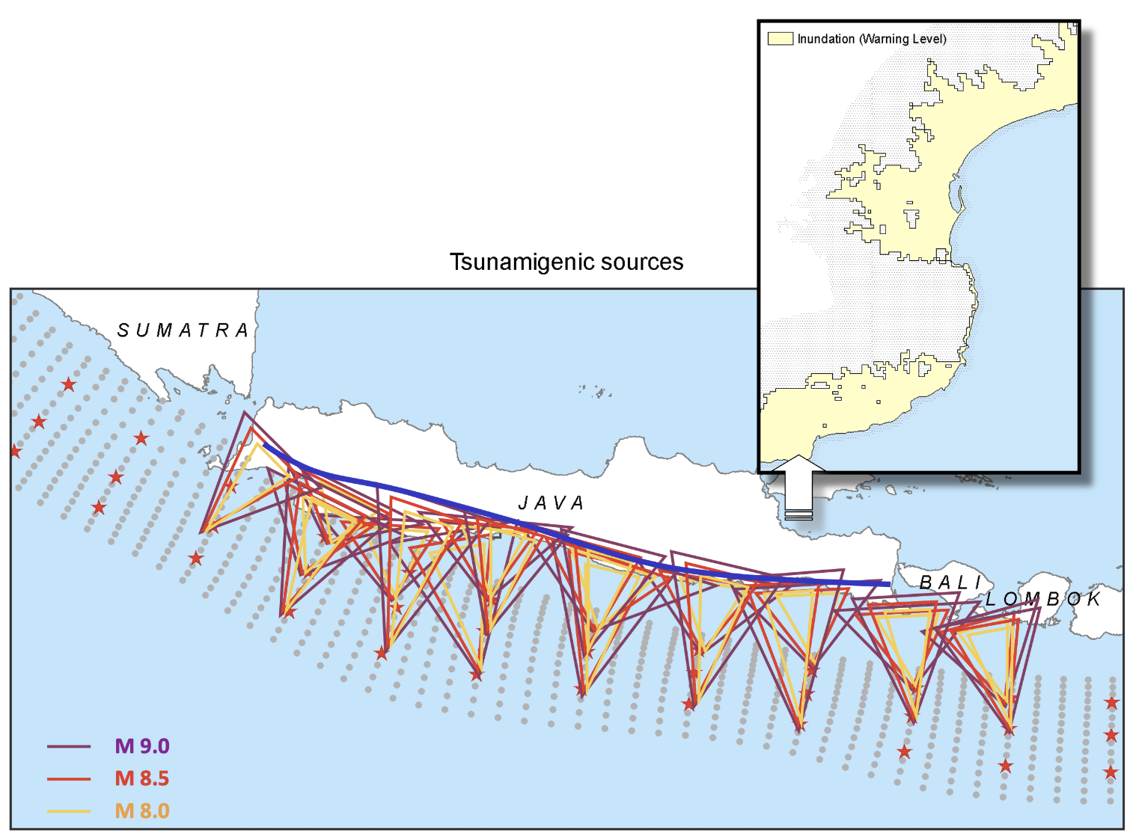
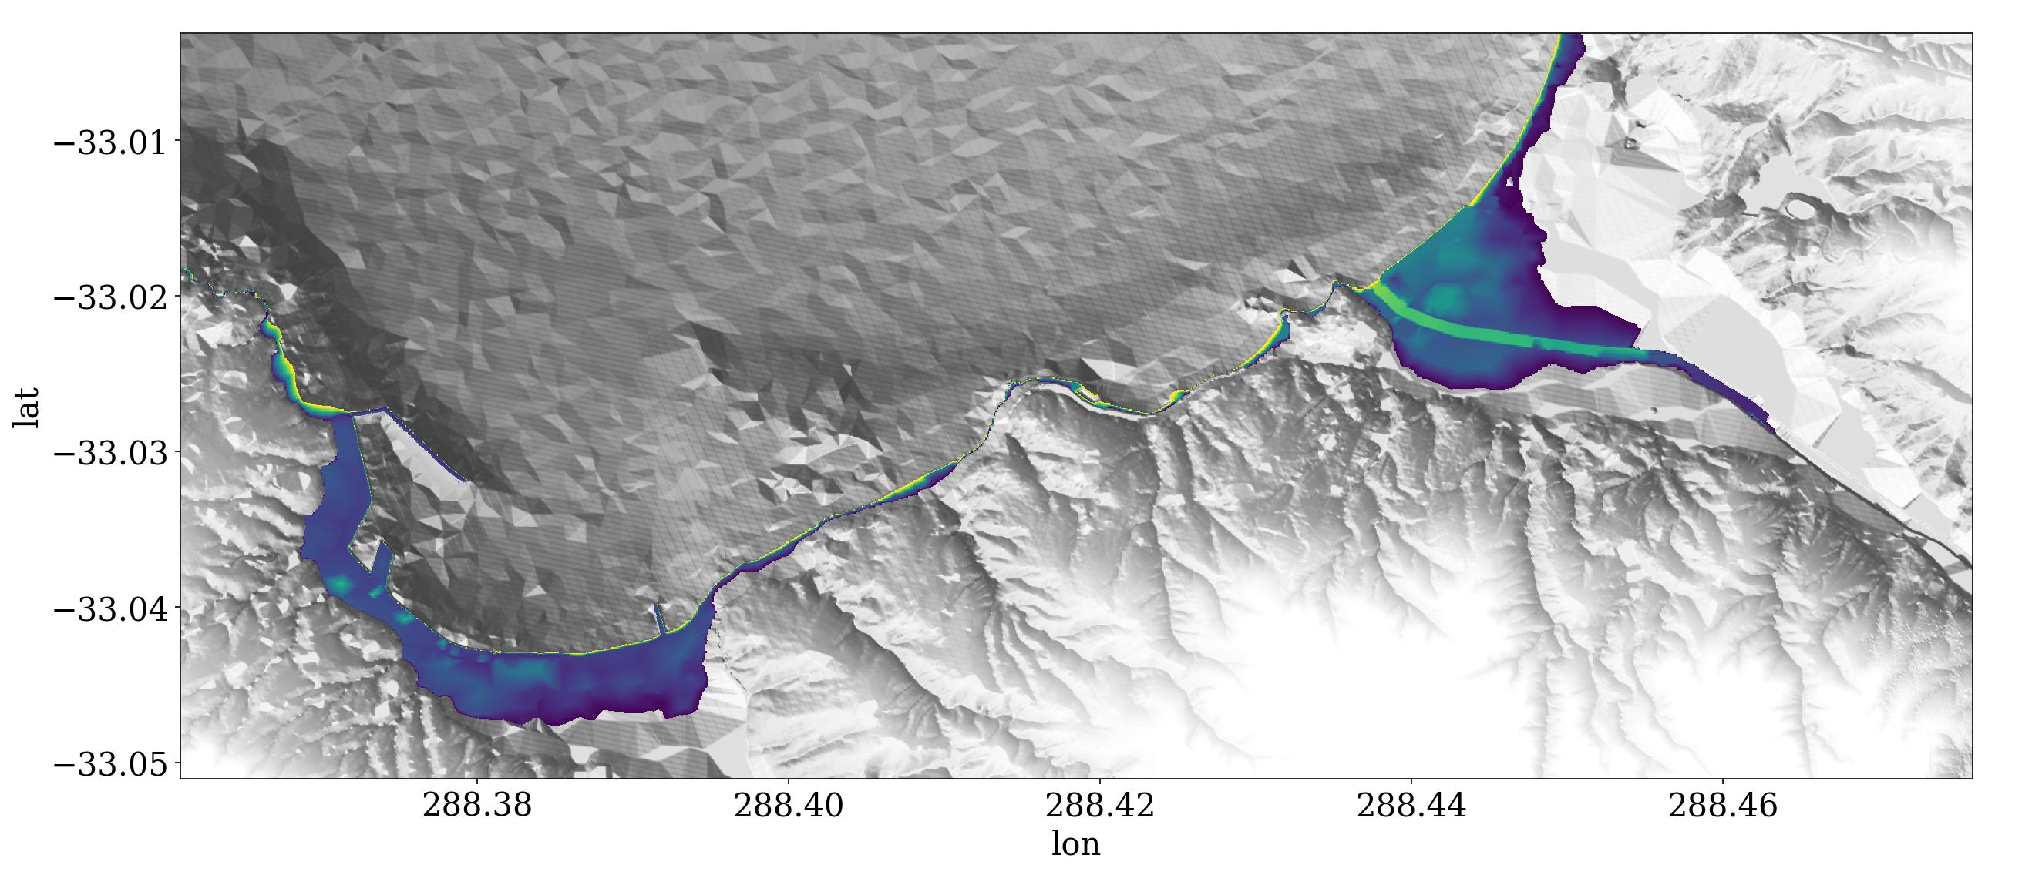
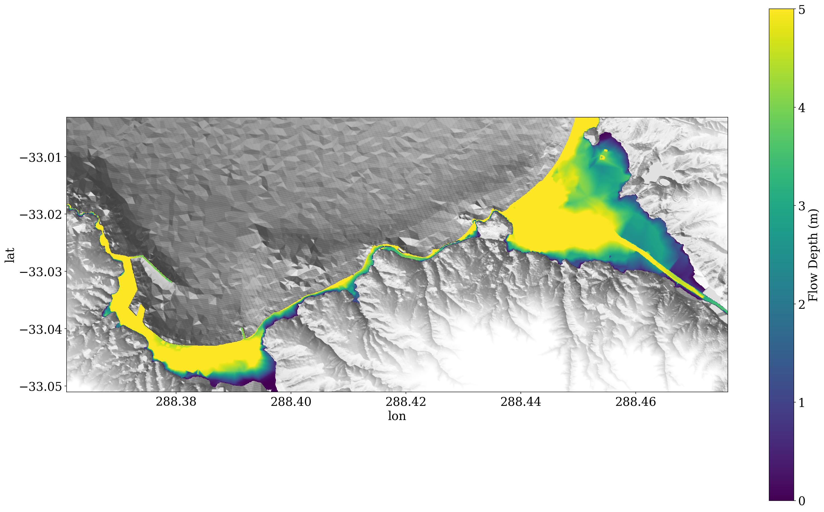
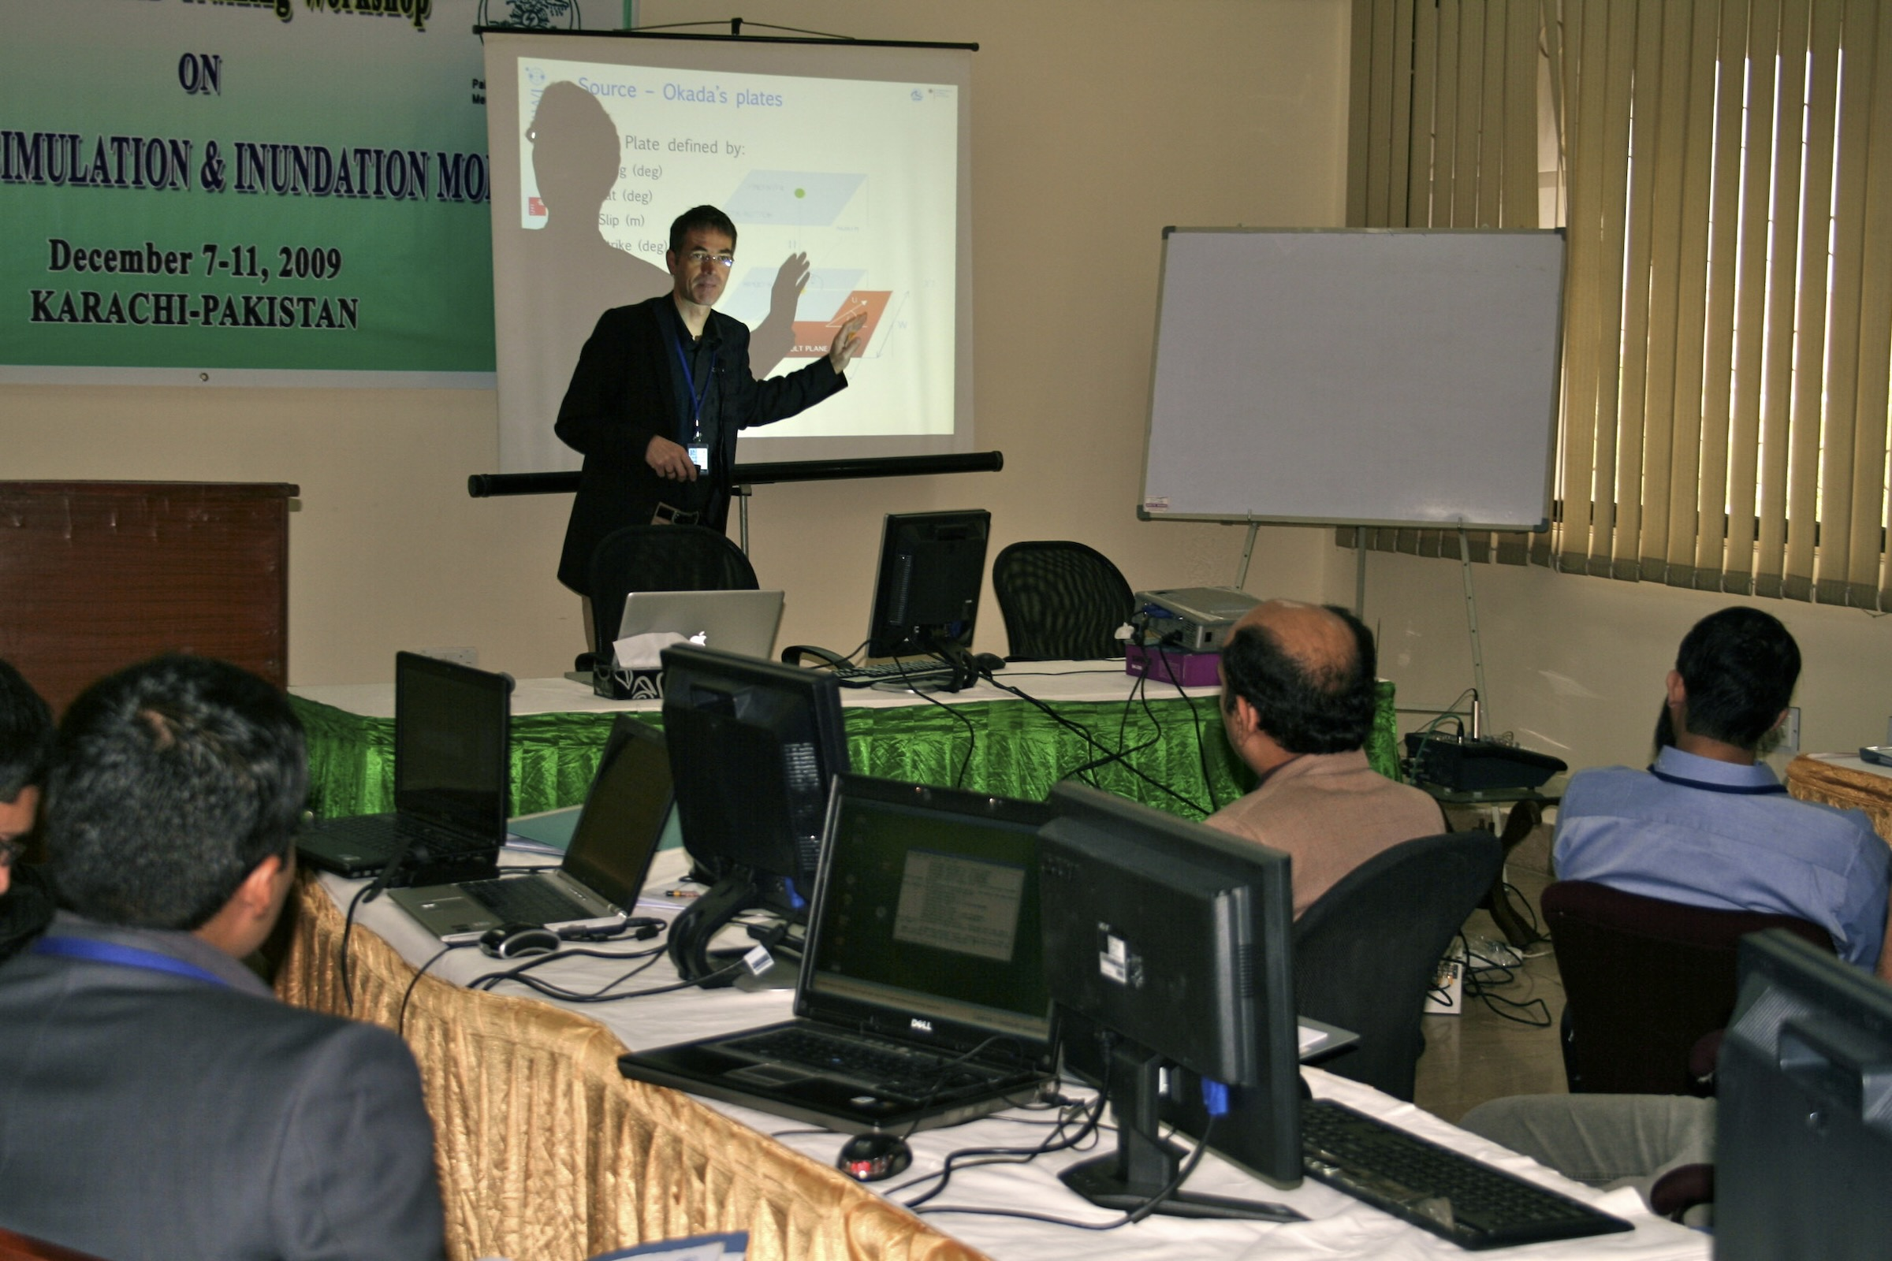
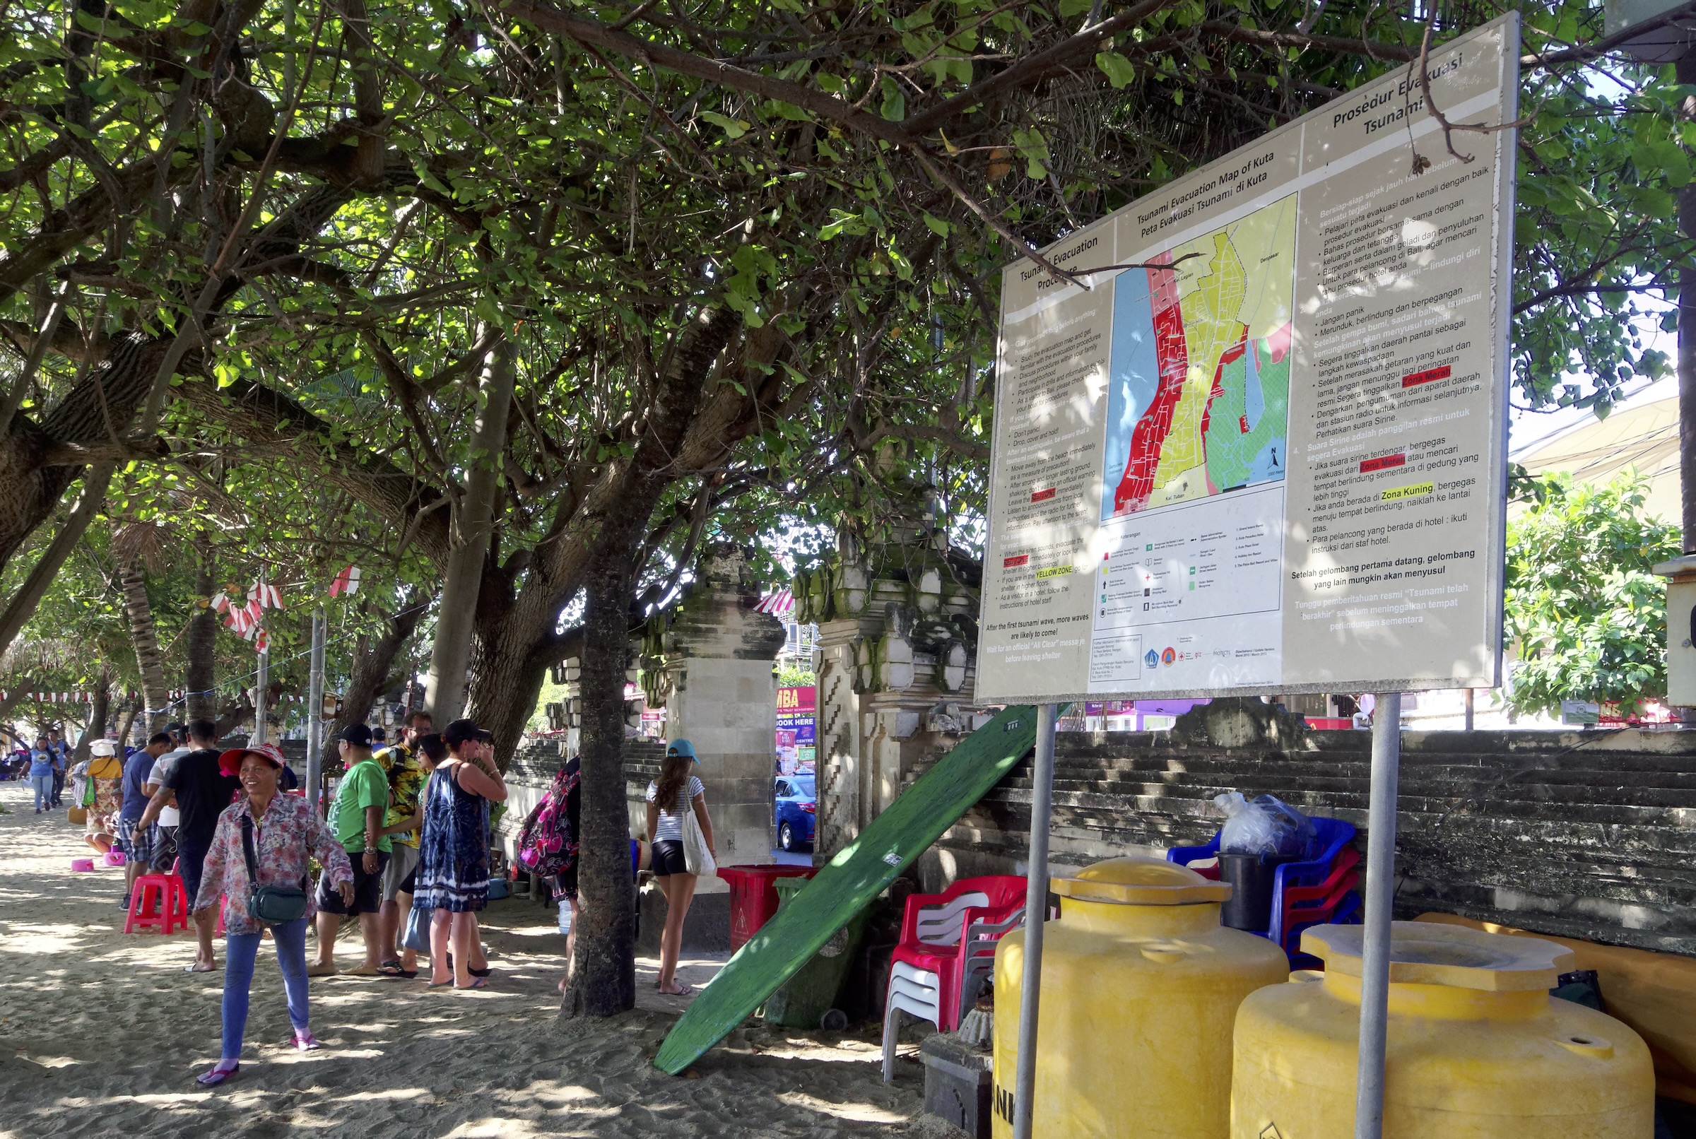
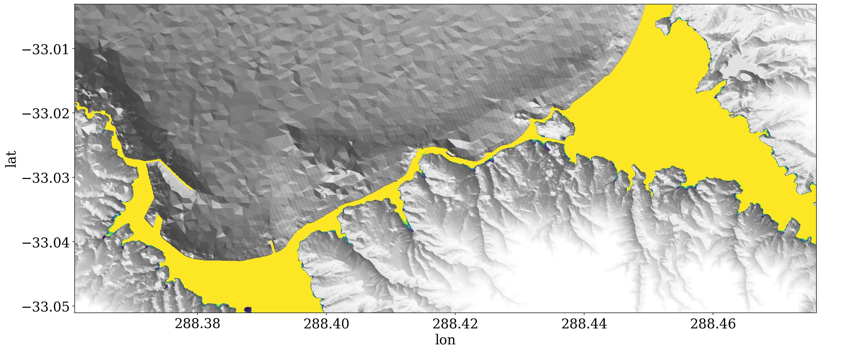
GTM’s contribution to ODTP High Level Objectives
Probabilistic Hazard Assessment (early warning)
  Capture Uncertainty
  Basis for decision
Inundation Mapping (tsunami ready)
  Explain uncertainty
  Help with risk communication
  integrated end-to-end thinking

Slide 9
Questions/Discussion
www.globaltsunamimodel.org

