Slide 1
The Italian Tsunami Service Provider CAT@INGV and the National System for Tsunami Warning
XX ICG-NEAMTWS, Paris, UNESCO HQ, December 03-05, 2025

Slide 2
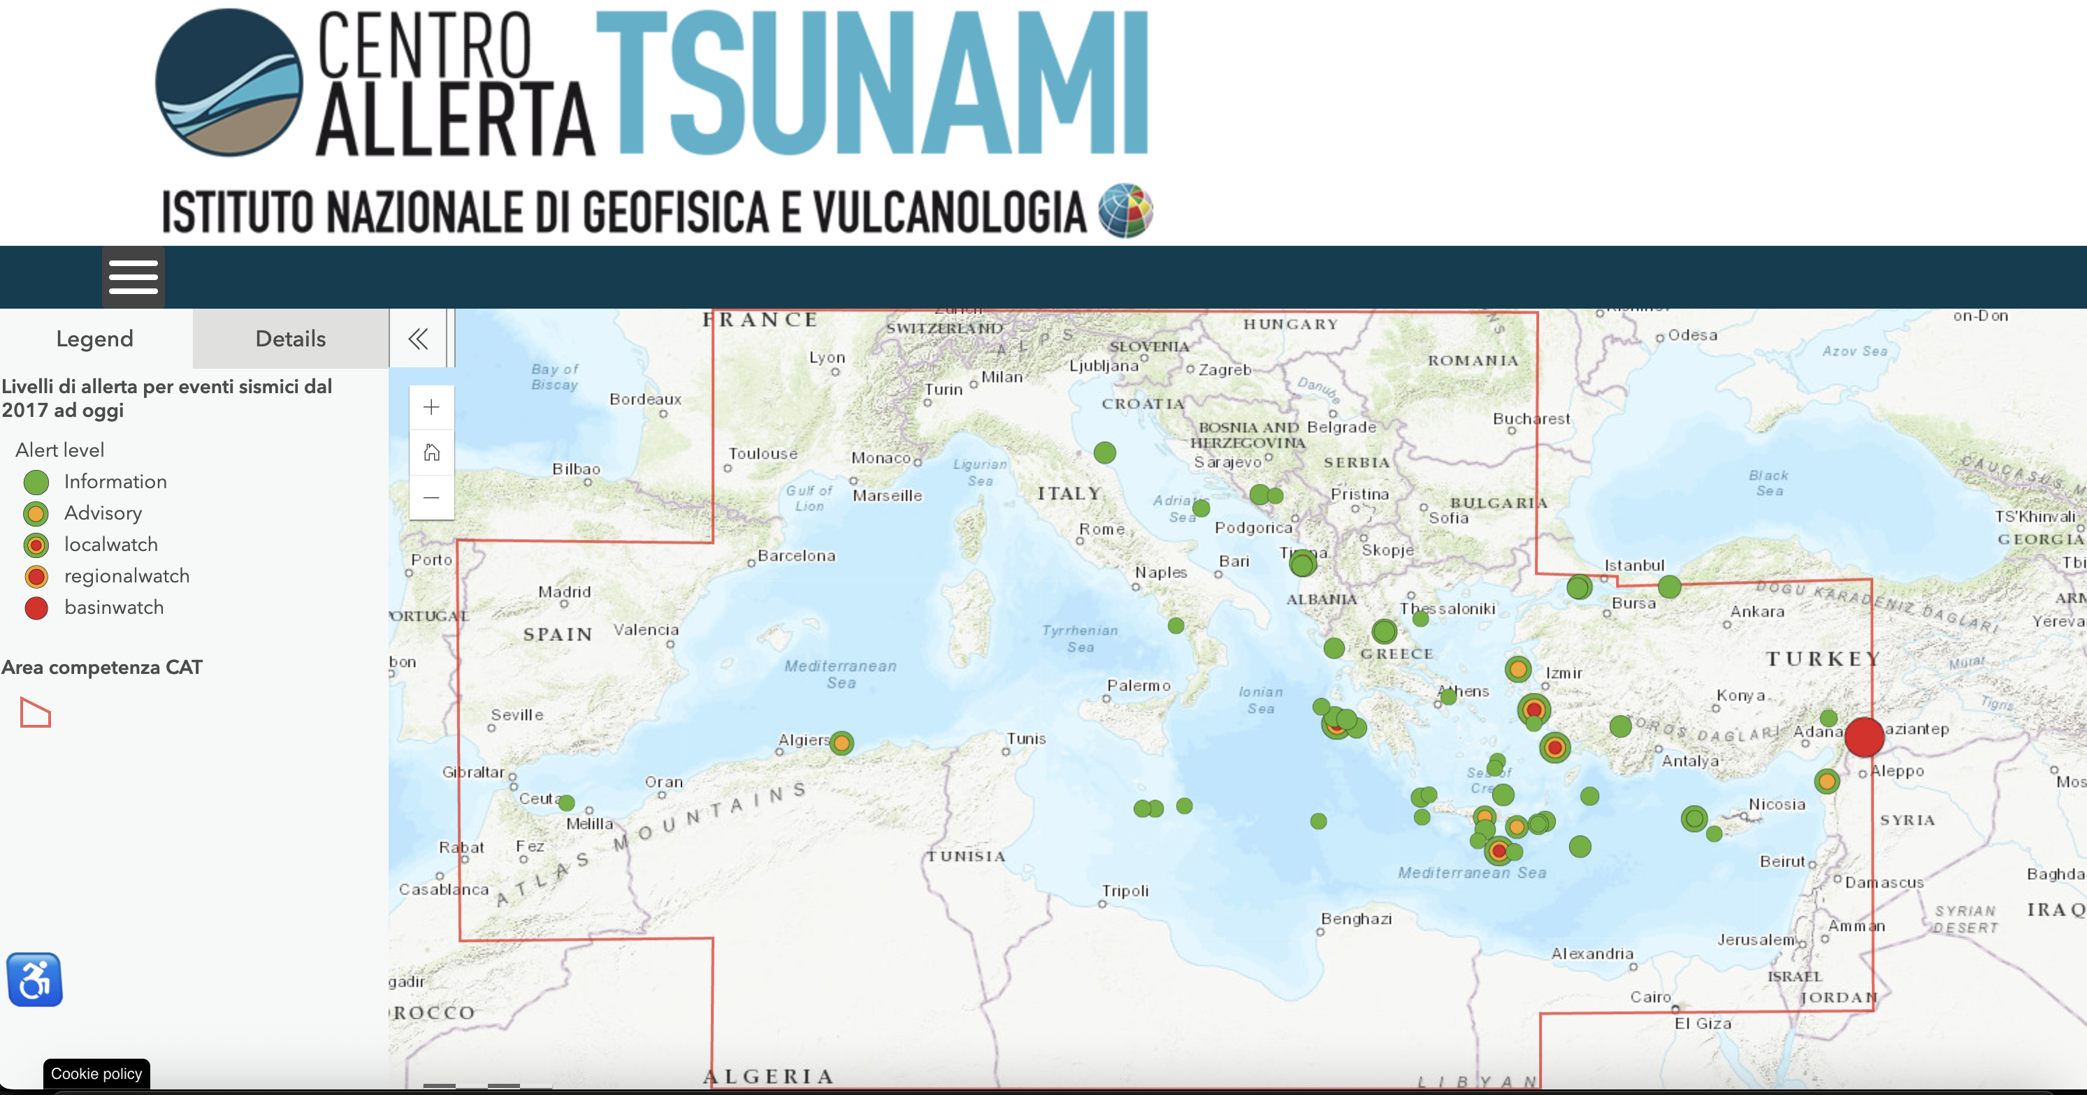
10 events in 2025 (9 INFORMATION, 1 ADVISORY)

Slide 3
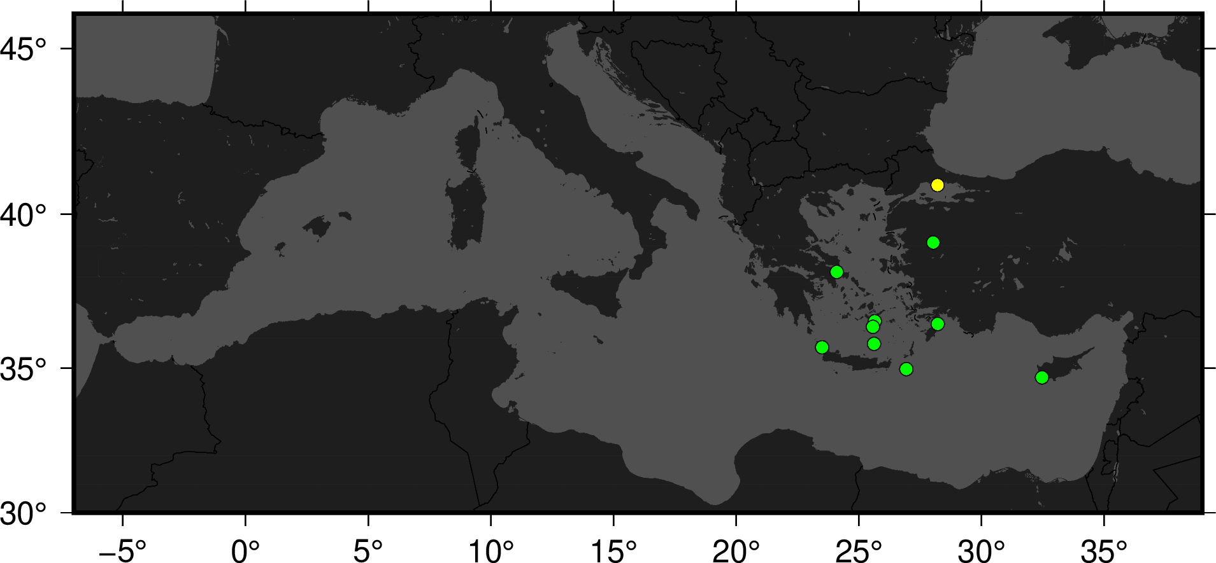
10 events in 2025 (9 INFORMATION, 1 ADVISORY)

Slide 4
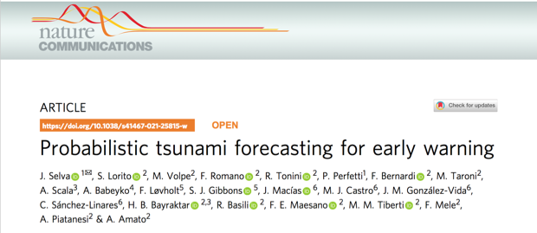
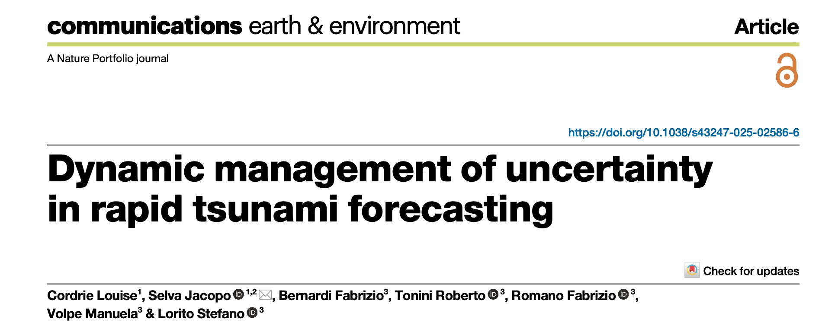
PTF (Probabilistic Tsunami Forecasting)
Probabilistic Tsunami Forecasting (PTF, Selva et al., 2021) is a recently introduced methodology that provides a forecast of a tsunami in terms of the probability distribution of a tsunami intensity measure at different forecast points within a few minutes after the occurrence of an earthquake.
Selva, Volpe, Lorito, Romano et al., Nature Communications, 2021
Alert levels - linked directly to response actions - can be defined based on the desired level of risk reduction, and they can be used in operational tsunami early warning or rapid post-event assessments.

Slide 5
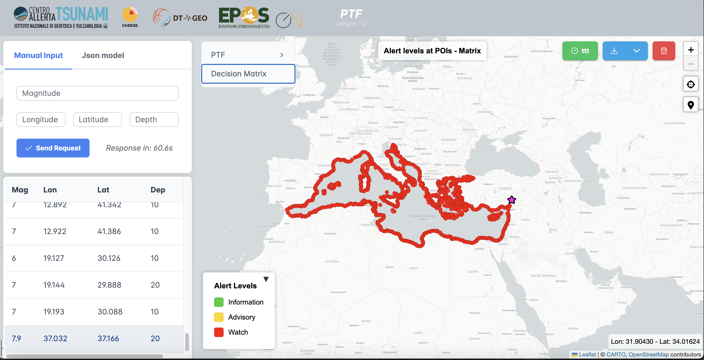
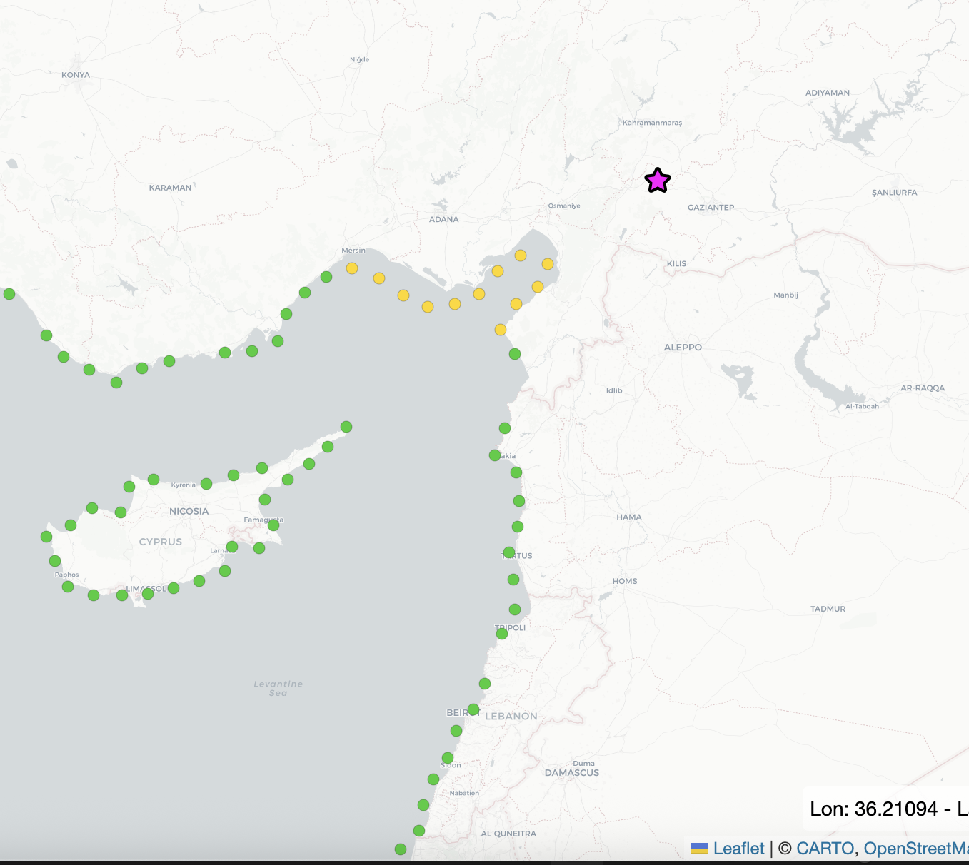
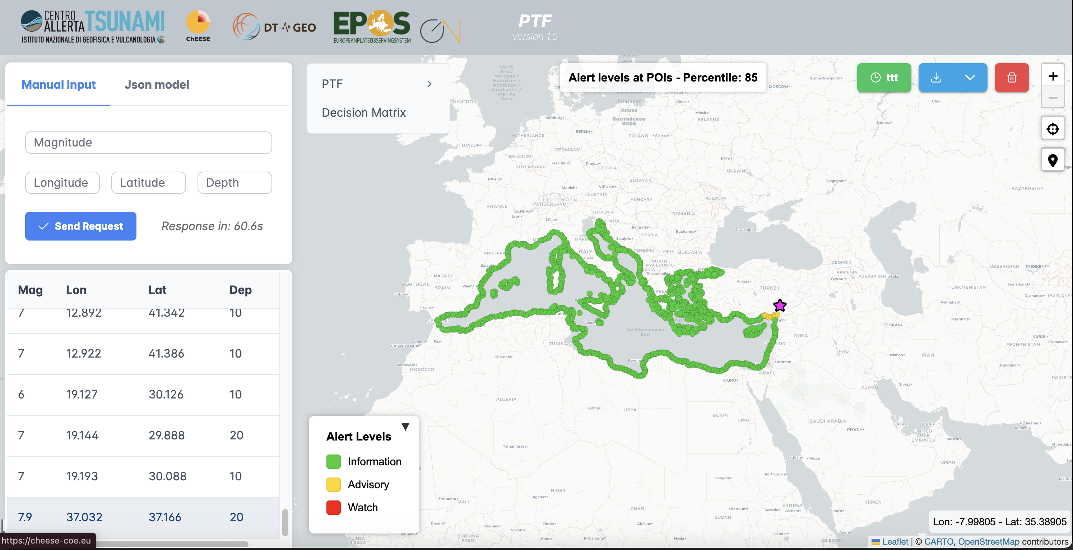
PTF (Probabilistic Tsunami Forecasting)
Probabilistic Tsunami Forecasting (PTF, Selva et al., 2021) is a recently introduced methodology that provides a forecast of a tsunami in terms of the probability distribution of a tsunami intensity measure at different forecast points within a few minutes after the occurrence of an earthquake.
Decision Matrix
2023, M7.8 Kahramanmaraş, Turkiye earythquake
PTF

Slide 6
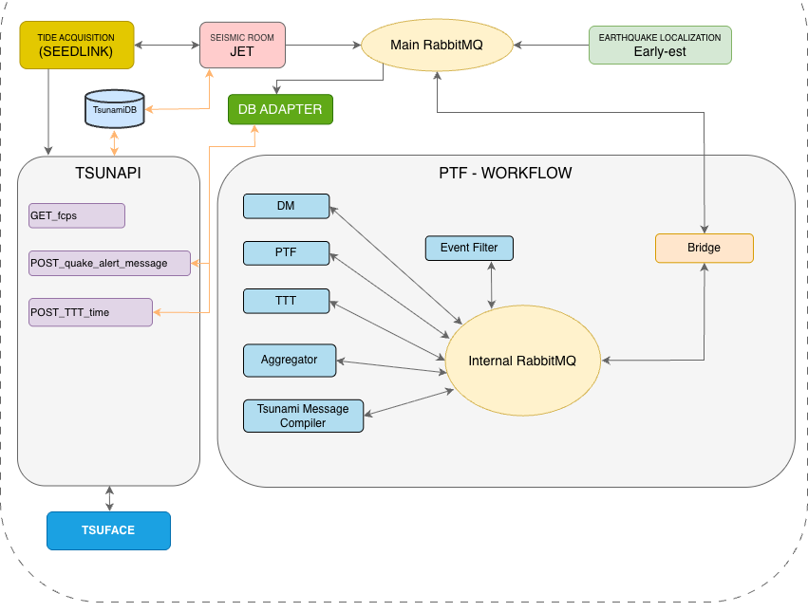
PTF (Probabilistic Tsunami Forecasting)
PTF is planned to become operational at CAT-INGV, Italy, NEAMTWS TSP at the beginning of 2026 after we finalised:
the IT implementation into the current INGV monitoring system
the Training for scientists on shift
We are working also to a global version of PTF

Slide 7

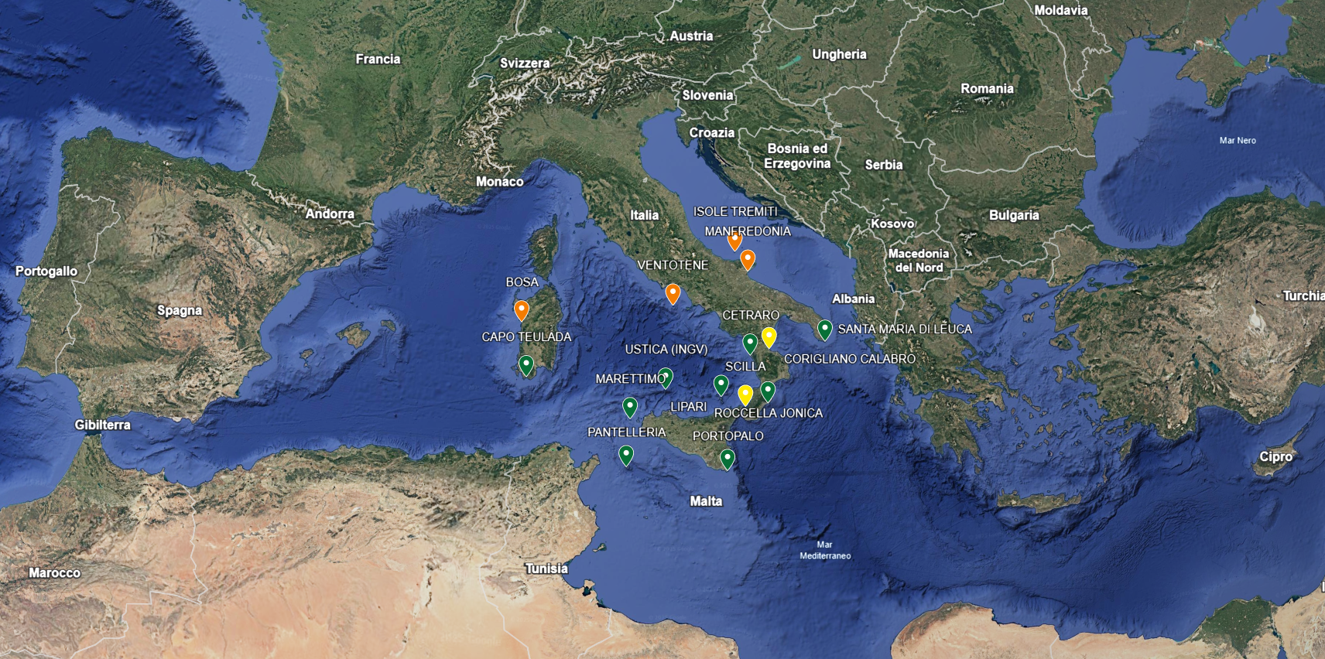
SiAM NETWORK
GREEN = OPERATIONAL YELLOW = IN PROGRESS RED= PROGRAMMED 2025
MILAZZO

Slide 8

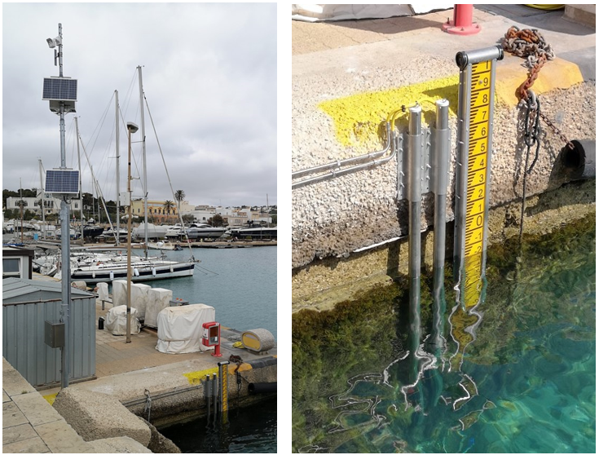
SiAM NETWORK UPGRADE
The technical features common to the first six ISPRA’s new-generation stations of the established SiAM surveillance network installed since 2021
Primary system with independent power supply, on-board camera,
Datalogger, control unit - transmits in real time the sea level (m) - sampling rate 15 sec. (FAST transmission) – 2 high precision piezometric sensors (integrated water thermistor ) in a stilling tube with full scale of 10 and 20 meters
Data transmission system (transmission redundancy)
  UMTS 4 or 5G channel - 2 SIMs on board with different providers
  IRIDIUM satellite module - starts in case of absence of UMTS signal
Data storage and transmission system are protected in sealed and IP68 waterproof boxes, on a pole about 10 m high - all metal components in AISI 316 steel (resistance to severe operating conditions)
tsunami.isprambiente.it
G. Giorgi – G. Arena - A. Barbano – C. Gera
ISPRA-CN-COS- Technical-operational Section supporting the Italian Tsunami Early Warning System (SiAM)

Slide 9
SiAM NETWORK UPGRADE
ISPRA’s new generation station - plus series
in addition to the technical features common to the first six ISPRA’s new-generation stations in the established SiAM network installed since 2021
3rd piezometric sensor (greater data redundancy) in a 2nd stilling tube
Backup Datalogger (electronic redundancy)
Independent power supply of the secondary system (backup)
Objectives: Reduction of interruptions due to faults, increased stability of the data collection system and transmission service (operational continuity)
tsunami.isprambiente.it
G. Giorgi – G. Arena - A. Barbano – C. Gera
ISPRA-CN-COS- Technical-operational Section supporting the Italian Tsunami Early Warning System (SiAM)

Slide 10
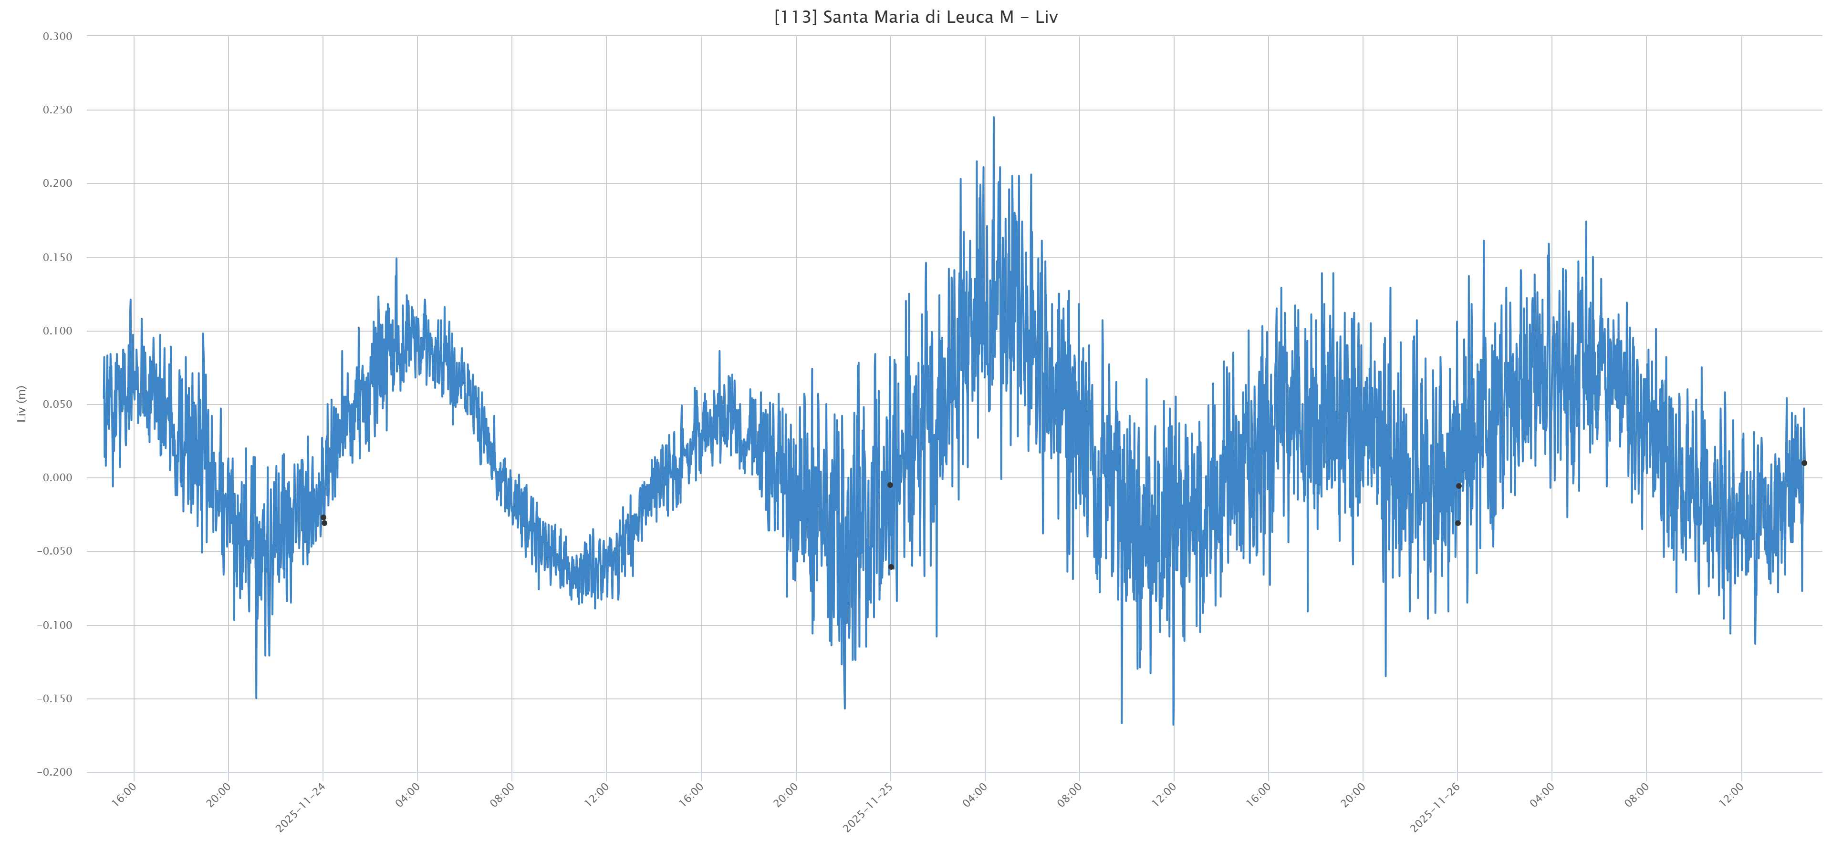
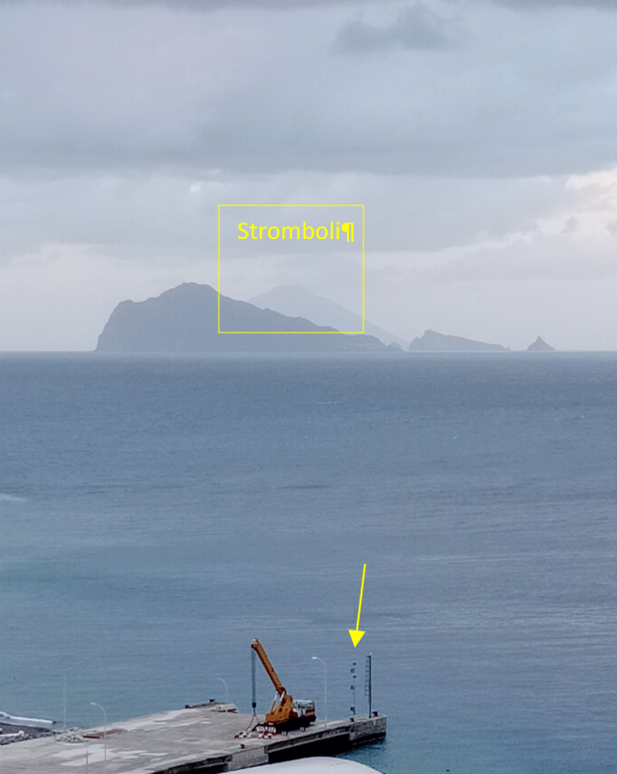
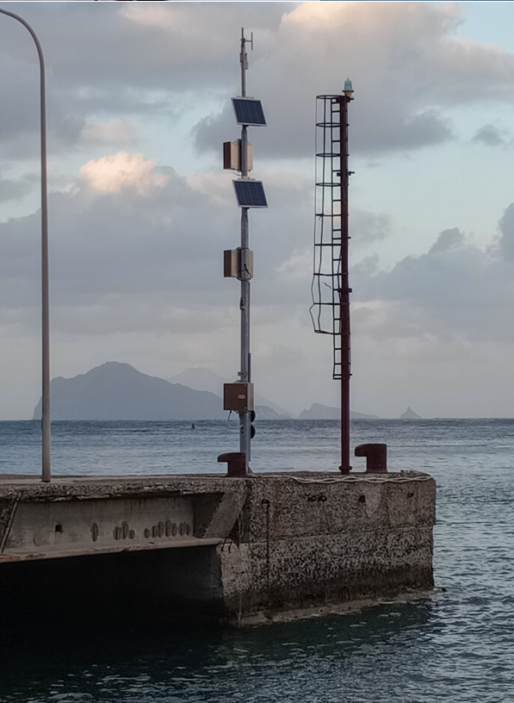
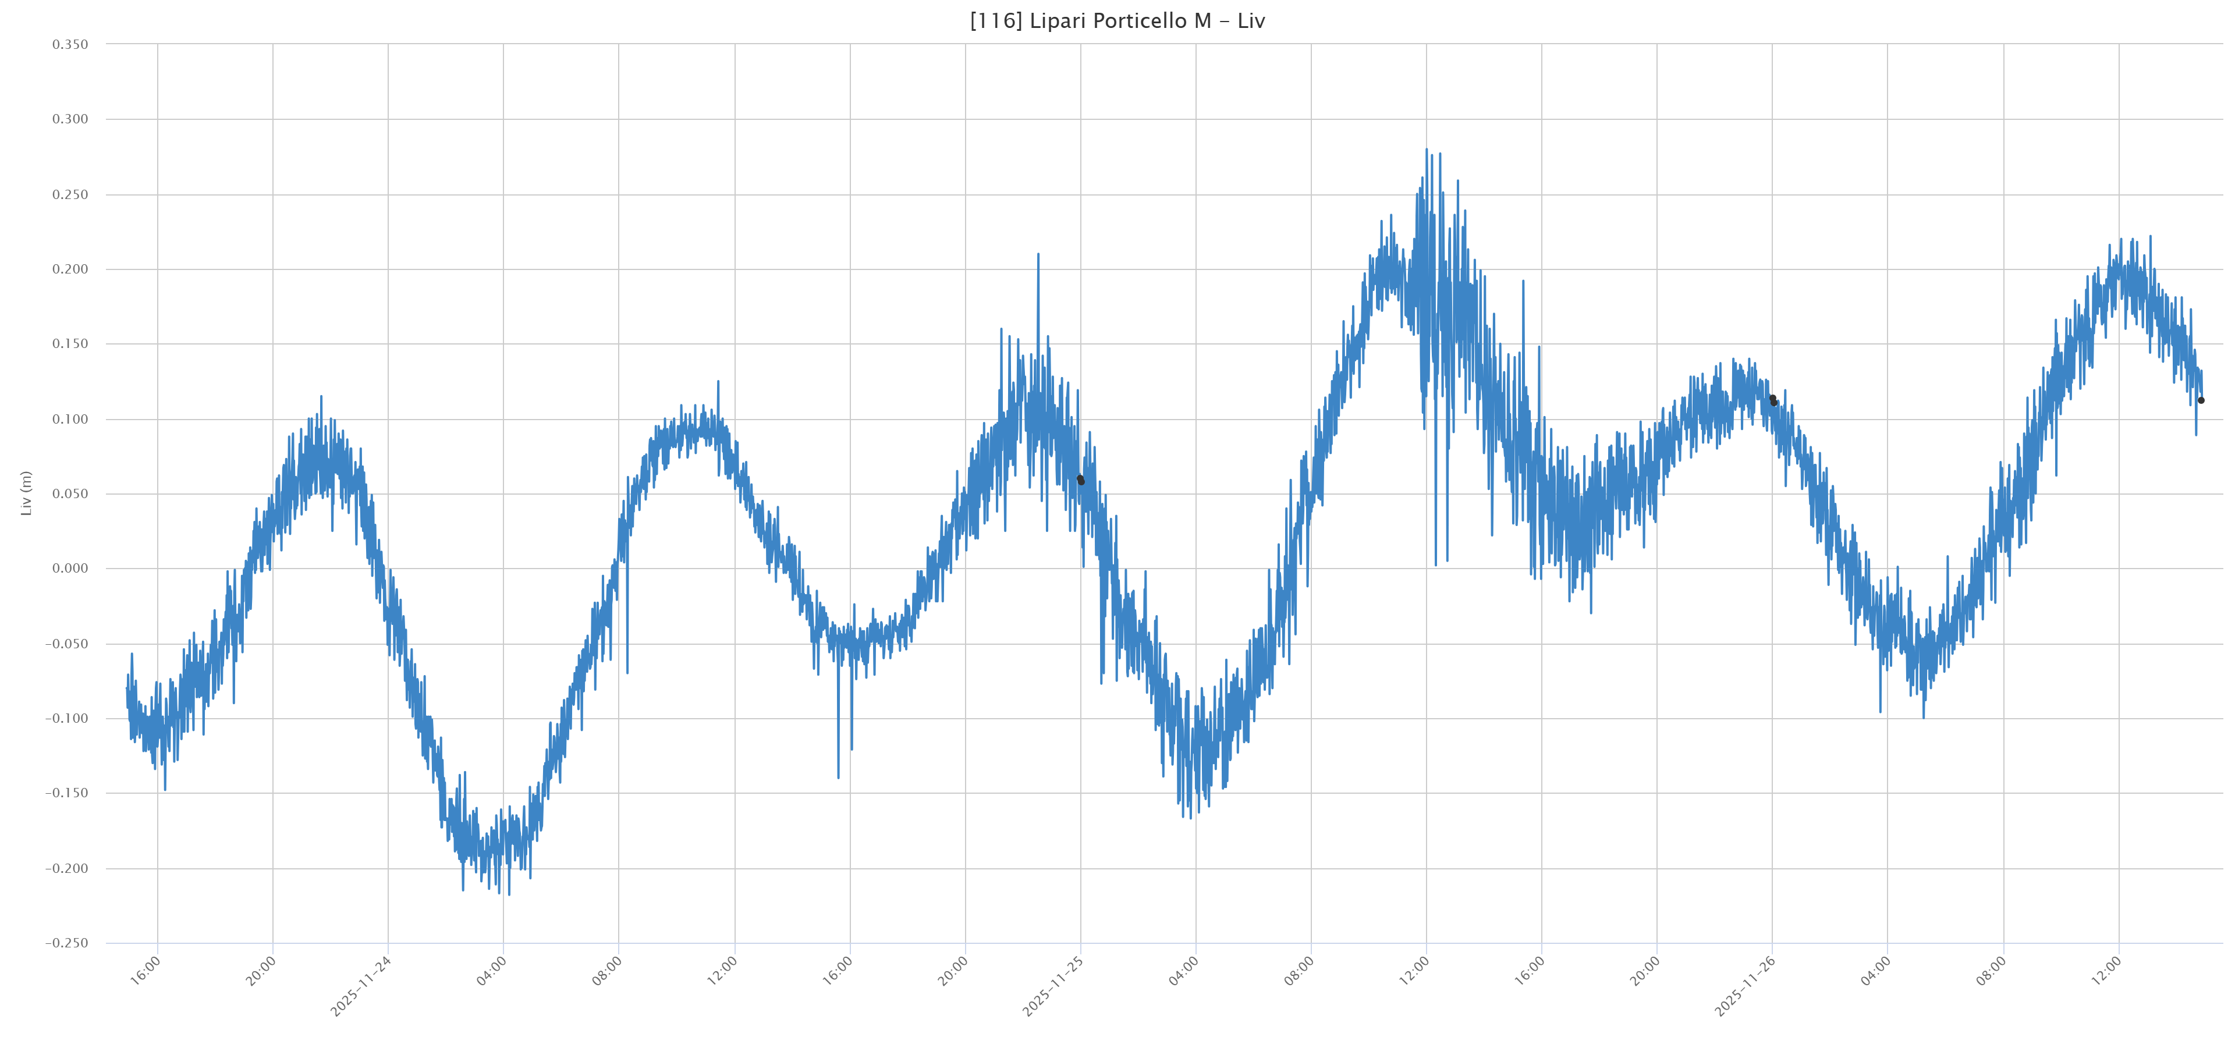
SiAM NETWORK UPGRADE
ISPRA’s new generation station - plus series
Santa Maria di Leuca - 2024
Lipari Island in the Aeolian Islands – 2025
located in front of the Stromboli volcano
The plus series configuration increases the sea level survey points from 2 to 3 and the independent measuring stations from 1 to 2
G. Giorgi – G. Arena - A. Barbano – C. Gera
ISPRA-CN-COS- Technical-operational Section supporting the Italian Tsunami Early Warning System (SiAM)

Slide 11
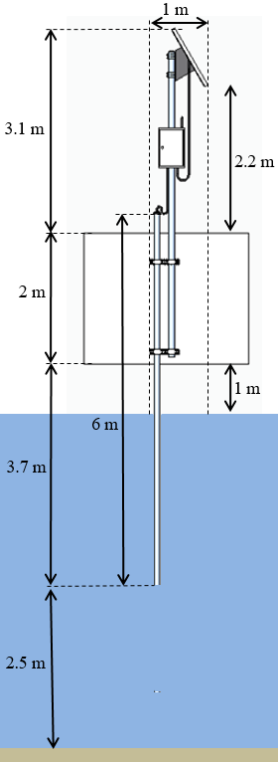
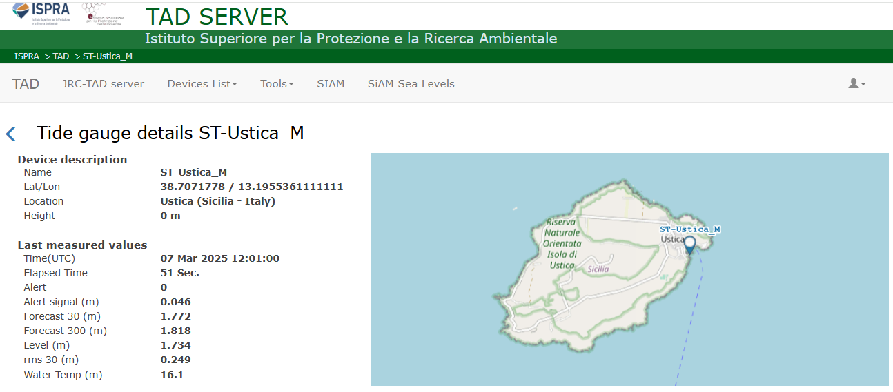
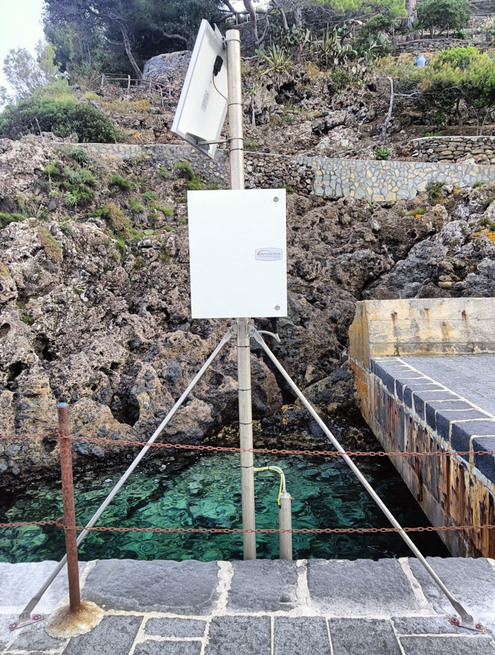
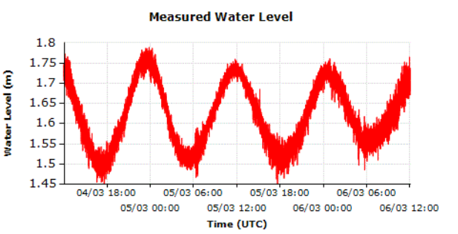
SiAM NETWORK UPGRADE
https://tsunami.isprambiente.it/TAD_Server/Device/226
Ustica Tide Gauge

Slide 12
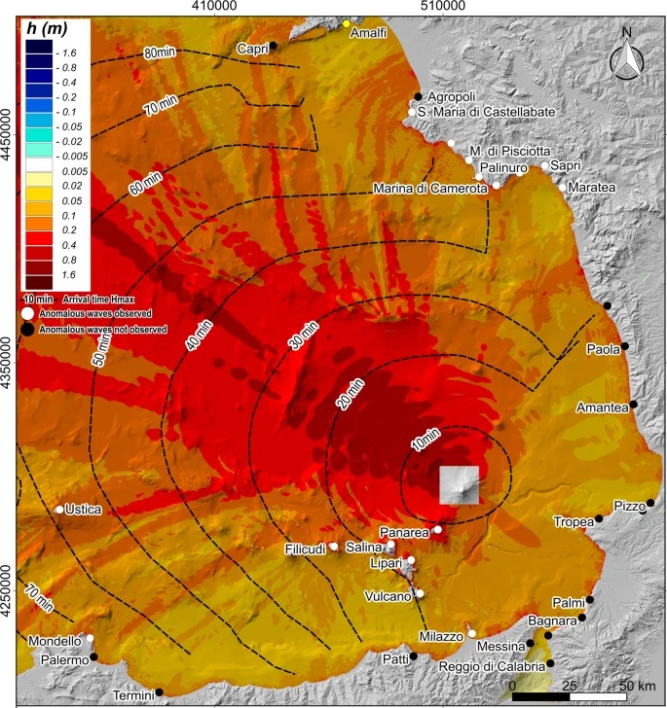
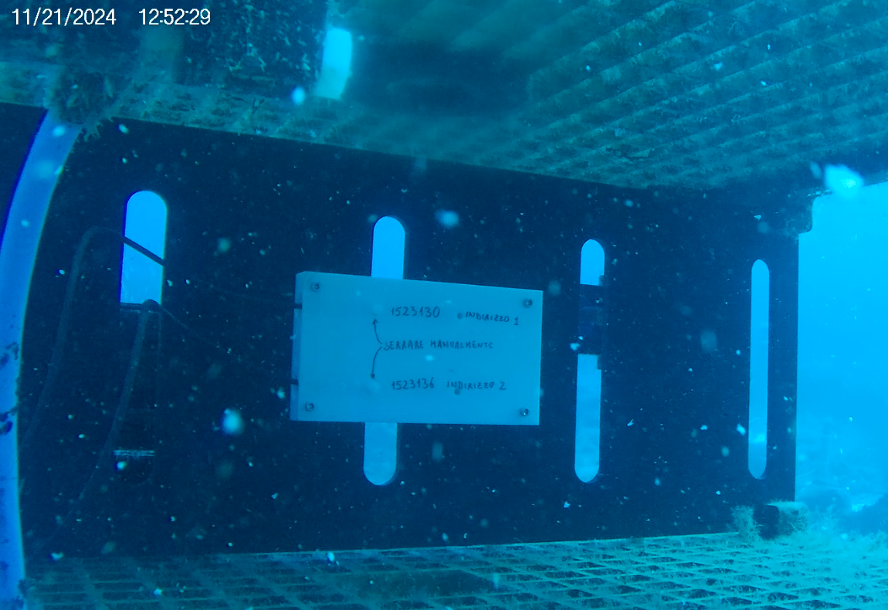
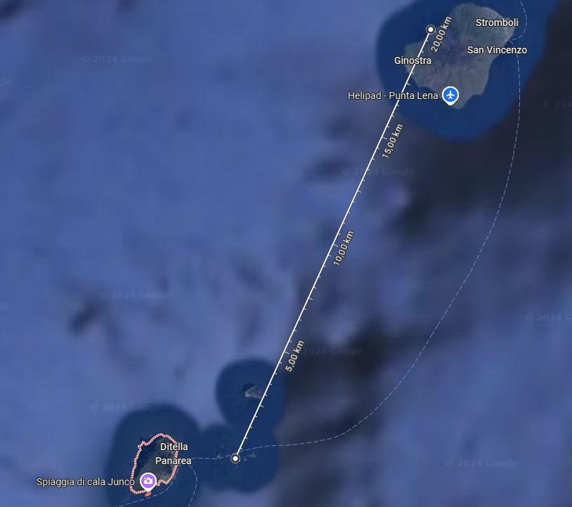
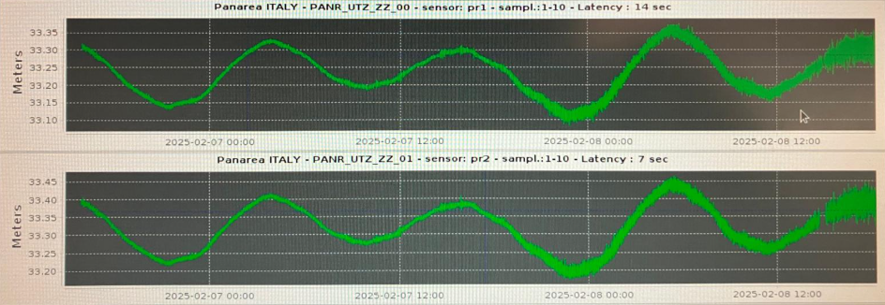
SiAM NETWORK UPGRADE
Two pressure sensors (Keller Series 36XW) have been installed in the seabed module of the Panarea multidisciplinary observatory, already installed by colleagues from the Palermo section. This station has also become part of the Tsunami Warning Center (CAT).
20 km between Sciara and the Panarea observatory
Tsunami arrival time from Stromboli's Sciara to Panarea: approximately 10 minutes

Slide 13
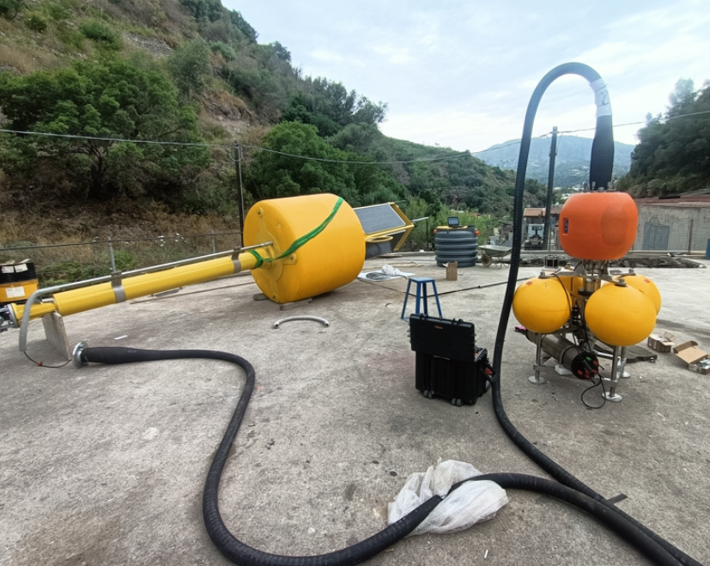
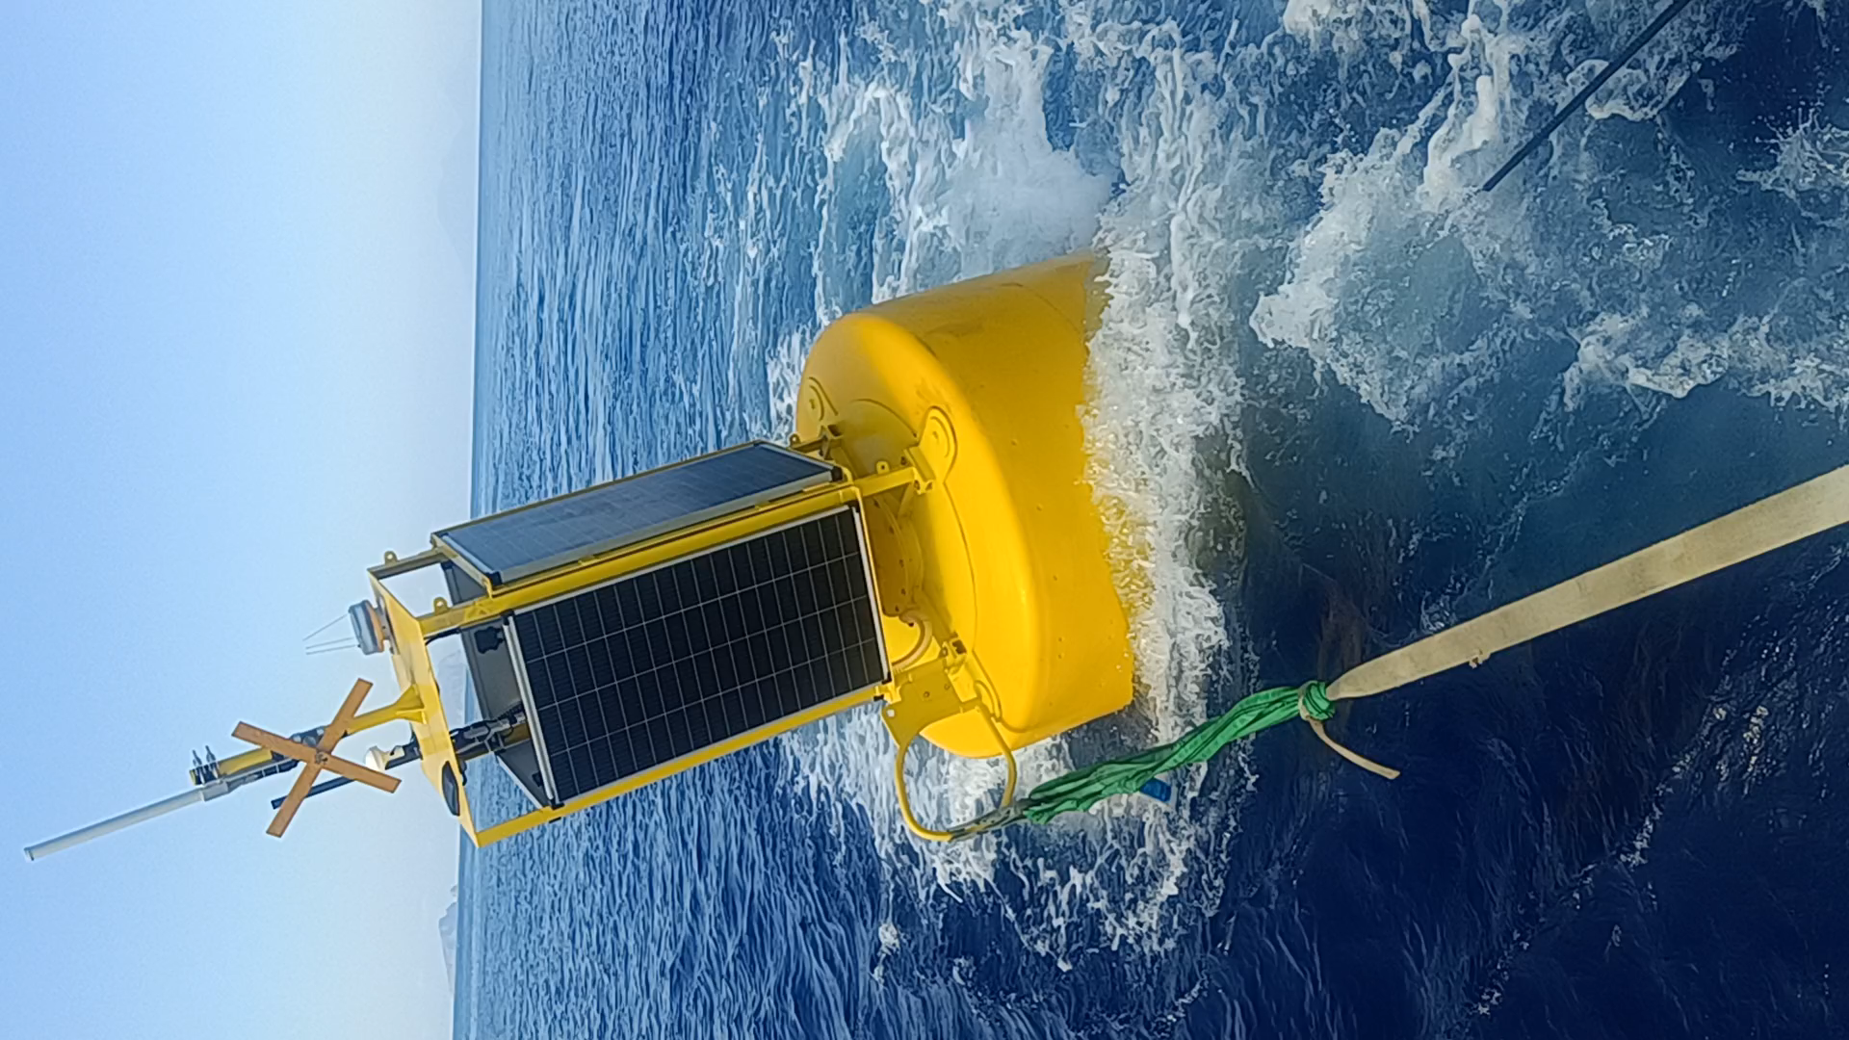
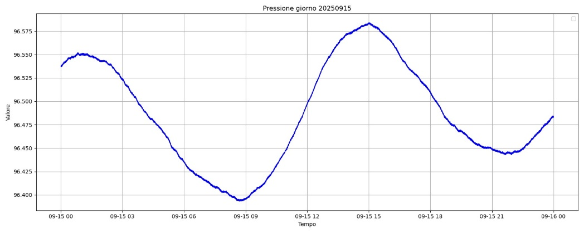
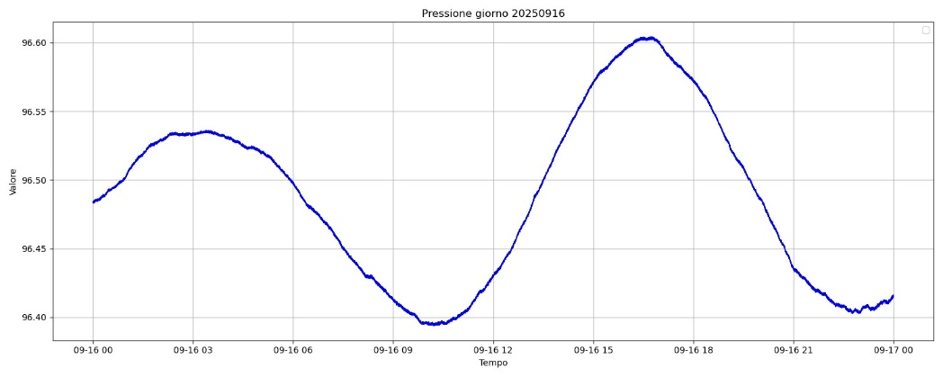
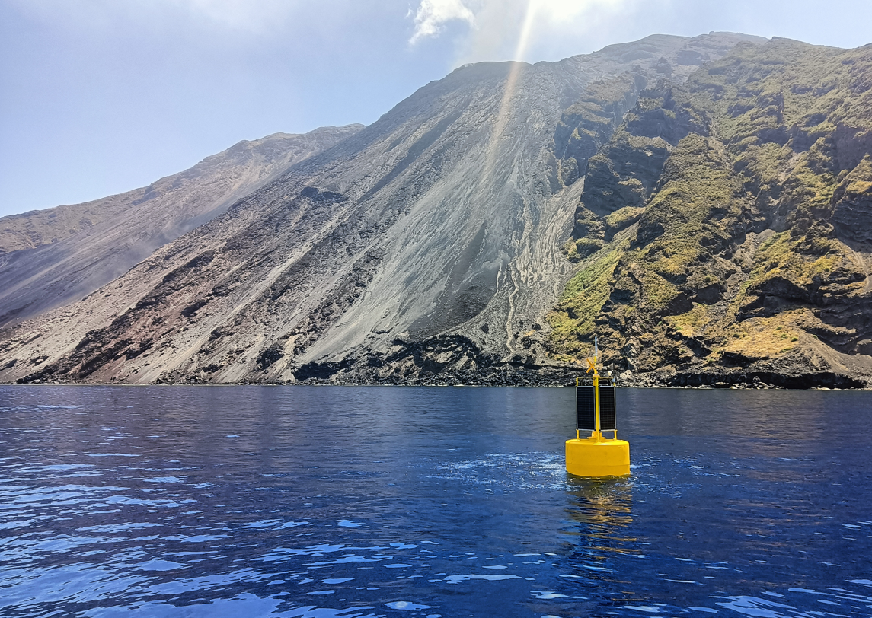
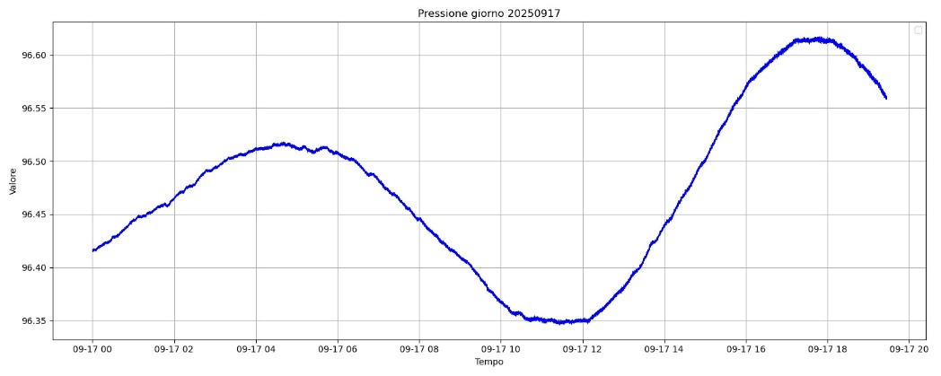
SiAM NETWORK UPGRADE
Stromboli cabled buoy (installed on July 2025)
2025 09 15
Deployment
Value
Time
2025 09 16
Value
Time
2025 09 17
Value
Time

Slide 14

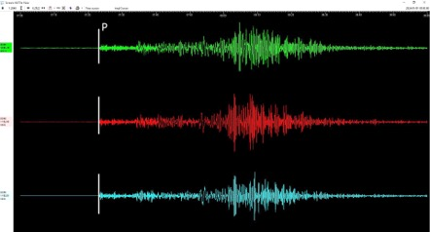
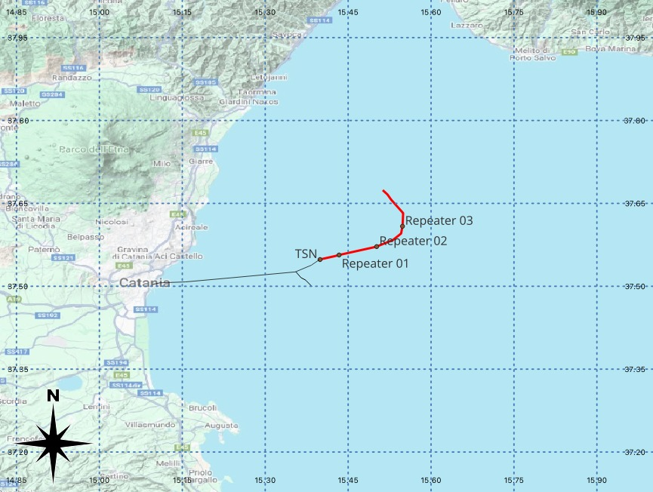
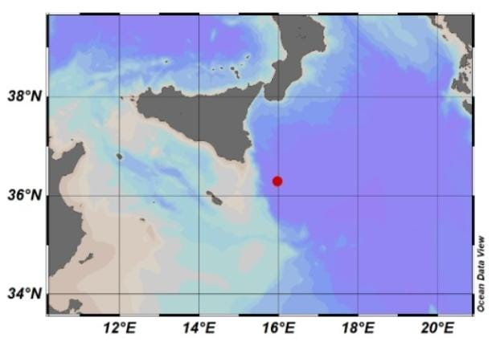
Additional marine sensors
WESTERN IONIAN SEA INFRASTRUCTURE
Deployed December 2023
WEST COAST, EASTERN HONSHU, JAPAN
01/01/2024 07:10 M_{wpd} 7.4
Sicily
Calabria
Mt. Etna
INFN Km3NeT Observatory @ 3,500 m depth
Trillium 120s + hydrophone + P-T sensor (RBR)
Cabled with fiber optic to land (100km)
Courtesy of G. Marinaro (INGV)

Slide 15
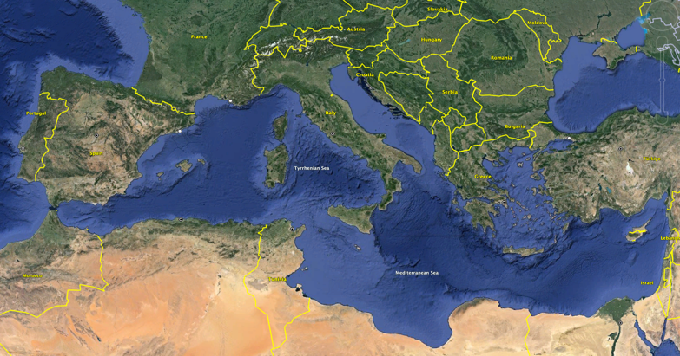
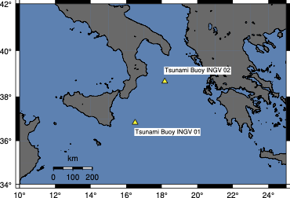

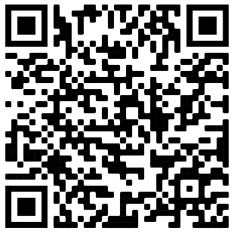

Tsunami buoys
TSUNAMI BUOYS
2 tsunami buoys have been installed in the Ionian sea in September 2025 by MSM (Mediterráneo Senales Marítimas) that was awarded contract
Location and technical requirements decided based on possible tsunami sources and ship traffic (in Italian exclusive economic zone)
Funding (~2.8 M€) by the Italian Ministery of Research through the European contribution Next Generation EU - NRRP (National Recovery and Resilience Plan) “MEET”, coord. by INGV

Slide 16
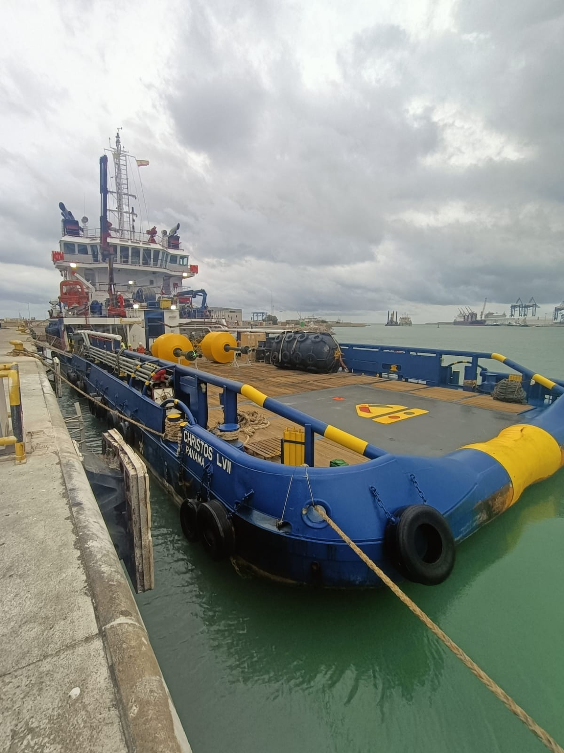
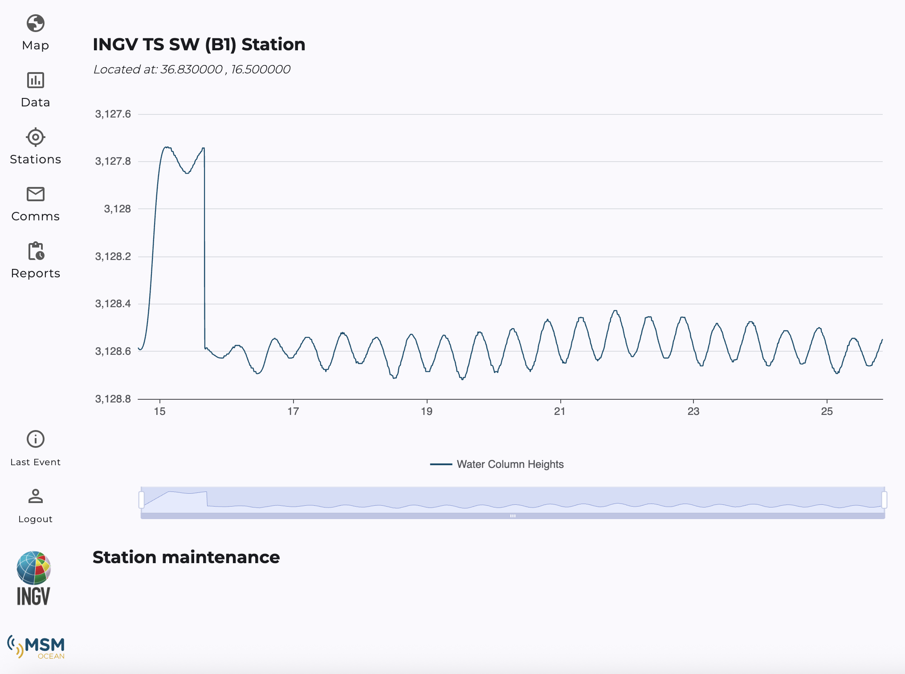
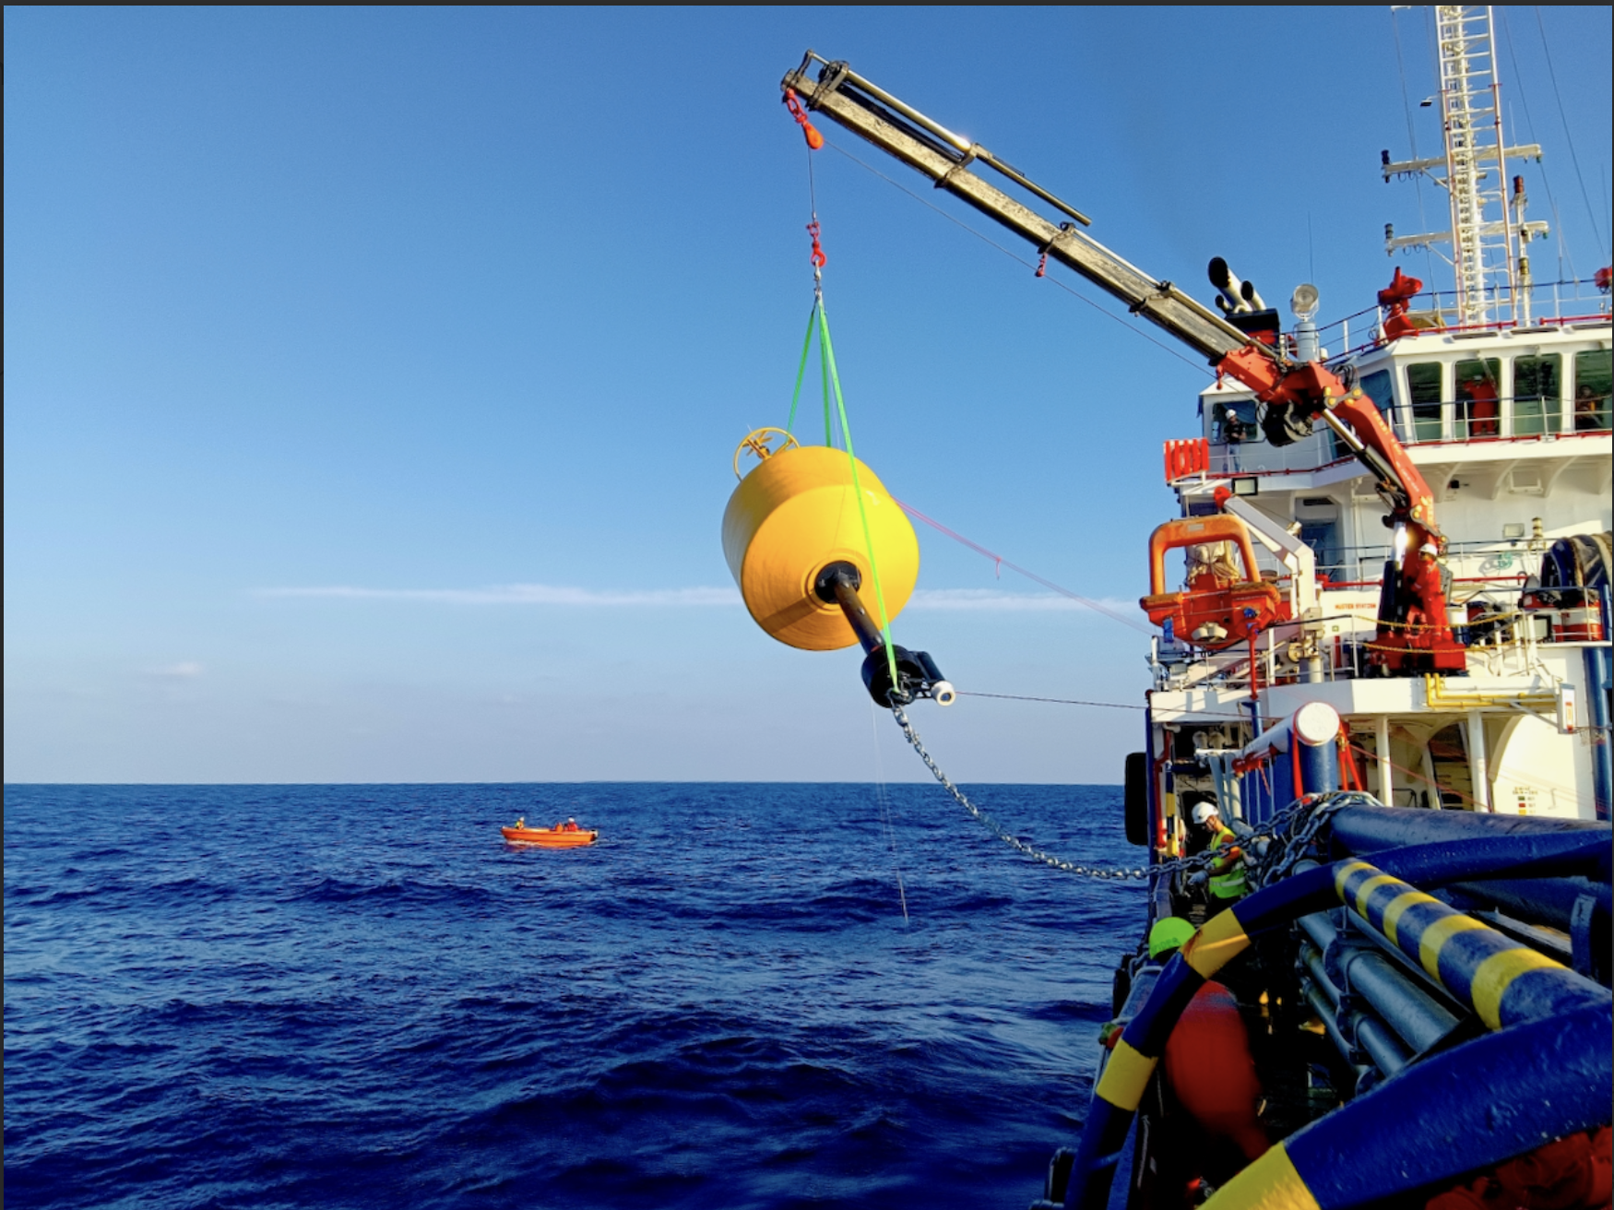
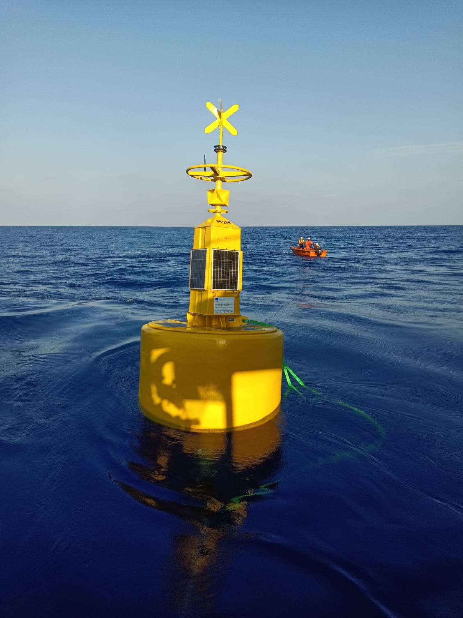
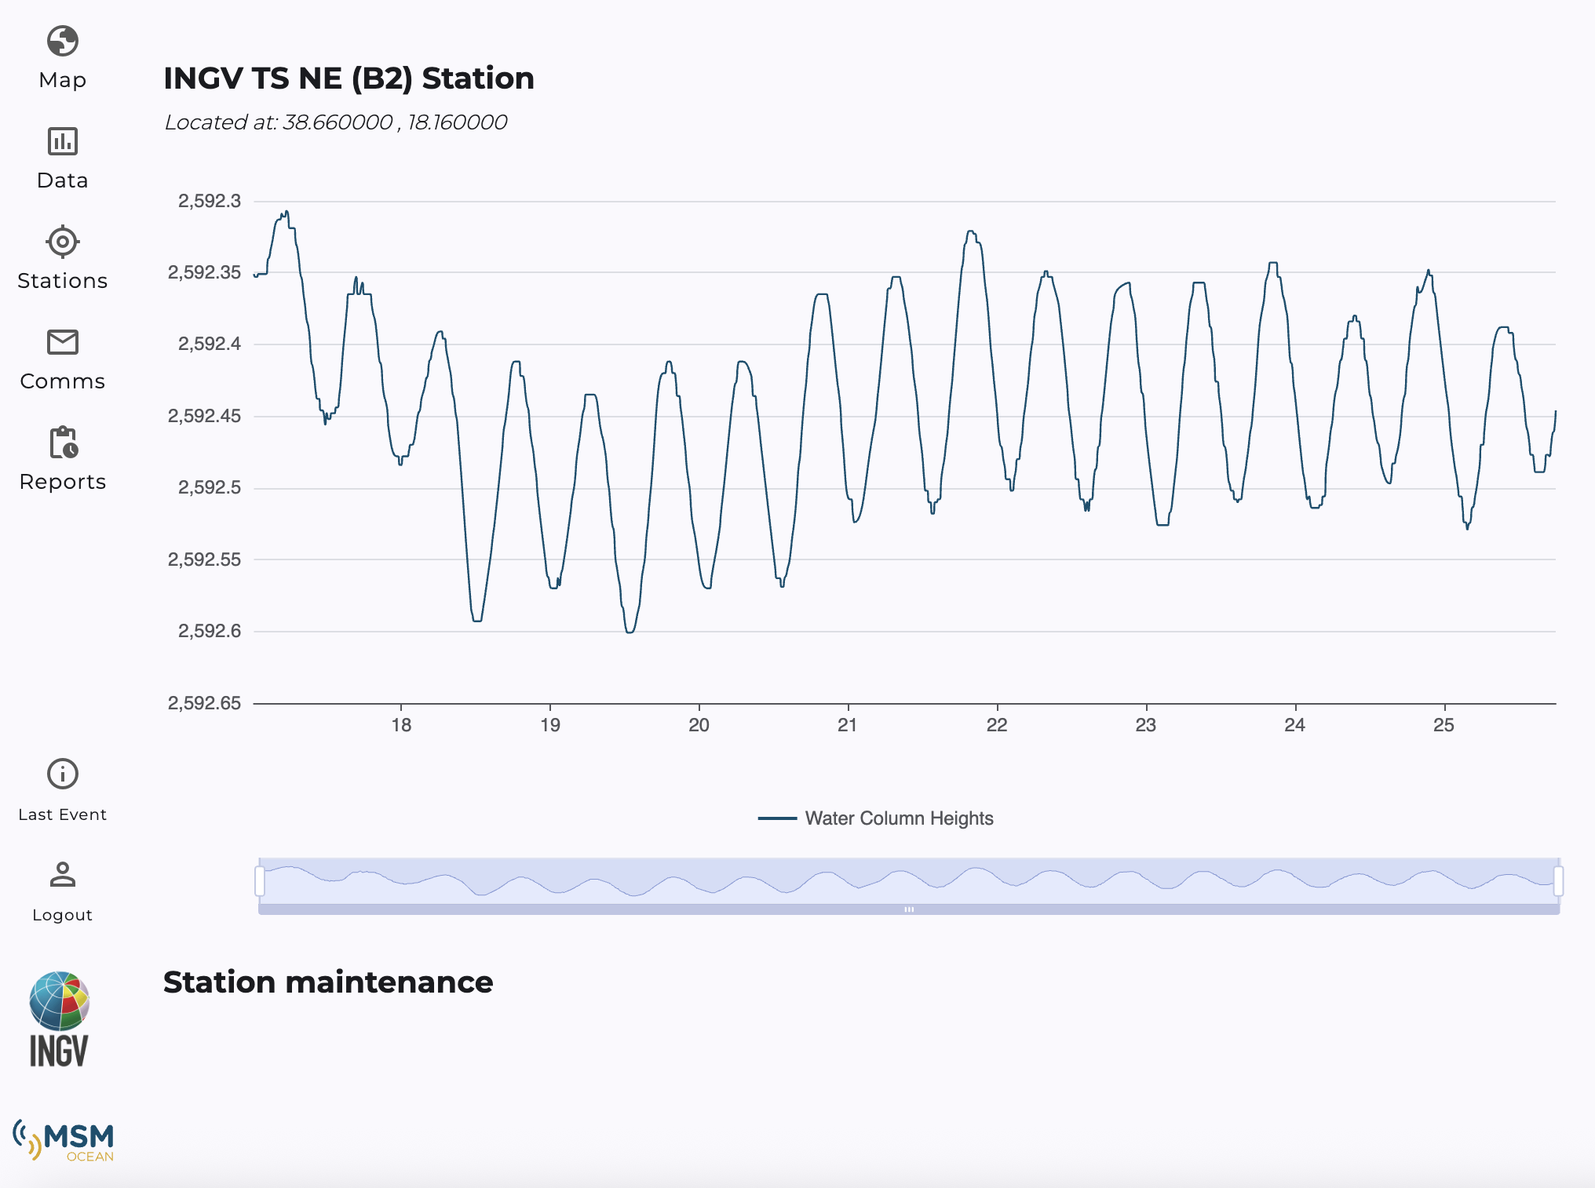
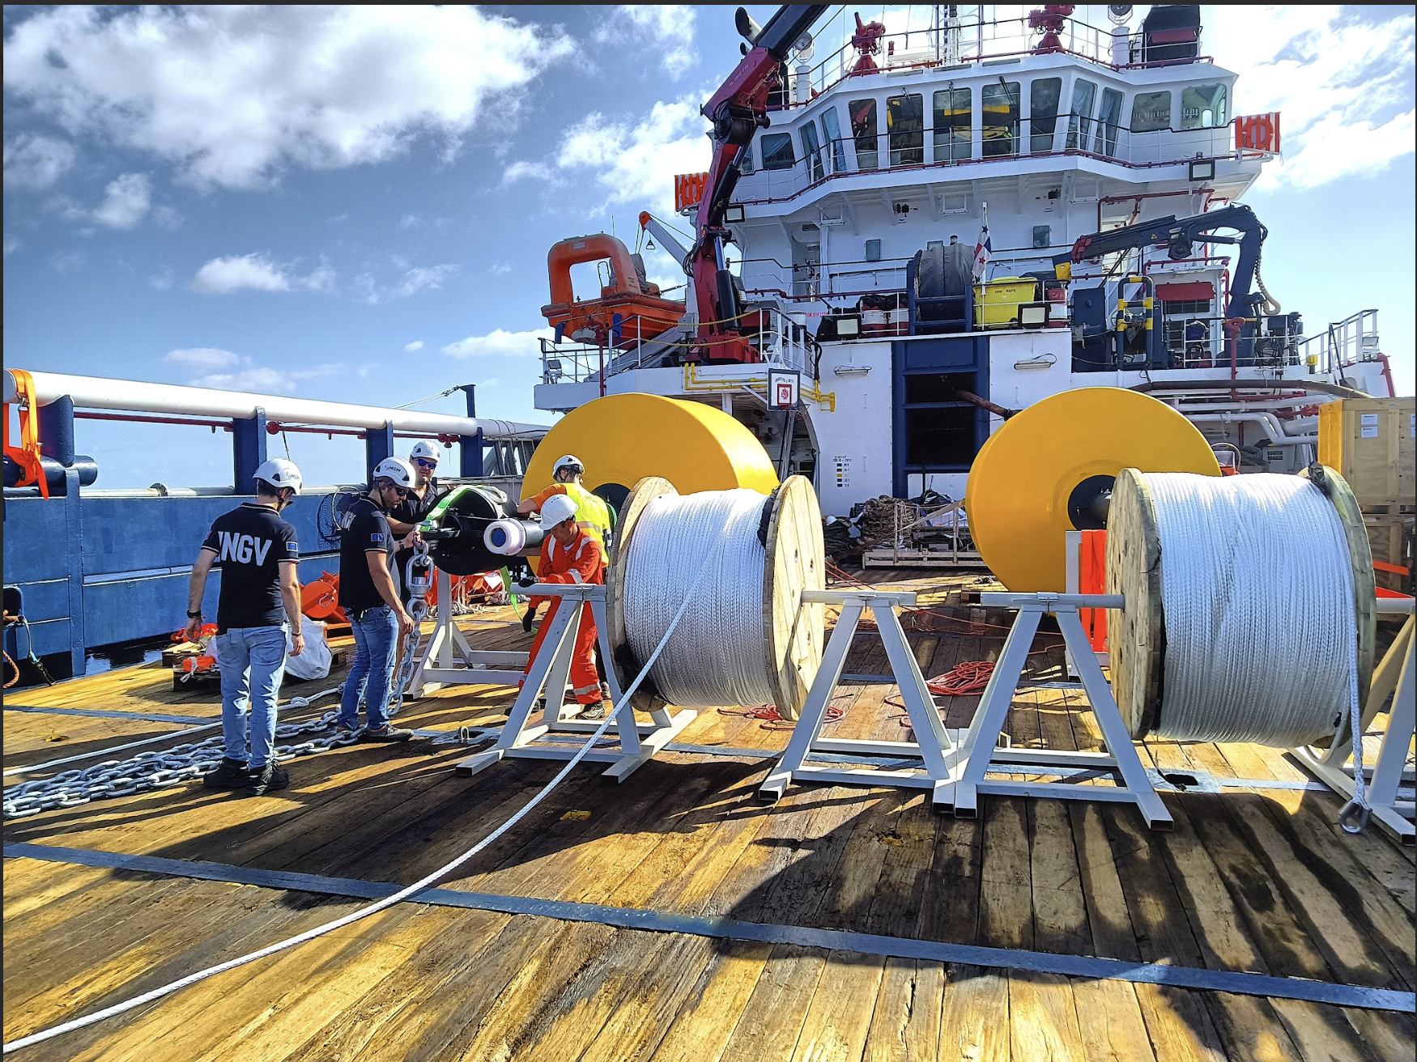
Tsunami buoys
Tsunami Buoy #1
~3200m depth, 100km off Siracusa
Tsunami Buoy #2
~2600m depth, 100km off Crotone

Slide 17
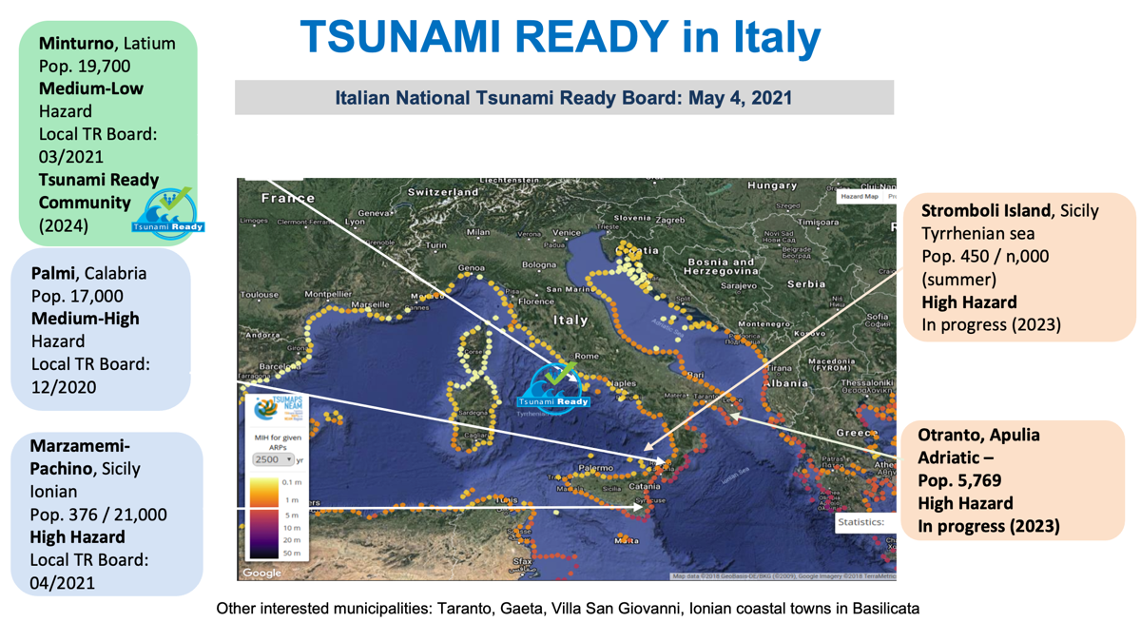
Italian Tsunami Ready Activities 2025
Four more Italian coastal municipalities expressed interest in joining the Tsunami Ready programme.
Notes:
Educational Video directed by Italian Civil Protection: “Io non rischio - Maremoto” in Italian and subtitled in English. To increase tsunami risk awareness in Italy. Published on YouTube and other official social platform
At the Genoa Science Festival (21 October to 3 November), a tsunami corner was set up with a didactic/interactive path for students and visitors. A tsunami video modelling in which the public could modify the physical parameters of using a leap-motion sensor was implemented. In this way, the visitors could change the height, length and consequent impact of the tsunami on the shore. (VIDEO PUBBLICO E VASCA)

Slide 18
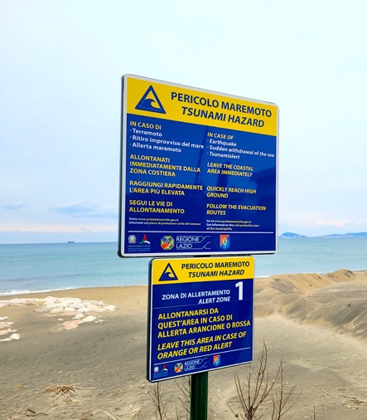
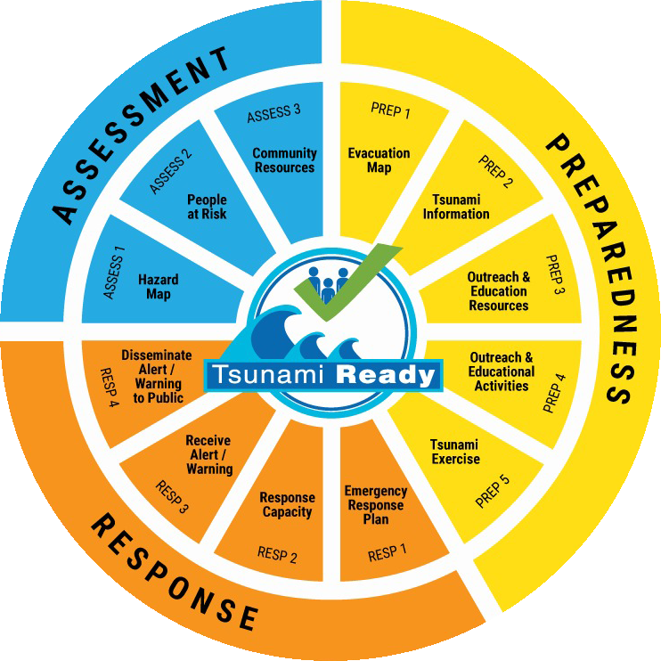
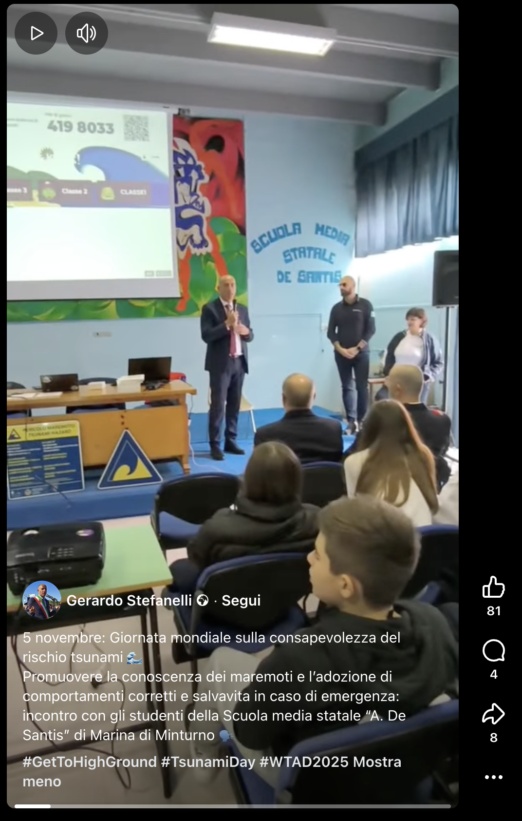
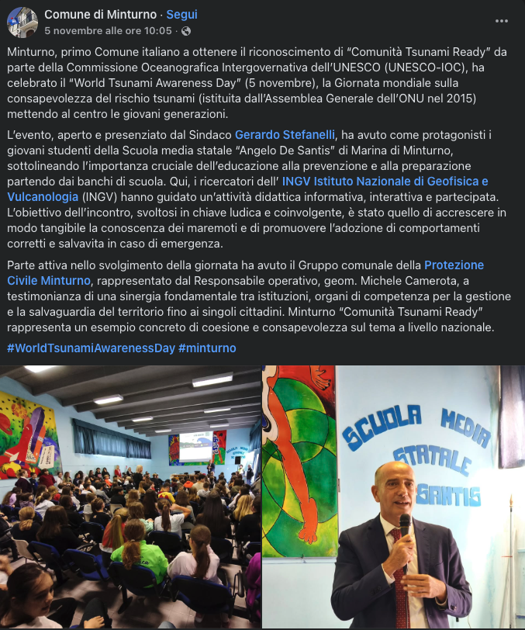
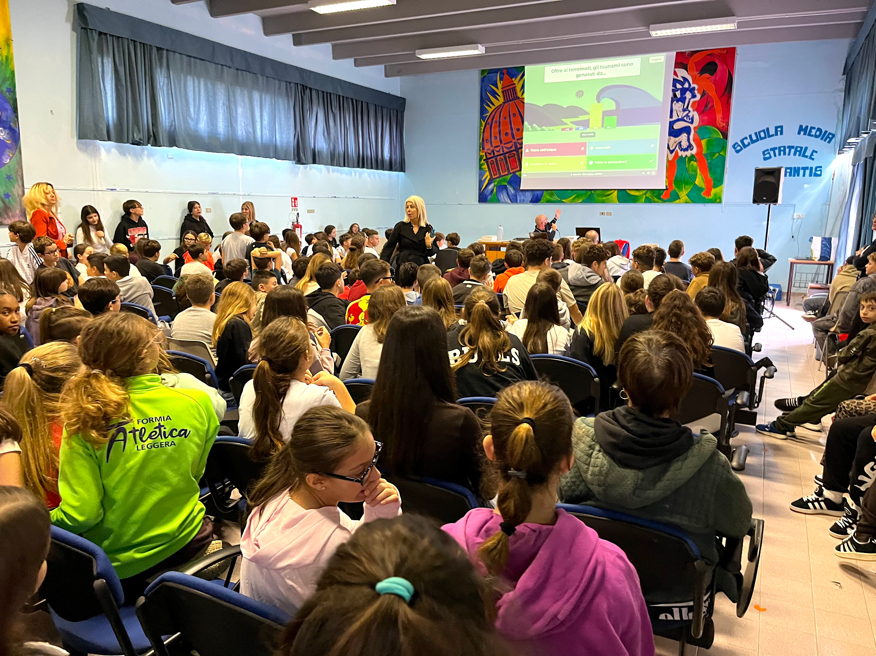
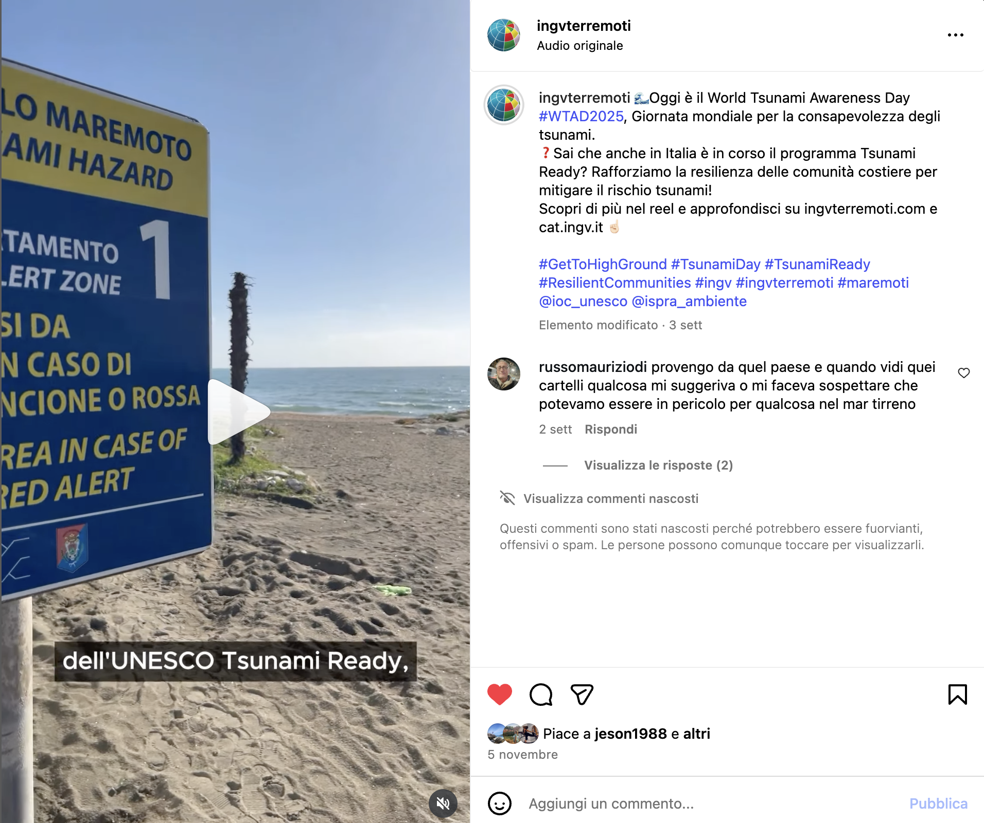
Italian Tsunami Ready Activities 2025
Minturno (LT) is currently the first and only Italian municipality recognised as Tsunami Ready (2024).
PREP 2. The mayor of Minturno and the local Civil Protection Agency shared information on their social media channels and on local television about the Tsunami Ready programme and the activities that took place in the municipality on 5 November 2025.
PREP 4. During WTAD, INGV met about 100 primary school students involving them in participatory activities on tsunamis. Through the use of a quiz game, students were informed about how tsunamis occur and how the risk can be reduced by adopting appropriate behaviours.
A short video for Instagram was taken in Minturno, illustrating Tsunami Ready program and the tsunami signage present in the area and explaining its meaning.
Notes:
Educational Video directed by Italian Civil Protection: “Io non rischio - Maremoto” in Italian and subtitled in English. To increase tsunami risk awareness in Italy. Published on YouTube and other official social platform
At the Genoa Science Festival (21 October to 3 November), a tsunami corner was set up with a didactic/interactive path for students and visitors. A tsunami video modelling in which the public could modify the physical parameters of using a leap-motion sensor was implemented. In this way, the visitors could change the height, length and consequent impact of the tsunami on the shore. (VIDEO PUBBLICO E VASCA)

Slide 19
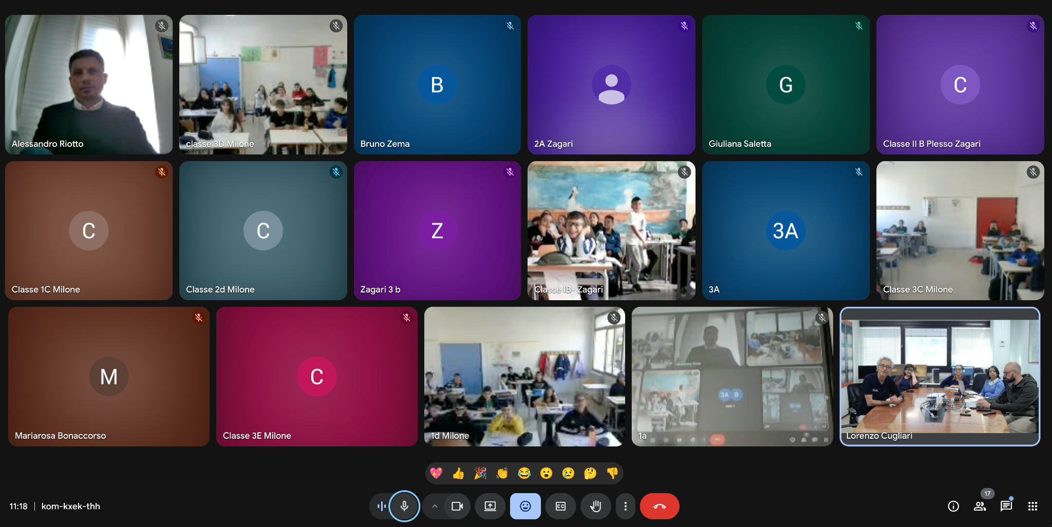
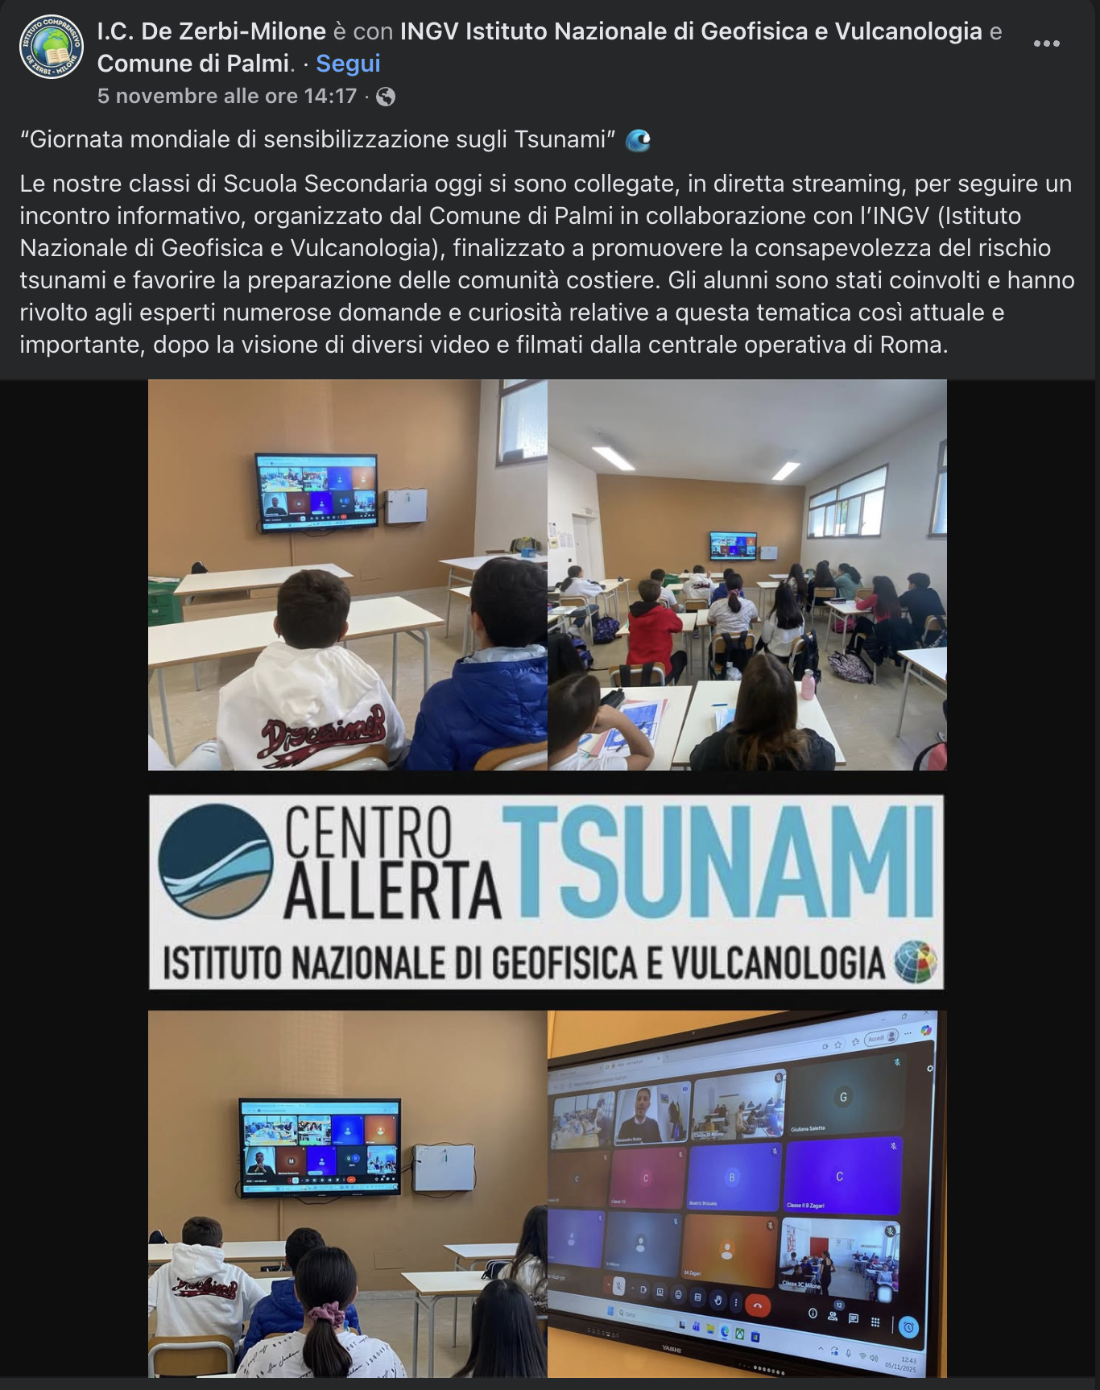
Italian Tsunami Ready Activities 2025
Palmi (RC) is currently one of the Italian municipalities that have committed to the Tsunami Ready Program
PREP 4. During WTAD, a training activity on tsunamis was held with the participation of three Schools: approximately 20 classes took part remotely, together with the representative of Municipality of Palmi. The session included educational videos on tsunamis, which generated strong interest among students, followed by a dedicated Q&A segment. At the end of the activity, participants were also given a virtual tour of the CAT-INGV monitoring room.
PREP 4. On the official channels of Palmi Municipality and in some local newspapers, the municipal councillor and the Local Civil Protection Agency shared information about WTAD and the Tsunami Ready Programme, which the municipality has joined.
Notes:
Educational Video directed by Italian Civil Protection: “Io non rischio - Maremoto” in Italian and subtitled in English. To increase tsunami risk awareness in Italy. Published on YouTube and other official social platform
At the Genoa Science Festival (21 October to 3 November), a tsunami corner was set up with a didactic/interactive path for students and visitors. A tsunami video modelling in which the public could modify the physical parameters of using a leap-motion sensor was implemented. In this way, the visitors could change the height, length and consequent impact of the tsunami on the shore. (VIDEO PUBBLICO E VASCA)

Slide 20
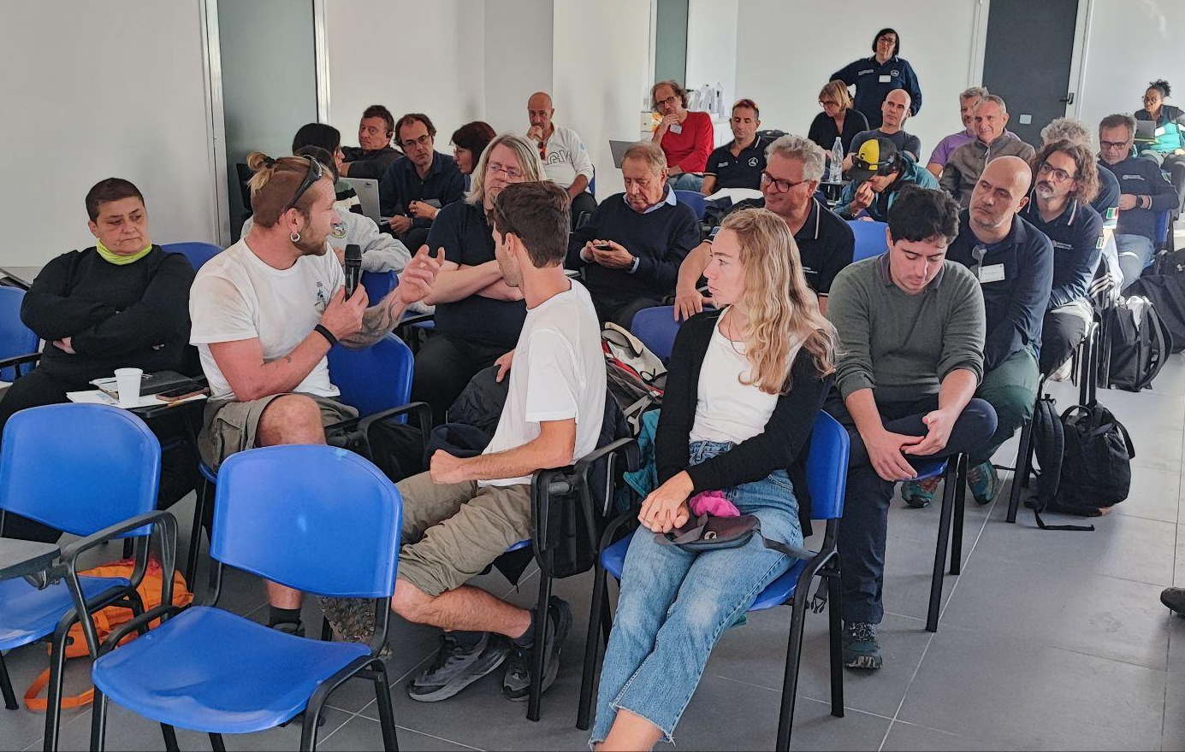
Italian Tsunami Ready Activities 2025
Stromboli (Municipality of Lipari, ME)
ASSESS (1-2-3) and PREP 4.
During the Multi-Hazards Workshop: 6–9 Oct 2025 in Stromboli in collaboration with EU NEAM-Commitment project the INGV researchers, Municipality of Lipari and the local Civil Protection Agency shared information with the local community of Stromboli about multi hazards. The project, structured with a multi-risk approach, aims to strengthen the preparedness of coastal communities in the event of a tsunami.
INGV has started a collaboration with the school in Stromboli, offering an educational program for the island’s elementary school.
A video interview with local witnesses of the 2002 Stromboli tsunami has been recorded and is now being edited.
On the occasion of WTAD, the Italian version of the Tilly Smith video was shown during outreach activities in local schools.
Notes:
Educational Video directed by Italian Civil Protection: “Io non rischio - Maremoto” in Italian and subtitled in English. To increase tsunami risk awareness in Italy. Published on YouTube and other official social platform
At the Genoa Science Festival (21 October to 3 November), a tsunami corner was set up with a didactic/interactive path for students and visitors. A tsunami video modelling in which the public could modify the physical parameters of using a leap-motion sensor was implemented. In this way, the visitors could change the height, length and consequent impact of the tsunami on the shore. (VIDEO PUBBLICO E VASCA)

Slide 21
Dissemination events for the general public
EXPO OSAKA 2025 (19 to 26 july): in the context of the Expo in Japan, CAT researchers presented some of the Centre's activities to visitors to the Italian Pavilion. An exhibit designed and developed by CAT was also shown, which allows the public to generate and manage the propagation of a tsunami through video modelling, varying the height of the wave using a motion sensor.
European Researchers’ Night (26 sept): For this event, CAT researchers welcomed the general public, presenting the scientific activities carried out by the centre through interactive workshops, games, guided tours, exhibitions, educational seminars, displays, conferences, and live scientific demonstrations.
Genova Science Festival: a seminar open to the public on tsunami risk involving has been held
“Tsunami virtual machine”, An exhibit to raise knowledge of the tsunami phenomenon among the general public. It consists of a video model in which the user, through a motion sensor (leap motion), can appreciate the difference between waves generated by wind and tsunamis generated by seismic activity. Furthermore, through hand movements, users can change the characteristics of the wave, which, as it approaches the shore, takes on all the features that characterise tsunamis.
Informative videos and social media posts describing the installation of deep-sea buoys in the Ionian Sea.
WTAD: On 5 November, two activities were held in person and online, involving students from two coastal municipalities. In Minturno, a Tsunami Ready municipality, middle school classes participated in person with their teachers, school staff, the local Civil Protection Agency and the Mayor of the Municipality. The students were involved in a quiz game followed by educational interludes to raise awareness. All this was supported by multimedia material. In Palmi, two middle schools and about 11 classes were involved.
Tsunami Risk Perception: The tsunami risk perception was surveyed using two questionnaires.
Notes:
With regard to the national Civil Protection campaign Io non rischio maremoto for tsunami risk mitigation, 374 squares were covered in 2024, as shown in the map.

Slide 22

A new “virtual” tsunami pool (Genova, Oct. 2024)
https://storymaps.arcgis.com/stories/32091c82e42a4d30a2f24b1e7b5955b6
Notes:
… as well as several videos o produced on tsunami warning, exercises, educational material, and so on.
As an example (particularly well done) is this short 1’ video showing the SAMOS tsunami of October 2020, whish has been viewed 3.7 million times!
Another tool we are using for increasing people awareness is the Story Maps, through which we can tell stories about past tsunamis, warning procedures, etc.

Slide 23
Papers 2025
A. Abbate, G. Davies, S. Lorito, N. Kalligeris, F. Romano, R. Tonini, M. Volpe, Importance sampling of seismic tsunami sources with near-field emphasis for inundation PTHA: benchmarking with complete ensembles, Geophysical Journal International, Volume 241, Issue 1, April 2025, Pages 155–169, https://doi.org/10.1093/gji/ggaf034
Lingling Ye, Yangming Hu, Tao Xia, Thorne Lay, Yingquan Sang, Xiaofei Chen, Hiroo Kanamori, Fabrizio Romano, Stefano Lorito, Zhou Gui (2025). The 2021 MW 8.1 Kermadec earthquake sequence: Great earthquake rupture along the mantle/slab contact. Journal of Geophysical Research: Solid Earth, 130, e2024JB030926. https://doi.org/10.1029/2024JB030926
Amato, A., Cugliari, L., Filosa, S., Graziani, L., Romano, F., & Valbonesi, C. (2025). Tsunami Ready, a public engagement tool for risk mitigation: The Italian experience. JOURNAL OF GEOETHICS AND SOCIAL GEOSCIENCES, 2(Special Issue), 1-28. https://doi.org/10.13127/jgsg-67
Cordrie, L., Selva, J., Bernardi, F., Roberto Tonini, Fabrizio Romano, Manuela Volpe & Stefano Lorito Dynamic management of uncertainty in rapid tsunami forecasting. Commun Earth Environ 6, 637 (2025). https://doi.org/10.1038/s43247-025-02586-6
Angeli, C., Armigliato, A., Zanetti, M., Zaniboni, F., Romano, F., Bayraktar, H. B., and Lorito, S.: Tsunami detection methods for ocean-bottom pressure gauges, Nat. Hazards Earth Syst. Sci., 25, 1169–1185, https://doi.org/10.5194/nhess-25-1169-2025 , 2025
Rea R., Scala A., Bernardi F., Luca Elia, Stefano Lorito, Simona Colombelli, Gaetano Festa, Fabrizio Romano, Alessandro Amato & Aldo Zollo, Feasibility study of an integrated earthquake and tsunami early warning system. Sci Rep (2025). https://doi.org/10.1038/s41598-025-25832-5

Slide 24

Papers 2025
A. Abbate, G. Davies, S. Lorito, N. Kalligeris, F. Romano, R. Tonini, M. Volpe, Importance sampling of seismic tsunami sources with near-field emphasis for inundation PTHA: benchmarking with complete ensembles, Geophysical Journal International, Volume 241, Issue 1, April 2025, Pages 155–169, https://doi.org/10.1093/gji/ggaf034
Lingling Ye, Yangming Hu, Tao Xia, Thorne Lay, Yingquan Sang, Xiaofei Chen, Hiroo Kanamori, Fabrizio Romano, Stefano Lorito, Zhou Gui (2025). The 2021 MW 8.1 Kermadec earthquake sequence: Great earthquake rupture along the mantle/slab contact. Journal of Geophysical Research: Solid Earth, 130, e2024JB030926. https://doi.org/10.1029/2024JB030926
Amato, A., Cugliari, L., Filosa, S., Graziani, L., Romano, F., & Valbonesi, C. (2025). Tsunami Ready, a public engagement tool for risk mitigation: The Italian experience. JOURNAL OF GEOETHICS AND SOCIAL GEOSCIENCES, 2(Special Issue), 1-28. https://doi.org/10.13127/jgsg-67
Cordrie, L., Selva, J., Bernardi, F., Roberto Tonini, Fabrizio Romano, Manuela Volpe & Stefano Lorito Dynamic management of uncertainty in rapid tsunami forecasting. Commun Earth Environ 6, 637 (2025). https://doi.org/10.1038/s43247-025-02586-6
Angeli, C., Armigliato, A., Zanetti, M., Zaniboni, F., Romano, F., Bayraktar, H. B., and Lorito, S.: Tsunami detection methods for ocean-bottom pressure gauges, Nat. Hazards Earth Syst. Sci., 25, 1169–1185, https://doi.org/10.5194/nhess-25-1169-2025 , 2025
Rea R., Scala A., Bernardi F., Luca Elia, Stefano Lorito, Simona Colombelli, Gaetano Festa, Fabrizio Romano, Alessandro Amato & Aldo Zollo, Feasibility study of an integrated earthquake and tsunami early warning system. Sci Rep (2025). https://doi.org/10.1038/s41598-025-25832-5

Slide 25
Participation in projects
CoastWAVE Phase 2 ”Scaling up and strengthening the resilience of coastal communities….”;
Global Tsunami Model (GTM) organization;
TSUNAMI Thematic Core Service (TCS) within EPOS The European Plate Observing System;
Other projects funded by EU contributing to the advancement of Tsunami science, including both R&D (DT-GEO, ended in August 2025) and warning-oriented (EPOS, GeoInquire), EPOS ON (EPOS Optimization and EvolutioN) dedicated to strenghten and evolve the EPOS Research Infrastructure;
DG-ECHO project NEAM-COMMITMENT (coord. NOA, Greece) with other MS and relevant stakeholders (2025-2027)
Stromboli project funded by Italian Civil Protection Dept. for improving the local tsuanmi warning system and for hazard assessment (2022-2025): extension?
Notes:
Let me conclude mentioning some of the most important projects and initiatives that are going on in our region. Besides the already mentioned CoastWAVE project there are other initiatives funded by the European Community, like the Agithar Cost Action working for the Global Tsunami Model, the EPOS Thematic Core Service recently approved, and other projects.

