Slide 1




FIRST CONFERENCE OF THE OCEAN DECADE TSUNAMI PROGRAMME
Hyderabad, India
10-11 November 2025

Slide 2

ODTP Conferece HLO1: Progress toward timely and actionable forecasts
Bill Fry, ICG-PTWS WG2 Chair
And members of TTFOO & TTISN
10-11 November 2025
INCOIS, Hyderabad, India
First Conference of the
Ocean Decade Tsunami Programme

Slide 3

Discussion points for achieving timely and actionable tsunami forecasts
The Challenges (ODTP targets)
The Current Operational Reality (The tsunami threat lifecycle)
The Limitations (Data and algorithms)
The Opportunities (Sector call to arms)
10-11 November 2025
INCOIS, Hyderabad, India
First Conference of the
Ocean Decade Tsunami Programme

Slide 4
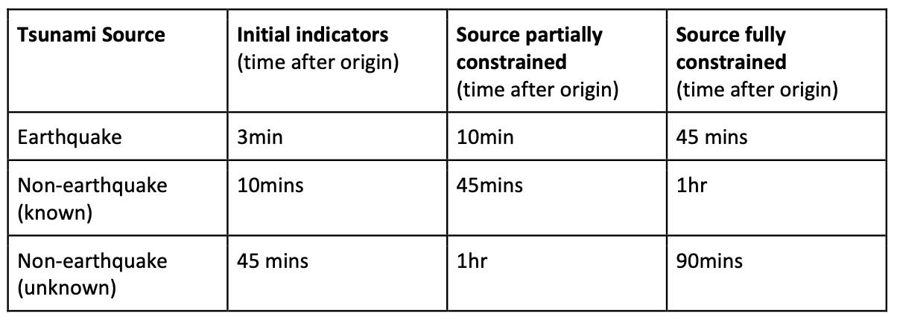
The Forecasting Challenge
Head’s up
Amplitude Forecast
Time-dependent Forecast
Table 1, IOC Technical Series 180
10-11 November 2025
INCOIS, Hyderabad, India
First Conference of the
Ocean Decade Tsunami Programme

Slide 5
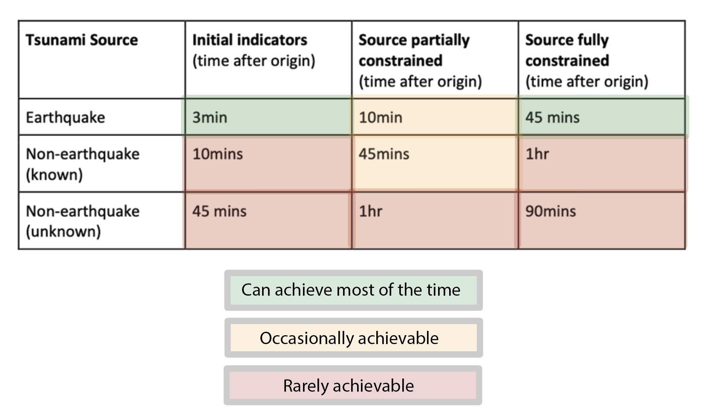
The Forecasting Status
10-11 November 2025
INCOIS, Hyderabad, India
First Conference of the
Ocean Decade Tsunami Programme

Slide 6
The Operational Reality: Tsunami Threat Lifecycle
Detection
Usually seismic proxy, first alert (based on seismic observations)
Confirmation
Evidence a tsunami has been generated (based on tsunami observations)
Forecasting
Coastal amplitudes (based on seismic and/or tsunami observations)
Verification
Validation of forecast (based on tsunami observations)
Cancellation
Time-dependent forecast (based on tsunami observations)
Decreasing forecast uncertainty
Gledhill, Angove, Moore, Kumar and Fry
10-11 November 2025
INCOIS, Hyderabad, India
First Conference of the
Ocean Decade Tsunami Programme

Slide 7
Tsunami Threat Lifecycle in ODTP terms
Detection
INITIAL INDICATORS (ODTP targets 3, 10 and 45 minutes)
Confirmation
Forecasting
SOURCE PARTIALLY CONSTRAINED (ODTP targets 10, 45 and 60 minutes)
Verification
Cancellation
SOURCE FULLY CONSTRAINED (ODTP targets 45, 60 and 90 minutes)
Decreasing forecast uncertainty
10-11 November 2025
INCOIS, Hyderabad, India
First Conference of the
Ocean Decade Tsunami Programme

Slide 8
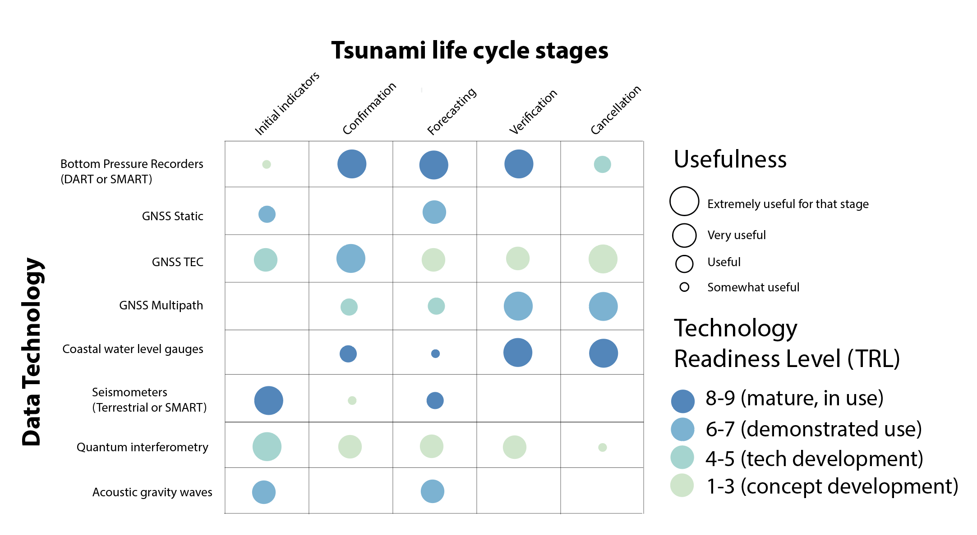
The Data Challenge
ICG-PTWS WG2 TTISN
10-11 November 2025
INCOIS, Hyderabad, India
First Conference of the
Ocean Decade Tsunami Programme
Notes:
TRL of data utilization, not of data acquisition

Slide 9
The Data Challenge in ODTP terms
3, 10, 45
10, 45, 60
45, 60, 90
10-11 November 2025
INCOIS, Hyderabad, India
First Conference of the
Ocean Decade Tsunami Programme

Slide 10
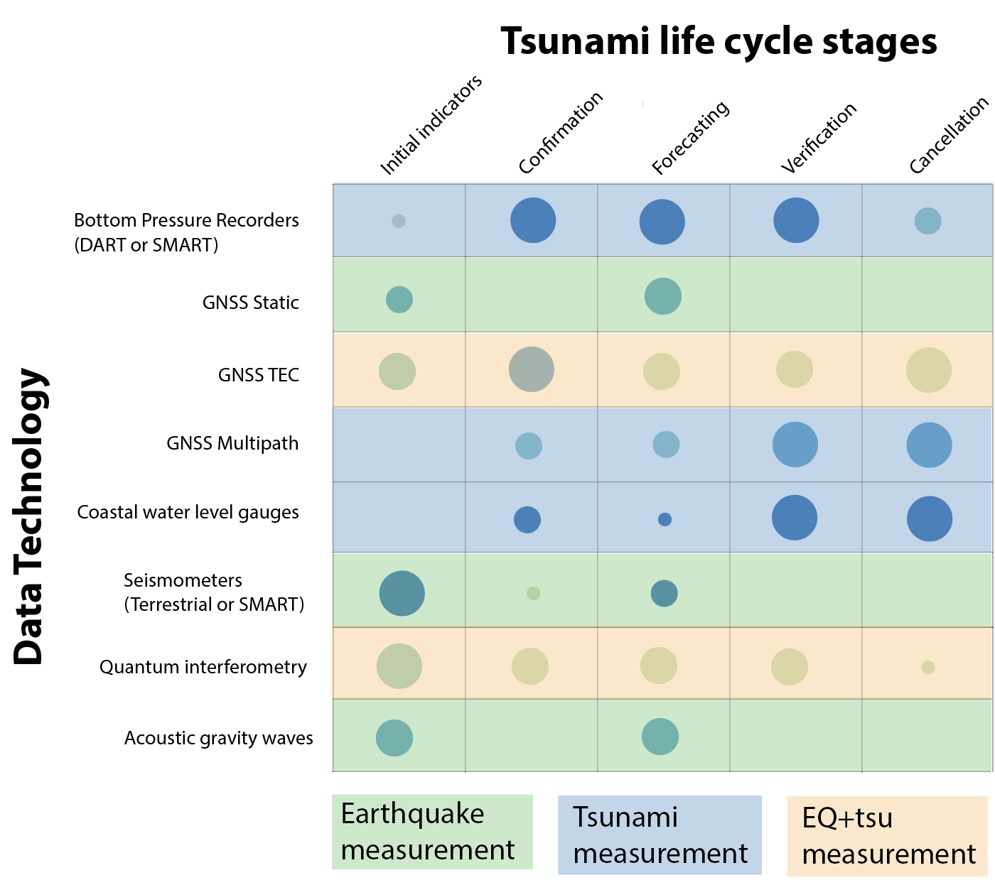
The Paradigm shift: Forecasting from ocean observations
10-11 November 2025
INCOIS, Hyderabad, India
First Conference of the
Ocean Decade Tsunami Programme

Slide 11
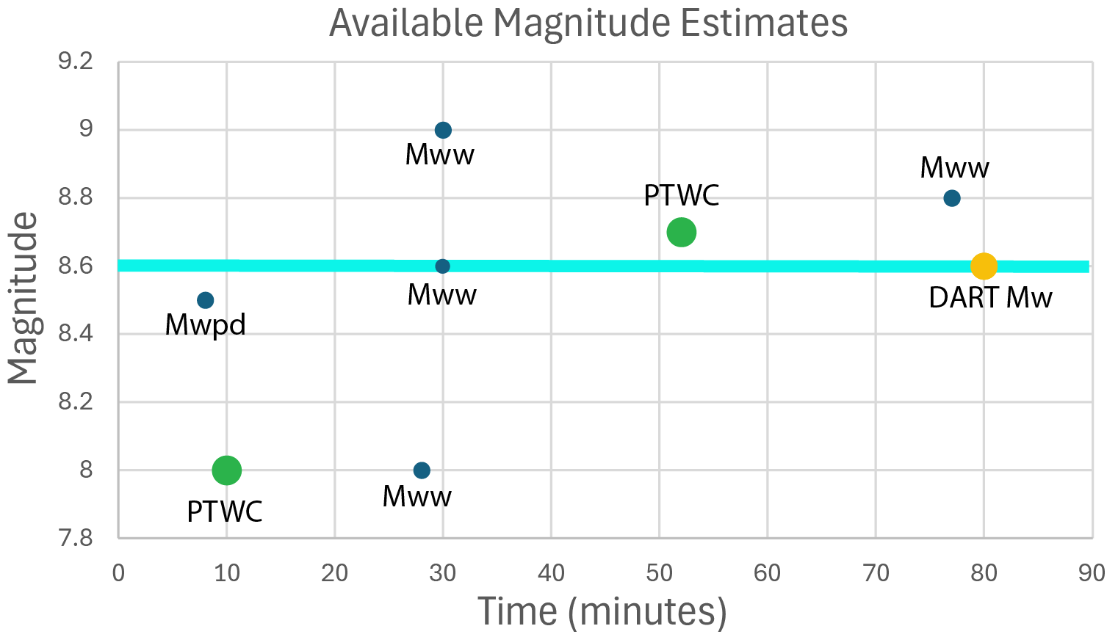
Forecasting Kamchatka: The problem with big earthquakes
Mww
Mw(p)
10-11 November 2025
INCOIS, Hyderabad, India
First Conference of the
Ocean Decade Tsunami Programme

Slide 12
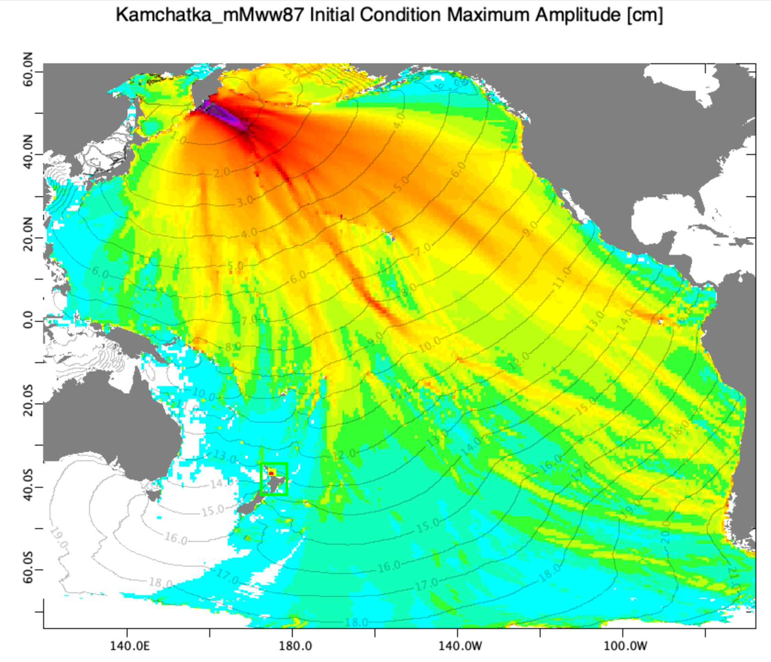
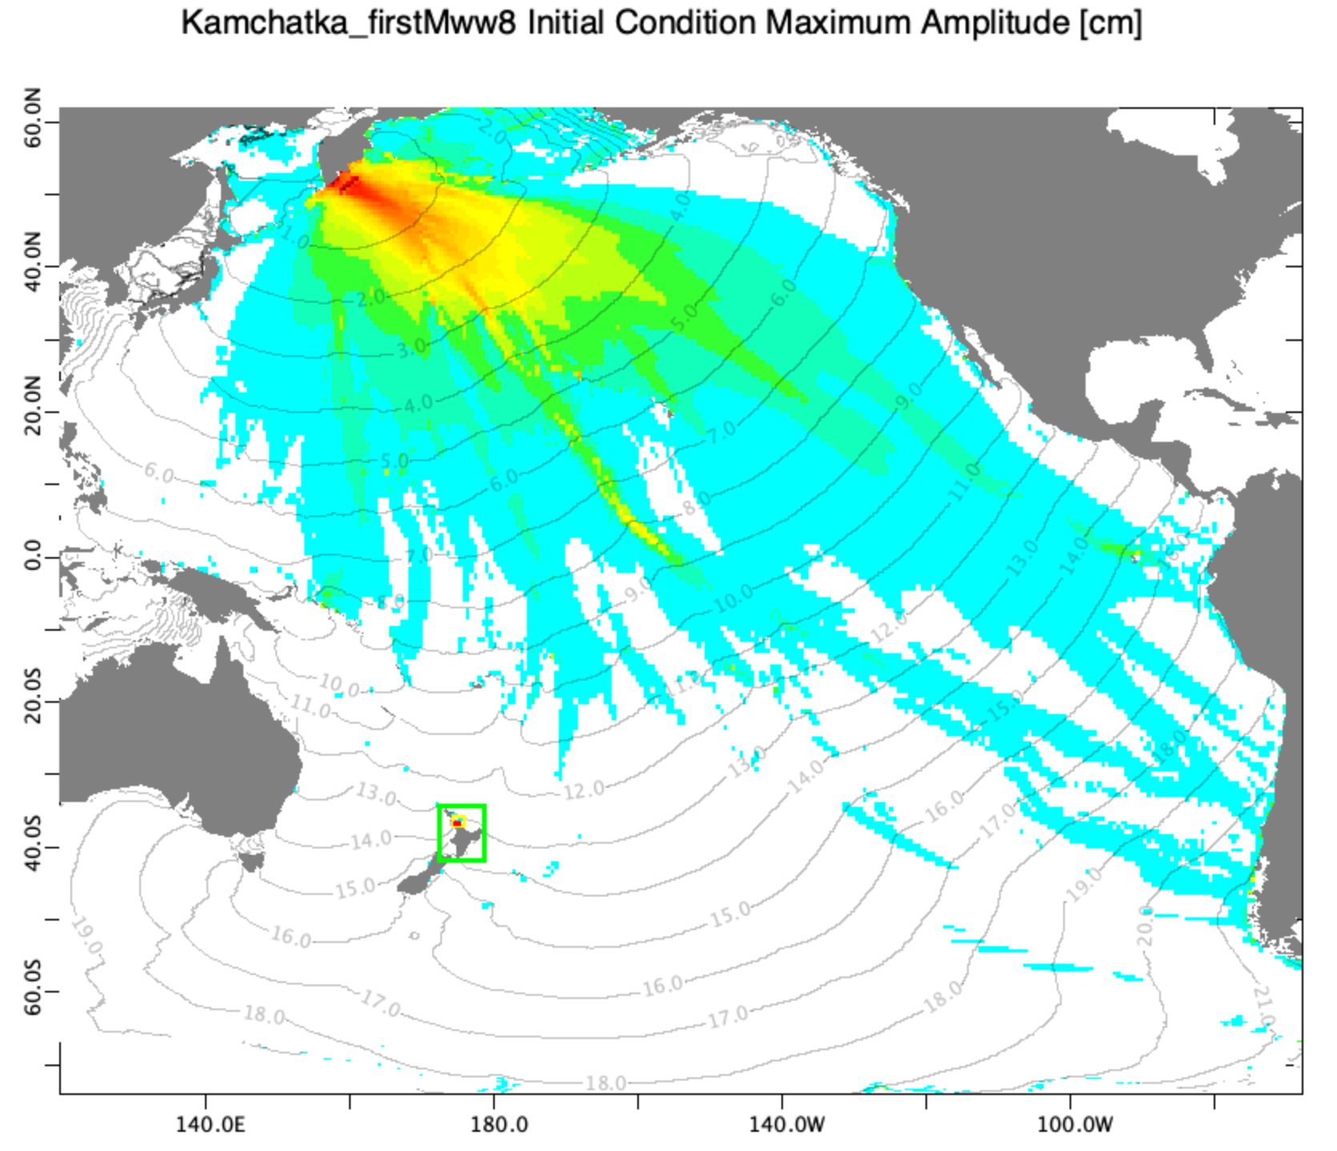
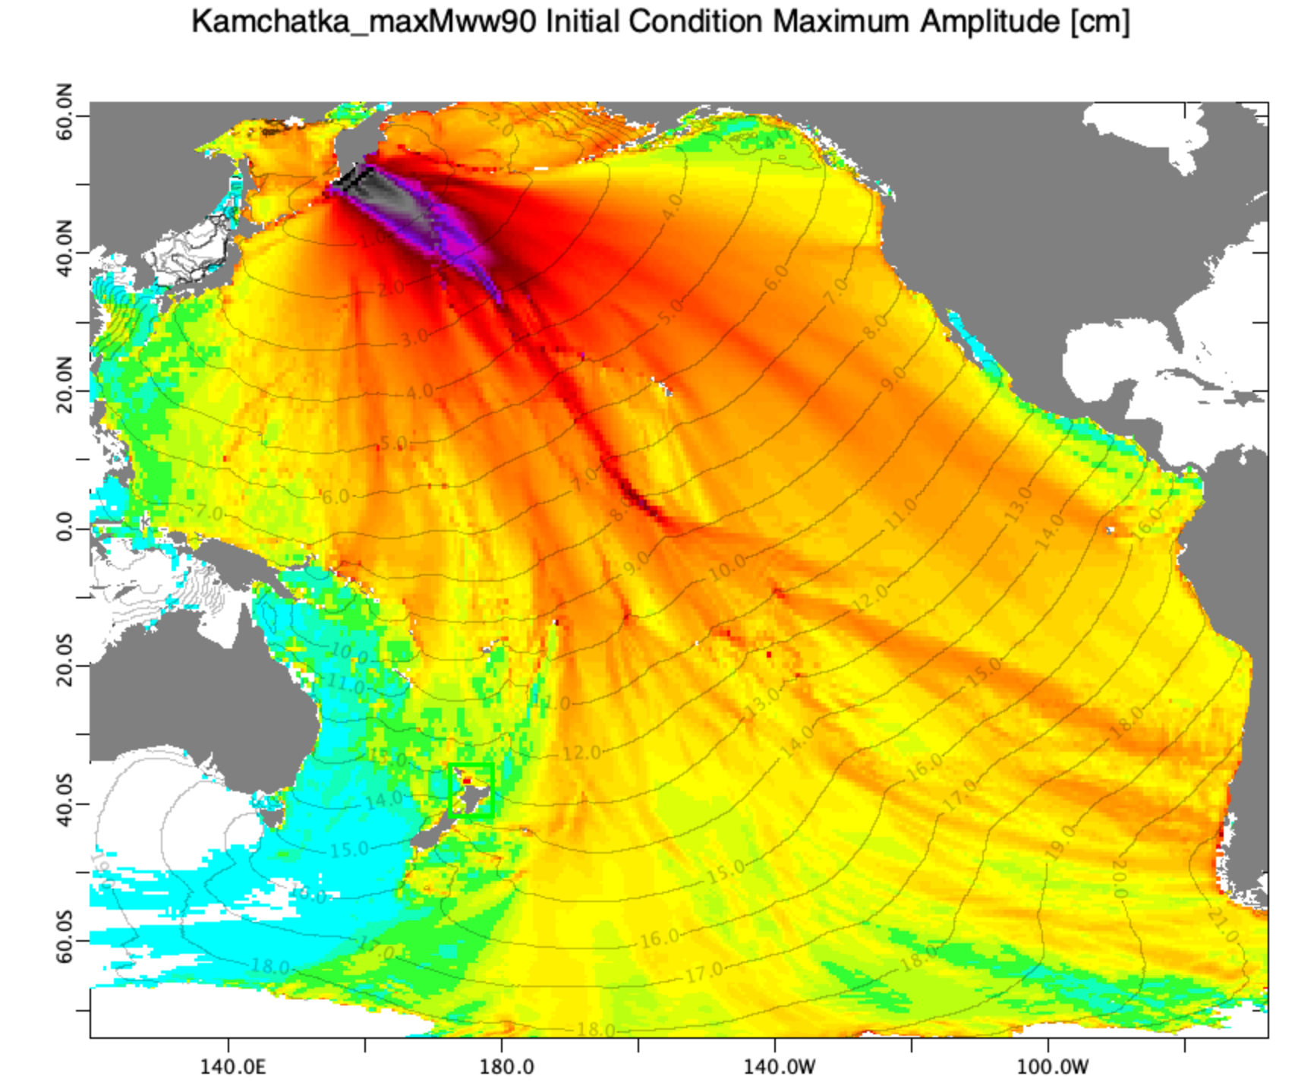
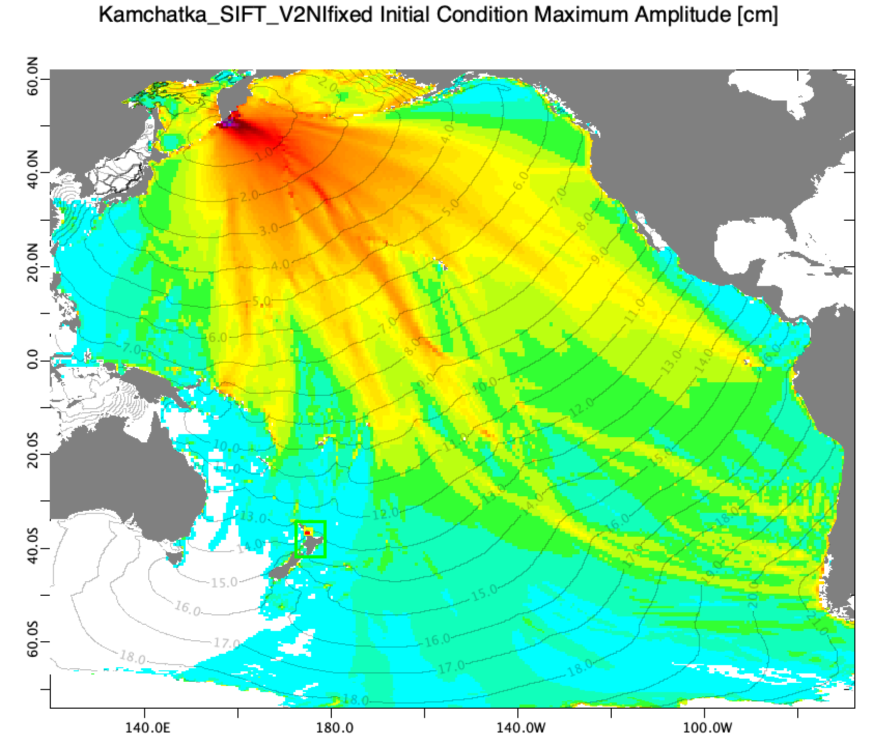
Opportunity 1: Forecasting from direct tsunami observations, let’s just get on with it!
Updated Mww
(~50 minutes / PTWC graphical products)
Initial Indicators
~10 minutes
Mww MAX
(~30 minutes)
Direct inversion (~80 minutes)
10-11 November 2025
INCOIS, Hyderabad, India
First Conference of the
Ocean Decade Tsunami Programme

Slide 13
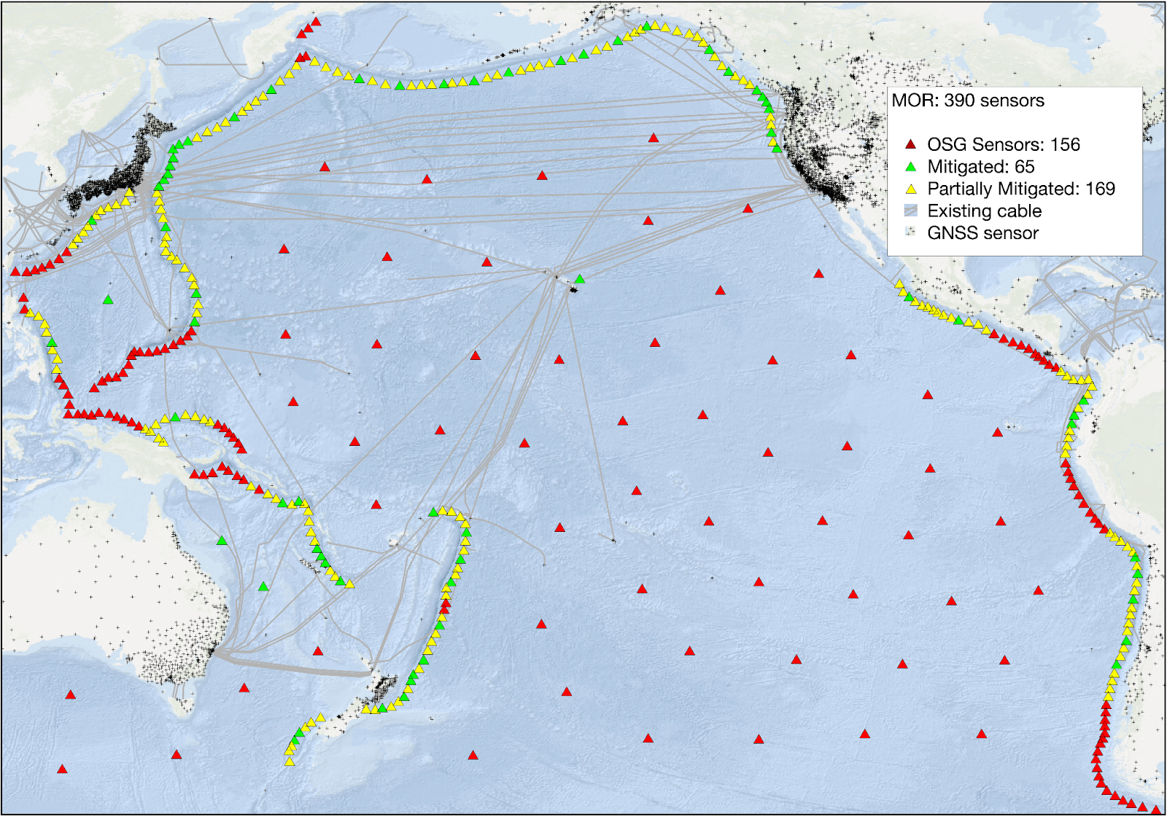
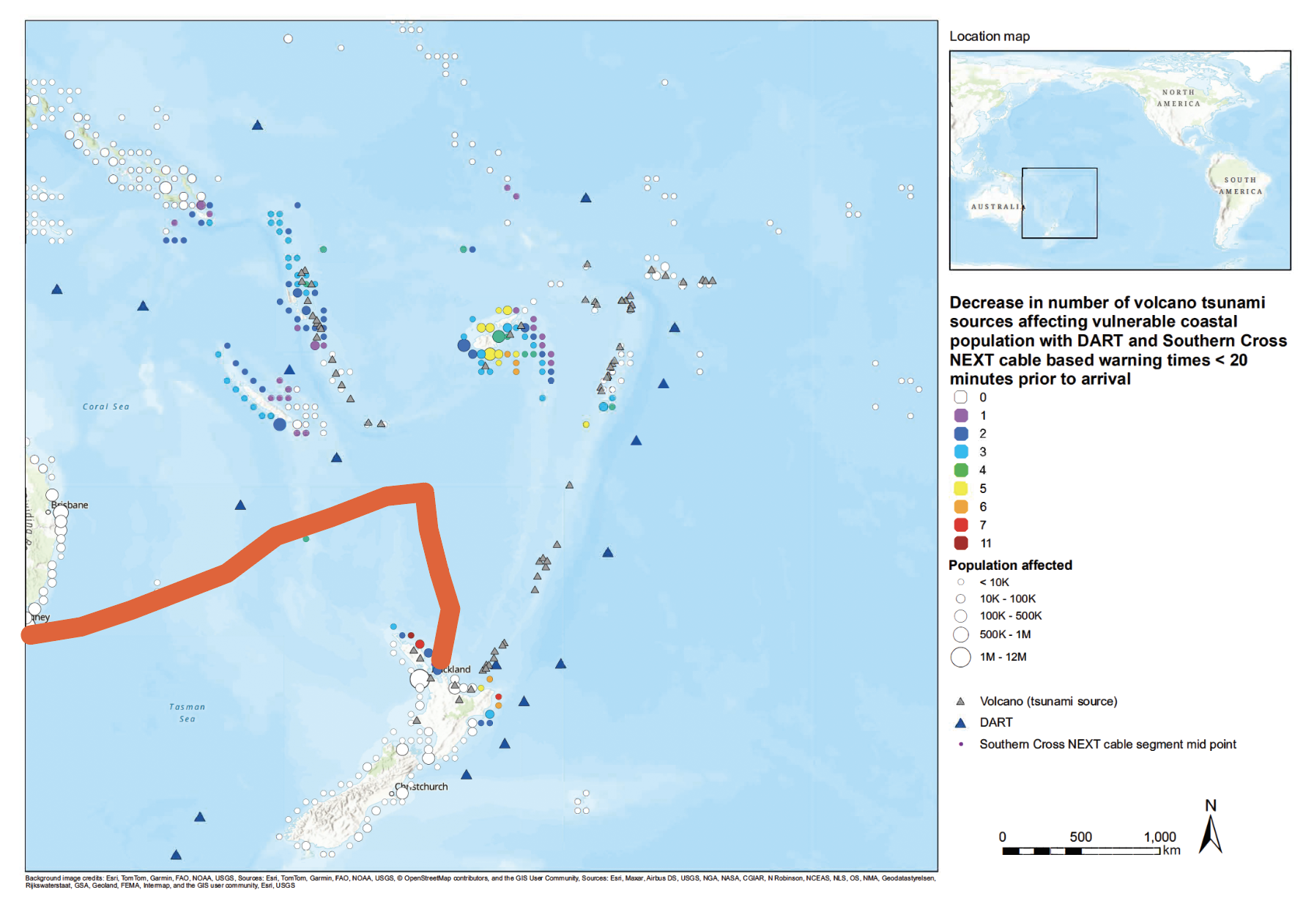
Opportunity 2: Cable observations (SMART and quantum), raising TRL and increasing coverage
RCET / U.K. NPL
ICG-PTWS WG2 Figure Chris Moore
Figure Chris Moore
10-11 November 2025
INCOIS, Hyderabad, India
First Conference of the
Ocean Decade Tsunami Programme

Slide 14
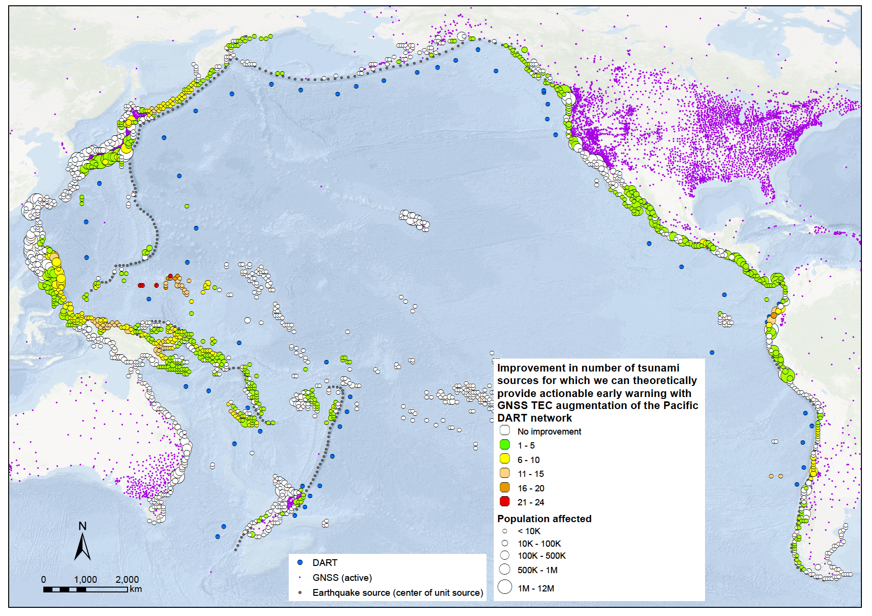
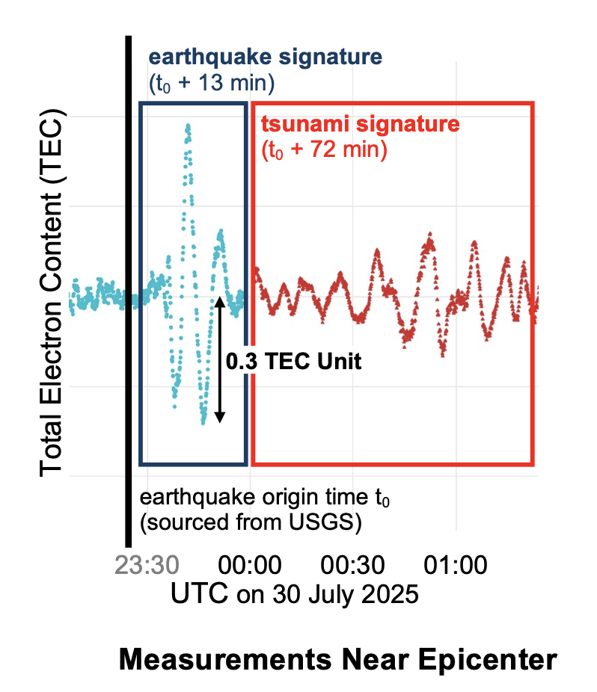
Opportunity 3: Remote sensing (Raising TRL!)
ICG-PTWS WG2 + Biljana Lukovic
JPL GUARDIAN (Krishnamoorthy, Martire, et al.)
10-11 November 2025
INCOIS, Hyderabad, India
First Conference of the
Ocean Decade Tsunami Programme

Slide 15
Opportunity 4: Multi-data integration of other novel techniques
It is clear that disparate and novel data streams have sensitivity to different aspects of forecasting the tsunami threat lifecycle
e.g. hydroacoustics (e.g. acoustic gravity waves), quantum sensing (interferometry and DAS) and GNSS TEC, OBP, seismic, etc.
We request help from the research community to explore avenues to integrate disparate sensing techniques into unified forecasting algorithms, rather that isolated techniques, to achieve the full suite of ODTP forecasting goals.
10-11 November 2025
INCOIS, Hyderabad, India
First Conference of the
Ocean Decade Tsunami Programme

Slide 16
Discussion points for achieving timely and actionable tsunami forecasts
The Challenges (ODTP targets) -> We can reliably achieve 2 of the 9.
The Current Operational Reality (The tsunami threat lifecycle) -> requires direct tsunami observations
The Limitations (Data and algorithms) -> currently available data are insufficient to achieve ODTP targets with existing strategies
The Opportunities (Sector call to arms) -> Promising opportunities exist with novel observational techniques and multi-data forecasting strategies
10-11 November 2025
INCOIS, Hyderabad, India
First Conference of the
Ocean Decade Tsunami Programme

Slide 17
Thank you for your kind attention and tsunami DRR mahi!
Bill Fry, ICG-PTWS WG2 Chair
B.Fry@gns.cri.nz
10-11 November 2025
INCOIS, Hyderabad, India
First Conference of the
Ocean Decade Tsunami Programme

