Slide 1

A Tsunami Warning and Communication Exercise
for the North-eastern Atlantic, the Mediterranean,
and Connected Seas Region
3 – 24 Μarch 2026
Coordinated by Task Team on NEAMWave Exercise
co-chairs: Ceren Ozer Sozdinler
Marinos Charalampakis
NEAMWave26 Information Workshop (online),19 February 2026

Slide 2

What is NEAMWave
- Regular tsunami exercise in NEAM (North-eastern Atlantic, the Mediterranean and Connected Seas) region between:
Message Providers (Tsunami Service Providers (TSPs) and
Message Recipients (Tsunami Warning Focal Points (TWFPs): National Tsunami Warning Centers (NTWCs) or Tsunami National Contacts (TNC) or Civil Protection Agencies (CPAs) and Emergency Response Coordination Center (ERCC))
- … within the coordination of UNESCO/IOC Intergovernmental Coordination Group (ICG) in three phases as: Phase A, Phase B and Phase C.
- TSPs of NEAMTWS ⇨ CENALT, INGV, IPMA, KOERI, NOA
NEAMWave26 Information Workshop • 19 February 2026

Slide 3
Scope of NEAMWave
TSPs ….. To maintain a high state of operational readiness and to test their communicational channels among message recipients in NEAM region
PHASE A
National Tsunami Warning Centres (NTWCs) and Civil Protection Agencies (CPAs) …..to practice their emergency response procedures in order to ensure that (i) vital communication links work seamlessly, and that (ii) agencies and response personnel know the roles that they will need to play during a real event.
PHASE B
Emergency Response Coordination Center (ERCC) ….. to practice their emergency response procedures in order to provide international assistance upon request.
PHASE C

Slide 4
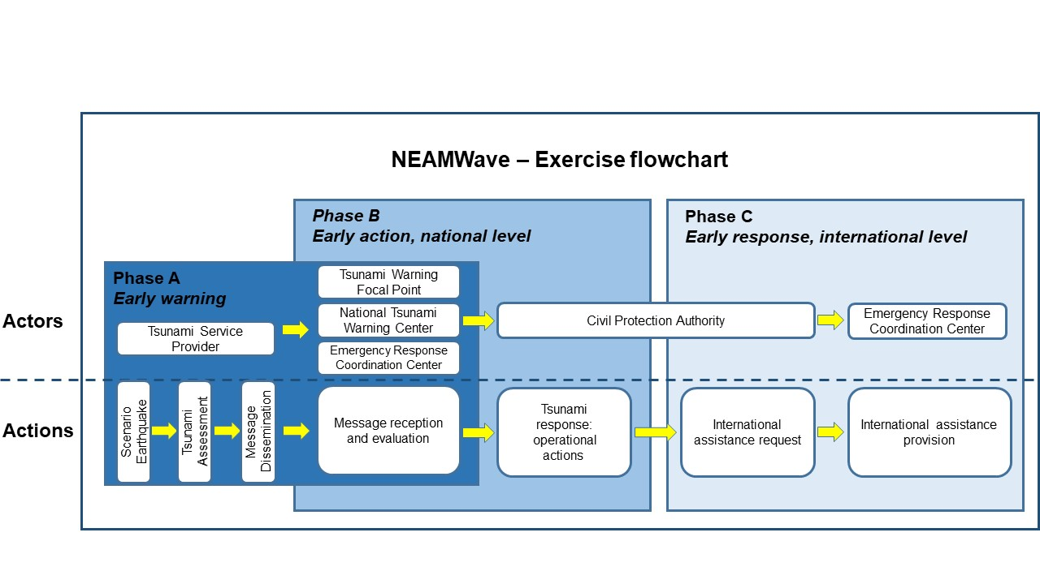
NEAMWave flow chart
NEAMWave26 Information Workshop • 19 February 2026

Slide 5
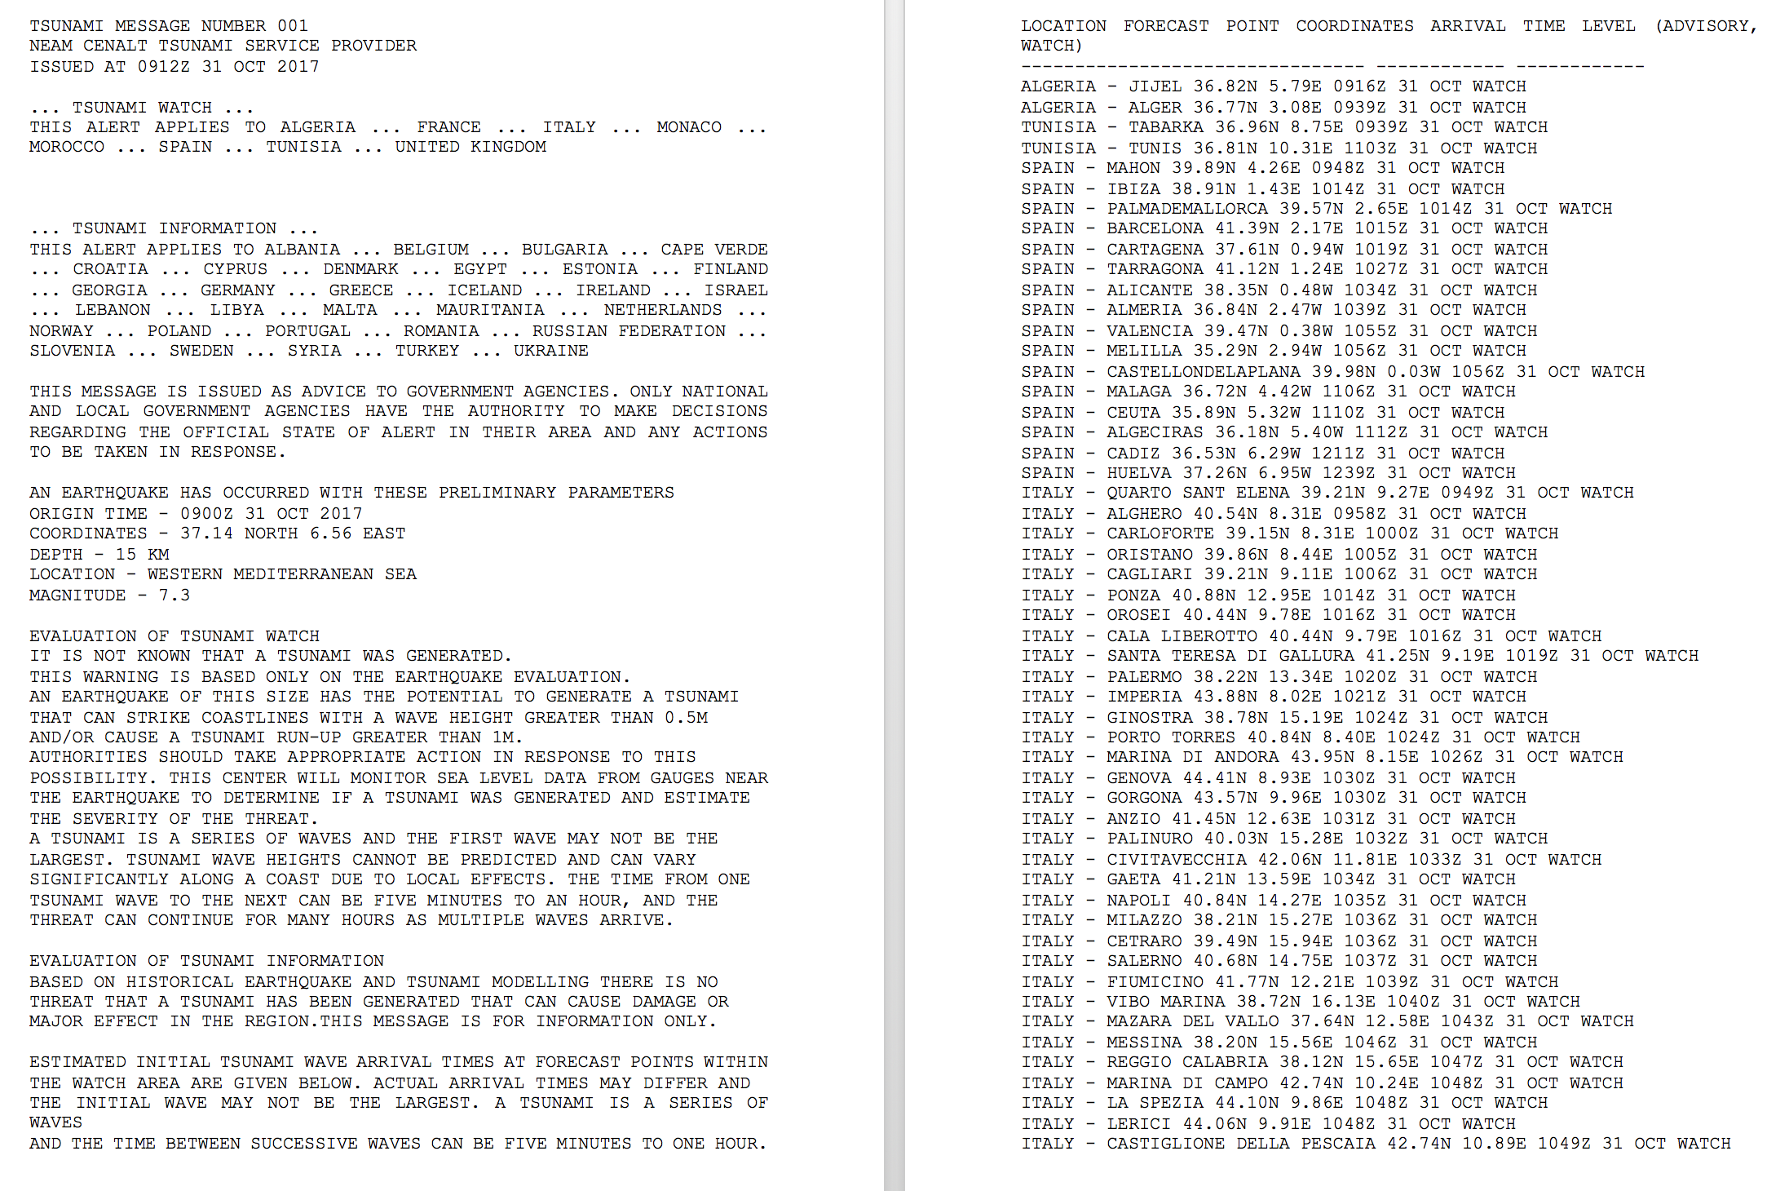
Phase A: Tsunami Alert Message Dissemination
E-MAIL
TWFP, TSP, CPAs
TSP
GTS
SMS

Slide 6
Phase B: Emergency management activities performed at national level
To move from an early warning approach towards an early action and response one
To develop an end-to-end management system of tsunami events (regional, national, local level)
To raise awareness of launching and contributing to the development of a national policy to tackle the tsunami risk.
NEAMWave26 Information Workshop • 19 February 2026

Slide 7
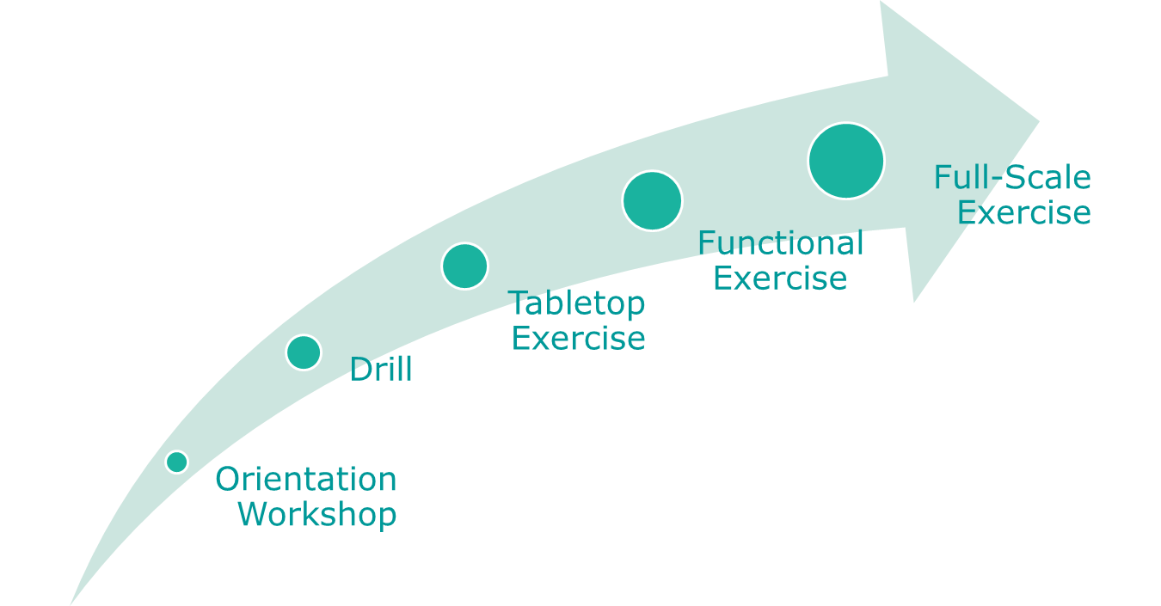
Phase B – Types of exercise
- Phase B is designed to test and evaluate interdependent groups of functions among various agencies;
- Organizations will test their internal/external communications using real time simulation tsunami bulletins;
- Phase B exercises command and control activities at locations such as emergency command centers, command posts,…

Slide 8
Types of Phase B Exercises
Orientation Workshop:
This type of exercise can be conducted through a workshop.
It is used to familiarise the players with the activity.
There is no time-frame element; the orientation workshop could be performed after the exercise, making use of the NEAMWave26 material (i.e. Exercise manual, exercise scenarios) to conduct the workshop planned at national level.
This kind of exercise would provide an opportunity to raise awareness among the National Emergency Operations Centre(s) and response officials regarding the NEAMTWS programme
An example of an orientation exercise would be setting up a welfare centre to take in tsunami evacuees, and briefing to the staff about how the centre is organized.
NEAMWave26 Information Workshop • 19 February 2026

Slide 9
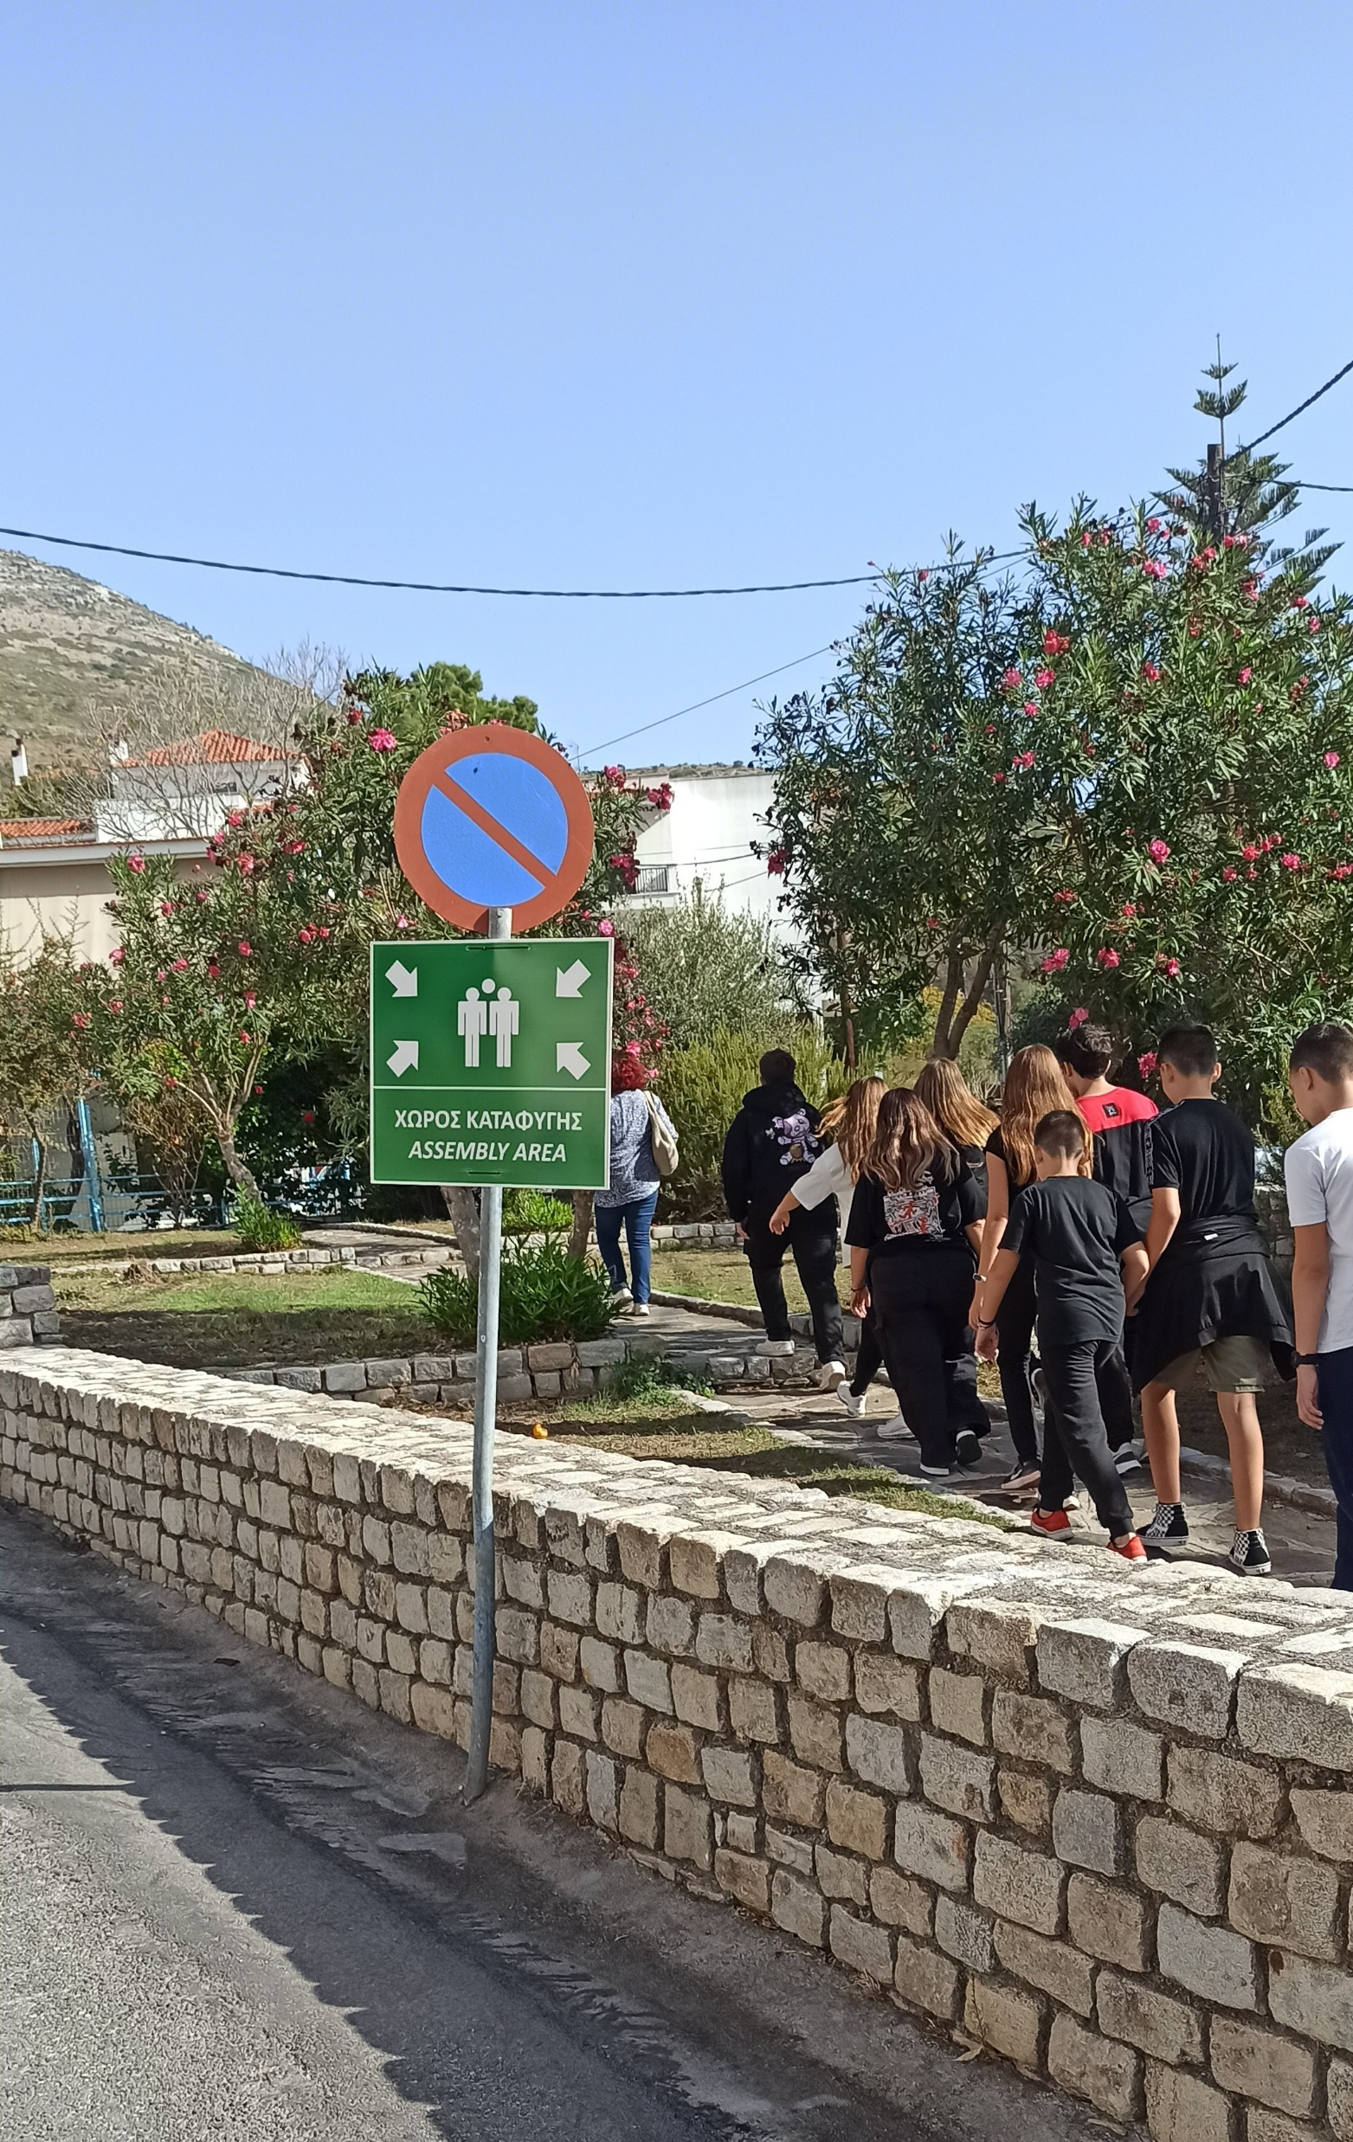
Types of Phase B Exercises
Drill:
Staff physically handle specific equipment or perform a specific procedure or single operation.
A drill usually focuses on a single organization, facility or agency such as a national emergency operation centre, a hotel, a school or a village.
The exercise usually has a time-frame element and is used to test procedures.
A drill is a subset of a full-scale exercise.
In NEAMWave26, Phase A will be conducted as a drill exercise; the ability to send multiple consecutive tsunami messages by the TSPs will be tested.
An example of a drill exercise would be activating an Emergency Operations Centre (EOC), testing the relative procedures and all the communications technologies foreseen for the activation of those procedures (i.e. Email, telephone, radios) in a tsunami exercise.
SamosWAVE, Exercise,
Greece, Nov2024
NEAMWave26 Information Workshop • 19 February 2026

Slide 10
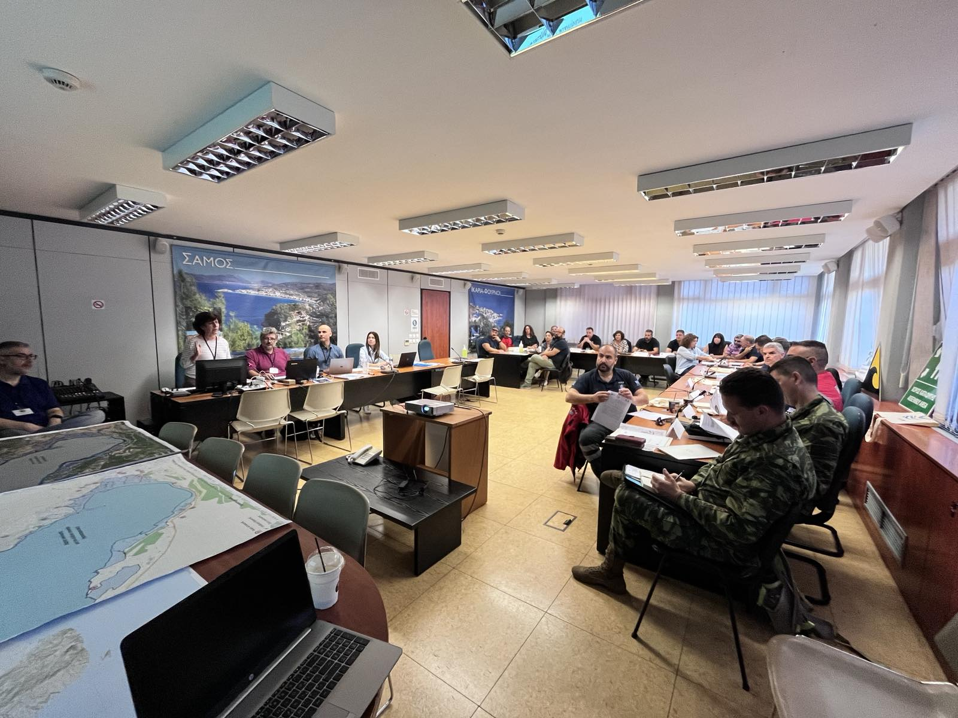
Types of Phase B Exercises
Table-top Exercise:
May also be referred to as a ‘‘discussion exercise’’, or ‘‘DISCEX’’.
Participants face with a situation or problem that they are required to discuss and they formulate the appropriate response or solution.
An exercise controller or moderator introduces a simulated scenario (prewritten exercise) to participants and, as the exercise advances (in time), exercise problems and activities are further introduced.
This type of exercise is used to practice problem-solving and coordination of services with or without time pressures.
There is no deployment or actual use of equipment or resources.
An example of a table top exercise may cover the participants discussing their response to a tsunami threat to a particular area, where the only input are tsunami messages from the TSPs.
Samos, Greece, tabletop exercise, Nov2024
NEAMWave26 Information Workshop • 19 February 2026

Slide 11
Types of Phase B Exercises
Functional Exercise:
May also be referred to as an ‘‘operational’’ or a ‘‘tactical’’ exercise.
It takes place in an operational environment and requires participants to actually perform the functions of their roles.
Participants interact within a simulated environment through an exercise control group which provides prewritten actions and respond to questions and tasks developing out of the exercise.
Functional exercises normally involve multi-agency participation (real or simulated) and can focus on one or more geographical areas.
Commonly, they involve the testing of standard operating procedures (SOP) and internal/external communications between organizations.
It lacks only the people "on the ground" to create a full-scale exercise
- An example would be a multi-agency response to a potentially devastating tsunami, where evacuation of a coastal community is required. Messages and actions are provided by exercise control group and are handled by the participants in the way described in appropriate plans and procedures.
NEAMWave26 Information Workshop • 19 February 2026

Slide 12
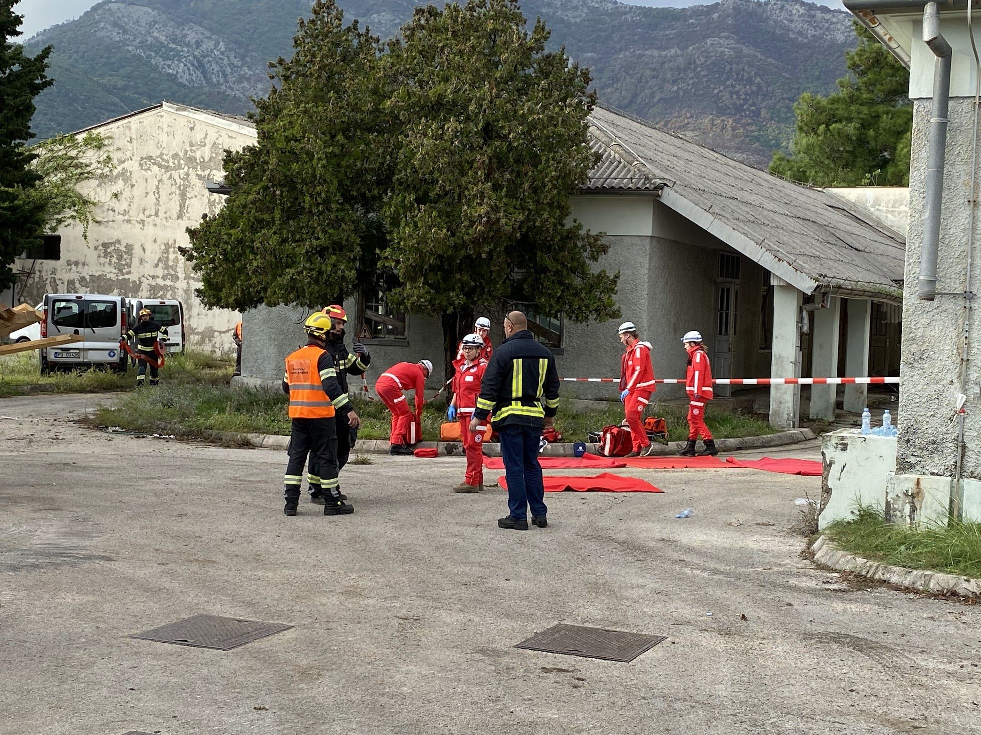
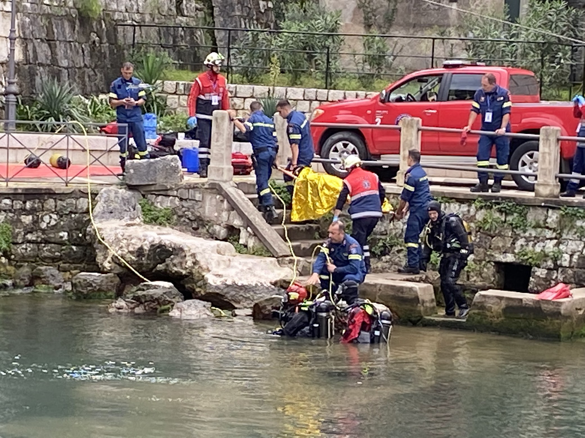
Types of Phase B Exercises
Full-scale Exercise:
- May also be referred to as a “practical’’ or ‘‘field’’ exercise.
- It includes the movement or deployment of people and resources to provide a physical response ‘‘on the ground’’ to a simulated situation.
- It can be ‘‘ground’’ focused only or may include the higher-level response structures. It can be simple (single agency) or complex (multi agency, multi-levels of government from national to local).
- Typically used to test all aspects of a country's warning and emergency management systems and processes; they are practical, using actual centres and communications methods.
- Full-scale exercises are the largest, most costly, most time-consuming and most complex to plan, conduct and evaluate.
- An example: a post-impact tsunami response with volunteers representing 'victims' and the emergency services using real rescue equipment at the scene. Multi-agency response to the event is played. Actual field mobilization and deployment of response personnel are also involved.
BALANCE full-scale exercise in Montenegro, Oct2022
NEAMWave26 Information Workshop • 19 February 2026

Slide 13
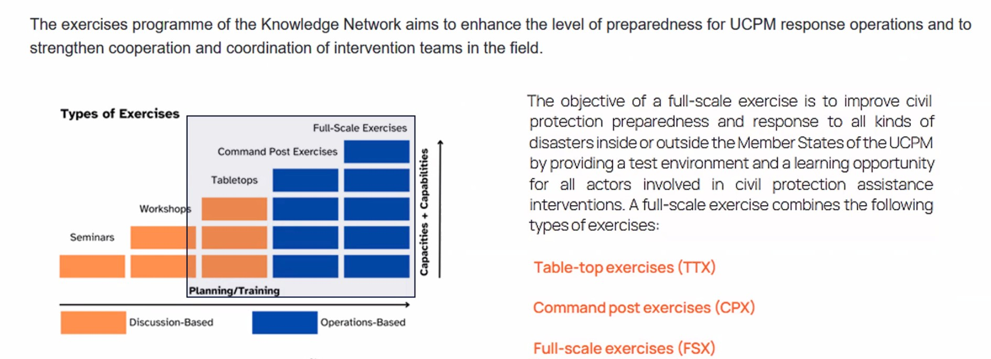
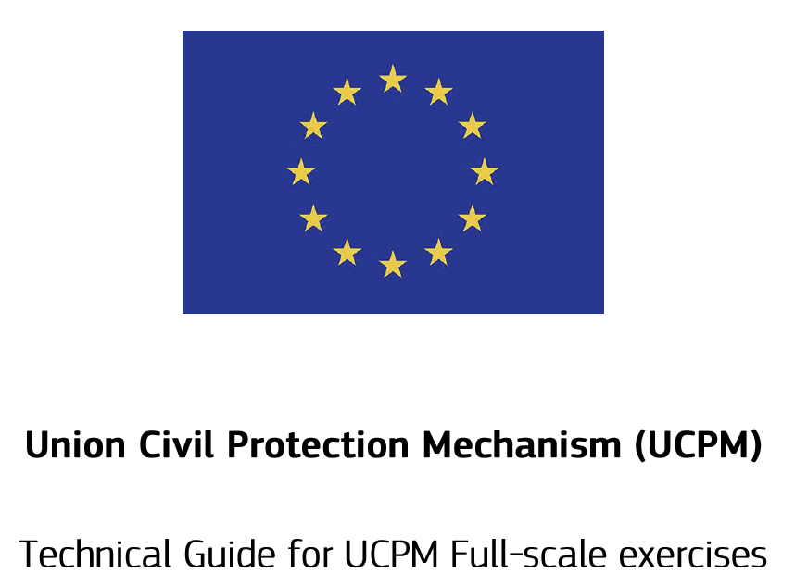
Phase B – Types of exercise

Slide 14
Phase C: International Assistance request and provision
Phase C is conducted for one selected scenario
Tsunami messages from Phase A are received by the European Commission’s ERCC
Affected NEAMTWS Member States may submit requests for international assistance to the ERCC
Activation of the Union Civil Protection Mechanism (UCPM) enables Participating States to offer assistance
ERCC coordinates international assistance, including relief items, expertise, civil protection teams, and specialized equipment
Selection and deployment procedures of assets from the European Civil Protection Pool (ECPP) and rescEU are exercised
Phase C concludes with the acceptance of offered assistance by the requesting country.
NEAMWave26 Information Workshop • 19 February 2026

Slide 15
Activities to be performed
Establishment of the National Contact of the Exercise
Establishment of the Exercise Team, at national and local (community) level
Appointment of roles: Coordinator - Director – Evaluators – Observers - Other
Set aim of the exercise and objectives
Participants in the exercise
Exercise scenario
Design of different activities that will be performed to fulfill the aim
Design the evaluation process
Master Schedule of Events List
NEAMWave26 Information Workshop • 19 February 2026

Slide 16
Schedule of the activities
Establishment of the National Contact of the Exercise
Establishment of the Exercise Team, at national and local (community) level
Appointment of roles: Coordinator - Director – Evaluators – Observers - Other
Set aim of the exercise and objectives
Participants in the exercise
Exercise scenario
Design of different activities that will be performed to fulfill the aim
Design the evaluation process
60 days
before
30 days
before
15 days
before
NEAMWave26 Information Workshop • 19 February 2026

Slide 17
@19th ICG/NEAMTWS
Decisions:
To organize the next NEAMWave exercise in March 2026 ⇨ 3 -24 March 2026
The exercise scenarios should be created through collaboration between TSPs and NTWCs ⇨ 3 NTWCs (CY, ES, RO) are collaborating with TSPs
One or more single or joint scenarios proposed to meet the specific needs of the MS ⇨ 3 joint scenarios / 2 single scenarios | 3 TSPs are participating in 2 scenarios
Encouraging the collaboration of CoastWAVE 2.0 activities
NEAMWave26 Information Workshop • 19 February 2026

Slide 18
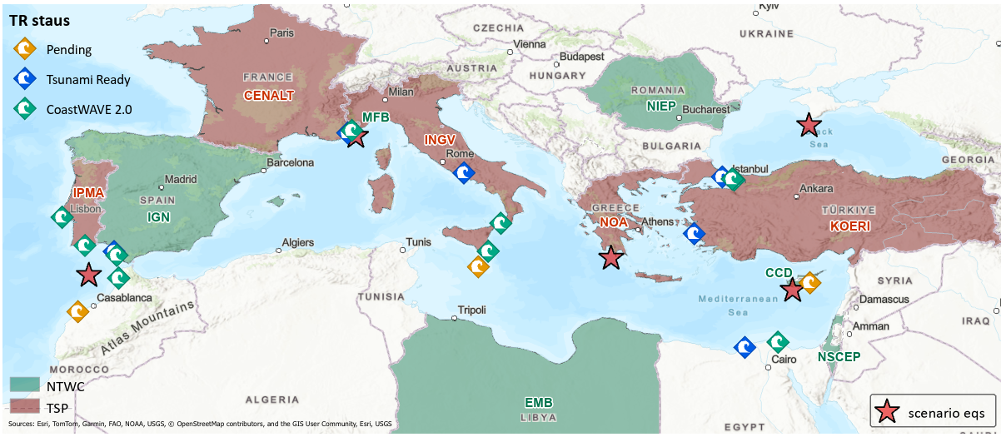
Scenarios
no | Date | Type | TSPs | NTWCs | Title | Epicenter (lat - lon) | Magnitude | Description | Potential affected MS
SN-01 | 03-Mar-26 | single | NOA | CD or GSD | Cyprian Arc | 34.55N - 32.65E | 7.5 | 1222 SW of Cyprus | Greece, Cyprus, Egypt, Libya, Malta, Italy
SN-02 | 11-Mar-26 | joint | INGV-NOA | EMB (LY) | Ionian Sea | 36.40N - 22.20E | 7.1 | 1867 Peloponnesus | Greece, Italy, Egypt, Malta
SN-03 | 12-Mar-26 | joint | CENALT-INGV | Monaco FB | Ligurian Sea | 43.42N - 7.50E | 6.9 | 1887 Ligurian Earthquake | Italy, France, Monaco
SN-04 | 13-Mar-26 | single | KOERI | NIEP | Black Sea | 44.04N - 33.60E | 7.5 | Black Sea | Turkiye, Romania, Bulgaria
SN-05 | 24-Mar-26 | joint | IPMA-CENALT | IGN | NE Atlantic Ocean | 36.64N -11.80W | 8.5 | Gorringe Bank fault | Portugal, Spain, Morocco

Slide 19
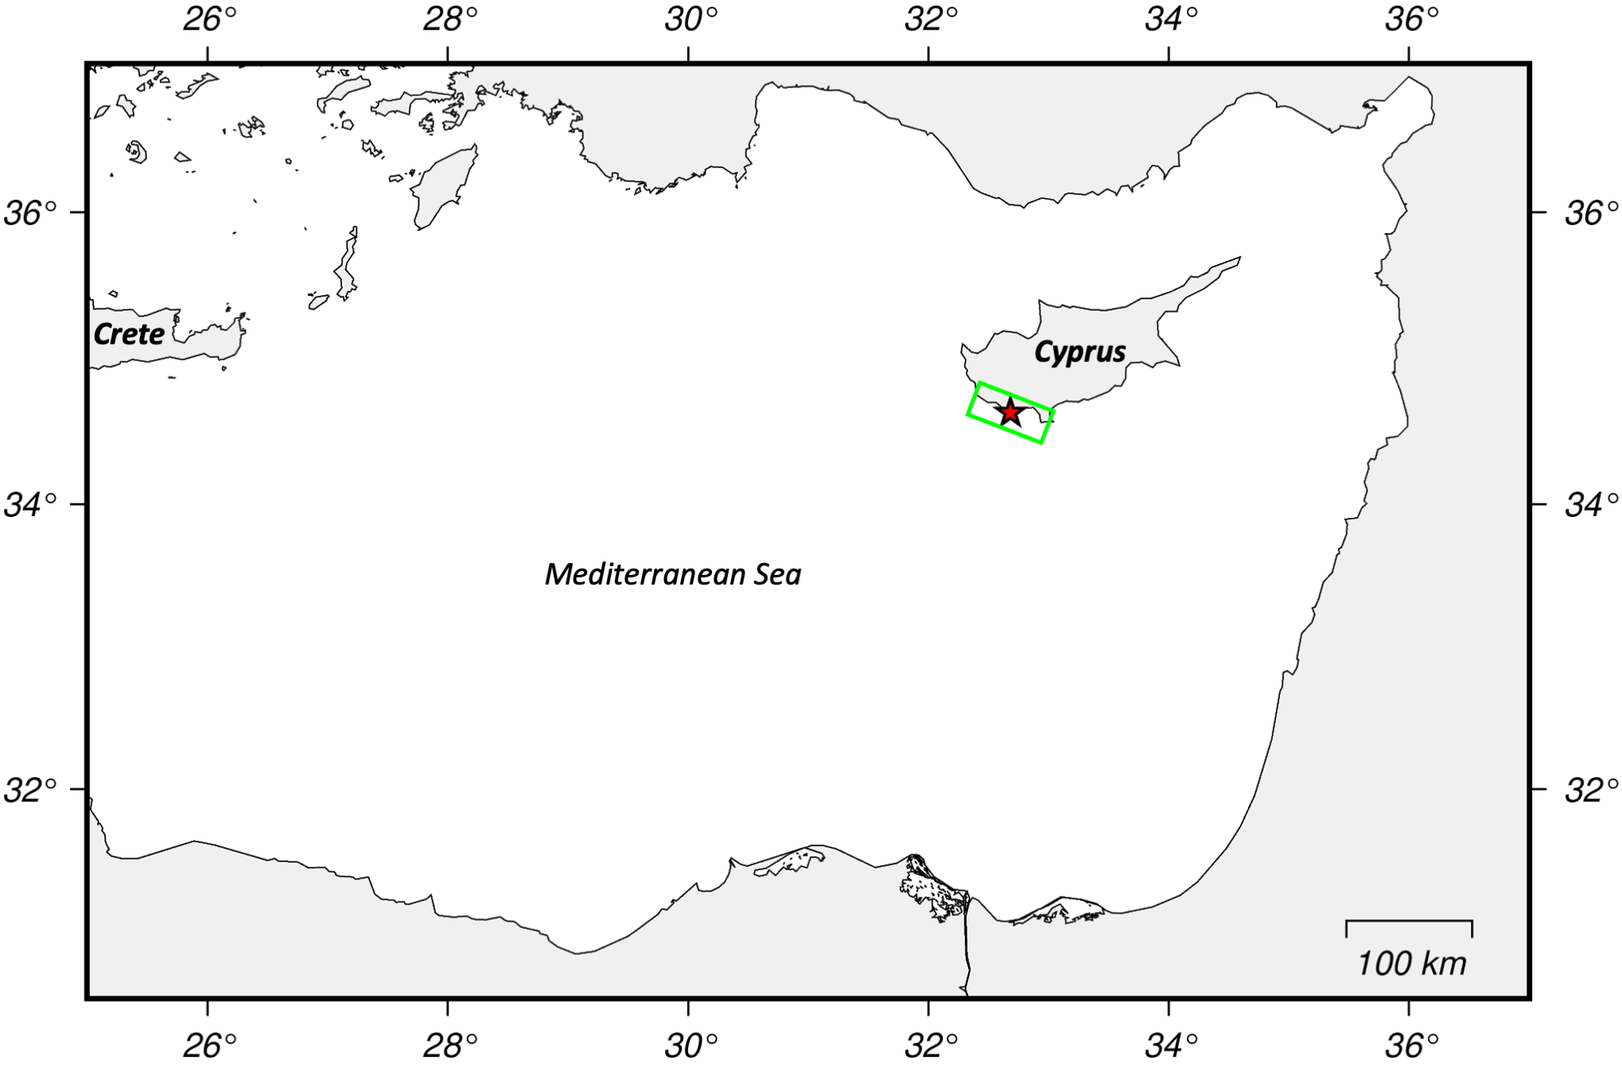
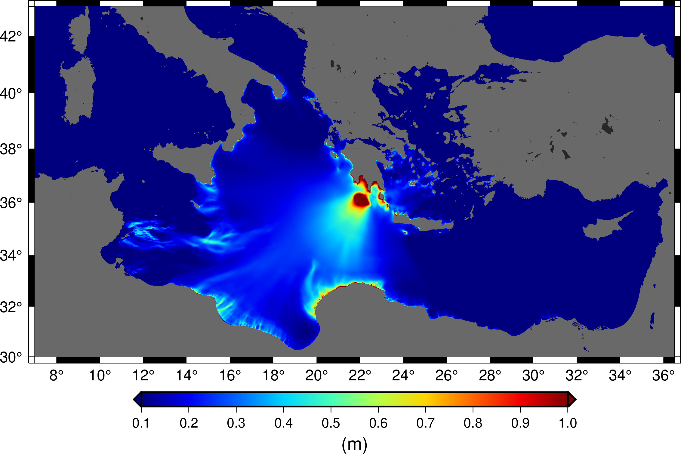
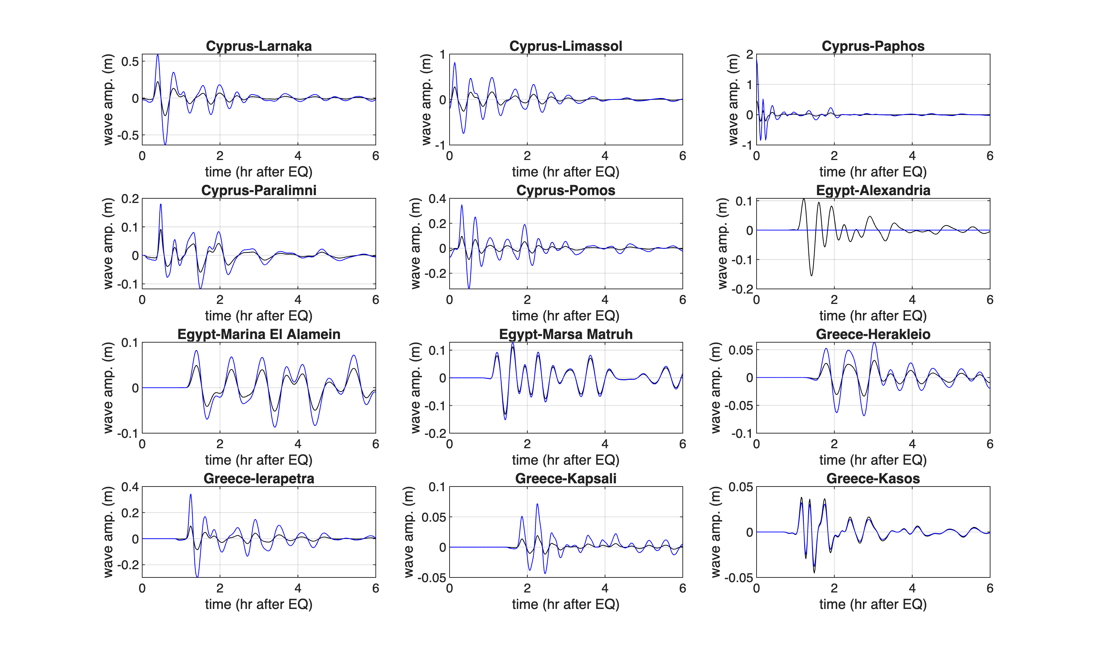
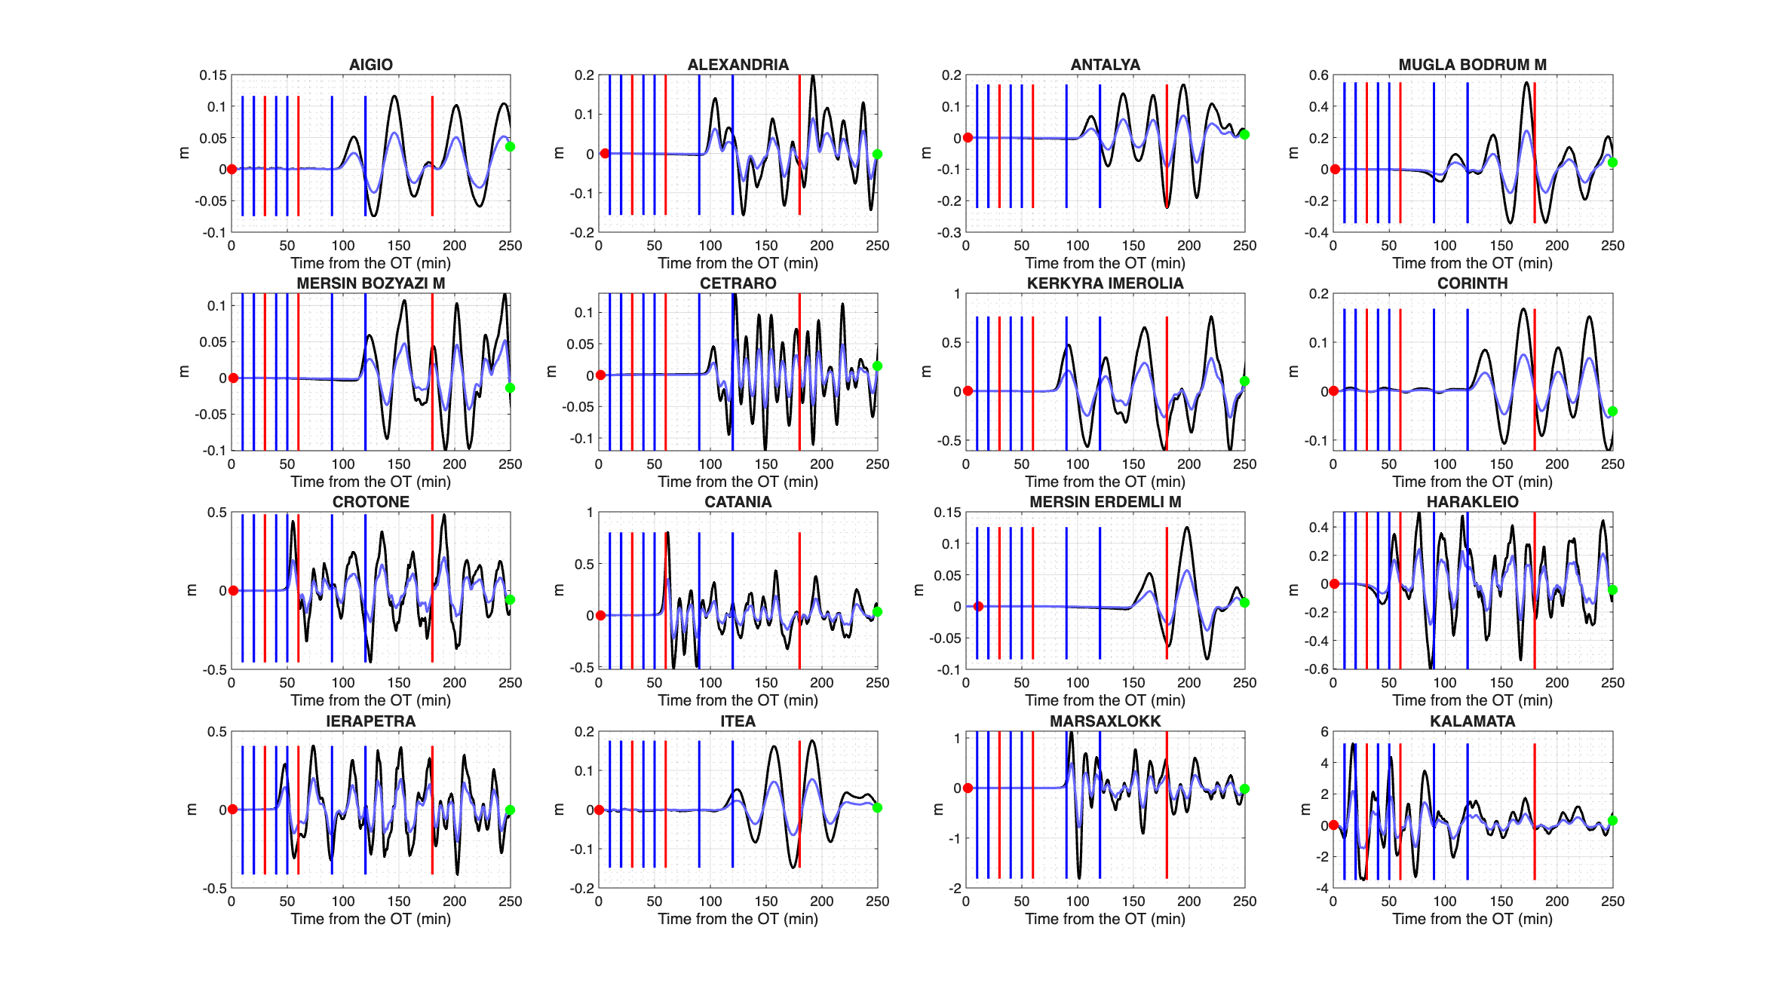
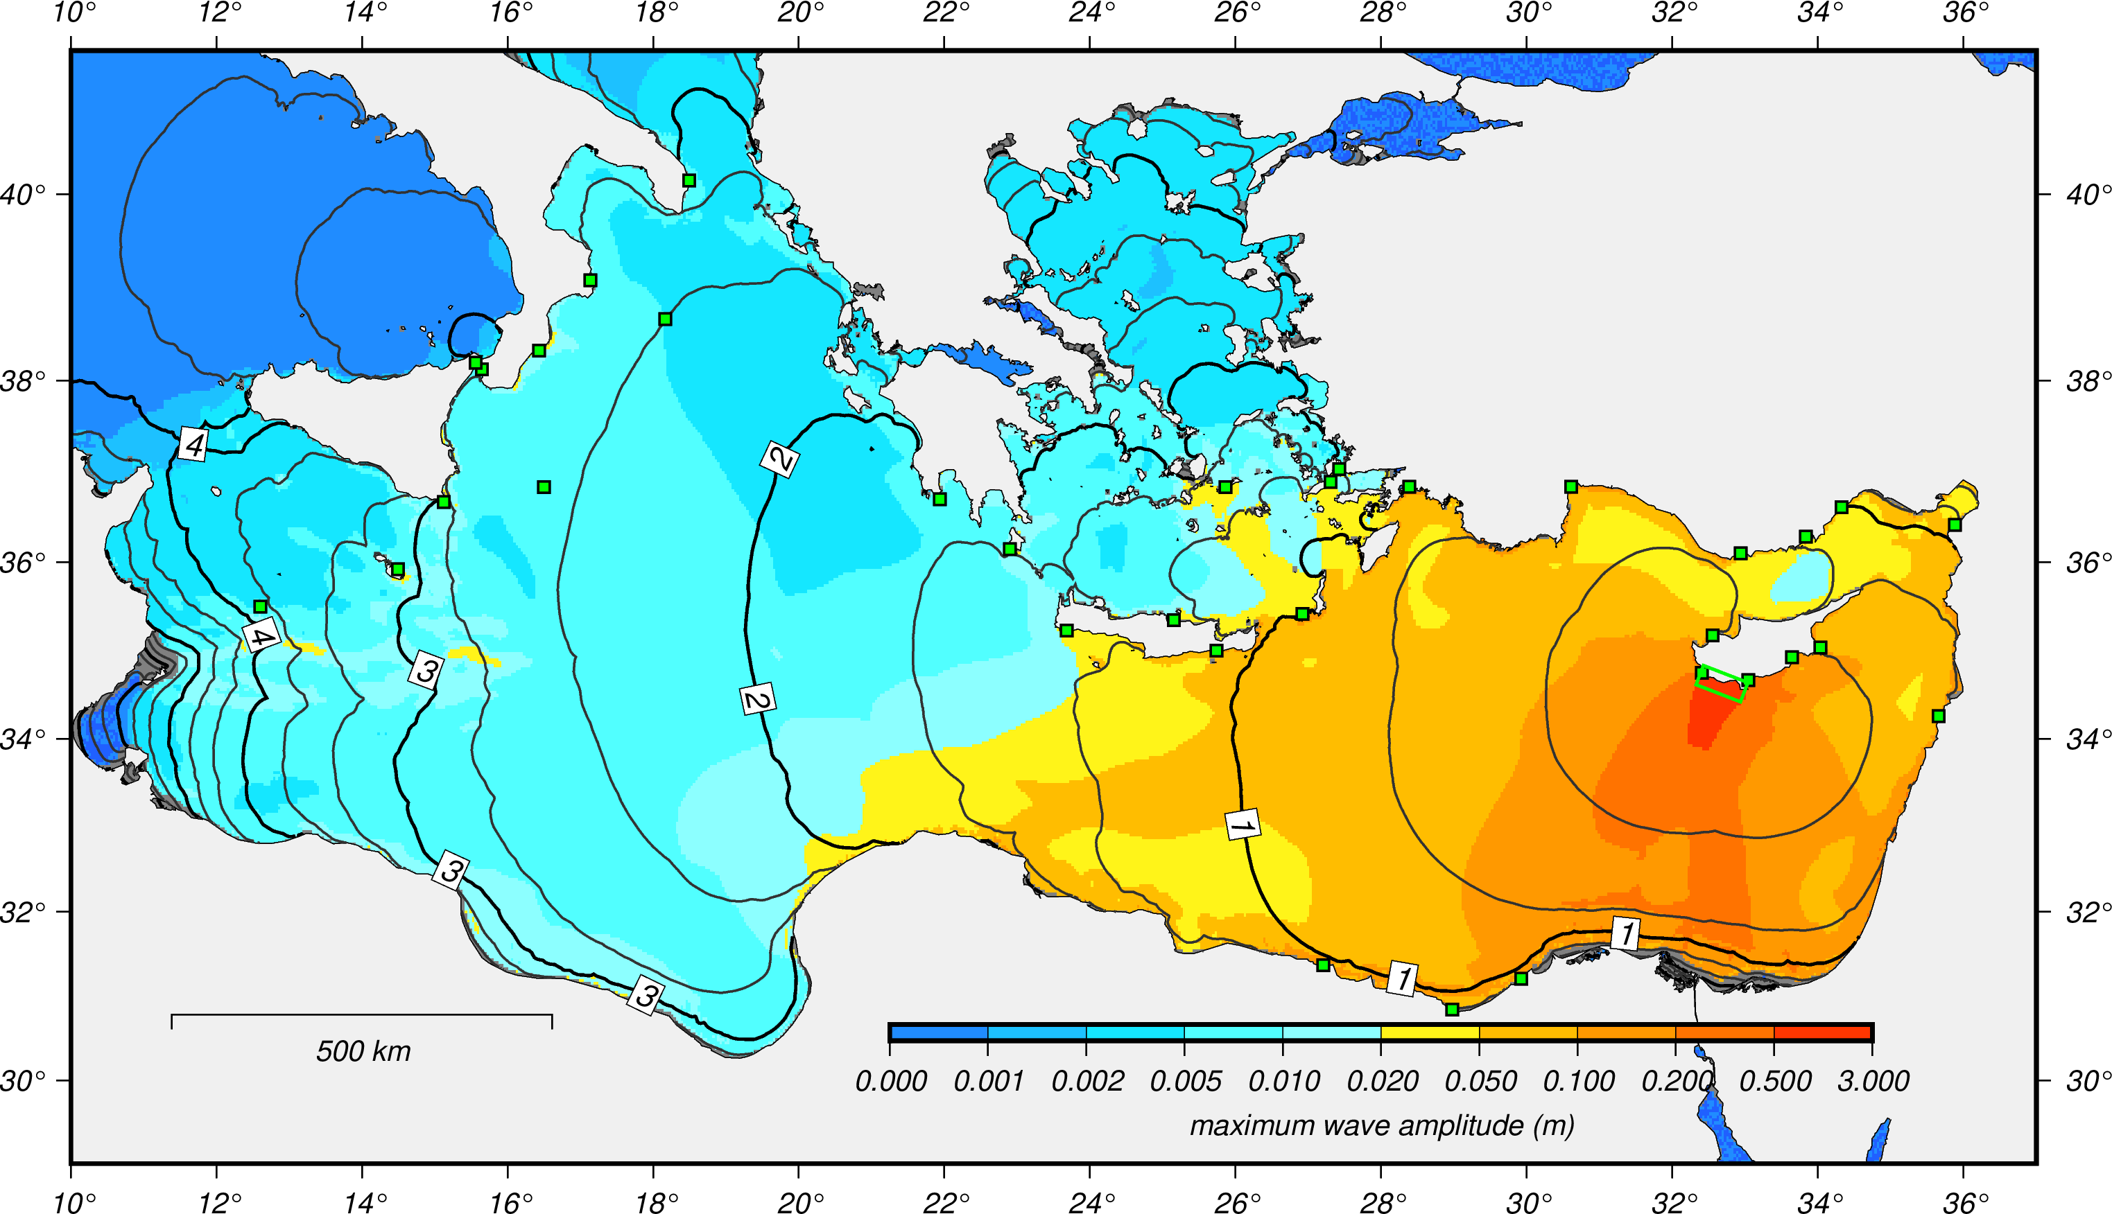
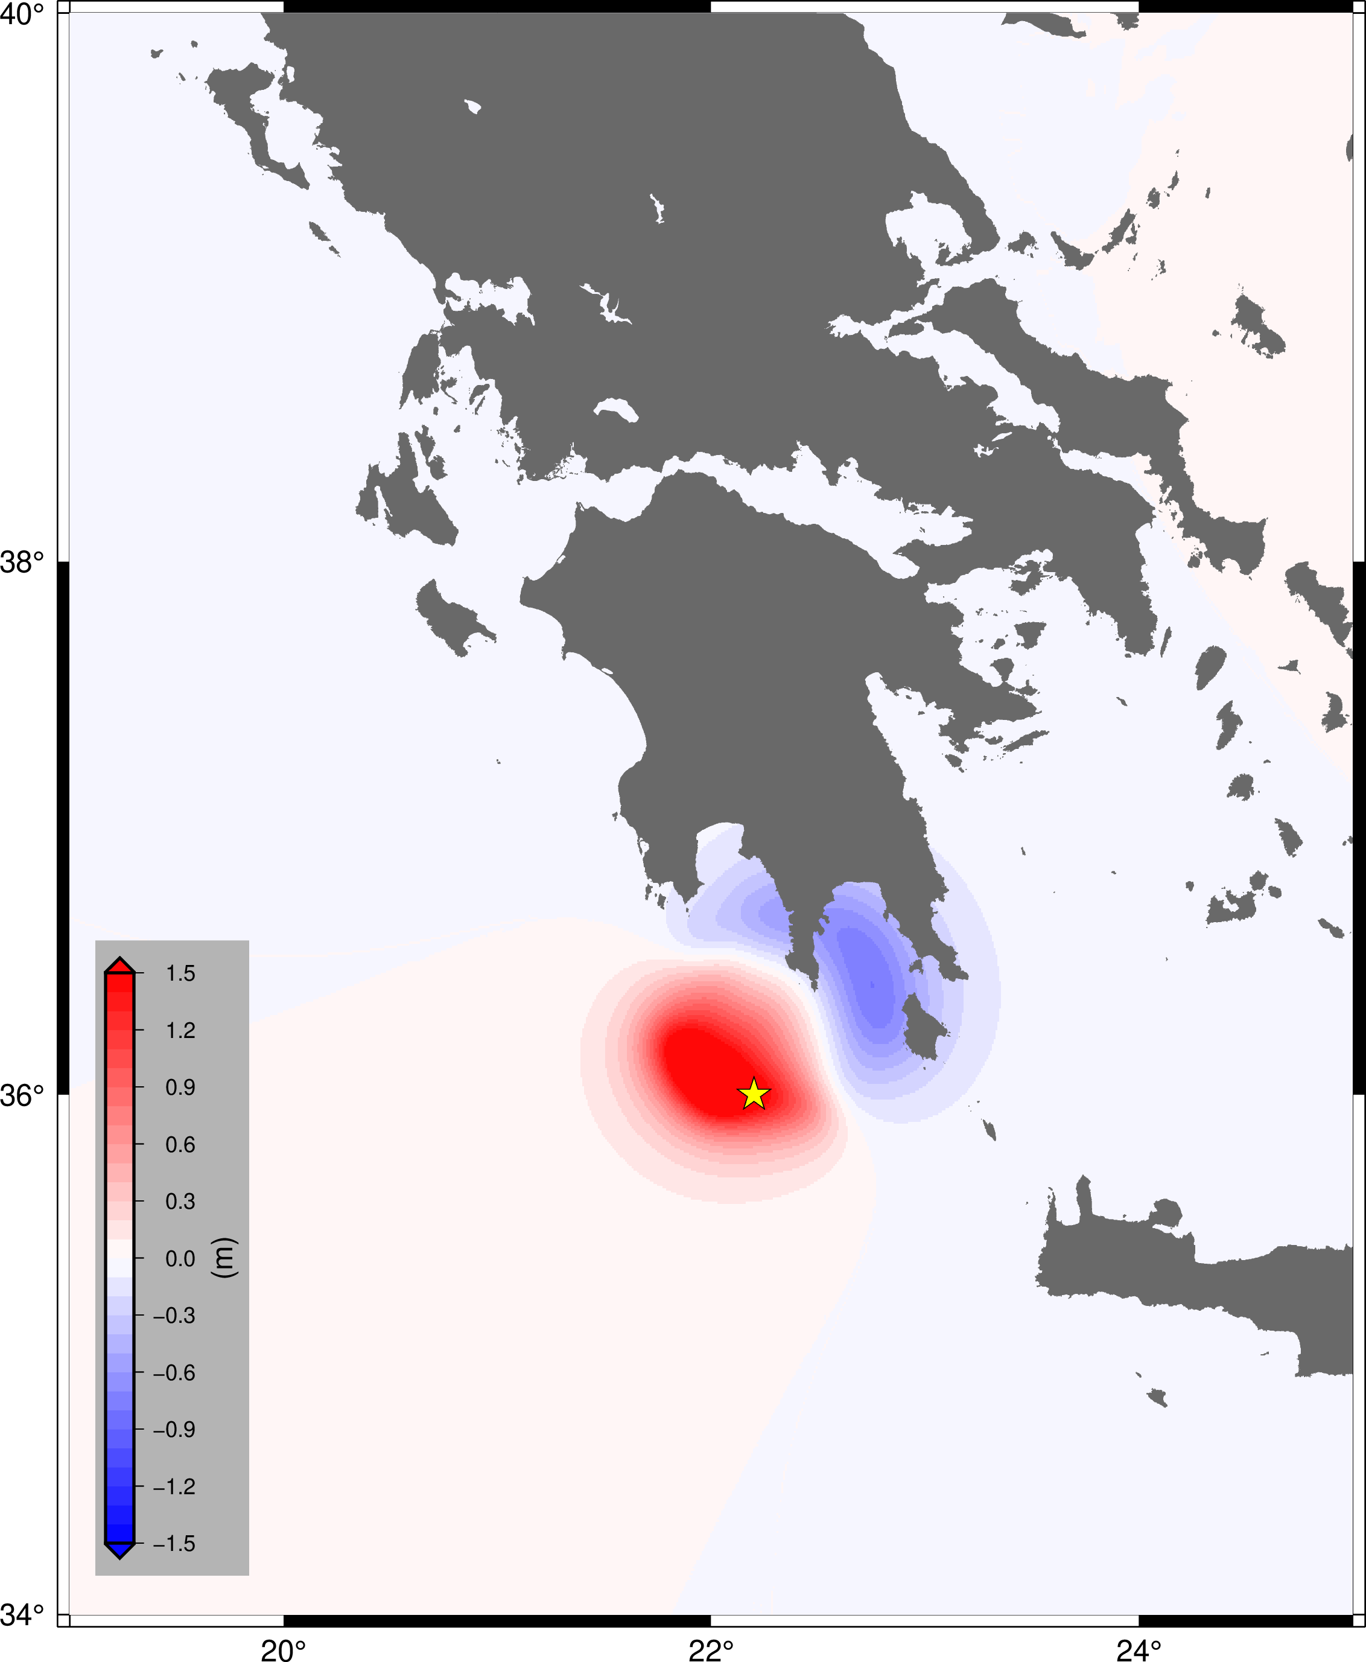
Scenarios
N O A
I N G V - N O A
NEAMWave26 Information Workshop • 19 February 2026

Slide 20
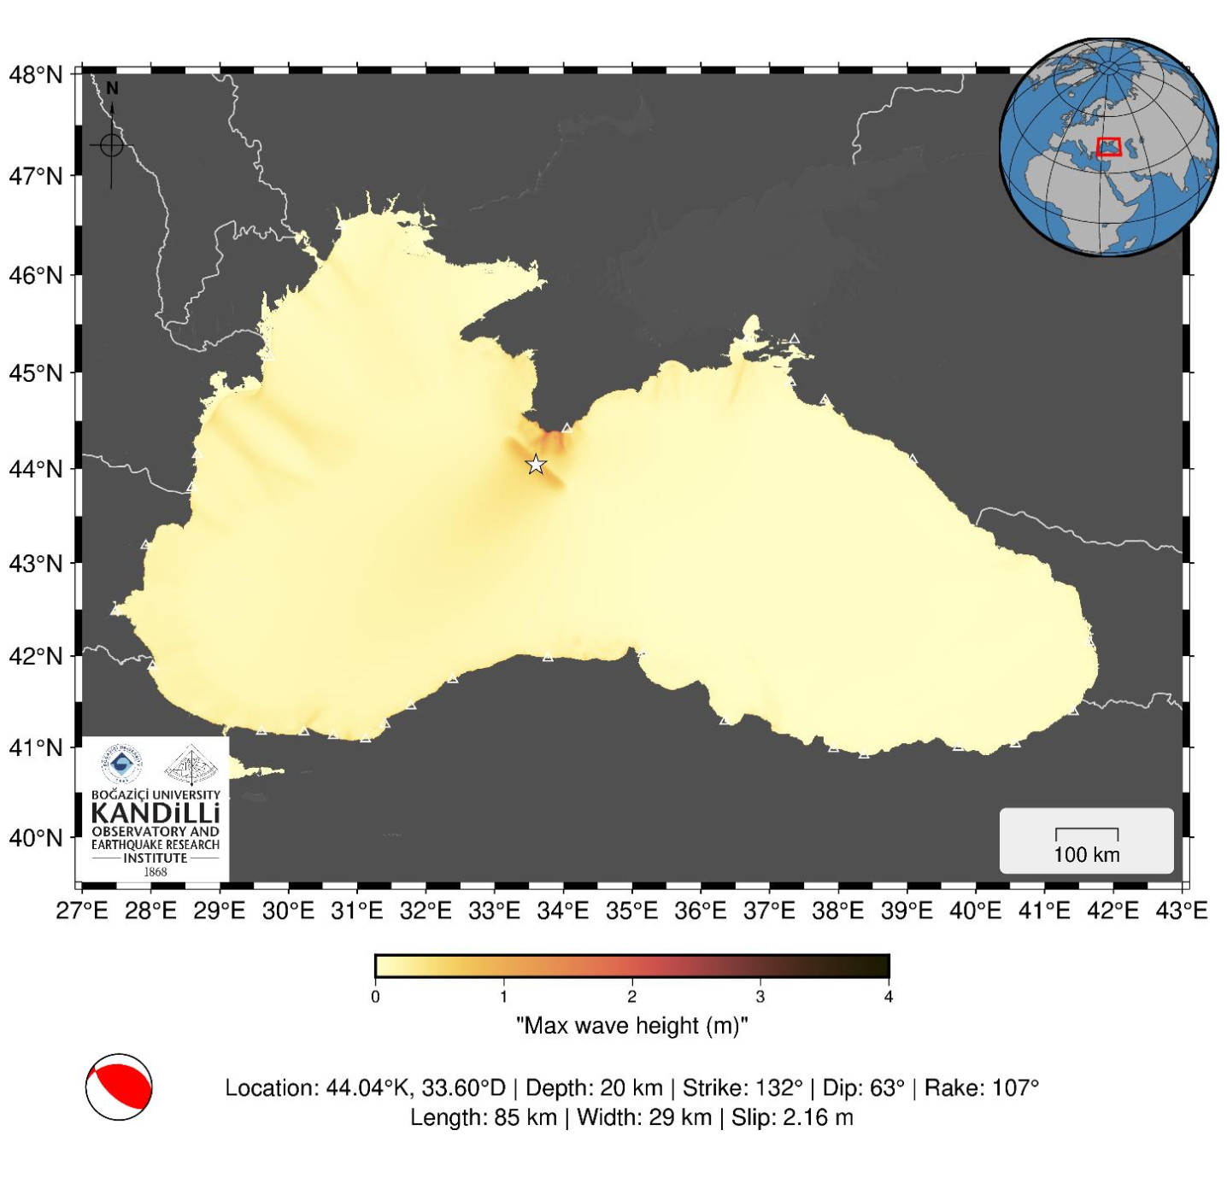
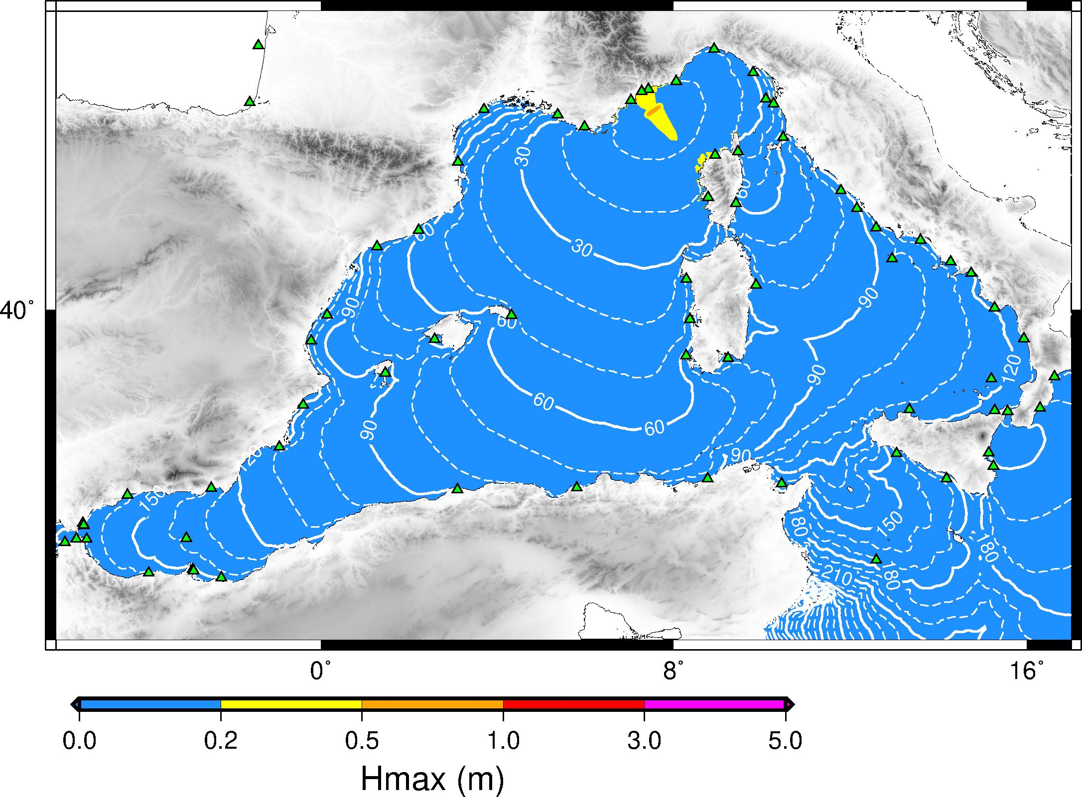
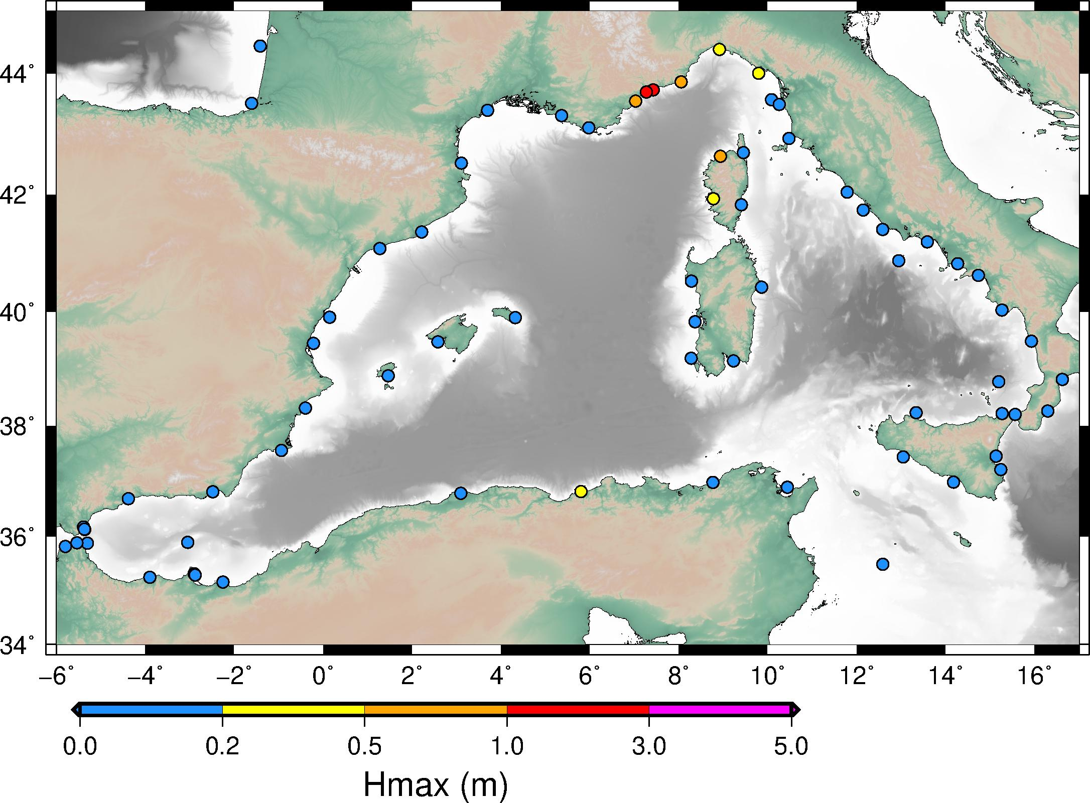
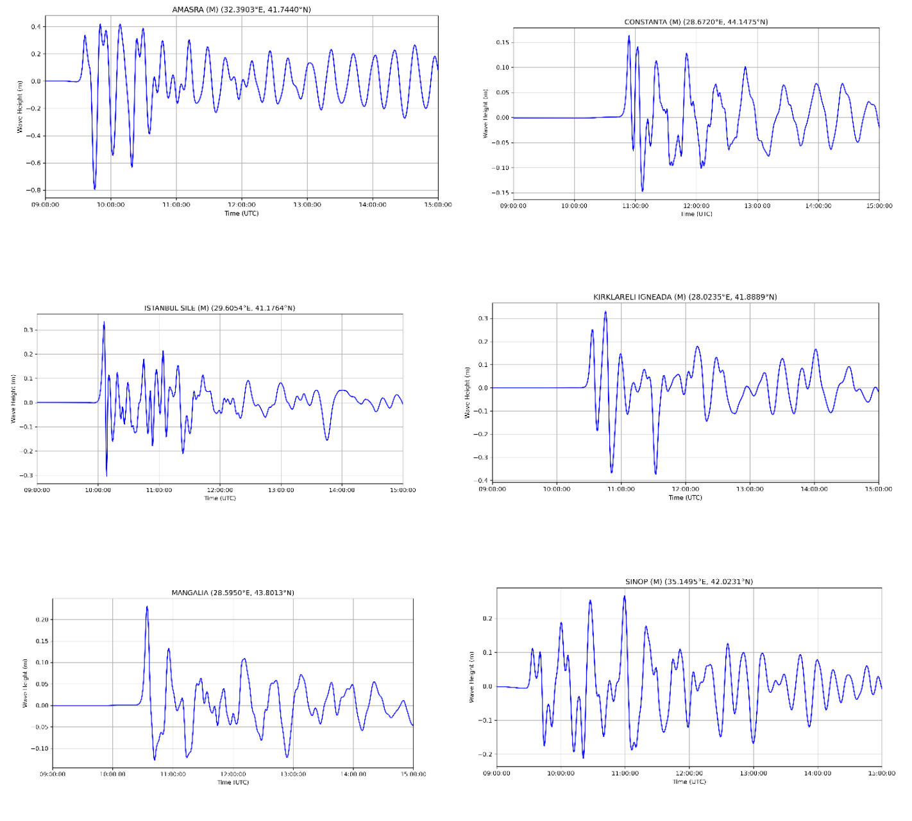
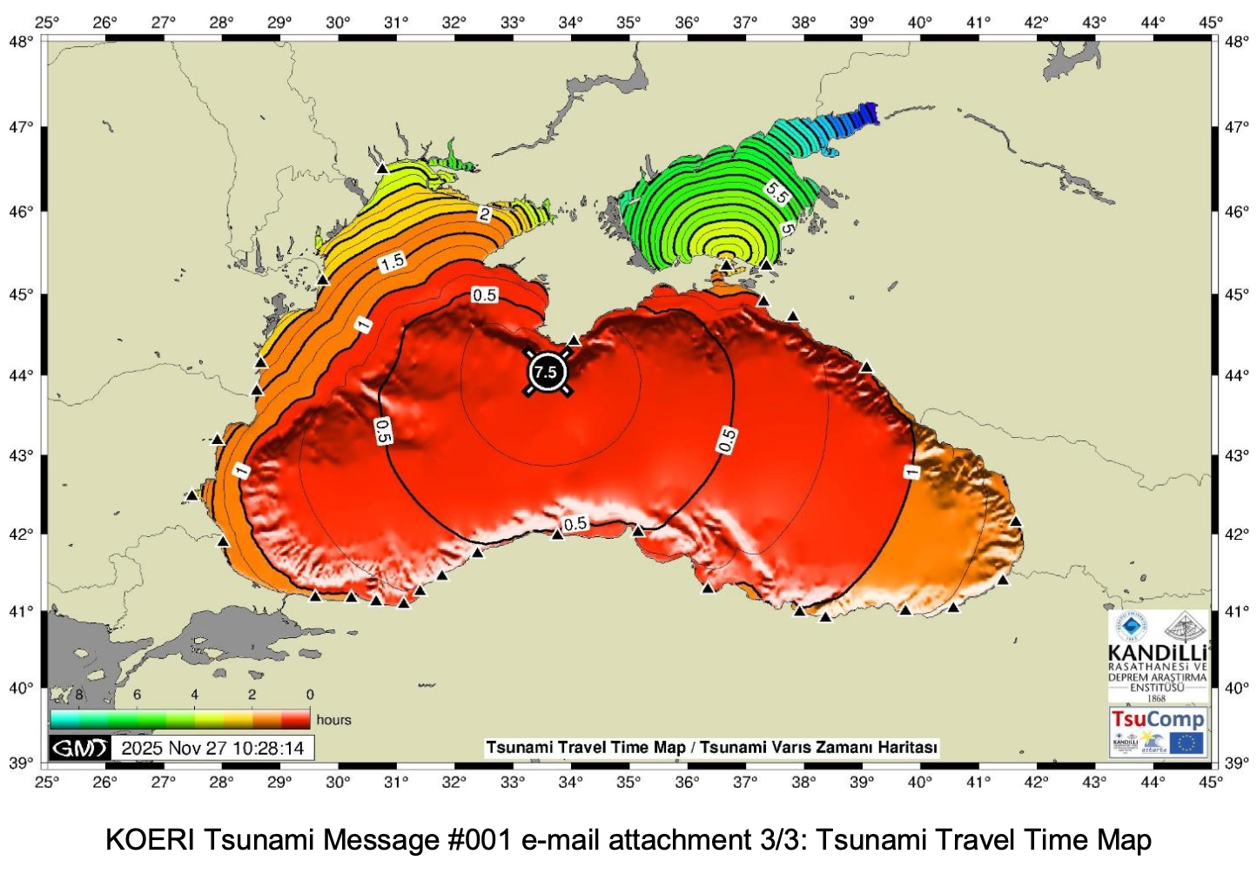
Scenarios
KOERI
CENALT-INGV
NEAMWave26 Information Workshop • 19 February 2026

Slide 21
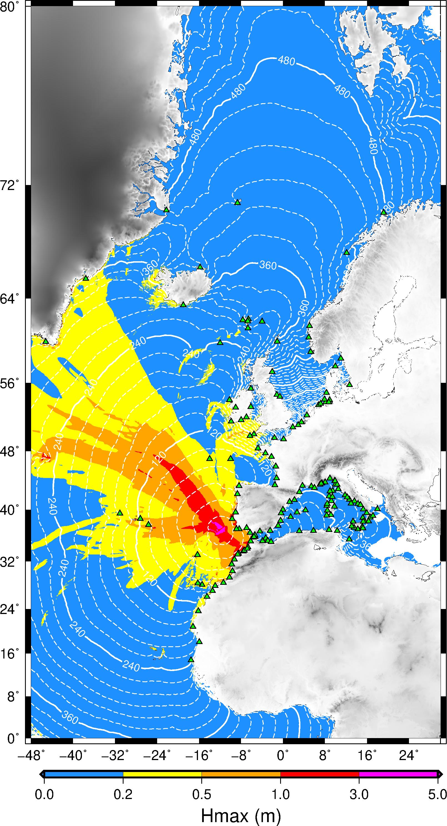
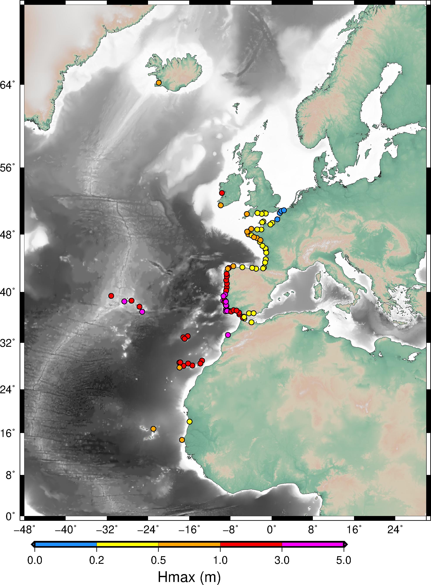
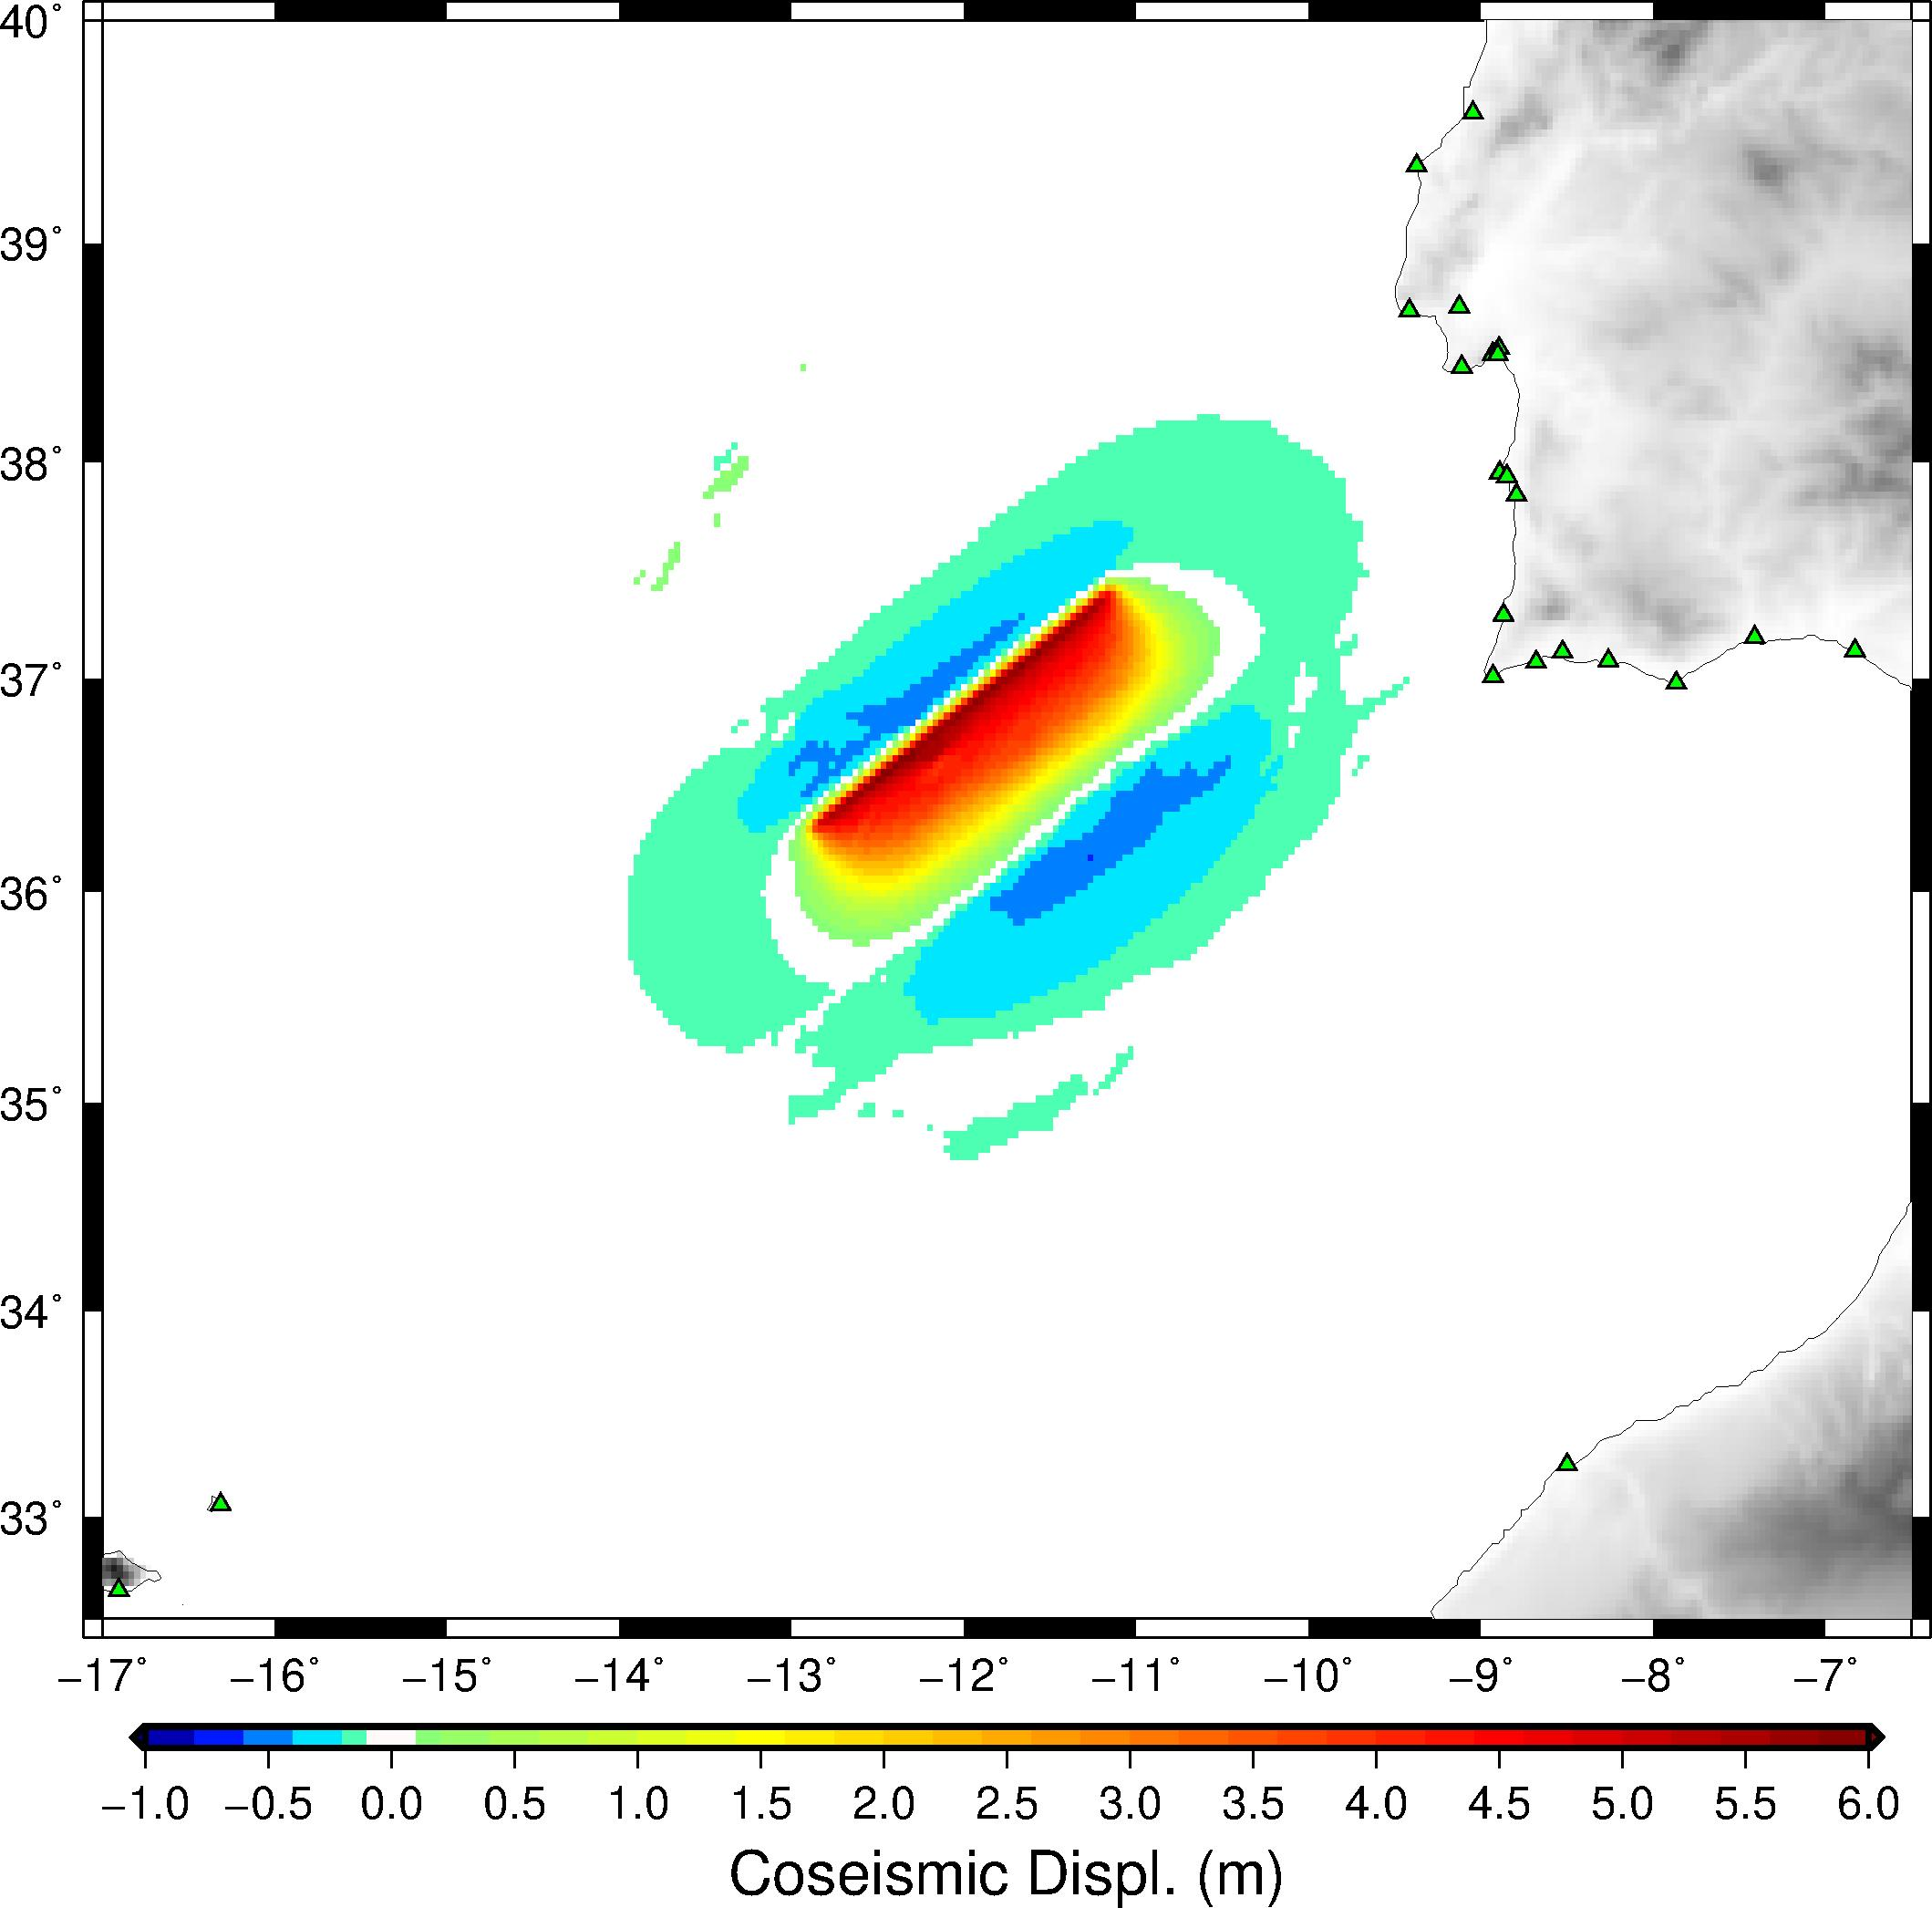
Scenarios
IPMA-CENALT
NEAMWave26 Information Workshop • 19 February 2026

Slide 22
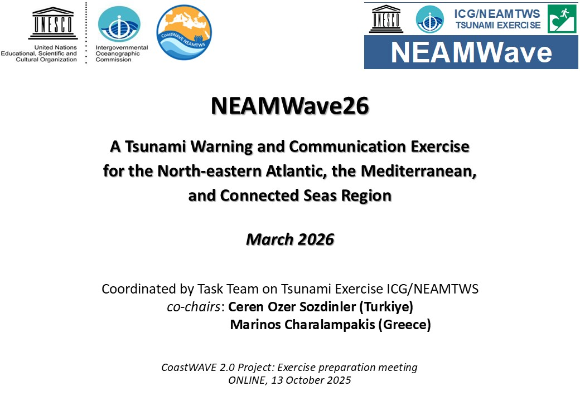
CoastWAVE
Meeting with CoastWAVE
NEAMWave26 Information Workshop • 19 February 2026

Slide 23
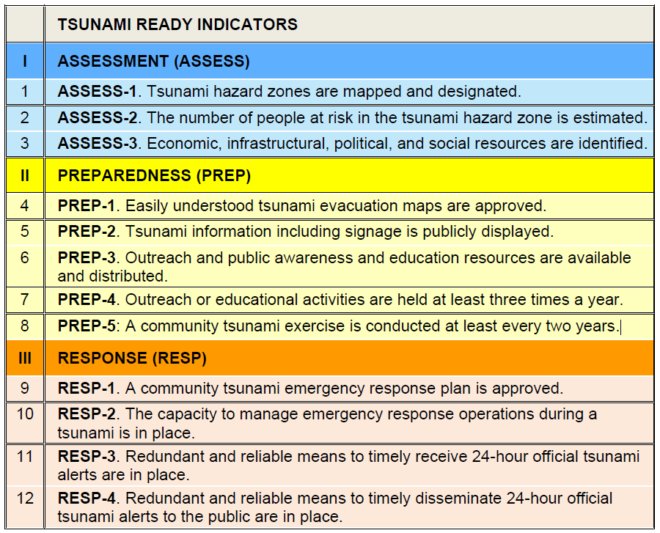
Recommendation
The CoastWAVE 2.0 project aims to improve the preparedness and response of coastal communities to tsunami events. As part of this project, the participating counties are expected to take part in Phase B, which involves conducting a local exercise using the NEAMWave26 scenario. By participating in Phase B, the counties can test their tsunami warning systems, emergency plans and public awareness campaigns.
NEAMWave26 Information Workshop • 19 February 2026

Slide 24


DEMONAX FSX
DEMONAX / DG-ECHO project
A Full Scale eXercise will be held between 20 - 23 April 2026, in Cyprus.
The earthquake’s epicenter will be in the south-west of Cyprus (offshore), generating also a subsequent tsunami event (injects in Larnaka).
The exercise will examine the response procedures of the essential services involved and based on the scenario; Cyprus will request assistance from the EU Civil Protection Mechanism (ERCC).
Cyprus Civil Defense (COO & NTWC) – NOA partner.
Synergy between NEAMWave26 and DEMONAX:
Table-top exercise one month before the FSX in April
NEAMWave26 Information Workshop • 19 February 2026

Slide 25
Important dates
Pre-Exercise
NEAMWave Exercise Brief (Arabic, French and Spanish) available online
Mid-January 2026 -> Exercise Manual available online
Deadline for providing updates regarding TNC, TWFP, NTWC & TWFP to the ICG/NEAMTWS Secretariat
February 6th 2026 -> Deadline for online subscription/registration
February 19th 2026 -> Informative Workshop on NEAMWave26
Exercise  3 – 24 March 2026
Post-Exercise
Mid-April 2026 -> Evaluation questionnaires by all participants available online
Mid-May 2026 -> TSPs Evaluation report
NEAMWave26 Information Workshop • 19 February 2026

Slide 26
Thank you!
co-chairs: Ceren Ozer Sozdinler
& Marinos Charalampakis
NEAMWave26 Information Workshop • 19 February 2026

