Slide 1

NEAMWave26 Registered Participants
TT-NE Co-chairs: Ceren Özer Sözdinler and Marinos Charalampakis
ICG/NEAMTWS NEAMWave26 Workshop
19 February 2026

Slide 2
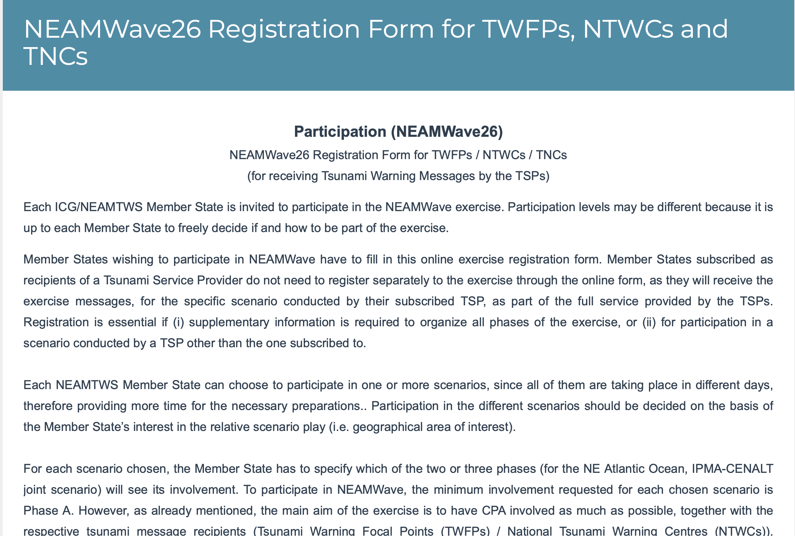
ICG/NEAMTWS NEAMWave26 Workshop
19 February 2026

Slide 3
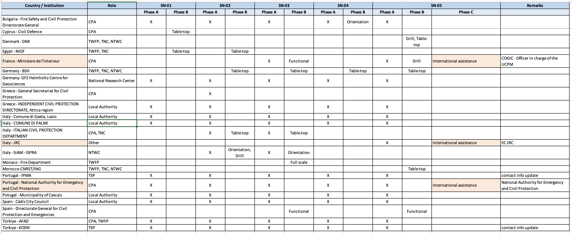
ICG/NEAMTWS NEAMWave26 Workshop
19 February 2026

Slide 4
Phase A
MS that are currently the subscribers of TSPs will receive the exercise messages without any need of registration.
6 MS with different agencies/authorities registered in Phase A, some of which are already the subscribers of TSPs but they probably updated their contact information.
3 local authorities, 1 CPA and 1 national research center will only participate in Phase A without applying Phase B exercise.

Slide 5
Phase B
11 MS registered in Phase B in multiple scenarios. Some MS are participated in Phase B with more than one agency.
Orientation (i.e. raising awareness among the National Emergency Operations Centre(s) and response officials regarding the NEAMTWS programme) , drill (i.e., the ability to send multiple consecutive tsunami messages by the TSPs), table-top (discussion of participants about response to a tsunami threat to a particular area, where the only input are tsunami messages from the TSPs), functional (testing of standard operating procedures (SOP) and internal/external communications between organizations) and full-scale (the movement or deployment of people and resources to provide a physical response ‘‘on the ground’’ to a simulated situation) exercises will be held in the frame of Phase B.
ICG/NEAMTWS NEAMWave26 Workshop
19 February 2026

Slide 6
Phase C
France and Portugal were registered for Phase C of SN-05.
JRC also filled up the registration form as an entity of international assistance.
The details will be discussed in “Item 4. International Assistance Exercise” that will be presented by Olympia from ERCC.

Slide 7

Thank you!
co-chairs: Ceren Ozer Sozdinler
& Marinos Charalampakis
NEAMWave26 Information Workshop • 19 February 2026

