Slide 1
Tsunami Ready Coalition
update
Dr. Laura Kong, Chair, TRC
Director, ITIC
TOWS WG TT-TWO, TT-DMP, 4-6 March 2026
Online

Slide 2
Tsunami Ready Coalition (IOC A-33/3.4.1, 2025)
IOC Decision A-33/3.4.1 (June 2025) Warning and Mitigation Systems of Ocean Hazards. Working Group on Tsunamis and Other Hazards related to Sea Level Warning and Mitigation Systems (TOWS-WG)
The Assembly,
Approves the Tsunami Ready Coalition Implementation Plan as reviewed by the UN Ocean Decade Tsunami Programme Scientific Committee (ODTP-SC) and the Task Teams on Tsunami Disaster Management and Preparedness, and Tsunami Watch Operations (TT-DMP and TT-TWO respectively) including:
  The Coalition mandate and terms of reference,
  The Coalition structure, and
  The identified key Coalition Partners;
…
Encourages Member States to provide voluntary financial contributions to the IOC special account and in-kind contributions to support the Ocean Decade Tsunami Programme, the IOC Tsunami Ready Recognition Programme and the Tsunami Ready Coalition;

Slide 3
Tsunami Ready Coalition (IOC A-33/3.4.1, 2025)
Requests the IOC Secretariat to:
inform Member States of the availability of the Tsunami Ready Toolkit through an IOC circular letter addressed to the Tsunami National Contacts, National Tsunami Ready Boards, and more widely by the attaching it as an appendix to the UNESCO-IOC Standard Guidelines for the Tsunami Ready Recognition Programme (IOC Manuals and guides, 74);
disseminate the final version of the basic tsunami warning product/template for use by the radio amateurs, as a guidance;
finalize the Tsunami Ready Coalition Implementation Plan in consultation with the Tsunami Ready Coalition Chair the Coalition Partners, 'Ambassadors' or similar namesake, and Coalition Co-Chair;
extend invitations to the proposed Coalition Partners and 'Ambassadors' or similar namesake, and a Coalition Co-chair, and urgently address needed resources;
Task Team on Tsunami Disaster Management and Preparedness (TT DMP)
Facilitate in collaboration with key international stakeholders and organizations (such as UNDRR, IFRC, UNDP, WMO, etc.), or initiatives (such as the Tsunami Ready Coalition, Coastal Inundation Forecasting Initiative etc.) the exchange of experiences and information on preparedness and mitigation actions, education/awareness, and other matters related to disaster management and preparedness for tsunamis and other coastal sea level related hazards;

Slide 4
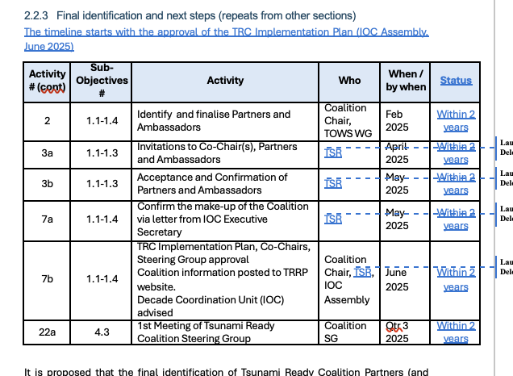

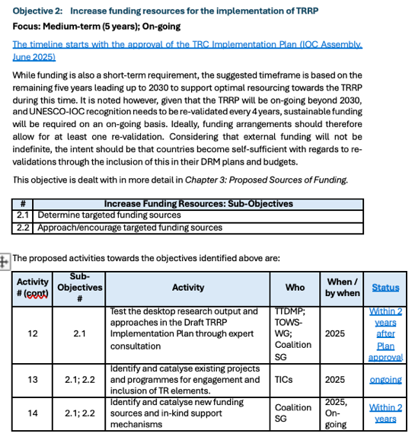
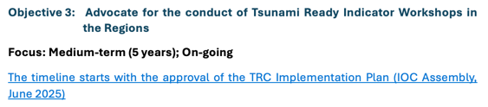

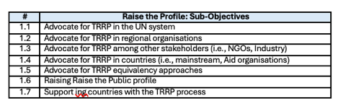
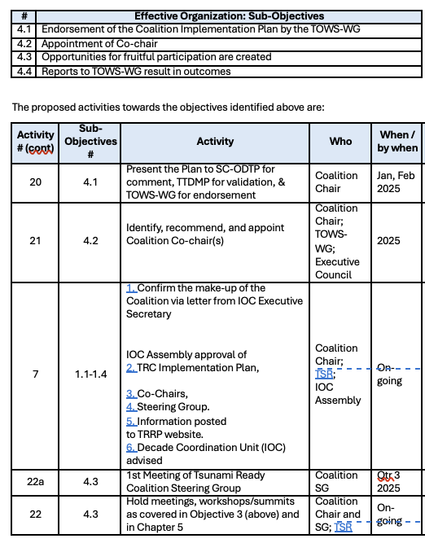
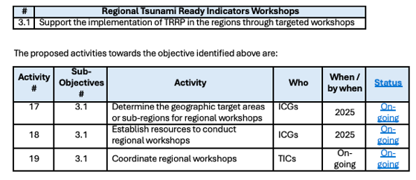
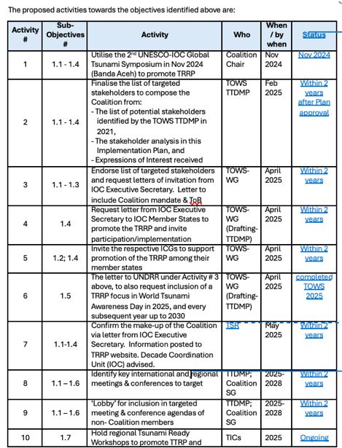
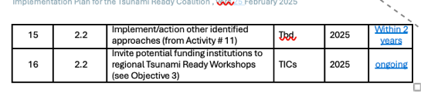
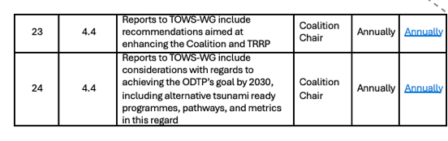

(iii) Finalize Implementation Plan
Incorporate feedback from TOWS WG
Relax time lines to (‘within 2 years’) considering TRC could not be fully constituted due to TSR Secretariat reduced resources

Slide 5
Nonetheless, activities continued: TRC Chair, TICs, TSR
Strong efforts for Objective 1 (short-term 2 years)
  Organize, Conduct Regional Summits, Regional Workshops (Caribbean, Pacific – PICT, LAC, SE Asia, IO Makran), National Workshops
  Encourage equivalency development - PTWS equiv approved for piloting in 2025
  Advocate for reporting by % prepared and resilient, not number of communities - more meaningful and consistent with PTWS Equivalency.
  100% increase in TR communities every year since 2022
  TSR seeking resources from ODCU for dedicated TRRP support
Advocate for TRRP in the UN system
Advocate for TRRP in regional organisations
Advocate for TRRP among other stakeholders (i.e. NGOs, Industry)
Advocate for TRRP in countries (i.e. mainstream, Aid Organisations)
Advocate for TRRP equivalency approaches
Raise the Public profile
Support countries with the TRRP process

Slide 6
TOWS WG TT Recommendation (2026)
  Notes the approval of the TRC Implementation Plan in June 2025, including its mandate, terms of reference, structure, and key Coalition Partners
  Welcomes the finalization of the Plan by the TSR and TRC Chair, and its publication as an IOC Technical Series XX, that establishes a strategic roadmap to achieve 100% tsunami readiness,
  Applauds the work of the TRC Chair, TICs, and the TSR toward progressing the Implementation Plan, especially with regard to
    Objective 1: Raise profile of the TRRP in collaboration with critical stakeholders through advocacy at meetings and workshops, support of TRRP equivalency approaches to build 100% resiliency, inclusion within tsunami disaster reduction or tsunami resilience projects, to the public around the world. Through the facilitation of the TICs, and generous support of Aid organizations to countries, there are now 108 recognized communities in 32 countries around the world, with about 70 additional communities in progress in the coming year,
    Objective 3: Advocate for the conduct Tsunami Ready Indicator Workshops in the Regions though regional workshops in the Pacific Islands held in 2023 and the Caribbean Sunmit I in 2010, the upcoming Caribbean Summit II in April 2026, upcoming regional workshops in 2026 for Latin American and Southeast Asian countries, and Makran region of the NW Indian Ocean, and national workshops that have brought tsunami agencies, with non-government organizations, industry, and Aid organizations to work collaboratively to recognize Tsunami Ready communities,UN system
  Recalls that the Plan is intended to be a dynamic document to allow for updates, as reflected in the Coalition’s annual reports to the TOWS-WG,
  Acknowledges the reduced resource and capacity of the TSR secretariat has prevented it from extending invitations to the proposed Coalition Partners and 'Ambassadors' or similar namesake, and a Coalition Co-chair that together will serve as the catalyst and leadership for the TRRP, and noting also that the UNESCO Expenditure Plan implies additional budgetary restrictions for IOC in the biennium 2026-2027
  Recommends the relaxation of the Plan’s timelines of actions and activities concerning Objective 2: Increase funding resources for implementation of TRRP, and Objective 4: Organize an effective Tsunami Ready Coalition, until such time that the full Coalition can be constituted,
  Requests the IOC Executive Secretary to urgently seek extrabudgetary resources to resume progress of the TRC Coalition Implementation Plan.

Slide 7
Tsunami Ready Coalition
update
Dr. Laura Kong, Chair, TRC
Director, ITIC
TOWS WG TT-TWO, TT-DMP, 4-6 March 2026
Online

Slide 8
Tsunami Ready Coalition (TRC, 2022)
IOC Decision EC-55/3.5.1 (June 2022) Warning and Mitigation Systems of Ocean Hazards. Part IV: Working Group on Tsunamis and Other Hazards related to Sea Level Warning and Mitigation Systems (TOWS-WG)
Approves the establishment of the UNESCO/IOC Tsunami Ready Recognition Programme (TRRP) as described in the working document “Tsunami Ready Programme – Proposal for endorsement by IOC” dated 21 February 2022;
Approves also
(ii) the Terms of Reference for the Tsunami Ready Coalition, as included under Annex 2 to this decision;
Annex 1. Revised Terms of Reference of the Working Group on Tsunamis and Other Hazards Related to Sea-Level Warning and Mitigation Systems (TOWS-WG)
  The membership of the TOWS-WG will be constituted by:
  a) The Chairpersons of the four ICG-TWSs, the Scientific Committee of the UN Ocean Decade Tsunami programme, the special Tsunami Ready Coalition, and representatives of the GOOS Steering Committee and IODE,
  b) …

Slide 9
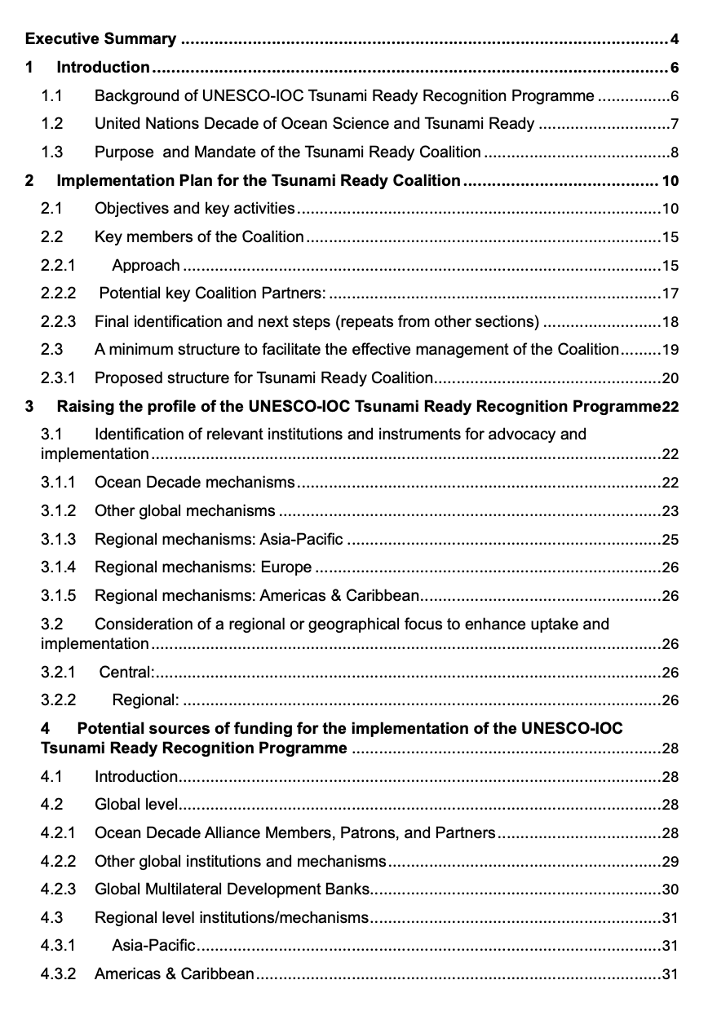
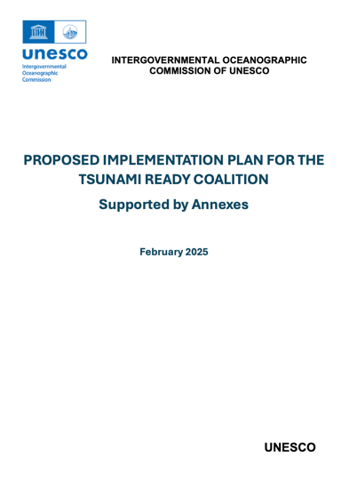
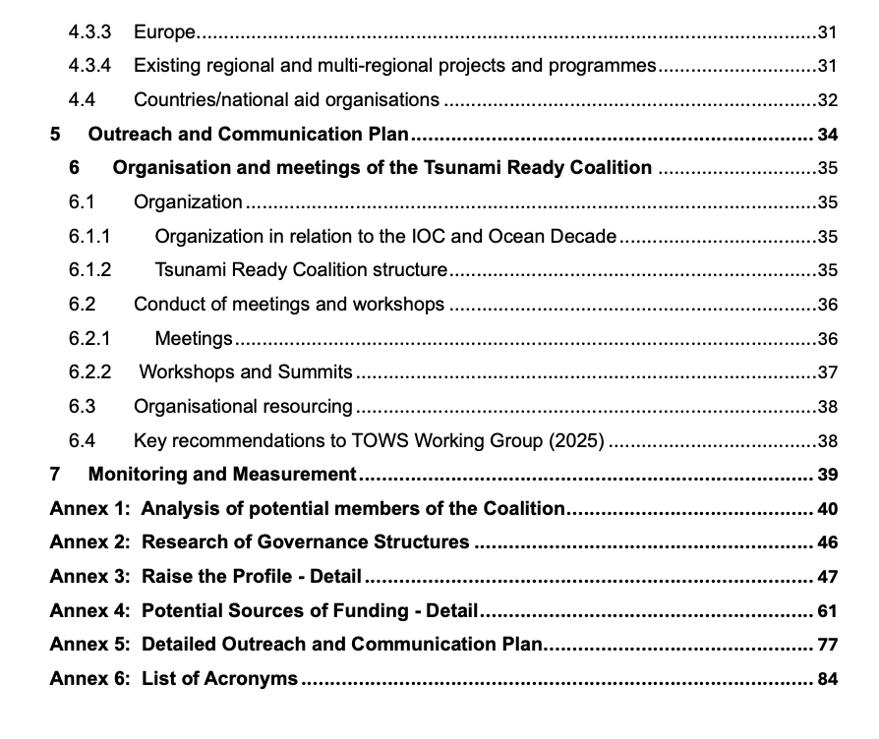
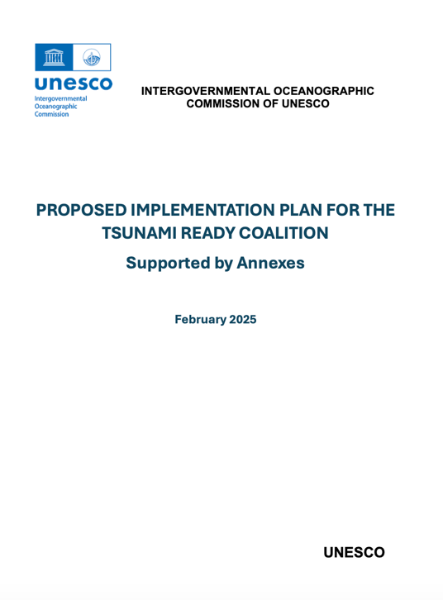
To meet TRC Goals, Implementation Plan created (2024)
  ODTP Scientific Committee & TOWS Task Teams provided input to improve Plan (Jan-Feb 2025)

Slide 10
Implementation Plan - Objectives
Objective 1: Raise profile of TRRP in collaboration with critical stakeholders
Focus: Short-term (2 years) – 1st priority objective
As goal “100% of communities at risk of tsunami prepared for and resilient to tsunamis by 2030 through implementation of the UNESCO-IOC TRRP and other initiatives. Prominent profile needed to support participation and funding.
Objective 2: Increase funding resources for implementation of TRRP
Focus: Medium-term (5 years); On-going
Given TRRP will be on-going beyond 2030, and UNESCO-IOC recognition renewed every 4 years, sustainable funding will be required on an on-going basis. Ideally, funding arrangements should therefore allow for at least one re-validation.
Objective 3: Advocate for the conduct Tsunami Ready Indicator Workshops in the Regions
Focus: Medium-term (5 years); On-going
Via regional workshops, focus on targeted Indicators/topics in accordance with needs, sharing of practical experience and best practice from within the regions, and mayavoid language barriers. ICGs, and specifically TICs, to play key role
Objective 4: Organize an effective Tsunami Ready Coalition.
Focus: On-going. Endorsed Coalition Implementation Plan, appointment of co-Chair. Advising TOWS-WG on implementation of TR including (among others): TRRP progress, resources, and opportunities, unique regional and/or local circumstances.

Slide 11
Objectives and Activities p. 11-13
Objective 1: Raise profile of TRRP in collaboration with critical stakeholders
Focus: Short-term (2 years)
# | Raising the Profile: Sub-Objectives
1.1 | Advocate for TRRP in the UN system
1.2 | Advocate for TRRP in regional organisations
1.3 | Advocate for TRRP among other stakeholders (i.e. NGOs, Industry)
1.4 | Advocate for TRRP in countries (i.e. mainstream, Aid Organisations)
1.5 | Advocate for TRRP equivalency approaches
1.6 | Raise the Public profile
1.7 | Support countries with the TRRP process

Slide 12
Objective 1 - Activities p. 12-13
Activity # | Sub-Obj # | Activity | Who | When / by when
1 | 1.1 - 1.4 | Utilise 2nd UNESCO-IOC Global Tsu Symposium Nov 2024 (Banda Aceh) to promote TRRP | Coalition Chair | Nov 2024
2 | 1.1 - 1.4 | Finalise the list of targeted stakeholders to compose the Coalition from: - The list of potential stakeholders identified by the TOWS TTDMP in 2021, - The stakeholder analysis in this Draft Implementation Plan, and - Expressions of Interest received | TOWS TTDMP | Feb 2025
3 | 1.1 - 1.3 | Endorse list of targeted stakeholders and request letters of invitation from IOC Executive Secretary. Letter to include Coalition mandate & ToR | TOWS-WG | April 2025
4 | 1.4 | Request letter from IOC Executive Secretary to IOC Member States to promote the TRRP and invite participation/implementation | TOWS-WG (Drafting- TTDMP) | April 2025
5 | 1.2; 1.4 | Invite respective ICGs to support promotion of TRRP among their member states | TOWS-WG | April 2025
6 | 1.5 | Letter to UNDRR under Activity # 3 above, to also request inclusion of a TRRP focus in World Tsunami Awareness Day in 2025, and every subsequent year up to 2030 | TOWS-WG (Drafting- TTDMP) | April 2025
7 | 1.1 - 1.4 | Confirm make-up of Coalition via letter from IOC Executive Secretary. Information posted TRRP website. Decade Coordination Unit (IOC) advised | TRS | May 2025
8 | 1.1 - 1.6 | Identify key international and regional meetings & conferences to target | TTDMP, Coalition SG | 2025-2028
9 | 1.1 - 1.6 | ‘Lobby’ for inclusion in targeted meeting & conference agendas of non-Coalition members | TTDMP; Coalition SG | 2025-2028
10 | 1.7 | Hold regional Tsunami Ready Workshops to promote TTRP and determine needs (see Objective 3 below). | TICs | 2025
11 | 1.5 | Monitor and review progress on, and advise in establishing TRRP equivalencies | TTDMP; Coalition SG | 2025

Slide 13
Obj 1. Raise the profile of TRRP – Relevant Institutions for Advocacy and Implementation - p. 22-27
Mechanisms | Activity {Engagement Point}
Ocean Decade | Barcelona Statement {Decade Coordination Unit, DCU} Ocean Decade Coordination Unit (DCU); Decade Collaborative Centres (DCCs); Decade Coordination Offices (DCOs) {DCU} Ocean Decade Projects and Programmes: CoastWAVE 2.0 Project {NEAMTWS} CoastPredict Programme {CoastPredict Secretariat} Integrated Multiple Coastal Hazard Early Warning System and Services for the Tropical Americas and Caribbean (iCHEWS TAC) {IOCARIBE}
Other Global | Early Warnings for All {IFRC, UNDRR, WMO} International Federation of Red Cross and Red Crescent Societies (IFRC) {Programme and Operations Division} International Union of Geodesy and Geophysics (IUGG) {IUGG Joint Tsunami Commission}, The Ocean & Climate Village {UNESCO-IOC} UN Office for Disaster Risk Reduction (UNDRR) {Intergovernmental Processes, Inter-agency Cooperation and Partnerships Branch; UNDRR Stakeholder Engagement Mechanism (UNDRR-SEM). (The latter may advise more than one engagement point)}. World Bank Group {See Chapter 3 World Bank’s International Development Association (IDA)}. World Meteorological Organization (WMO) {Services Department}
Meetings 2025 | First Ocean Decade International Coastal Cities Conference, 26-27 February 2025 in Qingdao, China: {Decade Coordination Centre, China} 8th Session of the Global Platform for Disaster Risk Reduction (GP2025), 2-6 June 2025 in Geneva, Switzerland {UNDRR} UN Ocean Conference, 9-13 June 2025 in Nice, France {UN Department of Economic and Social Affairs} 3rd UN Ocean Decade Conference, 2027 {Decade Coordination Unit}
Regional – Asia-Pacific | ASEAN {ASEAN Committee on Disaster Management (ACDM)} APEC {Asia-Pacific Economic Cooperation, Emergency Preparedness Working Group} ESCAP {Chapter 3 (Potential Sources of Funding) for detail for ESCAP Trust Fund for Tsunami, Disaster, and Climate Preparedness}, Pacific Community (SPC) {Partnerships, Integration, and Resource Mobilisation Division; Geoscience, Energy and Maritime (GEM) Division}, UNDP {See Ch 3 (Potential Sources of Funding) for detail in UNDP Strategic Plan 2022-2025, as well as Tsunami Project}
Regional – Europe | European Union {ECHO (for DIPECHO)}
Regional – Americas, Caribbean | Coordination Centre for the Prevention of Natural Disasters in Central America and the Dominican Republic (CEPREDENAC) {Executive Secretary}, Caribbean Disaster Emergency Management Agency (CDEMA) {CDEMA Coordinating Unit}

Slide 14
Objective 2 - Activities p. 13-14
Objective 2: Increase funding resources for implementation of TRRP
Focus: Medium-term (5 years), On-going
# | Increasing Funding Resources: Sub-Objectives
2.1 | Determine targeted funding sources
2.2 | Approach/encourage targeted funding sources
Activity # (cont) | Sub-Obj # | Activity | Who | When / by when
12 | 2.1 | Test the desktop research output and approaches in the Draft TRRP Implementation Plan through expert consultation | TTDMP; TOWS-WG; Coalition SG | 2025
13 | 2.1; 2.2 | Identify and catalyse existing projects and programmes for engagement and inclusion of TR elements. | TICs | 2025
14 | 2.1; 2.2 | Identify and catalyse new funding sources and in-kind support mechanisms | Coalition SG | 2025, On-going
15 | 2.2 | Implement/action other identified approaches (from Activity # 12) | Tbd | 2025
16 | 2.2 | Invite potential funding institutions to regional Tsunami Ready Workshops (see Objective 3) | TICs | 2025

Slide 15
Objective 3 - Activities p. 14
Objective 3: Advocate for the conduct Tsunami Ready Workshops in Regions
Focus: Medium-term (5 years), On-going
# | Regional Tsunami Ready Indicators Workshops
3.1 | Support the implementation of TRRP in the regions through targeted workshops
Activity # (cont) | Sub-Obj # | Activity | Who | When / by when
17 | 3.1 | Determine the geographic target areas or sub-regions for regional workshops | ICGs | 2025
18 | 3.1 | Establish resources to conduct regional workshops | ICGs | 2025
19 | 3.1 | Coordinate regional workshops | TICs | On-going

Slide 16
Objective 4 - Activities p. 15
Objective 4: Organize an effective Tsunami Ready Coalition
Focus: On-going
# | Effective Organization: Sub-Objectives
4.1 | Endorsement of the Coalition Implementation Plan by the TOWS-WG
4.2 | Appointment of Co-chair (from among Coalition partners)
4.3 | Opportunities for fruitful participation are created
4.4 | Reports to TOWS-WG result in outcomes
Activity # (cont) | Sub-Obj # | Activity | Who | When / by when
20 | 4.1 | Present the Plan to SC-ODTP for comment, TTDMP for validation, & TOWS-WG for endorsement | Coalition Chair | Jan, Feb 2025
21 | 4.2 | Identify, recommend, and appoint a Coalition Co-chair | Coalition Chair; TOWS-WG; Executive Council | 2025
7 | 1.1 - 1.4 | Confirm the make-up of the Coalition via letter from IOC Executive Secretary. IOC approval of TRC Implementation Plan, Co-chairs, Steering Group (SG). Information posted to TRRP website. Decade Coordination Unit (IOC) advised. | Coalition Chair; TSR; IOC Assembly | On-going
22a | 4.3 | 1st meeting of Tsunami Ready Coalition Steering Group | Coalition SG | Qtr 3 2025
22 | 4.3 | Hold meetings, workshops/summits as covered in Objective 3 (above) and in Ch 5 | Coalition Chair, SG; TSR | On-going
23 | 4.4 | Reports to TOWS-WG include recommendations aimed at enhancing the Coalition and TRRP | Coalition Chair | Annually
24 | 4.4 | Reports to TOWS-WG include considerations w/regard to achieving the ODTP’s goal by 2030, incl alternative tsunami ready programmes, pathways, and metrics | Coalition Chair | Annually

Slide 17
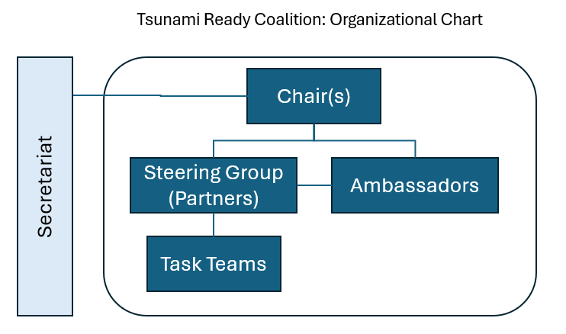
Effective TRC – Governance, Organization
p. 35-39
Chair and Co-chair
Steering Group (SG)
Partners – members of Steering Group
Steering Group - meets 2X year (at least 1 in-person, schedule alongside TOWS-WG and/or coincide with global conferences)
Meeting Agenda (notional)
    TRRP implementation status (per region)
    Countries requiring support
    Common implementation barriers (discussion with view on solutions)
    Promotion opportunities
    Future meetings and workshops (how can Partners assist)
    Reporting to TOWS-WG
Ambassadors (primarily implementational focus, participation in Steering Group meetings by invitation in advisory or observer role)
Task Teams (as required)
Secretariat (TSR)

Slide 18
Chairs, Steering Group p. 20
Considered IODE Ocean Best Practices, GOOS, CoastPredict Programme
Basic, relatively small structure to facilitate its management and coordination
1. Co-chairs: 1 appointed (Dr Laura Kong, ITIC). Propose 2nd appointed from Partners
2. Steering Group: Comprised of Key Partners
Up to 15 stakeholders + 4 TICs as ex-Officio
 | Steering Group Terms of Reference
1 | Steer the TRRP to achieve the aim of making 100% of communities at risk of tsunami prepared for and resilient to tsunamis by 2030.
2 | Keep an overall view on the implementation of the TTRP
3 | Identify and channel synergies and opportunities among Steering Group Partners to advance TRRP objectives.
4 | Negotiate the mobilizing of resources to advance the TRRP objectives.
5 | Invite and draw on other relevant stakeholders, such as the Decade Coordination Unit (DCU), Decade Collaborative Centres (DCCs), Decade Coordination Offices (DCOs) to support relevant discussions.
6 | Create enduring partnerships to support sustaining Tsunami Ready globally
7 | Develop strategic advice and reporting to the TOWS-WG.

Slide 19
3. Partners p. 16-20
Steering Group composed of “Partners”
To be efficient, target institutions with best ability or potential to support implementation:
For broad and diverse representation, recruit Strategic / Operational Partners (institutions)
Level | Implementation Role
Global | for mobilizing international support though promotion / funding, over next 5 yrs
Regional | for strengthening regional coordination and collaboration around TRRP.
National | for building bilateral and national momentum for implementation of TRRP.
Focus | Implementation Role
Strategic | aims at reinforcing existing or establishing new partnerships from an influence and decisions perspective
Regional | aims at exploring creative ways of leveraging on global and regional programmes, projects, and events.

Slide 20
Ambassadors, Task Teams, Secretariat p. 21
“Ambassadors” (or similar name) complement Coalition
May not have policy mandate or capacity to offer substantive support but keen to collaborate through sharing of experience and serving as examples of implementing best practices
 | Ambassadors Terms of Reference
1 | Act as TRRP representatives in their organizations or countries
2 | Raise awareness through advocating for TRRP in their areas of influence.
3 | Share expertise with aspiring countries/communities.
4 | Share TRRP best practice among Ambassadors.
5 | Advise the Coalition Steering Group about TRRP implementation.
6 | Participate in special task teams identified by the Steering Group as required.
5. Task Teams
Task Teams, reporting to Steering Group may be established to support Work Plan
6. Secretariat
Secretarial and logistical support by UNESCO-IOC Tsunami Resilience Section (TSR)

Slide 21
“Ambassadors” (or similar name) complement Coalition
May not have policy mandate or capacity to offer substantive support but keen to collaborate through sharing of experience and serving as examples of implementing best practices
 | Ambassadors Terms of Reference
1 | Act as TRRP representatives in their organizations or countries
2 | Raise awareness through advocating for TRRP in their areas of influence.
3 | Share expertise with aspiring countries/communities.
4 | Share TRRP best practice among Ambassadors.
5 | Advise the Coalition Steering Group about TRRP implementation.
6 | Participate in special task teams identified by the Steering Group as required.
ACTION – IOC Paris to ask what is possible”
UNESCO Goodwill Ambassador for Tsunami Ready – can only be 1 person
Tsunami Ready for XX region (SE Asia)
Tsunami Ready Patron, Influencer
Patron – help to raise profile
Advocate
Icon
2004 Tsunami movie “The Impossible” – actress Naomi Watts,Ewan McGregor
Tom Cruise – Mission Impossible
Ocean Decade – 4 presidents / 1 minister

Slide 22
Steering Group –
Include users as part of Mayors or ?
GOOS – now incl other than science, so users - Business, Industry
Liz – Exec Secr CDEMA
Ambassador – survivors and eyewitnesses might have story to share
ASEAN Mayor’s forum (last mtg 2024)
What do you want to promote? Capacity building – develop skills to be TR.

Slide 23
Needs - urgent
Need a Promotion / Public Relations / Campaign specialist, Create package - paid
Need to explore UNESCO ‘names’

Slide 24
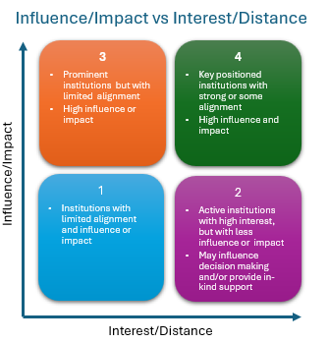
Analysis of Potential Partners, Ambassadors
Implementation Plan, Annex 1 p. 40-45
Annex 2 (original) identified 8+ intl, 12+ regional, 139+ natl candidates for TRC membership.
Important not to leave any relevant stakeholder behind, but the more participants involved, the more complex its coordination and management. Thus, Annex 2 list may be too broad – listed institutions had not been analysed for potential.
Partners reviewed for potential funding & promotional support, and to assure TRRP & relevant TR Indicators recognised in their Programmes
  Global: multilateral development aid organisations and programmes.
  Regional: regional development/aid organisations and programmes
  National: AID agencies and/or NDMO from each region, specifically with view on bilateral and national support.

Slide 25
Governance: Partners, Ambassadors – potential p. 17-18
Type
Global Partners | IFRC, Islamic Development Bank, UNDRR (WTAD; EW4All), UNDP (Tsunami Project), WMO (Weather Ready; EW4All), World Bank Group (IDA; GFDRR)
Regional Partners | High value regional institutions that are also involved in sub-regional programmes Asian Development Bank (Pacific Disaster Resilience Programme; Strengthening Cooperation on Disaster Risk Management within the Association of Southeast Asian Nations), Caribbean Development Bank, CEPREDENAC, ESCAP (Trust Fund for Tsunami, Disaster and Climate Preparedness), APEC (Asia-Pacific Economic Cooperation, Emergency Preparedness Working Group). EU Civil Protection and Humanitarian Aid Operations department – DG-ECHO (DIPECHO Programme; CoastWAVE), 4 x ICG-TICs (as key regional TRRP coordinators and representing the 4 ICGs), SPC (DCRP)
National Partners | High value national institutions that also support programmes on bilateral/international level Germany (GIZ – funded EWS in Indonesia; climate change initiatives in Pacific Island countries) Norway (Norad – strong engagement with the Decade), Japan (JICA; MEXT - funding UNDP Tsunami Project; CATAC), Switzerland (Agency for Development and Cooperation - funded Tsunami Capacity Assessment Validation Workshop for Indian and Pacific Oceans), USA (funded TRRP in Pacific Island countries)
Ambassadors | Government institutions that are implementing TRRP; best practice exemplars; may support via regional advice Note: For some countries, regional/provincial government institutions active in Tsunami Ready space may also serve as Ambassadors with endorsement of relevant national institution. For instance, the Odisha State Disaster Management Authority (OSDMA) in India Barbados , Costa Rica, Fiji, India, Indonesia

Slide 26
Type
Global Partners | IFRC, Islamic Development Bank, UNDRR (WTAD; EW4All, Making Cities Resilient, Safe Schools – GAEDRR (UNESCO Science Sector)), UNDP (Tsunami Project), WMO (Weather Ready; EW4All), World Bank Group (IDA; GFDRR), UNESCO Science (DRR, JICA Disaster Response – current review of DRR work and how it might be better synch)
Regional Partners | High value regional institutions that are also involved in sub-regional programmes Asian Development Bank (Pacific Disaster Resilience Programme; Strengthening Cooperation on Disaster Risk Management within the Association of Southeast Asian Nations), Caribbean Development Bank, CEPREDENAC, ESCAP (Trust Fund for Tsunami, Disaster and Climate Preparedness), APEC (Asia-Pacific Economic Cooperation, Emergency Preparedness Working Group). EU Civil Protection and Humanitarian Aid Operations department – DG-ECHO (DIPECHO Programme; CoastWAVE), 4 x ICG-TICs (as key regional TRRP coordinators and representing the 4 ICGs), SPC (DCRP)
National Partners | High value national institutions that also support programmes on bilateral/international level Germany (GIZ – funded EWS in Indonesia; climate change initiatives in Pacific Island countries) Norway (Norad – strong engagement with the Decade), Japan (JICA; MEXT - funding UNDP Tsunami Project; CATAC), Switzerland (Agency for Development and Cooperation - funded Tsunami Capacity Assessment Validation Workshop for Indian and Pacific Oceans), USA (funded TRRP in Pacific Island countries)
1. Global Ambassadors 2. Champions, Icons | Government institutions that are implementing TRRP; best practice exemplars; may support via regional advice Note: For some countries, regional/provincial government institutions active in Tsunami Ready space may also serve as Ambassadors with endorsement of relevant national institution. For instance, the Odisha State Disaster Management Authority (OSDMA) in India Barbados , Costa Rica, Fiji, India, Indonesia

Slide 27
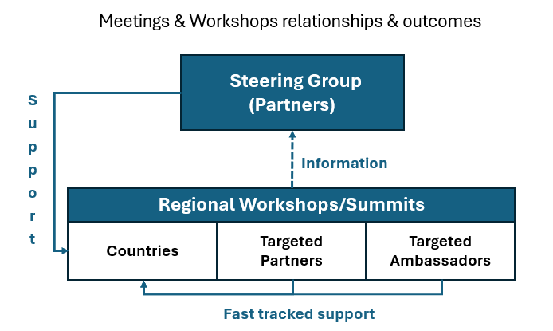
Objective 3: Advocate for the conduct Tsunami Ready Workshops
TRC Regional, Sub-regional Workshops
p. 37
Workshop/summit feedback/comments feed back to Steering Group
After 2025 workshops, at least one summit to should be organized to follow up before 2030.
TICs expected to play lead role in coordinating
Regional / sub-regional workshops/summits should
  Encourage countries in regions to adopt or extend TRRP implementation
  Identify barriers and solutions to TRRP implementation
  Solicit resources to support country TRRP implementation
  Share experience regarding TRRP implementation
  Discuss equivalency pathways to achieving Tsunami Ready communities where appropriate.

Slide 28
5. Communication and Outreach – Annex 5 p. 77-84
To maintain engagement of Tsunami Ready Coalition Partners and Ambassadors.
Document approach for connecting with other important stakeholders and audiences in international fora to register and to sustain prominence of Tsunami Ready, and the aim of 100% communities at risk are prepared and resilient to tsunamis by 2030.
Format consistent with communications practice
Covers:
  Background and environmental factors,
  An analysis of stakeholders and audiences,
  An outreach and communication approach,
  Consistent messages,
  An Outreach and Communication Action Plan, and
  Monitoring/measurement.

Slide 29
7. Monitoring and Measurement p. 39
Monitor implementation progress, and measure effectiveness of TRC through Performance Indicators (established by TRC SG, TTDMP).
Positive Progress and effectiveness indicated by increases each year
Report annually to TOWS WG – TRRP actions/outcomes compiled by TRC and TTDMP, supported by ICGs and TSR
TR Performance Indicators may include :
  # countries implementing Tsunami Ready every year.
  # communities implementing Tsunami Ready every year.
  % of each country that is Tsunami Ready
  # countries with TRRP Programmes
  # countries that have allocated funds for TRRP
  # countries in which the TRRP is embedded in policies and structures (e.g., TRRP included in national DRR strategy documents, example is Costa Rica (CNE) and Colombia (SECDRR))
TR Coalition indicators may include:
  # and status of institutions participating in the Coalition
  # and outcomes of Coalition engagements
  # and amount of resources available from diverse sources for implementing the TRRP

Slide 30
TOWS WG Recommendation (2025)
  Notes that TOWS-WG-XVI (2023) requested the Tsunami Ready Coalition Chair to propose a governing structure for the Tsunami Ready Coalition and that TOWS WG approval is essential for advancing the work of the Tsunami Ready Coalition
  Also notes that the Tsunami Ready Coalition Implementation Plan was reviewed by the Ocean Decade Scientific Committee (16-17 January 2025), by the TOWS-WG Joint Task Teams on TWO and DMO (20-22 February 2025), and is included as part of the Coalition Chair’s report to TOWS-WG-XVIII)
Having considered the Tsunami Ready Coalition Implementation Plan,
  Approves the Implementation Plan, including:
        The Coalition mandate and terms of reference,
        The Coalition structure, and
        The identified key Coalition Partners.
  Notes that the Plan will remain a dynamic document to allow for updates to the Plan, with updates reflected in the Coalition’s annual reports to the TOWS-WG
  Requests the Secretariat to finalize in consultation with the Tsunami Ready Coalition Chair the Coalition Partners, 'Ambassadors' or similar namesake, and Coalition Co-Chair.
  Recommends the IOC Executive Secretary to extend invitations to the proposed Coalition Partners and Ambassadors or similar namesake, and a Coalition Co-chair.
  Requests ICGs to prioritize regional Tsunami Ready workshops or summits in 2025 and conduct further workshops or summits before 2030.
  Notes resource and capacity constraints that will stymie progress of the TRC Coalition Implementation Plan, requests the IOC Executive Secretary to urgently address.

