Slide 1
Inclusive Tsunami
Preparedness
Tsunami Safety Program for the Visually Impaired in the Caribbean
Glorymar Gómez Pérez, glorymar.gomez@noaa.gov
Christa von Hillebrandt-Andrade, christa.vonh@noaa.gov
ITIC Caribbean Office
Presented by Laura Kong, ITIC
TOWS WG TT-TWO, TT-DMP, 4-6 March 2026
Online

Slide 2
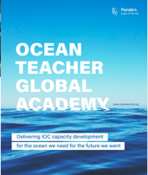

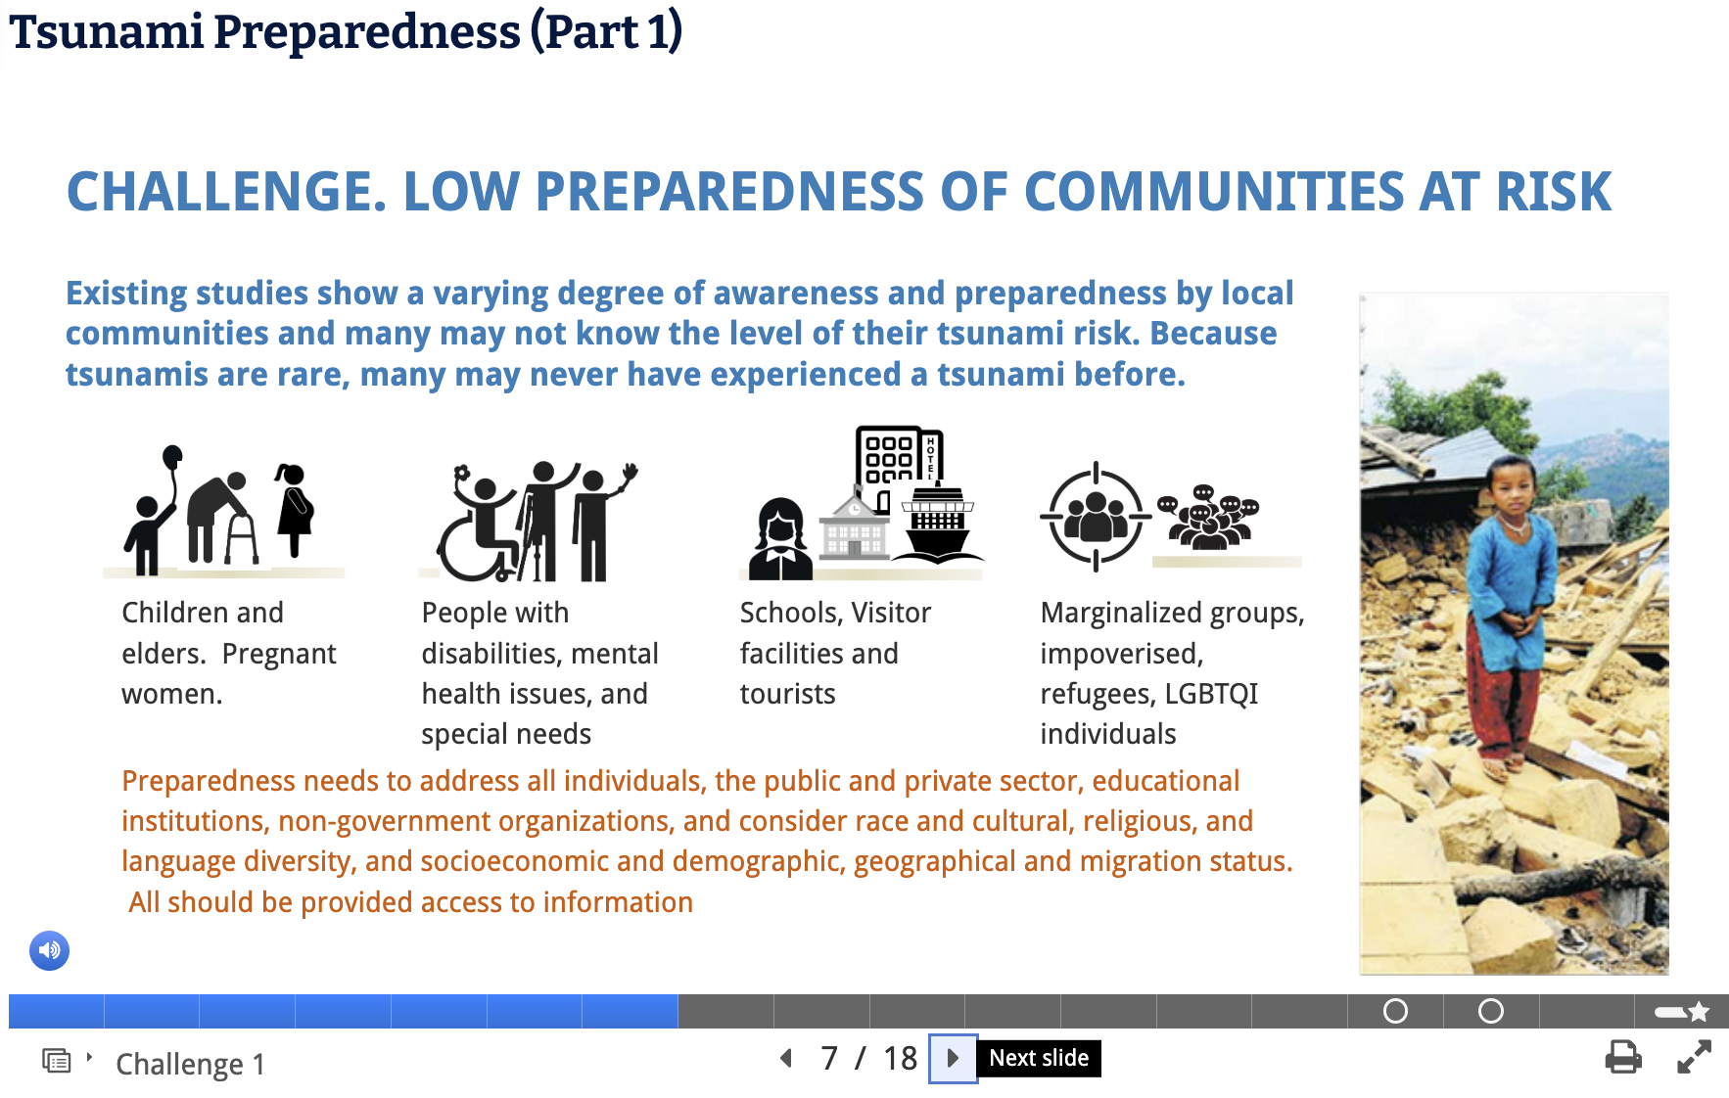
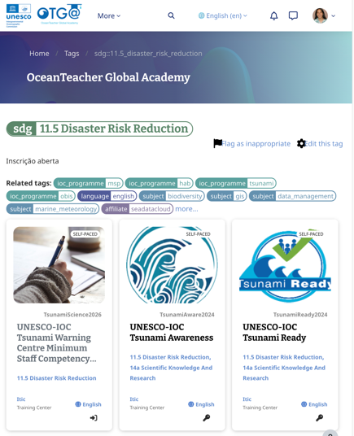

Slide 3
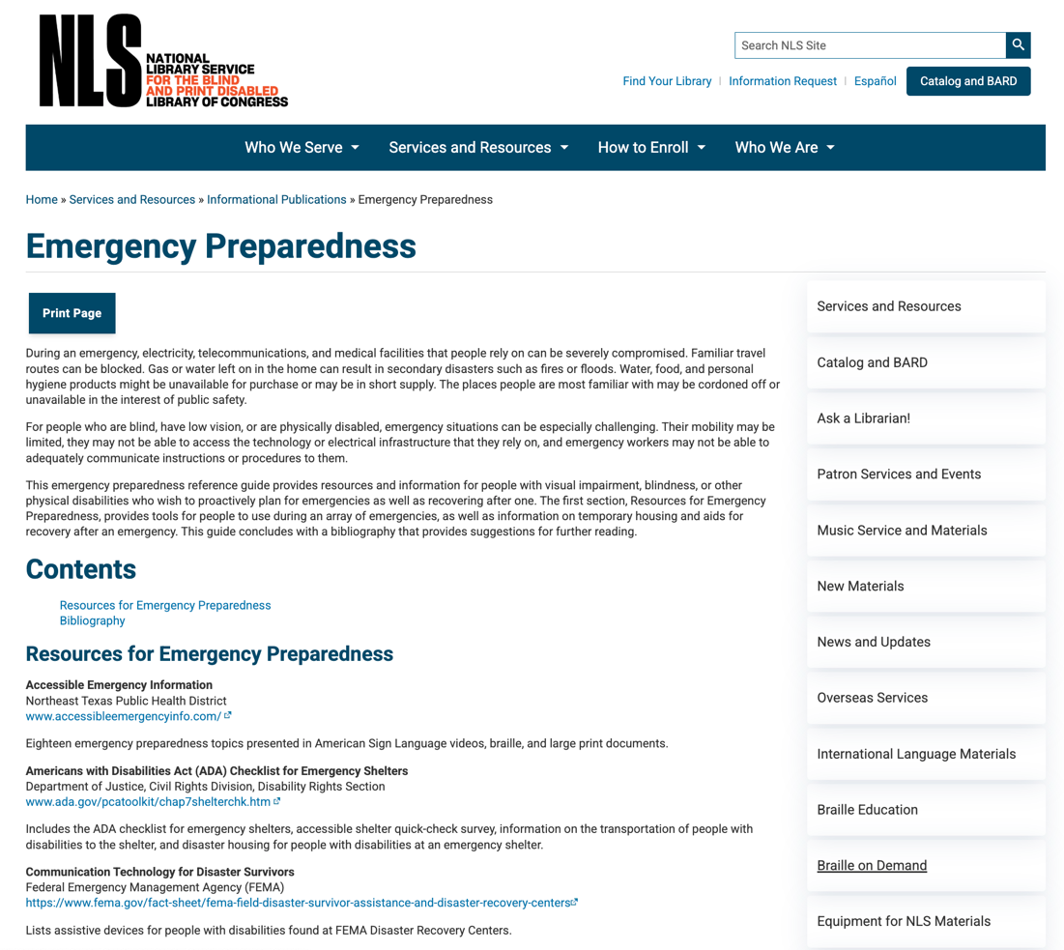
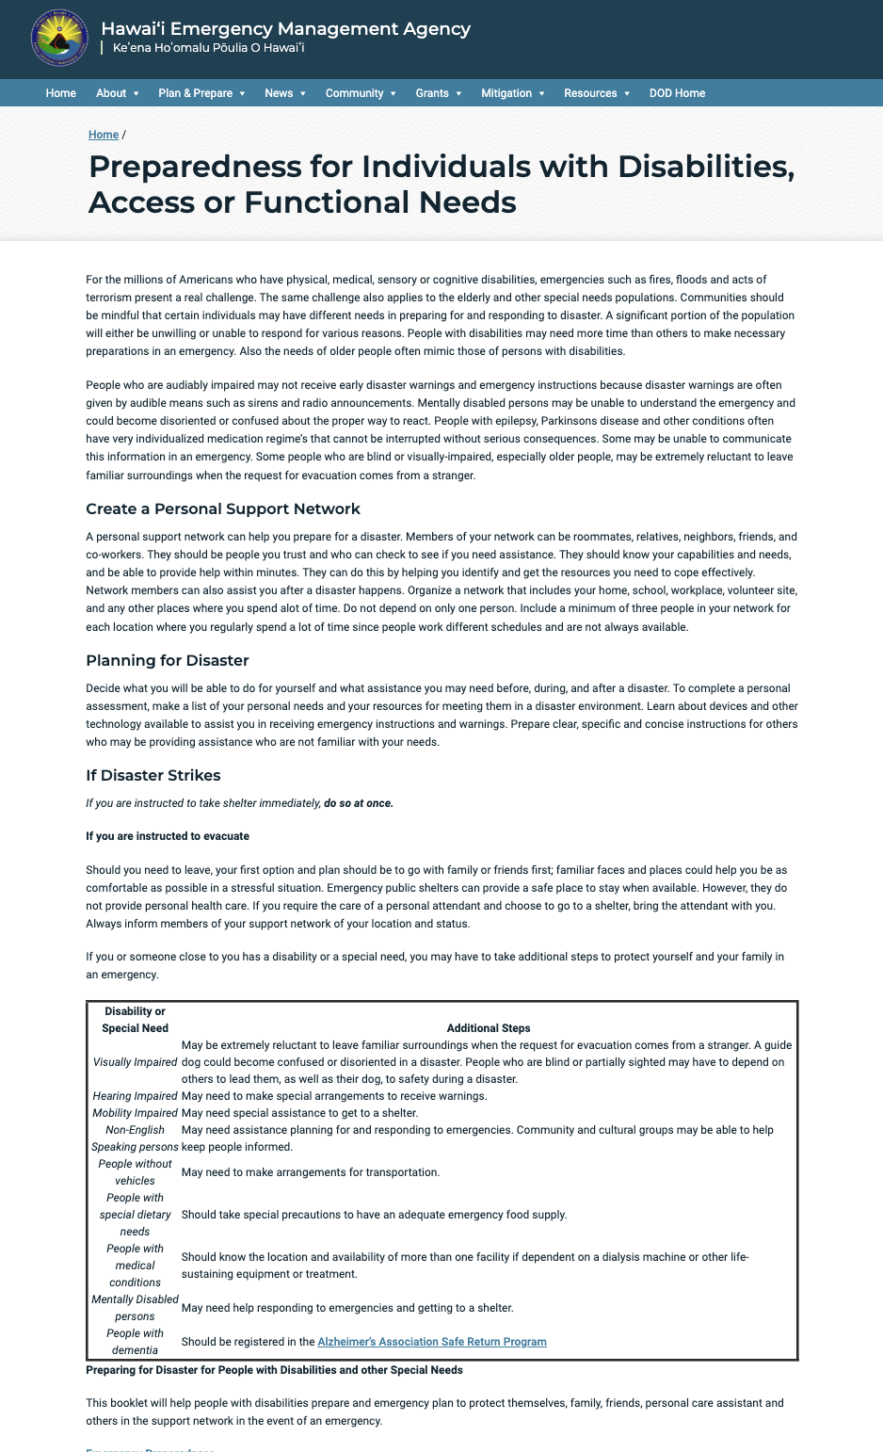
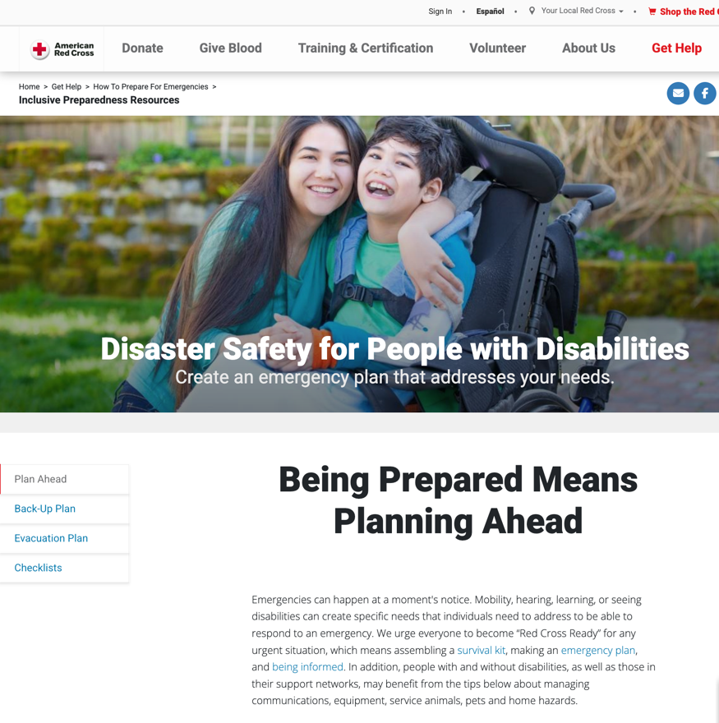
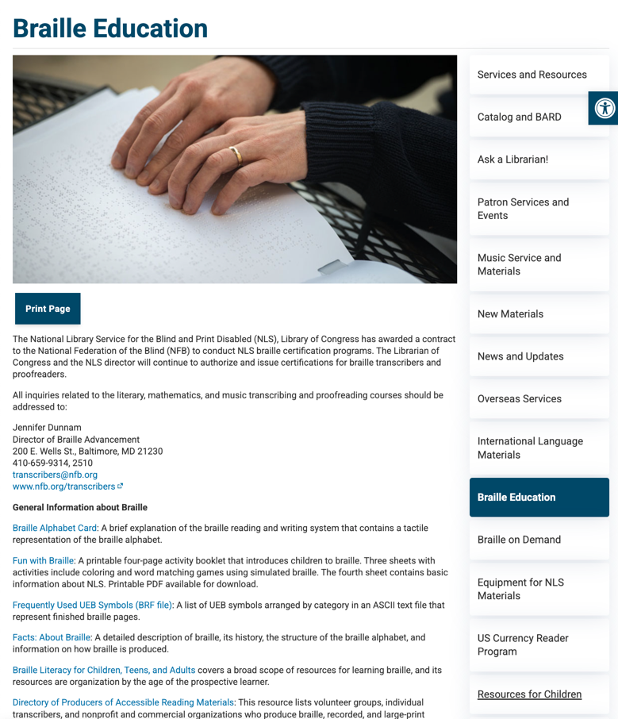
https://www.loc.gov/nls/services-and-resources/informational-publications/emergency-preparedness/
https://www.redcross.org/get-help/how-to-prepare-for-emergencies/inclusive-preparedness-resources.html?srsltid=AfmBOopLwHF5CttzZlh99_fXVNI1jVfRtw2UZxq71fwuB7JRyDjPJgNl
https://dod.hawaii.gov/hiema/special-needs-information/

Slide 4
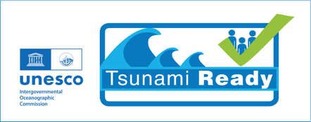


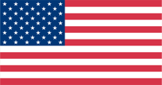
Tsunami Safety Program for the Visually Impaired in the Caribbean
Support from the US Dept of State, Office of International Disaster Response
to the US National Oceanic and Atmospheric Administration (NOAA)
International Tsunami Information Center

Slide 5
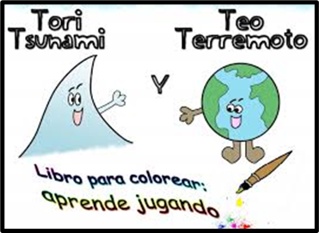
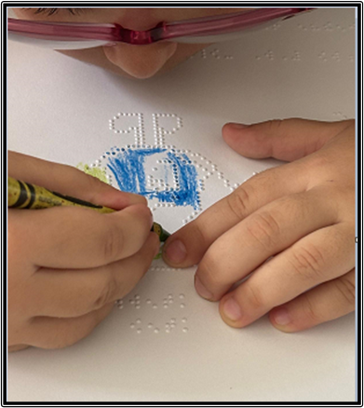
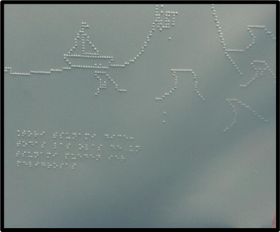
First ever printing of earthquake and tsunami themed coloring book adapted to Braille (Spanish and English)

Slide 6
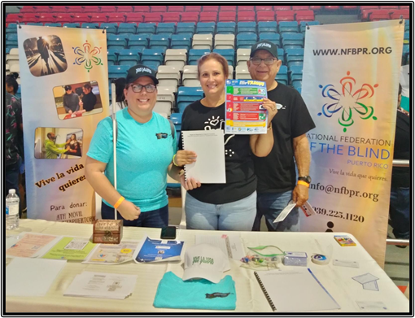
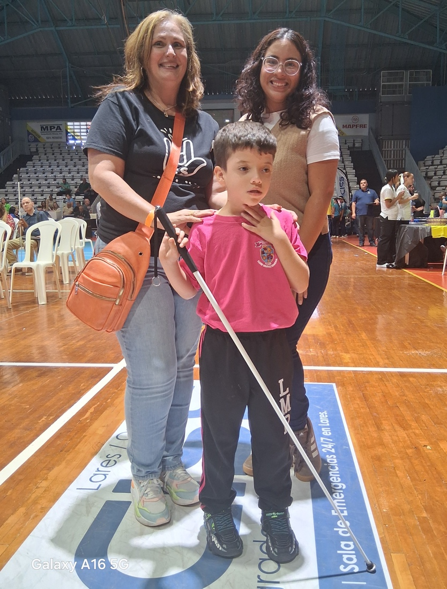
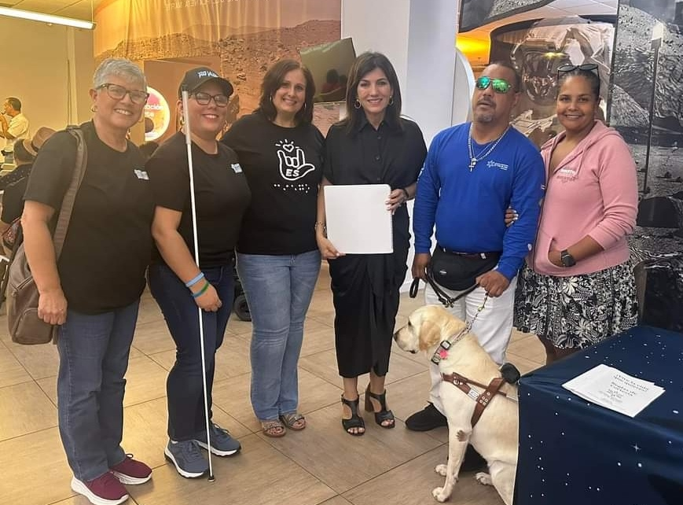
White Cane International Day
EcoExploratorio Museum
Participation in local, state and international events of organizations for the blind and visually impaired such as the

Slide 7
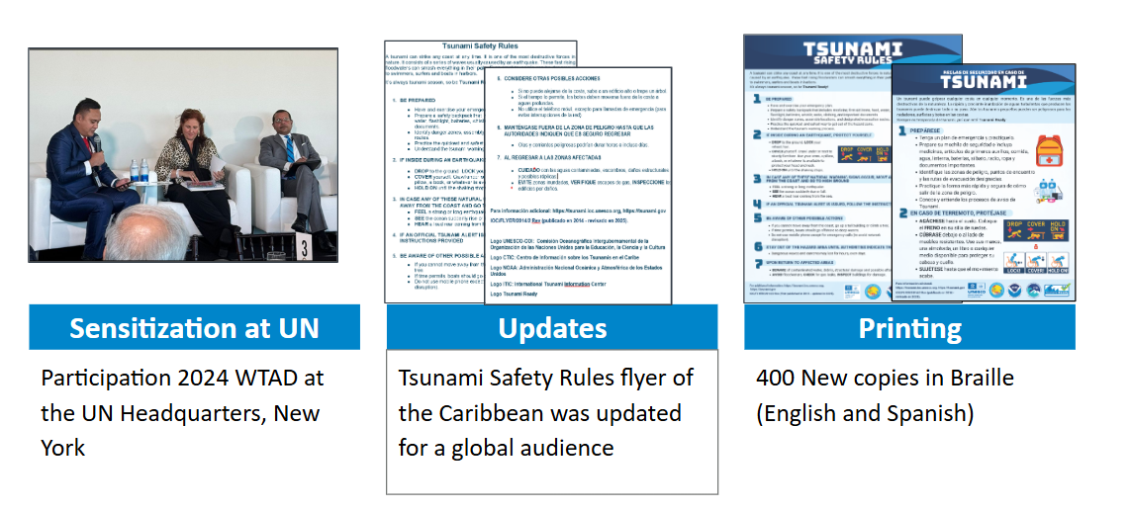

Slide 8
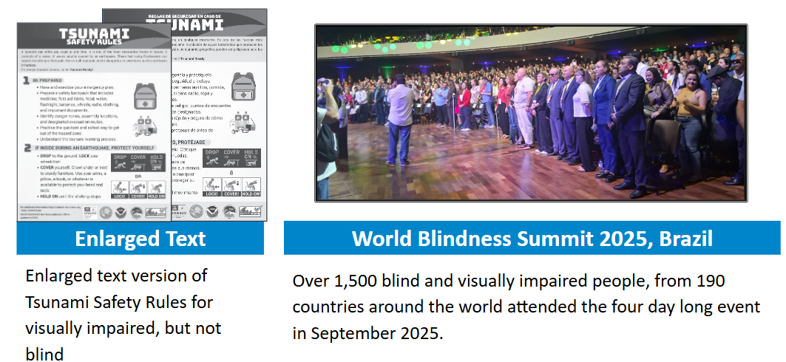
This event presented an opportunity to test the Tsunami Safety Rules flyer adapted to Braille in English and Spanish. Through interviews and questionnaries we were able to collect feedback of the content and structure of the document, from visually impaired individuals from around the world.

Slide 9
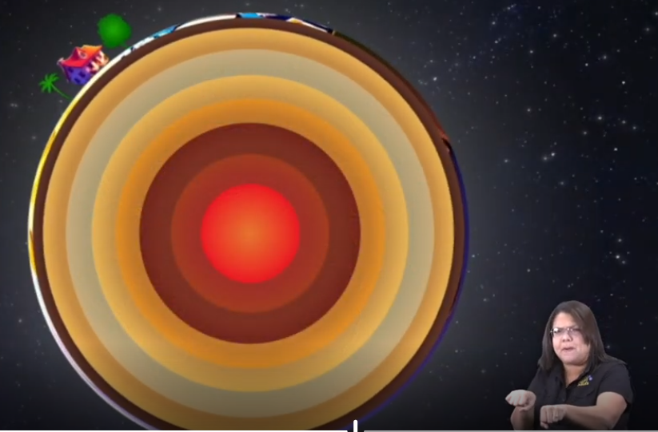
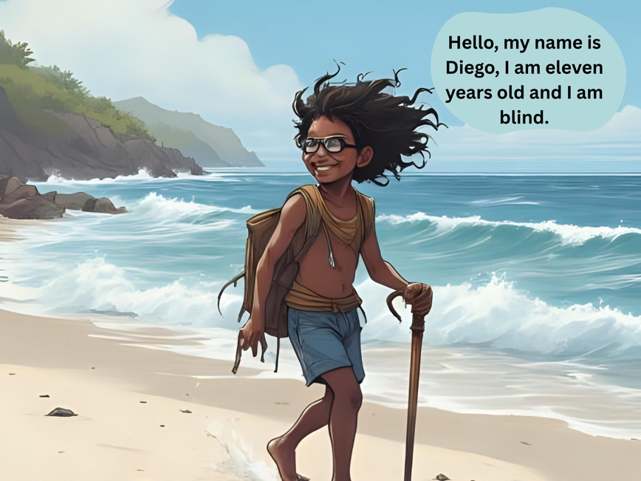
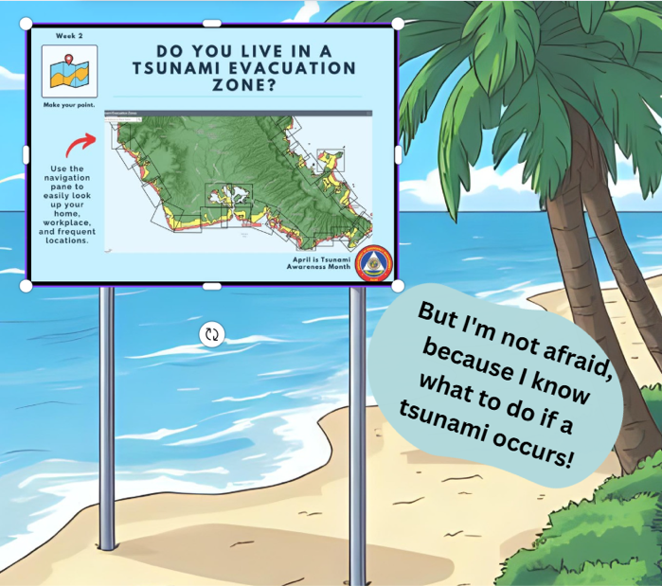
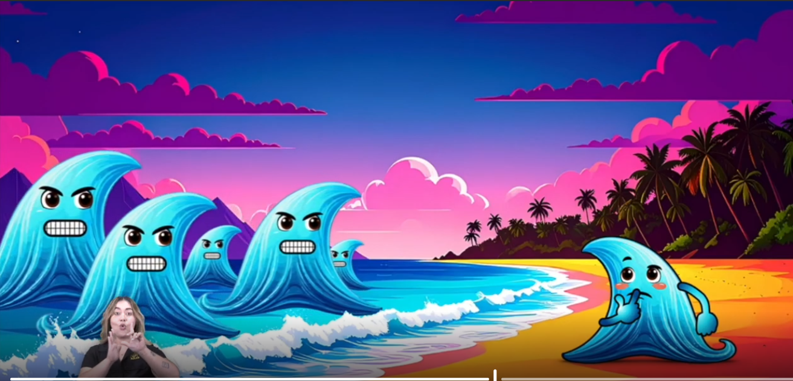
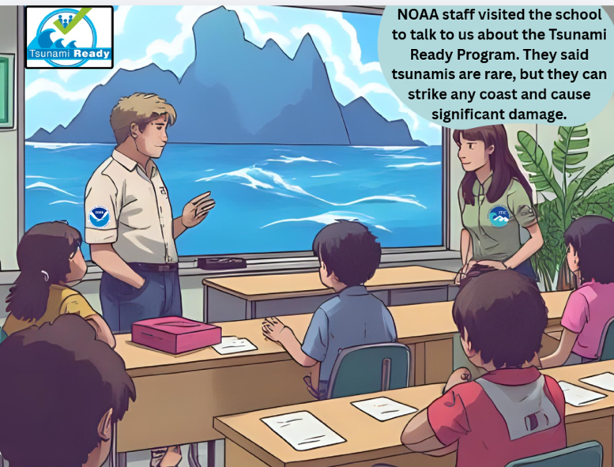
Tori and Teo video video with special effects
and sign language (English & Spanish) for blind, deaf and other special needs
Diego and the Invisible Waves is a comic book written and designed to créate awareness toward blind children. It encourages and teaches others how to guide and help a blind person in case of tsunami.

