Slide 1


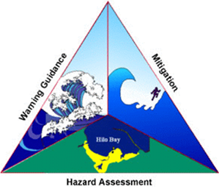
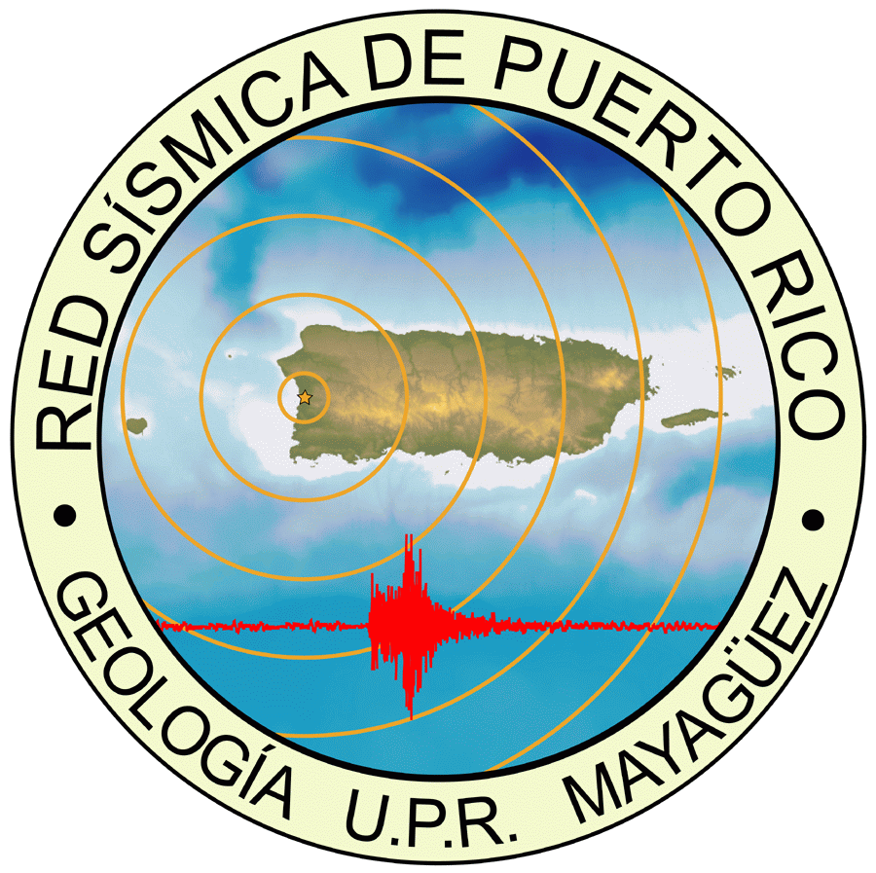
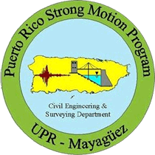
THE PUERTO RICO (PR) NETWORK
PRSN (PR SEISMIC NETWORK) & PR SMP (PR STRONG MOTION PROGRAM)
24/7/365
Victor A. Huerfano & Staff and Students
UNIVERSITY OF PUERTO RICO - MAYAGUEZ
GEOLOGY & CIVIL ENGINEERING DEPARTMENTS
Curaçao, 2026

Slide 2
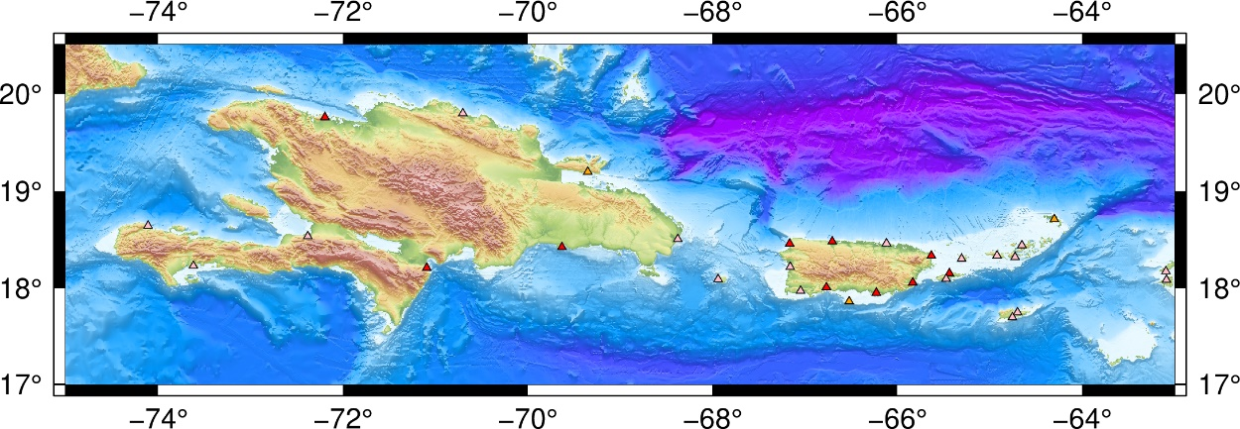
Sea Level Network
The PRSN of the University of Puerto Rico at Mayagüez (UPRM)
operates 7 sea level stations in Puerto Rico and help NOAA/NOS
in the maintenance of 10 more stations.
Support the operations of three regional stations (Tortola, Sto Domingo, Barahona).
The data are transmitted every 6 minutes on GOES or via EarthWorm export/seedlink modules each minute.
The data can be accessed via the PRSN GOES/tk, Tides and Currents/tsunami site & DCS NOAA, and the IOC Sea Level Data Facility.
PRSN operates three tsunami cameras.
Future Plans
Installation of two new Tide Gauges: (1) Samana, DR, (2) Anegada, BVI. Reinstall Isla Caja de Muertos, PR
Upgrade the PRSN web site and web services
Install additional tsunami cameras / wavemaps project
Incorporate the CARICOOS - HF radars

Slide 3

Seismic Network
The PRSN currently operates 35 seismic stations in Puerto
Rico, the Virgin Islands and the Dominican Republic.
Twelve of them use VSAT (PRSN & USGS)
PRSMP operate 120+ accelerometers (PR/VI, DR & Anguilla).
Relocation of the seismic station in Aruba.
One hundred type-C were installed in Puerto Rico. Fifty operational with new software
Seismic processing upgraded to the ANSS/AQMS.
The data can be accessed via the PRSN seedlink, and the EarthScope Data Facility.
Future Plans
Installation of one station in the northeastern part of the Island.
Two more accelerometers.
Upgrade the PRSN web site.
AI Processes (ShakeMap).

Slide 4

GPS/GNSS Network
The PRSN operates a GPS/GNSS Network of
twenty-two permanent high-rate stations.
All the permanent GPS stations are equipped with either a Trimble NetRs,
NetR9 or Alloy GPS/GNSS receiver and Choke ring antennae.
Twelve stations exporting RTX correction.
Continuous data are simultaneously logged to three sessions with different sampling rate, 15-sec per sample, 1-sec per sample (1 Hz), and 10-samples per second (10 Hz).
Data are available via the EarthScope server, and PRSN caster or seedlink.
Future Plans
Installation/Upgrade of two stations in the eastern part of the Island and US VI (NOAA & PRSN Program).
Implementation of the TEC and IR algorithms in PRSN.
Software upgrades.
Upgrade the PRSN web site.

Slide 5
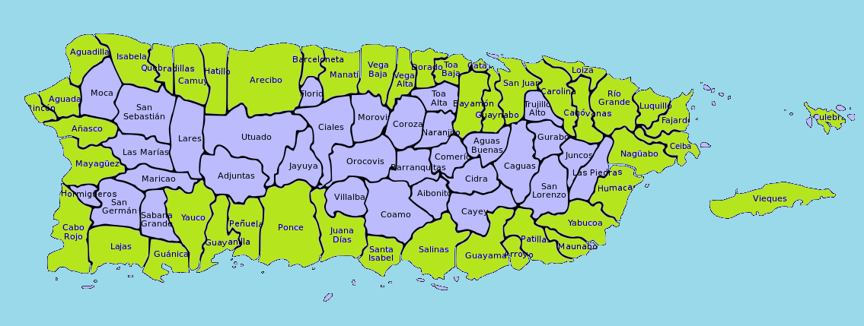
TsunamiReady® / NTHMP.
Forty-seven TsunamiReady communities and twenty-two supporters.
Fifty-six EMWIN/NWWS systems installed in PR, six of then equipped with
DartCom hardware.
Hundreds of NOAA radios distributed, updated and tested.
Tsunami signage maintenance, thousands installed.
Education & Outreach program (conferences, workshops, activities, interviews, social media, etc), thousands impacted.
Tsunami vulnerability profiles upgrade to use new census-2020 data, and new generation of tsunami maps.
More the 220,000 participants in the CaribeWave 2026, and more than 350,000 in ShakeOut 2025. Drills and
exercises (Full scale earthquake exercise in 2027).
Participation in the WTAD (775k FB followers).
TRC: 47
TRS: 22
Future Plans
A new DartCom installation, sign language support and not conventional tsunami signage.
The 20th anniversary of the first TsunamiReady Community in PR: Mayaguez (2026)
Financial uncertainty.

Slide 6
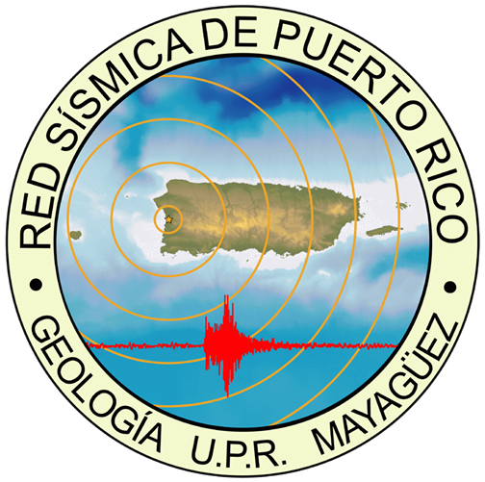
Nodal Arrays and SPAC for Vs30
SWPR: Seismic reflection profiles
TPHA
DR seismic hazard.
PR
R
E
S
E
A
R
C
H
Earthquake and Tsunami Outreach
Earthquake and Tsunami Threat, Hazard and Risk Assessment
Tsunami Preparedness
Seismic Hazard Map
Real Time SOP and Processes
Earthquake Early Warning

